Slide 1
HIV-Associated Neurocognitive Disorders
Christian Adams, MD
Assistant Professor, Dept. of Psychiatry
University of Kentucky College of Medicine

Slide 2
Disclosures
This program is supported by the Health Resources and Services Administration (HRSA) of the U.S. Department of Health and Human Services (HHS) under grant number U1OHA30535 as part of an award totaling $4.2m. The contents are those of the author(s) and do not necessarily represent the official views of, nor an endorsement, by HRSA, HHS, or the U.S. Government. For more information, please visit HRSA.gov.
“Funding for this presentation was made possible by cooperative agreement U1OHA30535 from the Health Resources and Services Administration HIV/AIDS Bureau. The views expressed do not necessarily reflect the official policies of the Department of Health and Human Services nor does mention of trade names, commercial practices, or organizations imply endorsement by the U.S. Government. Any trade/brand names for products mentioned during this presentation are for training and identification purposes only.”
This content is owned by the AETC, and is protected by copyright laws. Reproduction or distribution of the content without written permission of the sponsor is prohibited, and may result in legal action.

Slide 3
Disclosures
All planners, faculty, and others in control of educational content are required to disclose all their financial relationships with ineligible companies within the prior 24 months. An ineligible company is defined as one whose primary business is producing, marketing, selling, re-selling, or distributing healthcare products used by or on patients. Financial relationships are relevant if the educational content an individual can control is related to the business lines or products of the ineligible company.
None of the planners, faculty, and others in control of educational content for this educational activity have relevant financial relationship(s) to disclose with ineligible companies.
The material presented in this course represents information obtained from the scientific literature as well as the clinical experiences of the speakers. In some cases, the presentations might include discussion of investigational agents and/or off-label indications for various agents used in clinical practice. Speakers will inform the audience when they are discussing investigational and/or off-label uses.
Disclosure of a relationship is not intended to suggest or condone commercial bias in any presentation, but it is made to provide participants with information that might be of potential importance to their evaluation of a presentation.

Slide 4
AETC Program National Centers and HIV Curriculum
National Coordinating Resource Center – serves as the central web –based repository for AETC Program training and capacity building resources; its website includes a free virtual library with training and technical assistance materials, a program directory, and a calendar of trainings and other events. Learn more: https://aidsetc.org/
National Clinician Consultation Center – provides free, peer-to-peer, expert advice for health professionals on HIV prevention, care, and treatment and related topics. Learn more: https://nccc/ucsf.edu
National HIV Curriculum – provides ongoing, up –to-date HIV training and information for health professionals through a free, web –based curriculum; also provides free CME credits, CNE contact hours, CE contact hours, and maintenance of certification credits. Learn more: www.hiv.uw.edu

Slide 5
Learning Objectives
By the end of this session, participants will be able to...
Identify signs & symptoms of cognitive impairment in individuals living with HIV/AIDS.
Compare various stages of cognitive impairment, as defined by the Frascati Criteria.
Outline additional clinical factors that may be contributing to cognitive concerns.

Slide 6
Overview
Nomenclature & Diagnostic Criteria
Pathophysiology
Assessment
Diagnostic Markers
Differential Diagnosis
Clinical Considerations

Slide 7
Nomenclature & Diagnostic Criteria

Slide 8
Nomenclature
AIDS Dementia Complex (ADC)
Progressive subcortical dementia with disturbances of attention, working memory, fine motor skills, & gait
Behavioral symptoms including apathy, depression, agitation, & disinhibition
Associated mortality within 1 year of diagnosis

Slide 9
Nomenclature
1991 American Academy of Neurology criteria
HIV Minor Cognitive Motor Disorder
HIV-Associated Dementia (HAD)
  HAD with motor symptoms
  HAD with behavioral symptoms
  HAD with combined motor & behavioral symptoms

Slide 10
Frascati Criteria (2007)
Asymptomatic Impairment (ANI)
Acquired impairment (>1 SD) in two or more cognitive domains
Without impairment of daily functioning
Mild Neurocognitive Disorder (MND)
ANI Criteria met +
Mild functional impairment (i.e., work efficiency)
HIV-Associated Dementia (HAD)
Acquired impairment (>2 SD) in two or more cognitive domains
Marked functional impairment (e.g., inability to complete iADLs)

Slide 11
Pathophysiology

Slide 12
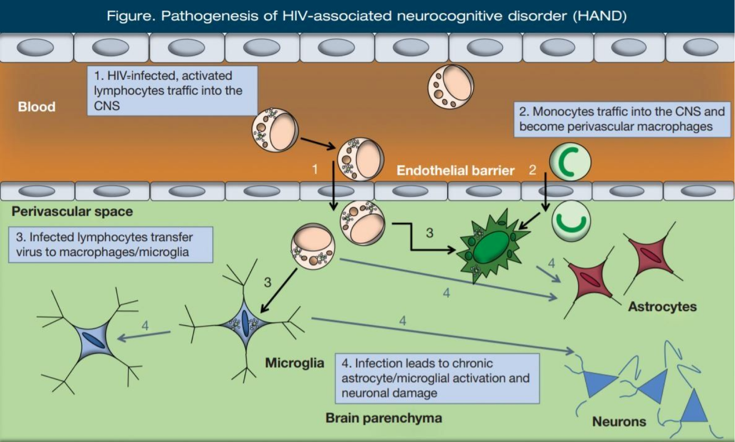
Pathogenesis
Initial infection —> direct viral invasion of CNS via monocytes & lymphocytes crossing BBB, releasing virions / cytokines / chemokines —> Excitotoxic, pro-inflammatory pathway —> synaptodendritic disruption and ultimately neuronal apoptosis

Slide 13
Assessment

Slide 14
European AIDS Clinical Society (EACS) Guidelines
Identify active confounding conditions
Screen for neurocognitive impairment with 3-item questionnaire OR
  Montreal Cognitive Assessment (MoCA) + International HIV Dementia Scale (IHDS) + HIV Dementia Scale (HDS)
Instrumental Activity of Daily Living (IADL) Scale
Formal neuropsychological evaluation/testing
Diagnostic evaluation to rule-out other causes

Slide 15
European AIDS Clinical Society (EACS) Guidelines
3-Item Screen for Neurocognitive Impairment
Do you experience frequent memory loss?
Do you feel that you are slowing when you are reasoning, planning activities, or solving problems?
Do you have difficulties paying attention?

Slide 16
Diagnostic Markers

Slide 17
Differential Diagnosis

Slide 18
DDx: Opportunistic Infections & Neoplasms
Toxoplasma gondii
Primary Central Nervous System Lymphoma (PCNSL)
Cryptococcus neoformans
Progressive Multifocal Leukoencephalopathy
Cytomegalovirus

Slide 19
Toxoplasmosis
Toxoplasma gondii, parasitic infection
Oral route via ingestion of cysts in undercooked meat or oocytes found in cat feces
30-50% of the world’s population demonstrate serologic evidence of latent infection
MCC of CNS mass lesions in HIV-infected patients
Reactivation in advanced-AIDS patients (CD4+ < 100) present with: fever, HA, AMS, focal signs, ataxia, PMR, & seizure
MC location of abscesses in grey-white junction, BG, deep WM, and thalamus
Multiple contrast-enhancing/“ring-enhancing” lesions on CT/MRI

Slide 20
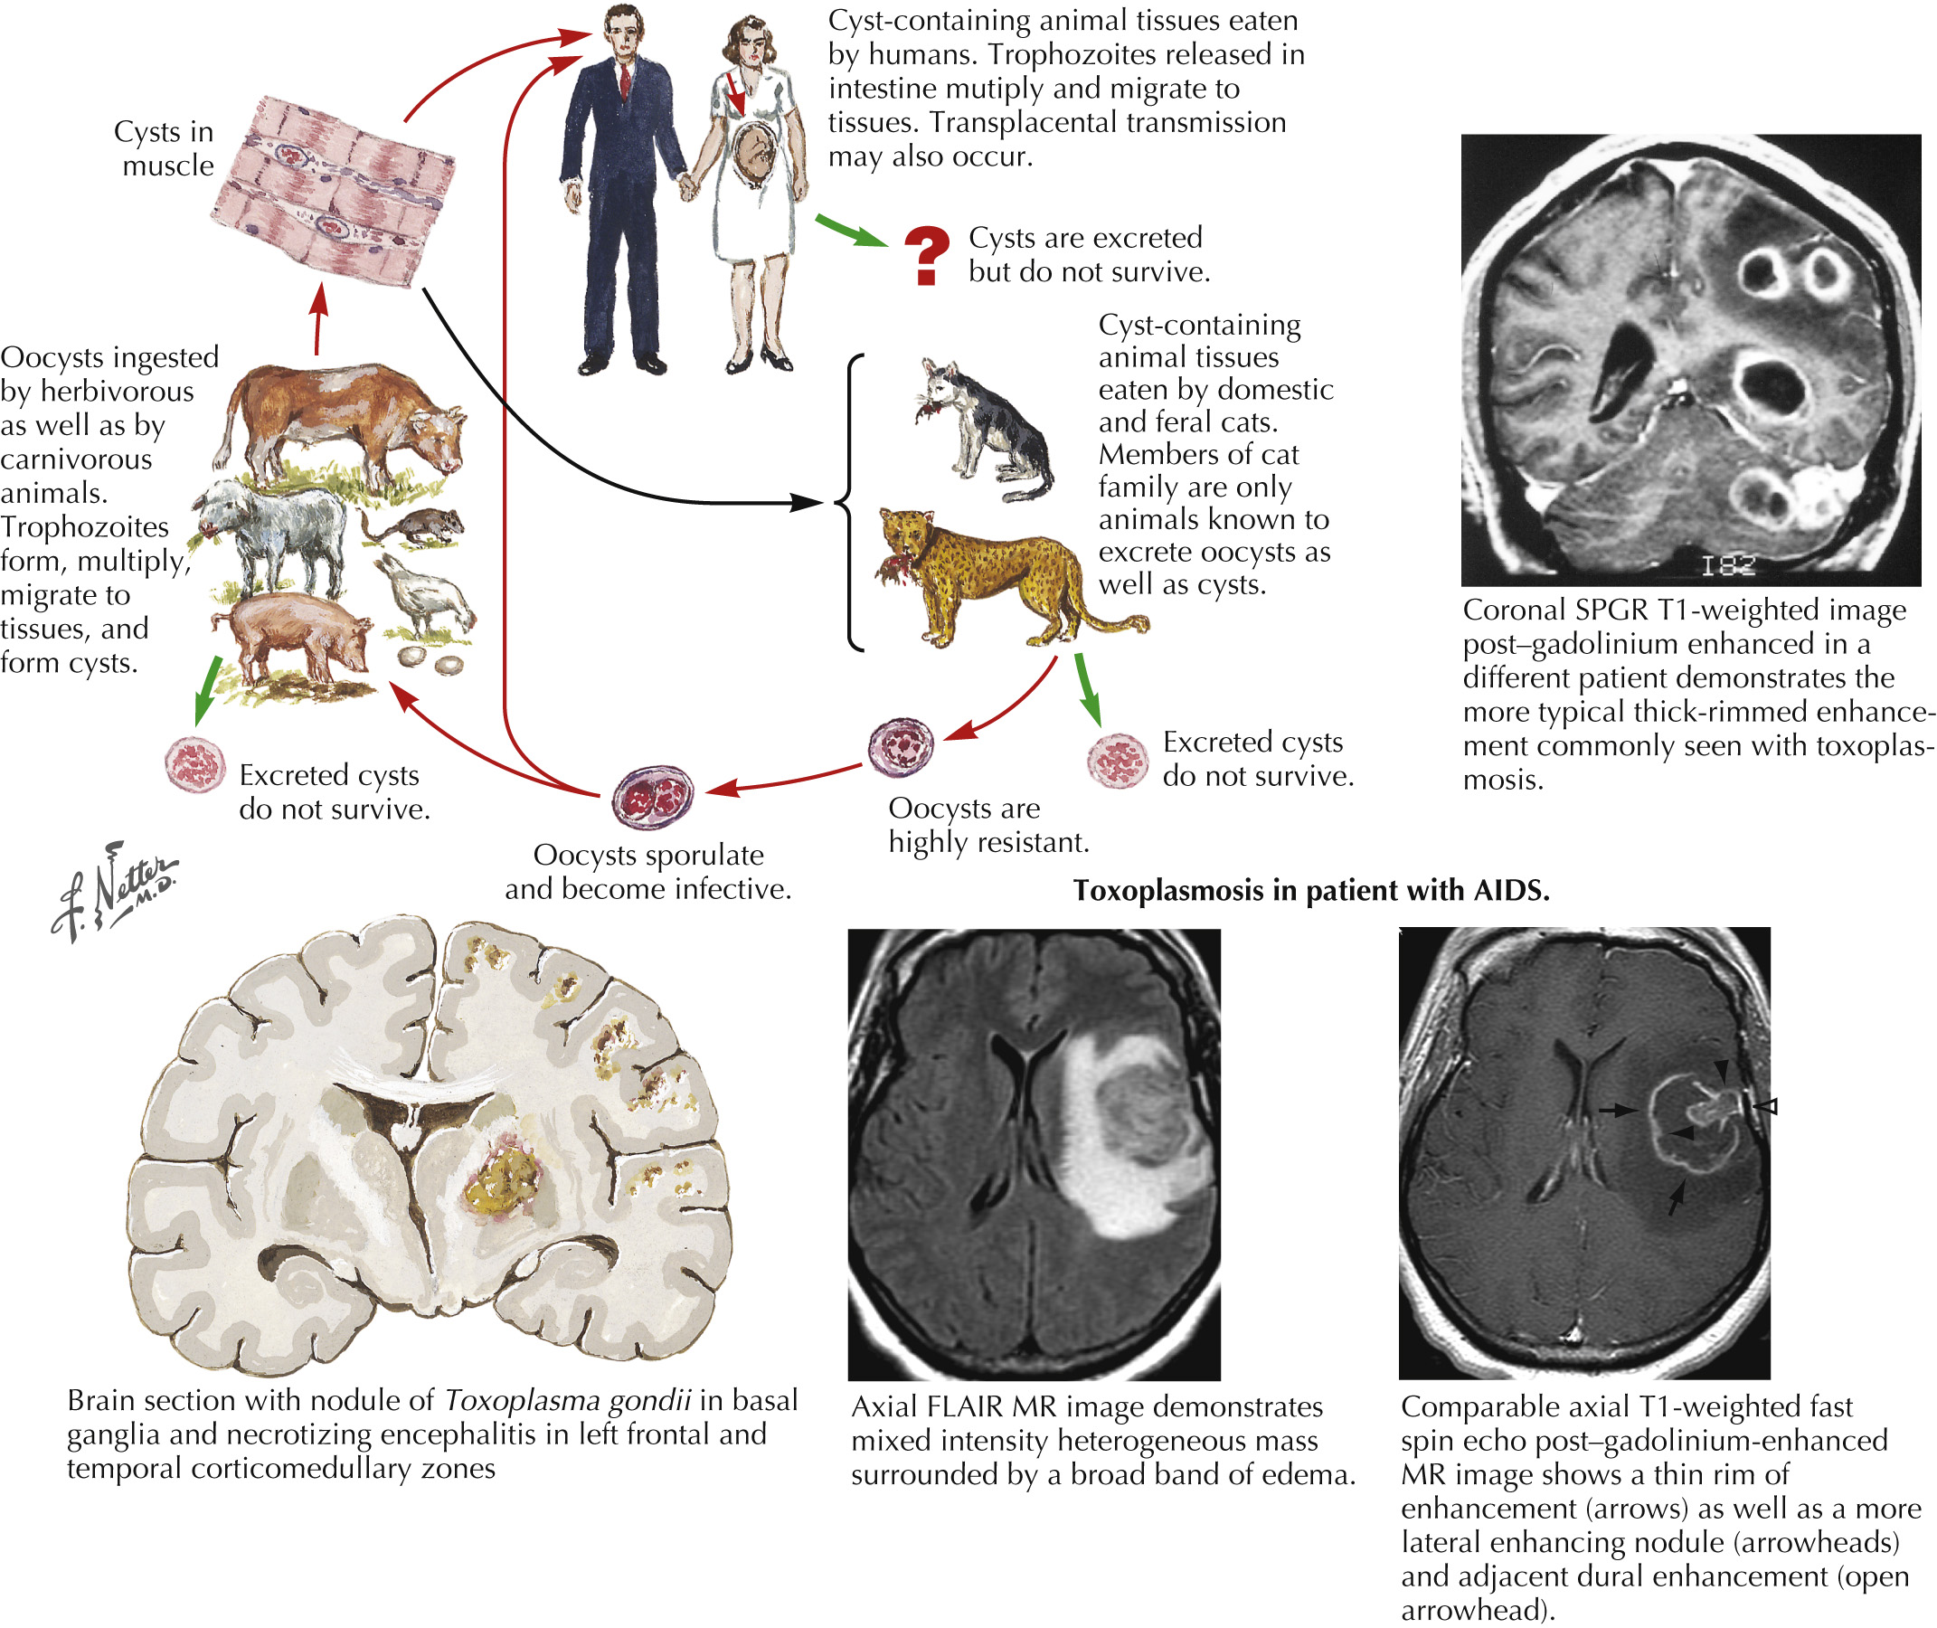
Toxoplasmosis

Slide 21
Primary CNS Lymphoma (PCNSL)

Slide 22
Clinical Considerations

Slide 23
Question & Answers

