Slide 1

The ABCs of ART: Designing Initial Antiretroviral Regimens for Beginners
Elizabeth Sherman, PharmD, AAHIVP
Associate Professor, Nova Southeastern University
Division of Infectious Disease, Memorial Physician Group
Faculty, Southeast AIDS Education and Training Center

Slide 2
Disclosures
This speaker does not have any financial relationships with commercial entities to disclose.
This program is supported by the Health Resources and Services Administration (HRSA) of the U.S. Department of Health and Human Services (HHS) under grant number U1OHA30535 as part of an award totaling $4.2m. The contents are those of the author(s) and do not necessarily represent the official views of, nor an endorsement, by HRSA, HHS, or the U.S. Government. For more information, please visit HRSA.gov.
“Funding for this presentation was made possible by cooperative agreement U1OHA30535 from the Health Resources and Services Administration HIV/AIDS Bureau. The views expressed do not necessarily reflect the official policies of the Department of Health and Human Services nor does mention of trade names, commercial practices, or organizations imply endorsement by the U.S. Government. Any trade/brand names for products mentioned during this presentation are for training and identification purposes only.”

Slide 3
Learning Objectives
By the end of this session, each participant will:
    List antiretroviral treatment goals and tools for achieving these goals
    Describe the process for selecting antiretroviral regimens for treatment-naive people with HIV
    Identify common mechanisms for drug interactions and the importance of recognizing clinically significant drug interactions with antiretrovirals

Slide 4
HIV Attacks CD4 T Cells
HIV attacks immune system CD4 T cells
    T cells are a type of white blood cell
    HIV uses T cell machinery to replicate
Depletion of CD4 T cells by HIV impairs immune defenses (leaving host susceptible to opportunistic infections)
Antiretroviral therapy (ART) suppresses viral load, allowing improvements in immune system functioning

Slide 5
HIV Life Cycle

Slide 6
Initiation of Antiretroviral Therapy (ART)
ART recommended for ALL persons with HIV to reduce morbidity and mortality and to prevent HIV transmission
Initiate ART immediately (or as soon as possible) after an HIV diagnosis
    Purpose: Increase ART uptake and linkage to care, decrease time to viral suppression, improve virologic suppression rates
When initiating ART, educate patients on ART benefits and deploy strategies to optimize care engagement and adherence
DHHS panel on antiretroviral guidelines for adults and adolescents. Available at
https://clinicalinfo.hiv.gov/en/guidelines/adult-and-adolescent-arv/

Slide 7
Goals of Antiretroviral Therapy
Decrease HIV RNA
    Goal HIV RNA or “viral load” <20-75 copies/mL or “undetectable”
Increase CD4 count
    500-1500 cells/mm³ is normal range
    AIDS diagnosis is CD4 < 200 or CD4% < 14% (or AIDS defining illness)
Improve quality of life and reduce HIV-related morbidity and mortality
Prevent HIV transmission to others
DHHS panel on antiretroviral guidelines for adults and adolescents. Available at
https://clinicalinfo.hiv.gov/en/guidelines/adult-and-adolescent-arv/

Slide 8
Tools to Achieve Treatment Goals
Performing pretreatment resistance testing
Maximizing adherence
Selecting individualized ART regimen

Slide 9
Tools to Achieve Treatment Goals
Performing pretreatment resistance testing
Maximizing adherence
Selecting individualized ART regimen

Slide 10
How Drug Resistance and Regimen Failure Occur
Poor regimen potency
Wrong dose
Medication intolerance
Poor absorption
Pharmacokinetic issues
Drug interactions
Poor Adherence
Drug Resistance
Regimen Failure
Insufficient
drug level
Viral replication in
the presence of drug
Psychosocial issues
Regimen issues
Side effects

Slide 11
Use of Drug Resistance Testing to Guide Therapy Decisions
Drug resistance is the reduction of the sensitivity of the virus to a particular drug
Resistance results from genetic mutation of viral enzymes & proteins leading to changes in the way drugs interact with them
Mechanisms for ARV resistance
    Transmitted resistance: Infected with a resistant strain of HIV at baseline
    Spontaneous resistance: HIV develops mutations easily and becomes resistant
Obtain genotype prior to initiation of therapy to determine if resistant virus transmitted
Obtain resistance test if virologic failure during ART or suboptimal suppression of viral load after start of therapy to determine if spontaneous resistance occurred

Slide 12
Tools to Achieve Treatment Goals
Performing pretreatment resistance testing
Maximizing adherence
Selecting individualized ART regimen

Slide 13
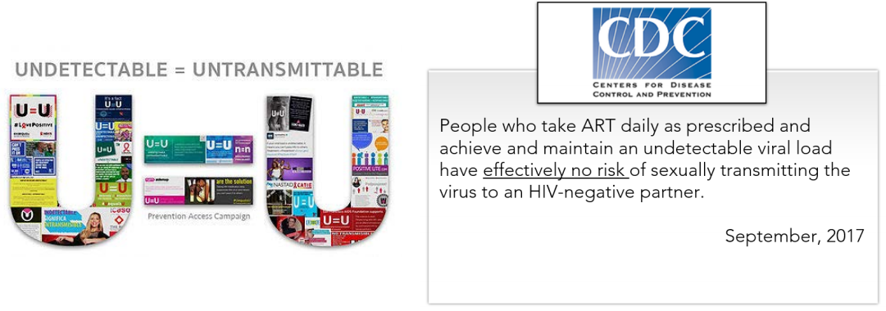
Importance of ART Adherence
ART adherence correlated with
    Suppressed HIV replication
    Reduced rates of viral resistance
    Increases in survival
    Improved quality of life
    Reduced HIV transmission to others
ART works by reducing viral replication to below level of detection
    Adherence rates near 100% needed for optimal viral suppression
DHHS panel on antiretroviral guidelines for adults and adolescents. Available at
https://clinicalinfo.hiv.gov/en/guidelines/adult-and-adolescent-arv/

Slide 14

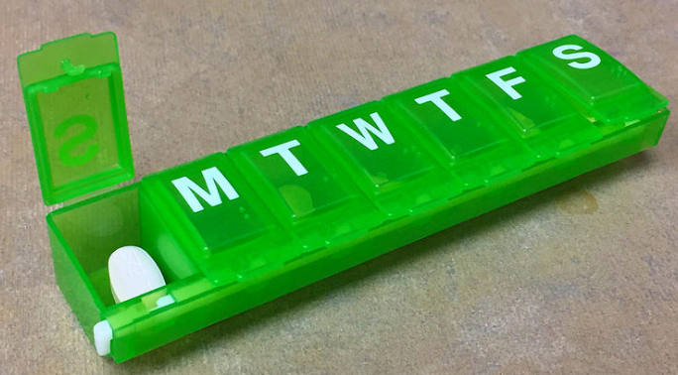
Adherence Interventions
Provide accessible, trustworthy, nonjudgmental multidisciplinary health care team
Find resources to assist with treatment costs to maintain uninterrupted access to both ART and appointments
Allow flexible appointment scheduling
Assist with transportation
Link patients to counseling to overcome stigma, substance use, or depression
Change ART to simplify dosing or reduce side effects
DHHS panel on antiretroviral guidelines for adults and adolescents. Available at
https://clinicalinfo.hiv.gov/en/guidelines/adult-and-adolescent-arv/

Slide 15
Simplified ART Regimens
Co-formulated antiretroviral agents and once-daily dosing can reduce pill burden and simplify dosing schedules
Use of single tablet regimens (STRs)
Simplified treatment regimens
    Effective
    Favored by patients and providers
    Associated with better adherence

Slide 16
Single Tablet Regimens (STRs)
Year of FDA Approval | Brand Name | Generic Name | Antiretroviral Drug Classes
2006 | Atripla | Efavirenz/tenofovir DF/emtricitabine | NNRTI + dual NRTI
2011 | Complera | Rilpivirine/tenofovir DF/emtricitabine | NNRTI + dual NRTI
2012 | Stribild | Elvitegravir/cobicistat/tenofovir DF/emtricitabine | INSTI + booster + dual NRTI
2014 | Triumeq | Dolutegravir/abacavir/lamivudine | INSTI + dual NRTI
2015 | Genvoya | Elvitegravir/cobicistat/tenofovir AF/emtricitabine | INSTI + booster + dual NRTI
2016 | Odefsey | Rilpivirine/tenofovir AF/emtricitabine | NNRTI + dual NRTI
2017 | Juluca | Dolutegravir/rilpivirine | INSTI + NNRTI
2018 | Biktarvy | Bictegravir/tenofovir AF/emtricitabine | INSTI + dual NRTI
2018 | Symtuza | Darunavir/cobicistat/tenofovir AF/emtricitabine | PI + booster + dual NRTI
2018 | Delstrigo | Doravirine/tenofovir DF/emtricitabine | NNRTI + dual NRTI
2019 | Dovato | Dolutegravir/lamivudine | INSTI + NRTI
Key: DF = disoproxil fumarate; AF = alafenamide; NNRTI = non-nucleoside reverse transcriptase inhibitor;
NRTI = nucelos(t)ide reverse transcriptase inhibitor; INSTI = integrase strand transfer inhibitor; PI = protease inhibitor

Slide 17
Food Considerations with STRs
STR Brand Name | STR Generic Name | Food Considerations
Atripla | Efavirenz/tenofovir DF/emtricitabine | Empty stomach
Biktarvy | Bictegravir/tenofovir AF/emtricitabine | With or without food
Complera | Rilpivirine/tenofovir DF/emtricitabine | With a full meal (not a protein drink)
Delstrigo | Doravirine/tenofovir DF/emtricitabine | With or without food
Dovato | Dolutegravir/lamivudine | With or without food
Genvoya | Elvitegravir/cobicistat/tenofovir AF/emtricitabine | With food
Juluca | Dolutegravir/rilpivirine | With a full meal (not a protein drink)
Odefsey | Rilpivirine/tenofovir AF/emtricitabine | With a full meal (not a protein drink)
Stribild | Elvitegravir/cobicistat/tenofovir DF/emtricitabine | With food
Symtuza | Darunavir/cobicistat/tenofovir AF/emtricitabine | With food
Triumeq | Dolutegravir/abacavir/lamivudine | With or without food
Key: DF = disoproxil fumarate; AF = alafenamide

Slide 18
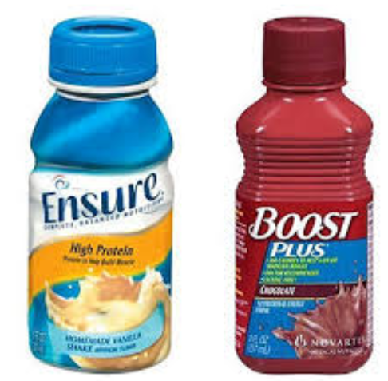






What exactly does empty stomach, with food, or with a full meal mean?
Empty stomach: 1 hour before a meal or 2 hours after a meal
With food: Within 2 hours after eating
With a full meal: At least 390 calories
X
X
X

Slide 19
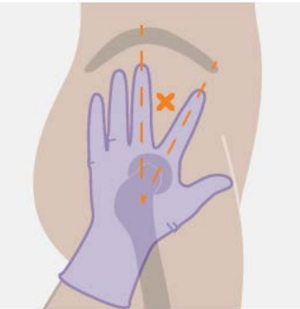
Simplified Regimen: Long-acting cabotegravir/rilpivirine (LA CAB/RPV)
2021: FDA approves IM injection every 4 weeks
2022: FDA approves IM injection every 8 weeks
DHHS guidelines panel recommends LA CAB/RPV as optimization strategy for HIV+ on ART with viral suppression for ≥ 3 months, who –
    have no baseline resistance to either medication,
    have no prior virologic failures,
    do not have active HBV infection (unless also receiving oral HBV treatment),
    are not pregnant and are not planning on becoming pregnant, and
    are not receiving medications with significant drug interactions
DHHS panel on antiretroviral guidelines for adults and adolescents. Available at
https://clinicalinfo.hiv.gov/en/guidelines/adult-and-adolescent-arv/

Slide 20
Tools to Achieve Treatment Goals
Performing pretreatment resistance testing
Maximizing adherence
Selecting individualized ART regimen

Slide 21
Process for Selecting an Initial ART Regimen
Regimen efficacy
    Standard therapy for HIV typically consists of 2-3+ drugs from 2+ classes (no monotherapy)
Comorbidities
    Potential adverse effects or drug-drug interactions
Drug resistance
    Presence of transmitted drug resistance or development of drug resistance on failure
Adherence potential
    Pill burden, dosing frequency, food restrictions

Slide 22
Overview of ART Drug Classes
Classification based on where in the viral life cycle each drug acts
6 antiretroviral classes
    Nucleos(t)ide reverse transcriptase inhibitors (NRTI)*
    Integrase strand transfer inhibitors (INSTI)*
    Protease inhibitors (PI)†
    Non-nucleoside reverse transcriptase inhibitors (NNRTI) †
    Entry inhibitors††
    Capsid inhibitor††
*Recommended for most people with HIV
†Recommended in certain clinical situations
  †† Not recommended for initial therapy
DHHS panel on antiretroviral guidelines for adults and adolescents. Available at
https://clinicalinfo.hiv.gov/en/guidelines/adult-and-adolescent-arv/

Slide 23
HIV Life Cycle & ARV Drug Classes

Slide 24
Antiretroviral Medications
Nucleoside Reverse Transcriptase Inhibitors (NRTIs)
Protease Inhibitors (PIs)
Abacavir (ABC) (Ziagen®)
Didanosine (ddI) (Videx®)
Emtricitabine (FTC) (Emtriva®)
Lamivudine (3TC) (Epivir®)
Stavudine (d4T) (Zerit®) withdrawn 2020
Tenofovir (TDF or TAF) (Viread® or Vemlidy®)
Zalcitabine (ddC) (Hivid®) withdrawn 2005
Zidovudine (ZDV, AZT) (Retrovir®)
3TC/ABC (Epzicom®)
3TC/ABC/ZDV (Trizivir®) to be discontinued January 2024
3TC/ZDV (Combivir®)
3TC/TDF (Cimduo®, Temixys®)
FTC/TDF (Truvada®)
FTC/TAF (Descovy®)
Amprenavir (APV) (Agenerase®) discontinued 2004
Atazanavir (ATV) (Reyataz®)
Atazanavir/cobicistat (ATV/c) (Evotaz®)
Darunavir (DRV) (Prezista®)
Darunavir/cobicistat (DRV/c) (Prezcobix®)
Fosamprenavir (FPV) (Lexiva®)
Indinavir (IDV) (Crixivan®)
Lopinavir/ritonavir (LPV/r) (Kaletra®)
Nelfinavir (NFV) (Viracept®)
Ritonavir (RTV) (Norvir®)
Saquinavir (SQV) (Invirase®)
Tipranavir (TPV) (Aptivus®)
Entry Inhibitors
Non-nucleoside Reverse Transcriptase Inhibitors (NNRTIs)
Enfuvirtide (ENF, T20) (Fuzeon®)
Fostemsavir (Rukobia®)
Ibalizumab (Trogarzo®)
Maraviroc (MVC) (Selzentry®)
Delavirdine (DLV) (Rescriptor®)
Doravirine (DOR) (Pifeltro®)
Efavirenz (EFV) (Sustiva®)
Etravirine (ETR) (Intelence®)
Nevirapine (NVP) (Viramune®)
Rilpivirine (RPV) (Edurant®)
Capsid Inhibitor
Lenacapavir (LEN) (Sunlenca®)
Single Tablet Regimens
Integrase Inhibitors (INSTIs)
BIC/FTC/TAF (Biktarvy®)
DRV/cobi/FTC/TAF (Symtuza®)
DOR/3TC/TDF (Delstrigo®)
DTG/3TC/ABC (Triumeq®)
DTG/RPV (Juluca®)
DTG/3TC (Dovato®)
EFV/FTC/TDF (Atripla®)
EFV/3TC/TDF (Symfi® or Symfi Lo®)
EVG/cobi/FTC/TAF (Genvoya®)
EVG/cobi/FTC/TDF (Stribild®)
RPV/FTC/TAF (Odefsey®)
RPV/FTC/TDF (Complera®)
Bictegravir (BIC)
Cabotegravir (CAB) (Vocabria®)
Dolutegravir (DTG) (Tivicay®)
Elvitegravir (EVG)
Raltegravir (RAL) (Isentress®)
Long-Acting Injectable ART
CAB/RPV (Cabenuva®)
Pharmacokinetic Enhancers “Boosters”
Cobicistat (cobi) (Tybost®)
Ritonavir (r) (Norvir®)

Slide 25
Initial HIV Management Principles
Initiate ART with 1 of 3 types of regimens
Most regimens should include 2 NRTIs plus 1 drug from a separate class:
    1-2 NRTIs + 1 INSTI*
    2 NRTIs + 1 PI (boosted PI)†
    2 NRTIs + 1 NNRTI†
*Recommended for most patients
†Recommended in certain clinical situations
DHHS panel on antiretroviral guidelines for adults and adolescents. Available at
https://clinicalinfo.hiv.gov/en/guidelines/adult-and-adolescent-arv/

Slide 26
Boosting a Protease Inhibitor (PI) With Ritonavir or Cobicistat
Unboosted PI
C_{max1}
Boosted PI
C_{max2}
Decreased variability in
trough concentrations
PI
Drug Level
Increased AUC
C_{min2}
Area of Potential HIV Replication
C_{min1}
Dosing Interval
Time
Dose
Dose

Slide 27
Recommended Initial Regimens for Most People with HIV
1-2 NRTIs
INTEGRASE INHIBITOR
Emtricitabine + Tenofovir
OR
Lamivudine +/- Abacavir
+
Bictegravir
Dolutegravir
Tenofovir alafenamide (TAF) and tenofovir disoproxil fumarate (TDF) are two forms of tenofovir approved by the FDA. TAF has
fewer bone and kidney toxicities than TDF, while TDF is associated with lower lipid levels. Safety, cost, and access are among
the factors to consider when choosing between these drugs.
DHHS panel on antiretroviral guidelines for adults and adolescents. Available at
https://clinicalinfo.hiv.gov/en/guidelines/adult-and-adolescent-arv/

Slide 28
Recommended Initial Regimens in Certain Clinical Situations
PROTEASE INHIBITOR
(boosted with ritonavir or cobicistat)
Darunavir + RTV or Darunavir + COBI
Atazanavir + RTV or Atazanavir +COBI
2 NRTIs
OR
Emtricitabine + Tenofovir
OR
Lamivudine + Abacavir
+
NNRTI
Doravirine
Efavirenz
Rilpivirine
OR
INTEGRASE INHIBITOR
Elvitegravir + cobicistat
Raltegravir
Tenofovir alafenamide (TAF) and tenofovir disoproxil fumarate (TDF) are two forms of tenofovir approved by the FDA. TAF has
fewer bone and kidney toxicities than TDF, while TDF is associated with lower lipid levels. Safety, cost, and access are among
the factors to consider when choosing between these drugs.
DHHS panel on antiretroviral guidelines for adults and adolescents. Available at
https://clinicalinfo.hiv.gov/en/guidelines/adult-and-adolescent-arv/

Slide 29
Recommended Initial Regimens in Certain Clinical Situations
PI: Patients w/ uncertain adherence or no resistance testing
PROTEASE INHIBITOR
(boosted with ritonavir or cobicistat)
Darunavir + RTV or Darunavir + COBI
Atazanavir + RTV or Atazanavir +COBI
2 NRTIs
DOR: NNRTI in a single tablet regimen
OR
EFV: Minimal drug interactions w/ rifamycins
ABC: No renal dose adjustment
Emtricitabine + Tenofovir
OR
Lamivudine + Abacavir
+
NNRTI
RPV: Small pill size
Doravirine
Efavirenz
Rilpivirine
OR
EVG: INSTI in a single tablet regimen
INTEGRASE INHIBITOR
RAL: No CYP3A4 drug interactions
Elvitegravir + cobicistat
Raltegravir
Tenofovir alafenamide (TAF) and tenofovir disoproxil fumarate (TDF) are two forms of tenofovir approved by the FDA. TAF has
fewer bone and kidney toxicities than TDF, while TDF is associated with lower lipid levels. Safety, cost, and access are among
the factors to consider when choosing between these drugs.
DHHS panel on antiretroviral guidelines for adults and adolescents. Available at
https://clinicalinfo.hiv.gov/en/guidelines/adult-and-adolescent-arv/

Slide 30

Selecting an Initial HIV Regimen:
The “Chinese Food Rule”
Tip of the hat to Royce Lin, MD

Slide 31
Recommended Initial Regimens in Certain Clinical Situations
PROTEASE INHIBITOR
(boosted with ritonavir or cobicistat)
Darunavir + RTV or Darunavir + COBI
Atazanavir + RTV or Atazanavir +COBI
2 NRTIs
OR
Emtricitabine + Tenofovir
OR
Lamivudine + Abacavir
+
NNRTI
Doravirine
Efavirenz
Rilpivirine
OR
INTEGRASE INHIBITOR
Elvitegravir + cobicistat
Raltegravir
Tenofovir alafenamide (TAF) and tenofovir disoproxil fumarate (TDF) are two forms of tenofovir approved by the FDA. TAF has
fewer bone and kidney toxicities than TDF, while TDF is associated with lower lipid levels. Safety, cost, and access are among
the factors to consider when choosing between these drugs.
DHHS panel on antiretroviral guidelines for adults and adolescents. Available at
https://clinicalinfo.hiv.gov/en/guidelines/adult-and-adolescent-arv/

Slide 32
Recommended Initial CHINESE FOOD in Certain Clinical Situations
PROTEASE INHIBITOR
(boosted with ritonavir or cobicistat)
Darunavir + RTV or Darunavir + COBI
Atazanavir + RTV or Atazanavir +COBI
2 NRTIs
OR
Emtricitabine + Tenofovir
OR
Lamivudine + Abacavir
+
NNRTI
Doravirine
Efavirenz
Rilpivirine
OR
INTEGRASE INHIBITOR
Elvitegravir + cobicistat
Raltegravir
Tenofovir alafenamide (TAF) and tenofovir disoproxil fumarate (TDF) are two forms of tenofovir approved by the FDA. TAF has
fewer bone and kidney toxicities than TDF, while TDF is associated with lower lipid levels. Safety, cost, and access are among
the factors to consider when choosing between these drugs.
DHHS panel on antiretroviral guidelines for adults and adolescents. Available at
https://clinicalinfo.hiv.gov/en/guidelines/adult-and-adolescent-arv/

Slide 33
Recommended Initial CHINESE FOOD in Certain Clinical Situations
PROTEASE INHIBITOR
(boosted with ritonavir or cobicistat)
Darunavir + RTV or Darunavir + COBI
Atazanavir + RTV or Atazanavir +COBI
2 NRTIs
OR
Emtricitabine + Tenofovir
OR
Lamivudine + Abacavir
+
NNRTI
Doravirine
Efavirenz
Rilpivirine
OR
INTEGRASE INHIBITOR
Elvitegravir + cobicistat
Raltegravir
Tenofovir alafenamide (TAF) and tenofovir disoproxil fumarate (TDF) are two forms of tenofovir approved by the FDA. TAF has
fewer bone and kidney toxicities than TDF, while TDF is associated with lower lipid levels. Safety, cost, and access are among
the factors to consider when choosing between these drugs.
DHHS panel on antiretroviral guidelines for adults and adolescents. Available at
https://clinicalinfo.hiv.gov/en/guidelines/adult-and-adolescent-arv/

Slide 34
Recommended Initial CHINESE FOOD in Certain Clinical Situations
PROTEASE INHIBITOR
(boosted with ritonavir or cobicistat)
Darunavir + RTV or Darunavir + COBI
Atazanavir + RTV or Atazanavir +COBI
2 SCOOPS OF RICE
OR
Emtricitabine + Tenofovir
OR
Lamivudine + Abacavir
+
NNRTI
Doravirine
Efavirenz
Rilpivirine
OR
INTEGRASE INHIBITOR
Elvitegravir + cobicistat
Raltegravir
Tenofovir alafenamide (TAF) and tenofovir disoproxil fumarate (TDF) are two forms of tenofovir approved by the FDA. TAF has
fewer bone and kidney toxicities than TDF, while TDF is associated with lower lipid levels. Safety, cost, and access are among
the factors to consider when choosing between these drugs.
DHHS panel on antiretroviral guidelines for adults and adolescents. Available at
https://clinicalinfo.hiv.gov/en/guidelines/adult-and-adolescent-arv/

Slide 35
Recommended Initial CHINESE FOOD in Certain Clinical Situations
PROTEASE INHIBITOR
(boosted with ritonavir or cobicistat)
Darunavir + RTV or Darunavir + COBI
Atazanavir + RTV or Atazanavir +COBI
2 SCOOPS OF RICE
OR
Emtricitabine + Tenofovir
OR
Lamivudine + Abacavir
+
NNRTI
Doravirine
Efavirenz
Rilpivirine
OR
INTEGRASE INHIBITOR
Elvitegravir + cobicistat
Raltegravir
Tenofovir alafenamide (TAF) and tenofovir disoproxil fumarate (TDF) are two forms of tenofovir approved by the FDA. TAF has
fewer bone and kidney toxicities than TDF, while TDF is associated with lower lipid levels. Safety, cost, and access are among
the factors to consider when choosing between these drugs.
DHHS panel on antiretroviral guidelines for adults and adolescents. Available at
https://clinicalinfo.hiv.gov/en/guidelines/adult-and-adolescent-arv/

Slide 36
Recommended Initial CHINESE FOOD in Certain Clinical Situations
BEEF
(enhanced with MSG)
Darunavir + RTV or Darunavir + COBI
Atazanavir + RTV or Atazanavir +COBI
2 SCOOPS OF RICE
OR
Emtricitabine + Tenofovir
OR
Lamivudine + Abacavir
+
CHICKEN
Doravirine
Efavirenz
Rilpivirine
OR
FISH
Elvitegravir + cobicistat
Raltegravir
Tenofovir alafenamide (TAF) and tenofovir disoproxil fumarate (TDF) are two forms of tenofovir approved by the FDA. TAF has
fewer bone and kidney toxicities than TDF, while TDF is associated with lower lipid levels. Safety, cost, and access are among
the factors to consider when choosing between these drugs.
DHHS panel on antiretroviral guidelines for adults and adolescents. Available at
https://clinicalinfo.hiv.gov/en/guidelines/adult-and-adolescent-arv/

Slide 37
Recommended Initial Regimens for Most People with HIV
1-2 NRTIs
INTEGRASE INHIBITOR
Emtricitabine + Tenofovir
OR
Lamivudine +/- Abacavir
+
Bictegravir
Dolutegravir
Tenofovir alafenamide (TAF) and tenofovir disoproxil fumarate (TDF) are two forms of tenofovir approved by the FDA. TAF has
fewer bone and kidney toxicities than TDF, while TDF is associated with lower lipid levels. Safety, cost, and access are among
the factors to consider when choosing between these drugs.
DHHS panel on antiretroviral guidelines for adults and adolescents. Available at
https://clinicalinfo.hiv.gov/en/guidelines/adult-and-adolescent-arv/

Slide 38
Recommended CHINESE FOOD for Most People with HIV
1-2 SCOOPS OF RICE
FISH
Emtricitabine + Tenofovir
OR
Lamivudine +/- Abacavir
+
Bictegravir
Dolutegravir
Tenofovir alafenamide (TAF) and tenofovir disoproxil fumarate (TDF) are two forms of tenofovir approved by the FDA. TAF has
fewer bone and kidney toxicities than TDF, while TDF is associated with lower lipid levels. Safety, cost, and access are among
the factors to consider when choosing between these drugs.
DHHS panel on antiretroviral guidelines for adults and adolescents. Available at
https://clinicalinfo.hiv.gov/en/guidelines/adult-and-adolescent-arv/

Slide 39
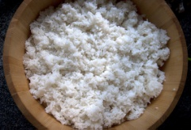
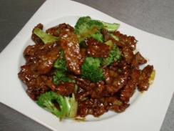
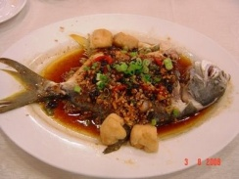

HIV Regimen / Chinese Food Selection: A Stepwise Approach
Get 1-2 scoops of rice
    Choose 2 NRTIs, co-formulated when possible
      Example: tenofovir + emtricitabine
      Example: abacavir + lamivudine
    Only 1 regimen uses 1 NRTI (lamivudine + dolutegravir)
Beef, fish, or chicken?
    Decide which class to use (PI, INSTI, NNRTI)
    Choose specific agent based on comorbidities, pill burden, drug interactions, resistance testing

Slide 40
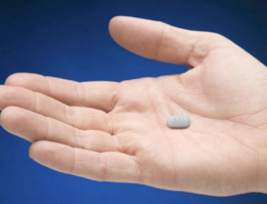

PI, InSTI, or NNRTI? (Beef, Fish, or Chicken?)
PI + RTV or COBI
(Beef + MSG)
INSTI
(Fish)
NNRTI
(Chicken)
PRO
Very strong, potency well established
Harder to get resistance
Best for patients with uncertain adherence or if resistance tests not available
PRO
Highly effective for most patients
Very few side effects
Less drug interactions
Less resistance seen with dolutegravir or bictegravir (strong, potent)
Dolutegravir or bictegravir can be used if resistance tests not available
PRO
Efavirenz: minimal drug interactions with rifamycins
Doravirine: less drug interactions, can take with or without food
Rilpivirine is in smallest single tablet regimen
CON
Prone to resistance
Efavirenz has CNS side effects
Doravirine comes co-formulated only with TDF/3TC
Oral rilpivirine has lower efficacy in some patients (use only if CD4>200 and VL<100,000) and requires acidic environment for absorption
CON
Many drug interactions (P450 metabolism)
Metabolic effects
(↑ cholesterol, glucose)
GI side effects
Boosting required
CON
Some delicate, prone to resistance (e.g., raltegravir, elvitegravir)
Weight gain (e.g. bictegravir, dolutegravir, especially when used with tenofovir alafenamide)

Slide 41
The Importance of Drug Interactions
Common drug interactions occur between ART and medications used to manage common comorbidities
Drug interactions range from mild to severe (and even potentially fatal, requiring FDA labeling to prohibit co-administration)
Ask about all medications: prescription, over-the-counter, herbal, recreational
    The INSTIs bictegravir, dolutegravir, & raltegravir have the fewest drug interactions
    Regimens containing ritonavir or cobicistat as boosters have a high potential for drug interactions
Any changes to the medication list require careful consideration of potential interactions

Slide 42
ARV Metabolism and Drug Interaction Potential
ARV Drug Class | Route of Metabolism | Drug Intxn Potential
NRTI | Mostly renal | Medium
NNRTI | Liver metabolism: P450 substrates, some are P450 inducers | High
PI | Liver metabolism: P450 substrates, most are P450 inhibitors | High
Integrase Inhibitors | Liver metabolism Raltegravir: UGT1A1 enzyme (not P450) Elvitegravir: P450 substrate (cobicistat: P450 inhibitor) Dolutegravir: P450 substrate & UGT1A1 Bictegravir: P450 substrate & UGT1A1 | Medium-High
Entry Inhibitors | Maraviroc: Liver metabolism: P450 substrate Fostemsavir: Liver metabolism: P450 substrate Enfuvirtide: Peptide undergoes catabolism to amino acids: No known drug interactions Ibalizumab: Metabolized by CD4 receptor internalization/ catabolism: No known drug interactions | Low-Medium
Capsid inhibitor | Liver metabolism: P450 substrate & UGT1A1 | Medium

Slide 43
Antiretrovirals Have Drug Interactions With Multiple Medications
Cholesterol medications
Anti-acid therapies
TB medications
Hormonal contraceptives
Asthma medications and corticosteroids
Seizure medications
Benzodiazepines
Hepatitis C medications
Antifungals
Antiplatelets & anticoagulants
Erectile dysfunction medications
Antiarrhythmics & calcium channel blockers
Antipsychotics and antidepressants
Herbal and dietary supplements
Other antiretrovirals

Slide 44
ARV Interactions with Cholesterol Medications
Statins (HMG Co-A reductase inhibitors) are P450 substrates
    Degree of P450 metabolism varies:
    simva, lova >> rosuva > atorva > pitava > pravastatin
May be affected by NNRTIs, PIs, cobicistat
NNRTIs can ↓ statin levels
    Monitor statin efficacy, ↑ dose as necessary (statin max dose limit applies)
PIs and cobicistat ↑ statin levels
    Avoid simvastatin, lovastatin (2000% ↑)
    Myopathy including rhabdomyolysis

Slide 45
Managing ARV Interactions with Statins
Statin | Interacting Antiretroviral(s) | Prescribing Recommendation
Atorvastatin | Atazanavir ± ritonavir | Titrate atorvastatin dose carefully and use lowest dose necessary while monitoring for toxicities
 | Darunavir/cobicistat Darunavir + ritonavir Elvitegravir/cobicistat Lopinavir/ritonavir | Do not exceed 20 mg atorvastatin daily
 | Atazanavir/cobicistat Tipranavir + ritonavir | Do not co-administer
Lovastatin | HIV protease inhibitors Elvitegravir/cobicistat | CONTRAINDICATED
Pitavastatin | HIV protease inhibitors | No dose adjustment necessary
 | Elvitegravir/cobicistat | No data; no dosage recommendation
Pravastatin | Atazanavir + ritonavir; Atazanavir/cobicistat Darunavir + ritonavir; Darunavir/cobicistat | Titrate pravastatin dose carefully while monitoring for toxicities
 | Lopinavir + ritonavir | No dose limitations
 | Elvitegravir/cobicistat | No data; no dosage recommendation
Rosuvastatin | Darunavir + ritonavir Elvitegravir/cobicistat | Titrate rosuvastatin dose carefully and use lowest necessary dose while monitoring for toxicities
 | Darunavir/cobicistat | Do not exceed 20 mg rosuvastatin daily
 | Atazanavir/cobicistat Atazanavir + ritonavir Lopinavir/ritonavir | Do not exceed 10 mg rosuvastatin daily
 | Tipranavir + ritonavir | No dose limitations
Simvastatin | HIV protease inhibitors Elvitegravir/cobicistat | CONTRAINDICATED
DHHS panel on antiretroviral guidelines for adults and adolescents. Available at
https://clinicalinfo.hiv.gov/en/guidelines/adult-and-adolescent-arv/

Slide 46
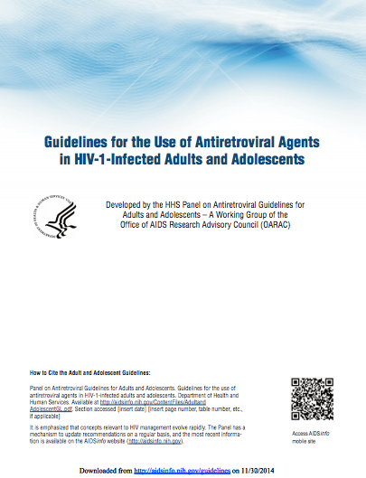

Resources: ART and Drug Interactions
Department of Health and Human Services (DHHS). Guidelines for the use of antiretroviral agents in adults and adolescents with HIV.
[clinicalinfo.hiv.gov/guidelines]
    Tables 24-25
University of Liverpool HIV iChart app for iPhone and Android
[www.hiv-druginteractions.org]

Slide 47
Summary
ART recommended for all HIV+
Treatment goals achievable by using viral resistance testing, maximizing adherence, and selecting individualized ART regimen
Initial ART = 1-2 NRTIs + INSTI or PI or NNRTI
(1-2 scoops of rice + 1 main entrée)
ART presents high potential for drug interactions due to the way the medications are absorbed and metabolized

Slide 48
The ABCs of ART: Designing Initial Antiretroviral Regimens for Beginners
Elizabeth Sherman, PharmD, AAHIVP
Associate Professor, Nova Southeastern University
Division of Infectious Disease, Memorial Physician Group
Faculty, Southeast AIDS Education and Training Center

Slide 49
AETC Program National Centers and HIV Curriculum
National Coordinating Resource Center – serves as the central web –based repository for AETC Program training and capacity building resources; its website includes a free virtual library with training and technical assistance materials, a program directory, and a calendar of trainings and other events. Learn more: https://aidsetc.org/
National Clinical Consultation Center – provides free, peer-to-peer, expert advice for health professionals on HIV prevention, care, and treatment and related topics. Learn more: https://nccc/ucsf.edu
National HIV Curriculum – provides ongoing, up –to-date HIV training and information for health professionals through a free, web –based curriculum; also provides free CME credits, CNE contact hours, CE contact hours, and maintenance of certification credits. Learn more: www.hiv.uw.edu
Notes:
This slide must remain as part of our funding requirements.

