Slide 1
Women’s Health and HIV
L. Beth Gadkowski MD MPH MS
Clinical Associate Professor, Division of Infectious Diseases and Global Medicine
University of Florida
Faculty, North Florida AETC
( 1 )

Slide 2
Disclosures
None
This program is supported by the Health Resources and Services Administration (HRSA) of the U.S. Department of Health and Human Services (HHS) under grant number U1OHA30535 as part of an award totaling $4.2m. The contents are those of the author(s) and do not necessarily represent the official views of, nor an endorsement, by HRSA, HHS, or the U.S. Government. For more information, please visit HRSA.gov.
“Funding for this presentation was made possible by cooperative agreement U1OHA30535 from the Health Resources and Services Administration HIV/AIDS Bureau. The views expressed do not necessarily reflect the official policies of the Department of Health and Human Services nor does mention of trade names, commercial practices, or organizations imply endorsement by the U.S. Government. Any trade/brand names for products mentioned during this presentation are for training and identification purposes only.”
( 2 )
Notes:
The HRSA disclosures must remain as part of our grant requirements.

Slide 3
By the end of this session, each participant will be able to:
Describe critical health screenings specific to women with HIV
Discuss reproductive considerations in women with HIV
Recognize appropriate perinatal care for people with HIV
( 3 )

Slide 4
QUESTION
What percent of your patient population identifies as cisgender female?
Notes:
Cisgener female is an individual ho as born biological female and identifies as a oman

Slide 5
Epidemiology of HIV in Women
Globally, about 50% of the population of people with HIV are women
In the US, women account for about 20% of the population living with HIV
In 2019, 84% of new HIV diagnoses in women were attributed to heterosexual sex, 16% to injection drug use
https://www.cdc.gov/hiv/group/gender/women/diagnoses.html

Slide 6
Trends in New HIV Diagnoses in Women
Between 2017 and 2021, there has been an 11% decline in new HIV diagnoses among US women
CDC. Diagnoses of HIV infection in the United States and dependent areas, 2021. HIV Surveillance Report 2023;34.
Notes:
The global epidemiology reflects

Slide 7
Health Screenings for women with HIV

Slide 8
Case
Mrs. T presents for follow-up of HIV. She has an undetectable viral load on bictegravir/TAF/FTC. She just turned 65 and she is so pleased because her PCP told her she doesn’t have to have any more PAP smears due to her age.
What do you tell her?

Slide 9
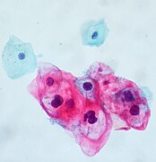
Cervical Cancer Screening
Cervical cancer screening is an essential component of care for all persons with HIV who have cervix
Abnormal cervical cytology is nearly 11 times more common among women with HIV than the general female population
Human papillomavirus (HPV) infection
Immune dysfunction
https://clinicalinfo.hiv.gov/en/guidelines/hiv-clinical-guidelines-adult-and-adolescent-opportunistic-infections/human-0?view=full
Notes:
HPV acquisition occurs through sexual transmission. The majority of infections are transient and resolve without intervention or treatment. HPV, specifically oncogenic strains (16,18, 31, 33, 35, 39, 45, 51, 52, 56, 58, and 59), may persist, a necessary but not sufficient step in the development of cervical dysplasia and ultimately cervical cancer.
HPV types 6 and 11 cause 90% of genital warts, but in general are not considered oncogenic

Slide 10
Cervical Cancer Screening
Age of Onset for Screening: 21 years of age
Duration of Cervical Cancer Screening: Cervical cancer screening should continue throughout the life of people with HIV who have a cervix, as opposed to the recommendation to stop after age 65 in the general population
https://clinicalinfo.hiv.gov/en/guidelines/hiv-clinical-guidelines-adult-and-adolescent-opportunistic-infections/human-0?view=full
Notes:
The other oncogenic HPV types each individually account for fewer than 5% of tumors. In the United States and Western Europe, women with HIV (WWH) have significantly higher rates of cervical cancer than women in the general population,²⁵⁻³¹ and recent cohort data show a direct relationship between low CD4 T lymphocyte (CD4) cell count and cervical cancer risk.

Slide 11
Screening in < 30 years old
Annual Pap testing is recommended in people with HIV younger than age 30 who have a cervix
If 3 consecutive annual screens are normal, Pap tests can be performed every 3 years
Co-testing with HPV is not recommended for routine screening in this age group due to high HPV prevalence
HPV testing can be done reflexively on abnormal Pap results to direct further evaluation
https://clinicalinfo.hiv.gov/en/guidelines/hiv-clinical-guidelines-adult-and-adolescent-opportunistic-infections/human-0?view=full

Slide 12
Screening in ≥ 30 years old
For those 30 or older, one of the following methods may be used:
1. Cervical cancer screening by Pap testing alone OR
2. Pap testing plus simultaneous HPV co-testing
If Pap testing alone, should be performed at baseline and every 12 months; if the results of 3 consecutive Pap tests are normal, then follow-up testing can occur every 3 years
If Pap and HPV co-testing are performed and both are negative, follow-up screening can be performed in 3 years
https://clinicalinfo.hiv.gov/en/guidelines/hiv-clinical-guidelines-adult-and-adolescent-opportunistic-infections/human-0?view=full

Slide 13
Management of Co-testing in ≥ 30 yo
If the Pap test is normal but HPV co-testing is positive, there are two options:
Option 1
Follow up test with Pap test and HPV co-testing in 1 year
If the 1-year follow-up Pap test is abnormal, or HPV co-testing is positive, referral for colposcopy is recommended
Option 2
Perform HPV genotyping
If the HPV genotyping is positive for HPV-16 or HPV-18, colposcopy is recommended
If the HPV genotyping is negative for HPV-16 and HPV-18, repeat the HPV co-testing in 1 year; if the follow-up HPV test is positive or the follow-up Pap test is abnormal, colposcopy is recommended
https://clinicalinfo.hiv.gov/en/guidelines/hiv-clinical-guidelines-adult-and-adolescent-opportunistic-infections/human-0?view=full

Slide 14
Management of Abnormal PAP Smear
Any Pap test result of low-grade squamous intraepithelial lesion (LSIL) or worse (including ASC-H, AGC, and HSIL)—refer for colposcopy regardless of HPV status
For atypical squamous cells of undetermined significance (ASC-US), HPV co-testing should be performed in women of all ages with HIV
If the HPV test is positive, the woman should be referred for colposcopy
If the HPV test is negative (or was not done) may be rescreened with Pap smear and reflex HPV test in 6 to 12 months
If the subsequent result is ASC-US or worse, or if the HPV test is positive, refer for colposcopy
https://clinicalinfo.hiv.gov/en/guidelines/hiv-clinical-guidelines-adult-and-adolescent-opportunistic-infections/human-0?view=full
Notes:
Screening for Women who have Received HPV Vaccine: Cervical cancer screening recommendations for women with HIV are not altered if they have received prior HPV vaccination

Slide 15
HPV 9-Valent Vaccine for Adult with HIV
For people with HIV aged 18-26 who have not been vaccinated previously, administer three doses of the recombinant HPV 9-valent vaccine at 0, 1 to 2, and 6 months
Catch up vaccination is not recommended for all adults over age 26
Shared clinical decision-making is recommended for some who were not adequately vaccinated previously
Ideally vaccination should occur prior to potential exposure to HPV through sexual contact
https://clinicalinfo.hiv.gov/en/guidelines/hiv-clinical-guidelines-adult-and-adolescent-opportunistic-infections/immunizations
Notes:
The to shot series is not recommended protects agains 9 different

Slide 16
Cancer Screening
Screening for breast, colon and lung cancer are the same as for the general population
Current United States Preventive Services Task Force (USPSTF) guidelines recommend biennial screening mammography for women ages 40-74
There is insufficient evidence to recommend routine breast cancer screening in women aged 75 or older
https://www.uspreventiveservicestaskforce.org/uspstf/draft-update-summary/breast-cancer-screening-adults
Notes:
Although persons with HIV have increased rates of certain cancers, screening It does not appear to be increased in prevalence
among women with HIV, although unusual clinical presentations
and rapid progression have been reported, suggesting that breast
cancer may behave more aggressively in this setting (bilateral di-
sease, poorly differentiated carcinoma, and early metastasis) [159].
At present, screening mammography in persons with HIV should
follow standard USPSTF guidelines [160
May 9

Slide 17
Case
Ms. D is 53 years old and is transferring her HIV care to your clinic. She was originally diagnosed in 2000, has been on various antiretroviral therapies (ART) since then and has never had to change medications due to virologic failure. She is currently well-controlled on bictegravir/FTC/TAF. She is post-menopausal and has been seeing TV ads for medications for osteoporosis. She notes that her mother had this and wonders if she could too.
What’s your next step?

Slide 18
Osteopenia and Osteoporosis in HIV
As the population of individuals living with HIV ages, osteopenia and osteoporosis are becoming more common, leading to increased fracture risk
Risk factors for increased bone loss include:
Physical inactivity
Suboptimal intake of calcium and vitamin D
Cigarette smoking
Alcohol and opiate use
Hepatitis C coinfection
Low BMI
Early menopause

Slide 19
Bone Mineral Density (BMD)
Bone loss occurs faster in women with HIV than in those who do not have HIV
Limited studies suggest that women experience more bone density loss after initiation of antiretroviral therapy (ART) compared with men
This is one of the reasons that TAF is preferred over TDF

Slide 20
Screening for Bone Mineral Density
Bone mineral density (BMD) screening with dual X-ray absorptiometry (DXA) scan is recommended in the United States for all postmenopausal females with HIV
If osteopenia or osteoporosis is identified, measure 25-OH-Vitamin D levels and if low, start supplementation with calcium and vitamin D (goal>30)
Encourage lifestyle changes: smoking cessation, increase weight-bearing exercise
Thompson MA et.al CID. 2021;73 (11) e3572-605

Slide 21
Family planning options for women with hiv

Slide 22
Case
Ms. J is 23 year-old woman presenting for routine HIV follow-up. She is doing well with Bictegravir/TAF/FTC one pill once a day, and has an undetectable viral load. She is in a new relationship and is wondering what birth control options are available to her. She has heard that only “certain types” of birth control will work with her antiretrovirals.
Is that true or false?

Slide 23
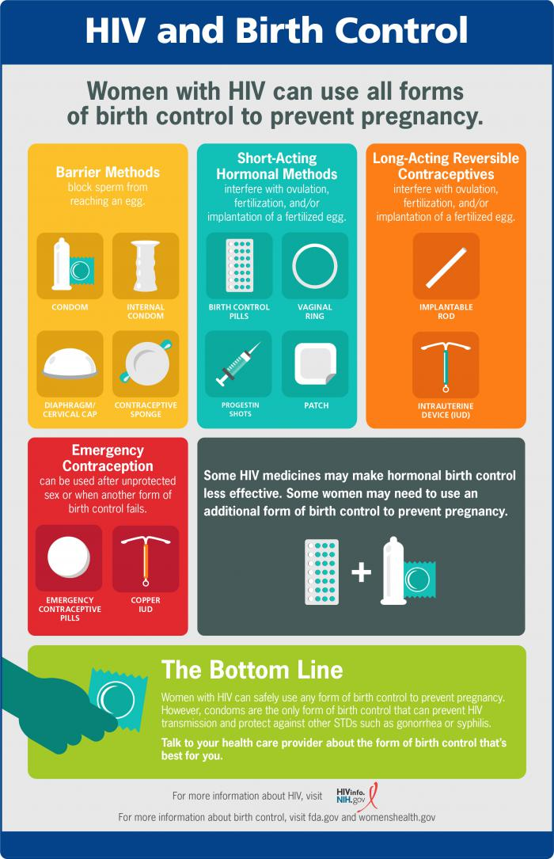
Contraceptive Options and HIV
Family planning should be incorporated into all health care visits
Women with HIV can use all forms of birth control
Choice may be determined by numerous factors including: desire to conceive, ability to disclose status, other medical conditions
Although HIV transmission does not occur if a person with HIV is ART and consistently virally suppressed, a form of barrier contraception is always recommended because of the risk of other sexually transmitted infection transmission

Slide 24
Hormonal Contraceptives
Hormonal contraceptives (oral, injectable, implants) are effective reversible methods for the prevention of pregnancy
Efficacy of hormonal contraception can be affected by drug interactions between progesterone/estrogen and certain antiretrovirals including:
Non-nucleoside reverse transcriptase inhibitors (specifically efavirenz)
Protease inhibitors
Boosting agents like ritonavir, cobicistat
Notes:
In particular, certain protease inhibitors (including ritonavir-boosted darunavir and lopinavir/ritonavir) decrease ethinyl estradiol and norethindrone levels; alternative or additional contraceptive methods should be used for patients taking these agents [131]. Similar precautions are advised for the cobicistat-boosted protease inhibitors and cobicistat-boosted elvitegravir. Unboosted integrase inhibitors, such as dolutegravir, raltegravir, and bictegravir, can be safely prescribed with hormonal contraceptives.
Efavirenz has also been implicated in significant drug interactions with certain hormonal contraceptives, in particular progestin-releasing implants (both levonorgestrel and etonogestrel), resulting in decreased contraceptive efficacy [133-135]

Slide 25
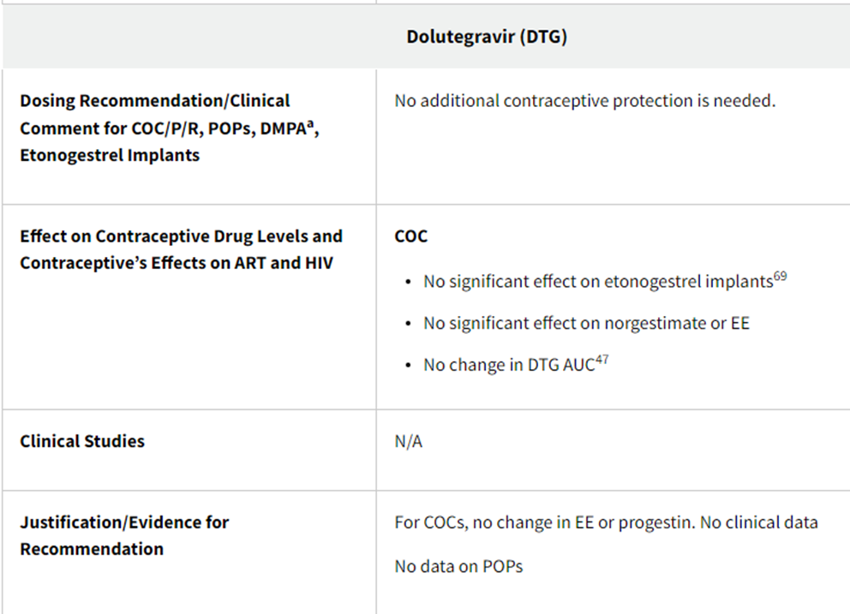
Interactions between ART and Hormonal Contraception
Drug interactions between ART
and hormonal contraceptives
are detailed in Table 3 of
the Perinatal HIV guidelines
https://clinicalinfo.hiv.gov/en/guidelines/perinatal
Notes:
COC is combined contraception, patch, ring progesterone only pill

Slide 26
Care of pregnant people with hiv

Slide 27
Rates of Females Aged 15-44 Years Living with Diagnosed HIV Infection by Area of Residence, 2017
CDC.gov. Available at https://www.cdc.gov/hiv/pdf/library/slidesets/cdc-hiv-surveillance-pediatric-2018.pdf. Accessed 3.7.20.
Notes:
Nearly 5,000 people living with HIV give birth in the United States each year. This map indicates the most recently published rates of people with HIV who are considered to have childbearing potential. It is important to consider pregnancy potential in any female in this age range and address this during clinical care. With appropriate care prior to, during and after pregnancy, people with HIV can achieve a healthy and safe pregnancy for both the mother and the baby.

Slide 28
Case
Ms. B is 38 years-old, on daily dolutegravir/lamivudine with undetectable viral load. She would like to start a family with her partner, who does not have HIV. She is would like to know how best to conceive to prevent transmission to partner and then steps to have a healthy pregnancy and baby.
How do you counsel her?

Slide 29
Preconception Counseling and Care
Discuss reproductive desires of all persons with HIV of childbearing potential on an ongoing basis throughout the course of their care (AIII)
Discuss contraceptive options & safer sex practices (AI)
Encourage elimination of alcohol, tobacco and other drugs of abuse (AII) or counsel on how to manage health risks
Methadone or buprenorphine
Syringe services programs
https://clinicalinfo.hiv.gov/en/guidelines/perinatal/prepregnancy-counseling-childbearing-age-overview?view=full

Slide 30
Preconception Counseling and Care
Persons with HIV should attain maximal viral suppression before attempting conception:
for their own health
to prevent sexual transmission of HIV to partners without HIV (AI),
to minimize the risk of in utero transmission to the infant (AI)
https://clinicalinfo.hiv.gov/en/guidelines/perinatal/prepregnancy-counseling-childbearing-age-overview?view=full

Slide 31
Pre-Conception Considerations When One or Both Partners Live with HIV
Both partners should be screened and treated for genital tract infections before attempting conception (AII)
Partners with HIV should attain maximal virologic suppression before trying to conceive (i.e. 2 recorded undetectable viral loads at least 3 months apart [AII])
.
https://clinicalinfo.hiv.gov/en/guidelines/perinatal/prepregnancy-counseling-childbearing-age-reproductive-options-partners?view=full
Notes:
Couples in which one or both partners are living with HIV should be counseled that once the partner(s) with HIV have initiated ART and have maintained HIV viral suppression, condomless sex to achieve conception is associated with effectively no risk of HIV sexual transmission. HIV viral suppression can be demonstrated with two recorded measurements of plasma viral loads below the limits of detection taken at least 3 months apart.

Slide 32
Pre-Conception Considerations
For couples with differing HIV statuses, sexual intercourse without a condoms allows for conception with effectively no risk of sexual HIV transmission to the partner without HIV when the partner is on ART and has achieved sustained viral suppression (BII)
https://clinicalinfo.hiv.gov/en/guidelines/perinatal/prepregnancy-counseling-childbearing-age-reproductive-options-partners?view=full
Notes:
Genital tract inflammation is associated with genital tract shedding of HIV

Slide 33
Pre-Conception Considerations
Administration of antiretroviral pre-exposure prophylaxis (PrEP) to the partner without HIV reduces the risk of sexual acquisition of HIV (AI)
When partners with different HIV statuses attempt conception, the partner without HIV can choose to take PrEP even if the partner with HIV has achieved viral suppression (CIII)
https://clinicalinfo.hiv.gov/en/guidelines/perinatal/prepregnancy-counseling-childbearing-age-reproductive-options-partners?view=full

Slide 34
Preconception Counseling and Care
When fully suppressive ART is started before pregnancy and undetectable viral load is maintained throughout pregnancy and at delivery, there is no risk of HIV transmission to the infant
https://clinicalinfo.hiv.gov/en/guidelines/perinatal/prepregnancy-counseling-childbearing-age-overview?view=full

Slide 35
French Perinatal Cohort: Update
14630 HIV-infected mother-infant pairs
2000 to 2017
Pregnant people received ART, delivered live-born children with determined HIV status, and did not breastfeed
Sibiude et al. CID 2023:76 (1 February)
Notes:
Mandelbrot L, et al. Clin Infect Dis, 2015 Dec 1;61(11):1715-25. was 2000 to 2011
2000-2005, 2006-20010, 2011-2017

Slide 36
French Perinatal Cohort: Update
5482 children born to mothers on ART prior to conception, ART throughout pregnancy, HIV viral load < 50 copies/mL at delivery, no breastfeeding
No HIV transmission
Regardless of viral load at birth, risk of transmission varied based on when ART was started
ART prior to conception 0.14%
ART started in first trimester 0.52%
ART started in second trimester 0.75%
ART started in third trimester 1.67%
Sibidue et al. CID 2023:76(1February)
Notes:
In this study, the overall rate of perinatal transmission was 0.7%, but in those who had virologic suppression prior to conception, throughout pregnancy and who had an HIV viral load < 50 copies/mL at delivery, there was no HIV transmission.
Regardless of the viral load at birth, the risk of transmission varied based on when antiretroviral therapy was started and was highest in those who started antiretroviral therapy in the second and third trimesters. It is currently recommended that pregnant people with HIV receive treatment throughout pregnancy, rather than waiting to start after the first trimester as was sometimes done in the past.

Slide 37
Preferred ART For Those Trying To Conceive
Dolutegravir 50 mg by mouth once daily (INSTI)
and
TAF/FTC or TDF/FTC (2 NRTIs)
NRTI = Nucleoside Reverse Transcriptase Inhibitor
INSTI = Integrase Strand Transfer Inhibitor

Slide 38
Notes:
The International Maternal Pediatric Adolescent AIDS Clinical Trials (IMPAACT)
MPAACT 2010 is a Phase III, three-arm, randomized, open-label study of HIV-1-infected pregnant women initiating either a dolutegravir-containing antiretroviral regimen or an efavirenz-containing antiretroviral regimen at 14-28 weeks gestation. The VESTED study (Virologic Efficacy and Safety of ART Combinations with TAF/TDF, EFV, and DTG) will compare the regimens with regard to safety and virologic efficacy during pregnancy and through 50 weeks of maternal and infant follow-up postpartum. A total of 643 pregnant women and their unborn babies were enrolled in IMPAACT 2010/VESTED between January 2018 and February 2019 at 22 IMPAACT sites in Botswana, Brazil, India, South Africa, Tanzania, Thailand, Uganda, the United States, and Zimbabwe. Pregnant women were randomly assigned, in pairs with their babies, to one of three ARV regimen groups: EFV/FTC/TDF, DTG+FTC/TDF, or DTG+FTC/TAF. Results, presented by Lameck Chinula on behalf of the IMPAACT 2010 Protocol Team, showed that all three ARV regimens were safe and effective in pregnancy. However, the DTG-containing regimens were more effective than the EFV-containing regimen at controlling HIV in pregnancy. This was discovered by comparing the number of mothers in each group who had a low HIV viral load at delivery. Almost all (98%) mothers who received DTG were virally suppressed at delivery, compared to most (91%) mothers who received EFV.
In addition, the regimen containing DTG and TAF had the best pregnancy outcomes. This was discovered by comparing the number of mothers in each group who had an adverse pregnancy outcome (stillbirth, pre-term delivery, infant small for gestational age). About one in four (24%) mothers who received DTG+FTC/TAF had an adverse pregnancy outcome, compared to about one in three (33%) mothers who received DTG+FTC/TDF or EFV/FTC/TDF. Two infants were found to have HIV infection within the first 14 days of life, and no neural tube defects were identified.

Slide 39
What about 2 drug or injectable regimens?
Pregnant persons who present to care on DTG/3TC or DTG/RPV and maintained viral suppression can continue the regimen (BIII) with viral load monitoring every 1 to 2 months throughout pregnancy (CIII)
Insufficent data exist regarding cabotegravir (CAB-LA) and RPV during pregnancy
https://clinicalinfo.hiv.gov/en/guidelines/perinatal/recommendations-arv-drugs-pregnancy-taking-therapy-when-pregnant

Slide 40
Case
Ms. M is 31 years old, presenting for HIV follow-up. She was last seen 6 months ago when her viral load was elevated to 2000 due to missing doses of bictegravir/TAF/FTC. She missed a prior followup appointment due to work schedule, difficulty with transportation.
She has been taking ART daily with no missed doses since she found out she was pregnant about 6 weeks ago. She is now 15 weeks pregnant. She read that her ART may not be good for the baby and would like your input.
How do you counsel her?

Slide 41
HIV Transmission from Mother to Baby
25% risk of perinatal transmission in absence of therapy
20% before 36 weeks
50% between 36 weeks and delivery
30% active labor and delivery
Less than 1% risk if
Suppressive antiretroviral therapy (ART) throughout pregnancy
Postnatal infant antiretroviral prophylaxis
C-section & zidovudine (AZT) if indicated
Avoidance of breastfeeding
Connor EM et al. N Engl J Med.1994;331:1173-80.
Kourtis AT et al. JAMA. 2001,285;709-12.

Slide 42
Perinatal Antiretroviral Therapy
Start as soon as possible
Earlier viral suppression = reduced risk of transmission to the fetus
Modify therapy later if needed
Goal: Maintain HIV viral load level below the limit of detection during and after pregnancy
“PrEP” for the fetus
https://clinicalinfo.hiv.gov/sites/default/files/guidelines/documents/PerinatalGL.pdf
Notes:
Selection of ARV drugs should be individualized according to the pregnant person’s ARV history, results of drug-resistance testing, and presence of comorbidities. In general, people who are already on a fully suppressive regimen when pregnancy occurs should continue their regimens. The Panel classifies ARV drugs for use in people who are pregnant or trying to conceive as preferred, alternative, insufficient data to recommend, not recommended except in special circumstances, and not recommended: PreP fo rhte infact—
There is no evidence that pregnancy decreases the efficacy of ART regimens recommended during pregnancy.^{[52,197]}
The efficacy of ART in preventing maternal–fetal transmission is primarily through lowering plasma HIV-1 RNA but also due to PrEP for the infant. The mechanism by which infant PrEP is effective is through ARV agents crossing the placenta, resulting in adequate systemic concentrations in the infant. This is especially important at the time of delivery when the infant is exposed to maternal blood and genital tract secretions. Because it is unclear what HIV-1 RNA level may be considered “safe” from concerns about transplacental transmission, all pregnant women with HIV should be offered ART.

Slide 43
Antiretroviral Therapy in Pregnancy Key Points
In most cases, people who present for obstetric care on fully suppressive HIV therapy should continue their current regimen
Use the same regimens recommended for nonpregnant adults in pregnant people when sufficient data suggests appropriate drug exposure, efficacy, and safety
Note: there are often incomplete data on safety of HIV drugs in pregnancy
https://clinicalinfo.hiv.gov/en/guidelines/perinatal

Slide 44
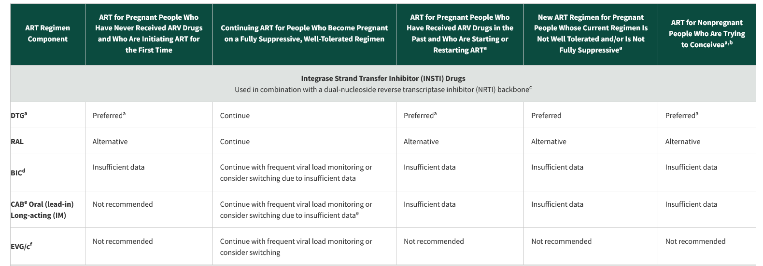
https://clinicalinfo.hiv.gov/en/guidelines/perinatal/recommendations-arv-drugs-pregnancy-situation-specific-conceive-full

Slide 45
Antiretrovirals Not Recommended In Pregnancy
Cobicistat containing regimens due to pharmacokinetic changes that can reduce medication efficacy
(Atazanavir/c, darunavir/c, elvitegravir/c)
Stavudine (d4T), Didanosine (ddI), Fosamprenavir, indinavir, nelfinavir, ritonavir (as sole PI), saquinavir, tipranavir, or a three NRTI regimen
DHHS Perinatal Guidelines Available at https://clinicalinfo.hiv.gov/en/guidelines/perinatal. Accessed 5/4/2023.

Slide 46
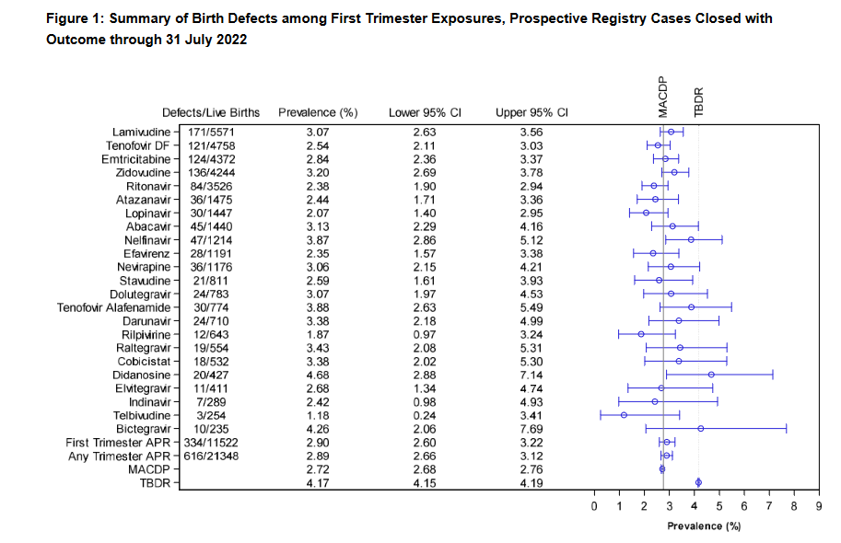
Apregistry.com
Notes:
Prospective, voluntary, confidential registry formed to detect any major teratogenic effects related to antiretroviral therapy received at time of conception throughout pregnancy—annually enrolls 1300-1700 pregnant people
25.000

Slide 47
Monitoring of HIV During Pregnancy
HIV viral load testing
Initial visit
2-4 weeks after starting or changing ART
Monthly until HIV viral load is below limit of detection of test (“undetectable”)
Every 3 months during pregnancy
34-36 weeks’ gestation to inform delivery decisions (4 weeks prior to delivery)
Antiretroviral resistance testing
Prior to starting ART if never on treatment
Prior to changing regimen if HIV RNA above threshold
for resistance testing (> 500 to 1,000 copies/mL)
https://clinicalinfo.hiv.gov/en/guidelines/perinatal

Slide 48
Case
Kelly is a 32-year-old woman, with perinatally-acquired HIV, well-controlled on DTG +TAF/FTC, pregnant with her first child
She understands that the baby will be given prophylactic ART upon delivery
She would like to breastfeed her child and wants to know how best to go about doing this for her and her child’s health
How do you advise her?
Notes:
Breastfeeding provides numerous health benefits to both the infant (e.g., reduction in asthma, gastroenteritis, and otitis media) and the parent (e.g., reduction in hypertension; type 2 diabetes; and breast and ovarian cancers).²¹

Slide 49
Infant Feeding for Individuals with HIV in the US
Fully suppressive ART during pregnancy and breastfeeding decreases breastfeeding transmission risk to less than 1%, but not zero
People with HIV should receive evidence-based, patient-centered counseling to support shared decision-making about infant feeding
https://clinicalinfo.hiv.gov/en/guidelines/perinatal/infant-feeding-individuals-hiv-united-states?view=full
Notes:
People with HIV should receive evidence-based, patient-centered counseling to support shared decision-making about infant feeding
Individuals with HIV on ART with a sustained undetectable viral load and who choose to breastfeed should be supported in this decision
Ensuring access to both a supportive clinical team (including lactation consultant) and peer support in the postpartum period
If breastfeeding is chosen, exclusive breastfeeding up to 6 months of age is recommended over mixed feeding (i.e., breast milk and formula)
Continue ART, frequent VL monitoring of parent and baby
May require prolonged administration of ART for baby

Slide 50
The Fourth Trimester: Postpartum Care
The 12 weeks postpartum are referred to as “the fourth trimester”
Address the following
Mood and emotional wellbeing
Infant care and feeding
Sleep, fatigue and physical recovery from birth
Sexuality, contraception, birth spacing
Chronic disease management and coordination of care with PCP
Health Maintenance
Women living with HIV are often lost to HIV follow-up during this time period
https://www.acog.org/clinical/clinical-guidance/committee-opinion/articles/2018/05/optimizing-postpartum-care
Notes:
By analyzing data from a single healthcare system in which HIV primary care, specialized HIV/obstetric care, and pediatric care for HIV exposed infants occurs in close geographic proximity, we showed, despite minimization of operational barriers that may be expected from co-located services [43], women in our study still experienced poor transition from obstetric to HIV primary care, similar to observations from US sites with varying structures of care [10, 12]. A recent single center report from South Carolina showed that HIV-centered prenatal care, in which HIV-trained obstetric providers provide care in a model that integrates services in one location, was associated with improved maternal virologic control during pregnancy and postpartum [44], but not improved HIV follow-up care in the 12 months postpartum, suggesting, consistent with our findings, that additional steps are likely needed across diverse care settings to improve long-term outcomes [45]. Such steps may need to also include policy changes, such as addressing insurance coverage gaps parental leave policies that particularly impact women with chronic health conditions during the postpartum period.
The American College of Obstetricians and Gynecologists (ACOG) recently highlighted the importance of the postpartum period and transition to primary care in a set of new guidelines, stressing the need for an individualized spectrum of follow-up over the initial twelve weeks postpartum [9]. With 50% of pregnancy related mortality and morbidity occurring in the postpartum period, it is critical to engage women in their postpartum healthcare plan during the prenatal period. This includes identifying a primary care and other providers, scheduling follow-up prior to delivery, choosing contraception, and counseling on the effects and complications of pregnancy on postpartum physical and mental health, as well as chronic conditions, such as hypertension, diabetes, mood disorders, among others. Interventions occurring during the prenatal period have been shown to improve postpartum care for women with several health conditions, including gestational diabetes [35], pregnancy-induced hypertension [39], depression [40], intravenous drug use [41], and tobacco use [42], further supporting the notion that pregnancy and the early postpartum period (the “4th trimester”) provide an opportunity to develop and implement interventions for chronic diseases requiring close follow-up, including HIV.

Slide 51
Postpartum HIV Care Continuum Atlanta 2011 - 2016
Meade CM, et al. Infect Dis Obstet Gynecol. 2019 Feb 14;2019:8161495.
Notes:
Meade et al. evaluated postpartum retention in HIV care and viral suppression in 207 women in Atlanta between 2011-2016:
While 75% of women attended their 6 week postnatal OB appointment, <40% of women attended an HIV care visit within 90 days postpartum
47% retained in care at 12 months with 41% achieving VL suppression
34% retained in care at 24 months with 30% achieving VL suppression
Attending an HIV care visit within 90 days postpartum was associated with retention in care (aOR 3.66) and viral suppression(aOR 2.40) at 12 months

Slide 52
Summary
Routine health screenings, including cervical cancer and BMD screenings, are an important part of providing optimal medical care to women with HIV
Women with HIV are able to utilize numerous family planning options
Preconception planning can help promote a healthy pregnancy for mother and baby

Slide 53
Thank you!
( 53 )

Slide 54
AETC Program National Centers and HIV Curriculum
National Coordinating Resource Center – serves as the central web –based repository for AETC Program training and capacity building resources; its website includes a free virtual library with training and technical assistance materials, a program directory, and a calendar of trainings and other events. Learn more: https://aidsetc.org/
National Clinical Consultation Center – provides free, peer-to-peer, expert advice for health professionals on HIV prevention, care, and treatment and related topics. Learn more: https://nccc/ucsf.edu
National HIV Curriculum – provides ongoing, up –to-date HIV training and information for health professionals through a free, web –based curriculum; also provides free CME credits, CNE contact hours, CE contact hours, and maintenance of certification credits. Learn more: www.hiv.uw.edu
( 54 )
Notes:
This slide must remain as part of our funding requirements.

