Slide 1
Care of Trans & Gender Non-Conforming Patients with HIV
Nicholas Van Sickels, MD
Associate Professor
University of Kentucky

Slide 2
Faculty Disclosure
I do not have any disclosures
This program is supported by the Health Resources and Services Administration (HRSA) of the U.S. Department of Health and Human Services (HHS) under grant number U1OHA30535 as part of an award totaling $4.2m. The contents are those of the author(s) and do not necessarily represent the official views of, nor an endorsement, by HRSA, HHS, or the U.S. Government. For more information, please visit HRSA.gov.
“Funding for this presentation was made possible by cooperative agreement U1OHA30535 from the Health Resources and Services Administration HIV/AIDS Bureau. The views expressed do not necessarily reflect the official policies of the Department of Health and Human Services nor does mention of trade names, commercial practices, or organizations imply endorsement by the U.S. Government. Any trade/brand names for products mentioned during this presentation are for training and identification purposes only.”

Slide 3
Objectives
Upon completion of this educational activity, you will be able to:
Address patients using proper terminology, and appropriately course correct when errors are made
Identify validated resources for management of trans- and gender non-conforming (TGNC) patients

Slide 4
Expected Outcome
What is the desired change/result in practice resulting from this educational intervention?

Slide 5
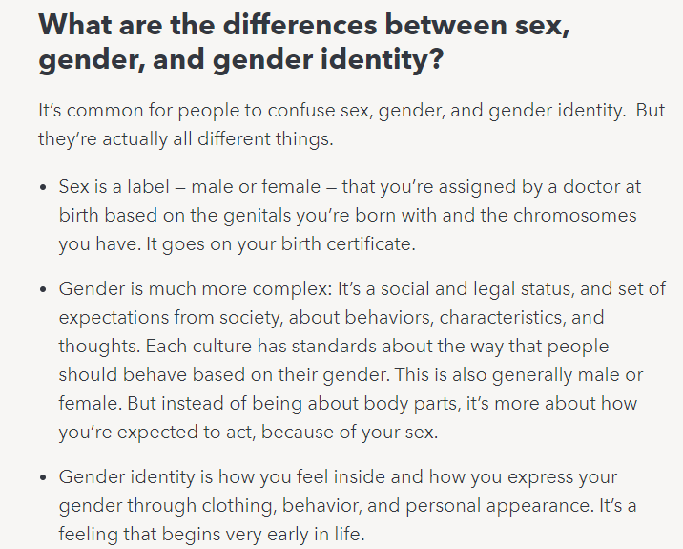
Names, Pronouns, Terminology

Slide 6
Service correction
Learn as much as you can
Know how to recover when you make a mistake
Move on with the visit and provide reassurance, as you would in any situation

Slide 7
Data – TGNC Patients in the United States
1.6 million youth and adults identify as transgender in the United States (0.6% of the population)
State-level estimates:
Kentucky – 0.51% of the population, 17,700 individuals
How Many Adults and Youth Identify as Transgender in the United States? - Williams Institute (ucla.edu)

Slide 8
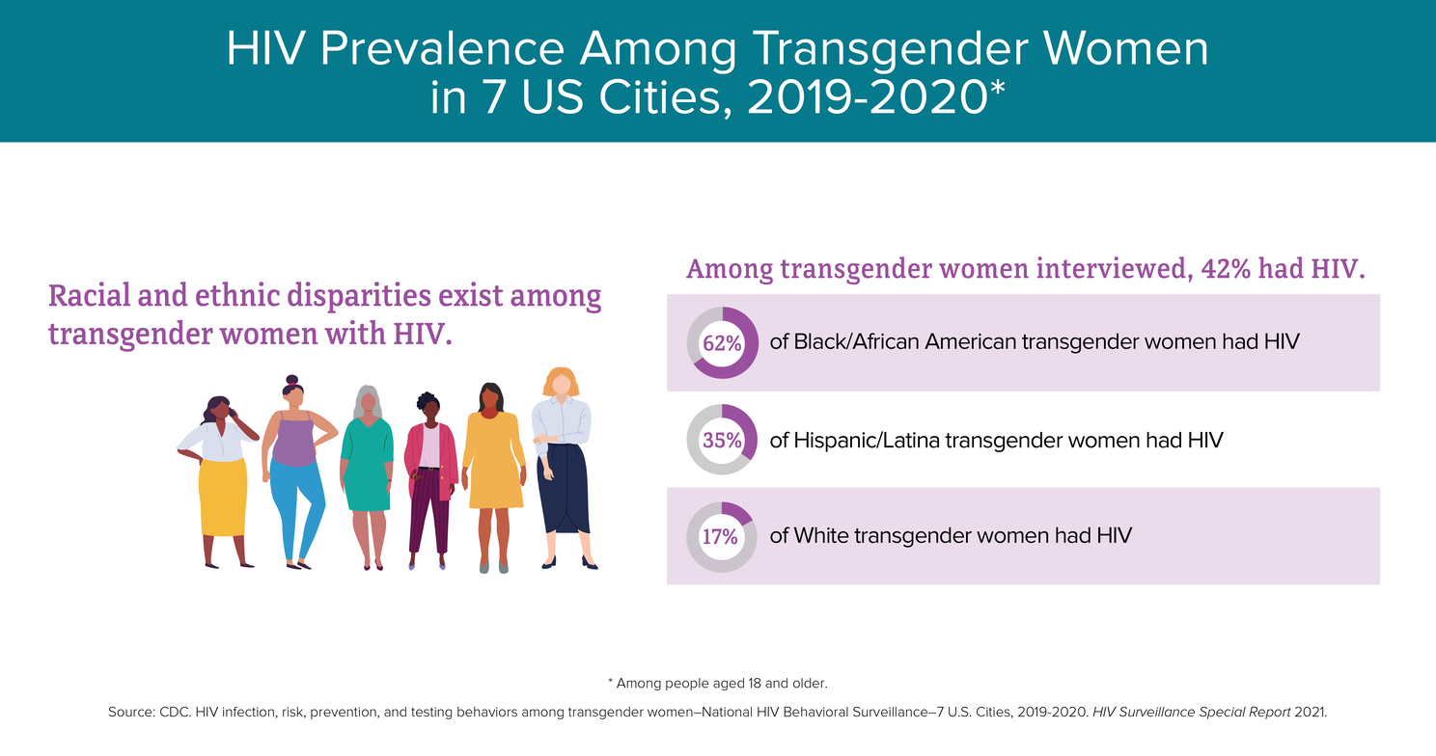
Data – TGNC Patients in the United States

Slide 9
Data – TGNC Patients in the United States

Slide 10
Resources
At the University of Kentucky
https://www.uky.edu/lgbtq/resources-and-forms
In-depth guidelines
WPATH Standards of Care, 8th Edition
Quick read- primary care guidelines
UCSF Primary Care Guidelines
Quick reference – Transline (also has consultation services)
Laminated and in the cabinet in the workroom

Slide 11
Approach to Management
Assessment
Are they on gender affirming hormone therapy (GAHT) already
Prescribed or non-prescribed
Have they received any other gender affirming therapy?
Are they interested in GAHT?
Are they interested in other gender affirming care?

Slide 12
Approach to Management
Why provide affirming therapy?
Seemingly obvious – but worth exploring data

Slide 13
Gender Affirming Hormone Therapy
Medical therapy does not require written consent for anyone over 18
Would advocate to use a smartphrase (I have some) to document potential risks a/w GAHT
Provide documentation to help with expectations, or, links to validated sites for resources
We have these printed out for you in clinic

Slide 14
Gender Affirming Hormone Therapy
Feminizing GAHT
Estradiol
Spironolactone
Considerations
Dosing
Possible risks & mitigation strategies

Slide 15
Gender Affirming Hormone Therapy
Masculinizing GAHT
Testosterone
Finasteride for some
Considerations
Dosing
Possible risks & mitigation strategies

Slide 16
Gender Affirming Surgery
Assessment
Surgical assessment, preparation, and approval
WPATH Guidelines
Letters and time on GAHT varies by procedure
Insurance assessment, preparation, and approval
Varies by insurer
Availibility of surgeons
Varies by state

Slide 17
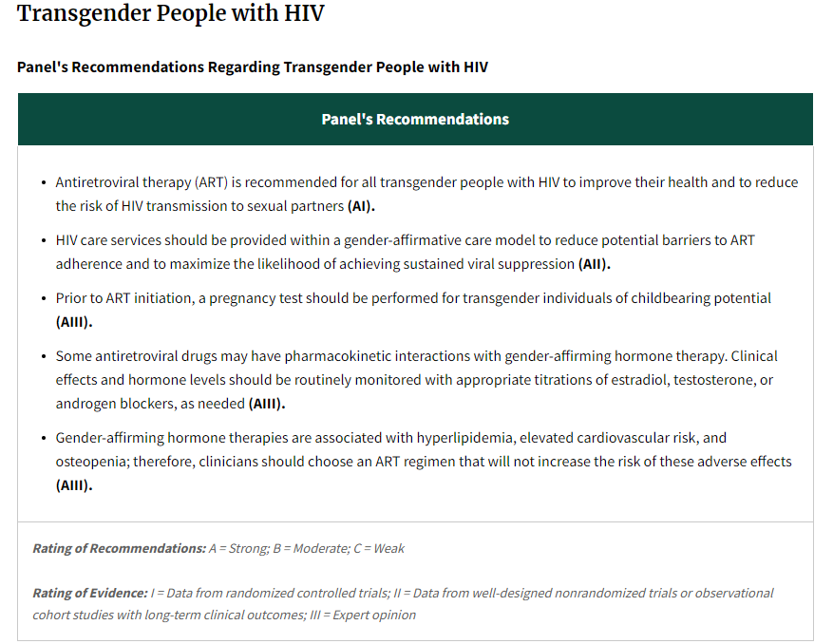
HIV and GAHT

Slide 18
Q&A

Slide 19
AETC Program
National Centers and National HIV Curriculum
National Coordinating Resource Center serves as the central web based
repository for AETC Program training and capacity building resources; its
website includes a free virtual library with training and technical assistance
materials, a program directory, and a calendar of trainings and other events.
Learn more: https ://aidsetc.org
National Clinician Consultation Center provides free, peer to peer,
expert advice for health professionals on HIV prevention, care, and treatment
and related topics. Learn more: https ://nccc.ucsf.edu
National HIV Curriculum provides ongoing, up to date HIV training and
information for health professionals through a free, web based curriculum;
also provides free CME credits, CNE contact hours, CE contact hours, and
maintenance of certification credits. Learn more: www.hiv.uw.edu

