Slide 1

Syphilis
Shelia Dunaway, MD
Vanderbilt University
US National Archives

Slide 2
Syphilis
1500s “The Great Pox”
  Spread from Italy & France throughout Europe
  "Syphilis, or the French Disease "
    Named from poem - shepherd named Syphilus who offended Apollo & was punished
  The French called it “the Italian disease”
    Dutch called it … “the Spanish disease”
    Russians called it “the Polish….”
    Turks called it “the Christian….”
    Japanese called it “the Portuguese disease”
Notes:
From “New World”/Columbus vs spread due to urbanization/social upheaval – debated. Sebastian Brandt’s 1496 woodcut “Syphilis is being inflicted upon the wicked. The Emperor Maximilian I receives the crown.” He associated syphilis with blasphemy.

Slide 3
Syphilis
Rapid spread in 16th century
  1767 John Hunter self –inoculation
    Urethral pus containing Neisseria gonorrhoeae and T. pallidum
    2 diseases were considered same for some time
  Mid-19th century, cause, epidemiology, and clinical manifestations of syphilis were well known
Leading cause of neurological & cardiovascular disease in middle-aged people turn of 20th century

Slide 4
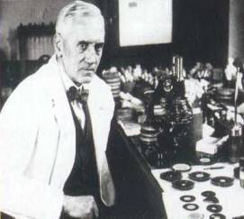
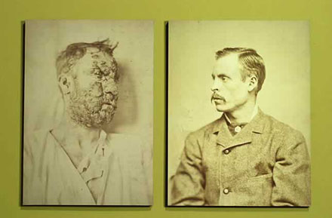
Syphilis
Ehrlich in 1910
  Arsenic derivative “magic bullet”
Mercury and bismuth
Induced-fever therapy (malaria, heat box, hot baths)
  Julius von Jauregg - Nobel Prize in 1927
    Malaria to treat “paralytica dementia” (neurosyphilis)
Penicillin
  1928 - Alexander Fleming
    Mold Penicillium notatum
  Late 1940s available in sufficient quantities
  1943 - John Mahoney, US Publlic Health Service – treated 1st patient with PCN
Brettman Collection. 1929.
Principles and Practice of Infectious Diseases, 8th ed.
Mandell, Douglas, and Bennett
Notes:
from the mould Penicillium notatum in 1928. Staph not grow

Slide 5
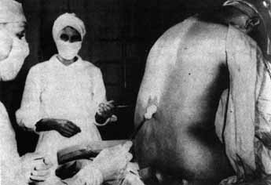
Syphilis
Tuskegee Syphilis Study
1932 until 1972 – FORTY years
~600 African American men prospectively followed
  412 WITH syphilis, 192 without
  Told being treated “for bad blood”– but not treated
  Despite proven efficacy of penicillin by late 1940s
    US Public Health Service in Macon County, Alabama
    Participants offered transportation, hot meals, burial insurance
    When asked why they had to receive several "back shots" (lumbar punctures), researchers repeatedly lied to the men, claiming the shots were “therapeutic.”
    Led to Belmont Report, establishment of National Human Investigational Board, and IRBs.
National Archives. CDC.
Notes:
Led to 1979 Belmont Report, the establishment of National Human Investigation Board, and requirement for Institutional Review Boards. Guatemala – 1946-1948 USPHS inoculated vulnerable people to evaluate prophylactic treatment.

Slide 6
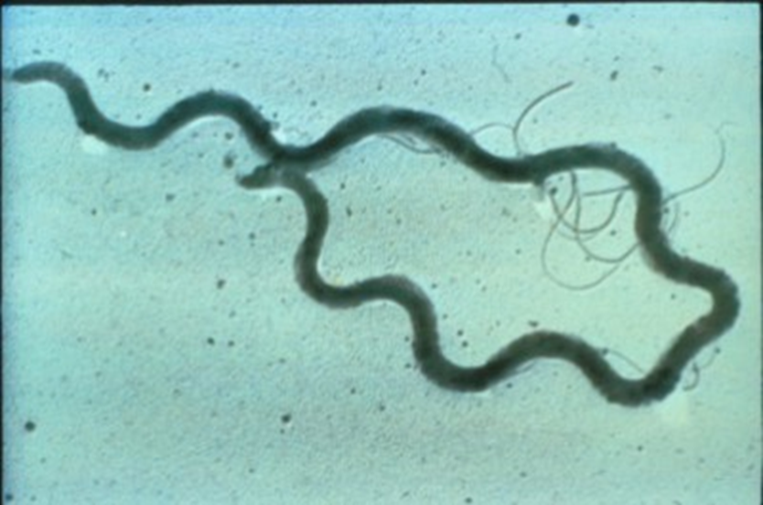
Syphilis
Order Spirochaetales
Treponema pallidum
  subsp. pallidum
Slender, tightly coiled, unicellular, helical cells
  5 to 15 nm long
  0.1 to 0.2 nm wide
Ends of cells are tapered
cdc.gov/std/syphilis/images.htm

Slide 7
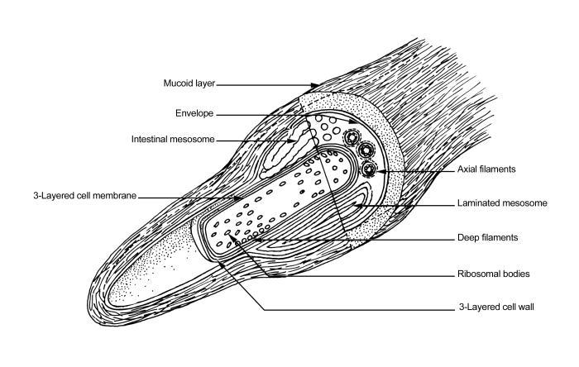
Syphilis
Outer membrane containing relatively few surface-exposed proteins
  Hypothesis – “stealth” by minimizing number of surface membrane-bound targets
Genome lacks transposable elements
  Genome is conserved
  Remains sensitive to penicillin
CDC.PHIL.

Slide 8
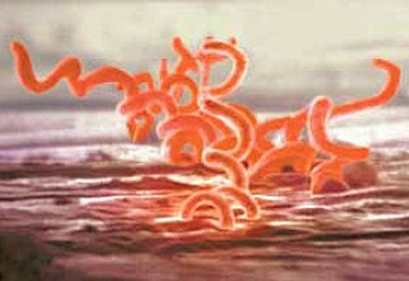
Syphilis
T. pallidum penetrates intact mucous membrane or gains access through abraded skin
  Enters lymphatics or blood stream
  Disseminates throughout body – w/in hours
    Any organ in body can be invaded
      CNS
    Divides ~ every ~30+ hours
    Incubation period is directly proportional to size of inoculum
    Median incubation period 3 weeks
Principles & Practice of Inf. Dis., 8th ed.
Mandell, Douglas, and Bennett.
CDC/Science photo library

Slide 9
Transmission
Risk of developing syphilis after sexual contact 10-60% (average about 30%)
Highest risk with contact to early syphilis
Courtesy – C. Marra

Slide 10
Syphilis
Acquired
  Sexual contact
    Most infectious early
      Chancre, mucous patch, or condyloma latum
      Decreased risk of infection w/ time
  Passage through placenta (congenital syphilis)
  Close contact with active lesion
    Wet nurses
  Transfusion of fresh human blood
    Blood donors tested for nontreponemal blood test
    T. pallidum not survive >24 - 48 hours in blood bank storage
  Accidental direct inoculation
Gareth Cowlin via CartoonStock
Notes:
“GSOH” – good sense of humor

Slide 11
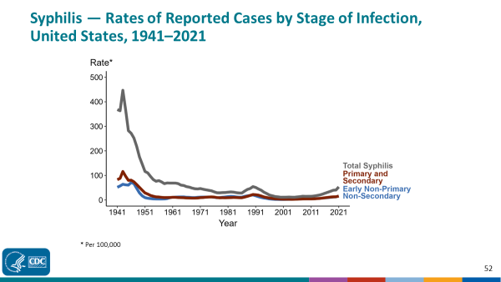
Syphilis
Notes:
1941, and syphilis was made a nationally notifiable condition in 1944. Rates of total syphilis include syphilis of all stages, including congenital syphilis. Steep declines in case rates in the 1940s and 1950s likely reflect expanded use of penicillin to treat infection.
In 2021, a total of 176,713 cases of syphilis were reported in the United States. During 2020 to 2021, the rate of reported total syphilis increased 31.7%
Disproportionate number in men who have sex with men from mid-1960s - 1980s
Adoption of safer sex practices - AIDS epidemic
Increase in new cases occurring among heterosexuals
Exchange of sex for drugs
Drug use
Concomitant infection with HIV

Slide 12
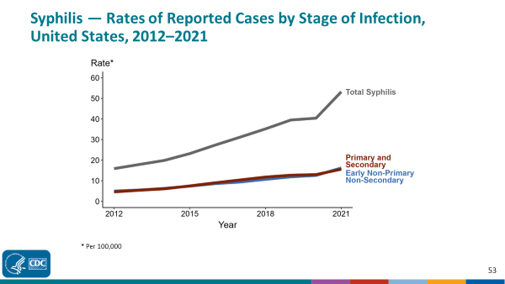
Syphilis
Notes:
2021, 176,713 total cases of syphilis, 51,830 cases of early non-primary non-secondary syphilis, and 53,767 cases of primary and secondary syphilis were reported in the United States. During 2020 to 2021, the total rate of syphilis increased 31.7% (40.4 to 53.2 per 100,000), the rate of early non-primary non-secondary syphilis increased 20.0% (13.0 to 15.6 per 100,000), and the rate of primary and secondary syphilis increased 28.6% (12.6 to 16.2 per 100,000).

Slide 13
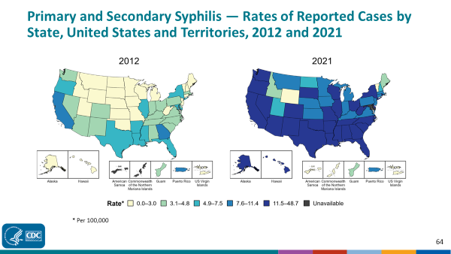
Syphilis

Slide 14
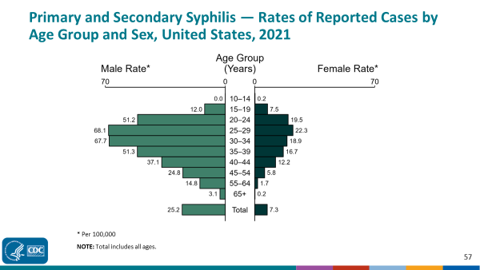
Syphlis
Notes:
In 2021, the rate of reported primary and secondary syphilis was higher among men (25.2 per 100,000) compared to women (7.3 per 100,000).
Among men, those aged 25 to 29 years had the highest rate of reported cases of primary and secondary syphilis (68.1 per 100,000), followed by men aged 30 to 34 years (67.7 per 100,000) and men aged 35 to 39 years (51.3 per 100,000). Among women, those aged 25 to 29 years also had the highest rate of reported cases of primary and secondary syphilis (22.3 per 100,000), followed by women aged 20 to 24 years (19.5 per 100,000) and women aged 30 to 34 years (18.9 per 100,000).

Slide 15
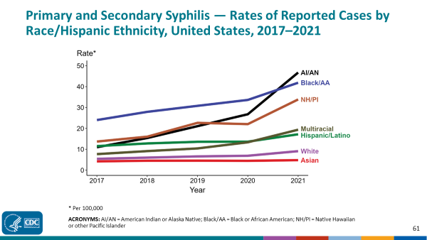
Syphilis
Notes:
In 2021, the highest rate of reported primary and secondary syphilis cases per 100,000 persons was among non-Hispanic American Indian or Alaska Native persons (46.7), followed by non-Hispanic Black or African American persons (41.9).
During 2020 to 2021, the greatest increase in rate of reported primary and secondary syphilis cases per 100,000 persons was among non-Hispanic American Indian or Alaska Native persons (26.8 to 46.7; 74.3% increase). Non-Hispanic American Indian or Alaska Native persons also had the greatest five-year increase in rate of reported primary and secondary syphilis (11.0 to 46.7; 324.5% increase from 2017).
There were no decreases in the rate of reported primary and secondary syphilis cases per 100,000 persons among any race/ethnicity group during 2020 to 2021. There were also no decreases in the rate of reported primary and secondary syphilis among any race/ethnicity group during 2017 to 2021.

Slide 16
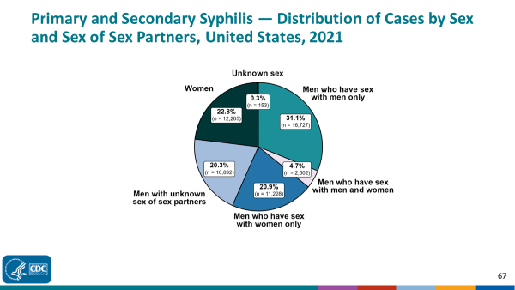
Syphilis

Slide 17
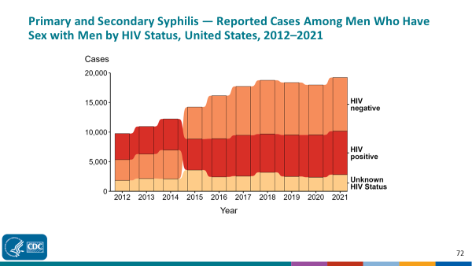
Syphilis
Notes:
During 2012 to 2021, a plurality (44.3%) of primary and secondary syphilis cases among gay, bisexual, and other men who have sex with men (MSM) were among persons reported as HIV negative.
During 2020 to 2021, the number of cases among MSM who were reported as HIV negative increased 7.4% (from 8,441 in 2020 to 9,068 in 2021), the number who were reported as HIV positive increased 2.6% (from 7,161 in 2020 to 7,345 in 2021), and the number who were reported with unknown HIV status increased 19.0% (from 2,366 in 2020 to 2,816 in 2021).
During 2012 to 2021, the number of cases among MSM who were reported as HIV negative increased 158.3% (from 3,510 in 2012 to 9,068 in 2021), the number who were reported as HIV positive increased 66.3% (from 4,416 in 2012 to 7,345 in 2021), and the number who were reported with unknown HIV status increased 53.6% (from 1,833 in 2012 to 2,816 in 2021).
Since 2015, the number of primary and secondary syphilis cases among MSM who are HIV negative has surpassed the number of cases among those who are HIV positive.

Slide 18
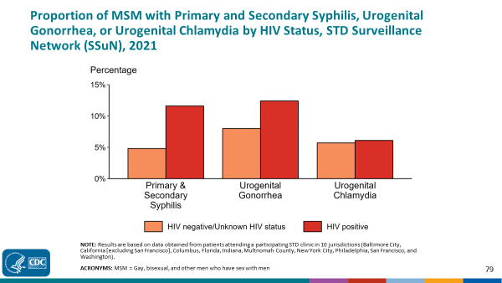
Syphilis
Notes:
Among gay, bisexual, and other men who have sex with men (MSM) attending participating STD clinics in the STD Surveillance Network, the portion diagnosed with primary and secondary syphilis was higher for those that were HIV positive compared with those not known to be HIV positive (11.6% versus 4.8%). The pattern was similar for urogenital gonorrhea, with the proportion of testing positive higher among HIV-positive MSM compared with MSM not known to be HIV positive (12.4% versus 8.0%); however, the proportion testing positive for urogenital chlamydia was similar (6.1% among HIV-positive MSM and 5.7% among MSM not known to be HIV positive).

Slide 19
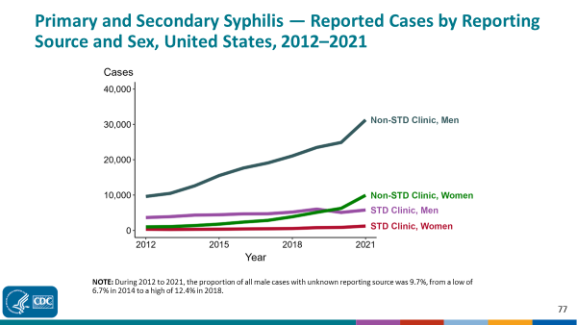
Syphilis

Slide 20
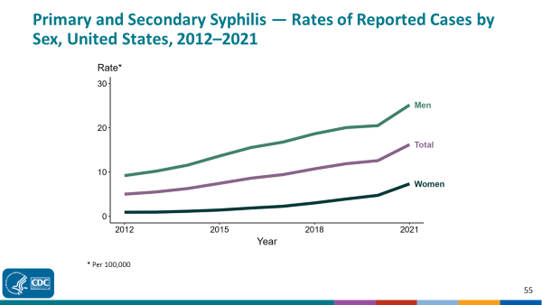
Syphlis
Notes:
2020 to 2021, the primary and secondary syphilis rate among women increased 55.3% (from 4.7 to 7.3 per 100,000) and the rate among men increased 22.9% (from 20.5 to 25.2 per 100,000).
Over the last five years, the primary and secondary syphilis rate among women increased 217.4% (from 2.3 to 7.3 per 100,000) and the rate among men increased 50.0% (from 16.8 to 25.2 per 100,000). Over the last 10 years, the primary and secondary syphilis rate among women increased 711.1% (from 0.9 to 7.3 per 100,000) and the rate among men increased 173.9% (from 9.2 to 25.2 per 100,000).

Slide 21
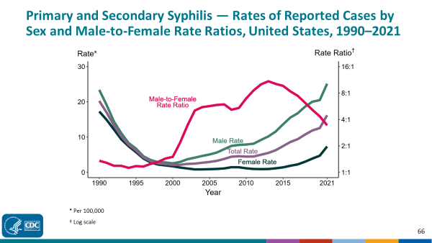
Syphilis
Notes:
Although the male-to-female rate ratio for primary and secondary syphilis increased from 1990 to 2013, the rate ratio is now declining due to the increasing rate of syphilis among women. During 2017 to 2021, the rate of primary and secondary syphilis among women more than doubled (2.3 per 100,000 in 2017 to 7.3 per 100,000 in 2021).

Slide 22
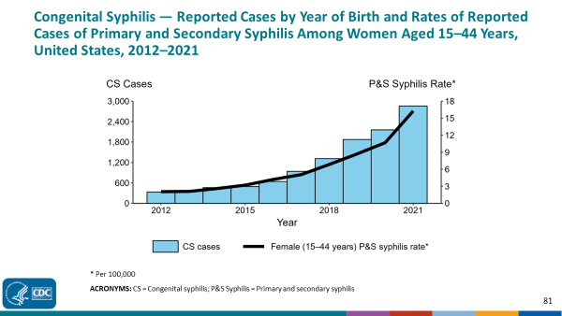
Congenital Syphilis
Notes:
In 2021, there were a total of 2,855 cases of congenital syphilis reported for a rate of 77.9 per 100,000 live births.
During 2020 to 2021, the number of cases of congenital syphilis increased 32.4% (2,157 to 2,855 cases), concurrent with a 52.3% increase (10.7 to 16.3 per 100,000) in the rate of primary and secondary syphilis among women aged 15 to 44 years.
During 2012 to 2021, the number of cases of congenital syphilis increased 754.8% (334 to 2,855 cases), concurrent with a 676.2% increase (2.1 to 16.3 per 100,000) in the rate of primary and secondary syphilis among women aged 15 to 44 years.

Slide 23
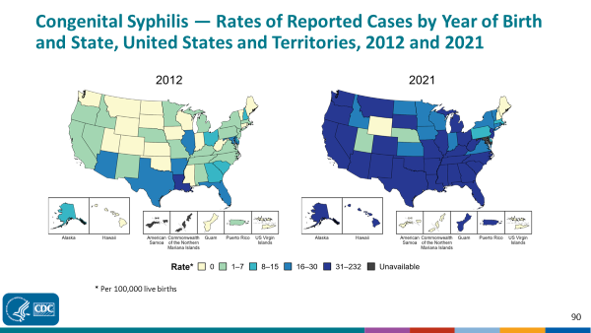
Congenital Syphilis
Notes:
In 2021, there were a total of 2,855 cases of congenital syphilis reported among states and the District of Columbia (DC) for a rate of 77.9 per 100,000 live births. Including data from US territories, there were a total of 2,865 cases of congenital syphilis reported for a rate of 77.7 per 100,000 live births.
In 2012, seven states (13.0% of areas with available data) had a rate of reported congenital syphilis greater than or equal to 16 cases per 100,000 live births. This increased to 41 states, DC, and two US territories (80.0% of areas with available data) in 2021.

Slide 24
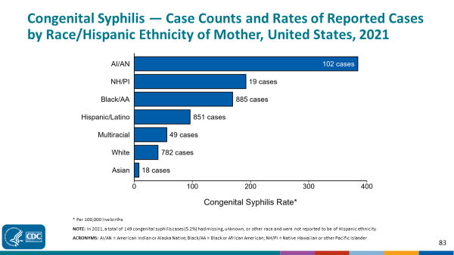
Congenital Syphilis
Notes:
In 2021, there were a total of 2,855 cases of congenital syphilis reported for a rate of 77.9 per 100,000 live births.
In 2021, rates of congenital syphilis were highest among mothers who were non-Hispanic American Indian or Alaska Native (384.5 per 100,000 live births), followed by mothers who were non-Hispanic Native Hawaiian or other Pacific Islander (192.1 per 100,000 live births) and mothers who were non-Hispanic Black or African American (169.2 per 100,000 live births). The greatest number of reported cases was among mothers who were non-Hispanic Black or African American (885 cases), followed by mothers who were Hispanic or Latino and of any race(s) (851 cases) and mothers who were non-Hispanic White (782 cases).

Slide 25

Syphilis Rates
2017- 2021
  Primary & Secondary syphilis
    Rates up 72% US
    Rates up 86% in Tennessee
  Congenital Syphilis
    Rates up 219% in US
    Rates up 288% in TN

Slide 26
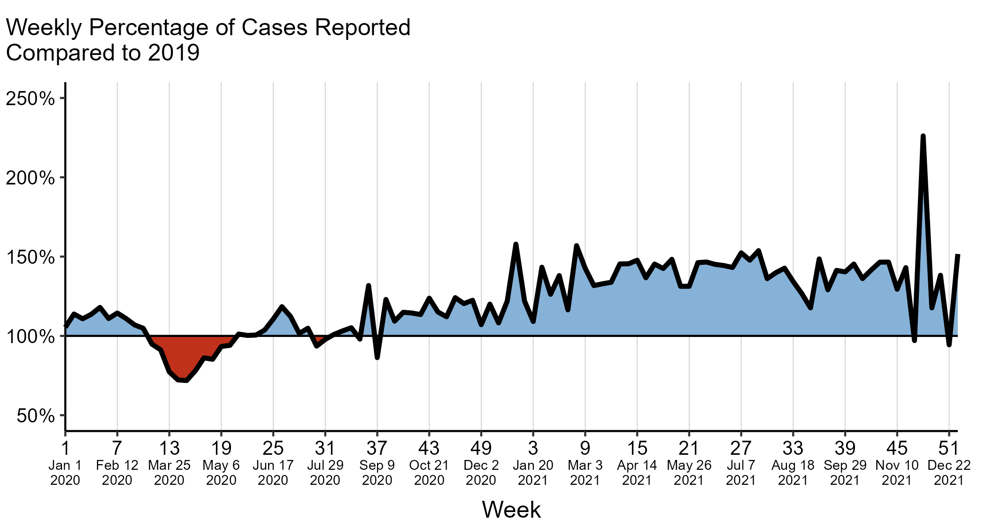
Syphilis & COVID
Division of STD Prevention, National Center for HIV, Viral Hepatitis, STD, and TB Prevention, Centers for Disease Control and Prevention
Notes:
Increased case counts seen in late-2020 and in 2021 may reflect an increase in service utilization as health care clinics re-opened and people sought care when available. Increases in diagnosed and reported cases could also reflect higher disease transmission. For example, due to reduced access to care, those with an STD may have had their infections longer, providing more opportunities to transmit infection to their sexual partners. Additionally, following the initial shelter-in-place orders, sexual behaviors like the frequency of new sex partners may have changed, causing STDs to spread in sexual networks.

Slide 27
Syphilis
Protean clinical manifestations
  “The great imitator” or “the great impostor”
Stages
  Incubating
  Primary
  Secondary
  Latent
    Early latent </= 1 year
    Late latent – less infectious
  Late or tertiary
Most patients control infection & do not progress to late disease
    Host develops intense immune response
      Resulting inflammation is responsible for most of clinical manifestations

Slide 28
Syphilis
Incubating Syphilis
  Median incubation period before clinical manifestations is 21 days
    Range 3 to 90 days
  Early spirochetemia develops
    Secondary invasion of virtually every organ

Slide 29
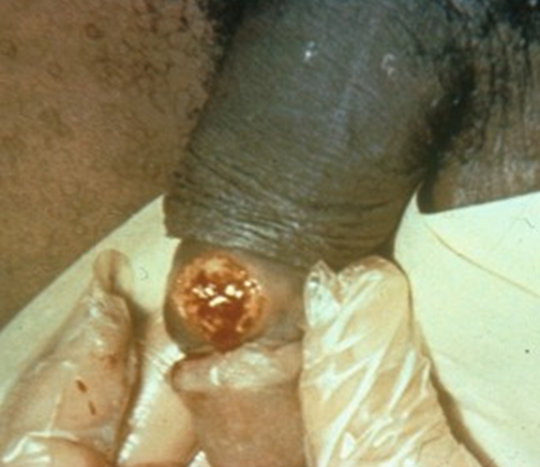
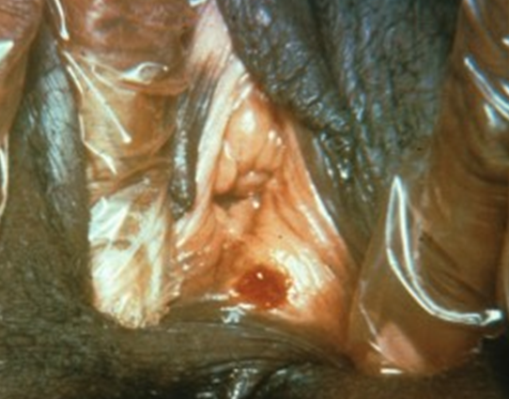
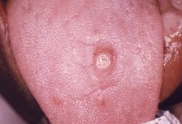
Primary Syphilis
Primary lesion or chancre
  2- 6 weeks after exposure
  Occurs at site of inoculation
    Usually external genitalia
      Cervix, mouth, perianal area, anal canal
  Single painless ulcer
  Multiple chancres can occur
    HIV
Regional lymphadenopathy
Spirochetes easily demonstrated
Heals spontaneously 2 - 8 weeks
  May persist for longer periods
    HIV-infected persons
Manifestations of 2⁰ with chancre
  Especially in HIV+ patients
cdc.gov/std/syphilis/images.htm
Notes:
smooth base with raised and firm borders. “Got stuck in my zipper.”

Slide 30
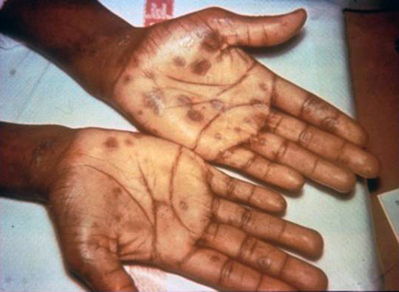
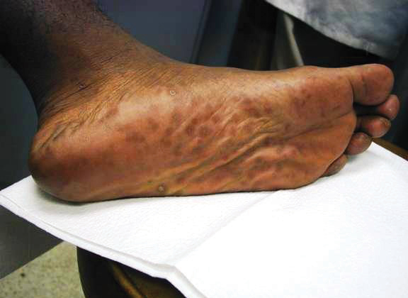
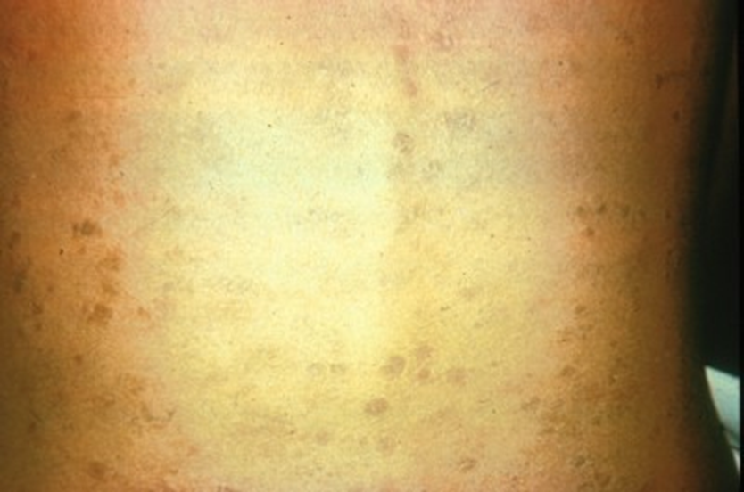
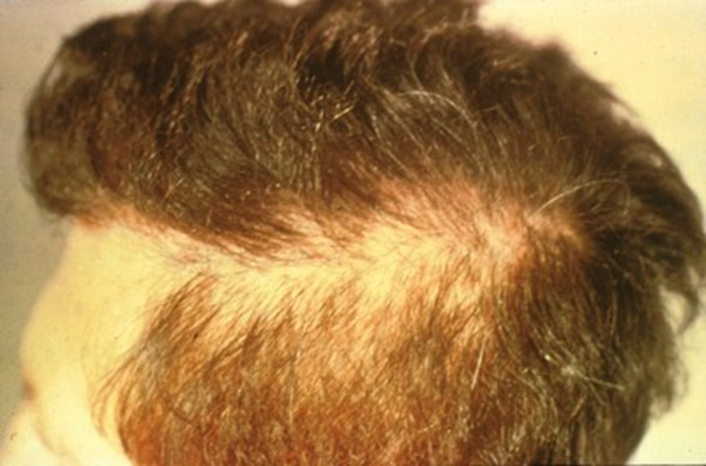
Secondary Syphilis
2 to 12 weeks after contact
  Generalized condition
  Manifestations- widespread and protean
    Parenchymal
    Constitutional
    Mucocutaneous
Rash – Non-pruritic macular, maculopapular, papular, or pustular lesions
  Vesicular lesions absent except congenital syphilis
  Trunk & proximal extremities
  Persist few days to 8 weeks
      Palms and soles
  Patchy alopecia
  Thinning/loss of eyebrows/beard
CDC www.cdc.gov/std/syphilis/images.htm

Slide 31
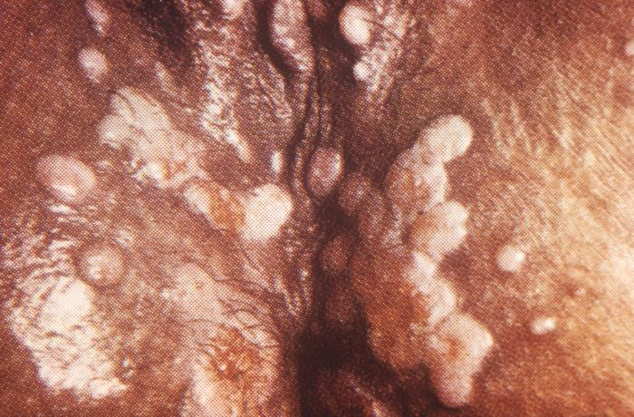
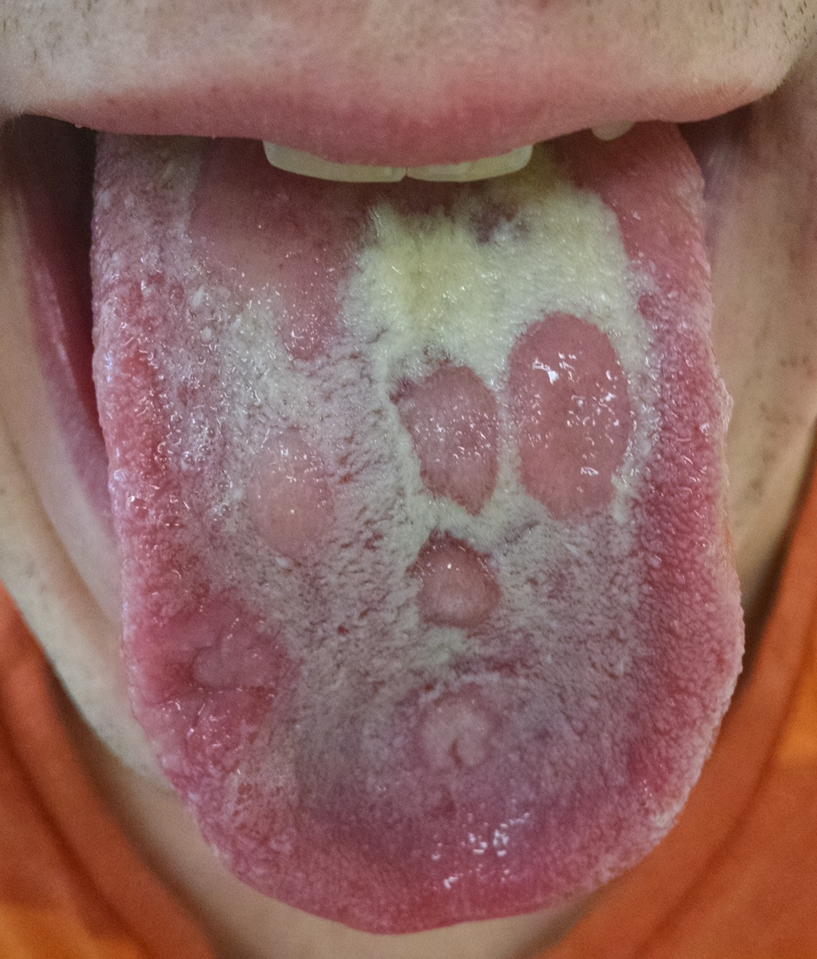
Secondary Syphilis
Condylomata lata
  Painless, broad, moist, gray-white to erythematous, plaques
  Warm, moist intertriginous areas
  Highly infectious
Mucous patches
  Painless lesion on mucous membranes
  Silvery gray, superficial erosion with red periphery
  Highly infectious
  Not painful
    Unless superinfected
cdc.gov/std/syphilis/images.htm

Slide 32
Secondary Syphilis
Constitutional symptoms
  Low-grade fever & Malaise
  Pharyngitis/Laryngitis
  Anorexia/weight loss
  Arthralgias
  Generalized painless LAD
    Enlarged epitrochlear LN
CNS
  40% involved
  Headache and meningismus
  Increased CSF protein & lymphs
    Spirochetes isolated from CSF with no CSF abnormalities
  CN involvement
Syphilitic paraplegia (Erb’s/brachial plexus)
Amyotrophic meningomyelitis
Renal involvement
  Immune-complex glomerulonephritis
  Proteinuria
  Acute nephrotic syndrome
Gastrointestinal tract
  Infiltrated and/or ulcerated lesions
  Syphilitic hepatitis
Anterior or pan-uveitis
  Worse with steroids
Synovitis, osteitis, and periosteitis
Notes:
asymmetrical paraparesis, hyperreflexia, Babinski’s sign, sphincter disturbances, spastic neurogenic bladder

Slide 33
Latent Syphilis
Latent period
  Secondary stage subsides – no symptoms
  Diagnosis only by obtaining positive serologic test
  Early latent
    Relapses possible
    90% of relapses occur within 1st year
      Usually consequence of dysfunction in cellular immunity
  Late latent
    Relapses very unlikely

Slide 34
Late Syphilis/Tertiary Syphilis
Slow progressive, inflammatory disease - over years
  Neurosyphilis
  Cardiovascular syphilis
    Aortitis with a saccular aneurysm
      Aortic regurgitation and coronary artery stenosis
  Gummatous syphilis
    Nonspecific, granulomatous-like lesion
    Skeletal, skin, and mucocutaneous
      Single or multiple, variable size
    Cirrhosis
    PCN- rapid and dramatic response
  Leuetic osteitis
    Moth eaten appearance on X-ray

Slide 35
Congenital Syphilis
Infection of the fetus in utero can occur at any stage of infection
  Early syphilis most common
Late abortion
Stillbirth
Neonatal death
Neonatal disease
Latent infection

Slide 36
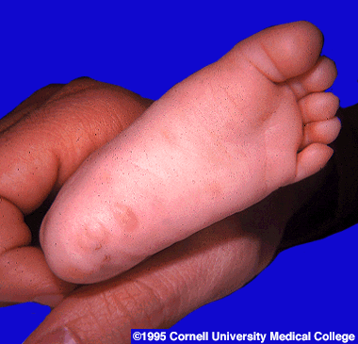
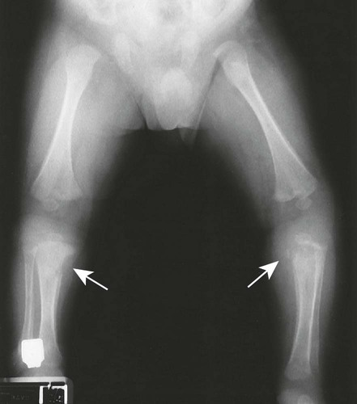
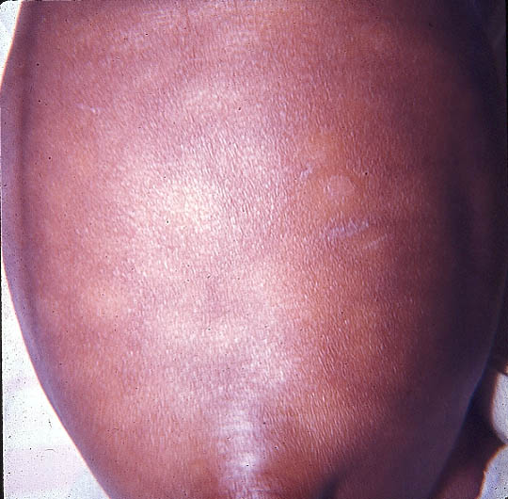
Congenital Syphilis
Normal exam
Rhinitis (snuffles)
  Earliest sign
Diffuse, maculopapular, desquamative rash
  Palms & soles
    Vesicular rash/bullae
Splenomegaly, anemia, thrombocytopenia, and jaundice
Osteochondritis and perichondritis or periostitis
  Saddle nose
  Anterior bowing or “saber shin”
Eighth-nerve deafness
Necrotizing funisitis
  Inflammatory process involving umbilical cord
Hutchinson’s teeth

Slide 37

Neurosyphilis
Can occur at any stage
Asymptomatic neurosyphilis
Syphilitic Meningitis
Menigovascular Syphilis
  Thrombosis, Ischemia, infarction
Parenchymatous - Late
  General paresis, Tabes dorsalis
Ocular
  Posterior uveitis, panuveitis, retinitis, optic atrophy, Argyll Robertson pupil
Otic, Vestibular
  Hearing loss, tinnitus,
Notes:
¼ untreated early syphilis have T pallidium in CSF, Some strain more likely to cause NS>
Argyll Robertson pupil
Small, irregular pupil
Accommodates to near vision
Not react to light or painful stimuli

Slide 38
Neurosyphilis
Clinical Suspicion
  Screening all patient with syphilis
Spinal Fluid Examination – Lumbar Puncture
  Neurologic, ophthalmologic symptoms
  Evidence of tertiary syphilis
  Treatment failure
  HIV infection
    Higher risk of Neurosyphilis
      RPR > 1:32
      CD4 < 350
      Detectable HIV RNA or not on antiretroviral
UpToDate. Neurosyphilis. Christina Marra
Notes:
Increases risk of NS 3-6x

Slide 39
Syphilis – Outcomes Study
PLWH – cognitive impairment w/ prior syphilis
Evaluated patients with risk for NS
  RRP > 1:32 or
  CD4 </= 350
  No neuro symptoms
  Randomized to LP vs no LP
    Enrolled and not randomized
  2/3 Cognitively impaired
  Cognitive impairment 3.8 x w/ CSF pleocytosis
    Patients treated -less cognitive decline vs non-treated
Davis, et al. Plos One. 16(7).2021
Notes:
Cognitive impairment – worse with HIV , depression (lower education) – not impacted by drug use.

Slide 40
Neurosyphilis
Patients with previous episodes of syphilis
  Less symptomatic
    ?Due to increased testing vs acquired immune response
    >/= 3 episodes of syphilis
      More likely early latent -> versus primary/secondary
    Lower levels Treponema pallidum DNA & RNA
      In blood and CSF (6x lower)
    Lower risk neurosyphilis
      2 times decreased risk
CID. Marra, et al. 74 (4). 2022

Slide 41
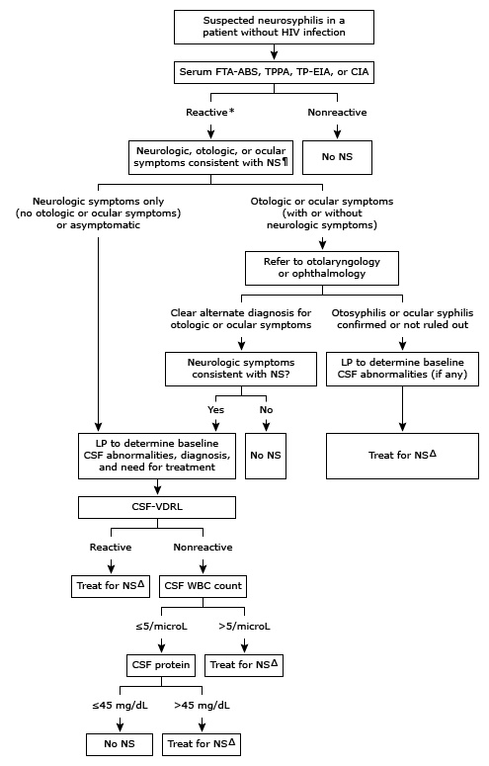
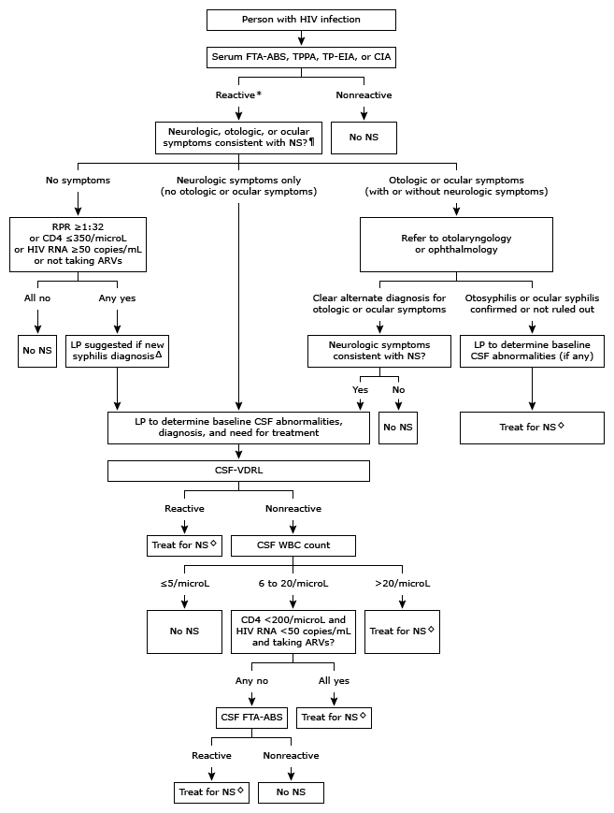

Neurosyphilis
UpToDate. Neurosyphilis. Christina Marra

Slide 42
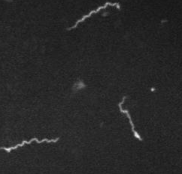
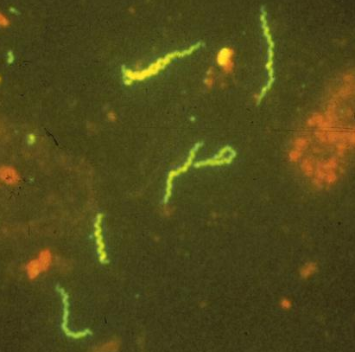
Syphilis Diagnosis
Direct examination
Not cultivable
  Rabbits – not develop 2⁰, Neuro
Darkfield microscopy
  Moves with drifting rotary motion
    Characteristic undulating movement about center - Corkscrew motility
    Not on oral specimen p not able to distinguish T. pallidum from other nonpathogenic treponemes
Direct or indirect immunofluorescent or immunoperoxidase antibody staining
Liu J. et al. JMB 2010;403
Courtesy N. Barg, MD, S. Lukehart, PhD

Slide 43
Syphilis Diagnosis
Serologic Tests
  Nonspecific nontreponemal reaginic antibody
  Specific anti-treponemal antibody
  To establish a diagnosis of syphilis, the two types of serologic tests are used together

Slide 44
Syphilis Diagnosis
Nontreponemal Reaginic Tests
  IgG and IgM antibodies resulting from interaction of host tissues with T. pallidum
  RPR
  VDRL – used CSF
  Prozone phenomenon
    Ab excess – High titer
      prevents agglutination
  False positives

Slide 45
Syphilis False Positive
Non-treponemal Test
Parenteral drug abuse
Autoimmune or connective tissue diseases
  Lupus
Aging
Hypergammaglobulinemic states
HIV co-infection
Pregnancy
Mycoplasma pneumonia
Lyme disease
Measles
Leptospirosis
Chickenpox (Varicella)
Relapsing fever
Lymphogranuloma venereum
Ratbite fever (Spirillum minor)
Hepatitis (especially Hepatitis C)
Leprosy
Infectious mononucleosis
Tuberculosis
Pneumonococcal pneumonia
Blood transfusions (multiple)
Malaria
Trypanosomiasis

Slide 46
Syphilis Diagnosis
Specific Treponemal Tests
  Antibodies against specific T. pallidum antigens
  FTA-abs
  T. pallidum agglutination tests
    TPHA and MHA-TP
  TP- EIA -
  Once positive, patient positive for life
    Rare primary diagnosis may revert after 2-3+ years.

Slide 47
Syphilis
Monitoring response to therapy
  RPR should fall by 4 fold (2 levels i.e. from 1:16->1:8 -> 1:4)
  Rise of 4 fold
    Indicate new infection
    Lack of response
      Neurosyphilis
Neurosyphilis
  Repeat LP @ 3, 6, 12 months
    CSF WBC should normalize @ 6 months
    CSF VDRL decline 4 fold or NR by 2 years after tx

Slide 48
Syphilis
Early (primary, secondary, or early latent)
  Penicillin G benzathine 2.4 mu IM once
  Doxycycline 100 mg po BID x 14 days
Late
  Penicillin G benzathine 2.4 mu IM q wk x 3
  Doxycycline 100 mg po BID x 4 weeks
Neurosyphilis
  Penicillin G 24 million units/day x 10 - 14 days
  Penicillin G procaine 2.4 mu IM daily plus probenecid 500 mg QID x 10 - 14 days
  Ceftriaxone 2 g IV QD x 10 -14 days
Congenital
  Penicillin G 50,000 units/kg q 8 - 12 hrs x 10 - 14 days
  Penicillin G procaine 50,000 units/kg IM QD x 10 -14 days
Notes:
Therapeutic levels ~ 3 weeks with single IM dose.

Slide 49
Drug Shortage
Benzathine Penicillin - Bicillin
  Shortages
  Increased demand due to syphilis
Procaine penicillin
  Not being manufactured

Slide 50
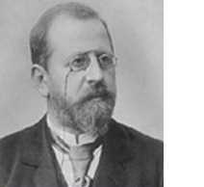

Syphilis
Jarisch-Herxheimer Reaction
  Systemic reaction resembling gram-negative sepsis
  1 to 2 hours after initial treatment of syphilis
    Abrupt onset of fever, chills, myalgias, headache, tachycardia, hyperventilation, vasodilation with flushing, varying degrees of obtundation, and mild hypotension.
    Lasts from 12 to 24 hours
    Reaction is self limited
    Prevent/treat with anti-inflammatory

Slide 51
Syphilis
Rates increasing – men, women, babies
  Need to increase screening
    Prevent infections
  Better access to care
  Treatment options available
  Ensure screening for neurosyphilis
    Lumbar punctures, ophthalmologic, ENT
    Treatment

Slide 52
Questions?
Thank you

Slide 53
Syphilis
“There was a young man from Back Bay
Who thought syphilis just went away
He believed that a chancre
Was only a canker
That healed in a week and a day.
But now he has “acne vulgaris”-
(Or whatever they call it in Paris);
On his skin it has spread
From his feet to his head,
And his friends want to know where his hair is.
There’s more to his terrible plight:
His pupils won’t close in the light.
His heart is cavorting,
His wife is aborting,
And he squints through his gunbarrel sight.
Arthralgia cuts into his slumber;
His aorta is in need of a plumber;
But now he has tabes,
And sabershinned babies,
While of gummas he has quite a number.
He’s been treated in every known way,
But his spirochetes grow day by day;
He’s developed paresis,
Has long talks with Jesus,
And thinks he’s the Queen of the May.”
Anonymous from 1920s
Notes:
Anonymous from 1920s

Slide 54
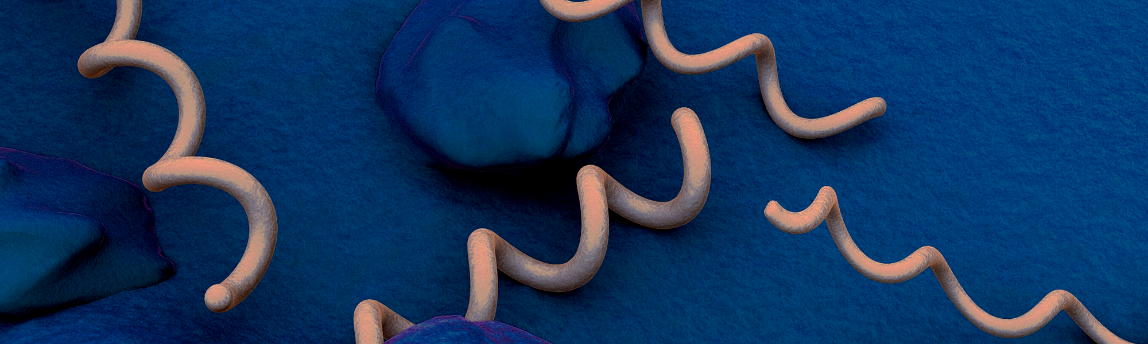
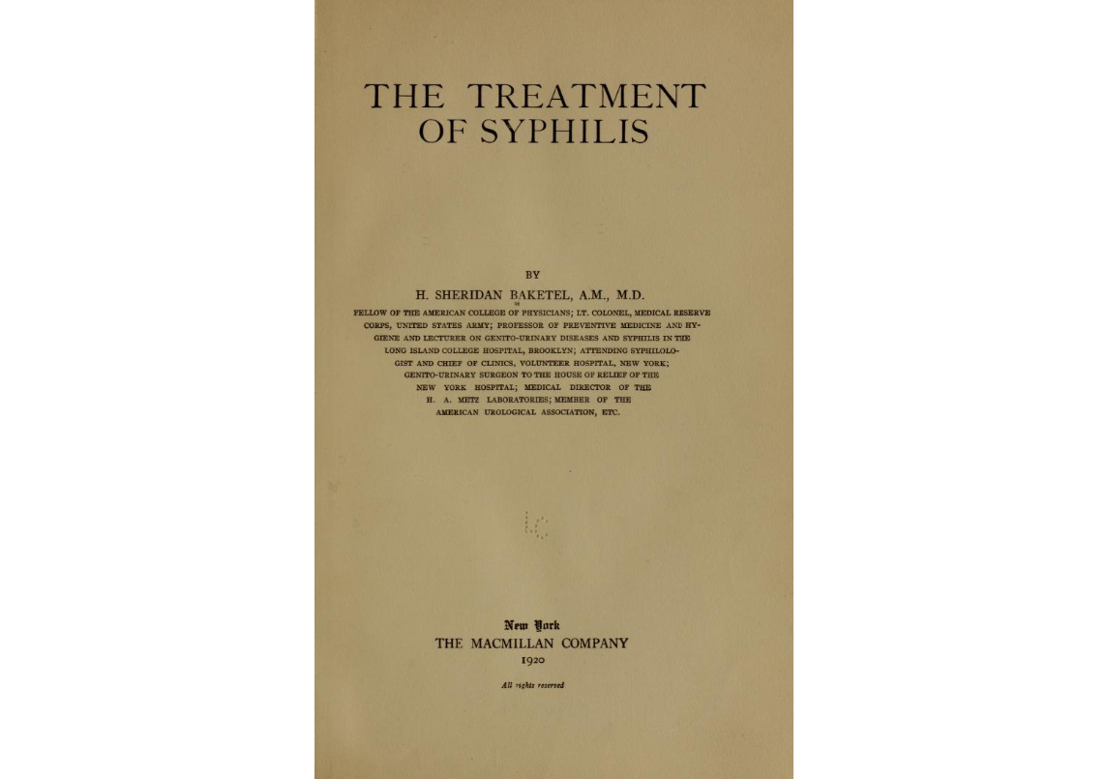
CDC.

