Slide 1
Primary Care in People with HIV (PWH)
Meagan Schaeffner, MD
Assistant Professor of Medicine
University of Kentucky

Slide 2
Disclosures
None
This program is supported by the Health Resources and Services Administration (HRSA) of the U.S. Department of Health and Human Services (HHS) under grant number U1OHA30535 as part of an award totaling $4.2m. The contents are those of the author(s) and do not necessarily represent the official views of, nor an endorsement, by HRSA, HHS, or the U.S. Government. For more information, please visit HRSA.gov.
“Funding for this presentation was made possible by cooperative agreement U1OHA30535 from the Health Resources and Services Administration HIV/AIDS Bureau. The views expressed do not necessarily reflect the official policies of the Department of Health and Human Services nor does mention of trade names, commercial practices, or organizations imply endorsement by the U.S. Government. Any trade/brand names for products mentioned during this presentation are for training and identification purposes only.”
( 2 )
2
Notes:
The HRSA disclosures must remain as part of our grant requirements.

Slide 3
Learning Objectives
Upon completion of this educational activity:
Participants will be able to identify drug interactions between ART and commonly prescribed medications in primary care
Participants will be able to compare recommended cancer screening and vaccinations for the general population and PWH.
Participants will be able to discuss incidence and types of HPV-related cancer with patients
Participants will be able to have informed risk/benefit discussion of medication for prevention of cardiovascular disease.
Participants will be able to identify which PWH need screening for osteoporosis.

Slide 4
Poll Questions
Join at menti.com
Code 9729 8259

Slide 5
Poll Question
63 yo man with PMH HIV, GERD, OA and DM2 comes to your office reporting increased thirst, frequent urination and fatigue. He’s been using his partner’s glucometer and has seen readings in the 200s-300s for the last week. His diabetes was previously very well controlled (last a1c 3 months ago was 6.9%).
Medications:
HIV: EVG/COBI/FTC/TAF
GERD: famotidine
OA: PRN IBU
DM2: metformin

Slide 6
What do you think happened?
A) He stopped taking his metformin without telling you
B) He started drinking a few bottles of soda a day because of stress
C) He had progression of his diabetes with worsening insulin resistance
D) Drug-drug interaction (DDI) with his ART

Slide 7
Drug Interactions
Boosters
Many meds
Cobicistat
Ritonavir
Both strongly inhibit CYP3A4
Migraines
CGRP antagonists (CI) (ubrogepant and rimegepant)
Men’s health
PDE5-I (dose reduce)
Alpha-blockers (except terazosin)
Gout
Colchicine (dose reduce)

Slide 8
More Drug Interactions with Boosters
Steroids (glucocorticoids)
Oral
Nasal sprays (except flunisolide and beclomethasone)
Inhalers (see below)
Joint injections
Eye drops (prolonged use)
Inhalers
LABA: except olodaterol, formoterol
ICS: except beclomethasone
Anticoagulants
Rivaroxaban (CI)
Apixaban (dose reduce 50%)
Coumadin (monitor closely)
Dabigatran (monitor closely)
No interaction with heparin
Antiplatelets
Clopidogrel (D)
Ticagrelor (CI)
No interaction with prasugrel
Mood
Buspirone (dose reduce)
Statins

Slide 9
Drug Interactions
INSTI
Bictegravir
Dolutegravir
Elvitegravir
NNRTI
Rilpivirine (PO only)
PI
Atazanavir
DM2
Metformin (dose reduction)
Polyvalent cations
Multivitamin, calcium, magnesium, iron
Must be separated or taken together with food
GERD
PPI (CI)
H2B (must be separated)

Slide 10
Poll Question
63 yo man with PMH HIV, GERD, OA and DM2 comes to your office reporting increased thirst, frequent urination and fatigue. He’s been using his partner’s glucometer and has seen readings in the 200s-300s for the last week. His diabetes was previously very well controlled (last a1c 3 months ago was 6.9%).
Medications:
HIV: EVG/COBI/FTC/TAF
GERD: famotidine
OA: PRN IBU
DM2: metformin

Slide 11
What do you think happened?
A) He stopped taking his metformin without telling you
B) He started drinking a few bottles of soda a day because of stress
C) He had progression of his diabetes with worsening insulin resistance
D) DDI with his ART
About two weeks ago, he went to see orthopedic surgery for his osteoarthritis. The same day he received a steroid injection in his right knee
Unfortunately, he had to be put back on insulin for about 2-3 months until the effect of the steroid wore off

Slide 12
Poll Question
42 yo woman with PMH HIV, HTN presents to your office to establish primary care. She recently moved to the US from the DRC. In the process of moving she was diagnosed with HIV and was just started on ART last month. She works as a nurse.
Initial lab work showed:
HIV VL 112,042
CD4 359
Hep A IgG +
Hep B Surface Ab +
Hep B Surface Ag -
Hep C Ab –
Measles Ab +
Mumps Ab -
Rubella Ab -
Varicella Ab +

Slide 13
Which of the following vaccines should NOT be offered to the patient?
A) PCV20 (pneumonia)
B) MMR (measles, mumps, rubella
C) MenACWY (meningitis)
D) RZV (recombinant shingles)
E) LAIV4 (intranasal flu vaccine)

Slide 14
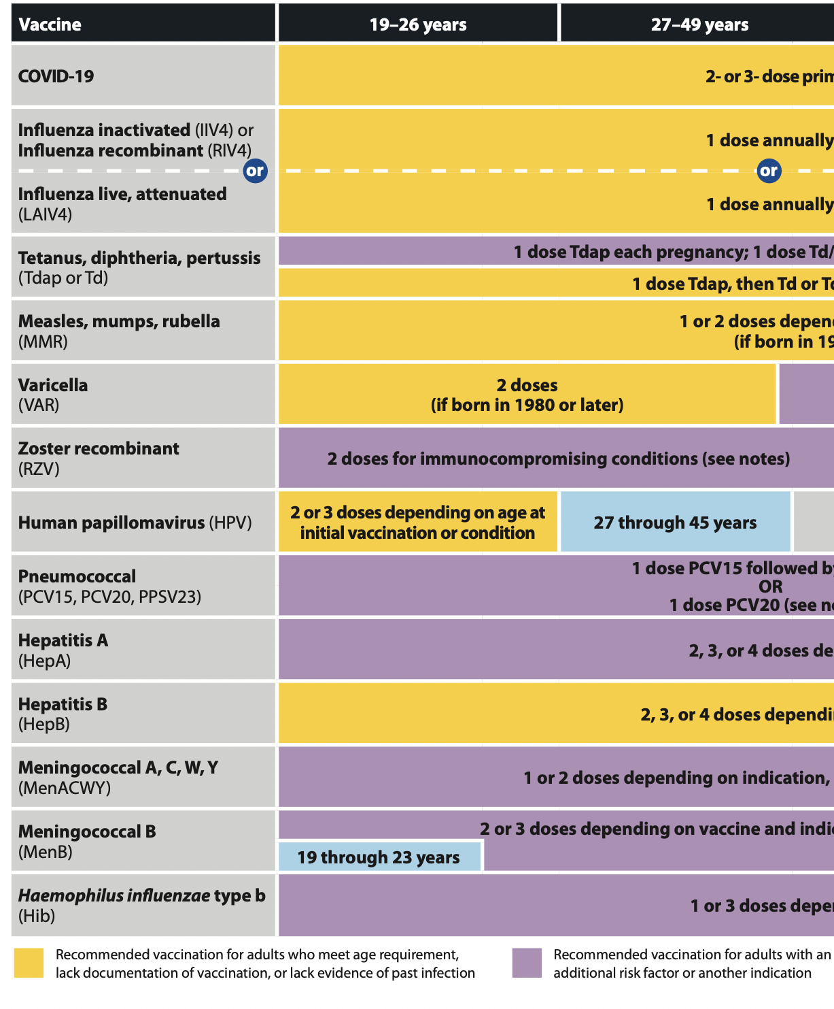
Vaccines
CDC Adult Immunization Schedule 2023

Slide 15
Highlights
RSV: ACIP approved 1 dose of RSV vaccine for adults 60+ at increased risk at June 2023 meeting
Mpox: ACIP approved 2-dose JYNNEOS series at February 2023 meeting for those at risk of mpox during an outbreak
Polio: ACIP recommended primary series with IPV if never vaccinated/incompletely vaccinated. Can consider booster with another dose of IPV if at increased risk of exposure to poliovirus
Pneumonia: PCV15 and PCV20 are now available
Shingles: ACIP recommended RZV in immunosuppressed individuals 19+ yo in fall 2021
Hepatitis B: not a new vaccine but we were only recently able to get Heplisav (with novel adjuvant) and it has worked well for patients who were non-responders to prior series of hepatitis B vaccine
Meningitis: most of our patients are at/past the 5 yr mark since primary series after ACIP recommendation in 2016 and are now due for a booster with MenACWY
Viens LJ, Henley SJ, Watson M, et al. Human papillomavirus-associated cancers - United States, 2008-2012. MMWR Morb Mortal Wkly Rep 2016;65:661-6.
Notes:
These numbers are for the general population.
Oropharyngeal cancers actually represent the largest group, NOT cervical cancer as many people might think.
These numbers vary widely by state. Not surprisingly, Kentucky ranked highest in US in rate of HPV-associated cancers among men and women combined

Slide 16
Poll Question
42 yo woman with PMH HIV, HTN presents to your office to establish primary care. She recently moved to the US from the DRC. In the process of moving she was diagnosed with HIV and was just started on ART last month. She works as a nurse.
Initial lab work showed:
HIV VL 112,042
CD4 359
Hep A IgG +
Hep B Surface Ab +
Hep B Surface Ag -
Hep C Ab –
Measles Ab +
Mumps Ab -
Rubella Ab -
Varicella Ab +

Slide 17
Which of the following vaccines should NOT be offered to the patient?
A) PCV20 (pneumonia)
B) MMR (measles, mumps, rubella
C) MenACWY (meningitis)
D) RZV (recombinant shingles)
E) LAIV4 (intranasal flu vaccine)
Live attenuated influenza vaccine (intranasal) is contraindicated for ALL patients with HIV
MMR is also live but patients with CD4 >200 and CD4% >15% can receive

Slide 18
HPV-Associated Cancers in US
From 2015-2019, CDC estimated 37,300 new cancers annually that were attributable to HPV
Oropharyngeal* cancers ~40%
Women 1.7 per 100,000
Men 9.1 per 100,000
Cervical cancer ~30%
Women 7.2 per 100,000
Anal/rectal cancer ~18%
Women 2.5 per 100,000
Men 1.4 per 100,000
Other cancers ~12%
Vulva, vagina, penis
*Oropharyngeal cancers include tongue, tonsils, soft palate, pharynx
National Program of Cancer Registries SEER*Stat Database: U.S. Cancer Statistics Incidence Analytic file 1998–2018. United States Department of Health and Human Services, Centers for Disease Control and Prevention. Released June 2021, based on the 2020 submission.
Notes:
These numbers are for the general population.
Oropharyngeal cancers actually represent the largest group, NOT cervical cancer as many people might think.
These numbers vary widely by state. Not surprisingly, Kentucky ranked highest in US in rate of HPV-associated cancers among men and women combined

Slide 19
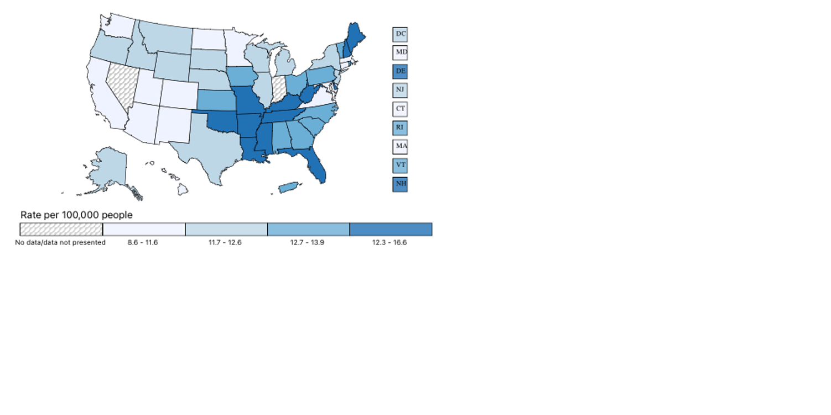
Rate of New HPV-associated Cancers By State
All HPV-associated Cancers, Male and Female, United States, 2016-2020
U.S. Cancer Statistics Working Group. U.S. Cancer Statistics Data Visualizations Tool, based on 2022 submission data (1999-2020): U.S. Department of Health and Human Services, Centers for Disease Control and Prevention and National Cancer Institute; https://www.cdc.gov/cancer/dataviz, released in June 2023.

Slide 20
HPV-associated Cancers in PWH
People with HIV/AIDS have a significantly higher risk of developing an HPV-associated cancer
Studies have shown a correlation between CD4 count and risk of cervical cancer and anal cancer
Both HIV and low CD4 count are associated with presence of HPV infection and precancerous cervical lesions
Despite this, impact of ART on reducing risk of HPV-associated cancer is uncertain
Screening guidelines for cervical cancer differ from the general population
No national screening guidelines for anal cancer currently exist
AIDS Info: Guidelines for the Prevention and Treatment of Opportunistic Infections in Adults and Adolescents with HIV- Human Papillomavirus Disease: Q1

Slide 21
Anal Cancer in PWH
https://anchorstudy.org/anal-cancer-risk-among-hiv-positive-men-and-women

Slide 22
HPV Vaccine
The current vaccine protects against 9 different strains of HPV
HPV 16 and 18- responsible for about 80% HPV-associated cancers, about 66% of cervical cancers and majority of other HPV-associated cancers in women and men
HPV 31, 33, 45, 52, 58- responsible for about 10-15% of cervical cancers, small % of other cancers
HPV 6 and 11- responsible for ~90% of anogenital warts
Viens LJ, Henley SJ, Watson M, et al. Human papillomavirus-associated cancers - United States, 2008-2012. MMWR Morb Mortal Wkly Rep 2016;65:661-6.

Slide 23
HPV Vaccine
Current recommendation for general population:
Initial vaccine series age 11-12 (2 doses only if 9-14 yo)
Catch-up through age 26 if missed (3 doses for 15+ yo)
“For adults aged 27 through 45 years, public health benefit of HPV vaccination in this age range is minimal; shared clinical decision-making is recommended because some persons who are not adequately vaccinated might benefit.”
Mietes E, Szilagyi PG, Chesson HW, et al. Human papillomavirus Vaccination for Adults: Updated Recommendations of the Advisory Committee on Immunization Practices. MMWR Morb Mortal Wkly Rep 2019;68:698-702.

Slide 24
HPV Vaccine
If people previously received the 2v or 4v vaccine, there is no official recommendation to give the 9v vaccine, but it is likely safe
While we have effective screening for cervical cancer with guidelines for follow-up and treatment of pre-cancerous lesions, this does not exist for the majority of HPV-associated cancers
Educate your patients so they can make an informed decision!

Slide 25
Poll Question
46 yo woman with HIV and no other medical history presents to your office to establish care. She was recently diagnosed with HIV after sexual assault 6 months ago
Social hx: smokes 1 ppd since age 20, rare alcohol use, no substances. Monogamous with 1 sexual partner for past 6 months, does not use condoms
Her only colonoscopy was done last year. No polyps found. Her mom was diagnosed with colon cancer at age 56
Last mammogram was done earlier this year, normal. No FH of breast cancer. No hx of abnormal mammograms.
Her last pap smear was done 2 yrs ago. She reports normal paps her whole life.
She has had no other testing/screening

Slide 26
Which cancer screening is indicated at this time?
A) Colonoscopy
B) Mammogram
C) Pap smear
D) CT chest
E) CT chest +abdomen/pelvis

Slide 27
Cancer Screening
*Though not specifically stated, all of these recommendations are based on assuption that patient has life expectancy >10 yrs and would desire treatment/intervention if cancer were found

Slide 28
Cervical Cancer Screening
AIDS Info: Guidelines for the Prevention and Treatment of Opportunistic Infections in Adults and Adolescents with HIV- Human Papillomavirus Disease: Q15

Slide 29
ANCHOR Study
Background:
4446 PWH with biopsy-proven anal HSIL (high-grade squamous intraepithelial lesions)
35 yrs or older
Multisite randomized controlled trial
Intervention: randomized 1:1 to treatment or active monitoring
Treatments included topical fluorouracil or imiquimod, office-based ablation, or ablation or excision under anesthesia
Follow-up: median follow-up 25.8 months
Primary outcome: progression to anal cancer (time-to-event analysis)
Palefsky JM, Lee JY, Jay N, et al. Treatment of anal high-grade squamous intraepithelial lesions to prevent anal cancer. N Engl J Med. 2022; 386(24):2273-82.

Slide 30
ANCHOR Study
Findings:
9 participants in treatment group and 21 participants in active monitoring group were diagnosed with anal cancer
Rate of progression was 173 per 100,000 person-years in treatment group and 402 per 100,000 person-years in active monitoring group
Serious adverse events were more common in treatment group though rare
Rate of progression to cancer was lower in treatment group by 57% (95% CI 6-80, p = 0.03)
Palefsky JM, Lee JY, Jay N, et al. Treatment of anal high-grade squamous intraepithelial lesions to prevent anal cancer. N Engl J Med. 2022; 386(24):2273-82.

Slide 31
What’s next?
What’s the best method of treating HSIL to prevent progression to anal cancer?
What’s the best method to screen for HSIL?
Anal pap and HPV-only testing both have major limitations
What’s the appropriate population to screen for HSIL?
What’s the optimal age to start screening?
What’s the optimal interval for screening?

Slide 32
Anal Cancer Screening
USPSTF: recommendation in progress
2020 HIV Primary Care Guidelines: recommends for patients with abnormal cervical pap smear, presence of genital warts, and/or history of receptive anal sex
Some states and some experts recommend screening but no data and no consensus
Everyone agrees that you should only screen patients if you have referral access to provider who can do high-resolution anoscopy to follow-up abnormal anal paps.
Thompson MA, Horberg MA, Agwu AL, et al. Primary care guidance for persons with human immunodeficiency virus: 2020 update by the HIV Medicine Association of the Infectious Diseases Society of America. Clin Infect Dis. 2021; 73(11):e3572-605.

Slide 33
Colon Cancer Screening (A/B/C)
US Preventive Services Task Force (USPSTF) (2021)
Average risk people 50-75 yrs old (A)
Average risk people 45-49 yrs old (B)
Discuss 76-85 yrs old (C)
American College of Physicians (ACP): screening for everyone at average risk should start at age 50 (2023)
American Cancer Society (ACS): screening for everyone at average risk should start at age 45
Many methods of screening, colonoscopy is gold standard but any screening is better than none

Slide 34
Lung Cancer Screening (B)
Everyone 50-80 yrs old who:
Has ≥ 20 pack-yr history AND
Current smoker OR quit within last 15 yrs
Stop screening if/when:
≥ 15 yrs since quit smoking
Life expectancy is limited
Patient not willing/able to undergo surgery
Screen with LDCT- low dose CT chest
“CT Lung Cancer Screening” in our EMR routes to the screening program coordinator

Slide 35
Breast Cancer Screening (B/C)
USPSTF/ACP:
Biennial mammogram for average-risk women 50-74 yo (B)
Discuss risks/benefits for average-risk women 40-49 yo (C)
ACS:
Annual mammogram for average-risk women 45-54 yo
Mammogram every 1-2 yrs for average-risk women 55+ yo
Discuss risks/benefits for average-risk women 40-45 yo
American College of Obstetricians and Gynecologists (ACOG) and American College of Radiology (ACR) agree about at least biennial screening for women 50-75
Bottom line: Women should start mammograms no later than 50 yo and continue every 1-2 yrs

Slide 36
Prostate Cancer Screening (C/D)
USPSTF:
Discuss risks/benefits for men 55-69 yo (C)
Do not screen men 70+ yo (D)
ACS:
Discuss risks/benefits for average-risk men 50+ yo
Discuss risks/benefits for high-risk men 45-49 yo
African American men and men with 1st degree relative diagnosed with prostate cancer <65 yo
Discuss risks/benefits for very-high-risk men 40-44 yo
Men with more than one 1st-degree relative diagnosed with prostate cancer at early age (undefined)
Screening with PSA (prostate-specific antigen) blood test

Slide 37
Prostate Cancer Screening (C/D)
https://www.uspreventiveservicestaskforce.org/Page/Document/UpdateSummaryFinal/prostate-cancer-screening1

Slide 38
Skin Cancer Screening
USPSTF (I)
Insufficient evidence to recommend screening for skin cancer
Not mentioned in 2020 update of Primary Care Guidance for Persons with HIV by HIVMA/IDSA
PWH have a higher rate of non-melanoma skin cancer (NMSC) than the general population
I counsel my patients about appropriate sun protection and have a low threshold to biopsy suspicious lesions/refer to dermatology
Omland SH, Ahlström MG, Gerstoft J, et al. Risk of skin cancer in patients with HIV: A Danish nationwide cohort study. J Am Acad Dermatol. 2018; 79(4):689-695.

Slide 39
Poll Question
46 yo woman with HIV and no other medical history presents to your office to establish care. She was recently diagnosed with HIV after sexual assault 6 months ago
Social hx: smokes 1 ppd since age 20, rare alcohol use, no substances. Not sexually active since HIV diagnosis
Her only colonoscopy was done last year. No polyps found. Her mom was diagnosed with colon cancer at age 56
Last mammogram was done earlier this year, normal. No FH of breast cancer. No hx of abnormal mammograms.
Her last pap smear was done 2 yrs ago. She reports normal paps her whole life.
She has had no other testing/screening

Slide 40
Which cancer screening is indicated at this time?
A) Colonoscopy
B) Mammogram
C) Pap smear
D) CT chest
E) CT chest +abdomen/pelvis
Pap smear is recommended at time of HIV diagnosis

Slide 41
Screening for Transgender People
Transgender Women
Transgender Men
If prostate intact, can discuss screening in appropriate age group
Screening for breast cancer with mammography is appropriate starting at 50 yo if completed at least 5 yrs of estrogen and/or progesterone therapy
If cervix intact, routine pap smears are indicated
If breast tissue remains (pt hasn't had mastectomy), routine mammograms are indicated
Both are regardless of testosterone treatment
Deutsch, MB. Screening for breast cancer in transgender women. UCSF Transgender Care. June 17, 2006.

Slide 42
Poll- Which of these patients should NOT be screened for osteoporosis at this time?
A) Pre-menopausal 51 yo F, was on TDF for 5 yrs, no FH hip fx, 10 yr FRAX 5.2%
B) Post-menopausal 49 yo F, never on TDF, no FH hip fx, 10 yr FRAX 4.7%
C) 48 yo M, was on TDF for 10 yrs, mom had hip fracture, 10 yr FRAX 11%
D) 50 yo M, never on TDF, no FH hip fx, 10 yr FRAX 3.5%
E) All of them should be screened
F) None of them should be screened

Slide 44
Osteoporosis Screening
Why do we screen?
HIV is associated with Vitamin D deficiency which is an independent risk factor for osteoporosis
Initiation of ART is associated with a 2-6% decrease in bone mineral density (BMD) in the first two years, depending on regimen used
Greatest with TDF and boosted PI regimens
Allavena C, Delpierre C, Cuzin L, et al. High frequency of vitamin D deficiency in HIV-infected patients: effects of HIV-related factors and antiretroviral drugs. J Antimicrob Chemother. 2012 Sep;67(9):2222-30.
Brown TD, Hoy J, Borderi M, et al. Recommendations for Evaluation and Management of Bone Disease in HIV, Clinical Infectious Diseases, Volume 60, Issue 8, 15 April 2015, Pages 1242–1251

Slide 45
Osteoporosis in PWH
Who to Screen?
How to Screen?
Men ≥ 50
Post-menopausal women
Anyone with fragility fracture regardless of age
Many other RFs...
People with high FRAX score
DEXA scan (preferably same machine every time)
Who to Treat?
Anyone with osteoporosis
Osteopenia with high FRAX score

Slide 46
https://www.sheffield.ac.uk/FRAX/tool.aspx?country=9

Slide 47
Osteoporosis Risk Factors
https://www.sheffield.ac.uk/FRAX/tool.aspx?country=9

Slide 48
Osteoporosis Treatment
Bisphosphonates
Oral (weekly) and IV (annually)
Both formualations have been studied in PWH
Monoclonal antibodies
Denosumab and romosozumab
Limited data in PWH but used clinically
Parathyroid hormone analogs
Teriparatide and abaloparatide
Limited data in PWH but used clinically

Slide 49
Osteoporosis Treatment
Bisphosphonates can be managed by primary care
Other treatments are usually managed by bone clinic
Who to refer?
Ineligible for bisphosphonate
Severe osteoporosis (t-score < -3)
New fractures or worsening bone density on bisphosphonate therapy
CKD with GFR <35

Slide 50
Osteoporosis Management
Consider a change in ART regimen if on TDF or PI
Plus treating vitamin D to maintain level >30, ensuring adequate dietary calcium intake or calcium supplement (separating from INSTI if applicable)
Brown TD, Hoy J, Borderi M, et al. Recommendations for Evaluation and Management of Bone Disease in HIV, Clinical Infectious Diseases, Volume 60, Issue 8, 15 April 2015, Pages 1242–1251
Notes:
Osteopenia recommendations from 2015 consensus group

Slide 51
Poll- Which of these patients should NOT be screened for osteoporosis at this time?
A) Pre-menopausal 51 yo F, was on TDF for 5 yrs, no FH hip fx, 10 yr FRAX 5.2%
B) Post-menopausal 49 yo F, never on TDF, no FH hip fx, 10 yr FRAX 4.7%
C) 48 yo M, was on TDF for 10 yrs, mom had hip fracture, 10 yr FRAX 11%
D) 50 yo M, never on TDF, no FH hip fx, 10 yr FRAX 3.5%
E) All of them should be screened
F) None of them should be screened

Slide 52
Poll Question
48 yo man with PMH HIV, HTN comes to your office for routine follow-up. He reveals that his mom recently had a heart attack (she’s in her 70s). He wants to know what he can do to lower his chances of having a heart attack in the future.
Social hx: he smoked ½ ppd but quit last week, occasional alcohol use, he runs on treadmill 45 min 4-5 days per week before work
Vitals: HR 68, BP 115/79, BMI 24
Medications:
HIV: BIC/FTC/TAF
HTN: amlodipine
Lipids: Total Cholesterol 215, HDL 43, LDL 107, TG 325
10-yr ASCVD risk is 3.6%

Slide 53
Besides counseling on importance of remaining quit from cigarettes and discussing heart healthy diet, what would you recommend?
A) Starting ASA 81 mg
B) Starting statin
C) Starting fenofibrate
D) Starting fish oil
E) Only lifestyle modification at this time

Slide 54
Cardiovascular Disease (CVD)
Relative risk of CVD 1.5-2x times higher in PWH
Includes not only myocardial infarction, but also stroke, heart failure, pulmonary arterial hypertension
Absolute burden of disease continues to increase as PWH are living longer
When imaged, PWH have more subclinical atherosclerosis
Coronary artery calcium (CAC) has been shown to progress more rapidly in PWH
Co-infection with Hepatitis C may increase stroke risk even more
Feinstein MJ, Hsue PY, Benjamin LA, et al. Characteristics, Prevention, and Management of Cardiovascular Disease in People Living With HIV: A Scientific Statement From the American Heart Association, Circulation. 2019; 140(2):e98-e124.

Slide 55
Risk Factors
Multifactorial
Traditional risk factors all still apply (diabetes, obesity, smoking, etc.)
Rate of smoking is higher in PWH
HIV-specific
Low current or nadir CD4
History of sustained viremia or untreated HIV
ART
PIs (except atazanavir)
Abacavir
Chronic inflammation/ immune activation even when virally suppressed
Feinstein MJ, Hsue PY, Benjamin LA, et al. Characteristics, Prevention, and Management of Cardiovascular Disease in People Living With HIV: A Scientific Statement From the American Heart Association, Circulation. 2019; 140(2):e98-e124.

Slide 56
Calculating Risk
Many calculators/models exist but all underestimate risk in HIV

Slide 57
Statins
Consider earlier in PWH
Per American Heart Association Scientific Statement in 2019, we should consider starting in PWH with an ASCVD risk ≥7.5%
Best choices:
High intensity: atorvastatin, rosuvastatin
Atorvastatin has lower maximum dose (20 mg) with DRV/r, DRV/COBI, and EVG/COBI
Rosuvastatin may require dose adjustment or close monitoring
Moderate intensity: pitavastatin, pravastatin
Pitavastatin does not require dose adjustment
Pravastatin may require close monitoring at higher doses
AVOID:
Lovastatin and simvastatin (CI with all PIs and EVG/COBI)
When in doubt, start low and go slow while titrating
Feinstein MJ, Hsue PY, Benjamin LA, et al. Characteristics, Prevention, and Management of Cardiovascular Disease in People Living With HIV: A Scientific Statement From the American Heart Association, Circulation. 2019; 140(2):e98-e124.

Slide 58
REPRIEVE Trial
Background:
7769 PWH on ART at low to moderate risk of ASCVD
40-75 yrs old
ASCVD risk 0-15% using 2013 ACC calculator
Multi-site international trial
Randomized 1:1 to pitavastatin 4 mg (moderate intensity) vs placebo
Median follow-up 5.1 yrs
Primary outcome: occurrence of MACE (major adverse cardiovascular event)
Study stopped early for benefit
Grinspoon SK, Fitch KV, Zanni MV, et al. Pitavastatin to prevent cardiovascular disease in HIV infection. N Engl J Med. Published online July 23, 2023. doi: 10.1056/NEJMoa2304146

Slide 59
REPRIEVE Trial
Findings:
“Pitavastatin to Prevent Cardiovascular Disease in HIV Infection” published online in NEJM on 7/23/23
LDL effect was not as large as expected
Hazard reduction was greater than expected
NNT 106 over 5 yrs
HR 0.65 (CI 0.48-0.90)
Grinspoon SK, Fitch KV, Zanni MV, et al. Pitavastatin to prevent cardiovascular disease in HIV infection. N Engl J Med. Published online July 23, 2023. doi: 10.1056/NEJMoa2304146

Slide 60
What’s next?
Does the benefit seen in this trial extend to all statins?
Should we offer a statin to all PWH 40-75 yrs of age?
Will ACC publish a new scientific statement or guideline for PWH?
How can we better predict which PWH will have a future cardiovascular event?
Are there other therapies that may further reduce risk of CVD?

Slide 61
PCSK9 Inhibitors
Alirocumab and evolocumab
Biweekly injections
Approved for patients with CVD or hyperlipidemia as adjunct to lifestyle changes and alone/in addition to other therapies
No DDI with ART
EPIC-HIV Trial
Effect of PCSK9 Inhibition on Cardiovascular Risk in Treated HIV Infection
Started 2018
Ends 2025
Primary outcome is arterial inflammation and endothelial dysfunction

Slide 62
Poll Question
48 yo man with PMH HIV, HTN comes to your office for routine follow-up. He reveals that his mom recently had a heart attack (she’s in her 70s). He wants to know what he can do to lower his chances of having a heart attack in the future.
Social hx: he smoked ½ ppd but quit last week, occasional alcohol use, he runs on treadmill 45 min 4-5 days per week before work
Vitals: HR 68, BP 115/79, BMI 24
Medications:
HIV: BIC/FTC/TAF
HTN: amlodipine
Lipids: Total Cholesterol 234, HDL 35, LDL 110, TG 445
10-yr ASCVD risk is 5.2%

Slide 63
Besides counseling on importance of remaining quit from cigarettes and discussing heart healthy diet, what would you recommend?
A) Starting ASA 81 mg
B) Starting statin
C) Starting fenofibrate
D) Starting fish oil
E) Only lifestyle modification at this time

Slide 64
Diabetes mellitus (DM)
DM is more common in PWH than general population
We commonly use HgbA1c to diagnose and monitor DM
HgbA1c underestimates hyperglycemia in PWH (tends to be falsely low) leading to underdiagnosis and undertreatment
Multifactorial issue
Mild anemia
Elevated MCV
ART (no consistent data as to which drug classes are responsible)
Not the same in every patient
Bottom line: use your clinical judgement, may need to use more FSBG or CGM

Slide 65
Could you test me for low T?
Only test men who are symptomatic and eligible for treatment
ACP Guidelines- 2020
Treatment may improve sexual function. If it doesn’t, stop treatment
Very little/no benefit for energy, vitality, cognition, physical function- DON’T PRESCRIBE
Order free testosterone level or panel because HIV affects sex hormone binding globulin (SHBG)
Lab should be drawn between 8-10 am, ideally fasting
If low, it should be repeated at least once to confirm
Qaseem A, Horwitch CA, Vijan S, et al. Testosterone Treatment in Adult Men With Age-Related Low Testosterone: A Clinical Guideline From the American College of Physicians, Ann Intern Med. 2020;172(2):126-133.

Slide 66
STI Screening
If you use it, swab it for gonorrhea and chlamydia
Not everyone has sex the same way
Ask if any new partners, sexual contacts at every visit
At minimum, test for STIs at least annually
For people with vaginas, this includes trichomonas
Syphilis is the great imitator- any rash/skin lesion that I’m not 100% confident about the diagnosis, I test for syphilis
For MSM and people who inject drugs, test for hepatitis C on a regular basis

Slide 67
Take Home Points
Check for drug interactions before prescribing new med!
There is an increased risk of HPV-associated cancers in PWH
Discuss HPV vaccine in individuals 27-45 if appropriate
Offer anal pap smears if able to refer for anoscopy
Transgender individuals: screen organs that are present
Transgender women- start mammograms at 50 if ≥ 5 yrs on hormone therapy
Screen for osteoporosis with DEXA (men 50+, women post-menopausal)
Calculate ASCVD risk in PWH ≥ 40 yo, discuss statin for everyone?? (at minimum PWH and ASCVD >7.5%), smoking cessation for all

Slide 68
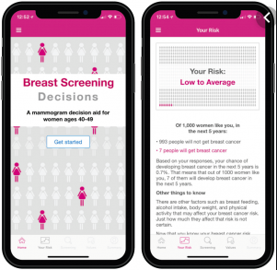
There’s an app for that!
Guided decision making tool for mammograms for women 40-49
CV Risk Calculator
Pap smear follow-up
Vaccine Schedule
USPSTF Recs
Notes:
Breast Screening Decisions- by researchers at Weill Cornell Medical Center and Memorial Sloan Kettering Cancer Center

Slide 69
Other Resources
AIDSInfo- by NIH (app)
Advisory Committee on Immunization Practices (ACIP)
CDC Vaccines App
US Preventive Services Task Force (app)
Lexicomp (also in UpToDate Drug Interaction Checker)
Liverpool HIV Drug Interaction Checker (also includes illicit substances)

Slide 70
AETC Program National Centers and HIV Curriculum
National Coordinating Resource Center – serves as the central web –based repository for AETC Program training and capacity building resources; its website includes a free virtual library with training and technical assistance materials, a program directory, and a calendar of trainings and other events. Learn more: https://aidsetc.org/
National Clinical Consultation Center – provides free, peer-to-peer, expert advice for health professionals on HIV prevention, care, and treatment and related topics. Learn more: https://nccc/ucsf.edu
National HIV Curriculum – provides ongoing, up –to-date HIV training and information for health professionals through a free, web –based curriculum; also provides free CME credits, CNE contact hours, CE contact hours, and maintenance of certification credits. Learn more: www.hiv.uw.edu
( 70 )
70
Notes:
This slide must remain as part of our funding requirements.

Slide 71
Questions?

