Slide 1
Infant Feeding Strategies for Mothers with HIV
Gweneth B. Lazenby MD MSCR
Medical University of South Carolina
Department of Ob/Gyn

Slide 2
Objectives
Review historical perspectives of perinatal HIV infection related to infant feeding
Review contemporary evidence for infant feeding and perinatal HIV risk reduction
Discuss new recommendations related to infant feeding strategies for U.S. mothers with HIV

Slide 3
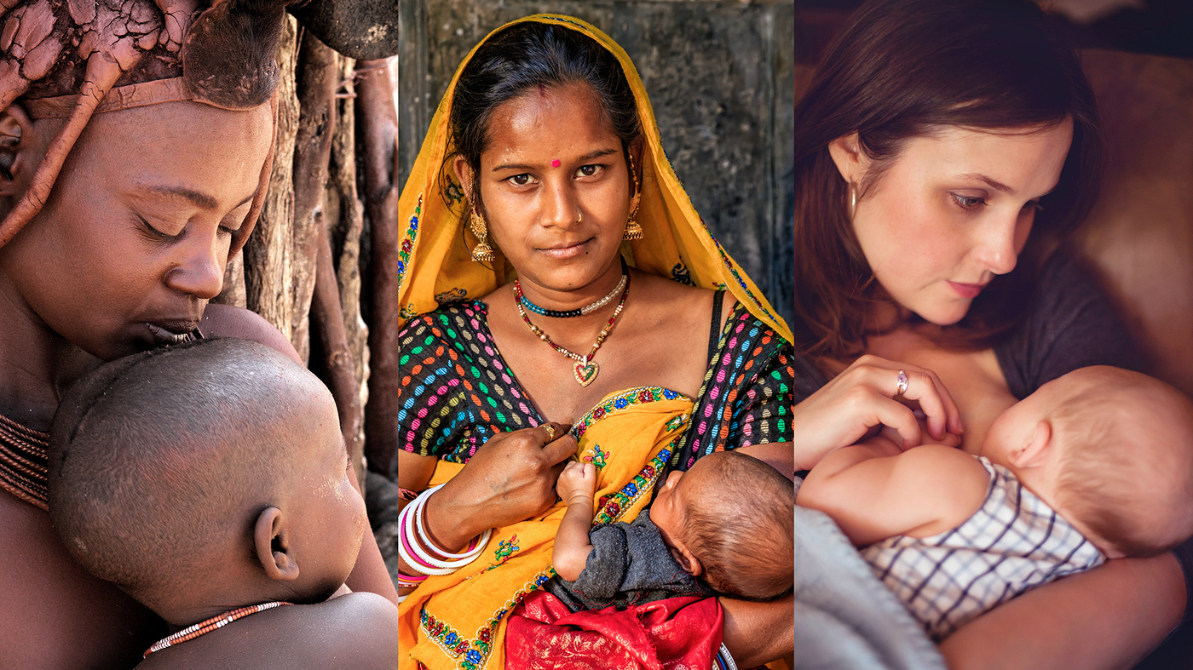
Evidence For Infant feeding and Perinatal HIV infection

Slide 4
Observational STUDIES

Slide 5
Early Case Series Data for PHIV through breast feeding
Cumulative risk of PHIV diagnosed in infants born to women who were HIV negative at birth
Dunn et al. Lancet. 1992

Slide 6
In 1996, the Joint United Nations Programme on HIV/AIDS (UNAIDS) recommended that HIV-1 seropositive women in resource-poor areas be encouraged to make informed choice about infant feeding.
Most-at-risk infants in the developing world breast fed to reduce the risk of infectious morbidity and mortality (ex. diarrhea, pneumonia, and otitis media)
Nduati et al. JAMA. 2000.

Slide 7
Infant Feeding and Risk of PHIV in Brazil
Observational study of Brazilian women-infant pairs, many women initiated breast feeding before HIV status was known; n, 432
Median duration of breast feeding 30 days
Outcome= PHIV (HIV-1 Ab+ at 18 months)
69/432 (16%) infants were diagnosed with HIV; advanced maternal HIV, longer duration of breast feeding, and mixed feeding were associated with increased risk (but not statistically significant)
Tess et al. JAIDS. 1998
Notes:
Observational, 1988-1993, 4 sites in Brazil
553 potential subjects, HIV status available for 434 and infant feeding data available for 432. 69/434 infants in the cohort were infected with HIV, vertical transmission rate 16%
Infants who breast fed (n= 168), 36/168 or 21% were HIV infected, most women who breast fed didn’t know their status
Advanced HIV/AIDS in mother was associated with a 4.5x higher risk of PHIV
Duration of BF mean 98 days, median 30 days; infants who BF > 90 days were more likely to be infected (Not statistically significant)
Infants who were fed breast and formula were 2.2x more likely to be infected (NS)

Slide 8
When children born to women with HIV can be ensured uninterrupted access to nutritionally adequate breast-milk substitutes that are safely prepared and fed to them, they are at less risk of illness and death if they are not breastfed. However, when these conditions are not fulfilled, in particular in an environment where infectious diseases and malnutrition are the primary cause of death during infancy, artificial feeding substantially increases children’s risk of illness and death.
UNAIDS, UNICEF, and WHO. HIV and infant feeding: guidelines for decision-makers.
1998

Slide 9
Influence of infant-feeding patterns on early PHIV
Observational study in Durban, South Africa
N, 549 women with HIV-1 + singleton infants
Infant-feeding strategies: formula, exclusive BF, and mixed feeding
Infants tested at birth, 1 weeks, 6 weeks, 12 weeks, and every 3 months until 15 months
Median duration of exclusive breast feeding 6 months (IQR 1-10)
Infants who exclusively breast fed were at the lowest risk of HIV-1 infection by 3 months age
*No comments on maternal ARV use
Coutsoudis et al. Lancet. 1999.
Notes:
Study period: 1995-1998
549 infants: 156 formula only, 102 breastmilk only, and 288 mixed feeding
6% of infants had HIV on DOL1, similar % between 3 groups
transmission rates of HIV were similar between 3 groups (all infants), p=0.5
When controlling for early HIV infection in infants, there was a difference between 3 groups, p= 0.03

Slide 10
RCT of Breast and formula feeding in women with HIV-1
Randomized controlled trial of 425 HIV-1 seropositive women in Nairobi, Kenya 1992-1998
212 to breastfeed and 213 to formula feed
401 mother-infant pairs followed for 24 months; 17% lost to follow up
Estimated risk of HIV-1 transmission through breast feeding 16% in 24 months
Most transmissions occurred in the first 6 months (75%)
Infant mortality rates were similar between groups
Nduati et al. JAMA. 2000.
Notes:
24 month period: seen monthly year 1 and quarterly year 2
Cumulative HIV-1 infection: 36.7% (95% CI 29-44) in BF and 20.5 (95% 14-27) in formula; HIV-transmission attributable to breast feeding 16%

Slide 11
Established Risk Factors & Suggested Intervention
Maternal breast abnormalities (infection)
Author/committee recommended
Exclusive breast feeding for short duration (4-6 mo)
Rapid weaning by 6 months
Treat mastitis and infant oral candidiasis quickly
Read and Committee on Pediatric AIDS. Pediatrics. 2003 .

Slide 12
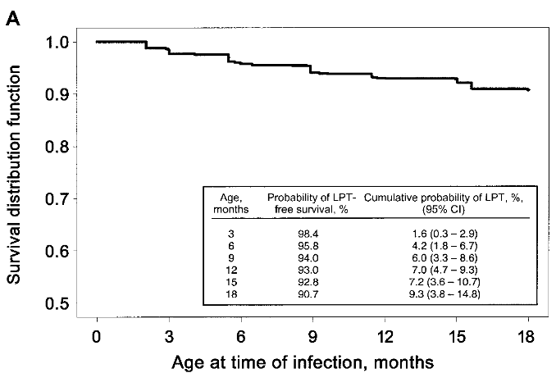
Postnatal transmission of HIV-1 in breastfed children: meta-analysis
9 studies, 4,085 African children breastfed
3,025 children were HIV negative at 4 weeks of age
All breastfed at least 28 days
Median 10 months (IQR 4.7-17 mo)
223 (7%) had late postnatal transmission
Independent risk factors for postnatal HIV
Maternal CD4 cell count < 200, aHR 8.0 (4.8-13.3)
Female infant, aHR 0.6 (0.4-0.9)
Infants were at risk of postnatal HIV infections while breastfeeding up to 18 months
Breastfeeding and HIV Int Trans Study Group. JID. 2004.

Slide 13
Clinical trials

Slide 14
Mashi study: suppression of HIV-1 RNA in breast milk
Nested cohort study Botswana 2001-2003
Women randomized to ART (n, 26) or no ART (n,25)
ART: zidovudine, lamivudine, and nevirapine
All women on ART had CD4 < 200 cells/mm3 and/or AIDS-defining illness. Controls were matched by CD4 cell count
Breast milk collected 2 or 5 months postpartum
No postnatal infections occurred
Women on ART had lower HIV-1 plasma and milk RNA. No difference in milk HIV-1 DNA.
Shapiro et al. JID. 2005.
Notes:
4 sites in Botswana
Outcomes of interest: 1) sdNVP given to mothers and infants provides additional MTCT prevention in the setting of ZDV therapy
2) Extended ZDV prophylaxis given to infants prevents MTCT through breast milk
HIV-1 DNA may decline more slowly than RNA. HIV-1 DNA may plan a role in infant infection.

Slide 15
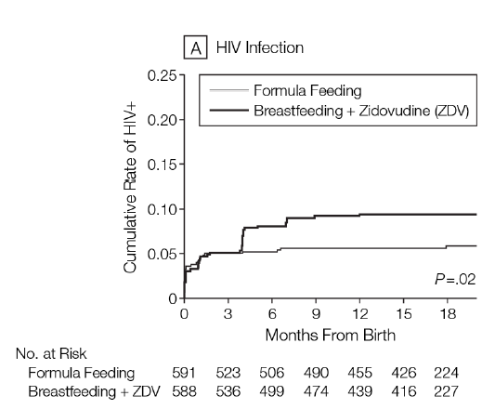
MASHI Study: formula and breast feeding + infant Zidovudine Prophylaxis
1,200 Botswanan women were randomized to formula feed or breast feed + infant zidovudine prophylaxis, 2001-2003
Infant dose: ZDV 4mg/kg BID 0-1 month, 4m/kg TID 1-2 months, and 6mg/kg TID 2-6 months
Wean between 5- 6 mos
Infants were evaluated at birth, monthly for 7 months, and q3 months until 18 months old
Outcome= PHIV
PHIV occurred in 6.0% of formula-fed infants and 9.5% of breastfed/ZDV infants
Wean
Thior et al. JAMA. 2006.
Notes:
Part 1 of Mashi study evaluated the efficacy of sdNVP added to maternal and infant ZDV prophylaxis. Maternal dose NVP 200mg and infant NVP 6 mg within 72 hours of delivery
Part 2 Mashi study: safety and efficacy of extended ZDV prophylaxis (6 mo) in breast feeding infants vs formula+ ZDV x4 weeks
All women received ZDV 300mg BID from 34 wks and then q3 hours in labor
HR for breastfeeding+ ZDV compared to formula, HR 1.65 (95% CI 1.07-2.55)
Women in formula group- 7% exposed infant to breast milk; 3 infants became HIV infected
Women in ZDV+BF group had low rates of exclusive breast feeding (page 800)

Slide 16
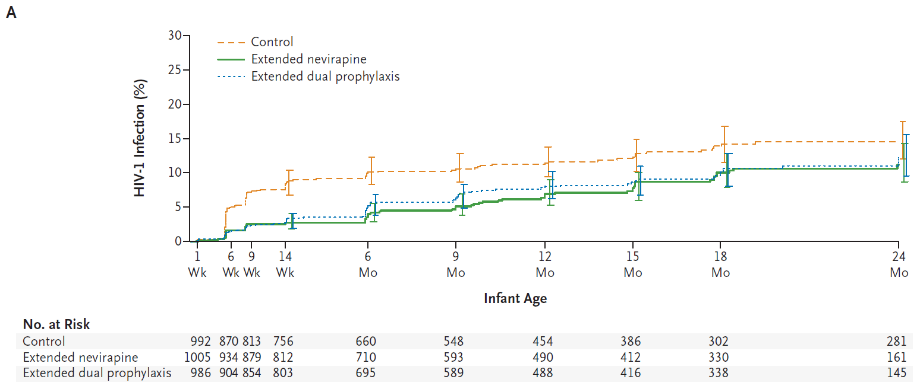
Extended Prophylaxis to reduce breast-milk HIV-1 Transmission
HIV-1 infections at
9 months
Control, 10.6% (n, 98)
NVP only, 5.2% (n, 51)
NVP+ ZDV, 6.4% (n, 61)
HIV-1 infections
At 24 months
Control, 15.6%
NVP only, 10.8%
NVP+ZDV, 11.2%
End PEP
RCT of 3,216 women and infants in Malawi, 2004-2007. All infants received sdNVP 2mg/kg+ ZDV 4mg/kg BID x 7 days (control)
NVP only: 2mg/kg daily x2 wks, 4mg/kg daily week 3-14
NVP + ZDV 4mg/kg BID 2-5 weeks, 4mg/kg TID 6-8 weeks, 6mg/kg TID 9-14 weeks
< 3% of women in each arm were prescribed maternal ART
Outcome, PHIV at 9 months; most weaned by 6 mos but 20% continued to breast feed at 9 months
Conclusion, either extended infant prophylaxis strategy was more effective than control at prevention of PHIV
Kumwenda et al. NEJM. 2008.; Taha et al. JAIDS. 2011
Notes:
Infants were followed 24 months
< 3% of women received ART during pregnancy in all 3 groups
Rates of exclusive breast feeding were low after 3 weeks (see Table 2)

Slide 17
***Mma Bana Study***
Botswana, 2006-2008, 709 women 18-34 wks and followed 6 months postpartum until weaning
Maternal treatment groups while breast feeding
(obs) NVP+ZDV/3TC BID, n 156
NRTI-based, ABC/ZDV/3TC BID n,283
PI-based, ZDV/3TC+ LPV/RIT BID n, 270
Outcomes: viral suppression and PHIV
Viral suppression ( <400 copies/mL) was similar between 3 groups
PHIV occurred in 1.1% infants (6 DOL4 and 2 HIV+ while breast feeding. Both infants in NRTI group)
Maternal ART and viral suppression resulted in fewer infant infections
Shapiro et al. NEJM. 2010
Notes:
MMA Bana “mother of the baby” in Setswana
Median duration of ART before delivery 11 weeks in Treatment arms and 13 weeks in Observational (control) group
71% participants breast fed to 5 months; 94% weaned by 6 months
Women on NRTI ART were more likely to have VL < 50 copies before delivery (81% NRTI vs 69% PI) (77% obs), rates of viral suppression were similar during breast feeding 83% NRTI and 77% PI ) (77% obs)
PHIV 8/709 infants by 6 months age (1.1%, CI 0.5-2.2); 6 infants in utero and 2 infants during BF (both in NRTI group)
Both infants infected during BF approx. 3 months of age. Maternal RNA was < 50 copies/mL in both cases

Slide 18
BAN Study: Breastfeeding, antiretrovirals, and Nutrition
Malawi RCT, 3 groups: 2,469 participants
maternal ART (849), infant ART (852), controls (668)
All mothers at birth: ZDV/3TC BID x 7 d during labor to PPD 7
All infants ZDV/3TC BID birth to DOL7
Maternal ART while breastfeeding: ZDV/3TC+NVP (39), ZDV/3TC+NFV (146), & ZDV/3TC+LPV/RIT (664)
Infants PEP while BF: NVP daily birth to 6 months
Outcome: PHIV
PHIV diagnoses after DOL14 were more common in controls and least likely among infants treated during breast feeding.
Chasela et al. NEJM. 2010.
Notes:
BAN- breast feeding, antiretrovirals, and nutrition study
All participants were advised to rapidly wean 24-28 weeks post-delivery
Mothers with CD4 200-250 cells/mm3 were given PJP prophylaxis
Infants received PJP prophylaxis
Sub-analysis, log-rank test, no difference in PHIV when comparing 3 maternal regimens, p=0.37

Slide 19
We now have the tools to make a considerable difference in controlling the pediatric HIV-1 epidemic. A generation of children awaits our actions.
Lynne M. Mofenson, Peds Inf Dis
Retired NIH
NEJM. 2010.

Slide 20
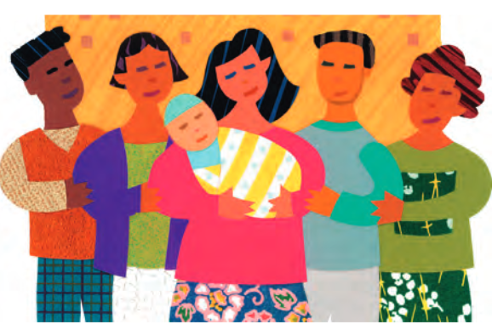
WHO recommends that women who breastfeed and receive ARVs or whose infants are receiving ARVs should exclusively breast feed their infants for 6 months and continue breast feeding until 12 months of age and only then consider stopping.
World Health Organization guidelines on “HIV and Infant Feeding 2010”
Option A: maternal ZDV 14wks to delivery and infant NVP daily for 7 days
Option B: maternal cART during pregnancy and 7 days post-weaning
Option B+: lifelong cART for all pregnant women
https://www.who.int/publications/i/item/FWC-MCA-12.1

Slide 21
McIntrye. “Use of antiretrovirals during pregnancy and breast feeding in low-income and middle-income countries.” Curr Opin HIV AIDS. 2010.

Slide 22
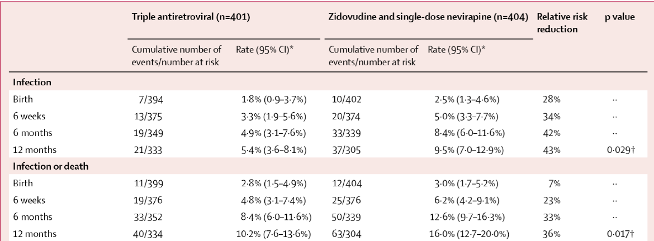
Kesho Bora study
RCT in Burkina Faso, Kenya, & S. Africa 2003-2008
Aim: assess efficacy of ART vs ZDV/NVP for prevention of PHIV during pregnancy and breast feeding. Outcome: PHIV by 1yr
Pregnant women with HIV-1 at 34wks: cART (ZDV/3TC+LOP/RIT) (n,412) or ZDV+ sdNVP (n,412)
*12/2006, protocol amendments: all women start ART28 weeks, receive ZDV/3TC x 7d pp for women in ZDV/NVP group and all infants received ZDV BID x 1 week pp
PHIV 2x more likely among ZDV/NVP group
Maternal cART
while BF reduces
PHIV
Lancet Inf Dis. 2011
Notes:
Kesho Bora study (A better future in Swahili)
Enrolled 34-36 weeks
After Dec 2006, study protocol was amended. ART initiated > 28 weeks for all participants
For ZDV/NVP group, ZDV 300mg/3TC 150mg BID for 7 days pp
8% of women breast fed after cART discontinued (26/307)
Late postnatal PHIV ( > 6 weeks of life) 2.2% in cART, 4.7% (ZDV/sdNVP)
Late transmissions only occurred in BF infants
Risk factors for late PHIV: longer breast feeding median duration 22.4 (IQR 11.1-28.7) weeks and higher maternal plasma viral load at delivery
Exclusive vs mixed feeding did not have an effect
WHO recommended infant prophylaxis during BF

Slide 23
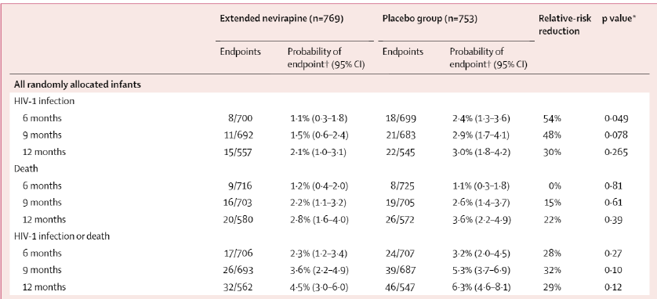
HIV Prevention Trials network (HPTN) 046
2008-2010 S. Africa, Tanzania, Uganda, and Zimbabwe
HIV DNA negative infants randomized to placebo (n, 765) OR NVP daily for 6 months or until weaned (n, 762)
All infants received 6 weeks of prophylaxis; Outcome: PHIV age 6 months
Infants receiving NVP
daily while BF at a 50%
risk reduction of PHIV at
6 months of age.
Coovadia et al. Lancet. 2012.
Notes:
Phase 3, double blind RCT vs placebo
Infants had to have HIV DNA negative DOL7 and > 2000gm at birth
Infants were stratified by maternal ART use (y/n)
In women on cART, there was no difference in PHIV between NVP PEP and placebo groups

Slide 24
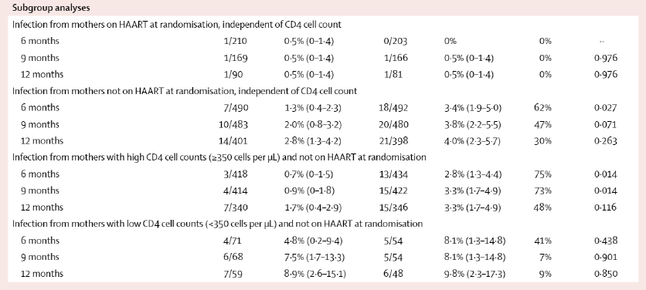
HPTN 046 Subgroup analyses
Women on ART while breastfeeding regardless of infant prophylaxis had VERY LOW rates of HIV-1 transmission

Slide 25
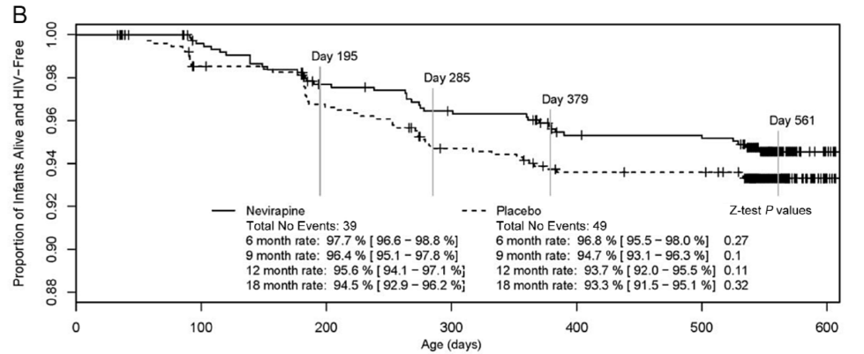
Extended HPTN 046 Trial
Outcome: PHIV at 18 months of age in infant who were HIV negative at 6 weeks of age and breast fed
1/3 of women were taking ART, 2/3 no ART
Infant NVP stopped at 6 months in study group. 95% infants were weaned by 12 months of age.
HIV-free survival was similar between groups at 18 months
PHIV rates were similar: NVP 2.2% (95% CI 1.1-3.3%) and Placebo 3.1% (95% CI 1.-4.4%)
95% weaned
NVP PEP end
Fowler et al. JAIDS. 2014

Slide 26
The longer duration of extended NVP dosing of infants, the longer the duration of protection against MTCT of HIV. Once prophylaxis is discontinued, the cumulative infant HIV infection rates continue to increase- suggesting that infant ARV prophylaxis…must continue as long as breast feeding continues.
Cochrane Review, 2014
Studies included: Gray 2005, SWEN 2008, Kumwenda 2008, Shapiro 2010, Chasela 2010, Kesho Bora 2011, and Coouvadia 2012
Notes:
Trials: Gray 2005, SWEN 2008, Kumwenda 2008, Shapiro 2010, Chasela 2010, Kesho Bora 2011, Coovadia 2012

Slide 27
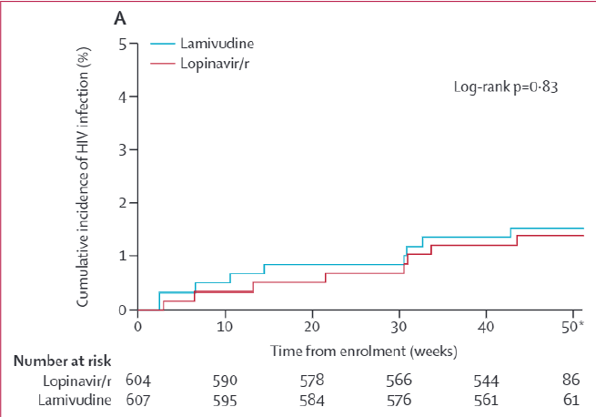
ANRS (French HIV Research Study) 12174
2009-2012 Burkina Faso, S. Africa, Uganda, and Zambia
PMTCT protocol: maternal ZDV at 28 weeks until delivery, single dose NVP in labor, and ZDV/3TC 7 days pp
Outcome: PHIV in infants 7-50 weeks of life
HIV-1 DNA negative infants DOL7 randomized to LPV/RIT (n, 636) or 3TC (n, 357) until 50 weeks or 7 days after weaning
Chose 3TC instead of NVP due to lower rates of ASEs and drug resistance profile.
PHIV weeks of life 1-50 occurred in LPV/RIT 1.4% (95% CI 0.4-2.5) and 3TC 1.5% (95% CI 0.7-2.5)
Infant prophylaxis should be extended until HIV exposure through breastfeeding ends.
Nagot et al. Lancet. 2016.
Notes:
45% of women had UD VL at day 7
Duration BF median 41 weeks (IQR 34-46) LPV/RIT and 41 weeks (IQR 36-47) in 3TC
HR for PHIV LPV/r vs 3TC was 0.9 (CI 0.35-2.34) (NS)
Cumulative PHIV rate, 0.7% (0.2-1.2%) at 26 weeks and 1.5% (CI 0.8-2.2) at 50 weeks

Slide 28
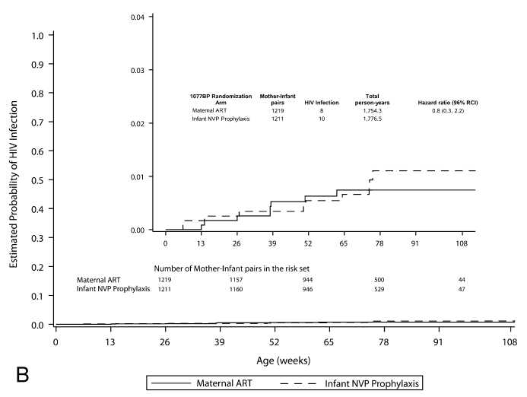
IMPAACT PROMISE postpartum component
“Promoting maternal infant survival everywhere”
2011-2014, Malawi, S. Africa, Zimbabwe, Uganda, Zambia, Tanzania, and India
2431 maternal-infant pairs RCT maternal ART (n, 1220) OR infant prophylaxis (n,1211) while breast feeding
ART regimens: Zidovudine only, ZDV/3TC+ LOP/RIT, or TDF/FTC+ LOP/RIT
Infant prophylaxis = NVP daily
Outcome: PHIV at 24 months of age
PHIV by 24 months mART 0.7% and iNVP 0.8%
PHIV/infant death by 24 months mART 2.9% and iNVP 2.3%
HIV-free survival 97% in both groups
iNVP
mART
Fowler et al. JAIDS. 2018
Notes:
Most women received TDF/FTC/LPV/r
Median age weaning 16 months (86% were BF at 9 months)
18 infants dx’d with PHIV post-randomization; 14 were included in analysis
8 infections/mART and 10 infections/NVP, median age at dx 38 weeks mART and 50 wks NVP

Slide 29
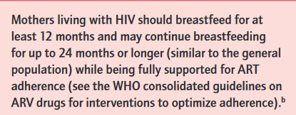
World Health Organization guideline updates on “HIV and Infant Feeding” 2016
https://apps.who.int/iris/bitstream/handle/10665/246260/9789241549707-eng.pdf

Slide 30
Summary of Current Data

Slide 31
Impact of Maternal ART on prevention of postnatal PHIV
Study | Maternal ART | Infant PEP | PHIV
MMA BANA NEJM. 2010 | NVP/ZDV/3TC n, 156 ABC/ZDV/3TC n, 283 ZDV/3TC/LPV/r n, 270 | n/a | 6 months NVP 1.1% n, 2
BAN study NEJM. 2010 | ZDV/3TC BID x labor/7 d ZDV/3TC/NVP n, 39 ZDV/3TC/NFV n, 146 ZDV/3TC+ LPV/r n, 664 | ZDV/3TC BID birth to DOL 7 NVP daily 6 months | 7 months control, 5.7% n, 32 mART, 2.9% n, 21 iPEP, 1.7 n, 12
Kesho Bora Lancet Inf Dis. 2011 | ZDV BID+ sdNVP n, 412 (added 7 days pp) ZDV/3TC/LOP/r n, 412 | ZDV BID 7 d pp | 12 months sdNVP, 9.5% n, 37 mART, 5.4% n, 21
PROMOTE AIDS. 2015 | ZDV/3TC/EFV n, 195 ZDV/3TC/LPV/r n, 194 | ZDV 7 d pp Or NVP 6 wks pp | 12 months EFV, 0% LPV/r 1.1% n, 2
IMPACT PROMISE NEJM. 2018 | ZDV only+ sdNVP n,506 ZDV/3TC/LOP/RIT n, 508 TDF/FTC/LOP/RIT n, 140 | NVP daily n, 1211 | 24 months mART, 0.7% n,7 iPEP, 0.8% n,7

Slide 32
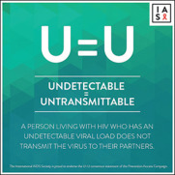
There is insufficient evidence to state with certainty that undetectable = untransmittable in the context of breast feeding.
Waitt et al. Lancet HIV. 2018.

Slide 33
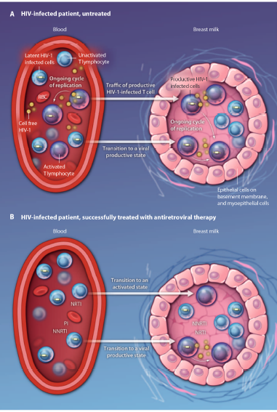
Factors Associated with HIV-1 Transmission in Breast feeding Infants
High maternal HIV-1 RNA viral load, ex. advanced HIV/AIDS (low CD4 cell count) or primary HIV infection (extreme viremia) while breast feeding
Mixed feeding before age 6 months
Breast inflammation i.e. mastitis, abscess, or engorgement
Van de Perre et al. Sci Transl Med. 2012.

Slide 34
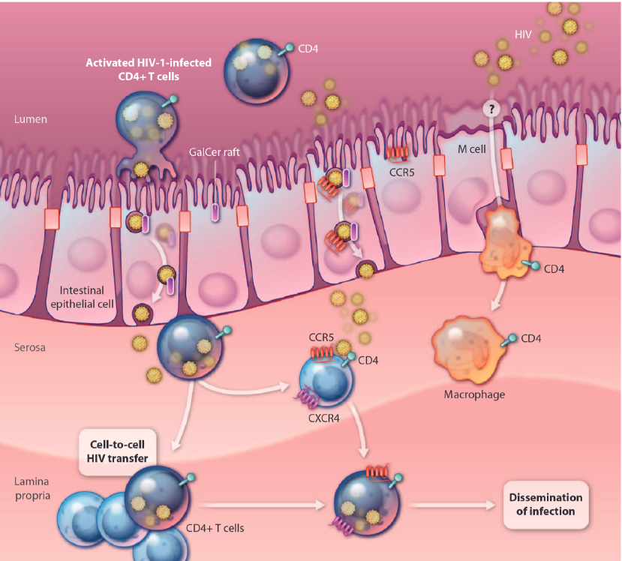
Potential Mechanism for HIV-1 Transmission through Breast Milk Despite Maternal Viral Suppression on Antiretroviral Therapy
“HIV-1 secreting cells in breast milk have direct access to gut mucosa and active immune cells from breast milk can infiltrate the gut mucosa.”
“An infant breast-fed by an HIV-1 infected woman ingests ~ 178 HIV-1 secreting cells/daily…(expected cumulative) exposure ~ 178,000 cell-associated viruses with a high capacity for cell-cell transfer”
Van de Perre et al. Sci Transl Med. 2012.

Slide 35
Before 2023, U.S. Perinatal HIV Treatment Guidelines Recommendations remained unchanged because…
Although low, there is a potential for HIV-1 transmission through breast milk despite maternal viral suppression.
The availability of safe formula feeding in high resource settings.
Provider and parents’ fears regarding HIV transmission.

Slide 36
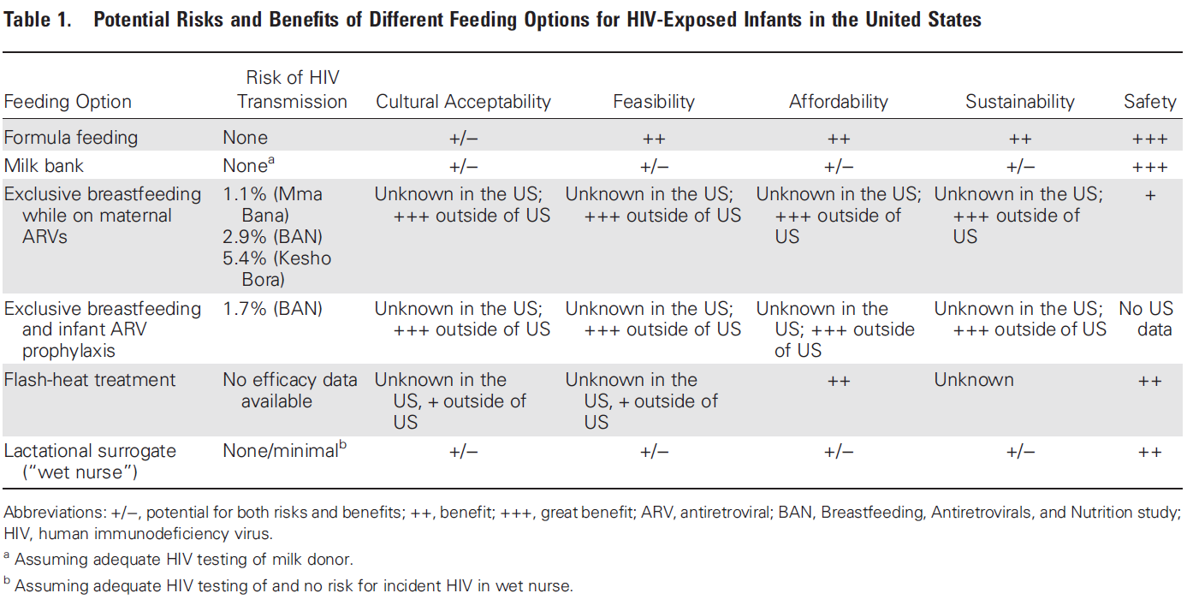
Summary of Infant Feeding Options and Risk of PHIV
Levison, Weber, and Cohan. CID. 2014

Slide 37
Maternal Antiviral therapy and breast milk

Slide 38
Transfer of TDF/FTC into Breastmilk
50 HIV-uninfected lactating women and infant pairs
Primary outcome: infant plasma concentrations of TDF and FTC
Secondary outcomes: maternal plasma and breast milk concentrations; maternal milk: plasma and infant plasma: milk ratios
Methods: directly observed doses of daily oral FTC-TDF for 10 days. Maternal serum and breast samples days 7 and 10 obtained 1-2 hours after Infant serum sample on day 7
Mugwanya et al. PLOS Medicine. 2016

Slide 39
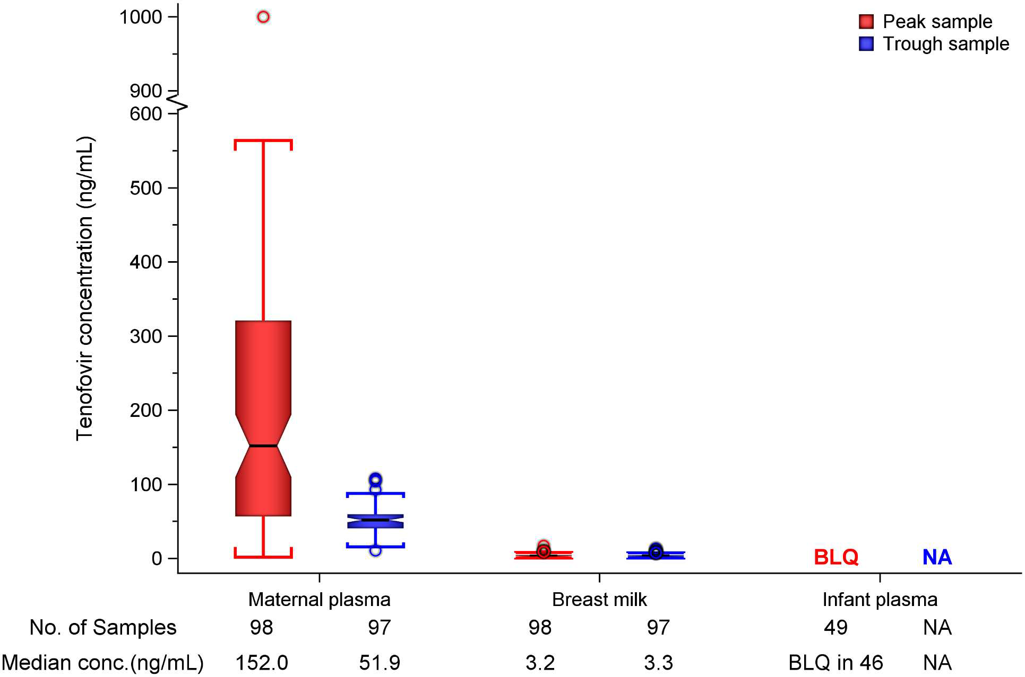
TDF concentration in breast milk and infant plasma
Median breastmilk doses of tenofovir have been shown to be 0.03% of infant oral doses.
Tenofovir was undetectable in 46 of 49 (94%) infant plasma samples
Mugwanya et al. PLOS Med. 2016
Notes:
Mugwanya et al. PLOS Medicine. 2016
2015, prospective study of 50 HIV-uninfected lactating women and infant pairs
Primary outcome: infant plasma concentrations of TNF and FTC
2ndary outcomes: maternal plasma and breast milk concentrations; maternal milk:plasma and infant plastma:milk ratios
Methods: directly observed doses of daily oral FTC-TDF PrEP for 10 days. Maternal serum and breast samples days 7 and 10 obtained 1-2 hours after PrEP
Infant serum sample on day 7
TNF and FTC concentrations in plasma determed by liquid chromatographic mass spectrometry at Johns Hopkins
Tenofovir was detected at concentrations consistent with steady-state use, and breast milk tenofovir concentrations were considerably lower than those in maternal plasma
From Hong et al. review “Median breastmilk doses of emtricitabine and tenofovir have been shown to be 2% and 0.03% of infant oral doses, respectively. Simulated infant plasma levels are low for women taking emtricitabine and tenofovir.”

Slide 40
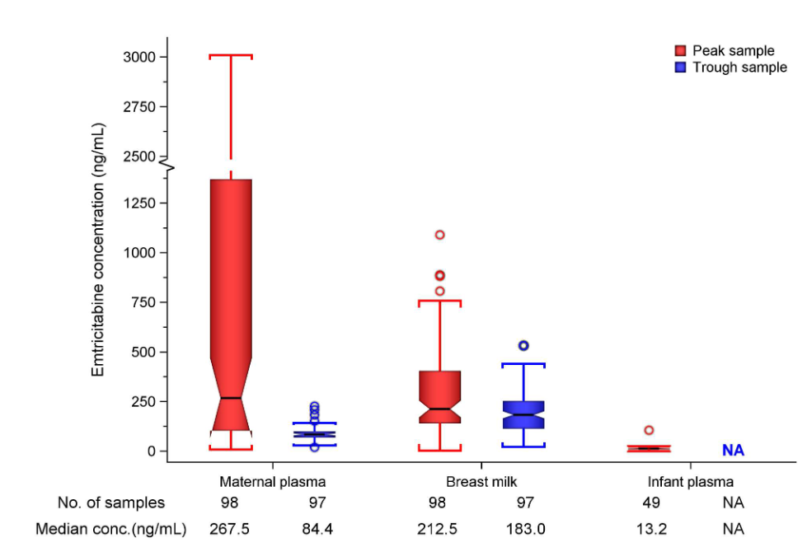
FTC concentration in breast milk and infant plasma
FTC detectable in 47 of 49 (96% ) of infant samples
Infant plasma concentration was 5% of breast milk concentration
FTC infant plasma concentration was 0.05% of pediatric therapeutic dose.
Mugwanya et al. PLOS Med. 2016

Slide 41
Transfer of Antiretrovirals into Breastmilk
Prospective Swiss Mother and Child HIV Cohort
21 WWH who elected to breast feed
Measured maternal and infant plasma and milk concentrations of ARVs
Aebi-Popp et al. J Antimicro Chemother. 2022

Slide 42
Transfer of Antiretrovirals into Breastmilk
ARV, frequency | Maternal Milk/Plasma Ratio | Median Infant Dose (mg/kg)
Raltegravir, daily | 0.96 | 0.02
Raltegravir, BID | 0.39 | 0.25
Bictegravir, daily | 0.01 | 0.01
Rilpivirine | 1.08 | 0.02
Darunavir + ritonavir, daily | 0.12 | 0.05
Tenofovir alafenamide, daily | 4.09 | 0.007
ARVs are minimally secreted in breast milk and infants are exposed to subtherapeutic doses

Slide 43
Emerging Commentary on Infant feeding strategies for Persons with HIV

Slide 44
Low HIV MTCT figures in low-resource settings, even if HIV-infected mothers do breastfeed, question whether a recommendation to abstain from breastfeeding in high-income countries is still justified.
Christian et al. Swiss Medical Weekly. 2018

Slide 45
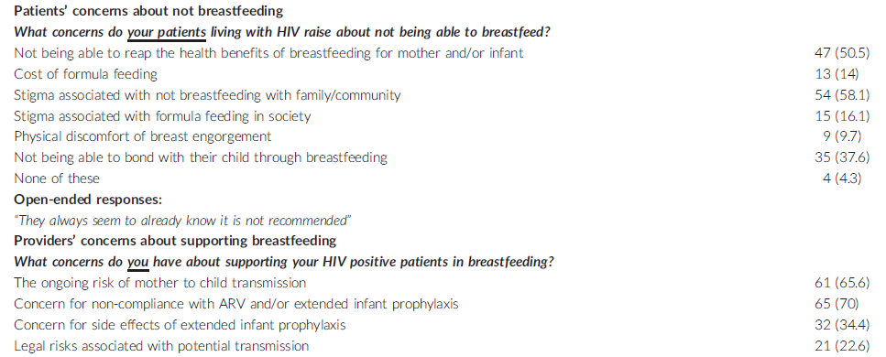
Provider Perspectives towards Infant Feeding in PWH
N, 93
Patient concerns
Provider concerns
Providers recognize that persons affected by HIV and medical providers have different perspectives on the safety of BF.
Tuthill et al. J Int AIDS Soc. 2019.

Slide 46
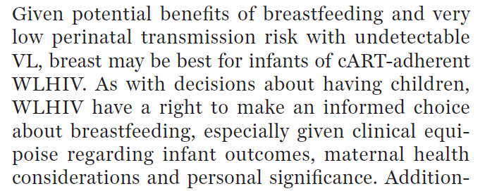
Gross et al. J of Law, Medicine & Ethics. 2019.

Slide 47
Proposed Additions to Current NIH Perinatal HIV Guidance
Women who desire to breastfeed and who are adherent to ART, undergo regular monitoring, and have undetectable HIV viral load have a choice to breastfeed.
Health professionals should be trained to identify WLHIV who can safely breastfeed based on their viral load status at birth and other clinical and social factors.
A risk profile and clinical tools should be developed to identify WLWH who are good candidates for breastfeeding.
WLHIV who choose to breastfeed should receive increased support and clinical monitoring, including consideration of more frequent viral load testing to insure HIV viral suppression.
WLHIV should be provided with counseling, clinical and social support, and home services that could enable them to safely breastfed their children.
Gostin and Kavanagh. J Law, Medicine & Ethics. 2019

Slide 48
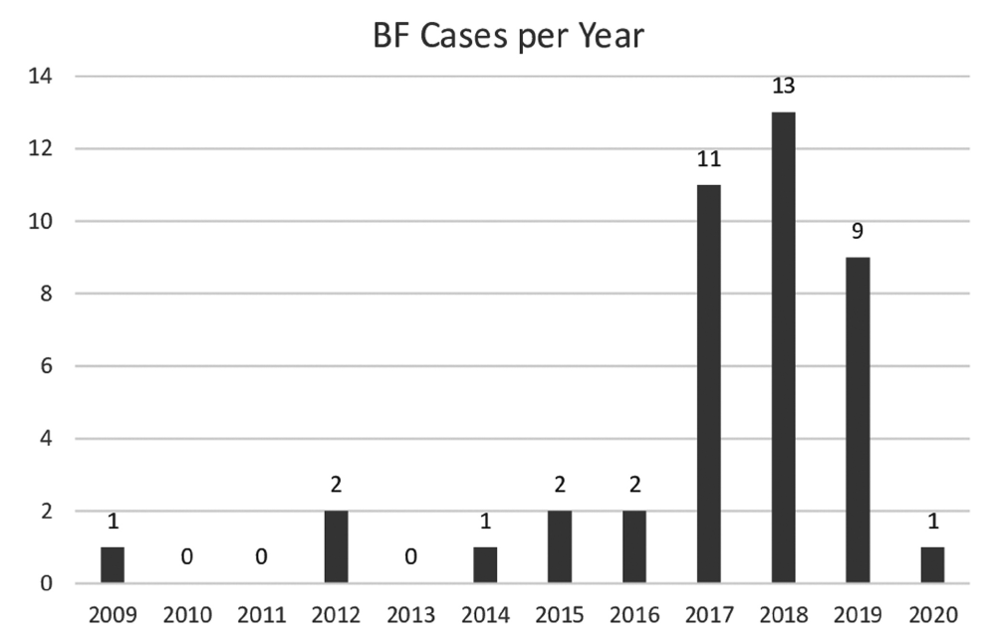
Breastfeeding among Women with HIV in Germany
2009-2020, retrospective cohort of women with HIV electing to breast feed (HELENE)
20 centers
63% of women born outside of Germany.
Increasing cases of maternal choice to BF against national recommendation to formula feed.
Clinicians should prepare to care for PWH who chose to breast feed.
Haberl et al. AIDS Patient Care and STDS. 2021.

Slide 49
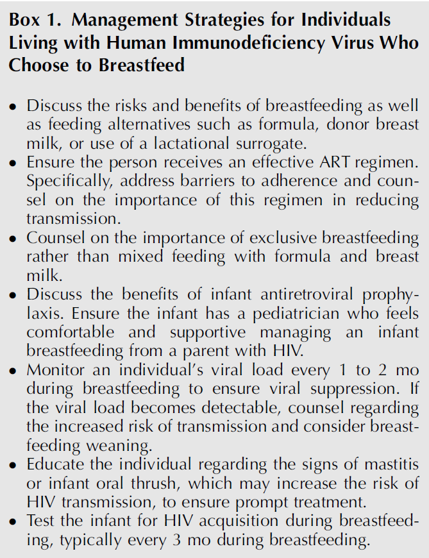
Recommendations for PWH who Elect to Breast Feed
Givens, Levison, and
Rahangdale.
Obstet Gynecol.
Clinical Expert Series.
2021.

Slide 50
Unanswered Clinical Questions
Which ARVs should be recommended in breast feeding PWH?
How should mothers be counselled to handle mastitis and ongoing breast feeding?
Should HIV RNA be measured in breast milk in addition to plasma?
Should extended infant prophylaxis be given in breast feeding infants when maternal HIV viral load is undetectable?
Waitt et al. Lancet HIV. 2018.

Slide 51
Revisions to the Current NIH guidelines for HIV-exposed infant feeding are expected 2023
https://clinicalinfo.hiv.gov/en/guidelines/perinatal/counseling-and-managing-individuals-with-hiv-united-states-who-desire-breastfeed?view=full

Slide 52
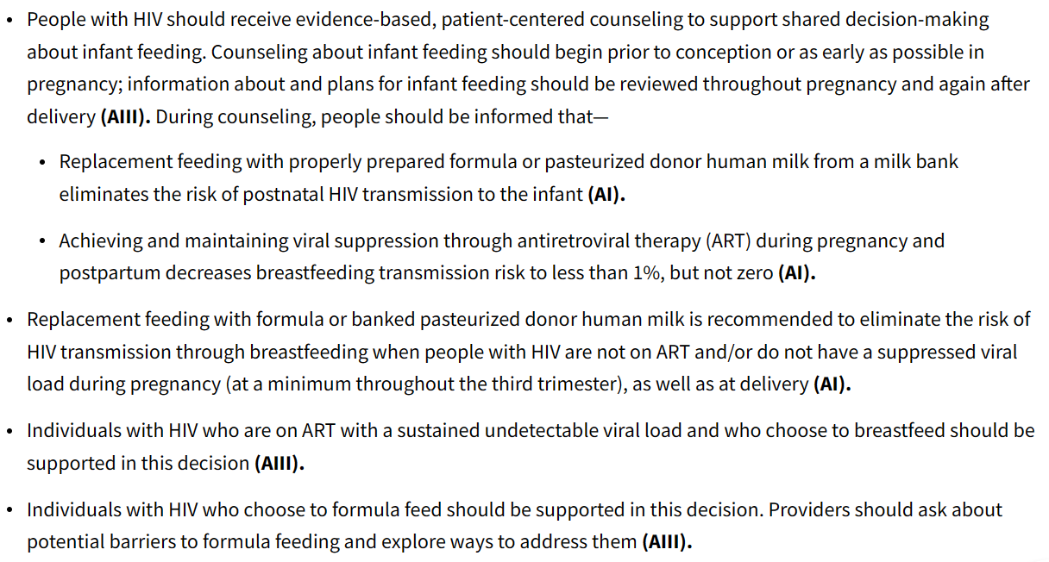
Summary of Recommendations for Infant Feeding

Slide 53
Conclusions
Prior to universal ART use in pregnancy, 1/3 of infant HIV infections were attributed to breast feeding.
When maternal ART or infant prophylaxis are used, the estimated risk of HIV transmission by breast feeding is 1-5%.
Maternal ART adherence and viral suppression during breast feeding are recommended to reduce the risk of HIV transmission.
Infant antiviral prophylaxis may provide some protection in addition to maternal ART.
Interdisciplinary care should be considered to support people with HIV who chose to breast feed and prevent infant HIV infection.

