Slide 1
HIV Medications 101
Louie Mar Gangcuangco, MD, MSc, AAHIVS
Assistant Professor of Medicine, Hawaii Center for AIDS
John A Burns School of Medicine, University of Hawaii at Manoa
Principal Investigator, Pacific AIDS Education & Training Center –
Hawaii and US-affiliated Pacific Islands
March 22, 2024

Slide 2
Disclaimer
The views and opinions expressed in this presentation are not necessarily those of the Pacific AIDS Education & Training Center (Pacific AETC) or its eight local partner sites in HRSA Region 9, the Regents of the University of California or its San Francisco campus (UCSF or collectively, University) nor of our funder the Health Resources and Services Administration (HRSA). Neither Pacific AETC, University, HRSA nor any of their officers, board members, agents, employees, students, or volunteers make any warranty, express or implied, including the warranties of merchantability and fitness for a particular purpose; nor assume any legal liability or responsibility for the accuracy, completeness or usefulness of information, product or process assessed or described; nor represent that its use would not infringe privately owned rights.
​
HRSA Acknowledgement Statement​ The Pacific AETC is supported by the Health Resources and Services Administration (HRSA) of the U.S. Department of Health and Human Services (HHS) as part of an award totaling $4,377,449. The contents are those of the author(s) and do not necessarily represent the official views of, nor an endorsement, by HRSA, HHS, or the U.S. Government. For more information, please visit HRSA.gov.
​
Trade Name Disclosure Statement​ Funding for this presentation was made possible by 5 U1OHA29292‐08‐00 from the Human Resources and Services Administration HIV/AIDS Bureau. The views expressed do not necessarily reflect the official policies of the Department of Health and Human Services nor does mention of trade names, commercial practices, or organizations imply endorsement by the U.S. Government. Any trade/brand names for products mentioned during this presentation are for training and identification purposes only.

Slide 3
Learning Objectives
At the completion of this presentation, participants will be able to:
List the initial laboratory tests needed in the work-up of a person with a reactive (positive) HIV antigen/antibody test
Discuss antiretroviral therapy options when initiating treatment for people with HIV
Identify best practices on how to strengthen linkage to care when providing services to people with HIV

Slide 4
Case:
A 40-year-old male presents to the clinic for a routine healthcare exam.
He has not seen a doctor in many years and decided that it’s time to take care of his health as part of his New Year’s resolution.
Asymptomatic. No acute complaints today.

Slide 5
Case: medical history
Past medical history: no known medical conditions
Past surgical history: appendectomy at 25 years old
Family history: hypertension and diabetes in father
Social history:
non-smoker
occasional alcohol, weekends, 2 to 3 drinks
unmarried, sex with females with inconsistent condom use, only 1 sexual partner in the past year
Works as an accountant

Slide 6
Case: physical exam
Vitals: BP 115/70 HR 65 RR 15 afebrile
BMI: 24.5 kg/m²
Unremarkable physical exam

Slide 7
What lab tests would you order? (1)

Slide 8
What lab tests would you order? (2)
Lipid panel: within normal limits
Metabolic profile: normal
CBC: normal
Hepatitis C: negative
HIV antigen/antibody test: positive
Notes:
Note: USPSTF recommendation on statin use : The USPSTF recommends that clinicians prescribe a statin for the primary prevention of CVD for adults aged 40 to 75 years who have 1 or more CVD risk factors (i.e. dyslipidemia, diabetes, hypertension, or smoking) and an estimated 10-year risk of a cardiovascular event of 10% or greater.

Slide 9
USPSTF Hepatitis C Screening Recommendation
Population | Recommendation | Grade
Adults aged 18 to 79 years | The USPSTF recommends screening for hepatitis C virus (HCV) infection in adults aged 18 to 79 years. | B
USPSTF. Final recommendation statement: hepatitis C screening. Available at https://www.uspreventiveservicestaskforce.org/uspstf/recommendation/hepatitis-c-screening Accessed December 17, 2023

Slide 10
USPSTF HIV Screening Recommendations*
Population | Recommendation | Grade
Pregnant persons | The USPSTF recommends that clinicians screen for HIV infection in all pregnant persons, including those who present in labor or at delivery whose HIV status is unknown. | A
Adolescents and adults aged 15 to 65 years | The USPSTF recommends that clinicians screen for HIV infection in adolescents and adults aged 15 to 65 years. Younger adolescents and older adults who are at increased risk of infection should also be screened. | A
*current as of December 2023; Topic is being updated.
USPSTF. Final recommendation statement on HIV Screening. Available at: https://www.uspreventiveservicestaskforce.org/uspstf/recommendation/human-immunodeficiency-virus-hiv-infection-screening Accessed December 17, 2023.

Slide 11
Human Immunodeficiency Virus (HIV)
HIV causes Acquired Immune Deficiency Syndrome (AIDS)
HIV attacks the immune system, making it difficult for the body to fight infections
Without treatment, People with HIV (PWH) will develop AIDS
Treatment greatly delays disease progression and prevents HIV transmission
Notes:
Starting with the basics
Here, you see an illustration of the Human Immunodeficiency Virus, HIV.
This is the virus that causes AIDS, the Acquired Immune Deficiency Syndrome. You might hear people use the term “Advanced HIV” because the term AIDS is being used less and less these days in medical settings.
Without treatment, HIV breaks down the immune systems and leaves it unable to fight infections.
With consistent treatment, however, someone newly diagnosed with HIV should expect to never be given an AIDS diagnosis nor even to transmit the virus to their sexual partners.
A really important teaching point to keep in mind when working with clients is that HIV and AIDS are not the same thing. HIV is the virus. AIDS is the disease state that happens over a number of years if HIV is left untreated. AIDS or Advanced HIV, is the a clinical definition of what happens when HIV goes untreated.
In my work, I find that it can give people a sense of control over their diagnosis as HIV+ to know that by taking medications to treat HIV, they are proactively keeping themselves healthy, keeping Advanced HIV at bay, and they are protecting their sex partners. My taking medications, they are taking action to keep themselves healthy…taking control and exerting their power over the diagnosis.
So, in respect to the question of why should someone get tested? Well, to know their status and if HIV-, take the proper steps to protect themselves from getting HIV such as taking PrEP, using condoms, or other prevention methods. And if HIV+, to engage in medical care and get on treatment to maintain their long-term health and protect their partners.

Slide 12
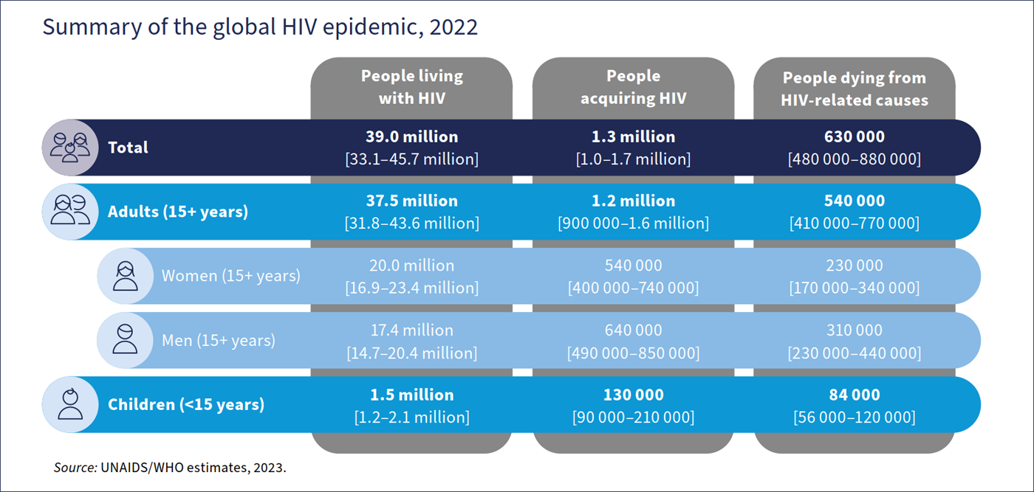
WHO HIV Epidemic 2023 estimates
World Health Organization. HIV data and statistics. Accessed Feb 19, 2024.

Slide 13
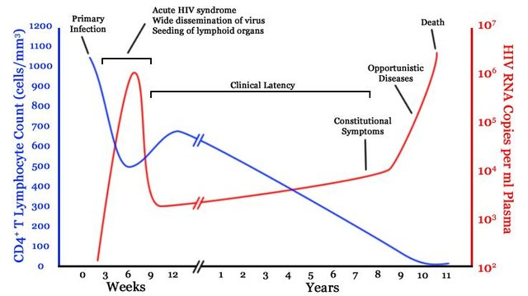
Natural History of untreated HIV infection
Popoola and Awodele. Afr. J. Med. med. Sci. (2016) 45, 5 - 21
Notes:
This is a figure presenting the natural history of untreated HIV infection. The blue line shows the level of CD4 T lymphocytes while the red line shows the HIV viral load. HIV is a virus that destroys the immune system, primarily infecting CD4 lymphocytes. During the first few years of HIV infection, the body is able to control the virus but after several years, the CD4 lymphocytes get depleted and viral load increases significantly. At this point, the patient would be susceptible to various bacterial, viral, and fungal infections.

Slide 14
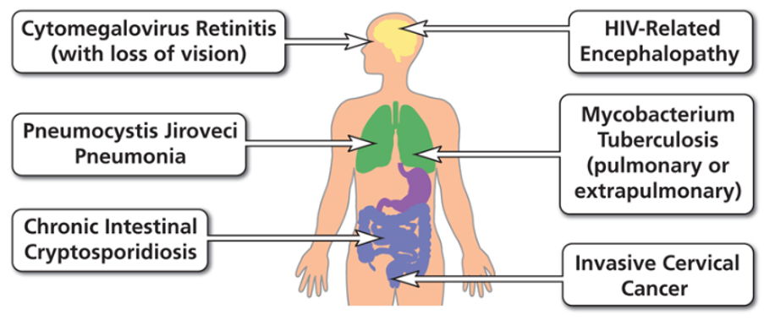
Examples of AIDS-Defining Conditions
https://aidsinfo.nih.gov/understanding-hiv-aids/glossary/784/aids-defining-condition

Slide 15
What lab tests would you order for the patient?

Slide 16
Initial work-up of a patient with HIV
HIV RNA: 100,000 copies/ml
T cell subset panel (CD4 count): 190 cells/mm^3
Baseline genotype and HIV resistance testing:
Subtype B, pansensitive
Hepatitis B serology: immune to Hep B
Tuberculosis screening: quantiferon negative
STI screening
Syphilis (RPR/VDRL)
Gonorrhea and chlamydia (triple site)
Metabolic panel (eGFR)
Special tests:
HLA-B*5701 if considering abacavir
Tropism assay if considering maraviroc
Consider dilated eye exam to screen for CMV retinitis
AIDS Panel on Antiretroviral Guidelines for Adults and Adolescents. Guidelines for the Use of Antiretroviral Agents in Adults and Adolescents with HIV. Department of Health and Human Services. Available at https://clinicalinfo.hiv.gov/en/guidelines/adult-and-adolescent-arv. Accessed December 2023
Notes:
US guidelines recommend genotype testing at human immunodeficiency virus (HIV) diagnosis (“baseline genotype”) to detect transmitted drug resistance (TDR) to nonnucleoside reverse transcriptase inhibitors (NNRTIs), nucleoside reverse transcriptase inhibitors (NRTIs), and protease inhibitors.

Slide 17
HIV Life Cycle
Notes:
This is a depiction of the HIV Life cycle from infection to the production of new virus. The cycle will be broken down into sections to describe the targets of HIV treatment.

Slide 18
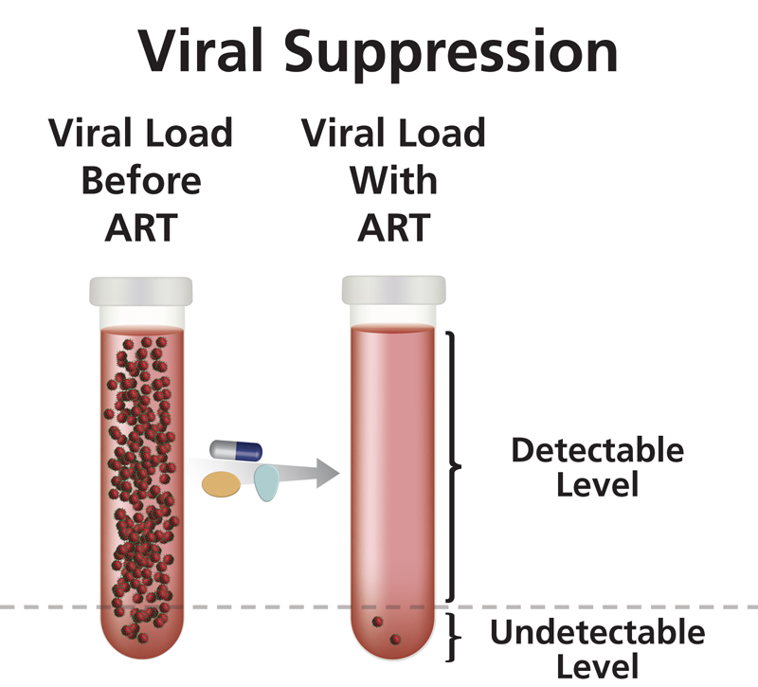
Antiretroviral Treatment (ART)
Clinical Goals
Reduce viral load as much as possible for as long as possible
Increase CD4 cell count
Ensure medication adherence to preserve ART options
Preserve quality of life
Reduce HIV transmission
https://clinicalinfo.hiv.gov/en/glossary/viral-suppression
U=U Undetectable = Untransmittable
Notes:
Once linked to care, medical clinicians will do a full panel of baseline labs and then start patients on Antiretroviral Treatment or ART with the clinical goals of:
Reducing HIV viral load to undetectable and keeping it that way
Increasing CD4 cell count and maintaining it in the normal range between 500 and 1600
Ensuring ART adherence on simple first line regimens such as one-pill-once-a-day meds
Preserving a patient’s quality of life
And reducing HIV transmission
Just to re-emphasize, a really empowering point for PWH is that when someone achieves an undetectable viral load and sustains it for longer than six months, research has shown that they cannot transmit HIV to their sexual partners.

Slide 19
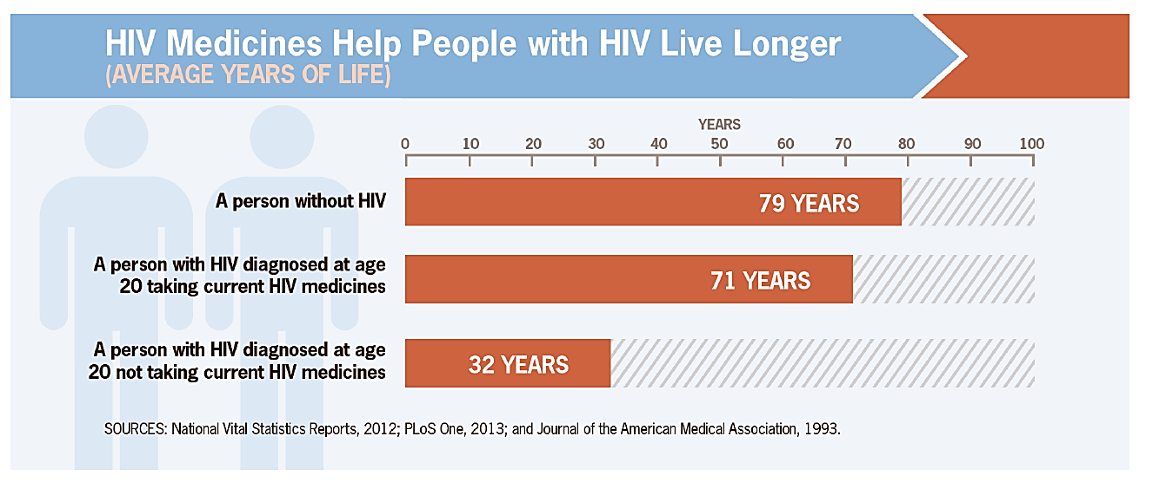
Effective Treatment Saves Lives
Infection is lifelong – HIV is treatable but not curable​

Slide 20
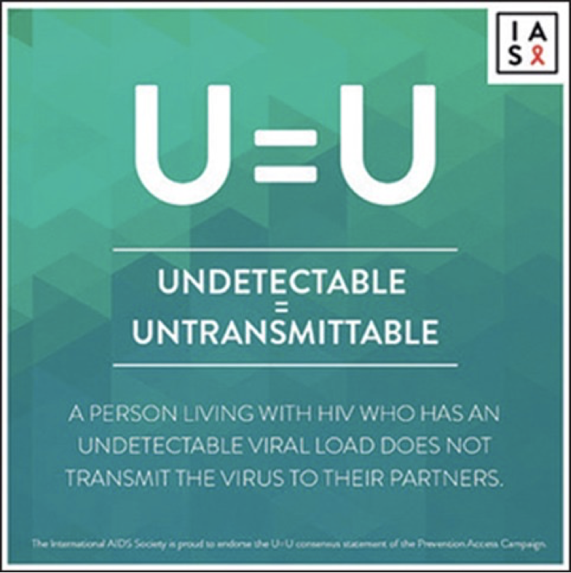
U=U and "Treatment as Prevention" has revolutionized HIV prevention and care
“HIV stigma is a public health crisis, and yet many people in positions of power are still sitting on their hands, overstating risk and not sharing this life changing information! We need people to move away from controlling people with HIV and toward trusting people with HIV.” (Bruce Richman, Prevention Access Campaign 2017)
Notes:
U=U and "Treatment as Prevention" has revolutionized HIV prevention and care

Slide 21
Key Concepts in HIV Antiretroviral Therapy [1]
Antiretroviral therapy (ART) is recommended for all persons with HIV to reduce morbidity and mortality and to prevent transmission to others
Initiate ART immediately (or as soon as possible) after HIV diagnosis to increase the uptake of ART and linkage to care, decrease the time to viral suppression, and to improve the rate of virologic suppression
When initiating ART, it is important to educate patients regarding the benefits of ART
AIDS Panel on Antiretroviral Guidelines for Adults and Adolescents. Guidelines for the Use of Antiretroviral Agents in Adults and Adolescents with HIV. Department of Health and Human Services. Available at https://clinicalinfo.hiv.gov/en/guidelines/adult-and-adolescent-arv. Accessed December 2023

Slide 22
Key Concepts in HIV Antiretroviral Therapy [2]
Medications from at least 2 different classes are combined to construct an antiretroviral regimen.
Never give only one medication as it promotes HIV resistance.
HIV drug resistance testing is recommended at entry into care for people with HIV to guide selection of antiretroviral regimen.
Treat all patients with hepatitis B.
Selection of a regimen should be individualized:
based on virologic efficacy, potential adverse effects, childbearing potential and use of effective contraception, pill burden, dosing frequency, drug–drug interaction potential, comorbid conditions, cost, access, and resistance-test results
AIDS Panel on Antiretroviral Guidelines for Adults and Adolescents. Guidelines for the Use of Antiretroviral Agents in Adults and Adolescents with HIV. Department of Health and Human Services. Available at https://clinicalinfo.hiv.gov/en/guidelines/adult-and-adolescent-arv. Accessed December 2023

Slide 23
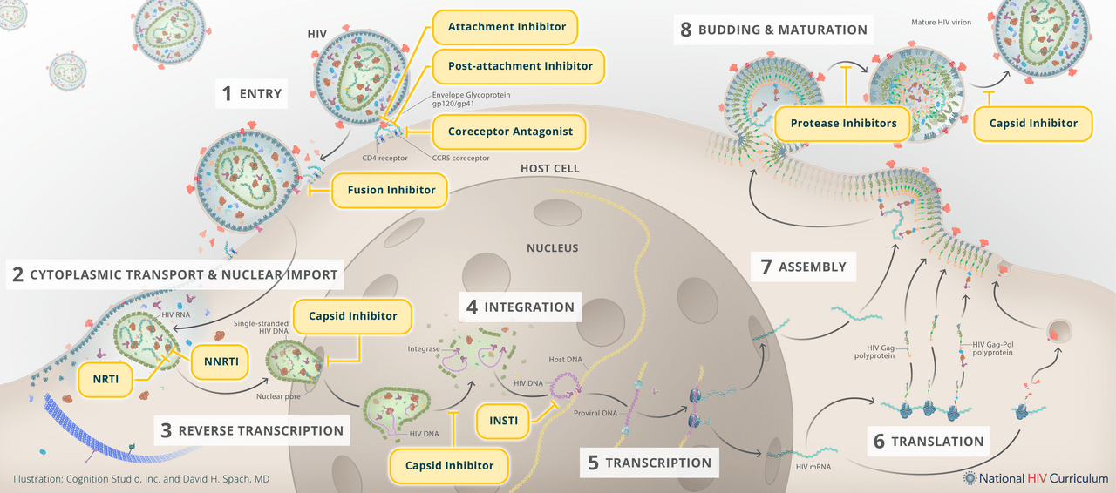
Site of Inhibitors of Viral Replication
Illustration: Cognition Studio, Inc. and David H. Spach, MD. Available at: https://www.hiv.uw.edu/go/antiretroviral-therapy/general-information/core-concept/all Accessed March 5, 2024.

Slide 24
Recommended Initial Regimens for Most People with HIV (in alphabetical order)
bictegravir/tenofovir alafenamide/emtricitabine (fixed-dose combination)
dolutegravir/abacavir/lamivudine (fixed-dose combination)
only for individuals who are HLA-B*5701 negative and without chronic hepatitis B virus (HBV) coinfection
dolutegravir + (tenofovir alafenamide or tenofovir disoproxil fumarate) + (emtricitabine or lamivudine)
dolutegravir/lamivudine (fixed-dose combination)
except for individuals with HIV RNA >500,000 copies/mL, HBV coinfection, or when ART is to be started before the results of HIV genotypic resistance testing for reverse transcriptase or HBV testing are available.
AIDS Panel on Antiretroviral Guidelines for Adults and Adolescents. Guidelines for the Use of Antiretroviral Agents in Adults and Adolescents with HIV. Department of Health and Human Services. Available at https://clinicalinfo.hiv.gov/en/guidelines/adult-and-adolescent-arv. Accessed December 2023
Notes:
Note: For people with a history of using cabotegravir as PrEP: INSTI genotypic resistance testing should be done before the start of ART. If treatment is begun prior to results of genotypic testing, the following regimen is recommended: Boosted darunavir plus (TAF or TDF) plus (FTC or 3TC) — pending the results of the genotype test (AIII)

Slide 25
Preferred Initial Regimens in Pregnancy who are Antiretroviral Naïve
Fixed dose combination: dolutegravir/abacavir/lamivudine
NOTE: only for HLA-B*5701 negative individuals
dolutegravir plus a preferred dual NRTI backbone:
TAF/FTC
TAF plus 3TC
TDF/FTC
TDF/3TC
Abbreviations: 3TC: lamivudine; FTC: emtricitabine; TAF: tenofovir alafenamide; TDF: tenofovir disoproxil fumarate
Other options may be appropriate
Panel on Treatment of HIV During Pregnancy and Prevention of Perinatal Transmission. Recommendations for the Use of Antiretroviral Drugs During Pregnancy and Interventions to Reduce Perinatal HIV Transmission in the United States. DHHS. Available at https://clinicalinfo.hiv.gov/en/guidelines/perinatal. Accessed Feb 26, 2024.

Slide 26
Common Antiretroviral Agents for HIV [1]
Antiretroviral | Drug Class | Key Concepts
Dolutegravir | INSTI | Coadministration with dofetilide is contraindicated
Bictegravir | INSTI | Fixed-dose combination: bictegravir/emtricitabine/TAF
Abacavir | NRTI | Only for HLA B5701 negative individuals
Emtricitabine | NRTI | Has hepatitis B coverage
Lamivudine | NRTI | Has hepatitis B coverage
Tenofovir disoproxil fumarate | NRTI | Tenofovir -- standard for hepatitis B treatment; may have renal and bone mineral density side effects
Tenofovir alafenamide | NRTI | Monitor cholesterol levels; potential weight gain and cholesterol elevations
Abbreviations: INSTI, integrase strand transfer inhibitor; NRTI: nucleoside reverse transcriptase inhibitors
AIDS Panel on Antiretroviral Guidelines for Adults and Adolescents. Guidelines for the Use of Antiretroviral Agents in Adults and Adolescents with HIV. Department of Health and Human Services. Available at https://clinicalinfo.hiv.gov/en/guidelines/adult-and-adolescent-arv. Accessed December 2023

Slide 27
Common Antiretroviral Agents for HIV [2]
Antiretroviral | Drug Class | Key Concepts
Darunavir | Protease inhibitor | For people with INSTI genotype resistance and for those who have HIV with history of cabotegravir for PrEP
Ritonavir | Protease inhibitor | Check for potential drug interactions: sedative hypnotics, antiarrhythmics, or ergot alkaloid preparations may result in potentially serious and/or life-threatening adverse events
Cobicistat | Pharmacokinetic booster | Check for potential drug interactions
Antiretroviral | Drug Class | Key Concepts
Cabotegravir | INSTI | Available as long-acting injectable
Rilpivirine | NNRTI | Available as long-acting injectable
AIDS Panel on Antiretroviral Guidelines for Adults and Adolescents. Guidelines for the Use of Antiretroviral Agents in Adults and Adolescents with HIV. Department of Health and Human Services. Available at https://clinicalinfo.hiv.gov/en/guidelines/adult-and-adolescent-arv. Accessed December 2023

Slide 28
The 95-95-95 Targets to end the HIV Epidemic
Image from: CIMSA Universitas Gadjah Mahda
Notes:
In December 2020, UNAIDS released a new set of ambitious targets calling for 95% of all people with HIV to know their HIV status, 95% of all people with diagnosed HIV infection to receive sustained antiretroviral therapy, and 95% of all people receiving antiretroviral therapy to have viral suppression by 2025

Slide 29
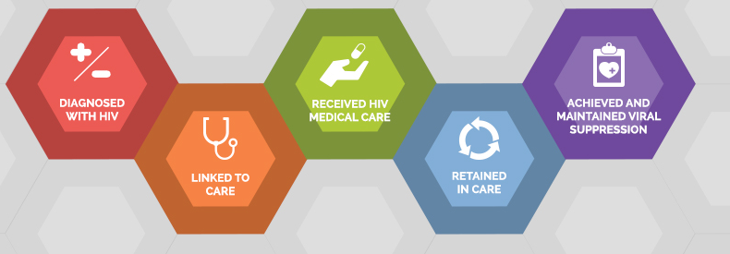
The HIV Care Continuum
The HIV care continuum is a public health model that outlines the steps or stages that people with HIV go through from diagnosis to achieving and maintaining viral suppression
U.S. DHHS https://www.hiv.gov/federal-response/policies-issues/hiv-aids-care-continuum/ Accessed May 2023

Slide 30
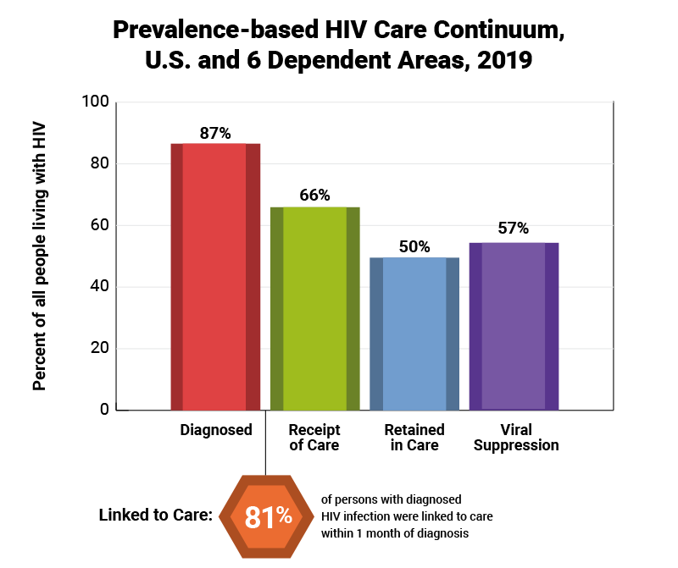
US HIV Care Continuum, 2019
U.S. DHHS https://www.hiv.gov/federal-response/policies-issues/hiv-aids-care-continuum/ Accessed May 2023
Notes:
This graphic is from HIV.gov and you can find in depth information about the HIV Care Continuum, also known as the Treatment Cascade, on that website
Basically, this is an overview of the engagement in testing, care and treatment by PLWH in the US
We start with 86% knowing that they are HIV+
After diagnosis, 78% are then linked to care
64% actually receive care
49% meet the clinical definition of being retained in care (CDC says: two or more CD4 or viral load tests, performed at least three months apart)
and 53% are virally suppressed, or undetectable
Frontline workers play a vital role in helping to improve this treatment cascade and as you can see, there is a lot of work to be done to ensure that PLWH in the US get tested, engaged in care and stay healthy. It all starts with the very important step of linking someone to care after they are diagnosed

Slide 31
Rapid ART Guidelines
Panel on Antiretroviral Guidelines for Adults and Adolescents [1]
Initiate ART immediately (or as soon as possible) after HIV diagnosis in order to:
increase the uptake of ART and linkage to care
decrease the time to viral suppression for individual patients
and improve the rate of virologic suppression among persons with HIV.
World Health Organization [2]
Rapid ART initiation should be offered to all people with HIV following a confirmed HIV diagnosis and clinical assessment.
Rapid initiation is defined as within 7 days from the day of HIV diagnosis; people with advanced HIV disease should be given priority for assessment and initiation.
Clinical Info HIV.gov Available at HIVinfo.NIH.gov Accessed May 2023.
World Health Organization. Consolidated guidelines on HIV prevention, testing, treatment, service delivery and monitoring: recommendations for a public health approach. July 2021.

Slide 32
Rapid ART: Published Studies
 | Design | Outcomes
Rapid initiation of Treatment (RapIT) (Sub-Saharan Africa, 2016) | Unblinded RCT: standard of care vs rapid initiation | Viral suppression at 10 months: 51% vs 64%
Same-Day HIV testing with Initiation of ART (Haiti, 2017) | Unblinded RCT: standard group (3 weeks after HIV testing) vs Same Day ART | Viral suppression and retained in care at 12 months: 44% vs 53%
CASCADE (Lesotho, Africa, 2018) | Multicenter open-label RCT: standard vs same-day ART | Linkage to care with 3 months: 43.1% vs 68.6% Viral suppression at 12 months: 34.3% vs 50.4%
DIAMOND (2019, USA) | Open-label, single-arm, multicenter where 1st dose of rapid ART received within 24 hours | Viral suppression at 48 weeks: 84%
Michienzi SM. Curr Infect Dis Rep . 2021;23(5):7.

Slide 33
Starting Rapid ART without baseline HIV lab results: pre-specified ART regimens
ARVs for RAPID
High genetic barrier to resistance
Potent at high viral load
Simple, tolerable, easy to take
Available through patient’s insurance
Do not use
2-drug regimens (risk of monotherapy)
Abacavir (requires HLA B5701 testing)
NNRTIs (transmitted resistance)
*Can change ARVs, if indicated, after genotype, other results available
Abbreviations: cobi: cobicistat; FTC: emtricitabine; TAF: tenofovir alafenamide
Preferred (alphabetical order):
Bictegravir/TAF/FTC
Dolutegravir + TAF/FTC
Darunavir/cobi/TAF/FTC
Other options possible
*Important to have options for pregnant persons

Slide 34
Rapid ART – timing and precautions
NOT indicated for persons with certain untreated opportunistic infections (OIs)— e.g., the CNS infections cryptococcal or TB meningitis; begin OI treatment before starting ART [1].
ART initiated as soon as possible within 2 weeks of initiating TB treatment, regardless of CD4 count, except when signs and symptoms of meningitis are present [2].
Immediate ART is not recommended for cryptococcal meningitis... ART should be deferred by 4 to 6 weeks from the initiation of antifungal treatment [2].
ART initiated as soon as possible within 2 weeks of initiating TB treatment, regardless of CD4 count, except when signs and symptoms of meningitis are present [2].
AIDS Education and Training Center Program. January 2023. AIDSETC.org Accessed May 2023
World Health Organization. Consolidated guidelines on HIV prevention, testing, treatment, service delivery and monitoring: recommendations for a public health approach. July 2021.

Slide 35
Offer Antiretroviral Therapy
If patient agrees and there are no contraindications, prescribe 30-day supply, give starter pack if available
If patient declines immediate ART, follow up within 1-2 weeks, re-offer ART, continue HIV education
Coffey S and Bacon O. Immediate ART Initiation & Restart: Guide for Clinicians. Available at AIDSETC.org Accessed Feb 19, 2024

Slide 36
Monitoring Lab Tests when treating HIV
Complete Blood Count
Neutrophils
Hemoglobin
Platelet
Comprehensive Metabolic Profile
Kidney function: creatinine/estimated glomerular filtration rate
Liver tests: AST/ALT
HIV RNA (viral load)
T cell subset panel (CD4 count)
ClinicalInfo.HIV.Gov Guidelines for the Use of Antiretroviral Agents in Adults and Adolescents with HIV. Accessed Feb 19, 2024

Slide 37
Monitoring CD4 and HIV RNA [1]
Clinical Scenario | Viral Load Monitoring | CD4 Count Monitoring
After initiating ART | Preferably within 4 to 8 weeks after initiation of ART; thereafter, every 4 to 8 weeks until viral load is suppressed. | 3 months after initiation of ART
After modifying ART because of virologic failure | Preferably within 4 to 8 weeks after modification; thereafter, every 4 to 8 weeks until viral load is suppressed. If viral suppression is not possible, repeat viral load testing every 3 months or more frequently if indicated. | Every 3 to 6 months
During the first 2 years of ART | Every 3 months | Every 3 months if CD4 <300 cells/mm3 Every 6 months if CD4 ≥300 cells/mm3
ClinicalInfo.HIV.Gov Guidelines for the Use of Antiretroviral Agents in Adults and Adolescents with HIV. Accessed Feb 19, 2024

Slide 38
Monitoring CD4 and HIV RNA [2]
Clinical Scenario | Viral Load Monitoring | CD4 Count Monitoring
After 2 years of ART (VL consistently suppressed, CD4 remains <300 cells/mm3) | Can extend to every 6 months for patients with consistent viral suppression for ≥2 years | Every 6 months
After 2 years of ART (VL consistently suppressed, CD4 consistently 300‍–‍500 cells/mm3) | Can extend to every 6 months for patients with consistent viral suppression for ≥2 years (AIII). | Every 12 months
After 2 years of ART (VL consistently suppressed, CD4 consistently >500 cells/mm3) | Can extend to every 6 months for patients with consistent viral suppression for ≥2 years (AIII). | Optional
While on ART with detectable viremia (VL repeatedly >200 copies/mL) | Every 3 months (AIII) or more frequently if clinically indicated | Every 3 to 6 months
ClinicalInfo.HIV.Gov Guidelines for the Use of Antiretroviral Agents in Adults and Adolescents with HIV. Accessed Feb 19, 2024

Slide 39
Pneumocystis prophylaxis for CD4<200 cells/mm³
Trimethoprim-sulfamethoxazole (cotrimoxazole)
Preferred Dose: 1 double strength tablet daily
Alternatives:
Dapsone
Atovaquone
AIDS Panel on Antiretroviral Guidelines for Adults and Adolescents. Guidelines for the Use of Antiretroviral Agents in Adults and Adolescents with HIV. Department of Health and Human Services. Available at https://clinicalinfo.hiv.gov/en/guidelines/adult-and-adolescent-arv. Accessed December 2023

Slide 40
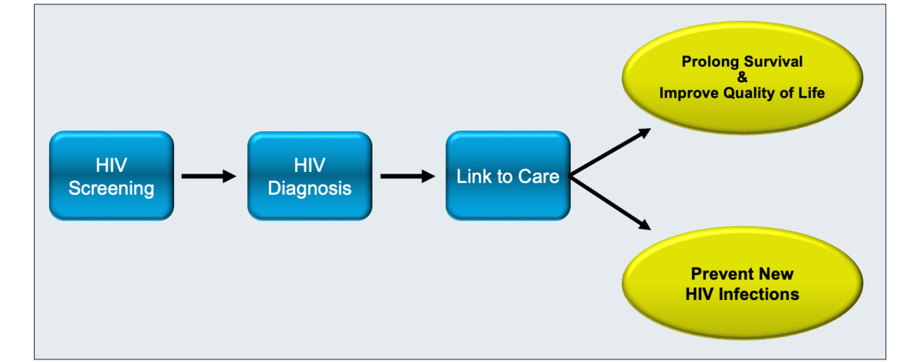
Linkage to HIV Care: Main Goals
Budak JZ. Linkage to HIV Care. Available from the National HIV Curriculum (online). Accessed Feb 19, 2024

Slide 41
Delayed Linkage to Care: Key Factors
substance use
lack of medical insurance
lack of access to primary care prior to HIV diagnosis
residence in a high-poverty area
Budak JZ. Linkage to HIV Care. Available from the National HIV Curriculum (online). Accessed Feb 19, 2024

Slide 42
Linkage to Care: Expert Panel Recommendations
For persons newly diagnosed with HIV, immediately refer to HIV care
Use case managers and patient navigators to assist in this process
Proactively engage persons who miss their initial clinic appointments, including provision of intensive outreach for those not engaged in care within 1 month of a new HIV diagnosis,
Use of case management to engage persons lost to follow-up
Provide transportation support for persons with HIV to attend their clinic visit
Budak JZ. Linkage to HIV Care. Available from the National HIV Curriculum (online). Accessed Feb 19, 2024

Slide 43
Strategies to Improve Linkage to Care
Strengths-based case management
asking individuals to identify their internal strengths and skills in order to attain needed resources such as medical coverage, transportation to appointments, housing, mental health treatment, or addiction treatment.
Intensive Outreach
Patient Navigators
HIV Partner Services
Financial Incentives
Studied as a component of HPTN-065 (“TLC-Plus”), a feasibility study evaluating an enhanced testing, linkage to care, and treatment strategy in the United States.
Results from the viral suppression component of the study indicated that most individuals with HIV found the use of financial incentives to be acceptable and helpful
Budak JZ. Linkage to HIV Care. Available from the National HIV Curriculum (online). Accessed Feb 19, 2024
Notes:
SHORTEN WAIT TIMES FOR INITIAL APPOINTMENT
Very short wait times for new patient visits may increase the likelihood of appointment completion. In a study at the University of Alabama at Birmingham (UAB) 1917 Clinic, among patients who called to establish HIV care from 2004 to 2006, 31% failed to attend a clinic visit within 6 months of their initial call.^{[46]} To address this problem, the UAB 1917 Clinic launched Project CONNECT (Client-Oriented New Patient Navigation to Encourage Connection to Treatment), which established a clinic standard of scheduling an intake and orientation appointment for all new patients within 5 days of an initial request for a new appointment.^{[47]} The orientation visit includes an intake questionnaire, baseline laboratory testing, case manager visit, initiation of opportunistic infection prophylactic medication if needed, and referrals to services for mental health and substance-use disorders, when indicated.^{[47]} The initial visit no-show rate decreased from 31% at baseline to 19% after the implementation of Project CONNECT.^{[47]}
FOLLOW-UP AFTER MISSED INITIAL APPOINTMENT
Calling or otherwise conducting outreach to follow up with patients who do not show up for their first scheduled HIV care visit should ideally be part of an HIV clinic protocol. Certain patient characteristics have been associated with higher “no-show” rates, including minority race/ethnicity (especially minority women) and having public health insurance or no health insurance.^{[47]} Specific strategies, such as improving the initial clinic orientation process, implementing reminder phone calls, using peer navigators, and accompanying patients to medical appointments should be implemented at the clinic level to engage populations at risk for higher no-show rates.^{[48]}

Slide 44
Rapid ART follow-up
Scheduling a phone check-in with a social worker, nurse, or clinician 2-3 days after the intake appointment
Clinic follow-up appointment at 1-2 weeks.
The timing of subsequent visits will depend on the needs of the patient (~within 1 month of the start of ART)
Image from MedOne Urgent Care
AIDS Education and Training Center Program. January 2023. AIDSETC.org Accessed May 2023

Slide 45
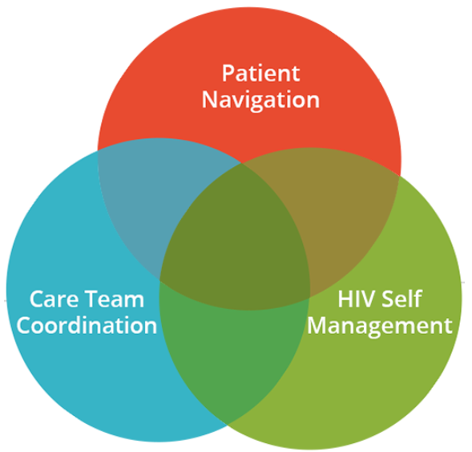
Key Facilitators of RAPID Intervention
Same-day appointments
Flexible provider scheduling
ART-regimen pre-approval prior to genotyping or lab testing
Availability of ART starter packs
Patient navigation
Accelerated process for health insurance initiation
Observation of first ART dose in clinic
Facilitate sustained access to ART
Image from CDC.gov
Colasanti J. Innovative Programs to End the HIV epidemic: ART Rapid Start. SEATEC Webinar. Jan 2020. Available at www.seaetc.com

Slide 46
Barriers to Rapid ART Implementation
Structural/systemic
HIV testing/diagnosis occurs off-site
Access to medications/insurance
Scheduling and provider availability
Provider/staff beliefs
"That's how we have always done it"
Preparatory lab results must be known (ie, creatinine, hepatitis B and C serology, genotype)
Latent TB infection screening must be performed first
Patients' attitudes and beliefs
Patient's psychosocial comorbidities
Unstable housing, food insecurity, mental illness, substance abuse
Colasanti J. Innovative Programs to End the HIV epidemic: ART Rapid Start. SEATEC Webinar. Jan 2020. Available at www.seaetc.com

Slide 47
Summary
Initial lab work-up of people with HIV includes: HIV viral load, baseline genotype, T cell subset panel, metabolic panel, CBC, hepatitis serology, tuberculosis and STI screening
Initial treatment of HIV for most individuals consists of combination antiretroviral therapy with an integrase inhibitor plus at least one other antiviral that belong to a different HIV drug class
Improving the care cascade includes initiation of rapid start of antiretroviral therapy, strengths-based case management, intensive outreach, patient navigators, and HIV partner services.

Slide 48
Questions?
Presenter: Louie Mar Gangcuangco, MD
louiemag@hawaii.edu

