Slide 1
Inpatient to Outpatient Transitions of Care and formation of a dedicated “Hospital Discharge Clinic”
Robert Deiss, MD (he/him/his)
Assistant Professor, Division of Infectious Diseases and Global Health
University of California, San Diego
March 14, 2024

Slide 2
Disclaimer
The views and opinions expressed in this presentation are not necessarily those of the Pacific AIDS Education & Training Center (Pacific AETC) or its eight local partner sites in HRSA Region 9, the Regents of the University of California or its San Francisco campus (UCSF or collectively, University) nor of our funder the Health Resources and Services Administration(HRSA). Neither Pacific AETC, University, HRSA nor any of their officers, board members, agents, employees, students or volunteers make any warranty, express or implied, including the warranties of merchantability and fitness for a particular purpose; nor assume any legal liability or responsibility for the accuracy, completeness or usefulness of information, product or process assessed or described; nor represent that its use would not infringe privately owned rights.
HRSA Acknowledgement Statement
The Pacific AETC is supported by the Health Resources and Services Administration (HRSA) of the U.S. Department of Health and Human Services (HHS) as part of an award totaling $3,887,700.00. The contents are those of the author(s) and do not necessarily represent the official views of, nor an endorsement, by HRSA, HHS, or the U.S. Government. For more information, please visit HRSA.gov.
Trade Name Disclosure Statement
Funding for this presentation was made possible by 5 U1OHA29292‐08‐00 from the Human Resources and Services Administration HIV/AIDS Bureau. The views expressed do not necessarily reflect the official policies of the Department of Health and Human Services nor does mention of trade names, commercial practices, or organizations imply endorsement by the U.S. Government. Any trade/brand names for products mentioned during this presentation are for training and identification purposes only.

Slide 3
Disclosures
All presenters of this continuing medical education activity have indicated that neither they nor their spouse/legally recognized domestic partner has any financial relationships with commercial interests related to the content of this activity.

Slide 4
Learning Objectives
Explain the rationale for post-hospitalization clinics as a dedicated transitions of care model for PWH
Apply best practices, such as the use of multidisciplinary teams, in discharge planning to develop a comprehensive and patient-centered approach for transitioning individuals with HIV to outpatient care
Identify factors associated with inpatient re-admission and retention in care among recently hospitalized PWH

Slide 5
Polling Question #1
Does your institution have a transitions of care (TOC) program, bridging inpatient to outpatient care, for PWH?
Yes – specifically for PWH
Yes – inclusive of PWH
No – no such program exists
N/A

Slide 6
Outline
Brief Literature Review (TOC)
UC San Diego HIV Transitions of Care Program
  Discharge Clinic
A Few Cases
UC San Diego Owen Clinic Experience/Outcomes
Discussion

Slide 7
LITERATURE REVIEW

Slide 8
Common Themes
Hospital readmissions a common outcome of interest
Post-discharge adverse events
Post-hospital follow-up rates
Knowledge gap: Outpatient follow-up among hospitalized PWH
  A unique form of linkage-to-care on its own continuum
Early readmissions don’t always tell the full story, particularly among select populations such as PLWH
  Sometimes expected (IRIS, severe illness)
  Lack of readmission may portend lack of overall follow-up

Slide 9
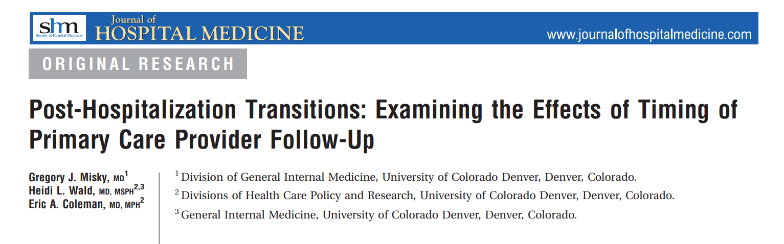
G. Miskey, et al. Journal of Hospital Medicine

Slide 10
University of Colorado, 2010
Cohort of 65 patients admitted to university hospital
Rate of “timely PCP follow-up” 49%
Patients lacking timely follow-up were 10x more likely (p = 0.04) to be readmitted for same medical condition
  Index hospital length-of-stay also longer (6.3 vs 4.4 days, p = 0.11)
Lack of insurance associated with lower rates of timely PCP follow-up
  29% vs 56%, p = 0.06

Slide 11
North Carolina Medicaid Claims, 2013
Effect of early follow-up on 30-day hospital readmissions
14-day follow-up
Low-risk patients: 1.5% risk reduction
High-risk patients: 19.1% risk reduction
“Most patients do not meaningfully benefit from early outpatient follow-up. Transitional care resources would be best allocated toward ensuring that highest risk patients receive follow-up within 7 days.”
Jackson et al, Ann Fam Med 2015;13:115-122.

Slide 12
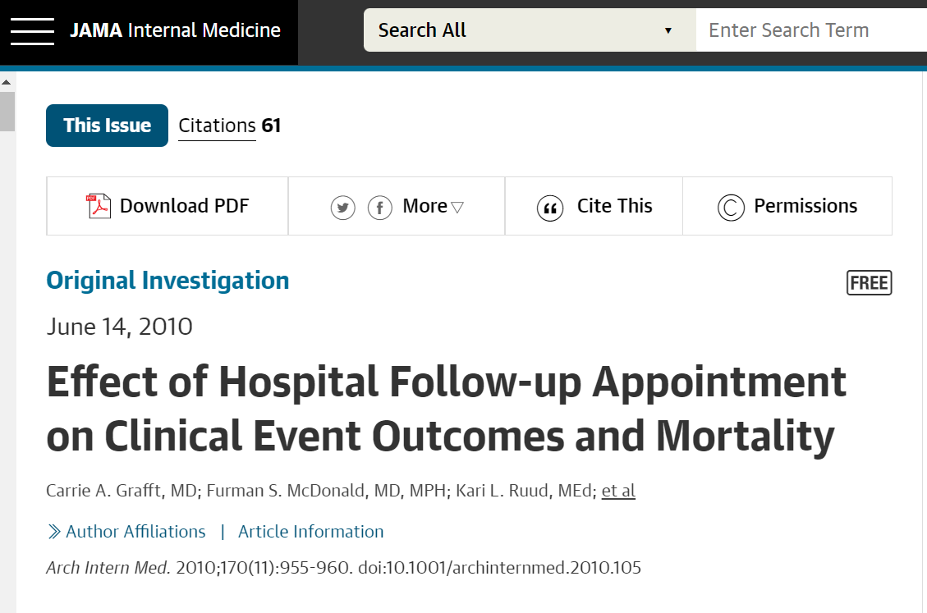
Mayo Clinic (Rochester MN)
No difference in hospital readmission between patients with and without primary care follow-up
However, those with follow-up appointment were more likely to have an adverse event or readmission within 180 days
  Sicker population?

Slide 13
HIV-related Transitions
UT Southwestern multidisciplinary consult team (HIV specialist, case manager, transitional care nurse)
  Analysis of care cascade before and after establishment of consult team
    Engagement in care, retention in care and virologic suppression before and after hospitalization all significantly improved
  Hospital re-admissions reduced over 4-year period (aOR 0.81 (95% CI 0.66–0.99, p= 0.04)
    Age, homelessness, Medicaid insurance, HIV viral load, abnormal labs (absolute lymphocytes, AST/ALT, HCT), length of stay and prior ED and inpatient visits were associated with readmissions.
Nijhawan A et al. AIDS Care. 2020; 32: 1343-1352
Nijhawan AE et al. J Acquir Immune Defic Syndr. 2022; 90: 161-169.

Slide 14
Summary
Literature is mixed, but in many settings, early hospital follow-up can be associated with reduction in hospital readmissions, particularly for high-risk populations including PWH

Slide 15
UCSD owen clinic Transitions Program

Slide 16
Transitions of Care - History
2013: Birth of UCSD’s HIV TOC Program
Primary goal: Linkage to outpatient HIV care
  Regular visits
  ARV access/administration
  Viral suppression (U=U)
  Improved health outcomes
Additional goals:
  HIV patient education
  Identify barriers to regular care and/or medication administration
  Healthcare system navigation
  Linkage to support to make engagement attainable (ex. Mental health, MAT)
  Provide consistency and build rapport
  Public health considerations

Slide 17
Transitions of Care - Activities
Daily review of hospital ER/inpatient population
  HIV diagnosis
  ARVs on MAR
Daily inpatient rounds to assess patient needs
  Owen inpatient team: formal consults
  Independent or TOC PharmD: non-consult patients
Multidisciplinary collaboration for admission & discharge needs
Healthcare navigation and resource connection
Networking and hand-offs to outside care facilities
Sign-out for Owen’s Discharge Clinic
Post-discharge contact with high-risk patients and SNFs
Assistance with Owen OPAT management
Notes:
Inpatient population: auto-populate using HIV dx and/or ARVs. Occasional “false” additions (ex. PEP, PrEP, HBV, HCV)
Patient needs assessment: current health + linkage, h/o outpatient care/treatment, barriers to care, readmission risk, insurance coverage
Multidisciplinary collaboration: communication with medicine teams for recommended labs / orders / treatment & patient advocacy, communication with inpt SW & CM for dispo planning – SNF vs Home +/- HH, placement, DMEs, etc
Healthcare navigation: usually “red tape” or hoops we need to jump prior to establishing care
Resource connection: SW team for urgent needs (food, housing – EARP), referral/networking with HIV case management programs and community support (Being Alive, The LGBT Center…), facilitate initial visit with HIV clinic of choice OR with assigned PCP to start referral/auth process, set-up with financial help (MCAL enrollment, ADAP enroll/renew, hospital charity, HMO changes)

Slide 18
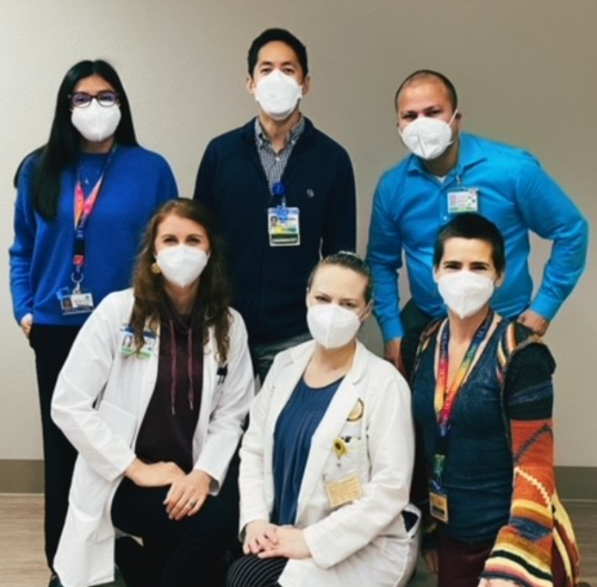
Transitions of Care Team
Nurse Practitioner (TOC Specialist)
Inpatient and Clinic (Retro) Pharmacy teams
Patient Navigator
Behavioral Health Counselor
Clinic Social Worker
Attending Owen Clinic M.D.
Owen Discharge Clinic M.D.

Slide 19
Most common indications for discharge visit
Complicated illness needing close follow-up
Complex medical or social needs
Newly diagnosed patient establishing care
Out-of-care patient re-establishing care
OPAT/IV Antibiotic
Unable to obtain timely follow-up with established PCP

Slide 20
The Discharge visit
Warm handoff from TOC Nurse Practitioner summarizing hospital course and items to be addressed at visit
  Delegation to multidisciplinary team members
  Pending diagnostic tests
Pharmacy visit
  Medication reconciliation/review/access
  History-taking
  PCP assignment (if needed)
M.D. appointment
Involvement of multidisciplinary team where appropriate
  Housing assistance
  Substance use counseling
  Transportation
  Insurance authorizations

Slide 21
Factors which facilitate the discharge visit
Extensive counseling during admission & at time of discharge
Reminder calls/MyChart messages when possible
Transportation
  (Lyft rides for patients lacking transport)
  Coordination with SNF/insurance
Addressing insurance barriers
Flexibility in scheduling
Anticipation of confirmed/potential visit needs
Notes:
Anticipation: as a way to prepare and conduct a smooth & efficient visit – referrals & outreach to case management agencies, form(s) completion or start, team member “heads up” for time-sensitive processes (ex. EARP hotel, ADAP deadline, etc), networking to obtain answers to questions that arose during admission (funding is common), outstanding specialty care f/u not yet scheduled

Slide 22
A FEW CASES

Slide 23
Case #1: (New diagnosis)
30 y/o M admitted with severe PJP PNA, syphilis, bloody diarrhea. Hospital course notable for slow improvement, ongoing diarrhea but pt otherwise stable for discharge.
  Colonoscopy initial report: No colitis identified
In the warm handoff, NP summarizes final pathology report, addended with a finding of “rare viral inclusion on CMV stain”.
  Primary team/consultants had not been notified.
At the time of his visit, pt reports significant improvement in prior constitutional symptoms but notes ongoing diarrhea
Provided with Valganciclovir and symptoms resolve within several days
Patient remains in care at 9 months: Viral load <20

Slide 24
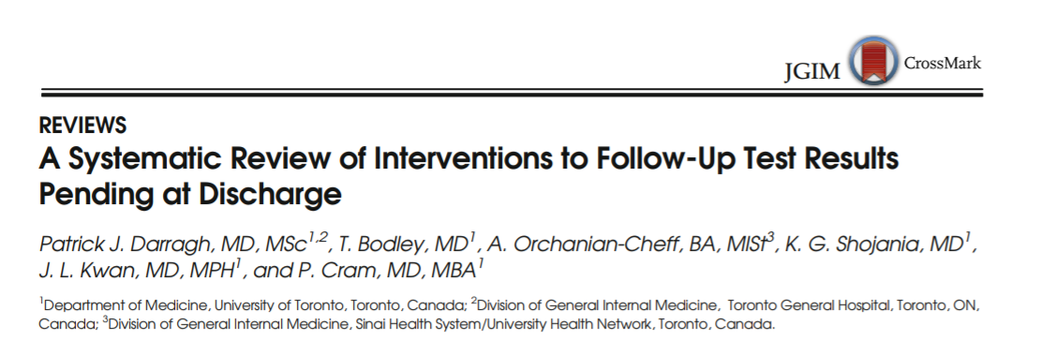
“Tests Pending at Discharge”

Slide 25
Case 2: “Routine Visit”
49 y/o M with Stage 5 CKD, HTN who is following up on recent admission for volume overload. Also, PD catheter placed 2 days prior as an outpatient.
At his visit, pt complains of abdominal pain and generalized weakness – using a cane for ambulation which is atypical.
Exam notable for BP of 220/132 and diffuse abdominal tenderness.
Pt referred to emergency department for further evaluation/treatment.

Slide 26
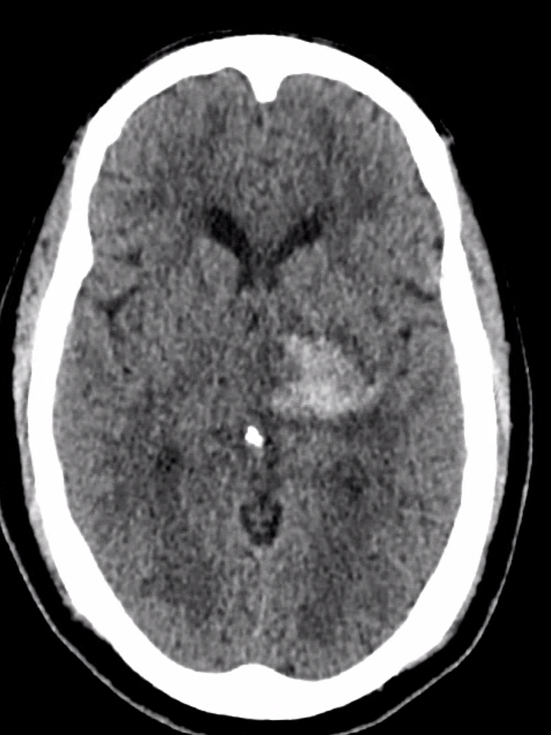
Case 2 (cont’d)
One hour after arrival, is found to be unresponsive with facial droop. Diagnosed with hemorrhagic stroke. Hospitalized for one month.
Six months later, slowly recovering neurologic function

Slide 27
Case #3: (Out-of-Care patient)
Pt with history of pulmonary TB (unclear if she completed tx) and alcohol use disorder presented to ER for symptoms of alcohol withdrawal. Pt endorses consumption of 3 liters of tequila, daily.
  Social history: Pt is U.S. born, children in San Diego, but she lives in Tijuana, MX with boyfriend.
ER Dispo: Discharge.
Follow-up visit scheduled in Owen Clinic, attended by patient and her daughter. Pt with visible signs of withdrawal, daughter asks about detoxification programs. Outpatient detox does not seem safe or feasible; pt is referred to ER for likely admission.
  No other complaints, ROS/PEX unremarkable.
Before patient arrival at ED, she drinks and therefore calms down and is no longer tremulous. Subsequently elopes from ED.

Slide 28
Case #3: continued
Pt and daughter return to Owen Clinic to pick up medications, and daughter is quite upset.
Later that night, on her own, the pt returns to the ED. ED plan is to discharge the patient following a dose of phenobarbital and clinical stability; advocacy of TOC NP helps convince team to admit.
Chest X-ray, primarily obtained for the purposes of admission to inpatient rehab…...

Slide 29
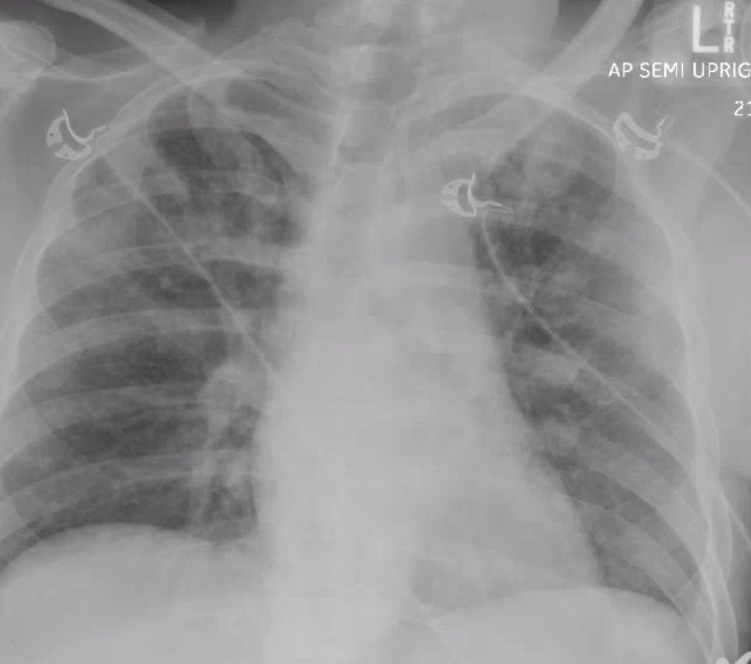
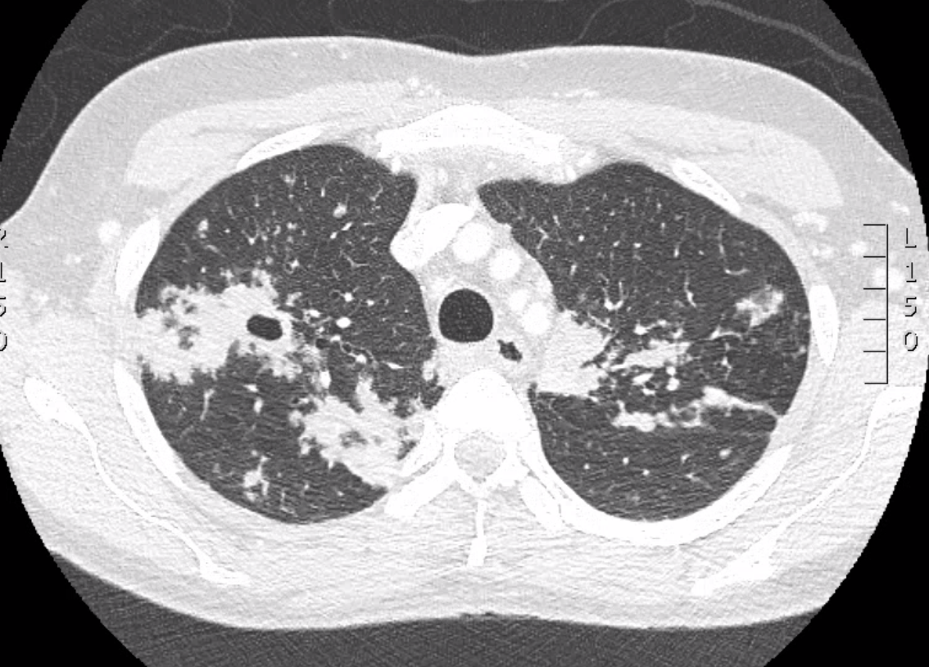
Case #3: Chest Imaging

Slide 30
Case #3: continued (2)
Diagnosis: Cavitary lesion. Pt placed in isolation, and AFB smears are positive.
Pt started on RIPE, and upon hospital discharge, is transferred to county-operated housing for patients with TB. Completes several follow-up visits at Owen.
Coda: unfortunately, several months later, the pt has been lost to follow-up

Slide 31
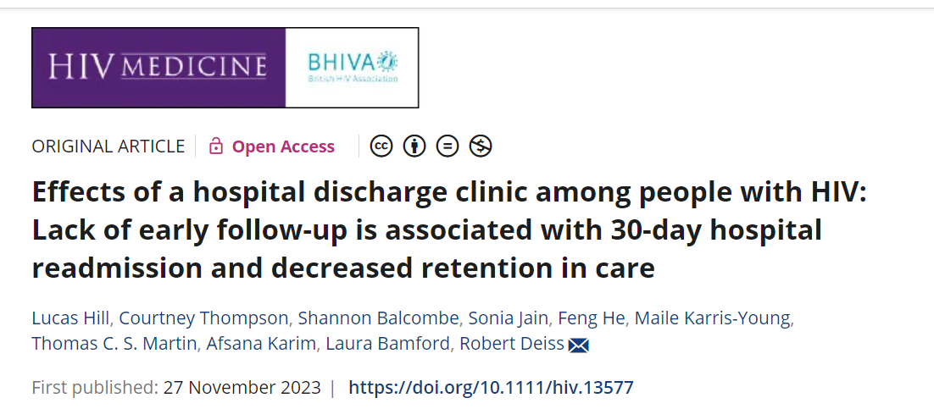
OWEN CLINIC EXPERIENCE

Slide 32
Analysis
Discharge Visits scheduled between June, 2020 – November, 2021 (N=114)
For patients with multiple hospitalizations/discharge visits, we only included the first (n=24)
Outcomes of Interest (Logistic regression)
30-day hospital readmission
6-month retention in care
Actual visit attendance
Any visit within 30 days (e.g. if missed appointment)

Slide 33
Important patient characteristics (variables)
Current residence in skilled nursing facility/incarceration
Newly diagnosed patient (within 30 days of admission)
Diagnosis of substance use disorder
Diagnosis of mental health disorder
Unstable housing
Presence of health insurance barrier
Patient receiving outpatient parental antibiotic therapy (OPAT)
CD4 and viral load

Slide 34
Clinic totals
Attended Discharge Clinic appointment 80/114 = 70.7%
  30% No-show rate slightly higher than overall clinic rate
Attended any appt within 30 days 91/114 = 79.8%
  10 patients with new diagnosis – 100%
30-day Hospital readmissions 22/114 = 19.3%

Slide 35
Study Data and Demographics
 | Total (n=114) | Showed (n=80) | Did not show (n=34) | p-value (univariate)
Median Age (IQR) | 51 (40-60) | 51 (39-61) | 51 (43-60) | 0.46
Sex (%) Female | 15 (13.2) | 11 (13.8) | 4 (11.8) | 1.0
Gender identity (%) Male Female Transgender Female | 97 (85.1) 15 (13.2) 2 (1.8) | 67 (83.8) 11 (13.8) 2 (2.5) | 30 (88.2) 4 (11.8) 0 (0.0) | 0.61
Race (%) White Black Asian Other/Mixed Race Unknown | 63 (55.3) 20 (17.5) 4 (3.5) 25 (21.9) 2 (1.7) | 42 (52.5) 11 (13.8) 4 (5.0) 22 (27.5) 1 (1.3) | 21 (61.8) 9 (26.5) 0 (0) 3 (8.8) 1 (2.9) | 0.08
Ethnicity (%) Hispanic Non-hispanic Unknown | 31 (27.2) 81 (71.1) 2 (1.8) | 26 (32.5) 53 (66.3) 1 (1.3) | 5 (14.7) 28 (82.4) 1 (2.9) | 0.13
Undetectable HIV viral load (%) | 42 (36.8) | 34 (42.5) | 8 (23.5) | 0.06
Median CD4 count (IQR) | 223 (48-538) | 286 (47-617) | 207 (54-385) | 0.76

Slide 36
More patient characteristics
 | Total (n=114) | Showed (n=80) | Did not show (n=34) | p-value (univariate)
Substance Use Disorder (%) | 63 (55.3) | 38 (47.5) | 25 (73.5) | 0.01
Mental health disorder (%) | 72 (63.2) | 46 (57.5) | 26 (76.5) | 0.06
Homeless or unstable housing (%) | 50 (43.9) | 30 (37.5) | 20 (58.8) | 0.04
Presence of at least one of SUD, MHD, unstable housing (%) | 91 (79.8) | 59 (73.8) | 32 (94.1) | 0.01
Presence of ALL: SUD, MHD, unstable housing (%) | 37 (32.5) | 21 (26.3) | 16 (47.1) | 0.048
Insurance barrier (%) | 28 (24.6) | 16 (20.0) | 12 (35.3) | 0.10
Discharged to SNF or jail (%) | 12 (10.5) | 11 (13.8) | 1 (2.9) | 0.10
On OPAT (%) | 13 (11.4) | 13 (16.3) | 0 (0.0) | 0.01
New diagnosis (%) | 10 (8.8) | 9 (11.3) | 1 (2.9) | 0.28

Slide 37
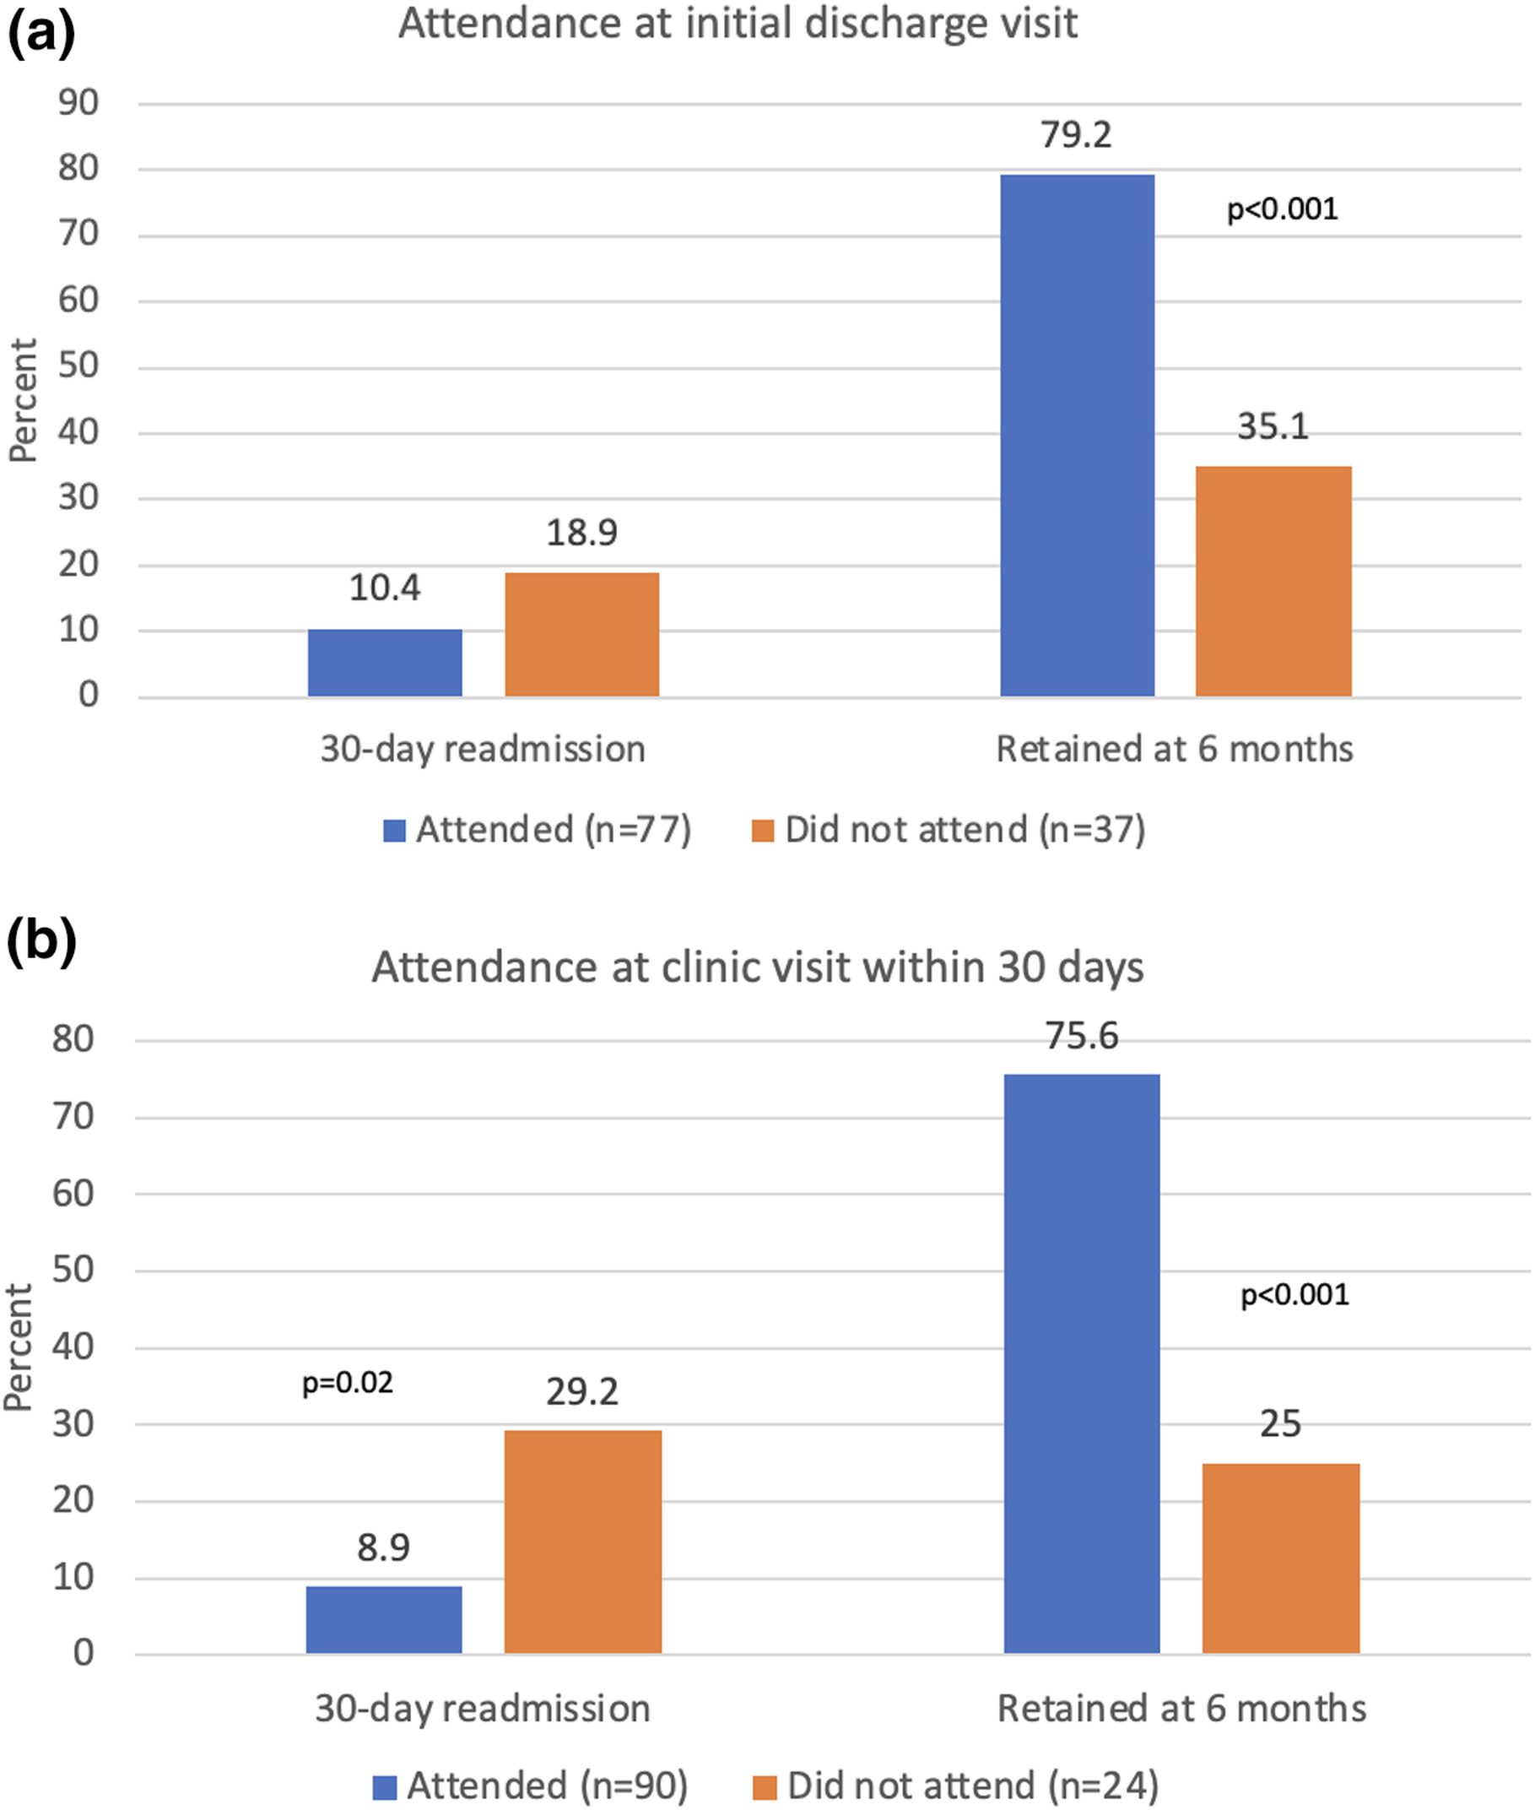
Hospital follow-up

Slide 38
Multivariate Analyses
Discharge Visit Follow-up
  Active substance use disorder (SUD) associated with failing to attend a discharge clinic visit (odds ratio 0.31; 95% confidence interval 0.13-0.77)
Hospital readmissions
  No significant differences in readmissions between people with HIV who did or did not attend a discharge clinic visit
  Any clinic visit within 30 days of discharge -> significantly fewer 30-day readmissions (8.9% vs. 29.2%, p = 0.02)
6-month retention in care
  Discharge clinic attendance associated with higher 6-month RIC (79.2% vs. 35.1%, p < 0.001)
  Any clinic visit within 30 days of discharge -> higher 6-month RIC (75.6% vs. 25.0%, p < 0.001)

Slide 39
Takeaways
Relatively high rates of hospital follow-up even among a population with significant psychosocial challenges
Nonetheless, challenges remain in re-engaging patients with certain psychosocial barriers, particularly SUD and unstable housing.
  Barriers are often additive/multifactorial
Success with certain key populations: Hispanic ethnicity, newly diagnosed, facility residents, OPAT

Slide 40
Next Steps/Future priorities
Cost-effectiveness research/incentives
Improved inpatient treatment for substance use disorders – link to Medication Assisted Treatment (MAT)
  Ideas welcome to address homelessness/unstable housing
Single-payer health (enough already!)

Slide 41



San Diego Sunrises
San Diego Sunrise – January, 2024

Slide 42

Acknowledgements
Manuscript Co-authors
Lucas Hill, Courtney Thompson, Shannon Balcombe, Afsana Karim, Sonia Jain, Feng He, Maile Karris-Young, Thomas Martin, Laura Bamford
The Transitions of Care Team
Monica Jones, Courtney Thompson, Velma Justice-Royster, Chris Mueller, Jordan Silva, Steven Sandoval, Shannon Balcombe, Kari Abulsohn, Christian Turner
TOC/Discharge Clinic Pioneers: Charles Hicks, Darcy Wooten

