Slide 1
Pacific AIDS Education & Training Center
(Pacific AETC)
PrEP Ready! Community of Practice:
PrEP is for Youth: Empowering youth to manage their sexual health
March 6, 2024

Slide 2

Waterfall Introductions in the Chat box
Name
Pronouns
Role
Organization
What is the first sign of Spring for you?
Image Source: Microsoft Stock Images

Slide 3
Disclaimer
The views and opinions expressed in this presentation are not necessarily those of the Pacific AIDS Education & Training Center (Pacific AETC) or its eight local partner sites in HRSA Region 9, the Regents of the University of California or its San Francisco campus (UCSF or collectively, University) nor of our funder the Health Resources and Services Administration (HRSA). Neither Pacific AETC, University, HRSA nor any of their officers, board members, agents, employees, students, or volunteers make any warranty, express or implied, including the warranties of merchantability and fitness for a particular purpose; nor assume any legal liability or responsibility for the accuracy, completeness or usefulness of information, product or process assessed or described; nor represent that its use would not infringe privately owned rights.
HRSA Acknowledgement Statement
The Pacific AETC is supported by the Health Resources and Services Administration (HRSA) of the U.S. Department of Health and Human Services (HHS) as part of an award totaling $3,887,700.00. The contents are those of the author(s) and do not necessarily represent the official views of, nor an endorsement, by HRSA, HHS, or the U.S. Government. For more information, please visit HRSA.gov.
Trade Name Disclosure Statement
Funding for this presentation was made possible by 5 U1OHA29292‐08‐00 from the Human Resources and Services Administration HIV/AIDS Bureau. The views expressed do not necessarily reflect the official policies of the Department of Health and Human Services nor does mention of trade names, commercial practices, or organizations imply endorsement by the U.S. Government. Any trade/brand names for products mentioned during this presentation are for training and identification purposes only.

Slide 4
Disclosures
All presenters of this continuing medical education activity have indicated that neither they nor their spouse/legally recognized domestic partner has any financial relationships with commercial interests related to the content of this activity.

Slide 5
About the AETC Program
The AETC Program is the training arm of the Ryan White HIV/AIDS Program*. This network of 2 national centers and 8 regional centers comprised of leading HIV experts, provides locally based, tailored education and technical assistance to healthcare teams and systems to integrate comprehensive care for those living with, at risk of, or affected by HIV. The AETC Program transforms HIV care by building the capacity to provide accessible, high-quality treatment and services throughout the United States and its territories.
* The Ryan White HIV/AIDS Program of HRSA HIV/AIDS Bureau provides HIV-related services to more than half a million people each year who do not have sufficient health care coverage or financial resources to cope with HIV disease. The Ryan White HIV/AIDS Program fills gaps in care not covered by other sources.

Slide 6
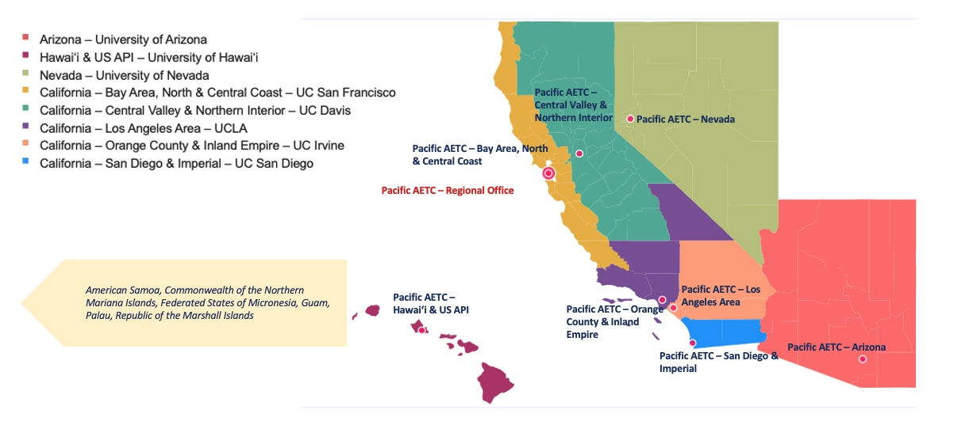
Our Pacific Region Area and Our Local Partners

Slide 7
Community of Practice
Consists of a group of people who share knowledge to develop a shared practice or obtain a shared outcome.
Learning communities can be defined as groups of people who share a common concern or a passion for something they do and strive to do it better as they interact regularly. These constituent-led communities of practice are crucial to connect people in the spirit of learning, knowledge sharing, and collaboration as well as in achieving individual and group development and goals.

Slide 8

Community of Practice Structure

Slide 9
4 Sessions + Tools + Discussion + Evaluation
September 6, 2023
PrEP Billing and Coverage 201: Advanced Strategies to pay for PrEP services
December 6, 2023
Centering the Margins: Expanding PrEP access to communities that need it most
March 6, 2024
PrEP is for Youth: Empowering youth to manage their sexual health
June 5, 2024
PrEP and Beyond: 21st Century HIV Prevention

Slide 10
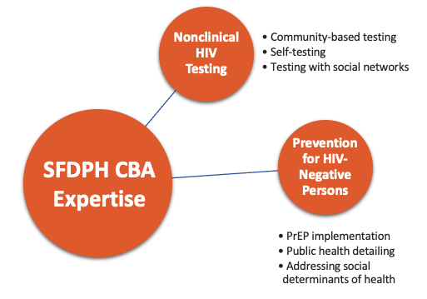

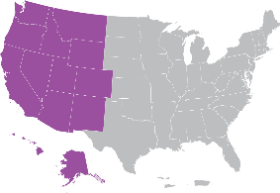

SFDPH CBA Program
SFDPH CBA Program
Capacity Building Initiatives
SFDPH, Center for Learning & Innovation
Visit: www.getSFcba.org
Email: get.SFcba@sfdph.org

Slide 11

Learning Objectives
By the end of this session, participants will be able to:
Review how engagement of youth in PrEP services differs from that of adults
Name at least 2 engagement strategies that increase PrEP uptake among youth
Discuss best practices and lessons learned from clinical PrEP youth programs
Review and discuss the organizational worksheet to assist with development and implementation of PrEP youth engagement strategy
Image Source: Microsoft Stock Images

Slide 12




Today’s Speakers
Geoffrey Hart-Cooper MD, Founder and Medical Director, Virtual PrEP Program for Adolescents and Young Adults, Stanford Children’s Health.
Alexandria Trubatisky MSN, FNP-C, Nurse Practitioner, Div. Adolescent and Young Adult Medicine, Children’s Hospital of Los Angeles (CHLA)
Vihaan Madahar, PrEP Navigator, Div. Adolescent and Young Adult Medicine, CHLA

Slide 13
PrEP for Adolescents and Young Adults (AYA)
PrEP for Adolescents and Young Adults (AYA)
Geoffrey Hart-Cooper MD
Founder and Medical Director, Virtual PrEP Program for Adolescents and Young Adults at Stanford
PrEP Ready! CoP – March 6, 2024

Slide 14
Overview
Describe epidemiology of HIV and PrEP use among AYA
Describe the AYA PrEP experience, including barriers
Learn how to support pediatric providers in becoming PrEP champions
Explore how virtual care and digital health tools can mitigate youth-specific barriers

Slide 15

Meet J
18 year old male
First relationship with male partner, not sexually active yet
Identifies as gay but not out to family
Image Source: Microsoft Stock Images

Slide 16
What is J’s lifetime risk of acquiring HIV?
18 year old man who has sex with men (MSM)
A. 1%
B. 10%
C. 50%
D. 70%
Image Source: Microsoft Stock Images

Slide 17
What is J’s lifetime risk of acquiring HIV? 1
18 year old man who has sex with men (MSM)
10-50%
Image Source: Microsoft Stock Images

Slide 18
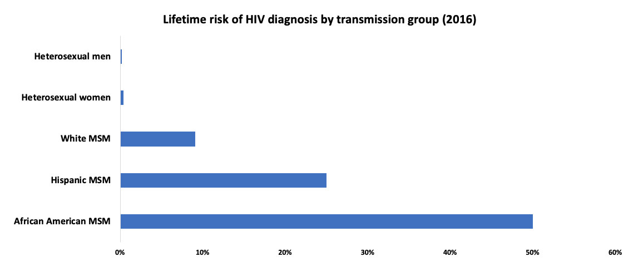
J has a high lifetime risk of acquiring HIV 2
https://www.cdc.gov/nchhstp/newsroom/2016/croi-press-release-risk.html#:~:text=If%20current%20HIV%20diagnoses%20rates,Control%20and%20Prevention%20(CDC).
Notes:
Men who have sex with men (MSM) have the highest lifetime HIV risk by far
Concerning racial and ethnic disparities
Attribute to disparities in HIV testing, linkage to care, retention in care, and adherence programs
Not due to differences in sexual behavior. (Millett, 2006)

Slide 19
J has a high lifetime risk of acquiring HIV 3
PrEP can reduce his HIV risk by >99%
https://www.cdc.gov/nchhstp/newsroom/2016/croi-press-release-risk.html#:~:text=If%20current%20HIV%20diagnoses%20rates,Control%20and%20Prevention%20(CDC).
Notes:
Men who have sex with men (MSM) have the highest lifetime HIV risk by far
Concerning racial and ethnic disparities
Attribute to disparities in HIV testing, linkage to care, retention in care, and adherence programs
Not due to differences in sexual behavior. (Millett, 2006)

Slide 20
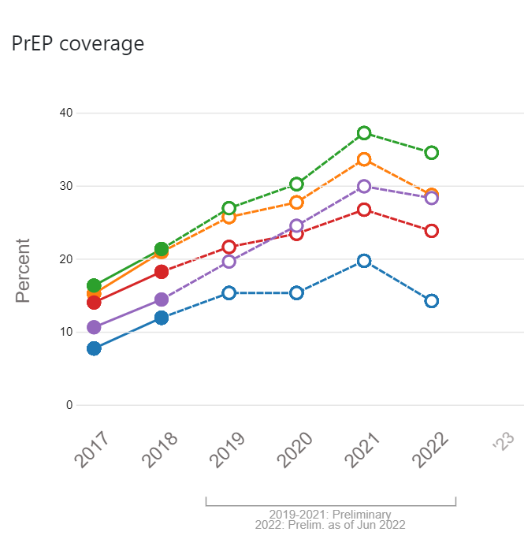
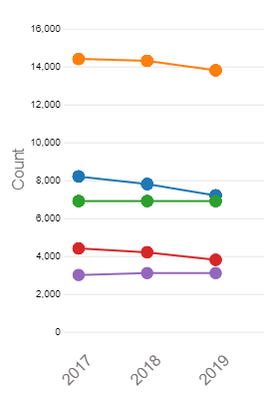
HIV incidence and PrEP coverage – By Age
HIV PrEP Coverage in the US
HIV incidence in the US
Age 35-44
Age 25-34
Age >55
Age 45-54
Age 13-24
Age 25-34
Age 13-24
Age 35-44
Age 45-54
Age >55
https://ahead.hiv.gov/data/prep-coverage

Slide 21
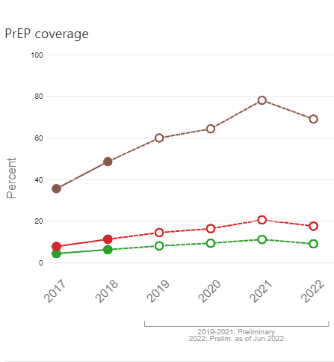
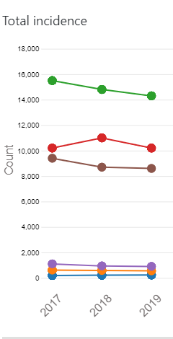
HIV incidence and PrEP coverage – By Race/Ethnicity
HIV PrEP Coverage in the US
HIV incidence in the US
Black/African American
Hispanic/Latino
White
Multiracial
Asian
American Indian/Alaska native
White
Hispanic/Latino
Black/African American
https://ahead.hiv.gov/data/prep-coverage

Slide 22
PrEP works if AYA patients take it
PrEP works if AYA patients take it – a glimpse at adherence data

Slide 23
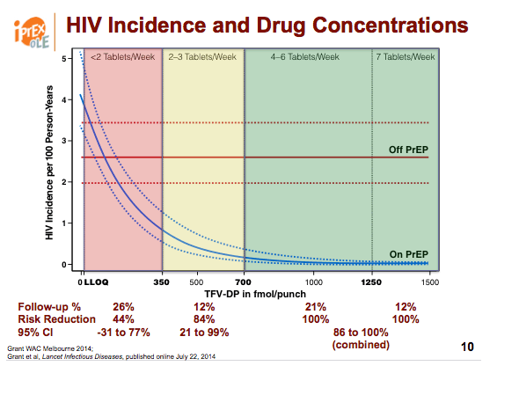
Greater adherence → greater protection
http://www.natap.org/2014/IAC/IAC_71.htm
Notes:
iPrEx Ole trial

Slide 24
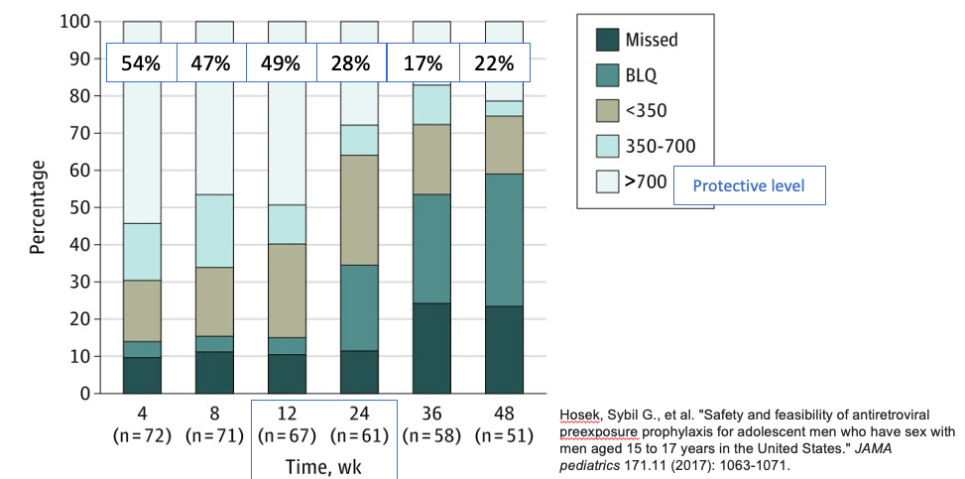
Lower adherence (and lower rates of protective levels) as visit frequency decreased
Hosek, Sybil G., et al. "Safety and feasibility of antiretroviral preexposure prophylaxis for adolescent men who have sex with men aged 15 to 17 years in the United States." JAMA pediatrics 171.11 (2017): 1063-1071.
Notes:
15-17yo MSM
6 cities part of Adolescent Medicine Trials Network (ATN 113)
Among 2864 individuals screened (from August 2013 to September 2014), 260 were eligible and 78 were enrolled (mean [SD] age, 16.5 [0.73] years), of whom 2 (3%) were Asian/Pacific Islander, 23 (29%) were black/African American, 11 (14%) were white, 16 (21%) were white Hispanic, and 26 (33%) were other/mixed race/ethnicity.
Over 48 weeks of PrEP use, 23 sexually transmitted infections were diagnosed in 12 participants.
The HIV seroconversion rate was 6.4 (95% CI: 1.3-18.7) per 100 person-years.
Tenofovir diphosphate levels consistent with a high degree of anti-HIV protection (>700 fmol/punch) were found in 42 (54%), 37 (47%), 38 (49%), 22 (28%), 13 (17%), and 17 (22%) participants at weeks 4, 8, 12, 24, 36, and 48, respectively.

Slide 25
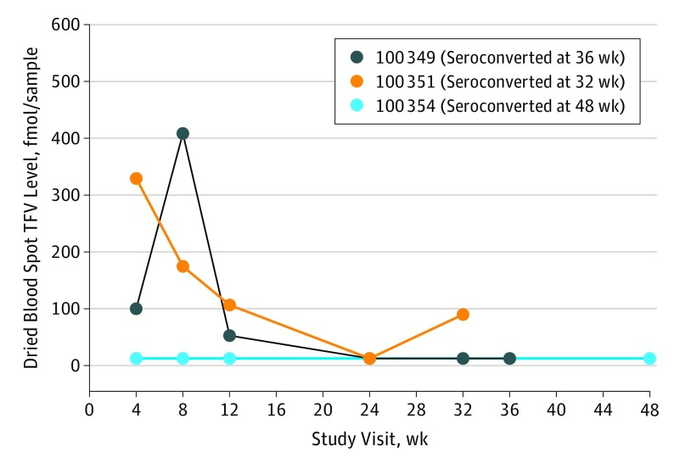
Patients who became HIV+ had low serum levels (low adherence)
Hosek, Sybil G., et al. "Safety and feasibility of antiretroviral preexposure prophylaxis for adolescent men who have sex with men aged 15 to 17 years in the United States." JAMA pediatrics 171.11 (2017): 1063-1071.

Slide 26
PrEPMate
mHealth intervention using SMS and interactive online content
Weekly check-in messages
Daily pill reminders at a customized time with fun facts/trivia
Staff provided tailored follow up to patient messages
Single site, parallel arm RCT (Chicago)
2:1 randomization (PrEPMate to standard of care with counseling support from a health educator)
April 2015-May 2016
121 participants (mean age 24, 27% Black, 36% Latino)
Notes:
SoC for PrEP delivery included
brief adherence and risk-reduction counseling all conducted by a health educator
access to a pager to reach a clinician whenever needed
Additionally, all participants were shown a video explaining how PrEP works in the body

Slide 27
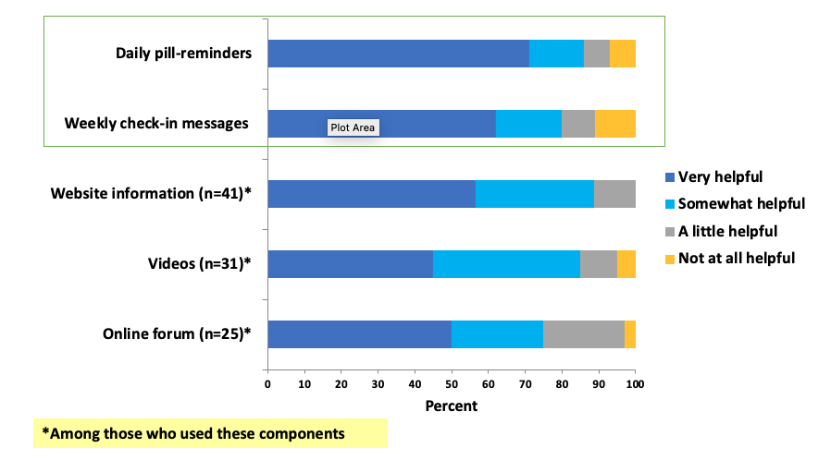
Acceptability of PrEPMate components
Albert Y Liu, et al, Randomized Controlled Trial of a Mobile Health Intervention to Promote Retention and Adherence to Preexposure Prophylaxis Among Young People at Risk for Human Immunodeficiency Virus: The EPIC Study, Clinical Infectious Diseases, Volume 68, Issue 12, 15 June 2019, Pages 2010–2017

Slide 28
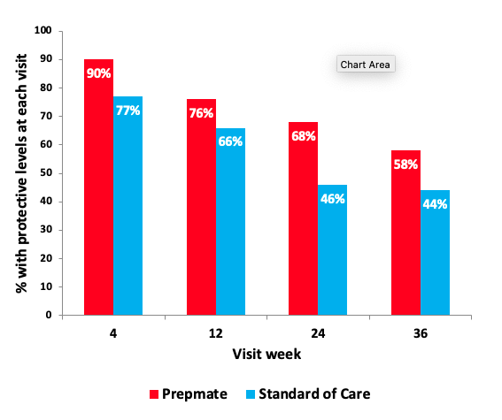
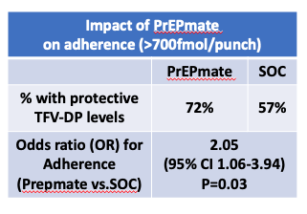
PrEPmate improved adherence compared to standard of care (SOC)
Prepmate efficacy did not differ significantly by age, race/ethnicity, education, or insurance
Albert Y Liu, et al, Randomized Controlled Trial of a Mobile Health Intervention to Promote Retention and Adherence to Preexposure Prophylaxis Among Young People at Risk for Human Immunodeficiency Virus: The EPIC Study, Clinical Infectious Diseases, Volume 68, Issue 12, 15 June 2019, Pages 2010–2017
Notes:
For the primary adherence outcome (Figure 4), a larger proportion of visits had protective TFV-DP levels ≥700 fmol/punch in the PrEPmate arm compared to SoC (72% vs 57% of all visits; OR 2.05; 1.06–3.94; P = .03), which remained significant after adjustment for baseline differences in depression (adjusted OR 2.06; 95% CI 1.07–3.99; P = .03).
PrEPmate efficacy for both retention and adherence did not differ significantly by age, race/ethnicity, education, or insurance (all P > .05 for interaction).

Slide 29
Support pediatric providers in becoming PrEP champions
Support pediatric providers in becoming PrEP champions

Slide 30
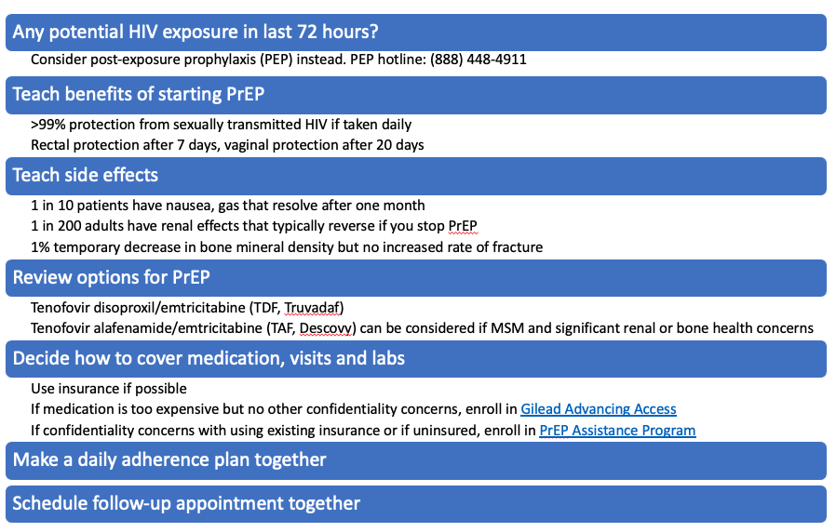
First PrEP visit

Slide 31
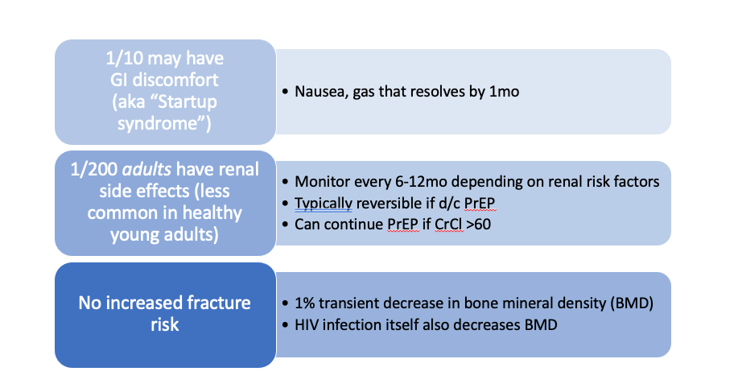
Side effect monitoring for TDF

Slide 32
Providers don’t order HIV tests often
Only 9% of students have ever been tested for HIV
Only 60% of HIV+ youth are aware they are HIV+
Kann L, McManus T, Harris WA, et al/ Youth risk behavior surveillance—United States, 2017. MMWR Surveill Summ. 2018;67(8):1–114
Centers for Disease Control and Prevention
. HIV Surveillance Report, 2017. Vol 29. Atlanta, GA: Centers for Disease Control and Prevention; 2018.
Notes:
9% of high school students had ever been tested (Youth Risk Behavior Survey)
Only 60% of HIV+ youth are aware they are HIV+

Slide 33
Your average pediatrician won’t see many PrEP patients
1546 patients a year
About 15% of these visits are teenagers (231 patients/year)
About 1-2% of teenagers would be eligible for PrEP (2-4 patients/year)

Slide 34
PrEP care is a departure from routine AYA care
Routine care
PrEP care
Annual “sports physical”
No daily medications
No routine labs
Lifelong pediatrician or family medicine provider
Visits every 1-3 months
Daily medication
Labs every 3 months
Sexual health clinic? Other new provider?

Slide 35
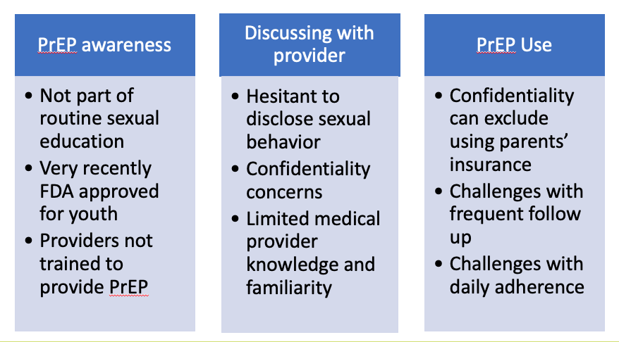
Patient and provider PrEP barriers

Slide 36
Tip: Frame PrEP like contraception
Contraception
PrEP
Great for anyone who could be exposed to pregnancy risk in the near future
Great for anyone who could be exposed to HIV in the near future

Slide 37
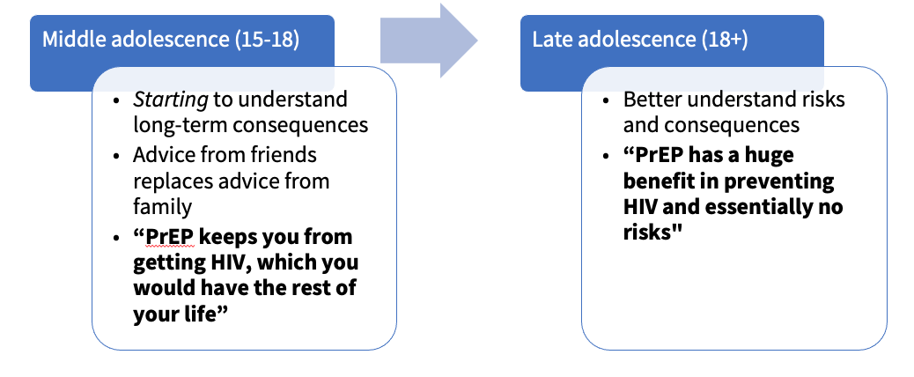
Tip: Target PrEP messaging by age
Notes:
Situations to consider:
Patient doesn’t think they would benefit from PrEP
Patient stopped taking PrEP

Slide 38
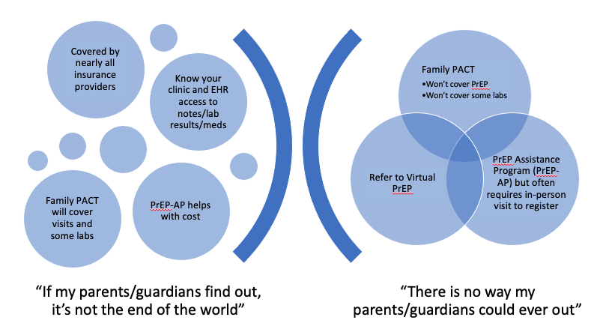
Tip: Don’t let confidentiality concerns keep you from moving forward. Providers are familiar with contraception, and there are programs to support
Notes:
CA allows minors aged ≥12 years to “consent to medical care related to the prevention of a sexually transmitted disease”

Slide 39
Tip: Think about anticipated risk – will your patient’s HIV risk change before you see them again?
If your patient is asking you about PrEP – they probably would benefit from it
Current or anticipated risk
  Not always using condoms
    Recent STIs are only part of the story
  Not always confident partners are HIV negative
    It’s more than just asking about HIV status – hard to know for sure!
    Do they know when partners were last tested?
    Do they know status of all their partners since the last HIV test?
  Injecting drugs and sharing needles
Notes:
Highlights why most sexually active MSM can benefit from PrEP

Slide 40

Virtual PrEP
Virtual PrEP was created to improve access to quality PrEP care for adolescents and young adults in California
prep.stanfordchildrens.org
Image Source: Microsoft Stock Images

Slide 41
Overcoming transportation barriers through home-based care
Visits
  Virtual visits can be more frequent – allowing more check-ins
Labs
  Home-based collection
Meds
  Mail order
Adherence
  Engaging staff for check ins between visits

Slide 42
New patient engagement strategy (toolkit)
 | Where are your patients learning about PrEP? | What ideas do you have for implementation?
Private providers/clinics |  | Example: Lunch and Learns.
Public providers/clinics
Other providers/clinics |  | Examples: family planning/reproductive health clinics.
Community based organizations |  | Examples: organizations serving LGBTQIA+ youth, young women, young people living with HIV (offer PrEP to partners); house ball community, foster care agencies.
School health (high school, wellness centers, colleges)
Social media outreach and digital advertising |  | Example: HHS PrEP social media toolkit with resources and content

Slide 43
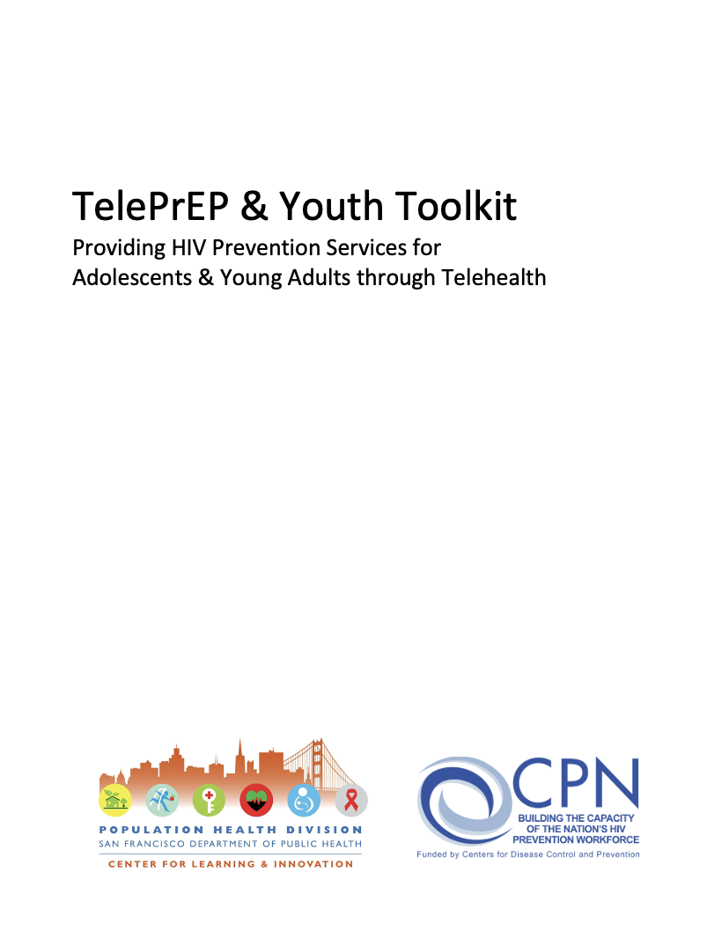
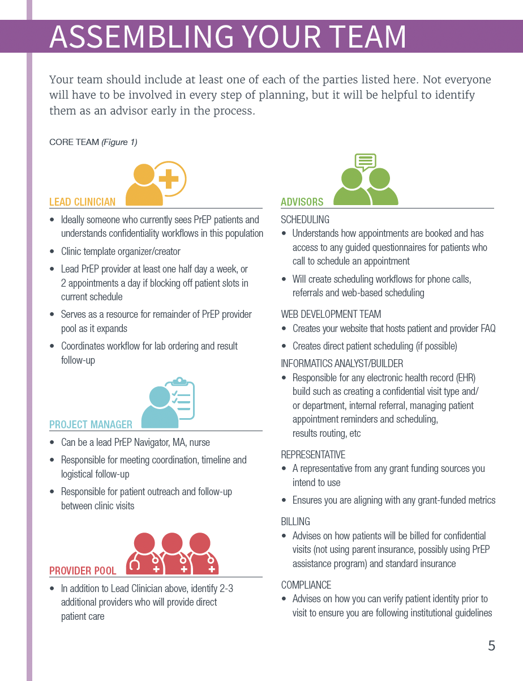
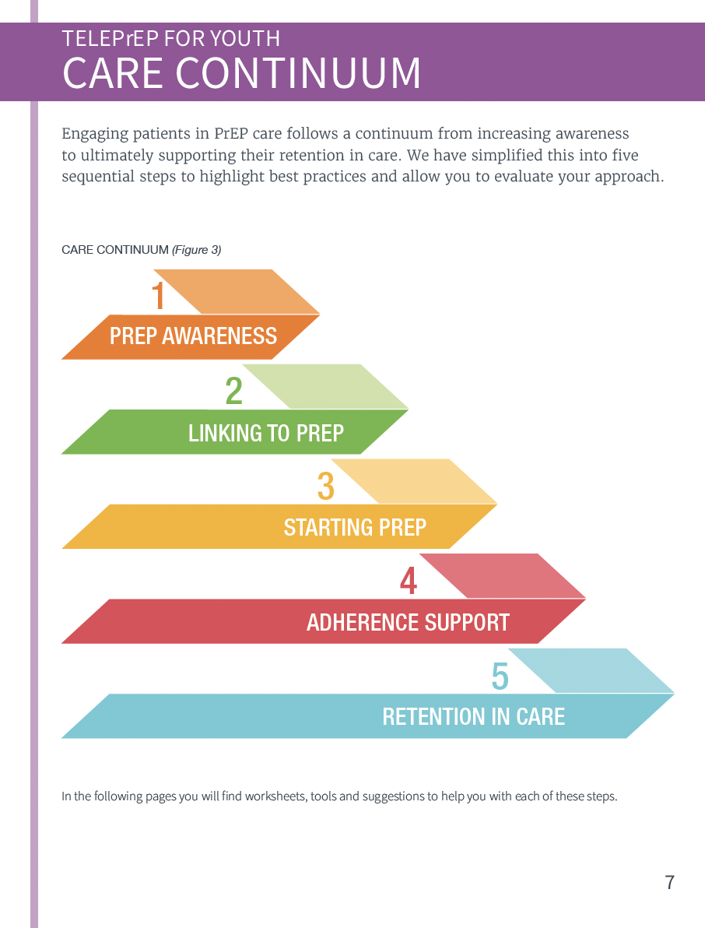
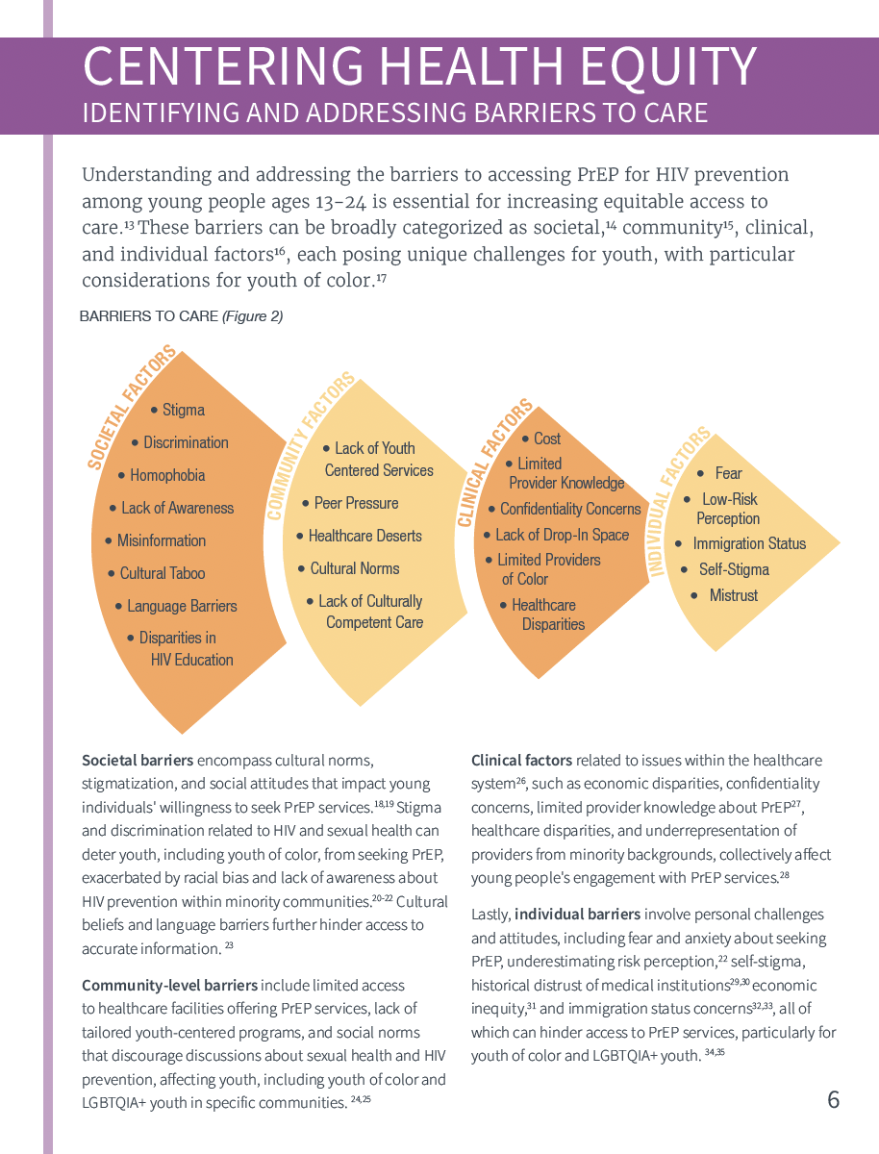
TelePrEP & Youth Toolkit
Step-by-step discussion of best practices in telehealth PrEP programs for youth
Resources for program implementation
Planning tools
Program evaluation
Coming soon to www.getSFcba.org

Slide 44
Take away messages
AYA have a significant unmet PrEP need
Our approach to AYA PrEP care is more than just confidentiality preservation – and needs to incorporate an understanding of their overall healthcare experience
Virtual care and digital health tools can mitigate youth-specific barriers and provide system-level solutions

Slide 45
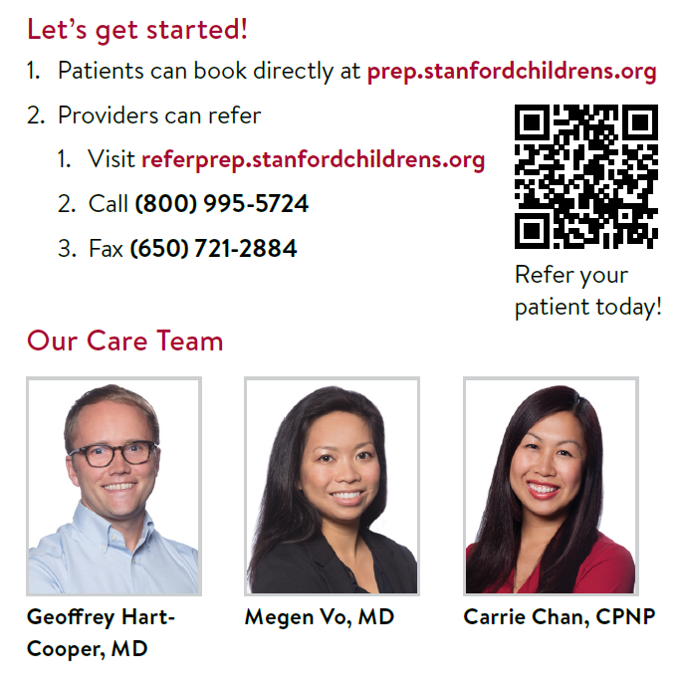

Thank you!
Thank you!
Image Source: Microsoft Stock Images
PrEPadmin@stanfordchildrens.org
Notes:
Questions?
Ideas for collaborations?

Slide 46

Q & A
What questions do you have for our speaker?

Slide 47

PrEP Ready!
Alexandria Trubatisky, MSN, FNP-C
PrEP/PEP Provider
Vihaan Madahar, BS
PrEP Navigator,
Children's Hospital Los Angeles
3/6/24

Slide 48
Overview 2
Provide overview of PrEP services at CHLA for adolescent and young adults
Discussion of interdisciplinary team involved in care
Overview of engagement and retention challenges
Discussion of strategies to support engagement and retention
Provide tools and resources for both providers and non-prescribing staff who may be able to engage clients in PrEP services

Slide 49
Who we serve
Ages 12-25, Adolescents and Young adults
General demographic of PrEP clinic:
  72 patients seen in 2023
    Gender:
      51 Cis men (71%), 6 Trans men (8%), 5 Non-Binary (7%), 7 Trans women (10%), 3 Cis women (4%)
    Sexual Orientation:
      43 Gay (60%), 12 Bisexual (17%), 9 Straight (13%), 6 Something else (8%), 2 Not Sure (3%)
    Race/Ethnicity:
      29 Latino (40%), 13 Black (18%), 7 Multiracial (10%), 15 White (21%), 7 Asian (10%), 1 Pacific Islander (1%)
Insurance Coverage:
  Visits:
    PrEP-AP Uninsured, PrEP-AP insured, PrEP-AP for minors, PrEP-AP with Confidentiality concerns
    Medi-Cal, Medi-Cal Managed
  Medication:
    Medi-Cal, Medi-Cal Managed, Gilead PAP, ViivConnect PAP

Slide 50

PrEP patients
Current # patients active on PrEP: 47
TDF (Truvada) daily: 23
TDF 2-1-1: 7
TAF: 8
Cabotegravir (Apretude) Injection: 7
Cabotegravir oral lead in: 1
Image Source: Microsoft Stock Images

Slide 51

PrEP Care Team:
    Emphasis on multidisciplinary approach:
      PrEP Navigators, patient service representatives, nursing, testing team, medical provider
    Support with linkage to:
      food pantry, clothing closet, mental health, substance use, health educators (for groups/programs), HAWC (Homeless Adolescent & Young Adult Wellness Center) team resources, gender affirming care (all on site)
    Referrals to external resources:
      mental health, housing, education, employment
Image Source: Microsoft Stock Images

Slide 52
PrEP clinic flow:
    Navigators:
      Health education sessions
      Scheduling for first appointments and follow ups
      Coordinate with insurance and delivery of injection
      Forms for signatures by patients and provider for insurance coverage
      Coordinate transportation
    Provider:
      HEADSSS and HPI/ROS, Physical exam and labs
      Sexual health history and education regarding HIV, STIs
      Review PrEP options / previous PrEP use / need for PEP
      Verify vaccinations
      Orders for pharmacy and administration on site if injection
    Nursing:
      completes blood draws and labs
      coordinates med delivery to clinic for injectables and administers injections
    Testing team: rapid HIV screening
    PSR team: scheduling, clinic forms

Slide 53
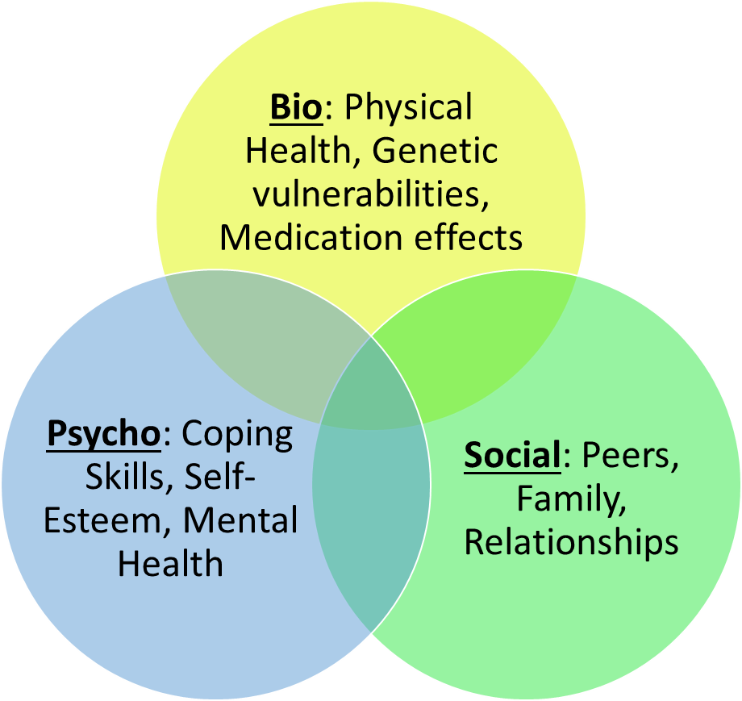
Tailoring care to Adolescents and Young Adults
Consider any barriers to care:
  Lack of awareness
  Frequent appointments
  Perceived risk
  Breach of confidentiality
  Stigma
  Access to providers
  Insurance
  Adherence
  Medical mistrust
  Competing priorities
Consider life event changes:
Education: Leaving high school
      Work: New responsibilities
      Health: Full ownership over health
      Family: From family living to autonomy
      Citizenship: Changing/new rights

Slide 54
PrEP Specific Challenges
    Navigators:
      Insurance approvals/changes
      Confidentiality concerns for Long-Acting Injectable Cabotegravir coverage
      Timing deliveries, scheduling and availability of providers/nursing for Cabotegravir administration
      Patient hesitancy with labs/side effect/new med on the market
      Outreach response from patients
    Provider orders:
      Future orders, reviewing charts in advance
      Spreadsheet shared amongst teams
Notes:
Insurance:
Requesting authorization for PrEP related labs to be conducted in clinic vs with PCP
Pushback from insurance requesting documentation why pt needs injectable over oral
Provider note usually suffices for PA submission
Confidentiality concerns:
Prior to PrEP-AP adding Apretude to formulary, confidential/minor pts used Viiv PAP
PAP would conduct insurance verification and see pts are insured and disqualify from PAP, would utilize covermymeds.org instead
Timing:
1st/2nd Apretude injection must be 4 weeks apart +/- 1 week, more difficult to coordinate
Pt hesitancy:
Having conversation w pt, meet them where they’re at, utilize MI and health literacy to inform and empower them. Provider general anecdotal stories for reassurance ie mention that most pts have side effects dissipate w/i a week for daily

Slide 55
Sex Positivity: Provider Consideration
Normalizing sex and pleasure
Reflect on decision-making
Provide support and education
Encourage bodily autonomy
Fix your face: Check personal biases
Frame the conversation
Focus on sexual well-being and their relationships
Open-ended questions: prompts more sharing of their story
Tailor the conversation to the client's needs
Be human

Slide 56
Retention Strategies
    Navigators:
      Checking in
      Build rapport
      Celebrate wins, big and small
      Reducing barriers to access care
      Host community events
      Tracking patients via excel sheet for care team to stay updated
    Provider:
      continued education regarding options as prescribing
      educating patients on options in case one doesn't work well for them
      importance of timing to maintain efficacy and strategizing resources for adherence (alarms, pill boxes/key chains)
      Assessing ability to come in for first two injections one month apart then every months or once daily or 2-1-1 depending what they qualify for
      Flexible schedules in case late or rescheduling
      Reevaluating PrEP use/side effects/repeat testing
Notes:
Maintaining contact with client and checking in multiple times, even after no response
Building rapport by conversing on topics other than PrEP ie personal life updates, sharing our own stories
Celebrating pts for prioritizing their health by being on PrEP, accessing supplies like condoms/lube, asking us follow up q’s
Reducing barriers to access care ie offering lyfts and calling insurance/pharmacies on pt behalf, accessible easy to understand info
Hosting community events for clients to connect with other folx in community and share experiences if they’re open to it
Tracking patients via excel sheet for care team to stay updated

Slide 57

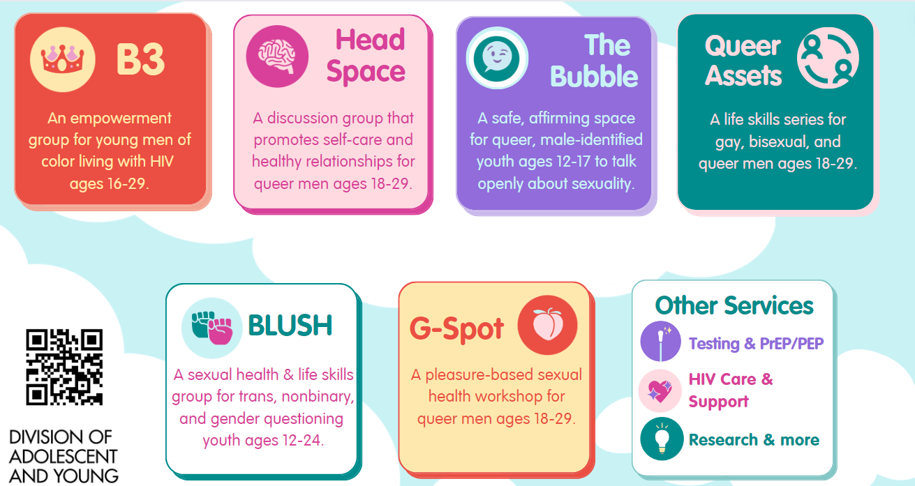
Examples of Programming
Examples of Programming
Digital Artists: Huan Nguyen (huan-nguyen.com) and Jonathan Torres (torresjonathan.com)
Notes:
Flyers for group programs designed in consultation with young mens CAB
Color scheme, design, graphics, verbiage used
Ppt designed by staff (also members of community)

Slide 58
Equity in PrEP access
    Navigators:
    Offering Lyft transportation to PEP/PrEP related visits
    Offering holistic services such as on-site linkage to clothing closet/food bank/substance use
    Provider:
    Social aspects that impact care (remember the barriers to care)
    Having conversation about sex, normalizing sexual health in the provider visit, respect patient autonomy

Slide 59
Youth Reflections on Medical Visits
    Youth shared an appreciation of a welcoming environment where they felt understood
    Youth appreciated that services were free and easy to navigate
    Most youth felt comfortable talking with staff about their health
    Youth appreciated that staff were approachable and helpful
    Youth shared an appreciation for having clear communication and timely follow-up

Slide 60
References/Resources
Taking a Sexual Health History
  http://publichealth.lacounty.gov/dhsp/Providers/PrEPActionKit/PREPSexualHistoryCard.pdf
PrEP/PEP Info:
  PleasePrEPMe.org
  GetPrEPLA.com
  https://www.cdph.ca.gov/Programs/CID/DOA/Pages/OA_prev_PrEP.aspx
Insurance Confidentiality Requests
  Covermymeds.com
  myhealthmyinfo.org

Slide 61
Thank you!
Contact
  Alexandria Trubatisky: atrubatisky@chla.usc.edu
  Vihaan Madahar: vmadahar@chla.usc.edu

Slide 62


Discussion

Slide 63
Q & A 2
What questions do you have for our speaker?

Slide 64
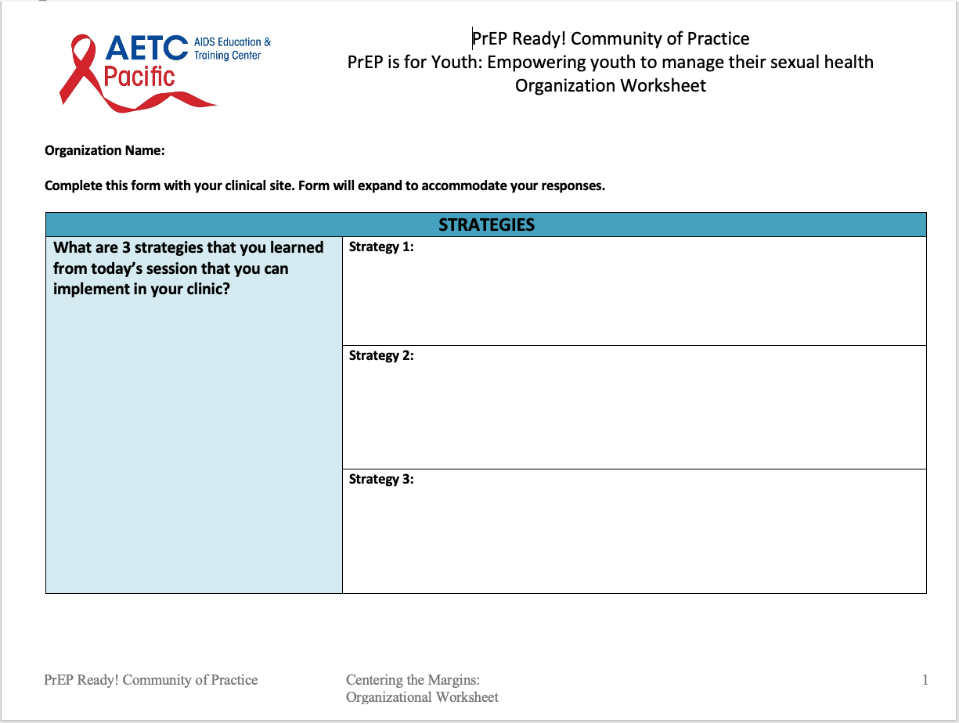
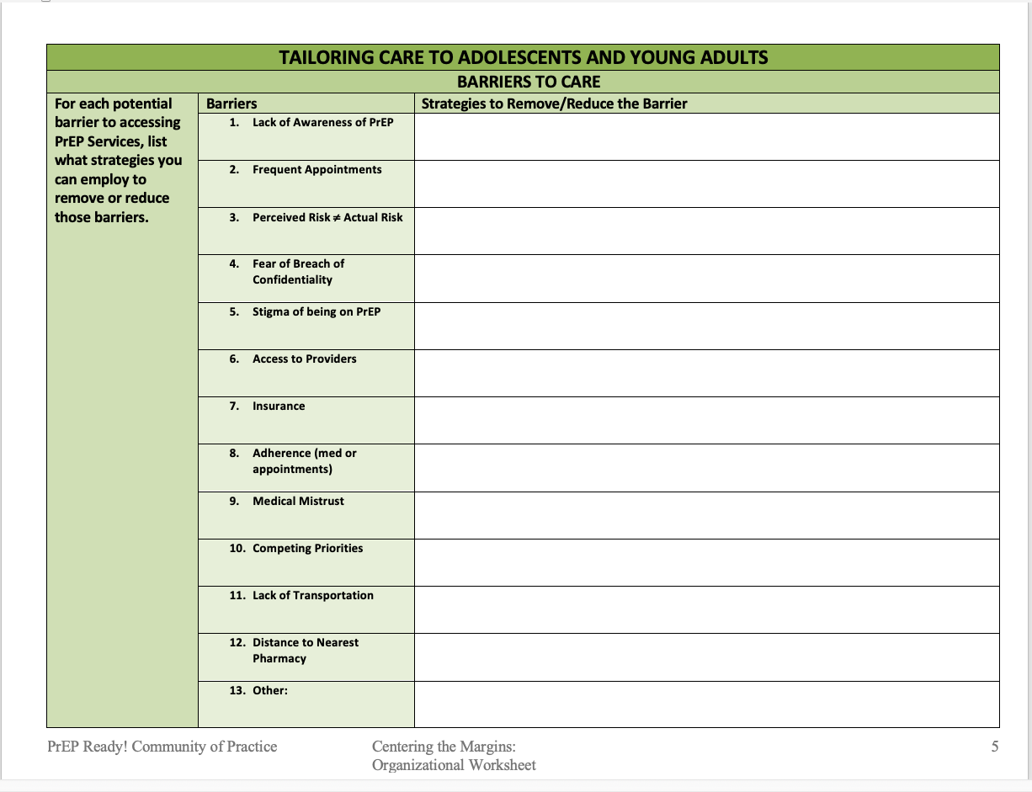
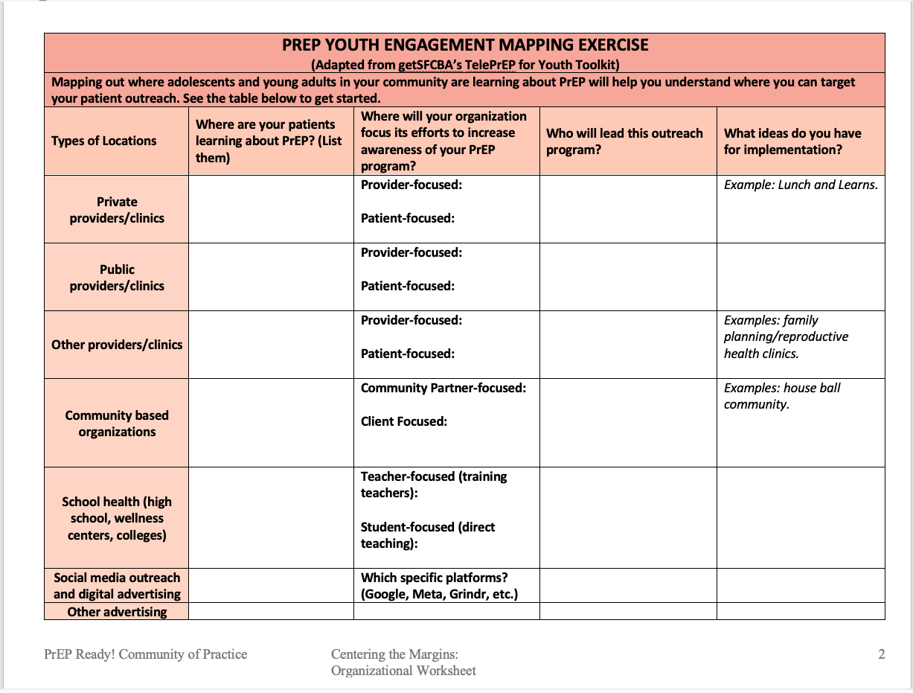
Organizational Worksheet
Completing this worksheet with your programs to:
  Apply strategies learned into today’s session to your PrEP programs
  Map Youth Engagement Strategies
  Assemble your PrEP for Youth Program Team
  Coordinate linkage to support services for equitable access
  Discuss potential barriers and possible solutions to youth accessing PrEP
  Prepare for life events young people may experience that affect their ability to engage in PrEP
  Practice self-reflection regarding sex positivity techniques
  Access related resources for today’s session

Slide 65
Breakout Session (15-20 min)
Groups of 8-10
Download the worksheet
Discussion Question: Think about 1 strategy you learned about today that you want to implement or enhance at your clinics:
  What are the potential benefits to implementing this strategy?
  What action steps will your clinic need to take to plan and implement this strategy?
Large group reflections

Slide 66

Thank you for participating!
Please check your emails for a unique link to complete the evaluation.
This Photo by Unknown Author is licensed under CC BY-SA

Slide 67

PrEP Ready! CoP Slack:
An Introduction
What is Slack?
  Slack is a messaging app that keeps teams connected. We use our Slack space to communicate and share resources.
Why the PrEP Ready! CoP Slack?
  Find materials from past sessions.
  Share resources and announcements with your peers.
  Be the first to hear about upcoming programs.
  Seek assistance with implementation strategies for you and your team.
  And more!
Our goal
  Our goal with the PrEP Ready! CoP Slack is to allow our community to collaborate, communicate, and stay engaged. Together, we can help each other advance our PrEP programs to offer equitable access to PrEP for the communities we serve.

Slide 68
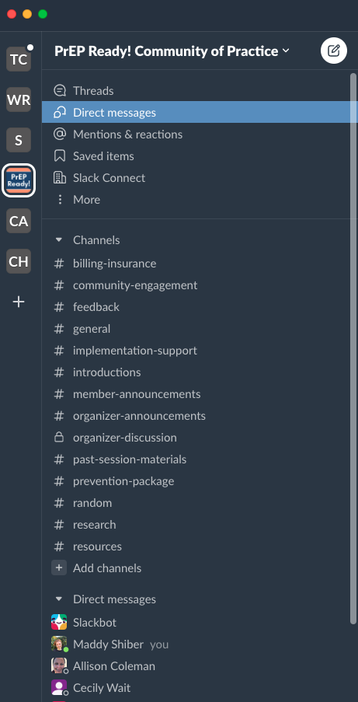
PrEP Ready! CoP Slack: Getting Started
All attendees will receive an invite, so check your email inbox! We will also post an invite link in the Zoom chat.
Navigate to the Slack environment by clicking the PrEP Ready! Logo on the left.
Here, you will find channels for announcements, post-session materials, and more!
  We will have a separate channel for each session held where we encourage discussion to continue.
Introduce yourself in the ”introductions” channel.

Slide 69

Questions? Feedback?
Remember that Slack is your one-stop shop for our materials, resources, and discussions
We’ll be tailoring it to YOUR needs so feel free to voice your opinion on how we can curate the platform!

Slide 70

Daylight Savings – March 10th!
This Photo by Unknown Author is licensed under CC BY-NC-ND

