Slide 1
Intersectionality in HIV Care: Navigating Diverse Population- Addressing the unique needs and challenges of individuals with HIV who belong to marginalized or intersecting communities.
Gianne D. Gerena, MPH
March 22nd, 2024

Slide 2
Disclosures
This program is supported by the Health Resources and Services Administration (HRSA) of the U.S. Department of Health and Human Services (HHS) under grant number U1OHA30535 as part of an award totaling $4.2m. The contents are those of the author(s) and do not necessarily represent the official views of, nor an endorsement, by HRSA, HHS, or the U.S. Government. For more information, please visit HRSA.gov.
“Funding for this presentation was made possible by cooperative agreement U1OHA30535 from the Health Resources and Services Administration HIV/AIDS Bureau. The views expressed do not necessarily reflect the official policies of the Department of Health and Human Services nor does mention of trade names, commercial practices, or organizations imply endorsement by the U.S. Government. Any trade/brand names for products mentioned during this presentation are for training and identification purposes only.”
This content is owned by the AETC, and is protected by copyright laws. Reproduction or distribution of the content without written permission of the sponsor is prohibited, and may result in legal action.

Slide 3
AETC Program National Centers and HIV Curriculum
National Coordinating Resource Center – serves as the central web –based repository for AETC Program training and capacity building resources; its website includes a free virtual library with training and technical assistance materials, a program directory, and a calendar of trainings and other events. Learn more: https://aidsetc.org/
National Clinical Consultation Center – provides free, peer-to-peer, expert advice for health professionals on HIV prevention, care, and treatment and related topics. Learn more: https://nccc/ucsf.edu
National HIV Curriculum – provides ongoing, up –to-date HIV training and information for health professionals through a free, web –based curriculum; also provides free CME credits, CNE contact hours, CE contact hours, and maintenance of certification credits. Learn more: www.hiv.uw.edu

Slide 4
Thank You!
This [project/publication/program/website, etc.] [is/was] supported by the Health Resources and Services Administration (HRSA) of the U.S. Department of Health and Human Services (HHS) under grant number U1OHA30535.. The contents are those of the author(s) and do not necessarily represent the official views of, nor an endorsement, by HRSA, HHS, or the U.S. Government. For more information, please visit HRSA.gov.

Slide 5
Learning Objectives
Identifying the social determinant of health impact navigating diverse populations living with HIV
Exploring the ways as public health professionals we can show acknowledge and pivot our work when faced with the unique needs and challenges of those living with HIV.
By the end of this session, each participant will be able to identify and explore how they can change they way they interact with the HIV + population and their unique and holistic needs
By the end of this session, each participant will be able to acknowledge that people living with HIV may face multiple forms of stigma, discrimination and marginalization that can affect access to care, treatment, adherence and overall health outcomes.

Slide 6
Introductions

Slide 7
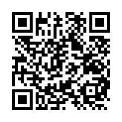
What is one thing you are looking to learn from this presentation?
slido.com with #2345243

Slide 8
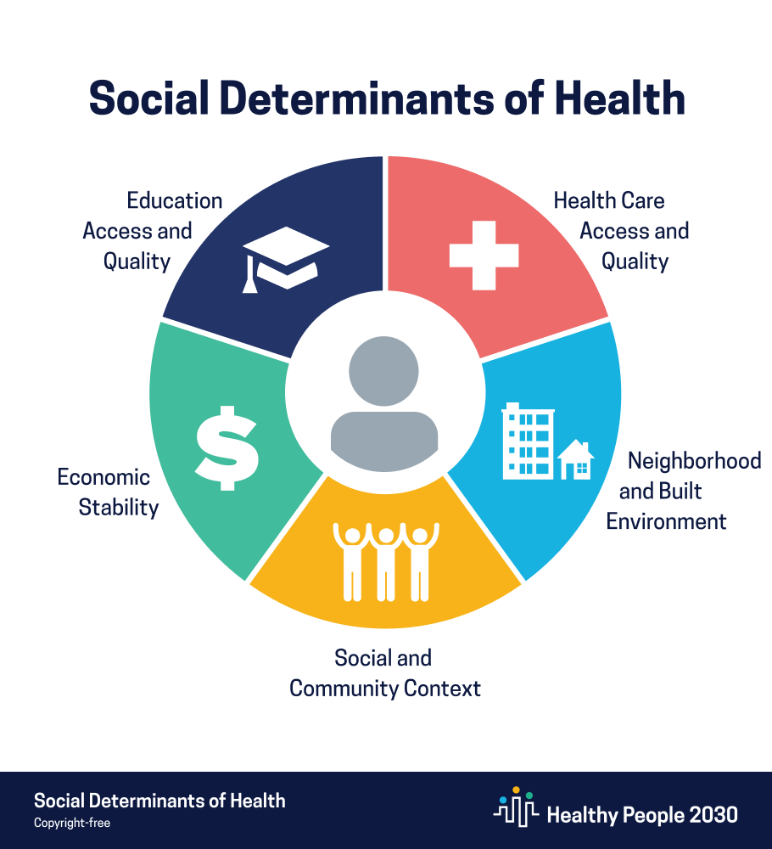

Slide 9
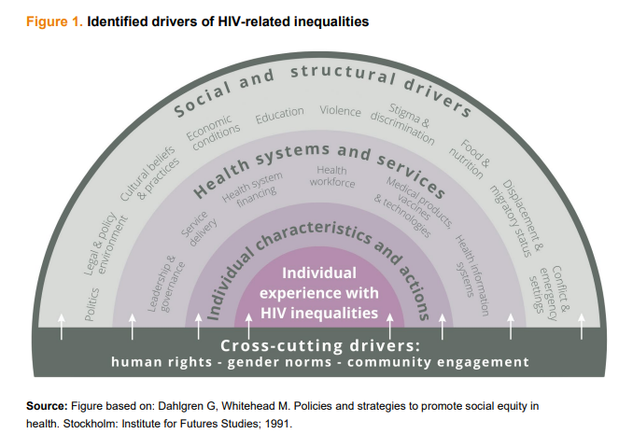
Notes:
The outer band in Figure 1 depicts the social and structural factors that can act as drivers of HIV inequalities, which affect an individual’s risk of acquiring HIV and deliver poor HIV outcomes. These social and structural factors shape and interact with the different elements of health systems and services (depicted in the second outermost band), which can themselves be drivers of HIV-related inequalities. These social, structural, systems and service drivers further interact with individual characteristics and actions in various ways that mould an individual’s experience with HIV-related inequalities.

Slide 10
Living with HIV in Rural Settings
Rural persons living with HIV face the following barriers :
The need to travel long distances to medical facilities and appointments
Lack of healthcare providers and mental health professionals who specialize in providing care to people living with HIV
A lack of personal or public transportation
Stigma toward people living with HIV
Higher rates of poverty and less likely to have health insurance
Notes:
Rural- Transportation to a clinic- may be far… small city clinic- people in your businesss
Urban issue- clinic may be where everyone goes, don’t want to be outte
The HIV epidemic was first widely centralized in major cities, which meant that resources and research attention were heavily concentrated in urban areas despite rural areas potentially also being impacted.5 In addition, incidence of HIV in rural communities may appear to be low because data are collected from where patients receive care, not where they live.6 Stigma also plays a role in increasing the possibility of rural residents getting treated in urban areas or providing a false address to testing facilities out of fear that others in their community might learn about their HIV status.6
People living with HIV disease, particularly those in small towns and rural areas, face many barriers that prevent them from receiving important life-care services.

Slide 12
The unique experiences that women face living with HIV
Women of all genders, including cisgender (cis) and transgender (trans) women, experience social and structural drivers of HIV inequities and pervasive barriers to HIV care.
Gender and racial inequities exist among cis and trans women regarding access to HIV care.
A large US population-based study showed that Black trans women were less likely to be retained in HIV care than Black cis women.
Women-centered HIV care addresses clinical (e.g. HIV and women’s health care priorities), social (e.g. social isolation and stigma), and structural concerns (e.g. violence, poverty) of women, through the promotion of peer support and women living with HIV’s leadership.

Slide 13
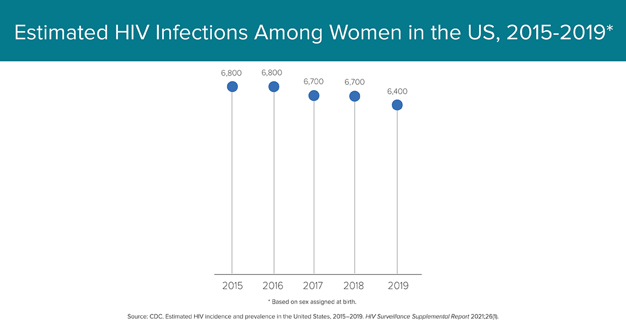
Notes:
18% of the estimated 34,800 new HIV infections were women in 2019.

Slide 14
Notes:
18% of the estimated 34,800 new HIV infections were women in 2019.

Slide 15
Notes:
Rural- Transportation to a clinic- may be far… small city clinic- people in your businesss
Urban issue- clinic may be where everyone goes, don’t want to be outted

Slide 16
The unique experiences that the Black and Latino communities face living with HIV
Notes:
Rural- Transportation to a clinic- may be far… small city clinic- people in your businesss
Urban issue- clinic may be where everyone goes, don’t want to be outted

Slide 19
Stigma
A set of negative and unfair beliefs that a society or group of people have about something
Stigma is one of the hardest experiences people living with HIV encounter
Stigma can create a “spoiled identity” for an individual or group of individuals.
Stigmatized people often lose status because of these assigned “signs of shame” which other people regard as showing they have done something taboo, wrong or bad.
Notes:
Stigma, discrimination, and bias by healthcare providers were among major barriers to care identified by the series authors and disproportionately affected marginalized racial groups, people who use drugs, and sexual and gender minorities.

Slide 20
Intersectionality Stigma
‘Intersectional stigma’ is a concept that has emerged to characterize the convergence of multiple stigmatized identities within a person or group, and to address their joint effects on health and wellbeing.

Slide 21
The Goal

Slide 22
How can we as health professionals show up for our patients living with HIV who are of diverse populations after this presentation?
slido.com with #2345243

Slide 23
How can we as health professionals show up for our patients living with HIV who are of diverse populations after this presentation?
Recognizing the structural and systematic barriers different populations face
Looking at the individual patient and addressing their needs with a unique approach- Not one size fits all
Culturally appropriate and tailored interventions
Notes:
We know that understanding these intersectionality's when working with folks can improve the way we interact and serve those living with HIV and apart of diverse communities

Slide 24
Key Take Aways
The social determinants of health impact on health outcomes
Living in a rural settings pose several barriers for people living with HIV
Cis women and trans women both face inequities and barriers living with HIV
Black and Latino people face a disproportionally affected by HIV than any other racial groups
Stigma
U=U

Slide 25
References
A framework for understanding and addressing HIV-related inequalities. (2022). In Global AIDS Strategy 2021–2026: End Inequalities, End AIDS [Report]. https://www.unaids.org/sites/default/files/media_asset/framework-understanding-addressing-hiv-related-inequalities_en.pdf
Pronk, N. P., Kleinman, D. V., & Richmond, T. S. (2021). Healthy People 2030: Moving toward equitable health and well-being in the United States. EClinicalMedicine, 33, 100777. https://doi.org/10.1016/j.eclinm.2021.100777
Heckman, T. G., Somlai, A. M., Peters, J., Walker, J., Otto-Salaj, L., Galdabini, C. A., & Kelly, J. A. (1998). Barriers to care among persons living with HIV/AIDS in urban and rural areas. AIDS care, 10(3), 365–375.
HIV and Women: Viral Suppression. (2023, February 1). Centers for Disease Control and Prevention. https://www.cdc.gov/hiv/group/gender/women/viral-suppression.html
Klein PW, Psihopaidas D, Xavier J, et al. HIV-related outcome disparities between transgender women living with HIV and cisgender people living with HIV served by the Health Resources and Services Administration’s Ryan White HIV/AIDS Program: a retrospective study. PLoS Med 2020; 17(5): e1003125. Crossref.
Lacombe-Duncan A, Berringer KR, Green J, Jacobs A, Hamdi A. “I do the she and her”: A qualitative exploration of HIV care providers’ considerations of trans women in gender-specific HIV care. Women’s Health. 2022;18. doi:10.1177/17455057221083809
O’Brien N, Greene S, Carter A, et al. Envisioning women-centered HIV care: perspectives from women living with HIV in Canada. Womens Health Issues 2017; 27(6): 721–730. Crossref. PubMed.
Social Determinants of Health - Healthy People 2030 | Health.gov. (n.d.). https://health.gov/healthypeople/priority-areas/social-determinants-health
Turan, J. M., Elafros, M. A., Logie, C. H., Banik, S., Turan, B., Crockett, K. B., Pescosolido, B., & Murray, S. M. (2019). Challenges and opportunities in examining and addressing intersectional stigma and health. BMC medicine, 17(1), 7. https://doi.org/10.1186/s12916-018-1246-9
Notes:
Intersecting forms of stigma are a common reality, yet they remain poorly understood.

Slide 26
Thank you!
Gianne D. Gerena, MPH
Linked-In: Gianne Gerena, MPH
Email: gianne.gerena@health.ny.gov

