Slide 1

Mandatory Reporting
HIV ECHO Clinic
Brant Hager, MD
Associate Professor of Psychiatry | University of New Mexico
Slides prepared in collaboration with Kathryn Lenberg, MPH, PhD
19 March 2024
Notes:
Version_ 08 2023
Target audience: all members of the healthcare team

Slide 2
Conflict of Interest Disclosure Statement
Speaker has nothing to disclose.
This presentation was reviewed by UNMHSC and SCAETC faculty to ensure it meets Continuing Education guidelines.
This program is supported by the Health Resources and Services Administration (HRSA) of the U.S. Department of Health and Human Services (HHS) as part of an award totaling $4,205,743 with 0% financed with non-governmental sources. The contents are those of the author(s) and do not necessarily represent the official views of, nor does mention of trade names, commercial practices, or organizations imply an endorsement by HRSA, HHS, or the U.S. Government. For more information, please visit HRSA.gov. Any trade/brand names for products mentioned during this presentation are for training and identification purposes only.

Slide 3
Use of Trade/Brand Names
This program is supported by the Health Resources and Services Administration (HRSA) of the U.S. Department of Health and Human Services (HHS) as part of an award totaling $4,205,743, with 0% financed with non-governmental sources.
The views expressed do not necessarily reflect the official policies of the Department of Health and Human Services, nor does mention of trade names, commercial practices, or organizations imply endorsement by the U.S. Government. Any trade/brand names for products mentioned during this presentation are for training and identification purposes only.
Notes:
Note: this slide must be included if trade and/or brand names for medications are used in the presentation.
It may be deleted if there is no reference to trade names, including presentations in which only generic medication names are mentioned.
Trade names must be put in parentheses after the generic name the first time it is mentioned - e.g., fluoxetine (Prozac). Trade names should only be mentioned for the initial reference and the generic name only should be used after that. This applies equally to all medications or products mentioned in this presentation.

Slide 4
Unconscious Bias Disclosure
SCAETC recognizes that language is constantly evolving, and while we make every effort to avoid bias and stigmatizing terms, we acknowledge that unintentional lapses may occur in our presentations.
We value your feedback and encourage you to share any concerns related to language, images, or concepts that may be offensive or stigmatizing.
Your input will help us refine and improve our presentations, ensuring they remain inclusive and respectful to participants.

Slide 5
Learning Objectives
Identify four situations in which reporting is necessary as you care for patients with HIV or those at risk for HIV.
Understand disclosure of mandatory reporting activities with patients/clients.
Describe process for consent and reporting when indicated.

Slide 6
Case Example
T.R. is a 73yo man (DMAB; he/him) with HIV (diagnosed 35 years ago), hypertension, and arthritis who is seen for routine follow up.
He is noted be disheveled without evidence of recent grooming, with unsteady gait, and with 10 lb weight loss over the past 6 mo.
He admits to feeling down and not following a regular self-care routine including not taking his medications, eating, bathing, or doing housework.
He admits to feeling that he would be better off dead.
DMAB = designated male at birth

Slide 7
Mandatory Reporting Laws
New Mexico
Mandatory Reporting Laws
  Necessary to protect vulnerable people
  Support public health and safety
Who are vulnerable people?
  Children
  Incapacitated adults
  Adults with developmental disabilities
When to report
  Abuse, neglect, exploitation
Notes:
Please use this slide as a guide when creating your presentation. Delete when presentation is completed
Detailed notes go here

Slide 8
Abuse
  Knowingly, intentionally, and without justifiable cause inflicting physical pain, injury or mental anguish
  The intentional deprivation by a caretaker or other person of services necessary to maintain the mental and physical health of a person
  Sexual abuse, including criminal sexual contact, incest and criminal sexual penetration
https://www.nmhealth.org/publication/view/report/6564/

Slide 9
Sexual Abuse
  Inappropriate touching which includes kissing, touching the genitals, buttocks, or breasts
  Causing the recipient of care or services to touch another for sexual purpose, or promoting or observing for sexual purpose
  Promoting or observing activity or performance

Slide 10
Verbal Abuse and Mental Anguish
Verbal abuse
  Profane, threatening, derogatory, or demeaning language, spoken or conveyed with intent to cause mental anguish
Mental Anguish
  Relatively high degree of mental pain and distress that is more than mere disappointment, anger, resentment, or embarrassment, although it may include all of these, and is objectively manifested by the recipient of care or services by significant behavioral or emotional changes or physical symptoms
https://www.nmhealth.org/publication/view/report/6564/

Slide 11
Neglect and Exploitation
Neglect
  Failure of the caretaker to provide basic needs of a person, such as clothing, food, shelter, supervision, and care for the physical and mental health of that person
  Causes or likely to cause harm to a person
Exploitation
  Unjust or improper use of a person’s money or property for another person’s profit or advantage, financial, or otherwise
https://www.nmhealth.org/publication/view/report/6564/

Slide 12
Suspicious Injuries and Environmental Hazard
Suspicious injuries
  Patterned bruises
  Unexplained serious injuries or bruises, cuts, abrasions
  Spiral fracture; dislocated joints
  Explanation of injuries is not reasonable, probable, or is unlikely
Environmental Hazard
  Condition in the physical environment which creates an immediate threat to health and safety of the individual

Slide 13
Likely Risk of Harm
Clinically significant harm which HAS NOT YET occurred but is LIKELY TO OCCUR
The level of future risk is identified as likely not just possible

Slide 14
Reporting Process
Most important, first step is to establish safety of the person
When patients is consenting to care, it is important to make sure they understand what you will need to report and when
If first aid is needed, please ensure you help the individual access the appropriate level of care
Requires a good deal of communication with the patient about how they can safety plan and eliminate contact with accused person

Slide 15
Other Forms of Mandatory Reporting
Notifiable conditions
Emergency psychiatric evaluation
Duty to warn or protect
Non-accidental injuries

Slide 16
Notifiable Conditions
Infectious diseases
  i.e. HIV, HCV, STIs
Nosocomial Infections
Occupational illness and injury
Environmental exposures and injuries
Vaccine reactions
Cancer
Human papilloma virus (HPV) pathology
Birth defects
Genetic and congenital hearing screening
https://www.srca.nm.gov/parts/title07/07.004.0003.html
Notes:
HCV=hepatitis C virus
STIs=sexually transmitted infections

Slide 17
Emergency Psychiatric Evaluation
Certificate for Evaluation (C for E)
Decision to file at discretion of provider
Once filed, breaches confidentiality
Facilitates law enforcement escort for evaluation
Permits temporary civil detention up to 72 hours
Criteria in New Mexico
    Imminent risk of serious harm
    Due to a mental disorder
May proceed to civil commitment
NM Stat § 43-1-10 (2021)
Notes:
Criteria in New Mexico
Imminent risk of serious harm
Due to a mental disorder
May proceed to civil commitment
In turn results in mandatory reporting by the court to National Instant Criminal Background Check System

Slide 18
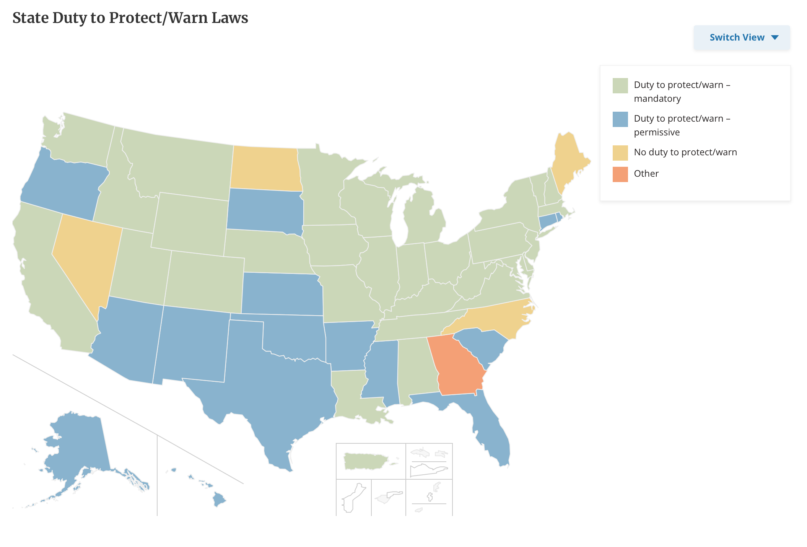
Duty to Warn or Protect
Also known as Tarasoff duties
  Warn and/or protect third party from a patient
  No statutory duty in New Mexico, some common law
https://www.ncsl.org/health/mental-health-professionals-duty-to-warn

Slide 19
Non-Accidental Injuries
Mandatory reporting to law enforcement
  Violent injuries (varies by jurisdiction)
    Firearm
    Edged weapons
    Burn
    Dog
    Specific exceptions for sexual assault/domestic violence
No duty to report in New Mexico, Oklahoma
  Unless otherwise mandated for vulnerable populations
Duty to report in Arizona, Arkansas, Colorado, Louisiana, Texas
http://4e5ae7d17e.nxcli.net/wp-content/uploads/2021/01/Mandatory-Reporting-of-Non-Accidental-Injury-Statutes-by-State.pdf

Slide 20
Resources and Information
Children, Youth, and Families Department
1-855-333-SAFE (7233) or #SAFE
https://www.cyfd.nm.gov/
Adult Protective Services (NM)
1-866-654-3219 (Statewide Intake)
  Northeast: Santa Fe, Los Alamos, Rio Arriba, Taos, Colfax, Union, Mora, Harding, San Miguel, and Guadalupe counties
  Northwest: San Juan, McKinley, Cibola, Valencia, and Socorro counties, in addition to part of Sandoval county
  Metro: Bernalillo, Torrance, and Sandoval counties
  Southeast: Serving Lincoln, De Baca, Quay, Curry, Roosevelt, Chaves, Eddy, and Lea counties
  Southwest: Serving Catron, Grant, Hidalgo, Sierra, Luna, Dona Ana, and Otero counties

Slide 21
References
https://www.nmhealth.org/publication/view/report/6564/
http://www.nmaging.state.nm.us/Adult_ProtectiveServices.aspx
https://cyfd.org/contact-us

Slide 22
Resources
National Clinician Consultation Center http://nccc.ucsf.edu/
  HIV Management
  Perinatal HIV
  HIV PrEP
  HIV PEP line
  HCV Management
  Substance Use Management
Present your case on ECHO
http://echo.unm.edu hivecho@salud.unm.edu
AETC National HIV Curriculum https://aidsetc.org/nhc
AETC National Coordinating Resource Center https://targethiv.org/library/aetc-national-coordinating-resource-center-0
HIVMA Resource Directory https://www.hivma.org/globalassets/ektron-import/hivma/hivma-resource-directory.pdf
Additional trainings scaetcecho@salud.unm.edu
www.scaetc.org
Notes:
Find additional ECHO sessions in your area: https://echo.unm.edu/locations-2/echo-hubs-superhubs-united-states/
https://hsc.unm.edu/echo/get-involved/join-an-echo/
IDEA Platform: Infectious Diseases Education & Assessment. https://idea.medicine.uw.edu/
AETC National HIV Curriculum: 6 core modules for self study; regularly updated; CME, CNE
Hepatitis C Online Curriculum: https://www.hepatitisc.uw.edu/
Hepatitis B Online Curriculum: https://www.hepatitisb.uw.edu/
National STD Curriculum: https://www.std.uw.edu/

Slide 23
