Slide 1
Methamphetamine and Implications for HIV
Fernando Montero, PhD
Chief T32 Postdoctoral Research Fellow, HIV Center for Clinical and Behavioral Studies, Columbia University; Postdoctoral Research Fellow, HEALing Communities Study, Social Intervention Group, Columbia University
April 10, 2024

Slide 2
Disclaimer
The views and opinions expressed in this presentation are not necessarily those of the Pacific AIDS Education & Training Center (Pacific AETC) or its eight local partner sites in HRSA Region 9, the Regents of the University of California or its San Francisco campus (UCSF or collectively, University) nor of our funder the Health Resources and Services Administration (HRSA). Neither Pacific AETC, University, HRSA nor any of their officers, board members, agents, employees, students, or volunteers make any warranty, express or implied, including the warranties of merchantability and fitness for a particular purpose; nor assume any legal liability or responsibility for the accuracy, completeness or usefulness of information, product or process assessed or described; nor represent that its use would not infringe privately owned rights.
HRSA Acknowledgement Statement The Pacific AETC is supported by the Health Resources and Services Administration (HRSA) of the U.S. Department of Health and Human Services (HHS) as part of an award totaling $4,377,449. The contents are those of the author(s) and do not necessarily represent the official views of, nor an endorsement, by HRSA, HHS, or the U.S. Government. For more information, please visit HRSA.gov.
Trade Name Disclosure Statement Funding for this presentation was made possible by 5 U1OHA29292‐08‐00 from the Human Resources and Services Administration HIV/AIDS Bureau. The views expressed do not necessarily reflect the official policies of the Department of Health and Human Services nor does mention of trade names, commercial practices, or organizations imply endorsement by the U.S. Government. Any trade/brand names for products mentioned during this presentation are for training and identification purposes only.

Slide 3
Disclosures
All presenters of this continuing medical education activity have indicated that neither they nor their spouse/legally recognized domestic partner has any financial relationships with commercial interests related to the content of this activity.

Slide 4
Learning Objectives
At the completion of this presentation, participants will be able to:
Describe current trends in methamphetamine use and its relation to HIV incidence and prevalence across the United States
Explain how methamphetamine use and HIV incidence and prevalence are linked through behavioral and neurological/physiological mechanisms
Explain how methamphetamine is used by people who use drugs, and how the emergence of fentanyl and xylazine in the street opioid supply has transformed the landscape of risk around methamphetamine and HIV
Explain emerging treatment options and ongoing clinical research around the combined treatment of substance use disorder (SUD) and HIV

Slide 5
Methamphetamine: Overview
Euphoria, behavioral disinhibition, and goal-directed behavior that devolves into anxiety, insomnia, paranoia, and often persecutory delusions similar to paranoid schizophrenia
Prevalence of MA use is much higher in groups who use other drugs and among people who live in rural areas, youth, men who have sex with men, shift workers, and people who engage in exchange sex (Shoptaw et al. 2022)
Frequent high doses lead to neuroinflammation and displacement of dopamine from synaptic vesicles in dendrites, which increases oxidative stress and neuronal damage. Sustained MA use strongly linked to cardiovascular disease, acute and chronic renal damage, liver problems, psychiatric conditions and neurological impairment (Shoptaw et al. 2022)

Slide 6
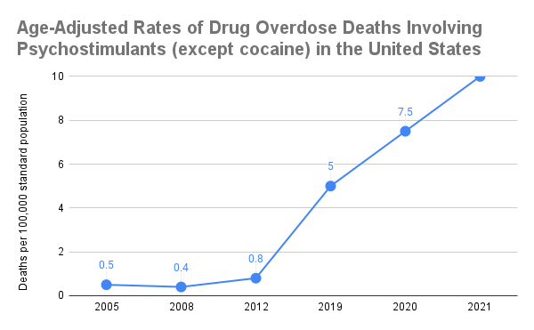
Methamphetamine Use in the United States: Current Trends
Psychostimulant overdose deaths in the United States rose by 1250% between 2012 and 2021 (from 0.8 deaths per 100,000 persons in 2012 to 10.0 deaths per 100,000 in 2021). (CDC 2022)

Slide 7
Racial/Ethnic and Gender Disparities: Men
Trends in Age-Adjusted Overdose Death Rates per 100 000 (95% CI) Involving Methamphetamine Among Adults Aged 25-54 Years by Sex and Race and Ethnicity
(Han et al. 2021:565)

Slide 8
Racial/Ethnic and Gender Disparities: Women
Trends in Age-Adjusted Overdose Death Rates per 100 000 (95% CI) Involving Methamphetamine Among Adults Aged 25-54 Years by Sex and Race and Ethnicity
(Han et al. 2021:565)

Slide 9
Regional Disparities
The Centers for Disease Control and Prevention (CDC) report that, as of 2018, ‘age-adjusted death rates for drug overdoses involving psychostimulants with abuse potential ranged from 1.2 [per 100,000] in the Northeast to 5.3 in the West.’ (CDC 2019:37)
Increasing use of MA in the US must be understood as a consequence of drug prohibitionism and in relation to changes in street opioid supply (Montero et al. 2022; Mars et al. 2024)
The US is only one part of a global phenomenon: Iran, China, Mexico, and Australia report similar issues with rising opioid-meth co-use (Rhed et al. 2022; Mehrjerdi et al. 2013)

Slide 10
Methamphetamine in Nevada
Nevada’s per capita rate of methamphetamine use was highest in the nation in 2018
Nevada has consistently ranked in the top quartile of opioid overdose deaths among all US states
Special attention must be given to Native American and Latinx groups
Source: Rhed et al. 2022:2

Slide 11
Methamphetamine-Opioid Co-Use Has Grown Exponentially in US
Lower quality of opioids appears to be driving increase in methamphetamine-opioid co-use nationwide
“Fentanyl is so short-lived that we gotta get high every 6 hours. But sometimes, let’s say things were tough or whatever, if we were 10 hours in and you started getting sick, a nice shot of meth will hold you over for another 6 hours, as far as not being sick altogether. You just wouldn’t be as sick, I mean eventually it would turn against you but it would keep you feeling better to get up and make a move to make money.”
“Meth does its part too, because if you really don’t have the money, meth can keep you well for a little bit longer, it kind of will help you like, give you some time to gather up money to find some dope, you know what I mean? And you can stay up later, scheming to get money, or if you do your thing at night, boosting or whatever. I scrap, so a lot of my work is nighttime stuff.” (Montero, Bourgois & Friedman 2022)
Methamphetamine as inverse of fentanyl in terms of duration and bodily experience

Slide 12
Why Methamphetamine? Why Now?
Three types of co-use (Ondocsin et al. 2023):
1. ‘Intrinsic use’: inherent pleasure of combined use greater than using both drugs separately or for self-medication of particular conditions
2. ‘Opioid assisting use’: methamphetamine perceived as helping people manage existing heroin/fentanyl use
3. ‘Reluctant or indifferent use’ for social participation, reflecting methamphetamine’s low cost and easy availability

Slide 13
Methamphetamine and HIV – Behavioral Links
MA use has been associated with HIV-risk behaviors such as unprotected sex, greater numbers of sex partners, casual or anonymous sex partners, engaging in marathon sex while high, and injection drug use (Cheng et al. 2010; Bogart et al., 2005; Semple et al. 2005)
Studies have also shown a link between MA use and increased libido, as well as associations to a desire to enhance sexual pleasure or to lower inhibitions in order to seek sex partners, thus potentially leading to greater numbers of partners and engaging in marathon sex (Brecht et al. 2004; Diaz et al. 2005) with simultaneous increases in STIs and HIV infection (Cai et al. 2020; Urbina & Jones 2004)
Frequency of MA use is linked to higher prevalence of HIV and greater viral load (Shoptaw et al. 2022:6)

Slide 14
Methamphetamine and HIV – Behavioral Links (continued)
Most research on methamphetamine use and HIV risk behavior has focused on MSM, but relationship between MA use and sexual risk has been documented among heterosexual populations of men and women, including among persons who inject MA (Cheng et al. 2010)
MSM who use MA report that sex and methamphetamine ‘always’ or ‘often’ go together, and qualitative studies report that MSM use methamphetamine specifically to enhance performance of sexual acts
People who engage in exchange sex widely report using MA to “reduce inhibition and enhance performance during sex work” (Shoptaw et al. 2022:1)
IDU enhances risk of blood-borne viral infection

Slide 15
Methamphetamine and HIV – Physiological Links
Neurological: Chronic use of MA damages dopamine and serotonin axons, leading to chronic neuroinflammation and decreases in gray matter volume
Neurological impact may impair cognitive function and cause psychiatric disorders
Neurological damage often leads to further behavioral risk-taking

Slide 16
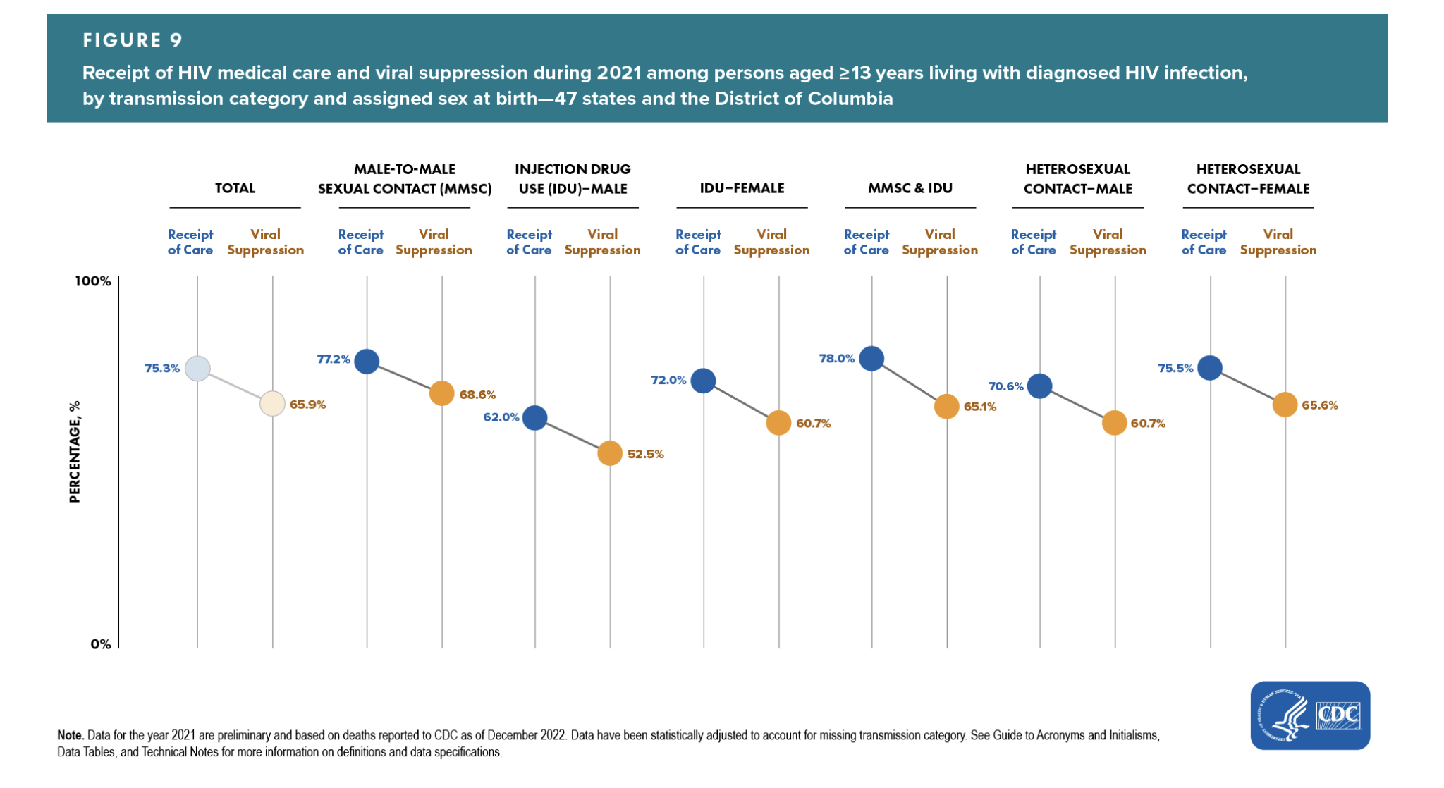
Methamphetamine and HIV – Structural Links 1
PWID have lowest rates of access to HIV care among all HIV transmission categories in the US (CDC 2023)

Slide 17
Methamphetamine and HIV – Structural Links (continued)
Unemployment, housing instability, and intimate partner violence all predicted higher levels of MA use among diverse samples of people who use MA in California (Shoptaw et al. 2022)
Feedback loops between structural determinants of health (SDOH) and chronic use of MA in high doses

Slide 18
SUD Care Is HIV Care
Screening for MA use is an important component of HIV prevention and care
Current treatment / harm reduction options for MA use disorder:
Contingency management (Benishek et al. 2014; Menza et al. 2010)
Repetitive transcranial magnetic stimulation proving somewhat effective at decreasing MA withdrawal symptoms – Pilot RCT by Liang, Wang & Yuan 2018
High-dose bupropion (450 mg) combined with naltrexone-XL showed significant decrease in methamphetamine use in a large RCT (n=403) (Trivedi et al. 2021)
Cognitive-behavioral therapy (Harada et al. 2018)

Slide 19
Looking Ahead
Need to bring HIV care to the street – partnerships with wound care teams
Overdose prevention centers will prevent overdoses, sexual assault, and transmission of blood-borne viruses
Safer Supply
Notes:
- What can be done to address the new harm reduction landscape produced by ongoing transformations in the US street drug supply?
First, it is crucial to bring the clinic to the street as much as possible given how the xylazine/meth wound crisis is aggravating access/adherence to care, including HIV prevention and treatment. HIV practitioners should consider partnerships with mobile/street wound care teams.
We must continue to call for the establishment of overdose prevention centers. In the context of xylazine adulteration, OPCs will help to prevent not only deadly overdoses, but also sexual assault given the extended periods of deep sleep that xylazine induces.
We must also continue to call for the democratization of sophisticated drug checking technology. Specifically, mass spectrometers should be distributed to community-based organizations and to PWUD peer navigators around the country. This will allow PWUD and public health service providers to learn in real time the exact composition of street drug supplies, allowing PWUDs to behave accordingly and enabling public health to respond more quickly and effectively to supply changes.
We must also continue to call for the establishment of safe supply programs in the United States. These programs, which have had great success in Canada and parts of Europe, involve the prescription of pharmaceutical grade opioids to people with opioid use disorder. Given the decrease in quality that fentanyl and xylazine presuppose in comparison to heroin, safe supply would be uniquely appealing to PWUDs in the current era of synthetic sedatives. Safe supply would be unambiguously superior to currently existing street supplies – a fact that would not have been true for many cities during the agricultural heroin era.

Slide 20
Towards Supply-Side Harm Reduction
Importance of not vilifying people who sell drugs (street sellers)
It is crucial to understand socioeconomic organization of narcotics markets at all levels of supply chain (vs. simply drug use)
Enhances understanding of how supply changes happen and how public health can intervene more efficiently and non-punitively
Notes:
- It is important for public health and harm reduction service providers NOT to throw people who sell drugs under the bus in order to attend to PWUDs. People who sell drugs are potential allies, not enemies, in the effort to address the ongoing overdose epidemic. People who sell drugs could distribute naloxone, syringes, fentanyl test strips, xylazine test strips, HIV home tests, and other life-saving harm reduction technologies to their customers.
- Public health has so far relinquished the study of narcotics supply chains to the DEA and to local law enforcement (Montero et al. 2022). Public health has been relegated to the downstream management of substance-use related pathologies, while law enforcement monopolizes the upstream assessment of narcotics supply chains. We must change this. Studying all levels of narcotics supply chains from a public health perspective would allow us to reimagine drug testing programs. It would enable new ways of engaging non-punitively with drug suppliers in order to regulate drug markets more effectively without relying on the punishment logics of law enforcement.

Slide 21
References
Cai, Y, Dai, Z, Wen, S and Bhandari, R. 2020. Risk factors associated with infection of blood-borne virus among people who used methamphetamine. BMC Infectious Diseases, 20:742. DOI: https://doi.org/10.1186/s12879-020-05464-y
Centers for Disease Control and Prevention, US (CDC). 2019. 2019 Annual Surveillance Report of Drug-Related Risks and Outcomes. Centers for Disease Control and Prevention, U.S. Department of Health and Human Services.
Ciccarone, D., and Shoptaw, S. 2022. Understanding stimulant use and use disorders in a new era. Medical Clinics of North America, 106(1): 81-97.
Han, B., Cotto, J., Etz, K., Einstein, EB., Compton, WM. And Volkow, ND. 2021. Methamphetamine overdose deaths in the US by sex and race and ethnicity. JAMA Psychiatry, 78(5): 564-567.
Hedegaard, H., Minino, A. and Warner, M. 2020. Drug overdose deaths in the United States, 1999-2019. NCHS Data Brief, 394. Hyattsville, MD: National Center for Health Statistics.
Liang, Y, Wang L, and Yuan TF. 2018. Targeting withdrawal symptoms in men addicted to methamphetamine with transcranial magnetic stimulation: a randomized clinical trial. JAMA Psychiatry 75(11):1199-1201.
Mars S, Ondocsin J, Holm N, and Ciccarone D. 2024. The influence of transformations in supply on methamphetamine initiation among people injecting opioids in the United States. Harm Reduction Journal 21(1):57. doi: 10.1186/s12954-024-00976-1.

Slide 22
References 1
Montero, F., Bourgois, P., and Friedman, J. Potency-Enhancing Synthetics in the Drug Overdose Epidemic: Xylazine (“Tranq”), Fentanyl, Methamphetamine, and the Displacement of Heroin in Philadelphia and Tijuana. Journal of Illicit Economies and Development 4(2):204-222. https://jied.lse.ac.uk/articles/10.31389/jied.122
Ondocsin, J., Holm, N., Mars, SG., and Ciccarone, D. 2023. The motives and methods of methamphetamine and ‘heroin’ co-use in West Virginia. Harm Reduction Journal 20:88.
Rhed, BD, Harding, RW, Markes, C, Wagner, KT, Fiuty, P, Page, K, and Wagner, KD.
2022. Patterns and Rationale for the Co-Use of Methamphetamine and Opioids: Findings from Qualitative Interviews in New Mexico and Nevada. Frontiers in Psychiatry 13:824940. doi: 10.3389/fpsyt.2022.824940
Shoptaw S, Li MJ, Javanbakht M, Ragsdale A, Goodman-Meza D, Gorbach PM. Frequency of reported methamphetamine use linked to prevalence of clinical conditions, sexual risk behaviors, and social adversity in diverse men who have sex with men in Los Angeles. Drug Alcohol Depend. 2022;232:109320. Epub 2022 Jan 19. PMID: 35093681; PMCID: PMC8885921.
Spencer, MR, Minino, AM, and Warner M. Drug overdose deaths in the United States, 2001-2021. NCHS Data Brief, 457. Hyattsville, MD: National Center for Health Statistics.
Trivedi, MH, Walker, R, Ling W, Dela Cruz, A, Sharma, G et al. 2021. Bupropion and naltrexone in methamphetamine use disorder. New England Journal of Medicine 384(2):140-153.

