Slide 1
HIV Diagnostic Perils and Pitfalls: from Pregnancy to PrEP and Beyond
Dr. Chris Bositis
Clinical Director, National Clinician Consultation Center
HS Associate Clinical Professor
UCSF Department of Family and Community Medicine

Slide 2
Disclosures
This program is supported by the Health Resources and Services Administration (HRSA) of the U.S. Department of Health and Human Services (HHS) under grant number U1OHA30535 as part of an award totaling $4.2m. The contents are those of the author(s) and do not necessarily represent the official views of, nor an endorsement, by HRSA, HHS, or the U.S. Government. For more information, please visit HRSA.gov.
“Funding for this presentation was made possible by cooperative agreement U1OHA30535 from the Health Resources and Services Administration HIV/AIDS Bureau. The views expressed do not necessarily reflect the official policies of the Department of Health and Human Services nor does mention of trade names, commercial practices, or organizations imply endorsement by the U.S. Government. Any trade/brand names for products mentioned during this presentation are for training and identification purposes only.”
This content is owned by the AETC, and is protected by copyright laws. Reproduction or distribution of the content without written permission of the sponsor is prohibited, and may result in legal action.

Slide 3
Disclosures
All planners, faculty, and others in control of educational content are required to disclose all their financial relationships with ineligible companies within the prior 24 months. An ineligible company is defined as one whose primary business is producing, marketing, selling, re-selling, or distributing healthcare products used by or on patients. Financial relationships are relevant if the educational content an individual can control is related to the business lines or products of the ineligible company.
None of the planners, faculty, and others in control of educational content for this educational activity have relevant financial relationship(s) to disclose with ineligible companies.
The material presented in this course represents information obtained from the scientific literature as well as the clinical experiences of the speakers. In some cases, the presentations might include discussion of investigational agents and/or off-label indications for various agents used in clinical practice. Speakers will inform the audience when they are discussing investigational and/or off-label uses.
Disclosure of a relationship is not intended to suggest or condone commercial bias in any presentation, but it is made to provide participants with information that might be of potential importance to their evaluation of a presentation.

Slide 4
AETC Program National Centers and HIV Curriculum
National Coordinating Resource Center – serves as the central web –based repository for AETC Program training and capacity building resources; its website includes a free virtual library with training and technical assistance materials, a program directory, and a calendar of trainings and other events. Learn more: https://aidsetc.org/
National Clinician Consultation Center – provides free, peer-to-peer, expert advice for health professionals on HIV prevention, care, and treatment and related topics. Learn more: https://nccc/ucsf.edu
National HIV Curriculum – provides ongoing, up –to-date HIV training and information for health professionals through a free, web –based curriculum; also provides free CME credits, CNE contact hours, CE contact hours, and maintenance of certification credits. Learn more: www.hiv.uw.edu

Slide 5
Learning Objectives
Describe the basic testing algorithm for HIV diagnosis in the US
Name at least 3 common causes of ambiguous HIV test results
Explain how to approach ambiguous test results in common clinical scenarios such as:
    Pregnancy
    People taking PrEP

Slide 6
Why talk about HIV testing?
It is still underutilized
    Approximately 1 in 8 people with HIV don’t know it/have never been tested
    Fewer than half of all adults in the US report ever being tested for HIV
    Approximately 55% of women, and 60% of men, in groups historically labeled as “high risk” have not been tested within the last 12 months
  There have been recent changes in approved tests as part of the diagnostic algorithm
  It can sometimes be difficult to interpret, particularly in the era of (LA) PrEP
1. CDC. Diagnoses of HIV infection in the United States and dependent areas, 2021. HIV Surveillance Report 2023;34
2. https://www.kff.org/hivaids/fact-sheet/hiv-testing-in-the-united-states/#:~:text=According%20to%20the%20CDC's%20Behavioral,%2Fethnicity%2C%20and%20other%20factors., accessed 3/29/24
3. Interval Since Last HIV Test for Men and Women with Recent Risk for HIV Infection — United States, 2006–2016. MMWR Morb Mortal Wkly Rep 2018;67:677–681. DOI: http://dx.doi.org/10.15585/mmwr.mm6724a2

Slide 7
Case 1
- 28 yo woman – OUD (daily fentanyl injection), cocaine use disorder, PTSD, anxiety, asthma
Albuterol MDI only active medication at time of visit
Presents to clinic asking for buprenorphine/naloxone, in withdrawal
    Overdosed 2 days prior
    Reports history of exchange sex
    No recent STIs
    Denies ever sharing injection related equipment
    Denies:
      Recent fevers/rash/flu-like illness
      History of HBV
      History of renal disease

Slide 8
Case 1 (cont.)
- In addition to discussing treatment for her OUD, you also discuss HIV testing and prevention options for her

Slide 9
ARQ 1: Which of the following tests is the preferred initial HIV screening test for this person according to current CDC guidelines?
Qualitative HIV NAT test
Quantitative HIV NAT test
HIV Western Blot
Rapid HIV-1/2 Antibody test
HIV Antigen/Antibody test

Slide 10
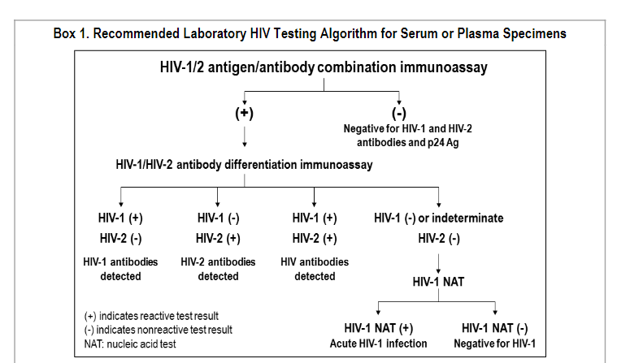
Standard HIV testing algorithm (2014)
Centers for Disease Control and Prevention and Association of PublicHealth Laboratories. Laboratory Testing for the Diagnosis of HIV Infection: Updated Recommendations. Available at http://dx.doi.org/10.15620/cdc.23447. Published June 27, 2014. Accessed 3/29/24

Slide 11
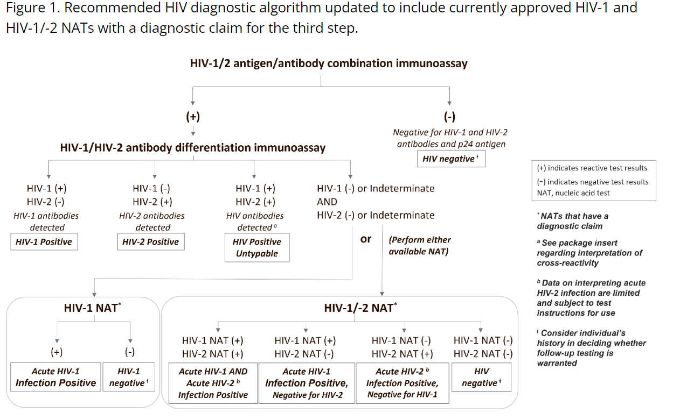
Standard HIV diagnostic testing algorithm (updated)
Downloaded from https://www.cdc.gov/hiv/guidelines/recommendations/technical-update-for-hiv.html, accessed 3/29/24
Notes:
Note that, when using the standard algorithm, the HIV-1 NAT can be a standard viral load – i.e. it does not need to include a NAT with a diagnostic claim
- Be prepared to answer questions about different options for NATs with diagnostic claims

Slide 12
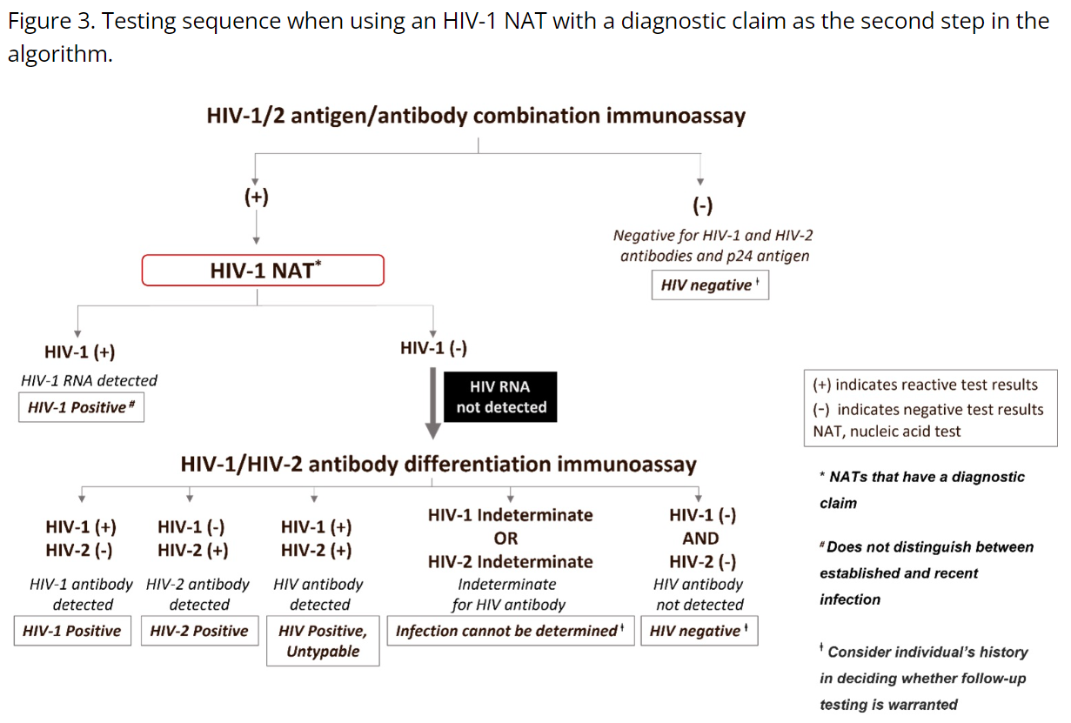
Alternate approved testing algorithm (updated)
Downloaded from https://www.cdc.gov/hiv/guidelines/recommendations/technical-update-for-hiv.html, accessed 3/29/24

Slide 13
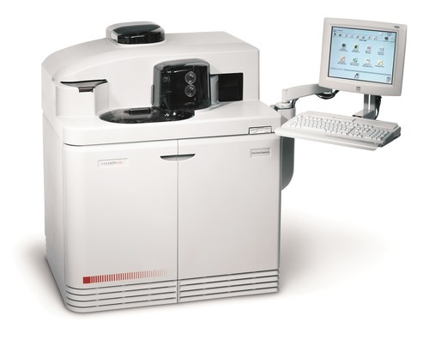
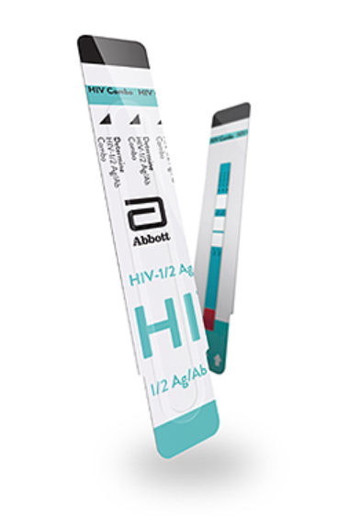
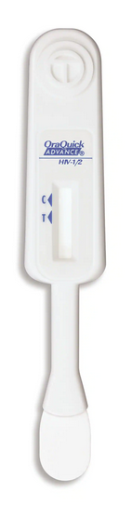
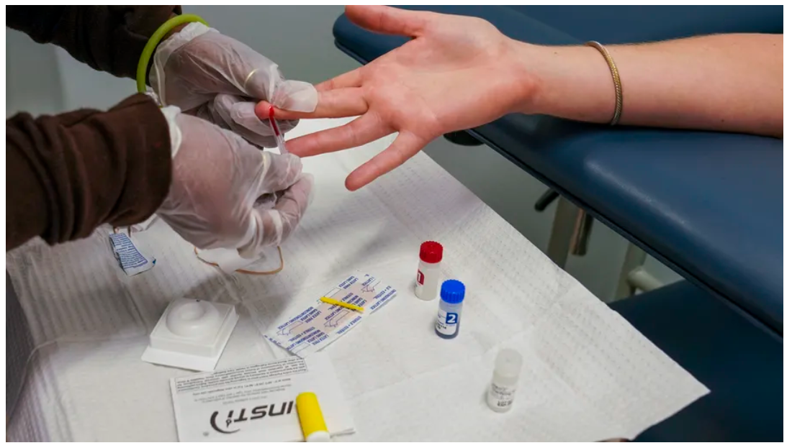
Instrumented vs. POC/non-instrumented testing
Mar. 20YY
Describe your subject’s impact
Determine HIV-1/2 Ag/Ab
INSTI HIV-1/2 Ab
Slide courtesy of Dr. Carolyn Chu
Notes:
Slide courtesy of Dr. Carolyn Chu
- Highlight differences between POC and instrumented testing
- POC – uses lateral flow technology (like a pregnancy test), provides rapid results
- Finger stick!
- Most detect antibodies alone, so longer window period
- Not quite as sensitive as instrumented tests (oral/saliva-based tests
specifically not recommended in certain settings, e.g. for PrEP)
- Not approved for diagnosis – need to confirm by sending to lab
- Useful in certain situations – L+D, PrEP, issues with venipuncture
- Instrumented
- Venipuncture required
- Longer turn around time, risk for lost to follow up
- More sensitive, detect Ag as well so shorter window period
- Sample can be used for FU/confirmatory testing

Slide 14

Traditional* sequence of lab marker appearance for HIV-1
Slide courtesy of Dr. Carolyn Chu
HIV RNA
RNA – Aptima
DNA
HIV p24 Ag
p24 Antigen
4th Gen (p24 & 3rd Gen) = Architect and GS HIV Combo
Viral set point
Insti HIV-1
Multispot HIV-1-2 Rapid
Reveal
Clearview (2)
Oraquick Advance Rapid
Unigold Recombigen 1/2
HIV Ab (IgG)
2nd Gen
18 – 38 days after
RNA
HIV infection
HIV Ab (IgM)
3rd Gen
IgM mostly
IgG some
Architect
Advia Centaur
Vitros
GS HIV 1-2
Abbott PRISM
Unigold Recombigen (Rapid)
. .
11 16
.
Time (days)
0 10 20 30 40 50 60 180 240
(1) Eclipse (2) Acute Recent (4) Long-standing (chronic)
period infection infection infection
(3) Seroconversion window period
Traditional rapid Ab assays
detect @ days ~28-35
Notes:
VL can be detected as early as 7-8 days (peaks ~week 3-4 after acquisition) then eventually transitions to ‘set point’ if ART not initiated
IgM Ab may be detected as early as 14 days
V. high levels of virus become detectable in serum and genital secretions during acute HIV and persist for 10-12 wks.

Slide 15
Case 2
36yo at 22wks GA, conceived via IVF
    Born/raised in Ethiopia, unknown vaccine history. 1 sex partner: husband (?testing history)
Pre-IVF work-up (or early antenatal screening?): HIV negative by patient report
8/5/2021 HIV Ag/Ab reactive → HIV-1 Ab reactive, HIV-2 Ab indeterminate → HIV-1 NAT not detected
    Started on ART based on these results

Slide 16
Case 2 (cont).
2 months later (after on ART x 3 weeks):
    HIV-1 NAT ND
    HIV-2 ND
    Lab director re-ran 8/2021 samples: same results—reactive env gp41, non-reactive env gp160
  Patient requested repeat HIV, HBV screening (Sept 2021)
  Works in meat factory --> read animal exposures can cause false pos
    HIV Ag/Ab with heterophile blocking reagent (HBR): non-reactive

Slide 17
ARQ 2 – Is this person infected with HIV?
Yes
No
I don’t know

Slide 18
Ambiguous HIV Test Results – what are they?
Results where the presence or absence of HIV cannot be clearly established based on the usual HIV diagnostic algorithm; e.g.:
    A positive HIV Ag/Ab test but an indeterminate HIV-1/HIV-2 differentiation assay in someone with no prior/recent ART exposure
    A positive HIV Ag/Ab test but a negative HIV RNA test (or vice versa) in someone on/recently exposed to PrEP

Slide 19
Ambiguous HIV Test Results – what causes them?
Laboratory error
False positives due to cross-reacting antibodies, e.g.:
  Influenza vaccine
  COVID (and ? COVID vaccine)
  EBV
  Malaria
  Pregnancy
  Autoimmune disease
Exposure to ART
HIV vaccines

Slide 20
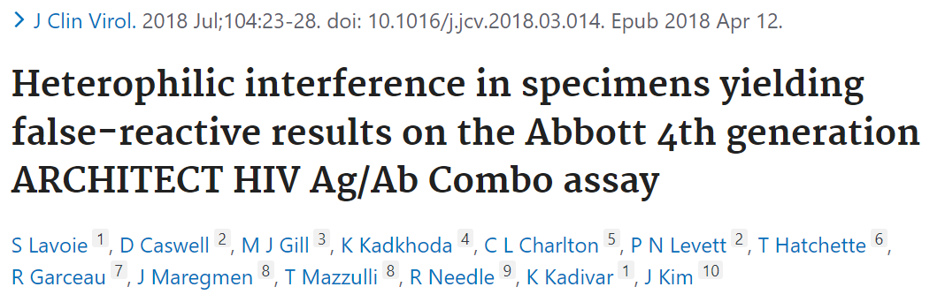
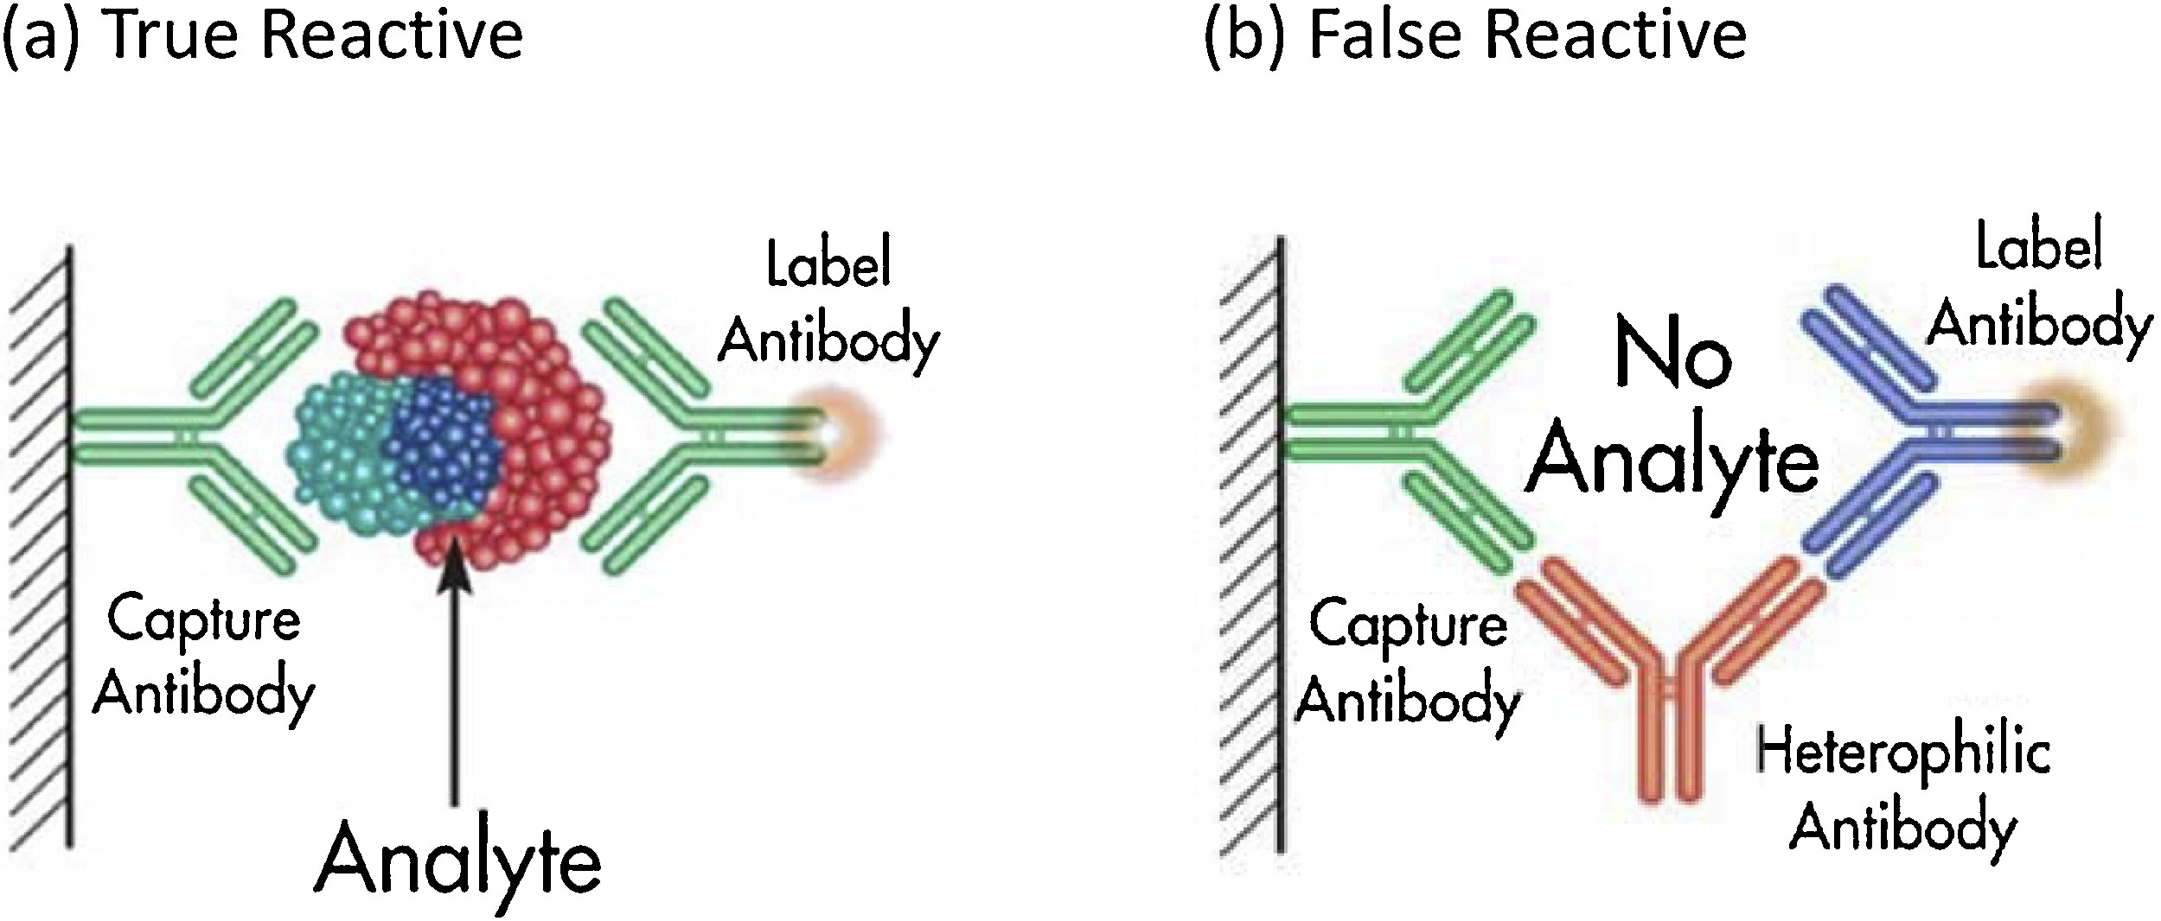
Heterophile antibodies
Slide courtesy of Dr. Carolyn Chu
Endogenous Ab in human serum/plasma that may interfere with IA --> false elevations of measured values
  ?Exposure to mice/mouse products
  ?Immunization, transfusion
  ?Autoimmune disease
  ?Infection (e.g., EBV)
0.17-40% prevalence¹
95% clinical specimens repeatedly reactive on one HIV screening platform negative when retested on different platform; HBR pre-treatment eliminated/reduced false reactivity
1. Morton A. (2014) Aust Fam Physician
Notes:
*Q&A with JJ:
If you suspect a false positive HIV test because of this, will repeating the test in some timeframe be helpful because these will have waned, or do they persist indefinitely? As indicated above, heterophilic Ab persistence depends on the suspected co-infection. Generally, it would not be advisable to wait for the course of co-infection to wane but rather repeat testing using a different platform.
Are heterophilic antibody blocking assays widely available in different labs? How can we direct callers to find out if a local lab offers them? Are they standardized? While heterophile Ab testing (aka., mono screen/mononucleosis test/anti-mouse Ab) is available in commercial labs, the tests are not FDA-approved for patient management. They can be informative as to evidence of false-reactivity, but it is not CONFIRMATION that a person is not infected. You would have to check if any lab has internally validated the test for reporting. I would suspect the test is not widely available at local public health/health dept labs.
Aust FP article: Prevalence of heterophile antibodies is 0.17–40% in the general population (article ref 1). Proposed sources for induction of heterophile Ab include exposure to mice and mouse products, immunization, blood transfusion, autoimmune diseases, dialysis and maternal transfer. Where suspected, presence of heterophile Ab interfering with the accuracy of investigations can be addressed through analysis by an alternative analytical platform, non-linearity of results on serial dilution or the use of heterophile-blocking reagents or immunoglobulin-blocking reagents.
Fig 1: Two-site immunometric or sandwich assays are particularly susceptible to analytical error in the setting of heterophile Ab. These assays use at least two Ab directed against different epitopes of an Ag: one bound to a solid-phase, the other in solution and tagged with a signal moiety. The Ag in the sample bridges the two Ab so that the amount of labelled Ab that binds to the solid-phase is proportional to the Ag concentration in the sample
Fig 2: Heterophile Ab can also bridge the two Ab independently of Ag, resulting in an increase in labelled Ab concentration
Lavoie paper (https://www.sciencedirect.com/science/article/pii/S138665321830091X?via%3Dihub):
Here we report that 95% (252/264) of clinical specimens that were repeatedly reactive on the Abbott ARCHITECT HIV Ag/Ab combo assay (S/Co range, 0.94–678) were negative when re-tested on a different fourth generation HIV combo assay (Siemens ADVIA Centaur HIV Ag/Ab). All 264 samples were subsequently confirmed to be HIV negative. On a small subset (57) of specimens with available volume, pre-treatment with two different reagents (HBT; Heterophilic Blocking Tube, NABT; Non-Specific Blocking Tube) designed to block heterophilic antibody interference either eliminated (HBT) or reduced (NABT) the false reactivity when re-tested on the ARCHITECT HIV Ag/Ab combo assay.
**we suspect that the false reactivity in the Abbott ARCHITECT HIV Ag/Ab combo assay is associated with the monoclonal antibody against HIV-1 p24 that is used in the Abbott assay. … This interference is unpredictable and although the use of heterophilic blocking tubes may be helpful in root-cause analysis, their use does not represent a practical method to address this issue. Although we do not have direct evidence it is possible that the cross-reactivity observed in the Abbott assay may be due to the specific (murine) monoclonal antibody used in their assay.
[The NLHRS-NML is a national reference laboratory for HIV and HTLV testing and receives specimens with any diagnostic uncertainty from public health laboratories, hospitals, blood screening agencies and research institutions across Canada. It is the only laboratory in Canada to be accredited under both the ISO 15189 (Medical laboratory testing) and ISO 17043 (Proficiency testing provider) accreditation schemes. The tests used in its confirmatory serological and NAT (nucleic acid testing) testing algorithms include the Bio-Rad GS HIV Combo Ag/Ab EIA, Bio-Rad Geenius HIV 1/2 Confirmatory assay, Fujirebio Inno-LIA HIV-I/II Score, Bio-Rad Genscreen HIV-1 Ag Screening and Confirmatory Assays, BioLytical INSTI HIV-1/HIV-2 Antibody Test, Roche COBAS AmpliPrep/COBAS Taqman HIV-1 Qual v2.0 and in-house HIV-1/2 PCR. Two different reagents (Scantibodies Lab Inc, San Diego, CA) both designed to reduce HAb interference were used; (a) Heterophilic Blocking Tube (HBT), cat #3IX762, containing specific binders that bind heterophilic antibodies and inactivates heterophilic interference, (b) Non-Specific Antibody Blocking Tube (NABT), cat# 3IX761 contains immunoglobulins that bind non-specific antibodies in plasma/serum and block interference in antibody detection immunoassays. ]

Slide 21
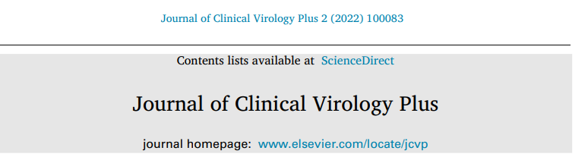
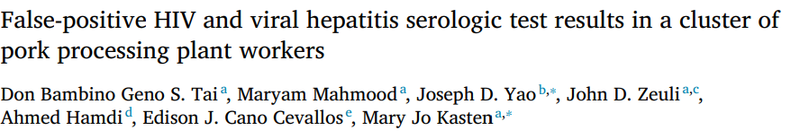
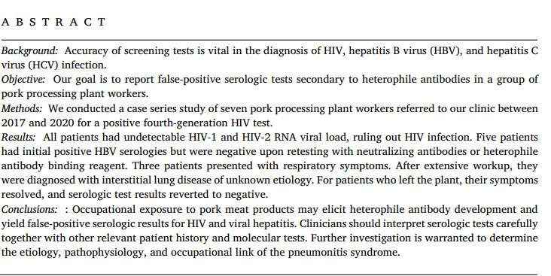

Slide 22
Case 2 (cont)
Called overnight:
    Infant delivered 2hrs ago: FT NSVD
    Sign-out from maternal HIV provider to Peds: "6wks AZT for infant and OK to breastfeed"
      Overnight Peds advised patient to pump/save until able to clarify prior breastfeeding
    Overnight convo with Hotline: ?Role of initial infant ARVs while awaiting further info

Slide 23
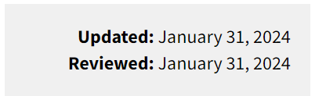
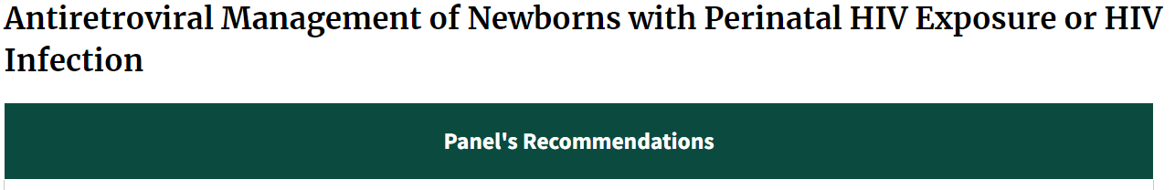
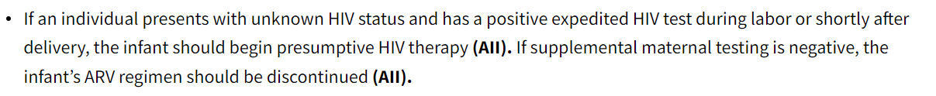
What to do about uncertain HIV test results in pregnancy
Downloaded from https://clinicalinfo.hiv.gov/en/guidelines/perinatal/whats-new, accessed 3/29/24

Slide 24
Case 2 (cont)
  Next day f/u: Likely interpretation of maternal testing = false positive... ? Decision to continue maternal ART to delivery and then D/C
    Infant testing: NAT? HIV Ag/Ab?
    Infant ARV management?
    Additional maternal testing?
  Final NCCC recommendations:
    Most likely maternal HIV test results false +
    Agree with decision to continue ART in pregnancy
    Suggest AZT for baby while awaiting further clarification of maternal status
    Repeat HIV Ag/Ab test on a different instrumented platform →
      If neg, stop infant ARVs
      If positive, do additional test (e.g. proviral DNA resistance test or Western blot)
Notes:
Discussed that likely interpretation of mom's HIV testing is that it is a false positive, though we support decision to give maternal ART during pregnancy
As far as he knows, plan was for mom to stop ART at delivery
Discussed following recommendations, which were obtained in consultation w 3rd tier consultant from peri-team (Ted Ruel), CDC lab (Jeff Johnson), and other peri team members (Carolyn Chu)
Recommend infant testing: in addition to RN, would check HIV Ag/Ab testing
Recommend repeat testing for mom - preferably with 4th gen HIV test from different platform
If repeat test for mom is negative, can say that previous tests were false positives and she is uninfected, baby is unexposed, and ppx can be stopped
If repeat test remains positive, would recommend addition testing to clarify diagnosis: 1. commercially available ultrasensitive DNA sequencing (archived DNA resistance test) 2. sending maternal sample to CDC for further testing. Will e-mail him with info on both of these.
Recommended 4 weeks of AZT, but could extend to 6 weeks if needed while awaiting above test results for clarification.
Mom currently using donor breast mild, but is pumping and storing - supported this decision.
Noted that ideally will have test results back before making a decision re: maternal breastfeeding. If not, may consider with careful consideration of risk/benefits. Discussed risk of breastmilk transmission in women with HIV suppressed on HIV, acknowledged that we (I) don't know numbers for elite controllers not on ART

Slide 25
Case 3
June 2023: 23 yo cis-M presents for repeat LA-CAB injection
    Previously on PrEP at different facility, but no records available.
    May 10: PrEP enrollment visit – HIV Ag/Ab and VL both negative
    May 30: Initial injection
      Rapid HIV Ab test negative on day injection given
    June 27: day of visit – Ag/Ab test and VL done, injection given
      No rapid test done

Slide 26
Case 3 (cont)
6/30: HIV Ag/Ab test results as “low-level positive”
    HIV VL: 451 c/mL
  Additional history: between 5/10 and 5/30, patient reports:
    4 sexual partners, all known to patient
    All either on PrEP or HIV status known
    Main partner also had been on PrEP, but off for about 1 week before first injection 5/30

Slide 27
ARQ 3: Is this person infected with HIV?
Yes
No
I don’t know

Slide 28
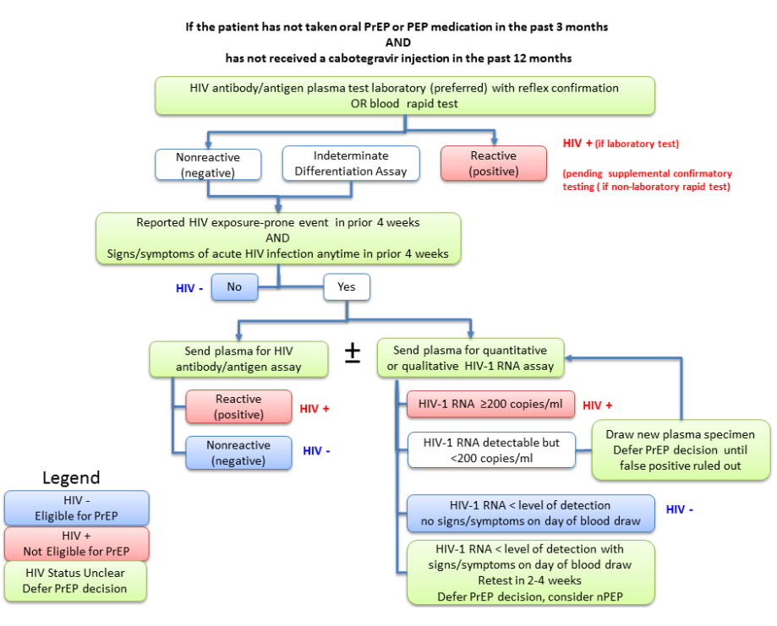
Recommended HIV testing algorithm prior to starting PrEP
For people with no recent PEP or PrEP exposure*
  HIV Ag/Ab with reflex to confirmatory differentiation assay
If high risk exposure/signs or symptoms of acute HIV within 4 weeks OR planning on injectable PrEP:
  Obtain HIV RNA (qualitative or quantitative) as well
* No oral PEP/PrEP within 3 mos, and no injectable PrEP within 12 mos
Centers for Disease Control and Prevention: US Public Health Service: Preexposure prophylaxis for the prevention of HIV infection in the United States—2021 Update: a clinical practice guideline. https://www.cdc.gov/hiv/pdf/risk/prep/cdc-hiv-prep-guidelines-2021.pdf. Published December 2021

Slide 29
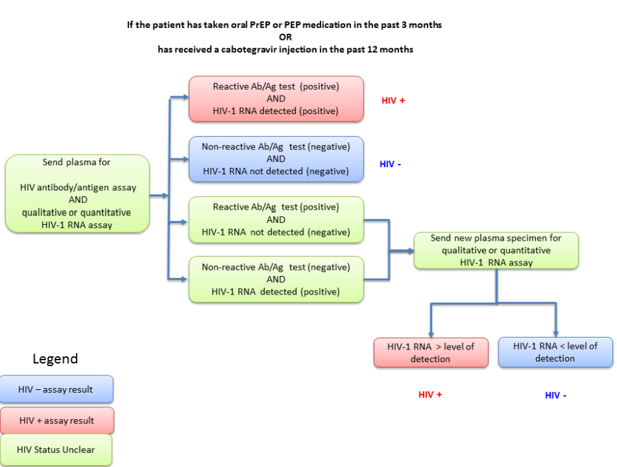
Recommended HIV testing algorithm for persons on/with recent exposure to PrEP (or PEP)
All people on PrEP, or with a recent exposure to PrEP, should get:
  HIV Ag/Ab test
  HIV RNA test (qualitative or quantitative)
If both positive = HIV infection
If both negative = no HIV infection
If one positive but the other negative – ambiguous test result, additional testing recommended
Centers for Disease Control and Prevention: US Public Health Service: Preexposure prophylaxis for the prevention of HIV infection in the United States—2021 Update: a clinical practice guideline. https://www.cdc.gov/hiv/pdf/risk/prep/cdc-hiv-prep-guidelines-2021.pdf. Published December 2021

Slide 30
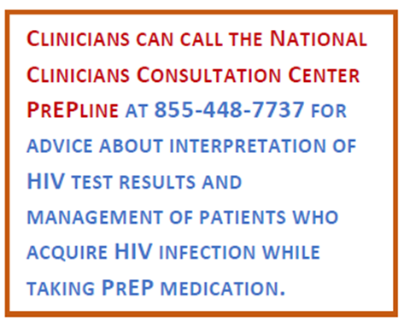
Ambiguous HIV Test Results – what to do about them
Get additional testing
Call the NCCC!
HIV Ag/Ab positive
AND
HIV-1/HIV-2 Ab differentiation assay negative/indeterminate
THEN
HIV RNA testing (Qualitative or quantitatve)
NO
HIV Ag/Ab positive
AND
HIV RNA
(Qualitative or quantitatve) negative
THEN
Repeat HIV RNA (Qualitative or quantitatve)
RECENT ART EXPOSURE?
YES
HIV Ag/Ab negative
AND
HIV RNA
(Qualitative or quantitatve) positive
THEN
Repeat HIV RNA (Qualitative or quantitatve)

Slide 31
LEVI Syndrome Patient Case: Detection of Infection
Retrospective sensitive HIV-1 RNA testing detected HIV infection 3 mo earlier than study site
Retrospective Testing
Ag/Ab test nonreactive
Qualitative RNA reactive
HIV-1 RNA 6.1 c/mL
Study Site
Ag/Ab test reactive
HIV-1 RNA not detectable
(LLOQ: 20 c/mL)
20
3 Mo
PEP
CAB (mcg/mL)
1.33
0.664
0.166
BLQ
0
5
10
15
20
25
30
35
40
45
50
55
60
65
70
75
Wk Since Enrollment
CAB concentration
CAB Injection
First site positive visit
First HIV positive visit
#
Months between first HIV positive visit and the first site reactive HIV test
Eshleman. CROI 2023. Abstr 160. Reproduced with permission.
Notes:
Ab, antibody; Ag, antigen; BLQ, below limit of quantification; CAB; cabotegravir; LEVI, long-acting early viral inhibition; LLOQ, lower limit of quantification; PEP, postexposure prophylaxis.

Slide 32
LEVI Syndrome Patient Case: Confirmation of Infection
HIV infection not confirmed by study site until after 9 mo from first HIV+ visit
Retrospective genotyping failed at first HIV+ visit (HIV-1 RNA 6.1 c/mL) and detected
INSTI resistance at study site HIV+ visit (HIV-1 RNA 23 c/mL)
Retrospective Testing
Ag/Ab test nonreactive
Qualitative RNA reactive
HIV-1 RNA 6.1 c/mL
Genotyping failed
Study Site
Discriminatory Ab positive
Qualitative RNA reactive
HIV-1 RNA 23 c/mL
N155H + S230R
9 Mo
20
PEP
CAB (mcg/mL)
1.33
0.664
0.166
BLQ
0
5
10
15
20
25
30
35
40
45
50
55
60
65
70
75
Wk Since Enrollment
CAB concentration
CAB Injection
First site positive visit
First HIV positive visit
#
Months between first HIV positive visit and the first site reactive HIV test
Eshleman. CROI 2023. Abstr 160. Reproduced with permission.
Notes:
Ab, antibody; Ag, antigen; BLQ, below limit of quantification; CAB; cabotegravir; INSTI, integrase strand transfer inhibitor; LEVI, long-acting early viral inhibition; PEP, postexposure prophylaxis.

Slide 33
AHI vs LEVI Syndrome With LA CAB PrEP
Feature | AHI | LEVI
Cause | Phase of natural HIV infection | LA ARV for PrEP
Onset | New infection | Infection during PrEP; initiation of PrEP during acute/early infection
Viral replication | Explosive | Smoldering
Symptoms | Fever, chills, rash, night sweats, muscle aches, sore throat, fatigue, swollen glands | Minimal, variable, often no symptoms reported
Detection | Ag/Ab, RNA (including point-of-care and pooled tests), DNA, and total nucleic acid assays | Ultrasensitive RNA assay (often low/undetectable HIV-1 RNA and HIV-1 DNA, diminished/delayed Ab production)
Assay reversion | Rare | Common for many test types
Duration | 1-2 wk (until Ab detection) | Mo (until viral breakthrough, drug clearance, or ART start); can persist mo after ARV is discontinued
Transmission | Very likely | Unlikely (except possibly via blood transfusion)
Drug resistance | No (unless transmitted) | Yes (can emerge early when HIV-1 RNA is low)
Eshleman. CROI 2023. Abstr 160.
Notes:
Ab, antibody; Ag, antigen; AHI, acute HIV infection; ART, antiretroviral therapy; ARV, antiretroviral; CAB, cabotegravir; LA, long-acting; LEVI, long-acting early viral inhibition; PrEP, pre-exposure prophylaxis.

Slide 34
INSTI Resistance Occurring During PrEP With LA CAB
In HPTN 083, INSTI resistance occurred in 10/18 cases within 6 mo of first HIV+ visit
  INSTI resistance was not observed if first HIV+ visit >6 mo after LA CAB injection
  Most infections detected by retrospective sensitive HIV-1 RNA assay before INSTI resistance emerged
HIV-1 RNA screening being considered in ongoing HPTN 083 and
HPTN 084 studies
Eshleman. CROI 2023. Abstr 160.
Notes:
CAB, cabotegravir; LA, long-acting; INSTI, integrase strand transfer inhibitor; PrEP, pre-exposure prophylaxis.

Slide 35
Summary/take home messages
HIV testing remains underutilized in the US
When choosing which test to use for your clinic/program, it’s important to understand the advantages and limitations of the different options
Remember to follow recommended testing algorithms to their completion
When results are uncertain/ambiguous → review guideline recommendations
    In pregnancy, current GLs endorse cautious approach for potentially exposed infants
    For people on LA PrEP, clarifying status early can help prevent resistance
Call a local expert for help, or
Call the NCCC

Slide 36
Acknowledgments
Dr. Carolyn Chu (UCSF/NCCC)
Dr. Jeff Johnson (CDC)
CCO

Slide 37


The National Clinician Consultation Center is a free telephone advice service for clinicians, by clinicians.
Go to nccc.ucsf.edu for more information.
HIV/AIDS Warmline
800-933-3413
HIV treatment, ARV management, complications, and co-morbidities
Perinatal HIV Hotline
888-448-8765
Pregnancy, breastfeeding and HIV
Hepatitis C Warmline
844-HEP-INFO/
844-437-4636
HCV testing, staging, monitoring, treatment
Substance Use
Warmline
855-300-3595
Substance use evaluation and management
PrEPline
855-HIV-PrEP
HIV Pre-exposure prophylaxis
PEPline
888-448-4911
Occupational & non-occupational exposure management
This project is supported by the Health Resources and Services Administration (HRSA) of the U.S. Department of Health and Human Services (HHS) under grant number U1OHA30039 (AIDS Education and Training Centers National Clinician Consultation Center) in partnership with the Centers for Disease Control and Prevention awarded to the University of California, San Francisco.

Slide 38

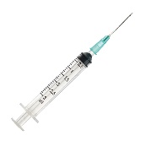
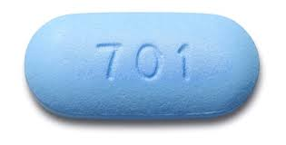
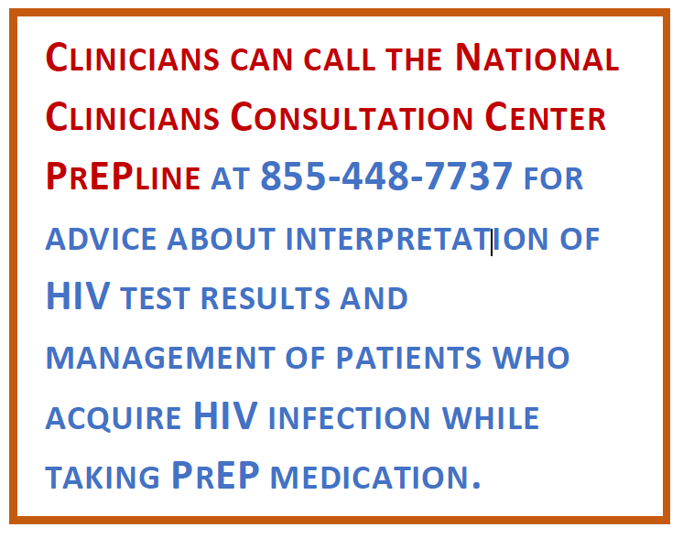

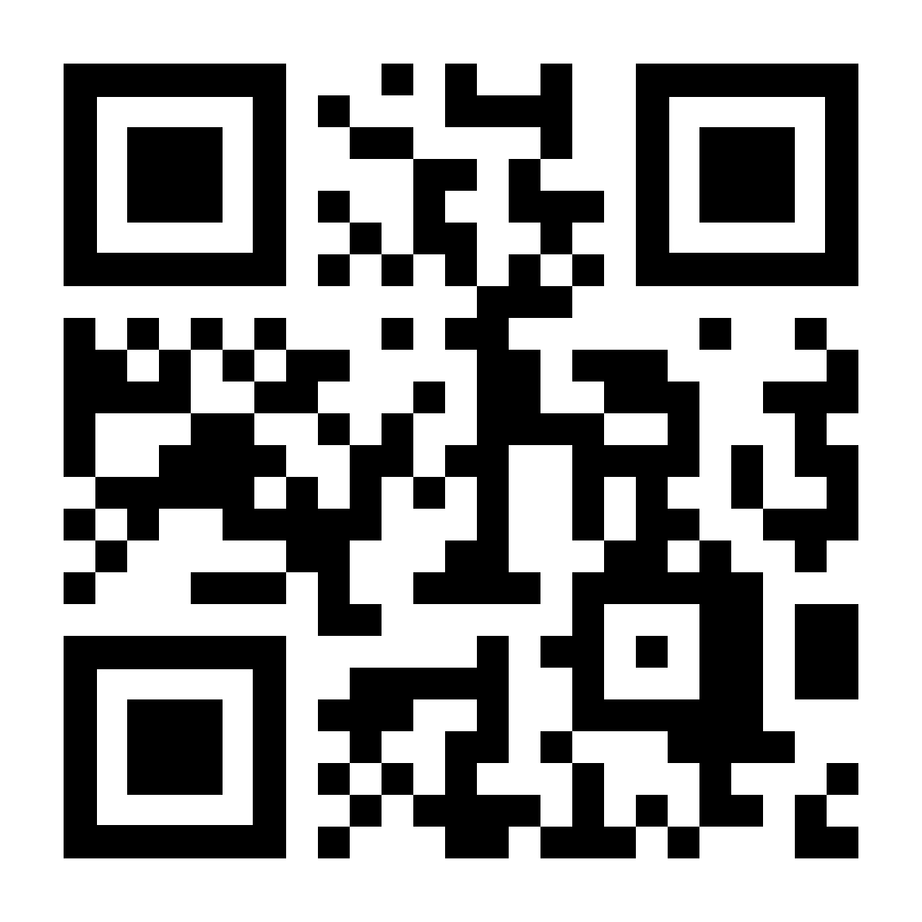
HELPMEPrEP Collaboration
SeroPrEP: A study of breakthrough
HIV infections on oral PrEP or CAB-LA
NCCC partnership to study cases of acute HIV infection on PrEP modalities --
CDC - Division of HIV Prevention - HIV Research Branch
SeroPrEP – NIH-funded research study (UCSF)
CDC PrEP Clinical Practice Guideline: NCCC serves as clinical consultation resource to help interpret HIV screening/diagnostic testing results and offer subsequent management recommendations for people receiving PrEP
Help identify potentially eligible cases for referral to SeroPrEP for research testing
SeroPrEP aims to evaluate causes of breakthrough HIV infections on CAB-LA or oral PrEP via sensitive assays for PrEP drug levels, ARV resistance, and HIV diagnostics; and assess subsequent HIV treatment outcomes
Patient eligibility includes:
Use or receipt of
CAB LA in the past 18 months
OR
Oral PrEP in the past 3 months
One or more HIV tests suggesting that HIV-1 infection has occurred (e.g. Ag/Ab, Ab, RNA)
At least 18 years of age
*SeroPrEP enrolls participants and supports sample collection from all 50 U.S. states and Puerto Rico.
For more information or to contact SeroPrEP study:
Visit: seroprep.ucsf.edu
Email: seroprep@ucsf.edu
Phone or Text: (415) 539-5688
https://nccc.ucsf.edu/

