Slide 1
Sexually Transmitted Infection (STI) Treatment Guidelines
Lucinda Lundy Zeinelabdin, MSN, APRN, FNP-C
Nurse Practitioner, Clinician Ambassador
Diana Morales, BSN, RN
Public Health Nurse, Clinician Ambassador
Notes:
Version date: 02 2024
Target audience: clinical team members

Slide 2
You Don’t Want to Miss These!
Upcoming Events for 2024
March 20, 2024 – Let’s Talk About Sex: LGBTQIA+ Health and Taking a Sexual History Workshop (In-Person)
April 17, 2024 – Syphilis Diagnosis and Treatment in Primary Care
May 15, 2024 – Hep C for Primary Care
June 12, 2024 – Let’s Talk About Sex: LGBTQIA + Health and Taking A Sexual History (In-person)
Image source: MS Office stock photo

Slide 3
Clinician Ambassador Overview
Clinician Ambassadors are a resource for clinicians in the San Antonio Metroplex, with an aim to improve public health through outreach and communication. We are available for in-person and virtual one-on-one and group discussions, educational presentations and assistance in implementing evidence-based practices. Please feel free to reach out by email or phone:
Lucinda Lundy Zeinelabdin, MSN, APRN, FNP-C
Nurse Practitioner, Clinician Ambassador
lucinda.zeinelabdin2@sanantonio.gov
Phone: 210-207-2407
Diana Morales, BSN, RN
Registered Nurse, Clinician Ambassador
Diana.morales1@sanantonio.gov
Phone: 210-207-5102
Provider Interest Form

Slide 4
Conflict of Interest Disclosure Statement
The presenters have no conflicts to declare.
Explicit photos shown are used for medical purposes.
This program is supported by the Health Resources and Services Administration (HRSA) of the U.S. Department of Health and Human Services (HHS) as part of an award totaling $4,205,743 with 0% financed with non-governmental sources. The contents are those of the author(s) and do not necessarily represent the official views of, nor does mention of trade names, commercial practices, or organizations imply an endorsement by HRSA, HHS, or the U.S. Government. For more information, please visit HRSA.gov. Any trade/brand names for products mentioned during this presentation are for training and identification purposes only.

Slide 5
Use of Trade/Brand Names
This program is supported by the Health Resources and Services Administration (HRSA) of the U.S. Department of Health and Human Services (HHS) as part of an award totaling $4,205,743, with 0% financed with non-governmental sources.
The views expressed do not necessarily reflect the official policies of the Department of Health and Human Services, nor does mention of trade names, commercial practices, or organizations imply endorsement by the U.S. Government. Any trade/brand names for products mentioned during this presentation are for training and identification purposes only.
Notes:
NOTE: THIS SLIDE MUST BE INCLUDED IF TRADE AND/OR BRAND NAMES FOR MEDICATIONS ARE USED IN THE PRESENTATION.
IT MAY BE DELETED IF THERE IS NO REFERENCE TO TRADE NAMES, INCLUDING PRESENTATIONS IN WHICH ONLY GENERIC MEDICATION NAMES ARE MENTIONED.
TRADE NAMES MUST BE PUT IN PARENTHESES AFTER THE GENERIC NAME THE FIRST TIME IT IS MENTIONED - E.G., FLUOXETINE (PROZAC). TRADE NAMES SHOULD ONLY BE MENTIONED FOR THE INITIAL REFERENCE AND THE GENERIC NAME ONLY SHOULD BE USED AFTER THAT. THIS APPLIES EQUALLY TO ALL MEDICATIONS OR PRODUCTS MENTIONED IN THIS PRESENTATION.

Slide 6
Unconscious Bias Disclosure
SCAETC recognizes that language is constantly evolving, and while we make every effort to avoid bias and stigmatizing terms, we acknowledge that unintentional lapses may occur in our presentations.
We value your feedback and encourage you to share any concerns related to language, images, or concepts that may be offensive or stigmatizing.
Your input will help us refine and improve our presentations, ensuring they remain inclusive and respectful to participants.

Slide 7
Learning Objectives
At the end of this presentation, learners will be able to:
Apply the 2021 Centers for Disease Control (CDC) Sexually Transmitted Infection (STI) Treatment Guidelines in the evaluation and treatment of Chlamydia, Gonorrhea, Trichomoniasis, Syphilis, HIV, Viral Hepatitis, Herpes, and HPV​
Determine the appropriate screening and testing recommendations for sexually transmitted infections based on the updated STI treatment guidelines

Slide 8
Learning Objectives cont’d
Implement Expedited Partner Therapy (EPT) as a best practice for optimal patient care​
Inform patients about Pre-Exposure Prophylaxis (PrEP) as an effective means to prevent HIV infections
Communicate HIV results in a way that decreases HIV stigma

Slide 9
Source: San Antonio Metro Health STI Infections in Bexar County
Notes:
Notes:
2019 showed lowest rates in a decade for chlamydia and gonorrhea infections. This is the only year in which Bexar County rates were below the Texas and US rates
Between 2020 and 2021, Primary and Secondary Syphilis rates increased 38.9% - most infectious stages of infection
*** CDC recommends offering syphilis testing to all sexually active persons ages 15-44 in areas where syphilis rates are above the Healthy People 2030 goal of 4.6 per 100k***

Slide 10
5 Strategies for Prevention and Control of STIs
Accurate risk assessment, education and counseling of people at risk on ways to avoid sexually transmitted infections (STIs) through changes in sexual behaviors and use recommended prevention services
Pre-exposure vaccination of people at risk for vaccine-preventable STIs
Identification of both symptomatic and asymptomatic people with STIs
Effective diagnosis, treatment, counseling, and follow up of people with infections
Evaluation, treatment, and counseling of sex partners of people with STIs
https://www.cdc.gov/mmwr/preview/mmwrhtml/rr6403a1.htm

Slide 11
Chlamydia & Gonorrhea

Slide 12
Screening for Chlamydia and Gonorrhea
Screen all sexually active women (esp. if pregnant) who are
24 years or younger regardless of risk factors or presence of symptoms
25 years or older and at increased risk for infection
Nucleic Acid Amplification Test (NAAT) preferred
Vaginal self-collection more accurate than urine
Consider extra genital (pharyngeal, rectal) testing based on risk factors; self-collection is acceptable
Free bathroom posters can be found here
Note: Extragenital testing is not always covered by insurance
(USPSTF, Sept. '21)
Notes:
What’s new?
This recommendation is consistent with the 2014 USPSTF recommendation.
Screen sexually active men if they have higher risk factors (men who have sex with men, high # of sex partners)
To whom does this recommendation apply?
Sexually active adolescents and adults, including pregnant persons, without signs and symptoms of chlamydia or gonorrhea infection.

Slide 13
Treatment

Slide 14
Treatment: Chlamydia
Doxycycline 100 mg orally twice a day for 7 days (assess tetracycline allergy)
Alternative:
Azithromycin 1 gm orally twice a day (no longer routinely recommended), or
Levofloxacin 500 mg orally once daily for 7 days
Consideration of levofloxacin for patients with rectal infections as azithromycin may not be as effective in treating these infections (p.67)
In pregnancy:
Azithromycin 1 g orally in a single dose
Alternative: amoxicillin 500 mg orally 3 times/day for 7 days

Slide 15
Treatment: Chlamydia
Test of cure to detect therapeutic failure is not advised for nonpregnant
people even with alternative regimens, unless therapeutic adherence is in question, symptoms persist, or reinfection is suspected (p.68)
Test of cure in pregnancy is not recommended before 4 weeks post treatment due to potential false positives
Bloody discharge, perianal ulcers, or mucosal ulcers among people with acute proctitis and rectal chlamydia should be presumptively treated for Lymphogranuloma Venereum (LGV) with extended doxycycline 100 mg orally twice a day for 3 weeks
If painful perianal ulcers are present or mucosal ulcers are detected on anoscopy, presumptive therapy should also include a regimen for genital herpes

Slide 16
Treatment: Uncomplicated Gonococcal Infections of Cervix, Urethra, or Rectum Among Adults and Adolescents
Ceftriaxone 500 mg intramuscular (IM) in a single dose for people weighing <150 kg.
For people weighing ≥150 kg, 1g ceftriaxone should be administered
If chlamydial infection has not been excluded, treat for chlamydia, preferably with doxycycline 100 mg orally 2 times/day for 7 days
Dual therapy with azithromycin is no longer recommended*
During Pregnancy
Treat N. gonorrhoeae with ceftriaxone 500 mg in a single IM dose plus treatment for chlamydia, if infection has not been excluded

Slide 17
Uncomplicated Gonococcal Infection of the Pharynx
Image source: MS Office stock images
Ceftriaxone 500 mg* IM in a single dose for persons weighing <150 kg
For persons weighing ≥150 kg, 1 g ceftriaxone should be administered.
Follow up and test of cure with either culture or a nucleic acid amplification test (NAAT) should occur 7**–14 days after initial treatment; testing at 7 days may increase likelihood of false-positive NAAT
A test of cure is unnecessary after a diagnosis of uncomplicated urogenital or rectal gonorrhea even with alternative regimens unless therapeutic adherence is in question, symptoms persist, or reinfection is suspected.
Notes:
No reliable alternative treatments for pharyngeal infections
We recommend retest at 10-14 days

Slide 18
Antimicrobial Resistance: Gonorrhea
Why did the treatment for gonorrhea change?
Appropriate use of antimicrobials is a major public health concern
Increase in azithromycin and ceftriaxone-resistant gonorrhea
Pharmacokinetic and pharmacodynamic considerations, especially with pharyngeal gonorrhea
Potential harm to the microbiome with dual therapy
For patients who present with proctocolitis and who have been treated, consider sexually transmissible enteric pathogens – shigella and campylobacter
Notes:
There are no

Slide 19
Ceftriaxone Treatment Failure
Persistence of lab-confirmed N. gonorrhoeae infection despite adequate treatment with ceftriaxone based on weight, after ruling out reinfection
Consider treatment failure if no reported sexual contact after treatment
AND
Symptoms do not resolve in 3-5 days after appropriate treatment OR
Positive test of cure after appropriate treatment
Culture or urethral Gram stain at least 72 hours after treatment, OR
Positive RNA-based NAAT 10-14* days after treatment of pharyngeal infection, OR
Positive DNA-based NAAT 14-28* days after treatment of pharyngeal infection
Source: Texas DSHS
Notes:
*recommended test of cure collection timeframes to avoid false positives
LabCorp and Quest both use Aptima, which is an RNA-based NAAT
Reinfection usually happens from lack of partner treatment (which is why EPT is so important), or from not waiting at least 7 days after treatment to resume sex. Our clinic has also seen examples when people do not consider that oral sex is also sex, or from shared or non-sanitized sex toys

Slide 20
Managing Possible Treatment Failure
If treatment failure is suspected after appropriate treatment of lab-confirmed N. gonorrhoeae infection using ceftriaxone
Order test-of-cure with culture/antibiotic sensitivity testing (AST) and NAAT of relevant clinical sites of exposure/infection prior to retreatment.
If persistent gonorrhea infection of the penile urethra, also obtain a urethral Gram stain, if available
Await test results prior to retreatment unless the client is symptomatic
Report positive test-of-cure result(s) to the health department within 24 hours.
Source: Texas DSHS

Slide 21
Managing Possible Treatment Failure
Consult with the STD Clinician Consultation Network at Denver Prevention Training Center for guidance on clinical management and retreat as indicated.
If there is any possibility of reinfection, retreatment with standard therapy of ceftriaxone dosed based on weight is preferred.
Urogenital: If reinfection is unlikely consider dual treatment with single doses of IM gentamicin 240 mg plus oral azithromycin 2 gm (particularly when isolates are identified as having elevated cephalosporin MICs)
Pharyngeal: If reinfection unlikely and initial treatment was ceftriaxone 500mg IM once, may consider retreatment with ceftriaxone 1g IM once
Source: Texas DSHS STD = Sexually Transmitted Diseases

Slide 22
Managing Possible Treatment Failure
Counsel to refrain from oral, vaginal, and rectal sex during post retreatment period and test-of-cure
Test all partners in the last 60 days at all sites of exposure and empirically treat with the same treatment as the client.
Source: Texas DSHS STD = Sexually Transmitted Diseases

Slide 23
Managing Possible Treatment Failure
If treatment failure is suspected after appropriate treatment of lab-confirmed N. gonorrhoeae infection using ceftriaxone
Order test of cure with culture/antibiotic sensitivity testing (AST) and NAAT of relevant clinical sites of exposure/infection prior to retreatment.
*If infection of the penile urethra, obtain a urethral Gram stain, if available
Source: CDC
Notes:
Reinfection unlikely – no reported sexual contact after treatment
** most patients are symptomatic in these cases – that’s why they are coming back in the first place.

Slide 24
Managing Possible Treatment Failure
If client is asymptomatic, await results of test of cure before retreatment.
Report positive test of cure result(s) to the health department within 24 hours.
Consult with the STD Clinician Consultation Network at Denver Prevention Training Center for guidance on clinical management and retreat as indicated.
**If there is any possibility of reinfection, retreatment with standard therapy of ceftriaxone dosed based on weight is preferred**

Slide 25
Managing Possible Treatment Failure
Urogenital: If reinfection is unlikely may consider dual treatment with single doses of IM gentamicin 240 mg plus oral azithromycin 2 gm (particularly when isolates are identified as having elevated cephalosporin MICs)
Pharyngeal: If reinfection unlikely and initial treatment was ceftriaxone 500mg IM once, may consider retreatment with ceftriaxone 1g IM once
Counsel to refrain from oral, vaginal, and rectal sex during post retreatment period and test-of-cure
Test all partners in the last 60 days at all sites of exposure and empirically treat with the same treatment as the client, OR Expedited Partner Therapy (EPT) with Cefixime
If reinfection is unlikely…
Source: Texas DSHS
Notes:
Reinfection unlikely – no reported sexual contact after treatment
Expect more nausea/vomiting with 2g dose of azithromycin – No need to re-dose if patient keeps it down for at least 30 mins
Can and should consider offering EPT with cefixime for partners from last 60 days if possible

Slide 26
Expedited Partner Therapy (EPT)

Slide 27
Overview
The clinical practice of treating the sex partners of patients diagnosed with chlamydia or gonorrhea by providing prescriptions or medications to the patient to take to his/her partner without the health care provider first examining the partner
EPT is legal in Texas
Recommended for chlamydia and gonorrhea infections
Use shared decision-making in men who have sex with men
Not recommended for Syphilis
Not recommended for trichomoniasis (lack of supporting evidence) – partners of those diagnosed should be referred for presumptive treatment
Concurrent treatment of partners is recommended to prevent reinfection
Notes:
https://www.dshs.texas.gov/sites/default/files/hivstd/ept/DearProviderEPT2022.pdf
DSHS Dear provider letter re: EPT issued in November 2022 (link above)

Slide 28
EPT Documentation
Do not write the names of partners receiving EPT in the index client health record
Sexual partners do not need a health record to get EPT
Document the following in the index client health record:
Number of partners receiving EPT
Medication and dose received
Whether partner(s) are pregnant or allergic to antibiotics (if known)
Keep a log that documents:
Date
Index client name
Date of birth
Name of medication and strength
Number of doses
National Drug Code (NDC), lot number and expiration date

Slide 29
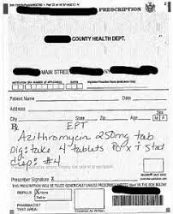
EPT Paper Prescription Example
Source: https://www.health.ny.gov/health_care/medicaid/program/update/2019/2019-04.htm

Slide 30
EPT Treatment of Gonorrhea Infections*
Oral EPT can be used to treat partners of patients diagnosed with gonorrhea
Give patient ceftriaxone IM, and give partner a single dose of oral cefixime 800 mg
If a chlamydia test result has not been documented, treat with oral cefixime regimen PLUS oral doxycycline 100mg twice daily x 7 days
*EPT may consist only of oral medications
https://www.cdc.gov/std/ept/gc-guidance.htm

Slide 31
Trichomoniasis

Slide 32
Screening Women
Test all women who seek care for vaginal discharge
Annual screening should be considered in:
Women with prior STIs, including HIV
Asymptomatic women at high risk for infection
Multiple sex partners
Transactional sex or sex work
Drug use
History of incarceration
Current partners should be referred for presumptive therapy
Advise to abstain from intercourse until patient and partners have been treated (concurrently, if possible) and any symptoms have resolved
Image source: MS Office stock photo
Notes:
Risk factors:

Slide 33
Trichomoniasis in Women with HIV
Up to 53% of women with HIV have T. vaginalis infection
T. Vaginalis is associated with Pelvic Inflammatory Disease (PID) in women with HIV
In non-virally suppressed women with HIV, treatment of trichomoniasis is associated with decreased viral load and viral shedding
Can reduce transmission to partners
Decreases vertical transmission of HIV to baby in pregnancy
Routinely screen non-pregnant women with HIV at entry to care and annually afterward
Routinely screen pregnant women with HIV at the first prenatal visit
Notes:
Benefits of routine screening of asymptomatic pregnant women has not been established

Slide 34
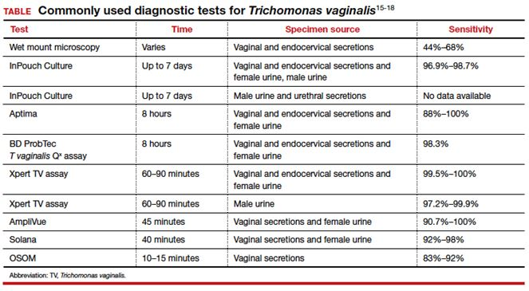
Diagnostic Tests
Notes:
Diagnostic testing among men with recurrent or persistent symptoms, including those with gonorrhea, chlamydia, M. genitalium, and trichomoniasis, can be used to
guide further management decisions

Slide 35
Treatment
Vaginal Trichomoniasis
Metronidazole 500 mg orally 2 times/day for 7 days
Reduces by half the number of women retesting positive, compared with single dose
No longer recommending vaginal gel due to lower efficacy
Urethral Trichomoniasis in Men
Metronidazole 2 g orally in a single dose
When managing recurrent non-gonococcal urethritis (NGU), include presumptive treatment for trichomoniasis*
Alternative Regimen (regardless of gender)
Tinidazole 2 g orally in a single dose
Image source: https://pixabay.com/static/uploads/photo/2014/04/02/14/07/bacteria-306246_640.png
Notes:
**Treatment is the same for women w/HIV
** Metronidazole crosses the placenta, but there is low risk to the fetus – benefit may outweigh risk in pregnancy
***recurrent of persistent NGU

Slide 36
When to Follow Up with Your Patients
Ask patients with diagnosed chlamydia, gonorrhea, or trichomoniasis to return in 3 months for repeat testing to detect possible re-infection, especially if the partner may not have been treated.
Notes:
Gonorrhea retest = test of cure

Slide 37
Syphilis

Slide 38
General Screening Recommendations
As San Antonio remains in a syphilis epidemic, syphilis screening should occur in the following situations:
Anytime a patient requests STI testing
Anytime a patient tests positive for another STI (if syphilis testing was not performed)
Notes:
**Screen asymptomatic adults at increased risk (hx of incarceration, transactional sex or sex work, geography, race/ethnicity Or male younger than 29 years) for syphilis infection. -CDC 2021 GL
Men accounted for 90.8% of all cases in 2014, Men aged 20-29 had highest prevalence rate – 3x higher than average population – USPFTS
Highest risk ethnic groups (primary and secondary syphilis) – AA = 18.9 cases per 100k, hispanic 7.6 per 100k, American Native/Alaskan Native 7.6 per 100k, Hawaiian/PI 6.5/100k, white 3.5/100k, asian 2.8/100k - USPFTS 2016 Recommendations
USPSTF gives A grade to screening for syphilis in asymptomatic, non-pregnant adults and adolescents who are at high risk – 2016 recommendation, and updated recommendation is in process
Frequency? Per the USPFTS – the optimal screening frequency for persons at increased risk for infection is not well established. MSM or PLWHIV – may benefit from more frequent screening – initial studies suggest detection improved among these groups when screening is performed q3mo. CDC and USPSTF do not make a recommendation regarding screening frequency among asymptomatic adults

Slide 39
Syphilis Screening Among Pregnant Persons
As of September 1, 2019, Texas Health and Safety Code §81.090 mandated syphilis screening:
At first prenatal care examination
During third trimester (between 28 and 32 weeks)
At delivery
Centers for Disease Control (CDC) recommends that women who experience a stillbirth after 20 weeks be tested for syphilis
Image source: MS Office stock photo
Notes:
Be sure that you (provider) are documenting any negative syphilis results in the chart – if the patient turns up positive at delivery or congenital syphilis case is suspected, documentation of the previous negative tests will be beneficial to you and to the health department.

Slide 40
Syphilis Screening Among Special Populations
Adolescents- Routine screening of asymptomatic adolescents and young adults who are not at increased risk is typically not recommended
Transgender and Gender Diverse Populations- Screening should be conducted based on the patient's current anatomy and sexual practices
Persons In Correctional Facilities- Opt-out screening should be conducted based on the local and institutional prevalence of early infectious syphilis
Early includes primary, secondary, and early latent syphilis
Notes:
More frequent screening for MSM or PLWHIV (as often as q3-6mo) is recommended by the USPSTF and CDC guidelines

Slide 41
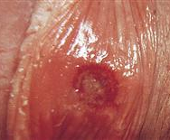
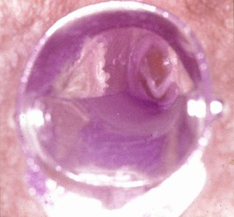
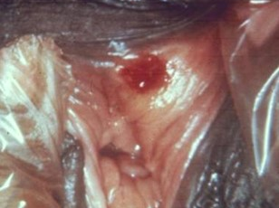
Syphilis Staging – A Quick Overview
Primary (chancre stage): 10-90 days after innoculation
Latent (the silent stage)
Late latent – infection acquired more than 12 months ago
Tertiary (the imprint stage- the disease leaves its mark on organ systems)
Neurosyphilis (can occur at any stage)
Typically presents as a single, painless ulcer or chancre at the site of inoculation
May also present as multiple, painful, atypical lesions
Secondary (rash stage): 0-7 months after primary lesion onset
Presents as skin rashes, mucocutaneous lesions, warts, alopecia
Classically a palmar/plantar rash
No symptoms of either the primary or secondary stages. Positive serology
Early latent – infection acquired within the previous 12 months
Unknown duration – treated the same way as late latent
Now rare. May present with lesions called gummas, cardiac or other organ involvement
Ocular, otic, meningovascular, meningitis
Notes:
*OBGYN only slide
Primary lesions usually located on genitals, anus or oral cavity, depending on location of contact
Remember – neurosyphilis can occur at ANY stage, so a neuro screening should always be a part of your assessment in patients with syphilis

Slide 42
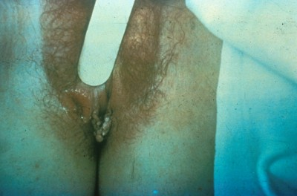
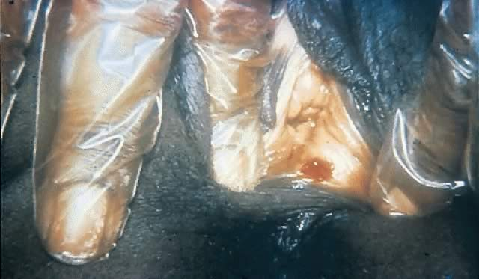
Primary (chancre stage): 10-90 days after innoculation
Typically presents as a single, painless ulcer or chancre at the site of inoculation
May also present as multiple, painful, atypical lesions
Secondary (rash stage): 0-7 months after primary lesion onset
Presents as skin rashes, mucocutaneous lesions, warts, alopecia
Classically a palmar/plantar rash
Late latent – infection acquired more than 12 months ago
Early latent – infection acquired within the previous 12 months
Unknown duration – treated the same way as late latent
Source:CDC
https://www.cdc.gov/std/training/clinicalslides/slides-dl.htm
Source:CDC https://phil.cdc.gov/Details.aspx?pid=17883
Source: CDC https://www.cdc.gov/std/syphilis/images/chancre-vaginal-1.jpg
Notes:
Staging syphilis does not differ during pregnancy. What does differ is that earlier treatment leads to better outcomes.
Primary lesions usually located on genitals, anus or oral cavity, depending on location of contact. Appear within 10-90D and resolve within 3-8 weeks (with or without tx)
Secondary symptoms – include maculopapular rash, patchy hair loss, mucous patches (flat, white lesions on mucus membranes), condylomata lata (C. Lata) soft, wart-like lesions found in intertriginous areas, generalized malaise or lymphadenopathy. Usually appear 4-10 weeks after primary lesion onset. Will resolve in 2-6 wks.
Latent infection – Begins after 2ndary sx resolve - no clinical manifestations of syphilis present during latent stage – the only thing left to figure out is when the infection was contracted. Late latent – less infectious sexually, BUT still can transmit vertically to fetus
A note – neurosyphilis can occur at ANY stage, so a neuro screening should always be a part of your assessment in patients with syphilis
CNII thru XII, assess eyes for injection, photophobia, nuchal rigidity and facial palsies ( or muscle weakness)

Slide 43
No symptoms of either the primary or secondary stages. Positive serology
Late latent – infection acquired more than 12 months ago
Tertiary (the imprint stage- the disease leaves its mark on organ systems)
Now rare. May present with lesions called gummas, cardiac or other organ involvement
Latent (the silent stage) Resolution of primary/secondary symptoms
Neurosyphilis (can occur at any stage)
Ocular, otic, meningovascular, meningitis
Early latent – infection acquired within the previous 12 months
Unknown duration – treated the same way as late latent

Slide 44
Syphilis Treatment - Adults
Primary and Secondary Syphilis
Benzathine penicillin G 2.4 million units IM in a single dose
Early Latent Syphilis
Benzathine penicillin G 2.4 million units IM in a single dose
Available data demonstrate that additional doses of penicillin or other antibiotics in early latent syphilis do not enhance efficacy
Alternative for Primary, Secondary, Early Latent
Doxycycline 100 mg orally/twice daily x 2 weeks
Late Latent Syphilis or Syphilis of Unknown Duration
Benzathine penicillin G 7.2 million units total, administered as 3 doses of 2.4 million units IM each at 1-week intervals
Alternative: Doxycycline 100 mg orally/twice daily x 4 weeks (if not-pregnant)
Notes:
Available data indicate that the majority of persons with HIV respond appropriately to the recommended doses of Benzathine Penicillin G. Additional doses of Benzathine PCN G or other antibiotics do not result in enhanced efficacy in treating persons with HIV and primary or secondary syphilis
Neurosyphilis, Otosyphilis, Ocular Syphilis – if suspected, patient should be referred for CSF examination and possible LP confirmation or to
Treatment = Aqueous crystalline penicillin G 18–24 million units per day, administered as 3–4 million units IV every 4 hours or continuous infusion, for 10–14 days
Ocular – these patients require full ocular examination, including cranial nerve exam – if CN exam abnormal, CSF exam needed
Oto – suspect if otologic symptoms or hearing loss – include CN exam (esp CN8) – if CNS exam is normal, CSF is not recommended before treatment. Collab with otorolygologist and treat.
Neuro – If CNS exam reveals clinical evidence of neurologic involvement, CSF exam should be performed prior to treatment

Slide 45
Syphilis Treatment
Pregnant Women–Treat with the same recommended penicillin regimen as non-pregnant women based on the stage of infection
New treatment window for syphilis during pregnancy is 7-9 days between doses
Patient needs to restart if they come earlier or later than the new timeframe
Penicillin G is the only known effective antimicrobial for treating fetal infection and preventing congenital syphilis
People with HIV- Should be treated with the same recommended penicillin regimen as those without HIV, based on the stage of infection.
Additional doses of penicillin or other antimicrobials are not recommended in this group
Notes:
* Available data indicate that the majority of persons with HIV respond appropriately to the recommended doses of Benzathine Penicillin G. Additional doses of Benzathine PCN G or other antibiotics do not result in enhanced efficacy in treating persons with HIV and primary or secondary syphilis
* CDC states that there is certain evidence that indicates that additional therapy in the form of a second dose of Benzathine PCN G 2.4M units may be beneficial for pregnant women to prevent congenital syphilis, in primary, secondary or early latent syphilis – this dose should be given 1 week after initial dose.

Slide 46
FDA added penicillin G benzathine (Bicillin L-A ®) to its list of medication shortages in April
Shortage reportedly due to increased demand
Shortage affecting doses including pediatric 600,000 unit/mL, 1.2M unit/2mL and 2.4M unit/4mL formulations
Shortages are not expected to be resolved until sometime in mid 2024
CDC recommends prioritizing this treatment for pregnant persons as this is the only recommended treatment for syphilis in pregnancy
Treat non-pregnant persons with recommended alternative (doxycycline)
Penicillin G Benzathine (Bicillin L-A ®) Injectable Suspension Product Shortage

Slide 47
Penicillin Allergy

Slide 48
Special Considerations for Penicillin Allergy
Nonpregnant, penicillin-allergic persons who have primary or secondary syphilis: Regimens of doxycycline 100 mg orally twice daily for 14 days and tetracycline (500 mg four times daily for 14 days) have been used for many years
Only acceptable alternatives for the treatment of latent syphilis are doxycycline (100 mg orally twice daily) or tetracycline (500 mg orally four times daily), each for 28 days
Pregnant women with primary or secondary syphilis who are allergic to penicillin should be desensitized and treated with penicillin G

Slide 49
HIV

Slide 50
Screening
CDC and United States Preventative Services Taskforce (USPSTF) recommend HIV screening at least once for all persons aged
15-65 years
HIV testing is recommended for all persons seeking STI evaluation who are not already known to have HIV infection
Testing should be routine at the time of the STI evaluation, regardless of whether the patient reports any specific behavioral risks for HIV
Persons at higher risk for HIV acquisition should be screened for HIV at least annually
Providers can consider the benefits of offering more frequent screening (e.g., every 3–6 months) based on risk factors
Opt-out HIV screening is recommended in all health care settings
Notes:
Why does this matter to you? – You may be the only provider a patient sees in a year or years, and therefore the only opportunity to get the patient tested

Slide 51
Screening
HIV screening should be voluntary and free from coercion
Patients should not be tested without their knowledge
Requirement of specific signed consent for HIV testing is not recommended
General informed consent for medical care is considered sufficient to encompass informed consent for HIV testing
Those whose HIV test results are negative and are at increased risk to acquire HIV, should be offered HIV PrEP – including adolescents who are at risk
Notes:
*December 2021 – CDC recommended sexually active adolescents at substantial risk of HIV acquisition should be offered PrEP
*Further – All sexually active adolescent patients should receive information about PrEP
Risk factors:
Adults or adolescents who have had vaginal or anal sex in the last 6 months and
Don’t know partners HIV status, has a partner living with HIV
Inconsistent condom use
Bacterial STI in last 6 months
People who inject drugs or share injection equipment

Slide 52
Screening
The USPSTF recommends that clinicians prescribe preexposure prophylaxis using effective antiretroviral therapy to persons who are at increased risk of HIV acquisition to decrease the risk of acquiring HIV. (A grade)
Daily oral antiretroviral PrEP with a fixed-dose combination of emtricitabine (FTC) and either tenofovir disoproxil fumarate (TDF) or tenofovir alafenamide (TAF)
Demonstrated safety and 99% reduction in the rate of HIV acquisition
All sexually active adults and adolescents should be informed about PrEP as an effective method to prevent HIV

Slide 53
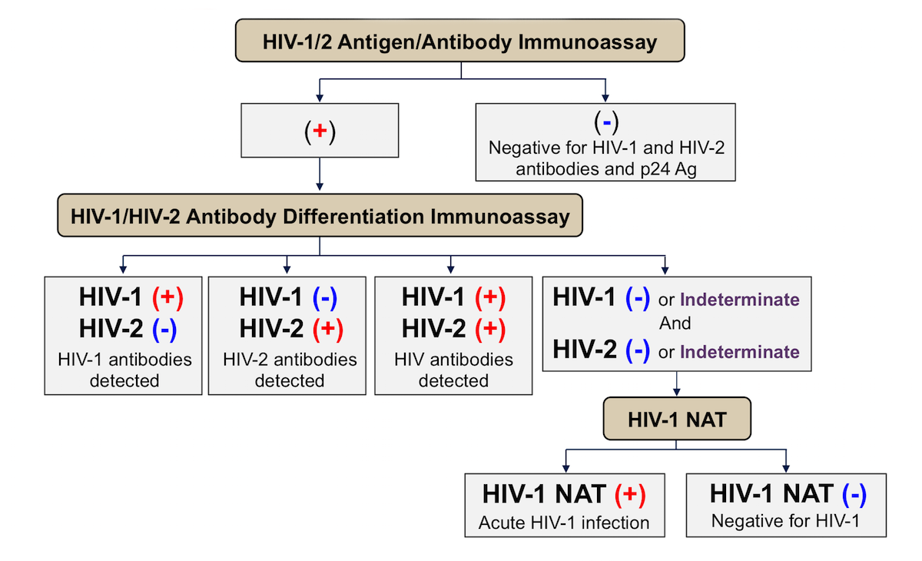
HIV Testing Algorithm
Notes:
HIV Agorithm-https://stacks.cdc.gov/view/cdc/50872

Slide 54
Treatment
Antiretroviral therapy (ART) should be initiated as soon as possible for all persons with HIV infection regardless of CD4+ T-cell count, both for individual health and to prevent HIV transmission
Persons with HIV infection who achieve and maintain a viral load suppressed to <200 copies/mL with ART have effectively no risk for sexually transmitting HIV
Provide prevention counseling to persons with diagnosed HIV
Provide additional counseling, either on-site or through referral, about the psychosocial and medical implications of having HIV infection
Assess the need for immediate medical care and psychosocial support

Slide 55
Communicating Test Results
Deliver results privately and in-person if possible
For rapid tests, explain that a confirmatory test is needed
HIV treatment works (Undetectable=Untransmissible, U=U)
HIV prevention works
PrEP is 99% effective at preventing HIV
PEP is at least 80% effective
HIV is a chronic health condition, not a death sentence
HIV stigma affects well-being of patients
RAPID Start Calendar
Notes:
Presenter Notes-
Stigma-Free guidelines were created based on patient's feedback
Almost 30% of people with HIV are lost to care after diagnosis, and some of that has to do with how they receive the news in the first place
Rapid Start-
Some clinics will accept even with rapid test result, others require confirmatory test
Explain that Metro Health will be reaching out
Not all patients can reach U=U due to other health conditions

Slide 56
Viral Hepatitis

Slide 57
Hep A Screening
Routine screening not recommended
Recommended only for those with higher risk factors
Notes:
Screening only recommended for persons with higher risk factors include MSM, PWUD, persons experiencing homelessness

Slide 58
Hep B Screening Recommendations (CDC, USPSTF)
Test for HBsAg during each pregnancy - preferably in the first trimester.
People who inject drugs (PWID)
Test for HBsAg, as well as for anti-HBc or anti-HBs to identify susceptible persons.
ALL pregnant persons (USPSTF A)
At delivery* (no documented testing, no Peripheral Nerve Catheter - PNC)
Infants born to mothers who test positive
All adults aged 18 and older at least once in their lifetime using triple panel test
Hep B Surface Antigen (HBsAG), antibody to hep B surface antigen (anti-HBs) and total antibody to hepatitis B core antigen (total anti-HBc)
Source: CDC.gov
Notes:
https://www.cdc.gov/hepatitis/hbv/pdfs/SerologicChartv8.pdf
*at delivery if no test results available or no PNC

Slide 59
Hep B Screening Recommendations (CDC, USPSTF)
Men who have sex with men (MSM)
Test for HBsAg, as well as for anti-HBc or anti-HBs to identify susceptible persons.
Persons diagnosed with HIV
Test for HBsAg, as well as for anti-HBc or anti-HBs to identify susceptible persons.
Any person who
Was born in the US and not vaccinated in the US, if parents from country with > 8% endemicity
Was born outside of the US in country with > 2% endemicity of HBsAG
Has been exposed to body fluids of someone with Hepatitis B
Is a household contact, shares needles or has sex with persons who have tested positive for HBsAG
Source: CDC.gov
Notes:
https://www.cdc.gov/hepatitis/hbv/pdfs/SerologicChartv8.pdf
*at delivery if no test results available or no PNC

Slide 60
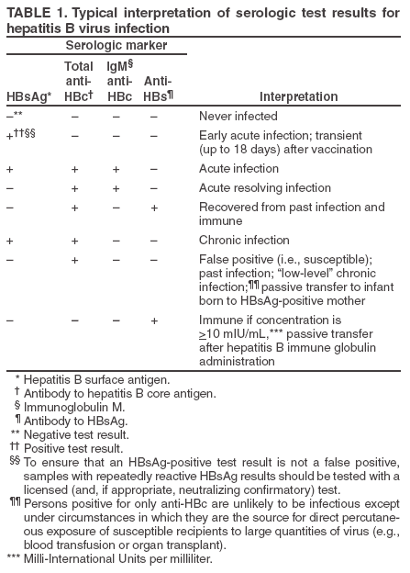
Hepatitis B Serology Interpretation
Source: https://www.cdc.gov/mmwr/preview/mmwrhtml/rr5416a1.htm#tab1
Notes:
https://www.cdc.gov/hepatitis/hbv/pdfs/SerologicChartv8.pdf

Slide 61
Hepatitis C Screening
Hepatitis C screening at least once in a lifetime for all adults aged 18 years and older
In Texas, the prevalence is estimated to be 1.8% overall, with South Texas having the state's highest rates.*
As of 2021, CDC, ACOG and Texas DSHS all recommend testing during each pregnancy
Hepatitis C testing should be initiated with an FDA‑approved anti‑HCV test. People testing anti‑HCV positive/reactive should have follow-up testing with an FDA‑approved nucleic acid test (NAT) for detection of HCV RNA
Notes:
Presenter Note-
Only acute Hep C, not chronic Hep C, is reportable, so we don’t have all the data we’d like
* As of 2014 data from DSHS Hep C surveillance team is working on revised prevalence estimates

Slide 62
Hepatitis Prevention and Treatment

Slide 63
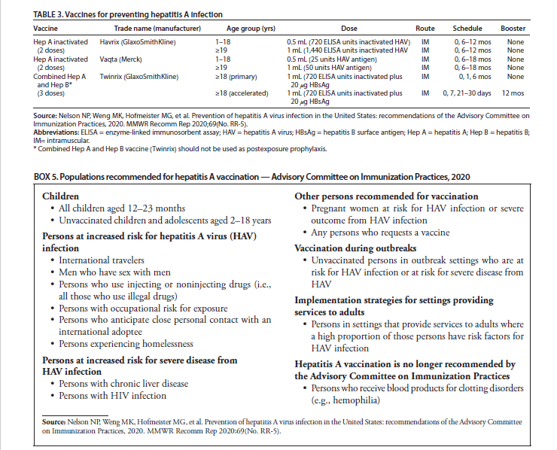
Hepatitis A
Notes:
Presenter Notes-
Vaccination is the most effective means of preventing HAV transmission among persons at risk for infection
Patients with acute HAV infection usually require only
supportive care, with no restrictions in diet or activity.
Hospitalization might be necessary for patients who become
dehydrated because of nausea and vomiting and is crucial
for patients with signs or symptoms of acute liver failure.
Medications that might cause liver damage or are metabolized
by the liver should be used with caution among persons with
HAV infection.

Slide 64
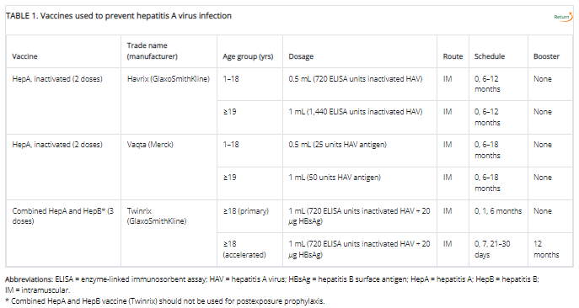
Hepatitis A Vaccines
Source: https://www.cdc.gov/mmwr/volumes/69/rr/rr6905a1.htm#T1_down

Slide 65
Hepatitis A Vaccine Recommendations
Children
All children ages 12-23 months
Unvaccinated children and adolescents 2-18 years
Persons at increased risk for HAV infection
MSM
International travelers
Persons at risk for severe disease from HAV
Persons with chronic liver disease
Others
People who Inject Drugs (PWID)
Occupational risk
Persons experiencing homelessness
Persons with HIV
Pregnant women at risk for HAV or severe HAV
Anyone requesting vaccination
Souce: https://www.cdc.gov/mmwr/volumes/69/rr/rr6905a1.htm#T1_down

Slide 66
Hepatitis B
Continued recommendation that vaccination be offered to people seeking STI care at STI clinics or other clinical settings
All people with HBV infection should be tested for other STIs
Two products have been approved for HBV prevention:
Hepatitis B immune globulin (HBIG) for PEP and
Hepatitis B vaccine

Slide 67
Hepatitis C
Image Source: The Fund for Elimination of Viral Hepatitis
HEP C IS CURABLE!
Prior authorization changed effective Sept. 1, and there is no more requirement for drug screenings for those on Medicaid for their Hep C Antiviral Medication
Texas Vendor Drug Program Form
Two of the three Medicaid therapies are pan genotypic, so genotyping usually not needed
Fibrosis (FIB-4) score often can be used in lieu of Fibroscan or biopsy. Learn more here

Slide 68
Herpes Simplex Virus 1 & 2 (HSV)

Slide 69
Screening
Test when lesions are present
FDA cleared PCR-based HSV tests are sensitive and specific, can distinguish HSV-1 from HSV-2
The trouble with blood tests:
Positive predictive value is only 50%
Due to low accuracy, CDC recommends two-step testing: If HSV EIA is positive, confirm with a Biokit or Western blot—neither of which is readily available. Do not confirm with HerpesSelect HSV-2 immunoblot, which uses the same antigen as the HSV-2 EIA
IgM testing: Not recommended because it isn't type-specific and can be positive in recurrent episodes
Limited cases where EIA might be useful:
Recurrent or atypical genital symptoms or lesions with a negative HSV PCR or culture result
Clinical diagnosis of genital herpes without laboratory confirmation
Patient’s partner has genital herpes
Not Useful- Screening of the general population
FDA= Food and Drug Administration; PCR= polymerase chain reaction
EIA= Enzyme immunoassay; IgM= Immunoglobulin M
Notes:
In other words, test when there are lesions present
FDA Letter to Healthcare Providers 12/27/2023 reminding providers of possibility of inaccurate results - Counsel patients about the limitations of available testing before obtaining HSV-2 serologic tests, and perform confirmatory testing for any positive results with western blot or biokit

Slide 70
Recommended Antiviral Treatment (no change since 2015)
First Clinical Episode, Genital HSV
Acyclovir 400 mg orally 3 times/day for 7–10 days
Famciclovir 250 mg orally 3 times/day for 7–10 days
Valacyclovir 1 g orally 2 times/day for 7–10 days
Treatment can be extended if healing is incomplete after 10 days of therapy.
Acyclovir 200 mg orally 5 times/day is also effective but is not recommended because of the frequency of dosing

Slide 71
Recommended Antiviral Treatment (no change since 2015)
Suppression of Recurrences
Acyclovir 400 mg orally 2 times/day or
Valacyclovir 500 mg orally once a day*
Valacyclovir 1 g orally once a day
Famciclovir 250 mg orally 2 times/day
Valacyclovir 500 mg once a day might be less effective than other valacyclovir or acyclovir dosing regimens for persons who have frequent recurrences (i.e., ≥10 episodes/year)

Slide 72
Recommended Antiviral Treatment cont'd...
Suppression of Recurrent Genital Herpes Among Pregnant Women
Acyclovir 400 mg orally 3 times/day or Valacyclovir 500 mg orally 2 times/day
Starting at 36 weeks’ gestation
Additional regimens exist for daily suppression for people with HIV (See guidelines)
Notes:
**Per aafp.org – for pregnant women with recurrent herpes, suppressive therapy should be offered at 36 weeks.
Urgent care providers – you may be seeing a pregnant patient who has not been previously diagnosed – if this is the case, the standard of care is to treat them – remember that timing is important for the effectiveness of the treatment, and the medication is Cat B for pregnancy.

Slide 73
Recommended Antiviral Treatment cont'd...
Episodic Therapy for Recurrent HSV-2
Acyclovir 800 mg orally 2 times/day for 5 days, or 800 mg orally 3 times/day for 2 days
Famciclovir 1 g orally 2 times/day for 1 day; or 500 mg orally once, followed by 250 mg 2 times/day for 2 days; or 125 mg orally 2 times/day for 5 days
Valacyclovir 500 mg orally 2 times/day for 3 days; or 1 g orally once daily for 5 days
Acyclovir 400 mg orally 3 times/day for 5 days is also effective but not recommended because of frequency of dosing
Notes:
**Per aafp.org – for pregnant women with recurrent herpes, suppressive therapy should be offered at 36 weeks.
Urgent care providers – you may be seeing a pregnant patient who has not been previously diagnosed – if this is the case, the standard of care is to treat them – remember that timing is important for the effectiveness of the treatment, and the medication is Cat B for pregnancy.

Slide 74
Human Papillomavirus (HPV)

Slide 75
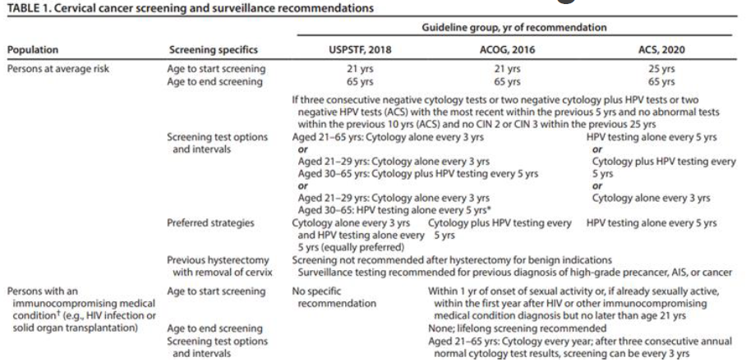
Screening

Slide 76
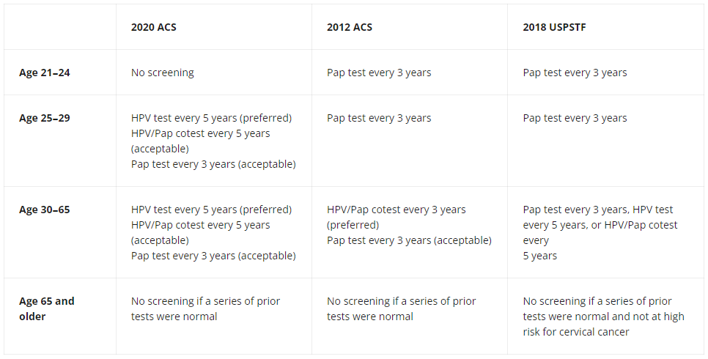
Screening Recommendations
Source: https://www.cancer.gov/news-events/cancer-currents-blog/2020/cervical-cancer-screening-hpv-test-guideline#:~:text=ACS%20recommends%20cervical%20cancer%20screening,Pap%20test%20every%203%20years.
Notes:
USPSTF recommendation is currently being updated
https://www.uspreventiveservicestaskforce.org/uspstf/recommendation/cervical-cancer-screening

Slide 77
Prevention
Routine HPV vaccination for all adolescents at age 11 or 12 years (can start as early as 9 years)
Catch-up vaccination through age 26 years
No blanket recommendations for adults aged >26 years
Instead, shared clinical decision-making between a patient and a provider is recommended for certain adults aged 27–45 years not vaccinated previously
Effectiveness is low for people who are already sexually active
A 2-dose vaccine schedule (at 0- and 6- to 12-month intervals) is recommended for persons who initiate vaccination before their 15th birthday
A 3-dose vaccine schedule (at 0-, 1–2-, and 6-month intervals) who initiate on or after their 15th birthday or for immunocompromised persons regardless of age of initiation
Notes:
Starting vaccines at age 9 usually due to risk factors – i.e. hx of abuse etc.

Slide 78
Resources & References
Subscribe to DOCALERT!
For health alerts from Metro
Health text "DOCALERT" to
1-844-824-COSA (2672)
Message and data rates apply
2021 CDC STI Treatment Guidelines
CDC 2021 PREP Guidelines
CDC Sexually Transmitted Infections Surveillance, 2022
2020 Hepatitis C Screening Guidelines
SA Metro Health STI Services
Hepatitis C ECHO UT Health San Antonio
End Sigma End HIV Alliance of SA
National HIV Curriculum
Fighting HIV Stigma to End the Epidemic: Evidence Based Solutions for Healthcare in Texas
Hepatitis C in Texas
EPT Legal in Texas
EPT Implementation Guide
NeedyMeds
USPSTF Cervical Cancer Screening Recommendations
USPSTF PrEP Recommendations

Slide 79
Post-Survey (Required for CME/CNE)
https://forms.office.com/g/7U2DTyVhnp
Notes:
https://forms.office.com/g/7U2DTyVhnp

Slide 80
Thank you. Questions?
lucinda.zeinelabdin2@sanantonio.gov

Slide 81
Follow us on Social Media!
@UTHSA_AETC
@UTHealthSAECHO

