Slide 1
Advancing Health and Racial Equity In Public Health
Tai Edward Few M.Div.,
Associate Director, Denver Prevention Training Center
March 28, 2024

Slide 2
Disclaimer
The views and opinions expressed in this presentation are not necessarily those of the Pacific AIDS Education & Training Center (Pacific AETC) or its eight local partner sites in HRSA Region 9, the Regents of the University of California or its San Francisco campus (UCSF or collectively, University) nor of our funder the Health Resources and Services Administration(HRSA). Neither Pacific AETC, University, HRSA nor any of their officers, board members, agents, employees, students or volunteers make any warranty, express or implied, including the warranties of merchantability and fitness for a particular purpose; nor assume any legal liability or responsibility for the accuracy, completeness or usefulness of information, product or process assessed or described; nor represent that its use would not infringe privately owned rights.
HRSA Acknowledgement Statement
The Pacific AETC is supported by the Health Resources and Services Administration (HRSA) of the U.S. Department of Health and Human Services (HHS) as part of an award totaling $4,377,449. The contents are those of the author(s) and do not necessarily represent the official views of, nor an endorsement, by HRSA, HHS, or the U.S. Government. For more information, please visit HRSA.gov.
Trade Name Disclosure Statement
Funding for this presentation was made possible by 5 U1OHA29292‐08‐00 from the Human Resources and Services Administration HIV/AIDS Bureau. The views expressed do not necessarily reflect the official policies of the Department of Health and Human Services nor does mention of trade names, commercial practices, or organizations imply endorsement by the U.S. Government. Any trade/brand names for products mentioned during this presentation are for training and identification purposes only.

Slide 3
Disclosures
All presenters of this continuing medical education activity have indicated that neither they nor their spouse/legally recognized domestic partner has any financial relationships with commercial interests related to the content of this activity.

Slide 4







Capacity Building Assistance (CBA) for High Impact HIV Prevention Program Integration
To strengthen the capacity and improve the performance of the national HIV prevention workforce
1. National Training
Electronic Learning (eLearning) Training Center
Classroom Learning Training Center
Clinical HIV Testing and Prevention for Persons with HIV
Nonclinical HIV Testing and Prevention for HIV- Negative Persons
Integrated HIV Activities and Structural Interventions
Reduce New HIV Infections
Increase Access to Care for Persons with HIV
Regional
Technical
Assistance
2.
Improve Health Outcomes and Reduce Mortality for Persons with HIV
3.
Continuous Quality Improvement and Sustainability for
Community-Based Organizations
Reduce HIV-related Disparities
4.
Marketing and Administrative Support for CBA Provider Network
Health Disparities, Social Determinants of Health, Cultural Competence
Retrieved from (March, 2023) : https://www.cdc.gov/hiv/pdf/funding/announcements/ps19-1904/PS19-1904-Overview-Webinar.pdf
Notes:
The Centers for Disease Control and Prevention (CDC) funded the CBA program for High Impact Prevention Program Integration. This CBA funding has four goals: Reduce New HIV Infections; Increase Access to Care for Persons with HIV; Improve Health Outcomes and Reduce Mortality for Persons with HIV; and Reduce HIV-related Disparities. The funding accomplishes it goals through 4 separate components: National Training (classroom and eLearning); Regional Technical Assistance; Continuous Quality Improvement and Sustainability for CBOs; and Marketing and Administrative Support for the CBA Provider Network. Finally, the CBA programs seek to address health disparities and social determinants of health and provide culturally competent and responsive HIV prevention services.

Slide 5
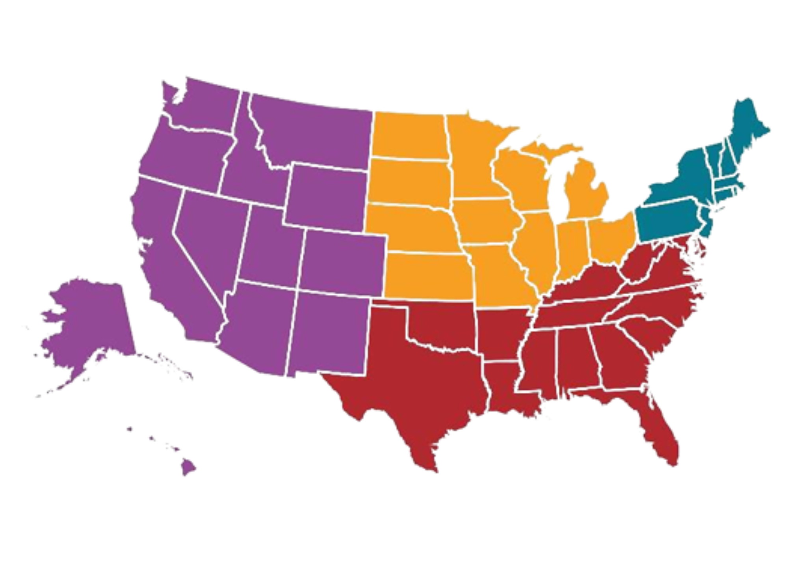
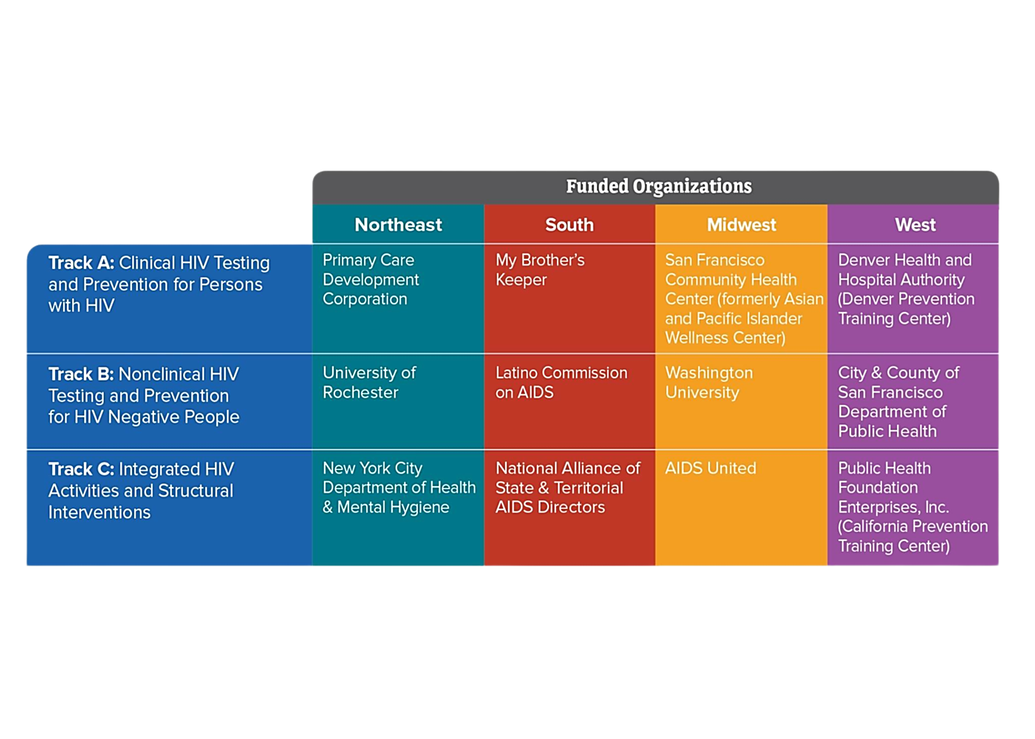

Regional Technical Assistance (TA)
Regional Technical Assistance (TA)
Notes:
The Denver PTC is part of the component 2 CBA providers serving the West Region in purple. A little more about this group of CBA providers – we are funded by CDC to provide regional TA. As you see there are 4 regions: Northeast in the teal, South in the red, Midwest in the yellow, and West in the purple.

Slide 6

West Region
West Region
West Region
Track A: Clinical HIV Testing and Prevention for Persons with HIV | Denver Health & Hospital Authority (Denver Prevention Training Center)
Track B: Nonclinical HIV Testing and Prevention for HIV Negative People | City & County of San Francisco Department of Public Health
Track C: Integrated HIV Activities and Structural Interventions | Public Health Foundation Enterprises, Inc. (California Prevention Training Center)
Requesting TA
Agencies directly funded by CDC can submit a request in the Capacity Building Assistance (CBA) Tracking System (CTS) at https://wwwn.cdc.gov/CTS
Non-directly funded organizations can contact their state or local health departments to submit a request on their behalf.
Notes:
There are 3 West TA providers: the Denver PTC, San Francisco Department of Public Health, and California PTC. Each West TA provider is assigned to a specific track and each track has specific responsibilities. At the Denver PTC, as a Track A TA provider, we work with organizations conducting HIV clinical testing and prevention for persons with HIV. Our partners at the San Francisco Department of Public Health provide TA to organizations conducting nonclinical HIV testing and prevention for HIV negative persons. Finally, the California PTC provide TA on integrated HIV activities and structural inventions, like condom distribution and syringe service programs.
If you want to access and request these free services there are two ways:
If you are a directly-funded jurisdiction (state health department or county LA or San Francisco) or organization you can enter request at wwwn.cdc.gov/CTS
If you are not a directly-funded jurisdiction or organization you can contact your jurisdictional health department and ask them to submit a request on your behalf.

Slide 7

Denver Prevention Training Center
To meet our team or read more about our work visit us at www.denverptc.org
Notes:
Founded in 1979, the Denver PTC provides innovative training, consultation and information to healthcare professionals and their organizations.
The Denver PTC has the unique advantage of being a program within a public health institute (The Public Health Institute at Denver Health) that resides within a large comprehensive healthcare system (Denver Health and Hospital Authority).
Our program is supported by a cooperative agreement with the U.S. Centers for Disease Control and Prevention (CDC).
(review slide)

Slide 8

Learning Objectives
Define anti-racism and its importance in public health and clinical care.
Describe the role of public health practitioners and clinical providers in advancing anti-racist clinical care.
Describe the introduction anti-racism clinical care course.
Apply anti-racism tools and strategies in clinical settings.
Image source iStock

Slide 9

Let’s Talk about Race
Image source iStock

Slide 10
How Do We Define Race?
There is consensus in the biological and social sciences.
Race is a social construct and not a biological fact.
Race designations have changed over time; a person who could be categorized as Black in the United States might be considered White in Brazil or colored in South Africa.
Today, scientists prefer to use the term “ancestry” to describe human diversity.

Slide 11
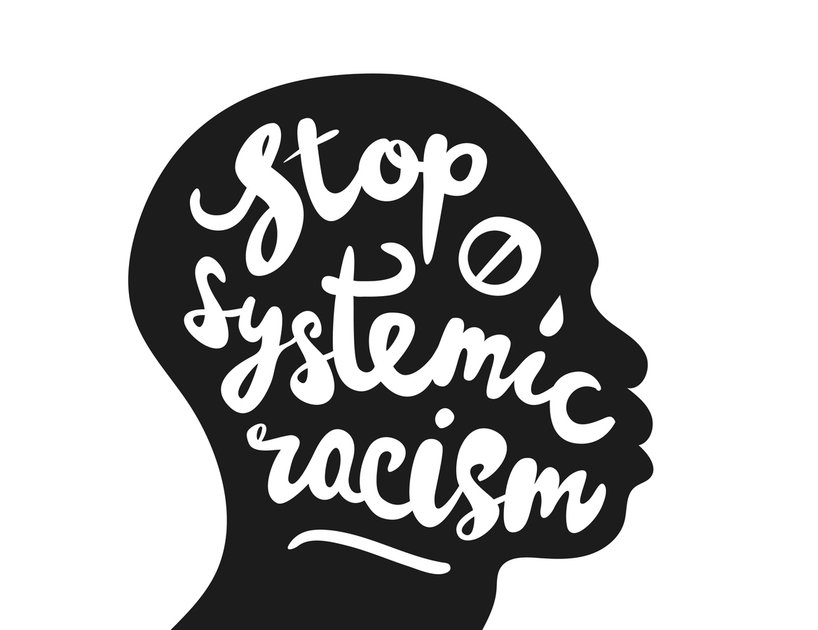
Racism Is A Public Health Crisis
Black people are more likely than white people to die from cancer.
Latinos are at a 66% greater risk of developing type 2 diabetes.
American Indians and Alaska Natives born today have a life expectancy that is 4.4 years less than the United States’ all races population.
https://www.brookings.edu/blog/how-we-rise/2020/09/25/latinos-often-lack-access-to-healthcare-and-have-poor-health-outcomes-heres-how-we-can-change-that/
Image source iStock

Slide 12

Racism
  Is a system of structuring opportunity and assigning value based on a phenotype that:
    Unfairly disadvantages some individuals and communities
    Unfairly advantages other individuals and communities
    Undermines realization of the full potential of the whole society through the waste of human resources
Jones, C. P. (2002). Confronting institutionalized racism. Phylon, 50(1/2), 7. https://doi.org/10.2307/4149999
Image source iStock

Slide 13

Structural Racism
Structural racism–the normalized and legitimized range of policies, practices, and attitudes produce cumulative adverse outcomes for people of color, especially Black people–is the main driver of racial inequality in America today.
Image source iStock

Slide 14
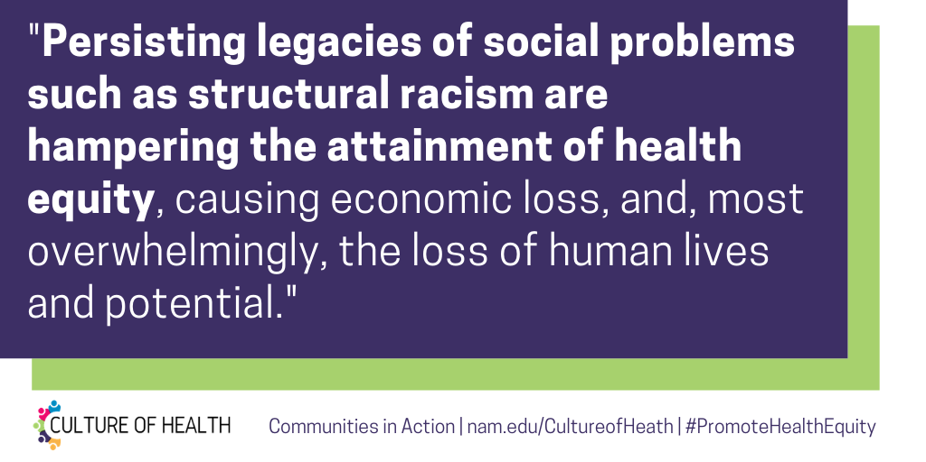
Impact of Structural Racism
Source: Culture of Health

Slide 15

Identifying the Impacts of Policies
Racist policies constitute structural racism without using or referring to race within the policy…
Dr. Ibram X. Kendi
Image source iStock

Slide 16
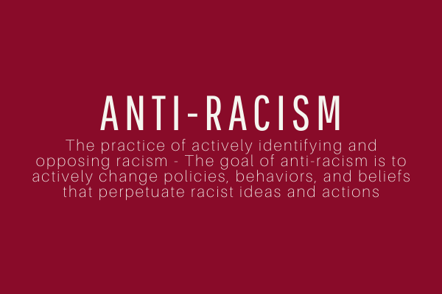
Anti-Racism

Slide 17
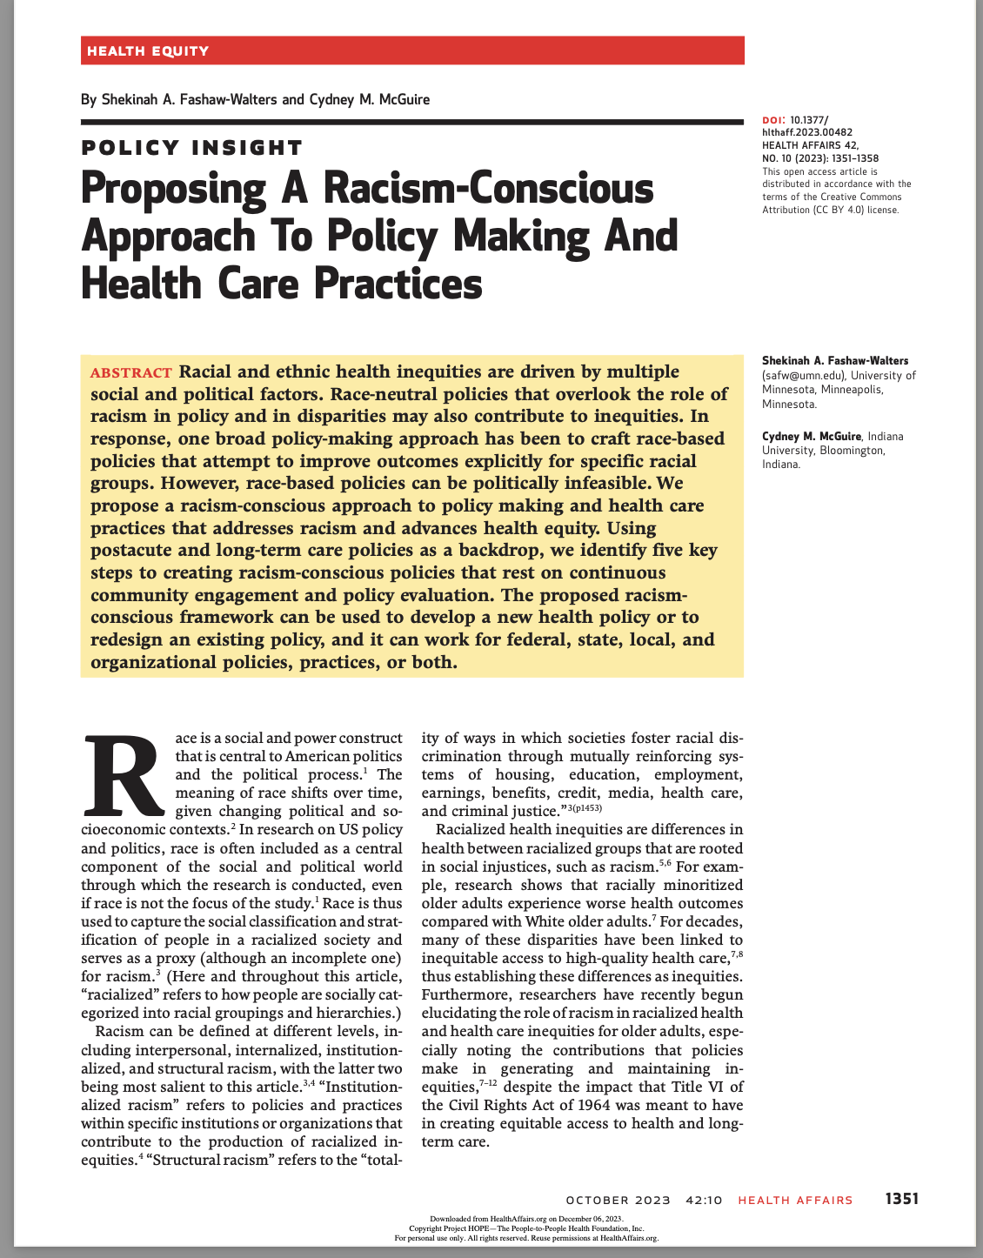
Policy
Race-neutral policy example:
    Early COVID-19 vaccination policies in the US prioritized vaccinations for adults older than age sixty-five, regardless of the fact that Black people have a lower life expectancy and are less likely to reach age sixty-five as a result of centuries of racism and discrimination.
    This meant Black Americans ages 55 - 64 would receive vaccines after older White Americans even though Black Americans had a much greater risk for COVID-19 infection.
Fashaw-Walters, S. A., & McGuire, C. M. (2023). Proposing A Racism-Conscious Approach To Policy Making And Health Care Practices: Article proposes a racism-concious health policy framework. Health Affairs, 42(10), 1351-1358.

Slide 18
HIV Healthcare Landscape
& Current Disparities

Slide 19
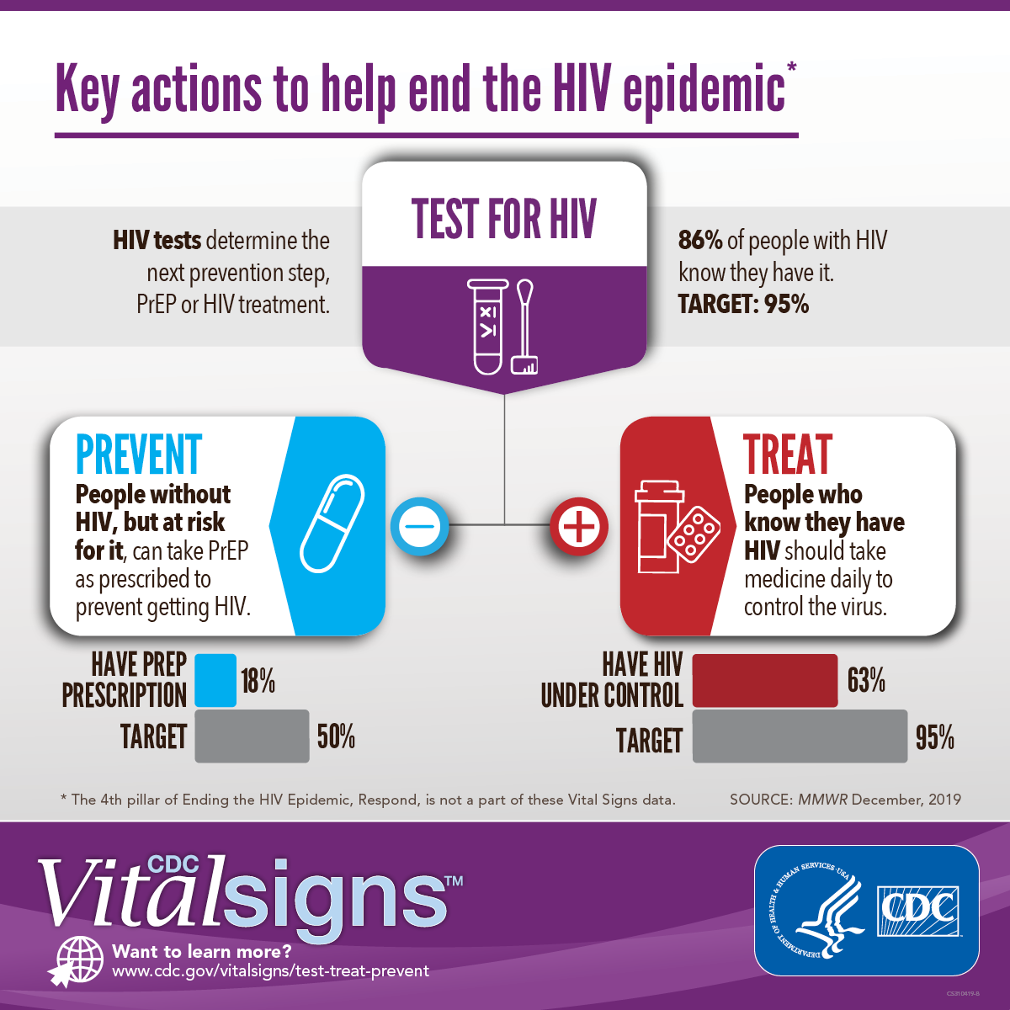
Key actions to help end the HIV epidemic

Slide 20
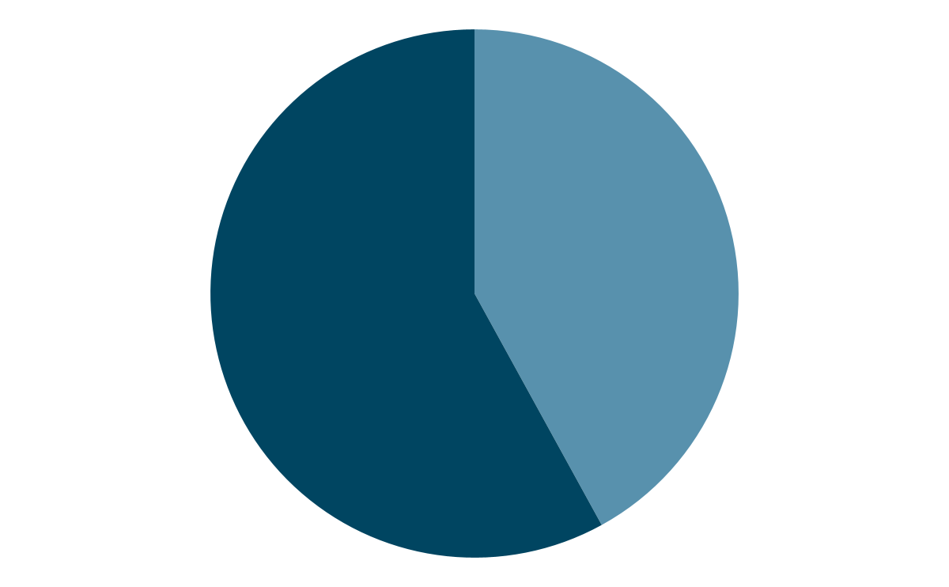
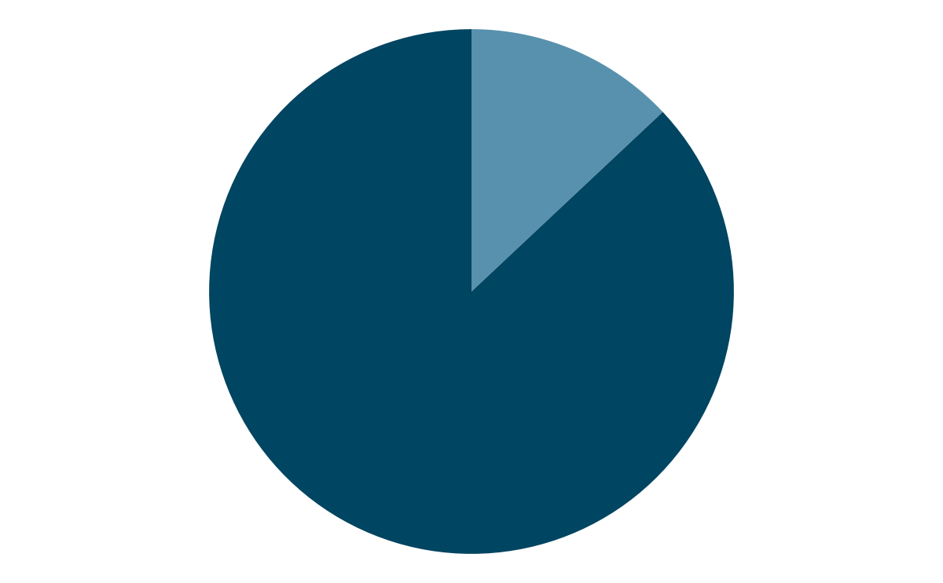
Disproportionate burden of HIV on Black/African American people
In 2018, Black/African American people made up 42% of the new HIV diagnoses yet were only 13% of the US population
42%
13%
https://www.cdc.gov/hiv/group/racialethnic/aian/index.html
https://www.census.gov/quickfacts/fact/table/US/PST045219

Slide 21
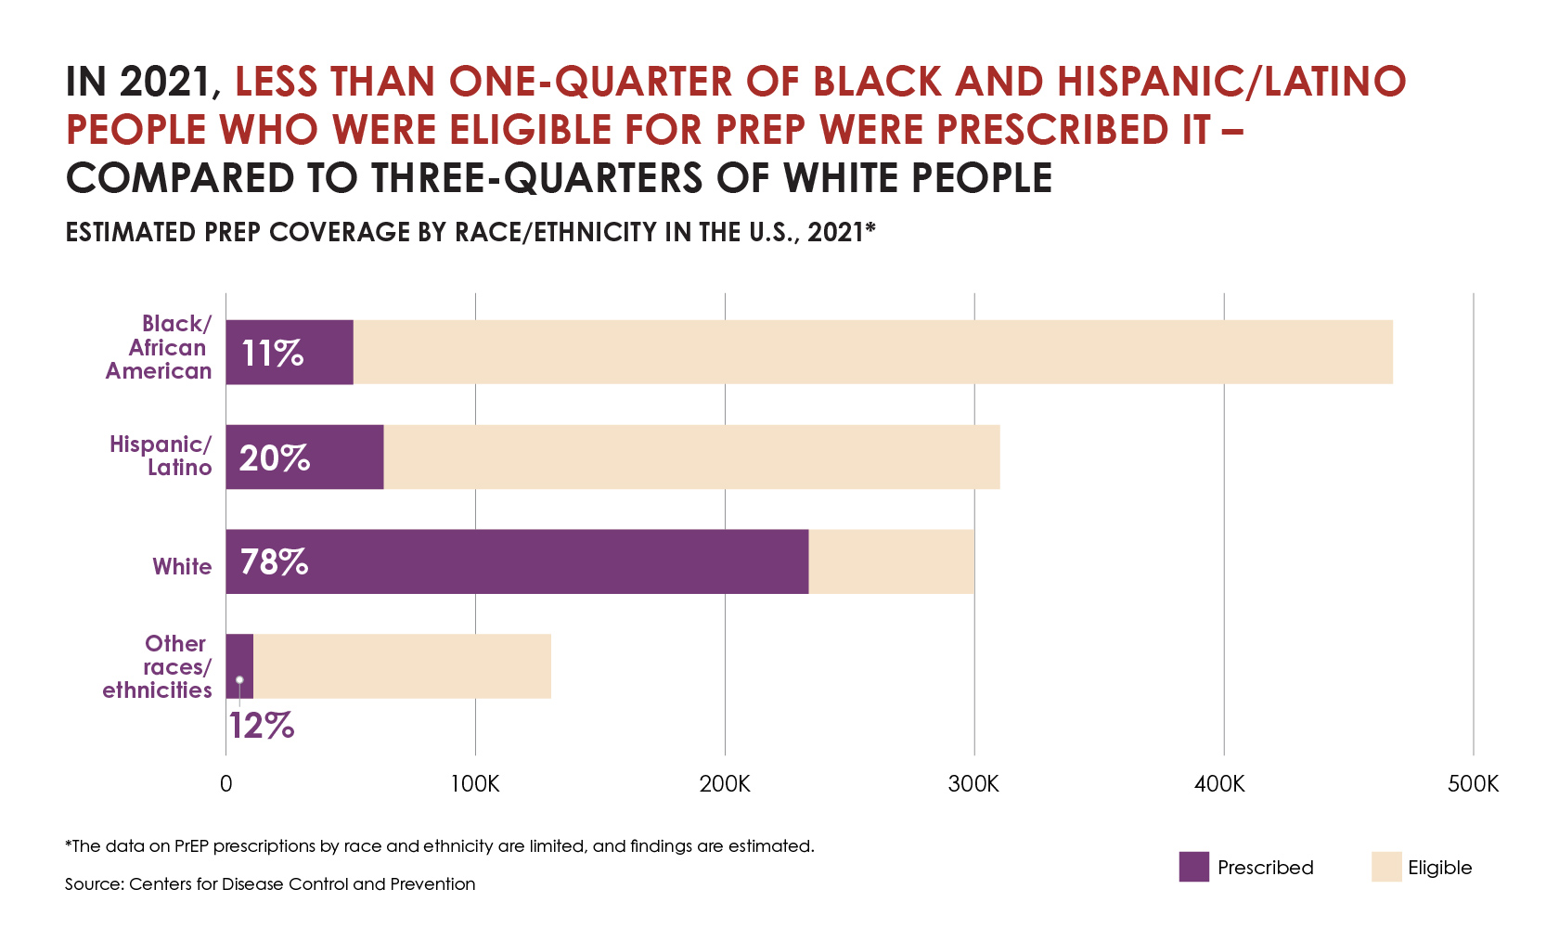
Disparities in HIV Prevention
Image Source: CDC – PREP for HIV Prevention in the U.S.

Slide 22
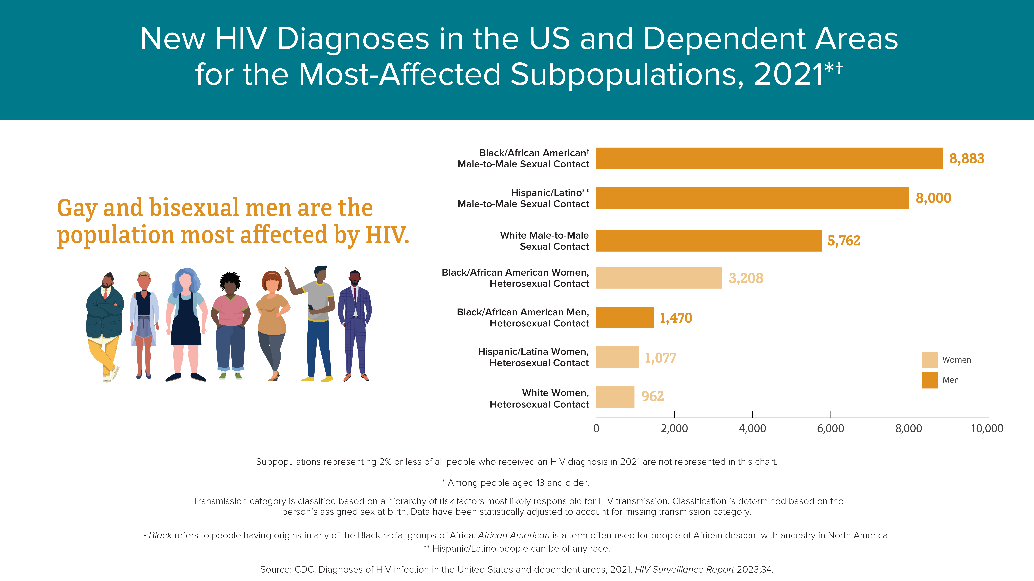
New HIV Diagnoses in the US and Dependent Areas for the Most-Affected Subpopulations, 2021
Source: CDC HIV Basic Statistics

Slide 23
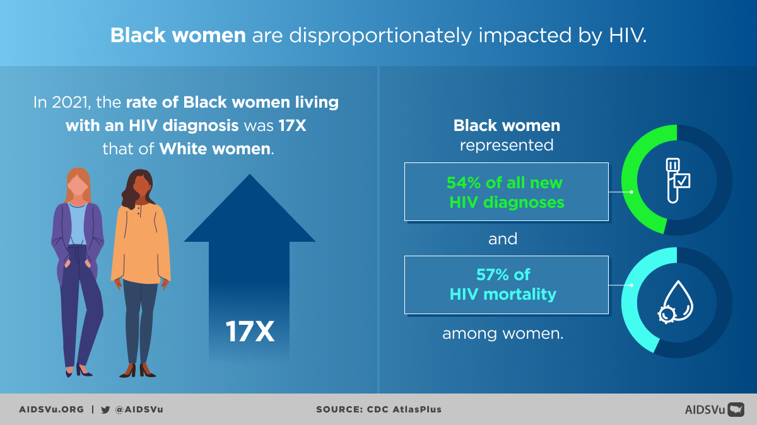
Black Women Impacted by HIV
Notes:
https://aidsvu.org/resources/deeper-look-hiv-in-black-communities/

Slide 24
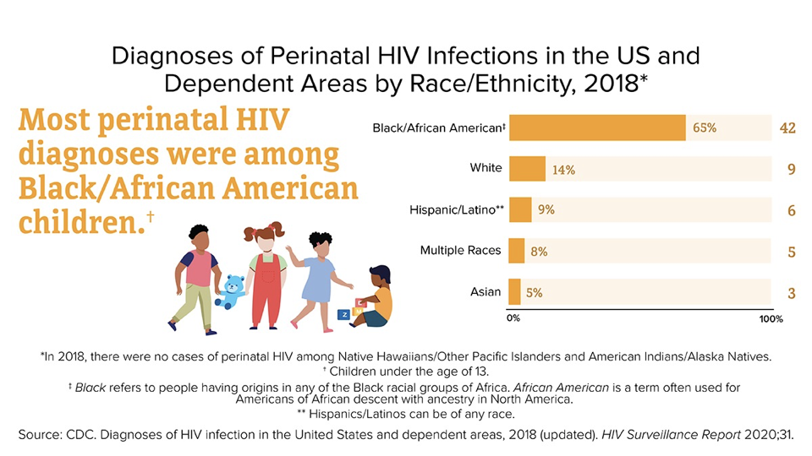
Diagnoses of Perinatal HIV Infections in the US and Dependent Areas by Race/Ethnicity, 2018 (2)

Slide 25
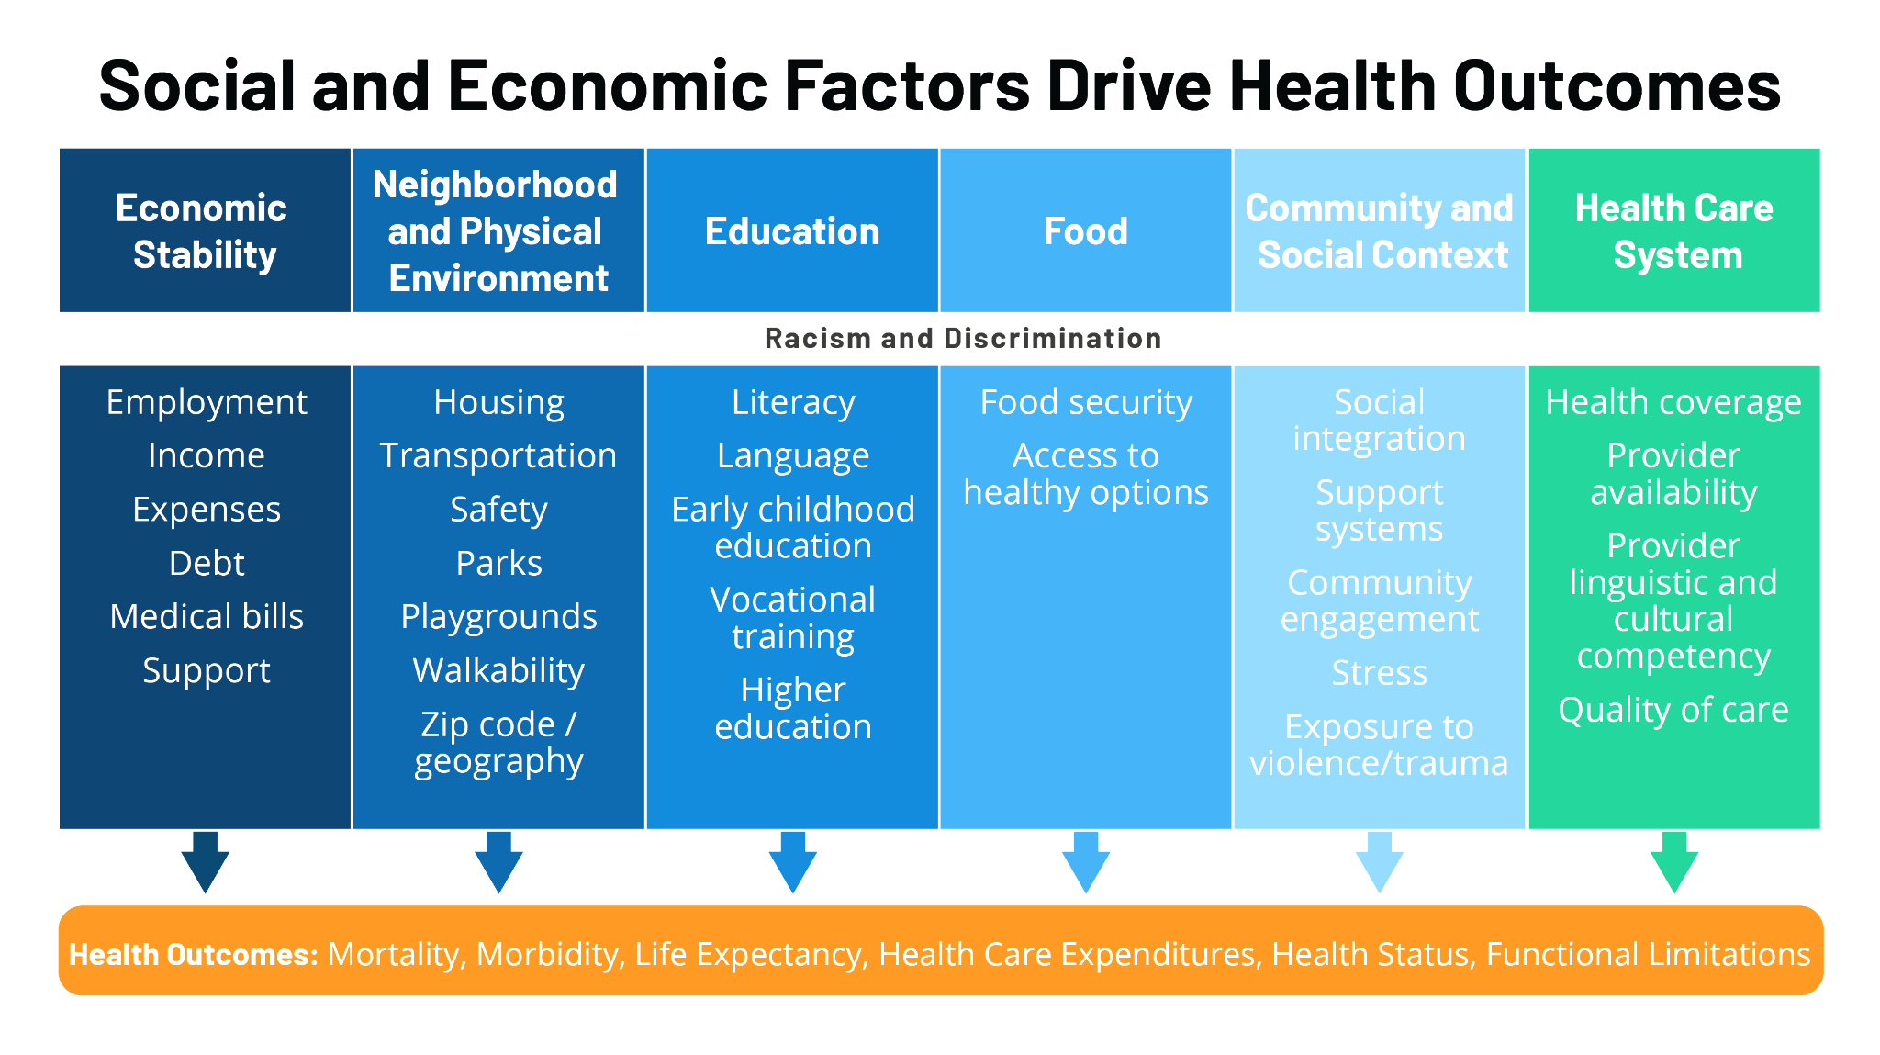
Health Disparities (2)
Image Source: Health Disparities are a Symptom of Broader Social and Economic Inequities (Samantha Artiga, SFF)

Slide 26
To be clear...
Racism, NOT race is the cause of these disparities!

Slide 27
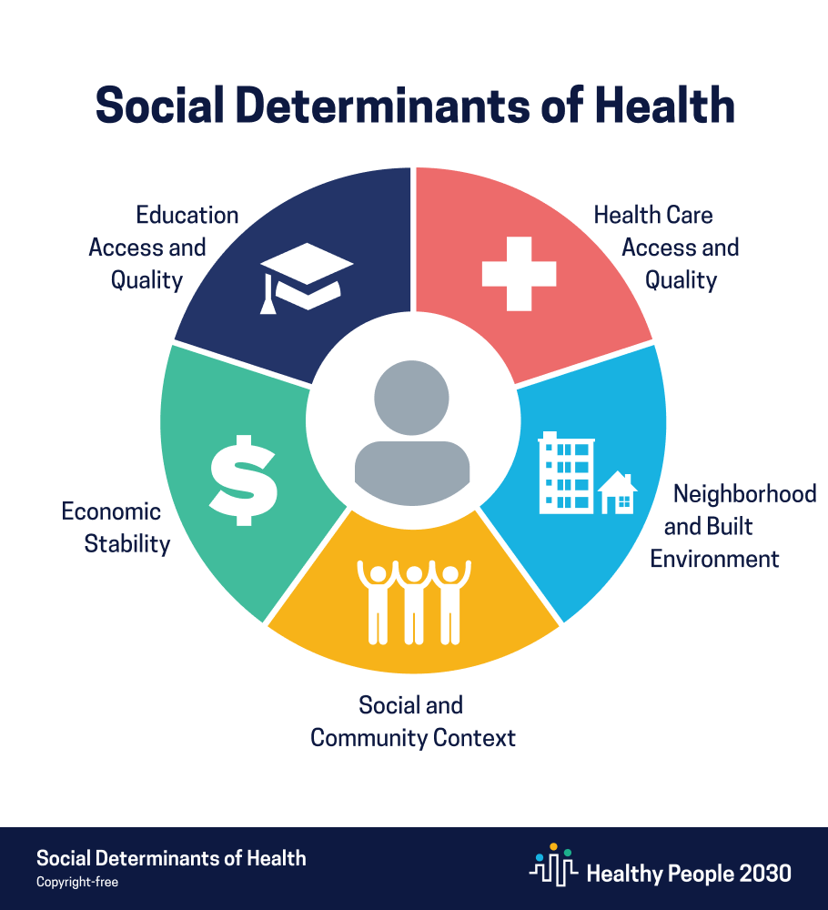
Social Determinants of Health
The various social and ecological factors that contribute to the health and wellbeing of individuals and communities.
“Social determinants of health (SDOH) are conditions in the places where people live, learn, work, and play that affect a wide range of health risks and outcomes.”
-CDC
https://www.cdc.gov/visionhealth/determinants/index.html

Slide 28
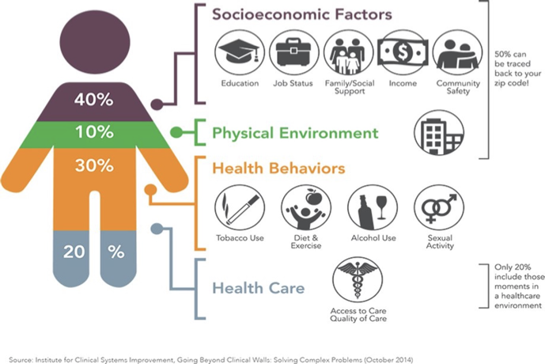
Social Determinants of Health

Slide 29
Introduction to Anti-Racist Clinical Care

Slide 30
Medical Mistrust Module

Slide 31
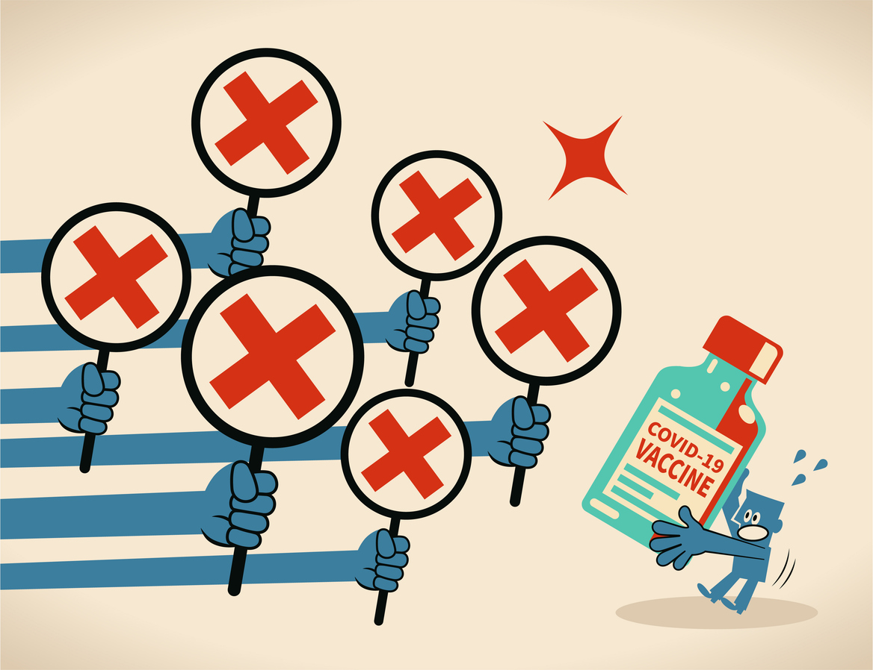
Medical Mistrust Module Purpose
The purpose of this module is to illuminate the deep roots of Medical Mistrust and identify interpersonal and structural strategies to mitigate Medical Mistrust.
Image source iStock

Slide 32
Medical Mistrust Module Learning Objectives
Discuss at least two examples that have contributed to Medical Mistrust.
Discuss at least two reasons why BIPOC communities mistrust the healthcare system and medical profession.
Identify three strategies to address behaviors that promote or maintain Medical Mistrust.

Slide 33

Medical Mistrust Module Activities
Examine the historical context of Medical Mistrust.
Discuss the concepts of distrust vs mistrust in healthcare.
Design tool to examine how to review and revise organizational policies.
Use a case study to consider how to address Medical Mistrust in patient/provider interactions.
Image source iStock

Slide 34
Intersectionality Module

Slide 35

Intersectional Module Purpose
The purpose of this module is to examine the application of an intersectional approach into clinical practice.
We want to answer the question – how does an intersectional lens inform the practice of healthcare providers?
Image source iStock

Slide 36

Intersectionality Module Learning Objectives
Define intersectionality.
Discuss how intersectionality is a paradigm that addresses the multiple ways we identify.
Discuss how structural intersectionality can address power and equity in healthcare.
Image source iStock

Slide 37

Intersectionality Module Activities
Examine intersectional identities to demonstrate the complexities of patient/provider interactions.
Define intersectionality and structural intersectionality.
Use a case study to demonstrate the dangerous impact of discrimination based on one identity.
Image source iStock

Slide 38
Implicit Bias Module

Slide 39
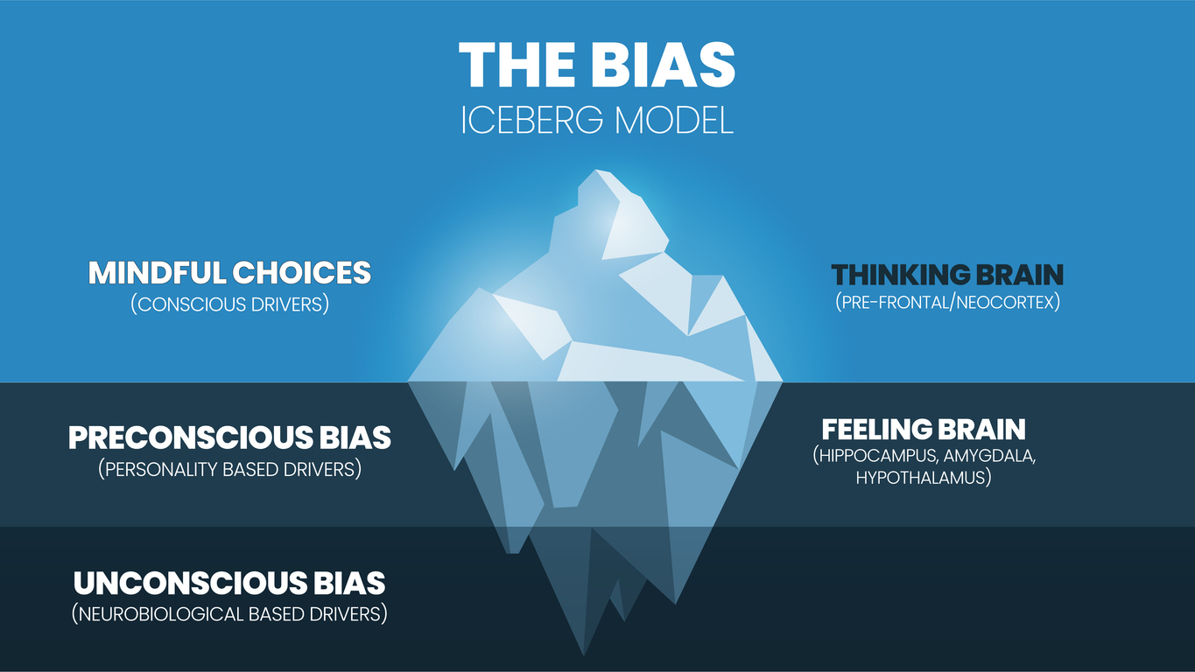
Implicit Bias Module Purpose
The purpose of this module is to assist providers in developing awareness, knowledge, and strategies to mitigate the negative impact related to implicit bias that occurs in clinical care and decision making.
Image source iStock

Slide 40

Implicit Bias Module Learning Objectives
Define and discuss implicit and explicit bias.
Identify and discuss the impact of implicit and explicit bias on provider behavior.
Discuss Implicit Association Test (IAT) experience and its usefulness as a tool to increase awareness of personal bias.
Develop a personal and organizational action plan to mitigate implicit bias.
Image source iStock

Slide 41
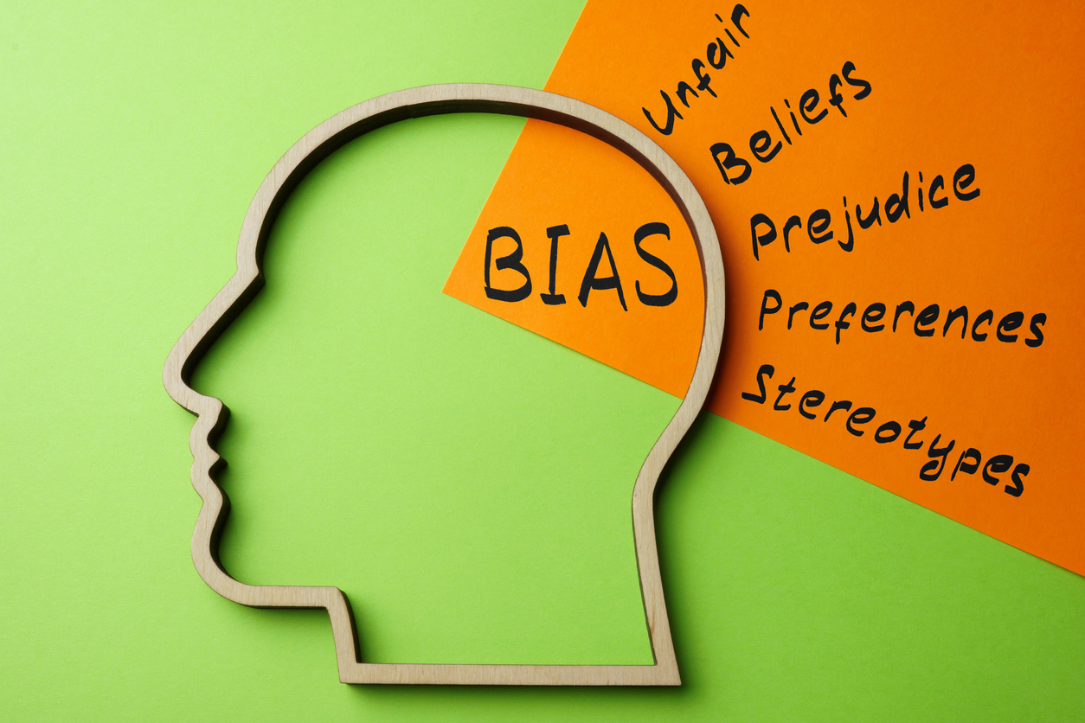
Implicit Bias Module Activities
Examine the difference between implicit and explicit bias
Use case study to consider the impact of implicit bias on provider behavior during care delivery
Take the IAT to inform personal strategies to mitigate implicit bias
Use the Addressing Bias in Healthcare Delivery Action Tool to create both personal and organizational action plans to address bias
Image source iStock

Slide 42
Anti-Racist Framework

Slide 43

Organizational Commitment to Change
Racism is, and has always been, a public health emergency that we must work to end.
Racial equity exists at the core of all initiatives & work to end adverse health outcomes for communities most impacted by racism.
Previous inaction & the need for introspection regarding our own complicit role in contributing to & upholding structural racism.
Image source iStock

Slide 44
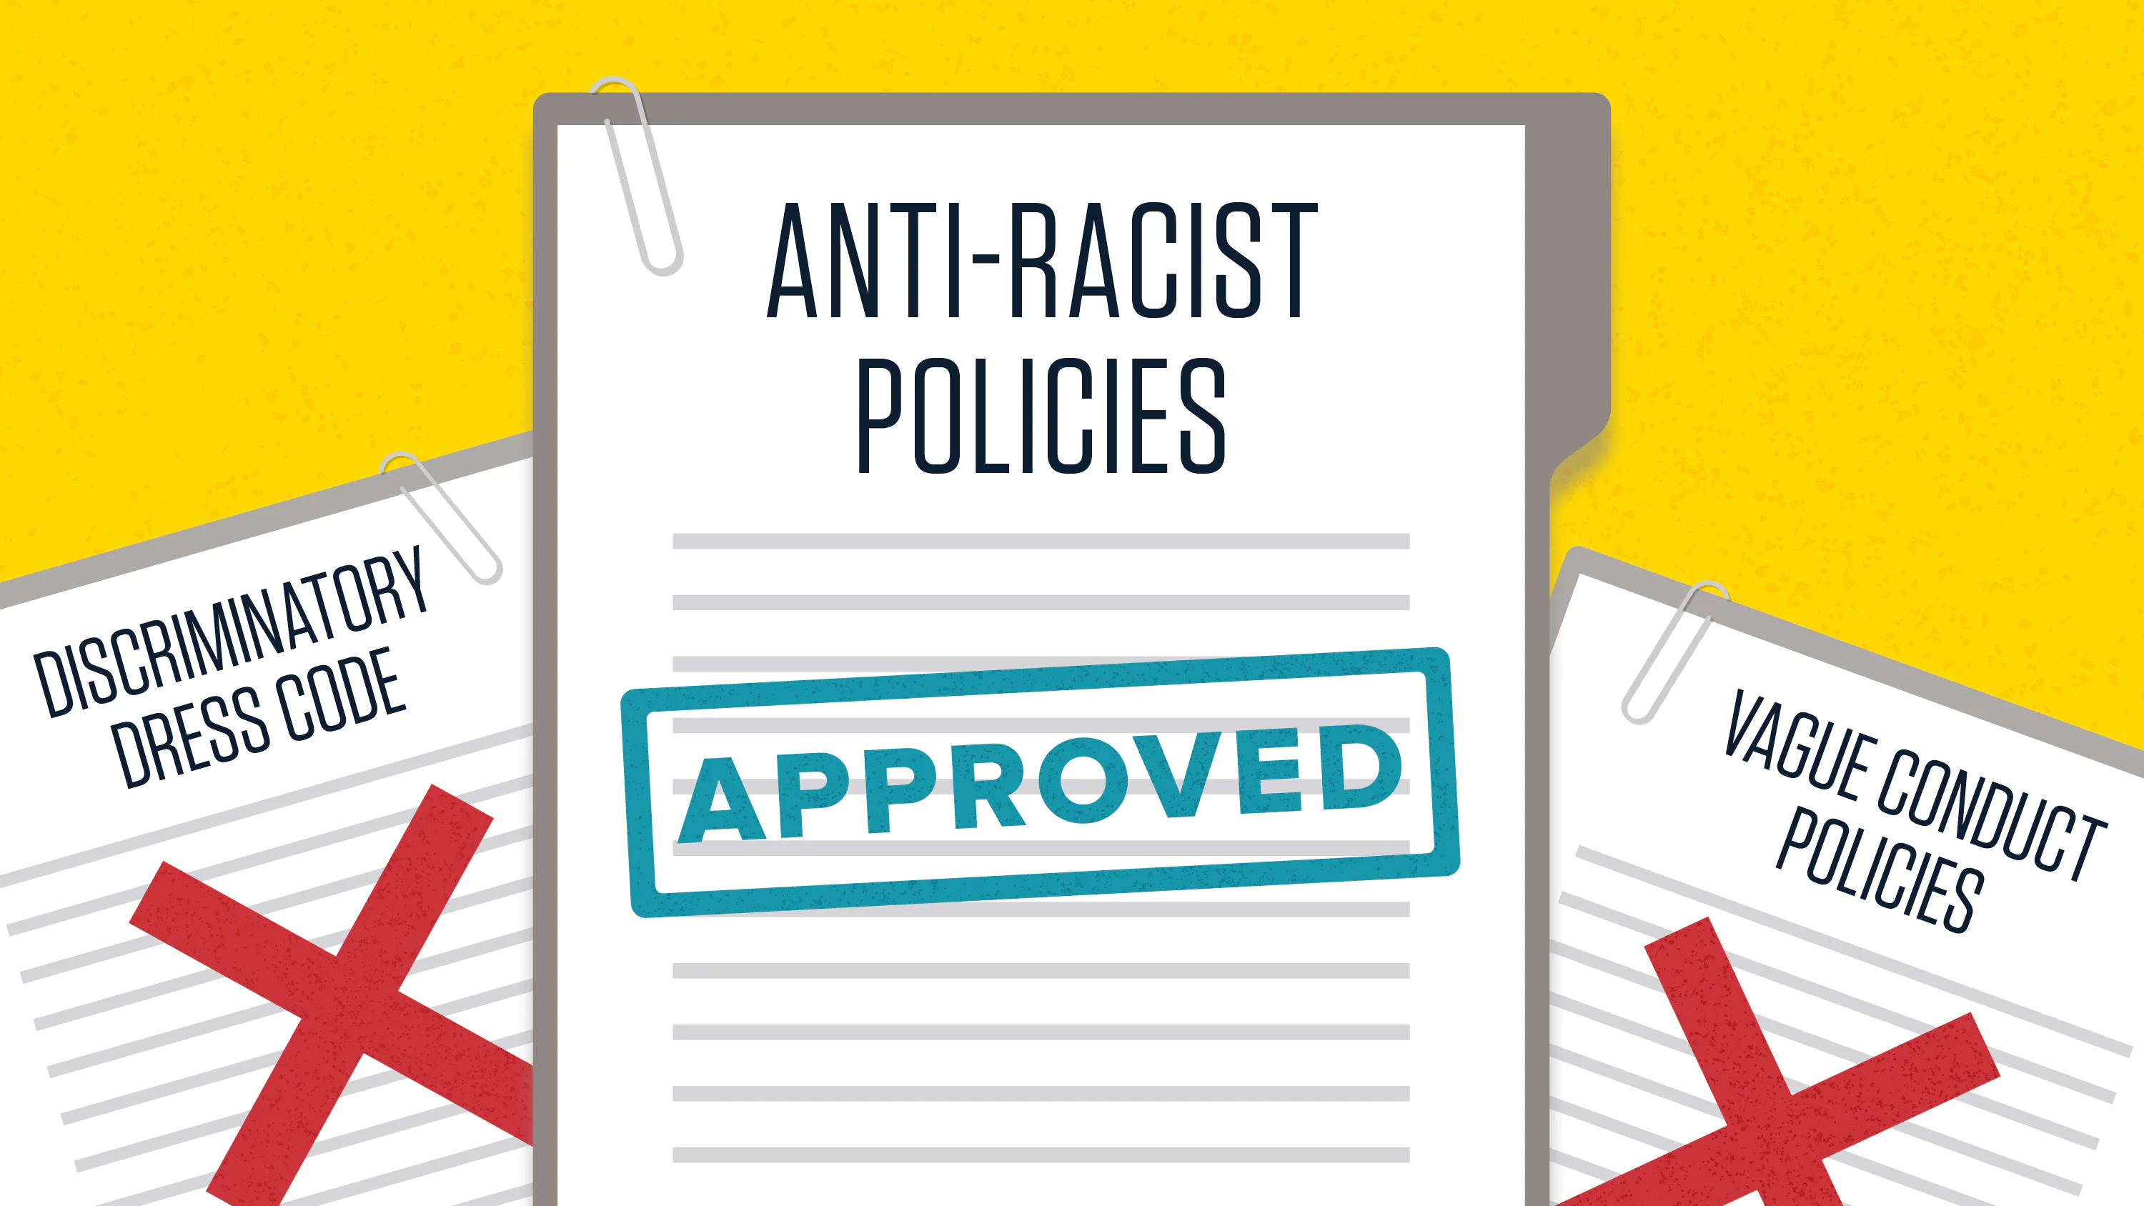
Anti-Racist, Policies, Practices, and Systems
Create & implement anti-racist policies & adopt anti-racist practices.
Promote inclusivity and belonging.
Create & sustain inclusive organizational cultures that support & uphold anti-racism in all policies and practices
Image source iStock

Slide 45

Anti-Racist Policies, Practices, and Systems (cont’d)
Ensure data is collected, interpreted, & shared in ways that promote health & racial equity.
Strive to recruit, hire, retain, and promote a diverse workforce that is representative of the communities that we serve.
Image source iStock

Slide 46
Community Activation and Empowerment
Partner with community organizations leading this work, as well as those most impacted by racism, is central to our success.
Promote belonging.
Cultivate and invest in partnerships with affected communities, ensure active inclusion of BIPOC voices, & develop shared power in public health.

Slide 47
Measurement, Evaluation, Learning and Reporting
Identify clear goals and objectives focused on health and racial equity.
Establish accountability structures, data collection methods, and reporting mechanisms to embed health and racial equity throughout our work.
Commit to advocating for changes in how data is collected and shared across the enterprise.
Support a culture of data that collects, monitors, analyzes, and shares data on health outcomes and behaviors to assess disparities and advance health and racial equity.

Slide 48
Principles for Anti-Racist Organizations
Confront, don’t hide from, racism; health care (public health) should be anti-racist.
Be interdisciplinary: learn from social sciences and humanities to understand race and structural racism.
Be creative and collaborative in addressing structural problems inside and outside the clinic.
Speak up more vocally about structural issues that impact patients and public health.
Image source iStock

Slide 49
References
Fashaw-Walters, S. A., & McGuire, C. M. (2023). Proposing A Racism-Conscious Approach To Policy Making And Health Care Practices: Article proposes a racism-concious health policy framework. Health Affairs, 42(10), 1351-1358.
Jones, C. P. (2002). Confronting institutionalized racism. Phylon, 50(1/2), 7. https://doi.org/10.2307/4149999
https://www.brookings.edu/blog/how-we-rise/2020/09/25/latinos-often-lack-access-to-healthcare-and-have-poor-health-outcomes-heres-how-we-can-change-that/
https://nam.edu/programs/culture-of-health/structural-racism-impact-on-health/

