Slide 1
SEXUAL HEALTH: More than sex
Cases in HIV for InterProfessional Students (CHIPS) SESSION 1
Lis Shell, PhD, PA-C
Assistant Professor, Physician Assistant Program
CHIPS Faculty
Baylor College of Medicine
Notes:
Version date_ 04 2024
Target audience: IPE trainees and faculty
Topic: Taking a sexual history and strategies to prevent STI

Slide 2
Conflict of Interest Disclosure Statement
Speaker has nothing to disclose
This program is supported by the Health Resources and Services Administration (HRSA) of the U.S. Department of Health and Human Services (HHS) as part of an award totaling $4,205,743 with 0% financed with non-governmental sources. The contents are those of the author(s) and do not necessarily represent the official views of, nor does mention of trade names, commercial practices, or organizations imply an endorsement by HRSA, HHS, or the U.S. Government. For more information, please visit HRSA.gov. Any trade/brand names for products mentioned during this presentation are for training and identification purposes only.
Notes:
Please add presenter disclosures here if any exist.

Slide 3
Use of Trade/Brand Names
This program is supported by the Health Resources and Services Administration (HRSA) of the U.S. Department of Health and Human Services (HHS) as part of an award totaling $4,205,743, with 0% financed with non-governmental sources.
The views expressed do not necessarily reflect the official policies of the Department of Health and Human Services, nor does mention of trade names, commercial practices, or organizations imply endorsement by the U.S. Government. Any trade/brand names for products mentioned during this presentation are for training and identification purposes only.
Notes:
NOTE: THIS SLIDE MUST BE INCLUDED IF TRADE AND/OR BRAND NAMES FOR MEDICATIONS ARE USED IN THE PRESENTATION.
IT MAY BE DELETED IF THERE IS NO REFERENCE TO TRADE NAMES, INCLUDING PRESENTATIONS IN WHICH ONLY GENERIC MEDICATION NAMES ARE MENTIONED.
TRADE NAMES MUST BE PUT IN PARENTHESES AFTER THE GENERIC NAME THE FIRST TIME IT IS MENTIONED - E.G., FLUOXETINE (PROZAC). TRADE NAMES SHOULD ONLY BE MENTIONED FOR THE INITIAL REFERENCE AND THE GENERIC NAME ONLY SHOULD BE USED AFTER THAT. THIS APPLIES EQUALLY TO ALL MEDICATIONS OR PRODUCTS MENTIONED IN THIS PRESENTATION.

Slide 4
Unconscious Bias Disclosure
SCAETC recognizes that language is constantly evolving, and while we make every effort to avoid bias and stigmatizing terms, we acknowledge that unintentional lapses may occur in our presentations.
We value your feedback and encourage you to share any concerns related to language, images, or concepts that may be offensive or stigmatizing.
Your input will help us refine and improve our presentations, ensuring they remain inclusive and respectful to participants.

Slide 5
CHIPS Logistics
Please complete the online participant information form and baseline student assessment if you have not done so already
2024 CHIPS Session dates: January 26, February 23, March 29, April 12
By joining CHIPS, you will be eligible to earn a CHIPS Certificate of Completion
To earn a CHIPS Certificate of Completion, you must attend all 4 sessions.
One live session can be missed, but you must watch the Zoom recording and complete a post-evaluation to receive credit.
Notes:
SCAETC is HRSA-funded and needs to submit demographic information for all participants in our trainings.
Once it has been filled out once, it will cover you for all AETC trainings and will not need to be filled out again for a year.

Slide 6
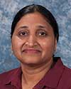
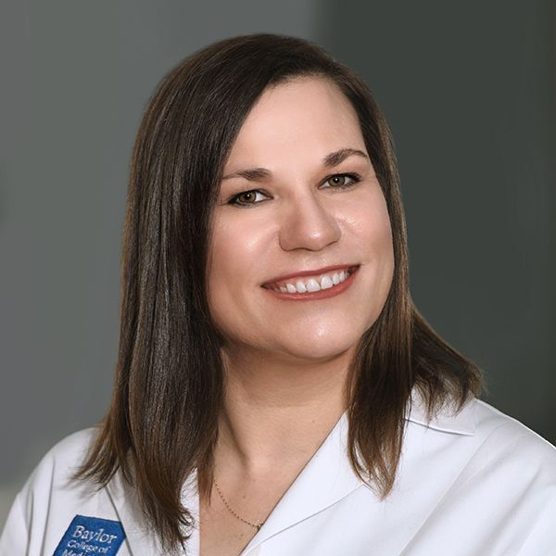
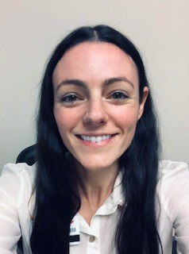
CHIPS Faculty and Collaborators
Padmavathy Ramaswamy, PhD
Assistant Professor
Cizik School of Nursing
The University of Texas
Erica Yu, PhD
Associate Dean & department chair
Cizik School of Nursing
The University of Texas
Sheryl Malone-Thomas, DNP, RN, FNP-BC
Assistant Professor
Cizik School of Nursing
The University of Texas
Shital Patel, MD
Assistant Professor
Infectious Diseases
Baylor College of Medicine
Melanie Goebel, MD
Assistant Professor
Infectious Diseases
Baylor College of Medicine
Chelsea Gilts Ratcliff, PhD
Assistant Professor
Department of Psychology and Philosophy
Sam Houston State University
School of
Health Professions
Lis Shell, PhD, PA-C
Assistant Professor
Baylor College of Medicine
Physician Assistant Program
Amy Moss, PharmD
Clinical Pharmacist
Harris Health System
Hongmei Wang, PharmD, PhD
Assistant Professor
Texas Southern University

Slide 7
Learning Objectives
Define what it means to be sexually healthy.
Identify strategies for having a proactive sexual health discussion with all patients.
Encourage sexual health and prevention of HIV and sexually transmitted infections (STIs).

Slide 8
Agenda
Introduction to interprofessional core competency: Values/Ethics
Case presentation
Breakout rooms (30 minutes)
Group discussion

Slide 9
Session Expectations for Students
Respectful, collaborative discussions
Use people-first language
Active participation from all
Focus on team-based care
Break out sessions will not be recorded
Zoom logistics:
please turn on your camera (if possible)
change your “name” in zoom (name, profession, year)
All sessions will be recorded on Zoom

Slide 10
Introduction to interprofessional core competency: Values/Ethics

Slide 11
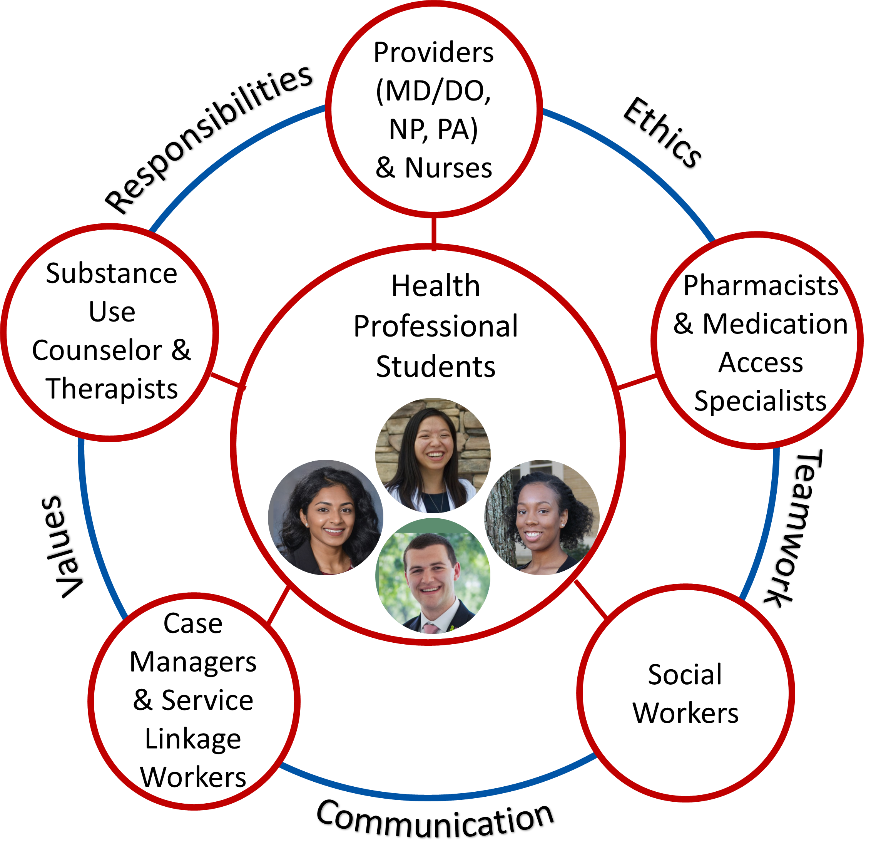
Core Competencies for Interprofessional Collaborative Practice
Values/Ethics for Interprofessional Practice
Roles/Responsibilities
Interprofessional Communication
Teams and Teamwork
Interprofessional Education Collaborative. (2016). Core competencies for interprofessional collaborative practice: 2016 update. Washington, DC: Interprofessional Education Collaborative.
Notes:
Image from IPE collaborative, sited above

Slide 12
Core Competency: Values/Ethics for Interprofessional Practice
Providing services to culturally-diverse people with HIV:
Embrace the cultural diversity and individual differences that characterize patients, populations, and the health team.
Develop a trusting relationship with patients, families, and other team members.
Manage ethical dilemmas specific to interprofessional patient population centered care situations.
Interprofessional Education Collaborative. (2016).
Core competencies for interprofessional collaborative practice: 2016 update. Washington, DC: Interprofessional Education Collaborative.
Notes:
For reference
VE1: Place interests of patients and populations at center of interprofessional health care delivery and population health programs and policies, with the goal of promoting health and health equity across the life span.
VE2: Respect the dignity and privacy of patients while maintaining confidentiality in the delivery of team-based care.
VE3: Embrace the cultural diversity and individual differences that characterize patients, populations, and the health team.
VE6: Develop a trusting relationship with patients, families, and other team members.
VE8: Manage ethical dilemmas specific to interprofessional patient/ population centered care situations.

Slide 13
CASE PRESENTATION

Slide 14
Patient History
A 55-year-old man (DMAB*; he/him) with HIV who presents for follow-up care.
Current concerns include a sore throat for the past 2 days.
DMAB= designated male at birth

Slide 15
HIV History
Diagnosed with HIV in 2/2023 at Ben Taub hospital
Current antiretroviral therapy (ART): bictegravir, tenofovir alafenamide, emtricitabine (single pill regimen, Biktarvy®)
Notes:
Bictegravir = integrase strand transfer inhibitor
Tenofovir and Emtricitabine = nucleoside reverse transcriptase inhibitors

Slide 16
Other Past Medical History
Cirrhosis
Barrett’s Esophagus/gastroesophageal reflux disease
Substance use disorder
Alcohol use disorder
Anxiety and depression
No surgeries

Slide 17
Social History
General: Unemployed but is attending community college and plans to major in information technology
Living Arrangement: Lives with a female friend and her daughter for the past 10 years
Sexual activity: Patient recently had oral sex with a male partner in a 24-hour bookstore
Notes:
The patient is single but recent visited a 24-hour book store to engage in anonymous oral sex and did not use condoms. Some 24-hour book stores have a room located in the back for individuals who want to participate in anonymous sex. Bath houses can also be used for anonymous sex as well. In Houston, there is a bath house located outside of downtown Houston.

Slide 18
Social History, Continued
Alcohol: No current use but previously consumed 9 ounces of hard liquor daily for 10 years
Tobacco: Quit a few months ago. History of 35-pack-year smoking history
Drugs: History of methamphetamine 12 months ago and typically during holidays
Travel History: None recently

Slide 19
Allergies and Medications
Allergies: No known drug allergies
Current outpatient medications:
Bictegravir-emtricitabine-tenofovir alafenamide
Carvedilol
Furosemide
Rifaximin
Dexlansoprazole
Bupropion extended release
Sertraline
Hydroxyzine
Notes:
Bictegravir-emtricitabine-tenofovir alafenamide (Biktarvy®) = HIV treatment; antiretroviral therapy
Carvedilol (Coreg®) = cardiac medication; beta blocker
Furosemide (Lasix®) = cardiac medication; diuretic
Rifaximin (Xifaxan®) = intestinal medication; antibiotic
Dexlansoprazole (Dexilant®) = stomach acid suppressant; proton pump inhibitor
Bupropion (Wellbutrin XL®) = mood medication; norepinephrine and dopamine reuptake inhibitor
Sertraline (Zoloft ®) = mood medication; selective serotonin reuptake inhibitor
Hydroxyzine (Atarax®) = as needed anxiety medication; antihistamine

Slide 20
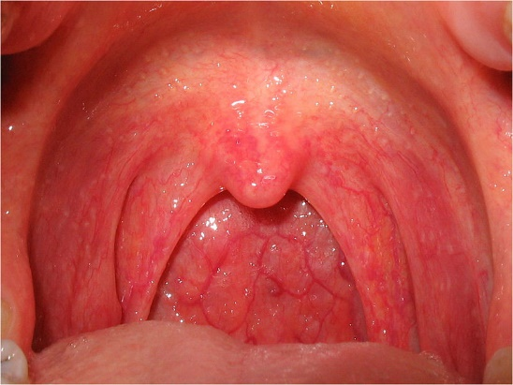
Physical Exam
VITALS: BP 128/71, pulse 61, temp 98.9 F, resp rate 18, O2 98% on room air, weight 80 kg
General: alert, No Abnormality Detected (NAD), cooperative, answering questions appropriately
Head, Ears, Nose and Throat Examination (HEENT): pupils equal round and reactive to light, extra-ocular motions intact. Below is a photograph.
https://creativecommons.org/licenses/by-sa/2.5/

Slide 21
Labs
HIV-1 viral load: 225 copies/ml (treatment goal=not detected or below level of detection)
CD4 count: 345 cells/mm³ (normal 550-1200)
HIV genotype (resistance testing): HIV-1, No mutations
Basic metabolic panel (includes electrolytes, glucose, renal function): normal
Liver function tests: albumin 3.4 (reference 4.4-5.5), otherwise normal
Complete blood count: normal
Notes:
WBC=white blood cells
Hgb=hemoglobin

Slide 22
A Brief Primer on Sexual Health and How to Take a Sexual History

Slide 23
Sexual Health Definitions
A state of physical, emotional, mental and social well-being in relation to sexuality; it is not merely the absence of disease, dysfunction or infirmity.
Requires:
A positive and respectful approach to sexuality and sexual relationships
Possibility of having pleasurable and safe sexual experiences, free of coercion, discrimination, and violence
https://www.who.int/health-topics/sexual-health#tab=tab_2
Notes:
What is sexual health?
ASHA believes that sexual health includes far more than avoiding disease or unplanned pregnancy. We also believe that having a sexually transmitted infection or unwanted pregnancy does not prevent someone from being or becoming sexually healthy.
Sexual health is the ability to embrace and enjoy our sexuality throughout our lives. It is an important part of our physical and emotional health. Being sexually healthy means:
Understanding that sexuality is a natural part of life and involves more than sexual behavior.
Recognizing and respecting the sexual rights we all share.
Having access to sexual health information, education, and care.
Making an effort to prevent unintended pregnancies and STDs and seek care and treatmentwhen needed.
Being able to experience sexual pleasure, satisfaction, and intimacy when desired.
Being able to communicate about sexual health with others including sexual partners and healthcare providers.

Slide 24
Sexual Health Definitions
The ability to embrace & enjoy sexuality throughout life
An important part of physical and emotional health
Being sexually healthy means:
Understanding sexuality is a natural part of life & involves more than sexual behavior
Recognizing & respecting sexual rights we all share
https://www.ashasexualhealth.org/sexual-health/
Notes:
Why is sexual health important?
Sexuality is an integral part of being human. Love, affection, and sexual intimacy contribute to healthy relationships and individual well-being. But along with the positive aspects of our human sexuality, there also are illnesses, mixed emotions and unintended consequences that can affect our sexual health.

Slide 25
Sexual Health Definitions
Being sexually healthy means:
Having access to sexual health information, education, & care
Making an effort to prevent unintended pregnancies & STIs, and seeking care and treatment when needed
Being able to experience sexual pleasure, satisfaction, and intimacy when desired
Being able to communicate about sexual health with others, including sexual partners and healthcare providers
https://www.ashasexualhealth.org/sexual-health/
Notes:
STI=sexually transmitted infections
There have been changes in sexual attitudes and practices over last century

Slide 26
Diversity of Human Sexuality & Sexual Orientation
Sexual health is connected!
Understanding gender identity and sexual orientation can facilitate better healthcare
Image: https://sites.psu.edu/mqlrcl/2016/02/15/ci-5-sexual-identity-issues/
Notes:
Gender identity: chemistry that composes you (eg, hormonal levels) and how you interpret what that means to you
Transgender: gender identity is not the same as the sex at birth
Cisgender: gender identity corresponds with birth sex
Gender expression: through actions, dress, behavior, and interactions
Biological sex: Female = vagina, ovaries, XX chromosomes; Male = penis, testes, XY chromosomes
Sexual orientation: who you are attracted to, based on their sex/gender in relation to your own

Slide 27
Barriers to Taking a Sexual History
Time
Discomfort
Patient
Provider
Lack of training or understanding

Slide 28
Benefits
Build trust
Behavioral counseling to prevent STIs
Support consistent, correct barrier use
Determine appropriate anatomical sites for certain STI tests
Determine appropriate prevention methods
Birth control
PrEP/PEP
Barrier protection
PrEP = Pre-Exposure Prophylaxis PEP = Post-Exposure Prophylaxis
Notes:
PrEP= HIV pre-exposure prophylaxis
PEP= HIV post-exposure prophylaxis

Slide 29
Approach to Sexual History
Set the Stage
Be sex-positive
Disarm
Dialogue
Open conversation
6Ps
Build Rapport
Gain trust
Empowerment
Notes:
Judgement free discussion
Sex positive-having or promoting an open, tolerant, or progressive attitude towards sex and sexuality.
Disarm-if they seem uncomfortable, have an open-ended discussion and prep for the discussion.

Slide 30
6 P’s of a Sexual History
Partners
Practices
Protection from STIs
Past history of STIs
Prevention/Planning of pregnancy
Pleasure
https://www.cdc.gov/std/treatment/sexualhistory.pdf
Notes:
Participation (consent)
Pleasure or pain
De-pathologize conversation

Slide 31
Establish Trust
Set the Stage
Bring up the sexual history as part of the overall history
Explain that you ask these questions of all patients
Ensure confidentiality
Begin with These Screening Questions
Are you having sex?
Who are you having sex with? Anyone else?
What types of sex are you having? (oral, vaginal, anal)
https://www.cdc.gov/std/treatment/sexualhistory.pdf
Notes:
Practices-insertive anal intercourse (Top), receptive anal intercourse (Bottom)
When you are having sex, what goes where?
“I understand these questions are very personal, but they are important for your overall health”
“I ask these questions to all of my patients, regardless of age, gender, or marital status”
“Like the rest of our visits, this information is kept in strict confidence”
“What questions do you have before we get started?”

Slide 32
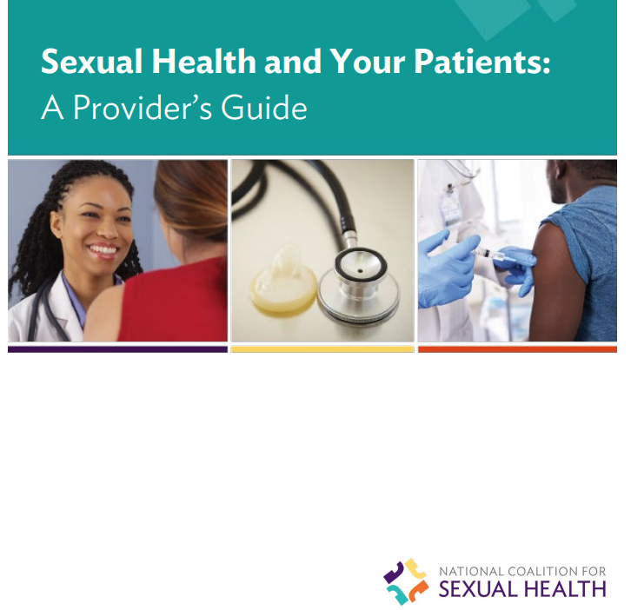
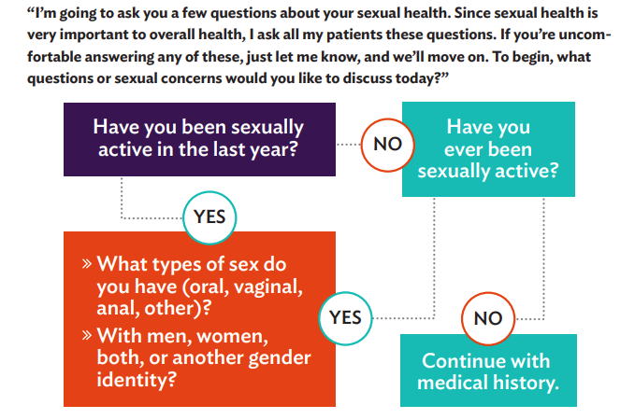
Resources for Taking a Sexual History
https://nationalcoalitionforsexualhealth.org/
https://nationalcoalitionforsexualhealth.org/tools/for-healthcare-providers/sexual-health-and-your-patients-a-providers-guide

Slide 33
Nonjudgmental Communication
Be sensitive and open
Use open-ended questions
No: “You always use condoms, right?”
Yes: “How do you protect yourself from HIV & STIs?”
Avoid assumptions
No: “Do you have a husband or boyfriend?”
Yes: “Do you have a partner or spouse?” or “Are you currently in a relationship?”
https://www.lgbtqiahealtheducation.org/wp-content/uploads/COM-827-sexual-history_toolkit_2015.pdf

Slide 34
Nonjudgmental Communication
Be straight forward but sensitive & open to different behaviors
Listen
How do patients address themselves? Their partners?
Address patient similarly
If unaware of gender identification, use gender neutral words & language (e.g., they, them, theirs, ze)
https://www.lgbtqiahealtheducation.org/wp-content/uploads/COM-827-sexual-history_toolkit_2015.pdf

Slide 35
Stigma
Internalized
Shame or stigma brought with patient
Externalized
Shame or stigma felt/put upon by others
Can be a barrier in discussions
HIV stigma
STI stigma
Sexual practices stigma
Age stigma

Slide 36
How to Counsel Patients to Prevent STIs
Give basic information about STIs and their transmission
Provide training on skills to lower risk of acquiring STIs (barrier protection)
Communicate about safer sex
Problem solving
Goal setting
Discuss strategies to lower risk for STIs
Abstinence
Reducing the number of sexual partners
Mutual monogamy
https://www.uspreventiveservicestaskforce.org/uspstf/recommendation/sexually-transmitted-infections-behavioral-counseling
https://nationalcoalitionforsexualhealth.org/tools/for-healthcare-providers/asset/Provider-Guide_May-2022.pdf
Notes:
Dialogue With Patient
● Do you and your partner(s)discuss STI prevention?
● If you use prevention tools, what methods do you use? (For example, external or internal condoms— also known as male or female condoms—dental dams, etc.)
● How often do you use this/these method(s)? More prompting could include specifics about:
○ Frequencies: sometimes, almost all the time, all the time.
○ Times they do not use a method.
● If“ sometimes,” in which situations, or with whom, do you use each method?
● Have you received HPV, hepatitis A, and/or hepatitis B shots?
● Are you aware of PrEP, a medicine that can prevent HIV? Have you ever used it or considered using it?

Slide 37
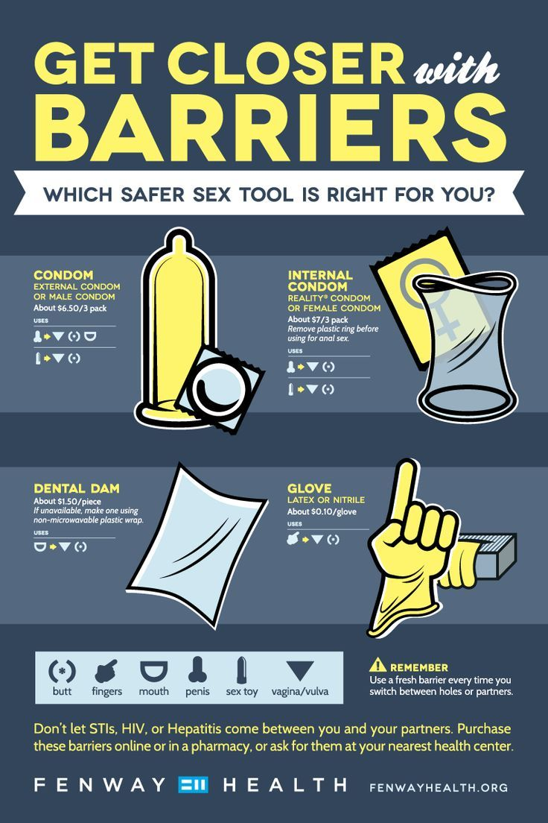

Slide 38
https://www.cdc.gov/std/prevention/lowdown/lowdown-text-only.htm
Notes:
What you can send home with patients.
Increased testing & linkage to care
Delayed or fewer partners
Less risky activities
Increased condom use
Empowerment & negotiation skills
Reducing alcohol & drug use
Syringe services where legal
Reduce psychosocial barriers
Circumcision
STI treatment
HIV PEP & HIV PrEP

Slide 39
Patient Case Summary
55-year-old man (pronouns he/him/his) comes to the clinic for follow-up on HIV care
Current concern includes a sore throat for the past 2 days
Sexual history includes recent oral sex with a male partner without the use of barrier protection
Recent labs remarkable for mild decrease in albumin and elevated HIV viral load at 225 copies/mL

Slide 40
BREAKOUT ROOMS

Slide 41
Breakout Rooms Icebreaker
Name and your school/program
What did you do over winter break?

Slide 42
Breakout Room Questions for Discussion:
What does this patient need today?
Role play: practice taking a sexual history. One member of the group will play the role of a fictional patient, and another member will play the role of healthcare team member.
How would you counsel this patient to change their behavior to prevent STIs?
Notes:
Back up questions:
What does sex positive mean to you?
How would you take this patient’s sexual history in a respectful way?

Slide 43
Labs
Treponema pallidum antibody non-reactive
COVID PCR negative
Rapid streptococcal antigen test negative
Throat gonorrhea/chlamydia NAAT (nucleic acid amplification test): positive gonorrhea, negative chlamydia

Slide 44
Team-Based Plan of Care
Problem: HIV with virologic failure (viral load > 200 copies/ml)
Team solution:
Labs: HIV viral load 225 copies/mL
Counseling on adherence and work with pharmacy to ensure access to medications
Notes:
Virologic failure: The inability to achieve or maintain suppression of viral replication to HIV-RNA level <200 copies/mL.

Slide 45
Team-Based Plan of Care
Problem: Pharyngeal gonorrhea
Team solution:
Labs: Positive for gonorrhea
Counsel on condom use and schedule appointment at the clinic for a single 500 mg intramuscular dose of ceftriaxone
Counseled patient to abstain from sexual activity for 7 days after treatment and until all sex partners are treated (7 days after receiving treatment and resolution of symptoms, if present).
Notes:
To minimize disease transmission, persons treated for gonorrhea should be instructed to abstain from sexual activity for 7 days after treatment and until all sex partners are treated (7 days after receiving treatment and resolution of symptoms, if present).

Slide 46
Team-Based Plan of Care
Problem: Anxiety and depression
Team solution:
Behavioral health referral
Problem: History of substance use
Team solution:
Referral to behavioral health
Referral to substance use counselor

Slide 47
Team-Based Care Summary
Healthcare provider contacted the patient with results of STI screening test
Nursing scheduled and administered ceftriaxone injection
Referred patient to psychiatry, behavioral health team and substance use counselor
Referred to clinical pharmacist for adherence counseling and assessment of drug-drug interactions
Notes:
https://www.mededportal.org/doi/10.15766/mep_2374-8265.10295

Slide 48
Patient Course
Patient was recently seen in clinic and treated for gonorrhea
Patient has referrals in place
Follow-up pharyngeal gonorrhea/chlamydia NAAT in 2 weeks was negative for gonorrhea
Plan for repeat HIV-1 viral load in 2 months
NAAT = Nucleic Acid Amplification Test
Notes:
Patients who have resolution of symptoms following treatment for uncomplicated urogenital or anorectal gonococcal infections do not need to return for a test of cure. However, the United States Centers for Disease Control and Prevention (CDC) recommends that a test of cure be performed in all individuals with oropharyngeal gonococcal infection.
Test of cure can be with either culture or nucleic acid amplification tests (NAATs) conducted 7 to 14 days following therapy.
Any person with pharyngeal gonorrhea should return 7–14 days after initial treatment for a test of cure by using either culture or NAAT; however, testing at 7 days might result in an increased likelihood of false-positive tests.

Slide 49
Take-Home Points
Sexual health is part of physical and emotional health
Should be considered & addressed as part of routine healthcare!
HIV & other STIs are preventable infections and continue to be a challenge
Especially in certain populations (age, race, gender, sexual behavior, and geography)
Use the 6 Ps to take a routine sexual history
Notes:
How do we do a good sexual health history in such a short period of time for the visit? 15 min? Possibly give a form before visit to be filled out? Remember clinic is our home but not necessarily the patient’s home.

Slide 50
It takes a village!

Slide 51
Questions?
https://www.cdc.gov/stophivtogether/index.html
Notes:
https://www.gettingtozerosf.org/

Slide 52
Evaluations
Please complete the follow up assessment within 1 week of the session
We greatly value your feedback!!

Slide 53
Resources
National Clinician Consultation Center http://nccc.ucsf.edu/
HIV Management
Perinatal HIV
HIV PrEP
HIV PEP line
HCV Management
Substance Use Management
Present on ECHO
https://hsc.unm.edu/scaetc/programs-services/echo.html​
AETC National HIV Curriculum https://aidsetc.org/nhc
AETC National Coordinating Resource Center https://targethiv.org/library/aetc-national-coordinating-resource-center-0
HIVMA Resource Directory https://www.hivma.org/globalassets/ektron-import/hivma/hivma-resource-directory.pdf
Additional trainings scaetcecho@salud.unm.edu
www.scaetc.org
Notes:
IDEA Platform: Infectious Diseases Education & Assessment. https://idea.medicine.uw.edu/
AETC National HIV Curriculum: 6 core modules for self study; regularly updated; CME, CNE
Hepatitis C Online Curriculum: https://www.hepatitisc.uw.edu/
Hepatitis B Online Curriculum: https://www.hepatitisb.uw.edu/
National STD Curriculum: https://www.std.uw.edu/

