Slide 1
HIV & Aging Communities of Practice
Cyril Goshima, MD
Senior Adviser, Pacific AIDS Education & Training Center –
Hawaii and US-Affiliated Pacific Islands
John A Burns School of Medicine, University of Hawaii at Manoa
April 3, 2024

Slide 2
Disclaimer
The views and opinions expressed in this presentation are not necessarily those of the Pacific AIDS Education & Training Center (Pacific AETC) or its eight local partner sites in HRSA Region 9, the Regents of the University of California or its San Francisco campus (UCSF or collectively, University) nor of our funder the Health Resources and Services Administration (HRSA). Neither Pacific AETC, University, HRSA nor any of their officers, board members, agents, employees, students, or volunteers make any warranty, express or implied, including the warranties of merchantability and fitness for a particular purpose; nor assume any legal liability or responsibility for the accuracy, completeness or usefulness of information, product or process assessed or described; nor represent that its use would not infringe privately owned rights.
​
HRSA Acknowledgement Statement​ The Pacific AETC is supported by the Health Resources and Services Administration (HRSA) of the U.S. Department of Health and Human Services (HHS) as part of an award totaling $4,377,449. The contents are those of the author(s) and do not necessarily represent the official views of, nor an endorsement, by HRSA, HHS, or the U.S. Government. For more information, please visit HRSA.gov.
​
Trade Name Disclosure Statement​ Funding for this presentation was made possible by 5 U1OHA29292‐08‐00 from the Human Resources and Services Administration HIV/AIDS Bureau. The views expressed do not necessarily reflect the official policies of the Department of Health and Human Services nor does mention of trade names, commercial practices, or organizations imply endorsement by the U.S. Government. Any trade/brand names for products mentioned during this presentation are for training and identification purposes only.

Slide 3
Learning Objectives
At this discussion, participants will be able to:
Describe the epidemiology of HIV in the United States
Identify the various challenges in caring for aging people with HIV
Discuss various support systems and services available for aging people with HIV in the community

Slide 4
Human Immunodeficiency Virus (HIV)
HIV causes Acquired Immune Deficiency Syndrome (AIDS)
HIV attacks the immune system, making it difficult for the body to fight infections
Without treatment, People with HIV (PWH) will develop AIDS
Treatment greatly delays disease progression and prevents HIV transmission
Notes:
Starting with the basics
Here, you see an illustration of the Human Immunodeficiency Virus, HIV.
This is the virus that causes AIDS, the Acquired Immune Deficiency Syndrome. You might hear people use the term “Advanced HIV” because the term AIDS is being used less and less these days in medical settings.
Without treatment, HIV breaks down the immune systems and leaves it unable to fight infections.
With consistent treatment, however, someone newly diagnosed with HIV should expect to never be given an AIDS diagnosis nor even to transmit the virus to their sexual partners.
A really important teaching point to keep in mind when working with clients is that HIV and AIDS are not the same thing. HIV is the virus. AIDS is the disease state that happens over a number of years if HIV is left untreated. AIDS or Advanced HIV, is the a clinical definition of what happens when HIV goes untreated.
In my work, I find that it can give people a sense of control over their diagnosis as HIV+ to know that by taking medications to treat HIV, they are proactively keeping themselves healthy, keeping Advanced HIV at bay, and they are protecting their sex partners. My taking medications, they are taking action to keep themselves healthy…taking control and exerting their power over the diagnosis.
So, in respect to the question of why should someone get tested? Well, to know their status and if HIV-, take the proper steps to protect themselves from getting HIV such as taking PrEP, using condoms, or other prevention methods. And if HIV+, to engage in medical care and get on treatment to maintain their long-term health and protect their partners.

Slide 5
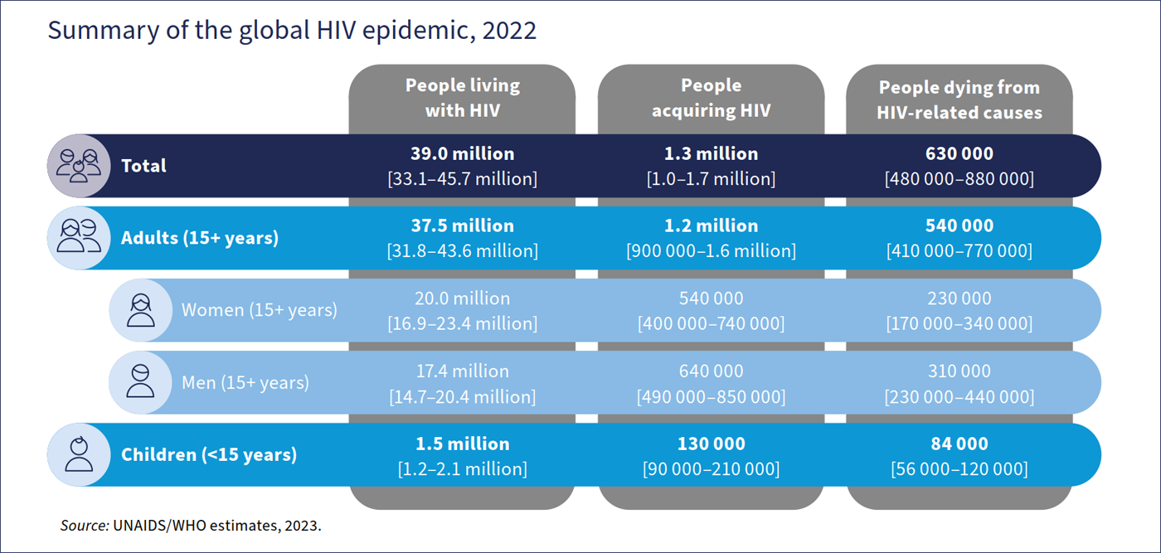
WHO HIV Epidemic 2023 estimates
World Health Organization. HIV data and statistics. Accessed Feb 19, 2024.

Slide 6
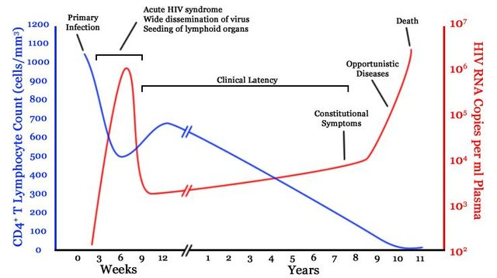
Natural Progression of untreated HIV
Popoola and Awodele. Afr. J. Med. med. Sci. (2016) 45, 5 - 21
Notes:
This is a figure presenting the natural history of untreated HIV infection. The blue line shows the level of CD4 T lymphocytes while the red line shows the HIV viral load. HIV is a virus that destroys the immune system, primarily infecting CD4 lymphocytes. During the first few years of HIV infection, the body is able to control the virus but after several years, the CD4 lymphocytes get depleted and viral load increases significantly. At this point, the patient would be susceptible to various bacterial, viral, and fungal infections.

Slide 7
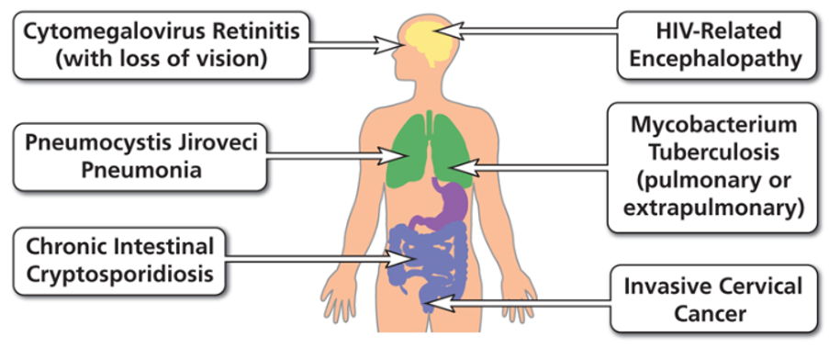
Examples of AIDS-Defining Conditions
https://aidsinfo.nih.gov/understanding-hiv-aids/glossary/784/aids-defining-condition

Slide 8
HIV Life Cycle
Notes:
This is a depiction of the HIV Life cycle from infection to the production of new virus. The cycle will be broken down into sections to describe the targets of HIV treatment.

Slide 9
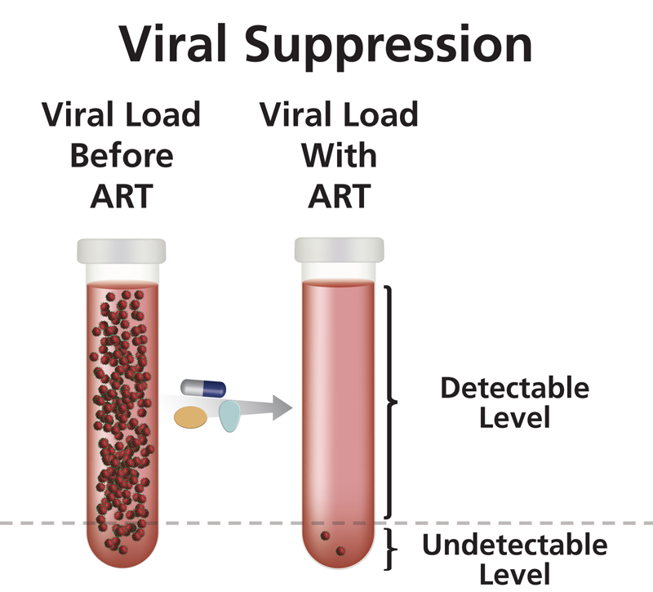
Antiretroviral Treatment (ART)
Clinical Goals
Reduce viral load as much as possible for as long as possible
Increase CD4 cell count
Ensure medication adherence to preserve ART options
Preserve quality of life
Reduce HIV transmission
https://clinicalinfo.hiv.gov/en/glossary/viral-suppression
U=U Undetectable = Untransmittable
Notes:
Once linked to care, medical clinicians will do a full panel of baseline labs and then start patients on Antiretroviral Treatment or ART with the clinical goals of:
Reducing HIV viral load to undetectable and keeping it that way
Increasing CD4 cell count and maintaining it in the normal range between 500 and 1600
Ensuring ART adherence on simple first line regimens such as one-pill-once-a-day meds
Preserving a patient’s quality of life
And reducing HIV transmission
Just to re-emphasize, a really empowering point for PWH is that when someone achieves an undetectable viral load and sustains it for longer than six months, research has shown that they cannot transmit HIV to their sexual partners.

Slide 10
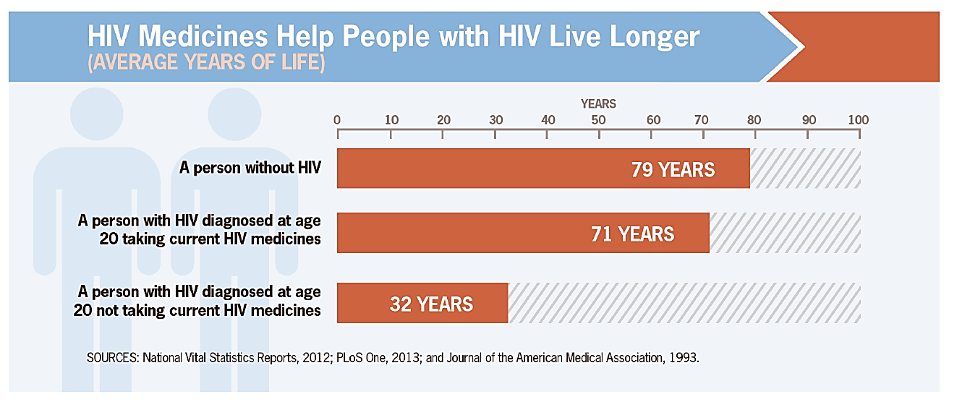
Effective Treatment Saves Lives
Infection is lifelong – HIV is treatable but not curable​
paetc.org

Slide 11
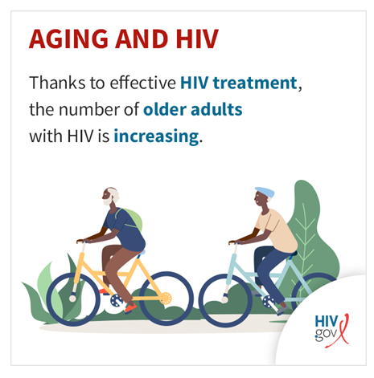
Aging with HIV (2021 Data)
According to the Centers for Disease Control and Prevention, in 2021, of the nearly 1.1 million people with diagnosed HIV in the United States and dependent areas, over 53% were aged 50 and up.
People aged 50 and older accounted for 16% of the 36,136 new HIV diagnoses in 2021 among people ages 13 and older in the United States and dependent areas.
www.HIV.gov. ‘Aging with HIV’ website. Accessed April 2024

Slide 12
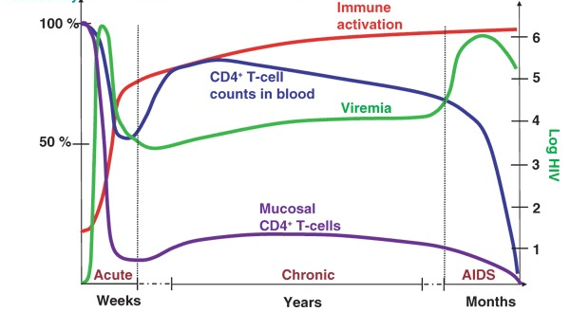
Natural history of untreated HIV infection
Despite antiretroviral therapy, people with HIV have persistent, low-grade immune activation and inflammation
Grossman Z, et al. Nature Medicine. 2006

Slide 13
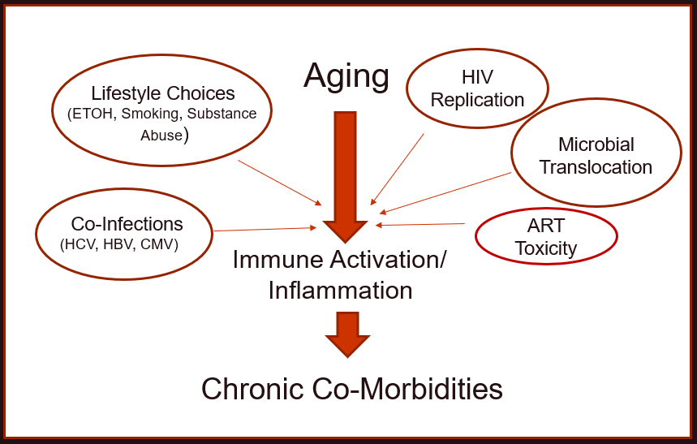
Factors Contributing to Immune Activation & Inflammation
Abbreviations: ART, antiretroviral therapy; CMV: cytomegalovirus; ETOH, ethanol/alcohol; HBV, hepatitis B virus; HCV, hepatitis C virus;
Babu H, et al. Front. Immunol., 26 August 2019
Notes:
Aging is associated with Low grade Inflammation and Immune Activation which then contributes to chronic co-morbidities.
Co-factors surrounding HIV makes this that much worse – HIV replication despite suppressive ART, microbial translocation with seepage of bacterial components thru a disrupted gut mucosa, and some ART toxicity such as increase in obesity due to integrase inhibitor contribute to immune activation;
As well as lifestyle choice such as alcohol, smoking and substance abuse and high rates among PWH of HCV, HBV and CMV co-infection

Slide 14
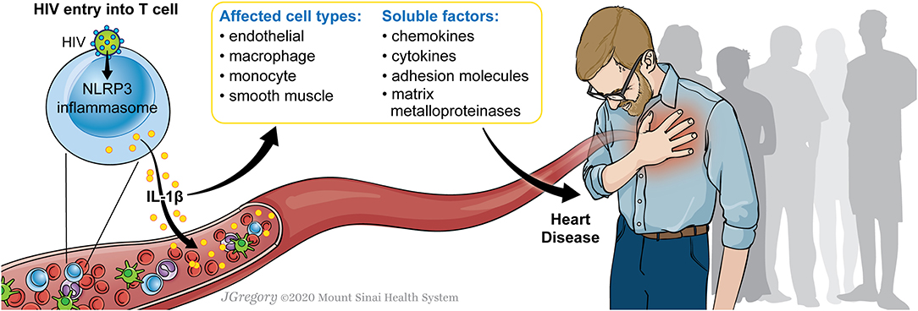
Cardiovascular disease in HIV
Coronary Artery Disease – approximately 2.0 increased relative risk (RR)
Strong evidence for the role of immune activation including monocytes/macrophages
Strokes occur more frequently and at a much younger age among people with HIV
Eyawo O et al. BMJ Open, 2019; Mullis C & Swartz TH. Front. Cardiovasc Med. 2020; Chow D, et al. AIDS. 2023; Crane HM, et al. JAIDS. 2021.

Slide 15
Neurocognitive disorders in HIV
Neurocognitive decline in people with HIV on antiretrovirals largely due to effects of multiple, potentially treatable comorbidities:
Diabetes
Hypertension
Chronic pulmonary disease
Frailty
Neuropathic pain
Depression
Lifetime history of cannabis use disorder
Heaton et al, Brain. 2022

Slide 16
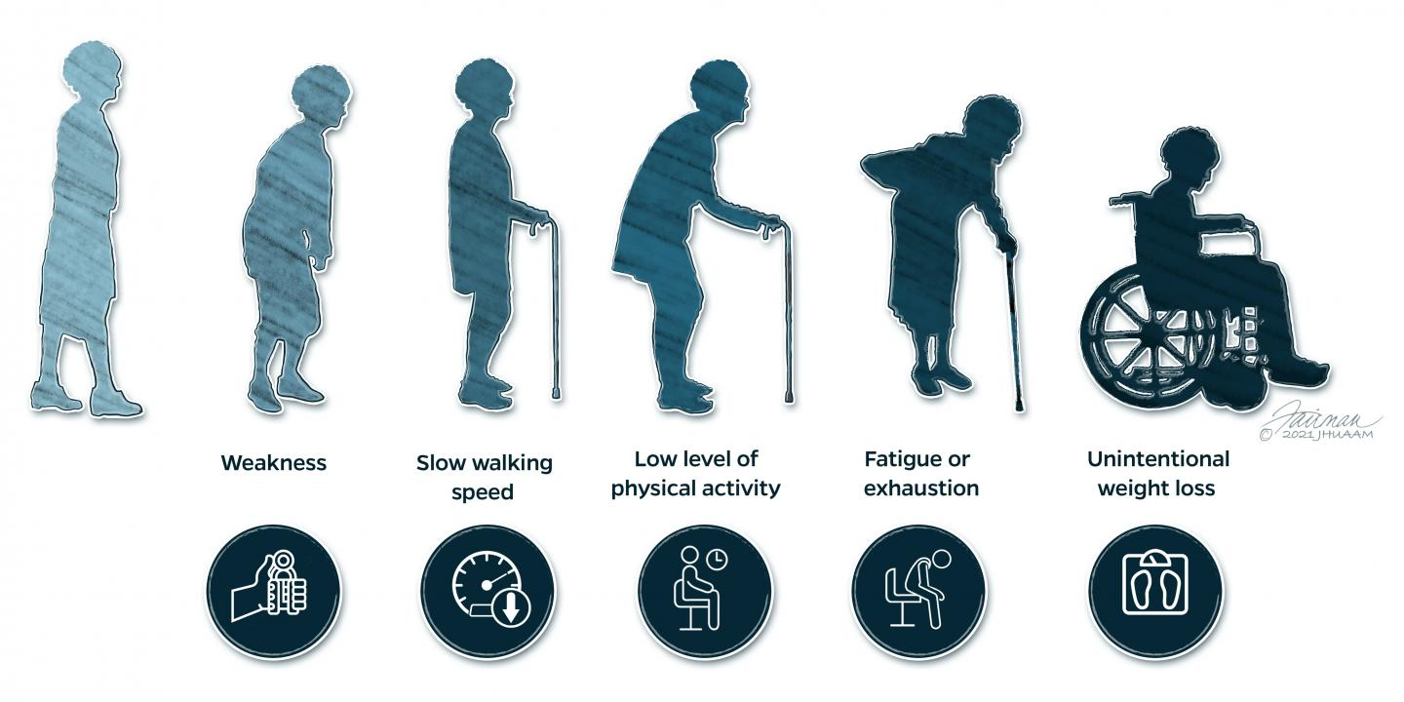
Frailty is associated with comorbidities
Leads to negative health outcomes, loss of independence, and early mortality
Fried LP, et al. J Gerontol A Biol Sci Med Sci. 2001

Slide 17
Discussion Points:
What have you observed regarding the age distribution of people with HIV in your community?
What are the needs of the aging people with HIV in your community that have to be prioritized?
What are the various support services available for aging people with HIV in your community?
What are the major gaps in care among aging people with HIV in your locality?

Slide 18
Questions?
Presenter: Cyril Goshima, MD
cgoshima@hawaii.edu

