Slide 1

Panel Session
Older Adults Living with HIV
Facilitator: Laine Snow
HIV, STD, Hepatitis Section Manager
Notes:
Version date_ 04 2024
Target audience: members of the health care team who currently care for or will be caring for older adults with HIV
60 min session

Slide 2
Conflict of Interest Disclosure Statement
Facilitator and speakers have nothing to disclose.
This program is supported by the Health Resources and Services Administration (HRSA) of the U.S. Department of Health and Human Services (HHS) as part of an award totaling $4,205,743, with 0% financed with non-governmental sources. The contents are those of the author(s) and do not necessarily represent the official views of, nor an endorsement of, by HRSA, HHS, or the U.S. Government. For more information, please visit HRSA.gov.

Slide 3
Use of Trade/Brand Names
The views expressed do not necessarily reflect the official policies of the Department of Health and Human Services, nor does mention of trade names, commercial practices, or organizations imply endorsement by the U.S. Government.
Any trade/brand names for products mentioned during this presentation are for training and identification purposes only.
Notes:
NOTE: THIS SLIDE MUST BE INCLUDED IF TRADE AND/OR BRAND NAMES FOR MEDICATIONS ARE USED IN THE PRESENTATION.
IT MAY BE DELETED IF THERE IS NO REFERENCE TO TRADE NAMES, INCLUDING PRESENTATIONS IN WHICH ONLY GENERIC MEDICATION NAMES ARE MENTIONED.
TRADE NAMES MUST BE PUT IN PARENTHESES AFTER THE GENERIC NAME THE FIRST TIME IT IS MENTIONED - E.G., FLUOXETINE (PROZAC). TRADE NAMES SHOULD ONLY BE MENTIONED FOR THE INITIAL REFERENCE AND THE GENERIC NAME ONLY SHOULD BE USED AFTER THAT. THIS APPLIES EQUALLY TO ALL MEDICATIONS OR PRODUCTS MENTIONED IN THIS PRESENTATION.

Slide 4
Unconscious Bias Disclosure
SCAETC recognizes that language is constantly evolving, and while we make every effort to avoid bias and stigmatizing terms, we acknowledge that unintentional lapses may occur in our presentations.
We value your feedback and encourage you to share any concerns related to language, images, or concepts that may be offensive or stigmatizing.
Your input will help us refine and improve our presentations, ensuring they remain inclusive and respectful to participants.

Slide 5


Slide 6
Learning Objectives
Explore changing demographics of people with HIV (PWH).
Identify challenges associated with these changes and strategies to support the aging community with HIV.
Recognize the opportunity to utilize community partnerships.

Slide 7
What’s Changing
Nationally
  10,000 U.S. baby boomers turning 65 daily
  The number of U.S. adults 65+ is growing: 36% between 2011-2021
New Mexico – 2030
  The 65+ population will more than double
  4th largest 65+ population % in the nation
  More people 65+ than under 18
  3rd in nation for seniors living in poverty

Slide 8
New Mexico Population 50+
39% of Ryan White participants > 50yo
59% male, 36% female & 5% transgender
29% White, 28% Hispanic, 16% American Indian/Alaska Native, and 12% African American
75% of NM population 50yo+<300% federal poverty level (FPL)
Stable housing 58%, unknown 26%
Notes:
65% of NM population 50yo+<200% FPL
15% 0 income, 26% <100% FPL, 24% <200% FPL, 10% <300% FPL
FPL= federal poverty level

Slide 9
Aging & Health
Costs reduced by keeping people healthy
  Independent, productive, high-quality lives
Chronic conditions erode quality of life and independence
  Cardiovascular, diabetes, obesity
  Alzheimer’s and related dementias
  Behavioral health and substance use
Account for 75% of the $2.7 trillion in annual healthcare costs in the U.S.

Slide 10
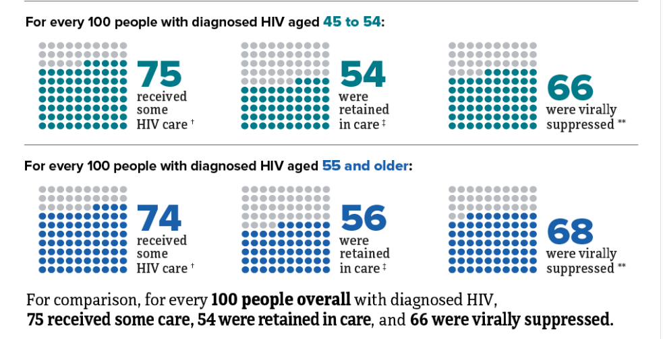
HIV Care Among People with HIV in 47 states and the District of Columbia by Age, 2021
HIV Surveillance Supplemental Report 2023;28(4)

Slide 11
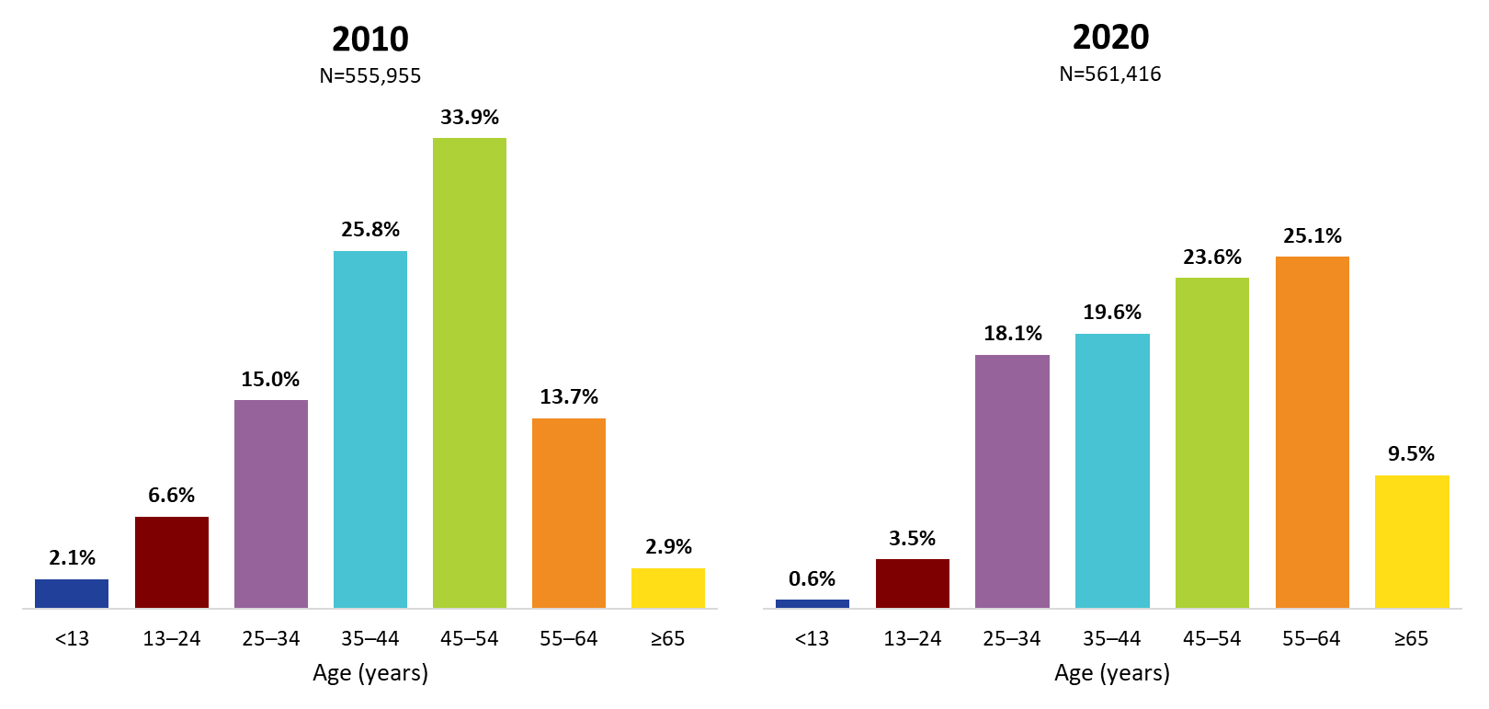
Ryan White HIV/AIDS Program Clients, by Age Group, 2010 and 2020—United States and 3 Territories
Source: HRSA. Ryan White HIV/AIDS Program (RWHAP) Data Report (RSR) 2020.
34.6%
{
16.6%
{

Slide 12
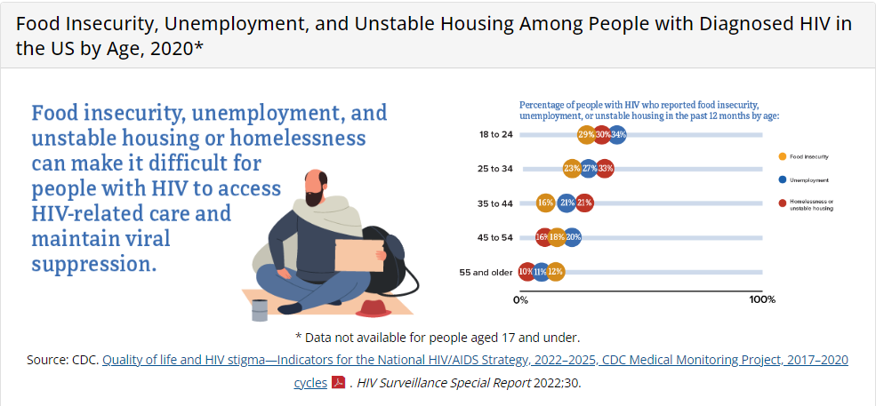
Notes:
Yellow=food insecurity
Blue=unemployment
Red=unhoused

Slide 13
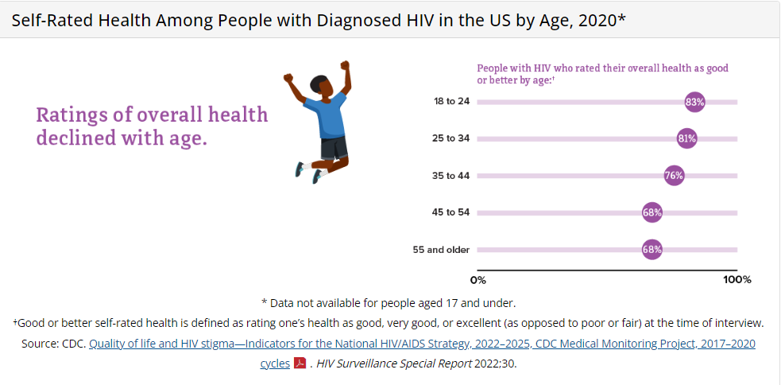

Slide 14
HIV and Age-Related Conditions
Chronic inflammation
HIV Associated Neurocognitive Disorder (HAND)
Long-term use of hormones
Survivors’ remorse
Social isolation & loneliness
Long term affects of stigma and late diagnosis

Slide 15
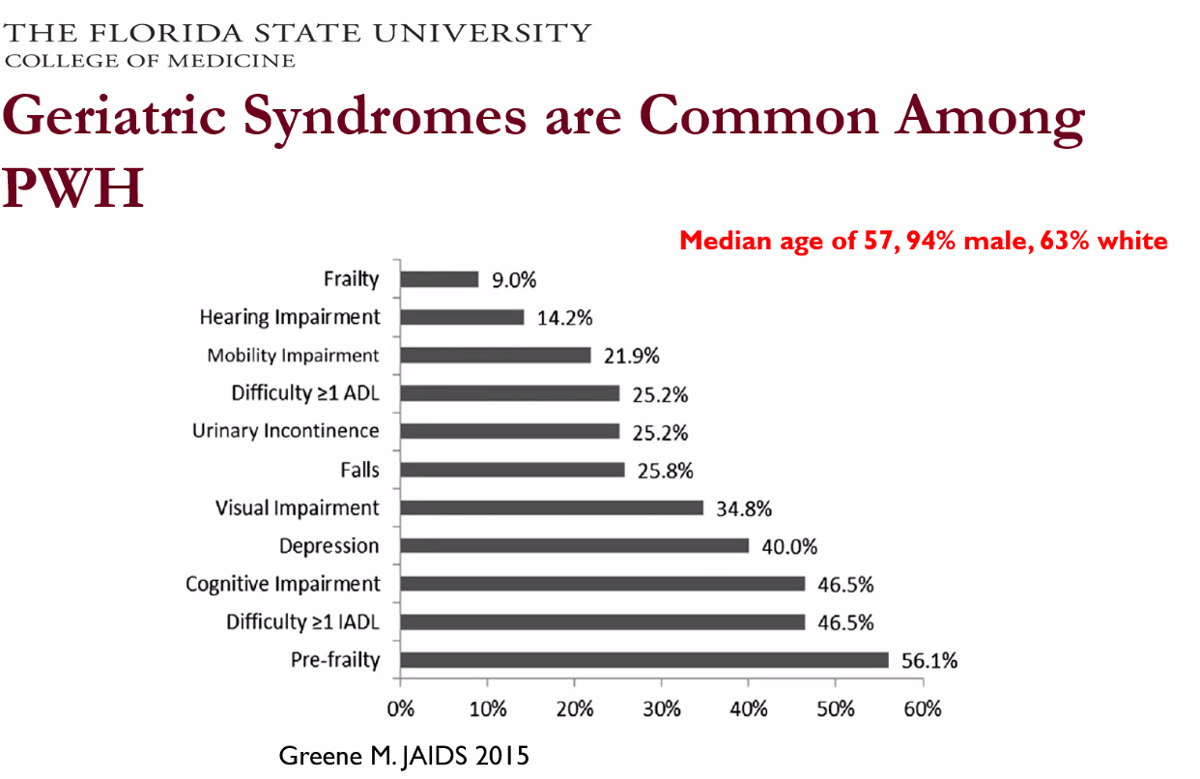

Slide 16
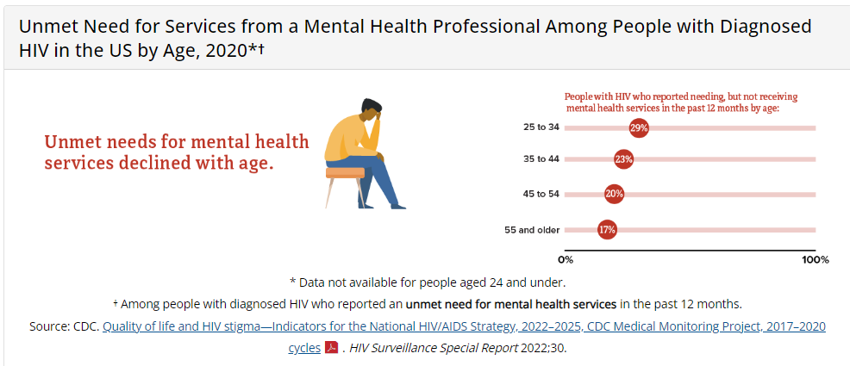

Slide 17
Intersectionality of Stigma in Aging PWH
Racism
Sexual
Orientation
Ageism
Behavioral
Health
Substance Use
Gender Identity

Slide 18
Barriers to Care
Clinician doesn’t have a caring manner
Could not understand provider (language and words)
Not very empathetic/sympathetic
Appears judgmental
Transportation
Clinicians' knowledge of HIV
Fear
Hard to talk with clinician about personal issues including, sexual behaviors
Embarrassment/shame

Slide 19
Unique Service Needs of Aging PWH
Senior care services
Polypharmacy & adherence
Food insecurity
Long term effects of ART
Housing
Poverty
Behavioral health & suicide
Insurance
Nutrition & food insecurity

Slide 20
Supporting Aging PWH
Connect
Listen
Ask – don’t assume
Be honest – tell the truth
Be patient & responsive
Don’t think because they are older that they
will not change their behaviors
Be aware & mindful
Notes:
PWH=people with HIV

Slide 21
What Now?
Assessment, disease prevention and screening guidelines
Consultative programs – referral to aging specialists
“Whole person” approach
Gerontology communities of practice for HIV specialists
Specialized case management & expanded services
Preventative programs – tobacco cessation, diet & nutrition, exercise, social connections, harm reduction
Individual & group counseling, psycho/social groups
Notes:
Communities of practice= example, ECHO

Slide 22
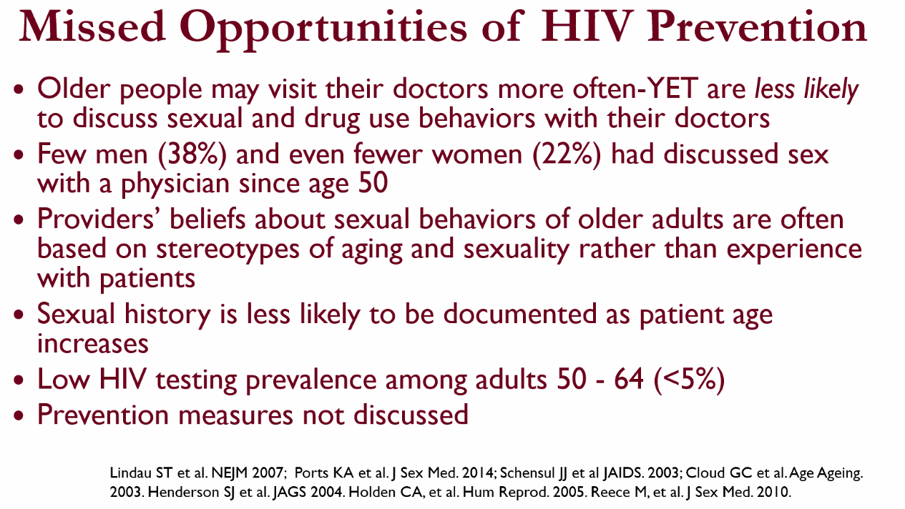

Slide 23
Resources
Administration for Community Living
  acl.gov
HIV.gov
  https://www.hiv.gov/topics/aging
CDC
  https://www.cdc.gov/hiv
Target HIV
  targethiv.org

Slide 24
Panelist Introductions
Notes:
30-min case presentation section with panelist discussion of interprofessional team-approach to holistic care of aging patients with HIV
Victor Valcour, MD (Alzheimer's), Kim Kalupa (BH), Melanie Dodd (PharmD), Deborah Parris (RN), Katherine Heroff (CM)

Slide 25
Case 1
68yo man (DMAB; he/him) with Stage 1 previously well-controlled HIV on antiretroviral therapy (ART) has missed several appointments and now has significant viremia.
His husband died 4 months ago and he admits that he has been very sad. He has not been eating regular meals and has been staying to himself. He thinks he may sometimes forget to take his medications. He recently received a notice from his landlord that his rent was late.
DMAB = designated male at birth
Notes:
DMAB = designated male at birth

Slide 26
Case 1, continued (1)
Past Medical History (PMH)
HIV Diagnosed in 1993. CD4 nadir 100. Prior opportunistic infections: cryptococcal meningitis. Multiple prior ART regimens. Multiple drug mutations. Stage 1 well controlled >20 years.
Hypertension
Hyperlipidemia
Osteopenia
Chronic kidney disease, Stage 3a
Neuropathic pain
Notes:
Stage 1 HIV= CD4>500
Well controlled HIV = undetectable HIV viral load

Slide 27
Case 1, continued (2)
Social history
40 pack year smoking history, quit 2 years ago
Remote history of “party drugs” in his 20s but none since
2-3 beers per night x 4mo, previously rare
Lives in rented home in Belen, NM with pet cat
Used to go to local gym with husband but not for the past 2 years
Deceased husband used to pay all the bills and did most of driving; reports their car is reliable
Income: retirement

Slide 28
Case 1, continued (3)
Family history
Father died from Myocardial Infarction (MI) at age 65yo, Mother died after complications from a broken hip at age 75yo
3 brothers who live out of state; estranged so does not know about their health
Allergies
Penicillin (rash in childhood)
Amlodipine (lower extremity swelling)
Notes:
MI=myocardial infarction, aka “heart attack”

Slide 29
Case 1, continued (4)
Medications
Dolutegravir 2x/day, darunavir/cobicistat 1x/day
Lisinopril 20mg 1x/day
Hydrochlorothiazide 25mg 1x/day
Rosuvastatin 10mg 1x/day
Nortriptyline 20mg 2x/day
Trazodone 50mg 1x/day
Ergocalciferol 50,000 IU 1x/week
Notes:
Dolutegravir = integrase strand transfer inhibitor (INSTI), antiretroviral agent
Darunavir= protease inhibitor (PI), antiretroviral agent
Cobicistat = cytochrome P450 blocker, increases level of protease inhibitor allowing for once daily dosing
Lisinopril = ace-inhibitor; blood pressure medication
Hydrochlorothiazide = thiazide diuretic; blood pressure medications
Rosuvastatin = HMG-CoA reductase inhibitor, “statin”; cholesterol medication
Nortriptyline= tricyclic antidepressant; used for neuropathic pain
Trazodone= serotonin receptor antagonist and reuptake inhibitor (SARI); used for insomnia
Ergocalciferol = vitamin D supplement

Slide 30
Case 1 Panel Discussion
What would be your approach to evaluate this patient’s health issues and challenges with retention in care?
What would you recommend to support this patient’s engagement in health care?
What preventative measures would you recommend?
Would you recommend any additional referrals or community linkages?
Notes:
Ask audience participants if they have additional recommendations for this patient.

Slide 31
Case 2
62yo Spanish-speaking woman (DFAB; she/her) recently hospitalized with esophageal candidiasis and malnutrition and found to have HIV with a CD4 170, HIV viral load 210,000.
She reports feeling shame about her new HIV diagnosis and does not feel that she can tell any of her family or friends. She has not seen her grandchildren since her diagnosis as she is afraid of making them sick. She admits to feeling overwhelmed by all the medications she needs to take and not knowing what they are all for. She also reports feeling tired all the time.
DFAB = Designated Female at Birth
Notes:
DFAB=designated female at birth

Slide 32
Case 1, continued (1)
Past Medical History (PMH)
HIV Diagnosed during recent hospitalization for esophageal candidiasis and malnutrition. CD4 nadir 170. No prior HIV screen. Baseline resistance testing: pansensitive. Started on ART while inpatient
Chronic anemia, on chronic iron supplementation
Hypothyroidism, on replacement
Post-menopausal since age 49 (13yrs)
Notes:
Stage 1 HIV= CD4>500
Well controlled HIV = undetectable HIV viral load

Slide 33
Case 2, continued (2)
Social history
Lifetime nonsmoker, no alcohol, no drugs
She reports her only sexual partner was her husband who died in a car accident 10 years previously.
No shared needles for any purpose. No blood transfusion.
Lives in home that she owns in Albuquerque, NM
Adult children and grandchildren live in town
She worked at local restaurant but has not been able to since her recent hospitalization
Finished 8th grade in Mexico. Does not read or speak English.

Slide 34
Case 2, continued (3)
Family history
Parents deceased but patient does not know the cause.
Several sisters and brothers in Mexico reportedly healthy. One of her adult children has diabetes.
Allergies
No known drug allergies

Slide 35
Case 2, continued (4)
Medications
Tenofovir/emtricitabine/bictegravir 1x/day
Fluconazole 200mg 1x/day
Trimethoprim/sulfamethoxazole 1x/day
Levothyroxine 75 mcg 1x/day
Ferrous sulfate 325mg 1x/day
Vitamin C 500mg 1x/day
Multivitamin with minerals 1x/day
Notes:
Dolutegravir = integrase strand transfer inhibitor (INSTI), antiretroviral agent
Darunavir= protease inhibitor (PI), antiretroviral agent
Cobicistat = cytochrome P450 blocker, increases level of protease inhibitor allowing for once daily dosing

Slide 36
Case 2 Panel Discussion
What would be your approach to evaluate this patient’s health issues and concern about pill burden?
What would you recommend to support this patient’s engagement in health care and understanding of her health condition?
What preventative measures would you recommend?
Would you recommend any additional referrals or community linkages?
Notes:
Ask audience participants if they have additional recommendations for this patient.

Slide 37
Questions??
Thank you
“Mean what you Say, Say what you mean, Don’t mean when you say it.”

Slide 38
AETC Resources
National Clinician Consultation Center http://nccc.ucsf.edu/
  HIV Management
  Perinatal HIV
  HIV PrEP
  HIV PEP line
  HCV Management
  Substance Use Management
Present case on ECHO hivecho@salud.unm.edu
AETC National HIV Curriculum https://aidsetc.org/nhc
AETC National Coordinating Resource Center https://targethiv.org/library/aetc-national-coordinating-resource-center-0
HIVMA Resource Directory https://www.hivma.org/globalassets/ektron-import/hivma/hivma-resource-directory.pdf
Additional trainings scaetcecho@salud.unm.edu
www.scaetc.org

Slide 39
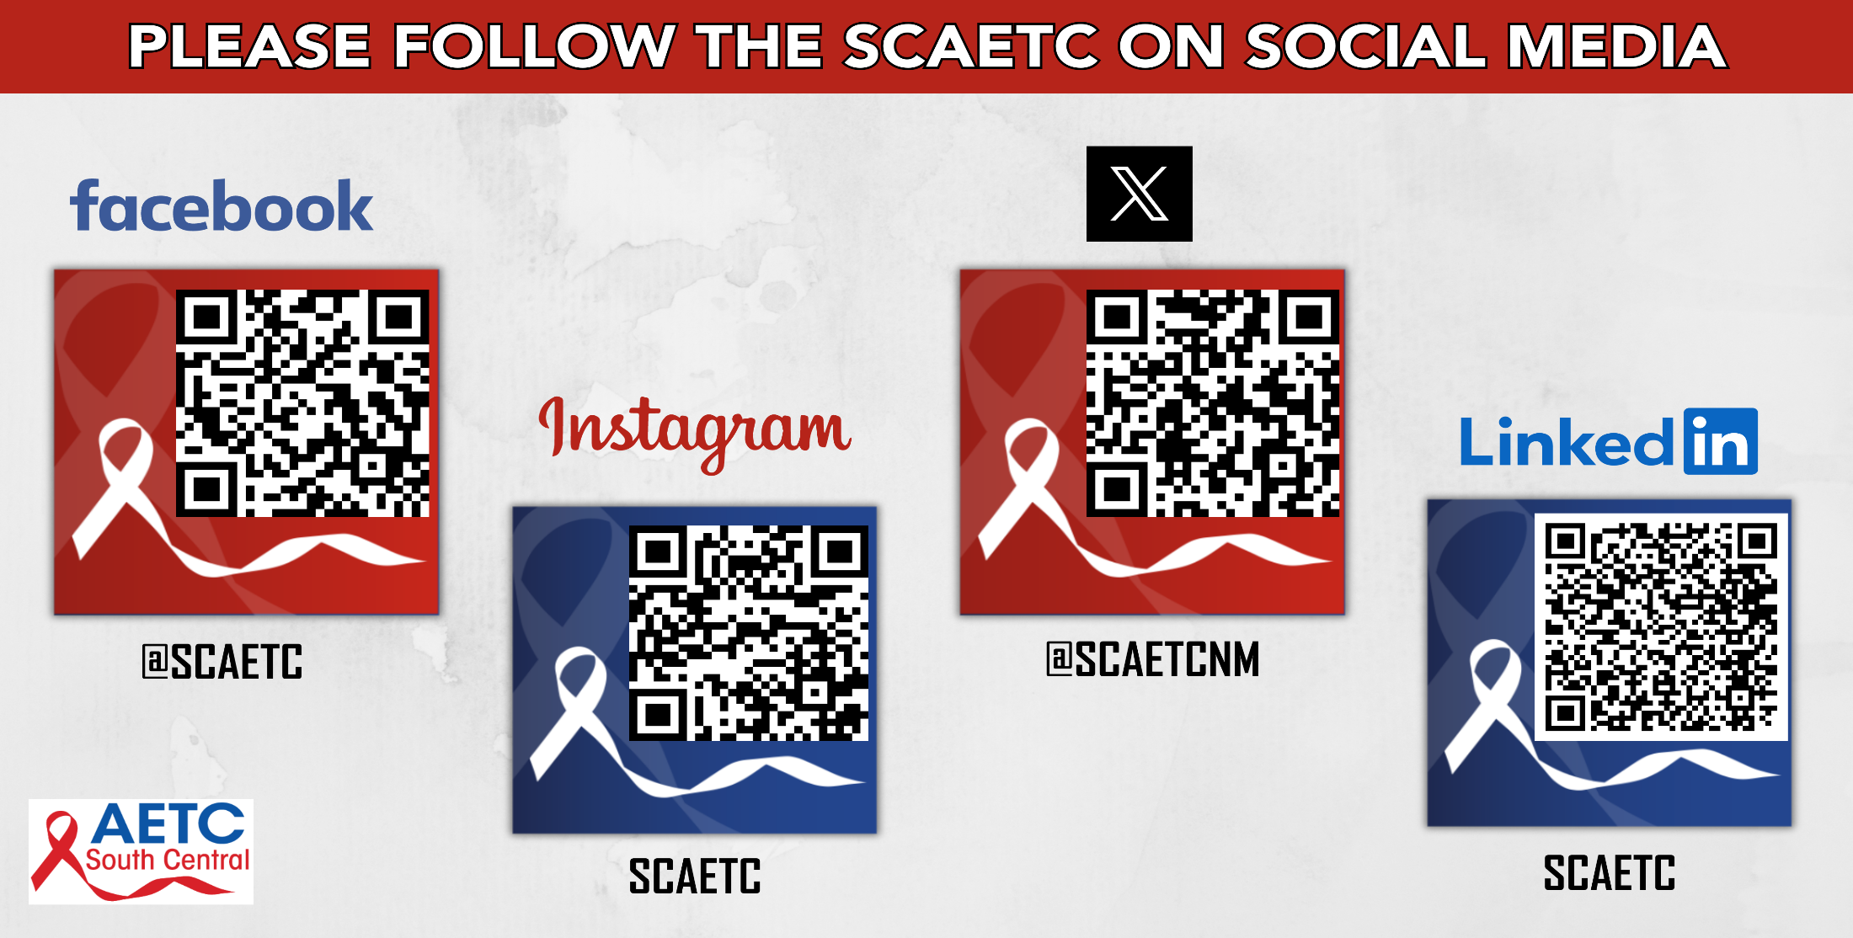
Notes:
Find an HIV-related topic TeleECHO in your area: https://echo.unm.edu/locations-2/echo-hubs-superhubs-united-states/
IDEA Platform: Infectious Diseases Education & Assessment. https://idea.medicine.uw.edu/
AETC National HIV Curriculum: 6 core modules for self study; regularly updated; CME, CNE
Hepatitis C Online Curriculum: https://www.hepatitisc.uw.edu/
Hepatitis B Online Curriculum: https://www.hepatitisb.uw.edu/
National STD Curriculum: https://www.std.uw.edu/

