Slide 1
Management of Opportunistic Infections in Patients with HIV
Zane Conrad, MD
Baylor College of Medicine
Notes:
Version Date: 2/27/24
Audience: Infectious Disease providers, residents, fellows & students
KF Reviewed: 4/1/24 – photo images added & font size adjusted
MG Reviewed: 4/1/2024
Submitted to SCAETC CO/HRSA: 4/1/24
HRSA Approved:

Slide 2
Conflict of Interest Disclosure Statement
Speaker has nothing to disclose
This program is supported by the Health Resources and Services Administration (HRSA) of the U.S. Department of Health and Human Services (HHS) as part of an award totaling $4,205,743 with 0% financed with non-governmental sources. The contents are those of the author(s) and do not necessarily represent the official views of, nor an endorsement of, by HRSA, HHS, or the U.S. Government. For more information, please visit HRSA.gov.

Slide 3
Use of Trade/Brand Names
This program is supported by the Health Resources and Services Administration (HRSA) of the U.S. Department of Health and Human Services (HHS) as part of an award totaling $4,205,743, with 0% financed with non-governmental sources.
The views expressed do not necessarily reflect the official policies of the Department of Health and Human Services, nor does mention of trade names, commercial practices, or organizations imply endorsement by the U.S. Government. Any trade/brand names for products mentioned during this presentation are for training and identification purposes only.
Notes:
NOTE: THIS SLIDE MUST BE INCLUDED IF TRADE AND/OR BRAND NAMES FOR MEDICATIONS ARE USED IN THE PRESENTATION.
IT MAY BE DELETED IF THERE IS NO REFERENCE TO TRADE NAMES, INCLUDING PRESENTATIONS IN WHICH ONLY GENERIC MEDICATION NAMES ARE MENTIONED.
TRADE NAMES MUST BE PUT IN PARENTHESES AFTER THE GENERIC NAME THE FIRST TIME IT IS MENTIONED - E.G., FLUOXETINE (PROZAC). TRADE NAMES SHOULD ONLY BE MENTIONED FOR THE INITIAL REFERENCE AND THE GENERIC NAME ONLY SHOULD BE USED AFTER THAT. THIS APPLIES EQUALLY TO ALL MEDICATIONS OR PRODUCTS MENTIONED IN THIS PRESENTATION.

Slide 4
Unconscious Bias Disclosure
SCAETC recognizes that language is constantly evolving, and while we make every effort to avoid bias and stigmatizing terms, we acknowledge that unintentional lapses may occur in our presentations.
We value your feedback and encourage you to share any concerns related to language, images, or concepts that may be offensive or stigmatizing.
Your input will help us refine and improve our presentations, ensuring they remain inclusive and respectful to participants.

Slide 5
Learning Objectives
Identify common manifestations of opportunistic infections in people with HIV (PWH) in the outpatient setting.
Review strengths and limitations of diagnostic testin.g
Define preferred and alternative therapies for opportunistic infections.
Review primary/secondary prophylaxis recommendations and Antiretroviral Therapy (ART) initiation in setting of opportunistic infections.

Slide 6
Syndrome Approach to Opportunistic Infections
Spec, A., Escota, G. V., Chrisler, C., & Davies, B. Comprehensive Review of Infectious Diseases (2019).

Slide 7
Case 1: History of Present Illness
29-year-old man (DMAB; he/him) with a recent diagnosis of HIV and substance use disorder (methamphetamine) who presents to clinic with shortness of breath and fatigue. Symptoms started 2 weeks prior with gradual worsening and associated with an intermittent non-productive cough.
DMAB= designated male at birth

Slide 8
Case 1: History of Present Illness
Initial clinic visit (4 months prior): New diagnosis of HIV (CD4: 132, HIV VL: 332,000) after being screened in the Emergency Department (ED). Started Biktarvy®* and primary prophylaxis with TMP/SMX**. Patient took medications for almost 3 weeks after the initial visit and then stopped. He missed his follow-up appointment.
*Biktarvy®; tenofovir alafenamide/emtricitabine/bictegravir
**TMP/SMX; trimethoprim/sulfamethoxazole (Bactrim®)

Slide 9
Case 1: Physical Exam
BP 102/68, Pulse 94, Temperature 97.6 °F (36.4 °C), RR 22, SpO2 92%.
General Appearance: uncomfortable appearing
HEENT: Head normocephalic, PERRL, EOMI, thrush
Neck: Supple, no cervical adenopathy
Lungs: CTAB, no wheezing, rales, or rhonchi
Heart: RRR, no murmur
Abdomen: Abdomen soft, non-tender, normoactive bowel sounds
Back: No pain to palpation
Extremities: No edema
Skin: No rashes or other lesions
Neurologic: Awake, Alert and Oriented (A&Ox3), Cranial Nerve (CNs) and sensation grossly intact

Slide 10
Case 1: Discussion
How would you manage the patient now?
Differential diagnoses?
Pneumocystis, endemic fungi, mycobacterial, lymphoma, Kaposi sarcoma
Disposition?
Hemodynamic stability, mentation, diagnostic studies needed
When to start antiretroviral therapy (ART)?
Empiric treatment?

Slide 11
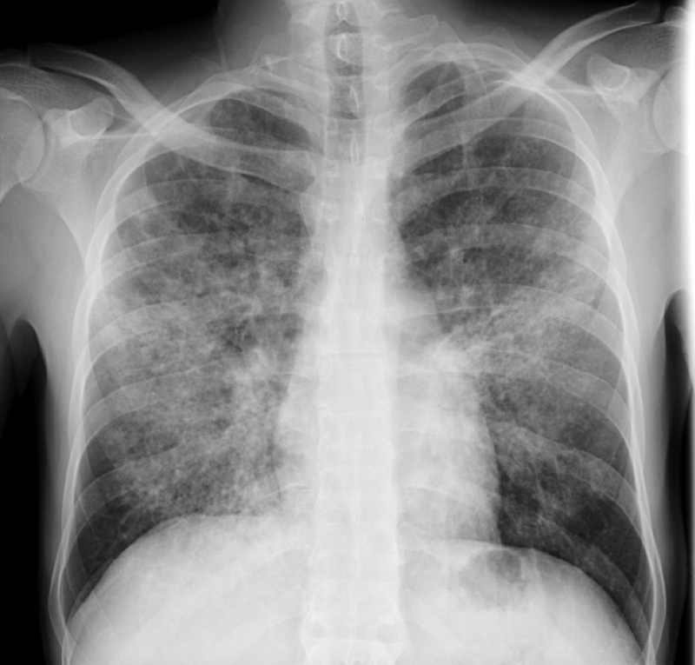
Case 1: Labs and Imaging
White Blood Cells (WBC) 2.8, Hemoglobin (Hgb) 9.8, Platelets 181
Sodium (Na) 136, Potassium (K) 4.7, Creatine (Cr) 0.91, Aspartate/Alanine Aminotransferase (AST/ALT) WNL, Alkaline Phosphatase (Alk Phos) WNL, Total Bilirubin (T. bili) WNL
HIV-1 RNA: 288,000; CD4: 48
Chest Radiography (CXR): extensive bilateral infiltrates
WNL= within normal limits
Photo Credit: Zane Conrad, MD

Slide 12
Case 1: Initial Management
Triage
Room air PO2 >70 mm Hg
Exercise desaturation test
Able to take oral medications
Insight into severity of disease and able to closely follow-up

Slide 13
Pneumocystis jirovecii
Fungus
Low virulence
Found in lungs of humans and other mammals
Lacks ergosterol in the plasma membrane, not sensitive to antifungals that target this pathway
Airborne transmission
Photo credit: https://medicine.en-academic.com/140233/methenamine_silver
Notes:
Fungus (protozoan and fungal characteristics)

Slide 14
Pneumocystis jirovecii Pneumonia
Occurred in nearly 80% of persons living with AIDS prior to ART and chemoprophylaxis
Clinical Manifestations
Fever, dyspnea, tachypnea, non-productive cough, progressive chest discomfort, hypoxemia, gradually progressive symptoms
Imaging
Chest Radiography (CXR): diffuse, bilateral, symmetrical interstitial infiltrates; lobar infiltrates; sometimes clear
CT: ground-glass attenuation that may be patchy; a normal CT has a high negative predictive value (NPV: 95%)
Spontaneous pneumothorax in PWH
Cavitation and pleural effusions are uncommon
CT = Computed Tomography

Slide 15
Triage / Disease Severity
MILD
MODERATE/SEVERE
Room air arterial oxygen PaO2 ≥70 mm Hg or alveolar-arterial PAO2-PaO2 gradient <35 mm Hg
Consideration for outpatient management
Oral treatment regimen
PAO2-PaO2 ≥35 to <45 mm Hg
PAO2-PaO2 ≥45 mm Hg
Inpatient management
Initial IV treatment regimen and close monitoring
PaO2 = Partial Pressure of Oxygen

Slide 16
Diagnostics
LDH is often elevated or >500 (non-specific)
(1,3)-Beta-D-Glucan often elevated (non-specific)
High negative predictive value at cutoff value <80
Microscopy:
Definitive diagnosis
Specimen quality is key (induced sputum with hypertonic saline sensitivity 50-90%; bronchoscopy samples, lung tissue sensitivity >90%)
Cannot be cultured; reliance on staining, DFA, and PCR
Li WJ et al. J Thorac Dis. 2015
DFA= Direct Fluorescent Antibody Stain PCR = Polymerase Chain Reaction
.

Slide 17
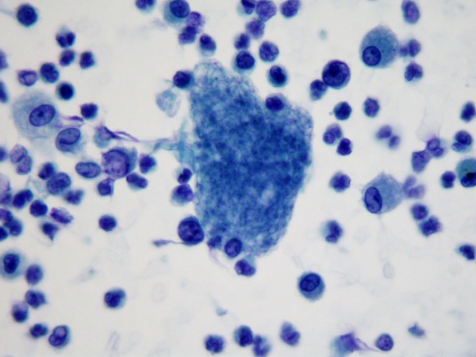
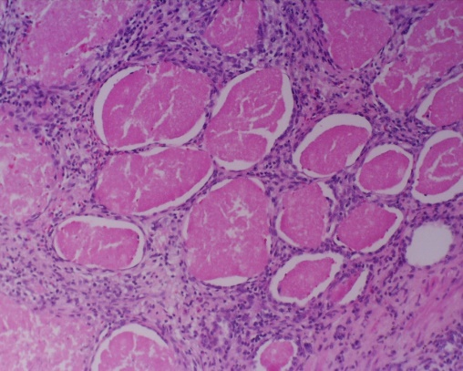
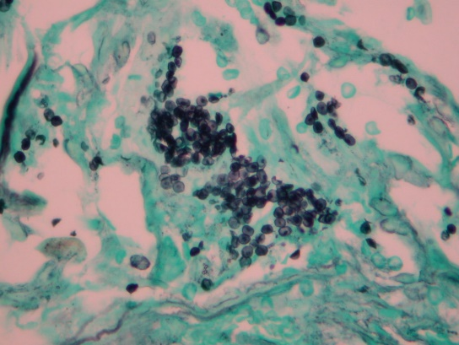
Microscopy
Direct Immunofluorescent Stain
Cytology
Tissue:
Hematoxylin & Eosin (H&E): foamy intra-alveolar eosinophilic exudates with minimal inflammatory infiltrate
Grocott Methenamine Silver Stain (GMS): thin-walled spheres of 2 to 5 mcm that have an intra-cystic focus
Photo Credit: https://www.cdc.gov/dpdx/pneumocystis/index.html

Slide 18
Pneumocystis PCR*
Several primers developed
High sensitivity and specificity
Colonization versus active disease
Quantitative cutoffs, cycle threshold cutoffs
Nasopharyngeal specimens?
Lieu A et al. J Clin Microbiol. 2023.
*PCR= polymerase chain reaction

Slide 19
Treatment
Preferred:
TMP/SMX dose 15-20 mg/kg TMP component IV/PO daily divided every 6 or 8 hours for 21 days
Adjunctive corticosteroids:
Room air PaO2<70 mm Hg or A-a gradient >35 mm Hg
Prednisone 21-day taper starting at 40 mg twice daily
IV methylprednisolone at 75% of prednisone dose
Alternative:
Mild Disease: primaquine + clindamycin or atovaquone
Severe Disease: pentamidine or primaquine + clindamycin
ART should be initiated within 2 weeks if not already started
Zolopa, A et al. Plos One. 2009
TMP/SMX; trimethoprim/sulfamethoxazole (Bactrim®)

Slide 20
Primary Prophylaxis
Indication: CD4 count <200, consider if percentage <14%
Preferred:
TMP-SMX 1 DS tablet PO daily
TMP-SMX 1 SS tablet PO daily
Alternative:
Atovaquone 1500 mg PO daily with food
Dapsone 100 mg PO daily
Dapsone 50 mg PO twice daily
TMP-SMX 1 DS tablet PO three times weekly
Stopping: CD4 count ≥200 for >3 months in response to ART
Guidelines for the Prevention and Treatment of Opportunistic Infections in Adults and Adolescents with HIV

Slide 21
Case 2: History of Present Illness
36-year-old man with advanced HIV (CD4: 12, HIV VL: 120,000) off ART, history of late latent syphilis, and CKD who presents to clinic with intermittent fevers for 2 weeks and non-bloody diarrhea off and on for the past month.
Reports unintentional weight loss of 15 lbs. over the past 2 months.
History of non-adherence with ART regimens and frequently lost to follow-up.
CKD = chronic kidney disease

Slide 22
Case 2: Physical Exam
BP 123/72, Pulse 103, Temperature 100.6 °F (38.1 °C), RR 18, SpO2 96%
General Appearance: uncomfortable appearing
Head, Eyes, Ears, Nose and Throat (HEENT): Head normocephalic, Pupils are Equal, Round and Reactive to Light (PERRL), Extra-ocular eye movement intact (EOMI)
Neck: Supple, no cervical adenopathy
Lungs: Clear to Auscultation Bilaterally (CTAB), no wheezing, rales, or rhonchi

Slide 23
Case 2: Physical Exam
Heart: Regular Rate and Rhythm (RRR), no murmur
Abdomen: Abdomen soft, non-tender, hepatomegaly
Back: No pain to palpation
Extremities: No edema
Skin: No rashes or other lesions
Neurologic: A&Ox3, CNs and sensation grossly intact

Slide 24
Case 2: Labs
WBC 2.2, Hgb 9.0, Plt 104
Cr 1.34 (near baseline), AST/ALT WNL, Alk Phos 260
HIV-1 RNA: 98,000; CD4: 8

Slide 25
Case 2: Work-up
Patient transported to the hospital
CT of the abdomen and pelvis showed mesenteric and retroperitoneal lymphadenopathy
Routine blood, fungal, stool cultures negative
Cryptococcus Antigen (Ag) negative
Acid-Fast Bacillus (AFB) blood culture with growth of Mycobacterium avium complex at 2 weeks
Followed up in outpatient setting and started on treatment
Photo Credit: Zane Conrad, MD

Slide 26
Mycobacterium avium Complex (MAC)
Environmental organism found in soil, water
Low virulence
Colonizes respiratory and GI tracts
Disseminated infection in CD4 <50
https://microbiologylearning.weebly.com/mycobacteriologyafb.html

Slide 27
Disseminated MAC
Incidence of 20-40% in persons living with Stage 3 HIV/AIDS prior to ART and chemoprophylaxis
Clinical:
Often disseminated and multi-organ involvement; fever, night sweats, weight loss, diarrhea, weight loss
Exam with hepatosplenomegaly
Anemia, elevated alkaline phosphatase
Imaging may identify lymphadenopathy (paratracheal, retroperitoneal, para-aortic)

Slide 28
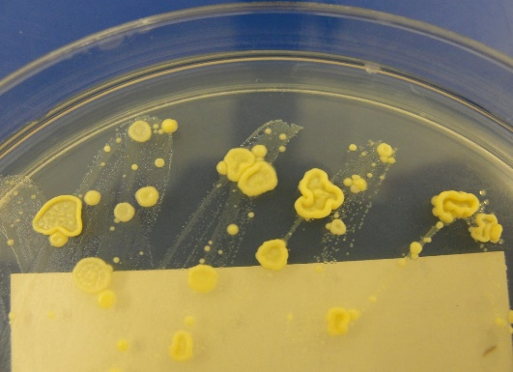
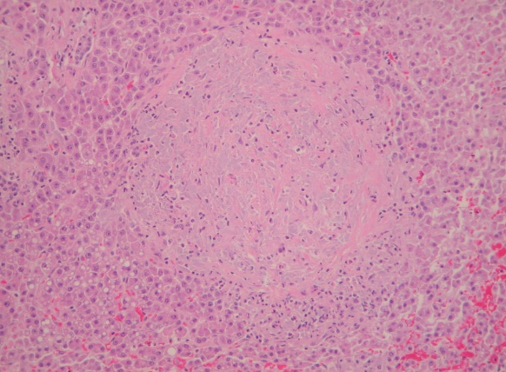
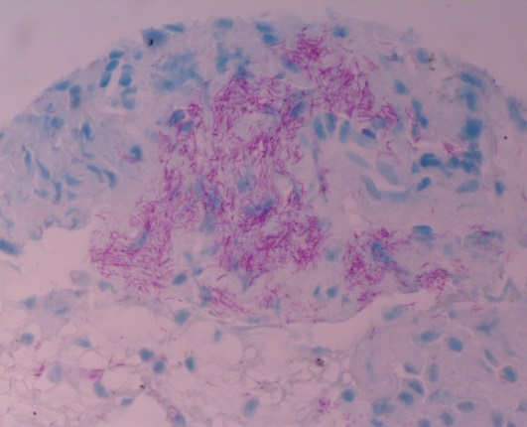
Diagnostics
AFB culture from blood, bone marrow, lymph node, or another sterile site
Tissue biopsy for H&E, AFB, GMS staining
16S rRNA PCR/sequencing
Photo credit: https://medicapacifica.com/

Slide 29
Treatment
At least 2 drugs as initial therapy to prevent emergence of resistance
Clarithromycin 500 mg PO twice daily + ethambutol 15 mg/kg PO daily
Azithromycin 500 mg + ethambutol 15 mg/kg PO daily when drug interactions or intolerance precludes the use of clarithromycin
+/- rifabutin 300 mg PO daily (high mycobacterial loads, absence of effective ART, etc.)

Slide 30
Maintenance and Secondary Prophylaxis
Chronic Maintenance:
Complete at least 12 months therapy
Continue until no signs and symptoms of MAC disease
>6 months CD4 count >100 in response to ART
Secondary Prophylaxis:
Resume chronic maintenance regimen if CD4 <100

Slide 31
Primary Prophylaxis
Not recommended if initiating ART immediately
Indication: If not receiving ART and CD4 counts <50 cells
Therapy:
Azithromycin 1200 mg PO once weekly
Clarithromycin 500 mg PO BID
Azithromycin 600 mg PO twice weekly
Stop once starting effective ART is started
Jung et al. Int J STD AIDS. 2017.

Slide 32
Case 3: History of Present Illness
42-year-old woman with history of HIV/AIDS who presents to clinic to resume medications. Last CD4 two years ago was 150 (prior CD4 nadir of 2).
She has been off ART for about one year. Feeling well overall but on further review of symptoms she reports increased floaters in left eye.

Slide 33
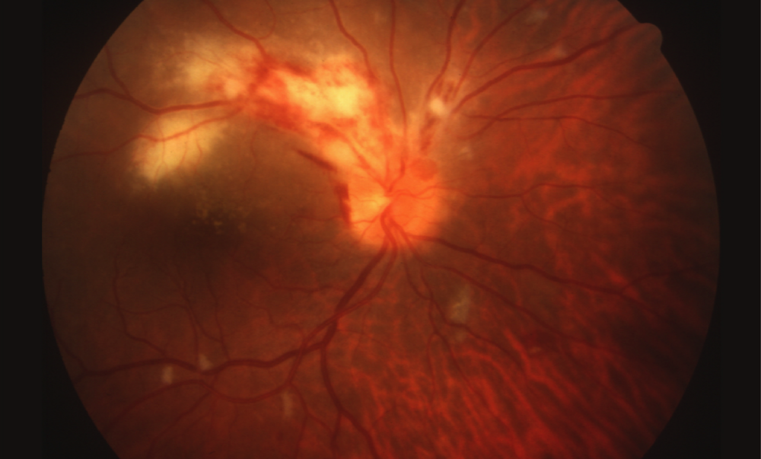
Case 3: Exam
https://www.hiv.uw.edu/go/co-occurring-conditions/opportunistic-infections-treatment/core-concept/all#cytomegalovirus-disease
Notes:
This retinal photograph taken from a person with HIV and cytomegalovirus retinitis shows an opacified, edematous retina (yellow) and hemorrhage (red); the retinitis involves the optic nerve head and extends adjacent to the macula along the retinal blood vessels. This lesion is considered an immediate sight-threatening lesion.

Slide 34
CMV Retinitis
Most common Cytomegalovirus Retinitis (CMV) manifestation in HIV (CD4 <50)
Estimated 30% of patients with Stage 3 HIV/AIDS had CMV retinitis prior to potent ART
Clinical:
Decreased visual acuity, “floaters,” vision loss; mostly unilateral
Exam:
Characteristic perivascular fluffy, yellow-white retinal infiltrates associated with hemorrhages
Diagnosis:
Retinal changes observed in dilated pupil exam by ophthalmologist, PCR of aqueous or vitreous humor, response to empiric anti-CMV therapy

Slide 35
Other CMV Disease
Diagnostic approach: consistent clinical manifestations and evidence of the virus in tissue
Colitis:
5-10% of patients
Weight loss, abdominal pain, diarrhea, fever
Esophagitis:
Small percentage of patients
Odynophagia, nausea, epigastric discomfort
Pneumonitis:
Uncommon in PWH
CMV PCR from BAL specimen with limited diagnostic value
Neurologic disease:
Dementia, ventriculoencephalitis (acute)

Slide 36
Treatment
Site-Threatening Lesions:
Ganciclovir 5 mg/kg IV q12h for 14–21 days, then 5 mg/kg IV daily
Ganciclovir 5 mg/kg IV q12h for 14–21 days, then valganciclovir 900 mg PO daily
Valganciclovir 900 mg PO q12h for 14–21 days, then 900 mg once daily
+/- Intravitreous injections of ganciclovir or foscarnet repeat weekly until lesion inactivity is achieved
Peripheral Lesions:
Valganciclovir 900 mg PO q12h for 14–21 days, then 900 mg once daily for 3–6 months
Guidelines for the Prevention and Treatment of Opportunistic Infections in Adults and Adolescents with HIV

Slide 37
Maintenance and Follow-up
Treatment with valganciclovir is continued until:
Treatment for a minimum of 3-6 months
All retinal lesions inactive and cleared by an ophthalmologist
Until CD4 count >100 for 3–6 months in response to ART
Routine ophthalmologic follow-up is recommended after stopping chronic maintenance therapy for early detection of relapse and then periodically
All PWH with CD4<50 should have biannual screening eye examinations for CMV retinitis

Slide 38
Case 4: History of Present Illness
34-year-old man with a history of HIV diagnosed in ~2009 (CD4: 81 and HIV VL: 24 copies 12 months ago on Triumeq®*) who comes to clinic to re-establish care.
Off all medications including ART for the past 12 months.
Patient developed skin lesions on the right wrist about 2 weeks prior to presentation. The lesion is painless, round, raised, and slowly growing. Mild bleeding when he picks at the lesion, but no other noted drainage.
*Triumeq®; abacavir/lamivudine/dolutegravir

Slide 39
Case 4: Physical Exam
BP 132/94
Pulse 98
Temp 36.6 °C
RR 18
SpO2 99% on room air
Photo Credit: Zane Conrad, MD

Slide 40
Case 4: Labs and Imaging
AST: 78
ALT: 78
Alk Phos: 93
HIV VL: 584,000
CD4 Count: 11
CT Abdomen: Two new hepatic hypodensities with peripheral enhancement as well as numerous splenic hypodensities
Photo Credit: Zane Conrad, MD

Slide 41
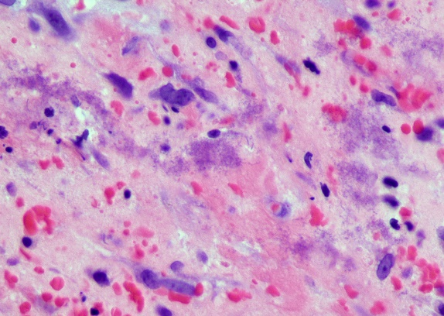
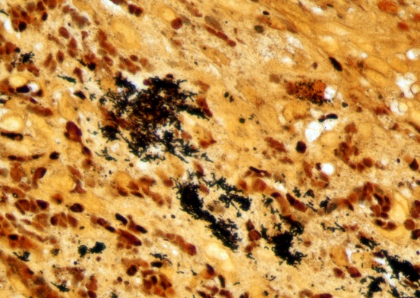
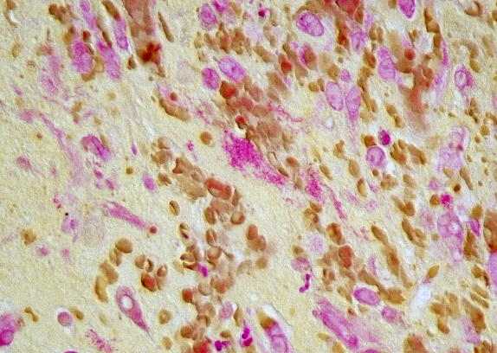
Case 4: Diagnosis
Bartonella DNA PCR on blood and tissue was positive
Photo Credit: Zane Conrad, MD

Slide 42
Bartonella spp.
Bartonella bacilliformis: Andes mountains of Peru, Ecuador, and Columbia; sand fly vectors; Oroya fever and verruga peruana
Bartonella quintana: human body louse vector; homelessness; bacillary angiomatosis, endocarditis, trench fever, osteomyelitis
Bartonella henselae: Global distribution, cats and cat fleas; Cat-Scratch Disease, bacillary angiomatosis, bacillary peliosis hepatis, endocarditis
https://www.clinmicronow.org/doi/abs/10.1128/9781683670438.CMPH.ch3.15-2

Slide 43
Bacillary Angiomatosis
B. henselae or B. quintana
HIV most often with CD4 <50
Chronic illness lasting months to years with skin lesions and intermittent bacteremia
Vascular proliferation in skin and regional lymph nodes
Cutaneous lesions are most common, but can affect most organ systems
Diagnosis with serology, histopathology, and tissue PCR
Hepatic and splenic lesions (bacillary peliosis) only with B. henselae

Slide 44
Treatment
For Cat Scratch Disease, Bacillary Angiomatosis, Peliosis Hepatis, and Osteomyelitis:
Doxycycline 100 mg PO or IV q12h
Erythromycin 500 mg PO or IV q6h
For Confirmed Bartonella Endocarditis:
Doxycycline 100 mg IV q12h + rifampin 300 mg IV or PO q12h for 6 weeks, then doxycycline 100 mg q12 h for ≥3 months
For Other Severe Infections:
Doxycycline 100 mg q12h + rifampin 300 mg q12h
Erythromycin 500 mg q6h + rifampin 300 mg q12h
Guidelines for the Prevention and Treatment of Opportunistic Infections in Adults and Adolescents with HIV

Slide 45
Long-Term Suppressive Therapy
If a relapse occurs after a ≥3-month course of primary treatment:
A macrolide or doxycycline as long as the CD4 <200
Indications for Discontinuing Suppressive:
Received at least 3–4 months of treatment, and
CD4 count >200 for at least 6 months
Bartonella titers have decreased by 4-fold
Primary prophylaxis not recommended; some retrospective data suggests that it is protective
Guidelines for the Prevention and Treatment of Opportunistic Infections in Adults and Adolescents with HIV

Slide 46
Case 5: History of Present Illness
46-year-old man with advanced HIV who presents with right-sided chest pain and an episode of hemoptysis
Right-sided chest pain was acute onset, sharp in character, no radiation, and worse with deep inspiration
One episode of hemoptysis, bright red blood with sputum, “about the size of a quarter,” no further episodes
Lives near a ranch with cows and horses

Slide 47
Case 5: Imaging
Three consolidative opacities in the anterior paramediastinal right upper lobe, posterior left upper lobe, and inferolateral right lower lobe measuring 5.0, 4.7, and 5.7 cm respectively.
Photo Credit: Zane Conrad, MD

Slide 48
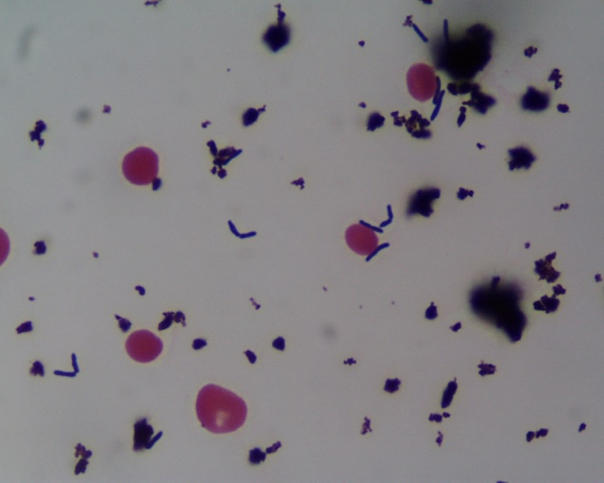
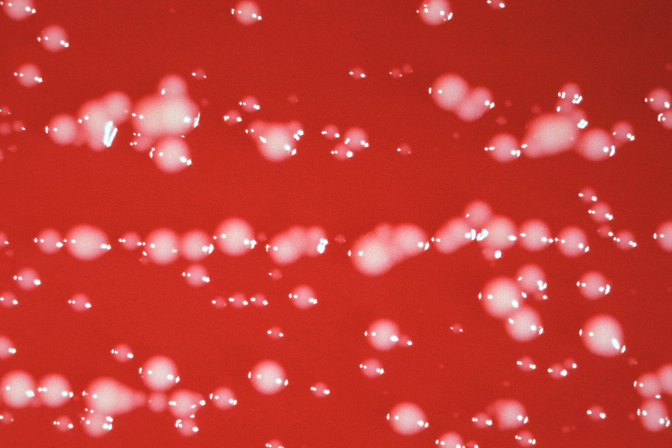
Rhodococcus equi
Facultative intracellular pathogen, survive and replicate in macrophages
Obligate aerobic gram-positive coccobacilli
Dusty, dry soil contaminated with herbivore manure; horses, goats, swine
Infection through inhalation or inoculation to wound or mucus membranes
Mucoid, salmon pink colonies, often on AFB cultures; slow growth and pigment development
Photo Credit: Zane Conrad, MD

Slide 49
Treatment
Combination therapy with a macrolide or fluoroquinolone and at least one additional active drug
Duration is variable, but at least 2 months
Initiation of ART

Slide 50
References
National HIV curriculum: https://www.hiv.uw.edu/
Panel on Guidelines for the Prevention and Treatment of Opportunistic Infections in Adults and Adolescents with HIV. Guidelines for the Prevention and Treatment of Opportunistic Infections in HIV-infected Adults and Adolescents: Recommendations from the Centers for Disease Control and Prevention, the National Institutes of Health, and the HIV Medicine Association of the Infectious Diseases Society of America. Available at https://clinicalinfo.hiv.gov/sites/default/files/inline-files/adult_oi.pdf.
Bennett, J. (2019). Mandell, Douglas, and Bennett's Principles and Practice of Infectious Diseases - Electronic (9th ed.). Elsevier - OHCE.
Jung Y, Song KH, Choe PG, et al. Incidence of disseminated Mycobacterium avium-complex infection in HIV patients receiving antiretroviral therapy with use of Mycobacterium avium-complex prophylaxis. Int J STD AIDS. 2017;28(14):1426-1432.
Li WJ, Guo YL, Liu TJ, Wang K, Kong JL. Diagnosis of pneumocystis pneumonia using serum (1-3)-β-D-Glucan: a bivariate meta-analysis and systematic review. J Thorac Dis. 2015;7(12):2214-2225.
Lieu A, Lee TC, Lawandi A, Tellier R, Cheng MP, Dufresne PJ. Microbiological characterization of Pneumocystis jirovecii pneumonia using quantitative PCR from nasopharyngeal specimens: a retrospective study in a Canadian province from 2019 to 2023. J Clin Microbiol. 2023;61(11):e0091323.
Metersky ML, Colt HG, Olson LK, Shanks TG. AIDS-related spontaneous pneumothorax. Risk factors and treatment. Chest. 1995;108(4):946-951.
Spec, A., Escota, G. V., Chrisler, C., & Davies, B. (2019). Comprehensive Review of Infectious Diseases. Elsevier - OHCE.
Zolopa A, Andersen J, Powderly W, et al. Early antiretroviral therapy reduces AIDS progression/death in individuals with acute opportunistic infections: a multicenter randomized strategy trial. PLoS One. 2009;4(5):e5575.

Slide 52
Notes:
Find an HIV-related topic TeleECHO in your area: https://echo.unm.edu/locations-2/echo-hubs-superhubs-united-states/
IDEA Platform: Infectious Diseases Education & Assessment. https://idea.medicine.uw.edu/
AETC National HIV Curriculum: 6 core modules for self study; regularly updated; CME, CNE
Hepatitis C Online Curriculum: https://www.hepatitisc.uw.edu/
Hepatitis B Online Curriculum: https://www.hepatitisb.uw.edu/
National STD Curriculum: https://www.std.uw.edu/

Slide 53
Resources
National Clinician Consultation Center http://nccc.ucsf.edu/
HIV Management
Perinatal HIV
HIV PrEP
HIV PEP line
HCV Management
Substance Use Management
Present on ECHO
https://hsc.unm.edu/scaetc/programs-services/echo.html​
AETC National HIV Curriculum https://aidsetc.org/nhc
AETC National Coordinating Resource Center https://targethiv.org/library/aetc-national-coordinating-resource-center-0
HIVMA Resource Directory https://www.hivma.org/globalassets/ektron-import/hivma/hivma-resource-directory.pdf
Additional trainings scaetcecho@salud.unm.edu
www.scaetc.org
Notes:
IDEA Platform: Infectious Diseases Education & Assessment. https://idea.medicine.uw.edu/
AETC National HIV Curriculum: 6 core modules for self study; regularly updated; CME, CNE
Hepatitis C Online Curriculum: https://www.hepatitisc.uw.edu/
Hepatitis B Online Curriculum: https://www.hepatitisb.uw.edu/
National STD Curriculum: https://www.std.uw.edu/

