Slide 1

CROI 2024 Update
Hyman Scott, MD MPH
San Francisco Department of Public Health
April 24, 2024

Slide 2
Disclaimer
The views and opinions expressed in this presentation are not necessarily those of the Pacific AIDS Education & Training Center (Pacific AETC) or its eight local partner sites in HRSA Region 9, the Regents of the University of California or its San Francisco campus (UCSF or collectively, University) nor of our funder the Health Resources and Services Administration (HRSA). Neither Pacific AETC, University, HRSA nor any of their officers, board members, agents, employees, students, or volunteers make any warranty, express or implied, including the warranties of merchantability and fitness for a particular purpose; nor assume any legal liability or responsibility for the accuracy, completeness or usefulness of information, product or process assessed or described; nor represent that its use would not infringe privately owned rights.
HRSA Acknowledgement Statement
The Pacific AETC is supported by the Health Resources and Services Administration (HRSA) of the U.S. Department of Health and Human Services (HHS) as part of an award totaling $4,377,449. The contents are those of the author(s) and do not necessarily represent the official views of, nor an endorsement, by HRSA, HHS, or the U.S. Government. For more information, please visit HRSA.gov.
Trade Name Disclosure Statement
Funding for this presentation was made possible by 5 U1OHA29292‐08‐00 from the Human Resources and Services Administration HIV/AIDS Bureau. The views expressed do not necessarily reflect the official policies of the Department of Health and Human Services nor does mention of trade names, commercial practices, or organizations imply endorsement by the U.S. Government. Any trade/brand names for products mentioned during this presentation are for training and identification purposes only.

Slide 3
Disclosures
All presenters of this continuing medical education activity have indicated that neither they nor their spouse/legally recognized domestic partner has any financial relationships with commercial interests related to the content of this activity

Slide 4
Learning Objectives
At the completion of this presentation, participants will be able to:
Describe advances in HIV treatment from CROI 2024.
Describe advances in HIV and STI prevention from CROI 2024

Slide 5
HIV Treatment

Slide 6
Long-acting ART summary
Effectiveness of CAB-RPV in clinical practice is similar to clinical trials
  Confirmed virologic failure with resistance 1-2%
  Watch for suboptimal injection technique
Virologic suppression of CAB-RPV in people with viremia is high
  Not FDA approved for this indication
  Reserve for those at highest risk of HIV-disease progression
Combination cabotegravir and lenacapavir effective in case series
Lenacapavir still can achieve virologic suppression even with no fully active agents

Slide 7
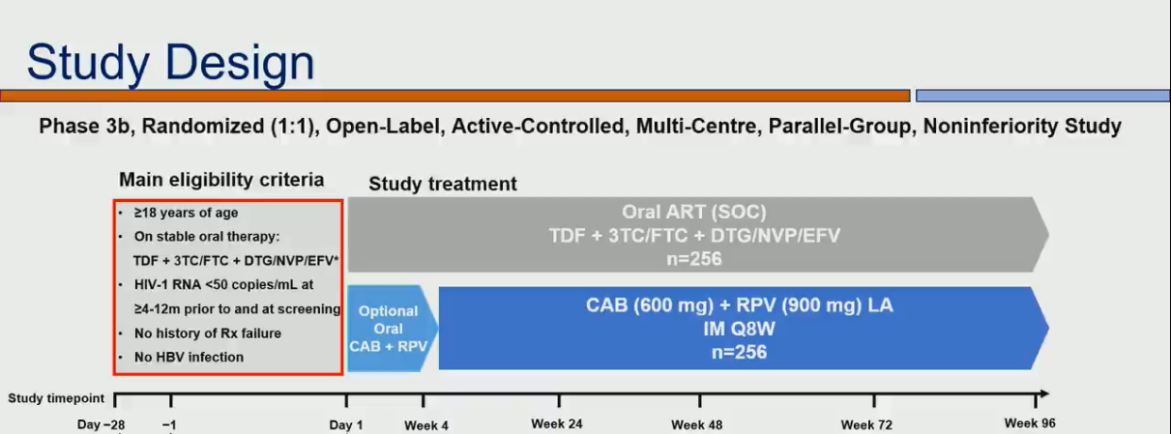
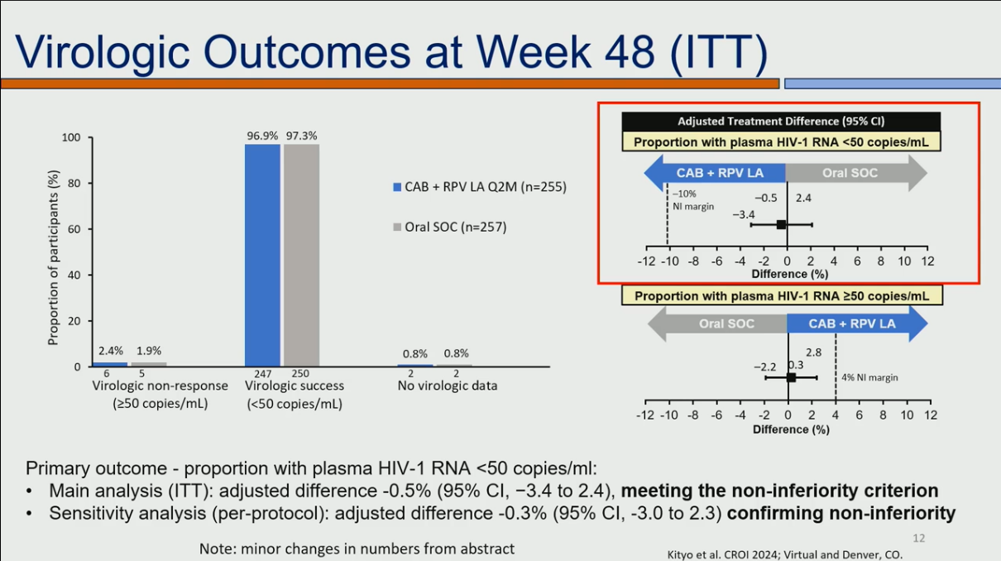
CAB-RPV in CARES Study
Source: Kityo et al. CROI 2024

Slide 8
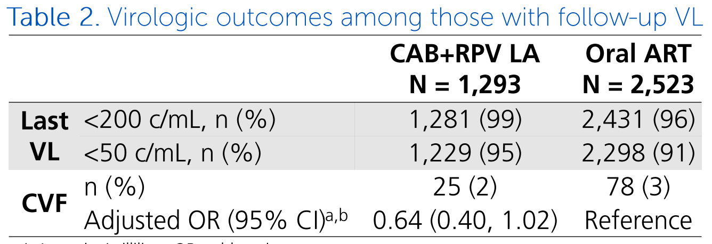
Effectiveness of CAB-RPV in clinical practice
Confirmed virologic failure:
OPERA Cohort: 2% (25/1,293), no different from oral ART (Table)
TRIO Cohort: 0.9% (2/278)
Single site: 4% (3/75) -- 2 related to “nonstandard injection practices – all 3 now on boosted PI regimens
Source: Hsu R, et al. CROI 2024, #623. Eron J, et al. CROI 2024, #625. Shankaran S, et al. CROI 2024, #686.

Slide 9
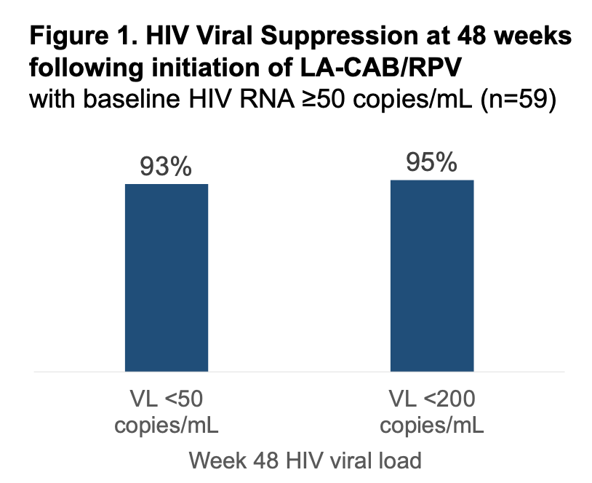
CAB-RPV in people with viremia due to poor medication adherence
59 patients with viremia – 29 with CD4 < 200, 19 with HIV RNA > 100K
Week 48 results: 81% (48/59) remained on CAB-RPV and virally suppressed; 7 others suppressed on alternative regimens
6/59 with “adverse virologic outcomes”, all with CD4 < 200 – 3 of them now suppressed on alternative regimens
Source: Hickey MD, et al. CROI 2024, #628,

Slide 10
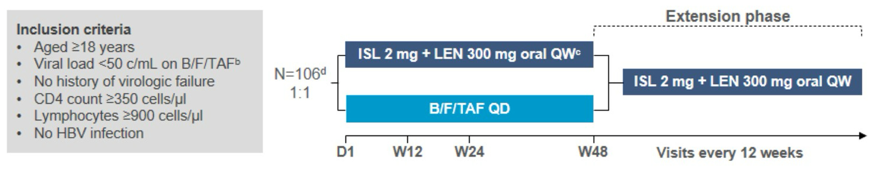
Weekly islatravir + lenacapavir – Phase 2
Results:
1 vs 0 participants with HIV RNA > 50 at week 24
No resistance
More treatment-related adverse events (open-label study)
No decline in CD4 or lymphocyte counts
Fully powered study planned
Source: Colson AE, et al. CROI 2024 #208.

Slide 11

Variable detection of resistance mutations by “archive” resistance testing
Longitudinal analysis of participants with virologic suppression enrolled in 3 switch studies
For those with 2 different timepoints assessed, 262 resistance associated mutations identified
  Detection at both time points: 103
  Detection at first time point only: 58
  Detection at second time point only: 101
Results underscore variable sensitivity of proviral DNA for detection of archived resistance mutations
Source: D'Antoni ML, et al. CROI 2024 #695.

Slide 12
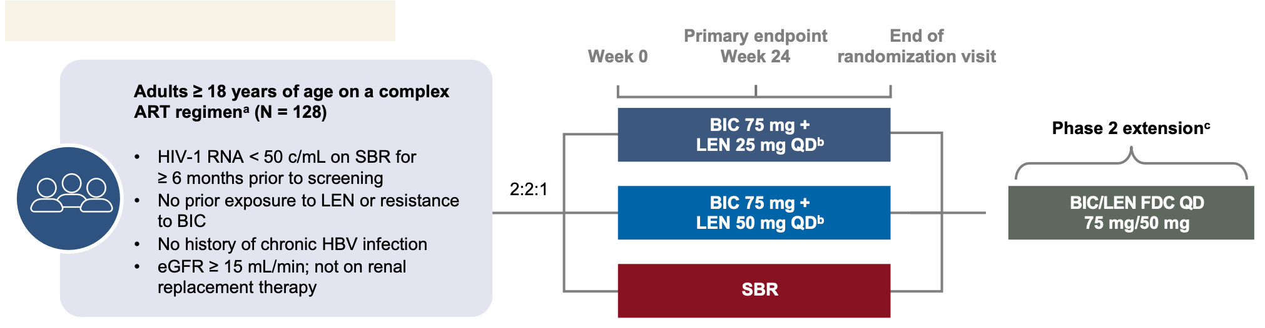
BIC plus LEN vs continued complex regimen
Complex regimen:
PI or NNRTI plus other class not NRTI or
2 or more pills/day or taken more than once-daily or
Injectable agent
Source: Mounzer K, et al. CROI 2024 #642.

Slide 13
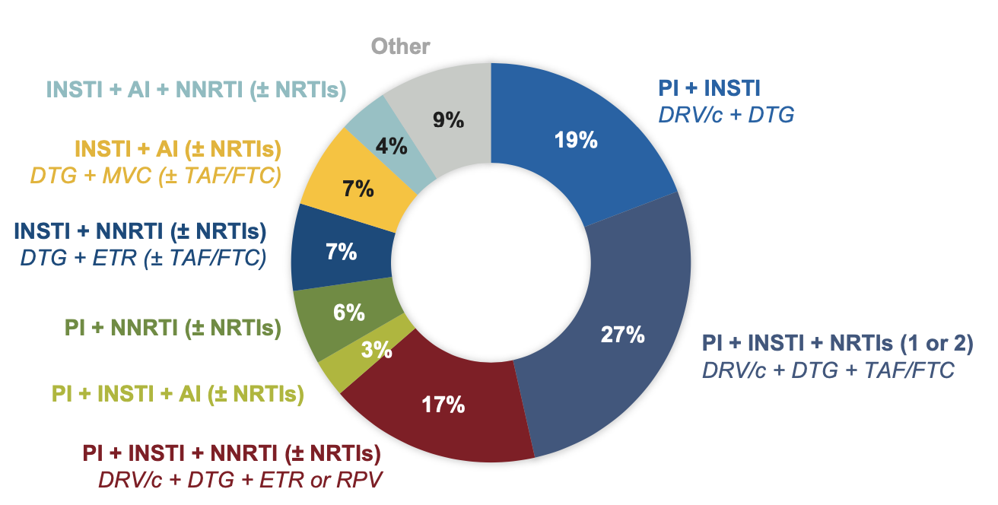
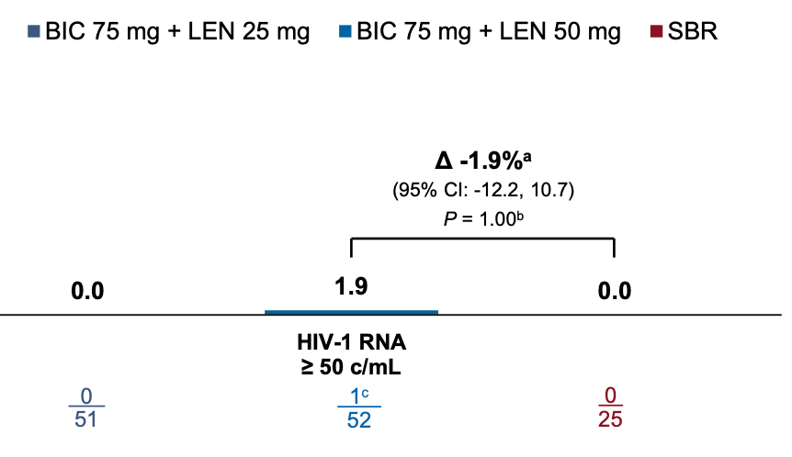
BIC + LEN: Baseline regimens and virologic results
Phase 3 study of BIC/LEN as a single tablet regimen ongoing
Source: Mounzer K, et al. CROI 2024 #642

Slide 14
HIV Epidemiology & Prevention

Slide 15
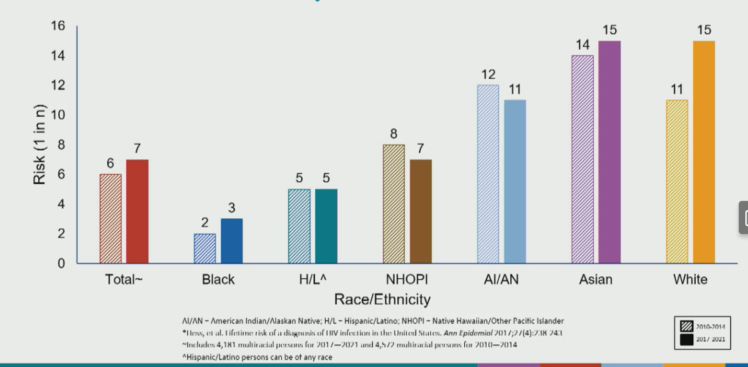
Lifetime risk of HIV infection among MSM
Source: Singh, et al CROI 2024 #193

Slide 16
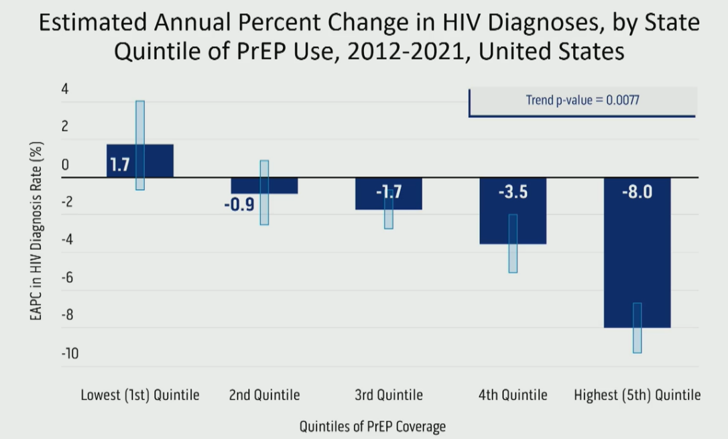
PrEP Coverage and HIV Diagnoses
PrEP Coverage was low across all and ranged from 5.8% in the lowest quintile to 15.7% in the highest quintile.
HIV diagnoses decline 8% in states with highest PrEP Coverage
No change among states in the lowest quintile.
Source: Sullivan et al CROI 2024 #165

Slide 17
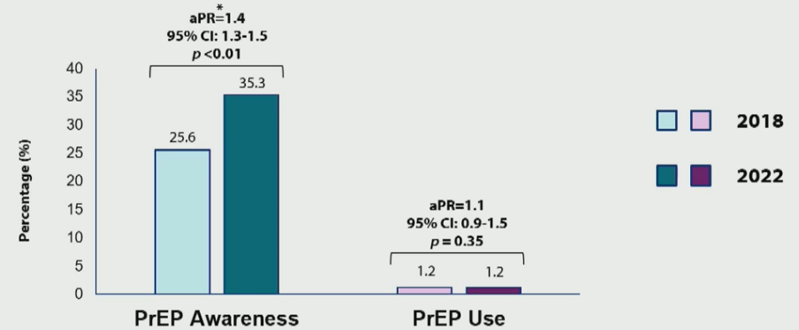
Low PrEP Awareness and Use Among PWID
Less than 1 in 3 PWID were aware of PrEP
PrEP use <2% and no improvement in time
Source: Chapin-Bardales et al CROI2024 #1009

Slide 18
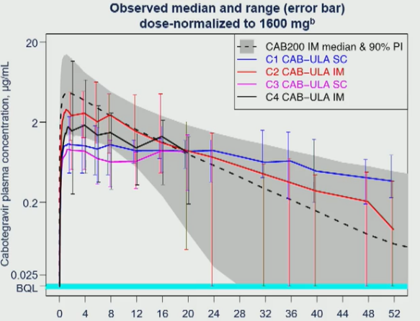
CAB Ultra Long Acting (CAB-ULA)
New longer acting formulation of CAB-LA.
Safe and tolerable for both IM and SC administration.
PK suggest longer dosing interval of > 4 months.
New formulation is being tested in late-stage trials.
Source: Han, et al. CROI 2024 #130

Slide 19
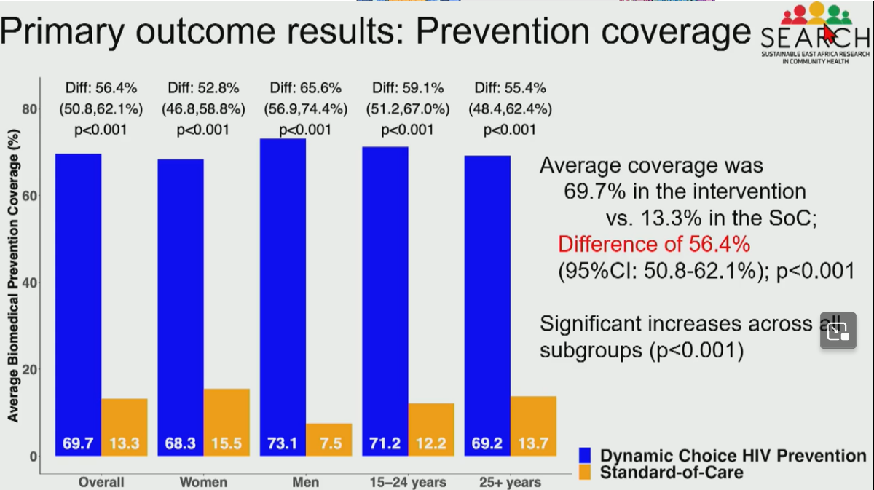
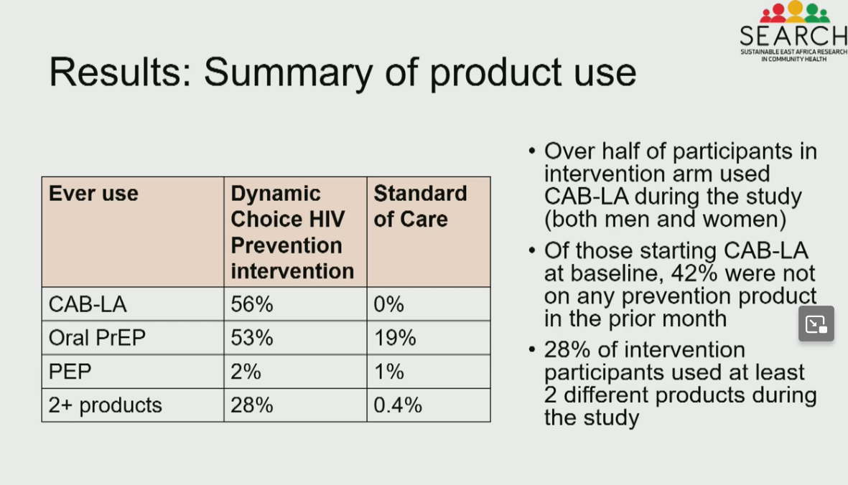
PrEP Choice Dynamic HIV Prevention
Source: Moses, et al. CROI 2024 #172

Slide 20
HIV Ab/Ag & Viral Load Testing among PrEP Users
8,053 tests among 4,908 oral PrEP users
  One new HIV diagnosis with RNA test (0.01%)
931 test among 439 CAB-LA users
  No new HIV diagnoses
HIV RNA False Positive Rate
  Oral PrEP: 0.04%
  Injectable PrEP: 0.11%
HIV Ab/Ag False Positive Rate
  Oral PrEP: 0%
  Injectable PrEP: 0.11%
Source: Zhu, et al. CROI 2024 #206

Slide 21
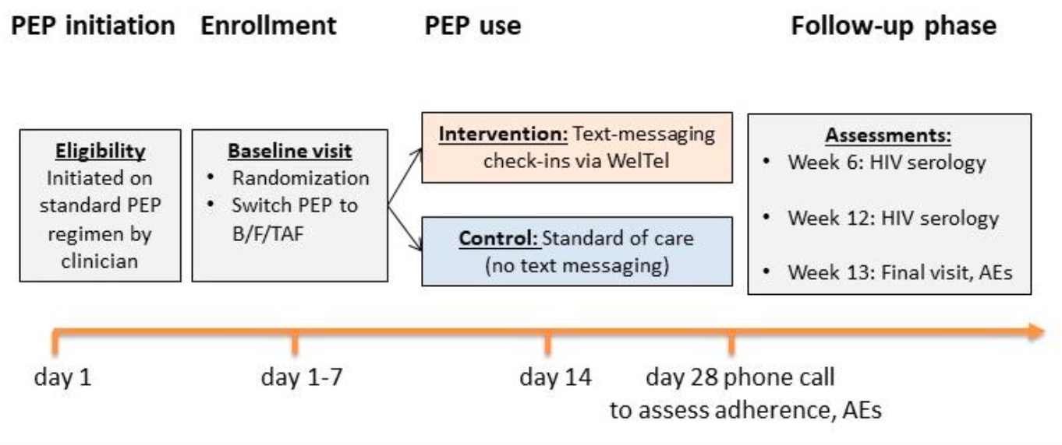
BIC/FTC/TAF for non-occupational PEP
N=119; 100 took at least 3 weeks or PEP; 23% linked to PrEP on final visit
No seroconversions
Confirms findings from two previous studies – time for a guidelines change?
Source: Tan DHS, et al. CROI 2024 #1134

Slide 22
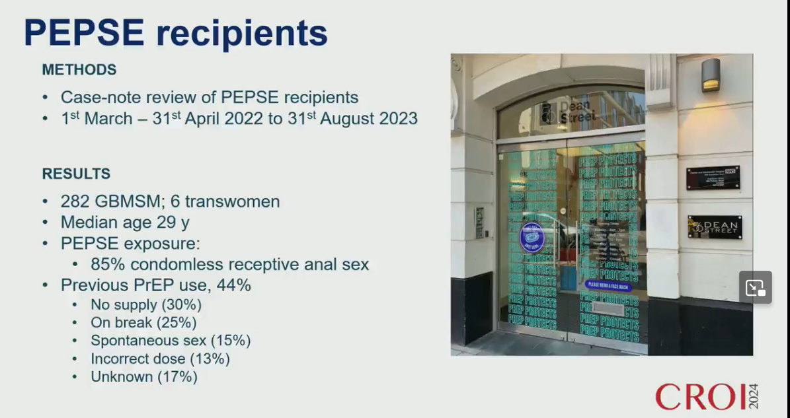
PEP to PrEP Transition @ Dean Street Clinic
212 (74%) subsequently started PrEP after PEP
More than half (54%) came back for at least one f/u PrEP appointment
PEP users who started PrEP were more likely:
  Been on PrEP in the past
  Had multiple partners during PEP exposures
  Been to the clinic before
Source: Witlock et al CROI 2024 #1133

Slide 23
Doxycycline Post-Exposure Prophylaxis

Slide 24
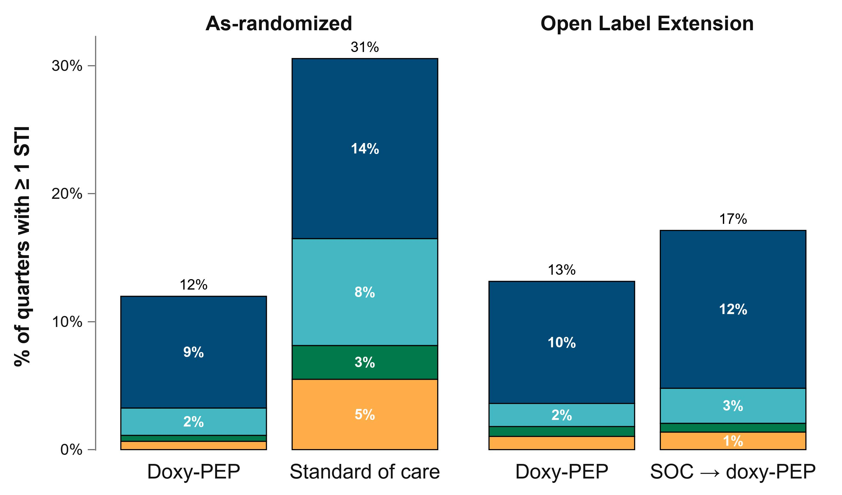
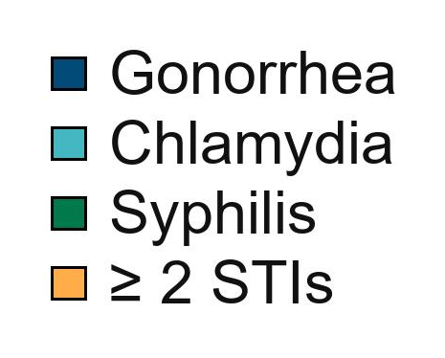
Sustained reduction in STIs during OLE
Source: Luetkemeyer, et al. CROI 2024 #125

Slide 25
Sexual behavior during OLE
 | As-randomized |  | AR→OLE
 | doxy-PEP N quarters = 1077 | SOC N quarters = 455 | doxy-PEP N quarters = 388 | SOC → doxy-PEP N quarters = 146
Median doxy doses/quarter | 15 (4-30) | — | 17 (7-32) | 17 (5-30)
Sex partners/quarter | 10 (4-25) | 8 (4-15) | 12 (6-25) | 16.5 (5-31)
Condomless insertive sex acts/quarter | 5 (1-20) | 4 (2-12) | 8 (2-20) | 8 (3-25)
Condomless receptive sex acts/quarter | 8 (2-20) | 5 (1-15) | 10 (2-23.5) | 10 (2-25)
% of condomless sex acts covered by doxy-PEP per quarter | 82.4% | — | 77.3% | 81.3%
Sexual partners: ↑ during OLE; more pronounced increase in SOC → doxy-PEP
Condomless sex acts: ↑ in both OLE groups
Reported doxy-PEP coverage of condomless sex: High (> 75%) during OLE; comparable to doxy-PEP AR
Source: Luetkemeyer, et al. CROI 2024 #125

Slide 26
Impact of DoxyPEP on Gut Microbiome
Minimal impact on gut microbiome
Increased expression of tetracycline resistance genes in microbiome
Source: Chu, et al. CROI 2024 # 1154

Slide 27
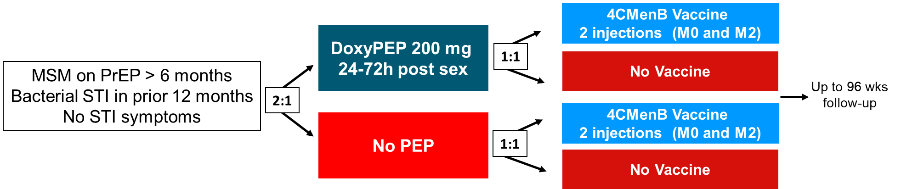
ANRS DOXYVAC Study Design
Multicenter, 2 x 2 factorial randomized, open-label, superiority, phase III trial (NCT04597424)
Primary efficacy end-points: impact of DoxyPEP on time to a first episode of syphilis or chlamydia and impact of the 4CMenB vaccine on time to a first episode of N. gonorrhoeae infection.
Sample size: based on vaccine effectiveness assuming no impact of Doxy on GC: 720 subjects needed for an HR: 0.70 (Estimated probability of a first GC episode over 18 months: 52%, power 85%, 18% lost to FU).
Quarterly visits with PCR tests (Roche dual target Cobas°) for GC/CT/MG (3 sites) and serology for TP
Doxycycline monohydrate purchased from Mylan and 4CMenB vaccine purchased from GSK
Source: CROI 2024 Abstract 124

Slide 28
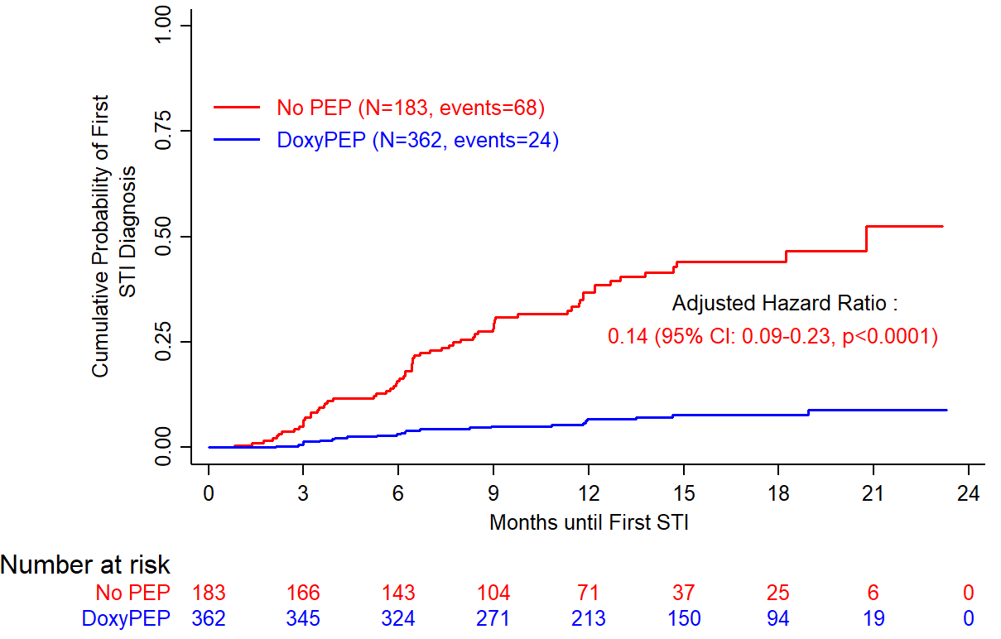
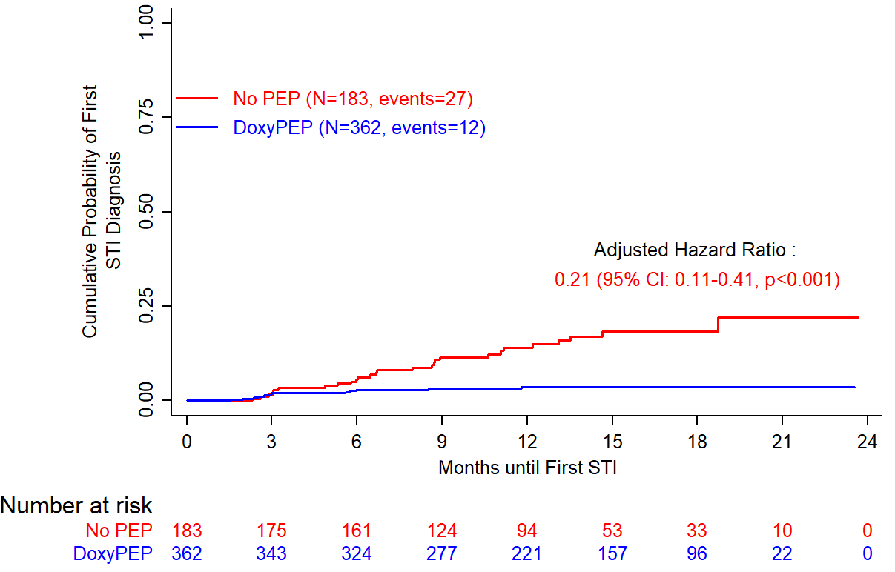
Doxycycline PEP
Time to First CT and Syphilis Infection
CT
Syphilis
92 subjects infected
68 in No PEP arm (incidence: 42.1/100 PY),
24 in Doxy PEP arm (incidence: 5.9/100 PY)
39 subjects infected
27 in No PEP arm (incidence: 14.5/100 PY),
12 in Doxy PEP arm (incidence: 2.9/100 PY)
Source: Molina, et al. CROI 2024 # 124

Slide 29
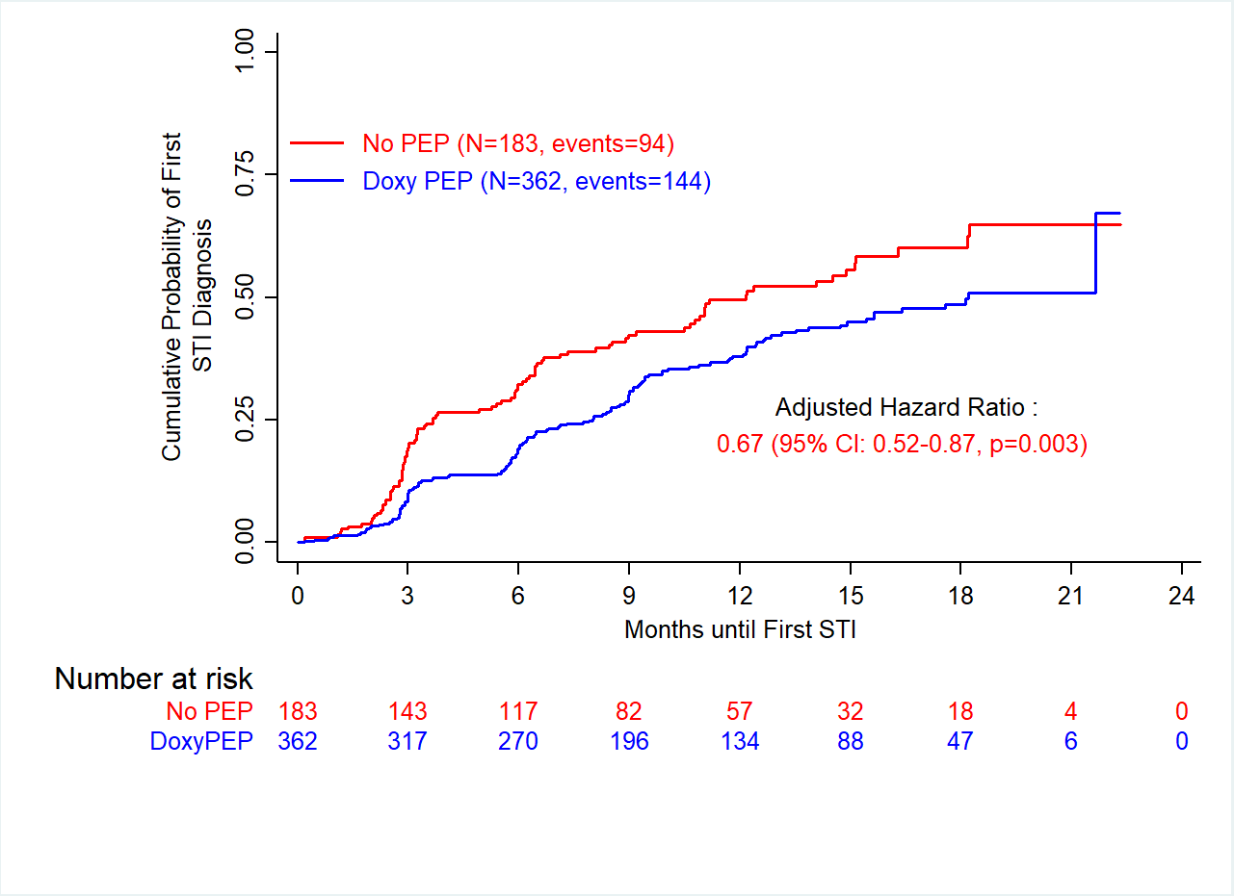
Doxycycline PEP
Time to First GC
GC
Interim analyis:
84 subjects infected, aHR: 0.49
238 subjects infected
94 in No PEP arm (incidence: 68.4/100 PY)
144 in Doxy PEP arm (incidence: 45.5 /100 PY)
Source: Molina, et al. CROI 2024 # 124

Slide 30
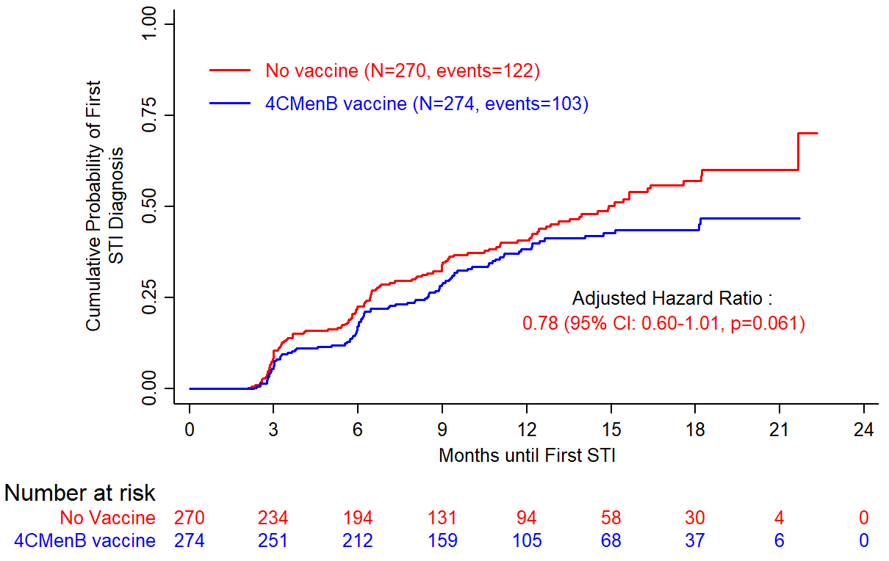
4C MenB Vaccine
Time to First GC infection
No interaction between Doxy PEP
and 4CMenB vaccine (p=0.82)
225 subjects infected
122 in No Vaccine arm
(incidence: 77.1/100 PY),
103 in 4CMenB vaccine arm
(incidence: 58.3/100 PY)
Interim analyis:
49 subjects infected, aHR: 0.49 (95%CI: 0.27 - 0.88)
GC infections were considered from M3 visit (1 month after 2nd vaccine dose)
Source: Molina, et al. CROI 2024 # 124
Notes:
30
30

Slide 31
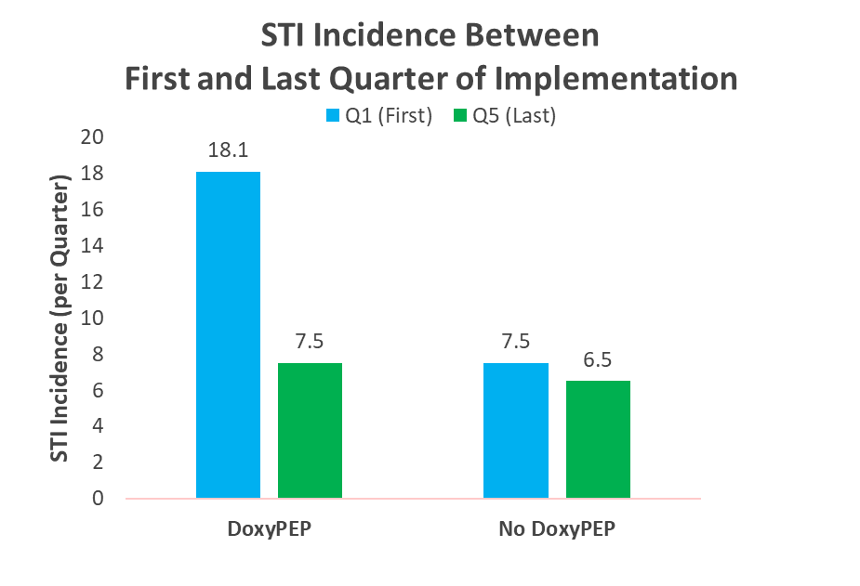
STI Incidence among DoxyPEP Users (Pre-Post Analysis)
Analysis of STI incidence after DoxyPEP implementation 6/2022-9/2023) at Magnet Clinic (SFAF)
High uptake (39%) among PrEP Users
 | IRR | 95% CI | p-value
Any STI | 0.42 | 0.24 - 0.74 | 0.003
Chlamydia | 0.33 | 0.23 - 0.46 | <0.001
Syphilis | 0.22 | 0.09 - 0.54 | 0.001
Gonorrhea | 0.89 | 0.69 - 1.15 | 0.383
Any STI: Chlamydia, Syphilis, or Gonorrhea infection
Source: Scott, et al. CROI 2024 #126
Notes:
The model includes the no DoxyPEP group to account for secular trends in mean STI incidence.
Any STI: 58% reduction
CT: 67% reduction
Syphilis: 78% reduction
Gonorrhea: 11% reduction

Slide 32
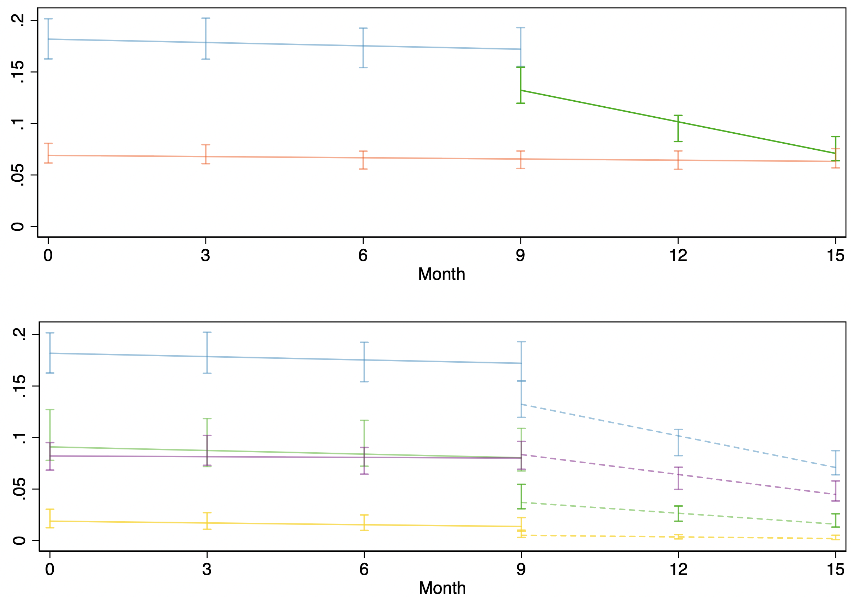
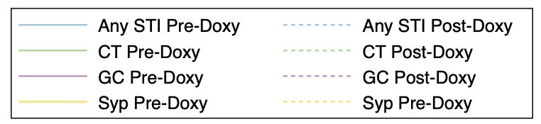
Interrupted Time Series: STI Incidence Pre- Post-DoxyPEP
Specific STI Incidence Per Quarter
ITS: Any STI: p=0.032; Chlamydia: p=0.021; Gonorrhea: p=0.003; Syphilis: p=0.360
Source: Scott, et al. CROI 2024 #126
Notes:
We saw similar declines for gonorrhea, chlamydia, and syphilis in the post-DoxyPEP period
For Gonorrhea: Before DoxyPEP GC was declining slightly, and afterwards the decline was steeper. The means are pretty close, so the lack of change in STI incidence may be secondary to follow-up time.
For Syphilis – the slope was lower in the post-DoxyPEP period, but there were fewer syphilis cases and this analysis has lower power to detect significant changes compared to the pre-post analysis of the means are lower

Slide 33
Chlamydia Results: Monthly SF cases among MSM and TGW
6.6%/month decrease in chlamydia cases in post-period (p<0.0001)
Predicted trend
50% decrease in chlamydia cases in November 2023
(95% CI: 38%-59%)
Post-period trend
Source: Sankaran, et al. CROI 2024 Abstract 127
Notes:
For chlamydia, we found that there was a significant decrease in observed cases in the post period compared to model predictions.
The black line on the graph is our observed monthly cases. The blue line represents the model's post-period prediction, which you can see stays in line with the observed pre-period trend in orange. The green line represents the observed post-period trend. You can see that the green observed line is sharply declining while the model predicted blue line is stable. When comparing the slopes of the blue and green lines, there is an average 6.6% decrease per month in observed cases compared to model predictions.
Another way to measure the impact of this intervention is to compare observed and predicted case counts at particular time points. For example, in November 2023, the end of the 13-month post-period in this analysis, there were 50% fewer observed cases compared to model predictions.

Slide 34
Early Syphilis Results: Monthly SF cases among MSM and TGW
2.7%/month decrease in early syphilis cases in post-period (p<0.0001)
Pre-period trend
Predicted trend
51% decrease in early syphilis cases in November 2023
(95% CI: 43%-58%)
Post-period trend
Source: Sankaran, et al. CROI 2024 Abstract 127
Notes:
For early syphilis, we also found that there was a significant decrease in observed cases in the post period.
Here when we compare the slopes of the green and blue lines, we see a 2.7% decrease per month in observed cases compared to model predictions.
If we look at the impact by the end of our analysis period, we see 51% fewer observed cases compared to the number predicted in November 2023. One important note about the findings for early syphilis is that much of this decline was due to a significant 33% decrease immediately after doxy-PEP implementation. You can see that here graphically by the jump between where the blue and green lines start on the y-axis at the beginning of the post-period.

Slide 35
Gonorrhea Results: Monthly SF cases among MSM and TGW
Pre-period trend
1.8%/month increase in gonorrhea cases in post-period (p<0.0001)
Post-period trend
1.8%/month decrease in gonorrhea cases in pre-period (p<0.0001)
Predicted trend
Source: Sankaran, et al. CROI 2024 Abstract 127
Notes:
Finally, for gonorrhea, we found that there was a significant increase in observed cases in the post-period compared to model predictions.
This is in the context of declining incidence in the pre-period, so while observed cases in the post-period are higher than predicted by the model, they are relatively stable.

Slide 36
Analysis of Doxycycline in hair levels among cisgender women in Kenya
Doxycycline levels were low (29%)
Use was associated with age > 24yrs; & not having a primary partner
Source: CROI 2024 #1148

Slide 37
Who Should be Offered doxy-PEP? Current guidelines do not agree
More restrictive use
Broader use
Broadest
Public Health England/BASHH (2017): Not endorsed; re-evaluating
ASHM (Sept 2023):
Use doxy-PEP primarily for prevention of syphilis in GBMSM; Use for defined period of time
San Francisco DPH (Oct 2022):
Tiered: Recommend to study population; Offer to broader group (Trans women, trans men and MSM with multiple cis male partners but without STI diagnosis in prior 12 months)
IAS-USA (Dec 2022): Case-by case
Seattle King County (June 2023):
Inform (not recommend); prioritize hx of syphilis or multiple STIs
US CDC Draft (Oct 2023): A1 recommendation for MSM and transwomen with at least 1 STI in past year; Insufficient evidence for other groups
California DPH (April 2023): Tiered: Offer to all non pregnant individuals at increased risk for bacterial STIs and those requesting doxy-PEP
German STI Society (Aug 2023):
Case-by-case; Reserved for selected individuals
Source: Slide courtesy of Stephanie Cohen
Notes:
Germany: "Doxycycline is not approved for use in terms of STI prevention; therefore, the use of doxycycline to prevent STIs is considered an off-label use. The costs of the prescription are to be borne by the individual concerned, and the legal liability rests with the prescribing physician.“
On Oct 21, based on the results of the DoxyPEP study and in response to significant and growing community interest in DoxyPEP use, SFDPH released interim guidelines for DoxyPEP. We knew that in SF we had many people who were already using DoxyPEP and providers who were prescribing it, and wanted to provide a framework for safe use of this intervention that could impact the STI epidemic in our city. We convened a group of stakeholders and experts in sexual health, HIV and STI prevention, gay men’s health and health equity, reviewed the data from the DoxyPEP study and developed these interim guidelines, with the expectation that they would evolve as additional evidence accrues and CDC and other agencies issue guidance
Multiple US jurisdictions now with provisional guidance: California DPH, Alameda, Santa Clara and LA, Seattle-King County, Oregon, NYC
IAS USA: Until more information is available, this strategy should be considered only on a case-by-case basis for individuals at high risk for acquiring syphilis, chlamydia, or gonorrhea.
ASHM (Sept 2023):
Use doxy-PEP primarily for prevention of syphilis in GBMSM; hx of syphilis, numerous STIs, sex with cis women; use for defined period of time

Slide 38
Thank You
Paul Sax
Annie Luetkemeyer
Susan Buchbinder
Stephanie Cohen
Madeline Sankaran
Jean-Michele Molina

