Slide 1
Taking a Sexual Health History
Justin Alves RN, FNP-BC, ACRN, AACRN, CARN, CNE (he/him)
Boston Medical Center
Notes:
Version date_02/2024
Target audience: clinical members of the healthcare team

Slide 2
Conflict of Interest Disclosure Statement
Speaker has nothing to disclose
This program is supported by the Health Resources and Services Administration (HRSA) of the U.S. Department of Health and Human Services (HHS) as part of an award totaling $4,205,743 with 0% financed with non-governmental sources. The contents are those of the author(s) and do not necessarily represent the official views of, nor does mention of trade names, commercial practices, or organizations imply an endorsement by HRSA, HHS, or the U.S. Government. For more information, please visit HRSA.gov. Any trade/brand names for products mentioned during this presentation are for training and identification purposes only.

Slide 3
Unconscious Bias Disclosure
SCAETC recognizes that language is constantly evolving, and while we make every effort to avoid bias and stigmatizing terms, we acknowledge that unintentional lapses may occur in our presentations.
We value your feedback and encourage you to share any concerns related to language, images, or concepts that may be offensive or stigmatizing.
Your input will help us refine and improve our presentations, ensuring they remain inclusive and respectful to participants.

Slide 4
Learning Objectives
Participants will be able to:
Identify the 5Ps of taking a sexual health history.
Match appropriate testing with relevant information from the sexual health history.
Recognize the role of stigma in collecting and recording sexual health histories.
Assess risk for HIV acquisition based on sexual health history findings.

Slide 5
Sexual Health Throughout the Lifespan
Arguably sexual health education should start long before sexual debut or puberty
should begin with early friendships and relationships
emphasize importance of building healthy relationships & what consent is
May become a major source of stress or focus for pubescence and into early and later adulthood
Flynn et al., 2016; Mitchell, 2016; Raimey, 2017; Sexual History Taking Toolkit | TargetHIV, 2022; West et al., 2022

Slide 6
Sexual Health Throughout the Lifespan
People may remain engaged in sex long after naturally occurring erections or menopause
providers should be able to address these needs appropriately based on additional comorbidities
Sexual health and its importance is also an under-recognized issue in other chronic and acute disease management
Flynn et al., 2016; Mitchell, 2016; Raimey, 2017; Sexual History Taking Toolkit | TargetHIV, 2022; West et al., 2022

Slide 7
Sexual Health and Primary Care
Bacterial STIs:
Chlamydia, Gonorrhea
Mycoplasma genitalium
Syphilis (Treponema pallidum)
Viral STIs:
Human papilloma virus (HPV)
Herpes simplex virus (HSV)
Viral hepatitis (HCV, HBV, HAV)
HIV
Non-infectious:
Pregnancy/termination of pregnancy
Sexual dysfunction
Injuries
Fissures/tears
Puberty
Menopause
Sexual violence
STI=sexually transmitted infection; HCV = hepatitis C virus, HBV = hepatitis B virus, HAV = hepatitis A virus Workowski et al, 2021; Savoy & O’Gurek, 2020
Notes:
Chlamydia/gonorrhea (pharyngeal, rectal, urethral)
HPV (rectal/cervical)

Slide 8
Clinical Pearl: 5 Ps of a Sexual Health History
Partners | Practices | Protection from STIs | Past History of STIs | Pregnancy Intention
Asking about the gender of the patient’s partners. Asking if patients have more than one partner. Asking patients how they meet their partners. | What kind of sex do you have, oral, vaginal, anal? What parts of your body do you use for sexual practices? What fluids are exchanged? | What tools are you using to protect against STIs? Behavioral interventions? Biomedical interventions? External or internal Condoms? | Have you ever had any bacterial STIs? (RPR titer) Viral STIs? Abnormal cervical or anal pap smear? | For people with uterine capacity are you trying to become pregnant or prevent pregnancy? If no uterine capacity, is there a possibility your partner may become pregnant? Is there sperm transfer
CDC, 2022

Slide 9
TAKING A SEXUAL HISTORY
How to Ask the Tough Questions
(NCSH, 2016)

Slide 10
DO YOU MIND IF I ASK YOU SOME QUESTIONS ABOUT SEX THAT WE ASK EVERYBODY?
Normalize the conversation and seek permission. You do this with everyone. It eliminates the stress about the questions that follow.

Slide 11
ARE YOU SEXUALLY ACTIVE, EVEN A LITTLE BIT?
A lot of people are not going to identify certain activities as sex

Slide 12
WHAT ARE THE GENDERS OF YOUR SEX PARTNERS? OR DO YOU HAVE SEX WITH MEN, WOMEN, OR BOTH?
Ask everyone regardless of what you might think or what the person may have previously told you about the types of sexual partners that they may have had.

Slide 13
WHAT KIND OF SEX DO YOU HAVE? ORAL, VAGINAL, ANAL, ALL THREE, A COMBINATION OF THE THREE OR SOMETHING ELSE?
It is important to identify what kind of sex they may be having because it tells you what sites need to be screened and indicates more information to you regarding their risk for acquisition of an STI
Notes:
STI = Sexually Transmitted Infection

Slide 14
ABOUT HOW MANY PARTNERS HAVE YOU HAD IN THE LAST YEAR?
For people who identify multiple partners in the last year it is important to try and identify how they are finding these partners. This may clue you in to whether or not the patient is having survival or transactional sex.

Slide 15
HOW WOULD YOU FEEL ABOUT A PREGNANCY RIGHT NOW?
Be more broad in asking questions about pregnancy to acknowledge that some people may or may not wish to be pregnant or parent a child at any given time

Slide 16
PREVENTING UNPLANNED PREGNANCY
Among female sex workers in North America, condoms were the most common form of contraceptives used.
Reasons that led to partner-dependent contraception include:
Cost
Stigma
Financial constraints
Active substance use
Co-location of harm reduction and reproductive services increased rates of patient controlled contraceptive choices!
Zemlak, Bryant, & Jeffers, 2020

Slide 17
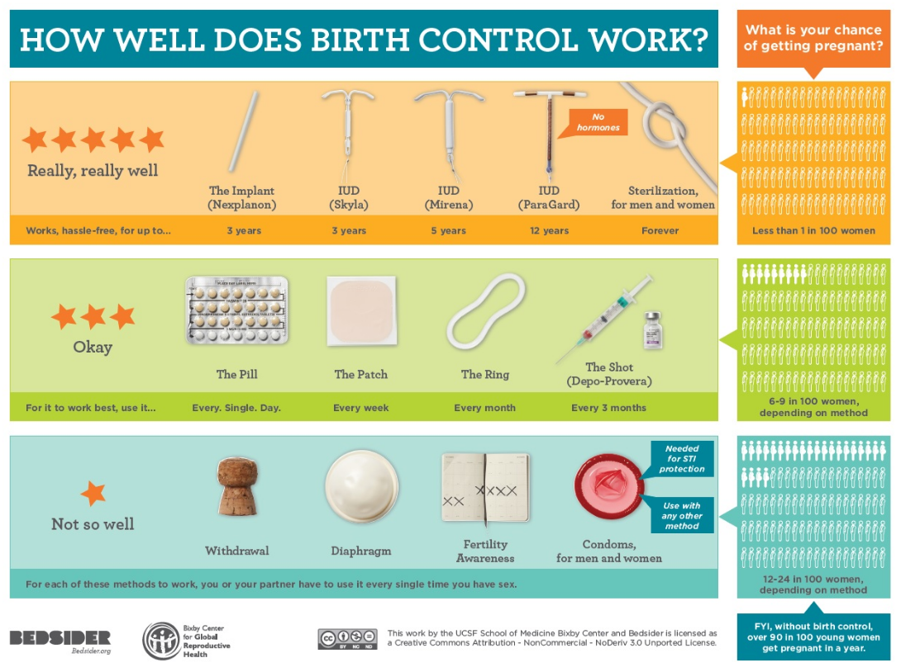
PREVENTING UNPLANNED PREGNANCY
https://www.bedsider.org/methods

Slide 18
HOW DO YOU PROTECT YOURSELF FROM STIS?
Asking open-ended question like this allows the person to explore strategies that they use or sometimes helps them identify that they are not doing enough to protect themselves

Slide 19
SCREENING FOR TRANSACTIONAL SEX
Have you ever exchanged sex for drugs, money, or a place to stay?
Has anyone ever forced you or convinced you to have sex for drugs, money, or a place to stay?
Image: Flaticon: Parzival 1997

Slide 20
SCREENING FOR CHEMSEX
Have you used drugs before/during sex in the last 6 months?
If yes, what do you use?
How frequently do you use them?
When was the last time you used drugs or alcohol to make sex more enjoyable?
What kind of drugs did you use?
When was the last time that you had sober sex?
Image: Flaticon: FreePik

Slide 21
WHAT TO DO POST-SCREENING?
Three Main Questions
Is this person requesting help for any of the information provided?
Are they safe to return to the community?
What is the most important intervention right now?
Image: Flaticon: FreePik

Slide 22
STI PREVENTION STRATEGIES
Offer both external and internal condoms
Educate about the use of internal condoms rectally
Try to have regular sex partners or regulars
Reducing the sexual network will help to reduce risk
Engage in activities that have reduced exposure to sexual fluids and try to reduce extended exposure to sexual fluids
Use lubricant to reduce micro-tearing and decrease the risk of blood-pathogen exposure
CDC, 2020. HCRC, 2020.
Images: Flaticon: FreePik

Slide 23
STI PREVENTION STRATEGIES
Avoid brushing your teeth right before or right after sexual activity, opt for mouthwash
Douching and enemas may remove normal flora that are protective. Avoid these when possible and opt for other strategies to reduce risk.
Stay hydrated to avoid drying out mucosal membranes, particularly if using stimulants in the setting of sex
HCRC, 2020
image: stock photo

Slide 24
SCREENING FOR STIS
 | MSM, SW | MSM+PWID | PWID | Non-MSM, SW, PWID
HIV | Q3-6m | Q3m | Q6m | Q12m
HCV | Once or q12m if PWH | Q12m | Q12m | Once (unless other risk factors present)
Bacterial STIs | Q3-6m | Q3m | Q6-12m | Q6-12m
HPV | Q2-3y | Q2-3y | Q3-5y | Q3-5y
HSV | If sx | If sx | If sx | If symptomatic (sx)
HBV | Once | Once | Once | Once
MSM = men who have sex with men, PWID = people who inject drugs, SW = sex worker; PWH=person with HIV.
CDC, 2020
Notes:
http://www.hcvguidelines.org/full-report/hcv-testing-and-linkage-care
http://www.hcvguidelines.org/sites/default/files/full_report.pdf
http://www.cdc.gov/std/prevention/screeningreccs.htm
http://www.cdc.gov/std/tg2015/screening-recommendations.htm
http://www.uspreventiveservicestaskforce.org/Page/Name/us-preventive-services-task-force-issues-new-cervical-cancer-screening-recommendations
http://www.lgbthealtheducation.org/wp-content/uploads/Anal-Dysplasia-and-Cancer-in-At-Risk-Groups_What-Providers-Need-to-Know.pdf

Slide 25
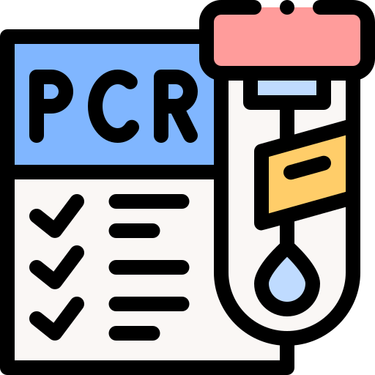
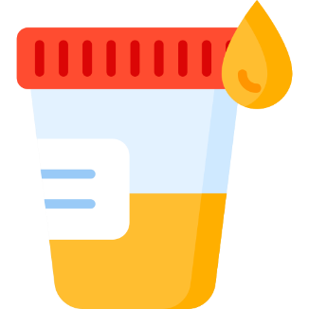
SCREENING FOR STIS
Where to Screen?
What Test?
Current guidelines recommend NAAT and PCR testing over culture and antibody testing in most circumstances
CDC, 2020.
NAAT=nucleic acid amplification test, PCR=polymerase chain reaction; Images: Flaticon: FreePik

Slide 26
SCREENING FOR STIS
What STIs to screen for?
Chlamydia: May be in urethra, vagina, rectum, or pharynx. Test all sites.
Gonorrhea: May be in urethra, vagina, rectum, or pharynx. May also infect other sites if untreated. Test all sites.
Syphilis: 3 stages, blood test (serology), may have different presentations and may infect other sites (i.e. neurosyphilis)
Trichomonas: protozoal infection; primarily vaginal infection
Notes:
Bacterial Vaginosis: Not a sexually transmitted infection but change to vaginal flora from polymicrobial overgrowth resulting in symptoms including vaginal discharge

Slide 27
STI TREATMENT STRATEGIES
Prioritize in-office same-day treatment when appropriate
If permissible by law, offer expedited partner therapy to the patients identified partners
If there is high suspicion or the patient is symptomatic, treat and test on the same day
CDC, 2017

Slide 28
HIV SCREENING
Most accurate & recommended testing for now is the p24 HIV Ag/Ab

Slide 29
Receptive anal sex is associated with more HIV transmission than injection drug use
CDC, 2018

Slide 30
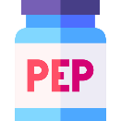
HIV Prevention
Method of Prevention | Pros | Cons
Pre-exposure Prophylaxis (PrEP) Oral: daily med (tenofovir AF or DF/emtricitabine) Injectable: cabotegravir every 2 months | Highly efficacious, >99% 1 tab daily or injection every 2 mos Taken with/without food Controlled by person at-risk | Must be taken every day Side effects: GI, bone mineral density loss $$$ without insurance Req’s person to be proactive No STI/pregnancy protection
Non-occupational Post-Exposure Prophylaxis (nPEP) 3 meds taken orally within 72 hrs of potential exposure x1 mo | Highly efficacious Controlled by the person at-risk Allows person to react to potential risky situation | Must start within 72 hrs and usually requires an ER visit Usually taken with food and some side effects Higher pill burden No STI/pregnancy protection
CDC, 2020
Notes:
ER=emergency room
GI=gastrointestinal

Slide 31
HIV Prevention
Method of Prevention | Pros | Cons
Condoms Barrier protection used at the time of a sexual encounter | No side effects from medications Does not require person to take a daily med Also prevents against other STIs and pregnancy | Requires some impulse control With regular use it is less than 90% efficacious May or may not be controlled by person at-risk
Serosorting A method of only having sex with people of a known HIV status similar to your own | May reduce the risk of exposure to HIV | Everyone isn’t truthful Stigmatizing No protection against STIs, pregnancy
CDC, 2020
Images: Flaticon: FreePik

Slide 32
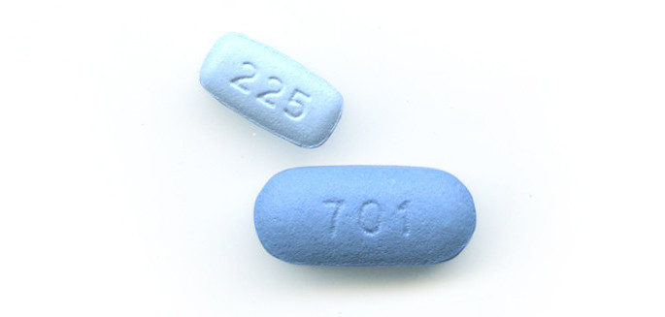
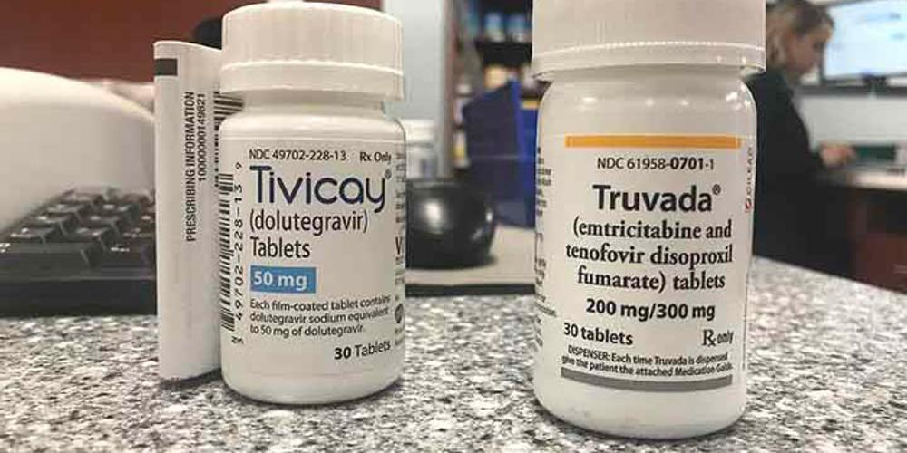
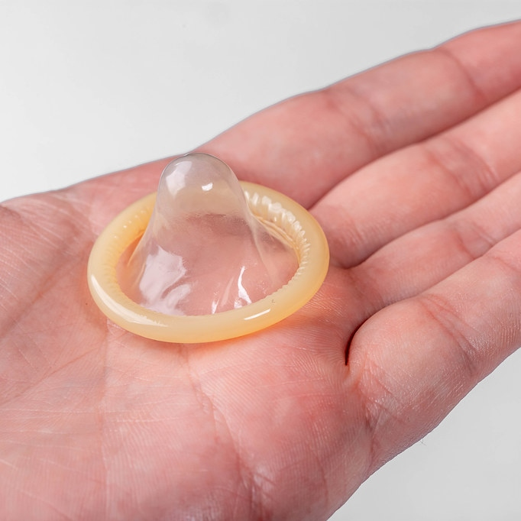
HIV PREVENTION
Educate on strategies to ask partners about their HIV serostatus
Educate on strategies to negotiate safer sex prior to in-person encounters to ensure there are agreed upon terms to a specific encounter to manage expectations
Depending on where you live, it may also be important to discuss HIV criminalization and strategies for disclosure or ways to stay safe if they are ever accused of transmission
It may be important to role play how to ask these questions
CDC, 2020

Slide 33
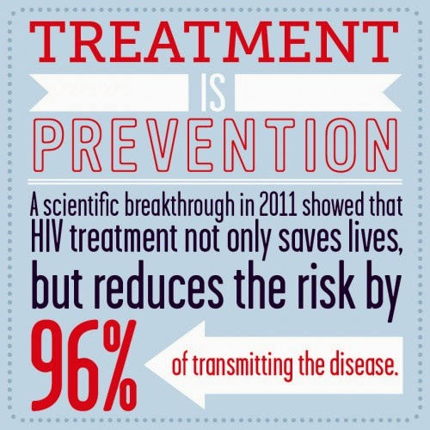
TREATMENT AS PREVENTION (TasP)
“It is certain that TasP needs to be considered as a key element of combination HIV prevention and as a major part of the solution to ending the HIV epidemic.”
WHO 2012
Notes:
http://www.who.int/hiv/pub/mtct/programmatic_update_tasp/en/
http://elblogdegabrieljmartin.blogspot.com/2014/03/indetectable-vih-intransmisible-y-punto.html

Slide 34
Making it Work and Why it Matters
An accurate and respectful sexual health history will promote a therapeutic relationship between the provider and the patient
Provider-initiated sexual health history will help people more readily disclose important health information that they may be uncomfortable talking about
Sexual health is an important part of primary care
providers should be able to address the needs of people of all genders and sexualities to provide comprehensive care in a respectful/non-judgmental manner
Mitchell, 2016. CDC, 2022

Slide 35
Practice Makes Perfect….

Slide 36
References
Centers for Disease Control (CDC). (2022). A Guide to Taking a Sexual History. (2022, January 14). https://www.cdc.gov/std/treatment/sexualhistory.htm
Flynn, K. E., Lin, L., Bruner, D. W., Cyranowski, J. M., Hahn, E. A., Jeffery, D. D., Reese, J. B., Reeve, B. B., Shelby, R. A., & Weinfurt, K. P. (2016). Sexual Satisfaction and the Importance of Sexual Health to Quality of Life Throughout the Life Course of US Adults. The Journal of Sexual Medicine, 13(11), 1642–1650. https://doi.org/10.1016/j.jsxm.2016.08.011
Mitchell, H. (2016, July 3). Addressing sexual health needs—An essential role for the primary care nurse. Nursing in Practice. https://www.nursinginpractice.com/clinical/womens-health/addressing-sexual-health-needs-an-essential-role-for-the-primary-care-nurse/
Raimey, D. D. (2017). NURSE PRACTITIONERS’ UNDERSTANDING OF SEXUAL HEALTH INTERVENTIONS. 39.
Savoy, M., & O’Gurek, D. (2020). Sexual Health History: Techniques and Tips. 101(3), 8.
Sexual History Taking Toolkit | TargetHIV. (2022). Retrieved February 28, 2022, from https://targethiv.org/library/sexual-history-taking-toolkit
West, N. E., Kazmerski, T. M., Taylor-Cousar, J. L., Tangpricha, V., Pearson, K., Aitken, M. L., & Jain, R. (2022). Optimizing sexual and reproductive health across the lifespan in people with cystic fibrosis. Pediatric Pulmonology, 57(S1), S89–S100. https://doi.org/10.1002/ppul.25703
Workowski, K. A., Bachmann, L. H., Chan, P. A., Johnston, C. M., Muzny, C. A., Park, I., Reno, H., Zenilman, J. M., & Bolan, G. A. (2021). Sexually Transmitted Infections Treatment Guidelines, 2021. 70(4), 192.

Slide 37
Resources
National Clinician
Consultation Center
http://nccc.ucsf.edu/
HIV Management
Perinatal HIV
HIV PrEP
HIV PEP line
HCV Management
Substance Use Management
Present on ECHO
https://hsc.unm.edu/scaetc/programs-services/echo.html​
AETC National HIV Curriculum https://aidsetc.org/nhc
AETC National Coordinating
Resource Center https://targethiv.org/library/aetc-national-coordinating-resource-center-0
HIVMA Resource Directory https://www.hivma.org/globalassets/ektron-import/hivma/hivma-resource-directory.pdf
Additional trainings scaetcecho@salud.unm.edu
www.scaetc.org
Notes:
IDEA Platform: Infectious Diseases Education & Assessment. https://idea.medicine.uw.edu/
AETC National HIV Curriculum: 6 core modules for self study; regularly updated; CME, CNE
Hepatitis C Online Curriculum: https://www.hepatitisc.uw.edu/
Hepatitis B Online Curriculum: https://www.hepatitisb.uw.edu/
National STD Curriculum: https://www.std.uw.edu/

