Slide 1
Drilling Down the Data Using Data to Make Meaningful Changes in a Clinic Setting
Adam Thompson, MPH (he/him)
Practice Facilitator
Notes:
Version date_01/2024
Target audience: members of the healthcare team who work with people with HIV who are responsible for tracking and reporting data, i.e. administrators, participants of quality improvement work

Slide 2
Conflict of Interest Disclosure Statement
Speaker has nothing to disclose
This program is supported by the Health Resources and Services Administration (HRSA) of the U.S. Department of Health and Human Services (HHS) as part of an award totaling $4,205,743 with 0% financed with non-governmental sources. The contents are those of the author(s) and do not necessarily represent the official views of, nor does mention of trade names, commercial practices, or organizations imply an endorsement by HRSA, HHS, or the U.S. Government. For more information, please visit HRSA.gov. Any trade/brand names for products mentioned during this presentation are for training and identification purposes only.

Slide 3
Learning Objectives
Define “pareto principle” in the context of health services delivery and HIV care.
Demonstrate a method for using clinical and health services data to identify improvement opportunities.
Demonstrate the generation of pareto charts to prioritize areas for improvement .

Slide 4
Too Much Data
Image: https://epmonthly.com/article/like-drinking-from-a-firehose/

Slide 5
Costs
Medication
Experience
Which barrier to address first?
Mental Health
Polypharmacy
Transportation
Notes:
Stock images

Slide 6
Pareto Principle
20%
80%
Causes
Effects

Slide 7
The Pareto Principle
The Pareto Principle states that roughly 80% of consequences come from 20% of causes
The 20% of causes are known as the "vital few“
The remaining 80% are known as the “useful many”
The “vital few” causes are important to address at the systems-level because they are having such an effect (80%)
The “useful many” still describe barriers to care and should be addressed but they are not likely caused by the system

Slide 8
Causal “Sorting Hat”
How can we determine which causes are our biggest problems?

Slide 9
Drilling Down Data

Slide 10
What is Drilling Down Data?
Drilling Down Data is a process of …
analyzing your clients care data …
in increasing detail …
to understand who is getting the expected outcome and who is not.

Slide 11
Steps to Drilling Down Data
Identify clients who do not meet the measure criteria
1
Assess reasons each client does not meet the criteria
2
Make a table and tally the reasons to create a pareto chart
3
Develop plans to the address the most common issues
4

Slide 12
Drilling Down Data In Action

Slide 13
Step One: Identify Clients
Select a measurable outcome of interest
Example: Viral Suppression, Retention to Nutrition Services, Screening for Negative Social Determinants of Health
Run the measure to identify those clients who are not in the numerator of the report
These are the clients not getting the expected outcome and are likely experiencing barriers
http://www.hivguidelines.org/wp-content/uploads/2015/04/drilling-down-data-to-understand-barriers-to-care-03-31-2015

Slide 14
Denominator Development
173
Unsuppressed
Clients
Example of PWH in practice with HIV viral suppression

Slide 15
Step Two: Assess Reasons
Prepare client data for the team to review
Convene the multi-disciplinary team to identify client barriers
Discuss potential barriers and document the discussion and findings using a standardized tool
http://www.hivguidelines.org/wp-content/uploads/2015/04/drilling-down-data-to-understand-barriers-to-care-03-31-2015

Slide 16
Drill Down Sessions
Preparations
Multidisciplinary Team
Staff prepared a case review tool which included a mix of client data (demographic, clinical, service utilization, psychosocial)
Staff were assigned to present the client to the team
The team asked questions and documented identified barriers and potential strategies
Physician
Nurse Care Manager
Medical Case Manager
Patient Navigator
Linkage Specialist
Client (Person with HIV)

Slide 17
Case Review Tool
Document Important Data
Next Medical Visit
Most Recent Viral Load
Track Identified Barriers
Document discussions for follow-up

Slide 18
Standardize the Collection of Barriers
Using a prepared template with common barriers can increase Drill Down Session efficiency and save time aggregating the data.
As teams discover new barriers, revise the template to include the new categories.
Untreated Mental Health Disorder
Active Substance Use
Unstably Housed
Un-/Underinsured
Transportation
No Next Medical Visit Scheduled
No Laboratory Test Ordered
Multi-Drug Resistant Virus

Slide 19
Step 3: Create a Table
Using data collected during the sessions, the team creates a table which lists the barriers, the number of times it was present, and what percentage of all barriers it represents.
This helps the team better identify those barriers which are causing most of the problems.
Barrier | Number | %
Barrier | # | X%
Barrier | # | X%
Barrier | # | X%
Barrier | # | X%
Barrier | # | X%
Barrier | # | X%
Barrier | # | X%
Total | # | 100%
http://www.hivguidelines.org/wp-content/uploads/2015/04/drilling-down-data-to-understand-barriers-to-care-03-31-2015

Slide 20
Table of Barriers
Barrier | Frequency | Percentage
No Scheduled Medical Visit | 39 | 49%
Untreated Mental Health Disorder | 12 | 15%
Insurance (un/under-insured) | 9 | 11%
Lost to Care & Follow-up | 8 | 10%
Active Substance Use Disorder | 7 | 9%
Multi-Drug Resistant Virus | 2 | 3%
Long-Term Non-Progressor | 1 | 1%
Declined Treatment | 1 | 1%

Slide 21
Remember the Pareto Principle
Vital Few
Causes
Useful Many
Effects

Slide 22
The Pareto Chart
A pareto chart is a specialized bar graph with a run chart.
The bars indicate the frequency of an event.
The run line represents the cumulative total.

Slide 23
Pareto Chart
A pareto chart can help to distinguish between those causes that are affecting a lot of patients and those which might only be affecting a few patients
Causes affecting a lot of patients indicate potential systems issues
Causes affecting a few clients might represent intersectional barriers unique to the client’s experience which might be best mitigated through tailored care and treatment

Slide 24
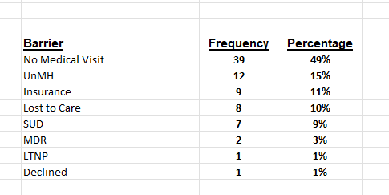
Table of Identified Barriers
Barrier | Freq. | Percentage
No Scheduled Medical Visit | 39 | 49%
Untreated Mental Health Disorder | 12 | 15%
Insurance (un/under-insured) | 9 | 11%
Lost to Care & Follow-up | 8 | 10%
Active Substance Use Disorder | 7 | 9%
Multi-Drug Resistant Virus | 2 | 3%
Long-Term Non-Progressor | 1 | 1%
Declined Treatment | 1 | 1%

Slide 25
Input Data into Database
List of barriers
Number of times the barrier was listed
Percent of all the barriers it represents
Notes:
Database example: Excel

Slide 26
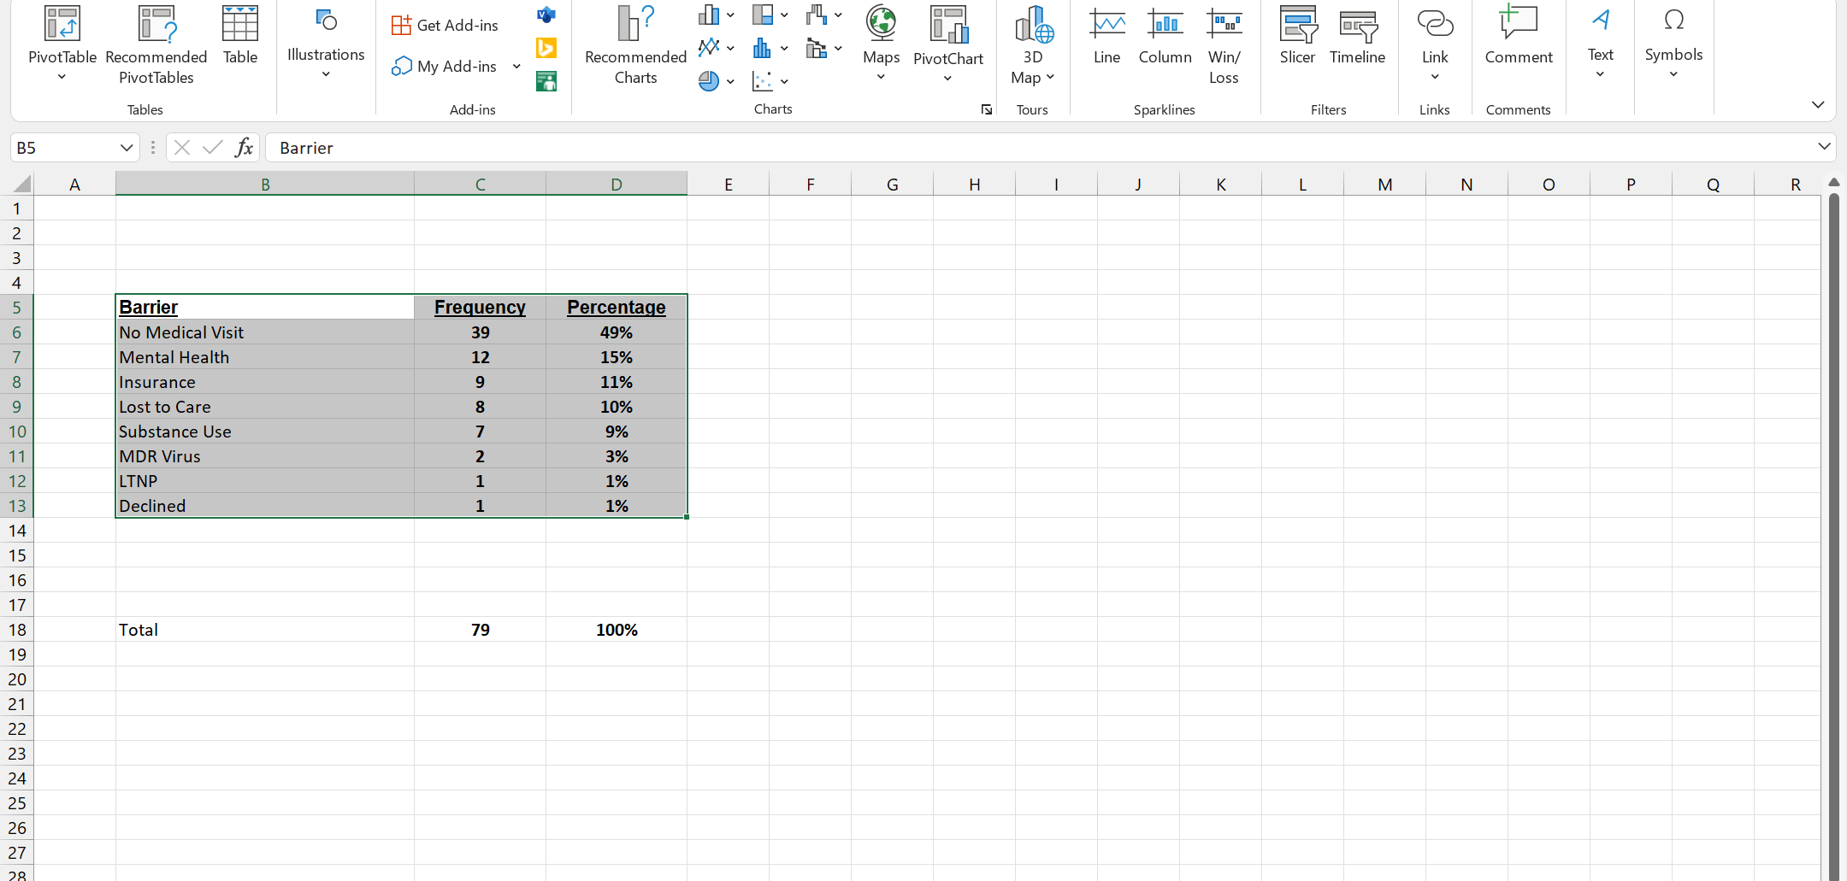
Highlight the Data in Database
Highlight the Data

Slide 27
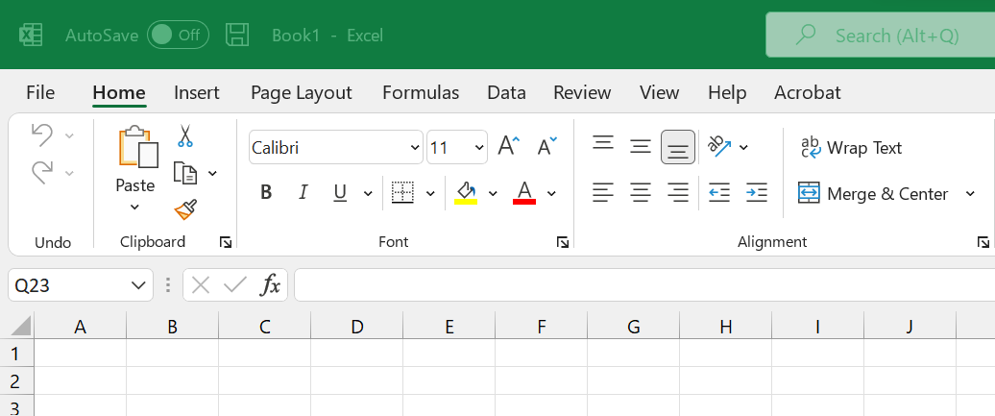
Select the Insert Tab from the Toolbar
Insert Tab
Example database show here = Excel

Slide 28
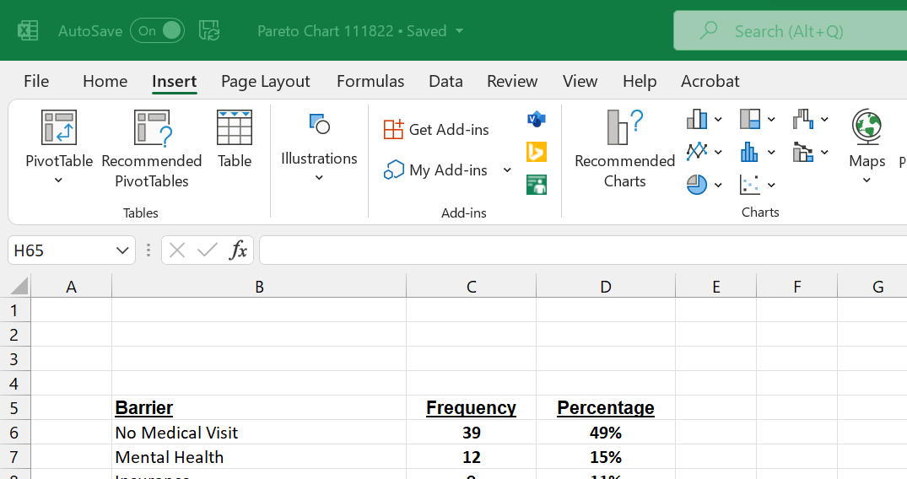
Click on “Recommended Charts”
Magical Charts Button

Slide 29
Chart Type: Pareto
Scroll down the list of charts and select the Pareto Chart
Click OK

Slide 30
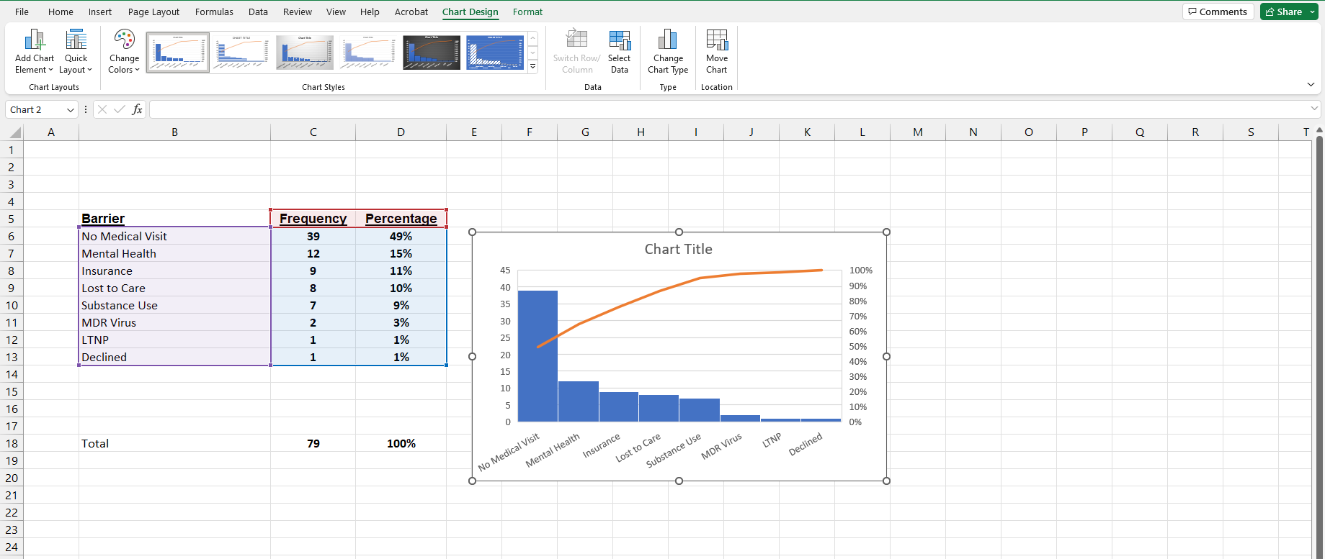
Magical Charts Button
Pareto Chart

Slide 31
Pareto Chart
Notes:
MDR= multidrug resistant virus
LTNP= long-term nonprogressor

Slide 32
Interpreting Pareto Charts
Cumulative Line

Slide 33
The Cumulative Line
If the cumulative line is steep, with a lot of arch to it, this shows that the first few problem areas rapidly add to a high percentage of the total problems.
If the cumulative line is straight, it is telling us that the contribution from each successive bar (after the first) is about even.
This says that no problems stand out as being more bothersome than the rest, which does not help much for problem solving.

Slide 34
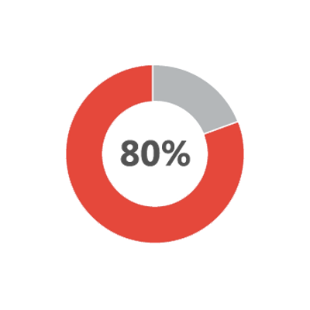
Interpreting Pareto Charts
Data from Kennedy EIP Quality Management Team Viral Load Suppression Plans

Slide 35
Interpreting a Pareto Chart
The pareto chart is telling us that if we address:
No Medical Visit
Mental Health
Insurance
that we will address 80% of our problem

Slide 36
Categorize Thoughtfully
Barrier | Number | %
No Scheduled Medical Visit | 39 | 49%
Behavioral Health Disorders | 19 | 24%
Insurance (un/under-insured) | 9 | 11%
Lost to Care & Follow-up | 8 | 10%
Multi-Drug Resistant Virus | 2 | 3%
Long-Term Non-Progressor | 1 | 1%
Declined Treatment | 1 | 1%
Total | 79 | 100%
Mental Health & Substance Use Disorder Recategorized as Behavioral Health
How barriers are categorized affects the results

Slide 37
New Pareto Chart

Slide 38
Acting on Pareto Chart Findings
For those causes which affected most patients, address through traditional quality improvement efforts
The most prevalent causes of an outcome are the “vital few” causes that when addressed should improve system performance
For those causes which affected only a few patients address through tailored plans designed to address the specific barriers of the patient or subpopulation.
These less prevalent causes from a systems perspective are the “useful many” because solutions to these problems are likely not systems-level issues but are useful in addressing individual client barriers

Slide 39
Step 4 Develop a Targeted Plan
Now that the team knows which barriers are causing most of the problems, they can begin to address the specific barrier with a targeted plan to:
address those currently experiencing the barrier
prevent others from experiencing it in the future
http://www.hivguidelines.org/wp-content/uploads/2015/04/drilling-down-data-to-understand-barriers-to-care-03-31-2015

Slide 40
Addressing No Scheduled Medical Visit
Fix
Prevent
Create “not-in-numerator” report of clients with no next medical visit
Refer clients to Linkage to Care Coordinator (LTCC)
LTCC schedules visits for clients
LTCC supports or refers as appropriate
Create “Cue to Action” for client and provider
Physician Cues
Client Cues
Quality Team will review Not-in-Numerator Report bi-monthly
Notes:
Create “Cue to Action” for client and provider
Physician Cues
Use Appointment Cards
Give clients verbal and physical cue
Client Cue
Appointment Card from Physician
Reminder Sign at Exit
Quality Team will review Not-in-Numerator Report bi-monthly

Slide 41
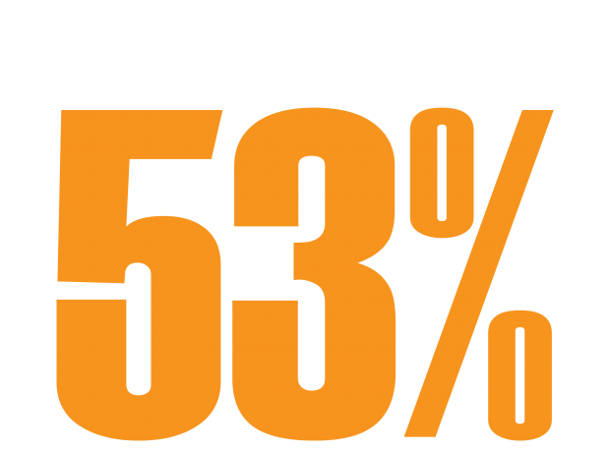
Performance Improvement

Slide 42
Drilling Down Data
Version 2.0

Slide 43
Clinic Viral Load Suppression

Slide 44
Panel Suppression Rates

Slide 45
Panel Comparison
Intervention Panel
All Other Provider Panels
More likely to be African American (67%)
Higher percentage of female clients (37%)
Higher percentage below 100% federal poverty level (FPL) (46%)
Twice as likely to have unstable housing (14%)
Less likely to be Gay, Bisexual, or other Men who have Sex with Men (MSM) (36%)
Less likely to be African American (43%)
Lower percentage of female clients (24%)
Lower percentage below 100% FPL (33%)
Predominantly stable housing (92%)
More likely to be Gay, Bisexual, or other MSM (51%)

Slide 46
Drilling Down the Data (Client-Level)
Identify Area of Interest
Determine Measure(s)
Convene Multi-disciplinary Team
Hypothesize about Key Drivers of Outcome
Create a List of Potential Interventions
Prioritize and Select Intervention
Implement Intervention
Evaluate Outcome
Additional or Different Strategies

Slide 47
Suppression in Intervention Panel

Slide 48
Change in Viral Load Suppression Rates

Slide 49
Questions or Comments

Slide 50
Resources
National Clinician
Consultation Center
http://nccc.ucsf.edu/
HIV Management
Perinatal HIV
HIV PrEP
HIV PEP line
HCV Management
Substance Use Management
Present on ECHO
https://hsc.unm.edu/scaetc/programs-services/echo.html​
AETC National HIV Curriculum https://aidsetc.org/nhc
AETC National Coordinating
Resource Center https://targethiv.org/library/aetc-national-coordinating-resource-center-0
HIVMA Resource Directory https://www.hivma.org/globalassets/ektron-import/hivma/hivma-resource-directory.pdf
Additional trainings scaetcecho@salud.unm.edu
www.scaetc.org
Notes:
IDEA Platform: Infectious Diseases Education & Assessment. https://idea.medicine.uw.edu/
AETC National HIV Curriculum: 6 core modules for self study; regularly updated; CME, CNE
Hepatitis C Online Curriculum: https://www.hepatitisc.uw.edu/
Hepatitis B Online Curriculum: https://www.hepatitisb.uw.edu/
National STD Curriculum: https://www.std.uw.edu/
National HIV PrEP Curriculum: https://www.hivprep.uw.edu/

