Slide 1
Beyond Viral Suppression: How Addressing Mental Health Directly Reduces Morbidity and Mortality in People with HIV
Francine Cournos, MD (she/hers)
Co-Principal Investigator | NECA AETC
Professor of Clinical Psychiatry | Columbia University
Notes:
Version date_02/2024
Target audience: clinical members of the healthcare team

Slide 2
Conflict of Interest Disclosure Statement
Speaker has nothing to disclose
This program is supported by the Health Resources and Services Administration (HRSA) of the U.S. Department of Health and Human Services (HHS) as part of an award totaling $4,205,743 with 0% financed with non-governmental sources. The contents are those of the author(s) and do not necessarily represent the official views of, nor does mention of trade names, commercial practices, or organizations imply an endorsement by HRSA, HHS, or the U.S. Government. For more information, please visit HRSA.gov. Any trade/brand names for products mentioned during this presentation are for training and identification purposes only.

Slide 3
Unconscious Bias Disclosure
SCAETC recognizes that language is constantly evolving, and while we make every effort to avoid bias and stigmatizing terms, we acknowledge that unintentional lapses may occur in our presentations.
We value your feedback and encourage you to share any concerns related to language, images, or concepts that may be offensive or stigmatizing.
Your input will help us refine and improve our presentations, ensuring they remain inclusive and respectful to participants.

Slide 4
Learning Objectives
Identify 3 causes of death that are direct outcomes of poor mental health among people with HIV (PWH).
Describe various life-threatening emergencies that present as changes in mental status among PWH.
Address mental health problems as a component of all HIV-related prevention, care, and treatment approaches.

Slide 5
Poll Question
In 2021, the leading cause of death in the U.S. among PWH ages 25-44 was HIV disease, listed as the cause of mortality in 33% of those who died. The next most common cause of death in PWH ages 25-44 was:
A. cancer
B. heart disease
C. overdose
D. COVID-19
E. hepatitis C

Slide 6
Mental Health Problems Impact HIV in Every Domain
As a risk factor for acquiring HIV infection. Key populations at risk for HIV in the U.S. have higher rates of pre-existing mental health problems when compared to the general U.S. population.
As an outcome of being newly diagnosed with HIV infection and managing the associated stressors.
As a co-morbidity of HIV infection (rates of mental illness increase as the number of medical illnesses increases).
As a cause of morbidity and mortality in people with or at risk for HIV infection.

Slide 7
Expanding Our Current HIV-related Approaches to Mental Health
We have unduly focused on addressing mental health among PWH as a means of achieving improved viral load suppression
This narrow focus is a poor match for many of our HIV goals
Preventing new HIV infections (VLS is not relevant)
Promoting the well being of people aging with HIV (many of whom have achieved VLS and feel their other problems are undertreated)
Narrowing the morbidity and mortality gap between people with or at risk for HIV and the general population
Reference
VLS = viral load suppression

Slide 8
Two Major Challenges to Addressing Mental Disorders among PWH in the US
Structural problems
Lack of universal access to basic health care
Unaddressed adverse social determinants of health
Shortage of HCPs with expertise to treat mental disorders
Siloed care
Fragmented access to medical records
Poor reimbursement, etc.
Stigma
A persistent barrier to the prevention, diagnosis, and treatment of mental illness
Stigma pervades HCP training
Most clinicians do not feel empowered to assess and treat people who behave in unusual ways
HCPs = health care providers
Notes:
This talk acknowledges these incredibly important challenges but does not elaborate on them

Slide 9
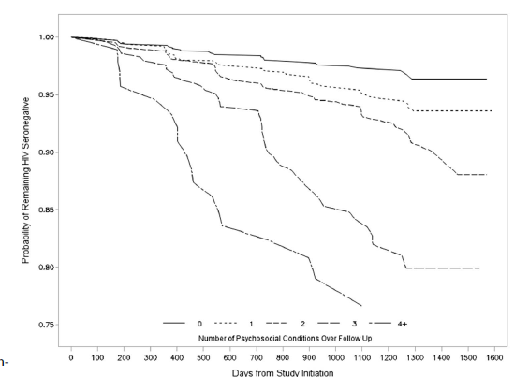
Mental Health Conditions Often Precede HIV Infection
4295 MSM from 6 US cities
Co-occurring conditions
Depressive symptoms
Heavy alcohol use
Stimulant use
Poly drug use
Childhood sexual abuse
0 conditions
1 condition
Probability of remaining HIV seronegative
2 conditions
3 conditions
Probability of staying HIV negative goes down as # of conditions increases
4+ conditions
MSM = men who have sex with men. Source: Mimiaga et al. JAIDS, 2015

Slide 10
Mental Wellness vs. Mental Illness
Focus on “mental wellness” increased dramatically in the US during early responses to the COVID-19 pandemic due to universally high levels of distress. Both clinicians and their patients were under duress and suggestions for mental wellness were widely disseminated.
Mental wellness is the province of all HCPs because it’s linked to all cause morbidity and mortality and affects whether patients engage in care and adhere to recommended medical advice. It cannot be viewed as the province of behavioral health care providers.

Slide 11
Brain and Body Cannot Be Separated
We know this, and it’s reflected in such everyday expressions as “chills ran down my spine”; “my heart skipped a beat”; “I had a knot in my stomach”
The brain is the master organ that pilots the body and records and responds to the body’s feedback
With an estimated 86 billion neurons and 100 trillion synaptic connections, the mind resides within the brain and is utterly unique from one person to another
Brain death = death

Slide 12
Addressing Mental Health is Part of Every HCP’s Job
Non-adherence is the #1 cause of treatment failure in medical care
Unhealthy behaviors are the #1 cause of premature death
Clinicians without mental health training are on the front lines of addressing adherence and unhealthy behaviors
There’s much that must be (and is) done to address these medical problems without specialized mental health training

Slide 13
Care for Minimal/Mild Distress Symptoms
Health care providers can review advice and/or employ behavioral change strategies with their patients focused on wellness and self care:
Identifying and utilizing pre-existing coping strategies
Reaching out to social supports
Physical activity, exercise, eating and sleeping well
Mindfulness and meditation, listening to music
Productive and pleasurable activities
Reducing negative stimuli (interpersonal conflict, excessive exposure to distressing news)
Caution about using alcohol and other substances for coping

Slide 14
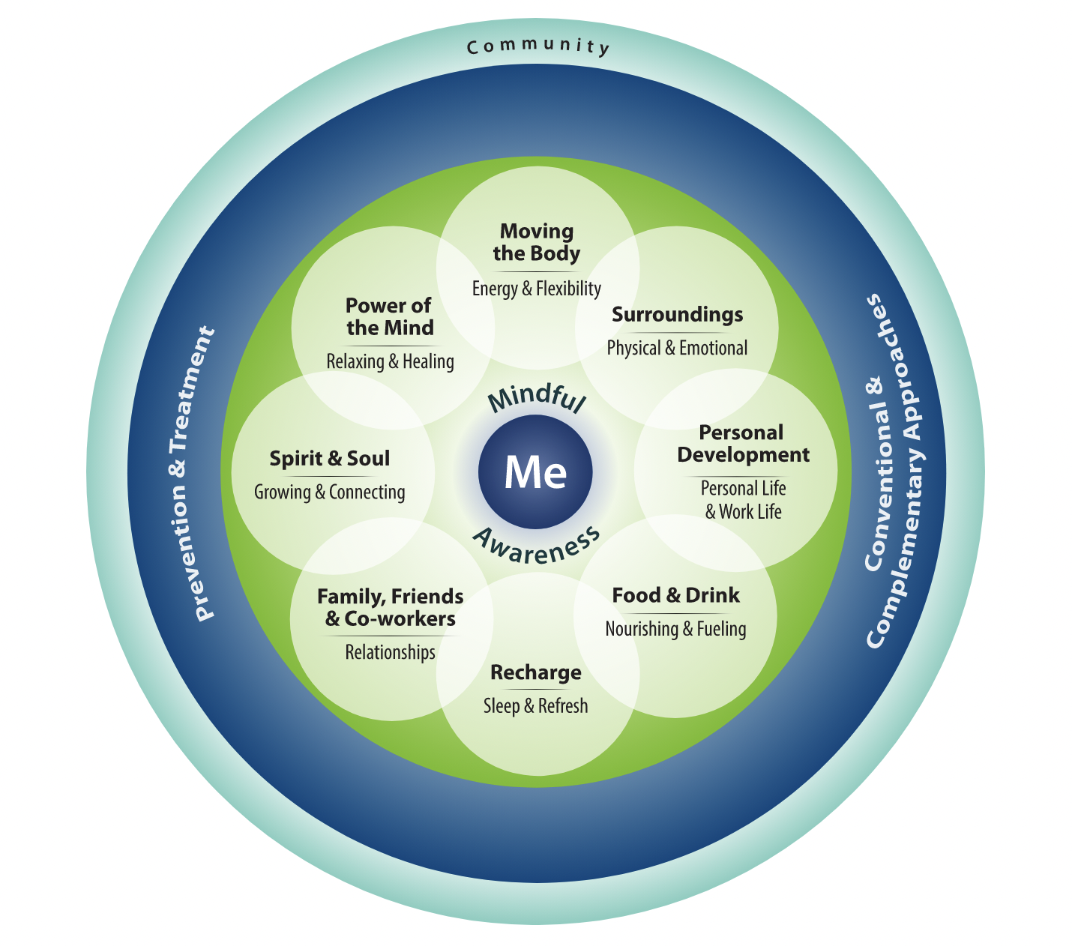
Veteran’s Administration (VA) Whole Health Approach
https://www.va.gov/WHOLEHEALTH/circle-of-health/index.asp
Notes:
https://www.va.gov/WHOLEHEALTH/circle-of-health/index.asp

Slide 15
VA’s Whole Health Library Excellent Resources for Clinicians
Grief Reactions
Practicing Mindful Awareness
Prescribing Movement
Tai Chi and Qi Gong
Yoga
Diaphragmatic Breathing
Guided Imagery
Progressive Muscle Relaxation
Therapeutic Journaling
Reducing Relapse Risk
https://www.va.gov/WHOLEHEALTHLIBRARY/tools/index.asp

Slide 16
VA’s Whole Health Library Excellent Handouts for Patients
Introduction to Mindful Awareness
Breathing and Health
Change Your Habits to Sleep Better
Compassion Practice
Coping with Grief Following a Death
Create a Gratitude Practice
Mindful Eating
Seated Meditation
https://www.va.gov/WHOLEHEALTH/veteran-handouts/index.asp

Slide 17
Prioritize Referrals- Distinguish Between Mental Distress & Mental Disorders
Mental Distress
Can occur in response to any adversity
Often does not meet criteria for a psychiatric diagnosis or require specialized mental health interventions
Often responds well to supportive strategies
Mental Disorders
Usually cause either persistent severe subjective distress and/or functional impairment
Meet recognized diagnostic criteria (ICD, DSM)
Call for evidenced informed mental health interventions such as medication & psychotherapy
ICD = International Classification of Diseases, DSM = Diagnostic and Statistical Manual

Slide 18
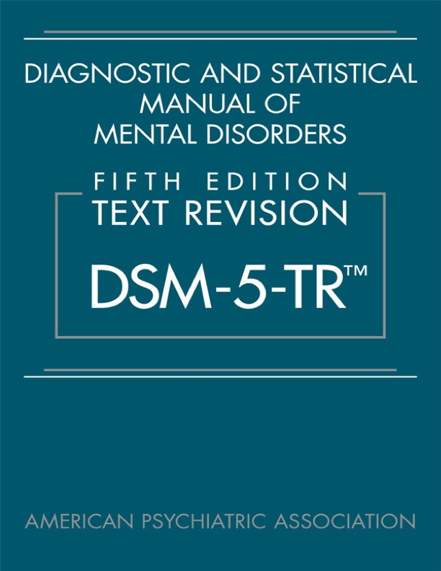
The Diagnostic and Statistical Manual of Mental Disorders
1,050 pages, describes all “mental disorders” including substance-related, neurocognitive, and every other recognized mental disorder
Created separate categories for:
depressive disorders
bipolar & related disorders
anxiety disorders
obsessive-compulsive & related disorders
trauma- and stressor-related disorders

Slide 19
Despite Our Elaborate Diagnostic Criteria, the Brain is a Mystery
The New York Times Carl Zimmer October 12, 2023:
The Human Brain Has a Dizzying Array of Mystery Cells
Researchers identified some 3,300 types of brain cells, an order of magnitude more than previously known, & have only a dim notion of what most of them do.
See October 2023 issues of Science Advances, Science, and Science Translational Medicine for a collection of studies that provide a breakthrough in our understanding of brain cell types in humans & nonhuman primates. Studies performed through a large international consortium brought together through the National Institutes of Health’s Brain Research through Advancing Innovative Neurotechnologies (BRAIN) Initiative Cell Census Network (BICCN), launched in 2017 with the aim of developing a comprehensive description of brain cell types.

Slide 20
Challenges Posed by Mysteries of Brain
Most mental disorders cannot be identified by biological tests
With little in the way of objective measures, people often receive multiple psychiatric diagnoses that change over time
Psychotropic meds are not targeted. They treat symptoms across diagnostic criteria & cause undesirable side effects throughout body.
Finding efficacious & tolerable meds often requires trial and error
This is frustrating, given incredible biological progress in HIV: PEP, PrEP, HIV testing, viral load, resistance mutations, CD4 cell counts, etc.
PEP = Post Exposure Prophylaxis, PrEP = Pre-Exposure Prophylaxis

Slide 21
Advocating for Mental Health Services
Despite the frustrations of diagnosing and treating mental illnesses, we must persist, since these illnesses are among the most painful and disabling of all medical conditions
Dante Alighieri captured this agony in his description of depression in the Divine Comedy: “I did not die, and yet I lost life’s breath”
However, advocating for mental health services based on disability has been less effective than advocating for such services based on mortality
Therefore, this presentation emphasizes the mortality of mental illness

Slide 22
Mental Health Problems Directly Linked to Mortality Among PWH
Unrecognized delirium caused by life-threatening medical conditions
Tobacco smoking
Suicide
Intentional and unintentional overdoses
Accidental death
End-organ damage due to alcohol and other substance use

Slide 23
Unrecognized Delirium
Delirium is a sudden change in mental status, often accompanied by agitation and confusion
Delirium signals potentially life-threatening conditions such as organ failure (liver, kidney, heart, lungs), low blood sugar, severe infection, poisoning, etc.
Identifying and treating delirium can prevent death
Every health care provider must achieve comfort in being with and assessing agitated and/or confused people
Referral of disturbed patients to mental health care can be fatal

Slide 24
Changing Patterns of Mortality Among PWH
HIV as a cause of death among PWH has been declining
Other causes of death among PWH are expanding, and many of them are directly or linked to mental health problems
These include:
Intentional or accidental overdose, including suicide
Intentional or accidental injury, including suicide
Damage to bodily organs caused by alcohol and other substance use (including liver failure, cardiovascular disease, and cancer of the lung and gastrointestinal tract)

Slide 25
Early Mortality Attributable to Smoking is Greater than Early Mortality Attributable to HIV Among PWH (Denmark Study)
Conducted from 1995-2010 in Denmark where HIV care and treatment is free
2,921 PWH ages 35 or over were followed for 14,281 person-years and compared to controls
Number of life-years lost in association with HIV was 5.1
The number of life-years lost in association with smoking among people with HIV was 12.3
Helleberg M et al. Clin Infect Dis. 2013;56:727-734

Slide 26
Kaplan-Meier curve showing survival by age, stratified by HIV and smoking status for all study subjects
Helleberg M et al. Clin Infect Dis. 2013;56:727-734

Slide 27
Suicidal Behavior Among PWH
A scoping review of suicidal behavior among PWH was published by Yi-Tseng Tsai, et al., in PLOS One, on March 20, 2023
93 studies from 49 countries published between 1988 and 2021 were included in the review. There were 53 U.S. studies.
Globally, most common risk factors for suicidal behavior were depression, substance use, low quality of life, and low social support
Looking only at studies conducted in the U.S. between 1997 and 2021 (after effective antiretroviral treatment for HIV was available), the authors found:
An attempted suicide rate of 17% to 21%
A completed suicide rate of 7.6% to 8.7%

Slide 28
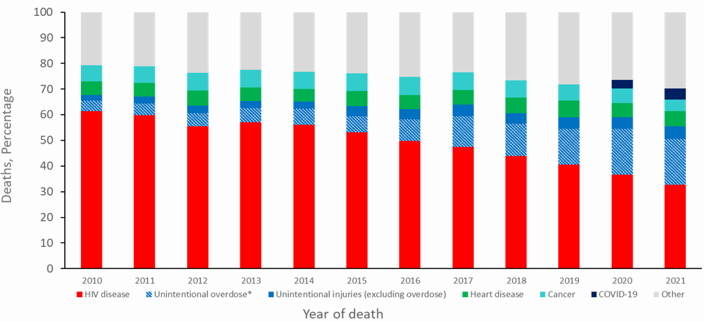
Overdose as a Growing Cause of Death among Persons Aged 25–44 Years with Diagnosed HIV Infection, 2010–2021—United States
Note: Data on cause of death among persons with diagnosed HIV infection are from the National HIV Surveillance System (NHSS) and presented for persons with a known cause of death.
Notes:
Note: Data on cause of death among persons with diagnosed HIV infection are from the National HIV Surveillance System (NHSS) and presented for persons with a known cause of death.

Slide 29
Treatment of Mental Disorders in Primary/HIV Care
Very wide range of treatments for mental disorders
Multiple psychotherapies
Multiple psychotropic medications and psychoactive agents
Multiple brain stimulation treatments
Some need to be routinely integrated into HIV/primary care. Examples include:
Motivational interviewing
Brief behavioral health interventions that require limited training
Medications for opioid addiction and tobacco smoking
Participation in the prescription of other psychotropic medications

Slide 30
Summary
Among PWH, death from HIV disease is diminishing, while death due to the direct effects of mental disorders are increasing
There is a great need to better integrate mental health and substance use services into HIV prevention, care, and treatment
Addressing mental wellness and mental illness is the job of every health care provider who works with people with or at risk for HIV

Slide 31
Poll Question
In 2021, the leading cause of death in the U.S. among PWH ages 25-44 was HIV disease, listed as the cause of mortality in 33% of those who died. The next most common cause of death in PWH ages 25-44 was:
A. cancer
B. heart disease
C. overdose
D. COVID-19
E. hepatitis C

Slide 32
Suggested Readings
AIDS Education and Training Center Program. National HIV curriculum. https://aidsetc.org/nhc. See automatic mental health and substance use screening tool calculators and chapters 5 and 6.
https://www.va.gov/WHOLEHEALTH/circle-of-health/index.asp
mhGAP Intervention Guide for mental, neurological and substance use disorders in non-specialized health settings. Version 2.0, World Health Organization, 24 June 2019
Fuenmayor A, Cournos F. Addressing depressive disorders among people with HIV, Topics in Antiviral Medicine, 2022 April/May 30(2): 454-463
Cournos F, McKinnon K, Wainberg M. (2017) Epidemiology of psychiatric disorders associated with HIV and AIDS, in Comprehensive Textbook of AIDS Psychiatry, Second Edition, Cohen MA, Gorman JM (eds.), New York, Oxford University, pp 29-45

Slide 33
Resources
National Clinician
Consultation Center
http://nccc.ucsf.edu/
HIV Management
Perinatal HIV
HIV PrEP
HIV PEP line
HCV Management
Substance Use Management
Present on ECHO
https://hsc.unm.edu/scaetc/programs-services/echo.html​
AETC National HIV Curriculum https://aidsetc.org/nhc
AETC National Coordinating
Resource Center https://targethiv.org/library/aetc-national-coordinating-resource-center-0
HIVMA Resource Directory https://www.hivma.org/globalassets/ektron-import/hivma/hivma-resource-directory.pdf
Additional trainings scaetcecho@salud.unm.edu
www.scaetc.org
Notes:
IDEA Platform: Infectious Diseases Education & Assessment. https://idea.medicine.uw.edu/
AETC National HIV Curriculum: 6 core modules for self study; regularly updated; CME, CNE
Hepatitis C Online Curriculum: https://www.hepatitisc.uw.edu/
Hepatitis B Online Curriculum: https://www.hepatitisb.uw.edu/
National STD Curriculum: https://www.std.uw.edu/
https://www.hivprep.uw.edu/

Slide 35
Question and Answer Session

