Slide 1


New Mexico Innovations and Plans for HIV,
Hepatitis C Virus, & Sexually Transmitted Infections
Laine Snow
HIV, STD and Hepatitis Section Manager
and
Janine Waters
STD Program Manager
1
Notes:
Version date_03 2024
Target audience: members of the healthcare team who care for people in New Mexico

Slide 2
Conflict of Interest Disclosure Statement
Speakers have nothing to disclose.
This program is supported by the Health Resources and Services Administration (HRSA) of the U.S. Department of Health and Human Services (HHS) as part of an award totaling $4,205,743 with 0% financed with non-governmental sources. The contents are those of the author(s) and do not necessarily represent the official views of, nor does mention of trade names, commercial practices, or organizations imply an endorsement by HRSA, HHS, or the U.S. Government. For more information, please visit HRSA.gov. Any trade/brand names for products mentioned during this presentation are for training and identification purposes only.
2

Slide 3

Learning Objectives
Identify the core elements of New Mexico’s Integrated HIV Plan for 2022 – 2026.
Identify New Mexico innovations and plan for Hepatitis C Virus (HCV) elimination.
Understand key data and trends on reportable sexually transmitted infections (STIs), particularly early and congenital syphilis.
Recognize strategies, innovations, and plans to turn the curve on syphilis in New Mexico.

Slide 4
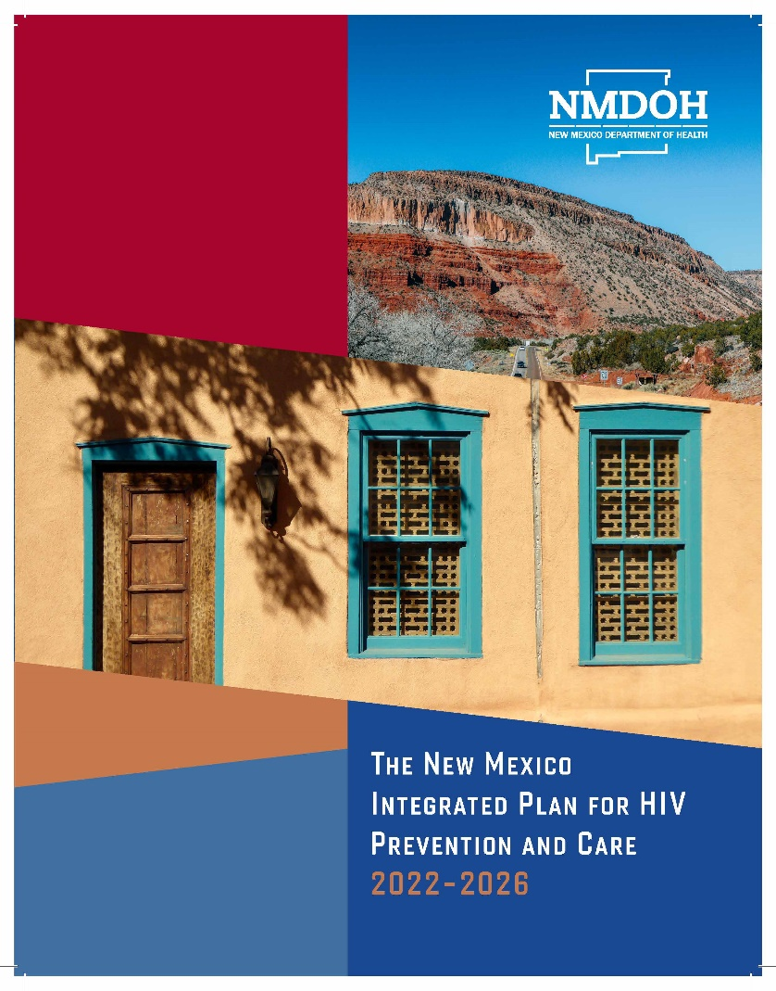
New Mexico Integrated Plan for HIV Prevention and Care: Year 1 Update

Slide 5
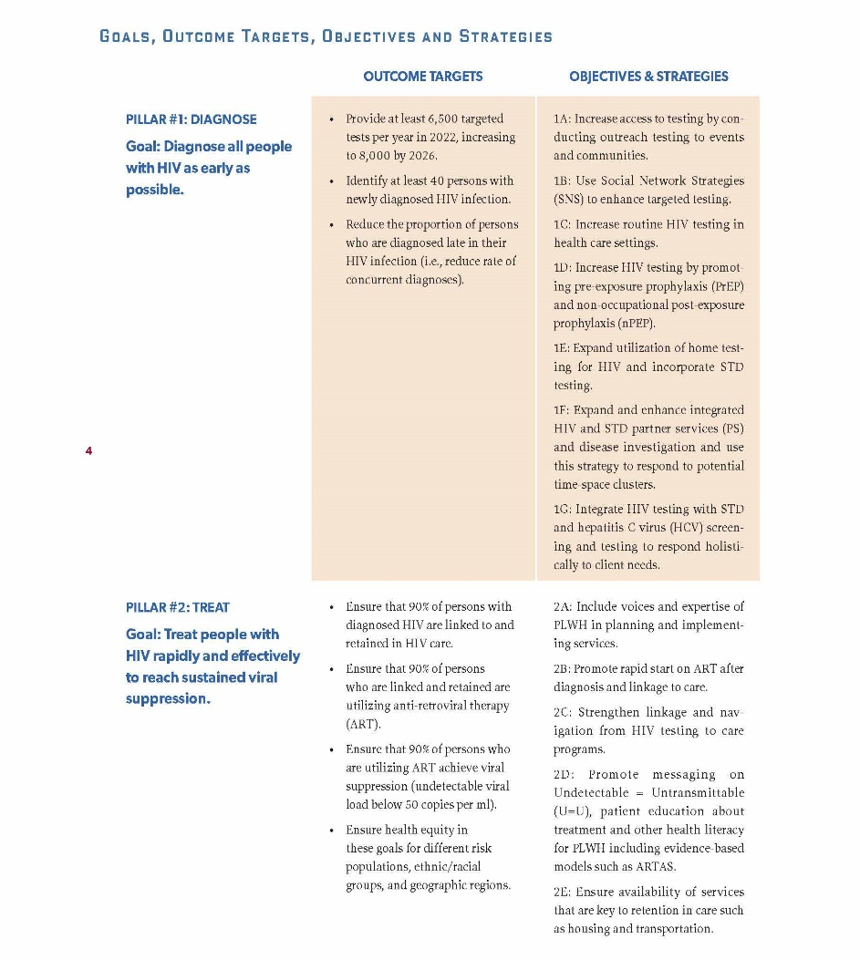
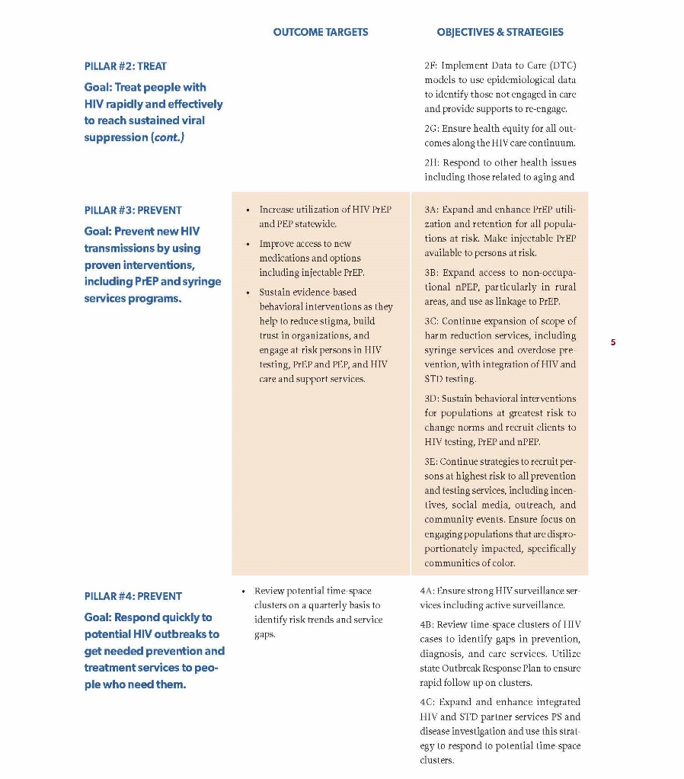

New Mexico Integrated Plan for HIV Prevention and Care: Goals

Slide 6
Pillar # 1: Diagnose
Goal: Diagnose all people with HIV (PWH) as early as possible.
Outcome Targets:
Provide at least 6,500 targeted tests per year in 2022 and increasing to 8,000 in 2026.
Identify at least 40 persons with newly diagnosed HIV infection.
Reduce the proportion of persons who are diagnosed late in their HIV Infection.
Notes:
U.S. Ending the HIV Epidemic Pillars https://www.cdc.gov/endhiv/about-ehe/index.html
4 pillars/key strategies: (1) diagnose, (2) treat, (3) prevent, (4) respond

Slide 7
Outcome Targets:
Provided 9,706 valid HIV tests
Priority Populations
Men Who Have Sex with Men (MSM) - 2,811
Sex with Male - 2,527
Sex with Female - 2,964
Sex with a Transgender person - 300
Persons engaged in injection drug use - 569
44 positive
31 newly diagnosed, 13 previously diagnosed

Slide 8
Rates of New HIV Diagnoses, by Race Ethnicity
New Mexico, 2015-2022
Data Sources: cases, eHARS application, electronic lab repository. Population estimates: NM IBIS, University of New Mexico Global Population Studies (GPS) Program *rates for 2022 use population estimates for 2021. ** due to lower numbers of Blacks and Asians in NM, rates are more affected by any variation year to year.

Slide 9
Rates of New HIV Diagnoses, by Birth Sex
New Mexico, 2015-2022
Data Sources: NM Electronic HIV & AIDS Reporting System (eHARS) database. HIV Surveillance & Epidemiology Program, Infectious Disease Epidemiology Bureau, Epidemiology & Response Division, New Mexico Department of Health. Population estimates: NM IBIS, University of New Mexico Global Population Studies (GPS) Program. *rates for 2022 use population estimates for 2021.

Slide 10
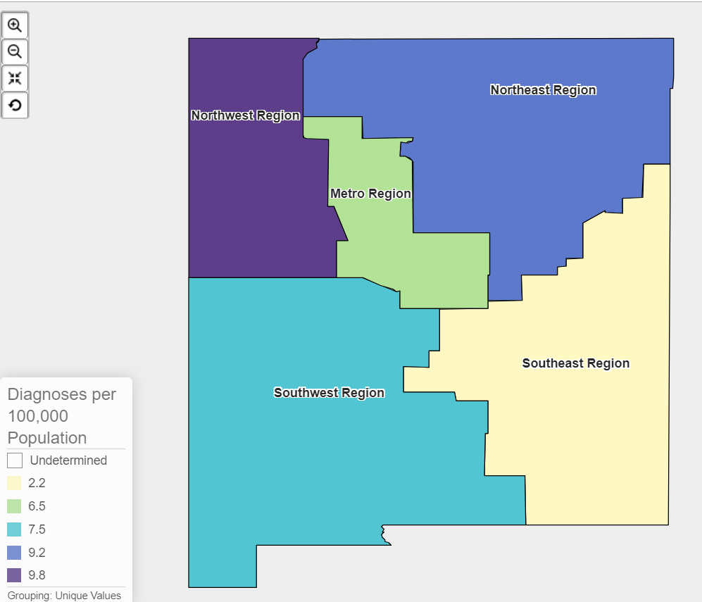
People newly with HIV (all stages) 13 years and older by Public Health Region, 2012-2021

Slide 11
Pillar # 2 Treat
Goal: Treat people with HIV rapidly and effectively to reach sustained viral suppression
Outcome Targets:
Ensure that 90% of persons diagnosed with HIV and are linked to and retained in care.
Ensure that 90% of persons who are linked and retained in care are utilizing anti-retroviral therapy (ART).
Ensure that 90% of persons who are utilizing ART achieve viral suppression.
Ensure health equity in these goals for different risk populations, ethnic/racial groups and geographic regions.
Notes:
U.S. Ending the HIV Epidemic Pillars https://www.cdc.gov/endhiv/about-ehe/index.html
4 pillars/key strategies: (1) diagnose, (2) treat, (3) prevent, (4) respond

Slide 12
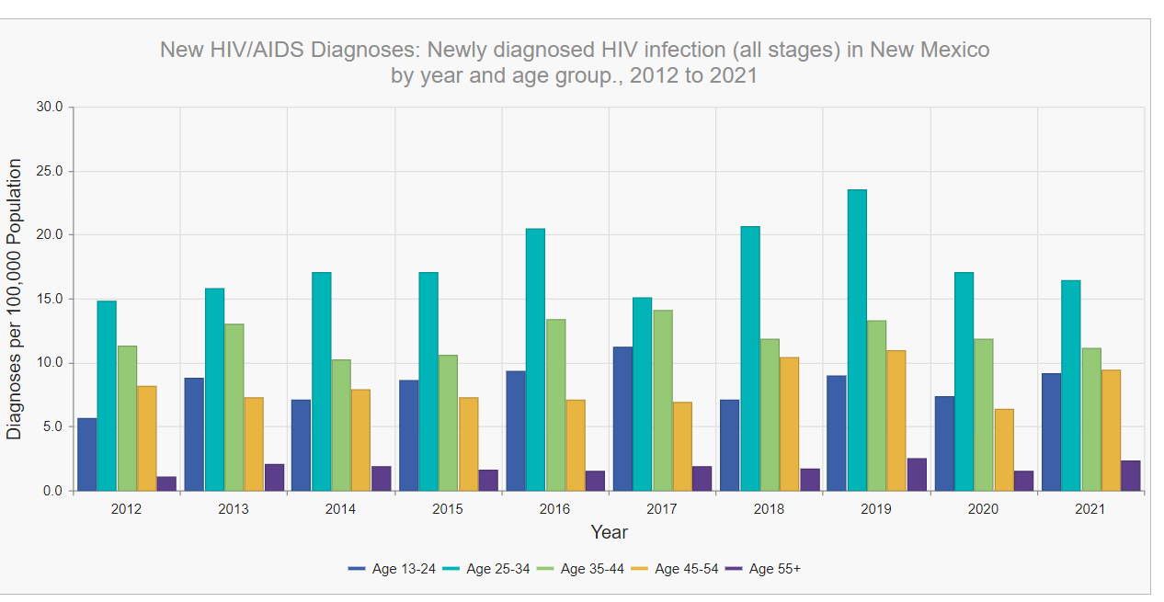
Data Sources: NM Electronic HIV & AIDS Reporting System (eHARS) database. HIV Surveillance & Epidemiology Program, Infectious Disease Epidemiology Bureau, Epidemiology & Response Division, New Mexico Department of Health. NM IBIS: Complete Health Indicator Report of HIV-1 Infections (Newly Diagnosed, All Stages) in Individuals aged 13 and above, New Mexico

Slide 13
Linkage to Care, diagnosed 2021

Slide 14
HIV Care Continuum, 2021-2023
Notes:
HIV Care Continuum
https://www.cdc.gov/hiv/pdf/library/factsheets/cdc-hiv-care-continuum.pdf
https://www.hiv.gov/federal-response/policies-issues/hiv-aids-care-continuum

Slide 15
Pillar # 3: Prevent
Goal: Prevent new HIV transmissions by using proven interventions, including pre-exposure prophylaxis (PrEP) and syringe service programs
Outcome Targets:
Increase utilization of HIV PrEP and post-exposure prophylaxis (PEP) statewide.
Improve access to new medications and options including injectable PrEP.
Sustain evidence-based behavioral interventions as they help reduce stigma, build trust in organizations, and engage in at-risk persons in HIV testing, PrEP and PEP and HIV care and support.
Notes:
U.S. Ending the HIV Epidemic Pillars https://www.cdc.gov/endhiv/about-ehe/index.html
4 pillars/key strategies: (1) diagnose, (2) treat, (3) prevent, (4) respond

Slide 16

New Mexico’s Innovations in
HIV Prevention & Care Services
Project SPICY Numbers
Cal. Year | Prescriptions | Unduplicated Clients
2019 | 227 | 82
2020 | 674 | 144
2021 | 763 | 148
2022 | 1,627 | 311
2023 | 2,707 | 419
Total | 5,998 | 720 (duplicated figure over 5-yr period)
Ages of clients enrolled in SPICY(%). Note: Majority fall within highest risk age group (25-34) of new HIV infections in NM.

Slide 17
https://aidsvu.org/local-data/united-states/west/new-mexico/#prep
Notes:
Number of PrEP users, 2022: 1980
Rate of PrEP users per 100,000 population, 2022

Slide 18



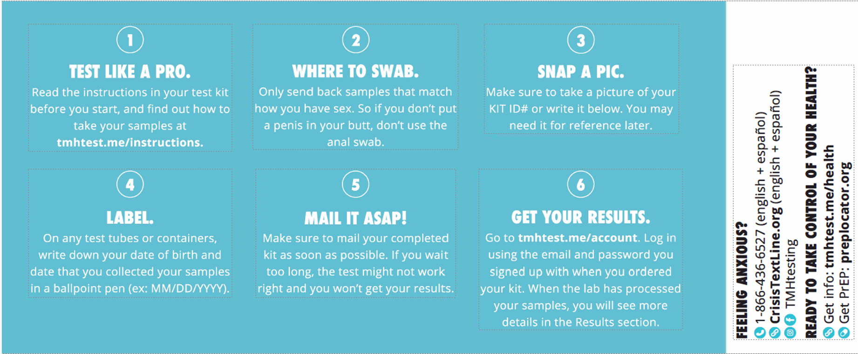
TAKEMEHOME
Notes:
TakeMeHome is a partnership between Building Healthy Online Communities (based at Springboard HealthLab), NASTAD, and Emory University. TakeMeHome enables state and local health departments to offer free in-home sexual health tests to eligible community members. HIV, sexually transmitted infection (STI), & PrEP tests.

Slide 19
TAKEMEHOME
As of January 2024, 182 test kits ordered from various regions in the state
  By 3/2024, 53 (40%) have been submitted
Of the test kits ordered, 79 were assigned male at birth and 103 assigned female at birth
  Gender identity information is not provided.
Age ranges vary from 21-79 yo
Positives for Gonorrhoeae (GC) or Chlamydia (CT) are provided with information to contact the DOH Help line.
Positives for syphilis or HIV are provided the same information and will receive a call from HIV Prevention or Surveillance, to help coordinate, answer questions, and ensure treatment delivery.
Notes:
TakeMeHome is a partnership between Building Healthy Online Communities (based at Springboard HealthLab), NASTAD, and Emory University. TakeMeHome enables state and local health departments to offer free in-home sexual health tests to eligible community members. HIV, sexually transmitted infection (STI), & PrEP tests.

Slide 20
Pillar #4: Respond
Goal: Respond quickly to potential HIV Outbreaks to get needed prevention and treatment services to people who need them.
Outcome Targets:
Review potential time-space clusters on a quarterly basis to identify risk trends and service gaps.
Notes:
U.S. Ending the HIV Epidemic Pillars https://www.cdc.gov/endhiv/about-ehe/index.html
4 pillars/key strategies: (1) diagnose, (2) treat, (3) prevent, (4) respond

Slide 21
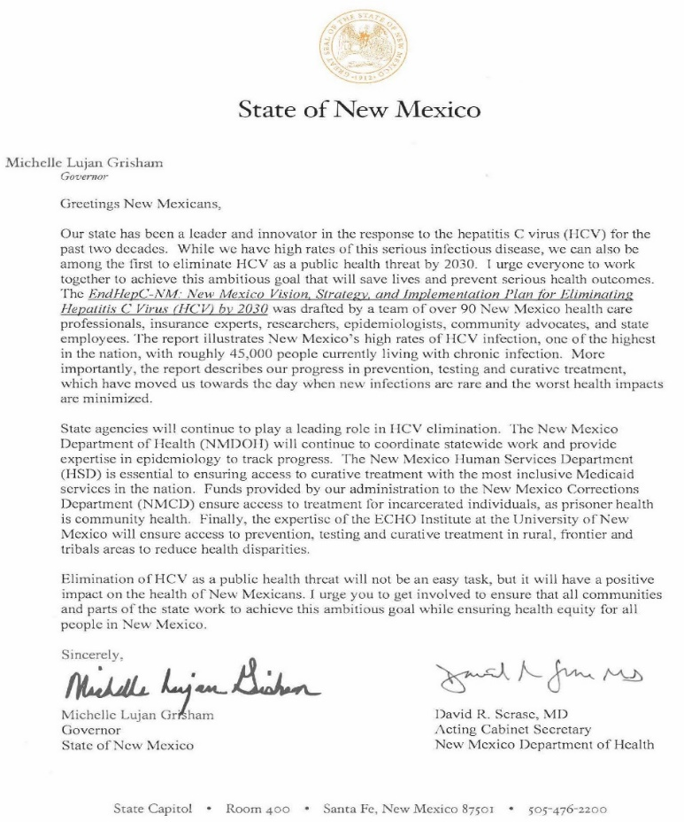

EndHepC-NM: Eliminating HCV by 2030

Slide 22
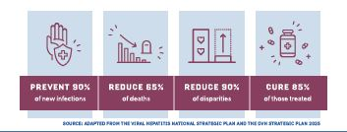
EndHepC-NM: Eliminating HCV by 2030
Goals
Prevent new infections
Diagnose cases of hepatitis C virus (HCV)
Expand access to curative treatment
Reduce health disparities
Enhance HCV surveillance data and utilize data to direct public health action
Ensure engagement of impacted communities.

Slide 23
EndHepC-NM: Eliminating HCV by 2030
Targets
Globally, ~71 million people are chronically infected with HCV.
In 2020, approximately 3.1% of the NM population (63,823 persons) have had exposure to HCV infection.
YEAR | Total Cases
2021 | 25,800
2022 | 23,350
2023 | 20,900
2024 | 18,450
2025 | 16,000
2026 | 13,550
2027 | 11,100
2028 | 8,650
2029 | 6,200
2030 | 3,750
2031 | 1,300
Corrections
Medical Cures
Medicare
4500 in 2021, declining to 1800 by 2030
New/Re- Infections
Private Insurance
Deaths
3,000 in 2021, declining by 90% to 300 in 2030
Uninsured
200 per year
Cleared Infection
Medicaid
750 cases, declining to 75 cases by 2030 (25% of yearly infection rate)

Slide 24
Project HEAT
Hepatitis Elimination Access to Treatment
2022 – 2023
Total patients: 19
Sustained virologic response (SVR) achieved: 9
Treatment in progress: 4
Lost to follow up: 1
Deceased: 1
Cleared without treatment: 1
New patient/treatment not yet started: 3

Slide 25
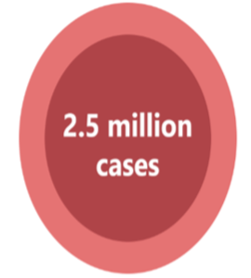
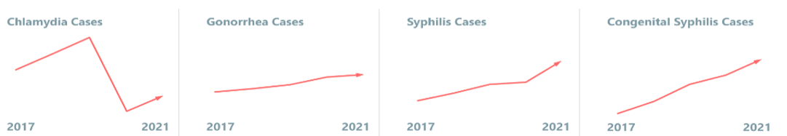
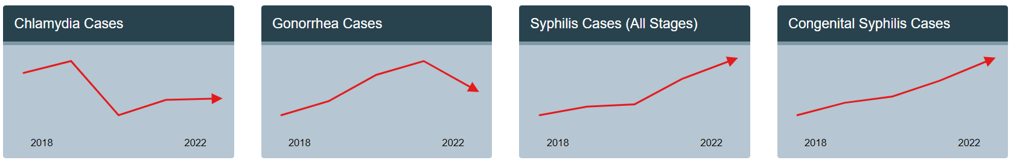
STI Data Overview: National 2021 vs. 2022

Slide 26
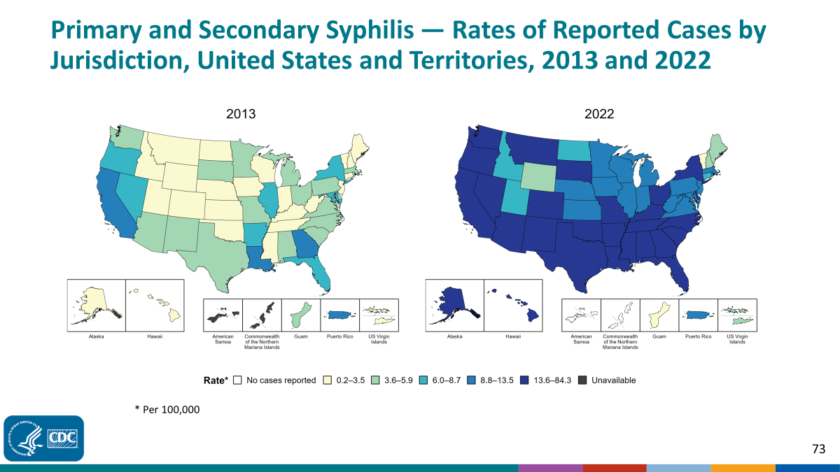
Syphilis Data Overview
www.cdc.gov

Slide 27
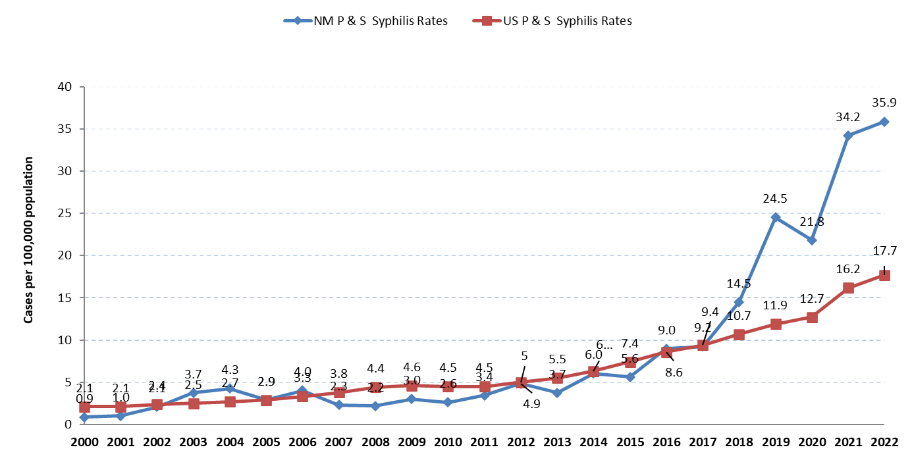
Syphilis Data Overview: Rates of Primary & Secondary Syphilis New Mexico & US, 2000 - 2022
https://www.nmhealth.org/about/phd/idb/std/data/

Slide 28
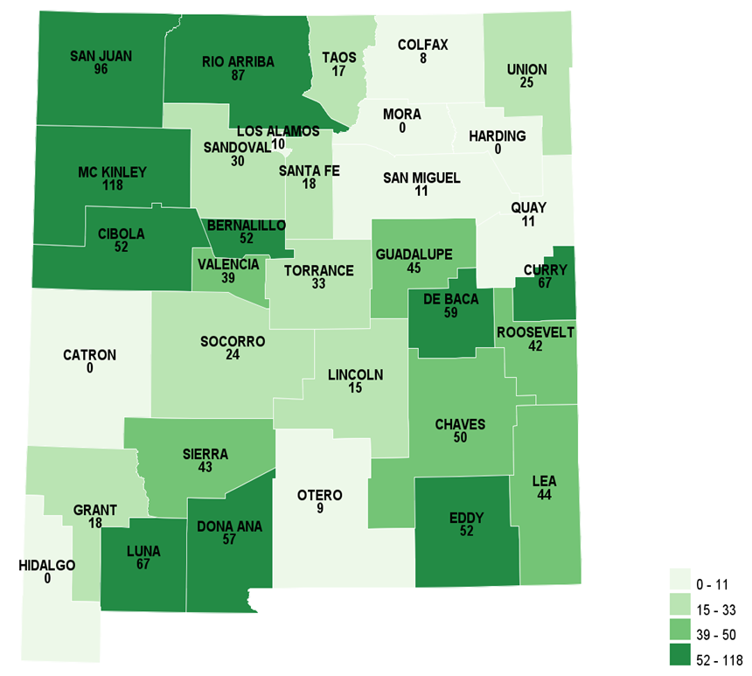
Primary, Secondary, and Early Latent Syphilis Rates per 100,000 population
by County, New Mexico, 2022

Slide 29
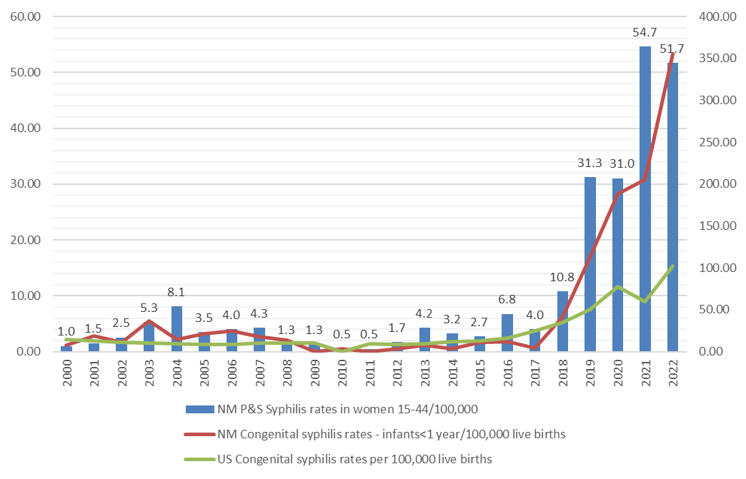
Congenital Syphilis rates in infants<1 year, per 100,000 live births, NM & US, and Primary & Secondary Syphilis rates in women aged 15 - 44, per 100,000 population NM, 2000 - 2022

Slide 30
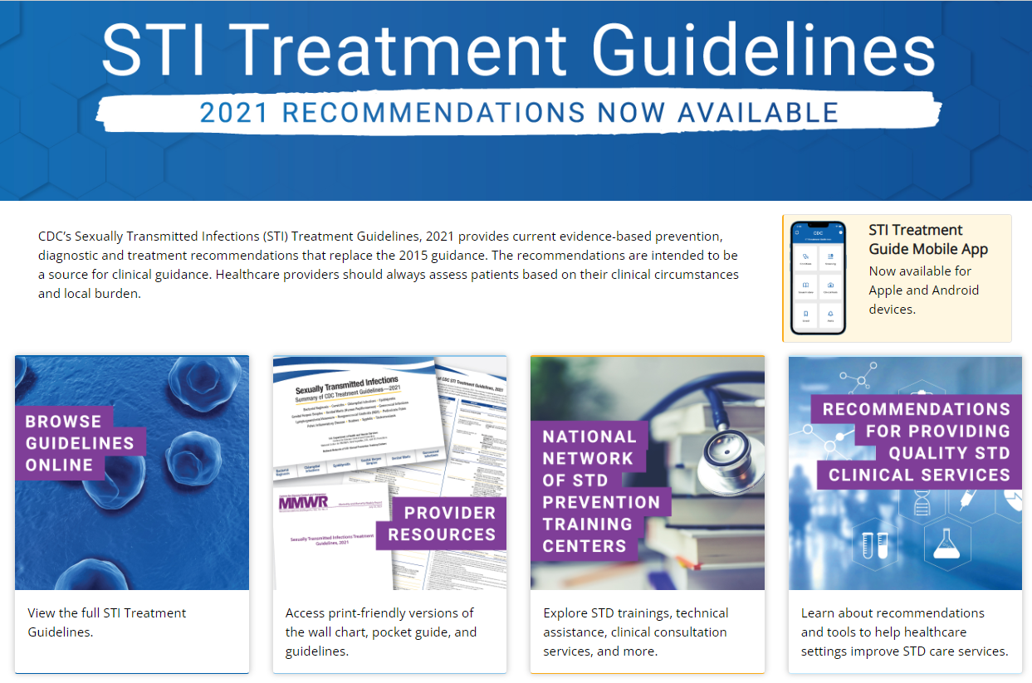
STD Program Plans and Innovations:
Education on New CDC 2021 Treatment Guidelines
STI = sexually transmitted infection, www.cdc.gov

Slide 31

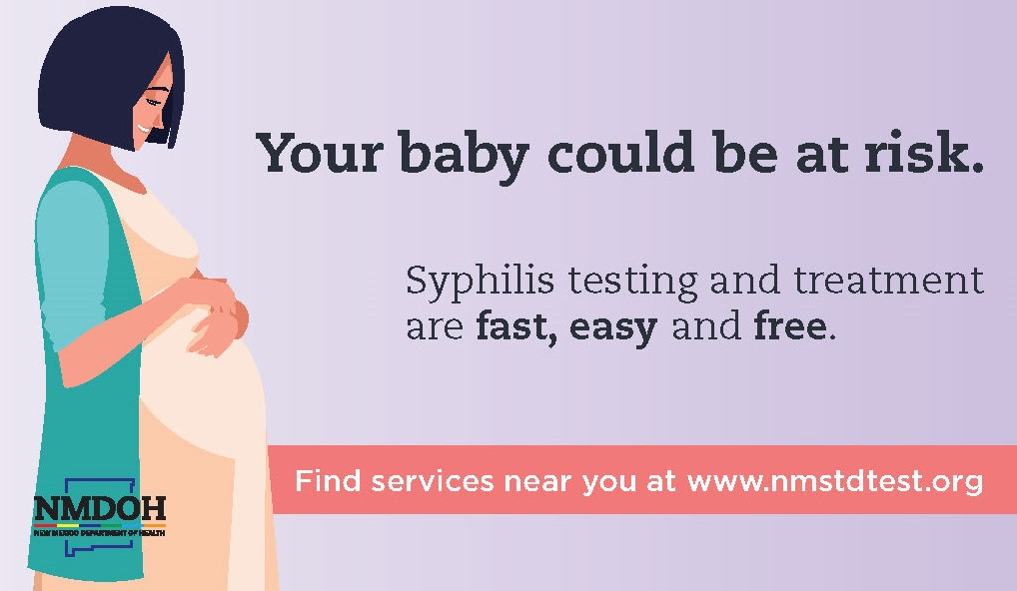
STD Program Plans and Innovations:
Outreach, Education and Marketing

Slide 32


Slide 33
Updated Public Health Order
NEW MEXICO DEPARTMENT OF HEALTH, OCTOBER 16, 2023
Increase Syphilis Testing in All Pregnant People and Adults Ages 18 to 50 to Prevent Congenital Syphilis
Testing for syphilis is required:
Adults aged 18 to 50 should be tested for syphilis at least once in the next 12 months
Syphilis testing for all pregnant people in their 1st trimester
Syphilis testing for all pregnant people in their 3rd trimester (28-32 weeks)
At delivery
Urgent care/ED if no prior prenatal care
In care of intrauterine fetal demise at any gestational age
Pregnant individuals in correctional facilities
https://www.nmhealth.org/publication/view/rules/8505/

Slide 34
S
T
R
I
V
E
Screen
Treat
Report
Investigate
View
Engage
Expanded guidelines
Law/policy–public health order, OSI outreach
Harm reduction sites
Home testing options
340B in corrections
Urgent care/emergency departments
Reproductive hotline
DOXY PrEP/PEP
Online reporting
Use data for action/prioritization
Disease Intervention Specialists (DIS)
Innovative technology
Healthy Babies
Culturally Specific – Tribal
Humor/Old School
Community
Health Care Providers
Reduce disparities
To Eliminate Syphilis

Slide 35
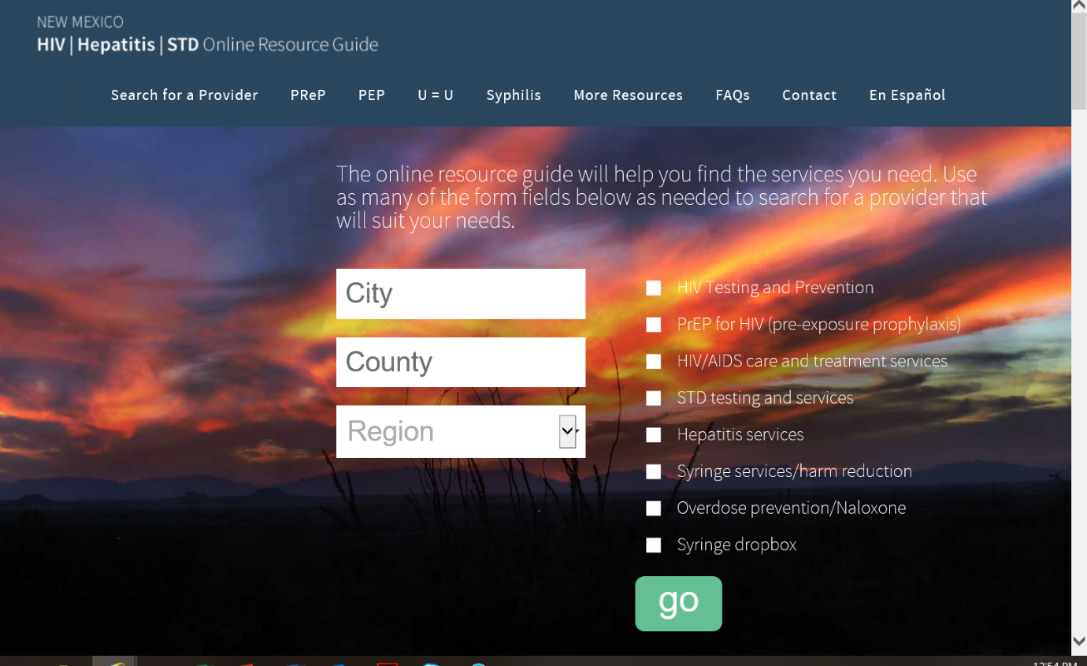
Key resources:
Statewide resource guide website https://nmhivguide.org/

Slide 36
NMDOH Contact Information
Laine Snow
HIV, STD and Hepatitis Section Manager
Public Health Division
New Mexico Department of Health (NMDOH)
LaineM.Snow@doh.nm.gov
(505) 479-1187
Janine Waters
STD Program Manager
Public Health Division
New Mexico Department of Health (NMDOH)
Janine.Waters@doh.nm.gov
(505) 490-1066
Rena Manning, PhD
HIV and Hepatitis Program Manager
Epidemiology & Response Division
New Mexico Department of Health
Rena.Manning@doh.nm.gov

Slide 37
AETC Resources
National Clinician Consultation Center http://nccc.ucsf.edu/
  HIV Management
  Perinatal HIV
  HIV PrEP
  HIV PEP line
  HCV Management
  Substance Use Management
Present case on ECHO hivecho@salud.unm.edu
National STD Curriculum https://www.std.uw.edu/
National PrEP Curriculum https://www.hivprep.uw.edu/
National HIV Curriculum https://aidsetc.org/nhc
HIVMA Resource Directory https://www.hivma.org/globalassets/ektron-import/hivma/hivma-resource-directory.pdf
Additional trainings scaetcecho@salud.unm.edu
www.scaetc.org

