Slide 1
More than Pushing Pills: Black AIDS Activism in the Bay Area
Antoine S. Johnson, Ph.D.
Postdoctoral Fellow, Department of the History of Medicine, Johns Hopkins University
February 22, 2024

Slide 2
Disclaimer
The views and opinions expressed in this presentation are not necessarily those of the Pacific AIDS Education & Training Center (Pacific AETC) or its eight local partner sites in HRSA Region 9, the Regents of the University of California or its San Francisco campus (UCSF or collectively, University) nor of our funder the Health Resources and Services Administration(HRSA). Neither Pacific AETC, University, HRSA nor any of their officers, board members, agents, employees, students or volunteers make any warranty, express or implied, including the warranties of merchantability and fitness for a particular purpose; nor assume any legal liability or responsibility for the accuracy, completeness or usefulness of information, product or process assessed or described; nor represent that its use would not infringe privately owned rights.
HRSA Acknowledgement Statement The Pacific AETC is supported by the Health Resources and Services Administration (HRSA) of the U.S. Department of Health and Human Services (HHS) as part of an award totaling $4,377,449. The contents are those of the author(s) and do not necessarily represent the official views of, nor an endorsement, by HRSA, HHS, or the U.S. Government. For more information, please visit HRSA.gov.
Trade Name Disclosure Statement Funding for this presentation was made possible by 5 U1OHA29292‐08‐00 from the Human Resources and Services Administration HIV/AIDS Bureau. The views expressed do not necessarily reflect the official policies of the Department of Health and Human Services nor does mention of trade names, commercial practices, or organizations imply endorsement by the U.S. Government. Any trade/brand names for products mentioned during this presentation are for training and identification purposes only.

Slide 3
Image Sources
Unless otherwise noted, all images in this presentation were obtained as part of Dr. Johnson’s research, and permission has been granted to use them for educational purposes.

Slide 4
Learning Objectives
At the completion of this presentation, participants will be able to:
Explain the ways in which structural forces increase and create "at risk" populations and their susceptibility to diseases, including HIV.
Describe how Black organizers implemented multiple approaches of harm reduction and HIV/AIDS care that often times ran counter to biomedicine.
Identify ways in which healthcare workers' efforts have both hindered and helped marginalized groups during the early AIDS crisis.

Slide 5
Polling Question #1
What comes to mind when you think about who is “at risk” to diseases like HIV/AIDS, and what makes them vulnerable to infection? [write freely in the chat]

Slide 6
The Guerrilla Clinic

Slide 7
Syndemic Theory
3 implicit rules of syndemic suffering:
1) The clustering of two diseases exist within a population
2) Contextual and social factors are co-constructed with that cluster
3) The disease cluster creates the potential for adverse disease interaction, increasing the burden of said population
(Mendenhall, 2012)

Slide 8
More than Pushing Pills: Black AIDS Activism in the Bay Area Chapter Outline
Chapter 1: Framing AIDS: Accounting for and Dismissing Black Susceptibility
Chapter 2: Tricking the System: Gloria Lockett and CAL-PEP’s Fight against AIDS
Chapter 3: Dr. Robert C. Scott, AIDS Project of the East Bay, and the Politics of Outreach
Chapter 4: Radical Inclusion: Bishop Yvette Flunder and Black Church Responses to the AIDS Epidemic, 1981-1996
Chapter 5: A Working Coalition: KWIC-FAN and the Radical Vision of Dr. Calu Lester (forthcoming)

Slide 9
Traditional Approaches to Care
BIOMEDICAL
BEHAVIORAL
STRUCTURAL

Slide 10
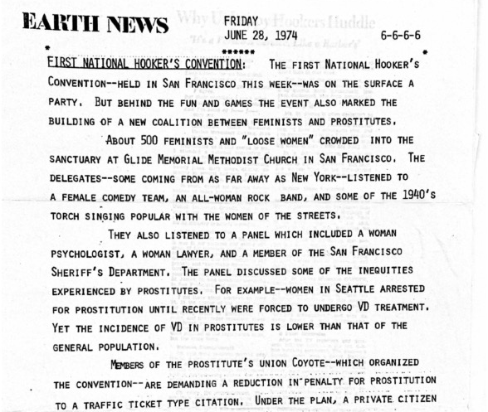
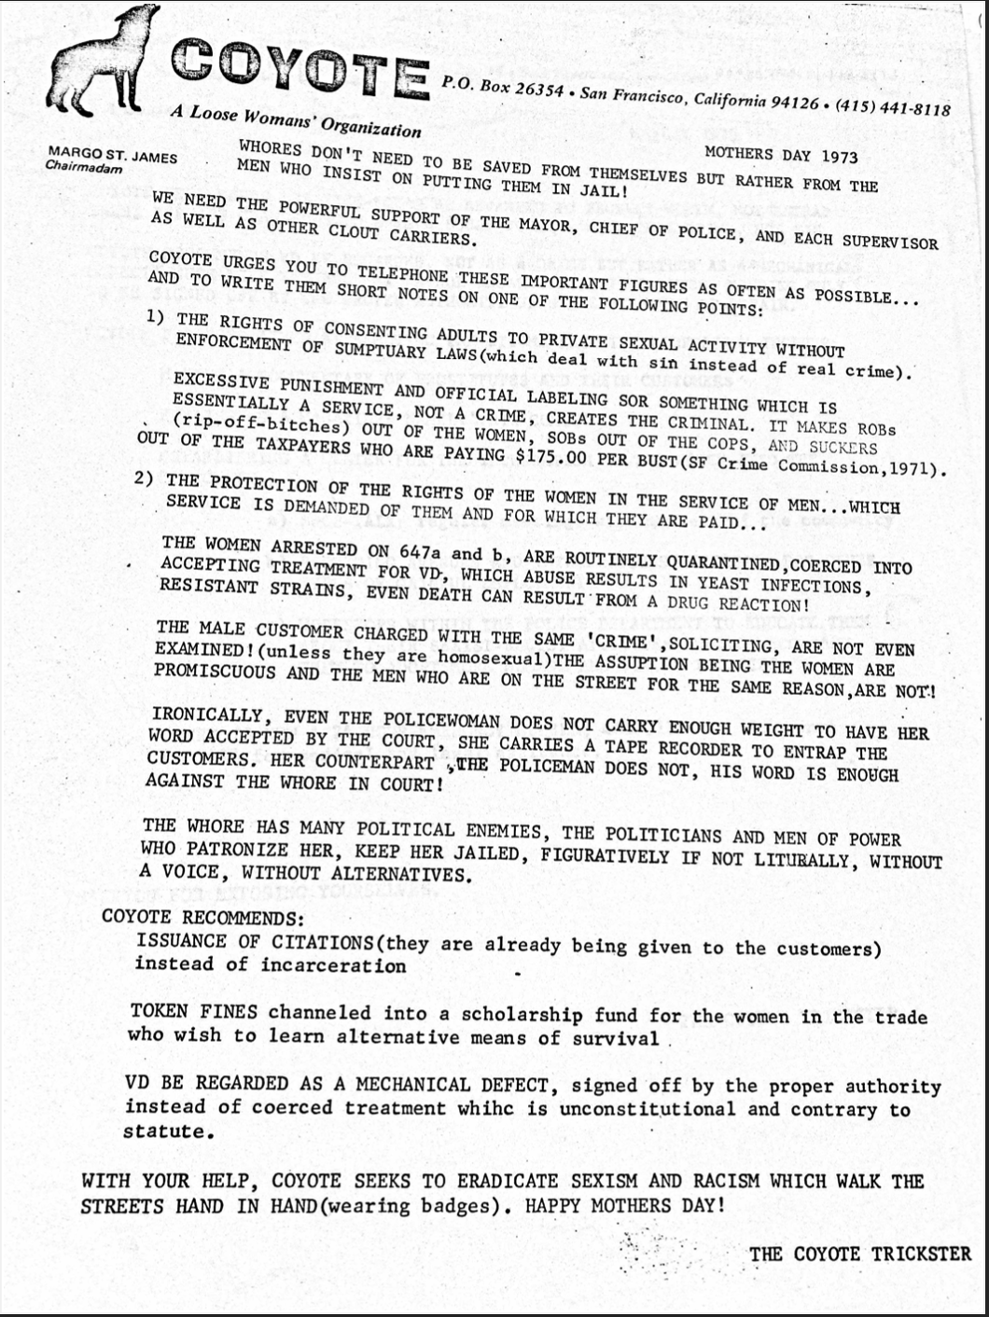
COYOTE (Call Off Your Old Tired Ethics)

Slide 11
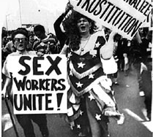
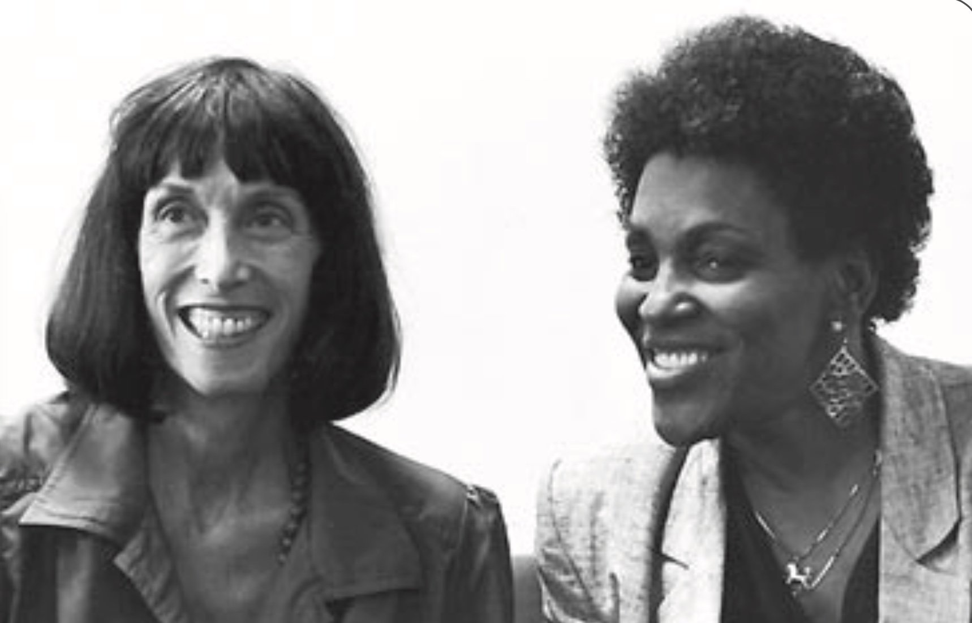
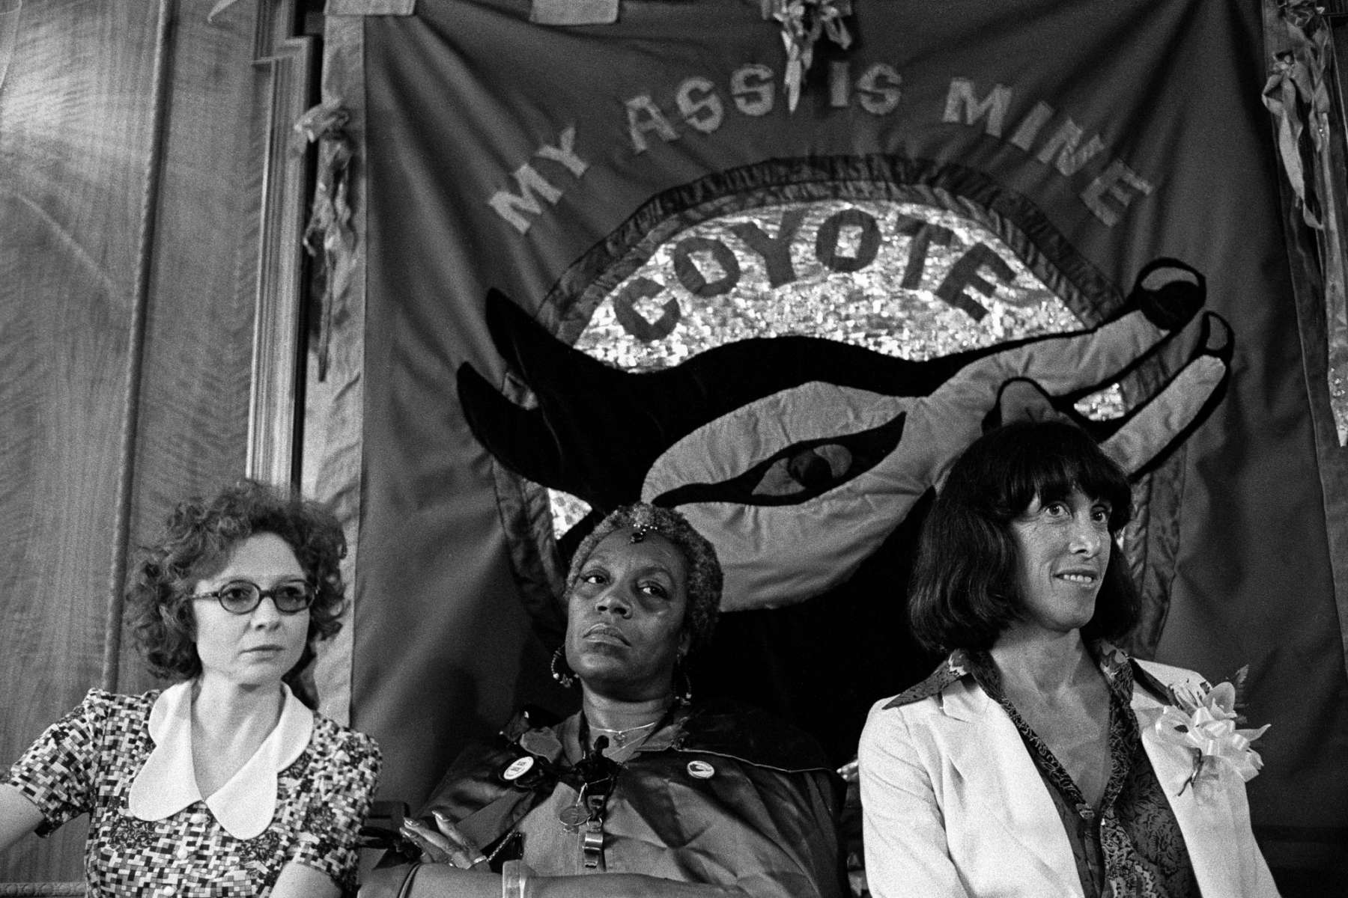
COYOTE & Gloria Lockett

Slide 12
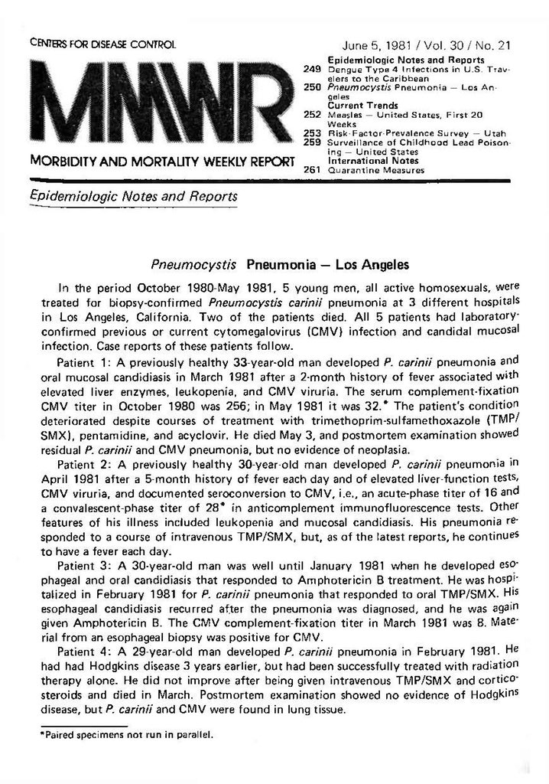
June 5, 1981. CDC MMWR

Slide 13
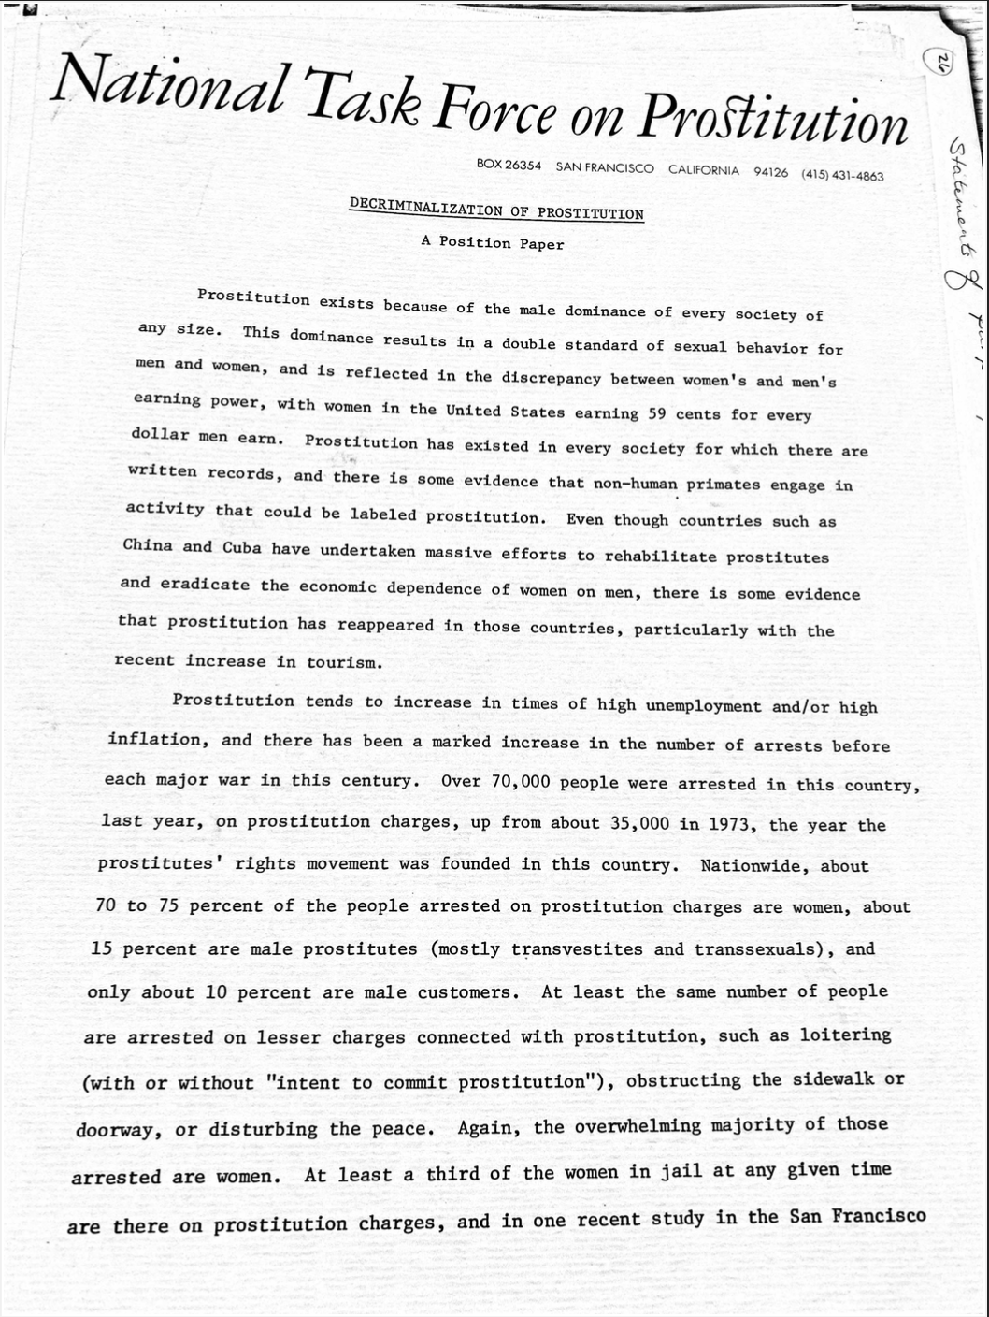
Scapegoating Sex Workers

Slide 14
California Prostitutes Education Project
“Women working indoors are a little less likely to get busted… The Women… are wise enough to know how to take care of themselves; they know that they have to use condoms… Some of the addicted prostitutes live from day to day. They’ll pay their room for one day, and then they have to go out and turn a date before they can get another room. And so, for instance, if it’s 2:00 and they haven’t had a date, and a guy comes along and says, ‘Here, I want to date you, but you can’t use a condom,’ they’re not going to use a condom. And they’ve told us that over and over again. So what CAL-PEP tried to do is work with them by telling them the games that they can play, what they can do to protect themselves and still get the money. We also try to make them understand what the risks are, because some of them really don’t know or haven’t paid enough attention… That’s why we’ve been concentrating on addicted prostitutes because the career prostitutes don’t need us to tell them much.” – Gloria Lockett
(Lockett, 1993)

Slide 15
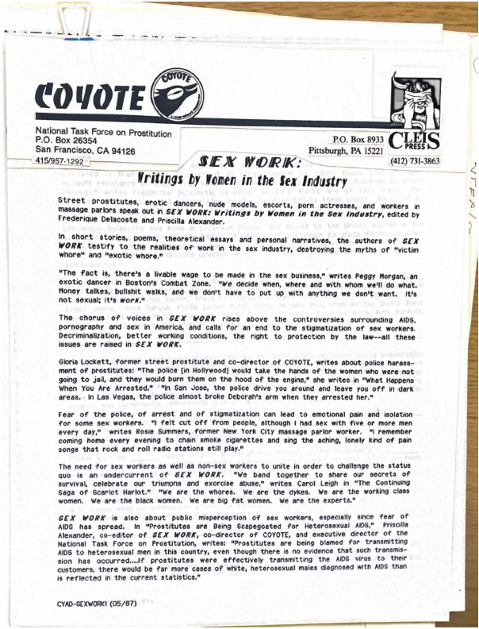
Stigma & Police Surveillance
“In San Jose, the police drive you around and leave you off in dark areas” – Gloria Lockett
(Lockett, 1987)

Slide 16
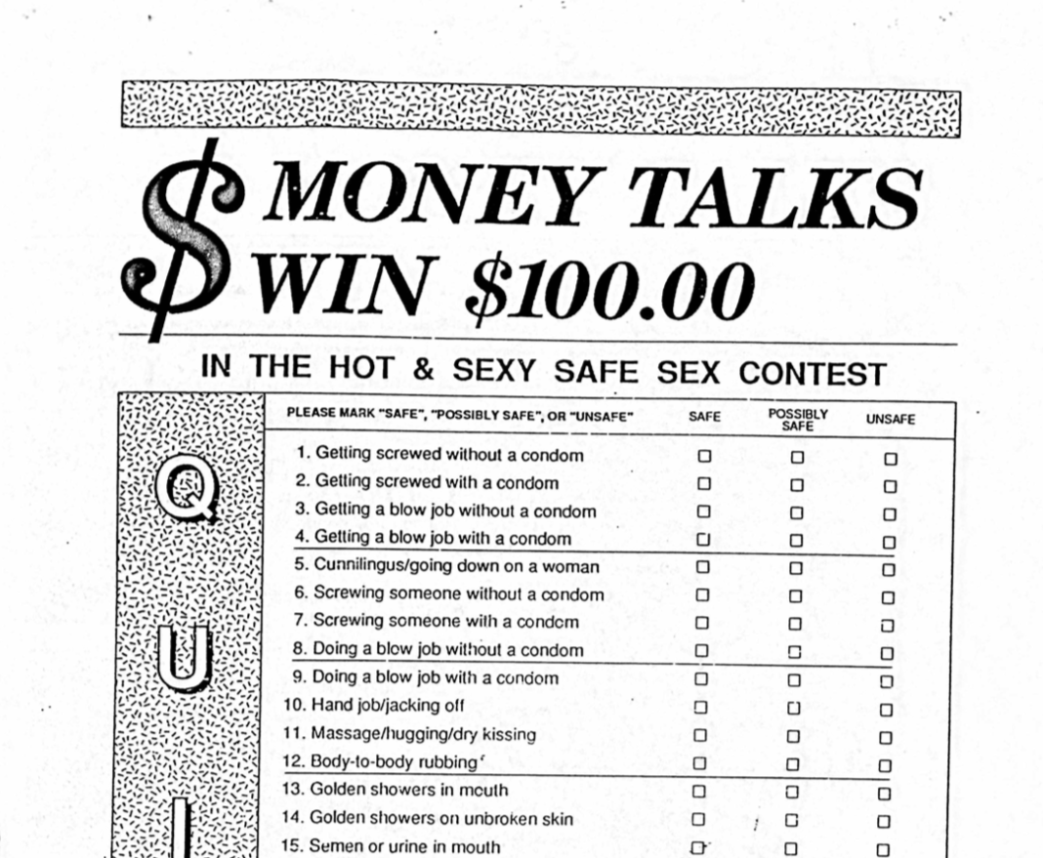
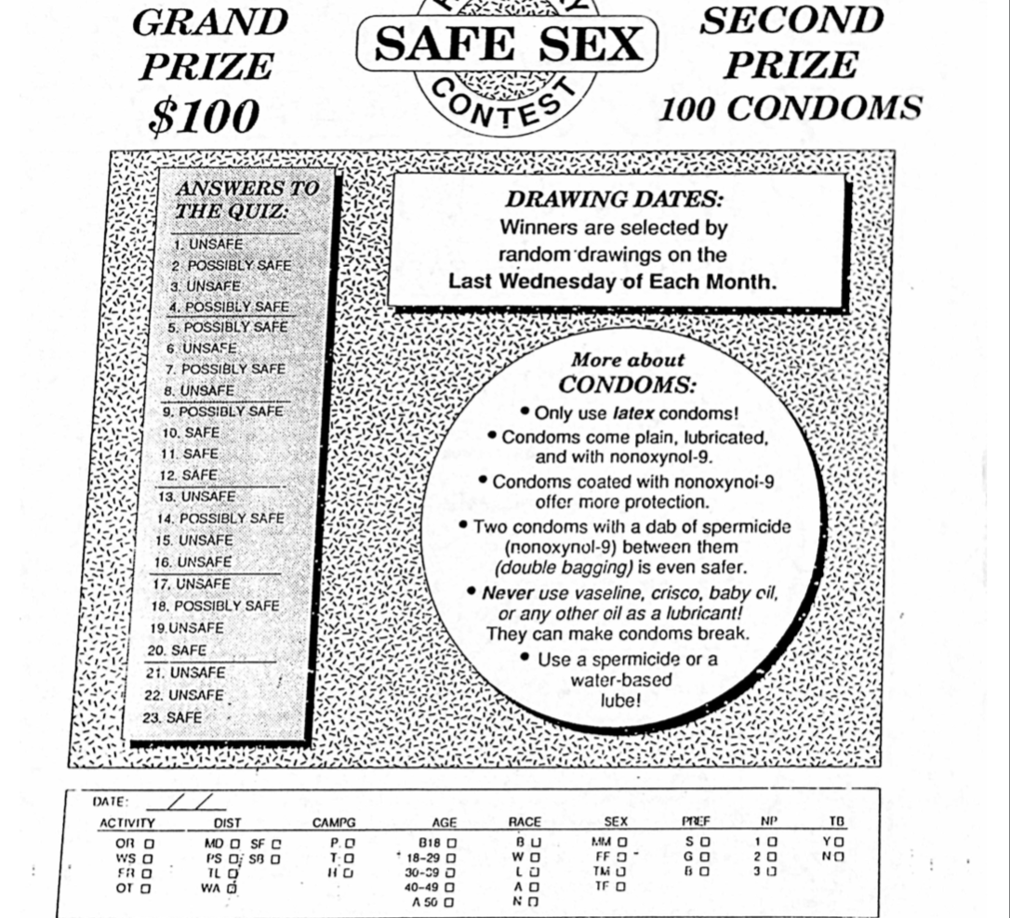
CAL-PEP’s Street Outreach

Slide 17
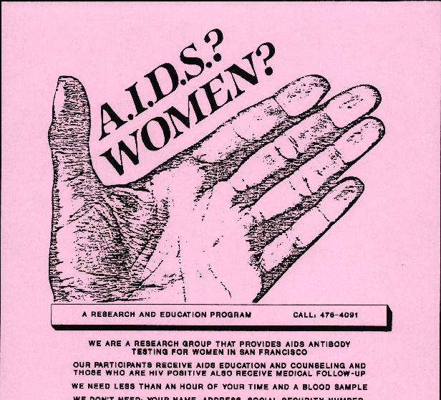
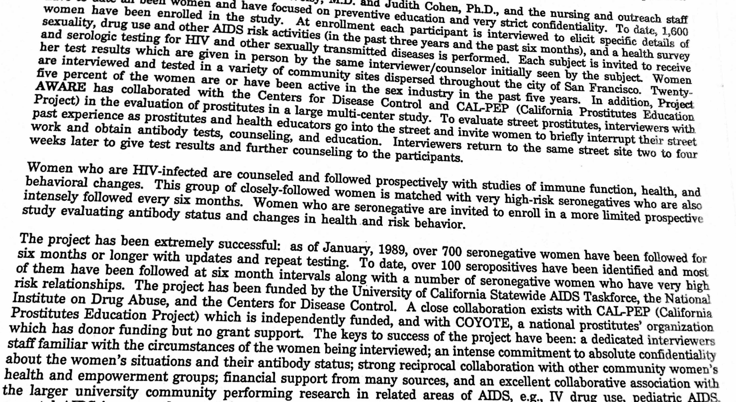
CAL-PEP and Project AWARE
“To evaluate street prostitutes, interviewers with past experience as prostitutes and health educators go into the street and invite women to briefly interrupt their street work and obtain antibody tests, counseling, and education. Interviewers return to the same street site two to four weeks later to give test results and further counseling to the participants.” – AWARE (Wofsy, 1985)

Slide 18
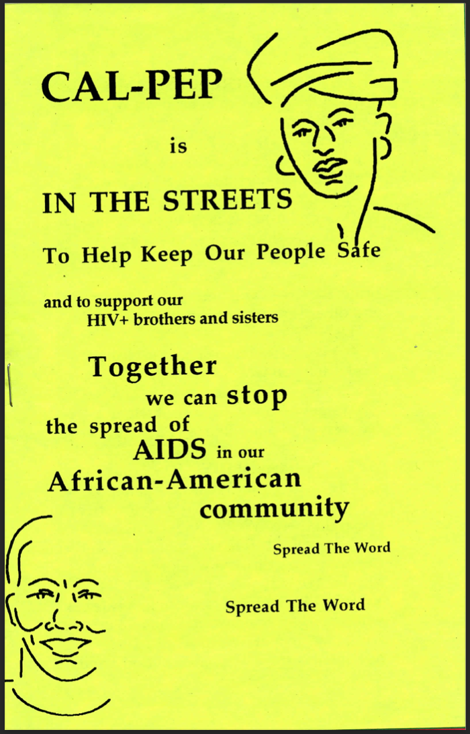
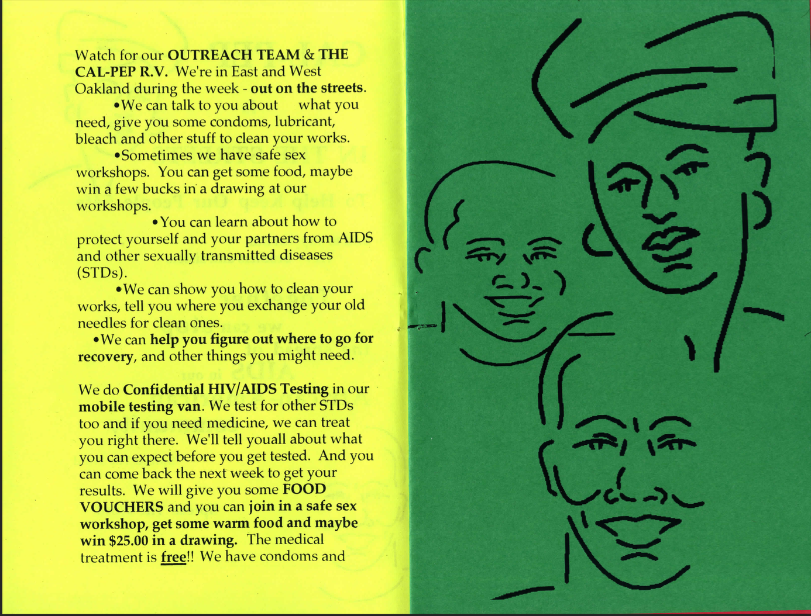
More Street Outreach

Slide 19
Gloria’s Story
“The man took my number, disappeared for a minute, then came back and said, ‘Your test is positive. Next please.’ I said, ‘But how much time do I have?’ He said, ‘Next please. You can make an appointment and come back and talk to me later if you like. “So here I am, told that I’ve tested positive for AIDS and that’s all. I don’t know what to do, where to go and I have no one to talk to. I walked around that way for about a month.” – Gloria
(Cole, 1989)

Slide 20
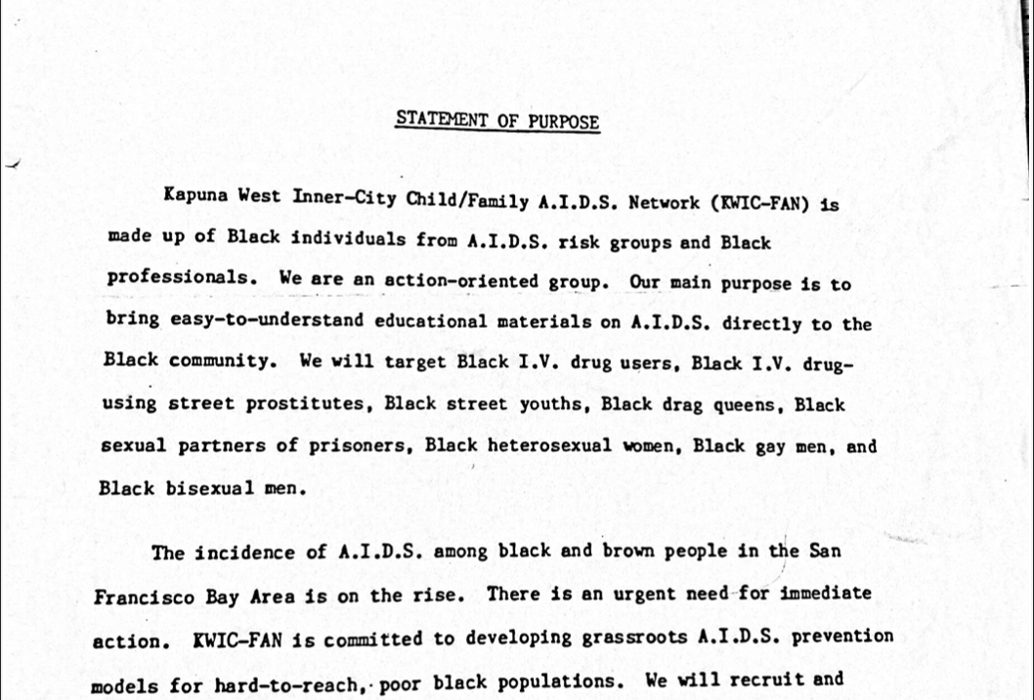
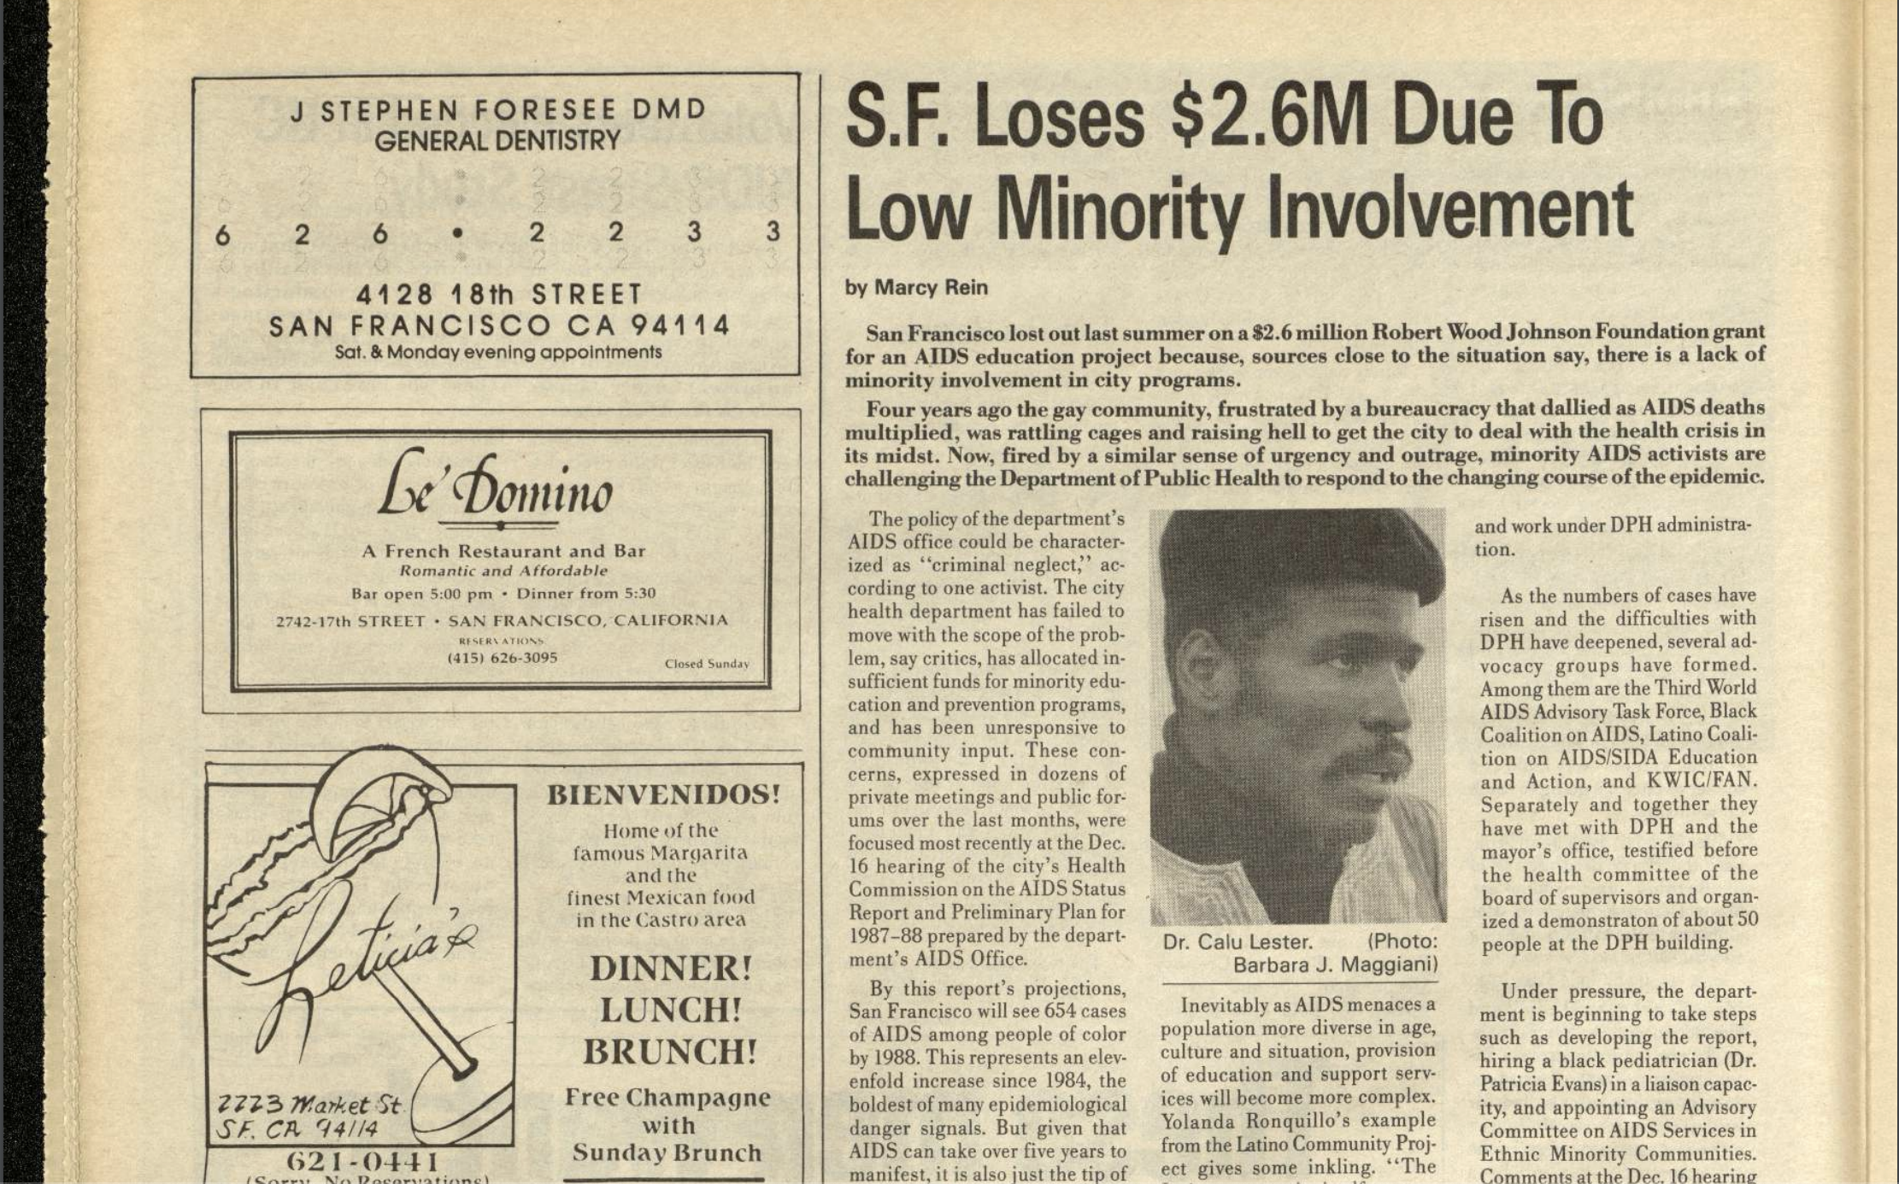
Dr. Calu Lester & KWIC-FAN

Slide 21
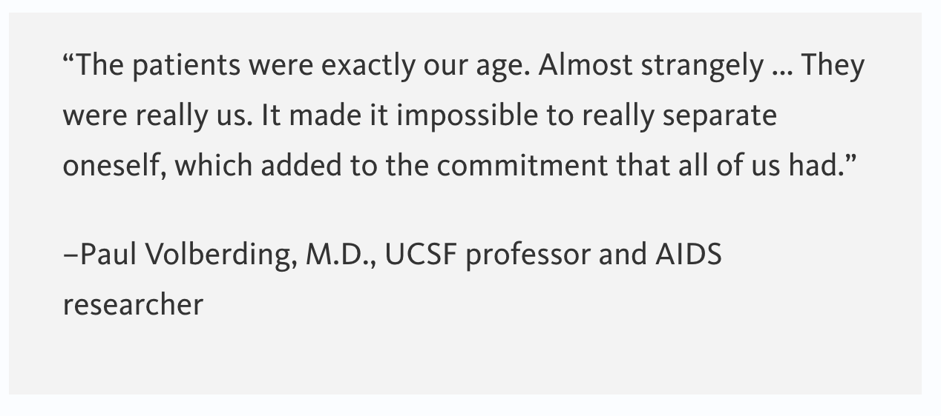
Race(ism) & the San Francisco Model of Care

Slide 22
APEB & The North Face AIDS Fundraiser

Slide 23
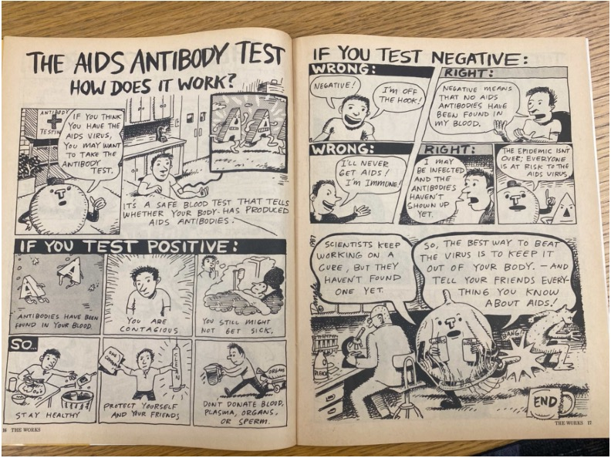
What is to be Done?

Slide 24
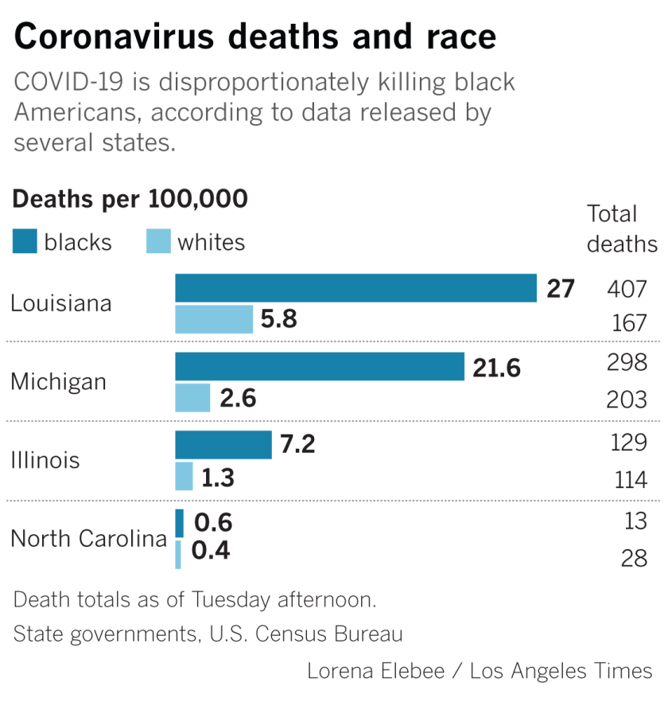
Racism = a Public Health Crisis
“Racism is a serious public health threat that directly affects the well-being of millions of Americans. As a result, it affects the health of our entire nation.” - former CDC Director Rochelle Walensky
(NPR, 2021)

Slide 25
References
Box 1, Folder 72, MSS 95-04. Women’s AIDS Network (WAN) Records. Archives and Special Collections. University of California, San Francisco.
Box 1, Folder 3, MSS 98-51. Constance Wofsy Papers. Archives and Special Collections. University of California, San Francisco.
Box 5, Folder 35, MSS 2000-6. Nancy Stoller Papers. Archives and Special Collections. University of California, San Francisco.
Cole, Janet. “Gloria: Turning a Life Around.” PWA Voice 2, no. 1 (Winter 1989): 12-13.
Lockett, Gloria. “Destroying Condoms.” In Sex Work: Writings by Women in the Sex Industry, edited by Frédérique Delacoste and Priscilla Alexander, 158. San Francisco: Cleis Press, 1987.
Mendenhall, Emily. Syndemic Suffering: Social Distress, Depression, and Diabetes among Mexican Immigrant Women. New York: Routledge, 2012.

