Slide 1
SNHD’s Detention Center Program: Taking a Syndemic Approach to Meeting the Needs of People Facing Incarceration in Clark County
Victoria Hughes
Southern Nevada Health District
Notes:
Version date_ 03 2024
Target audience: all members of the interprofessional healthcare team

Slide 2
Conflict of Interest Disclosure Statement
Speaker has nothing to disclose
This program is supported by the Health Resources and Services Administration (HRSA) of the U.S. Department of Health and Human Services (HHS) as part of an award totaling $4,205,743 with 0% financed with non-governmental sources. The contents are those of the author(s) and do not necessarily represent the official views of, nor does mention of trade names, commercial practices, or organizations imply an endorsement by HRSA, HHS, or the U.S. Government. For more information, please visit HRSA.gov. Any trade/brand names for products mentioned during this presentation are for training and identification purposes only.
Notes:
Please add presenter disclosures here if any exist.

Slide 3
Use of Trade/Brand Names
This program is supported by the Health Resources and Services Administration (HRSA) of the U.S. Department of Health and Human Services (HHS) as part of an award totaling $4,205,743, with 0% financed with non-governmental sources.
The views expressed do not necessarily reflect the official policies of the Department of Health and Human Services, nor does mention of trade names, commercial practices, or organizations imply endorsement by the U.S. Government. Any trade/brand names for products mentioned during this presentation are for training and identification purposes only.
Notes:
NOTE: THIS SLIDE MUST BE INCLUDED IF TRADE AND/OR BRAND NAMES FOR MEDICATIONS ARE USED IN THE PRESENTATION.
IT MAY BE DELETED IF THERE IS NO REFERENCE TO TRADE NAMES, INCLUDING PRESENTATIONS IN WHICH ONLY GENERIC MEDICATION NAMES ARE MENTIONED.
TRADE NAMES MUST BE PUT IN PARENTHESES AFTER THE GENERIC NAME THE FIRST TIME IT IS MENTIONED - E.G., FLUOXETINE (PROZAC). TRADE NAMES SHOULD ONLY BE MENTIONED FOR THE INITIAL REFERENCE AND THE GENERIC NAME ONLY SHOULD BE USED AFTER THAT. THIS APPLIES EQUALLY TO ALL MEDICATIONS OR PRODUCTS MENTIONED IN THIS PRESENTATION.

Slide 4
Unconscious Bias Disclosure
SCAETC recognizes that language is constantly evolving, and while we make every effort to avoid bias and stigmatizing terms, we acknowledge that unintentional lapses may occur in our presentations.
We value your feedback and encourage you to share any concerns related to language, images, or concepts that may be offensive or stigmatizing.
Your input will help us refine and improve our presentations, ensuring they remain inclusive and respectful to participants.

Slide 5
Overview
What is a Syndemic?
About Clark County
SNHD Jail Activities and Linkage to Action (L2A)
What can community partners do?

Slide 6
Learning Objectives
Understand how public health departments, Central Billing Offices (CBO’s) and public safety can work together by co-locating services.
Identify how braiding grants can enhance current efforts to address syndemics like HIV-STI (sexually transmitted infection) comorbidities, substance use disorder, and overdose.
Review how data sharing can help organizations use data to inform intervention planning activities.

Slide 7
Synergistic Epidemics

Slide 8
HIV WORK IS A SUPERPOWER
Having effective medical treatment is not enough
Acknowledge disparities
Systems level thinking
Image Reference: (ChatGPT image generator)

Slide 9
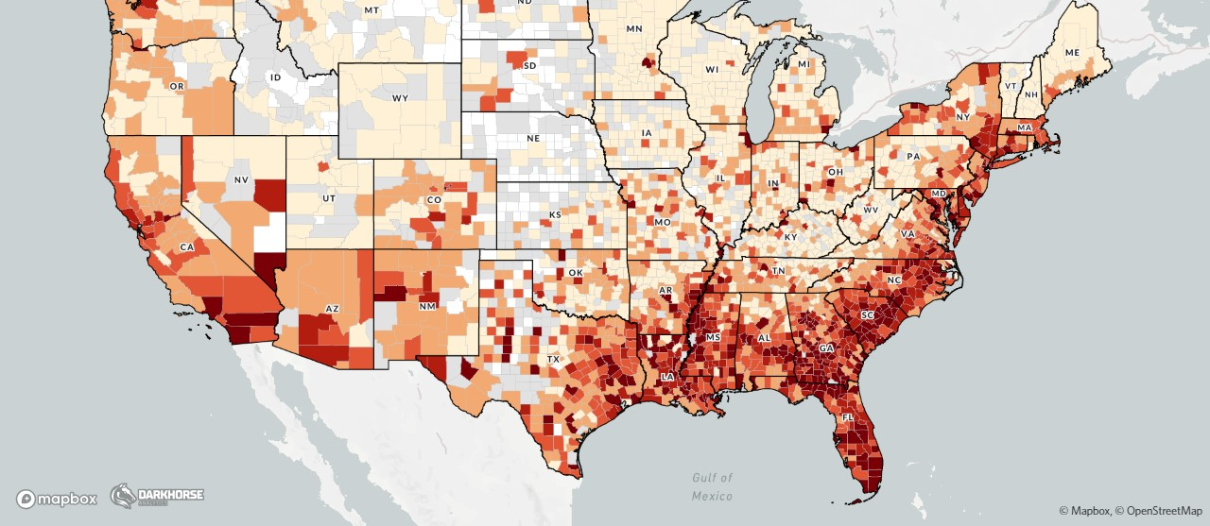
https://map.aidsvu.org/

Slide 10
EHE PRIORITY JURISDICTIONS

Slide 11
2022 Syphilis Nevada
902 Primary & Secondary cases
677 resided in Clark County
From 2017-2021, Nevada saw a 53% increase in infectious cases
Nevada ranks #8
65 congenital cases

Slide 12
SNHD LINKAGE TO ACTION
L2A provides HIV, Syphilis, Hep-C screening and SUD, HIV, and biomedical prevention linkage and education to our most vulnerable community members
Integration into Clark County Detention Center is a cornerstone of the mission to provide access to services
Image Reference: Nicol McNee

Slide 13
L2A intervention is based on SNHD previous adoption of HIV continuity of care models such as Transitional Care Coordination (TCC) that facilitates the care of individuals living with HIV during and after incarceration.
The need for enhanced linkage services was identified due to the complex needs of incarcerated individuals that are often disproportionally affected by co-occurring conditions.

Slide 14
~4,000 people incarcerated at CCDC
Medical screening at intake
L2A uses CCDC Electronic Medical Record (EMR) to identify individuals eligible for services
Priority: People who use opioids, People with HIV (PWH) & OOC, and people with no or insufficient Syphilis treatment history (Txt hx)
CCDC is considered the “largest mental health facility” in Nevada
OOC = Out of Care

Slide 15
Screen for HIV/Syphilis
Offer biomedical prevention linkage
Offer HIV linkage services
Offer linkage to Medications for opioid use disorder MOUD
Naloxone/Fentanyl Test Strips (FTS) Xylazine Test Strips (XTS) hygiene kits
Harm reduction and education
All clients assessed for unaddressed needs
Image Reference: https://www.istockphoto.com/

Slide 16
Why?
Image References: https://www.istockphoto.com/
(CHATGPT image generator)

Slide 17
SNHD-Clark County Detention Center Engagement
History of Engagement
Supportive Factors
Points to Consider
Current integration made possible through existing relationship with CCDC.
Partnership was established through meetings with key SNHD and CCDC leadership.
CCDC/LVMPD were expanding their collaboration with mental health and associated services.
Staff have access to CCDC internal EMR.
L2A is part of Division of Disease Surveillance and Control.
Existing SNHD data surveillance system is used for case management and to track needed variables.
Requires extensive integration of staff into CCDC contract employee processes. Peer coordination may not be feasible in-house
Jurisdictions may need new MOU/Interlocal agreements.
LVMPD = Las Vegas Municipal Police Department
Notes:
SNHD has had a presence in CCDC for over 20 years. Our department at SNHD is under the umbrella of disease surveillance and control which includes disease investigation. We historically have been able to have disease investigators badged and given access to CCDC for disease investigation purposes and for intervention purposes like drawing HIV, Syphilis and Hep-C labs. Fortunately, the relationship involved the right people at the right time as CCDC was looking expand the community services offered with the detention center. One of the takeaways from this process when I spoke with leadership on our side who were part of the process is that having key leadership on both sides with a common goal is needed for buy in.
Some supportive factors that allowed for integration is that fact that we have an existing data tool that can be used for case management and to document variables that can be documented and pulled by our epi’s and an existing data sharing plan was already in place to support the work.
Some factors that may hold true for other jurisdictions and are points to consider is the acknowledgement that this level of integration in any justice system requires adhering to the detention center’s policies and procedures. Our staff are given access only after a background check and finger printing process before being badged and once on site they must follow CCDC policy. Some consideration for this model will be needed by jurisdictions that employ peers as this process may be difficult for folks that may have had contact with the justice system in the past. Jurisdictions that are local health entities may require external approval to work with another governmental agency and so an interlocal may be needed which may need board of health approval for example.

Slide 18
Getting your foot in the door…
Leave behind programs
Offer HIV/STI screening-data sharing with medical staff
Education programs
Corrections Officer naloxone education
Warm referrals/Memorandum of understanding (MOU)
Notes:
STI = sexually transmitted infection

Slide 19
Resources
National Clinician Consultation Center http://nccc.ucsf.edu/
HIV Management
Perinatal HIV
HIV PrEP
HIV PEP line
HCV Management
Substance Use Management
Present on ECHO
https://hsc.unm.edu/scaetc/programs-services/echo.html​
AETC National HIV Curriculum https://aidsetc.org/nhc
AETC National Coordinating Resource Center https://targethiv.org/library/aetc-national-coordinating-resource-center-0
HIVMA Resource Directory https://www.hivma.org/globalassets/ektron-import/hivma/hivma-resource-directory.pdf
Additional trainings scaetcecho@salud.unm.edu
www.scaetc.org
Notes:
IDEA Platform: Infectious Diseases Education & Assessment. https://idea.medicine.uw.edu/
AETC National HIV Curriculum: 6 core modules for self study; regularly updated; CME, CNE
Hepatitis C Online Curriculum: https://www.hepatitisc.uw.edu/
Hepatitis B Online Curriculum: https://www.hepatitisb.uw.edu/
National STD Curriculum: https://www.std.uw.edu/
National HIV PrEP Curriculum: https://www.hivprep.uw.edu/

Slide 20
Notes:
Find an HIV-related topic TeleECHO in your area: https://echo.unm.edu/locations-2/echo-hubs-superhubs-united-states/
IDEA Platform: Infectious Diseases Education & Assessment. https://idea.medicine.uw.edu/
AETC National HIV Curriculum: 6 core modules for self study; regularly updated; CME, CNE
Hepatitis C Online Curriculum: https://www.hepatitisc.uw.edu/
Hepatitis B Online Curriculum: https://www.hepatitisb.uw.edu/
National STD Curriculum: https://www.std.uw.edu/

Slide 21
THANK YOU!
Victoria Hughes
Southern Nevada Health District
702-759-0735
hughes@snhd.org
Image Reference: Nicol McNee

