Slide 1



Syphilis Diagnosis & Treatment in Primary Care Settings
Lucinda Lundy Zeinelabdin, MSN, APRN, FNP-C Nurse Practitioner, Clinician Ambassador
Diana Morales, BSN, RN
Public Health Nurse, Clinician Ambassador
Notes:
Version date_04 2024
Target diagnosis: clinical members of the healthcare team

Slide 2



Conflict of Interest Disclosure Statement
The presenter has no conflicts to declare.
Explicit photos shown are used for medical purposes.
This program is supported by the Health Resources and Services Administration (HRSA) of the U.S. Department of Health and Human Services (HHS) as part of an award totaling $4,205,743 with 0% financed with non-governmental sources. The contents are those of the author(s) and do not necessarily represent the official views of, nor does mention of trade names, commercial practices, or organizations imply an endorsement by HRSA, HHS, or the U.S. Government. For more information, please visit HRSA.gov. Any trade/brand names for products mentioned during this presentation are for training and identification purposes only.

Slide 3
Use of Trade/Brand Names
This program is supported by the Health Resources and Services Administration (HRSA) of the U.S. Department of Health and Human Services (HHS) as part of an award totaling $3,132,205, with 0% financed with non- governmental sources.
The views expressed do not necessarily reflect the official policies of the Department of Health and Human Services, nor does mention of trade names, commercial practices, or organizations imply endorsement by the U.S. Government. Any trade/brand names for products mentioned during this presentation are for training and identification purposes only.

Slide 4

Unconscious Bias Disclosure
SCAETC recognizes that language is constantly evolving, and while we make every effort to avoid bias and stigmatizing terms, we acknowledge that unintentional lapses may occur in our presentations.
We value your feedback and encourage you to share any concerns related to language, images, or concepts that may be offensive or stigmatizing.
Your input will help us refine and improve our presentations, ensuring they remain inclusive and respectful to participants.

Slide 5



Clinician Ambassador Overview
Clinician Ambassadors are a resource for clinicians in the San Antonio Metroplex, with an aim to improve public health through outreach and communication. We are available for in-person and virtual one-on-one and group discussions, educational presentations and assistance in implementing evidence-based practices. Please feel free to reach out by email or phone:
Lucinda Lundy Zeinelabdin, MSN, APRN, FNP-C Nurse Practitioner/Clinician Ambassador lucinda.zeinelabdin2@sanantonio.gov
Phone: 210-207-2407
Diana Morales, BSN, RN
Registered Nurse/Clinician Ambassador Diana.morales1@sanantonio.gov Phone: (210) 207-5102
Provider Interest Form

Slide 6
Learning Objectives
At the end of this presentation, learners will:
Become familiar with syphilis screening and follow up intervals
Understand how to use the syphilis screening algorithms, and pertinent considerations
Learn how to accurately stage syphilis infections, and adequately provide treatment
Discuss the Texas statutes requiring syphilis screening during pregnancy, and reporting requirements

Slide 7
Syphilis
Sexually transmitted infection caused by bacterium Treponema pallidum (T. Pallidum)
Infection is curable
Symptoms of syphilis in adults vary by stage
Transmitted through
  Sexual transmission through vaginal, anal, or oral sex
  Abrasions and microtears in the skin or mucous membranes
  Mother to unborn baby (vertical transmission)
7

Slide 8
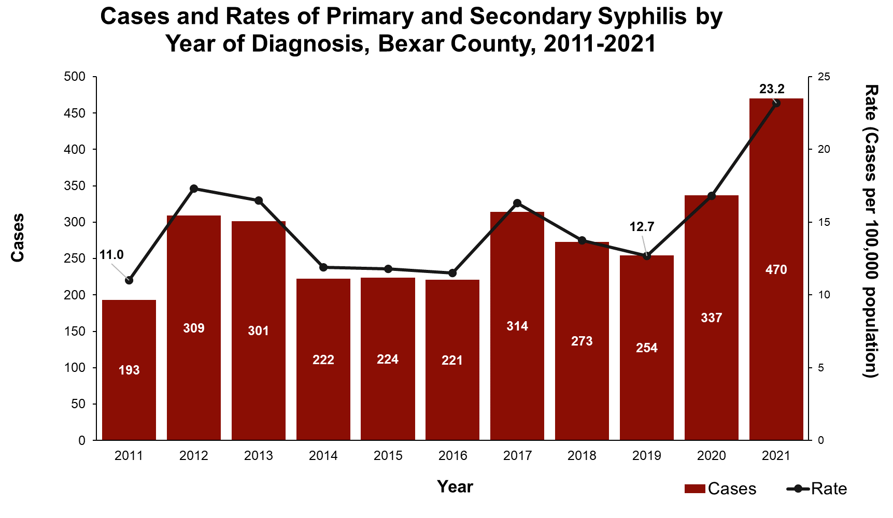
Source: Metropolitan Health District

Slide 9

SYPHILIS TESTING

Slide 10


General Screening Recommendations
San Antonio is currently in a syphilis epidemic, so syphilis screening should occur
  Anytime a patient requests sexually transmitted infection (STI) testing
Anytime a patient tests positive for another STI (if syphilis testing was not performed)
Image Source: https://cdn.pixabay.com/photo/2014/11/11/06/34/puzzle- 526404_960_720.jpg

Slide 11

Reasons syphilis might be missed without testing
If primary chancre is in vagina or rectum, patient will never know
Chancre is nontender and heals without treatment
40% of secondary syphilis rashes are atypical (not palmar-plantar)
75% of untreated women have no secondary symptoms
Most infants with congenital syphilis are asymptomatic at birth
Adhikari EH. (2020) Syphilis in Pregnancy, Ob Gyn 135(5):1121-1135.

Slide 12

Knowledge Check
When should syphilis screening occur during pregnancy? (Select all that apply)
At entry to care
At 12-16 weeks gestation
At 28 weeks of gestation
At 36 weeks of gestation
At delivery
At discharge
All of the above
None of the above

Slide 13
Knowledge Check
When should syphilis screening occur during pregnancy? (Select all that apply)
A. At entry to care
B. At 12-16 weeks gestation
C. At 28 weeks of gestation
D. At 36 weeks gestation
E. At delivery
At discharge
All of the above
None of the above

Slide 14

Syphilis Screening In Pregnancy
As of September 1, 2019, Texas Health and Safety Code
§81.090 mandated syphilis screening:
At first prenatal care examination
AND
During 3rd trimester (no earlier than 28 weeks and no later than 32 weeks)
AND
At delivery
CDC recommends testing after stillbirth
Overly frequent testing (closer than 8 weeks) makes it challenging to detect a 4-fold rise in titer
https://www.publicdomainpictures.net/picture s/50000/velka/pregnancy.jpg

Slide 15

A Tale of Two Algorithms…
Traditional Algorithm
Begin with Rapid Plasma Reagin (RPR) or Venereal Disease Research Laboratory (VDRL) (non-treponemal test), which provides a titer based on the amount of antigen present in specimen
This is the test that should be used to follow response to treatment
If it is non-reactive, a Treponema Pallidum Particle Agglutination Assay (TP-PA) is not needed—but could be useful later
Next: confirm with a treponemal test—required to diagnose syphilis
  A reactive RPR can be caused by other conditions, such as autoimmune conditions and even pregnancy
  Treponeme-specific tests include TP-PA, EIA, CIA, FTA-ABS, MHATP

Slide 16
A Tale of Two Algorithms…
Reverse Algorithm
Begin with Enzyme Imunoassay (EIA), Chemiluminescence immunoassay (CIA) or other treponeme-specific test
Identifies patients who were previously treated, had inadequate treatment or
have untreated syphilis
Next: Use a quantitative, nontreponemal test (RPR or VDRL) to follow response to treatment
If the nontreponemal test is negative, use a different treponemal test (ideally, TP-PA) to confirm

Slide 17
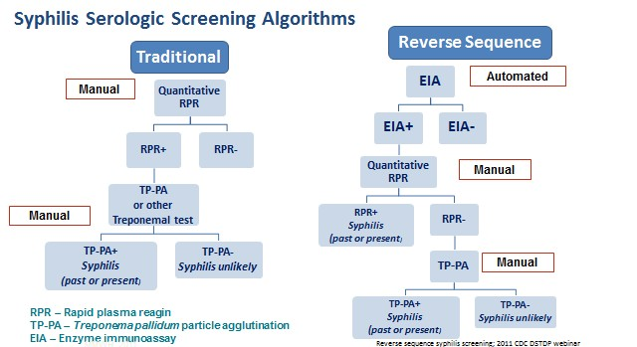
Source: CDC Reverse Sequence Syphilis Screening Webinar (CDC) MMWR, Feb 11, 2011, 60(5)

Slide 18
Key idea
Because hospitals use the reverse algorithm, consider obtaining a TP-PA even if the RPR is non-reactive when using the traditional algorithm.
Helps avoid discovering syphilis in labor and delivery (L&D)
A nonreactive quantitative test, combined with a positive TP-PA, is evidence of past or present infection

Slide 19
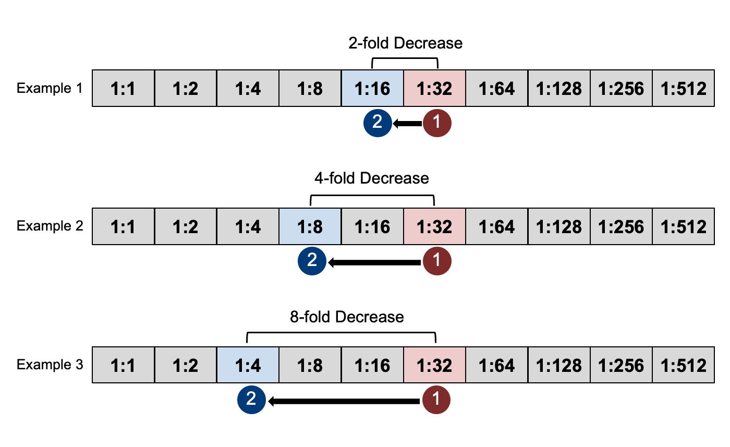

Interpretation of Titers
Source: National STD Curriculum

Slide 20

Biological False Positives
Biological false positives may occur with autoimmune diseases, chronic liver disease, following acute febrile illness, or during pregnancy.
Specimens with a reactive nontreponemal result and a nonreactive treponemal test result are considered biological false positives and make up 14 to 40% of reactive nontreponemal tests, depending on the prevalence of syphilis
Image source: Microsoft Office Stock Images

Slide 21
Syphilis Staging

Slide 22

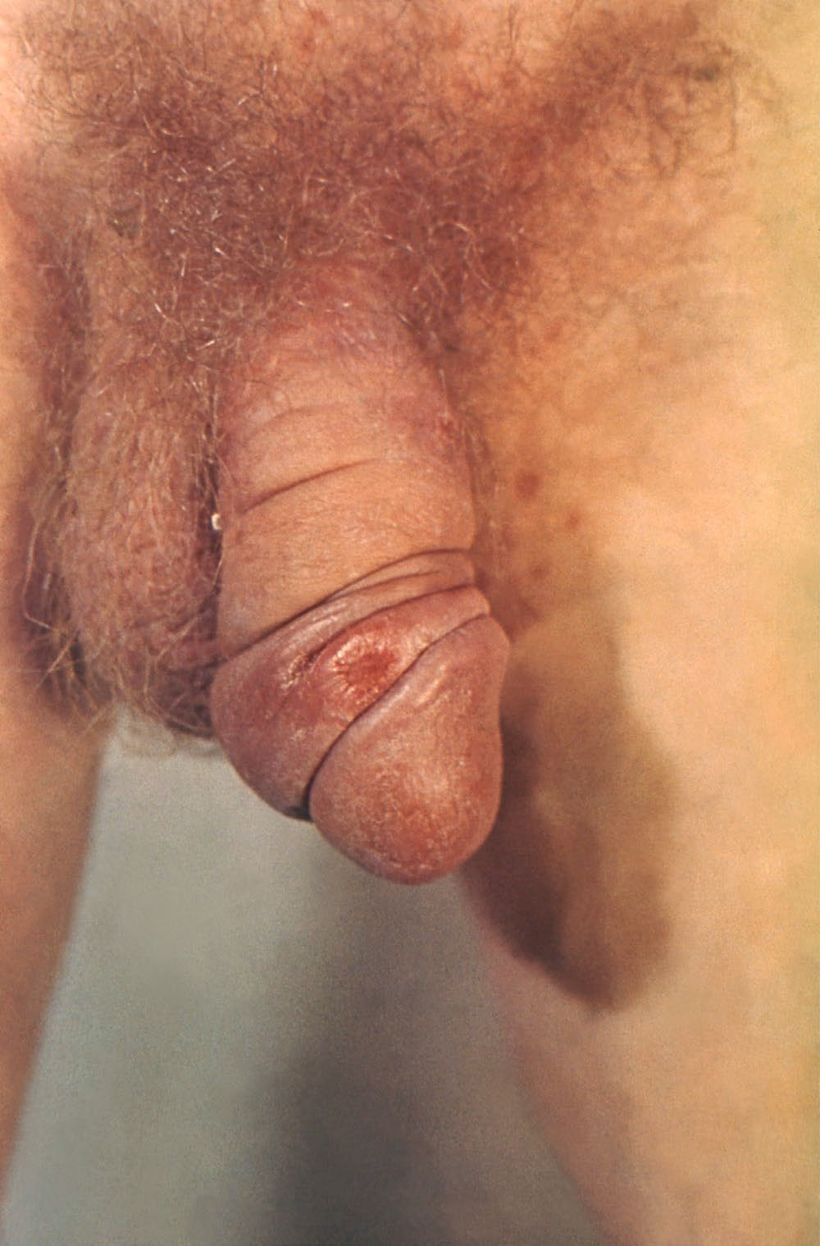
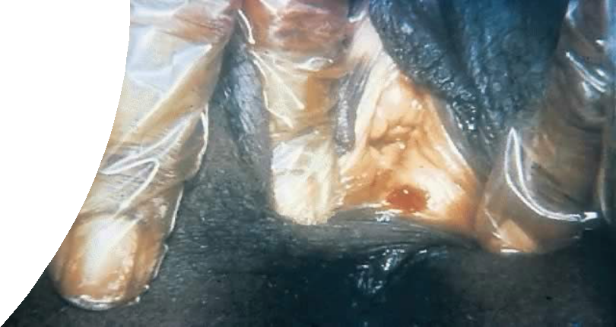
Primary (chancre stage): 10-90 days after innoculation
Typically presents as a single, painless ulcer or chancre at the site of inoculation
May also present as multiple, painful, atypical lesions
Secondary (rash stage): 0-7 months after primary lesion onset
Source:CDC https://www.cdc.gov/std/training/clinicalslides/slide
-dl.htm
Secondary (rash stage): 0-7 months after primary lesion onset
Presents as skin rashes, mucocutaneous lesions, warts, alopecia
Classically a palmar/plantar rash
Source:CDC https://phil.cdc.gov/Details.aspx?pid=17883
Latent (the silent stage) Resolution of primary/secondary symptoms
No symptoms of either the primary or secondary stages. Positive serology
Early latent – infection acquired within the previous 12 months
Late latent – infection acquired more than 12 months ago
Unknown duration – treated the same way as late latent
CDC
ww.cdc.gov/std/syphilis/images/chancre-vaginal-

Slide 23

Primary (chancre stage): 10-90 days after innoculation
Tertiary (the imprint stage- the disease leaves its mark on organ systems)
Now rare. May present with lesions called gummas, cardiac or other organ involvement
Neurosyphilis (can occur at any stage)
Source:CDC https://www.cdc.gov/std/training/clinicalslides/slide
-dl.htm
Neurosyphilis
Ocular, otic, meningovascular, meningitis
Source:CDC https://phil.cdc.gov/Details.aspx?pid=17883
CDC
ww.cdc.gov/std/syphilis/images/chancre-vaginal-

Slide 24
Secondary Syphilis Manifestations

Slide 25
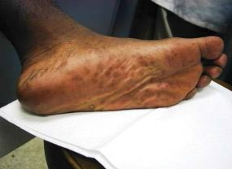

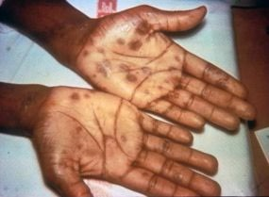

About that rash...
Image Source: https://www.cdc.gov/std/syphilis/images.htm

Slide 26


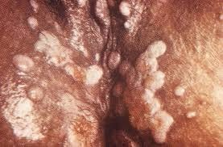
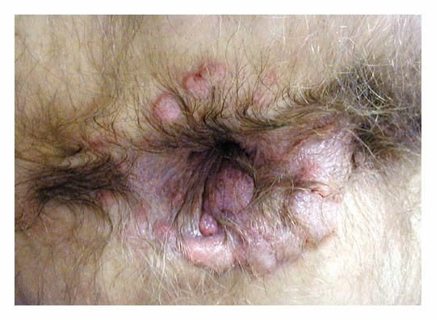

Image Source: CDC Public Health Image Library
Image Source: New England Journal of Medicine
Condylomata Lata

Slide 27


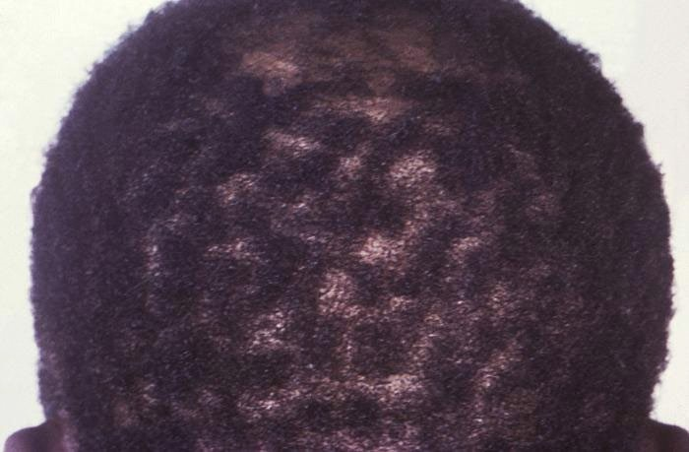
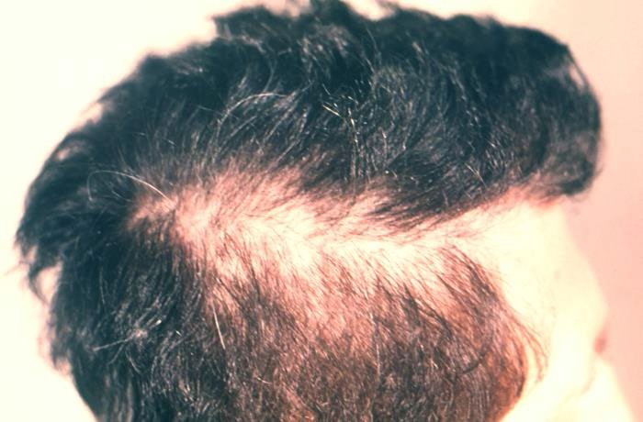
Image Source: CDC Public Health Image Library
Patchy "Moth-Eaten" Hair Loss
Notes:
Patchy alopecia

Slide 28


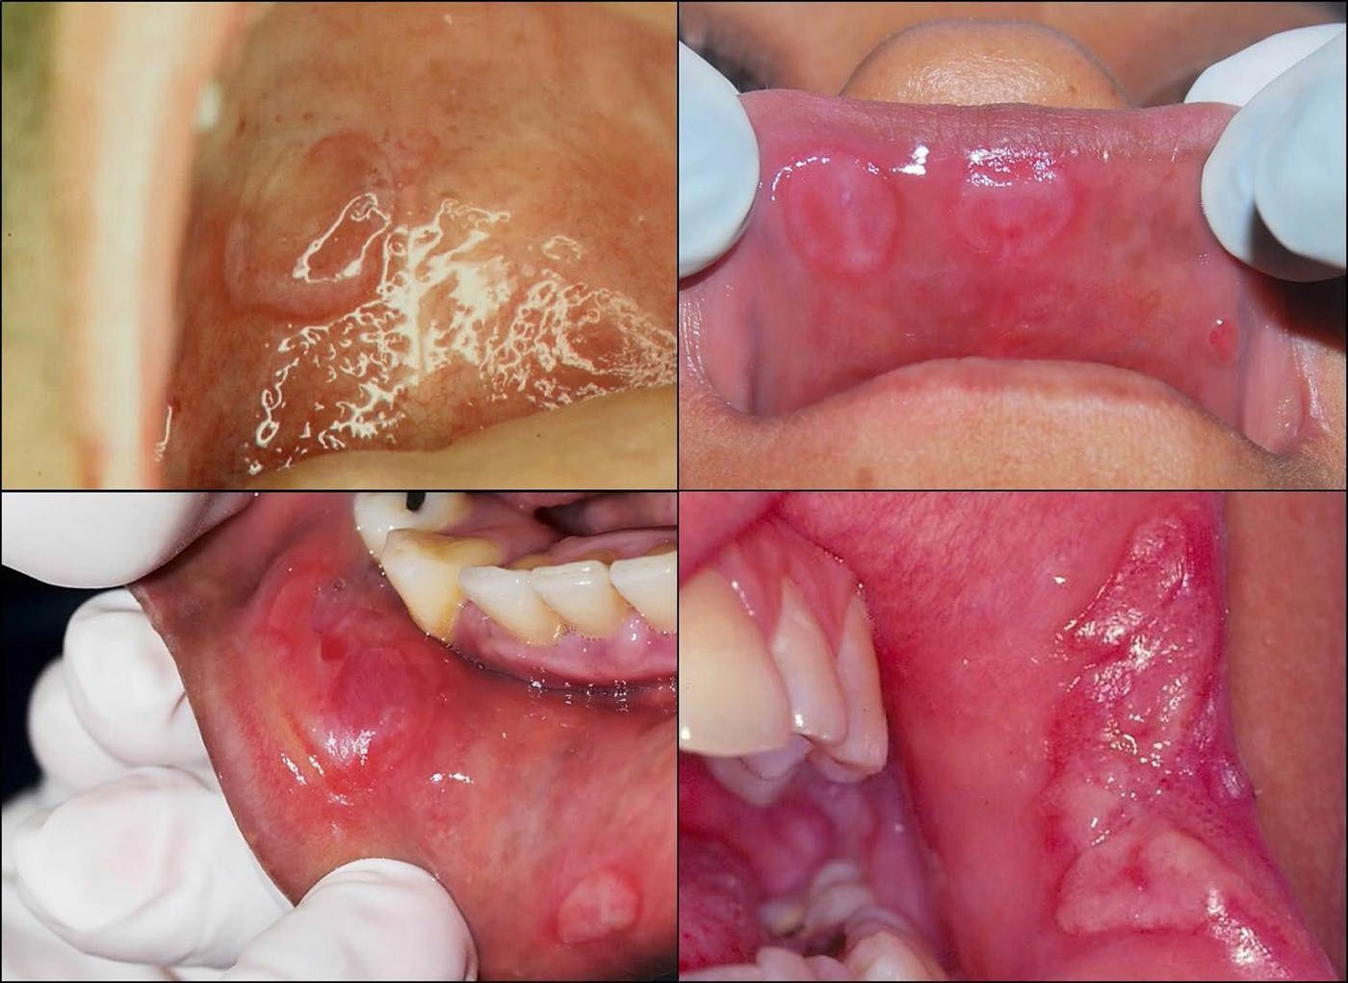
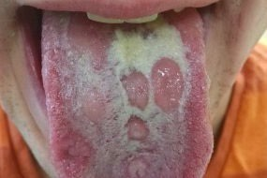

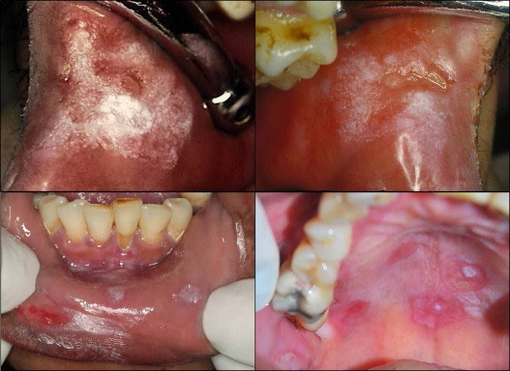

Image Source: CDC.gov
Source:https://www.sciencedirect.com/science/article/pii/S1201971215000934#fig0010
Name that symptom!
Source:https://www.sciencedirect.com/scienc e/article/pii/S1201971215000934#fig0010

Slide 29
Reasons syphilis might be missed without testing
If primary chancre is in vagina or rectum, patient will never know
Chancre is nontender and heals without treatment
40% of secondary syphilis rashes are atypical (not palmar- plantar)
75% of untreated women have NO secondary symptoms whatsoever
Most infants with congenital syphilis are asymptomatic at birth
Adhikari EH. (2020) Syphilis in Pregnancy, Ob Gyn 135(5):1121-1135.

Slide 30
Latent Syphilis

Slide 31

Early Latent Syphilis
Infection of less than one year duration
Unequivocal primary or secondary symptoms within the last 12 months
Known sexual contact with a person diagnosed with primary, secondary or early latent infection within the last 12 months
Documentation of a negative non-treponemal test result within the last 12 months
Only possible exposure occurred within the last year
Patient is seropositive for Treponenum pallidum infection
  Reactive non-treponemal test and
  Reactive treponemal test
No active symptoms of primary or secondary syphilis infection
Source: CDC.gov

Slide 32
Transmissibility
Syphilis is most transmissible in the first year after infection
Primary and secondary lesions are especially infectious
Latent syphilis is still transmissible sexually and mother-to-infant if acquired in the last 12 months (“early latent”)
Latent syphilis is still transmissible vertically even after 12 months
(“late latent”)

Slide 33
Late Latent Infection
Infection duration greater than 1 year
Diagnosis requires ALL of the following:
  Patient has both a reactive non-treponemal AND treponemal serologic test
  There are NO clinical manifestations of either primary or secondary syphilis
  Does not meet criteria for early latent
    See early latent slide
If the onset of infection cannot be determined = Latent syphilis of Unknown duration
  Treatment is the same as Late Latent

Slide 34
Tertiary Syphilis
Tertiary syphilis is rare in the United States, due to the availability of testing, early diagnosis and early treatment with widely available antibiotics, however
30% of untreated patients go on to develop tertiary syphilis
Can occur between 10 and 50 years after initial infection
Patient is not infectious at this stage
Persons diagnosed with tertiary syphilis should receive a Cerebrospinal fluid (CSF) examination prior to initiating therapy
HIV testing should be done
Persons with CSF abnormalities should be treated with a neurosyphilis regimen

Slide 35
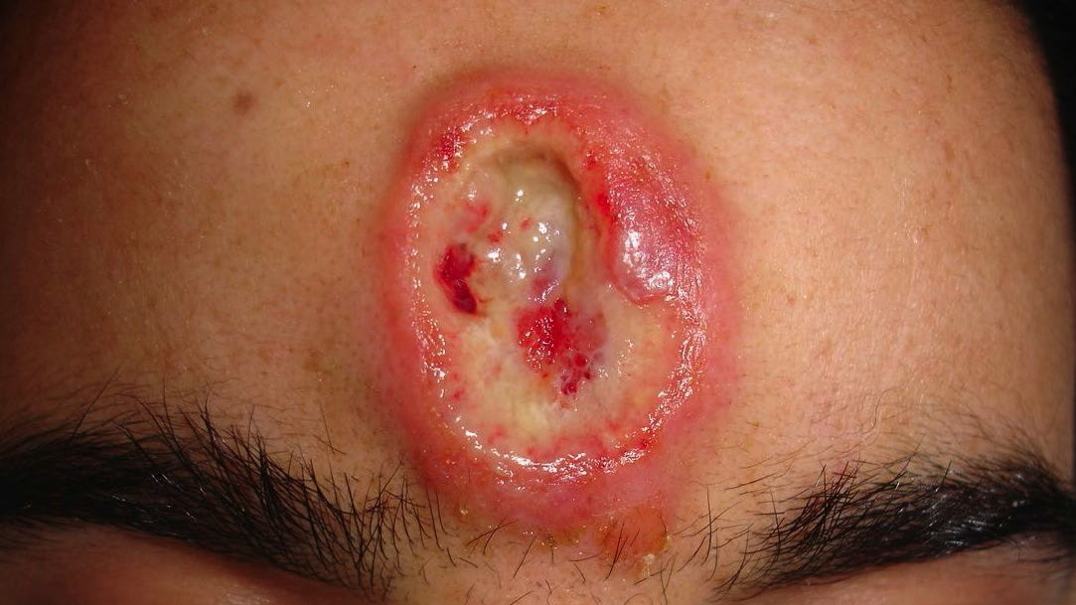
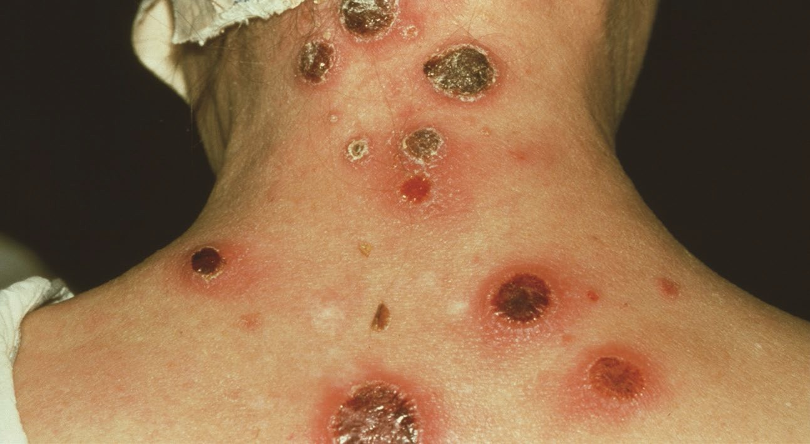
Clinical Manifestations of Tertiary Syphilis
Gummas – "lesions formed by a proliferative granulomatous process...can form in almost ANY tissue or organ...[and] may clinically mimic
carcinoma..."(2021, National STD Curriculum)
Cardiovascular syphilis – cardiovascular lesions may cause cardiovascular disease, ascending aortic aneurysms, aortitis and aortic valve insufficiency
Late Neurosyphilis - Psychiatric manifestations, e.g., memory loss or personality changes
Source: Dermatology Online Journal
Source: CNRI / SCIENCE PHOTO LIBRARY

Slide 36
Neurosyphilis

Slide 37
Neurologic syphilis
"Neurosyphilis" includes neurologic syphilis, ocular syphilis and otic syphilis
Neurologic syphilis refers to meningitis and meningovascular syphilis, which presents with stroke-like symptoms
All patients with syphilis and neurologic or ocular symptoms warrant a careful neurological exam and a CSF evaluation via a lumbar puncture (LP)
Symptoms of neurologic syphilis may include:
  Severe headache
  Difficulty coordinating muscle movements
  Paralysis
  Numbness
  Dementia

Slide 38
Neurologic syphilis
Early neurologic syphilis usually presents a few weeks or a few years after onset of infection and can occur at the primary and secondary stage
Late neurologic syphilis typically presents 10-30 years after onset of infection
  Manifestations include general paresis (chronic meningoencephalitis leading to dementia, muscle weakness and paralysis) or tabes dorsalis (demyelination of the posterior columns of the spinal cord)
All patients at high risk for syphilis presenting with neurologic symptoms should be tested for syphilis and HIV

Slide 39
Manifestations of Ocular Syphilis
Ocular syphilis can occur at any stage
Visual complaints consist of vision loss, blurry vision, eye pain, eye redness, etc.
Patients at high risk for Sexually Transmitted Infection (STIs) who present with ocular signs or symptoms should be tested for syphilis and HIV
Patients with syphilis & ocular symptoms should receive a careful neurological exam, an ophthalmologic assessment, and CSF evaluation via lumbar puncture
Treatment should not be delayed while awaiting the results of tests as severe outcomes, including permanent blindness, have been reported

Slide 40
Syphilis Treatment

Slide 41


Syphilis Treatment
Late Latent Syphilis and Syphilis of Uknown Duration
Tertiary Syphilis with normal CSF examination
Primary, Secondary and Early Latent Syphilis
Benzathine Penicillin G 2.4M units given via IM injection in a single dose
Alternative: doxycycline 100mg PO BID x 14 days
Benzathine Penicillin G
7.2 million units total
Administered as 3 2.4M unit IM injections, given at 1- week intervals over 3 weeks
Alternative: Doxycycline 100mg PO BID x 28 days
7.2 million units total, administered as 3 doses of 2.4 million units IM each at 1- week intervals

Slide 42
Syphilis Treatment Among Pregnant Persons
Treatment regimen for syphilis among pregnant persons, is the same as for non-pregnant persons, based on stage of infection
There is no alternative treatment to penicillin among pregnant persons
  Admit to hospital for desensitization protocol
New treatment window for syphilis during pregnancy is 7-9 days.
  If presenting earlier or later than the new timeframe – must restart
Many experts recommend an additional dose of 2.4 million units benzathine penicillin for pregnant women diagnosed with primary, secondary, or early latent syphilis
  Given 1 week after initial dose
  Based on clinician judgment

Slide 43
Special Considerations for Penicillin Allergy
Nonpregnant, penicillin-allergic persons who have primary or secondary syphilis. Regimens of doxycycline 100 mg orally twice daily for 14 days and tetracycline (500 mg four times daily for 14 days) have been used for many years
The only acceptable alternatives for the treatment of latent syphilis are doxycycline (100 mg orally twice daily) x 28 days or tetracycline (500 mg orally four times daily) x 28 days
  Neither of these drugs are acceptable in pregnancy – penicillin is the only treatment for pregnant persons diagnosed with syphilis
Pregnant women with primary or secondary syphilis who are allergic to penicillin should be desensitized and treated with penicillin
Penicillin desensitization in consultation with a specialist is recommended for neurosyphilis/ocular syphilis

Slide 44
Treatment of Neurosyphilis, Otosyphilis & Ocular Syphilis
Recommended Regimen
Aqueous crystalline penicillin G 18–24 MU per day, administered as 3–4 MU IV every 4 hours or
continuous infusion for 10–14 days
Alternative Regimen
Procaine penicillin G 2.4 MU IM once
daily plus Probenecid 500 mg orally
4 times/day, both for 10–14 days
Notes:
IV=intravenous
IM=intramuscular

Slide 45
Penicillin G
Benzathine (Bicillin L-A ®) Injectable Suspension Product Shortage
FDA added penicillin G benzathine (Bicillin L-A ®) to its list of medication shortages in April
  Shortage reportedly due to increased demand
  Shortage affecting doses including pediatric 600,000 unit/mL, 1.2M unit/2mL and 2.4M unit/4mL formulations
Shortages are not expected to be resolved until sometime in late 2024
CDC recommends prioritizing this treatment for pregnant persons as this is the only recommended treatment for syphilis in pregnancy
  Treat non-pregnant persons with recommended alternative (doxycycline)

Slide 46
Benzathine benzylpenicillin injection, powder, for suspension (Extencilline)
In January, FDA announced it will allow temporary importation and use of Benzathine benzylpenicillin injection, powder, for suspension (Extencilline) to mitigate the effects of the Bicillin L-A® drug
shortage.
The American College of Obstetricians and Gynecologists (ACOG) supports the use of Extencilline for pregnant and breastfeeding patients who meet the clinical criteria when Bicillin L-A® is unavailable

Slide 47
Jarisch-Herxheimer Reaction
Caused by endotoxins and lipoproteins released by spirochetes as they dissolve
  Common in early primary and secondary stages
May include nausea, vomiting, chills, worsening of syphilitic rash
>20 weeks gestation have a risk for premature labor, preterm contractions, decelerations. Rarely – stillbirth
Supportive care, usually resolves within 24 hours
If the patient has a high titer or fetal evidence of syphilis on ultrasound, monitor the patient on Labor & Delivery (L&D) during first dose
Educate patients to seek obstetric care if fever, contractions or decreased fetal movement

Slide 48
Post Treatment Follow-Up

Slide 49
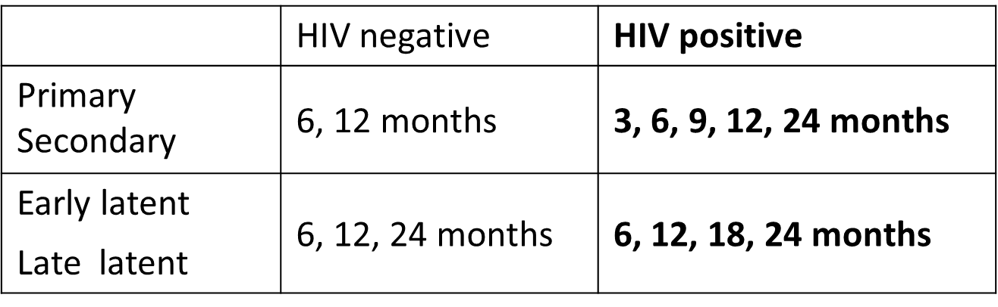
Post-Treatment Follow Up
Adults should have 4-fold drop at 12 months
Reproductive age women who had partial treatment and 4-fold drop still need re-treatment

Slide 50
Treatment Failure Considerations
Retest at 6 and 12 months after treatment. Consider reinfection or treatment failure for:
Primary and Secondary Syphilis Diagnosis, if
Persistence or recurrence of signs and symptoms occurs
Failure of nontreponemal titer to decrease fourfold by 6–12 months after treatment
Greater than fourfold increase in nontreponemal test titer at retesting*
Latent Syphilis Diagnosis, if
Development of signs and symptoms of primary or secondary syphilis occurs
A fourfold or greater increase in nontreponemal test titer at retesting*
*Reinfection is more likely than treatment failure*

Slide 51



Case Study
Image source: https://www.wakehealth.edu/locations/facilities/comprehensive-cancer-center/nurse-navigation-services

Slide 52
Case Presentation – Clinic Appointment
Non-pregnant 43-year-old cis-gender woman presents to the clinic with complaint of "rash" to bilateral hands that started approximately 1 month ago. Rash is now fading away, but lesions still slightly visible.
Medical: no prior history of Syphilis; Previous NR RPR done on 2/2/2023; No PCP; HPV dx in 2022 with surgical removal
Social: Denies recent travel outside of San Antonio, donating blood or plasma, incarceration, recreational or IV drug use or needle sharing, going to bars and clubs, or use of dating apps; reports drinking alcohol occasionally.
Sexual: 5 lifetime sexual partners, and 1 in the last 12 months. She states that all partners are male. She and current partner took a break at one time but recently got back together. Pt reports having only vaginal and oral sex, with no condom use. Last sexual encounter was 1 month ago, w/ current partner
  Partner: 42-year-old cis-gender male. Reported sore on penis and on tongue that lasted 3 weeks.
Notes:
PCP=primary care provider
HPV=human papilloma virus

Slide 53
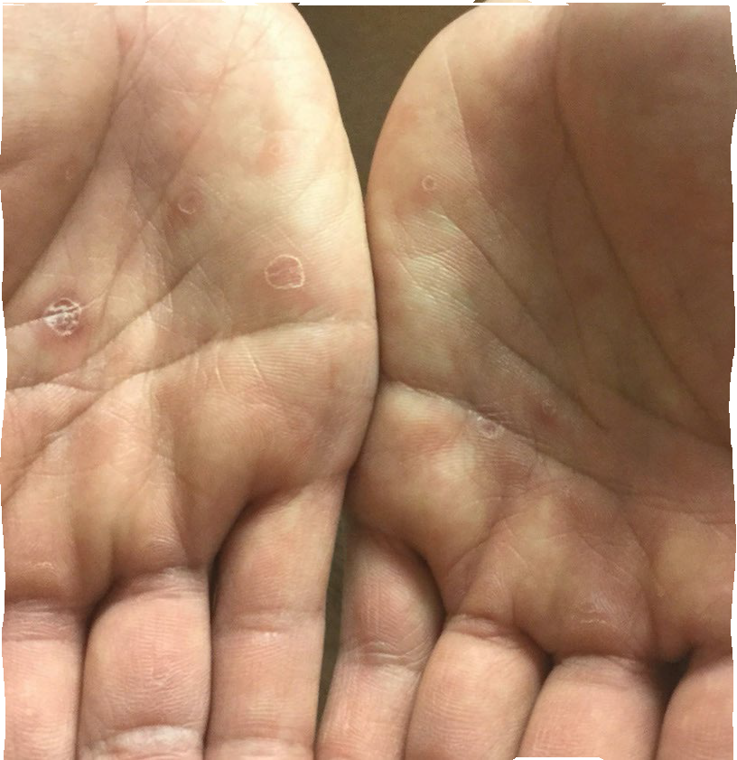
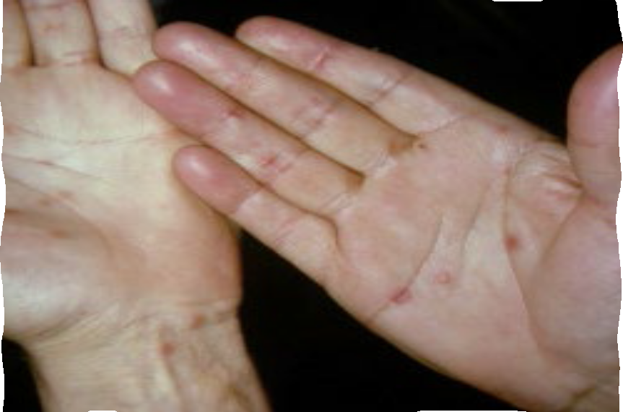
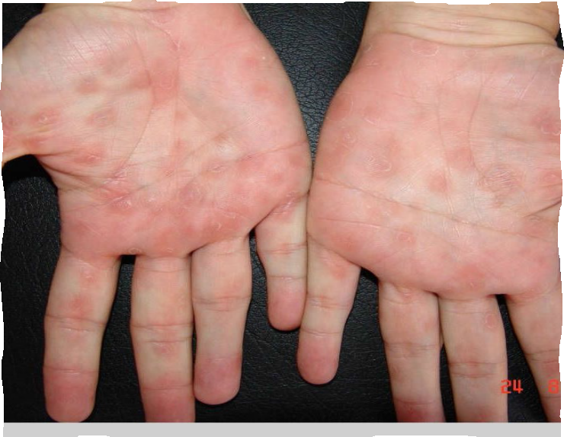
Physical Exam
Image source: https://cdn.std.uw.edu/doc/601- 1/maculopapular-rash-on-palms-hands.jpg
Image Source: https://dermnetnz.org/assets/Uploads/bacterial/syph10 90ZWN0Il0_FocusFillWzI5NCwyMjIsIngiLDFd.jpg
Image source: https://www.pcds.org.uk/imager/gallery/clinical/syphilis/11007/syp_17_2615ad df7111d83624b7a7a5f3466fb3.jpg
ProtectWyJQcm

Slide 54
What test(s) would you order for this patient? (select all that apply)
RPR
DARK FIELD
UA ANALYSIS
TPPA

Slide 55
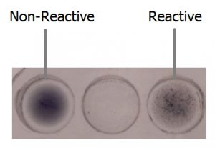
Results
TPPA Positive
▪ RPR 1:64
Image source: https://cdn.laboratoryinfo.com/wp-content/uploads/2017/03/RPR-Interpretation-300x207.png

Slide 56
What is this Patient's Diagnosis?
Early Latent Syphilis
Late Latent Syphilis
Primary Syphilis
Secondary Syphilis

Slide 57
WHY IS THIS SECONDARY SYPHILIS?
Let’s Discuss

Slide 58
What is the appropriate treatment for this patient?
 | A. Benzathine penicillin G 2.4 million units
 | IM x 1 doses
B. Azithromycin 1 g orally as a single dose
 | C. Benzathine penicillin G 2.4 million units
 | IM x 3 doses
 | D. Doxycycline 100 mg twice daily for 28
 | days

Slide 59

Hypothetical Follow-up
Hours later the clinic receives a call from the patient reporting fever, headache, and worsening of rash on hands.
The patient reports NO shortness of breath, lip swelling, or a cough.
Image source: https://blackmamasatx.com/breastfeeding-with-the-flu-or-cold/

Slide 60
Hypothetical Follow up - What is your diagnosis?
Penicillin allergy
Jarisch-Herxheimer Reaction
Normal Side Effect
Anxiety

Slide 61
Congenital Syphilis

Slide 62

Rates of Congenital Syphilis for Bexar County, Texas, and the United States, 2011 - 2021
350
319.7
300
250
200
180.2
150
100
34.9
50
26.5
77.7
9.1
0
2011
2012
2013
2014
2015
2016
2017 2018
Bexar Co.
2019
2020
2021
Year
Texas
USA
Source: Metropolitan Health District

Slide 63
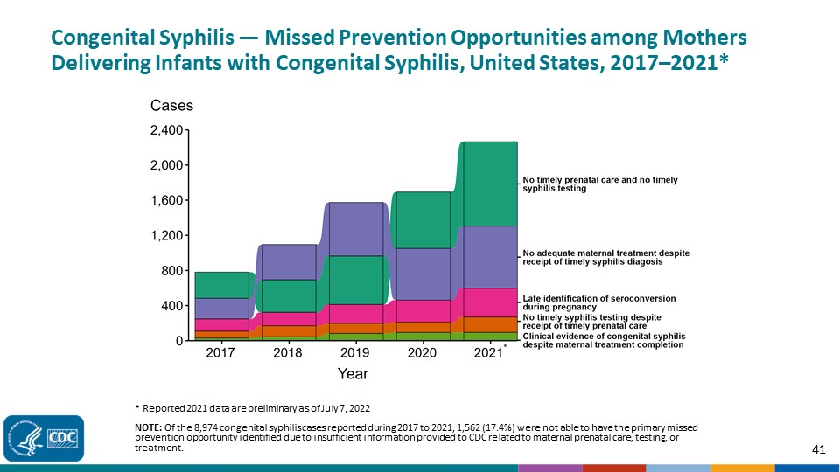

Slide 64
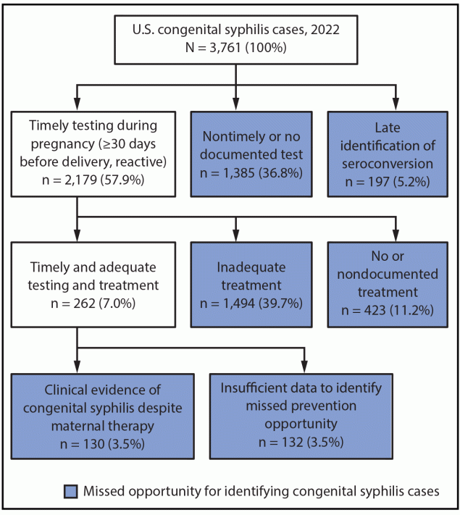
In 2022 there were 3,761 cases nationwide
36.8% no timely or no documented testing
39.7% inadequate treatment
11.2% no treatment or no treatment documented
Image source: https://www.cdc.gov/mmwr/volumes/72/wr/mm7246e1.htm

Slide 65
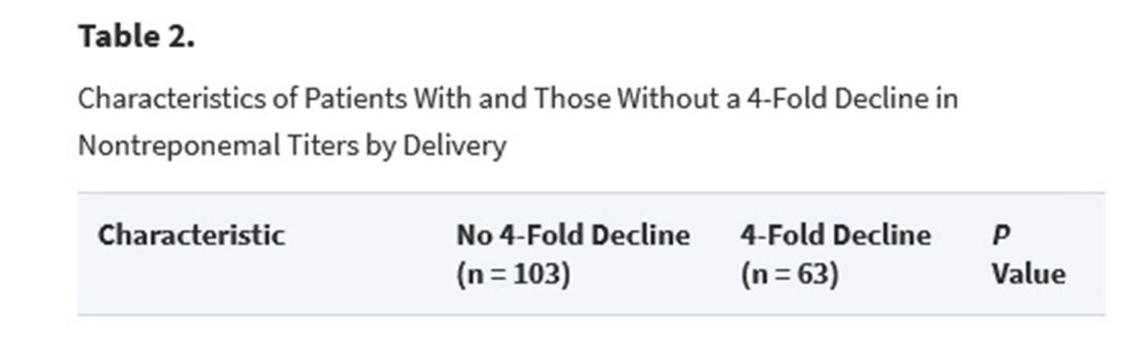

KEY IDEA: Timing counts more than titers
In one study, mothers with and without a 4-fold decline were equally likely to have infants with congenital syphilis. Early treatment matters more

Slide 66
For the Baby
If any of the following apply
Mother was not treated
Mother inadequately treated (including non-penicillin G regimen)
Mother has no documentation of having received treatment
Mother received recommended treatment <4 weeks before delivery
And infant's titer is similar to mother's titer (absence of a 4-fold difference)
Then recommendations for the newborn include
Spinal tap
10 days of IV antibiotic therapy
Ensuring that the mother receives appropriate and timely treatment helps prevent painful, invasive procedures for baby!

Slide 67
Bexar County Innovations
San Antonio Metro Health (Local public health department):
Nurse case managers for pregnant women diagnosed with syphilis
Congenital Syphilis Coordinator
Access to Care Clinician Ambassadors
Just The Facts Clinician Newsletter – Subscribe here!
DSHS (State public health department):
A community-based team reviews congenital syphilis cases to identify systemic barriers to care and find ways to reduce those barriers
  The next review workshop is scheduled for May 14, from 1:00 – 4:30 pm. Register here!
Health care providers welcome! Contact Amy.Carter@dshs.texas.gov

Slide 68
Lessons Learned from Morbidity Review Teams
Avoid stigmatizing pregnant women with syphilis, other STIs or with substance use disorders
Educate patients on their diagnosis and the tests being done – including the “why”
Have an open line of communication with the local health department to bridge gap
Notes:
STI=sexually transmitted infection

Slide 69
DID YOU KNOW?
If other efforts have failed, Metro Health can draw RPR and HIV tests at the patient’s home or another location convenient for the patient
Metro Health can transfer Bicillin to you for specific patients, after we screen them during a telehealth visit
We can help you train your staff on ventrogluteal injections (with a simulator)

Slide 70
SA Metro Health EPI Team
Metro Health EPI Hotline 24/7: 210-207-8876
Syphilis Titer & Treatment Look-up Estella Morales: 210-207-2284 (M-F)
Metro Health Surveillance Supervisor, Capri Berain: 210-207-8837 or capri.berain@sanantonio.gov (Monday through Friday 8-5)
Medical Director, Dr. Junda Woo: junda.woo@sanantonio.gov (Nights/weekends/holidays)
Congenital Syphilis Team Contact Brittany Garcia: 210-207-8862 or Brittany.garcia3@sanantonio.gov

Slide 71
Resources
Subscribe to DOCALERT! For health alerts from Metro
Health, text "DOCALERT" to 1-844-824-COSA (2672)
Message and data rates apply
Guidance
CDC: What Health Care Providers Can Do CDC 2021 STI Treatment Guidelines
CDC Syphilis Pocket Guide
STI Clinical Consultation Network
Training
John Hopkins Syphilis Webinar Jan 2021 National Online STD Curriculum Neurosyphilis Article
  Data
MMWR: Missed Opportunities for Prevention of Congenital Syphilis — United States, 2022
DSHS 2023 Congenital Syphilis Report

Slide 72
Resources & References
https://www.cdc.gov/nchhstp/atlas
CDC Fact Sheet
Click here to see a Medscape article and video
CDC’s Recommendations for Providing Quality STD Clinical Services, 2020
National Network of STI Clinical Prevention Training Centers

Slide 73

Survey (Required for CME/CNE/CE)
Please click the link or scan the QR code below to take a brief survey Your feedback is valuable to us!
https://forms.office.com/g/tBrUQ8DAGU

Slide 74

Thank you. Questions?
lucinda.zeinelabdin2@sanantonio.gov

Slide 75
Resources
National Clinician Consultation Center http://nccc.ucsf.edu/
HIV Management
Perinatal HIV
HIV PrEP
HIV PEP line
HCV Management
Substance Use Management
Present on ECHO https://hsc.unm.edu/scaetc/programs- services/echo.html
AETC National HIV Curriculum
https://aidsetc.org/nhc
AETC National Coordinating Resource Center
https://targethiv.org/library/aetc-
national-coordinating-resource-center-0
HIVMA Resource Directory
https://www.hivma.org/globalassets/ektr on-import/hivma/hivma-resource- directory.pdf
Additional trainings
scaetcecho@salud.unm.edu
www.scaetc.org

Slide 76



Follow us on Social Media!
@UTHSA_AETC
@UTHealthSAECHO

Slide 77
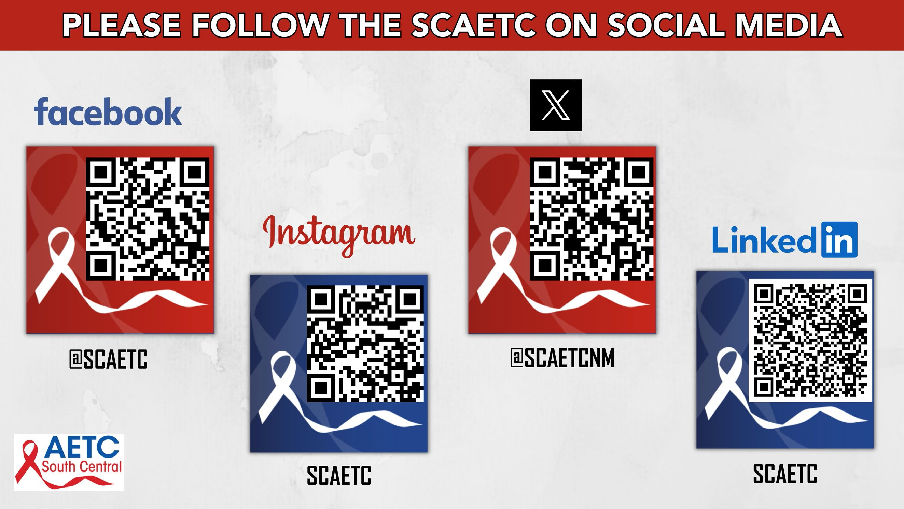
77

