Slide 1
From Hopeless to Hope-FULL: More than an ADDICT
Ceasar Corona CADC - III
Tarzana Treatment Centers
Notes:
Version date_04 2024
Target participants:

Slide 2
Conflict of Interest Disclosure Statement
Speaker has nothing to disclose
This program is supported by the Health Resources and Services Administration (HRSA) of the U.S. Department of Health and Human Services (HHS) as part of an award totaling $4,205,743 with 0% financed with non-governmental sources. The contents are those of the author(s) and do not necessarily represent the official views of, nor does mention of trade names, commercial practices, or organizations imply an endorsement by HRSA, HHS, or the U.S. Government. For more information, please visit HRSA.gov. Any trade/brand names for products mentioned during this presentation are for training and identification purposes only.

Slide 3
Unconscious Bias Disclosure
SCAETC recognizes that language is constantly evolving, and while we make every effort to avoid bias and stigmatizing terms, we acknowledge that unintentional lapses may occur in our presentations.
We value your feedback and encourage you to share any concerns related to language, images, or concepts that may be offensive or stigmatizing.
Your input will help us refine and improve our presentations, ensuring they remain inclusive and respectful to participants.

Slide 4
Learning Objectives
Describe the intersection between substance use, incarceration, hepatitis C (HCV), and HIV.
Describe the challenges for People with HIV (PWH) when trying to come to terms with their diagnosis and living in active addiction.
Discuss the role of Integrated Behavioral Healthcare has in navigating co-occurring diagnoses.
Explain the framework of the Transitional Housing Program and its role in contributing to The End of the HIV Epidemic goals.

Slide 5
13 years of active METH Addiction 1997-2010
2008 HIV diagnosis
2010 AIDS diagnosis/HCV diagnosis/Syphilis/ Incarceration
Notes:
Photo source: presenter

Slide 6
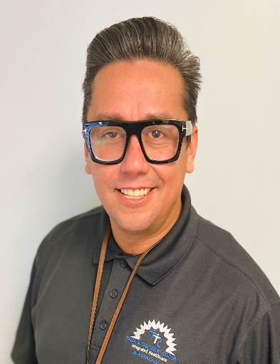
13 Years of Sobriety
Undetectable HIV
HCV cleared without treatment!
Licensed Zumba Instructor 9 years
Certified Alcohol and Drug Counselor
Currently Program Manager for Transitional Housing
Notes:
Photo source: presenter

Slide 7
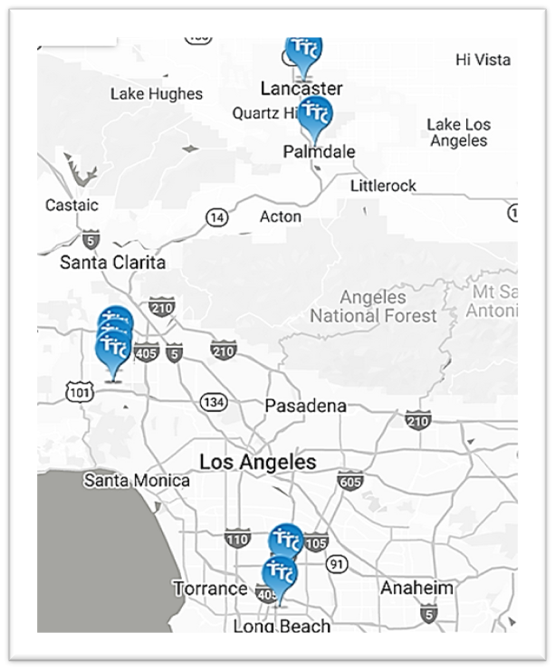
Tarzana Treatment Centers, Inc.
Non- Profit, full-service integrated healthcare organization
Provides high quality, cost effective
Substance Use Disorder and Mental Health treatment
Community-Based treatment & Services
Primary Medical & HIV Specialty care
In-patient behavioral health services
Residential alcohol and drug treatment
Home Health services
Housing and Peer support services
Covering All of Los Angeles County since 1972
Tarzana Treatment Centers, Inc.

Slide 8
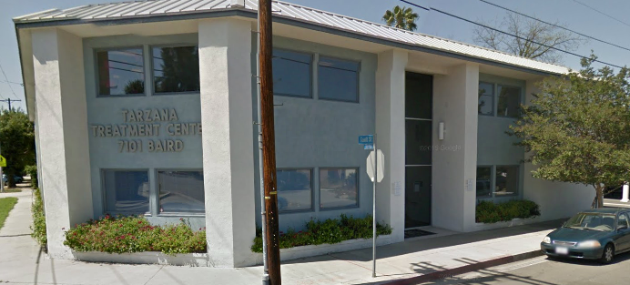
Tarzana Treatment Centers
HIV Specialty Services in Reseda
Tarzana Treatment Centers in Reseda is home to our Community Programs and Services.
Tarzana Treatment Centers provides HIV services for both those with HIV and those affected by HIV with vital health education, nutritional consulting, and treatment strategies for an improved and extended quality of life. Our goal is to help our clients get back to living the fullest life they can.
Tarzana Treatment Centers, Inc.
HIV Education & Prevention Programs
HIV Specialty Medical Care
Case Management
Housing
Vocational / Life Skills
Substance Abuse
Mental Health Services
Community Outreach Programs

Slide 9
Integrated System of
Behavioral & Medical Care
Medical
Mental Health
Substance Use
Social Services
Care Coordination
Tarzana Treatment Centers, Inc.
Whole Person Approach

Slide 10
Integrated System of
Behavioral & Medical Care
Guided by population-health metrics and patient-centered care standards,
TTC provides integrated services that are coordinated, comprehensive, and team-based.
Patients are screened and assessed for medical and behavioral health conditions and receive whole person care guided by an integrated treatment plan.
Care management and coordination for individuals with chronic substance use disorders, mental illness and/or medical conditions
Team based approach in ensuring medical and behavioral healthcare needs of patient are being met.
Tarzana Treatment Centers, Inc.

Slide 11
Transitional Housing Program (THP)
Our Houses
Our Contract
Our Promise
Currently we have multiple houses in our Transition Housing Program. All houses blend in with the neighborhood and are equipped with the necessities as set forth by our contract guidelines.
We house up to 6 patients in each residence with 2 occupants to a room. Our contract allows a person to use up to 365 days of treatment with the possibility of an extension if qualified.
To provide high quality, integrated healthcare, which improves the quality of life and health of our patients.
Tarzana Treatment Centers, Inc.

Slide 12
Stabilize, Utilize, and Mobilize The Benefits of The Transitional Housing Program

Slide 13
Stabilize: Let’s get them in…
Qualify
Interview
Assess/Enroll
Patients must have the following to qualify:
HIV Diagnosis
LA County Residency
Substance Use
Recent tuberculosis
Letter of Referral
Application needs to be completed with all qualifying documentation to schedule the patient for an interview.
Once interview is complete and patient is a good fit, they will be scheduled for Intake/Assessment and move in.
Tarzana Treatment Centers, Inc.

Slide 14
Utilize: Let’s create their map…
Orient
Connect
Navigate
Patients are asked to give 90 days of programming with no work or school to acclimate to the program. Housing Managers help patients become familiar with program.
Case Manager works with the patient on linkage through their treatment plan.
Patient implements plan by setting SMART goals with case manager to navigate treatment.
Tarzana Treatment Centers, Inc.

Slide 15
Tarzana Treatment Centers, Inc.

Slide 16
Mobilize: Allow them to steer…
Accountability
Consistency
Transition
Once the patients are established in the program, THP works with them to keep on task.
Patients are responsible for making weekly sessions. We hold weekly case conference to discuss patient participation, needs, and concerns.
The goal is preparing each participant for the next stage in their journey.
Tarzana Treatment Centers, Inc.

Slide 17
Our role in the ENDING THE HIV EPIDEMIC (EHE)
Our program focuses on the key strategy of TREAT:
Treat people with HIV rapidly and effectively to reach sustained viral suppression.
All participants are linked and connected to HIV Care.
All participants have sustained viral suppression.
All participants receive regular HIV education.
As an organization TTC focuses on all 4 key strategies:
We offer FREE HIV testing with rapid linkage to care.
We offer PrEP services with extensive outreach in our communities.
We have Syringe Services Programs (SSPs) that services Los Angeles County on a weekly basis.
Our organization has various program grants that specifically target gaps in HIV prevention and treatment services to stop ongoing transmission.
HIV.gov
Notes:
PrEP=pre-exposure prophylaxis

Slide 18
Thank you!
The more you praise and celebrate your life, the more there is in life to celebrate.
- Oprah Winfrey

Slide 19
QUESTIONS:

Slide 20
References
HIV.gov
https://www.hiv.gov/federal-response/ending-the-hiv-epidemic/key-strategies

Slide 21
Resources
National Clinician Consultation Center http://nccc.ucsf.edu/
HIV Management
Perinatal HIV
HIV PrEP
HIV PEP line
HCV Management
Substance Use Management
Present on ECHO
https://hsc.unm.edu/scaetc/programs-services/echo.html​
AETC National HIV Curriculum https://aidsetc.org/nhc
AETC National Coordinating Resource Center https://targethiv.org/library/aetc-national-coordinating-resource-center-0
HIVMA Resource Directory https://www.hivma.org/globalassets/ektron-import/hivma/hivma-resource-directory.pdf
Additional trainings scaetcecho@salud.unm.edu
www.scaetc.org
Notes:
IDEA Platform: Infectious Diseases Education & Assessment. https://idea.medicine.uw.edu/
AETC National HIV Curriculum: 6 core modules for self study; regularly updated; CME, CNE
Hepatitis C Online Curriculum: https://www.hepatitisc.uw.edu/
Hepatitis B Online Curriculum: https://www.hepatitisb.uw.edu/
National STD Curriculum: https://www.std.uw.edu/

Slide 22
Notes:
Find an HIV-related topic TeleECHO in your area: https://echo.unm.edu/locations-2/echo-hubs-superhubs-united-states/
IDEA Platform: Infectious Diseases Education & Assessment. https://idea.medicine.uw.edu/
AETC National HIV Curriculum: 6 core modules for self study; regularly updated; CME, CNE
Hepatitis C Online Curriculum: https://www.hepatitisc.uw.edu/
Hepatitis B Online Curriculum: https://www.hepatitisb.uw.edu/
National STD Curriculum: https://www.std.uw.edu/

