Slide 1
Conference Update: CROI 2024
Daniel Lee, MD
Clinical Professor of Medicine, UC San Diego Health – Owen Clinic
HIV Learning Network (HIVLN) Clinical Director
May 9th, 2024

Slide 2
Disclaimer
The views and opinions expressed in this presentation are not necessarily those of the Pacific AIDS Education & Training Center (Pacific AETC) or its eight local partner sites in HRSA Region 9, the Regents of the University of California or its San Francisco campus (UCSF or collectively, University) nor of our funder the Health Resources and Services Administration(HRSA). Neither Pacific AETC, University, HRSA nor any of their officers, board members, agents, employees, students or volunteers make any warranty, express or implied, including the warranties of merchantability and fitness for a particular purpose; nor assume any legal liability or responsibility for the accuracy, completeness or usefulness of information, product or process assessed or described; nor represent that its use would not infringe privately owned rights.
HRSA Acknowledgement Statement The Pacific AETC is supported by the Health Resources and Services Administration (HRSA) of the U.S. Department of Health and Human Services (HHS) as part of an award totaling $4,377,449. The contents are those of the author(s) and do not necessarily represent the official views of, nor an endorsement, by HRSA, HHS, or the U.S. Government. For more information, please visit HRSA.gov.
Trade Name Disclosure Statement Funding for this presentation was made possible by 5 U1OHA29292‐08‐00 from the Human Resources and Services Administration HIV/AIDS Bureau. The views expressed do not necessarily reflect the official policies of the Department of Health and Human Services nor does mention of trade names, commercial practices, or organizations imply endorsement by the U.S. Government. Any trade/brand names for products mentioned during this presentation are for training and identification purposes only.

Slide 3
Disclosures
The following presenter have disclosed the following relationship with a commercial interest.
Daniel Lee, MD
Gilead Sciences: stock ownership
Theratechnologies Inc.: advisor, consultant
EMD Serono, Inc.: advisor, consultant
Resolution: This presentation has been reviewed by the PAETC Clinical Director, who reports the above disclosures have had no effect on the content of this presentation.
All other presenters of this continuing medical education activity have indicated that neither they nor their spouse/legally recognized domestic partner has any financial relationships with commercial interests related to the content of this activity.
A special thanks goes to Dr. Meredith Greene for many of her slides that are used/adapted in this presentation

Slide 4
Learning Objectives
At the completion of this presentation, participants will be able to:
Describe the DoxyPEP studies for sexually transmitted infection (STI) prevention
Review the newest data regarding novel antiretroviral therapies in the pipeline
Summarize the recent updates regarding the management of antiretroviral therapy-related weight gain

Slide 5
STI PREVENTION

Slide 6
Q1: Which of the following is false regarding the use of Doxy-PEP?
Doxy-PEP reduces the incidence of syphilis
Doxy-PEP reduces the incidence of chlamydia
Doxy-PEP reduces the incidence of gonorrhea
Doxy-PEP reduces the incidence of sexually transmitted infections (STIs)
All of the above statements are true
Notes:
Answer is C

Slide 7
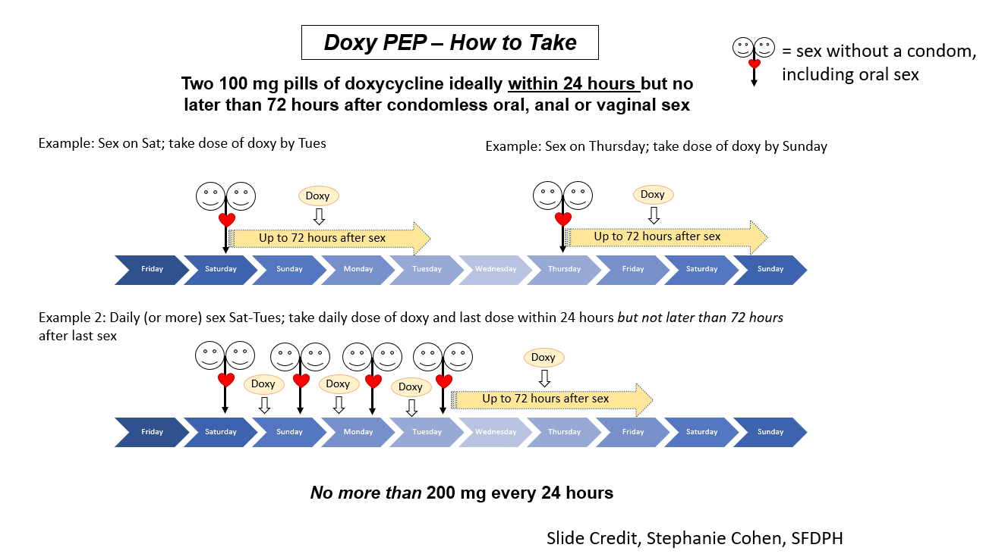
How to Take Doxy-PEP

Slide 8
DOXYVAC Study (Final Results): Prevention of STIs in MSM on PrEP
Phase 3
Open-label, superiority
MSM on PrEP for ≥6 months
Bacterial STI in prior 12 months
No STI symptoms
DoxyPEP
(n=362)
4CMenB
No Vaccine
Up to 96 Weeks Follow-Up
No DoxyPEP
(n=183)
4CMenB
No Vaccine
DoxyPEP: 200 mg within 72 hours of condomless sex.
4CMenB: Meningococcal type B vaccine.
STI testing: baseline and every 3 months.
GC: gonorrhea; CT: Chlamydia trachomatis.
Primary endpoints:
DoxyPEP: incidence of 1st episode of CT or syphilis.
4CMenB: incidence of a 1st episode of GC, 1 month after the second injection.
Baseline characteristics:
Age: 40 years.
Duration of PrEP use: 33 months.
STI (GC/CT/syphilis): 68%/49%/21%.
Sexual partners in past 3 months: 10.
Chemsex at last sex act: 22%.
Molina J-M, et al. CROI 2024. Abstract 124.

Slide 9
DOXYVAC Study (Final Results): Incidence of Time to First STIs in MSM on PrEP
Doxycycline PEP
Significantly reduced STIs
Well tolerated
4CMenB vaccine
Reduction in 1st episode of GC (P=0.06)
No interaction between doxycycline PEP and 4CMenB vaccine
DoxyPEP Cohort
4CMenB Cohort
Doxycycline PEP (n=362)
Standard of care (n=183)
4CMenB (n=274)
No vaccine (n=270)
33% reduction
aHR: 0.67
(P=0.003)
aHR: 0.78 (P=0.06)
77.1
83% reduction
22% reduction
aHR: 0.17
(P<0.0001)
68.1
58.3
53.2
Incidence (per 100 patient-years)
45.5
8.8
Chlamydia or Syphilis
Gonorrhea
Gonorrhea
GC: gonorrhea; CT: Chlamydia trachomatis.
Molina J-M, et al. CROI 2024. Abstract 124.

Slide 10
DoxyPEP Open-Label Extension: Doxycycline PEP for STI Prevention
Open-label trial in SF and Seattle
MSM and transgender women
Without HIV, on PrEP (n=327)
PWH (n=174)
≥1 STI in past 12 months
Condomless sex with ≥1 male partner in past 12 months
PEP
Doxycycline 200 mg*
DoxyPEP
Open-Label
Extension
(n=289)
Randomization
2:1
No PEP
Standard of Care
Month 0 6 12
DoxyPEP Reductions/Quarter
Bacterial STIs: 65%
CT and syphilis: ~80%
GC: ~50%
*Taken as PEP within 72 hours after condomless sexual contact.
GC: gonorrhea; CT: Chlamydia trachomatis; RPR: rapid plasma reagin.
STI testing: quarterly 3-site GC/CT testing + RPR, GC culture before treatment.
Primary endpoint: ≥1 incident STI (GC/CT/syphilis) during a follow-up quarter.
Open-label baseline demographics (median values):
Age: 36 years.
White/black/Asian/other: 64%/6%/12%/18%.
Man/transgender: 96%/4%.
STI (GC/CT/syphilis): 68%/58%/20%.
Sexual partners in past 3 months: 11.
Substance use in past 3 months: 58%.
Luetkemeyer A, et al. CROI 2024. Abstract 125.

Slide 11
DoxyPEP Open-Label Extension: Sustained Reductions in STI Incidence per Quarter
Randomized Phase (OLE Patients)
OLE
GT only Syphilis only
CT only ≥2 STIs
GT only Syphilis only
CT only ≥2 STIs
31%
Risk
Reduction
61%
Percent of
Quarterly Visits With STI
Percent of
Quarterly Visits With STI
17%
12%
13%
Doxycycline
PEP
(n=207)
Standard of Care
(n=82)
Doxycycline
PEP
(n=207)
Standard of Care to Doxycycline PEP
(n=82)
GC: gonorrhea; CT: Chlamydia trachomatis; OLE: open-label extension.
Luetkemeyer A, et al. CROI 2024. Abstract 125.

Slide 12
Clinical Implementation of DoxyPEP
Single-center cohort study of PrEP users (2022-2023)
DoxyPEP offered to all PrEP clients
Groups: DoxyPEP (n=1872) and no DoxyPEP (n=1209)
Overall STI incidence declined rapidly after implementation
No impact on GC
STI Incidence
IRR (95% CI)
Q1
Q5
Any STI: 0.42 (0.24-0.74) (P=0.003)
CT: 0.33 (0.23-0.46) (P<0.001)
Syphilis: 0.22 (0.09-0.54) (P=0.001)
GC: 0.89 (0.69-1.15) (P=0.4)
18.1
Any STI: 58% reduction
CT: 67% reduction
Syphilis: 78% reduction
GC: 11% reduction
STI Incidence per Quarter
7.5
7.5
5.5
DoxyPEP
No DoxyPEP
CT: Chlamydia trachomatis.
GC: gonorrhea.
Scott H, et al. CROI 2024. Abstract 126LB.

Slide 13
DoxyPEP Study: Impact of DoxyPEP on Gut Microbiome
Metagenomic sequencing of DNA and RNA from self-collected rectal swabs
Gut bacterial microbiome alpha diversity, beta diversity, and total bacterial abundance
No difference between DoxyPEP and no DoxyPEP arms
DoxyPEP did not significantly alter bacterial gut microbiome diversity or composition but was associated with an increase in tetracycline ARG, without affecting non-tetracycline ARG classes
Clinical impact of these findings remains undetermined and should be further studied
ARG: antimicrobial resistance genes.
Chu VT, et al. CROI 2024. Abstract 1154LB.

Slide 14
SWITCH STUDIES

Slide 15
Q2: What is the most common reason for switching antiretroviral therapy in your experience?
Switch due to patient-reported side effects (to improve tolerability)
Switch due to lab abnormalities (to reduce drug toxicity)
Switch to simplify or consolidate regimen (to reduce pill burden)
Switch to an updated integrase inhibitor regimen (following guidelines)
Switch to a long-acting injectable agent (to improve quality of life)
Other (please type in chat pod)
Notes:
No correct answer

Slide 16
CARES: Switch to Long-Acting Injectable Cabotegravir + Rilpivirine in Virologically Suppressed PWH
Phase 3b study conducted in
sub-Saharan Africa
On stable oral ART
Dolutegravir/nevirapine/efavirenz + 2 NRTIs
HIV RNA <50 copies/mL
No history of treatment failure
No HBV
Cabotegravir + Rilpivirine q8 weeks
(n=256)
Oral ART
(n=256)
Week 0 48 96
Current Analysis
Primary outcomes:
HIV RNA <50 copies/mL at week 48 (non-inferiority margin: -0.5%).
Baseline characteristics:
Age (median): 42 years.
Male: 42%.
BMI ≥30 kg/m²: 21%.
Archived DNA analysis (intermediate/high-level resistance):
Rilpivirine/cabotegravir: 10%/8%.
Kityo CM, et al. CROI 2024. Abstract 122LB.

Slide 17
CARES: Outcomes at Week 48
Virologic outcomes
Switching to long-acting injectable cabotegravir + rilpivirine was non-inferior to continuing oral ART
Virologic failure with cabotegravir + rilpivirine (HIV RNA ≥200 copies/mL) (n=2)
No delayed injections
Rilpivirine and cabotegravir mutations present
Resuppressed on dolutegravir + F/TDF (n=1)
Switching to cabotegravir + rilpivirine
Generally safe and well tolerated
Increased treatment satisfaction
Virologic Outcomes at Week 48 (ITT)
Difference: 0.5
(95% CI -3.4, 2.4)
97%
97%
Switch to cabotegravir + rilpivirine (n=255)
Continue oral ART (n=257)
Patients (%)
Difference: 0.3
(95% CI -2.2, 2.8)
2%
2%
HIV RNA
<50 Copies/mL
HIV RNA
≥50 Copies/mL
Kityo CM, et al. CROI 2024. Abstract 122LB.

Slide 18
IMPAACT 2017 (MOCHA): Switch to Long-Acting Injectable Cabotegravir + Rilpivirine in Adolescents
Phase 1/2, open-label, single arm study (n=144)
12 to <18 years of age
Vertically infected with HIV (93%)
Virologically suppressed on background ART before switch to long-acting injectable cabotegravir + rilpivirine q8 weeks (following 4-week oral lead-in)
Primary results
No virologic failures
Injection-site reactions: 35%
No deaths or life-threatening events
Preferred long-acting injectable ART over oral ART: 99%
Study conducted in Botswana, South Africa, Thailand, Uganda, and US.
Gaur A, et al. CROI 2024. Abstract 188LB.

Slide 19
ACTG A5359 (LATITUDE Study): Long-Acting Injectable ART in Non-Adherent PWH
Phase 3 study (open-label, 180 weeks)
Long-acting injectable cabotegravir + rilpivirine q4 weeks versus SOC ART
Inclusion criteria
On ART for >6 months, HIV RNA >200 copies/mL, non-adherence*, no INSTI or rilpivirine resistance-associated mutations, no HBV
Current analysis (Step 2)
Primary outcome: confirmed virologic failure or treatment discontinuation
Study Design
Step 1 (induction phase)
SOC oral ART, financial incentives for meeting study-specified goals
Step 2 (randomization phase)
Randomized 1:1 long-acting injectable ART or continue SOC for 52 weeks
Step 3 (continuation/crossover phase)
Continue long-acting injectable ART
Eligible SOC patients cross over to long-acting injectable ART for 52 weeks
Step 4 (observational phase)
Switch long-acting injectable ART (patients who are no longer eligible for injections) back to locally sourced oral SOC ART for 52 weeks
SOC: standard of care.
*Poor virologic response: HIV RNA <200 copies/mL (2x, ≥4 weeks apart) or
loss to follow-up with ART non-adherence for ≥6 consecutive months.
Rana AI, et al. CROI 2024. Abstract 212LB.

Slide 20
ACTG A5359 (LATITUDE Study): Outcomes at Week 52 (Step 2)
On time cabotegravir + rilpivirine injections: 93%
Cumulative probability of adverse events was similar between the 2 arms
Considering all endpoints together, long-acting injectable cabotegravir + rilpivirine demonstrated superiority compared with daily oral SOC ART
Key Findings at Week 52
 | Cabotegravir + Rilpivirine (n=146) | SOC (n=148) | Difference (95% CI)
Regimen failure (%) | 24 | 39 | -14.5 (-29.8, 0.8)
Virologic failure (%) | 7 | 25 | -18.2 (-31.1, -5.4)
Treatment-related failure (%) | 10 | 26 | -16.6 (-29.9, -3.3)
Permanent treatment discontinuation (%) | 21 | 25 | -4.1 (-18.0, 9.8)
SOC: standard of care.
Rana AI, et al. CROI 2024. Abstract 212LB.

Slide 21
ACTG A5357: bNAB (VRC07-523LS) + Long-Acting Injectable Cabotegravir for Maintenance of HIV Suppression
Phase 2 (n=74)
HIV RNA <50 copies/mL for ≥2 years
On PI/NNRTI/INSTI + 2 NRTIs
CD4 ≥350 cells/µL
No prior switch due to virologic failure
Step 1
Step 2
Step 3
Daily Oral
Cabotegravir
+ 2 NRTIs
(4 weeks)
IM Cabotegravir
q4 weeks +
IV bNAb q8 weeks
Standard of Care
ART
Week 0 48 96
Primary outcomes:
Safety.
HIV RNA ≥200 copies/mL at or prior to week 44).
Baseline characteristics:
Age (median): 54 years.
Male: 74%.
BMI: 28 kg/m².
CD4: 720 cells/µL.
Taiwo B, et al. CROI 2024. Abstract 119.

Slide 22
ACTG A5357: Outcomes
Stopped treatment due to safety criteria (17%)
Virologic failure (n=5): 7.5%
Cabotegravir trough levels were within the therapeutic range
bNAb concentrations were 100-fold than screening IC50 and IC80
No participant had anti-drug antibodies to VRC07-523LS
Combination was safe
Need for a better understanding of the mechanisms underlying breakthroughs
Taiwo B, et al. CROI 2024. Abstract 119.

Slide 23
ARTISTRY-1 Study: Switch to Daily Lenacapavir + Bictegravir in PWH on Complex ART Regimens
Phase 2
Open-label
HIV RNA <50 copies/mL on SBR
for ≥6 months
No prior lenacapavir exposure or
bictegravir resistance
eGFR: ≥15 mL/min
Bictegravir + Lenacapavir 25 mg qd
(n=51)
Bictegravir + Lenacapavir 50 mg qd
(n=52)
Continue SBR
(n=25)
Week 0 24 48
SBR: stable baseline regimen.
Primary outcome:
HIV RNA ≥50 copies/mL at week 24 (FDA snapshot).
Baseline characteristics:
Age (median): 50 years.
Male: 71%.
CD4: 610 cells/µL.
Prior AIDS: 26%.
Historical resistance mutations:
INSTI/NNRTI/NRTI/PI: 0%/52%/64%/36%.
Mounzer K, et al. CROI 2024. Abstract 642.

Slide 24
ARTISTRY-1 Study: Outcomes at Week 24
Virologic outcomes
Switching to bictegravir + lenacapavir was effective in maintaining viral suppression
CD4 cell gain
Numerical higher in the bictegravir + lenacapavir groups compared with SBR
All regimens were well tolerated with similar safety profiles
Data support the continued evaluation of bictegravir and lenacapavir to optimize ART in virologically suppressed PWH who are receiving complex regimens
Virologic Outcomes at Week 24
(FDA Snapshot)
100%
96%
96%
BIC + LEN 25 mg (n=51)
BIC + LEN 50 mg (n=52)
SBR (n=25)
Patients (%)
Difference: -1.9
(95% CI -12.2, 10.7)
0%
2%
0%
HIV RNA
<50 Copies/mL
HIV RNA
≥50 Copies/mL
SBR: stable baseline regimen.
Mounzer K, et al. CROI 2024. Abstract 642.

Slide 25
Potential future hiv treatments

Slide 26
Q3: Which of the following future HIV treatment options are you most excited about?
Longer-acting injectable antiretroviral therapy (every 6 months or longer)
Oral weekly antiretroviral therapy
Broadly neutralizing antibodies
Don’t know
Notes:
No correct answer

Slide 27
Ultra Long-Acting Injectables
Abstract 654: Nayan MU, et al. – Ultra long acting Bictegravir prodrug (NM2BIC and NMXBIC) has the potential for every 6 month dosing
Evaluated for possible SQ and IM administration
Abstract 656: Kearney BP, et al. – Cabotegravir stearate (XVIR-110) which is a ultra long prodrug has the potential for every 6 or 12 month dosing
Half-life is 120 days in rats, 150 days in beagles
May be considered for PrEP or HIV treatment

Slide 28
Phase II Trial of Oral Weekly ISL + LEN in People With HIV: Study Design
Islatravir = nucleoside reverse transcriptase translocation inhibitor (NRTTI)
Lenacapavir = capsid inhibitor
Open-label, active-controlled phase II trial
Primary endpoint: proportion of participants with HIV-1 RNA ≥50 c/mL at Wk 24 by FDA Snapshot algorithm
Secondary endpoints: proportion of participants with HIV-1 RNA ≥50 c/mL by Wk 12 and 48; proportion with HIV-1 RNA <50 c/mL at Wk 12, 24, and 48; change from baseline in CD4+ T-cells, AEs leading to discontinuation of study drug; PK
Wk 48
Adult people with HIV with VL <50 c/mL on BIC/FTC/TAF; no history of virologic failure; CD4+ T-cell count ≥350 cells/µL and ALC ≥900 cells/µL; no HBV infection (N = 106 randomized, 104 dosed)
ISL 2 mg + LEN 300 mg PO QW
(n =52)
Extension Phase
ISL 2 mg + LEN 300 mg PO QW
BIC/FTC/TAF PO QD
(n = 52)
ALC, absolute lymphocyte count; BIC, bictegravir; FTC, emtricitabine; HBV, hepatitis B virus; ISL, islatravir; LEN, lenacapavir; PK, pharmacokinetics; TAF, tenofovir alafenamide; VL, viral load.
Colson. CROI 2024. Abstr 208.
Notes:
ALC, absolute lymphocyte count; BIC, bictegravir; FTC, emtricitabine; HBV, hepatitis B virus; ISL, islatravir; LEN, lenacapavir; PK, pharmacokinetics; TAF, tenofovir alafenamide; VL, viral load.

Slide 29
Phase II Trial of Oral Weekly ISL + LEN: Baseline Demographics and Efficacy
Characteristic, n (%) | ISL + LEN (n = 52) | BIC/FTC/TAF (n = 52)
Median age, yr (range) | 40 (28-67) | 40 (26-76)
Female at birth, n (%) | 10 (19.2) | 9 (17.3)
Race, n (%) White Black Asian American/Alaska Native Hawaiian or Pacific Islander Other | 25 (48.1) 21 (40.4) 2 (3.8) 1 (1.9) 0 (0) 3 (5.8) | 27 (51.9) 16 (30.8) 1 (1.9) 2 (3.8) 1 (1.9) 5 (9.6)
Ethnicity, Hispanic or Latino/a, n (%) | 13 (25.0) | 17 (32.7)
Mean (SD) CD4+ T-cells/µL ≥500 | 755 (223.6) 46 (88.5) | 818 (271.3) 50 (96.2)
Mean (SD) ALC x 10³/µL | 1.94 (0.445) | 1.95 (0.652)
Viral Suppression at Wk 24
100
94.2
94.2
80
ISL + LEN
BIC/FTC/TAF
60
Participants (%)
40
20
1.9
3.8
5.8
0
0
N =
1
0
49
49
2
3
HIV-1 RNA ≥50 c/mL
HIV-1 RNA <50 c/mL
No data in window
Participant with HIV-1 RNA ≥ 50 c/mL:
Resuppressed at Wk 30 on ISL + LEN
No resistance and adequate PK
BIC, bictegravir; FTC, emtricitabine; ISL, islatravir; LEN, lenacapavir; PK, pharmacokinetics; TAF, tenofovir alafenamide.
Colson. CROI 2024. Abstr 208.
Notes:
BIC, bictegravir; FTC, emtricitabine; ISL, islatravir; LEN, lenacapavir; PK, pharmacokinetics; TAF, tenofovir alafenamide.

Slide 30
Phase II Trial of Oral Weekly ISL + LEN: Safety
Patients With AE, n (%) | ISL + LEN (n = 52) | BIC/FTC/TAF (n = 52)
Any AE | 40 (76.9) | 38 (73.1)
Any TRAE | 9 (17.3) | 3 (5.8)
Grade 1/2 TRAEs in ≥2 on ISL + LEN Dry mouth Nausea | 9 (17.3) 2 (3.8) 2 (3.8) | 3 (5.8) 0 0
Grade 3/4 TRAEs | 0 (0) | 0 (0)
Serious AE | 3 (5.8) | 0
AE leading to d/c | 2 (3.8) | 0
Patients With Grade 3/4 Lab Abnormality, n (%) | ISL + LEN (n = 52) | BIC/FTC/TAF (n = 52)
Grade 3 Increased ALT Increased SCr Decreased CrCl Fasting hyperglycemia Non-fasting hyperglycemia Hyperkalemia Glycosuria | 5 (9.6) 1 (1.9) 1 (1.9) 2 (3.8) 0 1 (2.5) 1 (1.9) 1 (1.9) | 4 (7.8) 0 0 2 (3.9) 1 (2.6) 2 (4.9) 0 2 (3.9)
Grade 4 Increased creatine kinase | 1 (1.9) 1 (1.9) | 0 0
Only clinically significant grade 3/4 lab abnormality was elevated ALT in a person with acute hepatitis B
AE, adverse event; ALT, alanine transaminase; BIC, bictegravir; CrCl, creatinine clearance; FTC, emtricitabine; ISL, islatravir; LEN, lenacapavir; SCr, serum creatinine; TAF, tenofovir alafenamide; TRAE, treatment-related adverse event.
Colson. CROI 2024. Abstr 208.
Notes:
AE, adverse event; ALT, alanine transaminase; BIC, bictegravir; CrCl, creatinine clearance; FTC, emtricitabine; ISL, islatravir; LEN, lenacapavir; SCr, serum creatinine; TAF, tenofovir alafenamide; TRAE, treatment-related adverse event.

Slide 31
Phase II Trial of Oral Weekly ISL + LEN: CD4 and ALC Changes Through Wk 24
Change in CD4
ISL+LEN
BIC/FTC/TAF
Change in Absolute Lymphocyte Counts
300
0.3
0.2
-0.01^{b}
100
-4ª
0.1
Mean (95% CI) Change, Cells/µL
Mean (95% CI) Change, x 10³ Cells/µL
0
P = .6301^{c}
P = .3477^{c}
-100
-0.1
-57^{b}
-0.2
-0.04^{d}
-300
-0.3
D1
W4
W8
W12
W18
W24
D1
W4
W8
W12
W18
W24
Mean Values
Mean Values
No between group differences for change from baseline to Wk 24 for CD4+ T-cells (P = .3477) or ALC (P = .6301)
No person discontinued treatment due to decline in CD4+ T-cells or ALC
ALC, absolute lymphocyte count; BIC, bictegravir; FTC, emtricitabine; ISL, islatravir; LEN, lenacapavir; TAF, tenofovir alafenamide.
Colson. CROI 2024. Abstr 208.
Notes:
ALC, absolute lymphocyte count; BIC, bictegravir; FTC, emtricitabine; ISL, islatravir; LEN, lenacapavir; TAF, tenofovir alafenamide.

Slide 32
Additional Oral Weekly HIV Treatments in Development
GS-1720 INSTI phase Ia/b results
Median t_{1/2} = 9.4 days
Potent antiviral activity
MK-8527 NRTTI phase I results
Following single oral doses of 0.5, 1, 3, and 10 mg, mean decrease in HIV-1 RNA at Day 7 was ≥1.0 log₁₀ c/mL
0
Historical Placebo
Log₁₀ c/mL, Mean (Range) | Change in Plasma HIV-1 RNA at Day 7
Trial A 10 mg (n = 6) 3 mg (n = 6) 1 mg (n = 5) | -1.39 (-0.87 to -1.67) -1.66 (-1.23 to -2.02) -0.95 (0.03 to -1.60)
Trial B 1 mg (n = 8) 0.5 mg (n = 6) 0.25 mg (n = 6) | -1.38 (-0.98 to -2.10) -1.40 (-1.24 to -1.54) -0.80 (-0.37 to -1.21)
-1
Mean (95% CI) HIV-1 RNA Change (log₁₀ copies/mL)
Mean (95% CI) Change From Day 1 to Day 11:
-1.74 (-2.45, -1.03)
-2.18 (-2.37, -2.00)
-2.44 (-2.83, -2.04)
-2.37 (-2.84, -1.90)
All P <.0001 vs placebo
30 mg
150 mg
450 mg
900 mg
2
-3
1
2
3
4
5
6
7
8
9
10
11
Days
GS-1720
Administered
CI, confidence interval; c/mL, copies/mL; INSTI, integrase strand transfer inhibitor; NRTTI, nucleoside reverse transcriptase translocation inhibitor; t_{1/2}, half-life.
Fichtenbaum. CROI 2024. Abstr 116. Carstens. CROI 2024. Abstr 115.
Notes:
CI, confidence interval; c/mL, copies/mL; INSTI, integrase strand transfer inhibitor; NRTTI, nucleoside reverse transcriptase translocation inhibitor; t_{1/2}, half-life.

Slide 33
Broadly Neutralizing Antibodies in HIV Treatment
Trial | Phase | N | Agents (Target) | Results
BANNER¹ | IIa | 62 | N6LS (CD4bs)* | Exposure-dependent antiviral activity BL N6LS activity predicted concentration needed to achieve adequate antiviral effect Higher exposure with IV vs SC
ACTG A5357² | II | 71† | VRC07-523LS (CD4bs) + LA CAB‡ | 5 cases of virologic failure, 2 resuppressed, no ADAs 1 developed R263K to CAB w/high BL VRC07-523LS IC50 16.9% w/AEs, 1 Grade 1 IRR leading to d/c
NCT04811040³ | Ib | 11 | LEN + TAB (CD4bs) + ZAB (V3)§ | 8/10 maintained suppression at Wk 26 when highly susceptible to 1 of 2 bNAbs, 2 w/HIV-1 RNA ≥ 50 c/mL Most common AE: grade 1 ISR related to LEN
T003⁴ | I/IIa | 12‖ | PGDM1400 (V2) + PGT121 (V3) + VRC07-523LS (CD4bs)¶ | 83% maintained suppression at Wk 28 36% maintained suppression at Wk 44 w/bNAb decline 2 cases early rebound w/BL resistance, 5 late rebound
*Single infusion 1-40 mg/kg IV or 10 mg/kg SC. †Received VRC01-523LS (CD4-binding site) + CAB LA. ‡40 mg/kg VRC01-523LS IV Q8W + IM CAB LA Q4W. §LEN 600 mg D1, D2, LEN 927 SC mg D1 + single infusion 30 mg/kg TAB on D1 + single infusion 10 mg/kg IV or 30 mg/kg IV ZAB on D1.
‖In analysis set. ¶20 mg/kg PGDM1400 IV Q4W, 20 mg/kg IV PGT121 Q4W, 20 mg/kg VRC01-523LS IV Q4W.
1. Losos. CROI 2024. Abstr 117. 2. Taiwo. CROI 2024. Abstr 119. 3. Eron. CROI 2024. Abstr 120. 4. Juelg. CROI 2024. Abstr 121.
ADAs, anti-drug antibodies; AE, adverse event; BL, baseline; CAB LA, long-acting cabotegravir; CD4bs, CD4 binding site; d/c, discontinuation; IRR, infusion-related reaction; ISR, injection site reaction; LEN, lenacapavir; TAB, teropavimab; ZAB, zinlirvimab.
Notes:
ADAs, anti-drug antibodies; AE, adverse event; BL, baseline; CAB LA, long-acting cabotegravir; CD4bs, CD4 binding site; d/c, discontinuation; IRR, infusion-related reaction; ISR, injection site reaction; LEN, lenacapavir; TAB, teropavimab; ZAB, zinlirvimab.

Slide 34
Management of WEIGHT GAIN/Obesity related to antiretroviral therapies

Slide 35
Q4: All of the following are potential side effects of using GLP-1 Receptor Agonists except…?
Nausea/vomiting
Diarrhea
Constipation
Fat loss
Muscle mass gain
None of the above – all are expected side effects
Notes:
Answer is E

Slide 36
GLP-1 Receptor Agonists

Slide 37
GLP-1 Session Overview

Slide 38
Impact of Semaglutide on Weight in PWH
CNICS cohort study (2018-2022; n=222)
Initiated injectable or oral semaglutide and had ≥2 weight measurements
Baseline characteristics
Age (53 years), virologically suppressed (89%), diabetic (77%), female (25%), HbA1c (7.7%)
Semaglutide results at 1 year
Associated with significant weight loss (6.5 kg [5.7% of bodyweight])
Amount of weight lost correlated with higher BMI (P<0.05)
CNICS: Centers for AIDS Research Network of Integrated Clinical Systems.
Crane HM, et al. CROI 2024. Abstract 797.

Slide 39
Impact of Semaglutide on Inflammation and Immune Activation in HIV-Associated Lipohypertrophy
Randomized, double-blind study (n=108)
Stable ART, HIV-associated hypertrophy, BMI ≥25 kg/m², waist circumference (male/female ≥95/≥94 cm)
Baseline characteristics
Age (53 years), HbA1c (5.6%), INSTI (82%)
Groups
Semaglutide versus placebo
Semaglutide had significant effects on several key biomarkers associated with CVD in HIV
Key Findings at Week 32
 | Changes With Semaglutide (%)
Visceral adipose tissue | -31
Subcutaneous adipose tissue | -11
Body weight | -10
Lean body mass | -6
hsCRP | -40
IL-6 | -19
sCD163 | -12
Eckard AR, et al. CROI 2024. Abstract 798.

Slide 40
ACTG A5371 (SLIM LIVER): Impact of Semaglutide on MASLD in PWH (1)
Phase 2b
Open-label, single arm
PWH on suppressive ART
Elevated waist circumference
Male (≥95 cm), female (≥94 cm)
Insulin resistance or pre-diabetes
≥5% IHTG on MRI-PDFF
Semaglutide sc weekly dose
(n=49)
0.25 mg
0.5 mg
1.0
mg
Week 0 2 4 24
MASLD: metabolic dysfunction-associated steatotic liver disease.
IHTG: intrahepatic triglyceride.
MRI-PDFF: magnetic resonance imaging-proton density fat fraction.
Primary outcome: change from baseline in IHTG at 24 weeks.
Baseline characteristics:
Age (median): 52 years.
Cis man: 57%.
BMI: 35 kg/m².
Waist circumference: 114 cm.
CD4: 701 cells/µL.
PI/NNRTI/INSTI ART: 4%/22%/82%.
Lake JE, et al. CROI 2024. Abstract 159.

Slide 41
ACTG A5371 (SLIM LIVER): Impact of Semaglutide on MASLD in PWH (2)
Clinically significant reductions in IHTG with semaglutide (P<0.001)
≥30% relative reduction: 58%
Greater reductions in women, white/Hispanic, and >60 years of age
Mean weight loss: 7.8 kg
Greatest losses in women, white/Hispanic, and ≥40 years of age
Significant improvements in fasting plasma glucose, HOMA-IR, HbA1c, and triglycerides
Semaglutide was well tolerated
Outcomes at Week 24
 | Result
Change in IHTG by MRI-PDFF (%) | -31*
Complete resolution of MASLD (%) | 29*
Change in: Waist circumference (cm) Glucose (mg/dL) HOMA-IR HbA1c (%) Triglycerides (mg/dL) | -6.7* -9.9* -1.5* -0.3* -27†
*P<0.001 and †P<0.01 versus baseline.
MASLD: metabolic dysfunction-associated steatotic liver disease.
IHTG: intrahepatic triglyceride.
MRI-PDFF: magnetic resonance imaging-proton density fat fraction.
Lake JE, et al. CROI 2024. Abstract 159.

Slide 42
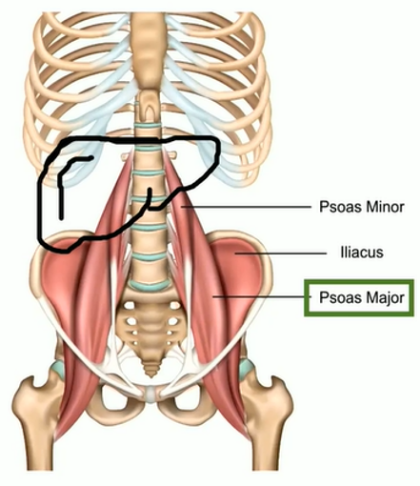
ACTG A5371 (SLIM LIVER): Effects of Semaglutide on Muscle Structure and Function (1)
METHODS
Outcomes (baseline to week 24)
Psoas volume/fat fraction: captured from the liver magnetic resonance imaging proton-density fat fraction (MRI-PDFF)
Physical function: timed chair rise test & 4-meter gait speed
Statistical Analysis
Mean change from baseline estimated with linear regression models
Spearman’s correlations used to examine associations between MASLD markers and muscle measures
MASLD: metabolic dysfunction-associated steatotic liver disease.
MRI-PDFF: magnetic resonance imaging-proton density fat fraction.
Ditzenberger G, et al. CROI 2024. Abstract 799.

Slide 43
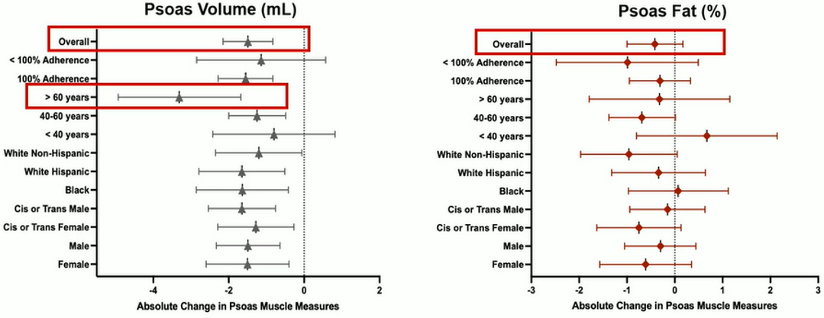
ACTG A5371 (SLIM LIVER): Effects of Semaglutide on Muscle Structure and Function (2)
RESULTS: Change in muscle volume and fat
Overall psoas muscle volume declined, but psoas muscle fat content did not significantly change. PWH >60 years had the greatest decline in muscle volume
Ditzenberger G, et al. CROI 2024. Abstract 799.

Slide 44
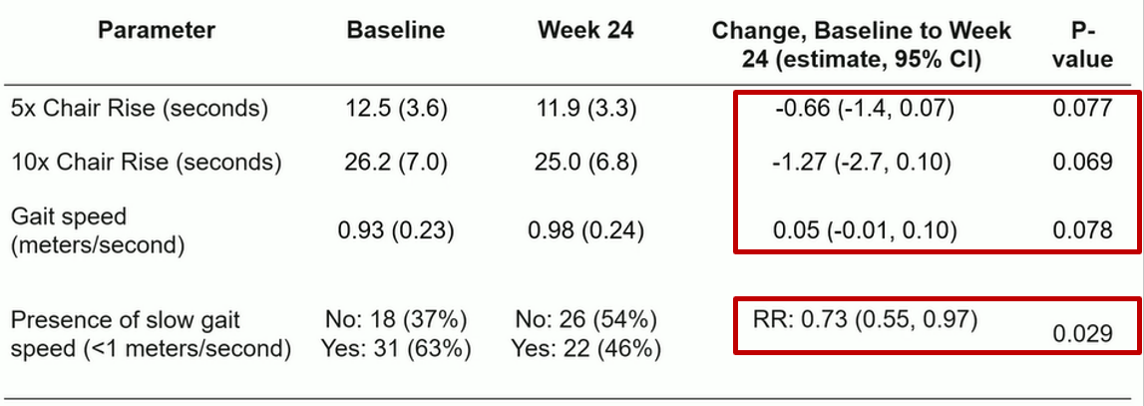
ACTG A5371 (SLIM LIVER): Effects of Semaglutide on Muscle Structure and Function
RESULTS: Change in physical function
Chair rise time and gain speed were preserved despite loss of psoas muscle volume. These changes in function were not correlated with change in overall weight or BMI.
Ditzenberger G, et al. CROI 2024. Abstract 799.

Slide 45
Conclusions
Doxy PEP is an effective strategy in the prevention of STIs
However, there still remains unanswered questions regarding effects of doxycycline on the microbiome and resistance
Switching antiretroviral therapies is a strategy that can be used to improve tolerability and quality of life for PWH
Switching to a long-acting injectable may improve virologic suppression in populations that are harder to suppress (e.g. those experiencing homelessness or adolescents)
Newer antiretroviral agents with alternative dosing strategies are being developed (weekly dosing, every 6-12 month dosing) for both PrEP and HIV treatment
Use of GLP-1RAs is increasing as weight gain/obesity is seen more often now in PWH
Medical providers must be aware of the potential side effects when prescribing GLPs

