Slide 1
HIV and Opioids: What Do HIV Care Providers Need to Know?
James A. Peck, Psy.D.
Psychologist III/Sr. Clinical Trainer, Division of Addiction Psychiatry, David Geffen School of Medicine at UCLA
May 23, 2024

Slide 2
Disclaimer
The views and opinions expressed in this presentation are not necessarily those of the Pacific AIDS Education & Training Center (Pacific AETC) or its eight local partner sites in HRSA Region 9, the Regents of the University of California or its San Francisco campus (UCSF or collectively, University) nor of our funder the Health Resources and Services Administration(HRSA). Neither Pacific AETC, University, HRSA nor any of their officers, board members, agents, employees, students or volunteers make any warranty, express or implied, including the warranties of merchantability and fitness for a particular purpose; nor assume any legal liability or responsibility for the accuracy, completeness or usefulness of information, product or process assessed or described; nor represent that its use would not infringe privately owned rights.
HRSA Acknowledgement Statement
The Pacific AETC is supported by the Health Resources and Services Administration (HRSA) of the U.S. Department of Health and Human Services (HHS) as part of an award totaling $4,377,449. The contents are those of the author(s) and do not necessarily represent the official views of, nor an endorsement, by HRSA, HHS, or the U.S. Government. For more information, please visit HRSA.gov.
Trade Name Disclosure Statement
Funding for this presentation was made possible by 5 U1OHA29292‐08‐00 from the Human Resources and Services Administration HIV/AIDS Bureau. The views expressed do not necessarily reflect the official policies of the Department of Health and Human Services nor does mention of trade names, commercial practices, or organizations imply endorsement by the U.S. Government. Any trade/brand names for products mentioned during this presentation are for training and identification purposes only.

Slide 3
Disclosures
All presenters of this continuing medical education activity have indicated that neither they nor their spouse/legally recognized domestic partner has any financial relationships with commercial interests related to the content of this activity.

Slide 4
Learning Objectives
At the completion of this presentation, participants will be able to:
Describe at least two (2) elements of the bidirectional causal relationship between HIV and opioids.
Apply at least three (3) of the current CDC opioid painkiller prescribing guidelines to patients with HIV.
Utilize at least two (2) strategies for having a productive, open discussion with patients about opioid medications and use of illicit opioids.

Slide 5
Poll Question #1
Fentanyl is _____ more potent than heroin.
2x
5x
20x
50x

Slide 6
HIV and Opioids
2011-2015: all deaths among people with HIV (PWH) decreased by 12.7%, but rate of opioid-related deaths was 42.7% higher in 2015 than in 2011 (Bosh et al., 2019)
Maximum viral suppression among newly released HIV-seropositive offenders with OUD was correlated with being on buprenorphine/naloxone 24 weeks post-release (Springer et al., 2012)

Slide 7
PWID and HIV
One of every 10 new HIV infections is among people who inject drugs (PWID) (CDC, n.d.)
New HCV infections increased 233% from 2010-2016 (CDC, n.d.)
People who inject drugs like heroin have elevated risk behaviors including (CDC, n.d.):
  Having sex without a condom
  Having sex partners who inject drugs
  Engage in sex work

Slide 8
Opioids and HIV
Chronic pain is common among People With HIV (PWH)
Opioids are more commonly prescribed to PWH than those without HIV, ranging from 21%-53% of the PWH population (Cunningham, 2018)
PWH more likely to receive higher doses of opioid pain medications and are more likely to have SUD and mental illness (Cunningham, 2018)
Thus an elevated risk of OUD in this population

Slide 9
HIV, Opioids, and Buprenorphine
BHIVES Study
386 PWH with opioid dependence (Weiss et al., 2011)
Viral suppression significantly higher for those initiating and maintaining buprenorphine/naloxone treatment (Weiss et al., 2011)
Retention in treatment with bup/naloxone associated with reduced use of opioids and stimulants (Weiss et al., 2011)
Retention in treatment with bup/naloxone also associated with improved physical and mental quality of life (Weiss et al., 2011)
No adverse effects on liver enzymes was observed (Weiss et al., 2011)

Slide 10
SUD Care Similar to HIV Care
Guiding principles:
  Harm reduction (person-centered care, focus on positive changes, patient safety & well-being) (Chu, 2019)
  Treatment and engagement (medications crucial part of treatment, providing “low threshold” care & rapid treatment initiation) (Chu, 2019)
  Linkage to care (early identification of barriers, integrated case management/navigators) (Chu, 2019)
  Other prevention & screening efforts i.e. screening for SUD in HIV care settings, screening for HIV in SUD settings

Slide 11
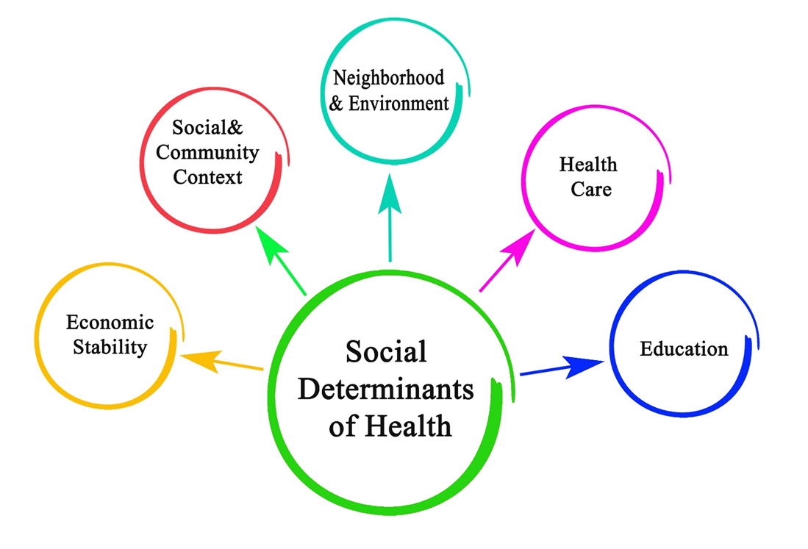
The Context: Social Determinants of Health
Notes:
Image Credit:
Purchased image, Adobe Stock, 2022.

Slide 12
Why Are We Talking About Social Determinants of Health?
Cannot discuss Opioid Use Disorders (OUD) among African-American and Latinx communities without the context of institutional racism
Institutional racism: “the structural and legalized system of policies, practices, and norms that results in differential access to goods and services” (Cobbinah & Lewis, 2018)
With regard to access to employment, housing, education, healthcare, government, and other public sector resources, when stratified by race, we see disparities (Cobbinah & Lewis, 2018)

Slide 13
Social Determinants of Health
Black Americans with SUD’s are doubly stigmatized because of their race and their SUD
Negative images of Black substance users contribute to mistreatment, discrimination, and harsh punishment rather than treatment/recovery services (SAMHSA, 2020)
Terms like “opioid epidemic” or “crisis” may put members of this community on alert and trigger fears of incarceration (SAMHSA, 2020)

Slide 14
Social Determinants of Health
Intergenerational and Polysubstance Use
Not uncommon to have multigenerational households using opioids and other substances (SAMHSA, 2020)
In low-income communities, using and/or selling drugs can be a survival mechanism (SAMHSA, 2020)
Important to disentangle behaviors of an individual’s social network, including their family, from the individual’s behaviors, i.e. who around them is also using substances?
This can be challenging but is necessary

Slide 15
Social Determinants of Health
Fear of Legal Consequences
Only 10% of people in general population with a SUD seek treatment (SAMHSA, 2020)
This is magnified in the Black and Latinx communities
Significant mistrust of healthcare, social services, and criminal justice systems contributes to this (SAMHSA, 2020)
For men, fear of severe sentencing and incarceration policies i.e. the Rockefeller Laws of 1973 (SAMHSA, 2020)
For women, fear of losing children to child protective/foster care system if they seek treatment (SAMHSA, 2020)

Slide 16
Social Determinants of Health
Misperceptions/Faulty Explanations re Addiction
Reflecting society in general, lack of understanding of SUD as a disease among Black/Latinx communities (SAMHSA, 2020)
People hide their SUD because addiction is seen as a weakness, not a disease
Solutions need to address how addiction is a disease/health condition and not a moral failing (SAMHSA, 2020)
Many people not informed about standard treatment options for OUD
Reduces chance of evidence-based solutions being accessed or implemented

Slide 17
Social Determinants of Health
Lack of Culturally Responsive Care
Shortage of Black & Latinx physicians (Lin & Knudsen, 2019)
Shortage of clinicians trained to prescribe buprenorphine (Lin & Knudsen, 2019)
Inability to engage with clinicians in their own community contributes to premature termination of treatment among people of color (Lin & Knudsen, 2019)
When cultural context is ignored, respect for patients may be lacking, little hope is provided, and it is very difficult for African-American and Latinx OUD patients to engage in treatment (Lin & Knudsen, 2019)

Slide 18
CDC Opioid Prescribing
Guidelines for Chronic Pain
CDC Opioid Prescribing
Guidelines for Chronic Pain
Source for next two slides is:
https://www.cdc.gov/opioids/healthcare-professionals/prescribing/guideline/index.html

Slide 19
CDC Guidelines for Opioid Prescribing for Chronic Pain
CLINICAL REMINDERS
• Opioids are not first-line or routine therapy for chronic pain
• Establish and measure goals for pain and function
• Discuss benefits and risks and availability of nonopioid therapies with patient

Slide 20
CDC Guidelines for Opioid Prescribing for Chronic Pain (2)
CLINICAL REMINDERS
• Evaluate risk factors for
opioid-related harms
• Check PDMP for high dosages and prescriptions from other providers
• Use urine drug testing to identify prescribed substances and
undisclosed use
• Avoid concurrent benzodiazepine
and opioid prescribing
• Arrange treatment for opioid use
disorder if needed

Slide 21
CDC Recommendations for Prescribing opioids for outpatients with pain
CDC Recommendations for Prescribing Opioids for Outpatients with Pain, Excluding Pain Management Related to Sickle Cell Disease, Cancer-Related Pain Treatment, Palliative Care, and End-of-Life Care (2022)
(Source for all material on the next 5 slides is Dowell et al., 2022)

Slide 22
Determining Whether or Not to Initiate Opioids for Pain (Recommendations 1 & 2)
Nonopioid therapies are at least as effective as opioids for many types of acute pain. Maximize use of nonpharmacologic and nonopioid pharmacologic therapies prior to considering opioids for acute pain.
Nonopioid therapies are preferred for subacute and chronic pain. Only consider initiating opioid therapy if expected benefits for pain and function are anticipated to outweigh risks to the patient.

Slide 23
Selecting Opioids and Determining Dosages (Recommendations 3, 4, & 5)
When starting opioid therapy for acute, subacute, or chronic pain, prescribe immediate-release opioids rather than extended-release or long-acting opioids.
When initiating opioids for acute, subacute, or chronic pain, prescribe lowest effective dose. If opioids are continued for subacute or chronic pain, evaluate individual benefits and risks when considering increasing dosage.
For patients already on opioid therapy: if benefits outweigh risks of continued opioid therapy, work w/patients to optimize nonopioid therapies while continuing opioid therapy. If benefits do not outweigh risks, optimize other therapies and work w/patients to gradually taper down dosage.

Slide 24
Deciding Duration of Initial Opioid Prescription and Conducting Follow-Up (Recommendations 6 & 7)
When opioids are needed for acute pain, prescribe no greater quantity than needed for the expected duration of pain severe enough to require opioids.
Evaluate benefits and risks w/patients within 1-4 weeks of initiating opioid therapy for subacute or chronic pain, or of increasing dosage.

Slide 25
Assessing Risk and Addressing Potential Harms of Opioid Use (Recommendations 8-12)
Before starting and periodically during continuation of opioid therapy, evaluate risk for opioid-related harms and discuss w/patients. Incorporate strategies to mitigate risk including offering naloxone.
When prescribing initial opioid therapy for acute, subacute, or chronic pain, and periodically during opioid therapy for chronic pain, review the state PDMP (Prescription Drug Monitoring Program) database to ensure the patient is not receiving opioids from another provider or other medications that may interact with opioids to put the patient at high risk for overdose.
When prescribing opioids for subacute or chronic pain, consider periodic toxicology testing to assess for prescribed medication and other controlled substances.

Slide 26
Assessing Risk and Addressing Potential Harms of Opioid Use (Recommendations 8-12) cont’d
Use caution when prescribing opioid pain medications and benzodiazepines concurrently and consider risk and benefits of concurrent prescribing of opioids and other CNS depressants.
For patients assessed to have an opioid use disorder, offer or arrange treatment with evidence-based medications. Detoxification on its own, without such medications, is not recommended for opioid use disorder due to increased risks of resumed drug use and overdose.
Notes:
REFERENCE:
Dowell D, Ragan KR, Jones CM, Baldwin GT, Chou R. CDC Clinical Practice Guideline for Prescribing Opioids for Pain — United States, 2022. MMWR Recomm Rep 2022;71(No. RR-3):1–95. DOI: http://dx.doi.org/10.15585/mmwr.rr7103a1

Slide 27
Fentanyl
Powdered fentanyl looks just like many other drugs. It is commonly mixed with drugs like heroin, cocaine, and methamphetamine and made into pills that resemble other prescription opioids.
Fentanyl is a synthetic opioid that is up to 50 times stronger than heroin and 100 times stronger than morphine. It is a major contributor to fatal and nonfatal overdoses in the U.S.
Signs of Overdose: Small, constricted “pinpoint pupils” - Falling asleep or losing consciousness - Slow, weak, or no breathing - Choking or gurgling sounds - Limp body - Cold, clammy, and/or discolored skin. Source: CDC, 2024

Slide 28
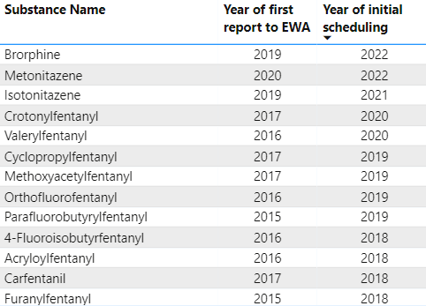
Synthetic Opioids, North America 2013-2023
Chemically diverse central nervous system depressants
Many are even more potent than fentanyl and are being found in opioid, cocaine, and methamphetamine supplies across the country. (Shafi et al., 2022)

Slide 29
Poll Question #2
HIV prevalence among individuals with a psychiatric disorder is ___ that of HIV prevalence among individuals without a psychiatric disorder.
2x
5x
7x
12x

Slide 30
HIV, Mental Health, and Opioids
Bidirectional relationship between HIV and mental illness
HIV prevalence among individuals with a psychiatric disorder is 7x that of prevalence among individuals without a psychiatric disorder (Nosik et al., 2021)
Likely causes: (Nosik et al., 2021)
  Impairment in cognitive functioning
  Use of psychoactive substances, i.e., opioids
  Sexual risk behaviors
  Sexual victimization
Opioids frequently used as coping mechanism for depression and anxiety (Buckner et al., 2023)

Slide 31
HIV, Mental Health, and Opioids (2)
HIV invades CNS and particular brain regions, even in the presence of antiretroviral therapy (Nosik et al., 2021)
Despite having undetectable viral load and restoration of normal immune status, incidence of moderate and mild cognitive impairments at all stages of HIV infection remains high, with 12–52% moderate and 33% asymptomatic cognitive impairments (Nosik et al., 2021)
Some ARTs cannot completely penetrate blood-brain barrier and completely suppress viral replication (Nosik et al., 2021)
Frequent co-occurring major depression and opioid use disorder among PWH (Denis et al., 2021)

Slide 32
Provider Recommendations When Discussing Opioid Use with Patients

Slide 33
Discussion Question
What is the most challenging aspect of talking with your patients about their possible or actual use of prescription opioid painkillers and/or illicit opioids?

Slide 34
Opioid Risk Tool
Assesses for potential opioid misuse in patients beginning opioid therapy for pain management
This tool should be administered to patients upon an initial visit prior to beginning opioid therapy for pain management. A score of 3 or lower indicates low risk for future opioid misuse, a score of 4 to 7 indicates moderate risk for opioid misuse, and a score of 8 or higher indicates a high risk for opioid misuse. (Webster & Webster, 2005)

Slide 35
Opioid Risk Tool
Notes:
Image Credit
NIDA public domain: https://nida.nih.gov/sites/default/files/opioidrisktool.pdf

Slide 36
Stigmatizing Language
Many of us use stigmatizing terms every day, not realizing the extent of their negative impact. To work collectively to humanize the issue of substance use disorders, the following terminology should be avoided when discussing substance use with patients.
Think about the negative connotation of each of the following statements:
“My friend is a drug addict”
“She can’t seem to get clean”
“Our community has a serious drug abuse problem”
“He can’t seem to avoid relapse”

Slide 37
Provider Recommendations When Discussing
Opioid Use with Patients (Rutkowski et al., 2014)
Use open-ended questions
  “Do you use any opioids, either prescription medications like hydrocodone or oxycodone, or other drugs like heroin or fentanyl?”
  If yes, “Tell me exactly what you use and how often you use it.”
  “How would you describe yourself when you take opioids, what’s it like for you?”
  “How do you think other people in your life would describe you at those times?”
  “What do you like about what opioids do for you?
  “What’s not so good about what opioids do to you?”
  “Have you ever thought about or tried cutting down or stopping using opioids?”
  If yes, “What have you tried, and how did it work?”

Slide 38
Provider Recommendations When Discussing
Opioid Use with Patients (2) (Rutkowski et al., 2014)
“Would it be ok if I tell you some of the possible long-term effects of using opioids?”
Provide the information (connect it to their existing medical issues if possible)
“So in light of that information, what do you think you’d like to do with regard to your use of opioids at this point?”
If pt says they’d like to try to cut down or stop, educate them about MAT (i.e., methadone or buprenorphine) and be prepared to refer them to a nearby MAT clinic.
If pt says they’re not interested in changing anything right now: “Ok let’s continue to keep an eye on it, and I’ll ask you about it again the next time I see you.”

Slide 39

ORN Evaluation Survey Link
Please scan the below QR code or use the link below to access a very brief survey.
Link to Survey: https://orn.qualtrics.com/jfe/form/SV_3FdzXtRH7gogcHI?RequestID=7231&Intensity=2&ActivityType=2&Training=1
The survey will ask about your satisfaction with the training program you just completed as well as some basic demographic information. Your responses will help the Opioid Response Network improve the services they provide.
Thank you in advance for completing this survey!

Slide 40
References
Bosh, KA et al. Abstract 147 – Opioid Overdose Deaths Rising among People Living with HIV. Presented at Conference on Retroviruses and Opportunistic Infections, Seattle, WA. Retrieved from: https://www.healio.com/news/infectious-disease/20190311/opioid-overdose-deaths-rising-in-people-living-with-hiv
Buckner, J. D., Scherzer, C. R., Rogers, A. H., & Zvolensky, M. J. (2023). Opioid and cannabis co-use: The role of opioid use to cope with negative affect. Journal of substance use and addiction treatment, 145, 208942. https://doi.org/10.1016/j.josat.2022.208942
Centers for Disease Control and Prevention. (no date given). Addressing the infectious disease consequences of the U.S. opioid crisis. Retrieved from: https://www.cdc.gov/nchhstp/budget/infographics/opioids.html
Chu, C. (2019). Ending the HIV & HCV Epidemics: A Critical Role for Substance Use Providers. Newark, NJ: AIDS Education and Training Center National Coordinating Resource Center. Retrieved from: https://aidsetc.org/resource/ending-hiv-hcv-epidemics-critical-role-substance-use-providers
Cobbinah, S. & Lewis, J. (2018). Racism & health: A public health perspective on racial discrimination. Journal of Evaluation in Clinical Practice, 24(5), 995–998.
Cunningham, C. (2018). Opioids and HIV infection: From pain management to addiction treatment. Topics in Antiviral Medicine, 25(4),143–146.
Denis, C. M., Dominique, T., Smith, P., Fiore, D., Ku, Y. C., Culhane, A., Dunbar, D., Brown, D., Daramay, M., Voytek, C., Morales, K. H., Blank, M. B., Crits-Christoph, P. F., Douglas, S. D., Spitsin, S., Frank, I., Colon-Rivera, K., Montaner, L. J., Metzger, D. S., & Evans, D. L. (2021). HIV Infection and Depression Among Opiate Users in a US Epicenter of the Opioid Epidemic. AIDS and behavior, 25(7), 2230–2239. https://doi.org/10.1007/s10461-020-03151-2
Dowell D, Ragan KR, Jones CM, Baldwin GT, Chou R. CDC Clinical Practice Guideline for Prescribing Opioids for Pain – United States, 2022. MMWR Recommendations and Reports 2022: https://www.cdc.gov/mmwr/volumes/71/rr/rr7103a1.htm?s_cid=rr7103a1_w
Fentanyl Facts. (2024, April 18). Centers for Disease Control and Prevention. https://www.cdc.gov/stopoverdose/fentanyl/

Slide 41
References (2)
Fiellin, D., Weiss, L., Botsko, M., Egan, J., Altice, F., Bazerman, L. B., … the BHIVES Collaborative. (2011). Drug treatment outcomes among HIV-infected opioid-dependent patients receiving buprenorphine/naloxone. Journal of Acquired Immune Deficiency Syndromes, 56(Suppl 1), S33–38.
HealthyPeople.Gov. (2020). [Webpage]. Social Determinants of Health. Retrieved from: https://www.healthypeople.gov/2020/topics-objectives/topic/social-determinants-of-health.
Lin L.A. & Knudsen H.K.. Comparing buprenorphine-prescribing physicians across nonmetropolitan and metropolitan areas in the United States. Annals of Family Medicine [Internet]. 2019 May 1;17(3):212-20. Retrieved from: https://doi.org/10.1370/afm.2384
Nosik, M., Lavrov, V., & Svitich, O. (2021). HIV Infection and Related Mental Disorders. Brain sciences, 11(2), 248. https://doi.org/10.3390/brainsci11020248
Rutkowski, B., Freese, T., Myer, P., Gil-Cantu, M., & Donohoe, T. (2014). Short and Simple: Screening and Brief Intervention Tips for HIV Clinicians Working with Alcohol and Drug Users. Pacific AIDS Education and Training Center, Los Angeles, CA.
Shafi, A., Berry, A. J., Sumnall, H., Wood, D. M., & Tracy, D. K. (2022). Synthetic opioids: a review and clinical update. Therapeutic advances in psychopharmacology, 12, 20451253221139616. https://doi.org/10.1177/20451253221139616
Springer, SA, Qiu, J, Saber-Tehrani, AS, Altice, FL. (2012). Retention on buprenorphine is associated with high levels of maximal viral suppression among HIV-infected opioid dependent released prisoners. PLoS ONE 7(5) 1-10. Retrieved from: https://journals.plos.org/plosone/article/file?type=printable&id=10.1371/journal.pone.0038335
Substance Abuse and Mental Health Services Administration. (2020). The Opioid Crisis and the Black/African-American population: An Urgent Issue. Publication ID: PEP20-05-02-001. Retrieved from: https://store.samhsa.gov/product/The-Opioid-Crisis-and-the-Black-African-American-Population-An-Urgent-Issue/PEP20-05-02-001.

Slide 42
References (3)
Webster LR, Webster R. Predicting aberrant behaviors in Opioid‐treated patients: preliminary validation of the Opioid risk tooL. Pain Med. 2005; 6 (6) : 432
Weiss, L., Egan J. E., Botsko, M., Netherland, J., Fiellin, D. A., & Finkelstein R. (2011). The BHIVES collaborative: organization and evaluation of a multisite demonstration of integrated buprenorphine/naloxone and HIV treatment. Journal of Acquired Immune Deficiency Syndromes, 56( Suppl 1), S22–S32.

Slide 43
Thanks for Attending!
For additional questions about today’s presentation, please contact
James A. Peck, Psy.D. at jpeck@mednet.ucla.edu

