Slide 1
STI Treatment Guidelines Update and Review: Syphilis & Congenital Syphilis
@
Kelly A. Johnson, MD, MPH
Medical Director, California Prevention Training Center, UCSF
Assistant Professor, Infectious Diseases, UCSF
May 16th, 2024

Slide 2
Disclaimer
The views and opinions expressed in this presentation are not necessarily those of the Pacific AIDS Education & Training Center (Pacific AETC) or its eight local partner sites in HRSA Region 9, the Regents of the University of California or its San Francisco campus (UCSF or collectively, University) nor of our funder the Health Resources and Services Administration (HRSA). Neither Pacific AETC, University, HRSA nor any of their officers, board members, agents, employees, students, or volunteers make any warranty, express or implied, including the warranties of merchantability and fitness for a particular purpose; nor assume any legal liability or responsibility for the accuracy, completeness or usefulness of information, product or process assessed or described; nor represent that its use would not infringe privately owned rights.
HRSA Acknowledgement Statement The Pacific AETC is supported by the Health Resources and Services Administration (HRSA) of the U.S. Department of Health and Human Services (HHS) as part of an award totaling $4,377,449. The contents are those of the author(s) and do not necessarily represent the official views of, nor an endorsement, by HRSA, HHS, or the U.S. Government. For more information, please visit HRSA.gov.
Trade Name Disclosure Statement Funding for this presentation was made possible by 5 U1OHA29292‐08‐00 from the Human Resources and Services Administration HIV/AIDS Bureau. The views expressed do not necessarily reflect the official policies of the Department of Health and Human Services nor does mention of trade names, commercial practices, or organizations imply endorsement by the U.S. Government. Any trade/brand names for products mentioned during this presentation are for training and identification purposes only.

Slide 3
Disclosures
All presenters of this continuing medical education activity have indicated that neither they nor their spouse/legally recognized domestic partner has any financial relationships with commercial interests related to the content of this activity.

Slide 4
Learning Objectives
At the completion of this presentation, participants will be able to:
Describe the varied clinical manifestations of primary and secondary syphilis in adults & congenital syphilis (CS) in infants
Interpret traditional and non-traditional syphilis screening algorithms
List at least 3 strategies to prevent CS
Name potential alternative treatments for syphilis

Slide 5
Background

Slide 6
Scope of the Problem
CDC Infographic, 2023

Slide 7
2023 Vital Signs Report Highlights CS Epidemic
McDonald, 2023

Slide 8
Case Presentation

Slide 9
Clinical Case
32 yo G0P0 heterosexual cis-gender F with h/o genital herpes presents to GYN clinic with genital ulcers.
The ulcers are a little bit painful. They are not pruritic. There are several of them.
The patient’s physical exam reveals the following…

Slide 10
Genital Exam
Image credit: Dr. J. Engelman, San Francisco City Clinic

Slide 11
Polling Question #1: What diagnosis do you suspect?
A. Genital herpes
B. Primary syphilis
C. Mpox
D. Chancroid
E. Lymphogranuloma venereum (LGV)
F. Granuloma Inguinale
Image credit: Dr. J. Engelman, San Francisco City Clinic

Slide 12
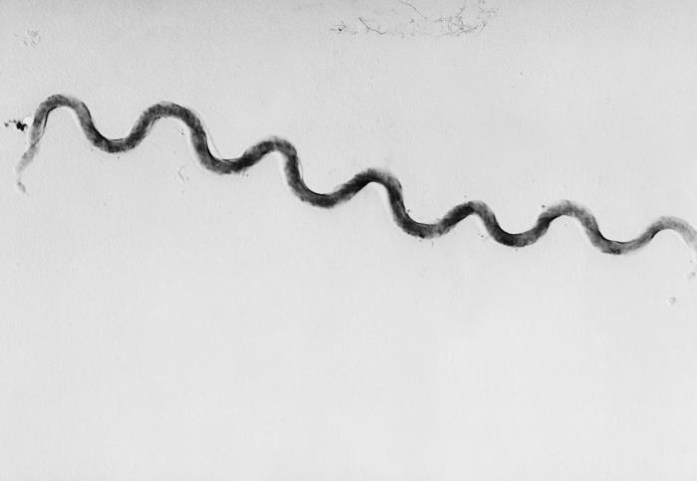
Syphilis Overview
Causative organism: Treponema pallidum, spirochete bacterium
Incubation: ~3-4 weeks; range 10-90 days
Causes systemic infection, with episodes of active disease interrupted by periods of latent infection
Transmission: direct contact to infectious lesion, blood-borne, in utero.
CDC Public Health Library, Image #2333
Notes:
To take a step back and provide a brief overview:
-Syphilis is caused by Treponema pallidum, a spirochete bacterium
-Its incubation period is typically 3-4 weeks, with a full range of 10-90 days
-It causes a systemic infection, with episodes of active disease interrupted by periods of latent or asymptomatic infection
-Transmission most commonly occurs via direct contact to infectious lesions but can also take place via the placenta in maternal to child cases.
--Of note: Transplacental transmission usually occurs in symptomatic maternal syphilis (aka primary or secondary syphilis, when maternal RPR/VDRL titers are typically higher) rather than in latent disease.
Image: Photomicrograph depicting a Treponema pallidum bacterium, a spirochete 5µm -15µm in length -- this is the causative agent of syphilis.

Slide 13
Syphilis Natural History – Episodes and Stages
Content credit: California Prevention Training Center & California Dept of Public Health, STD Control Branch
Notes:
On this slide, you can see the natural history of syphilis. This infection is characterized by episodes and stages of active disease during which patients have signs/symptoms of infection, interrupted by periods of latent – or asymptomatic – infection. Serious complications, including CNS infection (neurosyphilis) and congenital syphilis (which is in-utero material to child transmission) can occur at any stage

Slide 14
Natural History: Primary Syphilis
Content credit: California Prevention Training Center & California Dept of Public Health, STD Control Branch

Slide 15
Primary Syphilis: Typical Chancre
Exposure
Primary
Ulcer (Chancre)
Self limited
Well demarcated rolled rubbery edges
Single & painless
May be multiple and/or painful
CDC PHIL, Image #17055
Notes:
Images of primary syphilis are shown on this slide. Classically, the chancre of primary syphilis is a single, painless, indurated, clean-based lesion with rolled rubbery edges & a raised rubbery border, can go unrecognized, particularly if in the vagina or rectum
(SFCC = San Francisco City Clinic)

Slide 16
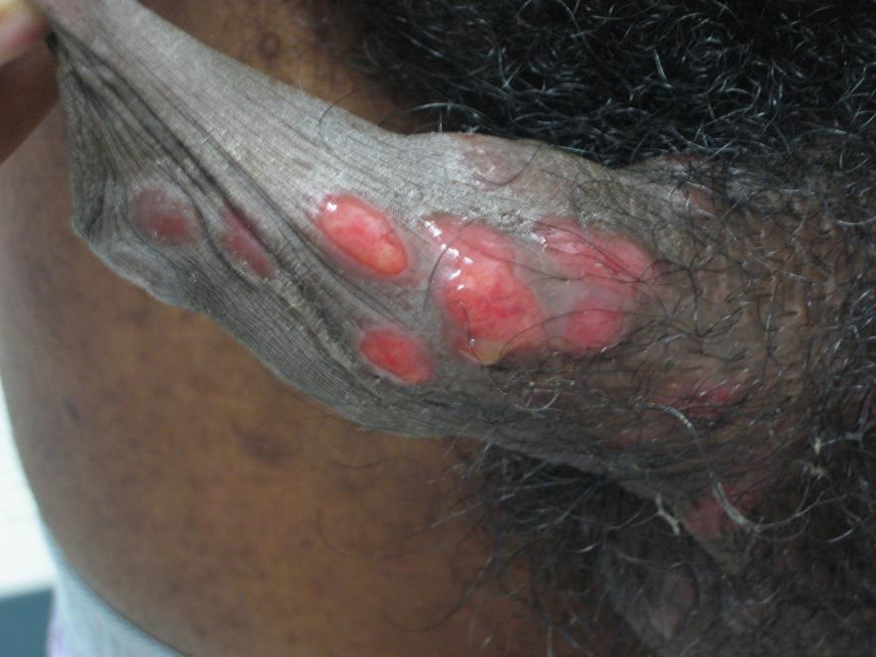
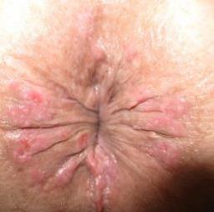
Primary Syphilis: Atypical Chancres Multiple, sometimes painful
Image: Joe Engelman, San Francisco City Clinic (SFCC)
Orange county healthcare agency
SFCC
Test for both HSV & primary syphilis if you see something like this!
Notes:
But syphilis has been called the great masquerader for a reason and – as you can see – the chancres of primary syphilis are not always classic in appearance. The chancres can sometimes be multiple and may be somewhat painful; these atypical appearances may be more common in immunosuppressed people, such as those with HIV.
Now you can easily see how the lesions on the left might have been confused for genital herpes – so the takeaway would be to test for both syphilis AND herpes if you see a patient like this!

Slide 17
DDx: Vulvar Herpes
STD Atlas, 1997
Slide Credit: S. Adler, CAPTC
Notes:
Groups of vesicular or ulcerated lesions on erythematous base

Slide 18
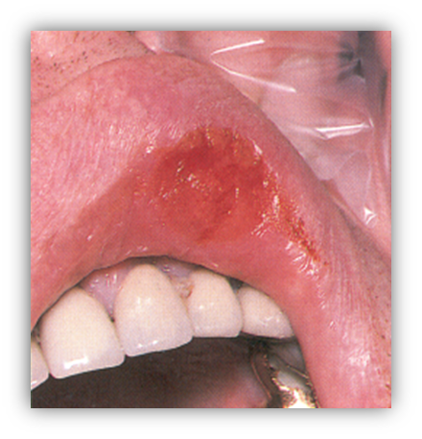
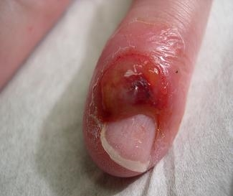
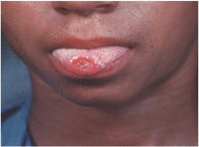
Primary Syphilis: Extragenital Chancres
SFCC
Clinics in Dermatology, 2016
SFCC
Notes:
The other thing to remember is that the chancres of primary syphilis appear at sites of inoculation – this can include extragenital anatomical sites, as shown here

Slide 19
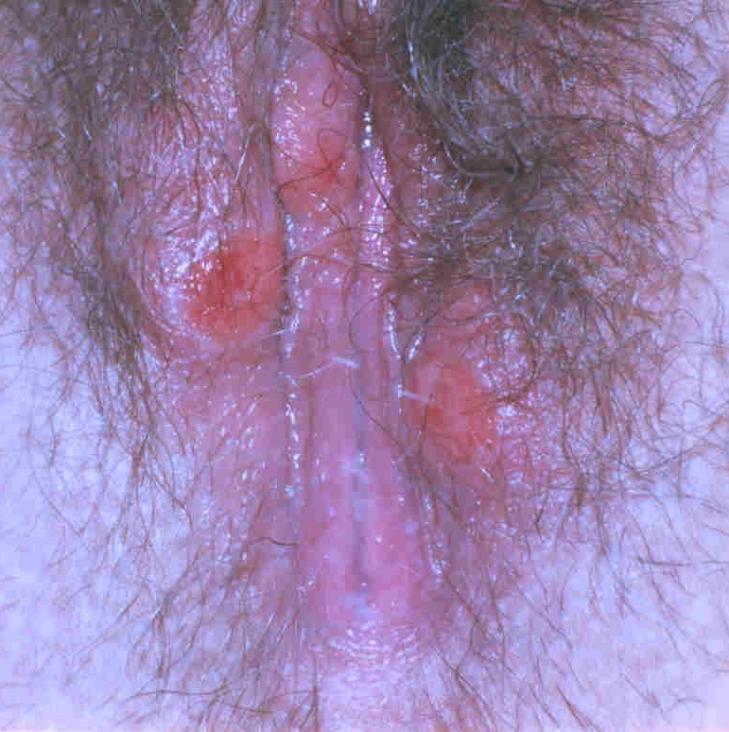
Clinical Case Continued…
After examining the patient’s genital ulcers, the GYN provider suspects genital herpes.
The patient is prescribed acyclovir.
Her ulcers resolve entirely; she feels well.
She goes to her PCP’s office a few weeks later, this time with a diffuse but subtle non-pruritic rash.
The appearance of the rash is as shown on the next slide…
Image credit: Dr. J. Engelman, San Francisco City Clinic

Slide 20
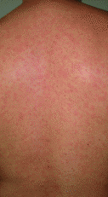
Physical Exam
Andrade et al, 2023
Notes:
Describe image – a diffuse, subtle, maculopapular rash

Slide 21
Polling Question #2: What is the most likely diagnosis?
A. Secondary syphilis
B. Tinea versicolor
C. Coxsackie virus (hand-foot-mouth disease)
D. Atopic dermatitis
E. Contact dermatitis
Notes:
Audience response question – read choices

Slide 22
Natural History: Secondary Syphilis
Content credit: California Prevention Training Center & California Dept of Public Health, STD Control Branch

Slide 23
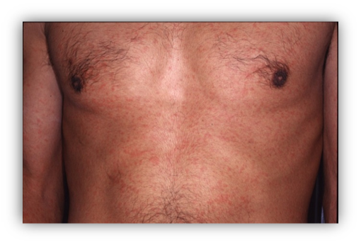
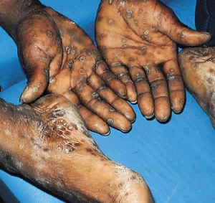
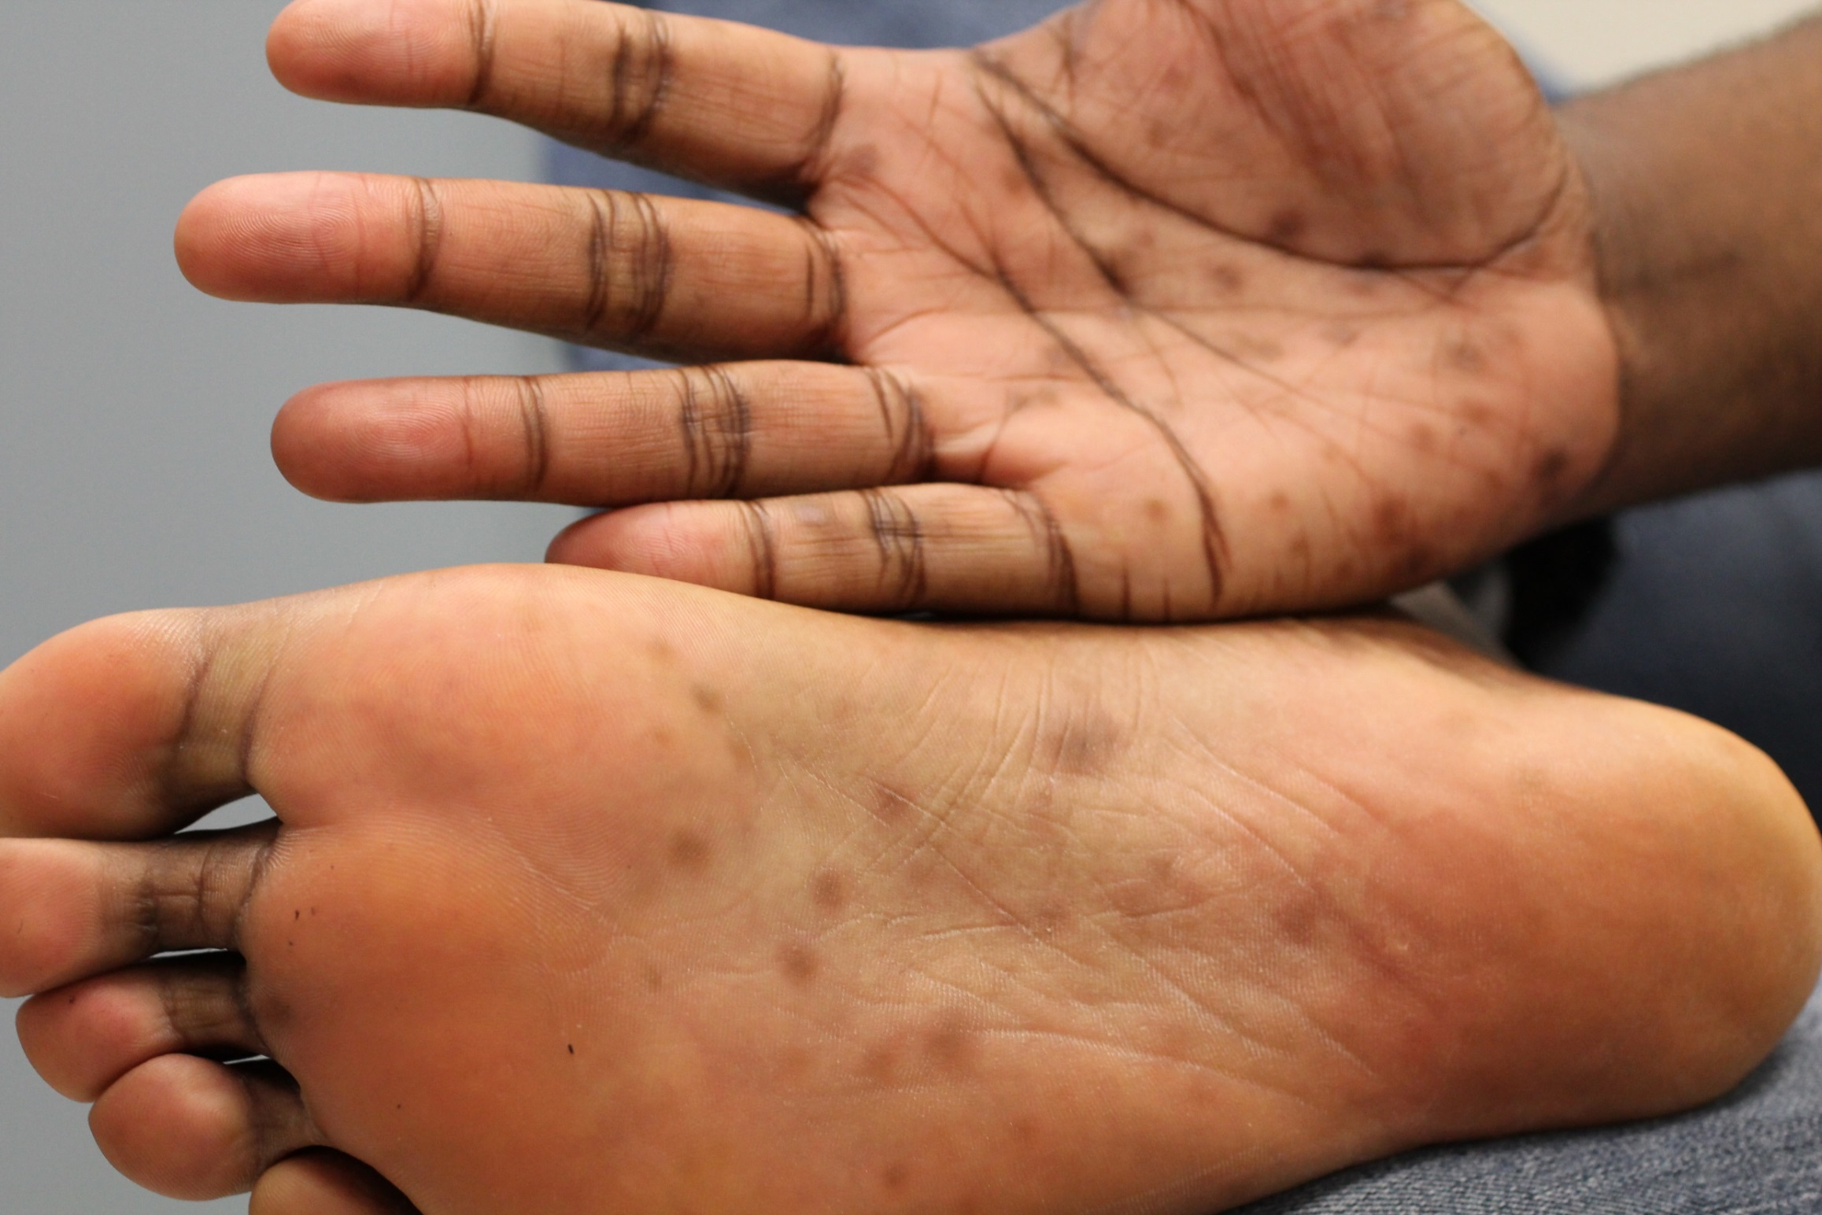
Secondary Syphilis: Rash
DMHC
Orange county healthcare agency
Mosby STD Atlas
Notes:
Images of the secondary syphilis rash – Again, it is classically a diffuse maculopapular rash involving the palms/soles
This rash is often missed by providers who don’t identify it because it is so subtle and can have an atypical appearance
Re-iterate: Even if the rash is very subtle, remember that it is important to look at the hands & feet as it can be a tip off
Also note that the palms/soles lesions can almost look like scars – this can be another reason why the diagnosis of syphilis is missed

Slide 24
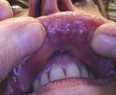
Secondary Syphilis: Mucous Patches
Images courtesy of: Gregory Melcher, UC Davis &
Susan Philip, SF DPH & UCSF
Notes:
These images show examples of mucous patches in the mouth – highly infectious.
Can be confused with other diagnoses that cause white plaques in the mouth, such as thrush, oral hairy leukoplakia

Slide 25
Secondary Syphilis: Patchy Alopecia
Mosby STD Atlas, 1997
Notes:
This slide shows the patchy alopecia of secondary syphilis. Note that this could easily be confused with alopecia areata – another place where a diagnosis of syphilis could be missed

Slide 26
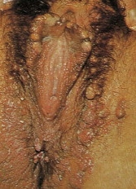
Secondary Syphilis: Condyloma Lata
Forbes CD, Jackson WF. Color Atlas and Text of Clinical Medicine, 3rd ed. London: Mosby; 2003
First two images from left courtesy: Gregory Melcher, UC Davis &
Susan Philip, SF DPH & UCSF
Notes:
Condyloma lata = term for large, raised, whitish or gray lesions found in warm moist areas, often see in perineum, peri vulvar area, or around the anus. These lesions are very infectious.
Can be confused for anogenital warts, so whenever you see condyloma acuminata, also think condyloma lata and secondary syphilis!

Slide 27
Differential dx: Condyloma Acuminata
Image source: National STD Curriculum – HPV. https://www.std.uw.edu/go/comprehensive-study/hpv/core-concept/all#clinical-manifestations
Notes:
Compare and contrast condyloma lata (syphilis) with condyloma acuminata (anogenital warts, shown on this slide).
Whereas the Condyloma lata we just saw on the previous slide are flat on the top, condyloma acuminata have a more irregular, cauliflower like appearance as shown here.

Slide 28
Back to our case…
After evaluating the patient’s rash, the PCP suspects contact or allergic dermatitis.
A topical steroid is prescribed.
The patient is adherent to steroid treatment.
Her rash resolves and she feels well.

Slide 29
Natural History: Latent Infection
Content credit: California Prevention Training Center & California Dept of Public Health, STD Control Branch
Notes:
- Note that the patient is now in a latent phase of disease.
- Early latent syphilis is when the only evidence of disease is laboratory evidence and/or a history that infection likely occurred within the past 12 months; otherwise (beyond the 12 month mark), it is considered late latent syphilis or syphilis of unknown duration.

Slide 30
Case Continued
Soon after her rash has improved, the patient learns she is pregnant and makes an OB-GYN appointment
At the first prenatal appointment, the provider takes a sexual history
Patient is monogamous, married to a cis-gender male partner for 3 years
She has no prior known history of STIs beyond genital herpes
STI testing is not performed, as the patient is considered “low risk”

Slide 31
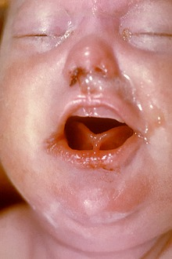
Case Ctd . . .
The remainder of the patient’s pregnancy is uncomplicated
STI testing is never pursued
At 38 weeks 4 days, the patient gives birth
The infant appears unwell
Diffuse rash
Copious nasal drainage
Hepatosplenomegaly
Increased work of breathing
Image: CDC PHIL #2246

Slide 32
Polling Question #3: What is the most likely diagnosis?
A. Toxoplasmosis
B. Rubella
C. Cytomegalovirus
D. Congenital Syphilis
Syphilis serologies are sent and reactive:
-Birthing parent: RPR 1:32, TPPA reactive
-Infant: RPR 1:16, CSF VDRL reactive
Diagnosis of congenital syphilis is made; the infant is started on IV penicillin for a 10-day course
Notes:
Audience response question – read choices

Slide 33
Syphilis Natural History – Episodes and Stages (Review)
Content credit: California Prevention Training Center & California Dept of Public Health, STD Control Branch
Notes:
Natural history one more time – CS can occur at any stage of untreated syphilis

Slide 34
CDC: “Up to 40% of infants born to [persons] with untreated syphilis may be stillborn or die from the infection”
Notes:
While the infant in our case survived… (read slide)

Slide 35
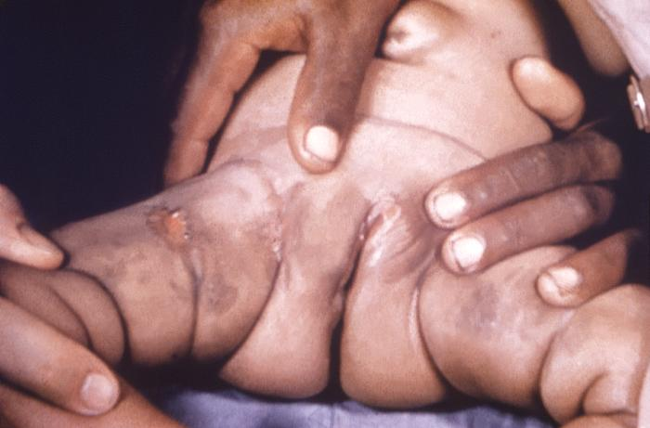
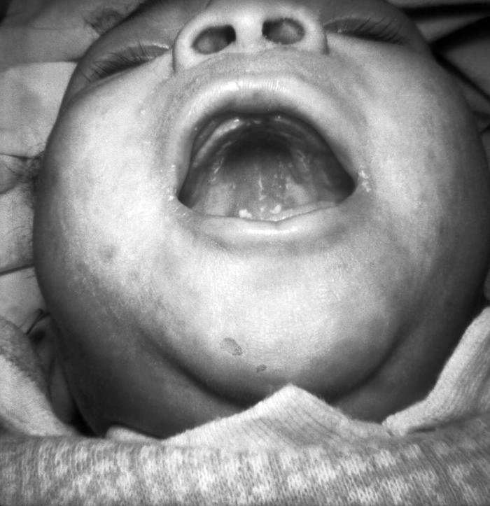
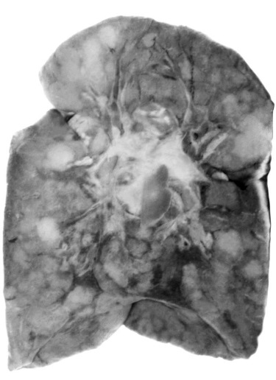
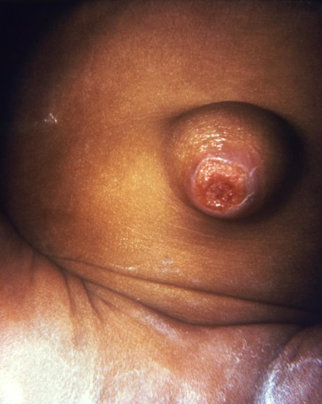
CS Physical Findings: Early (Birth to 8 weeks, but up to 2 years)
Hepatomegaly
Splenomegaly
Lymphadenopathy
Edema
Rash
Snuffles (copious nasal secretions – infectious!)
Mucocutaneous lesions (infectious!)
Pneumonia Alba
Osteochondritis
Pseudoparalysis
Hemolytic anemia or thrombocytopenia
Cutaneous lesion
Snuffles
Mucous patches
Sources of images: CDC PHIL, # 2446, 12597, 2382, 15566, 2349
Pneumonia Alba
Umbilical lesion
Most infants (60-90%) are ASYMPTOMATIC → important to TEST!
Notes:
Most infants are asymptomatic at birth (60-90% depending on the study)
However, early manifestations occurring shortly thereafter and up to 2 years can include those shown on this slide such as:
-Hepatosplenomegaly
-Snuffles (which are copious nasal secretions)
-Pneumonia alba (or a “white pneumonia,” where spirochetes in pulmonary tissue cause the lung to become firm and pale, with inflammatory cells and fibrosis in the alveolar septa)
-Osteochondritis
-Pseudoparalysis (typically of the upper limbs)
-Edema, rash, lymphadenopathy, and/or blood cell count abnormalities such as hemolytic anemia or thrombocytopenia
Images (as labeled in CDC PHIL):
Snuffles: This photograph depicts the face of a newborn infant, as the baby was displaying pathologic morphology indicative of congenital syphilis, caused by the bacterium, Treponema pallidum.
Mucocutaneous lesions: This image depicts the perineal region and upper thighs of an infant, born with what was diagnosed as congenital syphilis, caused by the bacterium Treponema pallidum. In this particular case, one will note the presence of early cutaneous syphilids.
Umbilical lesion: This image depicted the umbilicus of an infant, which displayed an inflamed lesion that under a dark field examination revealed the presence of Treponema pallidum spirochetes, and hence, a diagnosis of congenital syphilis was made.
Pneumonia alba: This image depicts a human lung from a congenital syphilis patient, and reveals the presence of a pathologic condition known as pneumonia alba, in which the lungs are become enlarged, heavy, uniformly firm, and yellow-white in color.

Slide 36
Evaluation of Infants Exposed to Syphilis in Utero
Maternal antibodies can be transferred via the placenta, complicating interpretation of reactive serologic tests in neonates
So: infant treatment decisions rely on:
Identification of syphilis in the mother
Adequacy of birthing parent’s treatment
Presence of clinical, lab, and x-ray evidence of neonatal syphilis
Comparison of maternal (at delivery) and neonatal non-treponemal titers
For infant diagnosis and management: Ensure pediatric colleagues aware of baby’s syphilis exposure
At minimum: both parent and baby need RPRs drawn, even if parent was treated properly
If birthing parent/mother did not initiate appropriate treatment >30 days before delivery, in addition to an RPR, full workup (LP, X-rays, CBC) and tx with IM or IV PCN are indicated for baby, even if well appearing
Notes:
Go through slide then …
Given limited time today, I am not going to focus on the management of infants , but rather on how we can PREVENT CS

Slide 37
CS Algorithm
https://californiaptc.com/wp-content/uploads/2023/11/CS-Algorithm-2023-11-08.pdf
Notes:
Now turning back to infants: There are several different scenarios that help guide clinical decisions for infants with possible or confirmed exposures to syphilis. I want to show this resource at the outset, as something you can come back to as a quick reference to help understand which scenario best fits your patient. Note that in all cases, the algorithm starts with the mother and infant both having a serum RPR or VDRL drawn at the time of delivery, then proceeds down the different pathways of evaluation and treatment.
If you are someone who takes care of infants, this could be a helpful resource for you

Slide 38
Syphilis Diagnostics

Slide 39
Step 1: Recognition
Primary syphilis
Chancres may be multiple, painless, or in locations you are not expecting – be sure to keep syphilis on your differential!
Orange county healthcare agency
SFCC
Clinics in Dermatology, 2016
Dr. Joseph Engelman, San Francisco City Clinic (SFCC)
Notes:
Next: Slide about principles from AETC talk

Slide 40
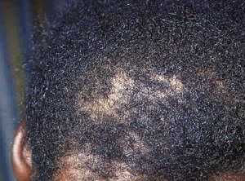
Step 1: Recognition
Secondary syphilis: Can have a variety of manifestations, many of which look like other diagnoses (drug rashes, contact/allergic dermatitis, alopecia areata, anogenital warts, etc)
STD Atlas, 1997
Acta Derm Vvenereol 2013; 93: 216-256
G. Melcher, UC Davis; S. Philip, UCSF
Latent Syphilis (Early or Late/Unknown Duration) = ASYMPTOMATIC
SCREENING is the only way to identify these patients

Slide 41
Step 2: Making the Diagnosis
Polling Question #4: What test(s) is/are needed to make a new diagnosis of syphilis in an adult?
A) A treponemal test (i.e., TPPA, EIA, or CIA) detecting antibodies to syphilis
B) A non-treponemal test such (i.e., RPR or VDRL)
C) Both a non-treponemal test and at least one treponemal test

Slide 42
Serology: Need both a treponemal AND a non treponemal test for new dx
Non-treponemal tests
Examples: RPR and VDRL
Quantitative tests, allowing for assessment of disease burden, treatment adequacy, and re-infection
Non-specific (can be positive in patients with other conditions)
Treponemal tests
Examples: TPPA, TPHA, FTA-ABS, EIA, CIA
Detect antibodies specific to T. pallidum
Antibodies usually stay positive for life after initial infection
Not quantitative; cannot be used to assess for reinfection or response to treatment
Notes:
Direct detection of T. pallidum from clinical specimens can only be done by darkfield microscopy or PCR, neither of which is widely available. So syphilis diagnosis relies on serologic testing, with tests that fall into two categories: treponemal and non-treponemal. Again, you need both types of serologic tests to confirm a syphilis diagnosis. (read slide)

Slide 43
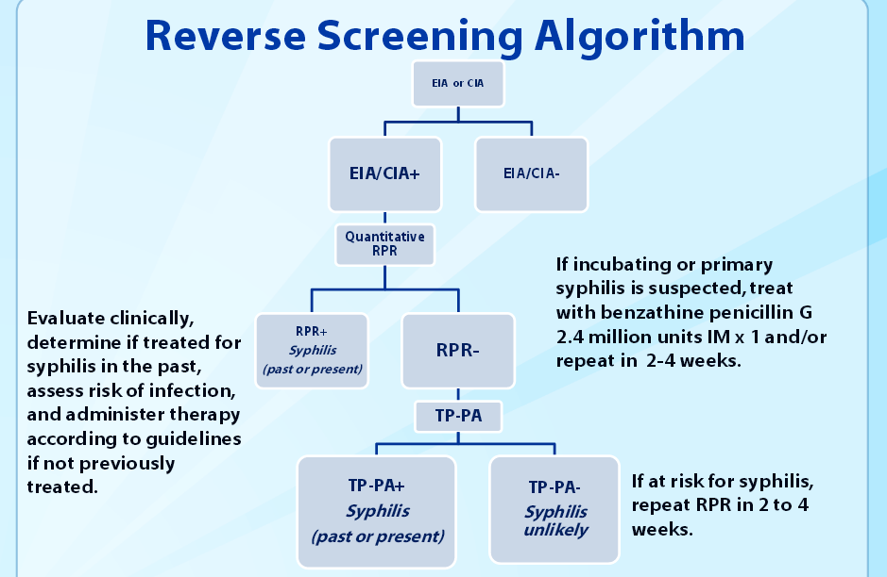
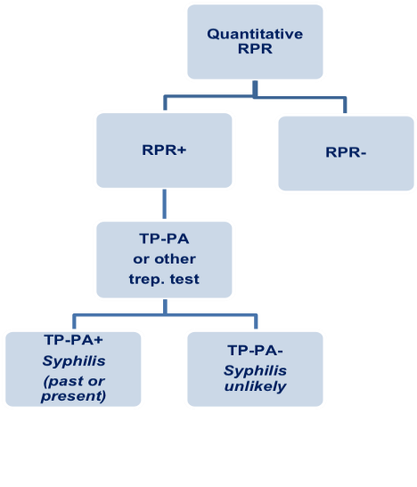
Serologic Screening for Syphilis: Traditional vs Reverse Algorithms
TRADITIONAL
Adapted from: Gaydos, 2016
Notes:
There are two different ways you can screen for syphilis – one via the traditional screening algorithm and the other way being the reverse screening algorithm, which is being used more frequently. We will go through each of these in turn.

Slide 44
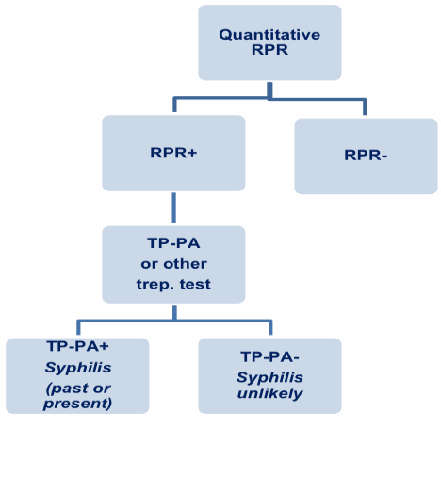
Traditional algorithm
RPR+/TPPA+ = Past or Present Syphilis
Possibilities:
Old, treated infection
Old untreated infection
New infection
Information needed:
Signs/symptoms
Any prior syphilis dx/tx
RPR titers (fourfold change)
Presumptive tx if high suspicion
In pregnancy: rescreen in 2-4 weeks
Adapted from: Gaydos, 2016
Notes:
In the traditional screening algorithm, you start with an RPR. If the RPR is negative, you are done; testing stops. But if the RPR is positive, the test should reflex to a treponemal test, such as the TPPA. If the TPPA is negative, syphilis is unlikely and the positive RPR is considered a false positive. You still want to rescreen in 2-4 weeks if the patient is pregnant, just to be sure you don’t miss an early case of syphilis (before TPPA conversion).
If the TPPA is positive, however, this indicates that the patient has either past or present syphilis. The patient’s clinical and testing history can then be used to determine whether it is:
an old, treated infection
a past infection that has been inadequately treated,
or a new infection.
Pertinent information used to make these determinations includes: any current symptoms of primary or secondary syphilis, any prior syphilis diagnosis/treatment history, and RPR titers (with a fourfold change from prior being considered clinically significant).
Few caveats/considerations:
--Even if RPR is neg, you should still treat presumptively if you clinically think the pt has early syphilis
--If you get discordant results (RPR pos, TPPA neg), You still want to rescreen in 2-4 weeks if the patient is pregnant, just to be sure you don’t miss an early case of syphilis (before TPPA conversion).

Slide 45
Reverse Screening Algorithm
Adapted from: Gaydos, 2016
Notes:
For the reverse screening algorithm, you start with a treponemal test such as an EIA/CIA – if negative, you are done. If the EIA or CIA is positive (or reactive), a standard RPR is performed next.
If the RPR is reactive, the patient has past or present syphilis, just as with the traditional screening algorithm. You use the clinical history and any prior available RPR titers to determine the likelihood of a new vs old syphilis infection, as well as the stage of syphilis.
However, if the RPR is negative, a second treponemal test (usually a TPPA) is done next, as a sort of tie breaker. If the TPPA is negative, syphilis is generally unlikely, though you will want to rescreen in 2-4 weeks if the patient is vulnerable to syphilis or in pregnancy. If the TPPA is positive, past or present syphilis is confirmed. Management at that point depends on the clinical scenario.
So for example: If the patient has a known history of treated syphilis and reports no new exposures, the positive EIA/CIA and TPPA likely represent prior exposure; no further treatment is needed.
Otherwise: Patients without a known history of treated syphilis but with a positive EIA/CIA and TPPA should be offered treatment. Unless the patient’s history or results of a physical examination suggest a recent infection within the past 12 months, previously untreated persons should be treated for late latent syphilis.
(Finally, just to add one caveat to the above: Going back up to the top of this algorithm, I do want to note that if the EIA/CIA is reactive but the RPR is non-reactive, it’s true that syphilis becomes less likely. BUT: If there is strong clinical suspicion for very early incubating or primary syphilis, you should still go ahead and treat for early syphilis and/or repeat an RPR in 2-4 weeks just to be sure. The rationale for this is that – on rare occasions – the EIA/CIA may actually become reactive BEFORE the RPR following an initial syphilis infection.)
https://slideplayer.com/slide/11456455/

Slide 46
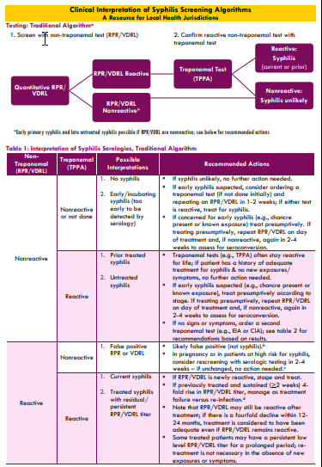
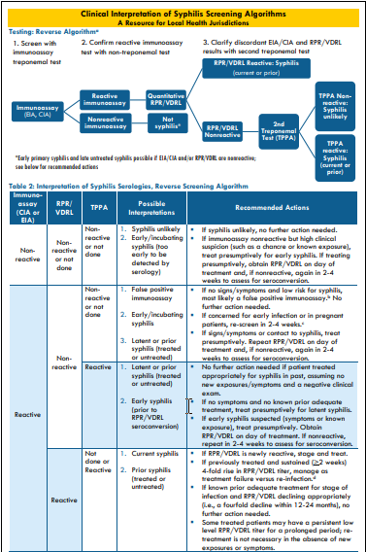
Clinical Interpretation of Syphilis Screening Algorithms: A Resource for Local Health Jurisdictions
https://californiaptc.com/wp-content/uploads/2022/10/Clinical-Resource_Syphilis-Diagnostics_V2-4_10.19.22_508.pdf
Notes:
I’d also like to highlight this new resource available from the CA PTC
https://californiaptc.com/wp-content/uploads/2022/10/Clinical-Resource_Syphilis-Diagnostics_V2-4_10.19.22_508.pdf

Slide 47
What about patients with a history of syphilis, how do you interpret non-treponemal (RPR/VDRL) titers?
1:1024
1:512
1:256
1:128
1:64
1:32
1:16
1:8
1:4
1:2
1:1
Higher numbers correspond to higher level of antibodies in patient’s serum
Two-fold change: Generally considered within margin of error of test
Four-fold change: Sustained for at least 2 weeks considered to be significant
Compare titers using the same serologic test: RPR often higher than VDRL
2-fold change
4-fold change
Notes:
A fourfold change in non-treponemal titers (like RPR/VDRL) is considered significant. A fourfold decline can indicate adequate response to treatment while a fourfold increase can be suggestive of a new infection

Slide 48
Syphilis Staging & Treatment

Slide 49
Syphilis Treatment: Depends on Staging
Notes:
This slide shows the treatment algorithm for syphilis in adults, including pregnant women. Early syphilis, comprised of primary, secondary, and early latent syphilis (which is asymptomatic syphilis within one year of diagnosis), only requires one dose of intramuscular benzathine penicillin. Syphilis of late or unknown duration requires 3 doses of intramuscular benzathine penicillin at weekly intervals. In pregnant women with late syphilis, if intervals are beyond 6-8 days, the full 3 dose course of therapy should be restarted. There are no alternatives to penicillin for syphilis treatment in pregnancy. Note that inadequate treatment consists of any non-penicillin therapy, or penicillin given less than 30 days before delivery.

Slide 50
Syphilis in Pregnancy
Penicillin is the only tx for syphilis in pregnancy
Treat with the penicillin regimen appropriate for stage of infection
Pregnant people with history of penicillin allergy should be desensitized and treated with penicillin
Notes:
Some experts recommend a 2nd dose of benzathine penicillin G 2.4 mu IM ( 7 days after 1st dose in early syphilis for pregnant people)

Slide 51
Importance of Early Tx
Early Rx = Fewer CS Infant Deaths
Mathematical model: % CS deaths preventable by treating pregnant people with syphilis at a given gestational age.
Around 70% of CS stillbirths were likely avoidable if treatment was given by 21weeks’ gestation
(Gust DA, Levine WC, St. Louis, M, et al. Mortality associated with congenital syphilis in the United States, 1992-1998. Pediatrics, 2002; 109(5):E79-9.)
Notes:
Also important to know that CS deaths are largely preventable if mothers are successfully diagnosed and treated before becoming pregnant or earlier in pregnancy. As shown here, mathematical modeling studies have shown that ~70% of CS stillbirths are likely avoidable if syphilis treatment is given by 21 weeks gestation.

Slide 52
Importance of Day of Treatment Titer
Content credit: California Prevention Training Center & California Dept of Public Health, STD Control Branch
Notes:
Performing a day of treatment titer establishes a baseline to compare response after treatment. This is a frequently forgotten component of syphilis management -- and without a true baseline documented -- it can make assessment of titer response to treatment difficult, as depicted on this slide.
Talk through the scenario a bit if time

Slide 53
Resources for Understanding Maternal Syphilis Serologies & Treatment History
Contact your local health department for assistance reviewing prior maternal syphilis tests & confirming whether adequate treatment was received
Can also help with: Partner notification, treatment access
For clinical consultation or help interpreting maternal syphilis test results, consider STD CCN www.stdccn.org
Notes:
There are several resources available to help you understand whether a mother received adequate treatment for syphilis… you can (read slide)

Slide 54
CS Prevention: Additional Strategies

Slide 55
Be aware of state and/or CDC guidelines for syphilis screening
Cis Women and Men Who Have Sex with Women | Screen asymptomatic adults at increased risk (history of incarceration or transactional sex work, geography, race/ethnicity, and being a male younger than 29 years) for syphilis infection
Pregnant Women | All pregnant women at the first prenatal visit Retest at 28 weeks gestation and at delivery if at high risk (lives in a community with high syphilis morbidity or is at risk for syphilis acquisition during pregnancy (using drugs, STIs during pregnancy, multiple partners, a new partner, partner with STIs)
Men Who Have Sex With Men | At least annually for sexually active MSM Every 3 to 6 months if indicated (based on sexual practices)
Transgender and Gender Diverse People | Consider screening at least annually based on reported sexual behaviors and exposure
Persons with HIV | For sexually active individuals, screen at first HIV evaluation, and at least annually thereafter More frequent screening might be appropriate depending on individual behaviors & local epidemiology
CDC, 2021 STI screening recommendations

Slide 56
Screening for Syphilis in HIV PrEP in groups at substantial risk of acquiring HIV :
Sexually-active adult MSM (men who have sex with men)
Adult heterosexually active men and women
Discuss with heterosexually-active women and men whose partners are known to have HIV infection (i.e., HIV-discordant couples), if positive partner has a detectable VL
Prevention option for adult persons who inject drugs (PWID) (also called injection drug users [IDU])
(Spadone 2023)

Slide 57
Assessments for oral PrEP follow up care:
(Spadone,2023)

Slide 58
Other strategies to consider (Ex: CDPH):
In people who could become pregnant:
At least one lifetime screening for syphilis
Screen for syphilis w/each HIV test
In jurisdictions where CS morbidity is high:
Consider screening in EDs & at intake into correctional facilities
Including via rapid syphilis testing
Use opt-out strategies when offering syphilis screening
Pregnancy & syphilis:
Offer syphilis screening at time of pregnancy dx
Get a pregnancy test when people who could become pregnant test positive for syphilis
Offer syphilis screening at locations frequented by persons who inject drugs (syringe services, drug treatment programs, etc)
Include rapid syphilis testing as part of street medicine or homeless outreach programs
California Dept of Public Health, 2020 and 2021

Slide 59
Syphilis & CS Updates

Slide 60
Adult Syphilis
Presentation:
Atypical presentation (painful, multiple lesions)
Enhanced clinical description (ocular, otic manifestations)
No new data on treatment
PCN G remains recommended treatment
Ongoing RCT early syphilis (1 vs 3 benzathine PCN)
Alternative regimens for early syphilis (non-pregnant patients only):
Doxycycline 100 mg BID x 14 days OR
Ceftriaxone 1 g IV daily x 10 days
Inadequate serologic response after treatment
12 months after primary, secondary, early latent
24 months after syphilis of late latent or unknown duration
Workowski et al, 2021

Slide 61
Syphilis screening prior to pregnancy
Screen asymptomatic women at increased risk (history of incarceration or transactional sex work, geography, race/ethnicity) for syphilis infection^{1,2}
Among those who are living with HIV: for sexually active individuals, screen at first HIV evaluation, and at least annually thereafter^{1,3}
More frequent screening might be appropriate depending on individual risk behaviors and the local epidemiology¹
^{1.} Workowski KA, Bachmann L, Chan P, Johnston C, Muzny C, Park I, Reno H, Zenilman J, Bolan G. Sexually Transmitted Infections, 2021. MMWR Recomm Rep 2021:70(No. RR-04):1-187
^{2.} Kirsten Bibbins-Domingo. USPSTF Recommendation Statement, Screening for Syphilis Infection in Nonpregnant Adults and Adolescents U.S. Preventive Services Task Force Recommendation Statement. JAMA June 7, 2016 Volume 315, Number 21: 2321-2327
3. Thompson MA, Horberg MA, Agwu AL, et al. Primary Care Guidelines for Persons With HIV: 2020 Update by the HIV Medicine Association of the Infectious Diseases Society of America. CID. Nov 6 2020.

Slide 62
Learning from the past: Perinatal HIV transmission reduction
“The implementation of strategies that reduce perinatal transmission of the human immunodeficiency virus (HIV) — including the prevention of infection in women, increased prenatal testing, and advances in maternal treatment — has been associated with a decline in annual cases of perinatal HIV from an estimated 1760 in 1991 to fewer than 40 in 2019. A similar commitment of resources could reduce or eliminate congenital syphilis.”
Bowen VB, McDonald R, Grey JA, Kimball A, Torrone EA. High congenital syphilis case counts among US infants born in 2020. New England Journal of Medicine. 2021 Sep 16;385(12):1144-5.

Slide 63
Syphilis in Pregnancy
Risk factors for congenital syphilis/syphilis in pregnancy
Multiple partners,
Sex with drug use, or transactional sex;
Late to prenatal care (>second trimester) or no prenatal care;
Methamphetamine/heroin use;
Corrections;
Unstable housing/homelessness
Risk of reinfection based on ongoing risk behaviors or partner treatment
Penicillin remains only acceptable treatment option in pregnancy
Monitoring
Repeat RPR 8 wks after treatment unless signs of primary or secondary syphilis
Syphilis diagnosed and treated at 24 weeks gestation → repeat serology at delivery
Most patients will not achieve 4-fold decrease in titers before delivery
Workowski et al, 2021

Slide 64
Evaluation for neuro & ocular syphilis
CSF evaluation needed for patients with clinical signs of neurosyphilis (i.e., cranial nerve deficits)
CSF interpretation:
CSF-VDRL positive is diagnostic
CSF-VDRL negative: lymphocyte count, protein
Consider TP-PA or FTA-ABS
Ocular exam needed for patients with positive serology and ocular symptoms
If cranial nerve dysfunction present perform LP
Isolated ocular abnormalities, no CSF evaluation necessary
Auditory abnormalities alone
Otologic exam, no CSF evaluation necessary
Neurosyphilis
No need for repeat CSF exam at 6 months with serum adequate RPR response (HIV- and HIV+/ART)
Workowski et al, 2021

Slide 65
Additional Management Considerations
Patients should receive a neurologic exam including ophthalmic and otic
Lumbar puncture is recommended if signs/ symptoms present
All patients with syphilis should be tested for HIV
Presumptively treat partners
If diagnosed during the second half of pregnancy, perform obstetric ultrasound
Repeat HIV, Chlamydia, and Gonorrhea screen in 3rd trimester

Slide 66
Bicillin Shortages

Slide 67
April 2023: FDA Announces Bicillin L-A Shortage
Bicillin L-a, Injection, 2400000 [iU]/4 mL (NDC 60793-702-10) | Limited Supply… Estimated recovery: Q4 2024
FDA, 2023
Notes:
Why do we think this is happening? Amox shortage potentially contributory; only one distributor (Pfizer)

Slide 68
NCSD Survey: Increasing Severity of Shortage
NCSD, 2023
Notes:
NCSD Bicillin L-A Shortage Severity Survey
151 clinics & 136 health departments representing 39 states, one territory, DC, and communities served by IHS

Slide 69
Potential Solutions During Bicillin Shortage
Take inventory:
Monitor local supply of Bicillin L-A® and determine the local pattern of use to forecast need.
Contact distributors to procure Bicillin L-A® as appropriate. Contact Pfizer (see “Dear Patient Letter” posted on the FDA website) if there is less than a 2-week supply, the distributor has no supply, and there is a risk that patients may not be treated.
Appropriately stage syphilis cases to ensure appropriate use of antimicrobials. Early syphilis (primary, secondary and early latent) only requires 2.4 million units of Bicillin L-A®
Prioritize using Bicillin L-A® to treat pregnant people with syphilis and babies with congenital syphilis.
Choose doxycycline for non-pregnant people to help preserve Bicillin L-A® supplies.
Consider involving antimicrobial stewardship leaders to help institute systems-level approaches to limit the use of Bicillin L-A® and encourage the use of alternative effective antimicrobials for treatment of other infectious diseases.
CDC, July 2023, https://www.cdc.gov/std/dstdp/dcl/2023-july-20-Mena-BicillinLA.htm
Notes:
For additional product availability questions, please reach out to your Pfizer Hospital sales representative or account executive. Alternatively, the Supply Continuity Team can be contacted between 7 a.m. and 5 p.m. (CT) at 1-844-646-4398 (select option 1 [Customer], then option 3 [Supply Continuity Team]).

Slide 70
Polling Question #5
You are treating a 22 yo trans woman for syphilis of late latent/unknown duration. She received her 1st Bicillin L-A injection 7 days ago, but now your clinic has run out of Bicillin. What do you do?
A) Give her doxycycline x 7 days
B) Give her doxycycline x 14 days
C) Give her doxycycline x 28 days
D) I have no idea!
Notes:
Bottom line: No data for a mix and match approach

Slide 71
No data support mixing/matching doxy & Bicillin L-A
Reminder re acceptable alternatives (non-pregnant only):
Early syphilis: Doxycycline x 14d (or ceftriaxone x 10d)
Late/unknown duration: Doxy x 28d
Safest course in this case = Restart doxy x 28d
CDPH, Sept 2023
Notes:
Technically ceftriaxone 1 gm x 10-14 days IM/IV is also acceptable for early syphilis

Slide 72
What about Extencilline? FDA temporarily authorized importation

Slide 73
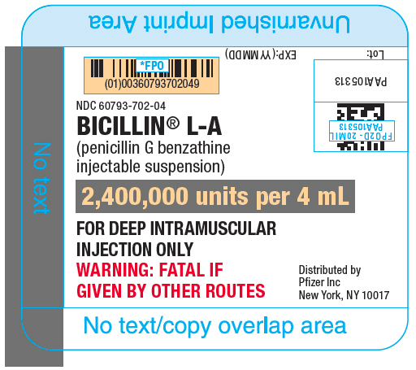
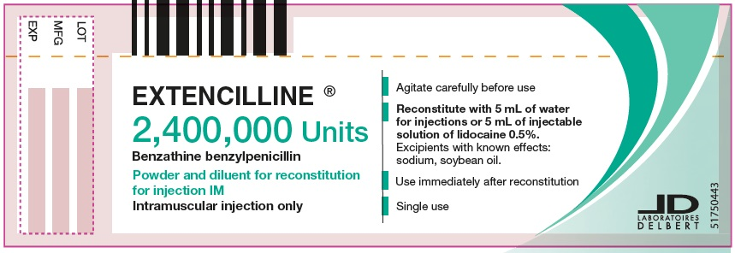
Major differences
Bicillin-LA | Extencilline
pre-filled syringe | powder packaged with sterile water for injection (can be made with 0.5-1% lidocaine)
4 ml | 7 ml (will need to be split)
Refrigerated | Room temp
0.53% lecithin | lecithin
h/o hypersensitivity to penicillins | h/o hypersensitivity to penicillins and soy
Caution: There are LESS warnings with extencilline. Follow all warnings listed for bicillin L-A.
Bicillin L-A (benzathine penicillin) [package insert]. Pfizer (Accessed Jan 27, 2024)
FDA Dear Healthcare Provider Letter https://www.fda.gov/media/175366/download (Accessed Jan 27, 2024)
Slide credit: Dr. K. Yang, UCSF
Notes:
Mention that cost may be a barrier – different programs are working on this
Exipient -- an inactive substance that serves as the vehicle or medium for a drug or other active substance:

Slide 74
Conclusions

Slide 75
Take-Aways
1) Syphilis is the “great masquerader” – presents differently in different stages of disease and can easily be misdiagnosed.
2) Outcomes of untreated syphilis can be severe and fatal (CS)
3) Preventing CS relies heavily on recognizing, diagnosing, and treating syphilis in adults
4) A new diagnosis of syphilis requires both treponemal and non-treponemal tests
5) During bicillin shortages, prioritize bicillin for use in pregnant patients or babies exposed in utero
6) Doxycycline & extencilline are potential alternative treatments for syphilis (doxy for non-pregnant patients only)
Notes:
Presentation Conclusions - Read slide

Slide 76
Acknowledgements
Dr. K. Jacobson – California Department of Public Health (CDPH)
Dr. E. Tang – CDPH
Dr. R. Plotzker – CDPH and California Prevention Training Center (CAPTC)
Dr. I. Park – CAPTC
Dr. S. Adler – CAPTC
Dr. K. Yang – UCSF

Slide 77
Bibliography
Centers for Disease Control and Prevention (CDC). The state of STIs – infographic. Available at: https://www.cdc.gov/std/statistics/infographic.htm. Accessed 4/8/24.
McDonald et al. Vital Signs: Missed Opportunities for Preventing Congenital Syphilis — United States, 2022. MMWR 2023; 72(46):1269–1274.
Andrade et al. Secondary syphilis with persisting hard chancre on the forearm. Acta Derm Venereol. 2013; 93: 216-256.
Gaydos. Point-of-care (POC) and automated treponemal tests for syphilis: ground gained in battle. Syphilis symposium @ IUSTI. May 9-12, 2016. Marrakesh, Morrocco.
Workowski et al. Centers for Disease Control and Prevention -- 2021 STI Treatment Guidelines: Syphilis and Congenital Syphilis. Available at: https://www.cdc.gov/std/treatment-guidelines/toc.htm. Accessed 4/8/24.
Gust DA, Levine WC, St. Louis, M, et al. Mortality associated with congenital syphilis in the United States, 1992-1998. Pediatrics, 2002; 109(5):E79-9.
Centers for Disease Control and Prevention. Screening recommendations and considerations referenced in treatment guidelines and original sources. Available at: https://www.cdc.gov/std/treatment-guidelines/screening-recommendations.htm. Accessed 4/8/24.

Slide 78
Bibliography
California Department of Public Health. Expanded syphilis screening recommendations for the prevention of congenital syphilis. 2020. Available at: https://www.cdph.ca.gov/Programs/CID/DCDC/CDPH%20Document%20Library/Expanded-Syphilis-Screening-Recommendations.pdf. Accessed 4/8/24.
California Department of Public Health. Health Alert: Increasing cases of syphilis and congenital syphilis in Northern California. October 2021. Available at: https://www.cdph.ca.gov/Programs/CID/DCDC/CDPH%20Document%20Library/Health-Alert-Increasing-Cases-of-Congenital-Syphilis-and-Syphilis-Among-Females-in-Northern-California.pdf. Accessed 4/8/24.
Food and Drug Administration (FDA). FDA Drug Shortages. Available at: https://www.accessdata.fda.gov/scripts/drugshortages/dsp_ActiveIngredientDetails.cfm?AI=Penicillin%20G%20Benzathine%20Injection&st=c&tab=tabs-1#. Accessed 4/8/24.
National Coalition of STD Directors (NCSD). Second survey exposes worsening bicillin L-A shortage amid national syphilis crisis. Available at: https://www.ncsddc.org/second-survey-exposes-worsening-bicillin-l-a-shortage-amid-national-syphilis-crisis/. Accessed 4/8/24.
Centers for Disease Control and Prevention. Clinical reminders during bicillin L-A shortage. July 2023. Available at: https://www.cdc.gov/std/dstdp/dcl/2023-july-20-Mena-BicillinLA.htm. Accessed 4/8/24.
California Department of Public Health. Dear Colleague Letter: Special considerations for the treatment of syphilis using alternative therapies in non-pregnant persons. September 2023. Available at: https://www.cdph.ca.gov/Programs/CID/DCDC/CDPH%20Document%20Library/Dear-Colleague-Letter_Special-Considerations-for-Treatment-of-Syphilis-Alt-Therapies_9-12-23.pdf. Accessed 4/8/24.
Bicillin L-A (benzathine penicillin) [package insert]. Pfizer. Accessed 01/27/24.
FDA Dear Healthcare Provider Letter https://www.fda.gov/media/175366/download. Accessed 01/27/24.

Slide 79
Questions? kjohnson@ucsf.edu

