Slide 1

HIV and Substance Use Disorders: Growing Threat of Xylazine in the Illicit Drug Supply
Hector Colon-Rivera MD, MBA, MRO, FAPA
Notes:
Version date_05 2024
Target participants:

Slide 2

Working with communities.
The SAMHSA-funded Opioid Response Network (ORN) assists states, organizations and individuals by providing the resources and technical assistance they need locally to address the opioid crisis and stimulant use.
Technical assistance is available to support the evidence-based prevention, harm reduction, treatment and recovery of opioid use disorders and stimulant use disorders.
Funding for this initiative was made possible (in part) by grant no. 1H79TI085588-02 from SAMHSA. The views expressed in written conference materials or publications and by speakers and moderators do not necessarily reflect the official policies of the Department of Health and Human Services; nor does mention of trade names, commercial practices, or organizations imply endorsement by the U.S. Government.

Slide 3
Working with communities.
The Opioid Response Network (ORN) provides local, experienced consultants in prevention, treatment and recovery to communities and organizations to help address this opioid crisis and stimulant use.
ORN accepts requests for education and training.
Each state/territory has a designated team, led by a regional Technology Transfer Specialist (TTS), who is an expert in implementing evidence-based practices.

Slide 4
Contact the
Opioid Response Network
To ask questions or submit a request for technical assistance:
    Visit www.OpioidResponseNetwork.org
    Email orn@aaap.org
    Call 401-270-5900

Slide 5
Conflict of Interest Disclosure Statement
Speaker has nothing to disclose
This program is supported by the Health Resources and Services Administration (HRSA) of the U.S. Department of Health and Human Services (HHS) as part of an award totaling $4,205,743 with 0% financed with non-governmental sources. The contents are those of the author(s) and do not necessarily represent the official views of, nor does mention of trade names, commercial practices, or organizations imply an endorsement by HRSA, HHS, or the U.S. Government. For more information, please visit HRSA.gov. Any trade/brand names for products mentioned during this presentation are for training and identification purposes only.

Slide 6
Use of Trade/Brand Names
This program is supported by the Health Resources and Services Administration (HRSA) of the U.S. Department of Health and Human Services (HHS) as part of an award totaling $4,205,743, with 0% financed with non-governmental sources.
The views expressed do not necessarily reflect the official policies of the Department of Health and Human Services, nor does mention of trade names, commercial practices, or organizations imply endorsement by the U.S. Government. Any trade/brand names for products mentioned during this presentation are for training and identification purposes only.
Notes:
NOTE: THIS SLIDE MUST BE INCLUDED IF TRADE AND/OR BRAND NAMES FOR MEDICATIONS ARE USED IN THE PRESENTATION.
IT MAY BE DELETED IF THERE IS NO REFERENCE TO TRADE NAMES, INCLUDING PRESENTATIONS IN WHICH ONLY GENERIC MEDICATION NAMES ARE MENTIONED.
TRADE NAMES MUST BE PUT IN PARENTHESES AFTER THE GENERIC NAME THE FIRST TIME IT IS MENTIONED - E.G., FLUOXETINE (PROZAC). TRADE NAMES SHOULD ONLY BE MENTIONED FOR THE INITIAL REFERENCE AND THE GENERIC NAME ONLY SHOULD BE USED AFTER THAT. THIS APPLIES EQUALLY TO ALL MEDICATIONS OR PRODUCTS MENTIONED IN THIS PRESENTATION.

Slide 7

Unconscious Bias Disclosure
SCAETC recognizes that language is constantly evolving, and while we make every effort to avoid bias and stigmatizing terms, we acknowledge that unintentional lapses may occur in our presentations.
We value your feedback and encourage you to share any concerns related to language, images, or concepts that may be offensive or stigmatizing.
Your input will help us refine and improve our presentations, ensuring they remain inclusive and respectful to participants.

Slide 8

Objectives
Learn about preventive and treatment approaches that might reduce health disparities among people with co-occurring HIV and OUD
Discuss considerations for treatment of individuals with HIV and substance use disorder (SUD)
Investigate trends in xylazine exposure and the prevalence and relevance of xylazine use.
Review xylazine pharmacology and clinical effects and understand the health risks and medical response to xylazine-related overdose, wounds, and dependence.
Explore diagnostic and management strategies for xylazine-related drug use.

Slide 9
Epidemiology Of Opioid Use In Adolescents And Adults

Slide 10
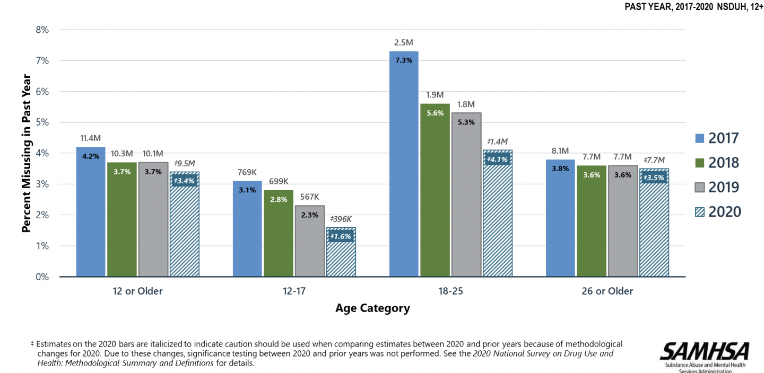
Opioid Misuse in Past Year: Among People Aged 12+

Slide 11
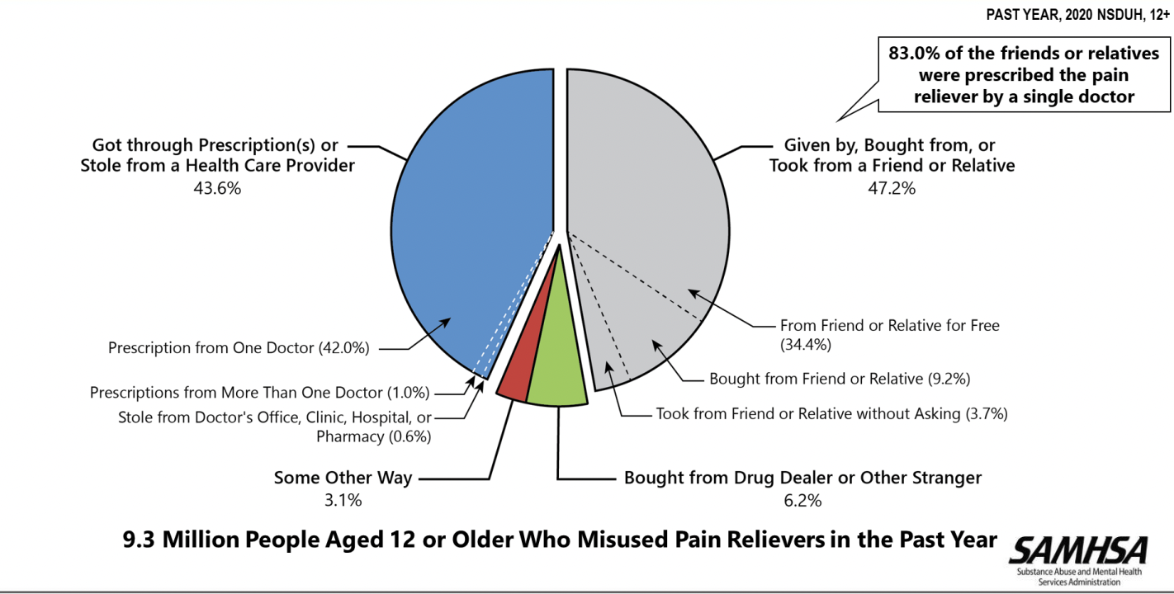
Sources Where Pain Relievers Were Obtained for Most Recent Misuse in Past Year: Among People Aged 12+ Who Misused Prescription Pain Relievers in Past Year

Slide 12
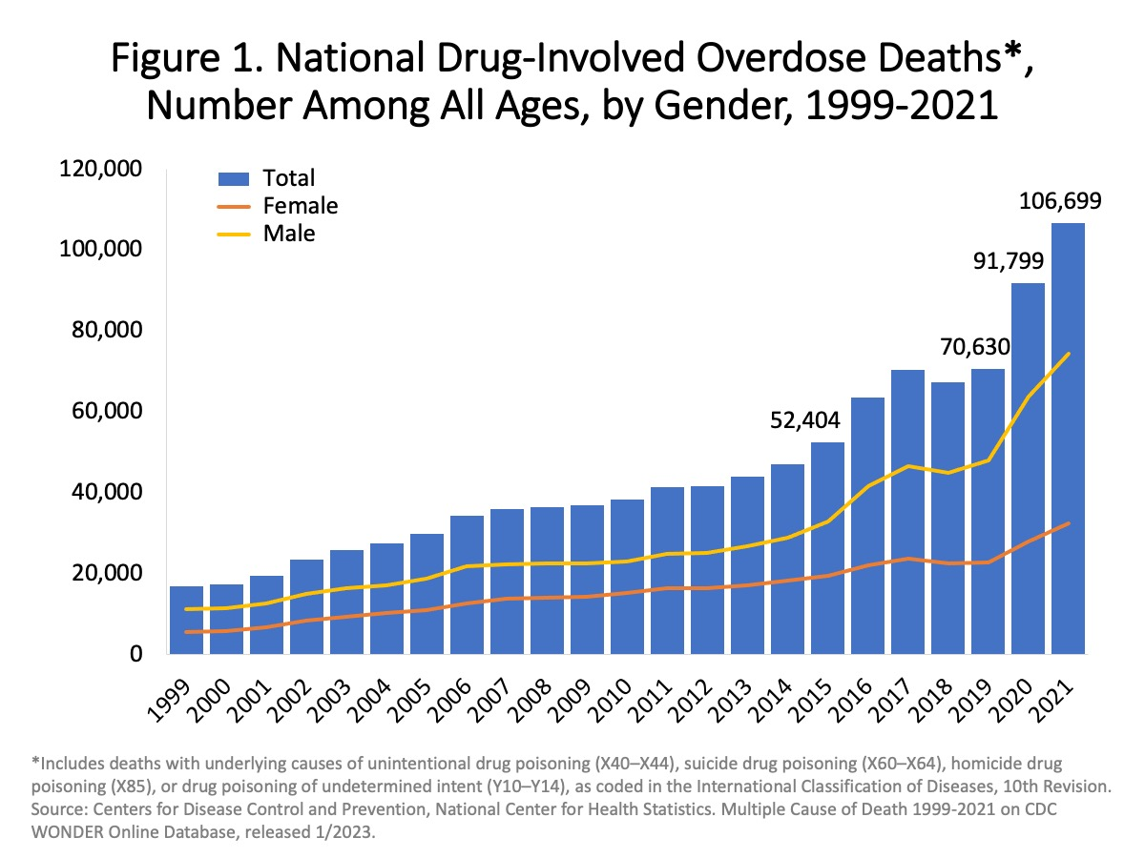
12
https://www.samhsa.gov/data/

Slide 13
Risks for Opioid Use

Slide 14




Mental Health Disorders Increase Opioid Use
Familial alcohol problem/drug use
Drug misuse/Dependence
OR: 7.89-7.92
Major depression, anxiety disorder, or panic disorder
Opioid use OR: 4.43
(95% CI 3.64-5.38)
PTSD
Drug misuse/Dependence OR: 8.68
Sources: 1) Kilpatrick DG, Acierno R, Saunders B, Resnick HS, Best CL, Schnurr PP. Risk factors for adolescent substance abuse and dependence: data from a national sample. J Consult Clin Psychol. 2000;68(1):19-30. 2) Sullivan MD, Edlund MJ, Zhang L, Unützer J, Wells KB. Association Between Mental Health Disorders, Problem Drug Use, and Regular Prescription Opioid Use. Arch Intern Med. 2006;166(19):2087-2093.
Notes:
Sullivan and colleagues analyzed longitudinal data from more than 6000 participants in the 1998 and 2001 cohorts of a nationally representative, longitudinal telephone survey. They found that participants who had a common mental health disorder in 1998 (major depression, dysthymia, generalized anxiety disorder, or panic disorder) were more likely to report opioid use in 2001 than those without these mental health disorders (odds ratio [OR], 4.43; 95% confidence interval [CI], 3.64-5.38; P<.001). Those with these disorders also had increased risk of initiating (OR 3.26) and continuing (OR 2.30) use of opioids. Because common mental health disorders are associated with initiation and use of prescribed opioids, it is important to consider mental health diagnoses when considering opioid therapy.
Kilpatrick and colleagues conducted phone interviews with more than 4,000 adolescents (12-17 years) about substance use, victimization experiences, familial substance use, and posttraumatic reactions in order to identify substance abuse/dependence (DSM4) risk factors. They found that use of hard or prescription drugs was associated with experiences of physical assault, sexual assault, witnessing or experiencing violence, PTSD, and having family members with problems with alcohol or drugs.

Slide 15
Substance Use Is Associated With Increased Risk Of:
Motor vehicle crashes
Unplanned pregnancy
Contraction of sexually transmitted diseases
Chronic disease
Poor school performance
Mental Illness
Suicide
Substance Use Disorder

Slide 16
Facts
People with HIV are more likely to have chronic pain, receive opioid analgesic treatment, receive higher doses of opioids, and to have SUDs and mental illness compared with the general population
Management of opioid use in people with HIV can be complex
Medication for opioid use disorder (MOUD) improves HIV outcomes and other outcomes
Cunningham CO. Opioids and HIV Infection: From Pain Management to Addiction Treatment. Top Antivir Med. 2018 Apr;25(4):143-146. PMID: 29689538; PMCID: PMC5935219.

Slide 17

Why Should We Discuss SUD And HIV With Our Patients?
Substance use accelerates the progression of HIV
  Increases the viral load
  Increases likelihood of AIDS-related morbidity (even when adherent to antiretroviral medications)
  Decreases medication adherence
Substance use can weaken the blood brain barrier
  HIV enters the brain
  Allows infection and damage to nerves and supporting cells (glia)
  Triggers release of neurotoxins
  Precipitates neuroinflammation or brain swelling
  Damage to subcortical areas of the brain
Sources: Dash, 2015; Schaffer 2017; Strazza 2011; Dahal 2015; Andriote 2012;
NIDA 2021 https://www.drugabuse.gov/publications/research-reports/common-comorbidities-substance-use-disorders/
Notes:
HIV+ people can experience a variety of types of pain, from a variety of causes. The virus itself and the immune response to it can lead to inflammatory responses that cause pain. Secondary complications of poorly managed HIV—such as cancers and opportunistic infections—are also associated with pain. Older HIV medications themselves tended to be neurotoxic, associated with nerve damage that can lead to pain. Even HIV+ patients who are managing their infection with antiretroviral therapy and have higher CD4 counts can experience pain

Slide 18

SAMHSA Recommendations
Substance Abuse and Mental Health Services Administration (SAMHSA) recommends universal HIV testing for
  Persons 15-65yo (and all pregnant persons)
  Younger and older persons at increased risk:
    People who inject drugs
    Have condomless sex
    Participate in commercial sex
US Preventive Task Force Rating A
  Requires Medicare and Medicaid to pay for testing
  Rapid tests are available- results within 30 minutes

Slide 19
Prevention
Screen for HIV and hepatitis A, B, and C
Vaccinate for hepatitis A and B and tetanus
Counsel about the risks associated with sharing injection equipment
Teach opioid overdose prevention and prescribe naloxone
Provide access to sterile needles and syringes
Distribute condoms and screen for Sexually Transmitted Infections (STIs)
Prescribe medications FDA approved for opioid use disorders.
Prescribe Pre-exposure Prophylaxis (PrEP) for HIV prevention
Provide access to supervised injection facilities
Prescribe or dispense naloxone

Slide 20
STTR Model
Seek those who need testing
Test
Treat
Retain
Testing a person who injects drugs every 6 months is cost effective
Sources: NIDA 2021 https://www.drugabuse.gov/publications/research-reports/common-comorbidities-substance-use-disorders
Blank MB, Himelhoch S, Walkup J, Eisenberg MM. Treatment considerations for HIV-infected individuals with severe mental illness. Curr HIV/AIDS Rep. 2013 Dec;10(4):371-9. doi: 10.1007/s11904-013-0179-3. PMID: 24158425
Inpatient and outpatient mental health settings should offer routine opt out testing to improve case findings
Notes:
The seek, test, treat, and retain model of care (STTR) involves reaching out to high risk, hard to reach drug abusing groups who have not been recently tested for HIV (seeking), engaging them in HIV testing (testing), initiating, monitoring, and maintaining HAART for those testing positive (treating) and retaining patients in care (retaining). This model of care is based on previous research demonstrating that expanding HIV testing and reducing viral load among HIV+ individuals through HAART therapy can be effective in reducing the HIV transmission at a population level.

Slide 21
Medications for OUD
Prescribe oral buprenorphine, long-acting injectable buprenorphine, or long-acting injectable naltrexone, or refer for methadone maintenance
Buprenorphine and methadone significantly reduce opioid use, increase treatment retention, and decrease overall mortality
HIV and HCV incidence are associated with participation and duration in a methadone maintenance program
OUD = Opioid Use Disorder

Slide 22
Overview of
Antiretroviral Therapy
Nucleoside or nucleotide reverse transcriptase inhibitors (NRTIs)
Protease inhibitors (PIs)
Nonnucleoside reverse transcriptase inhibitors (NNRTIs)
Fusion inhibitors
Chemokine receptor antagonists (CRAs)
Entry inhibitors (CD4-directed post-attachment inhibitors)
HIV integrase strand transfer inhibitors
Pharmcokinetic enhancers (boosting agents)
Notes:
Recommended treatment regimens are constantly modified and changed; any publication like this article may become quickly outdated. Therefore, this article is intended to be a primer, and all children should be referred to a pediatric infectious specialist for management.

Slide 23
Pharmacokinetic or Pharmacodynamic
Several antiretroviral drugs (ARDs) may affect or be affected by absorption kinetics
  Didanosine contains an aluminum and magnesium buffer that may affect the absorption of other drugs
  Delavirdine, atazanavir, and rilpivirine are poorly absorbed when the pH of the GI tract increases
Many ARD pharmacokinetic interactions alter the cytochrome P450 (CYP) metabolic enzyme system
Notes:
Newly Approved HIV Medications · Ibalizumab-Uiyk (Trogarzo) · Fostemsavir (Rukobia) · Bictegravir/Emtricitabine/Tenofovir Alafenamide (Biktarvy).

Slide 24
Opioid Crisis and Fentanyl and Xylazine Threats

Slide 25
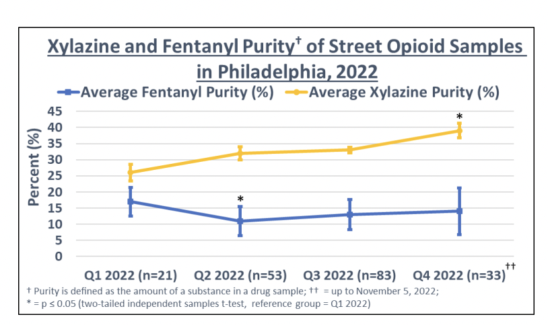
Xylazine (tranq) exposure among people who use substances in Philadelphia by Philadelphia Department of Public Health

Slide 26
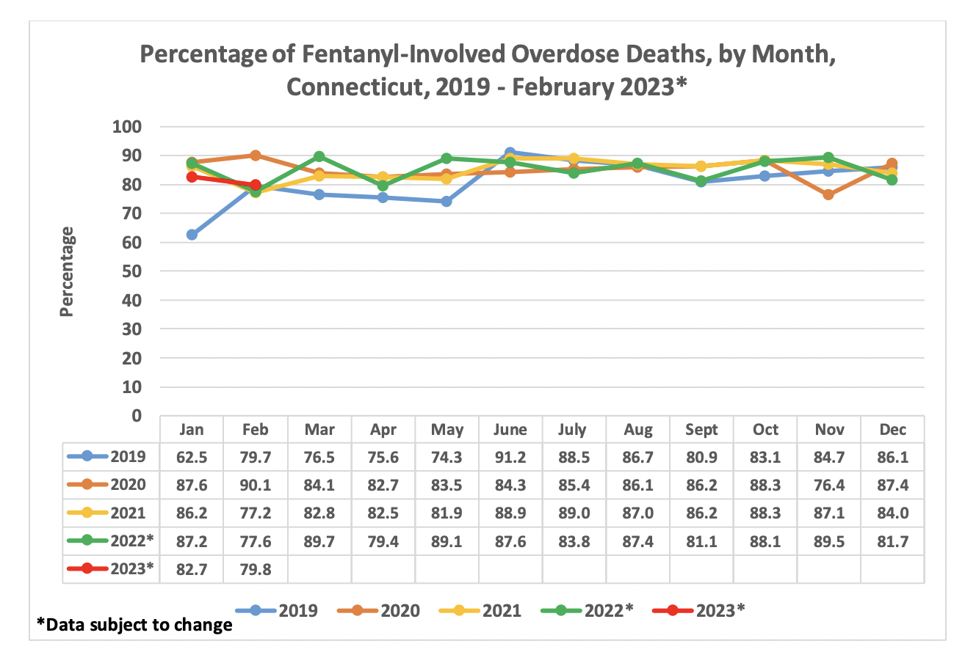
26
Connecticut Department of Public Health Drug Overdose Monthly Report

Slide 27
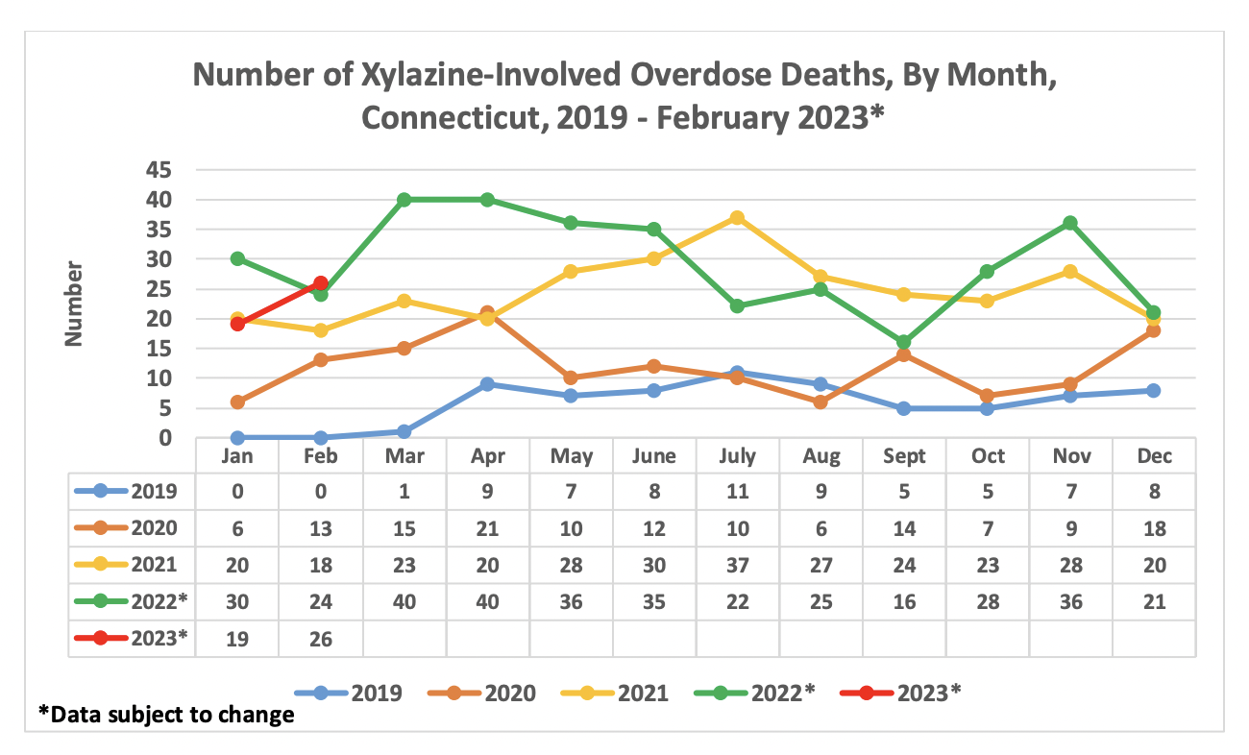
Connecticut Department of Public Health Drug Overdose Monthly Report

Slide 28
Fentanyl

Slide 29
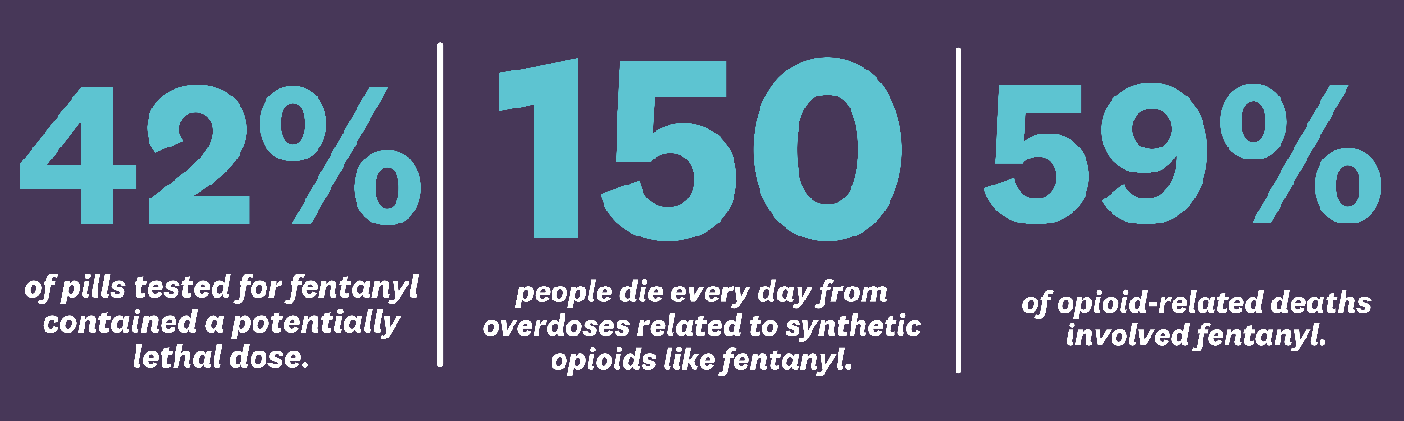
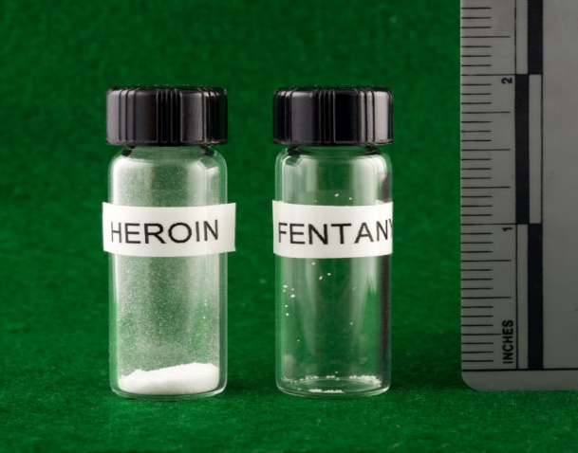
Fentanyl
SAFE Project 2023 (Stop the Addiction Fatality Epidemic = SAFE)

Slide 30
Overdose and Origins
From May 2020 to April 2021 more than 100,000 Americans died for a drug overdose.
Close to 60% of these deaths were due to synthetic opioids like fentanyl.
Fentanyl is synthesized in China, Mexico and, India and exported to The U.S. as a powder or pressed in pills.
A 5 lb bag of fentanyl is enough to produce 1,000,000 lethal doses.

Slide 31
“Oxys” M30s

Slide 32
The Fentanyl Problem
Fentanyl and its analogs are the primary drivers of death in the opioid overdose crisis.
Fentanyl is 50 times stronger than heroin.
It has contributed to overdose deaths
Overdose can occur by ingestion, injection, or inhalation.
Overdose by fentanyl can not occur by exposure through skin.
Reversal of fentanyl overdose may require repeated doses of naloxone

Slide 33
Testing for Fentanyl
Fentanyl test strips (FTS) can detect the presence of fentanyl in drug samples.
FTS cost is $1.00 per strip.
Testing is 96% accurate and can detect at least 10 fentanyl analogs.
The legality of FTS varies from state to state (some states view FTS as illegal drug paraphernalia).

Slide 34
New Fentanyl Compounds
Other fentanyl compounds are appearing in heroin, counterfeit pills and in autopsy findings.
Para-fluorofentanyl was developed through research efforts in the 1960’s and classified as a schedule I substance.
Para-fluorofentanyl is showing up now in seized heroin, counterfeit pills, and autopsy findings.
Carfentanil (100 times more potent than fentanyl) has been reported in a very few cases in the Midwest.

Slide 35
Xylazine

Slide 36
How Xylazine Works?
Has muscle relaxant properties, analgesic, and pain-relieving properties.
It is an agonist at Alpha-2 Andrenergic receptors. It decreases and inhibits the release of norepinephrine and dopamine.
Similar chemical structure to clonidine and guanfacine.

Slide 37
Use Of Xylazine In Veterinary Medicine
Xylazine is an essential tool universally used by veterinarians who work on livestock.
Administered intravenously or intramuscularly by a veterinarian
Xylazine is an anesthetic that lasts about an hour.
Xylazine has been studied in humans for its potential use as an analgesic.
Clinical trials were terminated due to its severe hypotension and central nervous system depressant effects.

Slide 38
Pharmacology and Clinical Effects
Central Nervous System (CNS) depression
Major clinical effect is profound sedation
Imidazoline receptor activity: hypotension/bradycardia
Time to effect is a 1-2 minutes
Duration of drug effect up to 4 hours
Xylazine is used together with fentanyl to prolong fentanyl effects

Slide 39
Behavioral Impacts
Adding Xylazine has implications for injection sites, wounds, and skin soft tissue infections.
Increased cardiovascular episodes.
Xylazine concentration and withdrawal may impact mental health, causing anxiety, depression, and sleep difficulties.

Slide 40
Long Term Effects of Xylazine
Headaches
Fainting
Weakness
Confusion
Hypotension
Elevated sugar blood levels
Overdose
Necrotizing skin
Nonhealing wounds

Slide 41
Impact on Drug Supply
Increase in fatalities in the States
Individuals are unaware
Some seek xylazine
Xylazine is present in other substances

Slide 42
Xylazine Information From NIDA
Also known as “tranq,” xylazine is a central nervous system depressant that can cause drowsiness and amnesia and slow breathing, heart rate, and blood pressure to dangerously low levels.
Taking opioids in combination with xylazine and other central nervous system depressants—like alcohol or benzodiazepines increases the risk of life-threatening overdose.

Slide 43
Xylazine Use and Other Names
Xylazine has been used alone, with heroin added, as an addition to other opioid, cocaine, or as an adulterant.
Known as: ‘tranq” “sleep cut.” “tranq dope”

Slide 44
Xylazine In An Overdose
Give naloxone because xylazine is frequently combined with opioids.
Remember that xylazine is not an opioid, therefore naloxone does not address the impact of xylazine on breathing.
Assistance with breathing can be useful in assisting with an overdose involving xylazine.

Slide 45
Impact In An Overdose And Post Management
Reversal is more complicated
May increase overdose risk
May look like an overdose when is not
Naloxone does not reverse the respiratory and central nervous system depression of xylazine
May need stabilization of vital signs and enhanced respiratory support

Slide 46
Wounds Associated with Xylazine

Slide 47
The Impact of Xylazine on Wounds
Believed to be related to decreased blood flow, oxygenation, and vasoconstriction
Wounds heal slowly and accelerate with dehydration
Reluctant to look for help due to stigma

Slide 48
Potential Causes of Wounds
Obliterative vasculitis from repetitive injections
Skin picking
Poor wound healing
Drug effect
Compression ulcers
Infections
Local effects

Slide 49
Wound Treatment
Cessation of Injection
Clean with soap and water
Chlorhexidine, Dakin's half Strength solution, or acetic acid (1%)
Debridement (it could be enzymatic or surgical)
Antimicrobial coverage
Skin Grafting, complete closure
Amputation
Notes:
Antimicrobial coverage ( Silver sulfadiazine cream, or bacitracin ointment)
Debridment (it could be enzumatic or surgical)

Slide 50
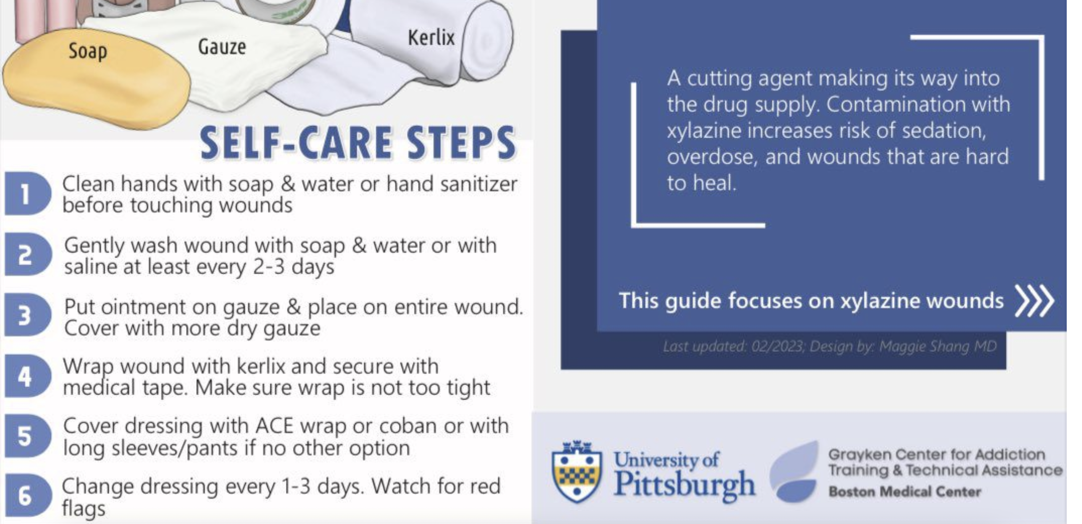

Slide 51
Helpful Tips
Avoid alcohol and hydrogen peroxide
Cover with a non-adherent dressing (Xeroform®) covered by an absorbent one
Keep skin around the wound clean of drainage and moisturized (Vitamin A+D ointment)
Goal for wound bed: keep moist (helps dead skin soften/fall on its own) OR debridement
Antibiotics may not be needed
Manage pain

Slide 52
Xylazine Testing Strips
Test strips can help you determine if drugs you plan to use contain xylazine.

Slide 53
How To Use The Xylazine Testing Strips
1. Put about 10 milligrams (mg) of your drugs (enough to cover Abraham Lincoln’s hair on a penny) in a clean, dry container (such as a medicine measuring cup) or a plastic microscoop (if you have one).
  If you cannot test 10 mg of your drugs, put at least a few grains in a clean, dry container
2. Add 5 milliliters (1 teaspoon) of water to your drugs and stir.
3. Place the test strip with the wavy side down in the water. Let the strip absorb the water for 15 seconds.
4. Take the test strip out of the water and place it on a flat surface for five minutes before reading the results.
Make sure to read the results within 10 minutes of taking the strip out of the water.

Slide 54
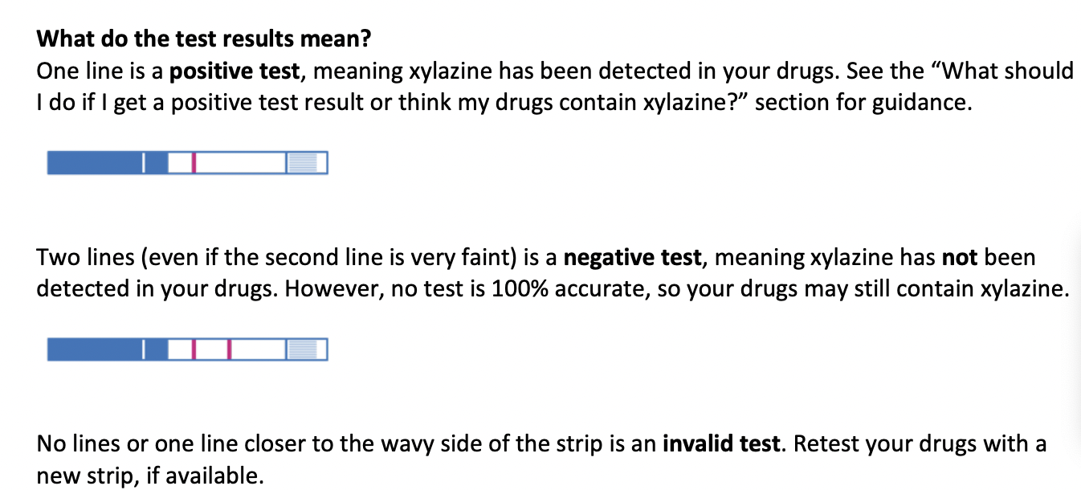
Results

Slide 55

Harm Reduction and Xylazine
Support the development, implementation and scale-up of harm reduction services
Advise healthcare professionals and first responders to consider xylazine exposure
Communicate xylazine trends to people who use drugs and those who work directly with them
Expand access to medication for opiate use disorder (MOUD)

Slide 56
What is the mechanism of action of xylazine?
A. It is a serotonin reuptake inhibitor
B. An agonist at Alpha-2 Andrenergic receptors. It decreases and inhibits the release of norepinephrine and dopamine
C. An opioid Agonist of the mu receptors
D. An antagonist of Alpha-2 Andrenergic and increase the release of norepinephrine and dopamine
E. An opioid antagonist medication similar to naltrexone

Slide 57
Treatment Options for opioid use disorder

Slide 58
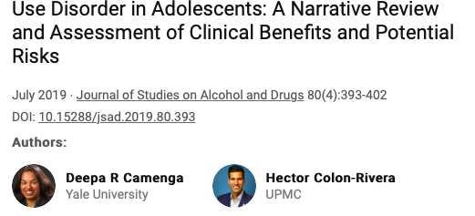


Slide 59
Treatment Options For Adolescents With Opioid Use Disorder
BEHAVIORAL | PHARMACOLOGIC
Residential | Detoxification
IOP/Partial | Clonidine, buprenorphine, methadone
12-Step Fellowship | Buprenorphine/naloxone
Group/Individual Therapy | FDA indicated age 16+
Therapeutic Schools | Tested in adolescents in 3 RCTs, multiple observational studies*a
Family Therapy | Methadone Naltrexone IM/PO
Ref: *Marsch 2005, Woody 2008, Marsch 2016; See Borodovsky 2018 for review
Dr. Deepa Camenga, Yale School of Medicine

Slide 60

Opioid Use Disorder: Pharmacotherapy: Decision making
Balanced assessment of alternative outcomes if medication treatment is not provided.
Overall evidence so far is that risk of untreated OUD outweighs the risk from MAT’s.
Untreated OUD: risk of unintentional overdose and death, HIV, Hep C and other infectious diseases, greater psychiatric comorbidity, other drug use, legal problems, decreased functioning.
Many adolescents do not receive treatment despite the evidence.
Detoxification is commonly used treatment but carries a subsequent risk of overdose and decreased rates of retention to care.
Maintenance treatment must be considered as an option whenever necessary in this population.
Ref: Hadland, S. E., Bagley, S. M., Rodean, J., Silverstein, M., Levy, S., Larochelle, M. R., . . . Zima, B. T. (2018). Receipt of Timely Addiction Treatment and Association of Early Medication Treatment With Retention in Care Among Youths With Opioid Use Disorder. JAMA Pediatr, 172(11), 1029-1037. doi:10.1001/jamapediatrics.2018.2143

Slide 61

Opioid Use Disorder: Methadone
Only prescribed in licensed and regular specialty clinics
Approved for ages 18 and over
Sometimes used in adolescents under 18 years of age.
Few studies, primarily retrospective chart review: Increased treatment retention, decrease in opioid use.
There are new guidelines for methadone that being implemented by SAMHSA.
Ref: Kellogg, S., Melia, D., Khuri, E., Lin, A., Ho, A., & Kreek, M. J. (2006). Adolescent and young adult heroin patients: drug use and success in methadone maintenance treatment. Journal of Addictive Diseases, 25(3), 15-25.

Slide 62

Opioid Use Disorder: Buprenorphine
Mu-opioid receptor partial agonist
FDA approved for 16 years and older
Three Randomized controlled trials in adolescents
No serious adverse events in Randomized Controlled Trials (RCT’s)
Headache is the most common side effect
RCT’s support treatment for at least 12 weeks
Ref: Borodovsky, J. T., Levy, S., Fishman, M., & Marsch, L. A. (2018). Buprenorphine Treatment for Adolescents and Young Adults With Opioid Use Disorders: A Narrative Review. J Addict Med.
Notes:
Clear difference between detox and 12 week bup group at weeks 4 and 8 by week 12 when bup had been tapered off from both groups at that time there was basically no difference

Slide 63
Opioid use Disorder: Extended-Release Naltrexone
FDA-approved for 18 years and older
Pilot studies show feasibility of use in adolescents
Single open-label prospective case series looking at XR-Naltrexone (380 mg IM) for youth admitted to inpatient detox.
  Well tolerated
  Clinical improvements
Ref: Fishman, M. J., Winstanley, E. L., Curran, E., Garrett, S., & Subramaniam, G. (2010). Treatment of opioid dependence in adolescents and young adults with extended release naltrexone: preliminary case-series and feasibility. Addiction, 105, 1669-1676. doi: http://dx.doi.org/10.1111/j.1360-0443.2010.03015.x

Slide 64
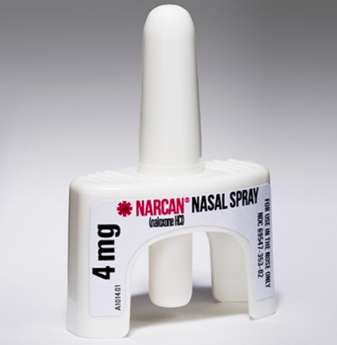
Naloxone And Overdose Prevention Training
Opioid receptor antagonist
Reverses opioid-related sedation and respiratory depression
No abuse potential
Usually acts within 2 to 3 minutes
Lasts 30 to 90 minutes, overdose may return
Family based overdose prevention education particularly for adolescents
Source: http://www.ct.gov/dmhas/lib/dmhas/presentations/Narcan.pdf, accessed on 05/06/2019

Slide 65
Which of the following medications is FDA-approved for the treatment of opioid use disorder is use in adolescents aged 16 and older?
A. Methadone
B. Buprenorphine
C. Disulfiram
D. Naltrexone
E. Naloxone

Slide 66
Benefits of Early Referral to Treatment
NIDA indicates that adolescents can benefit from substance abuse interventions, regardless of their level of use.
Referrals or “handoffs” for any additional treatment can be challenging.
Only 30% of clients discharged from residential care start a new level of care, and only 50% of those who start outpatient care complete their regimen (TEDS).
TEDS = Treatment Episode Data Set
Notes:
Any amount of substance use (starting with mere “experimentation”) is concerning for young people, due to the increased risk of motor vehicle accidents, other injuries, and unwanted pregnancy and contraction of sexually transmitted diseases (STDs) as a result of sexual risk taking, all of which can be a consequence of first time use. Adolescent use is also associated with increased risk of chronic disease, poor school performance, depression, suicide and future dependence.
David Gustafson has studied the characteristics of handoffs in activities as diverse as daycare drop-off and pick-up, surgery and post-operative care, air traffic control, relay races, 911 calls, railroad dispatch, professional football and automobile racing. These studies found that all situations require a smooth handoff, and a failed handoff disrupts service delivery and introduces errors, sometimes with disastrous consequences.
Data on referral patterns for adolescents is lacking in the literature. However, recent TEDS data provides information on referral sources for adolescents entering substance abuse treatment.

Slide 67
Questions?

Slide 68
References
National Institute on Drug Abuse, Research Topics: Xylazine. https://nida.nih.gov/research-topics/xylazine
Kariisa, M., Patel, P., Smith, H., & Bitting, J. (2021). Notes from the field: Xylazine detection and involvement in drug overdose deaths—United States, 2019. Morbidity and Mortality Weekly, 70(37), 1300–1302. https://www.cdc.gov/mmwr/volumes/70/wr/ mm7037a4.htm
3 Friedman, J., Montero, F., Bourgois, P., Wahbi, R., Dye, D., Goodman-Meza, D., & Shover, C. (2022). Xylazine spreads across the US: A growing component of the increasingly synthetic and polysubstance overdose crisis. Drug and Alcohol Dependence, 233, Article 109380. https://www.sciencedirect.com/science/article/abs/pii/S037687162200117X?via%3Dihub

Slide 69
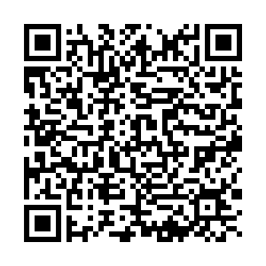
ORN Evaluation Survey Link
Please scan the below QR code or use the link below to access a very brief survey.
Link to Survey: https://orn.qualtrics.com/jfe/form/SV_3FdzXtRH7gogcHI?RequestID=6540&Intensity=2&ActivityType=5&Training=1
The survey will ask about your satisfaction with the training program you just completed as well as some basic demographic information. Your responses will help the Opioid Response Network improve the services they provide.
Thank you in advance for completing this survey!

Slide 70
If you are interested in other training opportunities, contact:
Dana Gray, SCAETC Program Director
LSU Health – New Orleans, School of Public Health
dgray@lsuhsc.edu or (504) 568-5647
Visit us at: https://hsc.unm.edu/scaetc/ or
https://sph.lsuhsc.edu/service/south-central-aetc/scaetc-events/

Slide 71
Resources
National Clinician Consultation Center http://nccc.ucsf.edu/
  HIV Management
  Perinatal HIV
  HIV PrEP
  HIV PEP line
  HCV Management
  Substance Use Management
Present on ECHO
https://hsc.unm.edu/scaetc/programs-services/echo.html​
AETC National HIV Curriculum https://aidsetc.org/nhc
AETC National Coordinating Resource Center https://targethiv.org/library/aetc-national-coordinating-resource-center-0
HIVMA Resource Directory https://www.hivma.org/globalassets/ektron-import/hivma/hivma-resource-directory.pdf
Additional trainings scaetcecho@salud.unm.edu
www.scaetc.org
Notes:
IDEA Platform: Infectious Diseases Education & Assessment. https://idea.medicine.uw.edu/
AETC National HIV Curriculum: 6 core modules for self study; regularly updated; CME, CNE
Hepatitis C Online Curriculum: https://www.hepatitisc.uw.edu/
Hepatitis B Online Curriculum: https://www.hepatitisb.uw.edu/
National STD Curriculum: https://www.std.uw.edu/

Slide 72
