Slide 1

Cognitive Functioning and Mental Health in Long-term HIV Survivors
Statewide Skill-building Symposium:
Addressing Mental Health among Older Adults with HIV
June 5, 2024
Linda M Ercoli, PhD
Longevity Center
Department of Psychiatry and Biobehavioral Sciences UCLA

Slide 2
Disclaimer
The views and opinions expressed in this presentation are not necessarily those of the Pacific AIDS Education & Training Center (Pacific AETC) or its eight local partner sites in HRSA Region 9, the Regents of the University of California or its San Francisco campus (UCSF or collectively, University) nor of our funder the Health Resources and Services Administration (HRSA). Neither Pacific AETC, University, HRSA nor any of their officers, board members, agents, employees, students, or volunteers make any warranty, express or implied, including the warranties of merchantability and fitness for a particular purpose; nor assume any legal liability or responsibility for the accuracy, completeness or usefulness of information, product or process assessed or described; nor represent that its use would not infringe privately owned rights.
HRSA Acknowledgement Statement
The Pacific AETC is supported by the Health Resources and Services Administration (HRSA) of the U.S. Department of Health and Human Services (HHS) as part of an award totaling $4,377,449. The contents are those of the author(s) and do not necessarily represent the official views of, nor an endorsement, by HRSA, HHS, or the U.S. Government. For more information, please visit HRSA.gov.
Trade Name Disclosure Statement
Funding for this presentation was made possible by 5 U1OHA29292‐08‐00 from the Human Resources and Services Administration HIV/AIDS Bureau. The views expressed do not necessarily reflect the official policies of the Department of Health and Human Services nor does mention of trade names, commercial practices, or organizations imply endorsement by the U.S. Government. Any trade/brand names for products mentioned during this presentation are for training and identification purposes only.

Slide 3
Disclosures
Scientific Advisory Board: The Key Home Health Care Agency

Slide 4

Dedication
Mike Henley
1959-1990
Source: AIDS Memorial

Slide 5
Learning Objectives
At the completion of this presentation, attendees will be able to:
Describe 3 areas of cognitive difficulty in people with HIV (Combination Anti-Retroviral Therapy era).
Describe two common mental health problems in older/LTS people with HIV.
Describe three important steps for assessing for cognitive change in people with HIV.

Slide 6
Dementia vs Mild Neurocognitive Disorder
Dementia/Major Neurocognitive Disorder
Impairment in cognitive abilities such as memory, executive function, attention, language.
Affects social and occupational functioning
Psychiatric symptoms may be present.
Results in dependency.
Mild Neurocognitive Disorder
Milder degree of impairment of cognitive abilities between ‘normal’ aging and dementia.
Minor decline in daily life difficulties or more effortful to complete them.
Source: APA, 2002
Notes:
Dementia is an old term replaced by Major Neurocognitive Disorder (MajND) in the Diagnostic Statical Manual 5th edition (APA, 2002).
The DSM-5 has a classification for MajND due to HIV.
The defining characteristic of dementia are cognitive impairment severe enough to cause social and occupational functioning.
People with dementia essentially cannot live independently.

Slide 7


Who Are the HIV Long-term Survivors (LTS)?
Longest-term survivors = people who have been living with HIV since before the advent of Anti-Retroviral Therapy (cART), which was in 1996.
People diagnosed after 1996 living with HIV for at least 10 years.
People living their entire life with HIV--born with HIV or seroconverted at a very young age (“Dandelions”).
Source: The Well Project
Notes:
LTS include the young, middled-aged and aged.

Slide 8
Cognitive Changes in Normal Aging
Crystallized Knowledge
  Information learned through education, experience, culture, occupation
  “Who was Harvey Milk?”
  Define “Legible”
Wisdom
Remains stable until late life (e.g. 70’s).
Fluid Knowledge
  Involves new learning, mental flexibility and speed
  Executive functions
  Learning and retrieval
  Speed of mental processing
  Reasoning
Speed declines as early as the late 20’s, other abilities cART declining in the 40’s.
Decline accelerates after 65 yrs.
Source: NIH.gov

Slide 9
HIV Associated Neurocognitive Disorder (HAND)
A spectrum of cognitive, motor, and/or mood problems collectively known as HIV-Associated Neurocognitive Disorder .
HAND excludes other causes of cognitive impairment.
About 50% of PWH have mild cognitive deficits. The prevalence of HIV associated dementia is greatly diminished thanks to cART.
HIV+ patients diagnosed and managed early had a low prevalence of HAND, comparable to matched HIV-uninfected persons. (Crum-Cianflone et al.. 2013)
Source: JINS
Notes:
Coined the modern era of HIV treatment (2006).
Less now compared to pre-cART--Slowed movements, gait disturbance, fine motor impairment and Problems in attention, concentration

Slide 10
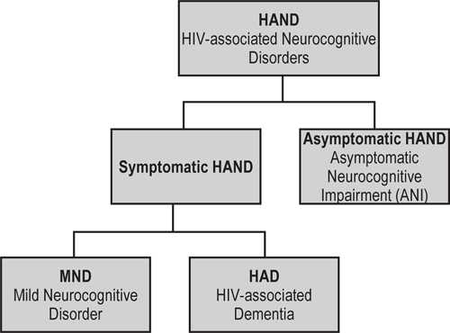
3 HAND Subtypes
about 50%
33% ; no functional impairment
12%
Mild functional impairment
2%; severe functional impairment
Source: Springer
Notes:
Prevalence of AIDS dementia has significantly decreased since cART therapy. Prevalence used to be 40%.

Slide 11
Risk Factors for HAND in Cross-Sectional Studies
Low nadir CD4 cell count.
Medication non-adherence
Older age --increased prevalence of HAND in people 50+ years.
  Not clear if this is due to a direct result of HIV infection versus advanced age itself.
Cardiovascular risk factors and obesity comorbidities
  Have a higher correlation with the development of HAND than HIV viral load or CD4 cell counts.
More depression
History of toxoplasmosis
Possibly, co-infection with Hepatitis C (mixed evidence)
Seizures and prolonged loss of consciousness
Detectable HIV RNA in plasma
Anemia
Low serum (blood) protein
Lifetime history of methamphetamine use
Source: Springer, JINS, NIH
Notes:
History of toxoplasm
History of toxoplasmosis: A prior history of toxoplasma infection has been associated with an increased risk of neurocognitive deficits, especially in patients with latent toxoplasma infections. This risk was observed independent of CD4 cell counts
A prior history of toxoplasma infection has been associated with an increased risk of neurocognitive deficits, especially in patients with latent toxoplasma infections. This risk was observed independent of CD4 cell counts

Slide 12
Cognitive Findings in cART Era in PWH*
Executive dysfunction –poor decision making
Working memory (mental manipulation of information)
Apathy (low motivation, poor follow-through) is common.
Learning problems—needing more exposures to new information to learn it.
Decision making problems have implications for making poor health/safety choices.
Apathy has negative implications for treatment adherence, sobriety and self-care.
*Learning Objective
Source: NIH 1, NIH 2, NIH 3

Slide 13
Does HAND Persist or Progress Over Time?
Findings have been mixed and largely inconclusive in meta-analytic studies, because of differing methodologies and small sample sizes.
HIV has not been definitively shown to cause progressive cognitive decline in people achieving sustained HIV RNA suppression in both plasma and CSF.
One major longitudinal study of long-term survivors found that HAND progressed in some, stayed stable, or even improved (CHARTER study, Heaton et al., 2023).
Treatment cannot entirely prevent the decline in people with HAND because other health and lifestyle factors play a role in cognitive deterioration.
Source: NIH 1, NIH 2, IDSA
Notes:
Neurocognitive performance, laboratory measures and neurological exams were performed every 6 months over a 42 month interval.
Most (61%) HIV patients remained stable, while 16.5% apparently improved neurocognitive status, and 22.7% declined.
Factors associated with risk of progression included the presence of severe co-morbidities (other infections, drug abuse, other neurological conditions) or evidence of failure of HIV therapy (off cART and/or low CD4 count)
(HIV seronegative controls were not available) (Heaton et al., 2015)

Slide 14
Twelve-year Neurocognitive Decline in HIV
Comprehensive assessments over 12 years of 402 people with HIV in the CNS HIV ART Effects Research (CHARTER) program.
Researchers recontacted 400 of the 1597 CHARTER participants to undergo a comprehensive re-evaluation 12 years (2015 - 2020) after their baseline (2003 - 2007) assessment.
Sample at follow-up was composed of younger (<60 years) and older (≥60 years) subgroups .
At baseline and follow-up every participant received a clinical interview and comprehensive neuromedical, neurobehavioural, and laboratory assessments.
Comprehensive neurocognitive battery of 15 tests.
Source: IDSA
Notes:
CHARTER is a prospective, observational study conducted at six US academic medical canters: The Johns Hopkins University, Baltimore, Maryland, the University of Texas Medical Branch, Galveston, Texas, the Icahn School of Medicine at Mount Sinai, New York, New York, the University of California, San Diego, the University of Washington, Seattle, and Washington University at St Louis, Missouri.
People were recruited between 1988 and 1999 and followed longitudinally.

Slide 15
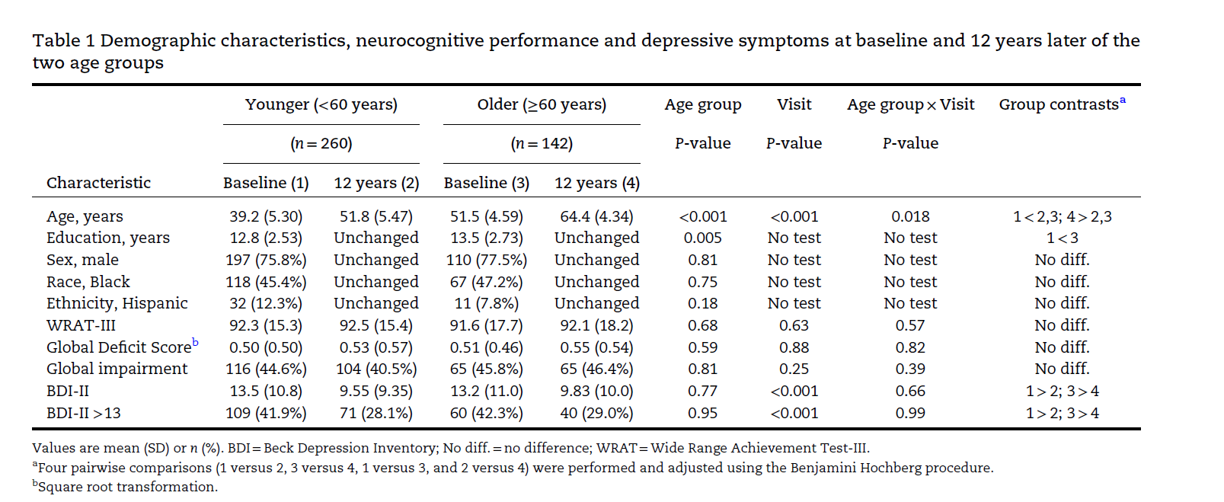
Twelve-year Neurocognitive Decline in HIV Continued
Source: IDSA

Slide 16
Longitudinal Results
Based on 15 neuropsychological tests, researchers calculated a global change Z score (GCS) indicating change over time. Negative values indicate worse change than would be expected based on baseline test results, demographics and test-retest interval.
On average, neurocognitive performance declined modestly (-.28 on a global cognitive change score) over 12 years, regardless of age or age group.
Groups were divided into “decliners” vs “non-decliners” based on a global change score. ,
23.7% declined, 70.0% remained stable, and 6.2% improved.
The impairment rate dropped over the12 years by about 15% for the non-decliners (45% to 31% ) and almost doubled for the decliners (44% to 81%).
Greater cognitive decline was seen in participants with a greater number of comorbidities at baseline (and follow-up).
Source: IDSA

Slide 17
Global Change Scores and Decliner Status by Comorbidity Indices at Baseline and at 12 Years.
(A) GCS by number of comorbidities at baseline and 12 years.
(C and D) Proportion of decliners by number of comorbidities at baseline and 12 years.
Source: IDSA
Notes:
This slide shows:
A. The more comorbidities at baseline, the higher the Global Change (worse) score over time. Values in A and B are mean and 95% confidence intervals. B shows that People with more co-morbidities as 12 year follow-up had greater worsening Global Change on cognitive tests. C shows that the worse decliners (those showing the most decline) had a higher number of comorbidities at baseline. At 12 year follow up, This was still true, and there were now more decliners (level of severity 4). In C and D, values are proportions

Slide 18
Factors Associated with Progressing HAND over 12 years
NOT age, HIV status (most well-treated) or cART status.
Cardiovascular risk factors (hypertension and diabetes),
Chronic pulmonary disease
Neuropathic pain
Depression
Anemia
Low serum (blood) protein
Evidence of liver injury
Prefrailty/frailty
Source: IDSA

Slide 19
HIV is Associated with Premature Aging
Evidence of physiological aging appears earlier in life in PWH than in general population.
High prevalence of inflammation associated disorders:
  Diabetes type 2, hypertension, coronary artery disease, stroke, frailty, cognitive impairment, Alzheimer’s disease, and other immune system-related medical complications
Accelerated aging process may result from a complex mix of HIV infection, antiretroviral treatment, chronic viral co-infections and lifestyle/behavioral factors (De Francesco et al., 2019).
Inflammation and chronic stress appear to be factors (Schrock, 2024).
Source: NIH, LWW Journals
Notes:
Aging is defined physiologically (biomarkers), not chronologically.
Dutch and UK, Cross-sectional analysis of 134 PWH on suppressive antiretroviral therapy, 79 lifestyle-comparable HIV-negative controls.
Aged 45 years or older from the Co-morbidity in Relation to AIDS (COBRA) cohort (from outpatient clinics), and 35 (super healthy) age-matched blood donors.
Earlier onset of comorbidities may be due to accelerated or accentuated aging process resulting from a complex mix of HIV infection, antiretroviral treatment, chronic viral co-infections and lifestyle/behavioral factors (De Francesco et al., 2019).
Persistent viral (cytomegalovirus Hepatitis B) co-infection and CD8⁺ T-cell activation may have contributed overall to accelerated aging in both HIV+ and HIV- people.
Age advancement remained greatest in PWH and was related to prior immunodeficiency and cumulative saquinavir exposure.

Slide 20
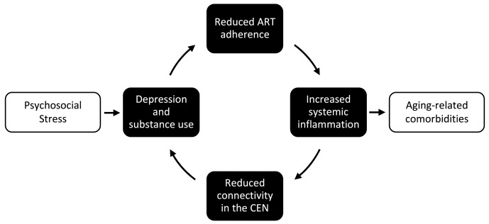
Chronic Stress May Lead to Accelerated Aging
Source: NIH

Slide 21
Sudden New Onset of Cognitive Decline
Sudden cognitive decline in PWH who have been cognitively stable.
This may be due to uncommon syndromes caused by brain HIV infection
  Viral Escape Syndrome-HIV replicates in the brain despite people being on cART.
  Immune Reconstitution Inflammatory Syndrome—Life threatening; headache, confusion, seizures and cognitive decline.
  Both require immediate attention and further testing to diagnose
Notes:
Viral Escape syndrome-uncommon People on antiretroviral therapy have adequate peripheral viral suppression, but there is evidence of CNS HIV replication. May indicate HIV drug resistance. Need testing to diagnose.
Immune Reconstitution Inflammatory Syndrome
Life threatening CNS HIV infection causing brain inflammation and neurological symptoms (headache, vomiting, cognitive decline, seizures), with changes in white and gray matter.

Slide 22
Mental Health in LTS
People with HIV are 44% more likely to have a mental health disorder than those without HIV.
  Depression, anxiety, substance abuse, PTSD
Longest term survivors are especially prone to mental health challenges due their living through the darkest era of HIV/AIDS.
Suffered many losses, discrimination, stigma
Foreshortened sense of the future
Increased stigma, trauma for PWH in the LGBTQI community and for minorities due to discrimination, racism, homophobia
Source: The Well Project, NIH, BMC

Slide 23
Mental Health Problems in Longest Term Survivors*
Depression and suicidal ideation
Treatment adherence burnout
Psychological trauma/PTSD (Aids Survivor Syndrome).
Experienced many losses, discrimination, stigma
Survivor’s guilt
Substance dependence/abuse
Negative thoughts such as deep regret and shame
Fear of treatment
Self-destructive behavior
Sexual risk-taking
Social withdrawal and isolation
Anxiety and nervousness
Irritability or flashes of anger
Sleep difficulty and nightmares
Low self-esteem and self-worth
Stigma
*Learning Objective
Source: The Well Project

Slide 24
Depression Related Challenges in People with HAND
Depression can cause and/or exacerbate cognitive problems
Depression is associated with poorer outcomes in PWH.
Lack of ability or motivation for treatment adherence
Poor ability to initiate self-care, follow-through on recommendations
Social isolation
Poor decision making leading to unsafe or unhealthy choices
  Unprotected sex
  Substance use
Source: The Well Project

Slide 25
Workshop:
Assessing for Dementia and Depression
Patient Health Questionnaire-9
International HIV Dementia Scale

Slide 26
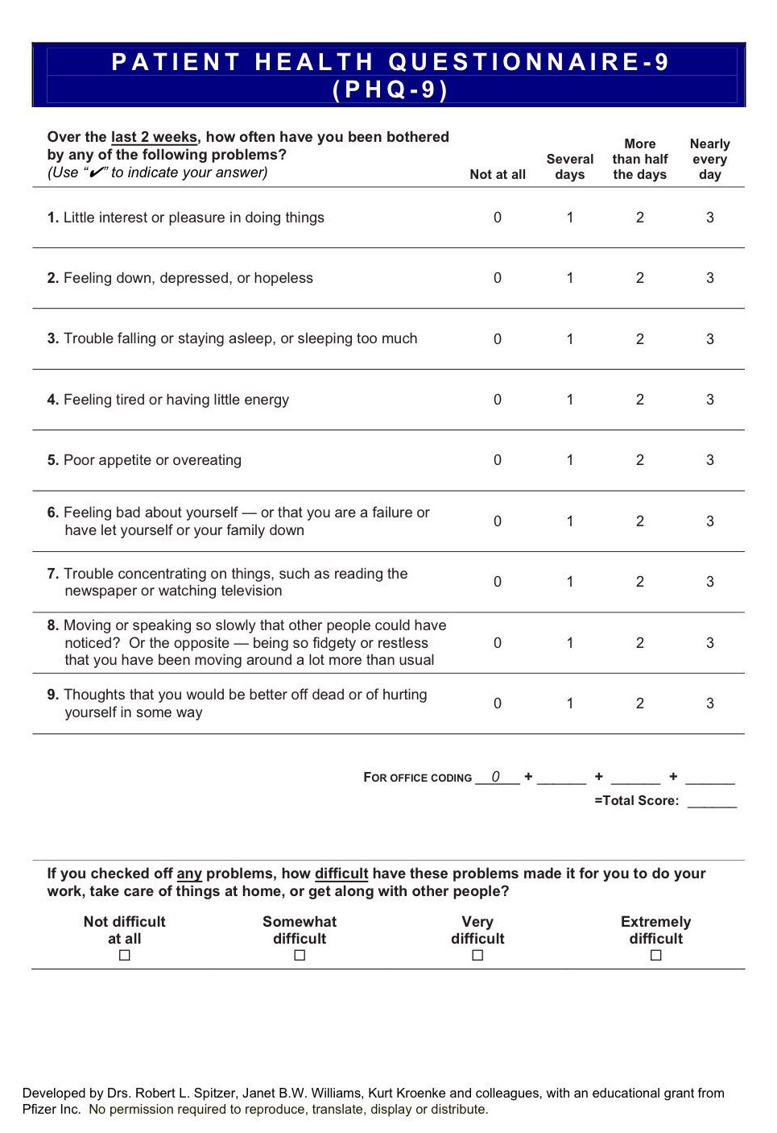
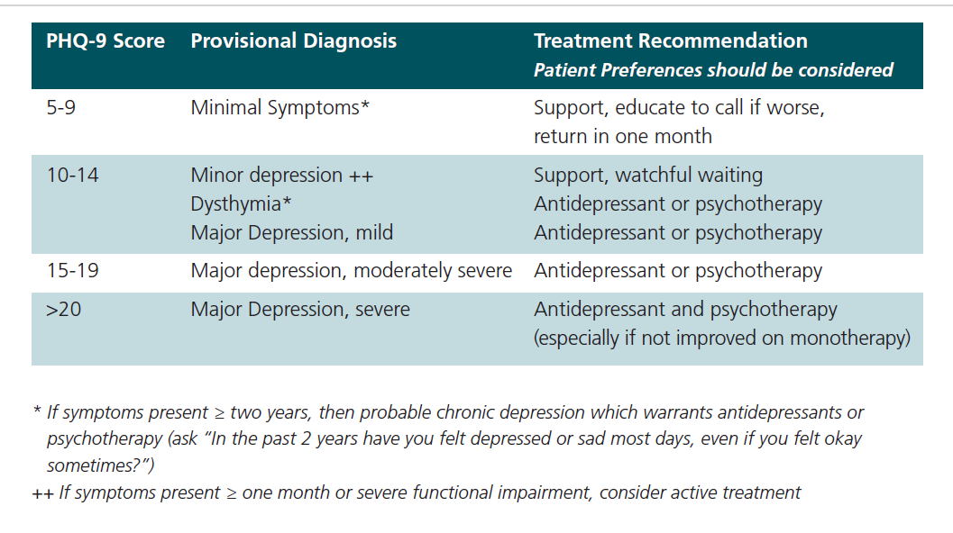
Assessing for Depression: Patient Health Questionnaire-9 (PHQ-9)
If endorses suicidality, assess for intent, plan, imminence. ask about and develop safety plan, give resources.
Consult, follow-up, Emergency Room visit may be warranted.
Image Source: APA Source: NIH

Slide 27
Daily Activity Challenges in People with HAND and Depression
May need reminders to follow through on recommendations or appointments
Check medication adherence.
Financial management
Home Repair, Laundry, Grocery Shopping, Cooking
Comprehension of Reading/TV material
Check household upkeep, food stock, freshness of food.
Monitor depression for worsening, and thoughts of suicide.
Source: JINS

Slide 28
When and Why to Screen Cognition
Before start of cART.
Periodically to monitor cognition.
  3 and 6 months and then periodically after that.
  In PWH who are not on cART or have worsening disease status or worsening cognition.
Client may complain of cognitive problems.
Don’t try to diagnose or attribute cognitive difficulties to HIV.
Testing informs about problems managing in daily life and treatment adherence.
Source: IDSA

Slide 29
Screening for Cognitive Difficulties
There is no consensus on a particular test to be used.
International HIV Dementia Scale (IHDS)--Dementia
Montreal Cognitive Assessment Test—Dementia and MCI
Mini Mental State Exam-Dementia and MCI
Source: ResearchGate, IDSA

Slide 30
Consider Bias in Cognitive Testing
Most tests are developed and normed on English speaking, largely Caucasian, American-born individuals.
Norms by age, gender, education, ethnicity and race are available for some tests.
Tests can penalize people
  People of color
  Bilingual
  Bicultural/lower acculturation
  Socioeconomic Status
  Low education or low quality of education
  Regional (e.g. rural)
  Sensory deficits
  Neurodiverse
Source: NIH, Springer

Slide 31
How to Evaluate for Cognitive Impairment*
Ask if clients experience memory loss, have difficulty paying attention, or feel slower while reasoning or doing complicated tasks?
Observe—repeating self, slow to respond
Gather collateral data
Screen cognition and determine if referral needed for check-up or more extensive testing.
Comprehensive neuropsychological Testing—a minimum of 5 cognitive domains evaluated
*Learning Objective
Source: IDSA

Slide 32
International HIV Dementia Scale (IHDS)
Developed specifically for assessing cognition in people with HIV.
Brief (10 min), easy to administer in office.
Will detect significant cognitive change but may not be sensitive enough to detect subtle deficits.
Use when you suspect PWH is struggling with independent activities of daily living, have serious complaints
Source: Europe PMC

Slide 33
Administering the IHDS*
Quiet office
Only examiner and client in the room
12 points possible
4 word registration
Motor speed
Psychomotor speed
4 word Recall
Score of 10 or less indicates need for referral
In the US, the mean IHDS score for HIV-positive individuals is:
  No dementia= 10.6
  Dementia = 9.3
  Using the cutoff of 10, the sensitivity and specificity for HIV dementia with the IHDS were 80% and 57%.
  IHDS as a test for all symptomatic HAND, the sensitivity and the specificity of this tool were 64% and 66% respectively
*Learning Objective
Source: Europe PMC, Springer

Slide 34
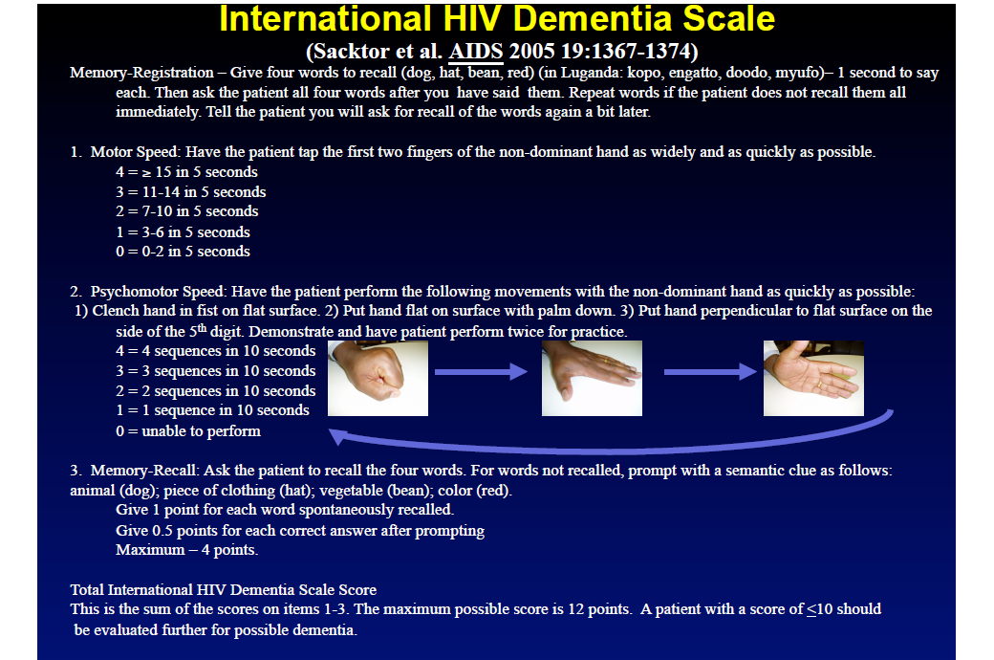
International HIV Dementia Scale
Source: UCSD

Slide 35
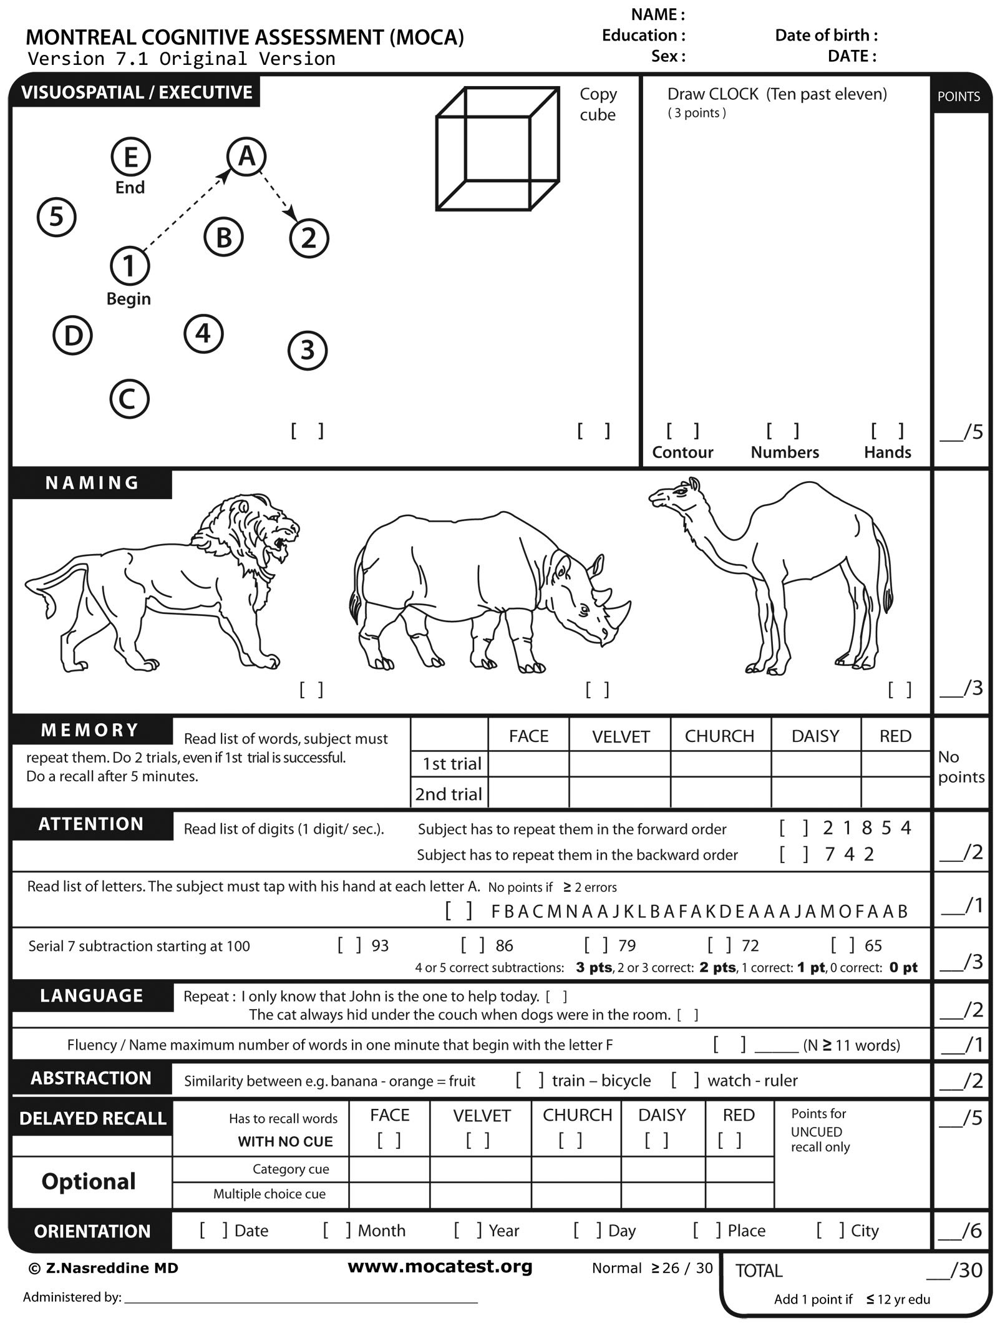
MoCA
Validated for dementia and MCI.
30 points possible.
Recommend cut-off of 23 for HAND, to balance sensitivity with specificity (Rosca et al., 2019).
The threshold of 23, offered a sensitivity of 0.44 and a specificity of 0.79.
Typical cut-off of 26 is NOT recommended for HAND
Source: AGS Journals, Science Direct
Notes:
(e.g. not falsely diagnose someone with HAND). 26 is typical cut-off for MCI BUT this may confuse ANI with MCI clients.
Use a lower cut-off for MoCA because many ANI patients and even patients without HIV can score 26. So to avoid the overlap with people with no functional impairment, use a lower cut=off. 23 is also a recommend cutoff in several studies of the MoCA in MCI.

Slide 36
MoCA Cut-Offs for Diagnosing HAND
Based on a meta-analysis of the MoCA in PWH
8 cross-sectional studies of 1014 patients from 2009 – 2015.
Cut-off of 23 yields the best balance of sensitivity of .44 (detecting deficits when present) and specificity of .79 (rejecting presence of deficits when they are truly absent)
Source: Springer

Slide 37

Thank
You
Source: Freepik

Slide 38
References
American Psychiatric Association. (2022). Diagnostic and statistical manual of mental disorders (5th ed., text rev.).
Baltes P. B., Staudinger U. M., Lindenberger U., Lifespan psychology: Theory and application to intellectual functioning. Annu. Rev. Psychol. 50, 471–507 (1999).
Birnstengal, G. “We Weren’t Expected to Live This Long”. Next Avenue. February 21, 2020. https://www.nextavenue.org/hiv-survivors/
Chen, P., Xin, X., Xiao, S., Liu, H., Liu, X., He, N., & Ding, Y. (2024). Cognitive impairment and neurocognitive profiles among people living with HIV and HIV-negative individuals older over 50 years: a comparison of IHDS, MMSE and MoCA. Journal of neurovirology, 10.1007/s13365-024-01205-y. Advance online publication. https://doi.org/10.1007/s13365-024-01205-y
Clifford DB, Ances BM. HIV-associated neurocognitive disorder (2013). Lancet Infect Dis. Nov;13(11):976-86. doi: 10.1016/S1473-3099(13)70269-X. PMID: 24156898; PMCID: PMC4108270.
Cole, M. A., et al. (2007). Longitudinally preserved psychomotor performance in long-term asymptomatic HIV-infected individuals. Neurology, 69(24), 2213–2220. https://doi.org/10.1212/01.WNL.0000277520.94788.82
Crum-Cianflone, et al. (2013). Low prevalence of neurocognitive impairment in early diagnosed and managed HIV-infected persons. Neurology, 80(4), 371–379. https://doi.org/10.1212/WNL.0b013e31827f0776
Cysique LA, Franklin D Jr, Abramson I, et al. Normative data and validation of a regression based summary score for assessing meaningful neuropsychological change. J Clin Exp Neuropsychol. 2011;33:505-522.

Slide 39
References (continued)
De Francesco, D., et al. (2019). Do people living with HIV experience greater age advancement than their HIV-negative counterparts?. AIDS (London, England), 33(2), 259–268. https://doi.org/10.1097/QAD.0000000000002063
Di Gennaro, F., et al. (2024). Stigma and mental health among people living with HIV across the COVID-19 pandemic: a cross-sectional study. BMC infectious diseases, 24(1), 423. https://doi.org/10.1186/s12879-024-09315-y
Eggers, C., et al. (2017). HIV-1-associated neurocognitive disorder: epidemiology, pathogenesis, diagnosis, and treatment. Journal of neurology, 264(8), 1715–1727. https://doi.org/10.1007/s00415-017-8503-2.
Goodkin, K. et al. (2017). Effect of ageing on neurocognitive function by stage of HIV infection: evidence from the Multicenter AIDS Cohort Study. Lancet HIV 4, e411–e422.
Heaton, R. K., et al. (2004). The impact of HIV-associated neuropsychological impairment on everyday functioning. Journal of the International Neuropsychological Society : JINS, 10(3), 317–331. https://doi.org/10.1017/S1355617704102130
Heaton RD, et al., (2015). Prevalence and predictors of neurocognitive decline over 18 to 42 months: A CHARTER longitudinal study. 19th Conference on Retroviruses and Opportunistic Infections -Seattle, WA. 2012:246.
Heaton, R. K., et al. (2010). HIV-associated neurocognitive disorders persist in the era of potent antiretroviral therapy: CHARTER Study. Neurology, 75(23), 2087–2096. https://doi.org/10.1212/WNL.0b013e318200d727.
Heaton, R. K., et al. (2011). HIV-associated neurocognitive disorders before and during the era of combination antiretroviral therapy: differences in rates, nature, and predictors. Journal of neurovirology, 17(1), 3–16. https://doi.org/10.1007/s13365-010-0006-1.

Slide 40
References (continued)
Heaton, R. K., et al. (2015). Neurocognitive change in the era of HIV combination antiretroviral therapy: the longitudinal CHARTER study. Clinical infectious diseases : an official publication of the Infectious Diseases Society of America, 60(3), 473–480. https://doi.org/10.1093/cid/ciu862.
Horn, J.L. Models of intelligence, in Intelligence: Measurement, Theory, Public Policy: Proceedings of a Symposium in Honor of Lloyd G. Humphreys (University of Illinois Press, 1989), pp. 29–73.
Kroenke K, Spitzer RL, Williams JB. The PHQ-9: validity of a brief depression severity measure. J Gen Intern Med. 2001 Sep;16(9):606-13. doi: 10.1046/j.1525-1497.2001.016009606.x. PMID: 11556941; PMCID: PMC1495268.
Lampe FC. (2022). Increased risk of mental illness in people with HIV, The Lancet HIV, Volume 9, Issue 3, 2022, Pages e142-e144, ISSN 2352-3018, https://doi.org/10.1016/S2352-3018(22)00034-0.
Loewenstein DA, et al. 1993). A comparative analysis of neuropsychological test performance of Spanish-speaking and English-speaking patients with Alzheimer’s disease. Journal of Gerontology: Psychological Sciences;48:142–149.
Manly J. J. (2008). Critical issues in cultural neuropsychology: profit from diversity. Neuropsychology review, 18(3), 179–183. https://doi.org/10.1007/s11065-008-9068-8.
Mind Exchange Working Group (2013). Assessment, diagnosis, and treatment of HIV-associated neurocognitive disorder: a consensus report of the mind exchange program. Clinical infectious diseases : an official publication of the Infectious Diseases Society of America, 56(7), 1004–1017. https://doi.org/10.1093/cid/cis975.
Mitra P, Jain A, Kim K. (2022). HIV and AIDS in Older Adults: Neuropsychiatric Changes. Curr Psychiatry Rep, Sep;24(9):463-468. doi: 10.1007/s11920-022-01354-z. Epub 2022 Jul 9. PMID: 35809165.

Slide 41
References (continued)
Mitra P, Sharman T. HIV Neurocognitive Disorders. [Updated 2022 Oct 20]. In: StatPearls [Internet]. Treasure Island (FL): StatPearls Publishing; 2024 Jan. Navia, B. A., & Price, R. W. (1987). The acquired immunodeficiency syndrome dementia complex as the presenting or sole manifestation of human immunodeficiency virus infection. Archives of neurology, 44(1), 65–69. https://doi.org/10.1001/archneur.1987.00520130051017
Nasreddine Z, et al. (2005). The Montreal Cognitive Assessment, MoCA: a brief screening tool for mild cognitive impairment. Journal of the American Geriatrics Society, 53(4), 695–699. https://doi.org/10.1111/j.1532-5415.2005.53221.x
National Aids Memorial. https://www.aidsmemorial.org/interactive-aids-quilt
Rosca, E. C., Albarqouni, L., & Simu, M. (2019). Montreal Cognitive Assessment (MoCA) for HIV-Associated Neurocognitive Disorders. Neuropsychology review, 29(3), 313–327. https://doi.org/10.1007/s11065-019-09412-9.
Sacktor NC, et al. The International HIV Dementia Scale: a new rapid screening test for HIV dementia. AIDS. 2005 Sep 02;19(13):1367-74. DOI: 10.1097/01.aids.0000180790.77379.3a. https://hnrp.hivresearch.ucsd.edu/images/pdfs/U13_Frascati_Sacktor.pdf

Slide 42
References (continued)
Salthouse TA. Trajectories of normal cognitive aging. Psychol Aging. 2019 Feb;34(1):17-24. doi: 10.1037/pag0000288. Epub 2018 Sep 13. PMID: 30211596; PMCID: PMC6367038.
Schrock J. M. (2024). Accelerated aging in people living with HIV: The neuroimmune feedback model. Brain, behavior, & immunity - health, 36, 100737. https://doi.org/10.1016/j.bbih.2024.100737Sheppard, D. P. et al. Accelerated and accentuated neurocognitive aging in HIV infection. J. Neurovirol. 23, 492–500 (2017).
Sheppard, D. P., et al. (2017). Accelerated and accentuated neurocognitive aging in HIV infection. Journal of neurovirology, 23(3), 492–500. https://doi.org/10.1007/s13365-017-0523-2
The Well Project. Long-Term Survivors of HIV. (https://www.thewellproject.org) https://www.thewellproject.org/hiv-information/long-term-survivors-hiv
The Well Project. https://www.thewellproject.org/sites/default/files/TWP-LTS-graphic_2021.jpg
Walker KA, Brown GG. HIV-associated executive dysfunction in the era of modern antiretroviral therapy: A systematic review and meta-analysis. J Clin Exp Neuropsychol. 2018 May;40(4):357-376. doi: 10.1080/13803395.2017.1349879. Epub 2017 Jul 9. PMID: 28689493; PMCID: PMC6164174.
Watkins CC, Treisman GJ. Cognitive impairment in patients with AIDS - prevalence and severity. HIV AIDS (Auckl). 2015;7:35-47.

