Slide 1
Scaling Up PrEP Equity to End the HIV Epidemic
May 18, 2024
Danny Toub, MD
Santa Rosa Community Health
BANCC Faculty
Shawn Demmons, MPH
PAETC-BANCC
Director

Slide 2
Disclaimer
The views and opinions expressed in this presentation are not necessarily those of the Pacific AIDS Education & Training Center (Pacific AETC) or its eight local partner sites in HRSA Region 9, the Regents of the University of California or its San Francisco campus (UCSF or collectively, University) nor of our funder the Health Resources and Services Administration (HRSA). Neither Pacific AETC, University, HRSA nor any of their officers, board members, agents, employees, students, or volunteers make any warranty, express or implied, including the warranties of merchantability and fitness for a particular purpose; nor assume any legal liability or responsibility for the accuracy, completeness or usefulness of information, product or process assessed or described; nor represent that its use would not infringe privately owned rights.
HRSA Acknowledgement Statement The Pacific AETC is supported by the Health Resources and Services Administration (HRSA) of the U.S. Department of Health and Human Services (HHS) as part of an award totaling $3,887,700.00. The contents are those of the author(s) and do not necessarily represent the official views of, nor an endorsement, by HRSA, HHS, or the U.S. Government. For more information, please visit HRSA.gov.
Trade Name Disclosure Statement Funding for this presentation was made possible by 5 U1OHA29292‐08‐00 from the Human Resources and Services Administration HIV/AIDS Bureau. The views expressed do not necessarily reflect the official policies of the Department of Health and Human Services nor does mention of trade names, commercial practices, or organizations imply endorsement by the U.S. Government. Any trade/brand names for products mentioned during this presentation are for training and identification purposes only.

Slide 3
Disclosures
All presenters of this continuing medical education activity have indicated that neither they nor their spouse/legally recognized domestic partner has any financial relationships with commercial interests related to the content of this activity.

Slide 4
Learning Objectives
Examine ways to apply an anti-oppression lens when providing patient care.
Identify at least two paths toward greater PrEP equity in underserved communities.
Discuss equity-focused strategies that will reduce PrEP disparities for BIPOC folks.

Slide 5
Why Equity Matters?
Notes:
Poll Everywhere Why does equity matter? (List)

Slide 6
Determinants of Health
2.
Biology &
Genetics
1.
Individual
Behaviors
5.
Health
Services
3.
Social
Environment
4.
Physical
Environment
Image source: MS PowerPoint Stock Images
Notes:
In looking for reasons for health disparities and accompanying inequities—what determines ones’ health is usually looked at in these categories-
Individual behaviors, biology and genetics, social environment, physical, health services---systems.
The last three are what we call social determinants of health and can influence the individual behavior, and the biology .

Slide 7
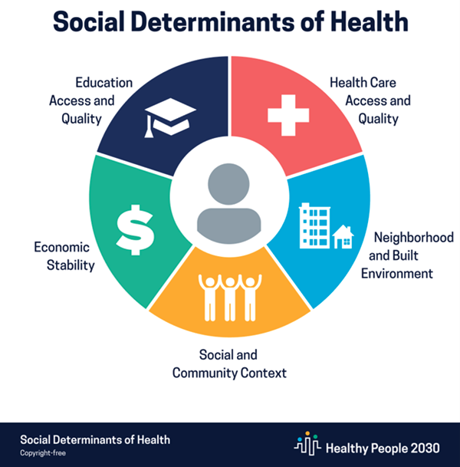
Social Determinants of Health
Conditions in which people are born, grow, live, work, pray and age
shaped by distribution of money, power and resources at global, national, local levels
influenced by policies and regulations
Adapted from World Health Organization (WHO)
WHO; 2018
Notes:
Go over the definition of SDH—adapted from World Health Organization –ask the participants How would they define SDH?
Here is the definition:
The complex, integrated, and overlapping social structures and economic systems that are responsible for most health inequities. These social structures and economic systems include the social environment, physical environment, health services, and structural and societal factors. Social determinants of health are shaped by the distribution of money, power, and resources throughout local communities, nations, and the world.

Slide 8
Examples of Social Determinants of Health
Housing Stability
Residential Segregation
Food Security
Social Norms and Attitudes--(e.g. stigma)
Racism
Socioeconomic Conditions
Culture
Social Support
Gender Identity
Access to Health Care Services
Educational Attainment
Sexual Orientation
Transportation Options
Language/Literacy
Exposure to violence, crime, social disorder
Access to mass media, and emerging technologies
Adapted from World Health Organization (WHO)

Slide 9
Social Determinants and the Updated NHAS
Source: HIV.gov: National HIV AIDS Strategy
Notes:
Let the participants know that in the updated National HIV/AIDS strategy particular attention is paid to the recognition of a focus and response to social determinants that influence HIV risk outcomes as well as a mention of the fact that racism is a public health threat that drives HIV outcomes and inequities.

Slide 10
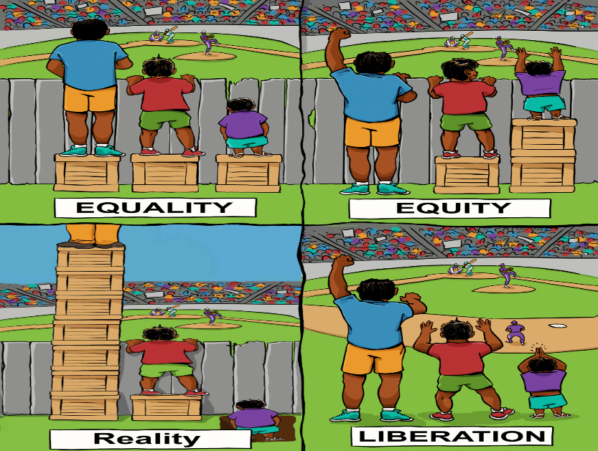
Health Equity
Health equity means that everyone has a fair and just opportunity to be healthier.
This requires removing obstacles to health such as poverty, discrimination, and their consequences, including powerlessness and lack of access to good jobs with fair pay, quality education and housing, safe environments, and health care.
Robert Wood Johnson Foundation (RWJF)
Image Source: Interaction Institute for Social Change | Artist: Angus Maguire
Notes:
Ask participants to look at the slide and get their thoughts and interpretations of the four images.
The first box describes equality—everyone gets the same thing.
The second box is equity—giving people the same advantage—but different people need different support or amount of support to get that equal advantage
The third box shows reality—how it may look presently’
The fourth box suggests that liberation is not only about getting people the box to create advantage—but removing the structural barriers that created the need to build the boxes.
The goals of equality, equity and liberation are different and your response, intervention may have some similarities but also distinctions.

Slide 11
Determinants of Equity
“Racism is a system of structuring opportunity and assigning value based on the social interpretation of how one looks (which is what we call "race"), that unfairly disadvantages some individuals and communities, unfairly advantages other individuals and communities, and saps the strength of the whole society through the waste of human resources."
APHA Past-President Camara Phyllis Jones, MD, MPH, PhD
Image credit: Beata Zawrzel—NurPhoto/Getty Images
Notes:
As we discuss social determinants of health, it is also important to recognize that there are systems of oppression that are foundational in influencing social determinants of health and contribute to health inequity. One way in which social determinants are influenced is by the dynamics of race.

Slide 12
Case review Activity
Notes:
Handout the brief patient profiles at registration first thing in the morning. Open the activity by reminding participants that they were each assigned one of the patient’s who will be profiled in the case review activity.
Now let’s review a few cases. The patient profiles that I will share in a bit are all based on the real-life circumstances from recent cases living in North Coast communities. As I read each profile, think about (1) were there any missed opportunities to offer PrEP or other HIV prevention strategies and (2) what are the equity-focused strategies that could help to address PrEP disparities in the North Coast.
Read the profile to the participants
Facilitate a large group discussion using the reflection question for each patient

Slide 13
Diego Ramirez, 23 yo (Latine cisgender MSM)
Image source: MS PowerPoint Stock Images
Notes:
Diego Ramirez (Latine MSM)
Diego is a 23 yo Latine cisgender male who self-identifies as gay. He grew up in Cloverdale, CA. Diego’s parents immigrated from Mexico shortly after his oldest brother was born to provide a better future for the family. From a young age, Diego felt different from his peers. While his friends talked about their crushes on girls, Diego found himself attracted to boys. But Diego knew that his conservative family and community wouldn’t accept his true self, so he kept it hidden.
After graduating high school, Diego left home to attend SF State and majored in political science. College offered him a newfound sense of freedom and independence. Away from the watchful eyes of his family, Diego began to explore his sexuality. He frequented bars in the Castro on weekends and sometimes would hook-up with guys he met there. Other times he used gay hook-up apps to meet his partners. In June of 2022, he attended SF Pride where he hooked-up with several different guys over the weekend and some encounters were condomless. After that fun filled Pride weekend, Diego decided to go in for a routine STI screening. He was diagnosed with syphilis, but not HIV. Without taking a sexual history the provider assumed Diego was heterosexual and at low risk for HIV.
Later that same summer, he met Carlos who shared his passion for social justice and advocacy. As their friendship deepened, Diego found himself falling in love for the first time. For a brief moment, he allowed himself to imagine a future where he could openly embrace his sexuality and build a life with Carlos. In October he presented at the ER with high fever, diarrhea, and rash. Initially he was diagnosed with an unknown viral syndrome and sent home. He returned to the ER later that same week as his symptoms persisted. During this visit he was screened for HIV and tested positive.

Slide 14
Reflection 1
What could have been done differently?
What individual and/or systemic biases are in place that contributed to the missed opportunities to offer PrEP?
What about missed opportunities outside of the clinic?

Slide 15
Javier Alvarez, 53 yo (Latine cisgender MSM, does not identify as gay, monolingual Spanish speaker, uses Meth)
Image source: MS PowerPoint Stock Images
Notes:
Javier Alvarez (Latine MSM cis gender who does not identify as “gay”, recently divorced, monolingual Spanish speaker, uses Meth)
Javier is a 53 yo Latine cis gender male who has sex with men, but who does not identify as gay. He currently resides alone in Ukiah after recently getting divorced from his wife of nearly 30 years. He has two daughters and three grandchildren. On the surface, Javier was a charismatic and energetic presence, beloved by friends and family alike. He embraced his Latinx heritage with pride, reveling in the rich tapestry of his culture. But he lived his life with a dichotomy that only few knew about. Growing up in a conservative household, Javier struggles to come to terms with his sexuality. The pressure to conform to societal expectations clashed with his own identity, leading him to bury his true self deep within.
Throughout his marriage, Javier grappled with his sexuality, feeling trapped between his love for his wife and his true desires. Ultimately, he became withdrawn from his wife and their marriage, which led to her decision to divorce Javier. Despite the divorce, he did not feel comfortable openly expressing his sexuality. Instead, he began to engage in anonymous sex with random guys he met in public spaces. Sometimes he used condoms and sometimes he didn’t. About six months after his divorce, he started using meth to deal with the internalized stigma and began to engage in condomless sex more often. After one of his now regular meth binges where he engaged in condomless group sex, he went to get screened for STIs and was diagnosed with Chlamydia at a local free clinic. He told the provider that he thought he may have gotten it from his wife before the divorce. The provider tried to get a more comprehensive sexual history, but the only Spanish speaking provider was out. Javier received treatment for Chlamydia. He was not diagnosed with HIV at this screening.
The next time Javier sought treatment was about a year later because of lesions on his mouth. The provider at a different clinic diagnosed him with herpes without testing him or taking a sexual history first and gave him a prescription for Valtrex. Javier returned the following month now with an outbreak on his genitals. Again, the provider did not test him for herpes, but gave him another prescription to treat the outbreak. When his lesions still would not heal, he went to the ER where the attending asked about his most recent HIV screening but did not order an HIV test. He instead referred Javier to a PCP at a local FQHC for follow-up. The new PCP ordered an HIV test and diagnosed Javier with HIV.

Slide 16
Reflection 2
What could have been done differently?
What individual and/or systemic biases are in place that contributed to the missed opportunities to offer PrEP?
What about missed opportunities outside of the clinic?

Slide 17
Siti Rahman, 30 yo (Southeast Asian cisgender married female)
Image source: MS PowerPoint Stock Images
Notes:
Siti Rahman (Indian cis gender female, married, immigrant)
Siti is a 30 yo Indian cis gender female married to a cisgender male, immigrant. Born and raised in a small village in Southeast Asia, her early years were marked by the simple joys of rural life and the warmth of a close-knit family. On her 21st birthday, Siti made the bold decision to follow her dream and immigrated to the United States. She initially landed in San Francisco and secured a job at a garment factory. She excelled at her job and easily earned the respect of her peers. She took classes at City College at night and occasionally would go on dates. Siti hoped to one day find the love of her life, settle down, and have a family. One night she attended a co-worker’s birthday party with Dennis, the guy she was currently seeing. Their relationship was not yet sexual, but they both drank too much that night and ended up having sex.
Shortly after that night Siti started to experience burning when she urinated. She went to the clinic to be screened and tested positive for chlamydia and gonorrhea. The provider briefly asked about her sexual history, but once she informed him that she was heterosexual and has only had a few partners in her life, they treated her for the two STIs. The provider did not offer her an HIV test. She gave them Dennis’ contact info, but she never spoke to him again.
After a year in community college, Siti relocated to Humboldt to attend the University. This is where she met the love of her life, Amir, a fellow student, and immigrant from her homeland. After several months of dating, the two decided to marry. Everything was going well with school and the marriage, so they decided to start a family. Within a few months Siti was pregnant! They were both overjoyed. Siti had morning sickness like many pregnant people. But in addition to the typical symptoms associated with morning sickness, Siti also complained about frequent headaches, muscle pains, and diarrhea at her initial prenatal visit. The provider assured her it was nothing to be concerned about and things would get better in a couple months. Siti’s prenatal labs came back positive for HIV.

Slide 18
Reflection 3
What could have been done differently?
What individual and/or systemic biases are in place that contributed to the missed opportunities to offer PrEP?
What about missed opportunities outside of the clinic?

Slide 19
Johnathan Mitchell, 40 yo white cisgender MSM, uses Meth
Image source: MS PowerPoint Stock Images
Notes:
Johnathan Mitchell (40 yo white MSM cisgender, uses Meth)
Johnathan is a 40 yo white MSM with a penchant for art and an affinity for adventure. Johnathan grew up in Clearlake. As a young child , he found solace in expressing himself through painting and drawing, but he always felt like he didn’t quite fit in. Johnathan struggled with his identity and internalized homophobia as a teenager. He knew early on that he was attracted to guys but could not reconcile his feelings with the societal and family expectations of him. After high school, he moved to Santa Rosa and enrolled in classes at the community college there. College offered Johnathan the freedom he craved to be able to explore his sexuality. He sought out LGBT-friendly spaces in the community and began to make friends. He sometimes would venture into the City with some of his new crew. Johnathan had finally found a community where he felt accepted for who he truly was even though he still struggled internally with his identity.
Johnathan had some challenges managing school and his social life. He finally completed his certificate program in graphic design and got an entry level position as a graphic designer. However, amidst the vibrant nightlife and endless possibilities, he found himself caught in the grips of addiction. Methamphetamine became his escape from the pressures of everyday life, offering him a temporary reprieve from his insecurities and internal struggle with himself.
Johnathan managed to maintain a successful career despite the chaos that often consumed his world. His creativity knew no bounds, but his personal life was a mess. He found himself in a relentless cycle of meth use.
It was during a routine STI screening that turned it around for Johnathan. His healthcare provider recognized the risks associated with Johnathan’s sexual and substance use practices, offered him information about PrEP. Johnathan had heard about PrEP but was apprehensive about using it. This time he decided to give it a chance. This was a pivotal moment in his journey toward self-care. After starting PrEP, Johnathan noticed a shift and that he became more conscious of his health and well-being and began to take steps to seek support for his addiction.

Slide 20
Reflection 4
Is there something to learn from how the provider responded to Johnathan?
What privileges did Johnathan posses that may have contributed to the providers investment in his health?
What SDOH may have increased his access to PrEP?

Slide 21
Summary reflection
Image source: MS PowerPoint Stock Images
Notes:
We discussed Diego, Javier, and Siti today, but you know there are more new cases who are BIPOC. Many more than the three discussed here.
Share the # of ppl who tested positive for HIV in past year in the North Coast (pull from epi presented earlier)
These are the people
We know
These are the people
We cared for
These are the people
We love…
Ask ‘”What will you do address these inequities?’ and transition to closing commitments…

Slide 22
Closing Commitments: What is one thing you could do/suggest to improve PrEP access, uptake, and/or persistence?
As an individual in your practice with clients/patients?
Within your organization/clinic?
In our region/culture/society?
Notes:
Poll everywhere - Wordcloud

Slide 23
THANK YOU!

