Slide 1
Substance Use and Harm Reduction Presentation for the MATEC Conference, 6/20/24
Kelly S. Ramsey, MD, MPH, MA, FACP, DFASAM
Kelly S. Ramsey Consulting, LLC
Notes:
Source: Cernasev A, Veve MP, Cory TJ, Summers NA, Miller M, Kodidela S, Kumar S. Opioid Use Disorders in People Living with HIV/AIDS: A Review of Implications for Patient Outcomes, Drug Interactions, and Neurocognitive Disorders. Pharmacy (Basel). 2020 Sep 11;8(3):168. doi: 10.3390/pharmacy8030168. PMID: 32932786; PMCID: PMC7559328. (https://www.ncbi.nlm.nih.gov/pmc/articles/PMC7559328/pdf/pharmacy-08-00168.pdf) and https://pttcnetwork.org/centers/global-pttc/harm-reduction
Cernasev A, Veve MP, Cory TJ, Summers NA, Miller M, Kodidela S, Kumar S. Pharmacy, 2020
PTTC Network

Slide 2
This conference is supported by the Health Resources and Services Administration (HRSA) of the U.S. Department of Health and Human Services (HHS) as part of an award totaling $4,036,482 with 0 percentage financed with nongovernmental sources. The contents are those of the author(s) and do not necessarily represent the official views of, nor an endorsement, by HRSA, HHS or the U.S. Government.

Slide 3
Disclosures
Dr. Ramsey has no disclosures to report
Dr. Ramsey will be discussing off label use of fentanyl, xylazine, and other test strips

Slide 4
Learning Objectives
Upon completion of this presentation, learners should be better able to:
Understand substance use, substance use disorder (SUD), and people who use drugs (PWUD)
Understand harm reduction principles and harm reduction strategies to utilize with PWUD
Understand how to incorporate the above with PWH

Slide 5
Why do people use substances?
Reasons include:
To feel good: euphoria, enhancement, relaxation
To feel better: to reduce stress, anxiety, depression
To work harder and longer
To avoid social pressures
To avoid withdrawal symptoms
Notes:
Source: Boys A, Health Educ Res. 2001 Aug;16(4):457-69; slide courtesy of Sharon Stancliff, MD, NYS DOH

Slide 6
A spectrum of use
www.canada.ca/en/health-canada/services/substance-use/about-problematic-substance-use.html
Notes:
Source: https://www.canada.ca/en/health-canada/services/substance-use/about-problematic-substance-use.html

Slide 7
Risk factors for potentially unhealthy use and substance use disorder
Community-level risk factors include easy access to inexpensive alcohol and other substances
Caregiver/family-level risk factors include low parental monitoring, a family history of substance use or mental health diagnoses, and high levels of family conflict or violence
Individual-level risk factors include current mental health diagnoses, low involvement in school, a history of abuse and neglect, and a history of substance use during adolescence
Notes:
Source: The Surgeon General’s Report on Alcohol, Drugs, and Health. Washington, DC: HHS, November 2016; slide courtesy of Sharon Stancliff, MD, NYS DOH

Slide 8
Definition of addiction
What is addiction?
Addiction is a treatable, chronic medical disease involving complex interactions among brain circuits, genetics, the environment, and an individual’s life experiences. People with addiction use substances or engage in behaviors that become compulsive and often continue despite harmful consequences.
Prevention efforts and treatment approaches for addiction are generally as successful as those for other chronic diseases.
What is the Definition of Addiction? (asam.org)
Notes:
Source: What is the Definition of Addiction? (asam.org)

Slide 9
Substance use and the brain
Notes:
Source: Substance Abuse and Mental Health Services Administration (US); Office of the Surgeon General (US). Facing Addiction in America: The Surgeon General's Report on Alcohol, Drugs, and Health [Internet]. Washington (DC): US Department of Health and Human Services; 2016 Nov. CHAPTER 2, THE NEUROBIOLOGY OF SUBSTANCE USE, MISUSE, AND ADDICTION. Available from: https://www.ncbi.nlm.nih.gov/books/NBK424849/ (https://www.ncbi.nlm.nih.gov/books/NBK424849/) and https://www.witf.org/2018/07/14/what_causes_addiction_a_look_at_the_science_behind_the_cycle/

Slide 10
National survey on drug use and health (NSDUH), 2022
SUD, AUD, or drug use disorder in the past year: among people aged 12 years or older, 2022
SUD severity level for specific substances in the past year: among people aged 12 years or older with a specific SUD; 2022
Notes:
Source: NSDUH, 2022

Slide 11
National survey on drug use and health (NSDUH), 2022
Past year or past month substance use: among adults aged 18 or older; by past year mental health status, 2022
Illicit drug use in the past month by racial and ethnic groups: among people aged 12 years or older
Notes:
Source: NSDUH, 2022

Slide 12
SUD screening and assessment tools
Brief screening instruments
SISQ-alc: How many times in the past year have you had X drinks or more in a day? (5 for men, 4 for women)
SISQ-drug: How many times in the past year have you used an illegal drug or a prescription medication for non-medical reasons? (because of the way it made you feel)
TAPS: Tobacco, Alcohol, Prescription medication, and other Substance use (TAPS) Tool (nih.gov)
SUBS: Figure - PMC (nih.gov)
AUDIT-C: AUDIT-C (nih.gov)
CAGE: Cut down/Annoyed/Guilty/Eye opener
Brief assessment instruments:
AUDIT: Alcohol Use Disorders Identification Test (AUDIT) (nih.gov)
DAST-10: DAST-10 (nih.gov)
ASSIST: The Alcohol, Smoking and Substance Involvement Screening Test (ASSIST) (who.int)

Slide 13
Screening for AUD
In 2018, the USPSTF updated screening recommendations to endorse screening for unhealthy alcohol use (UHU) in primary care settings for all adults > 18 yo, including pregnant persons, and providing brief behavioral counseling for those with UHU
UHU is defined by NIAAA as exceeding 4 drinks per day or 14 drinks per week for healthy adult men 21-64 yo; or 3 drinks per day or 7 drinks per week for adult women of any age and men > 65 yo
AAP recommends screening youth for UHU
The USPSTF recommends the AUDIT-C (3 items) or the Single Alcohol Screening Questionnaire (1 item) for assessing UHU in adults > 18 yo
If the screening is positive, use a more comprehensive assessment tool like the 10-item AUDIT
Notes:
Source: Source: Fairbanks J, Umbreit A, Kolla BP, Karpyak VM, Schneekloth TD, Loukianova LL, Sinha S. Evidence-Based Pharmacotherapies for Alcohol Use Disorder: Clinical Pearls. Mayo Clin Proc. 2020 Sep;95(9):1964-1977. doi: 10.1016/j.mayocp.2020.01.030. Epub 2020 May 20. PMID: 32446635. (https://pubmed.ncbi.nlm.nih.gov/32446635/)
Fairbanks, J., et al. Mayo Clinic Proc, 9/2020.

Slide 14
Clinician role: brief intervention
Be empathic and curious: note change; they could be indicating a problem
Listen; staying quiet is a learned skill (physicians, on average, interrupt a patient every 7 seconds…don’t be that provider…)
State your findings
Educate regarding potentially harmful use and substance use disorder
Advise: in a non-judgmental way (i.e. not prescriptive/accusatory/ declarative)
Follow-up (schedule an appointment)
Refer, if necessary
Notes:
Source: expert opinion

Slide 15
Diagnosis of SUD
DSM-5-TR Criteria: at least 2 criteria met within a 12-month period
Physiology:
Tolerance: using more for the same effect or less effect with the same amount
Withdrawal: characteristic withdrawal syndrome or similar substance taken to avoid withdrawal symptoms
The Core Problem of SUD:
Knowledge of adverse consequences, yet continued use
Internal Preoccupation:
Desire to cut down on use or unsuccessful attempts to stop using
Time: a lot of time spent acquiring, using, and recovering from use
Larger quantities used over a longer period of time than intended
Craving or a strong desire to use
External Consequences:
Activities reduced or given up because of use
Role obligations neglected
Social or interpersonal problems
Recurrent use in situations that are physically hazardous
Severity: Mild: 2-3 sx; Moderate: 4-5 sx; Severe: >6 sx
Notes:
Source: Psychiatry.org – DSM and P. Levounis, Academic Psychiatry, 2015

Slide 16
Vulnerabilities for developing SUD
Genetic predisposition (40-60% of risk)
Concomitant mental health diagnoses: bipolar disorder, anxiety (panic disorder, PTSD, social anxiety), major depression, ADHD, personality disorders (borderline, antisocial), antisocial conduct disorder (especially in adolescence), eating disorders; whether undiagnosed or undertreated or untreated or treated inappropriately
History of trauma and/or abuse: preadolescent sexual trauma (especially females), victim/witness to violence (males/females); LGBTQIA+ communities; BIPOC communities
Poor coping mechanisms: substances are used to cope; escapism from trauma or negative feelings
Impulsivity plays a role in the initiation of substance use
Sensation/novelty seeking play a role in the initiation of substance use
Environmental triggers/sensory cues are triggers to use/resume use
Lack of homeostatic reward regulation; reward “deficiency”: orientation towards pleasurable rewards, priming of the brain by early substance use
Notes:
Source: expert opinion

Slide 17
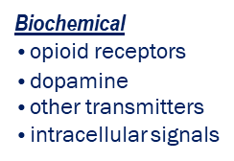
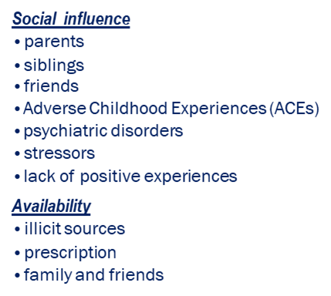
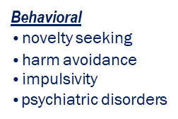
Vulnerabilities for developing SUD
Notes:
Source: Anokhin et al., 2015 Milivojevic et al., 2012 Reed et al., 2014, Volkow et al., 2016; slide courtesy of Bryan Johnston, MD, MCW

Slide 18
The role of trauma: adverse childhood experiences and outcomes
Notes:
Source: Centers for Disease Control and Prevention, Credit: Robert Wood Johnson Foundation

Slide 19
What is trauma?
What is trauma?
From violence to trauma
Exposure to actual or threatened death, serious injury, or sexual violence in one or more of four ways:
directly experiencing the event
witnessing, in person, the event occurring to others
learning that such an event happened to a close family member or friend
experiencing repeated or extreme exposure to aversive details of such events (i.e., first responders)
Notes:
Sources: American Psychiatric Association. (2013). Diagnostic and statistical manual of mental disorders (5th ed.). Washington, DC and “The Roots of Resilience”, Virginia Hughes 11 OCTOBER 2012 | VOL 490 | NATURE | 165, 490165a.pdf (nature.com)

Slide 20
Effects of trauma
Effects
Understand intersectionality and its role in identity, oppression, and privilege
Notes:
Source: Centers for Disease Control and Prevention, Robert Wood Johnson Foundation: Take The ACE Quiz — And Learn What It Does And Doesn't Mean : Shots - Health News : NPR and thanks to Anita Ravi, MD for her slides and Ijeoma Oluo for her concepts from the book So You Want to Talk About Race?

Slide 21
Development of a racist legal framework: the war on drugs
1971: The US declares a War on Drugs: a war fought by the police and the courts; the very intentional casualties of this war were African American males
1973: New York State Drug Laws: the penalty for selling 2 ounces of any illicit drug or possessing 4 ounces of any illegal drug was 15 years to life in NYS; the most severe laws in the US; many other states followed suit
Notes:
Source: Drug War History - Drug Policy Alliance and The war on drugs is a platform for racial inequality and unchecked police brutality (ctmirror.org)
Drug Policy Alliance and Sylvester I. Salcedo, CT Mirror, 6/2020

Slide 22
Substance-related overdose deaths, US, 2002-2022
Notes:
Source: CDC, NCHS Data Brief No. 491, March 2024

Slide 23
Substance-related overdose deaths, US, by age and race/ethnicity, 2021-2022
Notes:
Source: CDC, NCHS Data Brief No. 491, March 2024

Slide 24
Methamphetamine use, MSM, and sex: what’s the connection?
Synergism between illicit substance use and unprotected sex
Facilitated by environmental factors and norms: sexual (the role of sex in subgroups’ lives) and social venues, sex networking apps
Fueled by psychosocial burdens: racism, homophobia, trauma, stigma, discrimination, transphobia, minority stress effect, misogyny, IPV, comorbid mental health (MDD, PTSD, GAD, ADHD), psychological vulnerability, unstable or unsafe housing, homelessness, and victimization
Heightens the likelihood of unprotected sex: anal, oral, and “extreme” sex, sexual compulsivity, increased number of partnering (group sex, sex marathons/fisting/S&M->rectal trauma/bleeding), decreases sexual inhibitions and affects judgment about sexual partners and practices and risks, reduced condom use, development of ED or sexual performance anxiety in response to methamphetamine use->receptive anal SIC, decreased desire for “sober” sex, increased incidence of sexual assault, overrepresentation of HIV among MSM
Enables the transmission of bacterial and viral pathogens: HIV, HCV, HBV, STIs (HPV, HSV, gonorrhea, syphilis, chlamydia, NGU, LGV)
Risk of seroconversion to HIV heightened by use of drug combinations: stimulants only (OR 2.99) to stimulants/amyl nitrate/erectile dysfunction drugs (OR 8.45)
Risk for seroconversion to HIV is similar between those who use IDU and those who use psychostimulants non-IDU; increases with the number of drugs used: OR 3 with use of 1 drug, OR 9 with use of 3 drugs (regardless of the drugs used); is highly associated with psychostimulant use before sex
Notes:
Source: thanks to Perry Halkitis (NYU), Dr. Arty (Housing Works) and Dr. Poitevien (Housing Works) for contribution of concepts from their prn presentations; David G Ostrow ¹, Michael W Plankey, Christopher Cox, Xiuhong Li, Steven Shoptaw, Lisa P Jacobson, Ronald C Stall, Specific sex drug combinations contribute to the majority of recent HIV seroconversions among MSM in the MACS, J Acquir Immune Defic Syndr, 2009 Jul 1;51(3):349-55, https://pubmed.ncbi.nlm.nih.gov/19387357/; Beryl A Koblin, Marla J Husnik, Grant Colfax, Yijian Huang, Maria Madison, Kenneth Mayer, Patrick J Barresi, Thomas J Coates, Margaret A Chesney, Susan Buchbinder, Risk factors for HIV infection among men who have sex with men, AIDS. 2006 Mar 21;20(5):731-9. doi: 10.1097/01.aids.0000216374.61442.55; Steffanie A Strathdee , Jamila K Stockman, Epidemiology of HIV among injecting and non-injecting drug users: current trends and implications for interventions, Curr HIV/AIDS Rep. 2010 May;7(2):99-106. doi: 10.1007/s11904-010-0043-7
Ostrow, et al, J AIDS, 2009; Koblin, et al, AIDS, 2006; Strathdee, et al, Curr HIV/AIDS Rep, 2010

Slide 25
Methamphetamine use: applying syndemics theory
The complexities involved with methamphetamine use, particularly within potentially marginalized patient populations (MSM, bisexual men, persons who are transgender, persons living with HIV, etc.) require a complex prevention and treatment agenda that recognizes psychosocial vulnerabilities and stigma, is sex positive, and addresses substance use in a harm reduction framework
The HIV prevention world often focuses on sexual health for gay and bisexual men while the SUD treatment world often ignores sexuality; neither world may recognize the unique psychosocial vulnerabilities that complex populations face
Notes:
Source: thanks to Perry Halkitis (NYU), Dr. Arty (Housing Works), and Dr. Poitevien (Housing Works) for contribution of concepts from their prn presentations; Ron Stall, PhD, MPH, Thomas C. Mills, MD, MPH, John Williamson, PhD, Trevor Hart, PhD, Greg Greenwood, PhD, MPH, Jay Paul, PhD, Lance Pollack, PhD, Diane Binson, PhD, Dennis Osmond, PhD, and Joseph A. Catania, PhD, Association of Co-Occurring Psychosocial Health Problems and Increased Vulnerability to HIV/AIDS Among Urban Men Who Have Sex With Men, Am J Public Health. 2003 June; 93(6): 939–942. doi: 10.2105/ajph.93.6.939, Halkitis; Perry N. Wolitski, Richard J. Millett, Gregorio A., A holistic approach to addressing HIV infection disparities in gay, bisexual, and other men who have sex with men, American Psychologist, 68(4), 261–273. https://doi.org/10.1037/a0032746
Stall, et al, AJPH, 2003; Halkitis, et al, American Psychologist

Slide 26
Methamphetamine use and HIV: what’s the connection?
Increased risk for HIV acquisition
Worse HIV outcomes
Increased cytokine/inflammatory presence in the rectum (IL-1B, interferon-y, macrophage inflammatory protein, peripheral blood T-cell activation) in both HIV negative and HIV positive men
Epigenetic changes due to stimulant use ->immune activation->Expansion of HIV reservoir?
Increased soluble CD14: marker of monocyte activation that predicts faster clinical progression and CVD
Notes:
Source: Fulcher, J.A., and colleagues, Brief Report: Recent Methamphetamine Use Is Associated With Increased Rectal Mucosal Inflammatory Cytokines, Regardless of HIV-1 Serostatus. JAIDS, May 2018; and University of Miami Miller School of Medicine. "Link between crystal methamphetamine and immune changes in HIV." ScienceDaily. ScienceDaily, 4 May 2018. <www.sciencedaily.com/releases/2018/05/180504122344.htm>.

Slide 27
Trends in methamphetamine use among MSM in NYC, 2004-2017
↓ ARV adherence
↓ viral suppression
↑ Mortality
3x elevated standardized mortality ratio
Most pronounced with MA + nicotine (5x)
↑ Risky sex
Especially with comorbid depression
↑ STI prevalence
77 STIs in 286 MSM/MA over 9 months
78% PWH
Notes:
Source: Carrico JW JAIDS 2019, Reback CJ AIDS Ed and Prevent 2018; Feldman MB Drug Alc Depend 2018; Passaro R Drug Alc Depend 2019; Fletcher JB AIDS & Behavior 2018; and Joshua Blum MD for use of his slide

Slide 28
Alcohol-related emergencies and deaths in ths US
Notes:
Source: Alcohol-Related Emergencies and Deaths in the United States | National Institute on Alcohol Abuse and Alcoholism (NIAAA) (nih.gov)

Slide 29
Deaths attributable to excessive alcohol use: adults aged 20-64 yo
Alcohol-attributable deaths for 58 causes defined by the CDC
Approximately 2.1 million respondents to the 2015-2019 Behavioral Risk Factor Surveillance System (BRFSS)
Approximately 695,000 deaths among adults aged 20-64:
12.9% (89,700) deaths per year attributable to excessive alcohol consumption
1 in 8 deaths
20.3% (45,000) of deaths per year among those aged 20-49
1 in 5 deaths
Notes:
Source: Esser MB, Leung G, Sherk A, et al. Estimated Deaths Attributable to Excessive Alcohol Use Among US Adults Aged 20 to 64 Years, 2015 to 2019. JAMA Netw Open. 2022;5(11):e2239485. doi:10.1001/jamanetworkopen.2022.39485

Slide 30
Stigma, coping, and alcohol use severity among people with HIV (PWH): a prospective analysis of bidirectional and mediated associations
Background: HIV-related stigma is associated with health consequences among people living with HIV, including increased risk for alcohol problems. Theory suggests that maladaptive coping may mediate the relationship between HIV-related stigma and alcohol outcomes, and these variables may be bidirectionally associated over time.
Purpose: This study examined prospective bidirectional and mediated associations among HIV-related stigma, maladaptive coping, and alcohol use severity in patients.
Method: (N = 1,520)
Results: Greater HIV-related stigma at each wave consistently predicted increased maladaptive coping 1 year later. Similarly, maladaptive coping consistently predicted greater subsequent HIV-related stigma. Further, we observed some evidence that maladaptive coping mediated the prospective associations between HIV-related stigma and alcohol use severity in both directions (i.e., stigma to subsequent alcohol use severity and vice versa) although these associations were not observed across all waves.
Conclusion: Results suggest that HIV-related stigma and maladaptive coping are bidirectionally associated with one another over time. This study also provides some evidence that coping may be a relevant mediator of these associations, although findings were less consistent for mediated pathways. Future research should examine whether interventions addressing stigma and coping among people living with HIV may help to minimize health risks such as hazardous drinking.
Notes:
Source: Wardell JD, Shuper PA, Rourke SB, Hendershot CS. Stigma, Coping, and Alcohol Use Severity Among People Living With HIV: A Prospective Analysis of Bidirectional and Mediated Associations. Ann Behav Med. 2018 Aug 16;52(9):762-772. doi: 10.1093/abm/kax050. PMID: 30124756; PMCID: PMC6128374. (https://pubmed.ncbi.nlm.nih.gov/30124756/)
Wardell, JD, et al. Ann Behav Med, 2018 Aug.

Slide 31
Experiences of HIV-related discrimination and consequences for internalized stigma, depression, and alcohol use
Objective: We aimed to investigate the role of stress associated with events of HIV-related discrimination on internalized HIV stigma, as well as the downstream effects on depressive symptoms and alcohol use severity.
Design: 199 participants
Main study measures: HIV-related discrimination was assessed using items adapted from measures of enacted HIV stigma and discrimination. Participants rated perceived stress associated with each discrimination item. Internalized HIV stigma was assessed using the internalized stigma subscale of the HIV Stigma Mechanisms Scale. Depressive symptoms were assessed with the Centre for Epidemiological Studies-Depression Index. Alcohol use severity was assessed with the Alcohol Use Disorders Identification Test.
Results: In serial mediation models, HIV-related discrimination was indirectly associated with both depressive symptoms and alcohol use severity through its associations with stress and internalized HIV stigma.
Conclusions: Understanding the mechanisms through which PWH internalize HIV stigma and lead to poor health outcomes can yield clinical foci for intervention.
Notes:
Source: Crockett KB, Kalichman SC, Kalichman MO, Cruess DG, Katner HP. Experiences of HIV-related discrimination and consequences for internalised stigma, depression and alcohol use. Psychol Health. 2019 Jul;34(7):796-810. doi: 10.1080/08870446.2019.1572143. Epub 2019 Feb 17. PMID: 30773914; PMCID: PMC6557669. (https://pubmed.ncbi.nlm.nih.gov/30773914/)
Crockett, KB, et al. Psychol Health, 2019 Jul.

Slide 32
The prevalence of alcohol use disorder among people with HIV (PWH): a systematic review and melta-analysis
Background: Alcohol use disorder (AUD) is common among people living with HIV (PWH) and associated with a greater risk of poor medication adherence, unsafe sexual behaviors as well as poor quality of life.
Methods: PubMed, EMBASE, Psych INFO and SCOPUS databases were searched to identify the relevant studies.
Results: A total of 25 studies with 25,154 participants across developed and developing countries were included in the final analysis. Our meta-analysis revealed that the pooled prevalence estimate of AUD among PWHA was found to be 29.80% (95% CI; 24.10-35.76). The prevalence of AUD was higher in males (26.90%) than female (13.37%) HIV patients. In this study, the pooled prevalence of AUD was considerably higher (31.52%) when measured by Alcohol Use Disorders Identification Test (AUDIT) as compared to Composite International Diagnostic Interview (CIDI) (13.51%). In addition, the pooled prevalence of AUD was higher in the developed countries (42.09%) while lower for developing countries (24.52%).
Conclusion: In the current study, the pooled prevalence estimates of AUD among PWH was considerably high (29.80%). Screening and appropriate management of AUD among PWH are recommended.
Notes:
Source: Duko B, Ayalew M, Ayano G. The prevalence of alcohol use disorders among people living with HIV/AIDS: a systematic review and meta-analysis. Subst Abuse Treat Prev Policy. 2019 Nov 14;14(1):52. doi: 10.1186/s13011-019-0240-3. PMID: 31727086; PMCID: PMC6854786. (https://pubmed.ncbi.nlm.nih.gov/31727086/)
Duko, B., et al. Subst Abuse Treat Prev Policy, 2019 Nov.

Slide 33
Substance use treatment utilization among women with and without HIV
Background: We describe SU and SU treatment utilization among women with and without HIV in the Women's Interagency HIV Study (WIHS).
Methods: We included data from women enrolled in WIHS from 2013 to 2020. Current SU was self-reported, nonmedical use of drugs in the past year, excluding use of only marijuana. SU treatment utilization was self-reported use of a drug treatment program in the past year. Multivariable regression models were used to investigate associations between participant characteristics and SU treatment.
Results: Among 2559 women (1802 women living with HIV [WWH], 757 women without HIV), 14% reported current SU. Among those with current SU (n = 367), 71% reported crack/cocaine followed by 40% reporting opioids, and 42% reported any treatment in the past year. The most common treatments were methadone (64%), Narcotics Anonymous (29%), inpatient programs (28%), and outpatient programs (16%). Among women using opioids (n = 147), 67% reported methadone use in the past year compared to 5% using buprenorphine/naloxone. Multivariable analysis showed lower odds of treatment utilization among WWH with concurrent alcohol or marijuana use. Visiting a psychiatrist/counselor was associated with higher odds of treatment. Among WWH, SU treatment was not associated with HIV-related clinical outcomes.
Conclusions: Treatment utilization was high, especially for methadone use. Our results highlight opportunities for accessing SU treatment for WWH, such as the need to prioritize buprenorphine and comprehensive, wraparound services in HIV care settings.
Notes:
Source: Fujita AW, Ramakrishnan A, Mehta CC, Yusuf OB, Wilson T, Shoptaw S, Carrico AW, Adimora AA, Eaton E, Cohen MH, Cohen J, Adedimeji A, Plankey M, Jones D, Chandran A, Colasanti JA, Sheth AN. Substance Use Treatment Utilization Among Women With and Without Human Immunodeficiency Virus. Open Forum Infect Dis. 2022 Dec 21;10(1):ofac684. doi: 10.1093/ofid/ofac684. PMID: 36655189; PMCID: PMC9835749. (https://pubmed.ncbi.nlm.nih.gov/36655189/)
Fujita, AW, et al. Open Forum Infect Dis. 2022 Dec.

Slide 34
What is stigma?
The experience of being “deeply discredited” or marked due to one’s “undesired differentness”
To be stigmatized is to be held in contempt, shunned or rendered socially invisible because of a socially disapproved status.
When someone views another in a negative way because they have a distinguishing characteristic or personal trait that’s thought to be, or actually is, a disadvantage (negative stereotype)
Notes:
Source: Corrigan, P. W., Watson, A. C., & Miller, F. E. Blame, shame and contamination: The impact of mental illness and drug dependence stigma on family members. Journal of Family Psychology; Volume 20(2) (2006), 239-246.
Corrigan, PW, et al. Journal of Psychology, 2006

Slide 35
Stigma in health care settings
Notes:
Sources:
https://harmreduction.org/issues/harm-reduction-basics/undoing-stigma-facts/
https://www.drugabuse.gov/nidamed-medical-health-professionals/health-professions-education/words-matter-terms-to-use-avoid-when-talking-about-addiction
https://www.ncbi.nlm.nih.gov/pmc/articles/PMC3181836/#:~:text=Brain%20areas%20implicated%20in%20the,norepinephrine%20responses%20to%20subsequent%20stressors.
https://store.samhsa.gov/product/TIP-57-Trauma-Informed-Care-in-Behavioral-Health-Services/SMA14-4816
https://traumainformedoregon.org/resource/foundations-trauma-informed-care/

Slide 36
Stigma and language: what we say and how we say it matter
Words perpetuate stigma, especially when they imply fault or immorality
Stigmatizing language in medical records not only affects how patients feel; it can also affect the care they receive for years to come by perpetuating bias among other providers
Use person-centered language (e.g., person with a substance use disorder)
Use language that reflects an accurate, science-based understanding of SUD as a complex medical condition
Use clinically accurate, non-stigmatizing terminology
Avoid moral judgments, assumptions, or subjective language
Notes:
Sources:
https://facesandvoicesofrecovery.org/wp-content/uploads/2019/06/Words-Matter-How-Language-Choice-Can-Reduce-Stigma.pdf
https://harmreduction.org/issues/harm-reduction-basics/undoing-stigma-facts/
https://www.asam.org/docs/default-source/default-document-library/nidamed_wordsmatter3_508.pdf?sfvrsn=5cf550c2_2

Slide 37
Best practice to avoid using stigmatizing language

Slide 38
Consider the relationship between stigma and trauma

Slide 39
Practice trauma-informed care
Realizing the widespread impact of trauma
Recognizing signs and symptoms of trauma in people, including patients, their families, staff and clinical team members
Responding by fully integrating knowledge about trauma into policies, procedures, and practices
Seeking to actively resist Re-traumatization
Universal Trauma Precautions
Ability to adapt
One trauma is not ALL trauma!
Anticipate shame and stigma
Ask individuals “what happened to you?” rather than “what’s wrong with you?”
Notes:
Source: TIP 57 Trauma-Informed Care in Behavioral Health Services (samhsa.gov)

Slide 40
What is harm reduction?
Harm reduction is a set of practical strategies and ideas aimed at reducing negative consequences associated with drug use.
Harm reduction is also a movement for social justice built on a belief in, and respect for, the rights of people who use drugs. It is based on a strong commitment to public health and human rights.
Notes:
Source: National Harm Reduction Coalition and What Is Harm Reduction and How Does It Work? (clevelandclinic.org) and What Is Harm Reduction? | Johns Hopkins | Bloomberg School of Public Health (jhu.edu)

Slide 41
Harm reduction in theory
The goal of harm reduction is to move people from the place where they are to their most realized, healthy, and safe place. For some people, that place is abstinence, but for others it is not, because abstinence from drug use is not an actual requirement for full participation in society.
Incorporates a spectrum of strategies that includes safer use, managed use, abstinence, meeting people who use drugs “where they are now."
The two basic components of harm reduction are pragmatism—providing policies, strategies, and services that are effective—and respect for the human rights of PWUD.
Notes:
Source: National Harm Reduction Coalition

Slide 42
Harm reduction principles
Notes:
Source: National Harm Reduction Coalition

Slide 43
Harm reduction guiding principles
Notes:
Source: National Harm Reduction Coalition

Slide 44
Harm reduction strategies for people who use drugs (PWUD)
Notes:
Source: expert opinion

Slide 45
Harm reduction strategies for people who use drugs (PWUD)
Notes:
Source: expert opinion

Slide 46
What does harm reduction mean for PWUD?
(Truly) Meeting people where they are: not forcing PWUD to be where you want them to be and not leaving them behind; engaging with PWUD outside of brick-and-mortar settings
Harm reduction lies on the treatment continuum: with active use at one end and (perhaps) sustained abstinence from all substances on the other end; abstinence is one of many possible goals
(Any, even small) Change is positive: embrace it and encourage self-efficacy and resilience
Keeping patients alive is harm reduction: using buprenorphine intermittently to decrease heroin use is harm reduction as it decreases the risk of death by overdose (i.e., “dead drug users don’t recover”)
Notes:
Source: expert opinion and Iowa Harm Reduction Coalition – Working to improve health equity in Iowa communities

Slide 47
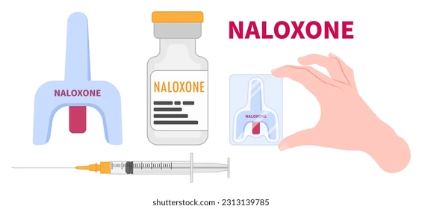
Dispense or prescribe naloxone to anyone using substances from the unregulated drug supply
An opioid antagonist: reverses opioid overdose; effective against all highly potent synthetic opioids in the unregulated drug supply
Easy to administer
Inert when opioids not on board; no medication-medication interactions with other medications, no contraindications with any co-morbid medical or mental health conditions
It is imperative that naloxone is in the hands of PWUD (who actually experience/witness/do the most reversals)
Overdose education should be done with all individuals regardless of substance use disorder diagnosis, last date of use, and intended substance of use
Naloxone is also OTC but the price point may be too high for some individuals
Notes:
Source: expert opinion and 422 Naloxone Images, Stock Photos, 3D objects, & Vectors | Shutterstock

Slide 48
Inform PWUD regarding polysubstance overdose
The use of multiple substances, also known as polysubstance use, is the most common use pattern
Polysubstance overdose is under recognized
Most fatal overdoses are the result of polysubstance use
Certain substances mask the effects of other substances, which may inadvertently make a person take higher doses than they normally would because they don’t feel the full, expected effects of using the intended substance.
Overdose from multiple substances is more difficult to treat.
Mixing opioids with other CNS depressants/sedatives (alcohol, prescribed benzodiazepines, synthetic benzodiazepines, xylazine) can cause them to interact in ways that increase their overall effect. This can:
Further decrease their respiratory rate and heart rate
Increase the risk of a fatal overdose
Notes:
Source: expert opinion

Slide 49
Inform PWUD regarding polysubstance overdose response
Experiences from PWUD, harm reduction programs, and overdose prevention centers:
Overdoses may look different because of sedation due to xylazine or synthetic benzodiazepines
Supporting the airway and breathing and providing oxygen are key
Call 911
Administer naloxone
Xylazine is typically mixed with fentanyl
Standard naloxone dose (intranasal 4 mg or IM 0.4 mg) effective for ALL opioids, including highly potent synthetic opioids
WAIT 2-5 minutes before giving a second dose of naloxone
Start rescue breathing
Use a facemask if available
To open the airway, use maneuvers such as a head tilt/chin lift
Perform rescue breathing for a full 2 minutes or until help arrives
Notes:
Source: expert opinion and Overdose prevention | Northern Health

Slide 50
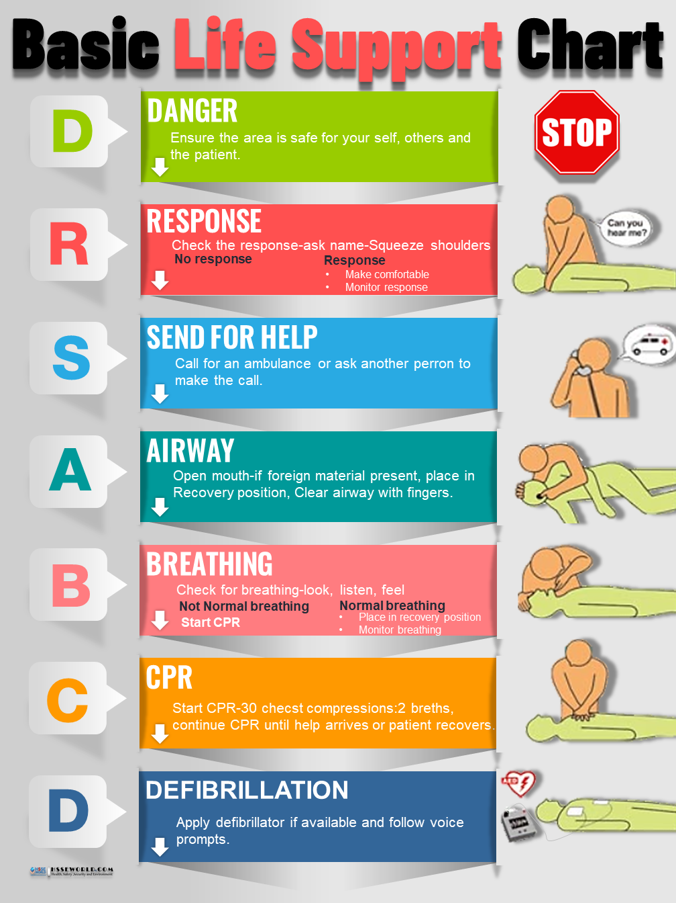
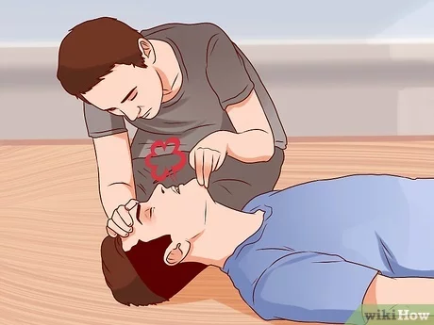
Inform PWUD regarding polysubstance overdose response
Administer a second naloxone dose if needed
1-2 doses of naloxone, 2-5 minutes apart
Over administration of naloxone can cause severe precipitated opioid withdrawal
The goal with administration of naloxone is normalizing breathing, not that the person is awake, walking, and talking
Continue rescue breathing until EMS arrives
Receipt of oxygen is critical, so keep the airway open
If available, use an oral or nasal airway, bag valve mask (e.g., Ambu bag), supplemental oxygen, pulse oximeter
Normal oxygen levels are in the 90s
Reversals may look different
Person may begin breathing again, but remain sedated for long periods of time
Place the person in the recovery position
CNS depression, avoid positions that restrict airflow
Stay with the person, monitor them, and watch their breathing
Notes:
Source: expert opinion and What is the Recovery Position? - Help-A-Heart CPR (helpaheartcpr.com) and How to Check Airway, Breathing and Circulation: 12 Steps (wikihow.com) and (4) Learn the DRSABCD action Plan | LinkedIn

Slide 51
Inform PWUD regarding monitoring after a polysubstance overdose
All people should be monitored for recurrence of signs and symptoms of opioid or other toxicity for at least 3-4 hours after the last dose of naloxone
Most people respond by returning to spontaneous breathing (remember normalization of breathing is the goal, not awake/walking/talking)
Because naloxone has a relatively short duration of effect, overdose symptoms may recur with long-acting lipophilic highly potent synthetic opioid (HPSO).
If a person does not respond to naloxone x 2 doses given at an appropriate time interval, an alternative explanation for the clinical symptoms should be considered. The most likely explanation is that the person is not overdosing on an opioid alone but rather some other substance or additional substances (polysubstance overdose) or may be experiencing a non-overdose medical emergency.
Notes:
Source: SAMHSA Overdose Prevention and Response Toolkit and #23 Opioid Overdose Treatment and Prevention with Dr. Alex Walley - The Curbsiders

Slide 52
Inform PWUD regarding safer use practices
Notes:
Source: Street Safe Program | Frederick County Health Department, MD (frederickcountymd.gov) and Distribution of Safer Drug Smoking Supplies as a Public Health Strategy (uw.edu)

Slide 53
Inform PWUD regarding wound care
Notes:
Source: Wound-Care and Stigma: Healthcare Must Do Better for People Who Inject (filtermag.org) and Wound Care Information Pamphlet, Edited by David Glanzer, RN and Carter Thurmond, MA

Slide 54
Inform PWUD regarding xylazine
Notes:
Source: Xylazine Basics: Overdose Prevention, Harm Reduction, and Wound Care - Prevention Technology Transfer Center (PTTC) Network (pttcnetwork.org) and Harm Reduction | Resources | Grayken Center for Addiction TTA | Boston Medical Center (addictiontraining.org)

Slide 55
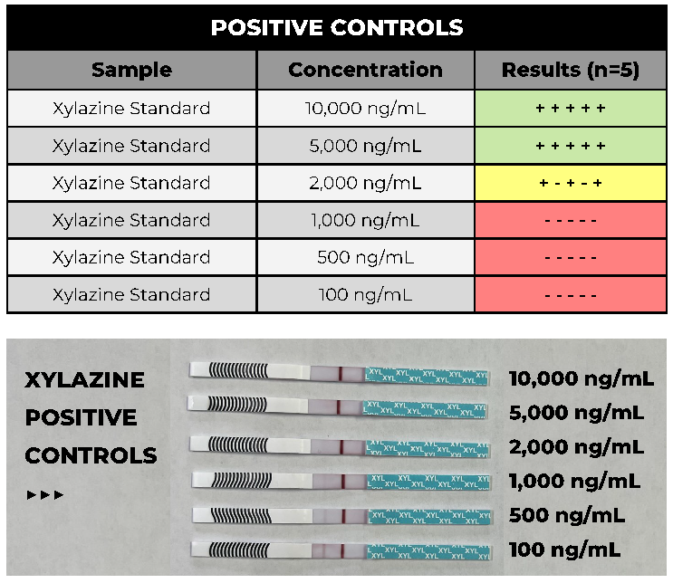
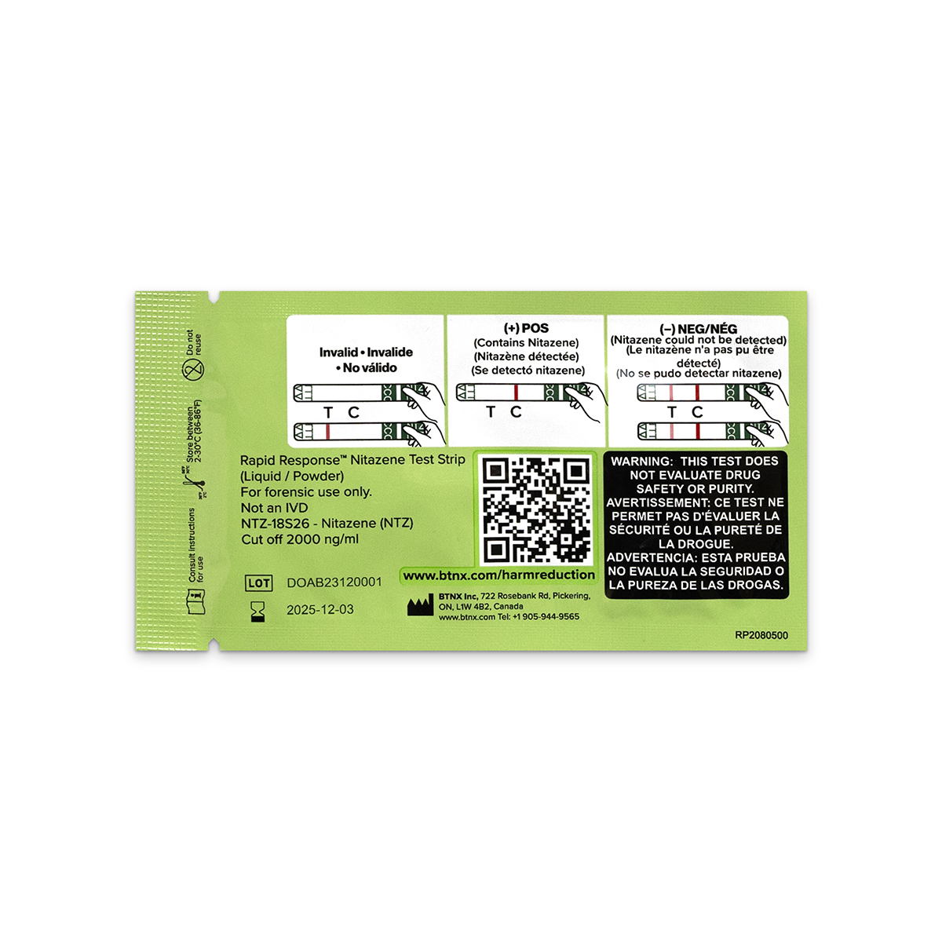
Inform PWUD regarding test strips and distribute them
Notes:
Source: Fentanyl Test Strips: A Harm Reduction Strategy (cdc.gov) and Evaluation of Xylazine Test Strips (BTNX) for Drug Checking Purposes (cfsre.org) and Nitazene test strip (exchangesupplies.org)

Slide 56
Inform PWUD regarding overamping
Overamping: a negative reaction to using stimulants; while different from overdosing, it can be life-threatening
Physical symptoms can include chest pain, dyspnea, HTN, tachycardia, hyperthermia, etc.
Psychiatric symptoms can include anxiety, paranoia, aggression, psychosis, etc.
Time of symptom onset is quickest when people use substances by smoking, sniffing, or injecting them
Occurs when someone is experiencing effects of stimulants so severe that their health or safety may be at risk.
The effects of stimulants on the body can vary greatly based on multiple factors, including potency of the substance being used, co-use with other substances, route of administration, amount of substance used, using alone (risk for lethal overamping), mental health and other medical comorbidities
Notes:
Source: NYC DOHMH pamphlet “Safety Tips for People Who Use Stimulants”

Slide 57
Inform PWUD regarding overamping
What could potentially lethal complications of overamping look like?
hyperthermia
hypertension
tachycardia
toxic delirium
seizures
stroke
myocardial infarction
arrhythmia
cardiac arrest
sudden death
Notes:
Source: Stimulant Guide | Feature Topics | Drug Overdose (cdc.gov)

Slide 58
Inform PWUD on tips to prevent overamping
General tips to prevent or address overamping:
stay hydrated, replenish electrolytes
find a quiet and calm space to reduce overstimulation
seek medical attention
protect the head in case of seizure
Notes:
Source: NYC DOHMH pamphlet “Safety Tips for People Who Use Stimulants” and Overamp Safety Guide - OnPoint NYC

Slide 59
Inform PWUD on safety tips to avoid overdose
Overdose: persons will overdose if exposed to enough opioids, whether the opioid exposure is intentional (speed balling: mixing opioids with stimulants) or unintentional (HPSO added to the stimulant supply)
Tips to avoid overdose:
test your substances with fentanyl test strips
try to avoid mixing substances
use smaller amounts/do a test dose/start low and go slow
carry naloxone: providers should dispense or prescribe naloxone to all persons who are actively using, regardless of the substance used (rare exceptions: if solely using alcohol and/or cannabis)
don’t use alone (Never Use Alone overdose prevention call line: 1-877-696-1996 https://neverusealone.com/)
advise regarding mail-order naloxone and other harm reduction supplies directly to the homes of PWUD (www.nextdistro.org)
consider prescribing buprenorphine off label for those at high risk for overdose (or who have experienced overdose) due to substances adulterated with HPSO
Notes:
Source: NYC DOHMH pamphlet “Safety Tips for People Who Use Stimulants” and expert opinion

Slide 60
Resources for the management of stimulant use disorder
ASAM/AAAP Clinical Practice Guideline on the Management of Stimulant Use Disorder
NYS DOH/Johns Hopkins University Clinical Guidelines Program: Clinical Guidance: Stimulant Use
NYS OASAS: Increasing Overdose Deaths Related to Cocaine and Other Stimulants: Guidance from the New York State Office of Addiction Services and Supports, Medical Advisory Panel

Slide 61
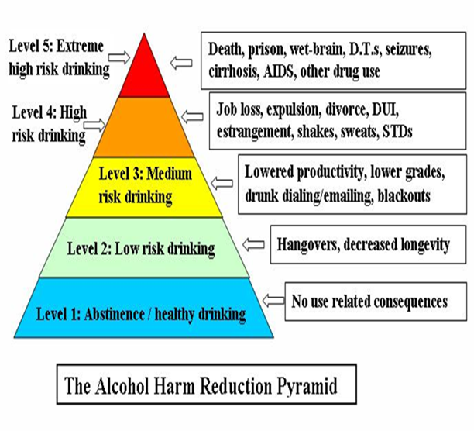
Harm reduction and alcohol use
Notes:
Source: Advances in the science and treatment of alcohol use disorder | Science Advances and The Alcohol Harm Reduction Pyramid (hams.cc) and DeMartini KS, Devine EG, DiClemente CC, Martin DJ, Ray LA, O'Malley SS. Predictors of pretreatment commitment to abstinence: results from the COMBINE study. J Stud Alcohol Drugs. 2014 May;75(3):438-46. doi: 10.15288/jsad.2014.75.438. PMID: 24766756; PMCID: PMC4002857. (https://www.ncbi.nlm.nih.gov/pmc/articles/PMC4002857/)

Slide 62
Pharmacotherapy for AUD
3 FDA Approved Medications:
Disulfiram: approved in 1949; MOA: aldehyde dehydrogenase inhibitor; least efficacious of the FDA-approved medications for AUD
Naltrexone: oral formulation approved in 1994; depot injectable formulation approved in 2006; MOA: opioid receptor antagonist; Cochrane Review: NNT to decrease heavy drinking: 12; NNT to decrease daily drinking: 25
Acamprosate: approved in 2004; MOA: NMDA/glutamate receptor antagonist; Cochrane Review: NNT for reducing the risk of any drinking: 9
Medications for AUD are highly underutilized
NNT = number needed to treat

Slide 63
Medication for opioid use disorder (MOUD) goals and options
Decrease risk for fatal and nonfatal overdoses
Eliminate opioid withdrawal syndrome (OWS)
Decrease opioid cravings
Increase patient functionality
Normalize brain anatomy and physiology
Decrease transmission/acquisition of viral infections (hepatitis B Virus, hepatitis C Virus, HIV) and infection complications (abscesses, cellulitis, endocarditis)
methadone: opioid full agonist; must be dispensed from an OTP; associated with decreased opioid-related (overdose) mortality and all-cause mortality (NNT 2.3 for large effects including decreased mortality)
buprenorphine: opioid partial agonist; Schedule III drug; no longer requires a DEA “X” waiver to prescribe; associated with decreased opioid-related (overdose) mortality and all-cause mortality (NNT <3 for prevention of one death due to OUD)
XR-naltrexone: opioid antagonist; not a controlled substance; not associated with decreased mortality (NNT 6.7 for treatment retention for one additional person
NNT=number needed to treat
Notes:
Source: NIDA/SAMHSA/CDC data

Slide 64
Stabilization of OUD with medication: MOUD is highly underutilized and is life saving
Notes:
Source: Treatment for opioid use disorder – Learn About Treatment and Medications for Opioid Use Disorder Save Lives | The National Academies Press

Slide 65
Opioid agonist treatment with methadone or buprenorphine is associated with a reduction in mortality by ~50%
Results: Compared with no MOUD, MMT was associated with decreased all-cause mortality and opioid-related mortality. Buprenorphine was associated with decreased all-cause mortality and opioid-related mortality. No associations between naltrexone and all-cause mortality or opioid-related mortality were identified.
Conclusion: Buprenorphine and methadone were associated with reduced all-cause and opioid-related mortality. Naltrexone was not associated with decreased mortality.
Notes:
Source: Larochelle MR, Bernson D, Land T, Stopka TJ, Wang N, Xuan Z, Bagley SM, Liebschutz JM, Walley AY. Medication for Opioid Use Disorder After Nonfatal Opioid Overdose and Association With Mortality: A Cohort Study. Ann Intern Med. 2018 Aug 7;169(3):137-145. doi: 10.7326/M17-3107. Epub 2018 Jun 19. PMID: 29913516; PMCID: PMC6387681.
Larochelle, MR, et al, Annals of Internal Medicine, 2018

Slide 66
Recovery is individualized
A process of change through which individuals improve their health and wellness, live a self-directed life, and strive to reach their full potential.
Health: overcoming or managing one’s health condition/s or symptoms;
Home: a stable and safe place to live;
Purpose: meaningful daily activities and the independence, income, and resources to participate in society; and
Community: relationships and social networks that provide support, friendship, love, and hope.
Notes:
Source: SAMHSA

Slide 67
Takeaways for the care team
Substance use and SUD are common. Addiction is a complex interplay of biological, psychological, and environmental factors.
Stigma towards PWUD, substance use, SUD, and substances themselves create barriers to services access and contribute to hopelessness and internalized stigma for marginalized persons.
Racism underlies the war on drugs and disparities in incarceration rates, toxicology testing, overdose deaths and access to MOUD all reflect this.
Harm reduction is an evidence-based practice that utilizes strategies to decrease harm associated with substance use. It emphasizes treating all persons using substances with dignity and respect regardless of where they are on the use continuum.
Health inequities exist in multiple domains due to structural racism, implicit bias, and stigma.
Applying harm reduction principles, including trauma-informed care and low threshold access and prescribing, can decrease these inequities.
There is robust data with respect to evidence-based harm reduction strategies for overdose prevention and intervention.
MOUD, naloxone education and distribution, drug checking, syringe services programs, and overdose prevention centers all have evidence-based research to support their use with PWUD to decrease the high morbidity and mortality related to unintentional overdose.
We must aggressively educate all persons with active substance use (regardless of the intended substance used), SUD (regardless of the SUD diagnosis), or a history of SUD (regardless of the SUD diagnosis and regardless of the time not using) on overdose prevention and intervention and dispense or prescribe naloxone and inform regarding and/or dispense fentanyl test strips and inform regarding polysubstance overdose and the importance of rescue breathing/EMS activation. It is imperative that this information and naloxone be in the hands of persons at risk for experiencing or witnessing an overdose.

Slide 68
Questions? Thanks.
kellysramsey@yahoo.com

Slide 69
MATEC Resources
National Clinician Consultation Center http://nccc.ucsf.edu/
HIV Management
Perinatal HIV
HIV PrEP
HIV PEP line
HCV Management
Substance Use Management
AETC National HIV Curriculum https://aidsetc.org/nhc
AETC National HIV-HCV Curriculum https://aidsetc.org/hivhcv
National PrEP Curriculum https://www.hivprep.uw.edu
Hepatitis B Online https://www.hepatitisb.uw.edu
Hepatitis C Online https://www.hepatitisc.uw.edu
AETC National Coordinating Resource Center https://aidsetc.org/
Additional Trainings https://matec.info

