Slide 1
HIV Post-Exposure Prophylaxis: Access and Barriers
Daniel Jude, PharmD, AAHIVP, CSP
June 6, 2024

Slide 2
MATEC Statement on Equity and Inclusion
MATEC has a strong commitment to fair, respectful and unbiased representation of humankind. We strive to be anti-racist, gender affirming and honor all people in an authentic way. This is our goal in all of our work, including this presentation.
Our commitment to you is that we take this stance seriously and invite you to do the same. We ask that if you find something offensive, off-putting, or inaccurate to please let us know.
We continue to grow and evolve and welcome you on our journey.

Slide 3
Disclaimer
This program is supported by the Health Resources and Services Administration (HRSA) of the U.S. Department of Health and Human Services (HHS) as part of an award totaling $4,036,482 with 0 percentage financed with nongovernmental sources. The contents are those of the author(s) and do not necessarily represent the official views of, nor an endorsement, by HRSA, HHS or the U.S. Government.

Slide 4
Disclaimer
Funding for this presentation was made possible by grant number U1OHA29293 from the Human Resources and Services Administration HIV/AIDS Bureau. The views expressed do not necessarily reflect the official policies of the Department of Health and Human Services nor does mention of trade names, commercial practices, or organizations imply endorsement by the U.S. Government.
Any trade/brand names for products mentioned during this presentation are for training and identification purposes only.

Slide 5
Email Distribution List
MATEC Minnesota/Iowa utilizes an email distribution list to send important information:
Training invitations
News and updates
Minnesota and Iowa participants will be added to the email distribution list
If you would prefer not to be added to the distribution list, email Nicole Benson at nrbenson@umn.edu

Slide 6
Learning Objectives
Apply current CDC guidance for both nPEP and oPEP in your local programs.
Determine appropriate medication options and length of therapy for nPEP and oPEP patients.
Understand critical complexities with PEP use.
Summarize clinical support program using pharmacy services to drive access.
Explore opportunities to promote access to PEP medications within local programs.

Slide 7
Disclosures
Daniel Jude is a member of Gilead’s HIV Speakers Bureau.

Slide 8
PEP – Background and Basics

Slide 9
HIV Post-Exposure Prophylaxis (PEP)
#1 lesson: TIMING - PEP should be started within 72 hours of the risk-event
Duration = 28 days (typically rounded up to 30 because few pharmacies wants to break expensive bottles)
Broken into two categories that are handled very differently
Occupational PEP (oPEP) – needle stick, altercation involving blood, splatter
Non-occupational PEP (nPEP) – sexual assault, broken condom, black-out events
Follow up needed for both oPEP and nPEP
Limited supporting data

Slide 10
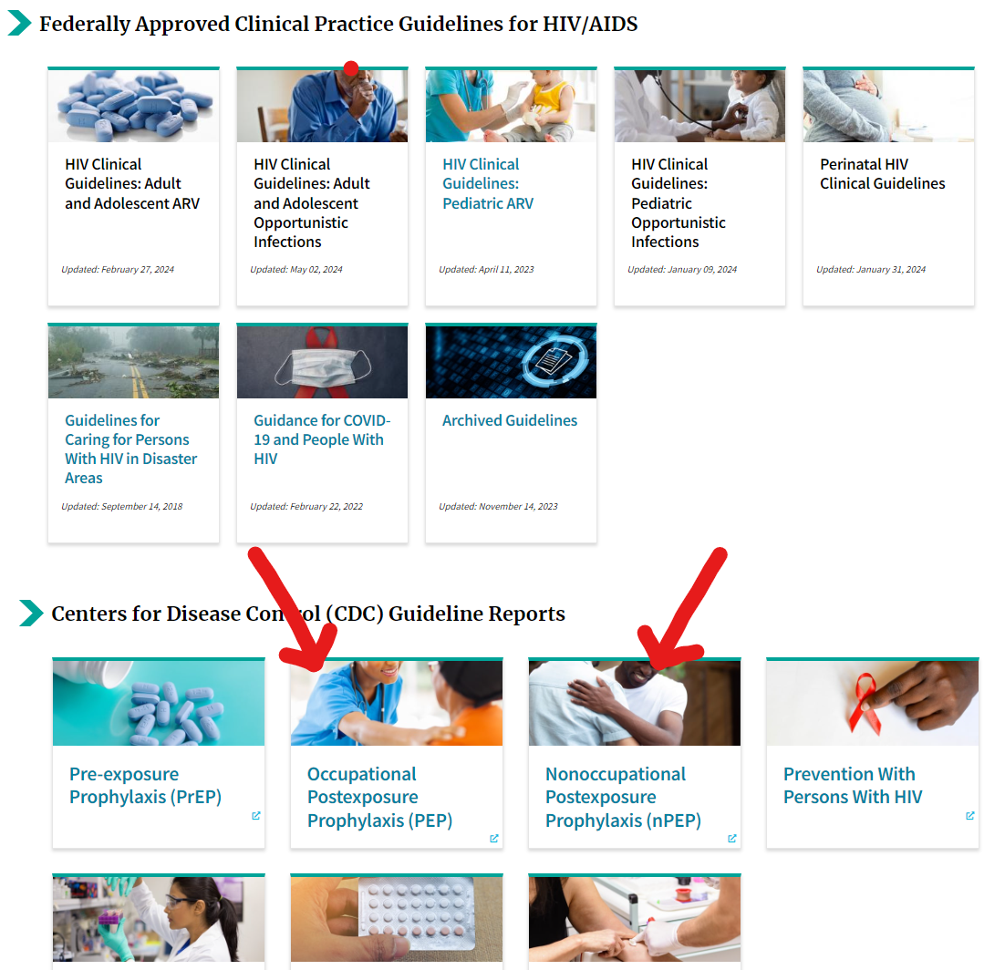
HIV PEP – CDC Guidance
Website finally links directly to the guidance documents!

Slide 11
PEP – CDC Guidance
oPEP – updated 2018
Still recommend Raltegravir BID, but large # of alt options
Scenarios for when to send to experts
Counseling recommendations
Source patient discussions
nPEP – updated 2018
Recommend Dolutegravir QD or Raltegravir BID
Thorough analysis of available data at the time
Decision making flow charts
Per-act relative risk chart
Lab chart
HBV-discussion
Prevention for STIs and HBV

Slide 12
Let’s Go Diving
https://clinicalinfo.hiv.gov/en/guidelines
Notes:
For oPEP will highlight
Box 1
Box 2
Appendix A
For nPEP will highlight
Thorough Content List
Different topics in each section
Figure 1
Table 1
Table 2
VII-F2 special populations
Studies at end of guidelines

Slide 13
oPEP – Evaluation and Access
No FDA-approved product
Risk? Requires eval by specialist
RF include source pt viral load, quantity of fluid from source pt, route of exposure,
Universal precautions – assume the worst so treat with PEP unless data shows low risk
Coverage – universally worker’s comp
Barriers – adherence and side effects, coverage by small employers

Slide 14
oPEP – Treatment and Counseling
Guidelines:
Raltegravir 400mg BID + Emtricitabine/TDF 200mg/300mg QD
Local:
Dolutegravir 50mg QD + Emtricitabine/TDF 200mg/300mg QD
Counseling
Adherence is critical (click here for a gem)
Side effects: nausea, headache, GI upset, fatigue, diarrhea
Avoid sexual contact or use condoms to reduce possible transmission until HIV ruled out
Cation-chelation with INSTIs (DTG, RAL)
Follow up: HIV-testing recommended at baseline, 6 weeks, 12 weeks, and 6 months post-exposure. CBC, SCr and liver panel at baseline and 2 weeks. (But in reality: employee health protocol)
DTG = dolutegravir, RAL = raltegravir

Slide 15
nPEP – Evaluation and Access
Be prepared to create a supportive and empathetic environment
Consensual risk vs. non-consensual risk
Often given first dose in ED
Sexual Assault Nursing Examiner (SANE) RNs often involved
Coverage: all types of insurance
Barriers – affordability (active coverage, large copays and deductibles), time of day of eval, uncommon inventory, communication for follow up

Slide 16
nPEP – Treatment and Counseling
Guidelines:
(Dolutegravir 50mg QD OR Raltegravir 400mg BID) + Emtricitabine/TDF 200mg/300mg QD
Other options might be used
Pts often given meds for bacterial STI prophylaxis (including 2g of metronidazole for trichomonas)
Counseling
Adherence is critical
Side effects: nausea, headache, GI upset, fatigue, diarrhea
Avoid sexual contact or use condoms to reduce possible transmission until HIV ruled out
Cation-chelation with INSTIs (DTG, RAL, BIC)
DTG, BIC can boost Metformin
Assess for mental health and primary care access, provide support as needed
DTG = dolutegravir, RAL = raltegravir, BIC = bictregravir

Slide 17
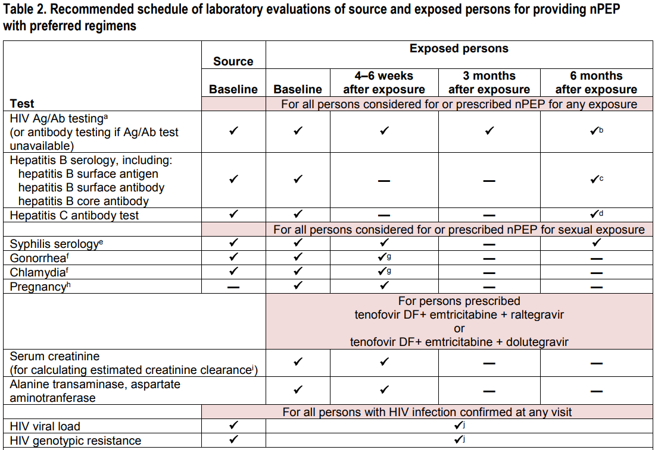

Slide 18
Complications (real world, non-exhaustive)
Psychological impact of trauma
Pregnancy/lactation
Presentation > 72 hours after exposure
CYP3A4-inducer interaction (significantly lowers DTG levels)
Admission for ingestion as well
Insurance not responding to urgent need (both oPEP and nPEP)
Young age; complex guardian dynamics

Slide 19
HIV Post-Exposure Prophylaxis (PEP) - Summary
#1 lesson: TIMING - PEP should be started within 72 hours of the risk-event
Duration = 28 days (typically rounded up to 30 because few pharmacies wants to break expensive bottles)
Broken into two categories that are handled very differently
Occupational PEP (oPEP) – needle stick, altercation involving blood, splatter
Non-occupational PEP (nPEP) – sexual assault, broken condom, black-out events
Follow up needed for both oPEP and nPEP
Limited supporting data

Slide 20
ED PEP Support Program

Slide 21
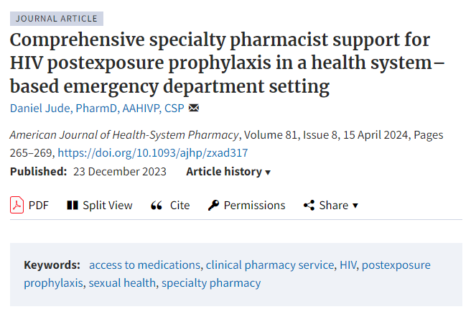
Local Program – finally published in a peer-reviewed journal!

Slide 22
ED PEP Support – Program Structure 1
Worked with IT to get an alert via EHR for any HIV med being prescribed by the Emergency Departments
Either PEP or an urgent need for someone living with HIV
Utilized mobile-app version of EHR to get alert on both personal and work phone
Called or visited ED as soon as alert was received to counsel patient
Added the following to standard specialty pharmacy assessment:
Insurance access
Primary care follow up access
Mental health access

Slide 23
ED PEP Support – Program Structure 2
Determined access to medications
Assessed preferred communication – phone, email, text
Follow up call scheduled for 3-5 days after start to assess tolerability and adherence
Call at end of therapy to confirm completion, assess status
Call for lab reminders at 6 weeks and 3 months

Slide 24
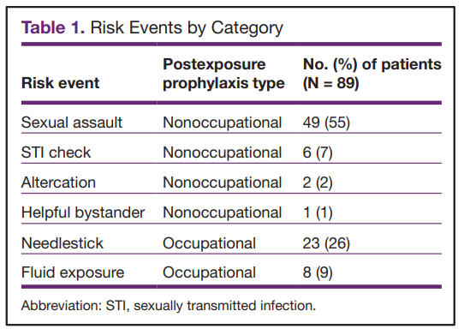
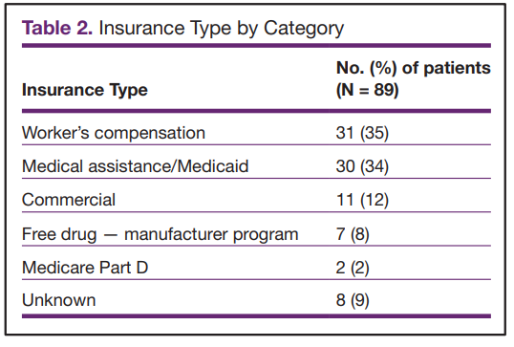
Total of 89 active alerts for prescribing PEP

Slide 25
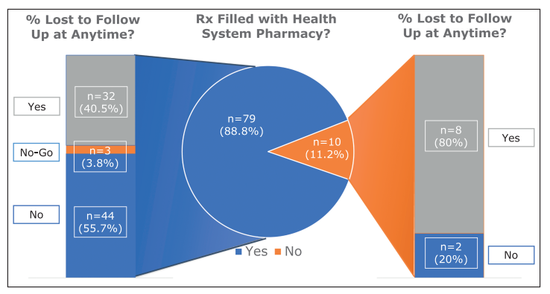
Loss to Follow Up

Slide 26
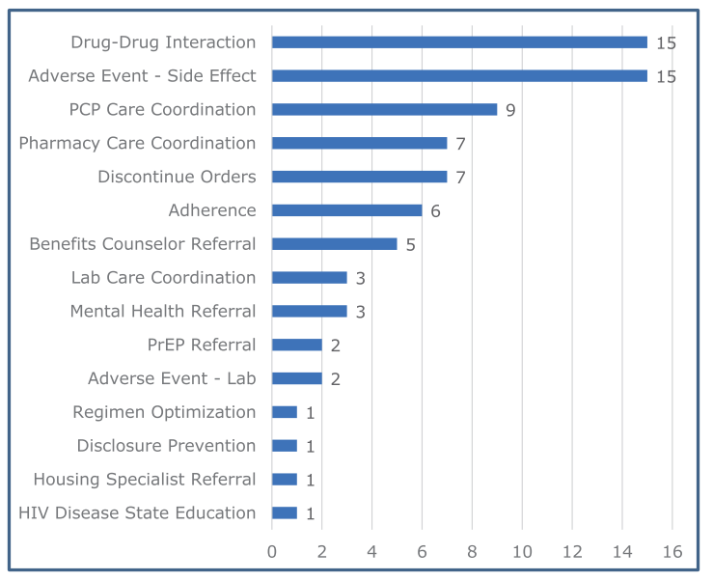
Categorized Interventions

Slide 27
ED PEP Support – Lessons and Pearls 1
Outcomes Measurement
Frequent loss to follow up
Biggest barriers: employee health privacy barriers and follow up outside of health-system
Filling for 1 month typically excludes patients from service surveys
Patient Communication
Not all patients are ready to be counseled; try to schedule follow up the next day
Be prepared for many levels of health-literacy
Some patients require more care coordination due to physical injuries sustained during assault
Get updated mailing address – young patient might put parent’s address due to insurance and follow up surveys can lead to difficult conversations

Slide 28
ED PEP Support – Lessons and Pearls 2
Alerts
Befriend IT early
Some alerts were for adding HIV meds to med list rather than order
ED Collaboration
Meet with the ED staff earlier in the process
Meet with ED staff at least annually to describe the process
SARS RNs were contracted in from large nearby hospital – had to connect with them as well
HUGE: ask them to get best contact info; some patients lost to follow up because contact info in EHR was not up to date

Slide 29
ED PEP Support – Lessons and Pearls 3
Affordability
Will need to work with 2 manufacturer programs for copay assistance
Educate weekend pharmacy staff on process for activating assistance plans
Non-profit health system can sometimes work through “pending” insurance statuses
Workman’s Comp insurance can take a very long time to get expensive meds authorized
Access
Delivering full 28-day supply at end of ED visit can ensure access
CDC Guidance supports this with data as well
Shipping same day is critical for success
Very few insurance plans fully prevent local filling in MN
Work with your pharmacy to ensure they can break bottles to 28-day supply

Slide 30
Newer Data, More Pearls and Discussion

Slide 31
CROI 2024 HIV PEP Highlights 1
Abstr 1130 “A Matter of Time: Factors Associated with Delayed nPEP Initiation”, Bana.
Retrospective study in Italian ED, 2011-2023 for pts receiving nPEP
n=522, 93.1% male, 67.8% MSM
Ano-genital/semen direct contact, Italian nationality, previous HIV testing assoc. with <24h presentation
Sexual intercourse under the influence assoc with >24 h presentation
Previous nPEP didn’t impact speed

Slide 32
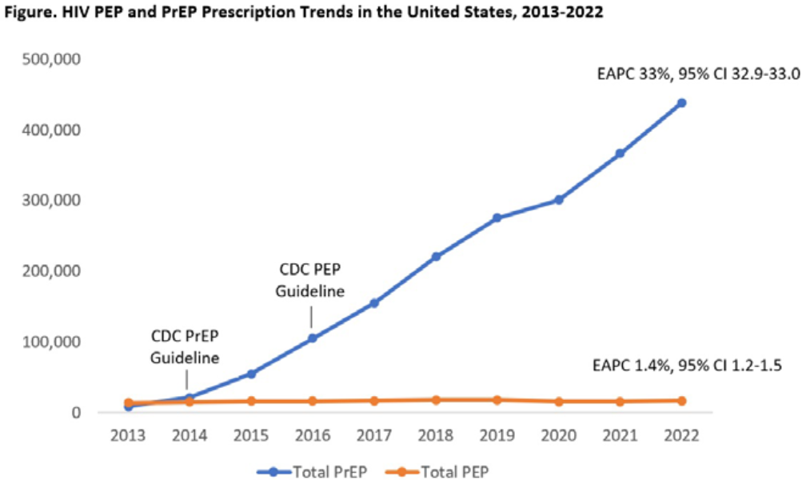
CROI 2024 HIV PEP Highlights 2
Abstr 1131 “HIV Post-Exposure Prophylaxis Prescription Trends: United States, 2013-2022”, Tanner.
Retrospective analysis of IQVIA retail pharmacy claims data, algorithm to determine PEP pts. Annual rx ranged from 13,999 to 17,966, 37.5% had public ins, 43.1% had private ins. In 2022, 12,042 PEP prescribers, 60.4% physicians, 38.3% NP/PA.
Noted inconsistent trends across ages, but much less increase in update compared to PrEP’s sharp rise.

Slide 33
CROI 2024 HIV PEP Highlights 3
Abstr 1133 “PrEP Following PEP: An Effective HIV Risk-Reduction Strategy” Whitlock
UK program starting 2021, offered 1 month of PrEP to nPEP pts to start immediately after nPEP completion; study is a case-note review over a 2-month period in early 2022
282 MSM and 6 transgender women, 31% used chems, 21.9% >1 sexual partner; 73.6% started PrEP
43.8% reported previous PrEP use (reasons include no supply (30.2%), on break (23.8%), spontaneous sex (15.1%)
(also submitted this data to a journal: https://pubmed.ncbi.nlm.nih.gov/36564186/)

Slide 34
CROI 2024 HIV PEP Highlights 4
Abstr 1134 “BIC/FTC/TAF as HIV PEP Was Well-Tolerated With High Adherence and No Seroconversions” Tan
SMS program study, switched to B/F/TAF to complete their 28-days, labs drawn at 2 weeks, med adherence at 4 weeks, HIV serology at 6 weeks and 12 weeks
119 enrolled; 86% men
Adherence generally hight, 101 had available data, 2 stopped prematurely, 11% experienced AE grade ≥ 2 severity. Most AE possibly associated with med were gastrointestinal.

Slide 35
Pearls – Interactions and Single Tablet Regimen
Phenytoin or Carbamazepine
Induces enzymes in liver, increases speed at which certain meds are cleared, including Dolutegravir
Option: switch to non-formulary Raltegravir, but not available
Option: increase DTG to BID in hopes of overcoming clearance (done with Rifampin in TB treatments)
Bictegravir/emtricitabine/tenofovir alafenamide
More observational studies exploring its use
Much more $$$ than DTG + generic FTC/TDF, but just one tablet
Personal concern – waiting for TAF data in cisgender women for PrEP

Slide 36
Pearls - HBV
Could be its own presentation
Vaccination can wane over time for some people
HBV-immunoglobulin (HBVIG) available; give ASAP with data supporting up to 7-days after exposure for acute blood exposure.
HOWEVER: no dose limit, weight-based dosing. 100kg = 6ml dose
If source pt is known, clinic staff often tracking down HBV serology and data alongside HIV serology and data.
While TDF and FTC have coverage against HBV-infection, there is no data supporting their use as PEP for HBV-exposure; still need to do the HBVIG.

Slide 37
Application Discussion
How do your sites handle requests for PEP? Actively converting to PrEP for patients with ongoing risk?
Where does your local ED send the Rxs for PEP pts?
Where do you send patients who wish to access support programs for sexual assault?
What local primary care providers do you trust to appropriately meet the care needs for sexual assault victims? Or non-binary patients?
What is your local organizations policies for fluid exposures?

Slide 38
Evaluation
Your feedback is important to us! Please take a moment now to complete our post-training survey.

Slide 39
Thank you!
Questions?
daniel.jude@northmemorial.com

Slide 40
Contact Information
Daniel Jude, PharmD, AAHIVP, CSP
daniel.jude@northmemorial.com
Clinic phone: 763-581-8621

Slide 41
Speaker Resources
CDC HIV PrEP and PEP Guidance Documents
https://clinicalinfo.hiv.gov/en/guidelines
oPEP Info:
https://www.cdc.gov/hiv/workplace/healthcareworkers.html
CROI 2024 Abstract eBook
https://www.croiconference.org/wp-content/uploads/sites/2/resources/2024/croi2024-abstract-ebook-v3.pdf
HBV Post Exposure Guidelines
https://www.cdc.gov/mmwr/volumes/67/rr/rr6701a1.htm

Slide 42
MATEC Resources
National Clinician Consultation Center http://nccc.ucsf.edu/
HIV Management
Perinatal HIV
HIV PrEP
HIV PEP line
HCV Management
Substance Use Management
AETC National HIV Curriculum https://aidsetc.org/nhc
AETC National HIV-HCV Curriculum https://aidsetc.org/hivhcv
National PrEP Curriculum https://www.hivprep.uw.edu
Hepatitis B Online https://www.hepatitisb.uw.edu
Hepatitis C Online https://www.hepatitisc.uw.edu
AETC National Coordinating Resource Center https://aidsetc.org/
Additional Trainings https://matec.info

