Slide 1
HIV-related Stigma and Discrimination in Primary Care Settings
St. Louis HIV Stigma Workshop
Adam Thompson, MPH
May 21, 2024

Slide 2
MATEC Statement on Equity and Inclusion
MATEC has a strong commitment to fair, respectful and unbiased representation of humankind. We strive to be anti-racist, gender affirming and honor all people in an authentic way. This is our goal in all of our work, including this presentation.
Our commitment to you is that we take this stance seriously and invite you to do the same. We ask that if you find something offensive, off-putting, or inaccurate to please let us know.
We continue to grow and evolve and welcome you on our journey.

Slide 3
Disclaimer
This program is supported by the Health Resources and Services Administration (HRSA) of the U.S. Department of Health and Human Services (HHS) as part of an award totaling $4,036,482 with 0 percentage financed with nongovernmental sources. The contents are those of the author(s) and do not necessarily represent the official views of, nor an endorsement, by HRSA, HHS or the U.S. Government.

Slide 4
Guest Speaker
Jillian Mancini, MBA, PCMH CCE
JSI Research & Training
Project Director of the HITEQ Center Health Center Supporter
Overall Data Lover

Slide 5
ENDING THE HIV EPIDEMIC
USING HEALTH IT TO SUPPORT PRIMARY CARE HIV PREVENTION

Slide 6
About The HITEQ Center
HITEQ Topic Areas
Virtual and digitally enabled care
Access to comprehensive care using health IT and telehealth
Privacy and security
Advancing interoperability and standards based exchange
Electronic patient engagement and digital health Readiness for value based care
Using health IT and telehealth to improve documentation integrity and health equity
Using health IT or telehealth to address emerging issues: behavioral health, HIV prevention, and emergency preparedness
The HITEQ Center is a HRSA-funded National Training and Technical Assistance Partner (NTTAPs) that supports health centers to become data-driven and equitable by providing training, technical assistance, and resources for effective use of data, health IT, and EHRs. This support aims to enhance the quality, security, and documentation of care while addressing barriers and maximizing value.
A national website with health center-focused resources, toolkits, training, and a calendar of related events.
Learning collaboratives, trainings, and on-demand technical assistance on key topic areas.
The HITEQ Center is a HRSA-funded National Training and Technical Assistance Partner operated by JSI Research & Training, Inc. and Westat.
This project is supported by the Health Resources and Services Administration (HRSA) of the U.S. Department of Health and Human Services (HHS) as part of awards totaling $693,000 with 0% financed with non-governmental sources. The contents are those of the author(s) and do not necessarily represent the official views of, nor an endorsement, by HRSA, HHS, or the U.S. Government. For more information, please visit HRSA.gov.
Website: www.HITEQcenter.org | Email: hiteqinfo@jsi.com

Slide 7
THE ROLE OF HEALTH IT IN HIV PREVENTION
HITEQ focuses on the primary role and the value of using your EHR and broader health IT system in HIV screening and prevention. The primary role of health IT in this is in standardizing, supporting decision making, and monitoring.
There is also an important role for digital patient engagement and digitally enabled care.
Access our EHE resources at this link.
3

Slide 8
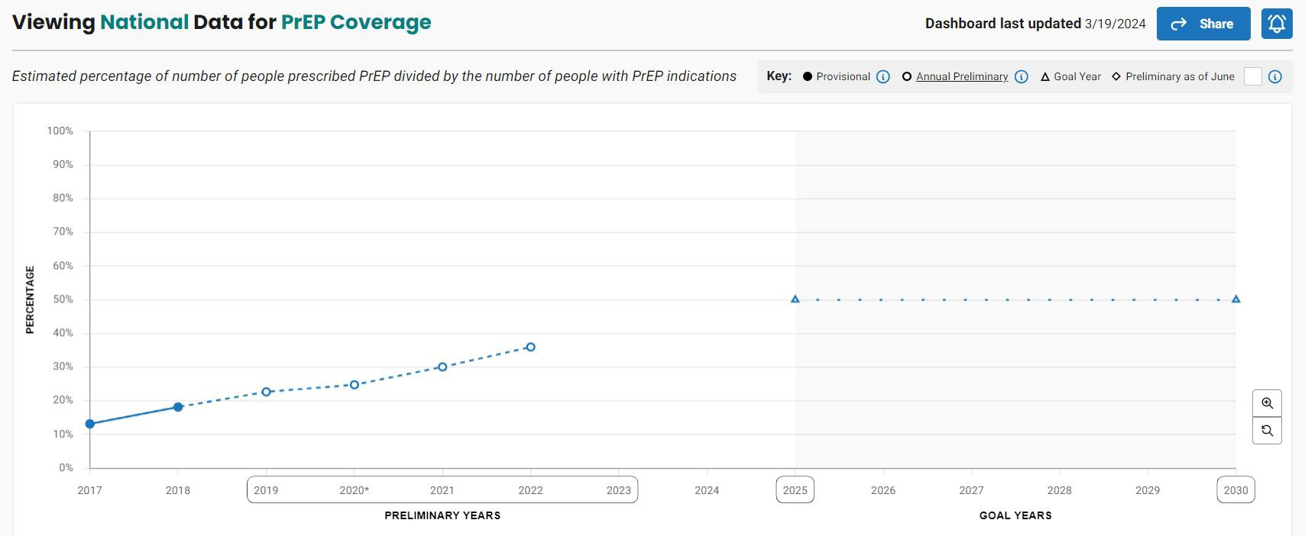
THE STATUS OF HIV PREVENTION
Incidence
Knowledge of status
Diagnosis
Linkage to care
Viral Suppression
PrEP Coverage
Visit the dashboards at https://ahead.hiv.gov
4

Slide 9
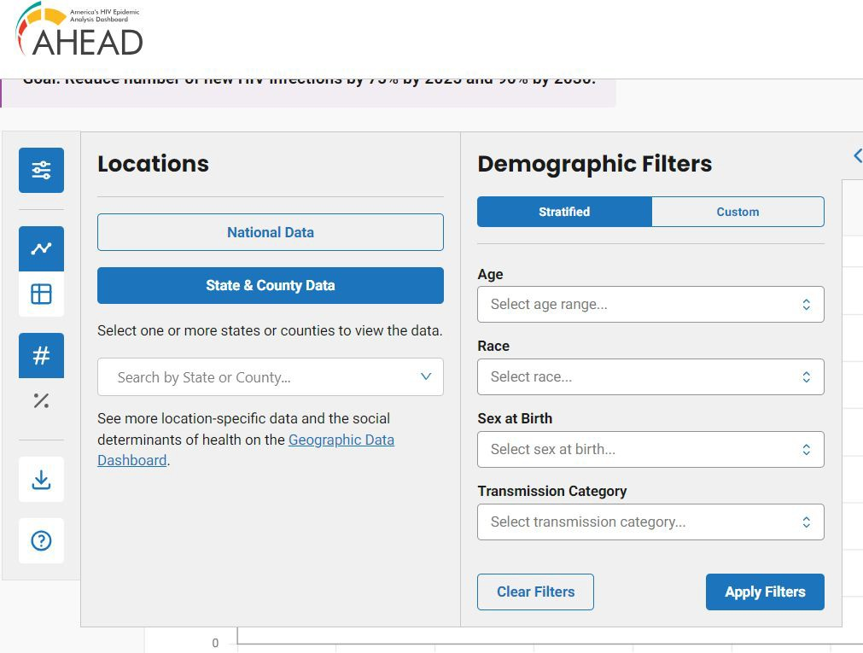
HOW TO USE THESE DATA
Use Filters to Explore Data by Location and Demographics to Find Areas of Opportunity
Understanding where your metrics and outcomes stack up compared to those in your locality generally or in the groups you are focused on is important.
It will assist in determining where opportunities for improvement are, what comparative benchmarks exist, and what goals are achievable,. Therefore, this will help establish SMARTIE goals.
Create Realistic Benchmarks and Goals
Visit the dashboards at https://ahead.hiv.gov
5

Slide 10
HIV PREVENTION HEALTH IT FUNCTIONS
STANDARDIZING
Once you have your plan for how HIV screening and prevention, such as PrEP services will be done at your clinic, the EHR can be used to standardize that approach with templates, order sets, alerts, etc.
CLINICAL DECISION SUPPORT
Particularly in primary care, clinicians are not always familiar with the details of what, for example, is needed to initiate and sustain PrEP. Clinical decision support tools can take some of that burden off of clinicians, giving then recommendations when appropriate.
MONITORING
With standardized, structured data within your health IT system, you are then able to use that information to build reports or dashboards that can monitor progress, outcomes, and even adherence to processes.
DIGITAL PATIENT ENGAGEMENT
Digital tools, whether those built into our EHR or third party tools, support outreach and engagement with patients beyond the clinic visit.

Slide 11
LET’S LOOK AT EACH
Following, we’ll discuss a couple of examples for each of these key functions. These might serve as ideas or inspiration as to what you might do in your health center.

Slide 12
STANDARDIZATION
SETTING THE EXPECTATION
Using care guidelines, alerts, and pre-visit planning in your EHR can set the expectation as to when and how HIV screening should be done.
For example, adding HIV screening (defined by the eCQM as one HIV test between the patient’s 15th and 66th birthday) can be added to
pre-visit planning tools as a way to reinforce the expectation. Similarly, alerts can be used to notify care teams when a patient is in need of an HIV test, or when they may benefit from PrEP, based on established guidelines.
SETTING DOCUMENTATION STANDARDS
Standardizing documentation is critically important for understanding the status of HIV prevention services in your health center. Using templates, favorites, smart phrases and other EHR tools can help ensure consistent documentation, when and where needed to use that information meaningfully for measurement, monitoring, and population health management.
Also consider the value of HIEs or other data exchange, where things like HIV test results from other providers may be available– thereby limiting duplication of services.

Slide 13
CLINICAL DECISION SUPPORT
Algorithms can take into account test results, diagnoses, and other structured data fields to support decision making for clinicians. These can typically be as broad or narrow as needed.
For example, you health center may decide on an algorithm that looks at whether the patient has a documented HIV test result in their chart, and if not, prompts for a test. Or, you may create an algorithm that looks for a set of diagnoses, such as certain STIs and/ or OUD, and prompts for PrEP if those are identified in the chart.
Note that the success of algorithms relies on standardization.
ALGORITHMS
TEMPLATES AND FLOWSHEETS
CDS systems help providers to interpret or determine next steps based clinical results, document patients' health status, and prescribe medications such as PrEP through the use of alerts, reminders, and customized data entry forms.
Data entry forms, such as templates and flowsheets can pull information in from different parts of the patient chart, and when used with clinical decision supports can prompt for
appropriate action.

Slide 14
MONITORING
DASHBOARDS OR REPORTS
Standardized information and defined processes lend themselves to regular monitoring which is useful for performance and continuous quality improvement. It’s also useful for monitoring changes to your processes to identify opportunities for retraining.
For example, you may use dashboards or reports to monitor performance on clinical quality measures like HIV screening and HIV linkage to care rates; but you may also create or use missed opportunity reports that identify patients who were seen but didn’t receive and HIV screening (and didn’t have opt-out documented).
REGISTRIES OR WORK LISTS
Keeping patients engaged in their care, including maintaining them on PrEP typically involves outreach and follow-up. Using your health IT systems to create registries or worklists for these purposes can be useful in taking the burden off teams to track outside of the system.
For example, a health center can use their analytics tools to generate a weekly list of patients who are in their last week of their PrEP prescription (according to the rx order date if you don’t have information about when the rx was filled). Then someone from the care team can reach out to these patients to bring them in.

Slide 15
DIGITAL PATIENT ENGAGEMENT
Digital patient engagement encompasses direct-to-consumer telehealth (meaning, between a provider at your health center and the patient somewhere else), facilitating patient access to providers through originating site telehealth, direct messaging, etc. and automated outreach such as through EHR driven SMS/ email campaigns.
These tools can open a whole new world of services for patients, increase retention, and increase adherence.

Slide 16
THANK YOU!
HITEQINFO@JSI.COM
WWW.HITEQCENTER.ORG

Slide 17
Let’s Chat.

Slide 18
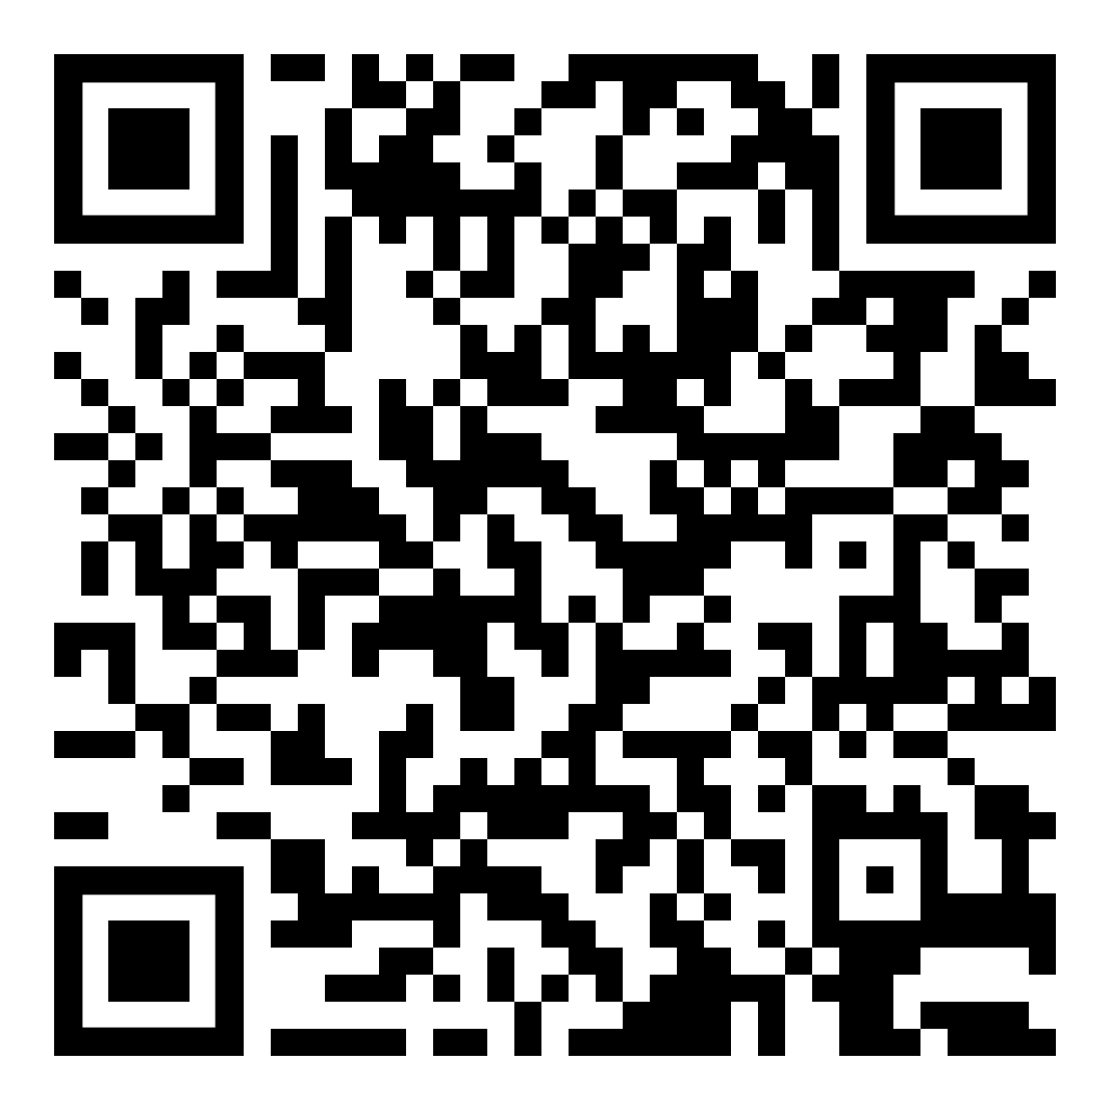
Evaluation for the Series
Notes:
https://matec.caspio.com/dp/ba507000a6b98678abbc4575b937?ER_ID=41597

Slide 19
MATEC Resources
National Clinician Consultation Center http://nccc.ucsf.edu/
HIV Management
Perinatal HIV
HIV PrEP
HIV PEP line
HCV Management
Substance Use Management
AETC National HIV Curriculum https://aidsetc.org/nhc
AETC National HIV-HCV Curriculum https://aidsetc.org/hivhcv
National HIV PrEP Curriculum https://www.hivprep.uw.edu
Hepatitis B Online https://www.hepatitisb.uw.edu
Hepatitis C Online https://www.hepatitisc.uw.edu
National STD Curriculum https://www.std.uw.edu/
AETC National Coordinating Resource Center https://aidsetc.org/
Additional Trainings https://matec.info

Slide 20
HIV Care
Tools
A mobile application for the clinical care team

Slide 21
Essential HIV care
information is always within reach.

