Slide 1
Minnesota HIV Outbreaks Provider Learning Series
Innovative Approaches to HIV Care and Prevention in MN Tribal Communities
June 18 2024
1
Notes:
Emily starts program off, welcomes, does first few slides. Turns it over to Cheryl.

Slide 2
MATEC Statement on Equity and Inclusion
MATEC has a strong commitment to fair, respectful and unbiased representation of humankind. We strive to be anti-racist, gender affirming and honor all people in an authentic way. This is our goal in all of our work, including this presentation.
Our commitment to you is that we take this stance seriously and invite you to do the same. We ask that if you find something offensive, off-putting, or inaccurate to please let us know.
We continue to grow and evolve and welcome you on our journey.

Slide 3
Disclaimer
This program is supported by the Health Resources and Services Administration (HRSA) of the U.S. Department of Health and Human Services (HHS) as part of an award totaling $4,036,482 with 0 percentage financed with nongovernmental sources. The contents are those of the author(s) and do not necessarily represent the official views of, nor an endorsement, by HRSA, HHS or the U.S. Government.

Slide 4
Disclosure
No speaker disclosures.

Slide 5
Learning Objectives
Discuss the most recent epidemiology of the HIV outbreaks in the Twin Cities and Duluth area, respectively
Describe starting a harm reduction program within an IHS pharmacy
Describe piloting an opt-out HIV testing program within a tribal clinic
Describe providing HIV treatment and prevention services within a primary care clinic

Slide 6
Update on HIV Outbreaks in Minnesota
Cheryl Barber, MS, MPH | Senior Epidemiologist

Slide 7
Persons who inject drugs (PWID) HIV Outbreaks Across the U.S. (2015-2019)
Start of HIV Outbreak among PWID | Location
2015 | Scott County, Indiana
August 2016 | Lawrence/Lowell, Massachusetts
December 2017 | Northern Kentucky/Hamilton County, OH
August 2018 | Seattle, Washington
October 2018 | Philadelphia, Pennsylvania
January 2019 | Cabell County, West Virginia
January 2019 | Portland, Oregon
2019 | Boston, Massachusetts
Notes:
In 2015, a large HIV outbreak occurred among PWID in Indiana. During 2016-2019, additional outbreaks among PWID occurred across the US. Across outbreaks, injection of opioids (including fentanyl) or methamphetamine predominated with many using both or cocaine. Most outbreaks included homelessness or unstable housing, previous incarceration, and hepatitis C exposure. In the fall of 2019, MDH started seeing an increase among PWID in the Hennepin Co and Ramsey Co area with similar risk factors as other outbreaks across the country.

Slide 8
Hennepin & Ramsey Counties Outbreak
8

Slide 9
Notes:
By comparing the number of cases in the past 12 months with those historically seen in the three prior 12-month periods through our time-space analyses, we identified a higher number of newly diagnosed HIV cases associated with the behavior of injection drug use (IDU) in Fall of 2019.
During 2021, we heard from partners in the field that this wasn’t representing the HIV transmission they were seeing in their day-to-day work in the encampments. It was determined that the prior exclusion of persons assigned male sex at birth who both inject drugs and also reported same sex partners should not be excluded.
In Oct 2022, MDH updated the case definitions for on-going outbreaks of HIV in Hennepin and Ramsey counties.
Based on newly available molecular HIV lab data from a backlog of several years of data recently reported to MDH. The HIV molecular clusters have verified/validated that there are two distinct outbreaks that are happening within Hennepin and Ramsey counties.
HIV transmission among persons who inject drugs that live or have spent time in a known encampment corridor in Minneapolis or St. Paul.
HIV transmission among persons who inject drugs that are NOT known to have spent time in a known encampment corridor in Minneapolis or St. Paul.
The analysis of molecular HIV lab data identified many additional cases for each of the two outbreaks.

Slide 10
Case Definition HIV Outbreak: Hennepin & Ramsey Counties (Current Definition as of Oct 2022)
Encampment-related Case Definition:
HIV diagnosis on or after December 1, 2018 in a person who:
Injects drugs and has spent time in a known encampment corridor prior to or at HIV diagnosis, and whose residence at diagnosis was (or were unstably housed or incarcerated) in Hennepin or Ramsey County
OR
regardless of transmission risk, is a named drug injection (needle/works) or sex partner or part of the social network*(self or provider report) to a person who meets criterion 1
OR
is molecularly linked (at <0.5%) to a person who meets criteria 1 OR 2.
*socialized, stayed, was known to buy, sell or use drugs, or has engaged in sex in an encampment
MSM/IDU & IDU-related Case Definition (non-encampment):
HIV diagnosis on or after December 1, 2018 in a person who:
Injects drugs (IDU) or who injects drugs and was assigned male at birth and has sex with people who are assigned male at birth (MSM/IDU) whose residence at diagnosis was (or were unstably housed or incarcerated) in Hennepin or Ramsey County and who is NOT known to have spent time in a known encampment corridor in Minneapolis or St. Paul prior to HIV diagnosis
OR
regardless of transmission risk, is a named drug injection (needle/works) or sex partner or part of the social network* (self or provider report) OR is molecularly linked (at <0.5%) to a person who meets criterion 1.
*socialized, stayed, was known to buy, sell or use drugs, or has engaged in sex
Notes:
In October 2022, MDH updated the case definitions for on-going outbreaks of HIV in Hennepin and Ramsey counties.
Based on newly available molecular HIV lab data from a backlog of several years of data recently reported to MDH. The HIV molecular clusters have verified/validated that there are two distinct outbreaks that are happening within Hennepin and Ramsey counties.
HIV transmission among persons who inject drugs that live or have spent time in a known encampment corridor in Minneapolis or St. Paul (case definition on the left).
HIV transmission among persons who inject drugs and are NOT known to have spent time in a known encampment corridor in Minneapolis or St. Paul.
Both case definitions also include persons that are epi-linked (named partners (sexual and/or needle-sharing partners) and HIV molecular linked cases.
The analysis of molecular HIV lab data in October 2022 identified many additional cases for each of the two outbreaks.

Slide 11
Current Case Count: Hennepin & Ramsey County
Current Total: 251 cases
Outbreak Sub-groups:
111 encampment-related
6 deaths (5 Drug Overdose, 1 homicide)
140 MSM/IDU & IDU (non-encampment)
33 (24%) Non-encampment Group Homeless/Unsheltered
9 deaths (7 Drug Overdose, 1 Alcohol use, 1 AIDS/cardiac arrest)
Notes:
Currently there are 232 cases in both outbreaks.
Among the Encampment group there are 101 cases, with 5 deaths within the Encampment group where the majority have been related to drug overdoses.
Among the Non-encampment group there are 131 cases, with 7 deaths within this group where the majority have been related to drug overdoses. About two in ten cases (23%) in this group have persons that have been homeless or unsheltered at the time of diagnosis, but have no known connections or associations with the encampments in Minneapolis or St. Paul.

Slide 12
HIV Outbreak: Hennepin & Ramsey Counties Epidemiology Curve of Cases by Groups
Notes:
Here we can see the count of each of the groups just described by the month in which each case was diagnosed with HIV (encampment-related group (dark blue) and non-encampment group (green)). In 2023, there were 22 new cases in encampment-related group and 38 new cases in the non-encampment group.

Slide 13
Race/Hispanic Ethnicity by Outbreak Group

Slide 14
Encampment Group, HIV Risk Factor
Notes:
The pie chart on the left side shows the HIV risk factors of persons in the HIV outbreak Encampment Group.
More than four in ten (44%) are PWID, with about two in ten (18%) that are MSM/IDU, about three in ten (29%) are MSM and about one in ten (9%) are persons that have heterosexual sex as a HIV risk factor.
On the right side, the pie chart shows the case definition make-up of the HIV outbreak Encampment Group. About half (49%) are persons living or associated with the encampments, more than one-third (36%) are HIV molecular linked cases to the encampment cases and 15% are epi-linked (named partners (sexual and/or needle-sharing partners).

Slide 15
Duluth Region Outbreak
Notes:
Now we will review information about the Duluth Region HIV outbreak.

Slide 16
Case Definition HIV Outbreak: Duluth Region
Any case of HIV newly diagnosed in persons after September 1, 2019 residing in the Duluth area* at the time of diagnosis** or reported cases of HIV that are linked to cases that are part of the outbreak as a sex partner, drug user sharing partner, person in their social network or molecular linkage.
*Duluth area includes the 30-mile radius around the City of Duluth.
**Including homeless, known to be in the area or people incarcerated or in chemical dependency treatment centers where their regular address is in the outbreak area.
Notes:
By comparing the number of cases in the past 12 months with those historically seen in the three prior 12-month periods through our surveillance time-space analyses, we identified 13 newly diagnosed HIV cases at the time the outbreak was declared in March of 2021. Typically, there are from 1-5 cases of HIV per year in St Louis County.
Here is the case definition for the Duluth Region outbreak.
Please note, the Duluth area outbreak includes any newly diagnosed HIV case in the 30-mile region, and any linked cases.

Slide 17
Current Case Count: Duluth Region
Current total: 39 cases
People at risk in Duluth Region:
People who use injection drugs or share needles/works.
People experiencing homelessness or unstable housing.
Men who have sex with men (MSM).
People who exchange sex for income and other items they need.
Homeless/Unstable Housing:
11 (28%) Homeless/Unsheltered
Notes:
By comparing the number of cases in the past 12 months with those historically seen in the three prior 12-month periods through our surveillance time-space analyses, we identified 13 newly diagnosed HIV cases at the time the outbreak was declared in March of 2021. Typically, there are from 1-5 cases of HIV per year in St Louis County.
Here is the case definition for the Duluth Region outbreak.
Please note, the Duluth area outbreak includes any newly diagnosed HIV case in the 30-mile region, and any linked cases.

Slide 18
HIV Outbreak: Duluth Region Epidemiology Curve of Cases
Notes:
The epidemiological curve shows the HIV diagnosis dates of newly identified cases at the time of diagnosis. Currently there are 39 cases in the outbreak. Since 2022, more than one-third (36%) of the cases are among persons who inject drugs and half are among men who have sex with men.

Slide 19
Race/Hispanic Ethnicity by Sex at birth

Slide 20
Duluth Region HIV Outbreak (N=39)
Other Factors: 11 (28%) Homeless/Unsheltered
Notes:
Currently there are 39 cases in the Duluth Region HIV outbreak.
The pie chart on the left side shows the HIV risk factors of persons in the Duluth HIV outbreak.
The majority (44%) are MSM, one-third (33%) are PWID (IDU HIV risk factor), with one in ten (10%) that are MSM/IDU, and about one in ten (5%) are persons that have heterosexual sex as a HIV risk factor.
On the right side, the pie chart shows the case definition make-up of the Duluth HIV outbreak. The majority (79%) are persons that are residents within the Duluth region at time of diagnosis, about two in ten (15%) are HIV molecular linked cases to the Duluth cases and a few (5%) are epi-linked (named partners (sexual and/or needle-sharing partners).
Other Factors: About one in three persons are homeless or unsheltered at HIV diagnosis.

Slide 21
Thank you
For questions/further information please contact:
Cheryl Barber, Senior Epidemiologist Specialist
cheryl.barber@state.mn.us

Slide 22
HIV Prevention and Care Services at the Native American Community Clinic (NACC)
Kari Rabie, MD
Notes:
Jace

Slide 23
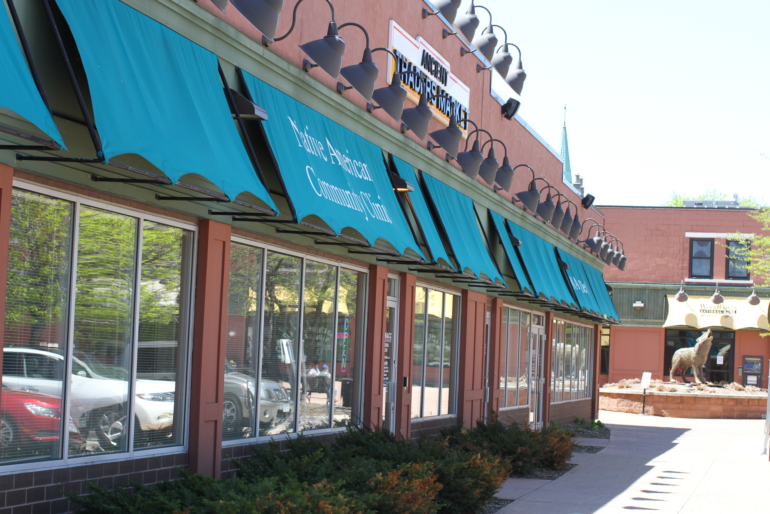
Who are we?
Native American Community Clinic (NACC) in Minneapolis
Federally Qualified Health Center (FQHC)
4,500 patients annually; ~85 % Native American
Comprehensive primary medical care, behavioral health, chemical health and dental care
Traditional healing including spiritual care, cultural programming, ceremony and mind-body medicine
Services are culturally-tailored and grounded in the principles of harm reduction, trauma informed care and cultural humility
Notes:
Jace

Slide 24
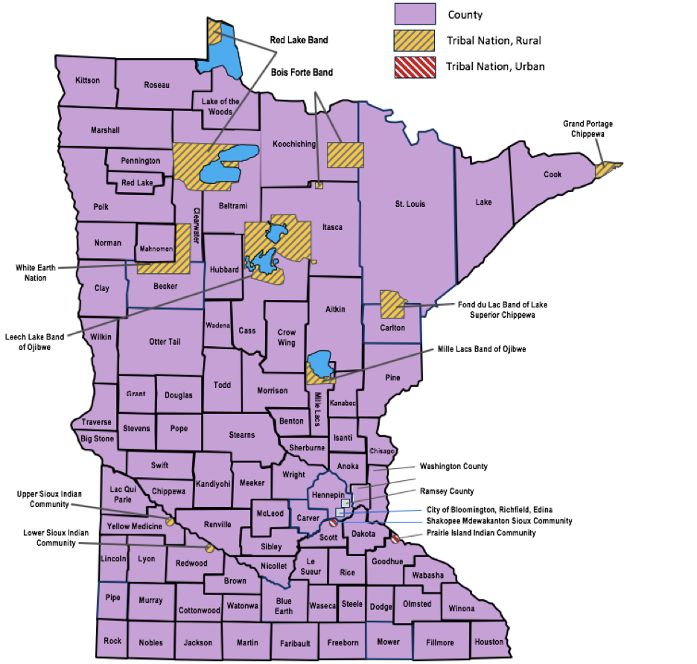
Tribal Nations in Minnesota
Native Americans represent nearly 2 percent of the total population of Minnesota and experience the worst disparities in the state.
The HIV outbreak in Minnesota has disproportionately impacted the Native Community.
Lost in the data – high risk communities need targeted strategies.

Slide 25
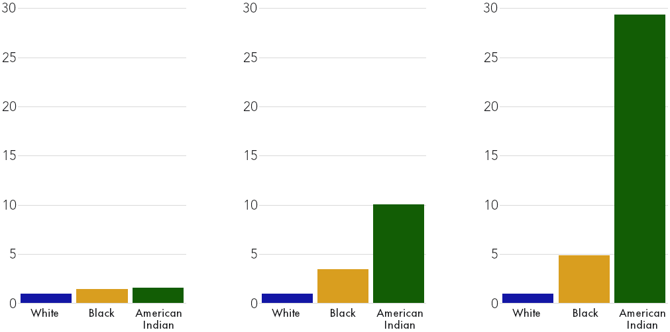
Race Disparities in Drug Overdose Mortality, 2021
United States
(all drugs OD)
Minnesota
(opioid OD)
Minneapolis
(opioid OD)
(per 100,000 residents) Source: Minneapolis Health Department/John P. Moore

Slide 26
Increased Prevalence of Risk Factors
Houselessness, food insecurity, lack of transportation, uninsured/underinsured
Substance misuse, increased overdose risk (especially with fentanyl)
Increased complications (endocarditis, cellulitis, overdose, HIV, Hep C)
Increased infectious disease burden (ex. HIV, HCV, syphilis, gonorrhea, chlamydia)
Increased complications of chronic disease (ex. DM II, HTN, ASCVD)
Increased risk of experiencing violence and sexual exploitation

Slide 27
Challenges for our community
Systemic racism / Trauma
Criminalization of drug use
Lack of understanding of substance use as a chronic condition
Lack of culturally competent care
Lack of trauma informed care
Historical trauma
Social determinants of health/lack of resources
Insurance
Transportation
Food
Shelter
Hierarchy of needs

Slide 28
Focusing on HIV
Acknowledged risk was there long before outbreak was announced
Increasing incidence of new HIV diagnoses given at NACC
Individuals engaged in MAT & Safer Use programming
Difficulty linking to traditional HIV care
Patients were not going! 0% linkage to care
Traditional medical model was not meeting the needs of our patients
Ex. rapid referrals, appointment navigation, and intensive care coordination
Notes:
Jace

Slide 29
NACC’s Principles of Care
Actively meet patients where they are at
Colocation of services
Harm reduction and trauma informed
Traditional healing and indigenous values
Collaborative team-based approach
Advocacy within other healthcare systems
Unconditional positive regard
High level management for high-risk patients
Tracking, ensuring they don’t “fall through the cracks”

Slide 30
NACC’s Foundations of HIV Care
Collaboration between Clinical AND Outreach Services, and with external partners
Co-location of services are tailored to our highest risk patients.
Harm reduction and trauma informed
Traditional healing and indigenous values
Focused on care and services for:
Native American community
people experiencing homelessness (particularly those unsheltered)
people who inject drugs
Addressing Barriers to HIV Care for community
Fear of community stigma & provider judgment
Comprehensive services for people who use drugs
Difficulty attending schedule appointments
Mental Health
Evidence based care by clinically competent professional staff
Notes:
Jace
Adjust slide to provide a larger overview of the key features of our HIV program

Slide 31
https://www.hiv.gov/federal-response/policies-issues/hiv-aids-care-continuum
Notes:
Jace

Slide 32
NACC’s HIV Care Continuum
Prevention
Safer Use Supplies & Education, PrEP, Wound Care, DIS
Diagnosis
Outreach & clinic-based testing, in-clinic rapid HIV testing
Linkage to Care
Incentives, collaboration with outreach organizations, provider appointment flexibility
HIV Medical Care
Same-day ART, specialty pharmacy coordination, harm reduction philosophy
Retention
Incentives, co-located services, follow up flexibility, case management
Viral Suppression
Adherence support & education, case management
Notes:
More details on following slides. This is just an overview

Slide 33
Harm Reduction: Meeting patients where they’re at
Trauma informed
Unconditional positive regard
Outreach services
Collaborative relationships with other organizations that create warm referral/linkage process
Staff competency in destigmatizing difficult conversations
sex work, trafficking, & trading
Harm reduction services -syringe & safer use supplies, vaccines, wound care kits, hygiene
Resources to meet patient’s basic needs
food, clothing, shelter, transportation, insurance
Incentives for linkage to care for any visit, helps patients to establish relationship with the clinic
Notes:
Jace

Slide 34
Co-location, Care coordination and Case Management
Walk-in appointments for concerns related to substance use (abscesses, STD/HIV/HCV screening, buprenorphine induction, referrals to detox and treatment)
Primary care including preventative care, acute care, care of chronic conditions, prenatal care, and care for children.
Dental, chemical health, mental health and traditional healing.
Medications for OUD (Suboxone, Sublocade, Vivitrol) and onsite dosing
Outpatient treatment programming, groups
Collaborative relationships with specialty care
High level management for high-risk patients - Nurse Care coordinator and Ryan White Non Clinical Case Manager shepherd patients through the process

Slide 35
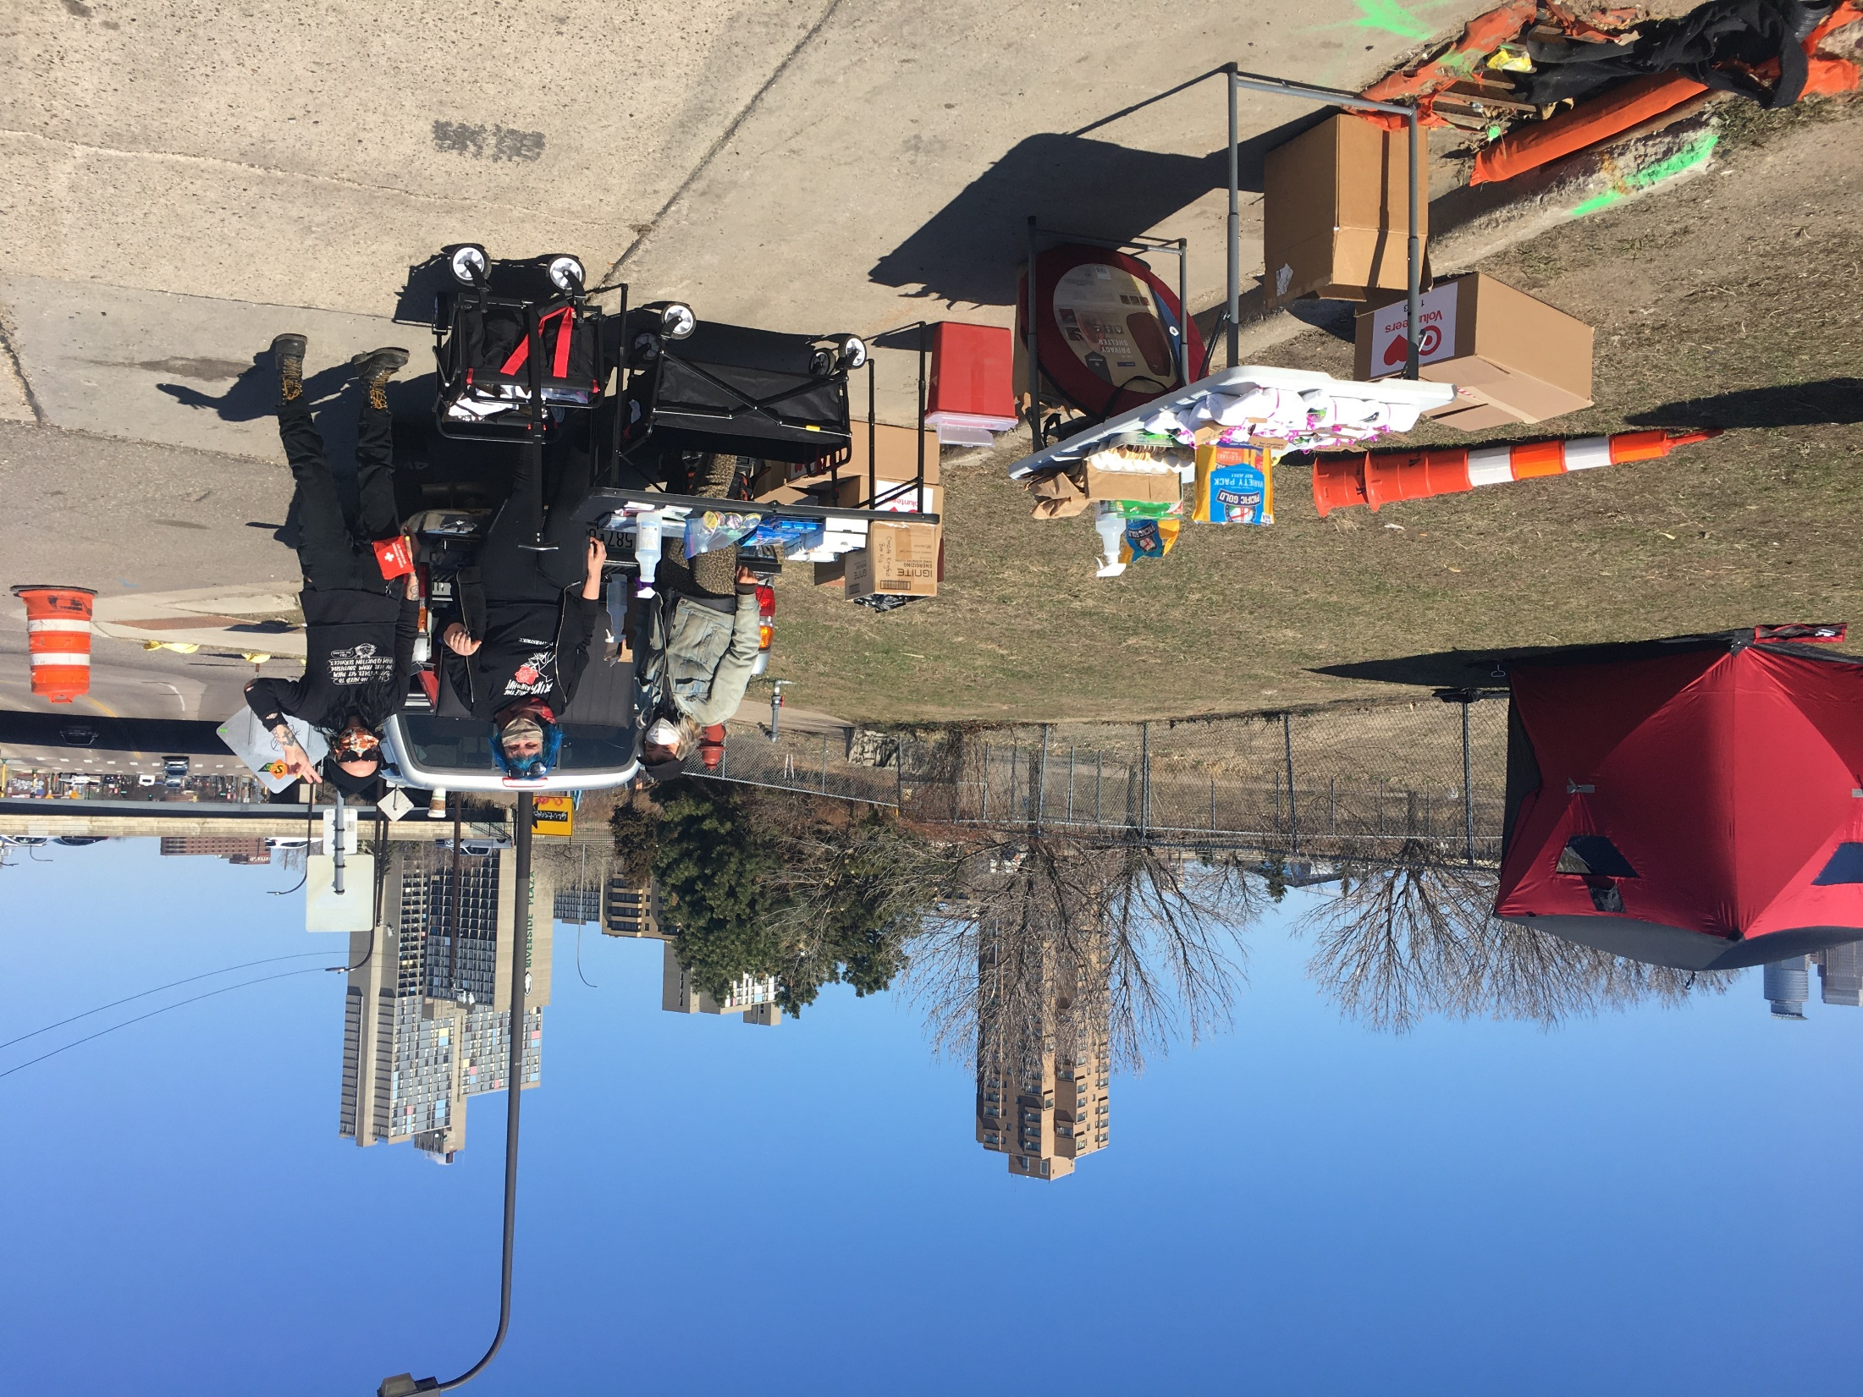
NACC Outreach HIV Testing/Diagnosis
In clinic protocols for testing
Rapid testing in outreach
Pop-up events
In encampments
HIV testing day once/week at adjacent clinic space
At local organizations
Armed with supplies, resources and incentives
Image courtesy of David Glanzer
Notes:
Tina
Example of HIV Outreach testing: describe where you are (off busy road, close to encampment, easy to access), providing food, etc.

Slide 36
Linkage to Care
Rapid Start ART/PrEP (for partners) with samples
Staff training: prioritize appointments for unsheltered and HIV patients
Telehealth - In the encampments, shelters, and tiny homes
Planning→ Positive result→ Org-to-org contact→ Pt-to-org contact→ Rapid referral -> Rapid start
Continuum of care avoids re-traumatization by repeating story over and over, and prevents falling through gaps
Throughout safer use supplies, transportation, incentives for Linkage to Care and collaboration with partners.
Notes:
Nikki

Slide 37
Engagement in Care
Nurse Care Coordinator facilitates nurse assisted visits for providers, and intensive care coordination for patients
Coordinate with specialty pharmacy (delivery, education, financial troubleshooting)
Non-medical case management provides intense coordination of other needs:
cell phones, housing, insurance, services specific to HIV, transportation
Potential to bring meds to patient as needed, working on med lockers
Throughout Safer Use Supplies, Transportation, Incentives for Linkage to Care and Collaboration with partners.
Notes:
Nikki
Nikki and Tina to update
Patient education
Resistance concerns
Adherence counseling looks different

Slide 38
HIV Retention in Care
Trauma-informed care
Prioritizing/minimizing labs for people who have difficult blood draws
Awareness of appointment length and triaging appropriately
Problem solving continued ART during periods of substance use
Thinking through medication breaks during times of difficult adherence
Emphasis on harm reduction–keep contact even during periods of use
Outreach for established patients to housing facilities/encampments, creative ROI’s
Notes:
Nikki

Slide 39
HIV Care/Treatment and Viral Suppression
Creating and Implementing Standardized Clinical Policies and Procedures
Same-Day Rapid Start Antiretroviral Therapy
Planning for Special Circumstances:
Co-infections, Opportunistic Infections, Perinatal HIV Care
Incorporation of Preventive & Primary Care
HIV Team Huddles
HIV Expert Support for Clinical Consultations
Online Curriculum
AETC Technical Assistance
Notes:
Nikki and Emily Talk about PTP
Nikki–look at what Jace incorporates into the NACC HIV Care slide and change this as needed
Tina at Avivo, patient has question 🡪 Call Nikki
Not able to utilize an outreach model for this…yet

Slide 40
PrEP and Other Prevention Services
PrEP
Same-day PrEP Start Clinical Protocol
Staff & patient education on utility
Limited uptake to date
Partner Services
Education: preventing transmission, U=U
DIS worker embedded in clinic
Notes:
Jace
Change slide to focus on overall HIV prevention efforts and partner services
-Brief overview of PrEP efforts, pearls & pitfalls

Slide 41
Expansion of Services and Staffing
In early 2021, NACC received sole-source funding to hire a Ryan White NMCM
In early 2024, received additional funding to hire another part time NMCM
340B Drug Pricing Program
Notes:
Tina
Tell Tina about how RW came to be

Slide 42
Successes
Areas for Growth
Population-specific clinical knowledge
Collaborative relationships, trust
Creatively addressing barriers
Networking and collaboration
Growing expertise
Growing team
Practice Transformation with MATEC
Improving PrEP strategies
Increased telehealth uptake
Physical infrastructure (space)
Formal patient feedback (projects to come)
Ongoing improvement of Linkages for those with the greatest barriers
Notes:
Nikki

Slide 43
Thank you!
Questions
Notes:
Ok to add NACC’s emails

Slide 44
Opt out HIV Testing at Fond Du Lac Tribal Clinics Jamie Conniff, MD
Notes:
Emily- 5 minutes

Slide 45
Fond Du Lac: Min No Ayo Win
Located near Cloquet, Minnesota on the Fond du Lac Band of Lake Superior Chippewa reservation
Most services available to Native American/American Indian folks regardless of tribal nation, enrolled and descendents
Provides medical and dental care, mental health services, social services, community health, on site pharmacy, prevention/intervention, and WIC services
The Medical Clinic services focus on individual and family wellness through holistically oriented and culturally sensitive care
Provide care to ___patients annually; ___% Native American/American Indian
Notes:
Will get the # of patients and % Native American ASAP!

Slide 46
Fond Du Lac: Center for American Indian Resources (CAIR)
Located in Duluth, Minnesota
Most services available to Native American/American Indian folks regardless of tribal nation, enrolled and descendents
Provides medical and dental care, mental health services, social services, community health, on site pharmacy, prevention/intervention, and WIC services
Provide care to ____ patients annually; ___ % Native American/American Indian
Notes:
Jace

Slide 47
HIV Testing: Background
Duluth area HIV outbreak
Disproportionately impacting Native people
People are living with undiagnosed HIV
Wanted a way to get our community tested for HIV in a way that was acceptable and feasible
Received funding from the Minnesota Department of Human Services
Covers the rapid tests, staff time, technology, and training
Also addresses rapid start treatment for people who test positive

Slide 48
Why Rapid Tests?
Versus traditional blood draws or clinic based tests
Patient population: can be difficult to reach to deliver results, needle phobias or other issues with needles
Can be difficult to absorb HIV testing into finances
Similar to processes that we were already using to screen for diabetes

Slide 49
Opt Out HIV Testing Project Set Up
Creating Policies, Procedures, Protocols
Clinic flow: when will the test be administered? By whom? Who will read the results? Who will deliver the results? Where is the patient during all of this?
HIV testing training for all staff involved (lab, nurses, MAs, providers)
Communicating with outside agencies: state agencies, outreach based orgs, harm reduction, case management, outside labs
Many, many meetings with leadership, clinic staff, lab staff, etc.
Reviewing best practices (DHHS Guidelines, CDC, etc)
Support for those providing the HIV tests like scripts, delivering HIV test results resource,
Standing orders created

Slide 50
Opt Out HIV Testing Project Set Up [2]
Timeline:
Initial conversations with MN DHS 2021
Re-connection with DHS January 2023
Email from DHS to let us know about grant funding August 2023
Started planning in earnest September 2023
Started piloting the service May 2024 (fingers crossed)
Grant goes until September 2024. Will evaluate after that for additional funding to continue to offer rapid opt out HIV testing.

Slide 51
(Hoped-for) Successes
So far we have tested:
So far very few people have opted out?
We hope to identify more people living with HIV that did not know their status
We hope to link folks back to HIV care with us for those that do test positive or are out of care
With rapid testing and rapid treatment start, will be able to immediately link to care/other services and will likely have less folks fall out of care
Reducing the stigma associated with HIV by incorporating it into every appointment, including with people who have very low risk
Adding HIV testing/care services to an array of already culturally sensitive services is better for the patient and our community

Slide 52
Challenges
Clinic flow
Staff skepticism
Staff confidence in processes for testing and delivering HIV test results
Lab testing for confirmatory tests/viral load/CD4
Various patient scenarios including patients that come with others- how to provide the test and deliver results without others knowing
Not having access to starter packs for PrEP or HIV meds- so potential wait time for starting meds

Slide 53
PrEP/HIV Prevention
Opt out HIV testing has led to increased conversations among clinic staff, leadership about PrEP
During this period we were able to add FTC-TDF to our clinic formulary
Work has dovetailed well with expansion of harm reduction services in clinic, eg medication for opioid use disorder, and partnership/conversation with harm reduction organizations

Slide 54
Lessons Learned
The work is important
The work is not difficult!
The work connects and intersects
Take time to build support, answer questions, and build the processes that help staff feel prepared and supported
More lessons to come!

Slide 55
Thank you!!

Slide 56
Cass Lake IHS Harm Reduction Program
Whitney Dickson, PharmD, BCPS
6.18.24
Notes:
Increase the availability of accessible and sustainable community-centered health systems
Harm Reduction and syphilis

Slide 57
Learning Objectives
Understand the need for local harm reduction services
Describe the steps taken to initiate harm reduction services
Identify benefits of harm reduction services

Slide 58
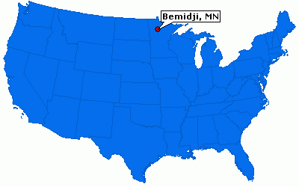
About Cass Lake IHS
Located in Northern Minnesota
Outpatient Ambulatory Care Clinic
3 physicians
8 nurse practitioners
Active user population of ~12,000 clients
Pharmacy also serves 4 area tribal clinics
12 pharmacists
Services provided
24/7 emergency department
Same Day Clinic
Dental
Pharmacy
Lab
Radiology
Physical Therapy
Podiatry
Cass Lake, MN

Slide 59
Need for Local Harm Reduction Services

Slide 60
Risk Factors for Hepatitis C at Cass Lake IHS
11.5%
6%
4%
10.5%
78%
90%
Notes:
Other- Blood transfusion, tattoo, partner +
Last 20- 19 out of 20 identified IVDU-95%

Slide 61
Need for Syringe Services
MN Pharmacy Syringe Access
Pharmacies can voluntarily participate
Individual pharmacist may decide
Limit of 10 syringes
Can not display syringes for purchase
Can not advertise availability of syringes
SEP Locations : NASEN Directory- north American syringe exchange network
https://www.nasen.org/map/
https://www.health.state.mn.us/
Notes:
SEP Locations : NASEN Directory- north American syringe exchange network
https://www.nasen.org/map/
Sharps containers broken into

Slide 62
Need for Syringe Services
ER visits for STI testing
Need for quick and easy access to testing outside of the ER
Association between our syphilis cases and IVDU
Increase in ER overdose visits
Need for additional access to naloxone
Patients accessing ER for services not empaneled with primary care provider

Slide 63
Getting Started - People
Meetings with Tribal counterparts
What services we can both provide
What gaps can we fill for each other
Meeting with Tribal Police Department
Pharmacy leadership and staff buy in
Survey staff
Presentation to medical staff
Word of mouth advertising
One Facebook post after ~ 3 months

Slide 64
Getting Started- Education
Gathered resources for patients
Mental Health
Substance use
Patient education
Safer injection
Numbers for clinic appointments
Sharps disposal in Minnesota
Education for pharmacy staff (ongoing)
Background presentation given
Invited NPAIHB staff to present and answer questions
Emailed resources on harm reduction
Rationale behind items provided
Notes:
Educated myself first

Slide 65
Getting Started- Supplies
Created list of supplies needed
Compared pricing from different sources
Created NASEN account
Majority of items the pharmacy already offered or the facility orders for other departments
Identified funding source
Resources
NPAIHB
National Harm Reduction Coalition
NASEN
NASTAD
Notes:
List of supplies can be overwhelming, can select a few items, reach out to other programs for best practice

Slide 66
Harm Reduction at CLIHS
Within CLIHS pharmacy provides harm reduction services which include
Syringe services
Sharps containers/syringe disposal
Naloxone
STI testing
Condom distribution
Education on safer use
Resources for mental health and addiction

Slide 67
Harm Reduction at CLIHS
Patients complete a voluntary intake form
Provided a participant card with an ID number
Encounter is not documented in medical record
Naloxone prescription and STD testing is entered in EHR, but not linked to harm reduction visit
Pharmacist or student pharmacist provides information on what is available
Handouts on safer use and mental health and addiction resources
Participant can request items they would like
Return visit participants can show their participant card to request services or ask to speak with a pharmacist
Pharmacy tracks visits based on ID number

Slide 68
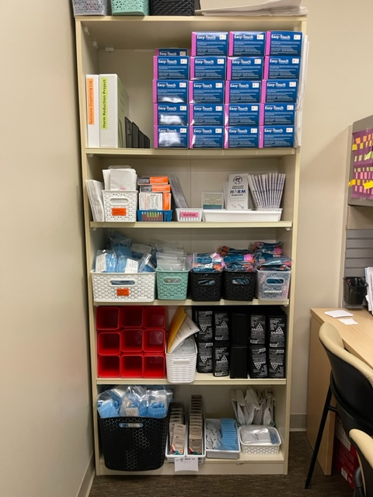
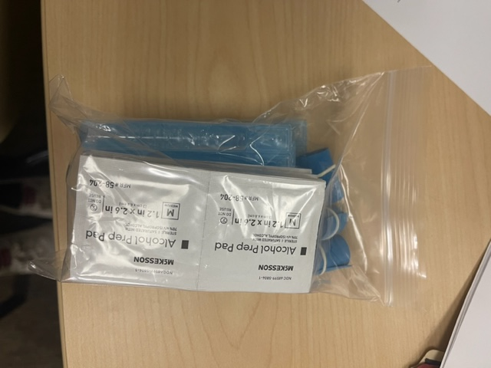
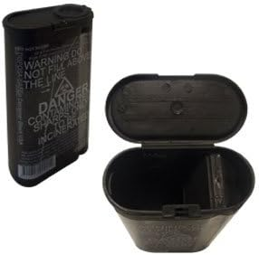
Harm Reduction Supplies

Slide 69
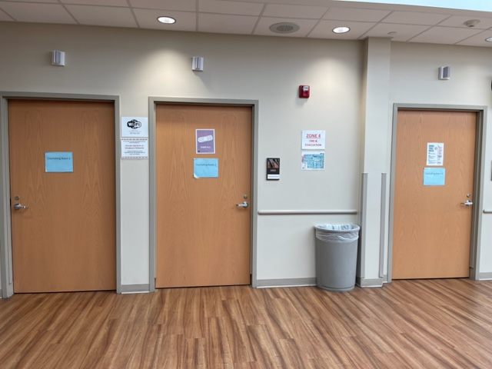
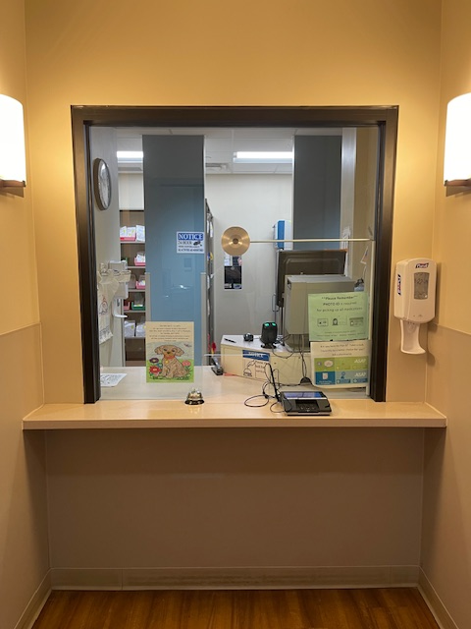
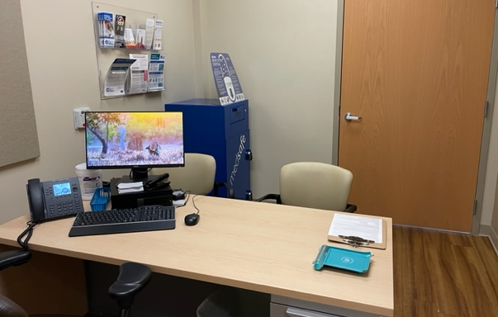

Slide 70
Harm reduction through Tribal Health
2 nurses
1 RN, 1 LPN
All of the same services provided at Cass Lake IHS
Ability to meet people where they are at
Rapid HCV and HIV testing*
Visit 3 different communities one day each week*
Disease intervention services
Syphilis, HCV, other STIs
Notes:
Would wound care require a referral from provider? Could we have a standing order?
Requirements for narcan dispensing- order?

Slide 71
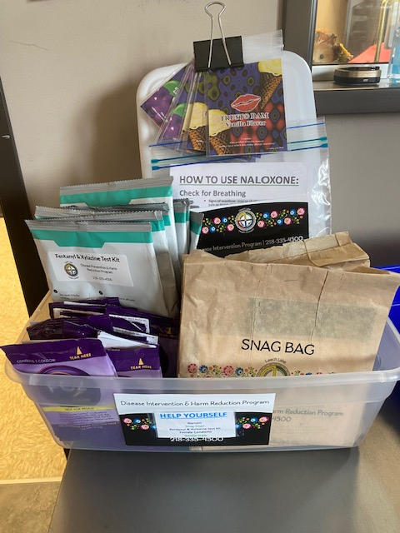
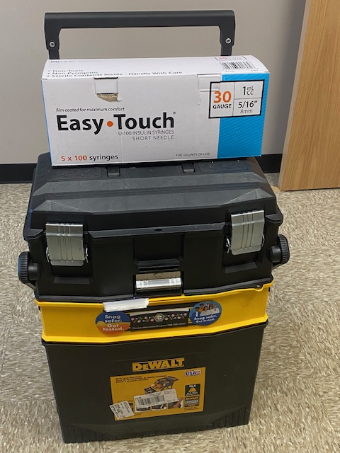
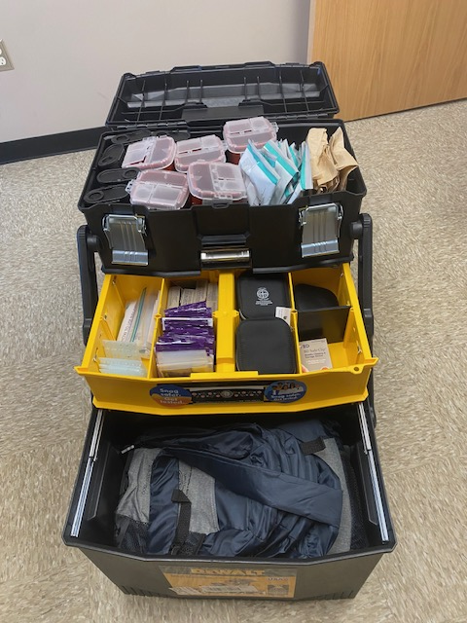
Supplies available in Tribal Clinics
New Community Wellness and Recovery Navigator Program
Independent Tribal program

Slide 72
Participant Demographics
First participant 10/24/22
Currently have 120 participants
Median age: 36
Age range: 21-68
71 participants with no primary care provider (70%)
490 visits
~23,500 syringes, 365 naloxone, and 1,200 condoms provided
Notes:
Sharps- 310
Clipper-69
Injection Kit-515
Cooker kits-128

Slide 73
Pharmacy STI Standing Order
STI Order Set “Bundle” | STI Treatment
Syphilis | Chlamydia
HIV | Gonorrhea
HCV | Syphilis
CT/GC | Trichomoniasis
Trichomonas
Pregnancy
HBV (Surface Ab, Surface Ag, Core Ab)
Allows any pharmacist to order STI testing and appropriate treatment

Slide 74
STI Testing first 7 months
STD panel ordered at 8 visits (6 patients)
Hepatitis C and syphilis positives
7 participants with known HCV in need of treatment
35 participants
Notes:
~35 participants
7000 syringes
130 visits

Slide 75
Pharmacy Based Incentive Program
Implemented July 10th 2023
$10 incentive card offered for STI testing
Testing ordered under pharmacy standing order
No STI testing within the last 3 months
Second $10 incentive card offered for notification of results or if treatment needed
Treatment ordered under pharmacy standing order
No advertising done
Do not have to be part of harm reduction program

Slide 76
Pharmacy Based Incentive Program
196 incentive cards given out in the first 6 months
101 STI bundles completed
33 not part of harm reduction program
Positive results– 44 positives in 40 patients
Syphilis
Hepatitis C*
Chlamydia
Gonorrhea
Trichomoniasis
Pregnancy
9 positives were outside of harm reduction program
Notes:
Within first week 20 people- 15 positives
21 with known HCV (27%)
Start 7/10/23-11/14/23
9 HCV patients- finished tx, on tx, or meds approved waiting to start

Slide 77
Difficult to Reach Patients
Tribal Disease Intervention Specialist Consult
Utilized if unable to reach patient by phone
Consult placed in EHR
Can assist with getting patient into clinic, obtaining labs, or providing treatment
Follow up Flag
Placed and removed by one pharmacist
Only used as a last resort if patient unable to be contacted after multiple attempts
Education needed for staff to ensure action when patient presents
Need to proactively remove flag as soon as action is taken
Internal communication
Notes in harm reduction binder
Notes in Scriptpro

Slide 78
Other Policies/Standing Orders
STI Partner Treatment
Expedited Partner Therapy
Treatment of non-eligible partners
Naloxone standing order
Allows pharmacy to order for any patient
Naloxone standing order for community members or first responders
Lab Express Testing
Allows patient to go directly to lab to request STI testing
Pharmacist follows up on results
Contacts patients
Orders treatment
Vaccination Standing order

Slide 79
What Works Well
People know where to find us
Consistent hours
Consistent location
Always a pharmacist available
10 pharmacists and typically 1-2 students
Private space
Same space used for all pharmacy services
Lab available during harm reduction program hours
Ability to test and treat for STIs/HCV within the pharmacy
Same Day clinic and ER on site if needed

Slide 80
What Could Be Better
Multiple staff might be a disadvantage
How do we engage more with patients
Consider adding fentanyl or xylazine test strips
Input from people with lived experience
Offer rapid testing
Remove barriers for HCV treatment
Medicaid, reimbursement limits
Could offer additional supplies
Offer PrEP and doxy PEP when indicated

Slide 81
Key Takeaways
It is ok to start small
Growth provides an opportunity for education/conversation
Be flexible
Alternate forms of communication are needed
You don’t have to be an expert
We are always learning

Slide 82
Questions?

Slide 83
Q & A
Please put your questions in the Q&A box

Slide 84
Evaluation
Please complete the evaluation for this program by clicking the link in the chat
We use your responses to plan future events!

Slide 85
Thank You!!
Please click on the evaluation survey in the chat to help us improve our programming and to provide input on future HIV Outbreak Provider Learning Series!
Contact the Planning Committee:
MATEC (Midwest AETC): Emily Petran (jone2730@umn.edu)
Department of Health: Jean Larson (Jean.T.Larson@state.mn.us)
Department of Human Services: Tim Prestley (Tim.Presley@state.mn.us)
Hennepin County and Positively Hennepin: Aurin Roy (aurin.roy@hennepin.us)
St Louis County Public Health: Rillis Eklund (eklundr@stlouiscountymn.gov)
Notes:
Emily starts program off, welcomes, does first few slides. Turns it over to Cheryl.

Slide 86
MATEC Resources
National Clinician Consultation Center http://nccc.ucsf.edu/
HIV Management
Perinatal HIV
HIV PrEP
HIV PEP line
HCV Management
Substance Use Management
AETC National HIV Curriculum https://aidsetc.org/nhc
AETC National HIV-HCV Curriculum https://aidsetc.org/hivhcv
National PrEP Curriculum https://www.hivprep.uw.edu
Hepatitis B Online https://www.hepatitisb.uw.edu
Hepatitis C Online https://www.hepatitisc.uw.edu
AETC National Coordinating Resource Center https://aidsetc.org/
Additional Trainings https://matec.info

Slide 87
Resources from Whitney:
Materials for Syringe Services Programs: A Guide for Staff & Volunteers | NASTAD
Safer Drug Use Technique | Bevel Up (bvlup.com)
National Harm Reduction TA Center
NASEN | North America Syringe Exchange Network: NASEN Directory

Slide 88
Other Resources Part 1
MDH HIV Testing https://www.health.state.mn.us/diseases/hiv/prevention/hivtesting.html
Minnesota PrEP & PEP Provider Directory: https://www.health.state.mn.us/diseases/hiv/prevention/prep/index.html
PrEP locator: https://preplocator.org/
Minnesota HIV Outbreak info: https://www.health.state.mn.us/diseases/hiv/stats/hiv.html
Hennepin County Positively Hennepin: https://www.hennepin.us/en/your-government/projects-initiatives/positively-hennepin
University of Minnesota School of Public Health HIV/STI Intervention & Prevention Studies (HIPS): https://www.sph.umn.edu/research/projects/hiv-sti-intervention-prevention-studies-hips/

Slide 89
Other Resources Part 2
Syringe Service Program Resources:
Twin Cities and Greater MN Syringe Exchange Calendar (contact Rainbow health for most up to date version)
Vivent Health, Superior, WI: https://viventhealth.org/locations/superior/
Minnesota Department of Health: https://www.health.state.mn.us/people/syringe/ssp.html
Centers for Disease Control (CDC): https://www.cdc.gov/ssp/index.html
The Harm Reduction Coalition: https://harmreduction.org/
Minnesota AIDSLine- Minnesota’s statewide information and referral service that can answer questions and link people to resources for HIV testing, prevention, and treatment and syringe service programs (and much more!)
Managed by Rainbow Health (https://rainbowhealth.org/)
Available by: Phone: 612-373-2437 or 1-800-248-2837, Email: aidsline@rainbowhealth.org, or Text: 839863

