Slide 1
Clinical Pearls: HIV for New Pharmacists
Dena Behm Dillon, Pharm.D., AAHIVP
June 2024
Notes:
*Add a bit about PrEP

Slide 2
MATEC Statement on Equity and Inclusion
MATEC has a strong commitment to fair, respectful and unbiased representation of humankind. We strive to be anti-racist, gender affirming and honor all people in an authentic way. This is our goal in all of our work, including this presentation.
Our commitment to you is that we take this stance seriously and invite you to do the same. We ask that if you find something offensive, off-putting, or inaccurate to please let us know.
We continue to grow and evolve and welcome you on our journey.

Slide 3
Disclaimer
This program is supported by the Health Resources and Services Administration (HRSA) of the U.S. Department of Health and Human Services (HHS) as part of an award totaling $4,036,482 with 0 percentage financed with nongovernmental sources. The contents are those of the author(s) and do not necessarily represent the official views of, nor an endorsement, by HRSA, HHS or the U.S. Government.
Any trade/brand names for products mentioned during this presentation are for training and identification purposes only.

Slide 4
LEARNING OBJECTIVES
Discuss the basics of antiretroviral classes and mechanisms of action
Discuss the reasoning behind food requirements with antiretrovirals, including renal dosing
Describe “Hidden” Interactions with HIV medications and “Old School” Interactions
Review Primary Care Guidelines including Monitoring Metabolic Comorbidities in patients with HIV
Describe HIV Medication Adherence

Slide 5
Commonly-used ARV Medications
NRTI (Nukes)
Abacavir (ABC)
Didanosine (ddI)
Emtricitabine (FTC)
Lamivudine (3TC)
Stavudine (d4T)
Tenofovir DF (TDF)
Tenofovir alafenamide (TAF)
Zidovudine (AZT, ZDV)
NNRTI (Non-nukes)
Delavirdine (DLV)
Doravirine (DOR)
Efavirenz (EFV)
Etravirine (ETR)
Nevirapine (NVP)
Rilpivirine (RPV)
Integrase Inhibitor (INSTI)
Bictegravir (BIC)
Cabotegravir (CAB)
Dolutegravir (DTG)
Elvitegravir (EVG)
Raltegravir (RAL)
PI (Protease Inhibitor)
Atazanavir (ATV)
Darunavir (DRV)
Fosamprenavir (FPV)
Indinavir (IDV)
Lopinavir (LPV)
Nelfinavir (NFV)
Saquinavir (SQV)
Tipranavir (TPV)
Pharmacokinetic (PK) Booster
Ritonavir (RTV, /r)
Cobicistat (COBI, /c)
Fusion Inhibitor
Enfuvirtide (ENF, T-20)
CCR5 Antagonist
Maraviroc (MVC)
Entry Inhibitor
Fostemsavir (FOS)
Ibalizumab (IBA)
Capsid Inhibitor
Lenacapavir (LEN)
aka “alphabet soup slide”

Slide 6
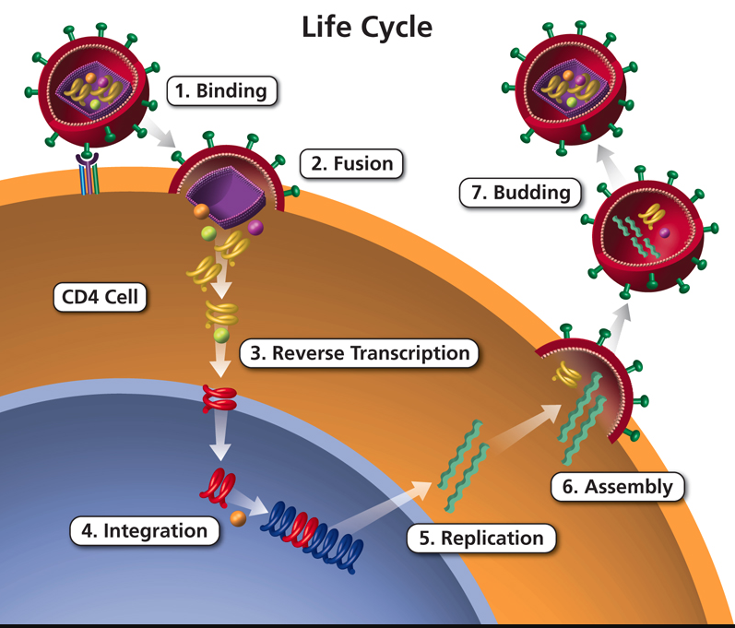
HIV Life Cycle and Targets for ARVs
Graphic: clinicalinfo.hiv.gov
April 2023 Susa Coffey

Slide 7
Commonly-used ARV Medications
NRTI (Nucleoside Reverse Transcriptase Inhibitor)
Abacavir (ABC)
Didanosine (ddI)
Emtricitabine (FTC)
Lamivudine (3TC)
Stavudine (d4T)
Tenofovir DF (TDF)
Tenofovir alafenamide (TAF)
Zidovudine (AZT, ZDV)

Slide 8
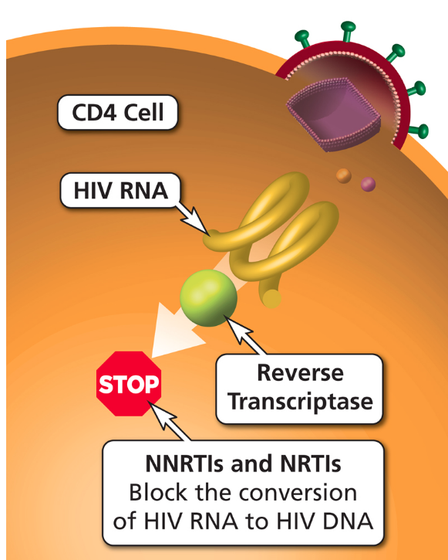
ARV Components in Initial Therapy: NRTI (Nucleoside Reverse Transcriptase Inhibitor) Pairs
ADVANTAGES
Established backbone of combination therapy
Minimal drug interactions
DISADVANTAGES
Lactic acidosis and hepatic steatosis reported with most NRTIs (rare)
Graphic: clinicalinfo.hiv.gov
April 2023 Susa Coffey

Slide 9
Initial Therapy: Dual-NRTI Pairs (1)
ABC/3TC (aka Epzicom®)
Once-daily dosing
Coformulated with DTG in single-pill regimens (Triumeq®)
Use only for patients who are negative for HLA-B*5701 (risk of hypersensitivity reaction if positive)
Possible risk of cardiovascular events; caution in patients with CV risk factors
Possible inferior efficacy if baseline HIV RNA >100,000 copies/mL and used with EFV, ATV/r, or RAL
Should not be used for treatment of HBV
April 2023 Susa Coffey

Slide 10
Initial Therapy: Dual-NRTI Pairs (2)
TDF/FTC (aka Truvada®), TDF/3TC
Once-daily dosing
In several single-pill regimen coformulations
Active against HBV
Potential for renal and bone toxicity (more than with TAF); exacerbated by PK boosters
Avoid if renal disease or osteoporosis
Lower lipid levels (vs ABC and TAF)
TAF/FTC (aka Descovy®)
Once-daily dosing
In several single-pill regimen coformulations
Active against HBV
Renal and bone toxicity; less common than with TDF/FTC
Approved for eGFR ≥30 mL/min
Excess weight gain (vs ABC and TDF) in some studies
April 2023 Susa Coffey

Slide 11
Commonly-used ARV Medications
Integrase Inhibitor (INSTI)
Bictegravir (BIC)
Cabotegravir (CAB)
Dolutegravir (DTG) - Tivicay®
Elvitegravir (EVG) – Genvoya® or Stribild®
Raltegravir (RAL) - Isentress®

Slide 12
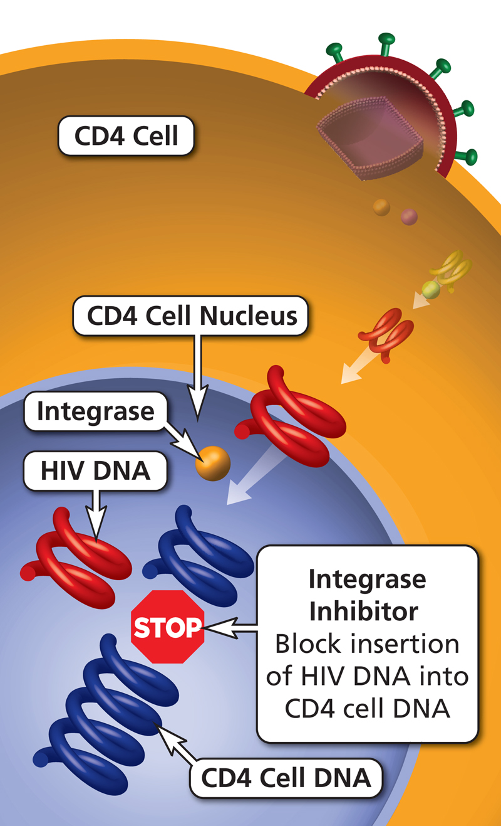
ARV Components in Initial Therapy: INSTIs (Integrase Inhibitors)
ADVANTAGES
DTG, BIC: higher barrier to resistance than RAL, EVG
Low rates of AEs
Few drug-drug interactions (not true of EVG/COBI)
Single-pill combination regimens available with BIC, DTG, EVG/COBI
CAB: long-acting injectable formulation
DISADVANTAGES
RAL, EVG: lower genetic barrier to resistance than DTG, BIC, PIs
COBI: many drug-drug interactions
Greater weight gain (especially with TAF)
Graphic: clinicalinfo.hiv.gov
April 2023 Susa Coffey

Slide 13
Commonly-used ARV Medications
PI (Protease Inhibitor)
Atazanavir (ATV) - Reyataz®
Darunavir (DRV) - Prezista®
Fosamprenavir (FPV)
Indinavir (IDV)
Lopinavir (LPV)
Nelfinavir (NFV)
Saquinavir (SQV)
Tipranavir (TPV)

Slide 14
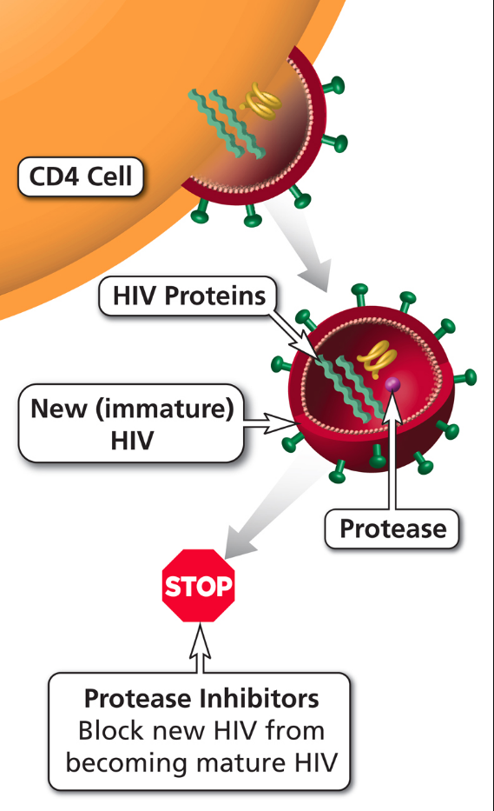
ARV Components in Initial Therapy: PIs (Protease Inhibitors)
ADVANTAGES
High genetic barrier to resistance
PI resistance uncommon with failure of boosted PIs
Single-pill combination regimen available with DRV
DISADVANTAGES
Metabolic complications (less likely with DRV and ATV than with older PIs)
GI intolerance
Higher potential for drug interactions (CYP450), especially with RTV
Graphic: clinicalinfo.hiv.gov
April 2023 Susa Coffey

Slide 15
Commonly-used ARV Medications
NNRTI (Non-nucleoside Reverse Transcriptase Inhbitor)
Delavirdine (DLV)
Doravirine (DOR)
Efavirenz (EFV)
Etravirine (ETR)
Nevirapine (NVP)
Rilpivirine (RPV)

Slide 16
ARV Components in Initial Therapy: NNRTIs (Non-nucleoside Reverse Transcriptase Inhibitors)
ADVANTAGES
Long half-lives
Less metabolic toxicity (dyslipidemia, insulin resistance) vs. some PIs
Single-pill combination regimens available with DOR, EFV, and RPV
RPV: long-acting injectable option
DISADVANTAGES
Low genetic barrier to resistance
High rates of NNRTI resistance if virologic failure
Cross-resistance among most NNRTIs
EFV: high rate of CNS adverse effects
RPV: lower efficacy if HIV RNA >100,000 or CD4 <200
Rash; hepatotoxicity
CYP450 drug interactions
Graphic: clinicalinfo.hiv.gov
April 2023
Notes:
high rates of resistance with virologic failure

Slide 17
Combination Tablets
Tenofovir alafenamide = TAF; Tenofovir disoproxil fumarate = TDF
Brand Name | NRTI | INSTI | PI | NNRTI
Biktarvy | Emtricitabine + TAF | Bictegravir
Triumeq | Lamivudine + Abacavir | Dolutegravir
Symtuza | Emtricitabine + TAF |  | Darunavir (+ cobicistat booster)
Delstrigo | Lamivudine + TDF |  |  | Doravirine
Odefsey | Emtricitabine + TAF |  |  | Rilpivirine
Complera | Emtricitabine + TDF |  |  | Rilpivirine
Atripla | Emtricitabine + TDF |  |  | Efavirenz
Dovato | Lamivudine | Dolutegravir
Juluca |  | Dolutegravir |  | Rilpivirine
Cabenuva |  | Cabotegravir |  | Rilpivirine
Prezcobix |  |  | Darunavir (+ cobicistat booster)
Descovy | Emtricitabine + TAF
Truvada | Emtricitabine + TDF
Epzicom | Lamivudine + Abacavir

Slide 18
Antiretroviral Therapy for Treatment-Naïve Patients
Recommended for most people with HIV
INSTI + 2 NRTI
INSTI + 1 NRTI
Other Options
PK-boosted PI + 2 NRTI
OR
NNRTI + 2 NRTI
Don’t use partial regimen!!!
Panel on Antiretroviral Guidelines for Adults and Adolescents. Guidelines for the Use of Antiretroviral Agents in Adults and Adolescents with HIV. Department of Health and Human Services. Available at https://clinicalinfo.hiv.gov/en/guidelines/adult-and-adolescent-arv. Accessed January 10, 2024.
Dena Behm Dillon, PharmD, AAHIVP

Slide 19
Recommended initial regimens for most people with HIV if no history of PrEP with long-acting cabotegravir
INSTI + 2 NRTIs
BIC/TAF/FTC (AI)
DTG/ABC/3TC (AI); only if HLA-B*5701 negative, no HBV
DTG + (TAF or TDF) + (FTC or 3TC) (AI)
INSTI + 1 NRTI
DTG/3TC (AI); not if HIV RNA >500,000 copies/mL, HBV coinfection, or ART is started before HIV resistance test or HBV test results are available
Notes:
3TC can be used in place of FTC and vice versa.
TAF: fewer bone and kidney toxicities; TDF: lower lipids.
Special considerations re persons of childbearing potential – see slide 77.

Slide 20
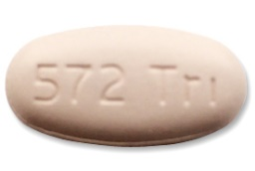
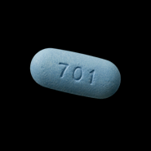
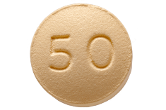
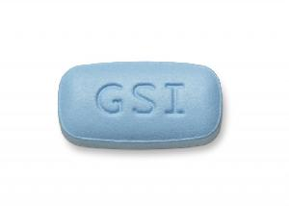
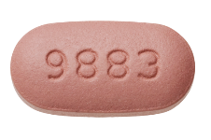
RECOMMENDED INITIAL REGIMENS FOR MOST PEOPLE – DHHS GUIDELINES DECEMBER 2023
DTG/ABC/3TC*
DTG + tenofovir/FTC**
BIC/tenofovir/FTC
DTG/3TC***
OR
*Only if HLA-B*5701 negative and w/o HBV coinfection; **3TC and FTC can be substituted for each other; ***not for individuals with HIV RNA >500,000 copies/mL, HBV coinfection, or in whom ART is to be started before the results of HIV genotypic resistance testing for reverse transcriptase or HBV testing are available
Recom may differ according to renal function, HLA-B*5701, HBsAg, osteoporosis, other comorbidities, pregnancy
https://clinicalinfo.hiv.gov/en/guidelines/adult-and-adolescent-arv. Accessed 1/10/24.
Dena Behm Dillon, PharmD, AAHIVP
Notes:
For most patients, an INSTI-containing regimen will be highly effective, have few adverse effects, and have no significant CYP3A4-associated drug interactions. In addition, in several head-to-head comparisons between boosted PI- and INSTI-containing regimens, the INSTI was better tolerated with fewer treatment discontinuations.

Slide 21
Choosing Initial ART Regimen: ARVs to Avoid in Specific Clinical Scenarios
CD4
<200
Do not use: higher rate of virologic failure
RPV-based ART
DRV/r + RAL
HIV RNA >100,000
Do not use: higher rate of virologic failure
RPV-based ART
ABC/3TC + EFV or ATV/r
DRV/r + RAL
HIV RNA >500,000
Do not use: higher rate of virologic failure
Regimens listed to left
DTG/3TC
HLA-B*5701 positive
Do not use: risk of abacavir hyper-sensitivity
ABC
April 2023, courtesy Susa Coffey

Slide 22
Food instructions with antiretrovirals
Which ones need to be spaced apart from food?
Which ones need to be taken with food?
WHY?

Slide 23
Medication | Food Considerations | Effect
Etravirine (Intelence®) | Following a meal | ↓ 50% AUC with fasting vs. meal (345-1160 kcal, 17-70 gm fat)
Rilpivirine (in Odefsey®, Complera®, Edurant®) | With a meal (at least 390 calories) | ↓ 40% conc in fasted conditions vs. normal caloric meal (533 kcal) or high-fat high-caloric meal (928 kcal)
 |  | ↓ 50% conc with protein-rich nutritional drink vs. with a meal
Atazanavir ( in Evotaz®, Reyataz®) | With food | RTV-boosted dose: ↑ 33% AUC, ↑ 40% Cmax with light meal (336 kcal, 5.1 g fat) vs fasted
 |  | Unboosted dose: ↑ 70% AUC, ↑ 57% Cmax with light meal (357 kcal, 8.2 g fat) vs fasted ; ↑ 35% AUC with high fat meal
Darunavir (in Prezcobix®, Prezista®) | With food | ↑ 40% AUC and Cmax with food (240-928 kcal, 12-56 gm fat) vs fasting
Elvitegravir (in Vitekta®, Genvoya®, Stribild®) | With food | ↑ 34% exposure with light (~373 kcal, 20% fat) meal ↑ 87% exposure with high fat (~800 kcal, 50% fat) meal vs. fasting
Efavirenz (in Atripla®; Sustiva®) | Preferably empty stomach to reduce side effects | Food increases drug absorption and CNS toxicities; ↑ 28% AUC and ↑ 79% Cmax with high-fat high-caloric meal (1000 kcal; 50-60% from fat) vs. fasting
Micromedex and Panel on Antiretroviral Guidelines for Adults and Adolescents. Guidelines for the Use of Antiretroviral Agents in Adults and Adolescents with HIV. Department of Health and Human Services. Available at https://clinicalinfo.hiv.gov/en/guidelines/adult-and-adolescent-arv. Accessed June 25, 2022.

Slide 24
Patient counseling
Don’t just tell patients to take certain meds with food
Tell patients why to take certain meds with food

Slide 25
Which ARVs need to be renally dose-adjusted?

Slide 26
Renal Adjustments
All NRTIs need a renal adjustment (EXCEPT abacavir)
Combination products with cobicistat + TDF are not started below a CrCl of 70 mL/min
Most other combination products are not given below a CrCl of 50 mL/min (TAF products: 30 mL/min; TDF/FTC can be dose-adjusted for 30-49 mL/min)
How to handle combo products?
Notes:
Break combo products into their individual components and adjust each one individually
Stribild can be used down to 50 mL/min, but not started if < 70 mL/min.

Slide 27
How to manage dolutegravir/Bictegravir adverse effects? First, what Are the adverse effects?
Neuropsychiatric
HA, insomnia, depression/SI, irritability, anxiety, dizziness (DTG 2-5% discontinue) > other INSTIs
GI side effects (more with EVG)
Weight gain (DTG/BIC > than other INSTIs)
Combo with TAF>TDF
Greater in women and black or Hispanic people
Hyperglycemia?
2 case reports sudden onset DM (RAL and DTG) – rapid resolution of A1C by 1-3 mo after d/c
Increased IRIS? Case reports and small observational study
Myocarditis? 2 cases after switch to DTG
Cuzin L et al. JAC 2019;74:754. Menard A et al. AIDS 2017; 31:1201. McLaughlin M et al. JAC 2017; 73:258. Psichogiou M et al. Curr HIV Res 2017;15:405. Lepik KJ et al. AIDS 2018;32:903. Fong PS et al. Int J STD AIDS 2017; 28:626. Mahiab K et al. Medicine 2016;95:47.

Slide 28
“Hidden” Interactions
Interactions with medications that patients might not be mentioning they are taking

Slide 29
Case
HD is a 28-year-old man who has been prescribed Biktarvy® (bictegravir, emtricitabine, tenofovir alafenamide) 1 tablet daily
The pharmacist is consulted to educate him on new antiretroviral regimen

Slide 30
Case
He reports to the physician and medical assistant that he also takes the following medications
Lisinopril
Atorvastatin
Famotidine
Sertraline

Slide 31
Medications patients often don’t mention they’re taking
Your thoughts?

Slide 32
Medications patients often don’t mention they’re taking
Antacids
Multivitamins
Herbals
Immune-boosting cold remedies
Other OTC products
How do we get them to fess up to EVERYTHING they’re taking?

Slide 33
Case
When talking with him, it is discovered that he is also taking Maalox Advanced ® (magnesium hydroxide/aluminum hydroxide/simethicone) 3 times per week for indigestion

Slide 34
Integrase Inhibitors
Dolutegravir (Tivicay®; contained in Triumeq ®)
Raltegravir (Isentress®)
Elvitegravir (contained in Stribild® and Genvoya®)
Bictegravir (contained in Biktarvy ®)

Slide 35
INSTI | Product | Dosing Recommendations for Antacids
Bictegravir | Biktarvy (BIC/FTC/TAF) | Aluminum / Magnesium Antacids: take Biktarvy at least 2 hours before antacids OR take 6 hours after antacids Calcium Antacids: take together with food; do not coadminister BIC simultaneously with antacids that contain calcium on an empty stomach
Dolutegravir | Tivicay (DTG) | Aluminum / Magnesium or Calcium Antacids: take Tivicay at least 2 hours before antacids OR take 6 hours after antacids
 | Triumeq (DTG/ABC/3TC) | Aluminum / Magnesium or Calcium Antacids: take Triumeq at least 2 hours before antacids OR take 6 hours after antacids
 | Dovato (DTG/3TC) | Aluminum / Magnesium or Calcium Antacids: take Dovato at least 2 hours before antacids OR take 6 hours after antacids
 | Juluca (DTG/RPV) | Aluminum / Magnesium or Calcium Antacids: take Juluca at least 4 hours before antacids or 6 hours after antacids
Elvitegravir | Stribild (EVG/c/FTC/TDF) | Aluminum / Magnesium or Calcium Antacids: separate intake from antacids by at least 2 hours
 | Genvoya (EVG/c/FTC/TAF) | Aluminum / Magnesium or Calcium Antacids: separate intake from antacids by at least 2 hours
Raltegravir | Isentress (RAL) | Aluminum / Magnesium Antacids: not recommended Calcium Antacids: no dose adjustment required
 | Isentress HD (RAL) | Aluminum / Magnesium Antacids: not recommended Calcium Antacids: not recommended
Permission to use slide created by Taylor Smith, Pharm.D.

Slide 36
INSTI | Product | Dosing Recommendations for Multivitamins and Supplements
Bictegravir | Biktarvy (BIC/FTC/TAF) | Calcium: take together with food; Iron: take together with food Note: Do not co-administer BIC under fasting conditions simultaneously with, or 2 hours after, supplements that contain Ca or Fe. Magnesium or Multivitamins: take together with food
Dolutegravir | Tivicay (DTG) | Calcium, Iron or Multivitamins: take Tivicay at least 2 hours before or 6 hours after supplements/vitamins OR take together with food Magnesium: take at least 2 hours before or 6 hours after supplements/vitamins
 | Triumeq (DTG/ABC/3TC) | Calcium, Iron or Multivitamins: take Triumeq at least 2 hours before or 6 hours after supplements/vitamins OR take together with food Magnesium: take at least 2 hours before or 6 hours after supplements/vitamins (European labeling)
 | Dovato (DTG/3TC) | Calcium, Iron or Multivitamins: take together with food OR under fasting conditions, take Dovato at least 2 hours before or 6 hours after supplements/vitamins Magnesium: take together with food OR under fasting conditions at least 2 hours before or 6 hours after supplements/vitamins (European labeling)
 | Juluca (DTG/RPV) | Calcium, Iron or Multivitamins: take together with food OR at least 4 hours before or 6 hours after supplements/vitamins Magnesium: take at least 4 hours before or 6 hours after magnesium
Elvitegravir | Stribild (EVG/c/FTC/TDF) | Calcium, Iron or Multivitamins: take together with food OR at least 4 hours before or 6 hours after supplements/vitamins (European labeling) Magnesium: take at least 4 hours before or 6 hours after magnesium
 | Genvoya (EVG/c/FTC/TAF) | Calcium, Iron or Magnesium: separate intake by at least 4 hours Multivitamins: separate intake by at least 4 hours (European labeling)
Raltegravir | Isentress (RAL) | Calcium, Iron, Magnesium or Multivitamins: separate intake by at least 4 hours
 | Isentress HD (RAL) | Calcium, Iron, Magnesium or Multivitamins: Not recommended
Permission to use slide created by Taylor Smith, Pharm.D.
Notes:
36

Slide 37
Case BF
General Medications
Heparin 5000 units SQ BID
Ortho Bowel Regimen
APAP for pain management
Esomeprazole 40mg po once daily
Fluticasone nasal spray both nostrils daily
ARV Regimen
Odefsey (rilpivirine/tenofovir alafenamide/emtricitabine)
Any Problems Here?

Slide 38
Rilpivirine
Interacts with acid-reducing agents
Proton pump inhibitors (e.g., omeprazole, esomeprazole, lansoprazole):
With omeprazole 20 mg daily, ↓RPV AUC 40%, Cmin 33%
contraindicated, do not combine
H2-receptor blockers (e.g., famotidine, ranitidine)
should be taken at least 12 hrs before or 4 hrs after RPV
Antacids (e.g., aluminum or magnesium hydroxide, calcium carbonate)
should be taken at least 2 hrs before or 4 hrs after RPV
Panel on Antiretroviral Guidelines for Adults and Adolescents. Guidelines for the Use of Antiretroviral Agents in Adults and Adolescents with HIV. Department of Health and Human Services. Available at https://clinicalinfo.hiv.gov/en/guidelines/adult-and-adolescent-arv. Accessed June 25, 2022.

Slide 39
PPIs and Atazanavir
Do not use if unboosted – i.e. on atazanavir (Reyataz®) 400mg daily without ritonavir or cobicistat
If ARV experienced, PPIs not recommended to be taken at all with atazanavir
If naïve, can use up to the equivalent of omeprazole 20mg daily, IF boosted
PPIs should be administered > 12 hrs prior to atazanavir/ritonavir
Reyataz package insert
Notes:
Antacids or buffered meds: should be given 1-2 hours before or at least 2 hours after atazanavir.
H2RAs:
Unboosted ATV: H2 receptor antagonist single dose should not exceed a dose equivalent of famotidine 20mg or total daily dose equivalent of famotidine 20mg BID in treatment-naïve patients. H2RA should be administered >2 hours after and/or >10 hours before after ATV.
ATV/r: H2 receptor antagonist dose should not exceed a dose equivalent to famotidine 40mg BID in treatment-naïve patients or 20mg BID in treatment-experienced patients. ATV 300mg + RTV 100mg should be administered simultaneously with and/or >10 hours after the H2 receptor antagonist. In treatment-experienced patients, if TDF is used with H2 receptor antagonists, ATV 400mg + RTV 100mg should be used.

Slide 40
Atazanavir
Requires acid for optimal absorption
Acid-reducing Agents | Treatment-naïve | PI-experienced
Antacids or buffered medications | ATV or ATV/r: Give at least 2 hrs before or 1-2 hrs after antacid | ATV/r: Give at least 2 hrs before or 1-2 hrs after antacid
H2 Receptor Antagonists (H2RAs) | ATV: Give at least 2 hrs before or at least 10 hrs after H2RA. Max dose of famotidine 20 mg bid (not to exceed 20 mg in single dose) [or equivalent]. | Don’t use unboosted with H2RA. ATV/r: Give simultaneously with or > 10 hrs after H2RA. Max dose of famotidine 20 mg bid [or equivalent].
 | ATV/r: Give simultaneously with or > 10 hrs after H2RA. Max dose of famotidine 40 mg bid [or equivalent]. | ATV/r (400/100 mg) with TDF: Give simultaneously with or > 10 hrs after H2RA. Max dose of famotidine 20 mg bid [or equivalent].
PPIs | ATV: not recommended | ATV/r: not recommended
 | ATV/r: Max dose of omeprazole 20 mg once daily [or equivalent] taken > 12 hrs prior to ATV/r.
Panel on Antiretroviral Guidelines for Adults and Adolescents. Guidelines for the Use of Antiretroviral Agents in Adults and Adolescents with HIV. Department of Health and Human Services. Available at https://clinicalinfo.hiv.gov/en/guidelines/adult-and-adolescent-arv. Accessed June 25, 2022.
Notes:
Kirsten Balano, HRSA’s clinical manual
Omeprazole: PPIs and H2-blockers decrease serum levels of atazanavir, even when boosted with ritonavir, but the clinical significance of this interaction has not been demonstrated. In general, it may be best to avoid concomitant use of these acid-blocking medications with atazanavir by either discontinuing the GERD medication or switching to another ARV. Unboosted atazanavir should not be used with PPIs. For patients without evidence of ARV resistance in whom coadministration of these medications is judged unavoidable, atazanavir/ritonavir may be used, but doses of omeprazole should not exceed 20 mg and must be taken at least 12 hours prior to taking atazanavir/ritonavir. Note that tenofovir also can lower atazanavir levels, so increasing atazanavir to 400 mg/ day with ritonavir 100 mg/day could be considered.

Slide 41
Patient Counseling on Drug Interactions
Educate patients that HIV medications, in particular PIs, NNRTIs, cobicistat, and maraviroc, have a high potential for significant interactions
Tell patients to bring everything they take
Vitamins
OTC products
Herbals
Other supplements
Tell patients to check with their pharmacist if considering a new product
Don’t “borrow” medications from family or friends
Balano K. Drug-Drug Interactions with HIV-related Medications in “Guide for HIV/AIDS Clinical Care”, p. 539, Coffey S ed. 2014 edition. US DHHS HRSA.

Slide 42
Patient counseling
Don’t just tell patients to separate certain products from meds
Tell patients why to separate certain products from meds

Slide 43
Drug Interactions (primer on pharmacokinetics)
A
d
M
E
Other: transporters,
ie DTG decreases the renal clearance of metformin by inhibiting organic cation transporters in renal tubular cells
Similar transporters aid hepatic, renal, and biliary clearance of drugs and may be susceptible to drug interactions
Much is still unknown
Notes:
Interactions include absorption, metabolism, and elimination

Slide 44
Permission to use slide granted by John Faragon, PharmD, BCPS, AAHIVP

Slide 45
 | Substrate | Inhibitor | Inducer
INSTIs
BIC | 3A4, P-gp, UGT1A1 | N/A | N/A
CAB | P-gp, UGT1A1 | N/A | N/A
DTG | 3A4 (minor), P-gp, UGT1A1 | N/A | N/A
EVG/c | 3A4, UGT1A1 | 3A4, 2D6, P-gp | 2C9
RAL | UGT1A1 | N/A | N/A
PIs
ATV | 3A4, P-gp | 3A4, 2C8, P-gp, UGT1A1 | P-gp
DRV | 3A4, P-gp | 3A4 | N/A
LPV/r | 3A4, 2D6, P-gp | 3A4 | 1A2, 2B6, 2C8, 2C9, 2C19, UGT1A1
NNRTIs
DOR | 3A, 3A5 | N/A | N/A
EFV | 2B6 (primary), 2A6, 3A4 | 3A4 | 3A4, 2B6, 2C19
ETR | 3A4, 2C9, 2C19 | 2C9, 2C19 | 3A4
NVP | 3A4, 2B6 | N/A | 3A4, 2B6
RPV | 3A4 | N/A | N/A
Other
MVC | 3A4, P-gp | N/A | N/A
FTR | 3A4, P-gp | N/A | N/A
http://www.aidsinfo.nih.gov/ContentFiles/AdultandAdolescentGL.pdf. Accessed July 31, 2021.
Notes:
Point out cobicistat, RTV; 3A4 actions, lack of P450 interactions of raltegravir, doravirine, and rilpivirine
Doravirine is also a substrate of CYP450

Slide 46
Uridine diphosphate glucuronosyltransferase (UGT) 1A1
Cabotegravir
Raltegravir
UGT1A1 + CYP 3A4
Bictegravir
Dolutegravir

Slide 47
Protease Inhibitor Class Interactions
Warfarin: ⬇
Rifampin: ⬇ PI by >75%
Do not co-administer, use rifabutin if indicated
Fluticasone/budesonide (inhaled or intranasal):
Adrenal insufficiency – Cushing’s syndrome
Do not co-administer
Consider beclomethasone
Statins: ⬆
Do not co-administer simvastatin or lovastatin
Consider atorvastatin (not with ATV/c) or rosuvastatin
Less interaction with fluvastatin or pravastatin or pitavastatin
St. John’s Wort: ⬇ PI expected
Do not co-administer
Midazolam/triazolam: ⬆
Do not co-administer
Consider lorazepam, oxazepam or temazepam

Slide 48
Make sure to think about drug interactions when stopping ARVs, too!
Notes:
For example, if a pharmacokinetic booster is stopped, then levels of some of the other meds can be increased

Slide 49
Case AJ
48 year old male
HIV infection diagnosed in 2002
Strong family history for CVD, including mother, father and 2 brothers
Medications:
Symtuza® (darunavir/cobicistat/emtricitabine/tenofovir alafenamide) – 800 mg/150 mg/200 mg/10 mg daily
Multivitamins – 1 daily

Slide 50
Case AJ
Patient recently admitted to a local hospital for Acute Coronary Syndrome, requiring PCI and stent placement with an uneventful hospital course
Discharge Medications
quinapril 10mg daily
metoprolol XL 50mg daily
simvastatin 40mg daily
aspirin 81 mg daily
clopidogrel 75 mg daily
Any problems here?
Other Meds
Symtuza
multivitamins – 1 QD
Notes:
Percutaneous coronary intervention

Slide 51
Lipid-Lowering Agents and PIs/COBI: Drug Interactions
Fibrates
Fluvastatin
Pitavastatin
Pravastatin*
Ezetimibe
Fish oil
Low interaction
potential
Statin + fibrate
Atorvastatin
Rosuvastatin
Niacin
Use cautiously
Lovastatin
Simvastatin
Contraindicated
*AUC ↑↑↑ with darunavir.
Fichtenbaum et al. AIDS. 16:569-577, 2002. Hsu et al. AAC. 45:3445-3450, 2001. Gerber et al. 2nd IAS. Abstract #870, 2003. Carr et al. 40th ICAAC. Toronto. Abstract #1644, 2000. Telzir Package Insert, 2003. Gerber et al. 11th CROI. Abstract # 603, 2004. Reyataz Package Insert, 2005. Aptivus Product Label, 2005.
Notes:
With NNRTIs, many statins decreased x fluvastatin inc with etravirine
Extra info for questions:
Summary
Coadministration of pravastatin (40 mg single dose) and darunavir/ritonavir (600/100 mg twice daily) did not increase exposure of pravastatin in most subjects but up to 5-fold in a limited subset of subjects. When administration of pravastatin and darunavir coadministered with 100 mg ritonavir is required, it is recommended to start with the lowest possible dose of pravastatin and titrate it up to the desired clinical effect while monitoring for safety. Prezista Summary of Product Characteristics, Janssen-Cilag Ltd, August 2008.
Coadministration of pravastatin (40 mg single dose) and darunavir/ritonavir (600/100 mg twice daily) was studied in 14 subjects. Pravastatin Cmax increased by 63%. The mean increase in pravastatin AUC was 81%; however, pravastatin AUC increased by up to 5-fold in some subjects. Use the lowest possible dose of pravastatin with careful monitoring, or consider other HMG-CoA reductase inhibitors such as fluvastatin in combination with darunavir/ritonavir. Prezista Prescribing Information, Tibotec Inc, October 2008.
The effect of darunavir/ritonavir (600/100 mg twice daily) on the pharmacokinetics of a single dose of pravastatin (40 mg) was investigated in 14 HIV- subjects. Pravastatin Cmax and AUC increased by 63% and 81% respectively. However, substantial interindividual variability in pravastatin exposure was observed (treatment ratios from 0.57 to 6.79) and in 4/14 subjects, pravastatin exposure was increased by over 200%. Coadministration was generally well tolerated but, due to the variation in response, it is recommended to start with the lowest possible dose of pravastatin and titrate as necessary whilst monitoring safety. Pharmacokinetic drug-drug interaction between the new HIV protease inhibitor darunavir (TMC114) and the lipid-lowering agent pravastatin. Sekar VJ, et al. 8th International Workshop on Clinical Pharmacology of HIV Therapy, Budapest, April 2007, abstract 54.
Slide #39: Lipid Lowering Agents and PIs: Drug Interactions
Although LLAs can be safely administered to the general population, more diligence is needed when considering these agents in HIV+ individuals being treated with HAART, because of potential drug-drug interactions.¹
The ACTG study A5047 was an open-label, randomized trial that evaluated drug interactions between PIs and pravastatin, simvastatin, and atorvastatin in 56 seronegative volunteers.¹
-The AUC of simvastatin and atorvastatin increased by 3059% and 79%, respectively, in patients receiving SQV + RTV.
-The AUC of pravastatin decreased by 50%.
Similar results were reported by Hsue et al, who measured the effects of NFV on the AUC of atorvastatin and simvastatin.²
LPV/r increases the AUC of atorvastatin and pravastatin by 588% and 30%, respectively.³
The use of lovastatin and simvastatin should be avoided in patients on PI-based regimens.
Statin-fibrate combinations or atorvastatin should be used with caution.
Fibrates, fluvastatin, and pravastatin, on the other hand, have low potential for interactions with PIs.

Slide 53
Drug Interactions: Exogenous Steroids
Injectable steroids: levels increased by PI, cobi
10% of patients on PIs who received steroid injection developed clinical evidence of steroid excess or adrenal insufficiency¹
Inhaled fluticasone² & budesonide³: systemic levels increased by PI, cobi
Beclomethasone is safer alternative⁴
¹Hyle E et al, JAIDS, 2013
²DHHS guidelines for use of antiretroviral agents in HIV-1-infected adults and adolescents. http://AIDSinfo.nih.gov
³http://www.fda.gov/ForConsumers/ByAudience/ForPatientAdvocates/HIVandAIDSActivities/ucm336367.htm
⁴Boyd S et al, JAIDS, 2013

Slide 54
Wholesale Acquisition Costs 2023
Combo | WAC (Monthly)
DTG/ABC/3TC | $3537
DTG + TAF/FTC | $4290
DTG + TDF/FTC (geq) | $2156
DTG + TDF/3TC (Cimduo) | $3260
BIC/TAF/FTC | $3795
DTG/3TC | $2810
Dena Behm Dillon, Pharm.D., AAHIVP
https://clinicalinfo.hiv.gov/en/guidelines/adult-and-adolescent-arv. Accessed 1/10/24.

Slide 55
PrEP (Pre-Exposure Prophylaxis)
Truvada ® (emtricitabine/tenofovir disoproxil fumarate) or generic
For all people at risk through sex or injection use
Descovy ® (emtricitabine/tenofovir alafenamide)
For people at risk through sex or injection drug use, except for people assigned female at birth who could get HIV from vaginal sex.
Apretude® (cabotegravir)
For all people at risk through sex
www.cdc.gov

Slide 56
PEP (Post-Exposure Prophylaxis)
Tenofovir disoproxil fumarate/emtricitabine (Truvada) 300/200 mg + dolutegravir (Tivicay) 50 mg – 1 tablet of each PO daily x 28 days (2016 Guidelines)
Many providers prescribe tenofovir alafenamide/emtricitabine (Descovy) in place of TDF/FTC, and bictegravir in place of dolutegravir. Bictegravir is available as a coformulation with TAF/FTC (bictegravir/TAF/FTC, Biktarvy).
If client is in the first trimester of pregnancy OR may become pregnant within the next 28 days: TDF/ FTC (Truvada) 300/200 mg 1 tab PO daily + EITHER dolutegravir (Tivicay) 50 mg 1 PO daily OR raltegravir (Isentress) 400 mg 1 tab PO twice a day.
The use of dolutegravir at conception and in very early pregnancy has been associated with a small, but not statistically significant, increase in the risk of fetal neural tube defects.
Truvada should not be used for those with CrCl less than 60 mL/min; an alternative regimen must be used in those circumstances.
https://aidsetc.org/sites/default/files/resources_files/AETC-nPEP-guide-111721.pdf

Slide 57
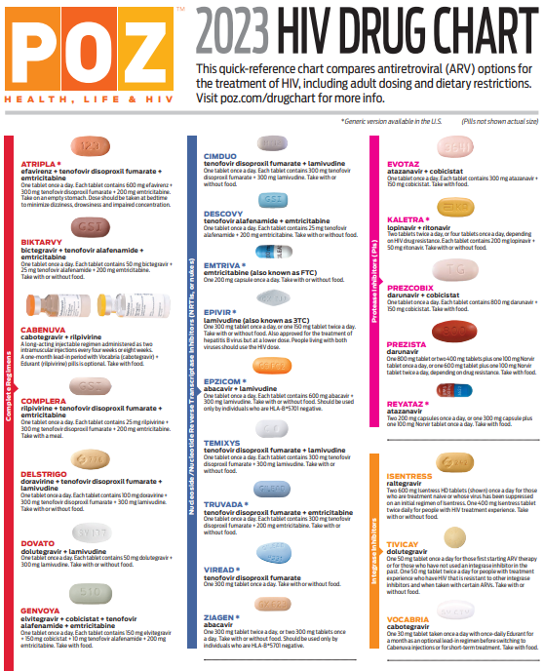
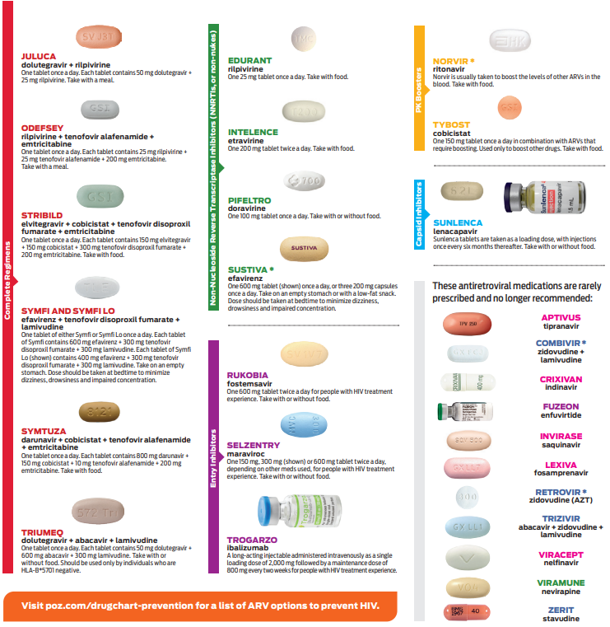
POZ_2023_HIV_Drug_Chart.pdf

Slide 58
Q & A

Slide 59
Evaluation
Please complete the evaluation for this program by clicking the link in the chat
We use your responses to plan future events!

Slide 60
MATEC Resources
National Clinician Consultation Center
http://nccc.ucsf.edu/
HIV Management
Perinatal HIV
HIV PrEP
HIV PEP line
HCV Management
Substance Use Management
AETC National HIV Curriculum
https://aidsetc.org/nhc
AETC National HIV-HCV Curriculum
https://aidsetc.org/hivhcv
National PrEP Curriculum https://www.hivprep.uw.edu
Hepatitis B Online https://www.hepatitisb.uw.edu
Hepatitis C Online
https://www.hepatitisc.uw.edu
AETC National Coordinating Resource Center
https://aidsetc.org/
Additional Trainings https://matec.info

Slide 61
Additional Resources
Toronto General Hospital Immunodeficiency Clinic
http://hivclinic.ca/drug-information/
Provides downloadable drug interaction tables, interactive web app, info on crushing, etc.
University of Liverpool
www.hiv-druginteractions.org
Drug interaction charts
Clinician Consultation Center
Expert peer-to-peer advice on HIV/AIDS management
(800) 933-3413 M-F 8:00 AM – 7:00 PM CST
Online case submission anytime http://nccc.ucsf.edu/login-register/ also has phone numbers for PEP, PrEP, and perinatal

