Slide 1
Clinician Scholars Program Collaborative Learning Series
June 11, 2024
4:00 PM – 5:30 PM CT | 5:00 PM – 6:30 PM ET

Slide 2
Disclaimer
This program is supported by the Health Resources and Services Administration (HRSA) of the U.S. Department of Health and Human Services (HHS) as part of an award totaling $4,036,482.00 with zero percent financed by nongovernmental sources. The contents are those of the author(s) and do not necessarily represent the official view of, nor an endorsement by, HRSA, HHS, or the U.S. Government.
Funding for this presentation was made possible by grant number U1OHA29293 from the Human Resources and Services Administration HIV/AIDS Bureau. The views expressed do not necessarily reflect the official policies of the Department of Health and Human Services nor does mention of trade names, commercial practices, or organizations imply endorsement by the U.S. Government. Any trade/brand names for products mentioned during this presentation are for training and identification purposes only.

Slide 3
MATEC Statement on Equity and Inclusion
MATEC has a strong commitment to fair, respectful and unbiased representation of humankind. We strive to be anti-racist, gender affirming and honor all people in an authentic way. This is our goal in all our work, including this presentation.
Our commitment to you is that we take this stance seriously and invite you to do the same.
“When we know better we do better.”
–Dr. Maya Angelou

Slide 4
Virtual Meeting Housekeeping
This session is being recorded
Post questions and comments in the chat box at any time
If you are joining by phone:
  Please mute your computer speakers
  Please do not place your phone on hold
If you need technical assistance, contact Karen (Curd) Harris via chatbox or email at kcurd@iu.edu

Slide 5



Meeting Room Logistics
The microphone is muted and camera is turned off if icon is red.
Closed captioning is available by clicking the “CC” icon on the left side of the menu bar. Captioning will appear at the bottom of your screen.
The chat box is accessible by clicking the chat symbol on the right side of the menu bar.

Slide 6
MATEC Collaborative Learning Series
Text Attendance
Please text 91622 to 317-671-8998.
You have 60 minutes prior, during, and 120 minutes after the end of the activity to text in your attendance

Slide 7

MATEC Collaborative Learning Series
CME Learner Information
Accreditation Statement
In support of improving patient care, this activity has been planned and implemented by Indiana University School of Medicine and Midwest AIDS Training and Education Center (MATEC) Indiana. Indiana University School of Medicine is jointly accredited by the Accreditation Council for Continuing Medical Education (ACCME), the Accreditation Council for Pharmacy Education (ACPE), and the American Nurses Credentialing Center (ANCC), to provide continuing education for the healthcare team.
Pharmacists
Indiana University School of Medicine designates this activity for (ACPE UAN 1.5) 1.5 ACPE contact hours. Pharmacists should only claim credit commensurate with the extent of their participation in the activity. Credit will be provided to NABP CPE Monitor within 60 days after the activity completion.
Physicians
Indiana University School of Medicine designates this live activity for a maximum of 1.5 AMA PRA Category 1 Credits™. Physicians should claim only the credit commensurate with the extent of their participation in the activity.
Notes:
Use for JOINT Providership

Slide 8
Disclosure Summary
Indiana University School of Medicine (IUSM) policy ensures that those who have influenced the content of a CE activity (e.g. planners, faculty, authors, reviewers and others) disclose all financial relationships with any ineligible companies so that IUSM may identify and mitigate any conflicts of interest prior to the activity. All educational programs sponsored by Indiana University School of Medicine must demonstrate balance, independence, objectivity, and scientific rigor.
There are no relevant financial relationship(s) with ineligible companies for anyone who was in control of the content of this activity, except:
Christine Balt has disclosed Speakers Bureau from Gilead.
Eric Farmer has disclosed Speakers Bureau from GlaxoSmithKline.
All of the relevant financial relationships listed for these individuals have been mitigated.
An ineligible company is any entity whose primary business is producing, marketing, selling, re-selling, or distributing healthcare products used by or on patients.
MATEC Collaborative Learning Series
CME Learner Information
The activity evaluation will be sent via email. Within 30-60 days following the activity, learners will receive a separate email with instructions on how to obtain proof of participation in this IUSM activity. For questions and concerns, please contact IU School of Medicine, Division of Continuing Education in Healthcare Professions, 317-274-0104, or cehp@iu.edu
Notes:
Disclosure Summary Slide

Slide 9
Today’s Presentation Topic
HIV Potpourri
Eric Farmer, PharmD, BCPS, AAHIVP
Indiana University Health LifeCare Clinic
efarmer1@iuhealth.org

Slide 10
Core Capabilities Addressed
Capability #1 – Clinical Guidelines: Utilize current HHS treatment guidelines, including those related to special populations, to manage HIV infection.
Capability #3 - Key Populations: Incorporate current guidelines related to key populations into the prevention and management of HIV.
Capability #4 - HIV Prevention: Provide appropriate screening, referral, counseling, and/or prophylaxis to prevent HIV.
Capability #7 - Antiretroviral Therapy: Choose optimum antiretroviral therapy (ART) regimens that achieve treatment goals.

Slide 11
National Curriculum Recommendations
Antiretroviral Therapy Module
Antiretroviral Medications and Initial Therapy
https://www.hiv.uw.edu/go/antiretroviral-therapy/general-information/core-concept/all
Adverse Effects of Antiretroviral Medications
https://www.hiv.uw.edu/go/antiretroviral-therapy/adverse-effects/core-concept/all
Prevention of HIV Module
Nonoccupational Postexposure Prophylaxis
https://www.hiv.uw.edu/go/prevention/nonoccupational-postexposure-prophylaxis/core-concept/all
Key Populations Module
HIV in Women
https://www.hiv.uw.edu/go/key-populations/women-hiv/core-concept/all

Slide 12

HIV Potpourri
Eric Farmer, PharmD, BCPS, AAHIVP
Indiana University Health LifeCare Clinic

Slide 13
Disclosures
I am a paid consultant on the Speaker’s Bureau for Viiv Healthcare.

Slide 14
Learning Objectives
List relevant selection criteria when rapidly initiating antiretroviral therapy (ART).
Select an appropriate ART regimen for patients initiating non-occupational post-exposure prophylaxis.
Recognize factors that may contribute to weight gain for patients taking ART.
Recommend appropriate ART for patients presenting with an opportunistic infection

Slide 15
Celebration of Learning: Case 1
Patient DD is a 24yo cisgender male diagnosed with HIV 6 days ago. He presents to you to establish care and initiate ART.
PMH: HIV, asthma
NKDA
Medications: albuterol inh prn, h/o of cabotegravir use for PrEP (last inj was 1 yr ago; had to discontinue d/t insurance issues)
Social History: HIV risk factor: MSM, social alcohol use, rare MJ use; employed FT in food service industry; has employer insurance
Labs: HIV-1/2 Ab/HIV Ag reactive

Slide 16

Celebration of Learning: Case 1 Jeopardy
What ART do you recommend starting for DD?
None at this time. Wait until CD4 is <500 cells/mm³
None at this time. Wait until labs come back in a few days.
Bictegravir/emtricitabine/tenofovir AF
Dolutegravir/lamivudine
Darunavir/cobicistat/emtricitabine/tenofovir AF
Something else?

Slide 17
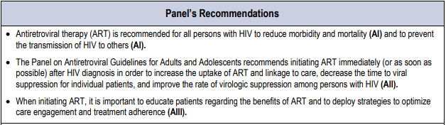
Starting ART
“Prior to ART initiation, HIV infection should be confirmed. HIV RNA and CD4 count also should be obtained, but results need not be available before starting ART.”
DHS Guidelines. https://clinicalinfo.hiv.gov/en/guidelines/adult-and-adolescent-arv. Accessed April 13, 2024

Slide 18
Indication to Start ART with Increased Urgency
CD4 count <200 cells/mm³
HIV viral load >100K copies/mL
Pregnancy
Presence of opportunistic infection*
Presence of hepatitis co-infection
*exclusions apply (e.g. toxoplasmosis encephalitis, cryptococcal meningitis, tuberculosis, etc.)
Presence of an HIV-associated malignancy (Kaposi’s, NHL, etc.)
Presence of HIV-associated condition (HIVAN, HAND, Wasting, etc.)
Acute HIV
Serodiscordance
Other compelling indication (advanced age, CV disease, DM, etc.)
DHS Guidelines. https://clinicalinfo.hiv.gov/en/guidelines/adult-and-adolescent-arv. Accessed April 13, 2024

Slide 19
ART Considerations for Initial Therapy
CD4 count
Viral load
HLA-B*5701 status
Hepatitis serology
Prior exposure to PrEP
Drug Interactions
ART-Specific considerations
Relevant social history considerations
PMH
  CKD
  Osteoporosis/age
  Psychiatric illness
  CV disease/HLD
  Pregnancy
Co-infections
  OIs
  TB
DHS Guidelines. https://clinicalinfo.hiv.gov/en/guidelines/adult-and-adolescent-arv. Accessed April 13, 2024
Notes:
Table 7

Slide 20
Recommended Initial Regimens for Most People with HIV
Recommended regimens are those with demonstrated durable virologic efficacy, favorable tolerability and toxicity profiles, and ease of use. Choice of ART during pregnancy should be guided by recommendations from the Perinatal Guidelines.
For people who do not have a history of CAB-LA use as PrEP, the following regimens are recommended: INSTI plus Two NRTIs BIC/TAF/FTC (AI)ª DTG/ABC/3TC (AI)—if HLA-B*5701 negative DTG plus (TAF or TDF)^{c} plus (FTC or 3TC) (AI) INSTI plus One NRTI DTG/3TC (AI), except for individuals with HIV RNA >500,000 copies/mL, HBV coinfection, or in whom ART is to be started before the results of HIV genotypic resistance testing for reverse transcriptase or HBV testing are available For people with HIV and a history of CAB-LA use as PrEP, INSTI genotypic resistance testing should be performed before the start of ART. If treatment is begun prior to results of genotypic testing, the following regimen is recommended: DRV/c^{b} or DRV/r with (TAF or TDF)^{c} plus (FTC or 3TC)—pending the results of the genotype test (AIII)
Selection of a regimen should be individualized based on virologic efficacy, potential adverse effects, childbearing potential and use of effective contraception, pill burden, dosing frequency, drug–drug interaction potential, comorbid conditions, cost, access, and resistance-test results. A pregnancy test should be performed in persons of childbearing potential, and choice of ART for pregnant individuals should be guided by recommendations from the Perinatal Guidelines. Drug classes and regimens within each class are arranged first by evidence rating and, when ratings are equal, in alphabetical order.
Panel on Antiretroviral Guidelines for Adults and Adolescents. Guidelines for the Use of Antiretroviral Agents in Adults and Adolescents with HIV. Department of Health and Human Services. Available at https://clinicalinfo.hiv.gov/en/guidelines/adult-and-adolescent-arv. Accessed 5/28/24 [Table 6 - Recommended Antiretroviral Regimens for Initial Therapy].

Slide 21
Rapid Start
Defined: ART initiated as soon as possible after a new diagnosis, preferably on the day of diagnosis.
Condense, compress, and accelerate intake process to facilitate prescribing and dispensing of ART at first medical visit.
Study | Rapid Start | Standard of Care
RapIT¹ | Start ART same day, next day, or within 30d of intake | Up to 6 visits over a period of 2-4 weeks
RAPID² | Referral 6d after HIV test but same day as dx disclosed and 1 day for intake and ART start | 10d to clinic intake and 22 days for ART start
REACH³ | First visit and ART start within 72h of presentation | Up to 8 visits over several weeks before starting ART
1. Rosen S, et al. PLOS Med. 2016. 2. Pilcher CD, et al. J Acquir Immune Defic Syndr. 2017. 3. Colasanti J, et al. OFID. 2018.
Notes:
RapIT – South Africa
RAPID – SFGH
REACH - ATL

Slide 22
Rapid Start Outcomes
Study | Rapid Start | Standard of Care
RapIT¹ | Retention in care: 81% Uptake of ART on same day: 72% + 7% next day; Total of 96% started within 30d Viral suppression at 10mos: 64% | Retention in care: 64% Uptake of ART within 30d: 58%; update of ART within 90d: 72% Viral suppression at 10mos: 51%
RAPID² | ART start: 89.7% same day and 94.9% started within 24h Lost to follow up: 10.3% Median time to viral suppression: 56 days Median time from referral to viral suppression: 1.8 months | ART start: 22 days (p<0.001) Lost to follow up: 14.9% (p=0.52) Median time to viral suppression: 79 days (p=0.009) Median time from referral to viral suppression: 4.3 months (p=0.0001)
REACH³ | Median days to first visit: 4 days Median time to ART start: 7 days Median time to viral suppression: 57 days | Median days to first visit: 15 days Median time to ART start: 21 days Median time to viral suppression: 77 days (p=0.0022)
1. Rosen S, et al. PLOS Med. 2016. 2. Pilcher CD, et al. J Acquir Immune Defic Syndr. 2017. 3. Colasanti J, et al. OFID. 2018.
Notes:
RapIT: retention in care: making a clinic visit between months 5 and 10

Slide 23
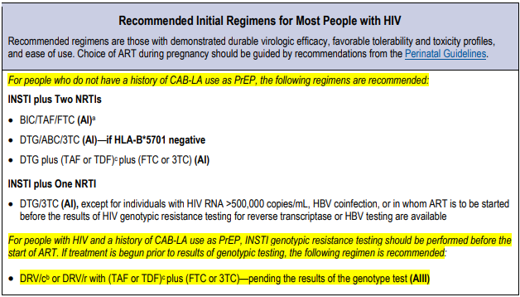
Recommended Initial Regimens for Most People with HIV
DHS Guidelines. https://clinicalinfo.hiv.gov/en/guidelines/adult-and-adolescent-arv. Accessed April 13, 2024

Slide 24
Celebration of Learning: Case 1
Patient DD is a 24yo cisgender male diagnosed with HIV 6 days ago. He presents to you to establish care and initiate ART.
PMH: HIV, asthma
NKDA
Medications: albuterol inh prn, h/o of cabotegravir use for PrEP (last inj was 1 yr ago; had to discontinue d/t insurance issues)
Social History: HIV risk factor: MSM, social alcohol use, rare MJ use; employed FT in food service industry; has employer insurance
Labs: HIV-1/2 Ab/HIV Ag reactive

Slide 25
Celebration of Learning: Case 1 Jeopardy
What ART do you recommend starting for DD?
None at this time. Wait until CD4 is <500 cells/mm³
None at this time. Wait until labs come back in a few days.
Bictegravir/emtricitabine/tenofovir AF
Dolutegravir/lamivudine
Darunavir/cobicistat/emtricitabine/tenofovir AF
Something else?

Slide 26
Celebration of Learning: Case 1, cont.
Labs:
  CD4 count: 851 (34%) cells/mm³
  HIV RNA: 975,000 copies/mL
  HLA-B*5701 negative
  HBsAb <3.5, HBsAg reactive, HBcAb reactive, HepC Ab negative
  Everything else: wnl
Resistance:
  RT: K103N
  No PI or INSTI mutations

Slide 27

Celebration of Learning: Case 1, cont.
Given updated lab information, do you change ART?
No, continue darunavir/cobicistat/emtricitabine/tenofovir AF
Yes, stop ART until CD4 count is <500 cells/mm³
Yes, switch to bictegravir/emtricitabine/tenofovir AF
Yes, switch to dolutegravir/lamivudine
Yes, switch to abacavir/dolutegravir/lamivudine
Yes, switch to cabotegravir/rilpivirine
Something else?
Notes:
A and C are best answers.
Wrong answers: B, D, E, F bc pt has active hep B and high VL

Slide 28
Celebration of Learning: Case 2
Patient JZ is a 38yo cisgender black male
PMH: Asthma, HTN, gout; HIV neg tested 4 months ago
Allergies: Sulfa
Medications: lisinopril/HCTZ 20/25mg daily, fluticasone/salmeterol 250/50mcg BID, albuterol prn, allopurinol 300mg daily
Social History: 1/2ppd cigarettes x20yrs, occasional MJ, reports 50% condom use for sexual activity
Presents today reporting unprotected vaginal intercourse ~36h ago with HIV+ GF; He reports GF is on medication; Has received PEP twice in past 12mos for similar incidents.

Slide 29
Celebration of Learning: Case 2 Jeopardy
What do you recommend for JZ?
No PEP because it has been too long since exposure; refer for PrEP
PEP with raltegravir 400mg BID + emtricitabine/tenofovir AF 200/25mg daily x10 days
PEP with bictegravir/emtricitabine/tenofovir AF 50/200/25mg daily x28 days
PEP with dolutegravir 50mg daily + emtricitabine/tenofovir DF 200/300mg daily x30 days

Slide 30
Pre- vs. Post-Exposure Prophylaxis
Preexposure prophylaxis (PrEP): initiated before exposure to reduce chance of infection
Postexposure prophylaxis (PEP): initiated soon after HIV exposure to reduce chance of infection
0
hour
36
hours
72
hours
1
month
6
months
nPEP Guidelines. https://www.cdc.gov/hiv/pdf/programresources/cdc-hiv-npep-guidelines.pdf Accessed April 21, 2024

Slide 31
Types of PEP
PEP
Occupational PEP
Non-occupational PEP (nPEP)
Sexual assault
Consensual sex
IVDA
Perinatal exposure
Needle stick

Slide 32
Estimated Per-Act Risk for HIV Transmission
Exposure Type | Estimated Risk
Blood transfusion | 92.5%
Needle sharing during IDU | 0.63%
Percutaneous (needlestick) | 0.23%
Receptive anal intercourse | 1.38%
Receptive penile-vaginal intercourse | 0.08%
Insertive anal intercourse | 0.11%
Insertive penile-vaginal intercourse | 0.04%
Receptive oral intercourse | Low
Insertive oral intercourse | Low
Biting, Spitting, Throwing body fluids (inc. semen, or saliva), and Sharing sex toys | Neglible
nPEP Guidelines. https://www.cdc.gov/hiv/pdf/programresources/cdc-hiv-npep-guidelines.pdf Accessed April 21, 2024

Slide 33
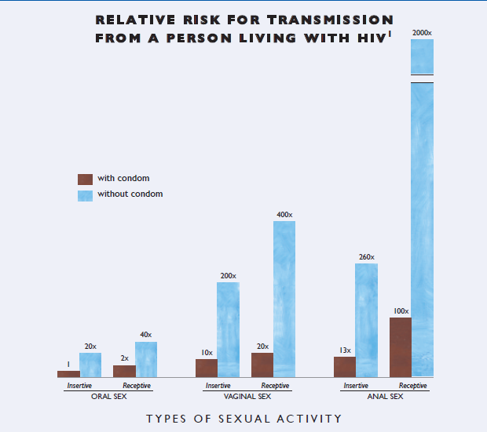
MMWR. 2003;52(RR1-12):9

Slide 34
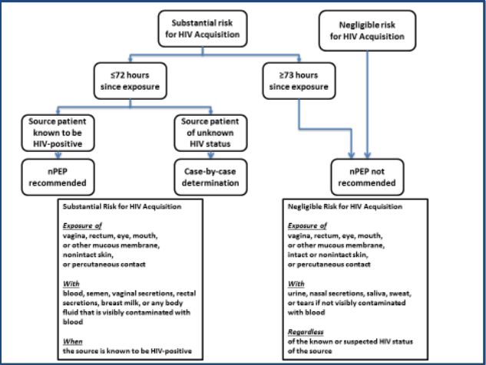
PEP Recommendations
nPEP Guidelines. https://www.cdc.gov/hiv/pdf/programresources/cdc-hiv-npep-guidelines.pdf Accessed April 21, 2024

Slide 35
PEP Treatment Recommendations
Patients | Priority | Medications
Adults and Adolescents aged ≥13 years, including pregnant women, with normal renal function | Preferred | Emtricitabine/ Tenofovir DF 200/300mg daily AND Raltegravir 400mg BID OR Dolutegravir 50mg daily
 | Alternative | Emtricitabine/ Tenofovir DF 200/300mg daily AND Darunavir 800mg daily AND Ritonavir 100mg daily
Duration: at least 28 days
Check your institutional policy or order set
nPEP Guidelines. https://www.cdc.gov/hiv/pdf/programresources/cdc-hiv-npep-guidelines.pdf Accessed April 21, 2024

Slide 36
Completion Rates of Alternative PEP Regimens
Regimen: | AZT/3TC/PI | FTC/TDF/RAL | EVG/COB/FTC/TDF | BIC/FTC/TAF
 | N=119 | N=100 | N=100 | N=52
 | 1/2000 – 5/2004 | 3/2008 – 3/2010 | 5/2013 – 11/2015 | 8/2018 – 3/2020
Completed as prescribed | 38.8% | 57.0% | 71.0% | 90.4%
Stopped or modified | 14.0% | 28.0% | 15.0% | 0
Lost to follow up | 47.3% | 15.0% | 14.0% | 9.6%
Mayer et al. J Acquir Immune Defic Syndr. 2022
Notes:
Demographics: Fenway Health Center:
-mean age: 37.2yrs
-67.3% gay/cisgender
-76.9% white; 9.6% Hispanic
-7.7% cisgender heterosexual male; 3.8% cisgender heterosexual female
-51.9% receptive anal sex; 42.3% insertive anal sex

Slide 37
Tolerability of Alternative PEP Regimens
Regimen: | AZT/3TC/PI | FTC/TDF/RAL | EVG/COB/FTC/TDF | BIC/FTC/TAF
Diarrhea | 58.8% | 21.0% | 38.0% | 7.7%
Fatigue | 48.5% | 14.0% | 28.0% | 9.6%
Nausea/Vomiting | 58.8% | 27.0% | 28.0% | 15.4%
Headache | 11.8% | 15.0% | 14.0% | 1.9%
Dizziness | 8.4% | 10.0% | 6.0% | 0.0%
Myalgia/Arthralgia | 10.9% | 8.0% | 2.0% | 1.9%
Mayer et al. J Acquir Immune Defic Syndr. 2022

Slide 38
Risk Reduction Counseling
Avoid blood, plasma, organ, tissue, semen, or egg donations
Avoid breastfeeding or pregnancy for 6-12 weeks
Use contraceptive barrier (condom) for sexual activity
Adherence to ART for full course
HIV transmission and disease education
No special precautions at work or change in patient care responsibilities
If history of presenting for multiple cases of nPEP, may consider referral to provider to discuss PrEP and doxyPEP
nPEP Guidelines. https://www.cdc.gov/hiv/pdf/programresources/cdc-hiv-npep-guidelines.pdf Accessed April 21, 2024

Slide 39
Celebration of Learning: Case 2
Patient JZ is a 38yo cisgender black male
PMH: Asthma, HTN, gout; HIV neg tested 4 months ago
Allergies: Sulfa
Medications: lisinopril/HCTZ 20/25mg daily, fluticasone/salmeterol 250/50mcg BID, albuterol prn, allopurinol 300mg daily
Social History: 1/2ppd cigarettes x20yrs, occasional MJ, reports 50% condom use for sexual activity
Presents today reporting unprotected vaginal intercourse ~36h ago with HIV+ GF; He reports GF is on medication; Has received PEP twice in past 12mos for similar incidents.

Slide 40
Celebration of Learning: Case 2 Jeopardy
What do you recommend for JZ?
No PEP because it has been too long since exposure; refer for PrEP
PEP with raltegravir 400mg BID + emtricitabine/tenofovir AF 200/25mg daily x10 days
PEP with bictegravir/emtricitabine/tenofovir AF 50/200/25mg daily x28 days
PEP with dolutegravir 50mg daily + emtricitabine/tenofovir DF 200/300mg daily x30 days

Slide 41
Celebration of Learning: Case 3
Patient PS is a 26yo cisgender heterosexual black female
PMH: Migraines
NKDA
Medications: Oral contraceptive daily
Social History: No tobacco, alcohol, or other substances; in a monogamous relationship with HIV-negative male; Works FT as a researcher in a lab processing blood samples for cancer treatment
Presents for PEP evaluation after touching a piece of paper with a smear of dried blood specimen on it with pad of R index finger. No open wounds noted. No blood transferred to patient’s finger.

Slide 42
Celebration of Learning: Case 3 Jeopardy
What do you recommend for PS?
No PEP because neglible risk for HIV acquisition
PEP with raltegravir 400mg BID + emtricitabine/tenofovir DF 200/300mg daily x30 days
PEP with bictegravir/emtricitabine/tenofovir AF 50/200/25mg daily x30 days
PEP with dolutegravir 50mg daily + emtricitabine/tenofovir DF 200/300mg daily x30 days
Notes:
Worried Well: best answer is A.

Slide 43
Celebration of Learning: Case 4
Patient QT is a 51yo cisgender white female
PMH: HIV (Dx 9 months ago), Obesity (BMI = 41kg/m²), HLD
NKDA
Medications: Abacavir/dolutegravir/lamivudine, atorvastatin 10mg daily
Social History: Denies tobacco use; rare alcohol use
Labs: Baseline CD4 count 119 cells/mm³ and HIV viral load 29,000 copies/mL; Today CD4 count 175 cells/mm³ and HIV viral load <20 copies/mL; No resistance
Presents for follow up of HIV disease. Patient is concerned weight has increased from 250lbs to 285lbs (>10% weight gain) since starting ART.

Slide 44
Celebration of Learning: Case 4 Jeopardy
Which factors have been associated with weight gain after ART initiation?
Pre-treatment obesity, female sex, and treatment with dolutegravir
White race, CD4 count <200 cells/mm³, and treatment with abacavir
Pre-treatment obesity, age >50 years, and HIV viral load >10,000 copies/mL
Female sex, CD4 count <200 cells/mm³, and treatment with dolutegravir

Slide 45
Weight Concerns with HIV Disease Over Time
Pre-ART Era
HIV-associated Wasting
Early ART Era
Peripheral lipoatrophy
Central lipohypertrophy
General lipodystrophy
Present ART Era
Overweight / Obesity
Weight gain
Cachexia

Slide 46
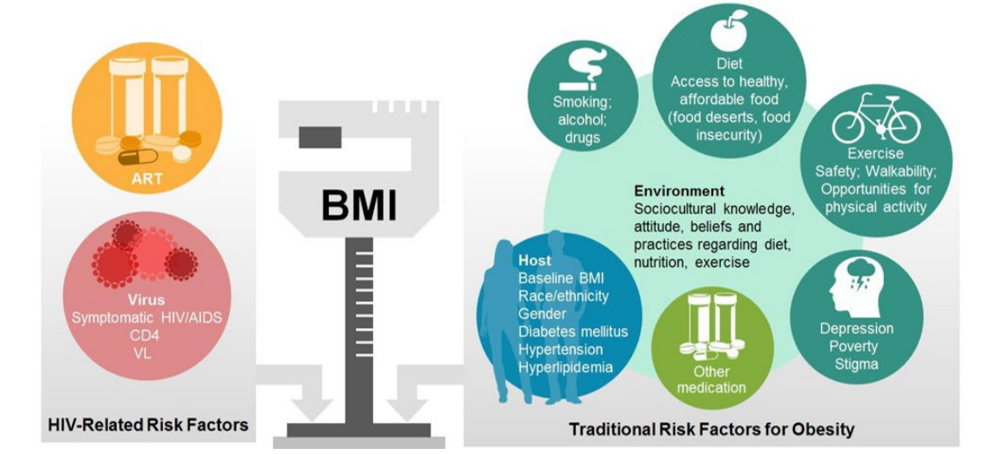
Risk Factors for Weight Gain in People with HIV
https://www.seaetc.com/wp-content/uploads/2019/10/5.-Weight-Gain-and-ART.pdf

Slide 47
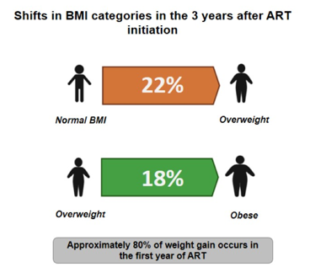
Weight Gain in People with HIV: NA-ACCORD 1998 - 2010
>80% of total weight gain over 3 yrs occurred in first 12 months
Weight gain greatest in white men and nonwhite women
Greatest weight gain associated with lower pre-treatment CD4 count, higher viral load, and age ~35 yrs
Koethe JR, et al. ARHR. 2016
Notes:
-Study population 97% male and 41% white; median age of ART initiation: 42 yrs.
-Majority of patients in all 3 grps had a TDF-containing NRTI backbone. Notably <1% of participants received TAF (to be discussed later).
-1: Individuals who started a PI or INSTI-based regimen gained more weight compared to NNRTI. There is considerable overlap between the INSTI and PI-based regimen weight gain vs. clear separate of NNRTI CI.
-3a: Male patients had greater weight gain for INSTI-based regimens where females had similar weight gain for INSTIs and PIs.
-3b: With race: INSTI-associated weight gain was greater than PI-associated weight gain only for non-whites vs. INSTI-associated change was INSTI-associated weight change was slightly lower than PI-associated weight change for whites, but these had overlapping CIs.

Slide 48
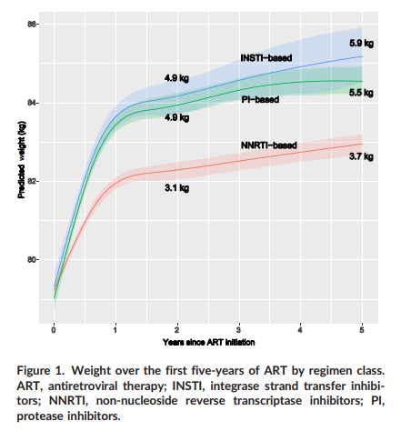
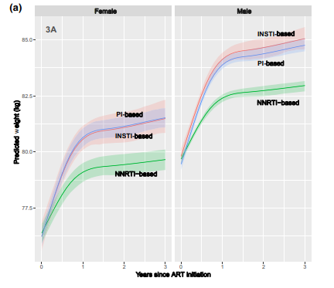
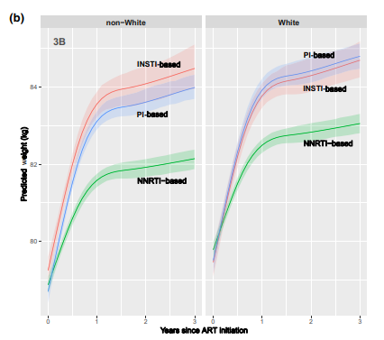
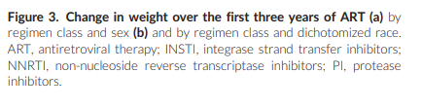
Weight Gain in People with HIV: NA-ACCORD 2007 - 2016
Bourgi K, et al. J Int AIDS Soc. 2020
Notes:
-Study population 97% male and 41% white; median age of ART initiation: 42 yrs.
-Majority of patients in all 3 grps had a TDF-containing NRTI backbone. Notably <1% of participants received TAF (to be discussed later).
-1: Individuals who started a PI or INSTI-based regimen gained more weight compared to NNRTI. There is considerable overlap between the INSTI and PI-based regimen weight gain vs. clear separate of NNRTI CI.
-3a: Male patients had greater weight gain for INSTI-based regimens where females had similar weight gain for INSTIs and PIs.
-3b: With race: INSTI-associated weight gain was greater than PI-associated weight gain only for non-whites vs. INSTI-associated change was INSTI-associated weight change was slightly lower than PI-associated weight change for whites, but these had overlapping CIs.

Slide 49
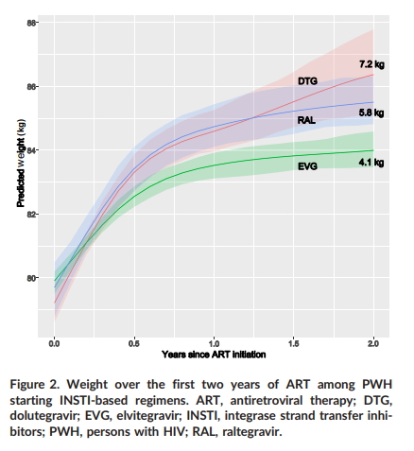
2007 – 2016 NA-ACCORD Weight Gain with INSTIs
Normal BMI to Overweight BMI
25% NNRTI
29% PI
32% INSTI
Overweight BMI to Obese BMI
22% NNRTI
26% PI
28% INSTI
Bourgi K, et al. J Int AIDS Soc. 2020
Notes:
-Notes: people starting RAL were older and had lower baseline CD4 counts; median year of ART initiation was earlier for RAL (2011) vs. EVG (2014) and DTG (2015). Majority of regimens with RAL and EVG were paired with TDF vs. regimens with DTG were co-formulated with ABC
-Patients who went from normal BMI to overweight BMI after 3 yrs
-Patients who went from overweight BMI to obese BMI after 3 yrs

Slide 50
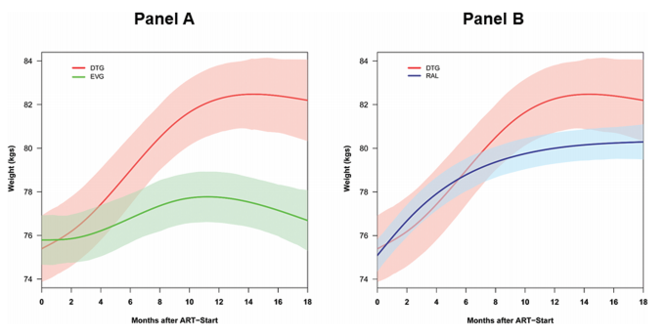
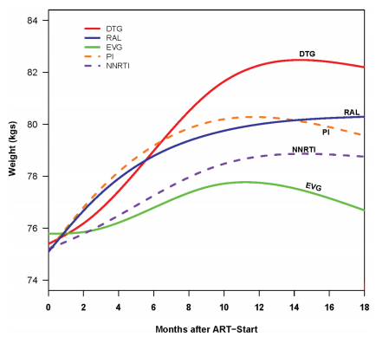
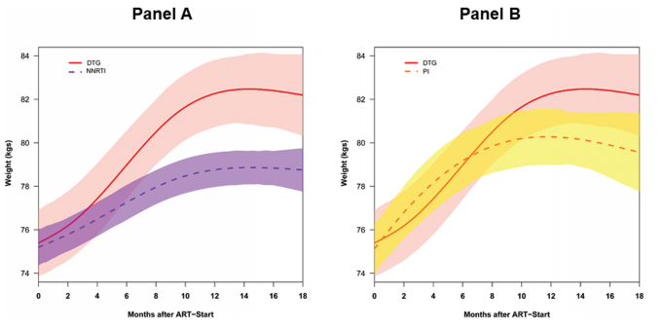
NA-ACCORD: Relative Weight Gain with Dolutegravir
Weight Gain at 18mos
DTG: +6.0kg
EVG: +0.5kg
RAL: +3.4kg
PI: +4.1kg
NNRTI: +2.6kg
Bourgi K, et al. J Int AIDS Soc. 2020
Notes:
-ALL patients had substantial weight gain within the first year of starting ART. Adjusted average weight gain was 2.4kg at 6 months and 3.9kg at 18 months.
-Dolutegravir-based regimens were associated with an adjusted average weight gain of 2.9kg at 6 months and 6.0kg at 18 mos. (significantly higher than EVG (0.6kg and 0.5kg) but not significantly different than RAL (3.0 and 3.4kg)
-NNRTI-based regimens associated with adjusted average weight gain of 1.1kg at 6 mos and 2.6kg at 18mos which was significantly less than DTG regimens but not significantly different than EVG regimens
-PI-based regimens associated with adjusted average weight gain of 2.6kg at 6mos and 4.1kg at 18mos which was statistically higher than EVG-based regimens and NOT significantly different than DTG regimens
-Neither sex nor race had a significant effect on weight gain. Women had an average of 0.4kg less than men. Black pts had an average of 0.1kg more than whites and other races.
-For patients with BMI <30, the odds of incident obesity during study follow up did not differ by ART regimen (odds of higher BMI were highest with DTG but this was not statistically significant)
-This study highlights the variation in short-term weight gain among ART-naïve PWH starting therapy
-By 2016, 1/3 of patients starting ART in this study were obese and more than half had a BMI higher than normal (over 25). In context of higher pre-treatment BMI among patients starting ART, short term weight gain after starting ART may be significantly contributing to longer term CV risk

Slide 51
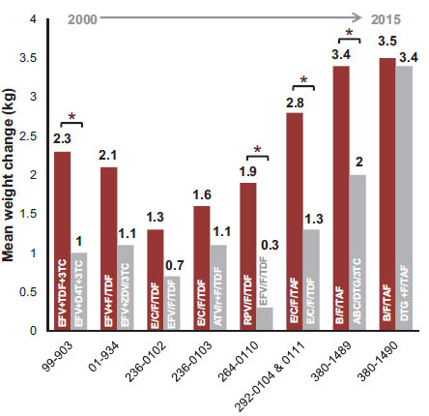
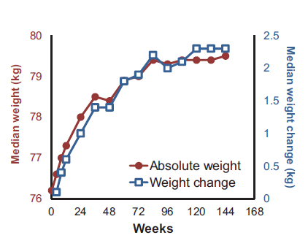
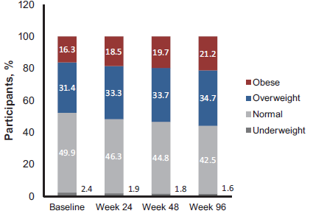
Weight Gain in People with HIV Starting ART: 2003 - 2015
Sax P, et al. Clin Infect Dis. 2020
Notes:
-Pooled analysis of 8 phase III RCTs of first-line ART initiation during 2003 – 2015 (N=5680) (over 10,000 person years of follow up)
-All studies included a baseline visit and FU visits every 12 weeks through at least week 96.
-Weight gain occurred in ALL study arms BUT not all study participants; 48.6% of participants had a 3% weight gain; 36.6% of participants had a 5% weight gain, and 17.3% of participants had a 10% weight gain and 30.2% of participants LOST weight
-(Left) Magnitude of weight gain was larger in more recent trials and the investigator regimen was consistently associated with more weight gain than comparator
-(Middle) Median weight gain in pooled analysis across all studies was 2kg with greatest gain noted in first 48 weeks [clinical significance?!]
-(Right) At ART initiation median BMI was 24.8 and 16.3% were considered obese; The proportion of participants in the overweight and obese BMI categories increased over time

Slide 52
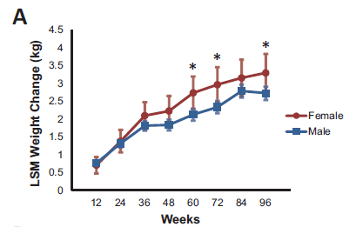
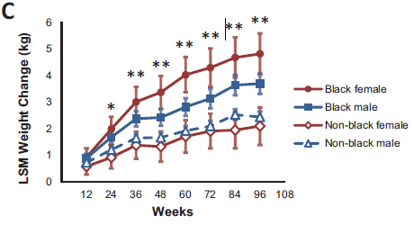
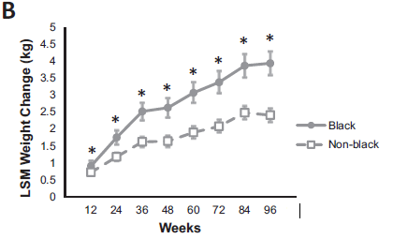
Demographics of Weight Gain in Pooled Analysis
Sax P, et al. Clin Infect Dis. 2020
Notes:
-Consistently females compared to males and blacks compared to nonblacks gained more weight
-Female sex and black race were associated with ≥10% weight gain. Statistically significant. OR for female vs. male: 1.54 and OR for black vs. nonblack: 1.32
-More black females experienced a statistically significant ≥10% weight gain than nonblack females (19.7% vs. 12.4%)
LSM = least squares mean

Slide 53
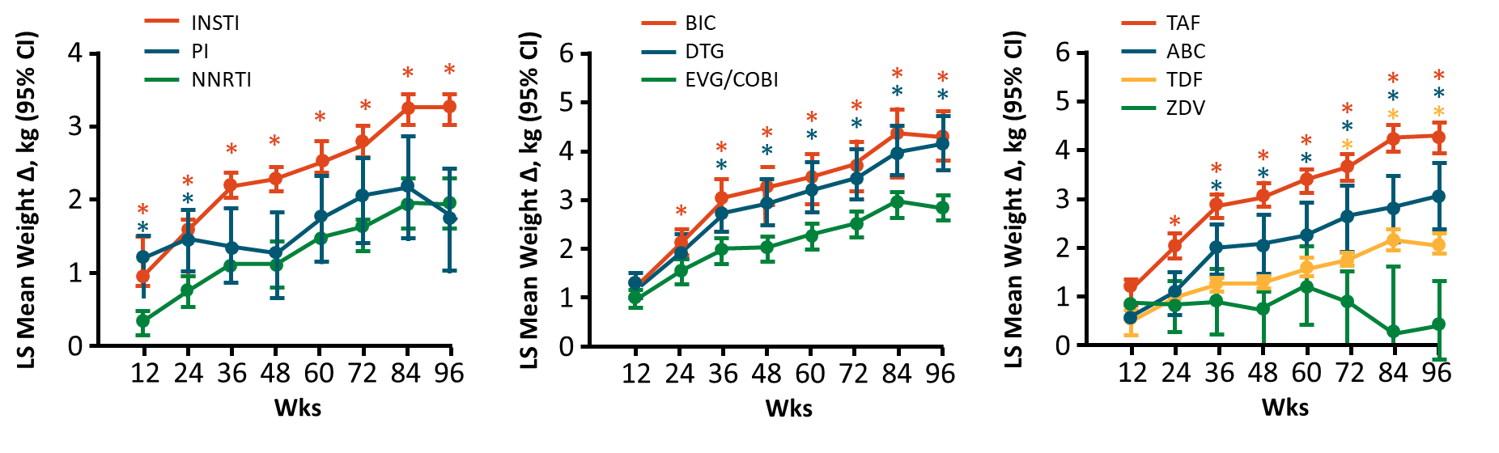
ART-Associated Weight Gain in Pooled Analysis
Sax P, et al. Clin Infect Dis. 2020, www.clinicalcareoptions.com
Notes:
These graphs are of MEAN weight. Similar trends were noted for absolute weights → see reference for those graphs
-(Left)Weight gain observed in all 3 drug classes: 3.24 for INSTI, 1.93 NNRTI, and 1.72 for PI class
-(Middle) Participants starting BIC or DTG had similar weight gain, both greater than those starting EVG/c; 4.24kg for BIC, 4.07kg for DTG, and 2.72kg for EVG/c
-(Right) Zidovudine used as a reference for the NRTIs; TAF had the most weight gain at 4.25kg, then ABC at 3.08kg, then TDF at 2.07kg and finally ZDV had 0.39kg weight gain.

Slide 54
Risk Factors for Weight Gain in Pooled Analysis
Risk Factors for ANY Weight Gain
Risk Factors for Significant (≥10%) Weight Gain
Variable | Difference, kg | (95% CI) | P value
CD4 count (<200 v ≥200) | 2.97 | (2.81-3.13 | <.001
IV drug use | 1.41 | (.97-1.85) | <.001
Race (black v nonblack) | 0.99 | (.87-1.11) | <.001
Viral load (>100k v ≤100k) | 0.96 | (0.84-1.08) | <.001
Symptomatic HIV | 0.51 | (.36-.65) | <.001
Sex (F v M) | 0.23 | (.07-.4) | .006
Age (<50 v ≥50y) | 0.22 | (.07-.37) | .004
BMI obese v normal overweight v normal | 0.21 0.24 | (.06-.36) (-.36 to -.13) | .005 <.001
Variable | OR | (95% CI) | P value
CD4 count (<200 v ≥200) | 4.36 | (3.6-5.27) | <.001
Viral load (>100k v ≤100k) | 1.98 | (1.65-2.37) | <.001
BMI obese v normal overweight v normal | 1.54 1.66 | (1.27-1.87) (1.29-2.15) | <.001 <.001
Sex (F v M) | 1.54 | (1.21-1.96) | <.001
Race (black v nonblack) | 1.32 | (1.10-1.59) | .003
Third ART Agent BIC/DTG v EFV EVG/c v EFV RPV v EFV ATV/r v EFV | 1.82 1.36 1.51 0.92 | (1.24-2.66) (1.04-1.78) (1.03-2.20) (.59-1.45) | .002 .026 .035 .73
NRTI TAF v ZDV TDF v ZDV ABC v ZDV TAF v ABC TDF v ABC TAF v TDF | 1.75 1.19 0.93 1.9 1.29 1.47 | (1.04-2.95) (.76-1.87) (.47-1.8) (1.25-2.88) (.79-2.11) (1.14-1.9) | 0.34 .44 .82 .003 .31 .003
Sax P, et al. Clin Infect Dis. 2020
Notes:
-Weight gain is ubiquitous in clinical trials of ART initiation and is multifactorial in nature with demographic factors, HIV-related factors, and the composition of ART regimens as contributors.
LEFT
-Baseline CD4 count had the strongest association with weight gain in multivariate models. People with CD4 <200 gained 2.97kg more than people with CD4 >200.
-Participants who did NOT inject drugs gained 1.41kg more than those who did
-Black race was associated with a mean of 0.99kg greater weight gain than other races
-Higher baseline viral load >100k was also associated with a mean of 0.96kg weight gain
-Stratification by sex and race revealed the greatest weight gain was among black female participants followed by black male participants
RIGHT
-Stratified data by those who gained ≥10% weight gain vs. those who did not over 48 weeks (which was 12.8% of total participants). People with ≥10% weight gain are more likely to be female or black, have a lower baseline weight or BMI, have a lower baseline CD4 count, and have a higher baseline HIV viral load.
-Multivariate analysis showed a lower CD4 cell count and a higher viral load were associated with greater odds of ≥10% weight gain
-Compared to EFV, the initiation of DTG or BIC as well as RPV but not ATV/r was associated with a ≥10% weight gain
-For NRTIs, Compared to ZDV, TAF was associated with ≥10% weight gain but not ABC or TDF; TAF also associated with ≥10% weight gain compared to ABC and TDF.

Slide 55
Weight Gain in the Current ART Era
Regimen | Change kg/6 mos | P value
EFV (reference) | 0.71 | 0.09
RPV | -0.36 | 0.58
ATV | 2.15 | 0.051
DRV | 3.68 | <0.001
RAL | 2.06 | 0.04
EVG/TDF | 1.81 | <0.01
EVG/TAF | 1.88 | <0.01
DTG/TDF | 2.61 | <0.001
DTG/TAF | 4.37 | <0.001
DTG/ABC | 2.28 | <0.001
BIC | 3.86 | <0.001
Ruderman SA, et al. J Acquir Immune Defic Syndr. 2021
Notes:
-Observational cohort with 1.9yrs of follow up
-Entire cohort gained weight after ART initiation across all regimens.
-Weight gain was most rapid in the immediate 6 months after ART initiation.
-More weight gained from regimens of BIC/FTC/TAF and DTG/FTC/TAF compared to other regimens.
-With extended follow up time, greater weight gain in INSTI- and DRV- based regimens compared to EFV/FTC/TDF and those taking DTG-based regimens had more weight than those on EVG/c regimens
-Conclusions: There is heterogeneity between regimens in weight gain following ART initiation. Trends for greater weight gain with INSTI-based regimens as well as DRV-based regimens confirmed from earlier studies.

Slide 56
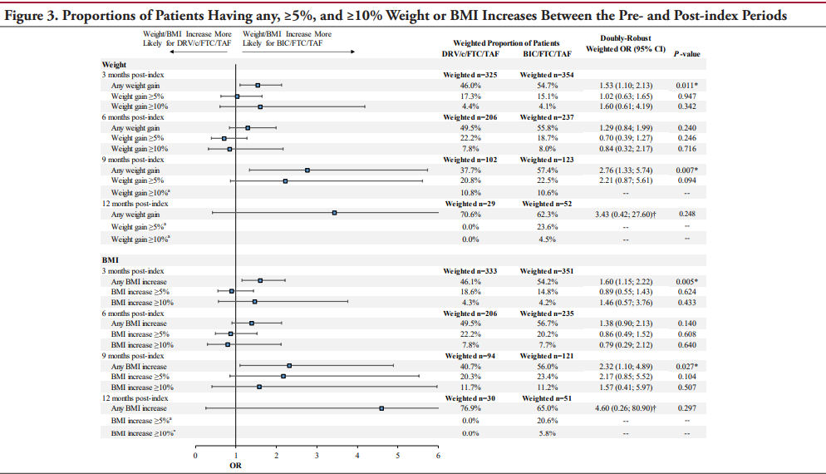
Predictors of Weight Change between Darunavir/C/F/TAF vs. B/F/TAF
Emond B, et al. JHEOR. 2021
Notes:
--Retrospective analysis comparing BMI and weight change for patients initiating treatment or are stable on current treatment with UD viral load (65-75% of patients switched from a previous regimen)
--Mean age: 52-53yo; 28-30% of females in each arm; 31-35% were white and 27-30% were black in each group; mean baseline BMI: 28-29 in each grp and mean baseline weight was 87-88kg
--Proportion of patients experiencing any weight or BMI increase was statistically significant for 3 mos and 9 months. The difference was not statistically significant for >5 or >10% increase (possibly due to small sample size)
--Overall mean difference in weight gain: 2.5kg (5.5#) and mean difference in BMI increase: 0.66.

Slide 57
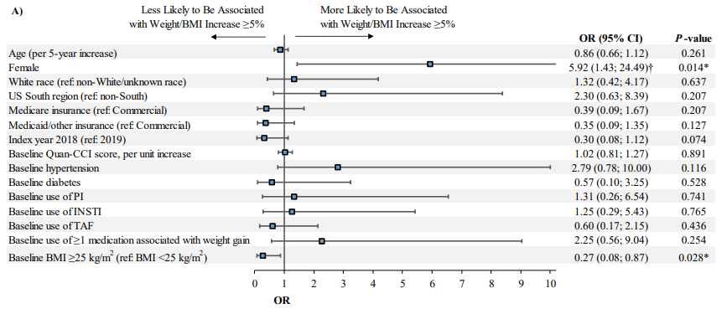
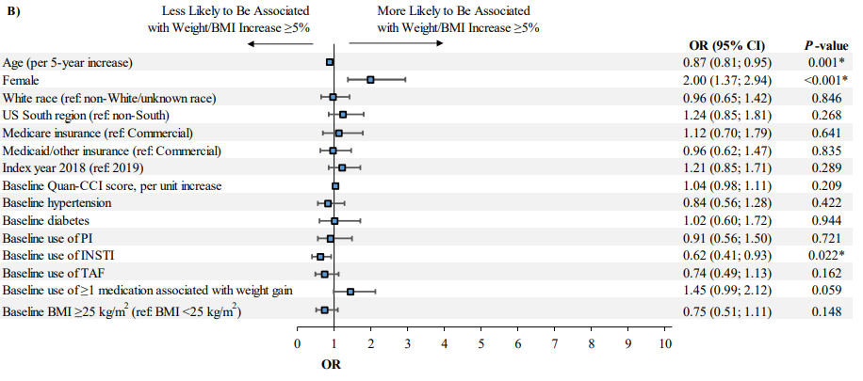
Predictors of Weight or BMI Increase ≥5%
Darunavir/Cobicistat/Emtricitabine/TAF
Bictegravir/Emtricitabine/TAF
Emond B, et al. JHEOR. 2021
Notes:
--For patients on DRV, female gender was associated with a higher likelihood of weight or BMI increase of ≥5% (OR=5.92) while higher baseline BMI (≥25) was associated with a lower likelihood of weight or BMI increase (OR=0.27).
--For patients on BIC, female gender was also associated with a higher likelihood of weight or BMI increase of ≥5% (OR=2.0) while a 5-yr increase in age and the previous use of an INSTI-based regimen were associated with a lower likelihood of weigh or BMI increase (OR for 5-yr age: 0.87) (OR for INSTI regimen: 0.62)
--Main predictor of weight or BMI gain in both cohorts was female gender.
--Study limited by small sample size but trends are consistent with prior studies.

Slide 58
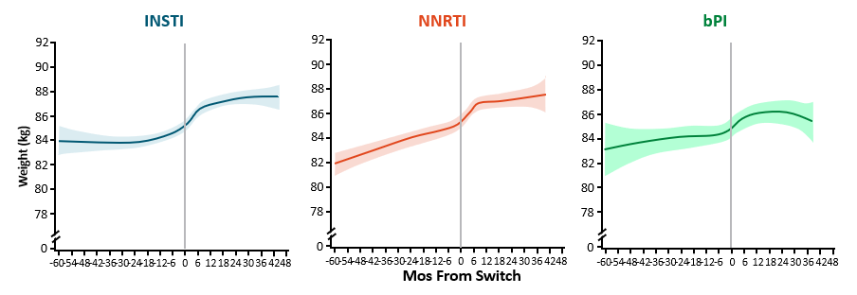
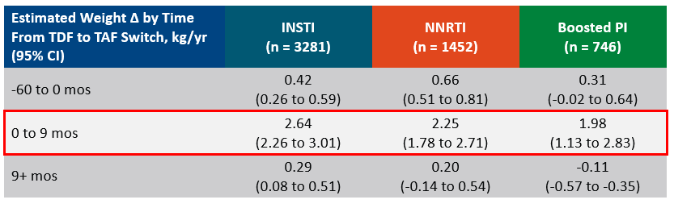
OPERA: Weight Change with Switch from TDF to TAF While Maintaining Other ART
Mallon PWG, et al. J Int AIDS Soc. 2021; www.clinicalcareoptions.com
Notes:
-Longitudinal cohort prospectively collecting data from 8% of US PWH (>115k people across US); people were receiving TDF-containing 3-drug regimen at baseline and were virologically suppressed
-Median age 44-51yo, 15-21% female, 37-39% black, 24-26% Hispanic, median BMI 26-27, median CD4 600-700
-Switch to TAF was associated with an immediate, pronounced weight gain regardless of other ART in regimen; During first 9-months after switch, estimated rates of weight gain ranged from 1.8-4.5kg/yr across regimens; Weight gain tended to slow down or plateau after 9mos after switch
-Modest weight gain observed over time on TDF for most of 0.24 – 0.71 kg/yr
-Data supports TAF as an independent contributor to weight gain

Slide 59
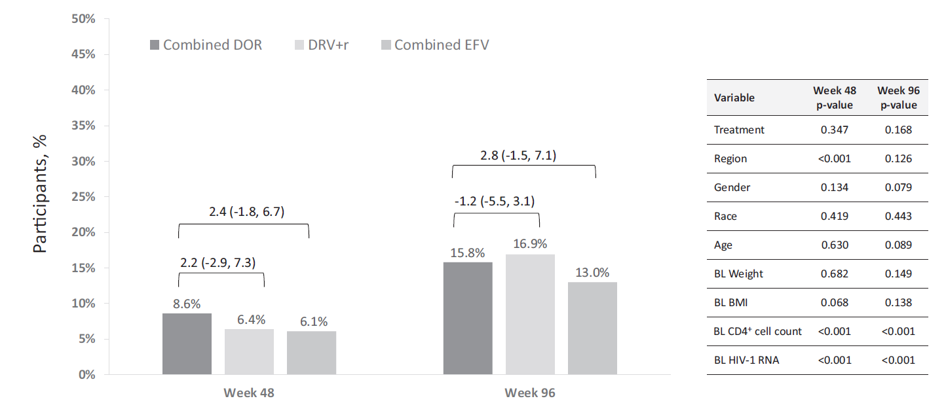
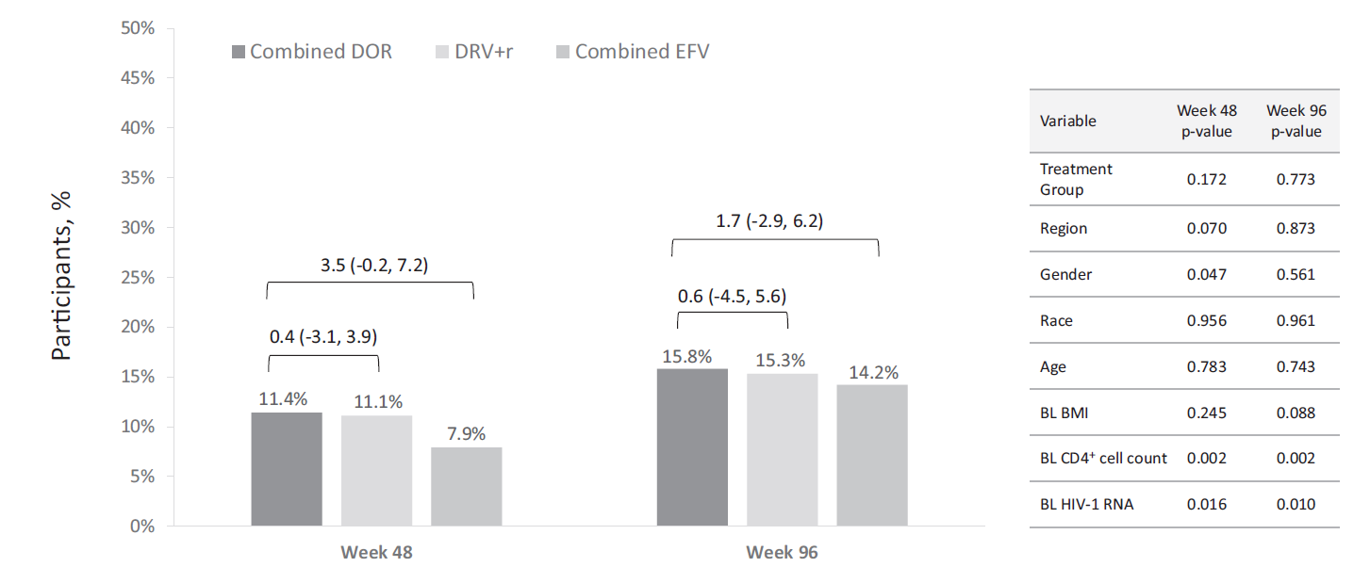
Weight and BMI Change Associated with Doravirine
Proportion of Patients with BMI Class Increase to Overweight or Obese
Proportion of Patients with At Least 10% Weight Gain
Orkin C, et al. AIDS. 2021
Notes:
-Pooled analysis from 3 RCT; patients been on DOR, DRV/b, or EFV-based regimen for at 48 weeks (measurements taken at 48 weeks and 96 weeks) (2 studies were DRIVE FORWARD and DRIVE AHEAD)
-Population 85% male, 20% black, 63% white, and 55.8% of patients were in the “normal” weight BMI category (BMI 18.5-25); 11.2% were considered obese
-(Left) Mean weight gain was similar at 48 wks with EFV having the least weight gain (DOR 1.7kg, DRV 1.4kg, EFV 0.6kg) and similar weight gain across all groups at 96 weeks (DOR 2.4, DRV 1.8, EFV 1.6) (not statistically different)
-(Right) The proportion of patients whose BMI class increased to overweight or obese was not statistically different between the DOR group and any of the other regimen grps at either 48 or 96 weeks
-Low baseline CD4 count and high baseline viral load were significant risk factors for at least 10% weight gain and for BMI class increase at both 48 and 96 weeks.
-Subgrp analysis did show mean weight gain tended to be higher in women and in black participants but sex and race were not consistently identified as risk factors for at least 10% weight gain or BMI class increase (study had low % of women and black participants so likely not powered enough to show this)
DRIVE FORWARD: DOR v. DRV/r with FTC/TDF or ABC/3TC (87% in each grp on FTC/TDF)
DRIVE AHEAD: DOR/3TC/TDF v. FTC/TDF/EFV

Slide 60
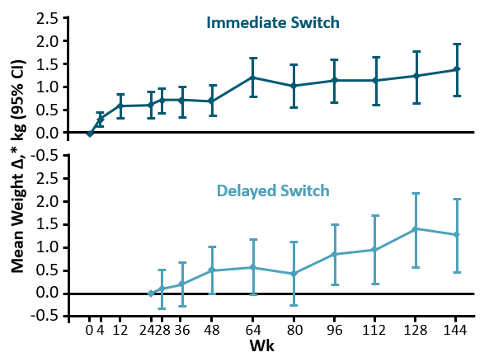
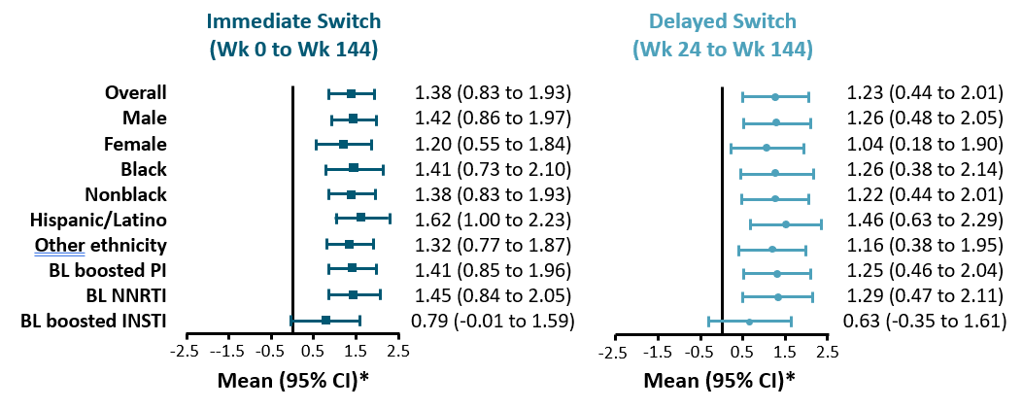
DRIVE SHIFT: Weight Gain with Doravirine
Johnson M, et al. J Acquir Immune Defic Syndr. 2019; Kumar P, et al. J Acquir Immune Defic Syndr. 2021; www.clinicalcareoptions.com
Notes:
-International, randomized, phase III open label study; adults stable on ART with UD VL switch immediately to DOR/3TC/TDF or delay switch for 24 wks
-Median age: 43yo, 83-87% male, 76-77% white, 12-14% black, mean CD4 650-665; 70% on baseline bPI, 23% on baseline NNRTI, and 5% on baseline EVG/c with TAF in most cases
-(Left) Modest weight gain noted. 0.7kg in immediate switch arm at 24weeks; 1.4kg and 1.2kg weight gained at 144wks
-(Right) No differences noted when stratified by sex, race, or ethnicity
-After 2 yrs, 71-73% of patients experienced <5% weight gain

Slide 61
Celebration of Learning: Case 4
Patient QT is a 51yo cisgender white female
PMH: HIV (Dx 9 months ago), Obesity (BMI = 41kg/m²), HLD
NKDA
Medications: Abacavir/dolutegravir/lamivudine, atorvastatin 10mg daily
Social History: Denies tobacco use; rare alcohol use
Labs: Baseline CD4 count 119 cells/mm³ and HIV viral load 29,000 copies/mL; Today CD4 count 175 cells/mm³ and HIV viral load <20 copies/mL; No resistance
Presents for follow up of HIV disease. Patient is concerned weight has increased from 250lbs to 285lbs (>10% weight gain) since starting ART.

Slide 62
Celebration of Learning: Case 4 Jeopardy
Which factors have been associated with weight gain after ART initiation?
Pre-treatment obesity, female sex, and treatment with dolutegravir
White race, CD4 count <200 cells/mm³, and treatment with abacavir
Pre-treatment obesity, age >50 years, and HIV viral load >10,000 copies/mL
Female sex, CD4 count <200 cells/mm³, and treatment with dolutegravir

Slide 63
Celebration of Learning: Case 4, cont.
What ART do you recommend for QT?
Continue abacavir/dolutegravir/lamivudine
Switch to darunavir/cobicistat/emtricitabine/tenofovir AF
Switch to bictegravir/emtricitabine/tenofovir AF
Switch to doravirine/lamivudine/tenofovir DF
Switch to dolutegravir/rilpivirine
Switch to raltegravir + emtricitabine/tenofovir AF
Switch to cabotegravir/rilpivirine
Something else?
Notes:
A not best and want to get patient off of ABC
B is ok, but DDI with atorvastatin is a consideration
C has essentially same weight gain associated with it as A
D is ok, but considerations are TDF with kidneys and bone density in 51yo female
E no bc CD4 <200 and requires food with admin
F ok but increased pill burden and TAF still associated with some weight gain
G maybe, but no enough data presented to make decision

Slide 64
Celebration of Learning: Case 5
Patient LL is a 29yo cisgender white female
PMH: HIV (Dx 3 years ago), HTN, chronic renal insufficiency, MAI (Dx last week)
Allergies: NKDA
Medications: amlodipine 5mg daily, lisinopril 20mg daily
Social History: 1 black and mild cigar daily; denies alcohol or illicit substance use; Employed FT as a cashier at local retail store; has Medicaid
Presents to clinic for return to care appointment and wishes to re-start ART. Was previously on ART regimen of darunavir/cobicistat/emtricitabine/tenofovir AF

Slide 65
Celebration of Learning: Case 5, cont.
Vitals:
  BP: 134/85mmHg
  Wt: 75kg
  BMI: 26kg/m²
Medications to start:
  Bactrim 400/80mg daily
  Azithromycin 500mg daily
  Ethambutol 1200mg daily
  Rifabutin 300mg daily
Labs
  Baseline genotype: no significant mutations
  CD4 count: 32 (2%) cells/mm³
  HIV RNA: 189,000 copies/mL
  HLA-B*5701 negative
  BUN/Scr: 25/2.2 mg/dL (stable; baseline)
  Crcl: 45-55 mL/min
  LFTs: wnl
  HepA Ab Neg
  HBsAb <3.5; HBsAg Neg
  HepC Ab Neg

Slide 66
Celebration of Learning: Case 5 Decision
What ART do you recommend starting for LL?
Darunavir/cobicistat/emtricitabine/tenofovir AF
Bictegravir/emtricitabine/tenofovir AF
Dolutegravir/abacavir/lamivudine
Doravirine/lamivudine/tenofovir DF
Dolutegravir + emtricitabine/tenofovir DF
Emtricitabine/rilpivirine/tenofovir DF
Dolutegravir/lamivudine
Something else?
Notes:
Best answers: C, E, G
No d/t drug interactions; would need to decrease rifabutin to 150mg TIW
No d/t drug interaction with rifabutin and TAF
D. No d/t drug interaction with rifabutin and DOR; recommended to use doravirine 100mg BID
F. No d/t rilpivirine component; shouldn’t use with CD4 <200 and VL >100K; when given with rifabutin, recommended to increase dose to 50mg daily
Rifabutin will decrease TDF concentrations so less concerned with renal function but monitor to make sure it doesn’t get worse
Treatment course x1 year

Slide 67
TDF vs. TAF Summary
eGFR, estimated glomerular filtration rate; HIP BMD, hip bone mineral density; LDL, low-density lipoprotein; PWID, people who inject drugs.
CDC PrEP Guidelines. https://www.cdc.gov/hiv/pdf/risk/prep/cdc-hiv-prep-provider-supplement-2021.pdf Accessed April 27, 2024; Ogbuagu O, et al. DISCOVER study. Lancet. 2021;8(7):e397-e407.

Slide 68
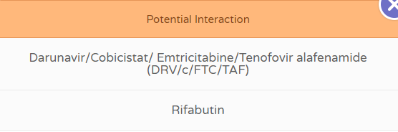
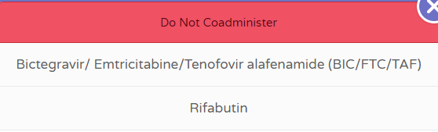
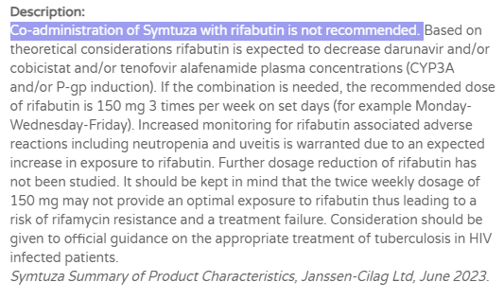
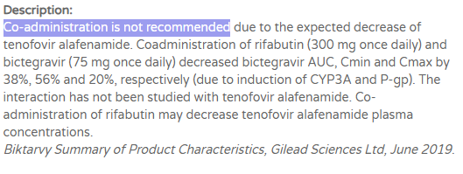
Rifabutin Drug Interactions
www.hiv-druginteractions.org

Slide 69
Summary
With only rare exceptions, most all patients will qualify for immediate or rapid start of ART after diagnosis.
All HIV-negative patients exposed to HIV with substantial risk for transmission should be started on a 3-drug ART regimen of, or equivalent to, dolutegravir + emtricitabine/tenofovir DF.
Female sex, lower baseline CD4 count, higher baseline viral load, and black or non-white race, in addition to initiation of an integrase inhibitor-based ART, may be factors that contribute to weight gain.
Many factors must be taken into consideration when starting a patient on ART who also has an OI, including but not limited to: resistance history, co-morbidities, and drug interactions.

Slide 70

Questions?

Slide 71
Thank you!

Slide 72
Contact Information
Eric Farmer, PharmD, BCPS, AAHIVP
Indiana University Health LifeCare Clinic
efarmer1@iuhealth.org

Slide 73
Resources
National Clinician Consultation Center: nccc.ucsf.edu
HIV Management
Perinatal HIV
PrEP and PEP Lines
HCV Management
Substance Use Management
National Coordinating Resource Center: aidsetc.org
Opioid Response Network: opioidresponsenetwork.org
National HIV PrEP Curriculum: hivprep.uw.edu
National HIV Curriculum: hiv.uw.edu
National STD Curriculum: std.uw.edu
Hepatitis C Online: hepatitisc.uw.edu
Hepatitis B Online: hepatitisb.uw.edu
AETC National HIV-HCV Curriculum: aidsetc.org/hivhcv
IU HIV ECHO: echo.iu.edu
Midwest AIDS Training + Education Center: matec.info

Slide 74
MATEC Collaborative Learning Series
REMINDER:
Text Attendance
Please text 91622 to 317-671-8998.
You have 60 minutes prior, during, and 120 minutes after the end of the activity to text in your attendance

