Slide 1
Hepatitis C Overview for Primary Care
Jan M. Stockton, MSN, RN, AACRN, ACNS
Project Coordinator, MATEC-OH
University of Cincinnati Medical Center

Slide 2
MATEC Statement on Equity and Inclusion
MATEC has a strong commitment to fair, respectful and unbiased representation of humankind. We strive to be anti-racist, gender affirming and honor all people in an authentic way. This is our goal in all of our work, including this presentation.
Our commitment to you is that we take this stance seriously and invite you to do the same. We ask that if you find something offensive, off-putting, or inaccurate to please let us know.
We continue to grow and evolve and welcome you on our journey.

Slide 3
Disclaimer
This presentation is supported by the Health Resources and Services Administration (HRSA) of the U.S. Department of Health and Human Services (HHS) as part of an award totaling $4,067,580.00 with 0 percentage financed with nongovernmental sources. The contents are those of the author(s) and do not necessarily represent the official views of, nor an endorsement, by HRSA, HHS or the U.S. Government.

Slide 4
Disclosure
Nothing to disclose

Slide 5
Learning Objectives
Define “hepatitis”, including differences and similarities among Hepatitis A, Hepatitis B, and Hepatitis C.
Describe Hepatitis C epidemiology in the US, routes of transmission, and associations with HIV infection.
List tests used to diagnose and stage Hepatitis C.
Describe the plan of care for persons with chronic Hepatitis C including recommended treatment, patient education, and follow up.

Slide 6
Acknowledgements
Hepatitis B Online Course
https://www.hepatitisb.uw.edu/
Hepatitis C Online Course
https://www.hepatitisc.uw.edu/
Hepatitis C Questions and Answers for Health Care Professionals
https://www.cdc.gov/hepatitis/hcv/hcvfaq.htm

Slide 7
Acknowledgements
Hepatitis B Online Course
https://www.hepatitisb.uw.edu/
Hepatitis C Online Course
https://www.hepatitisc.uw.edu/
Hepatitis C Questions and Answers for Health Care Professionals
https://www.cdc.gov/hepatitis/hcv/hcvfaq.htm

Slide 8
Define “hepatitis”, including differences and similarities among Hepatitis A, Hepatitis B, and Hepatitis C.

Slide 9
Functions of the Liver
Manufactures key substances
Cholesterol
Used in producing hormones
Component of cell membrane
Proteins
Support normal body functions
Clotting factors
Glucose storage
Metabolizes medications
Removes toxic substances

Slide 10
Hepatitis
Inflammation of the liver
Caused by:
Chemical agents
Alcohol
Medications
Industrial solvents
Viral infection
5 types
Hepatitis A, Hepatitis B, and Hepatitis C most common

Slide 11
Hepatitis A (HAV)
NOT a bloodborne pathogen
Transmitted by oral-fecal route
Poor handwashing
Contaminated water
Oral-anal contact
11,500 new cases estimated in 2021 with 135 deaths
4x higher than 2015
Highest among age 30-39
Usually asymptomatic
Vaccine available
Safe and effective

Slide 12
Hepatitis B (HBV)
About 90% persons over age 6 with HBV infection will clear it
Only 30-35% in infants and children
2.2 million in US chronically infected
70% foreign born
Only 25-35% diagnosed
Decreasing incidence since vaccine made available

Slide 13
Hepatitis B (HBV)
Routes of Transmission
Sharing drug injection equipment
Sexual contact, particularly MSM
From pregnant woman to infant
Mortality
Treatable but not curable
25% with chronic HBV progress to liver cancer
Leading cause of liver cancer worldwide

Slide 14
HBV Risk Groups
Men having sex with men
Multiple sex partners
Injecting drug users
Infants born to infected mothers
Healthcare workers
Emergency responders
Hemodialysis patients

Slide 15
Hepatitis C (HCV)
Most common blood-borne pathogen in US
Estimated 2.4 million persons with chronic HCV
Decreasing due to availability of treatment
85% develop chronic hepatitis with fibrosis
20% develop cirrhosis over 20-30 years
5% die of liver cancer or failure
No vaccine available
Over 90% cure rates with treatment

Slide 16
HCV Infection
Symptoms
Jaundice
Nausea
Abdominal pain
Clay-colored stools
Up to 80% asymptomatic until advanced disease
45-50% unaware of infection

Slide 17
Describe Hepatitis C epidemiology in the US, routes of transmission, and associations with HIV infection.

Slide 18
HCV Demographics
Males 3x females
50+% total chronic HCV cases over age 55
Most new cases among persons aged 30-39
Caucasians 80% of cases
Rate highest among Native American/Alaska Native
Region: 9 states account for 52% of cases
CA
TX
FL
NY
PA
OH
MI
TN
NC

Slide 19
HCV Transmission
Substance use
Persons who inject drugs 60-90% of cases
Intranasal cocaine use
Sexual transmission
10% HCV+ persons only risk factor is sexual contact with HCV-infected partner
MSM rates higher than other groups
HIV+ > HIV-
Perinatal exposure
6% risk
12% if mother is co-infected with HIV

Slide 20
HCV Transmission
Infected blood/blood products
Transfusion recipients (before 1992)
Less than 1 case per 2 million transfused units
Inadequately disinfected surgical instruments and dialysis equipment
Failure to adhere to infection control principles
Reusing syringes, single-dose vials
Contaminated needles and sharps
Healthcare workers and emergency responders
Household contacts, tattoos rare

Slide 21
Comparing Bloodborne Pathogens in US
 | HBV | HCV | HIV
Prevalence | 2.2 million | 2.4 million | 1.2 million
Incidence | 14,229 | 69,800 | 35,769
Unknown Diagnosis | 25% | 45-50% | 13%
Primary Routes of Transmission | Inj. Drug Use Sexual Contact | Inj. Drug Use Sexual Contact | Sexual Contact Inj. Drug Use
Curable | No | Yes | No
Deaths | 1,752 | 13,385 | 19,623

Slide 22
Duration of Injection Drug Use and Prevalence of Blood-Borne Viruses
100
80
HCV
60
Estimated Seroprevalence (%)
HBV
HIV
40
HTLV
20
0
0-4
5-8
9-12
13-24
25-36
37-48
49-60
61-72
Duration of Injection Drug Use (Months)
HTLV, human T-lymphotropic virus.
Garfein RS, et al. Am J Public Health. 1996;86:655-661.
clinicaloptions.com/hep
Notes:
22
In this study, Garfein and colleagues estimated the prevalence and correlates of 4 blood-borne viral infections in drug users with up to 6 years of injecting experience.
Overall, seroprevalence of HCV was very high (77%) among short-term injection drug users and exceeded that of any other blood‑borne infection, including HIV and hepatitis B. Seropositivity for HCV was rapidly acquired. The prevalence of HCV was 64.7% among those who had injected for 1 year or less. The hepatitis C and B viruses were associated with injection drug habits, whereas HIV was associated with sexual variables.

Slide 23
HCV-HIV Co-infection
5% adults with chronic HCV also HIV-infected
15-30% adults with HIV infection also chronic HCV
Impact of co-infection on HCV disease
Accelerated progression of fibrosis
Cirrhosis occurs 12-16 years earlier
Impact of co-infection on HIV disease
Higher levels of liver-related complications
80-90% liver-related deaths due to HCV

Slide 24
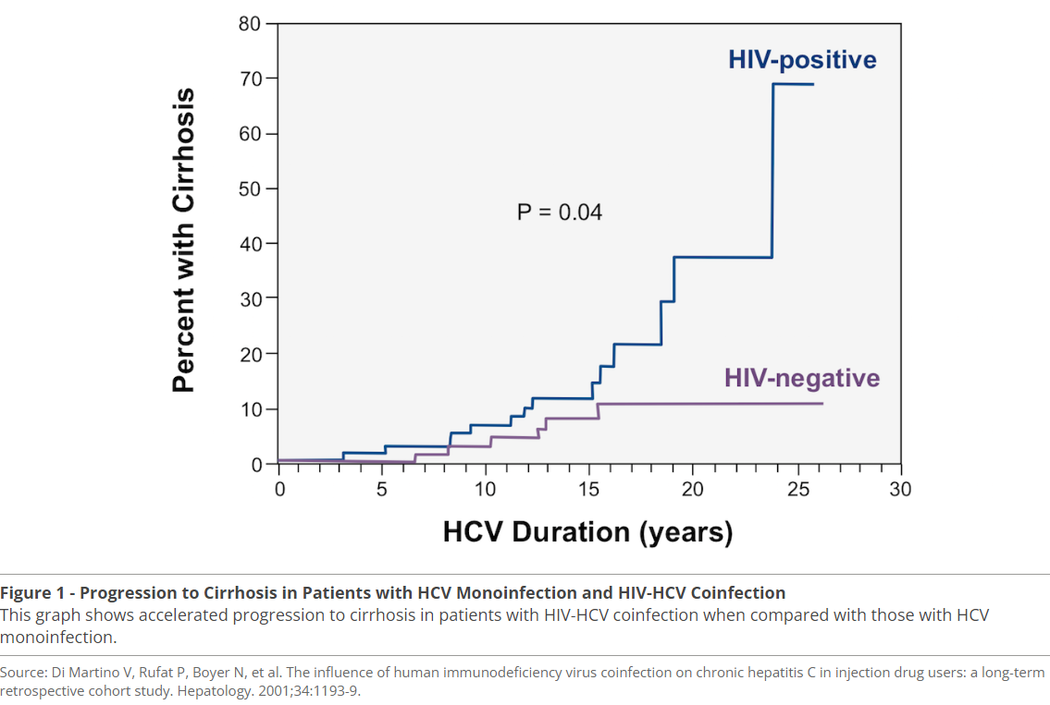

Slide 25
List tests used to diagnose and stage Hepatitis C.

Slide 26
Screening for HCV Infection
Schillie S, Wester C, Osborne M, Wesolowski L, Ryerson AB. CDC Recommendations for Hepatitis C Screening Among Adults - United States, 2020. MMWR Recomm Rep. 2020;69:1-17.

Slide 27
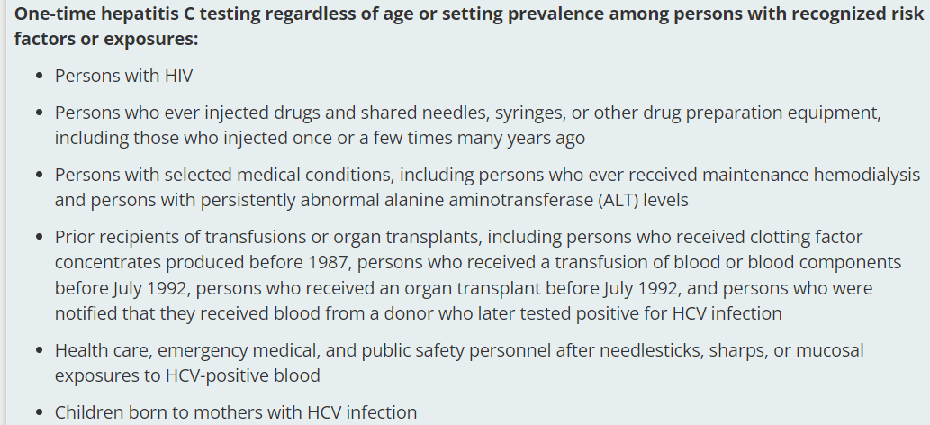
Testing for HCV Infection
Schillie S, Wester C, Osborne M, Wesolowski L, Ryerson AB. CDC Recommendations for Hepatitis C Screening Among Adults - United States, 2020. MMWR Recomm Rep. 2020;69:1-17.

Slide 28
Testing for HCV Infection
Schillie S, Wester C, Osborne M, Wesolowski L, Ryerson AB. CDC Recommendations for Hepatitis C Screening Among Adults - United States, 2020. MMWR Recomm Rep. 2020;69:1-17.

Slide 29
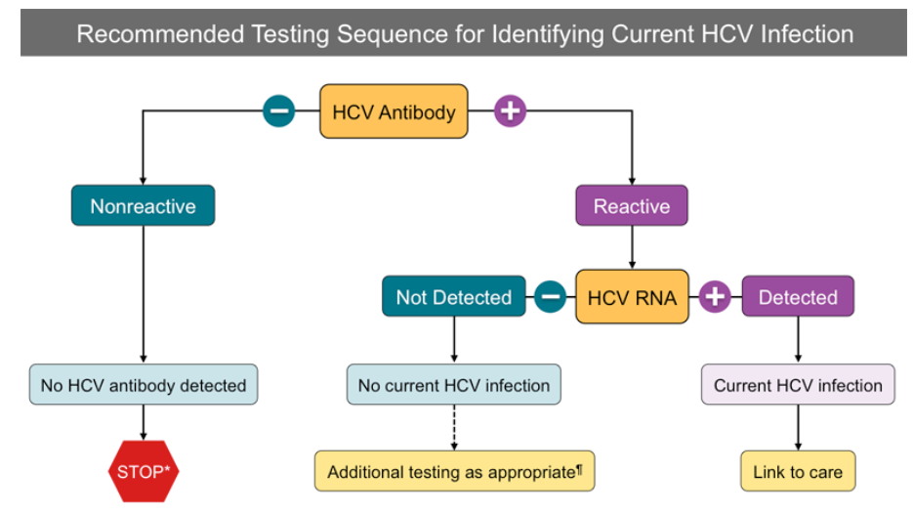
HCV Antibody with reflex to HCV RNA
Centers for Disease Control and Prevention (CDC). Testing for HCV infection: an update of guidance for clinicians and laboratorians. MMWR Morb Mortal Wkly Rep. 2013;62:362-5.

Slide 30
Spontaneous Clearance
Estimated 55-85% persons with HCV infection will develop chronic HCV.
Factors associated with clearance
Younger age
Female gender
Symptoms during acute infection
Absence of HIV infection
Lower rates in Black men

Slide 31
Initial Laboratory Evaluation
HCV Studies
HCV RNA, genotype
Hepatic profile
CBC, renal profile, thyroid function
Relevant co-infections
HAV IgG
HBV SAg, CAb, SAb
HIV

Slide 32
Fibrosis Staging
Scarring due to ongoing inflammation, eventually causing cirrhosis and end-stage liver disease
Progresses faster with older age, coinfection with HIV and/or HBV, male sex, obesity, fatty liver disease, insulin resistance, alcohol consumption, and possibly cannabis use
Mild to moderate fibrosis can be treated in primary care settings, but persons with cirrhosis should be referred to Hepatology or Infectious Disease

Slide 34
Fibrosis Staging
Liver biopsy
Only if non-invasive studies provide conflicting results or second cause of liver disease is suspected
Indirect Markers predict presence or absence of significant fibrosis or cirrhosis
APRI (AST, AST ULN, Platelet count)
FIB-4 (Age, AST, ALT, Platelet count)
Fibroindex (AST, Platelet count, Gamma Globulin)
FORNS Index (Age, GGT, Cholesterol, Platelet Count)
Fibro Test (Age, Gender, 5 biomarkers associated with hepatic fibrosis)

Slide 35
Fibrosis Staging
Hepatic ultrasound
Screening for hepatocellular carcinoma
Not recommended for liver disease staging
Transient elastography (FibroScan)
Uses ultrasound transducer to measure liver stiffness
Examines larger area than biopsy
Takes 5-10 minutes
Most accurate for identifying cirrhosis

Slide 36
Describe the plan of care for persons with chronic HCV, including recommended treatment, patient education, and follow up.

Slide 37
Plan of Care for Persons Living with HCV
OH Medicaid removed most HCV treatment restrictions in 2021.
No longer has any sobriety requirement
Consistent with the recommendations of the American Association for the Study of Liver Disease
Includes Medicaid provider managed care plans (Molina, CareSource, Buckeye, Paramount, United Healthcare)
No longer has requirement for severe fibrosis
Still requires consultation by GI, Hepatology, or Infectious Diseases specialist
https://www.harmreductionohio.org/what-you-need-to-know-about-hepatitis-c-treatment-in-ohio/
Accessed 1/31/2024

Slide 38
Simplified HCV Treatment for Treatment Naïve Patients
Eligibility Criteria
Adults with chronic HCV infection, including persons living with HIV:
Infected with any HCV genotype
Have NOT previously received HCV treatment
Without cirrhosis or with compensated cirrhosis (Child-Pugh A)
Cirrhosis determination based on any of the following: - Liver stiffness >12.5 kPa by FibroScan - FIB-4 >3.25 - Non-invasive serologic test (HCV FibroSure or enhanced liver fibrosis test) - Liver biopsy - Liver modularity or splenomegaly on imaging - Platelet count <150,000/mm³
https://www.hepatitisc.uw.edu/go/treatment-infection/multi-genotype-treatment-new-lesson/core-concept/all
Accessed 2/12/2024

Slide 39
Simplified HCV Treatment for Treatment Naïve Patients
Ineligibility Criteria
Adults with chronic HCV infection who have any of the following:
Previously received HCV treatment
Hepatitis B surface antigen-positive
Compensated cirrhosis (Child-Pugh A) with end-stage renal disease (eGFR <30 mL/min/m²
Current or prior decompensated cirrhosis, defined by Child-Pugh score ≥7
Current Pregnancy
Known or suspected hepatocellular carcinoma
Prior liver transplantation
https://www.hepatitisc.uw.edu/go/treatment-infection/multi-genotype-treatment-new-lesson/core-concept/all
Accessed 2/12/2024

Slide 40
Recommended HCV Treatment Options
Routine genotype assessment is not part of the simplified HCV treatment algorithm for patients without cirrhosis, and as such, the AASLD-IDSA HCV Guidance recommends the following two pan-genotypic regimens for persons without cirrhosis who have met eligibility for the simplified treatment approach:
gle/pib: Mavyret®; sof/vel: Epclusa®
https://www.hepatitisc.uw.edu/go/treatment-infection/multi-genotype-treatment-new-lesson/core-concept/all#recommended-simplified-treatment-regimens-patients-without-cirrhosis
Accessed 2/12/2024

Slide 41
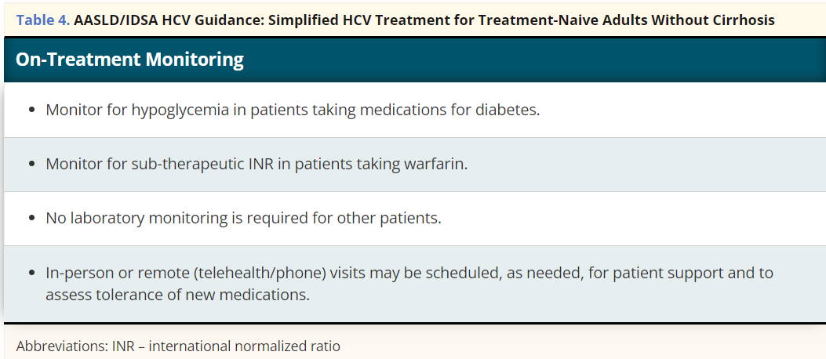
AASLD-IDSA. HCV Guidance: Recommendations for testing, management, and treating hepatitis C. Simplified HCV Treatment for Treatment-Naive Adults Without Cirrhosis.
https://www.hcvguidelines.org/treatment-naive/simplified-treatment Accessed 2/12/2024

Slide 42
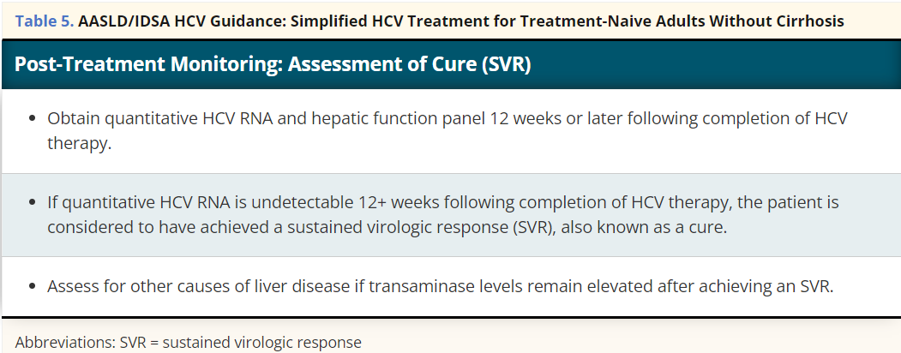
AASLD-IDSA. HCV Guidance: Recommendations for testing, management, and treating hepatitis C. Simplified HCV Treatment for Treatment-Naive Adults Without Cirrhosis.
https://www.hcvguidelines.org/treatment-naive/simplified-treatment Accessed 2/12/2024

Slide 43
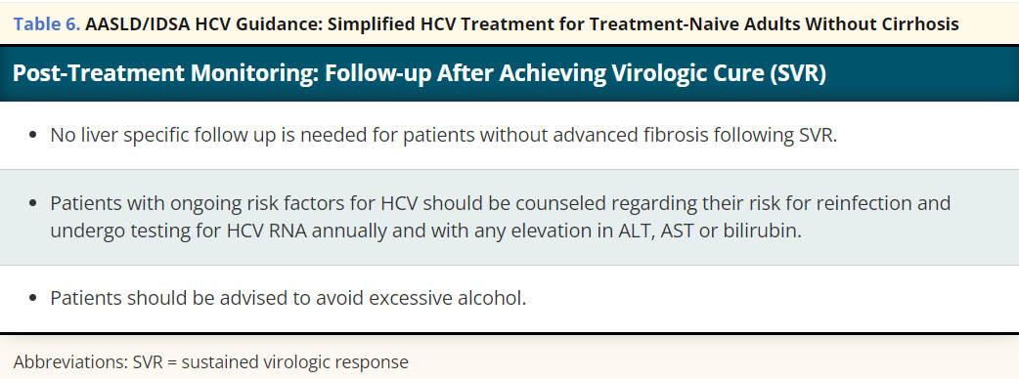
AASLD-IDSA. HCV Guidance: Recommendations for testing, management, and treating hepatitis C. Simplified HCV Treatment for Treatment-Naive Adults Without Cirrhosis.
https://www.hcvguidelines.org/treatment-naive/simplified-treatment Accessed 2/12/2024

Slide 44
Plan of Care for Persons Living with HCV or HCV-Related Liver Disease
Reduce risk of advanced liver disease
Minimize risk of preventable infections
Educate about preventing transmission to others

Slide 45
Plan of Care for Persons Living with HCV or HCV-Related Liver Disease
Reduce risk of advanced liver disease
Alcohol consumption: no “safe” level
Baseline Screening
Periodic follow up screening

Slide 46
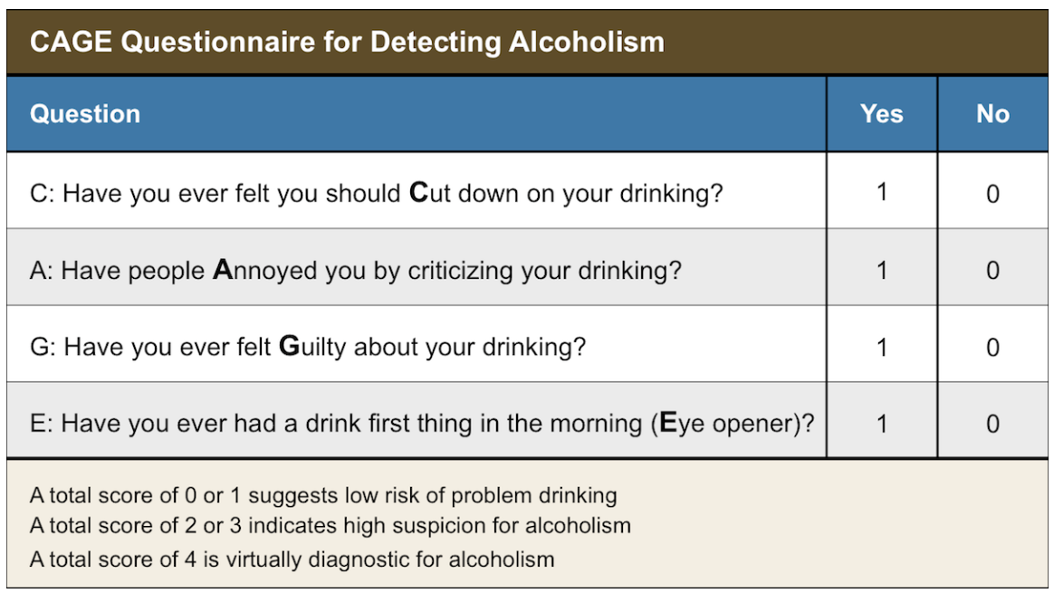

Slide 47
Bush K, Kivlahan DR, McDonell MB, Fihn SD, Bradley KA. The AUDIT alcohol consumption questions (AUDIT-C): an effective brief screening test for problem drinking. Ambulatory Care Quality Improvement Project (ACQUIP). Alcohol Use Disorders Identification Test. Arch Intern Med. 1998;158:1789-95.

Slide 48
Plan of Care for Persons Living with HCV or HCV-Related Liver Disease
Reduce risk of advanced liver disease
Alcohol consumption: no “safe” level
Baseline Screening
Periodic follow up screening
Cannabis
Mixed results, with several studies showing “frequent” smoking increases risk of cirrhosis
Tobacco
Potentially accelerates hepatic fibrosis
Increases risk of HCC

Slide 49
Plan of Care for Persons Living with HCV or HCV-Related Liver Disease
Reduce risk of advanced liver disease
OTC medications
Acetaminophen up to 2 gm/daily if no cirrhosis; 1 gm/daily max with cirrhosis
Avoid aspirin, NSAIDs with cirrhosis
Avoid iron supplements unless anemic or GI bleeding
Vit A and D at standard doses only
Complimentary/Alternative Therapies
May have harmful effects on liver
Possible interactions with HCV treatment

Slide 50
Plan of Care for Persons Living with HCV or HCV-Related Liver Disease
Reduce risk of advanced liver disease
Well-balanced diet
Cirrhosis often associated with malnutrition
Protein restriction does not reduce risk of encephalopathy
Obesity
Fatty liver disease increases risk of cirrhosis, HCC, ESLD; requires ongoing monitoring after HCV treatment
Coffee
3+ cups/day significantly reduces hepatic fibrosis, cirrhosis

Slide 51
Plan of Care for Persons Living with HCV or HCV-Related Liver Disease
Minimize risk of preventable infections
HAV immunization
HBV immunization
Pneumococcal immunization
Persons aged 19-64 with chronic liver disease receive one dose of 23-valent polysaccharide pneumococcal vaccine (PPSV23)
Persons over age 65: standard vaccine recommendations

Slide 52
Plan of Care for Persons Living with HCV or HCV-Related Liver Disease
Educate about preventing transmission to others
Injection drug use
Reduce the frequency of injecting
Use new, sterile needles/syringes each time
Do not share or reuse needles/syringes
Safely dispose of needles and syringes
Do not share or reuse other injection materials, including cookers, cottons, water, and drugs
Receive substance use treatment and support for safe injection practices

Slide 53
Plan of Care for Persons Living with HCV or HCV-Related Liver Disease
Educate about preventing transmission to others
Sexual contacts
Using latex condoms
Avoiding sex practices that potentially result in bleeding
Household contacts
Avoid sharing personal care items that contain any trace of blood
HCV can survive outside the body for at least several days
Blood clean up with dilution of 1 part bleach to 10 parts water
Wear gloves during entire cleanup.
HCV is not spread through food, water, eating utensils, or casual contact

Slide 54
Questions?

Slide 55
Contact Information
Jan M. Stockton, MSN, RN, AACRN, ACNS
HIV Clinical Nurse Specialist/Project Consultant
Midwest AIDS Training + Education Center
University of Cincinnati Medical Center
stocktjm@ucmail.uc.edu

Slide 56
Speaker Resources
Hepatitis B Online Course
https://www.hepatitisb.uw.edu/
Hepatitis C Online Course
https://www.hepatitisc.uw.edu/
Hepatitis C Questions and Answers for Health Care Professionals
https://www.cdc.gov/hepatitis/hcv/hcvfaq.htm

Slide 57
MATEC Resources
National Clinician Consultation Center http://nccc.ucsf.edu/
HIV Management
Perinatal HIV
HIV PrEP
HIV PEP line
HCV Management
Substance Use Management
AETC National HIV Curriculum https://aidsetc.org/nhc
AETC National HIV-HCV Curriculum https://aidsetc.org/hivhcv
National PrEP Curriculum https://www.hivprep.uw.edu
Hepatitis B Online https://www.hepatitisb.uw.edu
Hepatitis C Online https://www.hepatitisc.uw.edu
AETC National Coordinating Resource Center https://aidsetc.org/
Additional Trainings https://matec.info

