Slide 1
Transgender 101
Jonna J Cooley, PhD Executive Director of Phoenix Center Team
June 6, 2024

Slide 2
MATEC Statement on Equity and Inclusion
MATEC has a strong commitment to fair, respectful and unbiased representation of humankind. We strive to be anti-racist, gender affirming and honor all people in an authentic way. This is our goal in all of our work, including this presentation.
Our commitment to you is that we take this stance seriously and invite you to do the same. We ask that if you find something offensive, off-putting, or inaccurate to please let us know.
We continue to grow and evolve and welcome you on our journey.

Slide 3
Disclaimer
This program is supported by the Health Resources and Services Administration (HRSA) of the U.S. Department of Health and Human Services (HHS) as part of an award totaling $4,036,482.00 with 0 percentage financed with nongovernmental sources. The contents are those of the author(s) and do not necessarily represent the official views of, nor an endorsement, by HRSA, HHS or the U.S. Government.

Slide 4
Disclaimer
Funding for this presentation was made possible by grant number U1OHA29293 from the Human Resources and Services Administration HIV/AIDS Bureau. The views expressed do not necessarily reflect the official policies of the Department of Health and Human Services nor does mention of trade names, commercial practices, or organizations imply endorsement by the U.S. Government. Any trade/brand names for products mentioned during this presentation are for training and identification purposes only.

Slide 5
Speaker Disclosures
Speaker: Jonna J Cooley PhD
Disclosures: None

Slide 6
Learning Objectives
Explain the four main LGBT concepts.
Define key terminology and concepts related to transgender individuals.
Discuss social and medical transitioning.
Identify implicit bias and microaggressions as they apply to the transgender community.
Demonstrate how to create a welcoming environment for transgender individuals and the LGBTQ community.
Discuss the impact of HIV within the transgender community and healthcare barriers.

Slide 7
Four Main Concepts

Slide 8
Four Main Concepts
Biological Sex Sexual Orientation Gender Identity Gender Expression

Slide 9
Biological Sex
Biological sex refers to the internal and external sex organs, hormones, and chromosomes you possess.
Female
Male

Slide 10
Sexual Orientation
Sexual and/or romantic attraction

Slide 11
Gender Identity
Gender identity is one's personal experience of one's own gender. Gender identity is all about how you think about yourself. This is generally described as one's private sense of being male or female.
Research indicates that we form our gender identities around the age of three.

Slide 12
Gender Dysphoria

Slide 13
Gender Expression Gender expression is how you demonstrate gender through the ways you act, dress, behave, and interact – whether intentional or unintended.

Slide 15
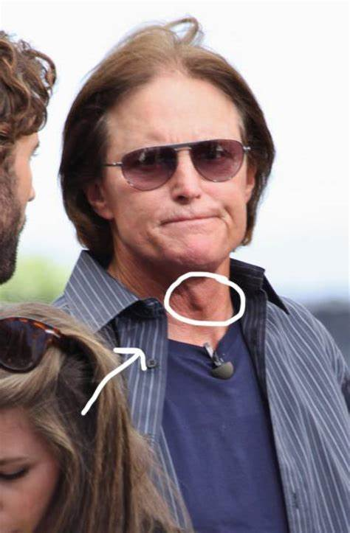
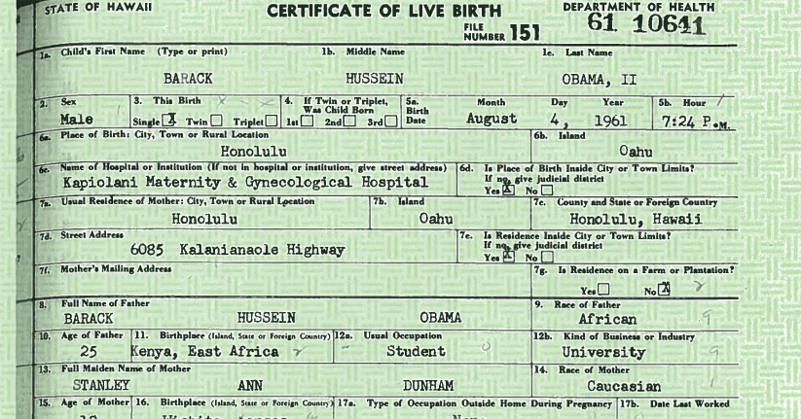
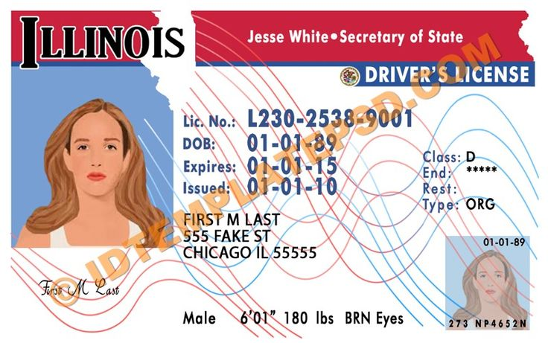
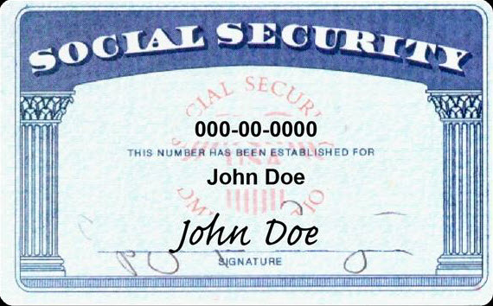
Social & Medical Transitioning

Slide 16
Bias

Slide 17
Bias & Myths

Slide 18
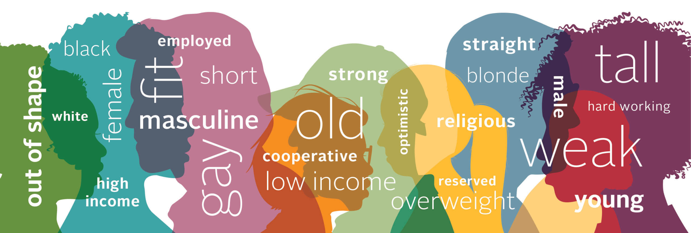
Implicit Bias
Relatively unconscious and relatively automatic features of prejudiced judgment and social behavior.

Slide 19
Affinity Bias
We tend to be more accepting of people who resemble us.

Slide 20
Confirmation Bias
We look for information that supports our beliefs and ignore details to the contrary.

Slide 22
Perception Bias
Stereotyping people based on a group they belong to.

Slide 23
Bandwagon Bias
Believing something because others believe it..

Slide 24
HOMOSEXUAL (gay, lesbian, queer)
SEXUAL PREFERENCE /LIFESTYLE CHOICE
PREFERRED PRONOUNS / PREFERRED NAME (drop preferred)
First day of class – “my name is Jonna Cooley and my pronouns are she/her – how about you?”
PASSING
FINALLY, DON’T CREATE YOUR OWN TERMS

Slide 25
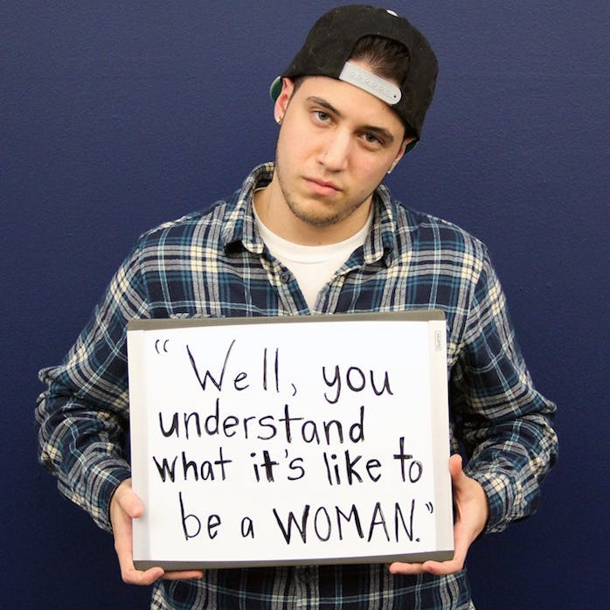
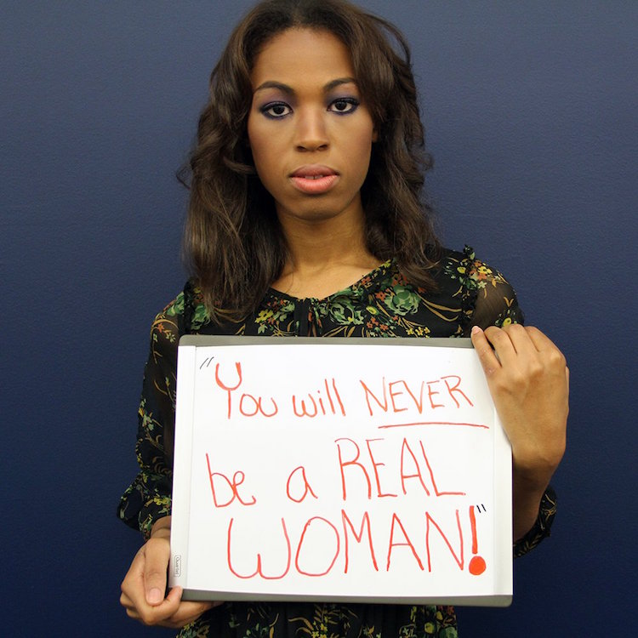
MICROAGGRESSIONS
A statement, action, or incident regarded as an instance of indirect, subtle, or unintentional discrimination against members of a marginalized group.

Slide 26
Some realities…
Bullying – more likely to miss class, avoid bathrooms, lower GPA’s
HIGH rates of suicide
High rates of unemployment
High rates of substance use
Homelessness
Significant medical disparities including higher HIV+ rates

Slide 27
As it relates to HIV

Slide 28
HIV and Transgender Men & Women
According to the CDC
Approximately 1 million people in the U.S. identify as transgender.
2% of new HIV diagnosis were among transgender individuals.
21.6% of transgender women are with HIV.
By age, the largest group to receive a HIV diagnosis was transgender women aged 20–24 years (24%), followed by transgender women aged 25–29 years (23%).

Slide 29
Why are transgender women at higher risk?
Stigma
Discrimination
Economic Vulnerability
Sex Work
Drug Use
Low Self Esteem
Lack of Support
Gender Affirming Surgery

Slide 30
Barriers to Treatment
Lack of access to healthcare professionals who are knowledgeable on transgender health
Financial insecurity
Discrimination and stigma
Homelessness or housing instability
Unemployment
Denial of treatment due to being transgender
Lack of support from healthcare professionals
Insufficient coverage under health insurance
Unmet gender affirmation requirements such as not being on hormone therapy
Lack of knowledge regarding healthcare and treatment options
Mental health complications due to stigma

Slide 31
Prevention Tips
Using barrier methods such as condoms during sex.
Taking pre-exposure prophylaxis (PrEP) before sex to reduce the risk of contracting HIV.
Taking post-exposure prophylaxis (PEP) within 72 hours of a possible exposure to HIV.
Avoid sharing needles if using injectable drugs, including estrogen.
Consider limiting the number of sexual partners.

Slide 32
Create a welcoming space

Slide 33
Scan your environment.
Learn more about transgender individuals from transgender individuals.
Attend trainings and community events.

Slide 34
Questions?

Slide 35
Contact Information
Jonna J Cooley PhD
jcool@phoenixcenterspringfield.org
217-528-5253

Slide 36
MATEC Resources
AETC National HIV-HCV Curriculum https://aidsetc.org/hivhcv
Hepatitis C Online https://www.hepatitisc.uw.edu
AETC National Coordinating Resource Center https://aidsetc.org/
Additional Trainings https://matec.info
National PrEP Curriculum https://www.hivprep.uw.edu/
Hepatitis B Online https://www.hepatitisb.uw.edu/
National Clinician Consultation Center http://nccc.ucsf.edu/
HIV Management
Perinatal HIV
HIV PrEP
HIV PEP line
HCV Management
Substance Use Management
AETC National HIV Curriculum https://aidsetc.org/nhc

