Slide 1
Aging with HIV Communities of Practice: Current Guidelines on Immunization
Cyril Goshima, MD
Senior Adviser, Pacific AIDS Education & Training Center –
Hawaii and US-Affiliated Pacific Islands
John A Burns School of Medicine, University of Hawaii at Manoa
June 12, 2024

Slide 2
Disclaimer
The views and opinions expressed in this presentation are not necessarily those of the Pacific AIDS Education & Training Center (Pacific AETC) or its eight local partner sites in HRSA Region 9, the Regents of the University of California or its San Francisco campus (UCSF or collectively, University) nor of our funder the Health Resources and Services Administration (HRSA). Neither Pacific AETC, University, HRSA nor any of their officers, board members, agents, employees, students, or volunteers make any warranty, express or implied, including the warranties of merchantability and fitness for a particular purpose; nor assume any legal liability or responsibility for the accuracy, completeness or usefulness of information, product or process assessed or described; nor represent that its use would not infringe privately owned rights.
​HRSA Acknowledgement Statement​ The Pacific AETC is supported by the Health Resources and Services Administration (HRSA) of the U.S. Department of Health and Human Services (HHS) as part of an award totaling $4,377,449. The contents are those of the author(s) and do not necessarily represent the official views of, nor an endorsement, by HRSA, HHS, or the U.S. Government. For more information, please visit HRSA.gov.
​Trade Name Disclosure Statement​ Funding for this presentation was made possible by 5 U1OHA29292‐08‐00 from the Human Resources and Services Administration HIV/AIDS Bureau. The views expressed do not necessarily reflect the official policies of the Department of Health and Human Services nor does mention of trade names, commercial practices, or organizations imply endorsement by the U.S. Government. Any trade/brand names for products mentioned during this presentation are for training and identification purposes only.

Slide 3
Learning Objectives
At the end of the discussion, participants will be able to:
Describe the epidemiology of vaccine-preventable diseases among people with HIV (PWH) in the United States
Identify the vaccines/immunizations indicated for PWH
Discuss barriers to the uptake of immunization among PWH

Slide 4
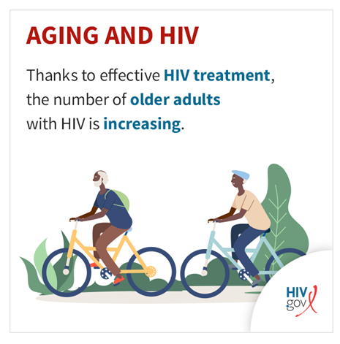
Aging with HIV (2021 Data)
According to the Centers for Disease Control and Prevention, in 2021, of the nearly 1.1 million people with diagnosed HIV in the United States and dependent areas, over 53% were aged 50 and up.
People aged 50 and older accounted for 16% of the 36,136 new HIV diagnoses in 2021 among people ages 13 and older in the United States and dependent areas.
HIV.gov ‘Aging with HIV’ website Accessed April 2024

Slide 5
Brief Vaccine History
When Developed: 11th century Chinese use of variolation
Purpose of Vaccine: Prevent Infections that lead to significant morbidity and mortality. Now, also to prevent certain cancers.
How Vaccines Work: Increase body’s ability to recognize and eradicate pathogen by induction of protective antibodies. In the future induction of T-cell immunity. The vaccine doesn’t directly eradicate the pathogen like Penicillin kills Strep.
Types of Vaccines
Live, attenuated, killed, fragments, synthetic
Efficacy of vaccines: decrease mortality, decrease morbidity e.g. COVID vaccine decrease hospitalizations.
Special Consideration in patients with impaired immune function

Slide 6
Latest Recommendations on Immunization (2024)
Available at: https://www.cdc.gov/mmwr/volumes/72/wr/pdfs/mm7206a1-H.pdf
Notes:
Put in chat: https://www.cdc.gov/vaccines/schedules/hcp/imz/adult-index.html
Also give/send handout of Adult Immunization Schedule by Age and Immunization by Medical Condition

Slide 7
HIV and Vaccine Preventable Illness
HIV co-infection:
Can increase the severity of illness: COVID, Zoster
Can increase risk of developing malignancy: HBV hepatoma, cervical cancer, anal cancer, squamous cell carcinoma
Person with HIV may be considered a priority in receiving vaccine when there is a limited vaccine supply
Childhood Immunizations may have other parameters (CD4, viral load, attenuated vaccines, post-vaccine follow-up) for administration
Adults 60 years and older have similar guidelines as persons with HIV

Slide 8
Routine Vaccinations and Childhood Immunizations
All standard childhood immunizations in the United States can be given to children with or exposed to HIV, although live vaccines should be deferred in individuals who are severely immunocompromised.
Adults with HIV should receive:
seasonal influenza vaccine
tetanus, diphtheria, and pertussis immunizations according to routine recommendations for the general population

Slide 9
Vaccines Indicated for People with HIV
There are certain vaccines for which HIV is itself an indication.
These include:
pneumococcal vaccination
hepatitis A virus (HAV) vaccine
hepatitis B virus (HBV) vaccine
meningococcal vaccination
recombinant zoster vaccine

Slide 10
Hepatitis A and Hepatitis B
Hepatitis A vaccination
- Hepatitis A virus: Fecal to oral route of transmission
- Adequate immunologic response should be checked with serum hepatitis A IgG antibody testing.
Hepatitis B vaccination
3-dose series schedule: 0, 1, 6 months
Heplisav-B vaccine (2 doses) 1 month apart
Strategies to improve antibody response:
evaluating choice of vaccine
using a double dose of vaccine
checking for vaccine response
revaccinating non-responders.
There is a combination Hep A & B vaccine: hepatitis A inactivated & hepatitis B (recombinant) vaccine

Slide 11
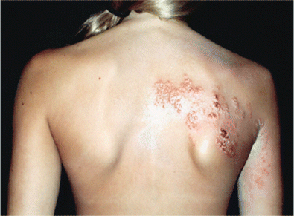
Herpes zoster vaccination
Recombinant zoster vaccine (RZV) is administered as two doses, at least eight weeks apart.
Persons with HIV are at increased risk for herpes zoster. Although the risk of herpes zoster is reduced in those receiving antiretroviral therapy (ART), it remains higher than the general population.
Thoracic herpes zoster.
Image from: Dworkin RH et al. Clin Infect Dis. Jan 2007

Slide 12
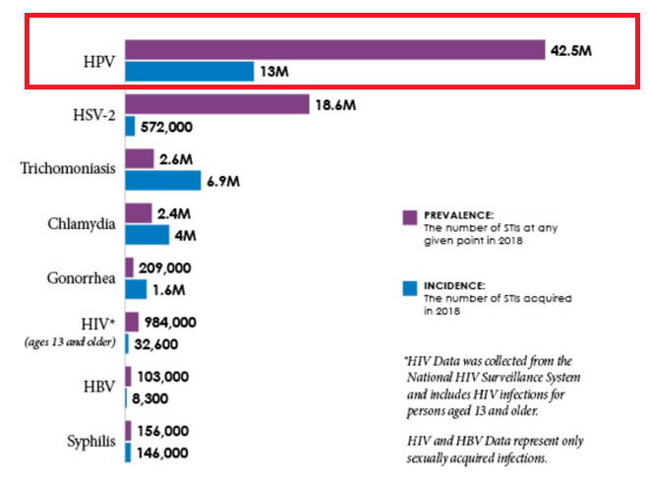
High Rates of Human Papilloma Virus infection in the United States
CDC. NCHHSTP Newsroom Accessed Feb 2024.

Slide 13
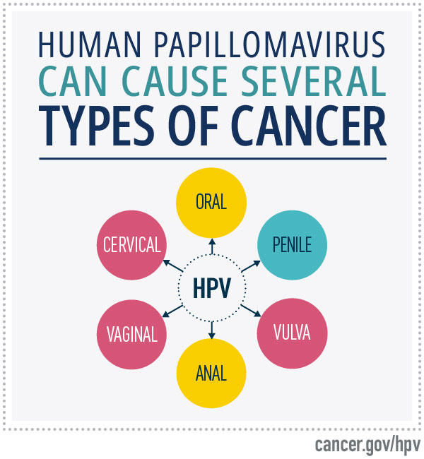
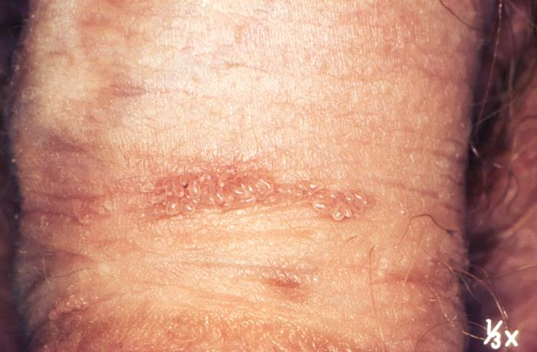
Human papilloma virus, anogenital warts, and cancer
Genital (penile) warts. Image from CDC: https://phil.cdc.gov/Details.aspx?pid=15861

Slide 14
Types of HPV vaccines
Three licensed types of HPV vaccines:
9-valent HPV vaccine
quadrivalent HPV vaccine
bivalent HPV vaccine
All three HPV vaccines protect against HPV types 16 and 18 that cause most HPV cancers.

Slide 15
Human Papilloma Virus [1]
Routine HPV vaccination is recommended for people with HIV.
Ideally, initiated at age 11 or 12 years but may be started as early as age 9 years.
For all people with HIV aged 13 to 26 years who were not vaccinated previously, regardless of gender, administer three doses of the recombinant HPV nonavalent vaccine (Gardasil 9) at 0, 1 to 2, and 6 months. The two-dose series is not recommended in people with HIV.
For people with HIV aged 27 to 45 years not adequately vaccinated previously, shared clinical decision-making regarding HPV vaccination is recommended.
At present, vaccination with commercially available HPV vaccine is not recommended during pregnancy

Slide 16
Meningococcal Disease: Transmission and Clinical Features
Meningococci are transmitted person-to-person by respiratory droplets or secretions
Incubation period 3 to 4 days (range, 1 to 10 days)
Meningitis is the most common presentation of invasive disease (~50% of U.S. cases)
Meningococcal septicemia (30% of cases)
Bacteremic pneumonia (15% of cases)
Image from: National Meningitis Association

Slide 17
MenACWY vaccination
ACIP recommends MenACWY vaccination for the following groups:
Routine vaccination for persons aged 11 or 12 years, with a booster dose at age 16 years
Routine and booster vaccination of persons aged ≥2 months at increased risk for meningococcal disease (dosing schedule varies by age and indication, and interval for booster doses varies by age at time of previous vaccination):
Persons with certain medical conditions including anatomic or functional asplenia, complement component deficiencies, or HIV infection

Slide 18
MenB vaccination
Routine and booster vaccination of persons aged ≥10 years at increased risk for meningococcal disease (dosing schedule varies by vaccine brand; boosters should be administered at 1 year after primary series completion, then every 2–3 years thereafter for those who remain at increased risk):
Persons at increased risk during an outbreak (e.g., in community or organizational settings, and among men who have sex with men)
Vaccination of adolescents and young adults aged 16–23 years with a 2-dose MenB series on the basis of shared clinical decision-making.
The preferred age for MenB vaccination is 16–18 years

Slide 19
Pneumococcal Vaccination
Vaccination against Streptococcus pneumoniae is recommended for all patients with HIV. The dosing schedule depends on the patient's immunization history and the availability of vaccines.
The most important risk factor for developing pneumococcal infections is the level of immunosuppression (eg, CD4 count <200 cells/microL)
Adults aged 19–64 years with certain underlying medical conditions or other risk factors (such as HIV infection) who previously have not received a pneumococcal vaccine, or whose previous vaccination history is unknown, should receive:
a single dose of PCV20 or PCV15.
When PCV15 is used, it should be followed at a ≥1 year interval with a single dose of PPSV23

Slide 20
Mpox rash: visual examples

Slide 21
Orthopoxvirus (smallpox and mpox) vaccines
The Modified Vaccinia Ankara is approved for prevention of mpox (previously referred to as monkeypox) and smallpox.
Schedule: Two doses administered 28 days (4 weeks) apart
ACAM2000 smallpox vaccine should generally be avoided in persons with HIV because it is replication-competent.

Slide 22
Indications for Orthopox Vaccines
For people aged 18 years and older at risk of mpox during an mpox outbreak
For people aged 18 years and older with the following risks:
Gay, bisexual, and other men who have sex with men, transgender or nonbinary people who in the past 6 months have had one of the following:
A new diagnosis of ≥1 sexually transmitted disease
More than one sex partner
Sex at a commercial sex venue
Sex in association with a large public event in a geographic area where mpox transmission is occurring
Sexual partners of people with the risks described above
People who anticipate experiencing any of the above

Slide 23
Vaccines and CD4 count
In general, live vaccines should be avoided in individuals with HIV who have CD4 counts <200 cells/microL.
Do NOT administer regardless of CD4 count:
BCG (Bacillus Calmette Guerin) vaccine
Live attenuated influenza vaccine
May be administered if CD4 count > 200 cells/microL:
measles, mumps, and rubella (MMR) vaccine
varicella vaccine
yellow fever vaccine

Slide 24
Recommended Immunizations for Older Adults
Should get:
Annual Flu Vaccine
Pneumococcal Vaccine
Herpes Zoster Vaccine, over 50
Respiratory Syncytial Virus Vaccine
Encourage to get:
COVID
Tdap (Tetanus, diphtheria, acellular pertussis) after age 65 one dose

Slide 25
Discussion Points
What challenges do you face when immunizing patients?
What are potential provider barriers?
Are there patient barriers?
Are there systemic and/or logistical barriers?

Slide 26
References
US Department of Health and Human Services, Centers for Disease Control Prevention, “Recommended Adult Immunization Schedule for ages 19 years or older, United States 2024. www.cdc.gov /vaccines/hcp/acip-recs/index.html
Hibberd, Patricia L., Garland, Joseph M., “Immunizations in Persons with HIV,” UptoDate, Literature review current through April 2024, Updated 12/22/2022.
Plotkin, Stanley A.,“Vaccines: past, present and future,” Nature Medicine Supplement, vol. 11 (4). April 2005.

Slide 27
Registration Link: Questions?
Presenter: Cyril Goshima MD
cgoshima@hawaii.edu

