Slide 1
HIV Surveillance Clinical Updates
Megan Baker, MPH
HIV Surveillance Epidemiologist
Office of HIV and Hepatitis C Services Arizona Department of Health Services
June 7, 2024

Slide 2
Disclaimer
The views and opinions expressed in this presentation are not necessarily those of the Pacific AIDS Education & Training Center (Pacific AETC) or its eight local partner sites in HRSA Region 9, the Regents of the University of California or its San Francisco campus (UCSF or collectively, University) nor of our funder the Health Resources and Services Administration (HRSA). Neither Pacific AETC, University, HRSA nor any of their officers, board members, agents, employees, students, or volunteers make any warranty, express or implied, including the warranties of merchantability and fitness for a particular purpose; nor assume any legal liability or responsibility for the accuracy, completeness or usefulness of information, product or process assessed or described; nor represent that its use would not infringe privately owned rights.
HRSA Acknowledgement Statement The Pacific AETC is supported by the Health Resources and Services Administration (HRSA) of the U.S. Department of Health and Human Services (HHS) as part of an award totaling $3,887,700.00. The contents are those of the author(s) and do not necessarily represent the official views of, nor an endorsement, by HRSA, HHS, or the U.S. Government. For more information, please visit HRSA.gov.
Trade Name Disclosure Statement Funding for this presentation was made possible by 5 U1OHA29292‐08‐00 from the Human Resources and Services Administration HIV/AIDS Bureau. The views expressed do not necessarily reflect the official policies of the Department of Health and Human Services nor does mention of trade names, commercial practices, or organizations imply endorsement by the U.S. Government. Any trade/brand names for products mentioned during this presentation are for training and identification purposes only.

Slide 3
Disclosure
I have no conflicts of interest to disclose.

Slide 4
Learning Objectives
By the end of this presentation, participants will be able to:
Interpret statewide HIV Surveillance data
Explain trends in recent years
Understand HIV testing frequency pre and post COVID-19

Slide 5
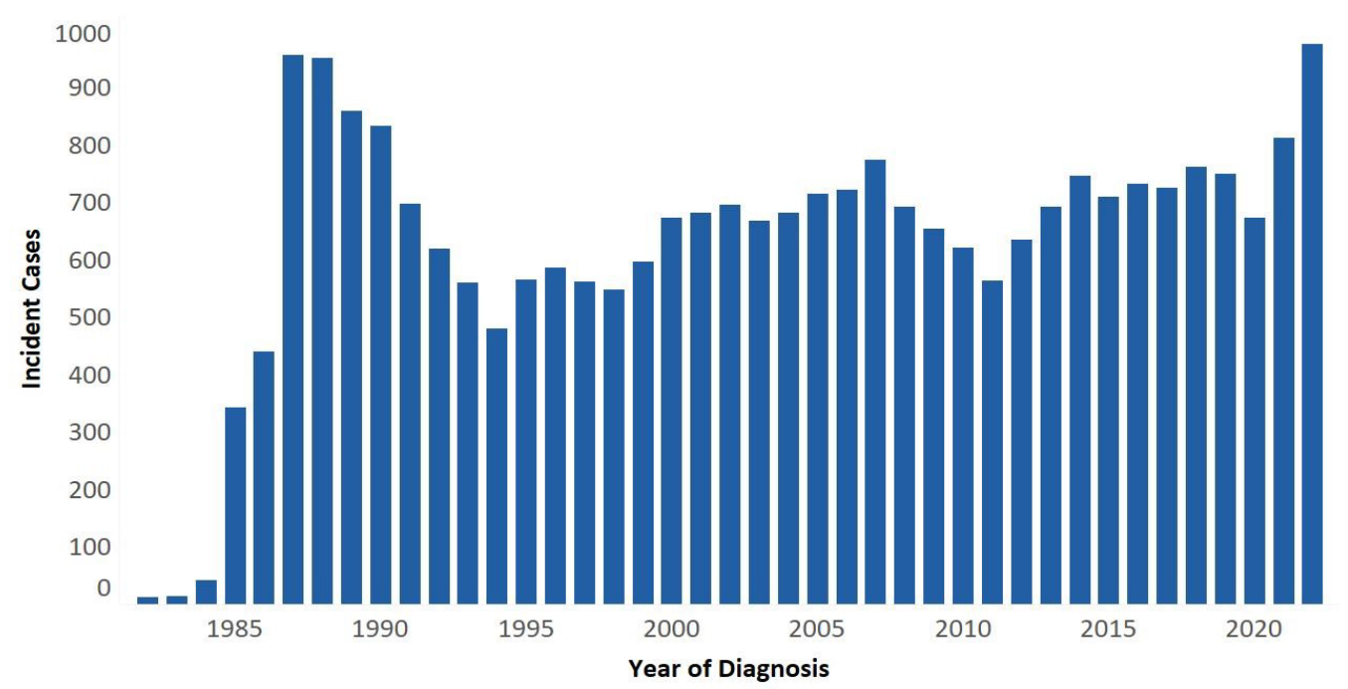
HIV Incident Cases Persons ≥13 1982 - 2022

Slide 6
HIV Trends & Fluctuation
Incidence and prevalence metrics fluctuate due to routine deduplication efforts
Semi-annual routine interstate deduplication review (RIDR)
Soundex
*Both work to determine jurisdiction and reflect accurate diagnosis in eHARS

Slide 7
2022 Incidence in July 2023 vs March 2024
Metric | Data Pull July 2023 | Data Pull March 2024
HIV/AIDS Incidence Count | 975 | 894
HIV/AIDS Incidence Rate | 13.2 per 100,000 | 12.1 per 100,000
Percent Change from 2021 to 2022 | 20% Increase | 11% Increase
Annual Report Incidence for 2021:
852 new cases
Rate of 11.4 per 100,000

Slide 8
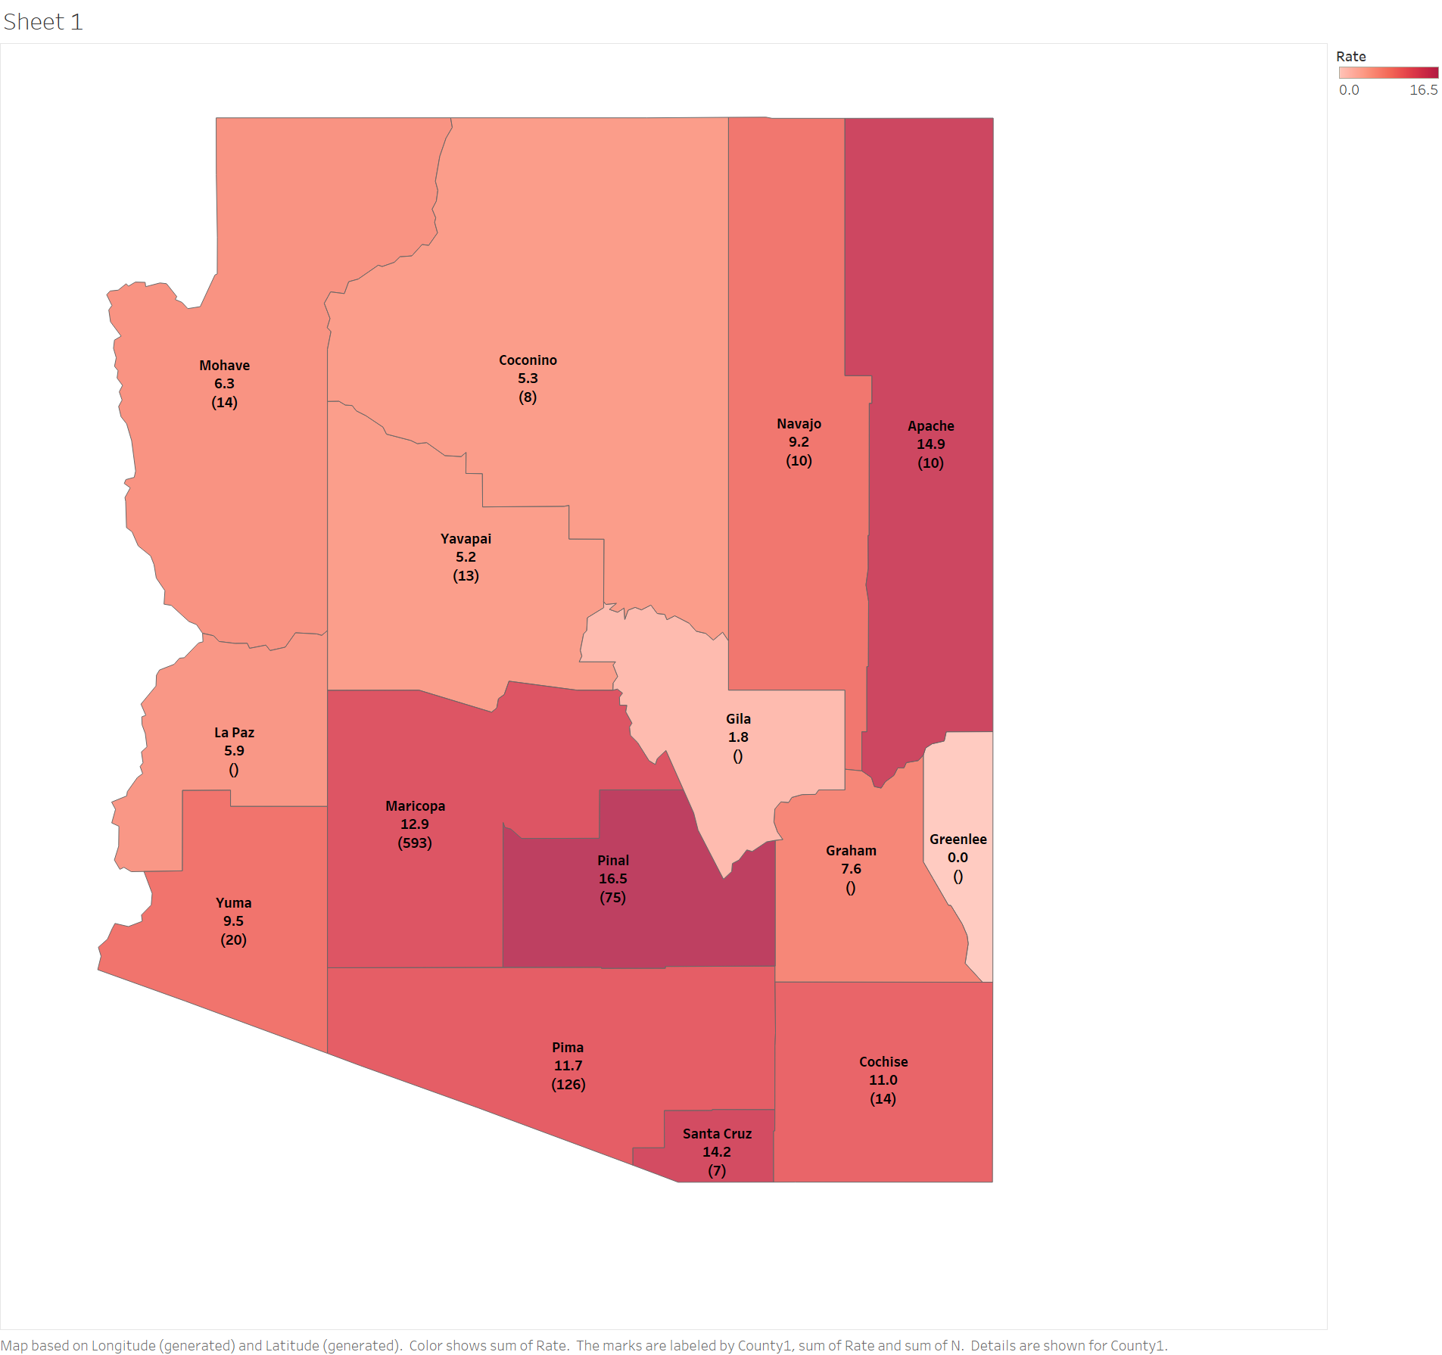
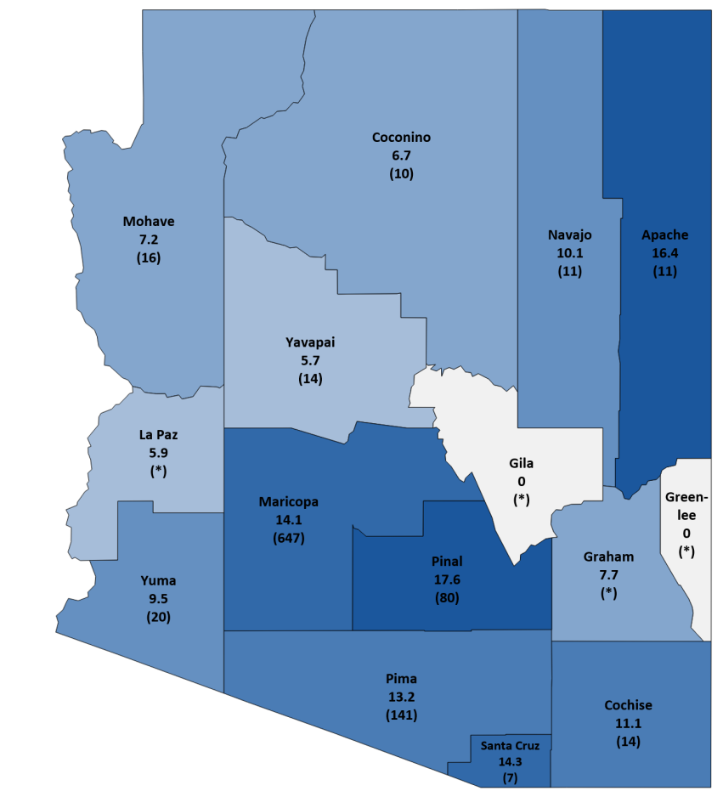
2022 State Wide Overview
Mohave
6.3
(14)
Coconino
5.3
(8)
Navajo
9.2
(10)
Apache
14.9
(10)
Yavapai
5.2
(13)
La Paz
5.9
(*)
Gila
1.8
(*)
Maricopa
12.9
(593)
Greenlee
0.0
(*)
Pinal
(75)
16.5
Graham
7.6
(*)
Yuma
9.5
(20)
Pima
11.7
(126)
Cochise
11.0
(14)
Santa Cruz
14.2
(7)

Slide 9
HIV/AIDS Incidence Count by Sex at Birth, 2022

Slide 10
HIV/AIDS Incident Cases by Race/Ethnicity, 2022

Slide 11
HIV/AIDS Incidence County by Age Category, 2022
* Data is suppressed based on suppression criteria to protect privacy and confidentiality
*
*

Slide 12
HIV/AIDS Incidence Count by Risk Category, 2022
* Data is suppressed based on suppression criteria to protect privacy and confidentiality
*
*

Slide 13
HIV/AIDS Care Continuum, 2022
18,192
78.8% of individuals newly diagnosed with HIV/AIDS in 2022 were linked to care (LTC) within 30 days of diagnosis.
13,360
12,267
9,485

Slide 14
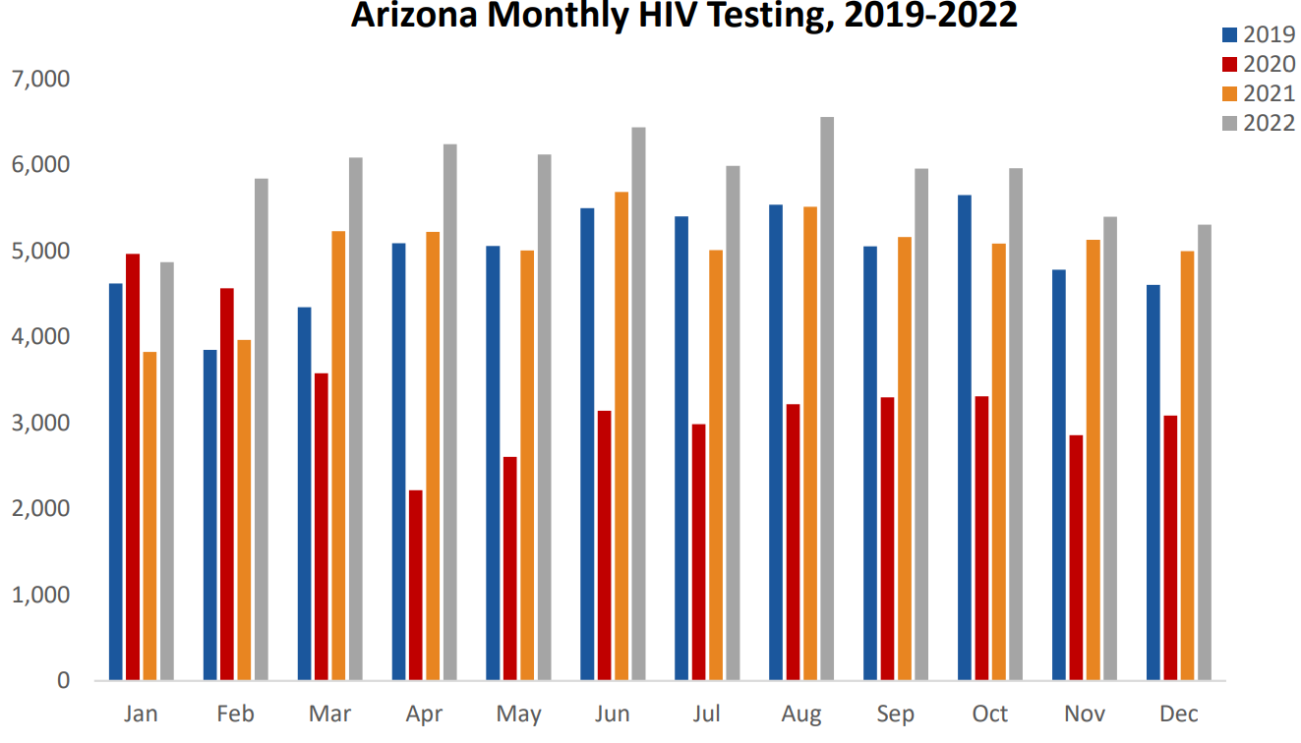
Arizona Monthly HIV Test, 2019-2022
: 59,468
: 39,813
: 59,807
: 70,737
18.3% increase in publicly funded HIV testing in 2022 when compared to 2021
Notes:
19% increase in publicly funded HIV testing in 2022 when compared to 2019

Slide 15
Questions?
Email: Megan.Baker@azdhs.gov

