Slide 1
Current Topics in HIV
J Kevin Carmichael MD FIDSA DABFM
DISH AZ (Detailing for Improved Sexual Health)
Arizona Department of Health Services
Office of HIV & Hepatitis C Services
June 7, 2024

Slide 2
Disclaimer
The views and opinions expressed in this presentation are not necessarily those of the Pacific AIDS Education & Training Center (Pacific AETC) or its eight local partner sites in HRSA Region 9, the Regents of the University of California or its San Francisco campus (UCSF or collectively, University) nor of our funder the Health Resources and Services Administration (HRSA). Neither Pacific AETC, University, HRSA nor any of their officers, board members, agents, employees, students, or volunteers make any warranty, express or implied, including the warranties of merchantability and fitness for a particular purpose; nor assume any legal liability or responsibility for the accuracy, completeness or usefulness of information, product or process assessed or described; nor represent that its use would not infringe privately owned rights.
HRSA Acknowledgement Statement The Pacific AETC is supported by the Health Resources and Services Administration (HRSA) of the U.S. Department of Health and Human Services (HHS) as part of an award totaling $3,887,700.00. The contents are those of the author(s) and do not necessarily represent the official views of, nor an endorsement, by HRSA, HHS, or the U.S. Government. For more information, please visit HRSA.gov.
Trade Name Disclosure Statement Funding for this presentation was made possible by 5 U1OHA29292‐08‐00 from the Human Resources and Services Administration HIV/AIDS Bureau. The views expressed do not necessarily reflect the official policies of the Department of Health and Human Services nor does mention of trade names, commercial practices, or organizations imply endorsement by the U.S. Government. Any trade/brand names for products mentioned during this presentation are for training and identification purposes only.

Slide 3
Disclosure
Relevant Financial Relationships Statement
I am part-time contracted employee of the Arizona Department of Health Services. I have no relevant financial relationships with ineligible companies that would constitute a conflict of interest concerning this CME activity.
In the course of this presentation and subsequent discussion I may present my personal opinions. I will try to identify my opinions as such. My opinions are informed by my long clinical experience and my review of published data from trusted sources as well as personal communications with experts directly and at clinical conferences. My opinions are mine alone and do not reflect official policies or positions of the Arizona Department of Health Services.
There are no drugs with labeled indications for HIV PEP. I will discuss medications included in current CDC and NYS AIDS Clinical and PAETC guidelines: dolutegravir, raltegravir, bictegravir, lamivudine, emtricitabine, and tenofovir (both TDF and TAF) I will also share new guidance from the IAS-USA on the use of injectable cabotegravir/rilpivirine in persons with unsuppressed viral loads which is off label.

Slide 4
Learning Objectives
At the end of this presentation participants will be able to:
Demonstrate the ability to comprehend the current available options for HIV PEP and effectively choose the most suitable options for specific individuals.
Interpret HIV test results in diverse scenarios and possess the capability to access resources that aid in resolving ambiguous test results.
Be aware of and able to implement current guidance around immunization, statin use, and anal cancer screening in persons with HIV.
Implement the latest guidance around Long-Acting Antiretroviral Therapy (LAART) in persons with unsuppressed virus and be able to evaluate this treatment option for specific patients.

Slide 5
Overview
HIV PEP
HIV PrEP, DoxyPEP, Syphilis (covered by others)
Acute HIV
Diagnosis of HIV in persons on PrEP
HIV Primary Care
Immunizations
Meningococcus
Mpox
Increased indications for Statins
Anal Cancer Screening
LAART use in persons without viral suppression
Increasing rates of INSTI resistance

Slide 6
Post Exposure Prophylaxis
If you needed to take HIV PEP which regimen would you use?
A) DTG and FDC TDF/FTC
B) FDC BIC/TAF/FTC
C) RAL and FDC TDF/FTC
D) Something else

Slide 7
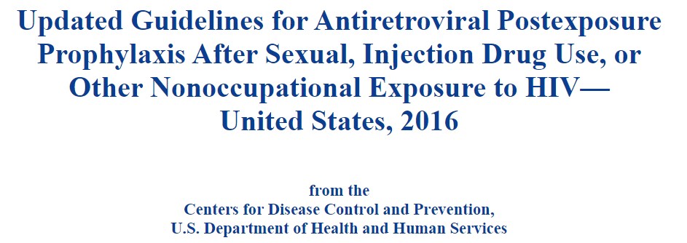
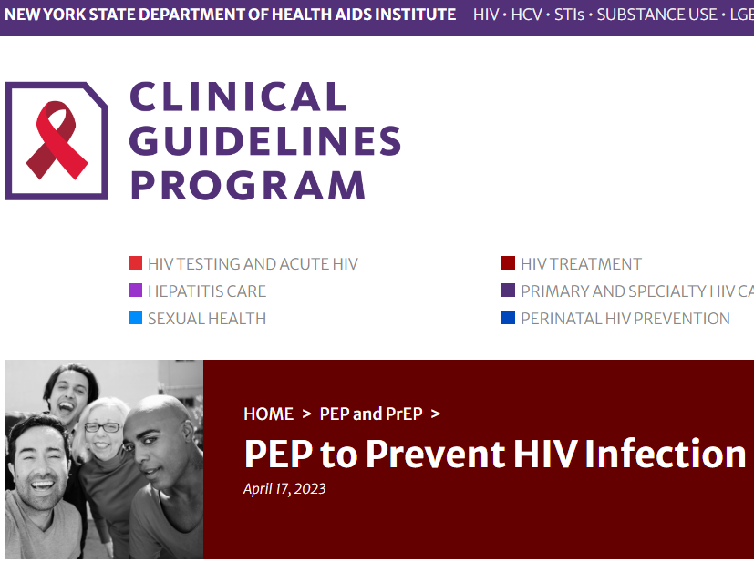
Post Exposure Prophylaxis (2)
Current guidance from the CDC is from 2016
Preferred regimen is TDF/FTC plus either RAL BID or DTG Q day
Current guidance from Clinical Guidelines Program was updated 4/2023
Preferred regimen is TDF/XTC plus either RAL BID or DTG Q day
“TAF: Decreased vaginal, cervical, and rectal tissue concentrations of the active moiety of (tenofovir diphosphate) in healthy volunteers [Cottrell, et al. 2017]”
There is an AETC Fact Sheet from 11/2021 which also mentions FDC BIC/TAF/FTC
The IAS-USA 2022 guidance recommended regimen is TXF/XTC plus dolutegravir or bictegravir
I have heard that new CDC guidance may come out in 2024

Slide 8
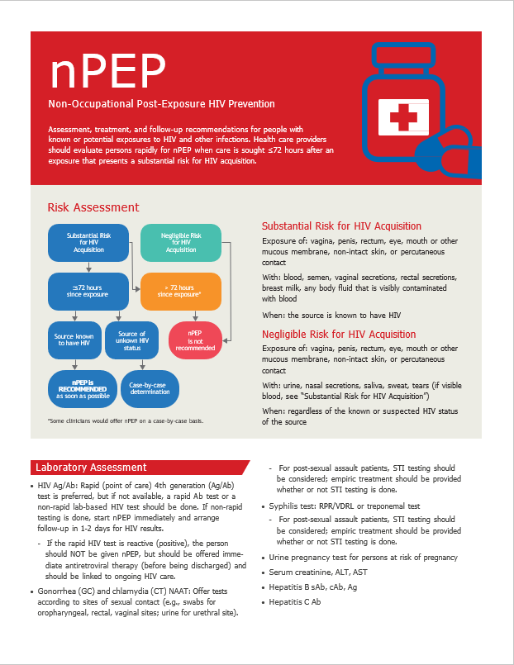
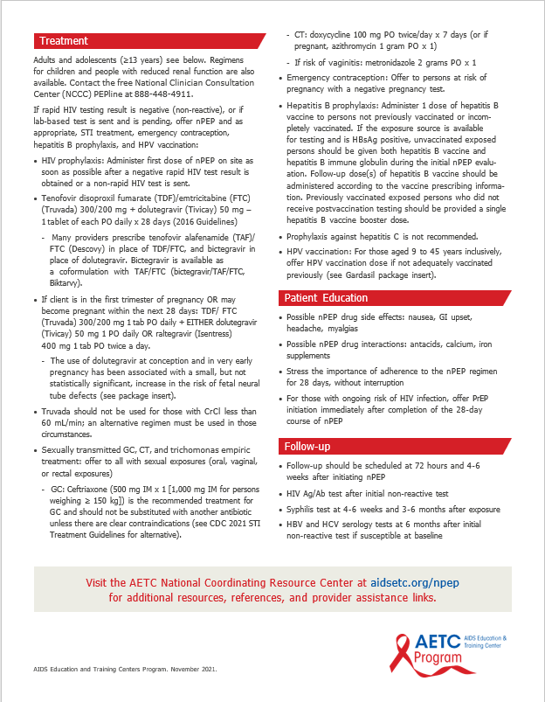
nPEP

Slide 9
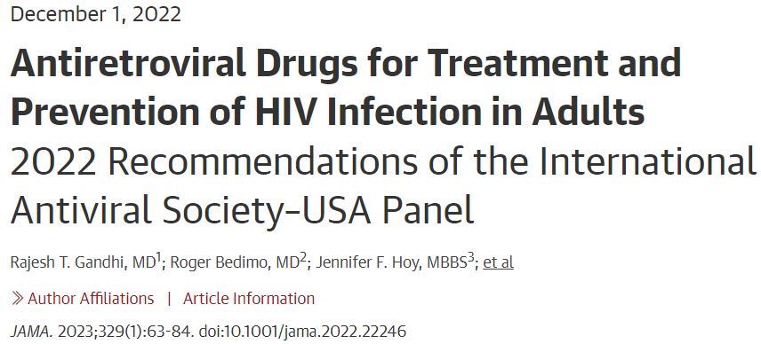
Post Exposure Prophylaxis (3)
Postexposure Prophylaxis for HIV and Bacterial STIs
A 3-drug fully suppressive ART regimen for 28 days is recommended to be administered as rapidly as possible but within 72 hours of a percutaneous, mucous membrane, or sexual exposure to known or suspected HIV-positive blood, genital secretions, or visibly bloody secretions. The recommended regimen is TXF/XTC plus dolutegravir or bictegravir (evidence rating: AIII). PEP should be initiated even if awaiting results of HIV testing on the source person (evidence rating: BIII). If there is concern for drug-resistant HIV or in the setting of pregnancy or breastfeeding, expert consultation is advised (evidence rating: AIII) (for example, through the National Clinician Consultation Center).
Gandhi RT, Bedimo R, Hoy JF, et al. Antiretroviral drugs for treatment and prevention of HIV infection in adults: 2022 recommendations of the International Antiviral Society-USA Panel. JAMA. 2022; doi:10.1001/jama.2022.22246. [epublished online December 1, 2022]

Slide 10
Post Exposure Prophylaxis (4)
Safety and Tolerability of Once Daily Coformulated Bictegravir, Emtricitabine, and Tenofovir Alafenamide for Postexposure Prophylaxis After Sexual Exposure
“BIC/FTC/TAF coformulated as a single daily pill was found to be safe, well-tolerated, and highly acceptable when used for PEP, and compared more favorably than historical PEP regimens used at an urban health center”
An open-label evaluation of safety and tolerability of coformulated bictegravir/emtricitabine/tenofovir alafenamide for post-exposure prophylaxis following potential exposure to human immunodeficiency virus-1
“A once daily, STR of BIC/FTC/TAF used as PEP was safe and well-tolerated with a high rate of completion and adherence in Chinese. BIC/FTC/TAF may be a good option for PEP.”
BIC/FTC/TAF as HIV PEP was well-tolerated with high adherence and no seroconversions
BIC/FTC/TAF PEP was safe, well-tolerated and associated with high adherence and no HIV seroconversions and is an appropriate single tablet INSTI-based HIV PEP regimen
Tan DHS, et al. CROI 2024, Poster 1134
Mayer KH, Gelman M, Holmes J, Kraft J, Melbourne K, Mimiaga MJ. Safety and tolerability of once daily coformulated bictegravir, emtricitabine, and tenofovir alafenamide for postexposure prophylaxis after sexual exposure. J Acquir Immune Defic Syndr 2022; 90: 27–32.
Liu A, Xin R, Zhang H, et al. An open-label evaluation of safety and tolerability of coformulated bictegravir/emtricitabine/tenofovir alafenamide for post-exposure prophylaxis following potential exposure to human immunodeficiency virus-1. Chin Med J 2022; 135: 2725–29.

Slide 11
Post Exposure Prophylaxis (5)
Optimal PEP Regimen Attributes:
Safe in all persons
Renal disease, pregnancy, few drug interactions
Optimizes Adherence
Well tolerated
Low pill burden
Available
Affordable
Endorsed in published guidance

Slide 12
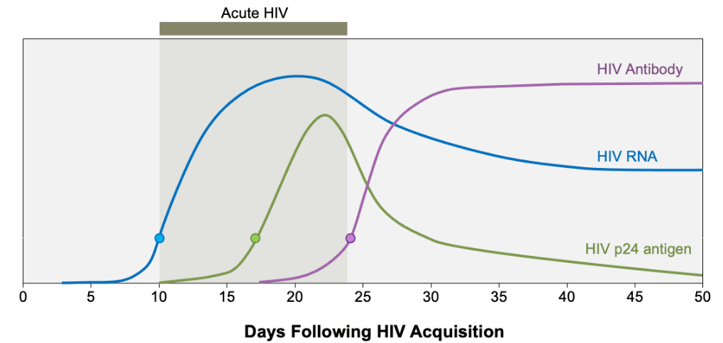
Acute HIV Infection
Antibodies to p24 are produced during seroconversion, rendering p24 antigen undetectable after seroconversion in most cases.
Immune control of HIV results in decline in VL to “viral setpoint” unique to each individual.
Acute HIV Infection: Defined as the phase of HIV disease that occurs soon after HIV acquisition and is characterized by detectable HIV RNA or HIV p24 antigen in the absence of anti-HIV antibodies
https://www.hiv.uw.edu/go/screening-diagnosis/acute-recent-early-hiv/core-concept/all Accessed 4/25/2024

Slide 13
Acute Retroviral Syndrome
Acute retroviral syndrome ranges from an asymptomatic infection, to a mild nonspecific viral illness resembling mononucleosis, to a severe systemic illness that requires hospitalization.
The transient surge of viremia that accompanies acute HIV typically correlates with the timing of the onset of clinical manifestations, which typically begin within 28 days of HIV acquisition.
The signs and symptoms are typically nonspecific, protean, and self-limited. Therefore, a high index of suspicion and inquiry into risk factors are generally necessary to identify primary infection
The most common manifestations associated with acute HIV are fever, fatigue, myalgia, skin rash, headache, pharyngitis, and cervical adenopathy.
The skin rash is typically morbilliform or maculopapular and most often involves the trunk.
https://www.hiv.uw.edu/go/screening-diagnosis/acute-recent-early-hiv/core-concept/all Accessed 4/25/2024

Slide 14
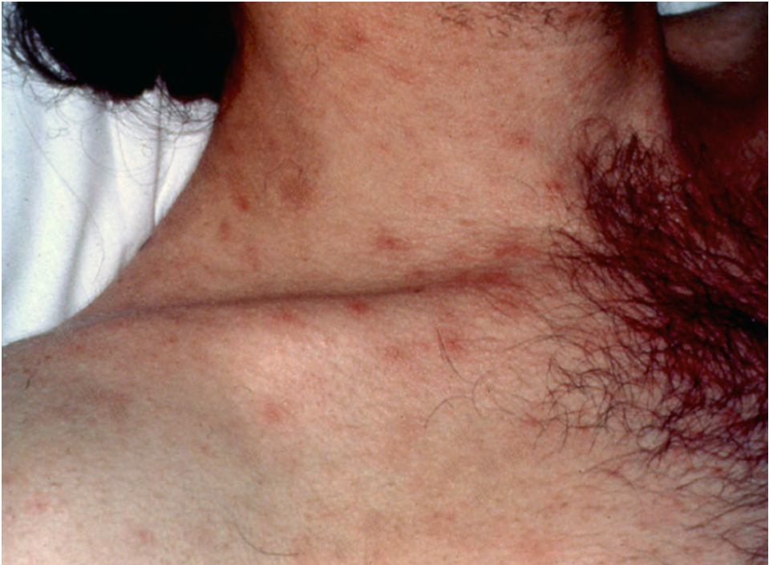
Acute Retroviral Syndrome Picture
Photo by David Spach MD.
Used with permission.
https://www.hiv.uw.edu/go/screening-diagnosis/acute-recent-early-hiv/core-concept/all

Slide 15
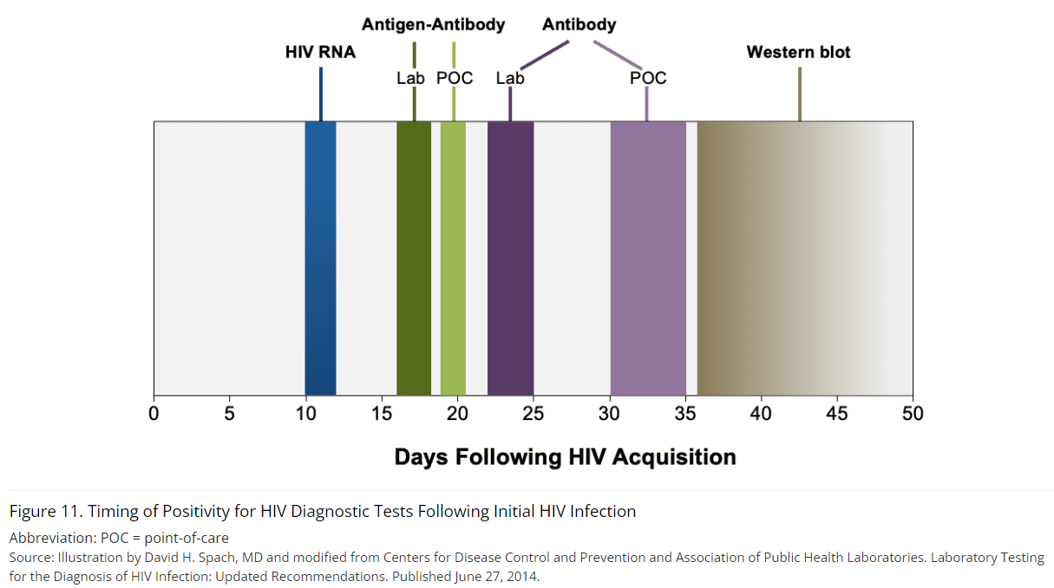
Testing in Acute HIV Infection
For individuals in whom there is a strong clinical suspicion of acute HIV infection, but initial testing with the HIV-1/2 antigen-antibody immunoassay is negative, additional testing should be performed with an HIV-1 RNA assay. The rationale for this approach is that individuals with very early HIV infection can have a negative HIV-1 p24 antigen test, and the only assay that would detect HIV in that setting is an HIV-1 RNA.
https://www.hiv.uw.edu/go/screening-diagnosis/acute-recent-early-hiv/core-concept/all Accessed 4/25/2024

Slide 16
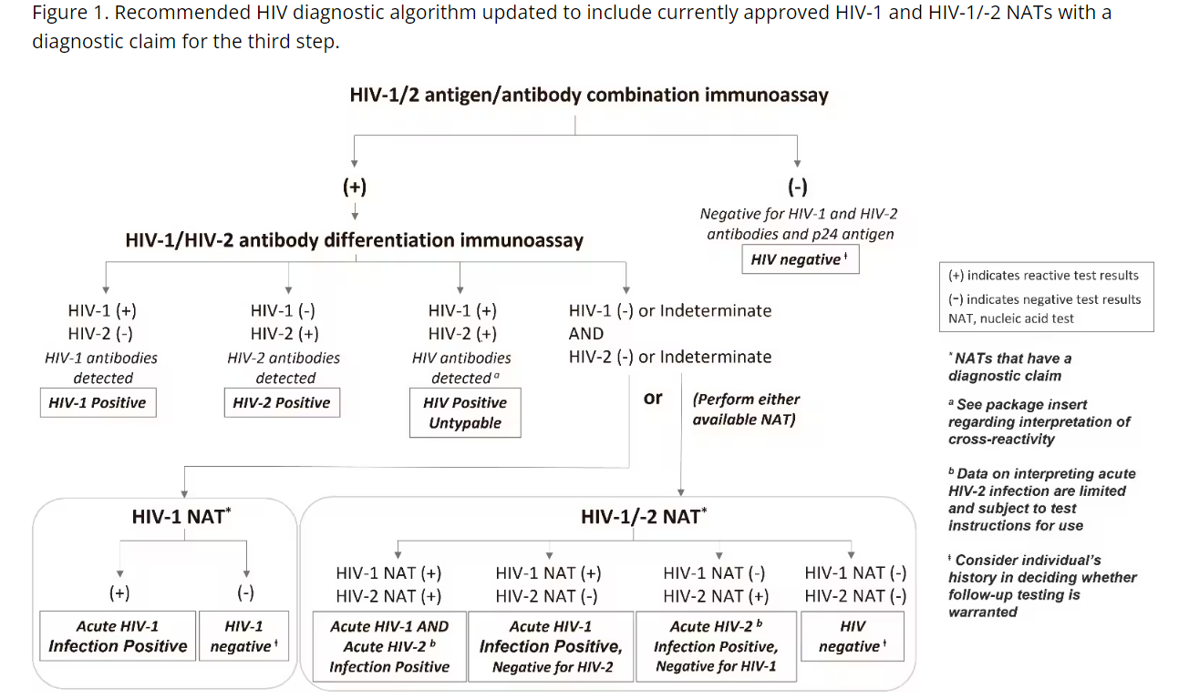
Figure 1. Recommended HIV diagnostic algorithm updated to include currently approved HIV-1 and HIV-1/2 NATs with a diagnostic claim for the third step.
https://www.cdc.gov/hiv/guidelines/recommendations/technical-update-for-hiv.html accessed 4/29/2024

Slide 17
Testing in Acute HIV Infection (2)
HIV NAT Tests Approved for Diagnosis
Aptima HIV-1 QuantDx Assay (Hologic)
Alinity m HIV-1Assay (Abbott)
Both of the above tests provide qualitative and quantitative results
Cobas HIV1/HIV2 Qualitative Test (Roche)
Can differentiate between HIV1 and HIV2
Provides qualitative result only

Slide 18
Patient on PrEP
32 year old man recently relocated to your city from Chicago. He had been taking HIV PrEP (2:1:1) with TdF/FTC and wants to establish care and a refill in order to continue his PrEP.
He has been generally healthy although did have GC urethritis about 3 years ago. Has had COVID x 1 after 3 doses of vaccine. No recent illness. ROS negative. PEx unremarkable as well.
He is sexually active with men, “versatile”, rarely uses condoms. “I do a pretty good job with my 2:1:1 PrEP”. Completed recent 2:1:1 dose 48 hours ago, does not know HIV status of last partner.
Provider ordered labs and Rx continued PrEP.

Slide 19
Patient on PrEP 2
Labs:
RPR negative, 3 site testing for CT and GC return negative
HCV negative, HBsAB positive,
Renal panel and UA unremarkable
4th Gen HIV: antigen/antibody screen positive, differentiation assay negative, NAT positive
What do you do now?

Slide 20
Diagnosing HIV in Persons using HIV PrEP
Establishing a diagnosis of HIV in a person taking HIV PrEP can be more difficult and complicated than in a person who is not receiving HIV PrEP.
Among some individuals who acquire HIV while taking HIV PrEP, especially when intermittently taking HIV PrEP, the HIV PrEP medications may be providing partial HIV treatment, potentially blunting the very high initial plasma HIV RNA levels that typically occur with acute HIV and blocking the host antibody responses to HIV. Further, in this situation, HIV p24 antigen levels may remain below a detectable level.
To this end, among people taking HIV PrEP who acquire HIV, the diagnosis of HIV may be significantly delayed, and ambiguous HIV testing results may develop.
https://www.hivprep.uw.edu/custom/hiv-prep-fundamentals/follow-up-monitoring-on-prep/5 accessed 4/27/2024

Slide 21
Delays In HIV Diagnosis in Persons using PrEP
In the HPTN 083 study that compared oral TDF-FTC with CAB-LA, the diagnosis of HIV was frequently delayed when using standard HIV-1/2 antigen-antibody testing—for a substantial number of participants who had incident HIV infection. The delay in HIV diagnosis was proven by retrospective testing of these blood samples using a highly sensitive HIV-1 RNA assay.
In the TDF-FTC arm, 18% (7 of 39) had a delayed HIV diagnosis, with a median delay for the incident infection of 31 days for these 7 individuals.
In the CAB-LA arm, the diagnosis of HIV was delayed in 58% (7 of 12) of the incident infections, and the median delay for these 7 incident infections was 98 days.
Investigators noted that using a common quantitative HIV RNA test (viral load) would also have detected most of the cases that qualitative HIV RNA detected.
Because of this concern the 2021 CDC HIV PrEP Guidelines recommend including HIV-1 RNA testing in conjunction with an HIV-1/2 antigen-antibody immunoassay as the HIV screening method for persons taking HIV PrEP.
https://www.hivprep.uw.edu/custom/hiv-prep-fundamentals/follow-up-monitoring-on-prep/5 accessed 4/27/2024

Slide 22
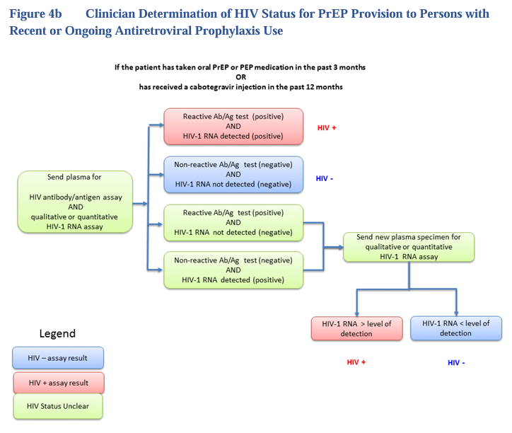
Figure 4b. Clinician Determination of HIV Status for PrEP Provision for Persons with Recent or Ongoing Antiretroviral Prophylaxis Use
https://www.cdc.gov/hiv/pdf/risk/prep/cdc-hiv-prep-guidelines-2021.pdf Accessed 4/26/2024

Slide 23
Patient on PrEP 3
The provider treated acute HIV with a 3 drug FDC.
BIC/TaF/FTC
Ordered HIV genotype, HIV VL quant, CD4 and other labs

Slide 24
Rationale for treatment of acute HIV infection
Preservation of immune function and delayed disease progression
Impact on latent reservoir
Reduced risk for HIV transmission
https://www.hiv.uw.edu/go/screening-diagnosis/acute-recent-early-hiv/core-concept/all Accessed 4/23/2024

Slide 25
Patient on PrEP 4
CD4 returned at 800 with normal CD4 %.
HIV VL quant was undetectable
HIV Genotype failed
Repeat 4th generation test was non-reactive
Qualitative HIV RNA was negative
What do you do now?

Slide 26
Causes of Ambiguous Test Results
False positives due to cross reacting antibodies (Heterophile antibodies)
Pregnancy
Covid and Flu vaccine.
EBV, malaria, autoimmune disease
ART exposure
HIV Vaccines
Laboratory Error

Slide 27
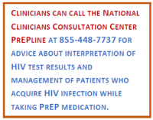
Management Of Ambiguous Test Results
Reactive HIV1/2 antibody/antigen immunoassay with other tests indeterminate /negative
Does patient have significant risk?
Low risk is likely false positive
Has patient been taking ARV’s?
ARV’s for PrEP especially injectable complicate test interpretation
Repeat test and do HIV RNA testing (qual/quant)
Get help!
Reactive HIV1/2 antibody/antigen immunoassay with negative differentiation assay and positive NAT
Does patient have significant risk?
Acute HIV vs false positive NAT
Has patient been taking ARV’s?
Repeat test and do HIV RNA testing (qual/quant)
Get help!

Slide 28
HELPMEPrEP Collaboration

Slide 29
HIV Primary Care (Immunization)
Persons who completed a two dose vaccination series with the Jynneos vaccine for mpox in 2022 are completely protected against re-infection.
Persons who completed a two dose vaccination series with the Jynneos vaccine for mpox in 2022 now require a booster dose.
The two statements above are:
1) True
2) False
3) One is true and one is false

Slide 30
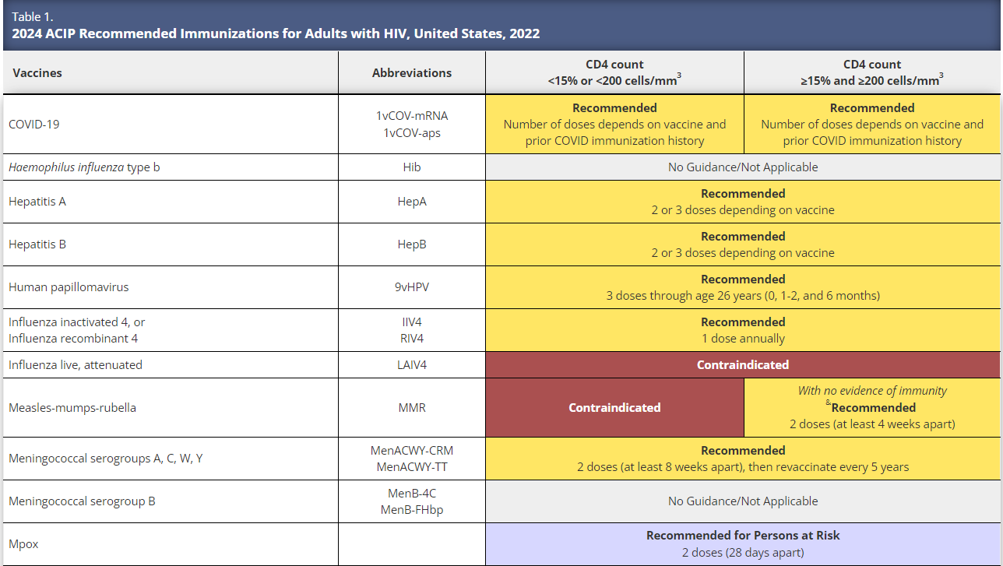
Table 1. 2024 ACIP Recommended Immunizations for Adults with HIV, United States 2022
https://www.hiv.uw.edu/go/basic-primary-care/immunizations/core-concept/all

Slide 31
HIV Primary Care (Immunization)
Any person at risk for Mpox infection:
2-dose series, 28 days apart.
Risk factors for Mpox infection include:- Persons who are gay, bisexual, and other MSM, transgender or nonbinary people who in the past 6 months have had: A new diagnosis of at least 1 sexually transmitted disease More than 1 sex partner Sex at a commercial sex venue Sex in association with a large public event in a geographic area where Mpox transmission is occurring- Persons who are sexual partners of the persons described above- Persons who anticipate experiencing any of the situations described above.
RZV for persons with HIV age 19 or older regardless of CD4 count:
2-dose series recombinant zoster vaccine (RZV, Shingrix) 2–6 months apart (minimum interval: 4 weeks; repeat dose if administered too soon).
MenACWY:
All persons with HIV. 2-dose series MenACWY (Menveo or MenQuadfi) at least 8 weeks apart and revaccinate every 5 years if risk remains
Hepatitis B:
Multiple options however Heplisav-B probably most immunogenic.
Pneumococcal vaccination:
Complex now with PPV 23, PCV 13, PCV 15, and PCV20…please read guidance.
https://www.iasusa.org/wp-content/uploads/2024/04/april-2024.pdf
https://www.cdc.gov/vaccines/schedules/downloads/adult/adult-combined-schedule.pdf Accessed 4/28/2024

Slide 32
2024 Meningococcal Disease
CDC 3/28/2024: “In 2023, 422 cases were reported in the United States, the highest annual number of cases reported since 2014. As of March 25, 2024, 143 cases have been reported to CDC for the current calendar year, an increase of 62 cases over the 81 reported as of this date in 2023.”
ADHS 4/11/2024: Similar to national trends, Arizona is seeing an increase in invasive meningococcal disease, predominantly in Neisseria meningitidis serogroup Y. As of 4/29/2024, Arizona has already seen 10 confirmed cases (7 due to serogroup Y). This matches the number of meningococcal cases seen statewide in the entirety of the year in 2014, the year with the highest number of cases in the last decade. A new sequence type 1466 is responsible for 68% of the serogroup Ys of those typed.
The Arizona Department of Health Services (ADHS) recommends that healthcare providers statewide:
Maintain a high level of clinical suspicion for meningococcal disease, especially with high risk populations.
Current increases in disease are disproportionately affecting people ages 30–60 years (65%), Black or African American people (63%), and people with HIV (15%).
Be aware that patients with invasive meningococcal disease may present with atypical presentations such as sepsis, bacteremia, and septic arthritis.
Ensure that all people who are recommended to receive meningococcal vaccination, are up-to-date on their meningococcal vaccine, including people at increased risk (e.g., with HIV).
https://emergency.cdc.gov/han/2024/han00505.asp
https://www.asapa.org/blogpost/1143865/499882/Increase-in-Invasive-Meningococcal-Disease-in-Arizona

Slide 33
HIV Primary Care (Use of Statins)
You’re are seeing a 43-year-old African-American woman with well controlled HIV for a routine follow-up visit.
She has well controlled hypertension and is a current smoker.
When reviewing her labs you calculate her 10-year ASCVD risk at 5.2%.
Would you recommend she start a statin drug?
1) Yes
2) No
3) Not sure

Slide 34
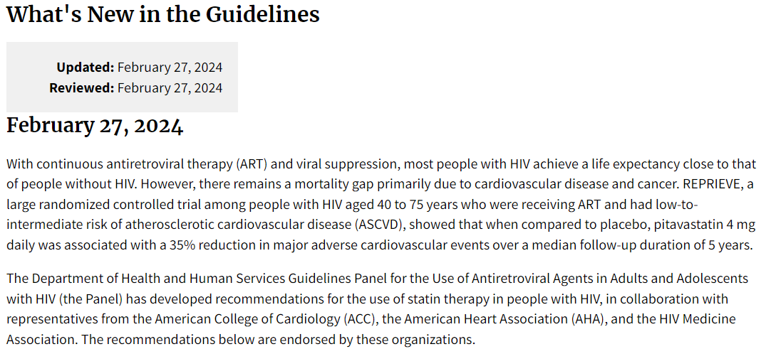
HIV Primary Care (Use of Statins) (2)
In Reprieve and other statin studies the risk reduction is greater that that predicted by LDL lowering alone.
Current risk tools underestimate the risk in persons with HIV.
Panel on Antiretroviral Guidelines for Adults and Adolescents. Guidelines for the Use of Antiretroviral Agents in Adults and Adolescents with HIV. Department of Health and Human Services. Available at https://clinicalinfo.hiv.gov/en/guidelines/adult-and-adolescent-arv Accessed 4/24/2024

Slide 35
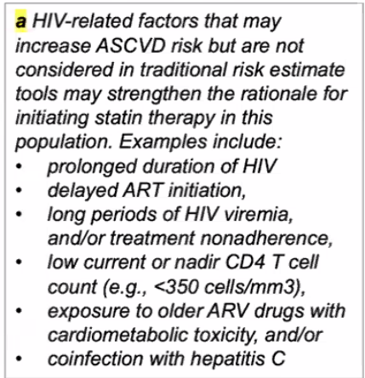
HIV Primary Care (Use of Statins) (3)
For people with HIV who have low-to-intermediate (<20%) 10-year ASCVD risk estimates:
Age 40–75 years
When 10-year ASCVD risk estimates are 5% to <20%, the Panel recommends initiating at least moderate intensity statin therapy (AI).
Recommended options for moderate intensity statin therapy1 include:
Pitavastatin 4mg once daily (AI)
Atorvastatin 20mg once daily (AII)
Rosuvastatin 10mg once daily (AII)
When 10-year ASCVD risk estimates are <5%, the Panel favors initiating at least moderate intensity statin therapy (CI). The absolute benefit from statin therapy is modest in this population, therefore the decision to initiate a statin should take into account the presence or absence of HIV-related factors that can increase ASCVD risk.
Same options for moderate intensity statin therapy as recommended for 10-year ASCVD risk estimates of 5 to <20% (see above)
Age <40 years
Data are insufficient to recommend for or against statin therapy as primary prevention of ASCVD in people with HIV. In the general population, lifestyle modifications are recommended for people age <40 years, with statin therapy considered only in select populations (see AHA/ACC/Multisociety Guidelines).
https://tools.acc.org/ldl/ascvd_risk_estimator/index.html#!/calulate/estimator/
Panel on Antiretroviral Guidelines for Adults and Adolescents. Guidelines for the Use of Antiretroviral Agents in Adults and Adolescents with HIV. Department of Health and Human Services.
Available at https://clinicalinfo.hiv.gov/en/guidelines/adult-and-adolescent-arv. Accessed 4/24/2024

Slide 36
HIV Primary Care (Use of Statins) (4)
The AHA/ACC/Multisociety Guidelines provide the following key recommendations for the general population; these recommendations should also be applied to people with HIV:
For people aged 40–75 years who have high (≥20%) 10-year ASCVD risk estimates:
Initiate high intensity statin therapy.
For people aged 20–75 years who have low density lipoprotein-cholesterol ≥190 mg/dL:
Initiate high intensity statin therapy at maximum tolerated dose.
For people aged 40–75 years with Diabetes Mellitus:
Initiate at least moderate intensity statin therapy. Perform further risk assessment to consider using a high intensity statin.
Panel on Antiretroviral Guidelines for Adults and Adolescents. Guidelines for the Use of Antiretroviral Agents in Adults and Adolescents with HIV. Department of Health and Human Services.
Available at https://clinicalinfo.hiv.gov/en/guidelines/adult-and-adolescent-arv. Accessed 4/24/2024

Slide 37
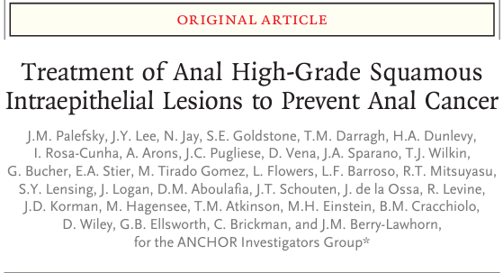
HIV Primary Care (Anal Cancer Screening)
The ANCHOR Trial (evaluation of treatment of anal HSIL to prevent anal cancer) was published in June 2022.
“Among participants with biopsy-proven anal HSIL, the risk of anal cancer was significantly lower with treatment for anal HSIL than with active monitoring”
https://www.nejm.org/doi/pdf/10.1056/NEJMoa2201048

Slide 38
HIV Primary Care (Anal Cancer Screening) (2)
Preventing Anal Cancer
Some cost-effectiveness evaluations indicate that in patients who are HIV seropositive, screening for lesions using anal cytology and treating anal precancerous lesions to reduce risk of anal cancer in PWH may provide clinical benefits comparable to measures to prevent other opportunistic infection. AIN lesions are similar in many ways to CIN, but differences may exist in natural history, optimal screening, and treatment approaches to prevent cancer. At this time, no national recommendations exist for routine screening for anal cancer. However, some specialists recommend anal cytologic screening or high-resolution anoscopy (HRA) for men and women who are HIV seropositive (CIII). An annual digital anal examination may be useful to detect masses on palpation that could be anal cancer (BIII). Screening for such symptoms as anorectal bleeding, anorectal pain, and palpable anorectal masses or nodules also may be useful (CIII). Screening for anal cancer with anal cytology should not be done without the availability of referral for HRA. If anal cytology is performed and indicates ASC-US, ASC-H, LSIL, or HSIL, then it should be followed by HRA (BIII). Visible lesions should be biopsied to determine the level of histologic changes and to rule out invasive cancer (BIII) (see section on Treating Disease for details on treating AIN).
Panel on Guidelines for the Prevention and Treatment of Opportunistic Infections in Adults and Adolescents with HIV. Guidelines for the Prevention and Treatment of Opportunistic Infections in Adults and Adolescents with HIV. National Institutes of Health, Centers for Disease Control and Prevention, HIV Medicine Association, and Infectious Diseases Society of America. Year. Available at https://clinicalinfo.hiv.gov/en/guidelines/adult-and-adolescent-opportunistic-infection. Accessed 4/24/2024

Slide 39
HIV Primary Care (Anal Cancer Screening) (3)
Screening for Anal Disease
For all patients with HIV ≥35 years old, regardless of HPV vaccination status, clinicians should:
Inquire annually about anal symptoms, such as itching, bleeding, palpable masses or nodules, pain, tenesmus, or a feeling of rectal fullness. (A2)
Perform a visual inspection of the perianal [a] region. (A3)
Provide information about anal cancer screening and engage the patient in shared decision-making regarding screening, including anal cytology before DARE. (A3)
Perform DARE annually and whenever anal symptoms are present. (A*)
For adults ≥35 years old who have HIV and are men who have sex with men (A3), transgender women (A3), women (B3), or transgender men (B3), clinicians should perform or recommend annual (A3) anal Pap testing to identify potentially cancerous cytologic abnormalities.
New York State Dept of Health AIDS Institute Clinical Guidelines Program. Screening for Anal Dysplasia and Cancer in Adults With HIV. Bruce Hirsch, MD, FACP, FIDSA 08.09.2022 https://www.hivguidelines.org/guideline/hiv-anal-cancer/ Accessed 04/25/2024

Slide 40
HIV Primary Care (Anal Cancer Screening) (4)
Clinicians should promote smoking cessation for all patients with HIV, especially those at increased risk for anal cancer. (A3)
For all patients with HIV ≥35 years old, clinicians should recommend and perform annual DARE to screen for anal pathology. (B3)
Clinicians should evaluate any patient with HIV <35 years old who presents with signs or symptoms that suggest anal dysplasia. (A3)
Clinicians should conduct HRA and histology (via biopsy) for any patient with LSILs or HSILs or refer as needed. (A2)
For patients with anal cytology results indicating ASC-US, clinicians should perform HPV testing (A2):
If HPV testing is available and results are negative, repeat anal cytology in 1 year. (A3)
If HPV testing is available but reflex testing is not available, perform HPV test at follow-up within 6 months. (B2)
If positive for high-risk HPV or if HPV testing is not available, refer for HRA. (B2)
Clinicians should refer patients with suspected anal cancer determined by DARE or histology to an experienced specialist for evaluation and management. (A3)
Clinicians should discontinue screening for anal cancer when life expectancy is less than 10 years and in individuals with 2 consecutive negative anal cytology specimens who are not currently sexually active. (B3)
New York State Dept of Health AIDS Institute Clinical Guidelines Program. Screening for Anal Dysplasia and Cancer in Adults With HIV. Bruce Hirsch, MD, FACP, FIDSA 08.09.2022 https://www.hivguidelines.org/guideline/hiv-anal-cancer/ Accessed 04.25.2024

Slide 41
HIV Primary Care (Anal Cancer Screening) (5)
The International Anal Neoplasia Society (IANS) developed consensus guidelines to inform anal cancer screening use among various high-risk groups. Anal cancer incidence estimates by age among risk groups provided the basis to identify risk thresholds to recommend screening.
Guided by risk thresholds, screening initiation at age 35 years was recommended for men who have sex with men (MSM) and transgender women (TW) with HIV.
For other people with HIV and MSM and TW not with HIV, screening initiation at age 45 years was recommended.
For solid organ trans-plant recipients, screening initiation beginning from 10 years post-transplant was recommended.
For persons with a history of vulvar precancer or cancer, screening initiation was recommended starting within 1 year of diagnosis of vulvar precancer or cancer.
Persons aged ≥45 years with a history of cervical/vaginal HSIL or cancer, perianal warts, persistent (>1 year) cervical HPV16, or autoimmune conditions could be considered for screening with shared decision-making, provided there is adequate capacity to perform diagnostic procedures (high-resolution anoscopy [HRA]).
Anal cytology, high-risk (hr) human papillomavirus (HPV) testing (including genotyping for HPV16), and hrHPV-cytology co-testing are different strategies currently used for anal cancer screening that show acceptable performance. Thresholds for referral for HRA or follow-up screening tests are delineated.
These recommendations from IANS provide the basis to inform management of abnormal screening results, considering currently available screening tools. These guidelines provide a pivotal foundation to help generate consensus among providers and inform the introduction and implementation of risk-targeted screening for anal cancer prevention.
Stier EA, Clarke MA, Deshmukh AA, et al. International Anal Neoplasia Society's consensus guidelines for anal cancer screening. Int J Cancer. 2024;1‐9. doi:10.1002/ijc.34850 https://onlinelibrary.wiley.com/doi/10.1002/ijc.34850

Slide 42
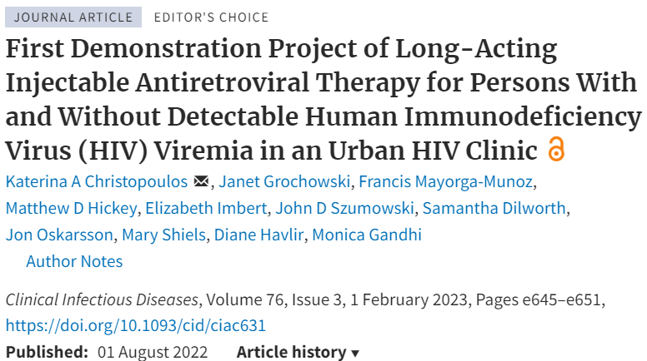
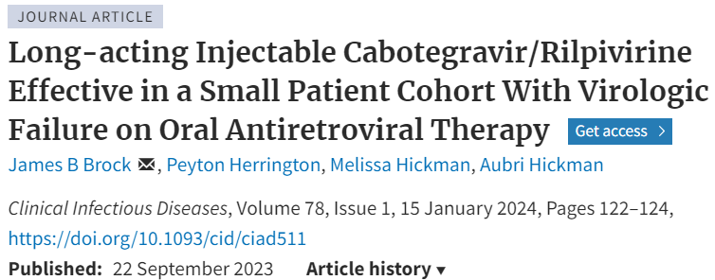
Antiretroviral Therapy (LAART in non-suppressed Patients)
Clinical Infectious Diseases

Slide 43
Antiretroviral Therapy (LAART in non-suppressed Patients) (2)
“When supported by intensive follow-up and case management services, injectable cabotegravir and rilpivirine (CAB-RPV) may be considered for people with viremia who meet the criteria below when no other treatment options are effective due to a patient’s persistent inability to take oral ART (rating AIIa under the conditions described).
Unable to take oral ART consistently despite extensive efforts and clinical support
High risk of HIV disease progression (CD4 cell count <200/μL or history of AIDS-defining complications)
Virus susceptible to both CAB and RPV
If applicable, patients should also be referred for treatment of substance use disorder and/or mental illness.”
However, no randomized clinical studies exist to support this recommendation, and available data are limited by small numbers with variable follow-up, variation in dosing regimens, and insufficient information regarding the types and intensity of clinical support deployed.
Updated Treatment Recommendation on Use of Cabotegravir and Rilpivirine for People With HIV From the IAS-USA Guidelines Panel
JAMA. 2024;331(12):1060-1061. doi:10.1001/jama.2024.2985
March 1, 2024

Slide 44
Antiretroviral Therapy (LAART in non-suppressed Patients) (3)
Understand data are limited but growing.
LA CAB/RPV is approved only for suppressed patients. If a patient’s virus is sensitive then oral suppression should be attempted prior to LAART.
Use in patients who remain viremic despite all efforts is a “a desperate measure”.
Prioritize those at high risk for disease progression and death
It is clear that high levels of support services are critical in success.
Adherence support, addressing mental health, substance use and other social determinants of health are essential.

Slide 45
INSTI Resistance
In 2019, WHO recommended dolutegravir (DTG) based antiretroviral therapy (ART) as the preferred first-line regimen for children, adolescents and adults living with HIV and as the preferred secondline ART for individuals receiving NNRTI-based ART with unsuppressed viral load, and more than 25 million people currently are receiving it.
WHO recommends monitoring HIV resistance to DTG in surveys of pretreatment and acquired HIV drug resistance.
Recent studies supported by the United States President’s Emergency Plan for AIDS Relief in some low- and middle-income countries report prevalence estimates of DTG resistance among individuals receiving DTG-based ART with detectable viremia ranging from 3.9% to 19.6%.
As witnessed with other ARV drug classes, drug resistance to INSTIs can and will emerge. In high-income countries, HIV drug resistance testing of individuals is often used to tailor regimen selection and predict treatment response. However, in most if not all resource-limited settings, HIV drug resistance testing is not routinely available for individual management, and this is currently not recommended by WHO. Even with recent technological advancements, HIV drug resistance testing is unlikely to be routinely available for millions of people in the near future.
HIV drug resistance – brief report 2024 https://www.who.int/publications/i/item/9789240086319

Slide 46
References
Dominguez, Ken. (2016). Updated Guidelines for Antiretroviral Postexposure Prophylaxis After Sexual, Injection Drug Use, or Other Nonoccupational Exposure to HIV—United States, 2016. 10.13140/RG.2.1.1166.3767.
Gandhi RT, Bedimo R, Hoy JF, et al. Antiretroviral Drugs for Treatment and Prevention of HIV Infection in Adults: 2022 Recommendations of the International Antiviral Society–USA Panel. JAMA. 2023;329(1):63–84. doi:10.1001/jama.2022.22246
Mayer KH, Gelman M, Holmes J, Kraft J, Melbourne K, Mimiaga MJ. Safety and tolerability of once daily coformulated bictegravir, emtricitabine, and tenofovir alafenamide for postexposure prophylaxis after sexual exposure. J Acquir Immune Defic Syndr 2022; 90: 27–32.
Liu A, Xin R, Zhang H, et al. An open-label evaluation of safety and tolerability of coformulated bictegravir/emtricitabine/tenofovir alafenamide for post-exposure prophylaxis following potential exposure to human immunodeficiency virus-1. Chin Med J 2022; 135: 2725–29.
Preexposure Prophylaxis for the Prevention of HIV Infection in the United States – 2021 Update Clinical Practice Guideline
Panel on Antiretroviral Guidelines for Adults and Adolescents. Guidelines for the Use of Antiretroviral Agents in Adults and Adolescents with HIV. Department of Health and Human Services. Available at https://clinicalinfo.hiv.gov/en/guidelines/adult-and-adolescent-arv Accessed 4/24/2024
Panel on Guidelines for the Prevention and Treatment of Opportunistic Infections in Adults and Adolescents with HIV. Guidelines for the Prevention and Treatment of Opportunistic Infections in Adults and Adolescents with HIV. National Institutes of Health, Centers for Disease Control and Prevention, HIV Medicine Association, and Infectious Diseases Society of America. Year. Available at https://clinicalinfo.hiv.gov/en/guidelines/adult-and-adolescent-opportunistic-infection. Accessed 4/24/2024
New York State Dept of Health AIDS Institute Clinical Guidelines Program. Screening for Anal Dysplasia and Cancer in Adults With HIV. Bruce Hirsch, MD, FACP, FIDSA 08.09.2022 https://www.hivguidelines.org/guideline/hiv-anal-cancer/ Accessed 04/25/2024
Stier EA, Clarke MA, Deshmukh AA, et al. International Anal Neoplasia Society's consensus guidelines for anal cancer screening. Int J Cancer. 2024;1‐9. doi:10.1002/ijc.34850 https://onlinelibrary.wiley.com/doi/10.1002/ijc.34850

Slide 47
Thank you!
Questions?

