Slide 1
TB in AZ: Data Overview
Timothy Chan ADHS TB Special Projects Epi timothy.chan@azdhs.gov

Slide 2
Disclaimer
The views and opinions expressed in this presentation are not necessarily those of the Pacific AIDS Education & Training Center (Pacific AETC) or its eight local partner sites in HRSA Region 9, the Regents of the University of California or its San Francisco campus (UCSF or collectively, University) nor of our funder the Health Resources and Services Administration (HRSA). Neither Pacific AETC, University, HRSA nor any of their officers, board members, agents, employees, students, or volunteers make any warranty, express or implied, including the warranties of merchantability and fitness for a particular purpose; nor assume any legal liability or responsibility for the accuracy, completeness or usefulness of information, product or process assessed or described; nor represent that its use would not infringe privately owned rights.
HRSA Acknowledgement Statement The Pacific AETC is supported by the Health Resources and Services Administration (HRSA) of the U.S. Department of Health and Human Services (HHS) as part of an award totaling $3,887,700.00. The contents are those of the author(s) and do not necessarily represent the official views of, nor an endorsement, by HRSA, HHS, or the U.S. Government. For more information, please visit HRSA.gov.
Trade Name Disclosure Statement Funding for this presentation was made possible by 5 U1OHA29292‐08‐00 from the Human Resources and Services Administration HIV/AIDS Bureau. The views expressed do not necessarily reflect the official policies of the Department of Health and Human Services nor does mention of trade names, commercial practices, or organizations imply endorsement by the U.S. Government. Any trade/brand names for products mentioned during this presentation are for training and identification purposes only.

Slide 3
Disclosure
No conflicts of interest.
Not to be used as clinical advice
Information is based on surveillance data.

Slide 4
Objectives
By the end of today’s presentation, you will be able to:
Utilize your understanding about national TB data in your work
Identify Arizona’s TB data in relation to national TB data
Learn more about Arizona TB Class B data and how it is incorporated into the whole picture

Slide 5
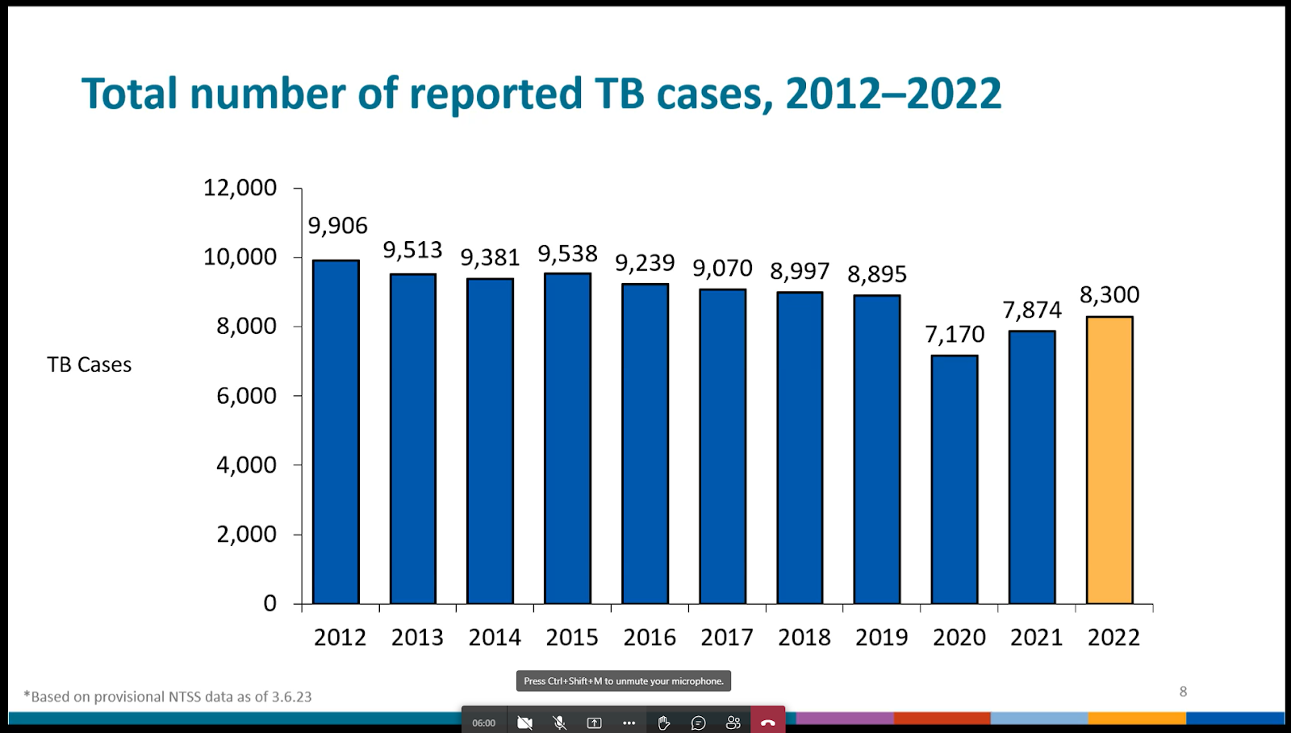
Total number of reported TB cases, 2012-2022

Slide 6
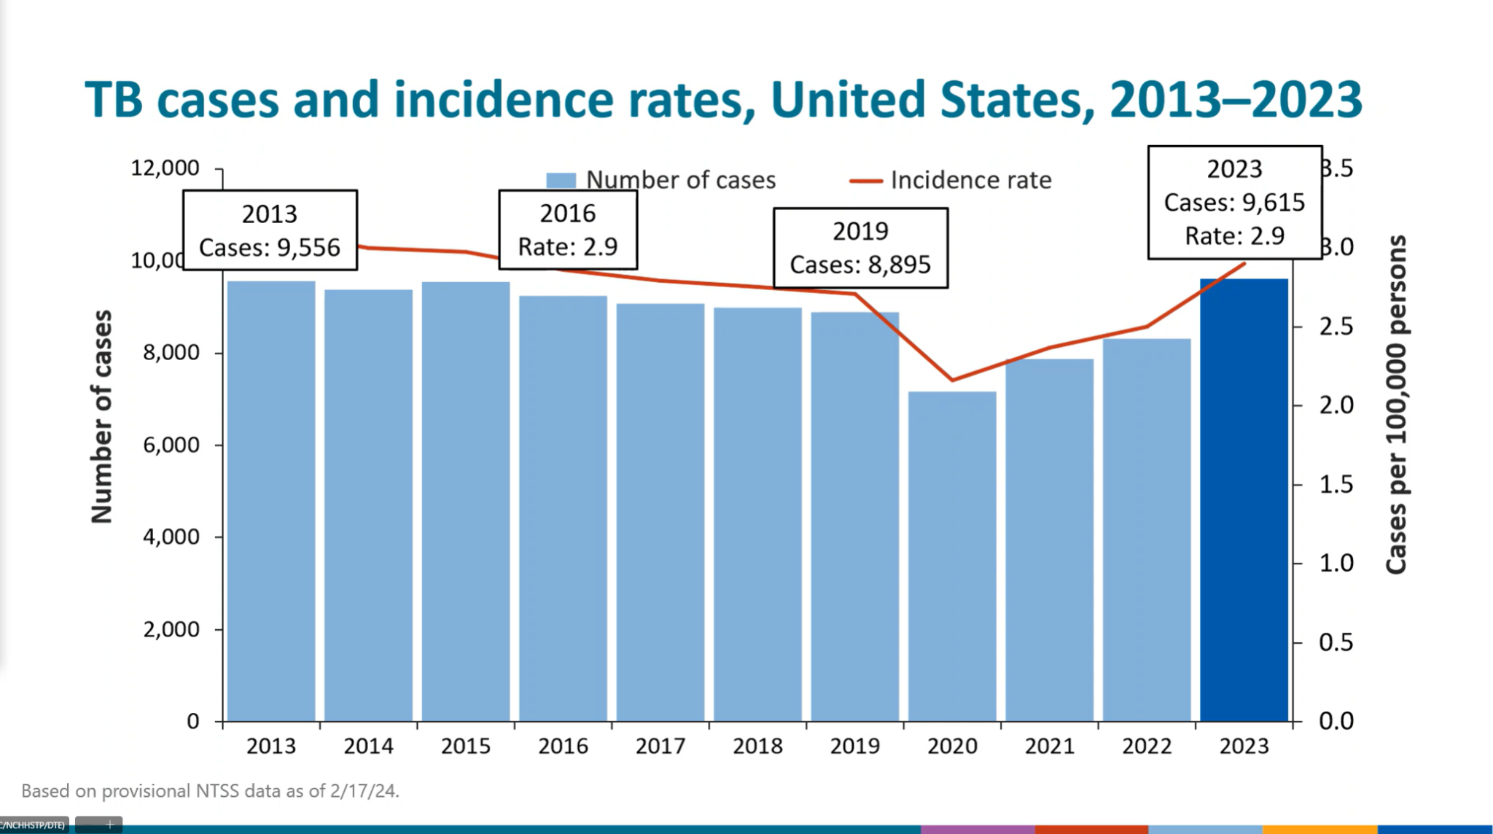
TB cases and incidence rates, United States, 2013-2023

Slide 7
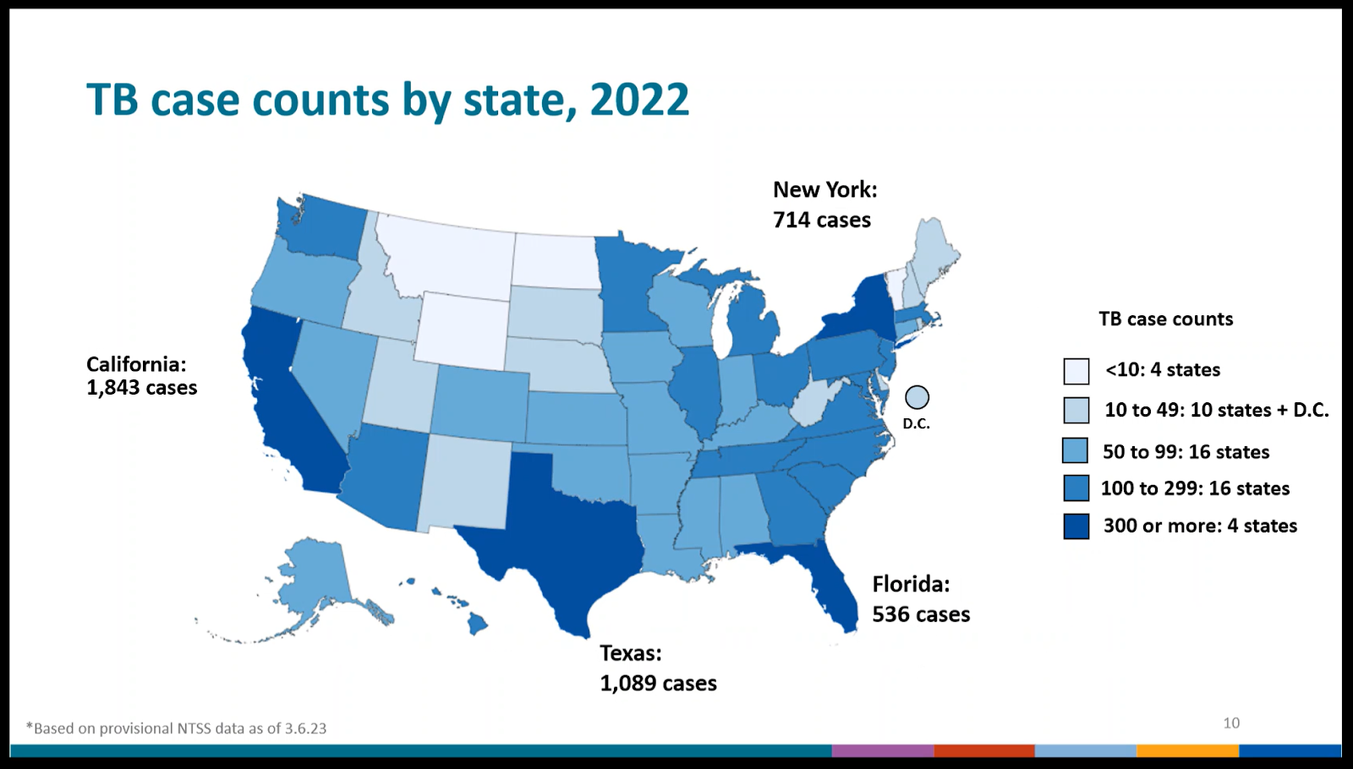
TB case counts by state, 2022

Slide 8
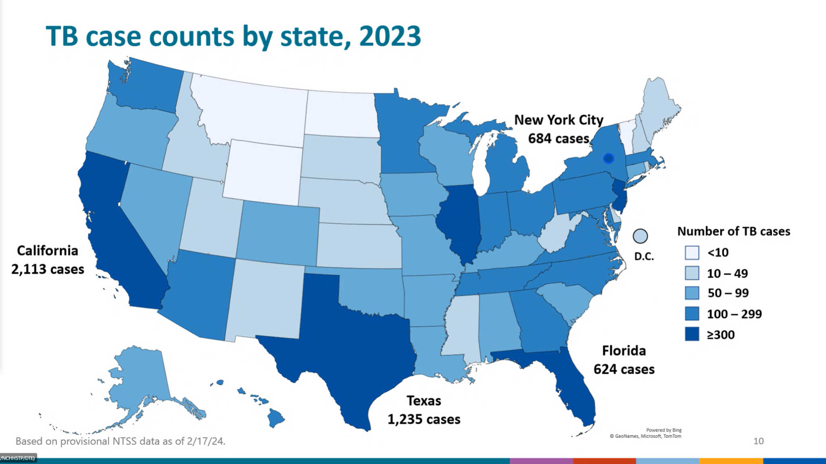
TB case counts by state, 2023

Slide 9
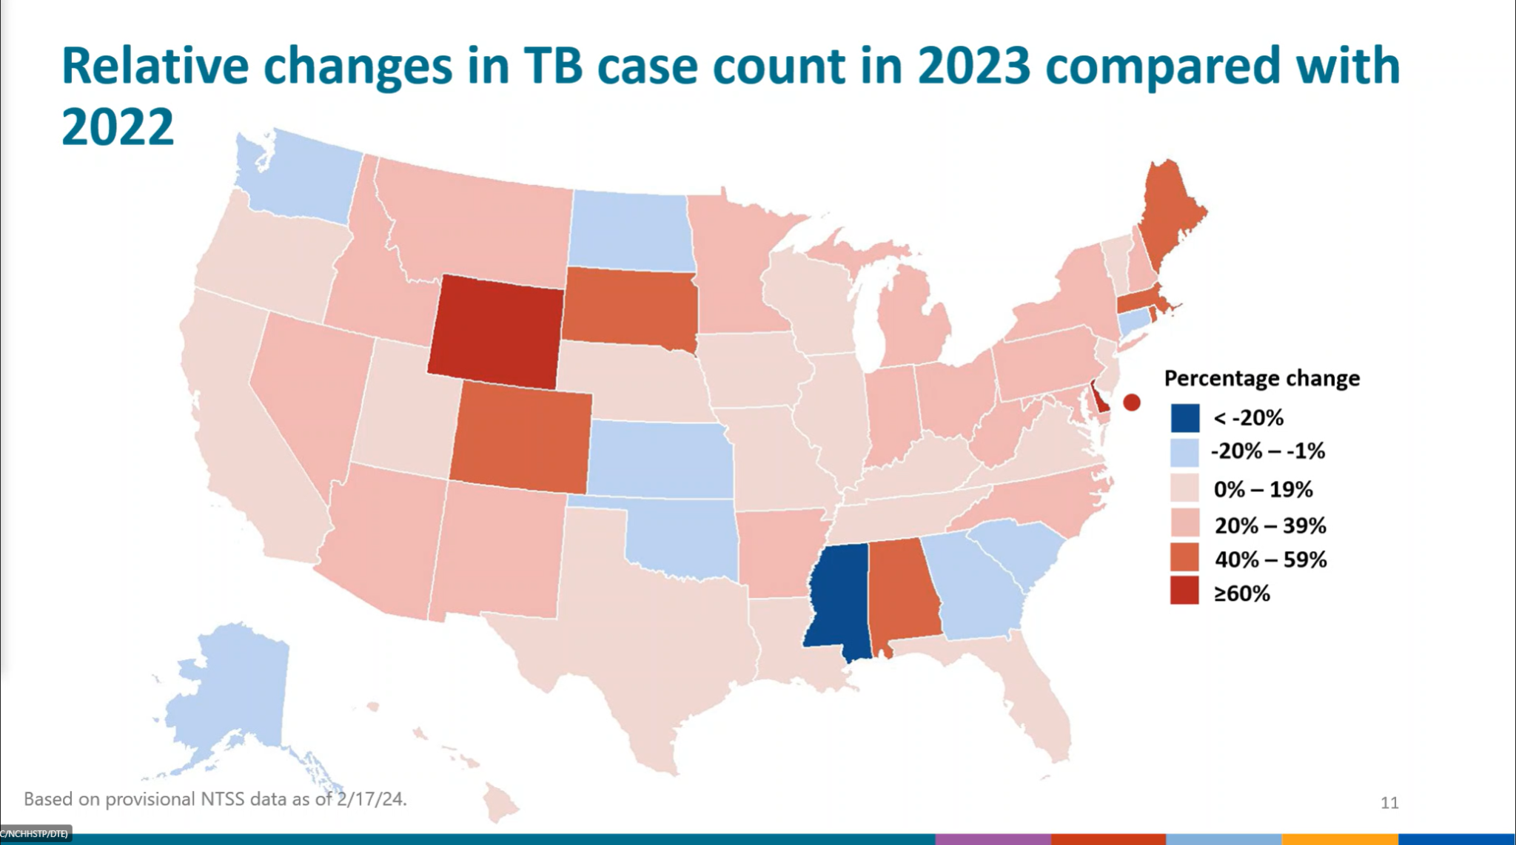
Relative changes in TB case count in 2023 compared with 2022

Slide 10
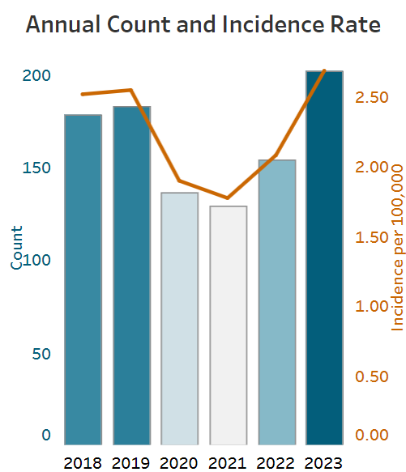
Arizona Data 2023
2023: 202 Active Countable TB Cases
Up 48 cases from 2022
Incidence: 2.68 cases per 100,000
Up 29% from 2022
https://www.azdhs.gov/preparedness/epidemiology-disease-control/disease-integration-services/tb-control/#tb-control-data-reports

Slide 11
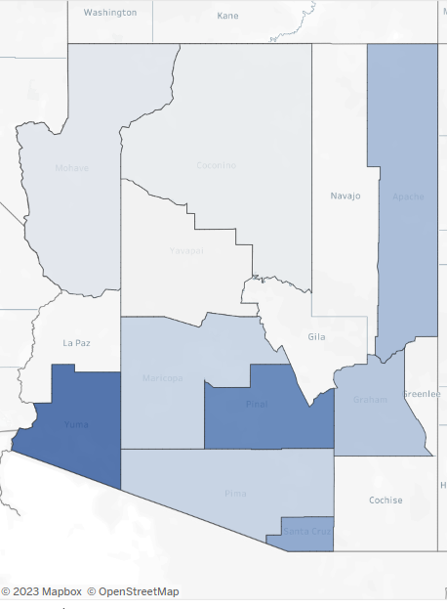
Arizona Map Data 2022
Counties | Total Case Count | Incidence Rate (cases per 100,0000)
Pinal | 27 | 6.15
Yuma | 16 | 7.72
Pima | 20 | 1.89
Maricopa | 82 | 1.82

Slide 12
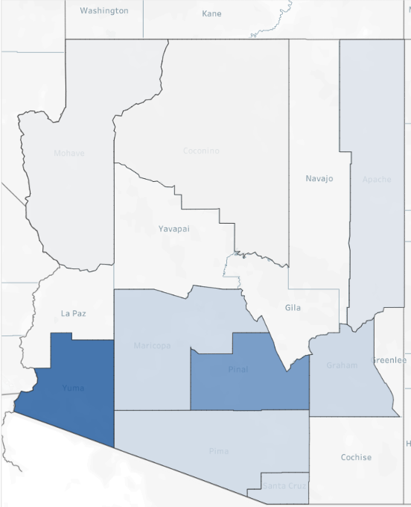
Arizona Map Data 2023
Counties | 2022 Total Case Count | 2022 Incidence Rate (cases per 100,0000)
Pinal | 27 | 6.15
Yuma | 16 | 7.72
Pima | 20 | 1.89
Maricopa | 82 | 1.82
Counties | 2023 Total Case Count | 2023 Incidence Rate (cases per 100,0000)
Pinal | 35 | 7.49
Yuma | 25 | 11.67
Pima | 24 | 2.22
Maricopa | 112 | 2.40

Slide 13
Class B’s

Slide 14
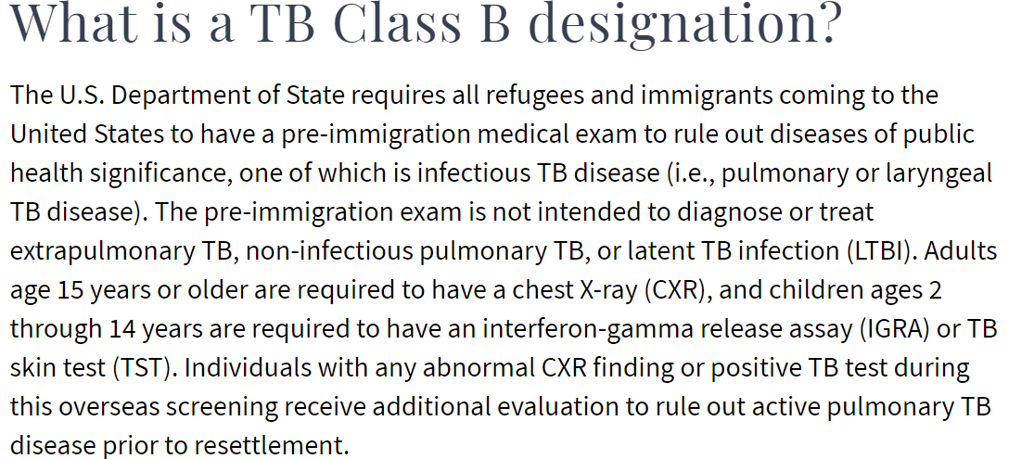
What is a TB Class B designation?
https://www.health.state.mn.us/diseases/tb/lph/lphclassb.html

Slide 15
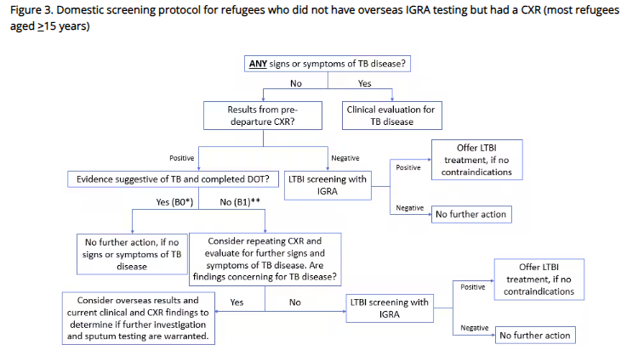
Domestic screening protocol for refugees who did not have overseas IGRA testing but had a CXR (most refugees aged >= 15 years)
https://www.cdc.gov/immigrantrefugeehealth/panel-physicians/tuberculosis.html

Slide 16
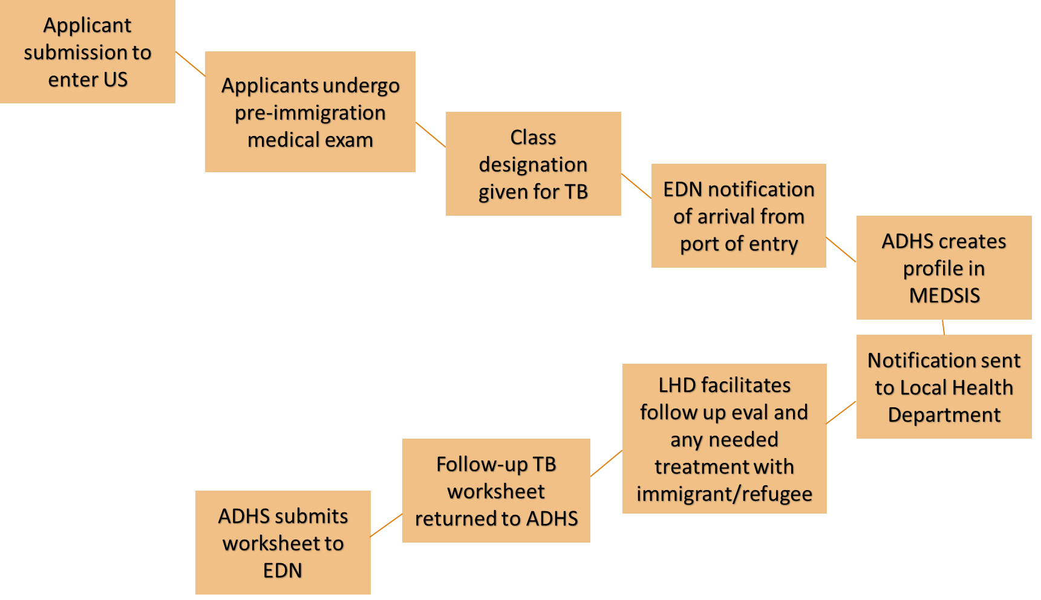
Class B’s flow chart

Slide 17
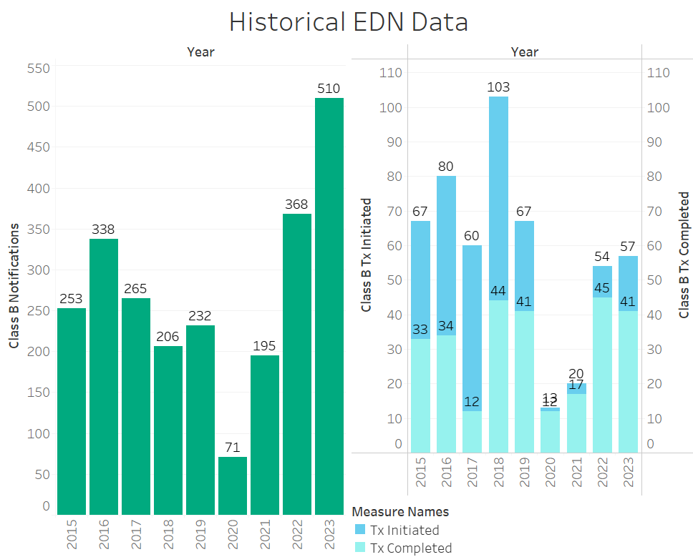
Arizona Class B Data

Slide 18
Class B Resources
•“TB Class B Arrivals - Minnesota Dept. of Health.” TB Class B Arrivals - Minnesota Dept. of Health, https://www.health.state.mn.us/diseases/tb/lph/lphclassb.html
•“Tuberculosis Technical Instructions for Panel Physicians.” Centers for Disease Control and Prevention, Centers for Disease Control and Prevention, 17 Oct. 2019, https://www.cdc.gov/immigrantrefugeehealth/panel-physicians/tuberculosis.html
•“Tuberculosis Technical Instructions for Civil Surgeons.” Centers for Disease Control and Prevention, Centers for Disease Control and Prevention, 15 Mar. 2021, https://www.cdc.gov/immigrantrefugeehealth/civil-surgeons/tuberculosis.html

Slide 19
Thank you!
Thank you!
Any Questions after today? Contact tb@azdhs.gov
All Images from Flaticon.com

