Slide 1
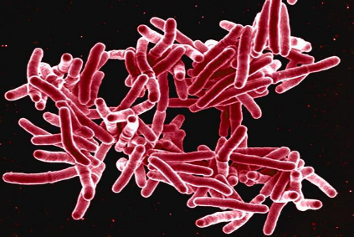
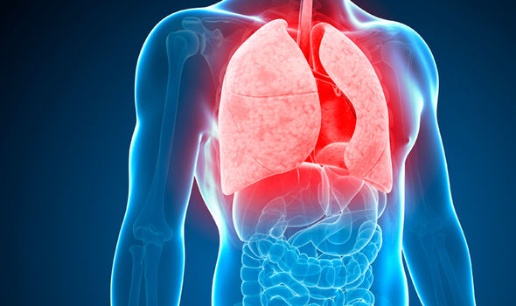
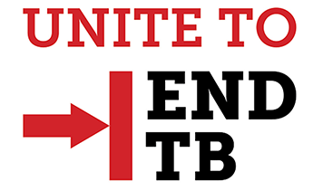
Tuberculosis Infection (TBi) Overview Think, Test and Treat
Renuka Khurana, MD, MPH, FAAP
Medical Director , Community Health and Record Services Division
04/29/2024

Slide 2
Disclaimer
The views and opinions expressed in this presentation are not necessarily those of the Pacific AIDS Education & Training Center (Pacific AETC) or its eight local partner sites in HRSA Region 9, the Regents of the University of California or its San Francisco campus (UCSF or collectively, University) nor of our funder the Health Resources and Services Administration (HRSA). Neither Pacific AETC, University, HRSA nor any of their officers, board members, agents, employees, students, or volunteers make any warranty, express or implied, including the warranties of merchantability and fitness for a particular purpose; nor assume any legal liability or responsibility for the accuracy, completeness or usefulness of information, product or process assessed or described; nor represent that its use would not infringe privately owned rights.
HRSA Acknowledgement Statement The Pacific AETC is supported by the Health Resources and Services Administration (HRSA) of the U.S. Department of Health and Human Services (HHS) as part of an award totaling $3,887,700.00. The contents are those of the author(s) and do not necessarily represent the official views of, nor an endorsement, by HRSA, HHS, or the U.S. Government. For more information, please visit HRSA.gov.
Trade Name Disclosure Statement Funding for this presentation was made possible by 5 U1OHA29292‐08‐00 from the Human Resources and Services Administration HIV/AIDS Bureau. The views expressed do not necessarily reflect the official policies of the Department of Health and Human Services nor does mention of trade names, commercial practices, or organizations imply endorsement by the U.S. Government. Any trade/brand names for products mentioned during this presentation are for training and identification purposes only.

Slide 3
Disclosure
No disclosures
No conflicts of interest

Slide 4
TB and HIV
HIV (human immunodeficiency virus) and tuberculosis (TB) are two infectious diseases that have a well-established connection. People living with HIV have a higher risk of developing tuberculosis compared to those without HIV infection. This is because HIV weakens the immune system, making individuals more susceptible to various infections, including tuberculosis.
The interaction between HIV and TB is often referred to as a "deadly synergy" because the two diseases worsen each other's impact on the body.

Slide 5
TB and HIV: Key Points
Here are some key points regarding the connection between latent tuberculosis and HIV:
Latent TB infection (LTBI): TB bacteria can enter the body and remain inactive, causing no symptoms. This is known as latent TB infection. People with LTBI do not have an active TB disease and are not contagious, but they are at risk of developing active TB in the future if their immune system weakens.
Reactivation of TB: HIV weakens the immune system by primarily targeting CD4 cells, which are crucial for maintaining a robust immune response. When the immune system is compromised, latent TB can reactivate and progress to active TB disease. HIV-infected individuals with latent TB are at a higher risk of developing active TB compared to those without HIV.
Increased susceptibility: HIV infection increases the susceptibility to acquiring TB from an infected individual. TB is an airborne disease transmitted through respiratory droplets, and weakened immune defenses in HIV-positive individuals make them more prone to contracting TB when exposed to the bacteria.

Slide 6
TB and HIV: Key Points (cont.)
Here are some key points regarding the connection between latent tuberculosis and HIV:
Diagnostic challenges: Diagnosing TB in HIV-positive individuals can be more challenging due to the atypical presentation of symptoms and the higher likelihood of extrapulmonary TB (TB occurring outside the lungs). Specialized tests and procedures may be required for an accurate diagnosis.
Treatment complications: Managing TB in HIV-positive individuals can be more complex. There are potential drug interactions between antiretroviral therapy (ART) used to treat HIV and the medications used to treat TB. Close monitoring and coordination between healthcare providers are essential to ensure effective treatment and minimize adverse effects.
Public health implications: The HIV-TB co-epidemic presents significant public health challenges, especially in areas with high HIV prevalence and TB burden. Coordinated efforts are required to strengthen prevention, diagnosis, and treatment programs for both diseases.

Slide 7
Objectives
By the end of this presentation, participants will be able to:
Define TB infection
Identify high-risk groups for TB screening
List tests required for the evaluation of TB infection
Describe treatment regimens for TBi treatment and challenges associated with short-course regimens

Slide 8
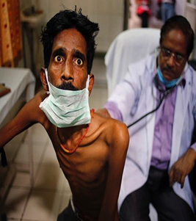
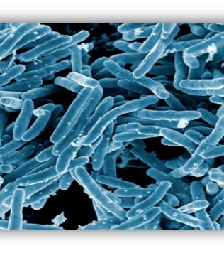
Topics
USPSTF Screening Recommendations for TBi
Risk Factors for progression to TB Disease
TB Infection Recommendations for Treatment and Monitoring

Slide 9
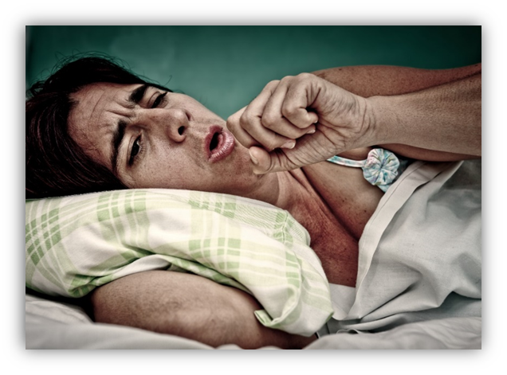
Global TB Incidence/Prevalence
TB is the top infectious
killer worldwide.
In 2022…
1.3 million
0.167 million
Died from TB.
Died from TB and HIV.
Notes:
Globally in 2022, there were an estimated 1.13 million deaths among HIV-negative people (95% uncertainty interval [UI]: 1.02–1.26 million) and an estimated 167 000 deaths among people with HIV (95% UI: 139 000–198 000). The combined total of 1.3 million is almost back to the level of 2019. However, the net reduction in the total number of deaths caused by TB between 2015 and 2022 was only 19%, far from the 2025 milestone of the End TB Strategy (a 75% reduction between 2015 and 2025).

Slide 10
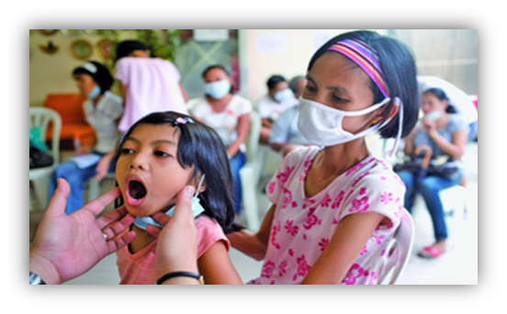
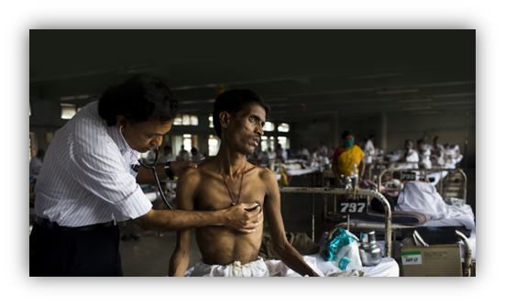
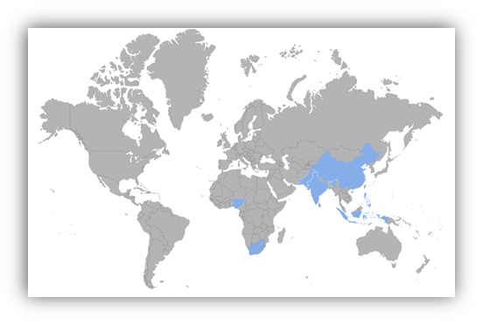
Global TB Burden
There are….
10.6 million incident cases
1.25 million children living with TB
6.3% living with TB and HIV
Regions affected SE Asia 43%, Africa 23%, Western Pacific 18%, East Mediterranean 8.1%, Americas 3.1% and Europe 2.2%
Eight countries account for 2/3 cases:
India (27%), Indonesia (10%), China (7.1%),
Philippines 7.0%), Pakistan (5.7%), Nigeria (4.5%),
Bangladesh (3.6%) and Democratic Republic of
Congo (3.0%)
Notes:
The estimated 10.6 million people (95% UI: 9.9–11.4 million) who fell ill with TB worldwide in 2022 is an increase from 10.3 million in 2021 (95% UI: 9.6–11 million) and 10.0 million (95% UI: 9.4–10.7 million) in 2020, continuing the reversal of the downward trend that had been sustained for many years up to 2020 (Fig. 1.1.1a). Similarly, the TB incidence rate (new cases per 100 000 population per year) is estimated to have increased by 1.9% between both 2020–2021 and 2021–2022 (Fig. 1.1.1b).
Two consecutive years of global increases in TB incidence (in 2021 and 2022) mean that in 2022, the TB incidence rate reverted back to the level of 2019 (Fig. 1.1.1b). Globally, the net reduction in the TB incidence rate from 2015 to 2022 was 8.7%, far from the WHO End TB Strategy milestone of a 50% reduction by 2025 (1, 2).
WHO’s recently released Global Tuberculosis Report, highlights that an estimated 1.25 million children and young adolescents (aged 0-14 years) fell ill with TB in 2022, which is 12% of the global TB burden. Almost half were under 5 years of age.
Photos:
http://www.tbonline.info/galleries/image/1/
http://nano-synth-sensors.com/tb-detection/

Slide 11
Global Drug Resistant TB Burden
410,000
MDR-TB Cases in 2022
Only 36% (2021)
Largest share of these are living in India 27%), Philippines (7.5%), and the Russian Federation (7.5%)
that needed MDR-TB treatment were enrolled in it
TB is the leading cause of deaths due to anti-microbial resistance among people with HIV
Notes:
Globally in 2021, 161 746 people were enrolled on treatment for MDR/RR-TB, a small increase of 7.5% from 150 469 in 2020 but still below 181 533 in 2019. Most of those enrolled on treatment were adults

Slide 12
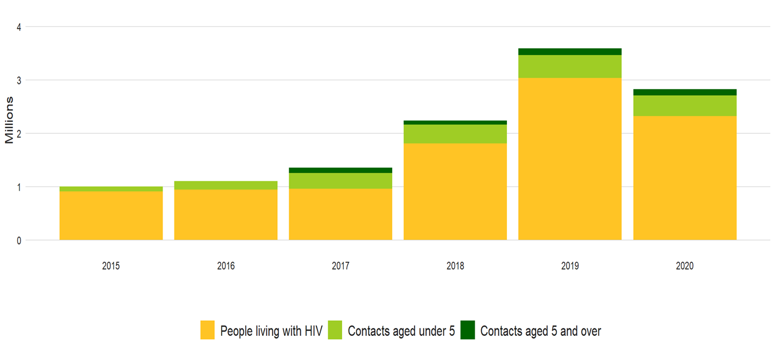
Global TB Infection Treatment
Notes:
The global number of people living with HIV and household contacts of people diagnosed with TB who were provided with TB preventive treatment increased from 1.0 million in 2015 to 3.6 million in 2019, with a particularly large increase (1.4 million) between 2018 and 2019 (Fig. 4.1). However, this positive trend reversed between 2019 and 2020 (Fig. 4.1), probably reflecting disruptions to health services caused by the COVID-19 pandemic. The total number of people provided with TB preventive treatment in 2020 was 2.8 million, a 21% reduction compared with 2019. Progress made in the past 3 years lags far behind that needed to reach the global target set at the UN high-level meeting on TB: the combined total of 8.7 million in 2018–2020 is only 29% of the target of 30 million for the 5-year period 2018–2022 (Fig. 4.2).
Provision of TB preventive treatment to household contacts increased between 2015 and 2019 (Fig. 4.1) but fell from 0.56 million in 2019 to 0.50 million in 2020 (a reduction of 11%). The cumulative number of contacts initiated on TB preventive treatment in the 3-year period 2018–2020, at 1.5 million, is only 6.2% of the target of 24 million for the 5-year period 2018–2022. This number included 1.2 million children aged under 5 years (29% of the 5-year target of 4 million) and 0.32 million people in older age groups (1.6% of the 5-year target of 20 million) (Fig. 4.2).
Globally in 2020, 7.0 million contacts of bacteriologically confirmed pulmonary TB cases were reported, of whom 3.9 million (55%) were evaluated for both TB infection and disease. These numbers were decreases (of 29% and 31%, respectively) from the 9.8 million reported and 5.6 million evaluated in 2019. Coverage of screening and initiation of TB preventive treatment varied widely among countries (Fig. 4.3, Fig. 4.4). There was also considerable variation in treatment completion rates. For the first time this year, countries reported TB preventive treatment completion data: among household contacts starting TB preventive treatment in 2019, the median completion rate was 86% (IQR, 71–96%) in 80 countries (Fig. 4.5).
Most of those provided with TB preventive treatment to date have been people living with HIV (Fig. 4.1). Globally, the annual number increased from fewer than 30 000 in 2005 to 3.0 million in 2019, before falling to 2.3 million in 2020, a reduction of 23% compared with 2019 (Fig. 4.6). There were reductions in most WHO regions between 2019 and 2020. Six countries - India, Mozambique, Nigeria, South Africa, Uganda and Zambia - each reported initiating over 200 000 people with HIV on TB preventive treatment in 2020, accounting collectively for 74% of the 2.3 million reported globally (Fig. 4.7). Between 2018 and 2020, 7.2 million people with HIV received TB preventive treatment, meaning that the UN high-level meeting target of 6 million has been achieved well ahead of schedule. This represents a milestone achievement. However, accelerated scale-up will be needed to meet the implementation target of 90% by 2025, set out in the End TB Strategy and reaffirmed at the 2021 UN high-level Meeting on HIV and AIDS.
Between 2005 and the end of 2020, 13 million people living with HIV were initiated on TB preventive treatment, equivalent to about one third of the 37.7 million people estimated to be living with HIV in 2020 (4). Coverage varies widely among countries: in eight high TB/HIV burden countries that reported data for 2020, the median coverage was 54% (interquartile range [IQR], 41–79%) among eligible people newly started on antiretroviral treatment. In 20 countries reporting data, a median of 84% (IQR, 70–92%) of people living with HIV who started TB preventive treatment in 2019 completed their treatment. This was the first time that these data were collected.

Slide 13
TB Infection (TBi) US Burden
13.2 Million (4.7%) in US estimated to be infected with TB (TBi)
TBi not reportable in US (except in few states), not reportable in AZ
Decline in TB Disease rates in US
No change in TBi rates
>75% of TB Disease cases likely to be due to reactivation of untreated TBi
TBi screening and treatment a goal to accelerate TB elimination in US

Slide 14
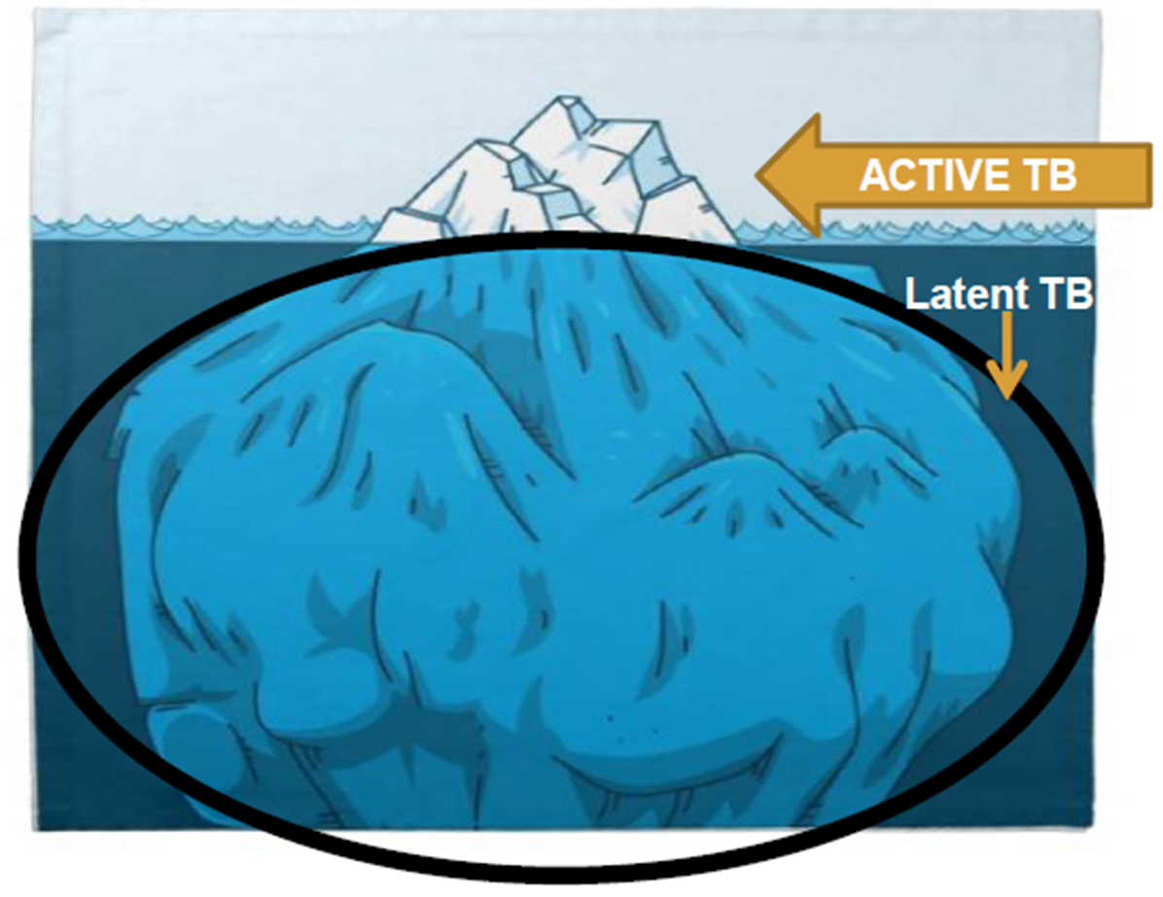
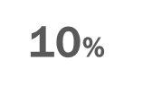
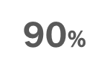
TB Hides in Plain Sight
Notes:
TB elimination efforts are increasingly focusing on TBi. About 13 million people in the US have TBi. Without treatment, these people are at risk for developing TB disease. [Up to 10% will develop TB in their lifetime]

Slide 15
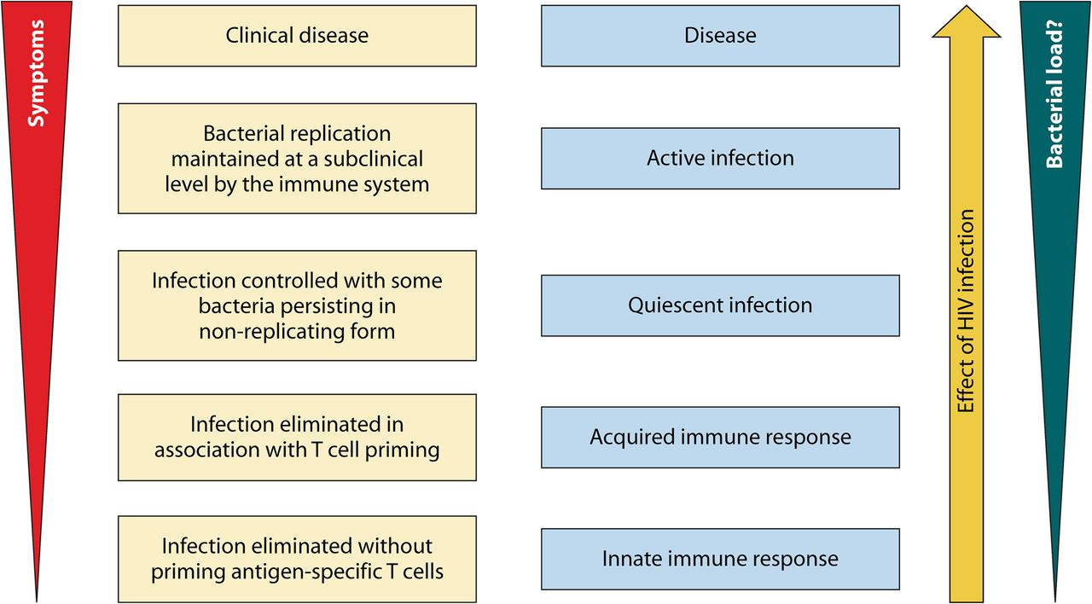
Proposed framework for considering tuberculosis infection as a spectrum
Notes:
Proposed framework for considering tuberculosis infection as a spectrum. (Reproduced from reference 2 by permission from Macmillan Publishers Ltd.)‏

Slide 16
TB Disease (Active) vs TB Infection (TBi)
TB Infection (TBi)
TB Disease (Active)
Inactive, contained tubercle bacilli
IGRA or TST positive
Non-infectious
Asymptomatic for TB disease
Imaging (CXR) typically normal
Sputum smears and cultures if collected are negative
Active, multiplying tubercle bacilli
IGRA or TST usually positive
Often infectious before treatment
Symptomatic with TB related symptoms
Imaging (CXR/CT Scan) typically abnormal
Sputum smears and/or cultures are usually positive
Notes:
LTBI is defined as a state of persistent immune response to stimulation by Mycobacterium tuberculosis antigens with no evidence of clinically manifest active TB.

Slide 17
Implications for TB Elimination
Guideline is a catalyst for moving TB elimination efforts forward by addressing the reservoir of TBi
Changed focus for TB prevention and control from state and public health departments to community health centers and private health care providers (Think, Test and Treat)
100,000 screened:
52-146 active TB cases averted
7-67 with Hepatotoxicity
Need to treat 111-314 TBi cases to avert 1 case of TBi progressing to TB
Notes:
Transmission of bacteria,
Establishment of infection, and
Progression to disease.
Directly related to number of bacilli-laden droplets expelled into the air
Infection occurs when person inhales droplets, which travel to alveoli
Young children with TB less likely to be infectious, but can transmit M. tb
Infectiousness usually declines rapidly with treatment
However, some remain infectious for weeks or months
High concentration of droplet nuclei in the air
Exposure in small, enclosed spaces
Poor ventilation that inadequately dilutes or removes droplet nuclei
Recirculation of air containing droplets
Improper specimen handling procedures
Positive air pressure in patient’s room causing flow to other areas
Transmission dependent on three factors
Infectiousness of the person with TB
Environment in which the transmission occurs
Duration of the exposure to TB bacteria

Slide 18
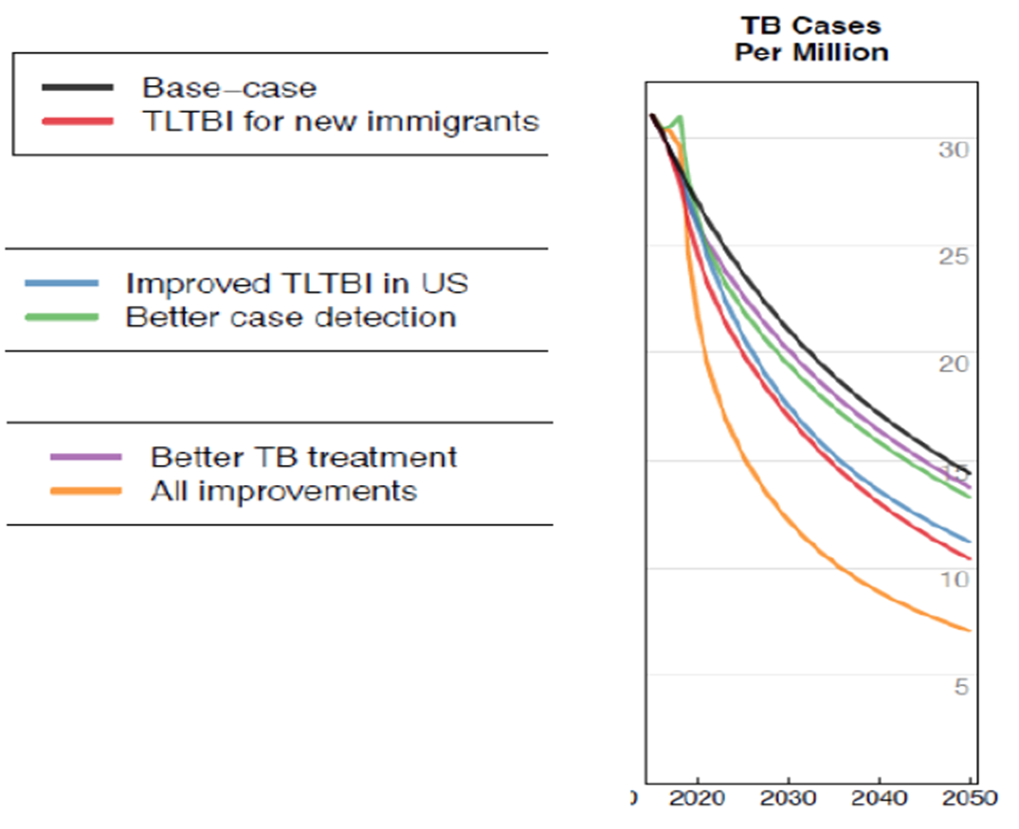
TBi treatment strategies for new immigrants will have the biggest impact.
Notes:
This is a Harvard Study showing different projections to year 2050 by type of intervention in reducing the number of TB cases. The graph compares interventions such as better treatment for TB, better case detection, and improved treatment for TBi. Shown as a yellow line are all strategies implemented together and this clearly will have the biggest impact. But if you compare TB disease strategies with TBi strategies you can see that treatment for TBi in new immigrants, the line in red, and improved treatment for TBi in the US, the line in blue, have the biggest impact.

Slide 19
THINK TB– Who to Target

Slide 20
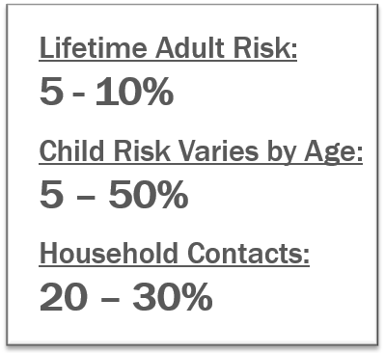
Transitions in Tuberculosis
Notes:
10% of infected persons with normal immune systems develop TB at some point in life
HIV strongest risk factor for development of TB if infected
-Risk of developing TB disease 7% to 10% each year
Certain medical conditions increase risk that TB infection will progress to TB disease

Slide 21
TBi USPSTF Screening Recommendation 2016
B Recommendation = USPSTF recommends this service. There is high certainty that the net benefit is moderate or there is moderate certainty that the net benefit is moderate.

Slide 22
USPSTF Net Benefit Grade
USPSTF has moderate certainty that screening for TBi in persons at increased risk of infection provides a moderate net benefit
Treatment of TBi provides moderate benefit in preventing progression to active TB and harms of screening and treatment are small
100,000 screened:
52-146 active TB cases averted
7-67 with Hepatotoxicity
Need to treat 111-314 TBi cases to avert 1 case of TBi progressing to TB

Slide 23
Targeted Testing -- Who is at Risk?
Two broad categories
At high risk for exposure to infection with M.tuberculosis
At high risk of progression to TB disease once infected with M.tuberculosis
Notes:
It does not apply to adults with symptoms of TB disease or children and
adolescents (children and adolescents screening addressed in Bright
Futures).

Slide 24
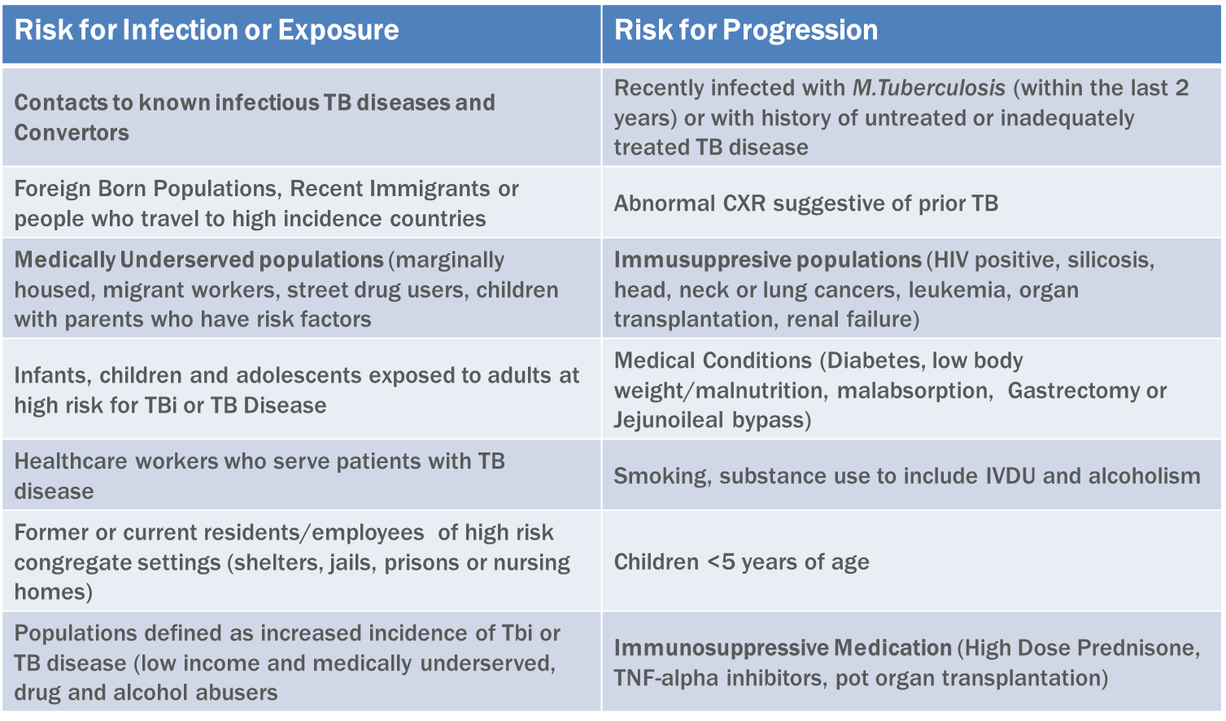
Targeted testing Risk Factors for TBi
Notes:
CDC recommends the following populations continue to be tested for TBi
as part of other screening efforts:
– Persons with immunosuppression: TB testing is included in standards of care
for disease or medical management for HIV/AIDS, immunosuppressive
medications, and silicosis.
– Persons who are contacts of persons with active TB disease: TB testing is
conducted as part of public health programs.
– Health care workers and workers in high‐risk congregate settings: TB testing is
conducted as part of employee health programs.
Disease Relative risk
Silicosis 30
Jejunoileal bypass 27-63
Renal transplant 37
Head or neck cancer 16
Renal failure 10-25.3
Diabetes 2.0-4.1
Gastrectomy 2-5

Slide 25
Case Study
47-year-old Hispanic male from Bolivia immigrated to us 4 years ago
Known contact of infectious TB case
TST = 5 mm of induration
3 months later TST = 23 mm of induration
No symptoms of TB disease

Slide 26
Question
What are this patient’s risk factors for TB infection or disease?
A. Contact to an infectious TB case
B. Immigration from Bolivia
C. TST 5 mm
D. TST 23 mm
E. All of the above

Slide 27
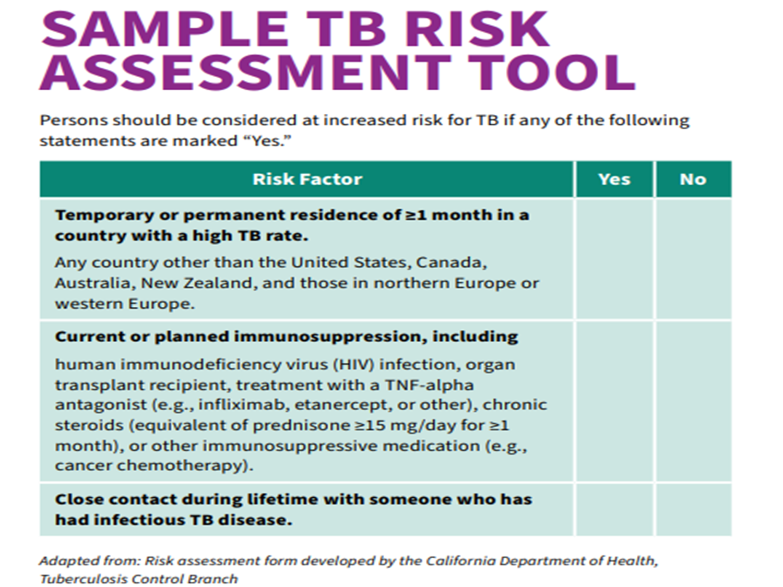
Sample TB Risk Assessment Tool

Slide 28
Test the identified risk categories people-TBi Tests for Screening

Slide 29
Question 1
44-year-old immigrated from Bangladesh immigrated 2 months ago
How will you screen for TB on the initial office visit?
A. TST
B. QFT-G
C. CXR
D. TB Symptoms
E. Answers A and C
F. Answers B and D

Slide 30
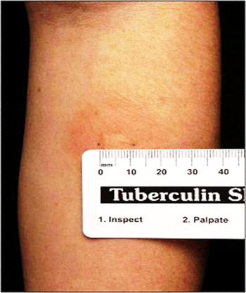
Tests for TB infection
Neither TB test differentiate between TBi and Active TB Disease

Slide 31
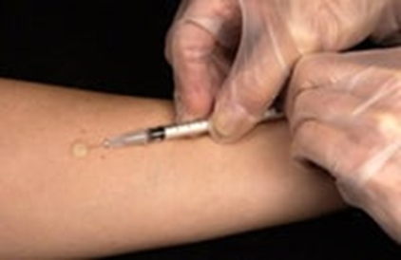
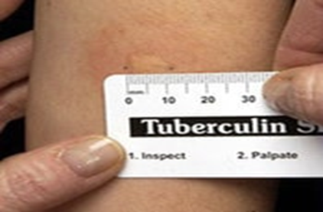
Tuberculin Skin Test (TST)
TST (5TU of PPD) placed intradermally, and a wheal MUST be raised for accurate reading
Induration MUST be read 48-72 hours after placement in mm
Interpretation is based on risk category and the size of the induration
TST must be repeated if not measured in mm and recorded
TST is affected by BCG
Requires two visits

Slide 32
Interferon Gamma Release Assay (IGRA-QFT-G Plus, T-Spot)
No cross reactivity
With the BCG
With most Non-tubercular Mycobacteria except M.kansasii, M.szulgai, M. flavescens and M marinum
Cross reacts with
M.bovis, microti and africanum
Uses control antigens
NIL (negative) control
Mitogen phytohemagglutinin antigen (positive) control

Slide 33
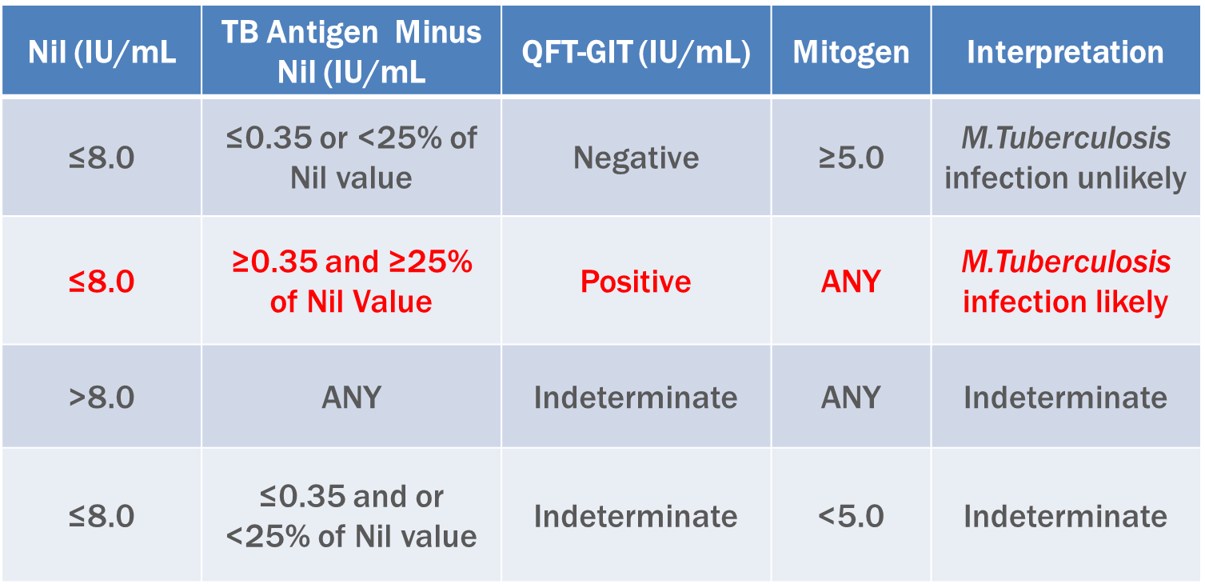
Interpretation Criteria for QFT-GIT
Notes:
QFT variability
– Phlebotomy
– Shaking
– Incubation
– Reading
– Host variability

Slide 34
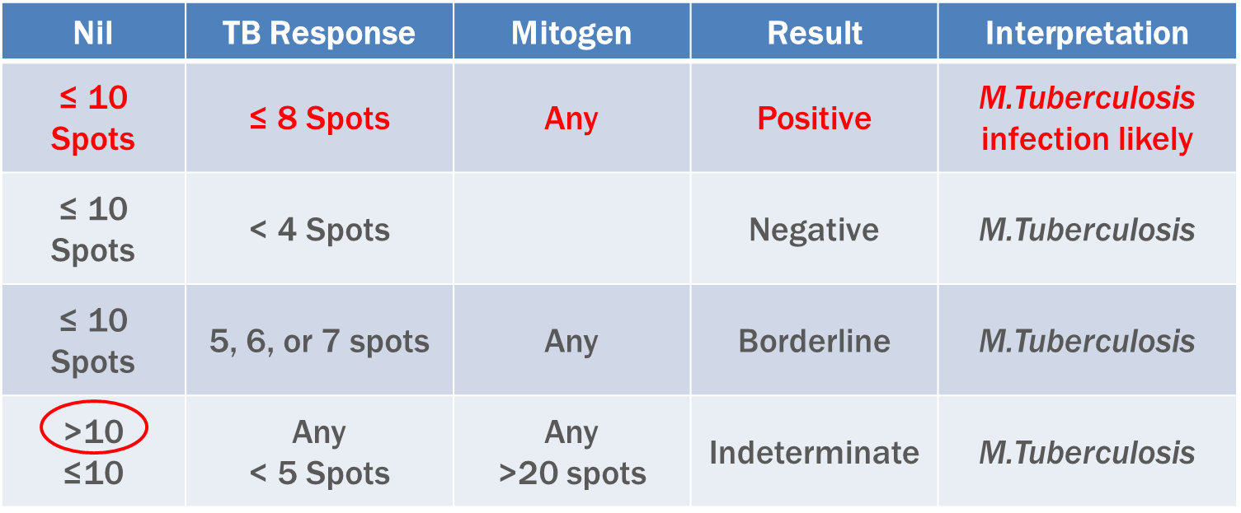
Interpretation Criteria for T-SPOT
Notes:
The T-SPOT is one of the IGRAs.
_______________________________________________________________________________________________________________________________________________________________________________
In the T-SPOT test, Interferon-gamma is captured and presented as spots from T cells sensitized to TB infection. Results are interpreted by subtracting the spot count in the negative (NIL) control from the spot count in Panels A and B.
T-SPOT.TB variability
– Phlebotomy
– Shipping conditions
– Xtend
– Reading
– Host variability

Slide 35
IGRA can be used in all places where TST is used.
IGRA Preferred
Low rates for returning for TST read
BCG inoculated foreign born
TST Preferred
Children <2 years old
IGRA can be used at any age especially in children who were vaccinated with BCG
Interferon-γ Release Assays in Children <15 years of age Ahmed, A; et al Pediatrics 2020, January ; 145
(1), Redbook 2024
No Preference
Contact to cases
Periodic testing for groups with occupational exposure
Both tests can be used
Risk for progression, infection, poor outcome is increased
e.g. HIV infection, Children<5 years old
Clinical suspicion for active TB is high
Additional information is required. to increase compliance
Initial IGRA is indeterminate/borderline
Notes:
Future Directions and Questions IGRA
Natural History of conversion and reversion is unknown
Uncertain of response to treatment---if IGRA increase, decrease or demonstrate no change
Uncertain predictive value for disease progression in IGRA positive
Test selection QFT-G vs T-spot
Specific IGRA for certain populations—children and immunocompromised
Indeterminate results--what to do

Slide 36
IGRA’s
Sensitivity Specificity
TST 65%-74% 46-87%
QFT-G IT 70%-89% 99%
T-spot 89%-96% 97%
T-spot more sensitive in children<2years,
immune-compromised and malnourished clients
T-spot is more labor intensive

Slide 37
Cohen’s Kappa Coefficient
0.81 - 1
Almost Perfect Agreement
0.61 - 0.8
Substantial Agreement
0.41 - 0.6
Moderate Agreement
0.21 - 0.4
Fair Agreement
0 - 0.2
Slight Agreement

Slide 38
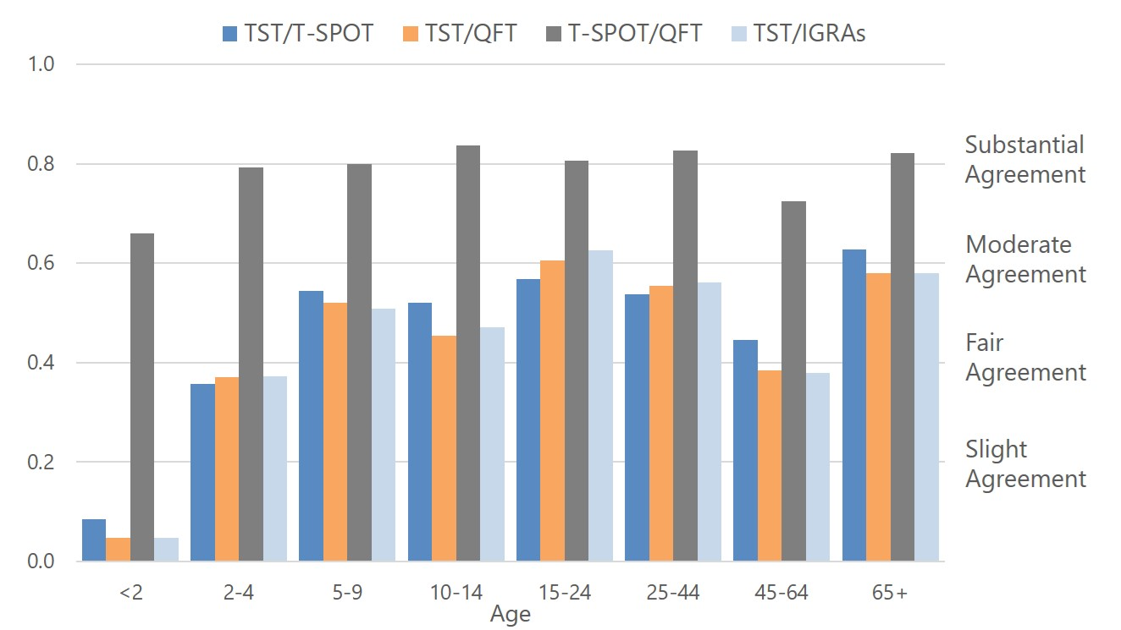
Test agreement was higher between QFT and T-SPOT.

Slide 39
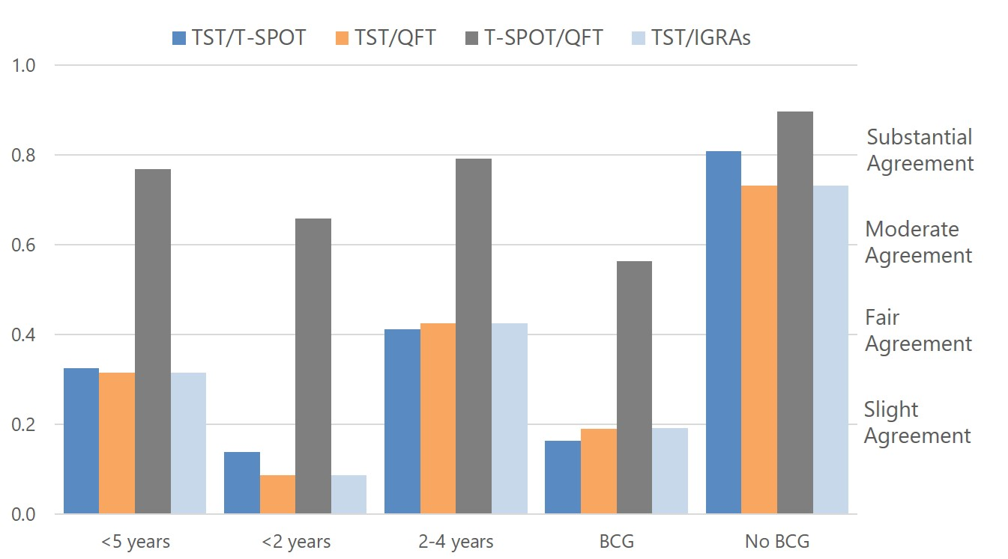
Agreement between TST and IGRAs was higher for children <5 without BCG history.

Slide 40
Evaluation
Epidemiological Risk Assessment
Exposure
Travel
Medical
History, symptoms, co-morbidities, previous treatments
Social evaluation
Diagnostic Tools
Interferon Gamma Release Assays vs. Tuberculin Skin Test
Radiological (CXR, CT Scan, MRI)
Bacteriological, pathological
HPLC, Nucleic Acid Amplification, Molecular Tests
Notes:
Contacts of infectious persons
HIV-infected persons
Foreign-born persons
Homeless persons
Those in congregate living situations
Persons who inject illicit drugs
Detainees and prisoners
HIV infection
Chronic renal failure
Diabetes mellitus
Malignancy
Silicosis Immunosuppressive Rx
TNF Alpha blocker therapy
> 15 mg Prednisone/day
Transplant recipients

Slide 41
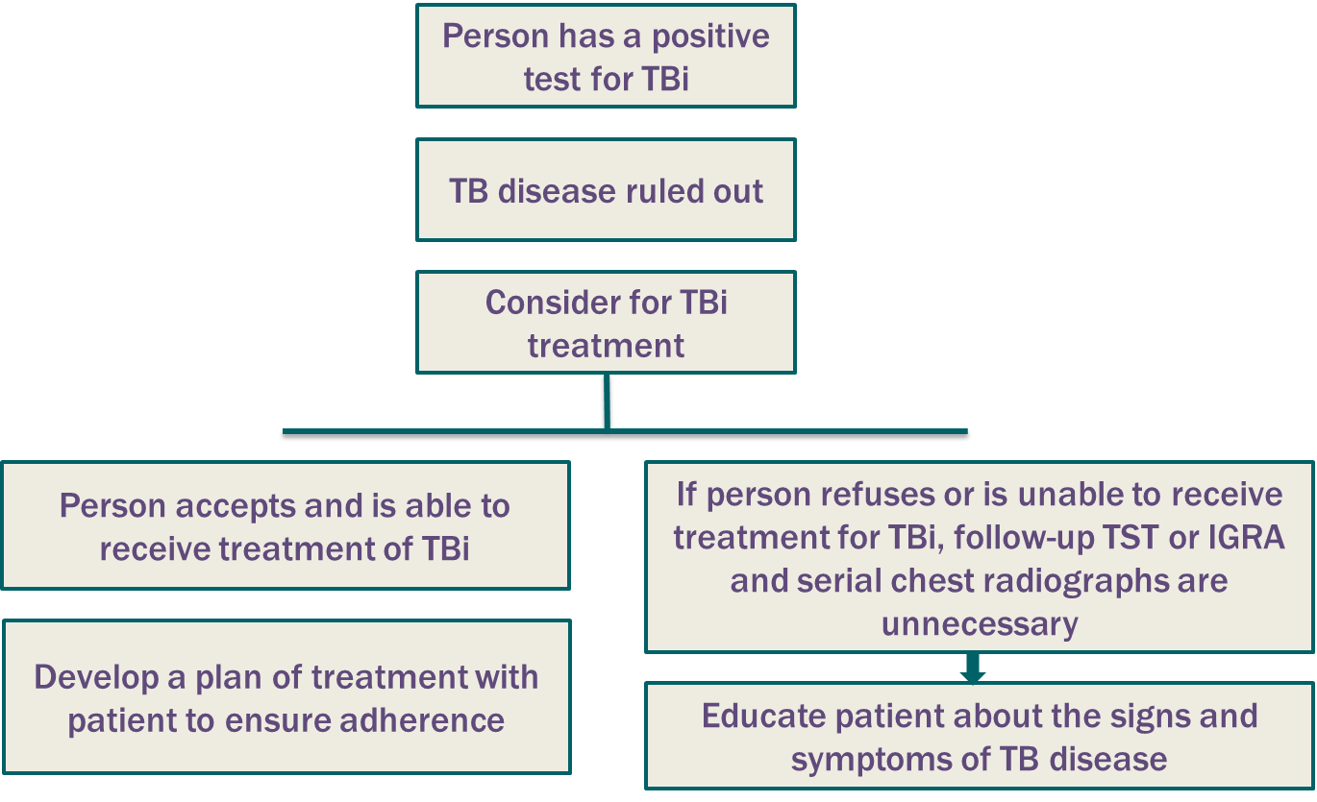
Evaluation of TBi
Notes:
Contacts of infectious persons
HIV-infected persons
Foreign-born persons
Homeless persons
Those in congregate living situations
Persons who inject illicit drugs
Detainees and prisoners
HIV infection
Chronic renal failure
Diabetes mellitus
Malignancy
Silicosis Immunosuppressive Rx
TNF Alpha blocker therapy
> 15 mg Prednisone/day
Transplant recipients

Slide 42
Question 2
What are the risk determinants for TB disease
A. Country of origin
B. Diabetes
C. Upper lobe fibrosis on CXR
D. Exposure to Infectious TB
E. All of the above

Slide 43
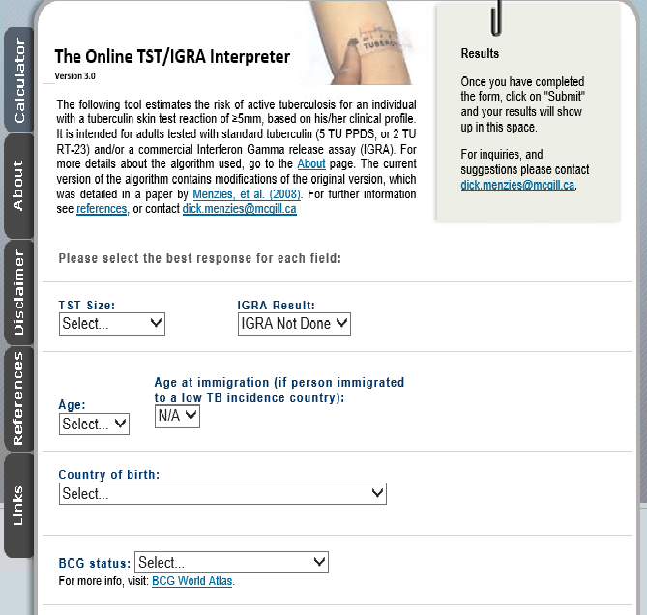
The online TST/IGRA Interpreter
Notes:
the cumulative risk of disease will be substantial
in adults with important medical risk factors,
particularly if the PPV of the test is 50%. These predictions
are supported by a recent modelling study that
emphasized the importance of medical conditions in determining
the lifetime risk of TB.52 However, in healthy
low-risk adults, the cumulative risk of disease is low,
even if the TST is almost certainly true-positive.

Slide 44
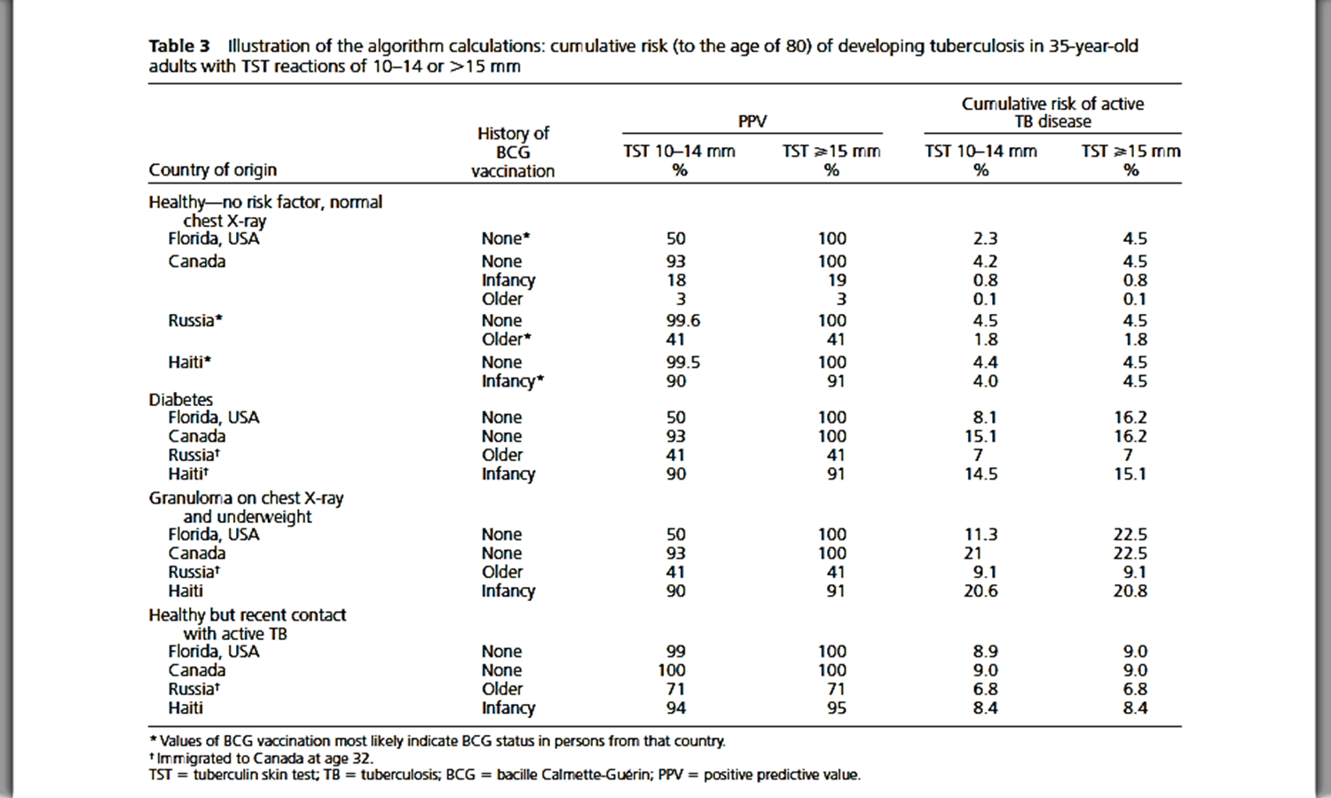
Risk for Disease

Slide 45
Relative Risk for TB

Slide 46
Applying Online Interpreter
44 year old from Bangladesh with Positive IGRA, BCG vaccinated TST 10-14 mm, immigrated when 12 years old
The likelihood that this is a true positive test (PPV) is: 99.5%
The annual risk of development of active tuberculosis disease is estimated to be 0.1%.
The cumulative risk of active tuberculosis disease, up to the age of 80, is: 3.58%
If treated with INH, the probability of clinically significant drug-induced hepatitis is 1.2%, and the associated probability of hospitalization related to drug-induced hepatitis is 0.2%.

Slide 47
Risk Estimates-TST Interpreter
No guidelines for level of risk for TB progression and TBi treatment recommendations
Cut off of 3%-5% risk used by some experts
Age related INH toxicity
<20 years = 0.1%
50-64 = 2.4%
>65 years = 4.6%

Slide 48
Question 3
40 year old from Mexico with BCG, TST 25 mm, asymptomatic, normal CXR and QFT-G Negative, contact to a case with Rheumatoid Arthritis
What would you do?
Treat for LTBI
Repeat TST
Repeat QFT
Do a T-Spot
Notes:
Risk for progression
Risk for infection

Slide 49
Latent Tuberculosis Infection Treatment Regimens
Notes:
Risk for progression
Risk for infection

Slide 50
Isoniazid (INH) and Rifapentine (RPT)-3HP
3-month regimen of INH and RPT is an option equal to 9-month INH regimen for treating LTBI in certain groups, such as otherwise healthy people, 12 years of age and older, who were recently in contact with infectious TB or who had tuberculin skin test conversions or positive blood test for TB
Not recommended for
children younger than 2 years of age,
HIV-infected people taking antiretroviral therapy that clinically significant or unknown drug interactions
Pregnant women or women expecting to be pregnant within the 12-week regimen
TBi INH or RIF resistant M.tuberculosis
INH and RPT once a week for 3 months - 12 doses within 4 months

Slide 51
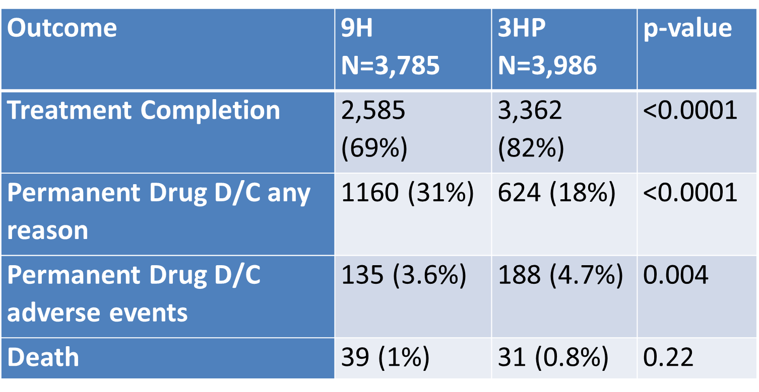
Non Inferiority 3HP vs 9H

Slide 52
Risk Benefit and Shared Decision Making for TBi Treatment
Patient Motivation to complete treatment
Completion rates lower with longer duration of therapy
Risk for Progression to TB by patient factors vs Risk for drug related toxicity
Medical Comorbidities
Patient Age
Region of Origin may impact risk
Social Stigma
Notes:
TST+, HIV-negative, no fibrosis, not recently infected:
Historical incidence: 0.10-0.16% per year
More recent data: 0.04-0.056% per year
Think about future benefit (age) and…
Dominant risk factors:
HIV, other immunosuppression
Fibrosis
Recent acquisition
Diabetes and other key medical conditions
http://www.tstin3d.com/en/calc.html

Slide 53
TBi Treatment Special Situations
Children
Window Prophylaxis for children <5 years
Pregnancy
Ideally TBi treatment can be delayed until 2-3 months post partum
4R, 3HR, or 6Hor 9H regimens can be taken in pregnant women
Women at high risk for progression to TB disease should not delay LTBI treatment; monitor carefully
Breast-feeding not contraindicated with either INH or RIF taken separately
HIV Infection
INH/RPT not recommended for HIV-infected on ART with drug to drug interactions with 3HP or Rifamycin
Rifabutin with dose adjustments can sometimes be substituted for RIF

Slide 54
Monitoring Treatment
Monitor monthly for adherence, compliance and sign and symptoms of TB
Monitor monthly of medication related side effects
Hepatoxicity
Isoniazid vs Rifampin relative risk 3.29 (95% CI 1.72-6.28) for isoniazid
Rifapentene + Isoniazid vs Isoniazid relative risk reduced of 0.90 (95% CI 0.75-1.08)
Gastrointestinal
Higher discontinuation rate with Isoniazid vs placebo (RR 1.33, 95% CI 1.01-1.75)
Increased RR when compared with RIF (RR1.60, 95% CI 0.76-3.40)
Risk of discontinuation with Rifapentene + INH (RR , 95% CI 1.03-1.59) vs INH alone

Slide 55
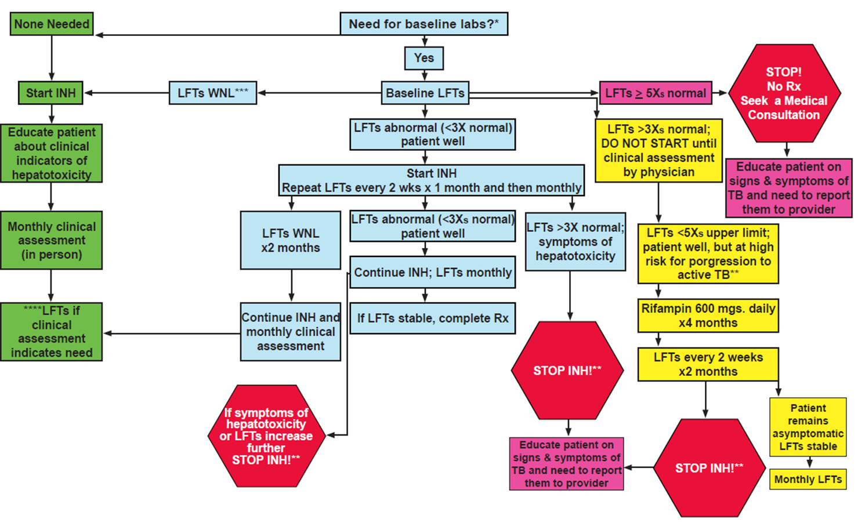
Assessing and Managing the Risk of Liver Disease in the Treatment of TBi

Slide 56
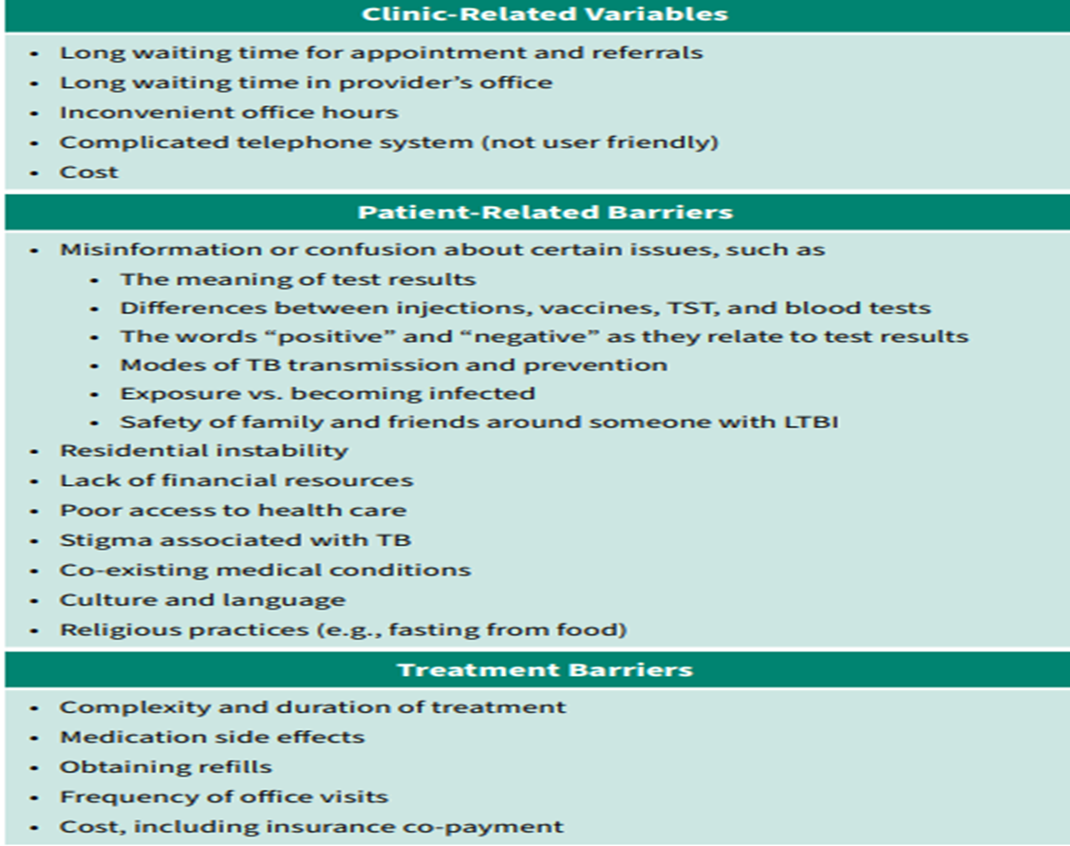
Adherence Barriers to TBi treatment

Slide 57
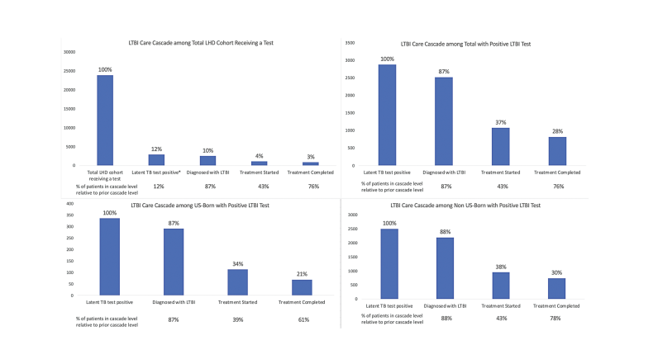
TBi Care Cascade

Slide 58
Summary
IGRA’s are more specific than TST
US Guidelines recommend either TST or IGRA but not both
Evaluate high risk individuals for TB infection and offer treatment
Interpret all screening tests based on
Local epidemiology
Clinical context
Risk factors

Slide 59
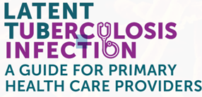
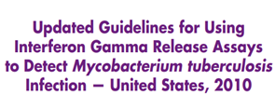
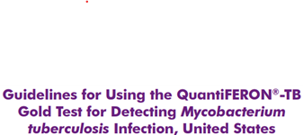
Resources
https://www.cdc.gov/tb/publications/ltbi/pdf/LTBIbooklet508.pdf
https://www.cdc.gov/mmwr/volumes/69/rr/pdfs/rr6901a1-H.pdf
https://www.cdc.gov/mmwr/volumes/67/wr/pdfs/mm6725-h.pdf
Update of Recommendations for Use of Once-Weekly Isoniazid-Rifapentine Regimen to Treat Latent Mycobacterium tuberculosis Infection
https://www.cdc.gov/mmwr/PDF/rr/rr5905.pdf
https://www.cdc.gov/mmwr/pdf/rr/rr5415.pdf

Slide 60
Thank You
Renuka Khurana, MD, MPH, FAAP
Medical Director, Clinical Services
Maricopa County Department of Public Health
1645 E. Roosevelt St | Phoenix, AZ 85006
RenukaKhurana@mail.maricopa.gov
Office: (602) 506-6879

Slide 61
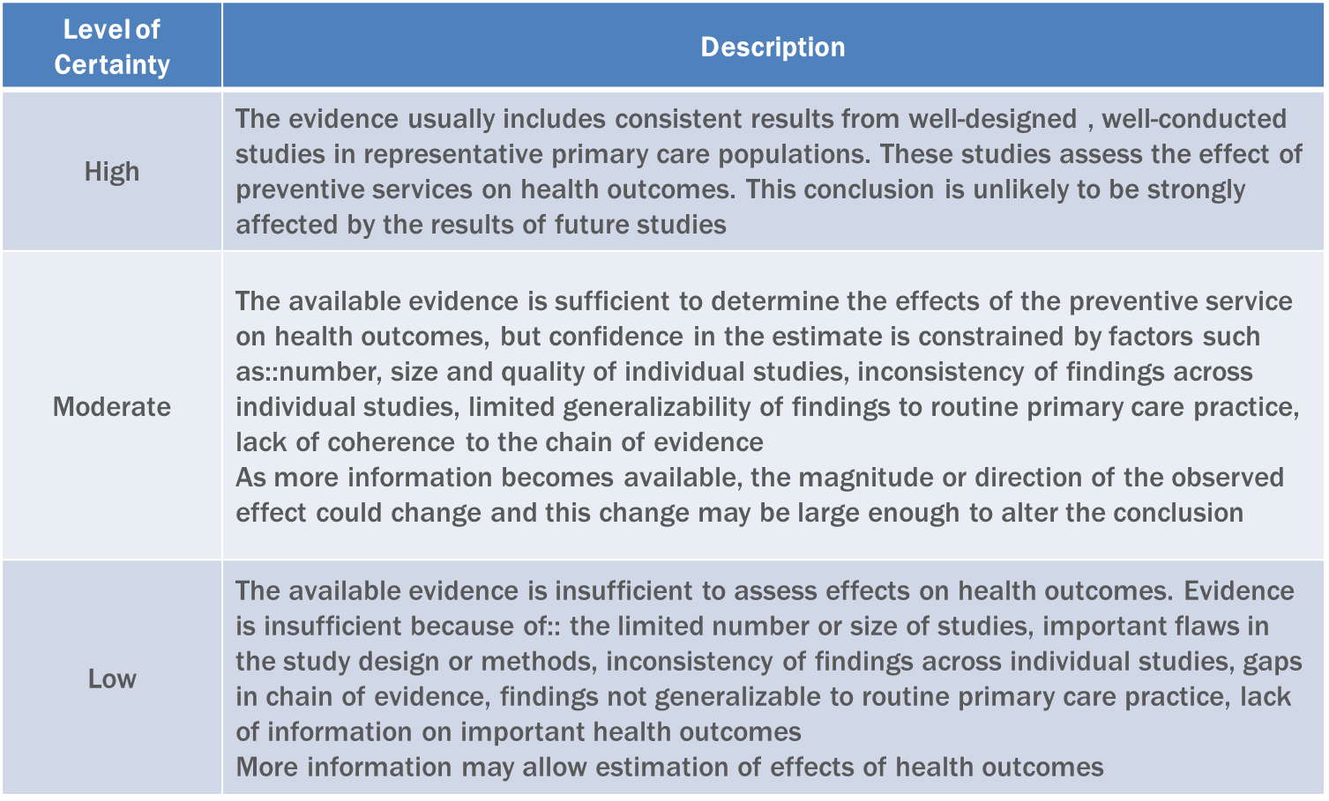
USPSTF Level Of Certainty Regarding the Net Benefit
Notes:
Net benefit is defined benefit – harm of the preventive service as implemented in a general primary care population
Based on the nature of overall evidence available

Slide 62
QFT-GIT Procedure

Slide 63
Title
Born in or former residents of countries with increased prevalence of TB
Philippines, China, Mexico, Haiti, Guatemala, India, Vietnam
Live in or have lived in high risk congregate settings
Homeless Shelters, Long-term care facilities, correctional facilities
Asymptomatic Adults only

Slide 64
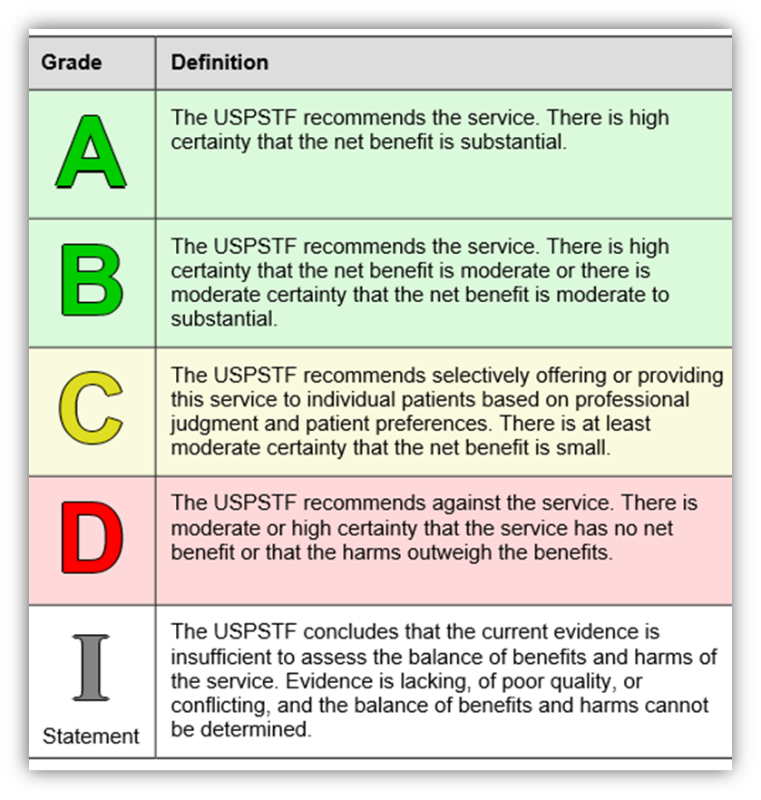
United State Preventive Service Task Force (USPSTF)
Independent panel of national experts in prevention and evidence based medicine
Recommendation assigned a letter grade based on strength of evidence
Notes:
The USPSTF is an independent, volunteer panel of national experts in
prevention and evidence‐based medicine.
▪ The primary goal of the USPSTF is to develop and disseminate evidence‐based
recommendations about clinical preventive services such as screenings,
counseling services, and preventive medications.
▪ Recommendations are developed based on rigorous review of existing peer reviewed
evidence, and evaluation of benefits and harms.
▪ Recommendations address only services offered in the primary care setting or
services referred by a primary care clinician.
▪ Recommendations apply only to people who have no signs or symptoms of the
specific disease or condition that the screening, counseling, or preventive
medication targets.
▪ Recommendations are available online and in peer‐reviewed literature.
– http://www.uspreventiveservicestaskforce.org/BrowseRec/Index/browse‐recommendations

