Slide 1
SEXUALLY TRANSMITTED INFECTIONS IN ARIZONA
Becca Scranton
Deputy Bureau Chief
Bureau of Infectious Disease & Services
Arizona Department of Health Services
Notes:
Hello everyone! My name is Meagan Surgenor, I am the STI Control Initiatives Manager at the Arizona Department of Health Services. Today I will be giving an overview of Sexually Transmitted Infections, or STIs, in Arizona.
---
Title: Sunset in the Sonoran Desert near Phoenix, Arizona
Creator: Brent Coulter
Source: https://www.shutterstock.com/image-photo/sunset-sonoran-desert-near-phoenix-arizona-1903518325
Copyright information:

Slide 2
Disclaimer
The views and opinions expressed in this presentation are not necessarily those of the Pacific AIDS Education & Training Center (Pacific AETC) or its eight local partner sites in HRSA Region 9, the Regents of the University of California or its San Francisco campus (UCSF or collectively, University) nor of our funder the Health Resources and Services Administration (HRSA). Neither Pacific AETC, University, HRSA nor any of their officers, board members, agents, employees, students, or volunteers make any warranty, express or implied, including the warranties of merchantability and fitness for a particular purpose; nor assume any legal liability or responsibility for the accuracy, completeness or usefulness of information, product or process assessed or described; nor represent that its use would not infringe privately owned rights.
HRSA Acknowledgement Statement The Pacific AETC is supported by the Health Resources and Services Administration (HRSA) of the U.S. Department of Health and Human Services (HHS) as part of an award totaling $3,887,700.00. The contents are those of the author(s) and do not necessarily represent the official views of, nor an endorsement, by HRSA, HHS, or the U.S. Government. For more information, please visit HRSA.gov.
Trade Name Disclosure Statement Funding for this presentation was made possible by 5 U1OHA29292‐08‐00 from the Human Resources and Services Administration HIV/AIDS Bureau. The views expressed do not necessarily reflect the official policies of the Department of Health and Human Services nor does mention of trade names, commercial practices, or organizations imply endorsement by the U.S. Government. Any trade/brand names for products mentioned during this presentation are for training and identification purposes only.

Slide 3
Disclosure
I have no conflicts of interest to disclose.

Slide 4
Learning Objectives
By the end of this presentation, participants will be able to:
Describe STI surveillance data in Arizona
Explain trends in recent years
Describe the landscape of congenital syphilis

Slide 5
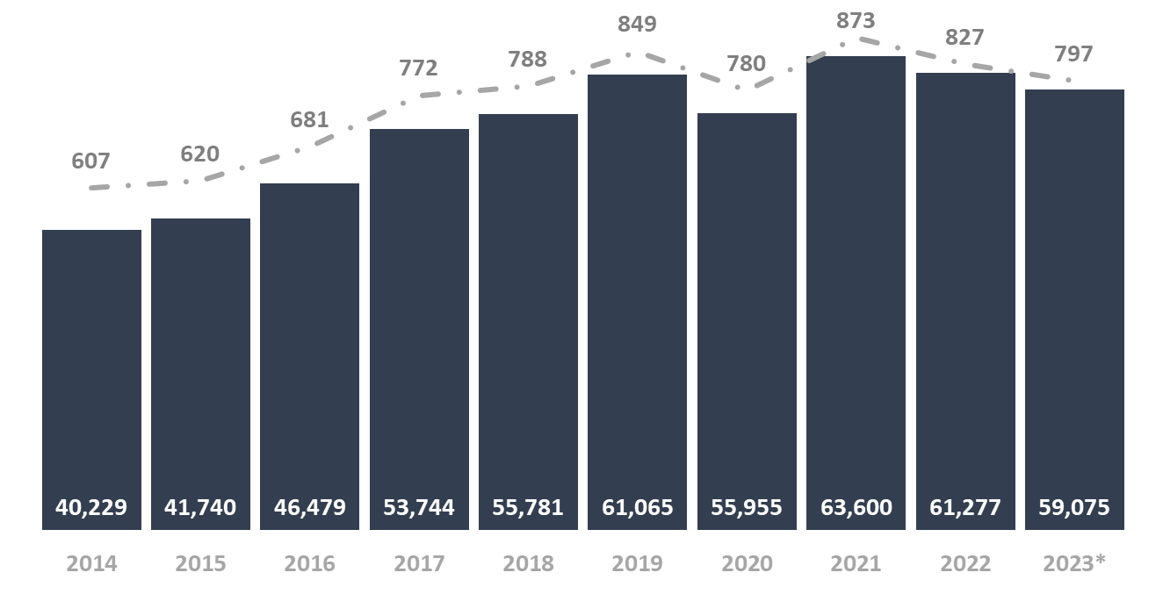
STIs Increasing in Arizona
Reported STI cases have increased 47% since 2014.
2023 data are preliminary at this time and subject to change.
Notes:
In Arizona, STIs have been increasing fairly steadily since 2000. The graph shown here is the total STI count by year from 2014 to 2023, excluding any late latent syphilis cases. During this ten year period, STI case counts have increased 47%.
Looking at more recent years, STI case counts have decreased slightly. From 2021 to 2023, overall case counts decreased about 7%. Additionally, in 2020, there was a larger decrease seen in cases reported, however, this decrease was due to the effects of COVID-19.
Additionally, I’d like to point out that although STI case counts have increased over the past decade, the Arizona population has been increasing over the years as well. We will take a look at STI rates in the next few slides, which give a clearer indication of trends as they account for changes in the population.
Notes:
-Excluding late latent/unknown duration syphilis because of the transmission method. Late latent stages don’t have symptoms and syphilis can only be transmitted when symptomatic. Early stages are included because we know the patient acquired their infection within the past year and would be at risk of passing the infection to others if they are sexually active while symptomatic.
-2023 data are preliminary at this time.
-Rates are calculated per 100,000 population.

Slide 6
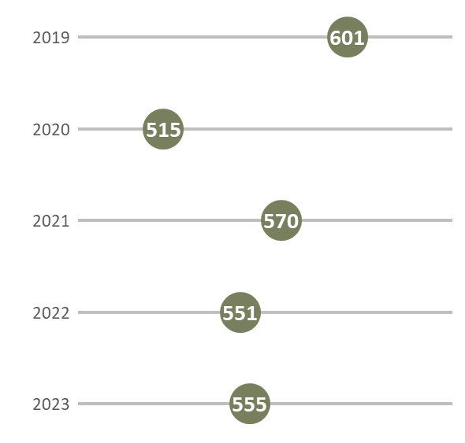
Chlamydia Rates
Chlamydia rates have varied over the last 5 years.
Apache and Navajo counties reported the highest rates of chlamydia in 2023.
2023 data are preliminary at this time and subject to change.
Notes:
Next, we will take a look at the trends of each individual infection, starting with chlamydia.
Presented in the graph on the left are chlamydia rates in Arizona from 2019 through 2023. In 2019, the chlamydia rate was at an all-time high with 601 cases reported per 100,000 population. We saw a rather significant decrease in 2020 due to the COVID-19 pandemic (decline in health care seeking behaviors, especially considering that 70% of women and 50% of men are asymptomatic), with the rates rebounding slightly in the last few years, but we’ve yet to return to pre-pandemic rates.
On the right, we have a map showing chlamydia rates by county in 2023. While our 2023 data is still preliminary, Apache (with 790 cases) and Navajo (with 748 cases) have the highest reported rates of chlamydia in Arizona.
Notes:
-2023 data are preliminary at this time.
-Rates are calculated per 100,000 population.
-Map: darker color indicates higher rate.

Slide 7
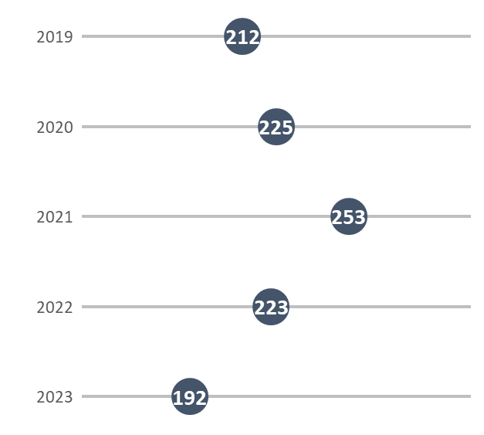
Gonorrhea Rates
Gonorrhea rates have decreased 32% since 2021.
Navajo, Apache, and Maricopa counties reported the highest rates of gonorrhea in 2023.
2023 data are preliminary at this time and subject to change.
Notes:
Similar to chlamydia, gonorrhea rates have varied over the past five years. Despite the COVID-19 pandemic, gonorrhea rates continued to increase in 2020. Arizona reported it’s highest gonorrhea rate in 2021, with 253 cases reported per 100,000 population. However, our preliminary 2023 data suggests that Arizona’s gonorrhea rate has decreased two years in a row and is lower than the 2019 rate.
When looking at gonorrhea rates by county, Navajo (at 262), Apache (at 252), and Maricopa (at 232) reported the highest rates in 2023.
Notes:
-2023 data are preliminary at this time.
-Rates are calculated per 100,000 population.
-Map: darker color indicates higher rate.

Slide 8
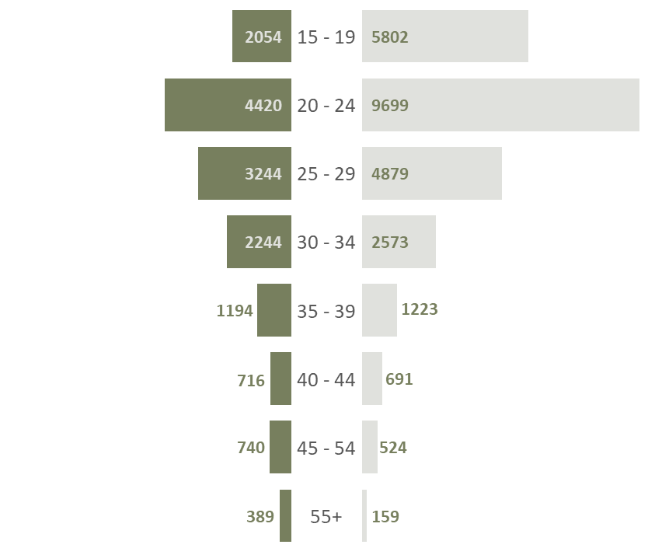
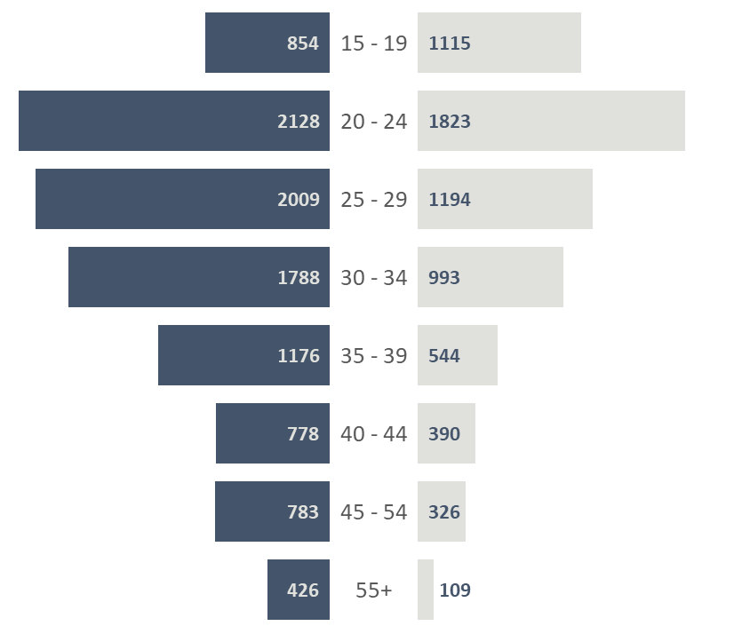
Chlamydia & Gonorrhea
Chlamydia is most commonly reported among females aged 20-24.
Gonorrhea is most commonly reported among males aged 20-24.
Male | Female
Male | Female
2023 data are preliminary at this time and subject to change.
Notes:
Chlamydia infections were predominantly reported among females in Arizona in 2023. However, it’s important to note that screening recommendations vary between men and women, thus this doesn’t represent the true proportion of infections. When looking at age groups, chlamydia was most commonly reported among those aged 20 to 24 years old.
On the other hand, gonorrhea is primarily reported among males, specifically among males aged 20 to 24, followed by males aged 25 to 29.
While these graphs are displaying case counts, we see similar trends when looking at rates of each infection over the past five years, in that females consistently have higher rates of chlamydia and men experience higher rates of gonorrhea.
Notes:
-2023 data are preliminary at this time.
-Case counts, not rates.

Slide 9
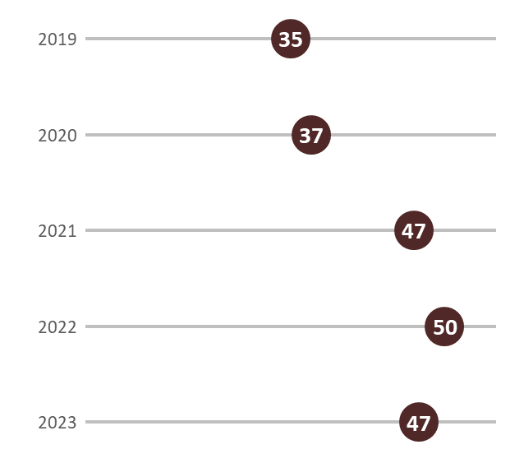
Adult Syphilis Rates
Syphilis rates have increased 34% since 2019.
Apache, Navajo, and Graham counties reported the highest rates of syphilis in 2023.
2023 data are preliminary at this time and subject to change.
Notes:
Presented here are rates of new syphilis, which is only including primary, secondary, and early latent stages of syphilis. Rates of new syphilis cases have increased 34% from 2019 to 2023, with 47 cases per 100,000 population being reported in 2023. Our preliminary 2023 data suggests that there might be a slight decrease in the new syphilis rates since 2022, however, it’s important to remember that this data is still preliminary and may change as we finalize the 2023 case counts.
Additionally, as shown on the right, new syphilis is widespread throughout Arizona. Apache County reported the highest rate at 206 cases per 100,000 population, followed by Navajo and Graham counties reporting the second and third highest rates.
Notes:
-Excluding late latent/unknown duration syphilis.
-2023 data are preliminary at this time.
-Rates are calculated per 100,000 population.
-Map: darker color indicates higher rate.

Slide 10
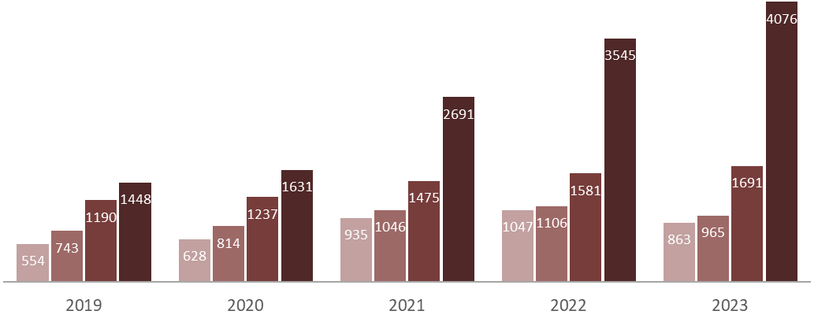
Adult Syphilis
Since 2019, all stage syphilis has increased 93%.
Primary | Secondary | Early Latent | Late Latent/Unknown Duration
2023 data are preliminary at this time and subject to change.
Notes:
As we saw on the previous slide, syphilis has been increasing in Arizona over time, however we were only looking at the stages of syphilis that occur within the first year of infection. Presented here are case counts by syphilis stage, including late latent and unknown duration syphilis in dark red. When assessing syphilis trends, we typically only look at primary, secondary, and early latent stages due to how syphilis is transmitted, but it’s important to note that late latent and unknown duration syphilis are also increasing. Overall, when looking at all stages of syphilis, we’ve seen a 93% increase in the past 5 years.
Notes:
-2023 data are preliminary at this time.

Slide 11
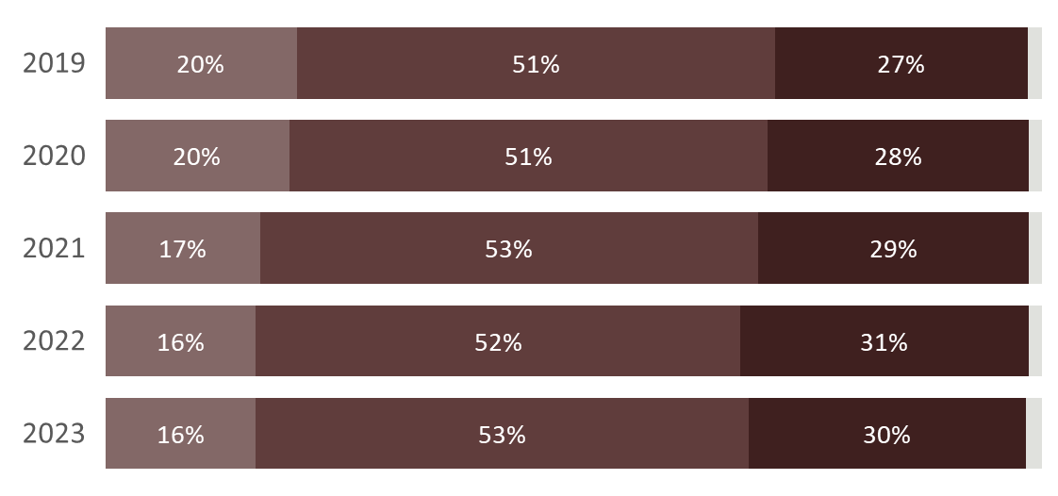
Adult Syphilis Ages 10-65+
New syphilis is consistently reported the most among persons aged 25 to 39.
10-24 | 25-39 | 40-64 | 65+
2023 data are preliminary at this time and subject to change.
Notes:
While chlamydia and gonorrhea are more prevalent in younger populations, new syphilis is most commonly reported in persons aged 25 to 39 years old, followed by persons aged 40 to 64.
Notes:
-Excluding late latent/unknown duration syphilis.
-2023 data are preliminary at this time.

Slide 12
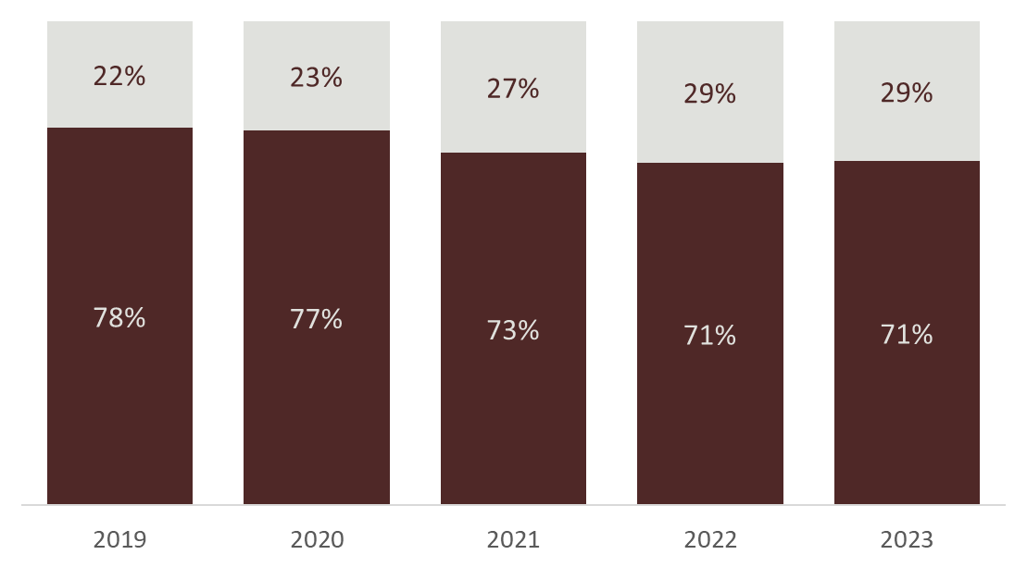
Adult Syphilis in Males and Women
New syphilis is primarily reported among males, but has been increasing in females.
Female
Male
2023 data are preliminary at this time and subject to change.
Notes:
Historically, new syphilis has primarily been reported among males. However, we have started to see a shift in this trend in recent years, where the proportion of cases reported among females has been increasing. From 2019 to 2023, the number of cases reported among females has increased 86%.
Notes:
-Excluding late latent/unknown duration syphilis.
-2023 data are preliminary at this time.

Slide 13
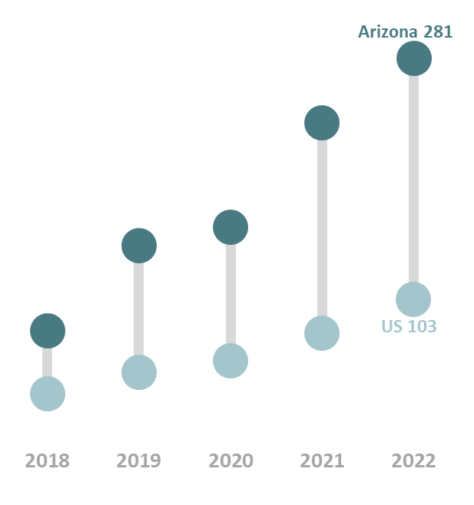
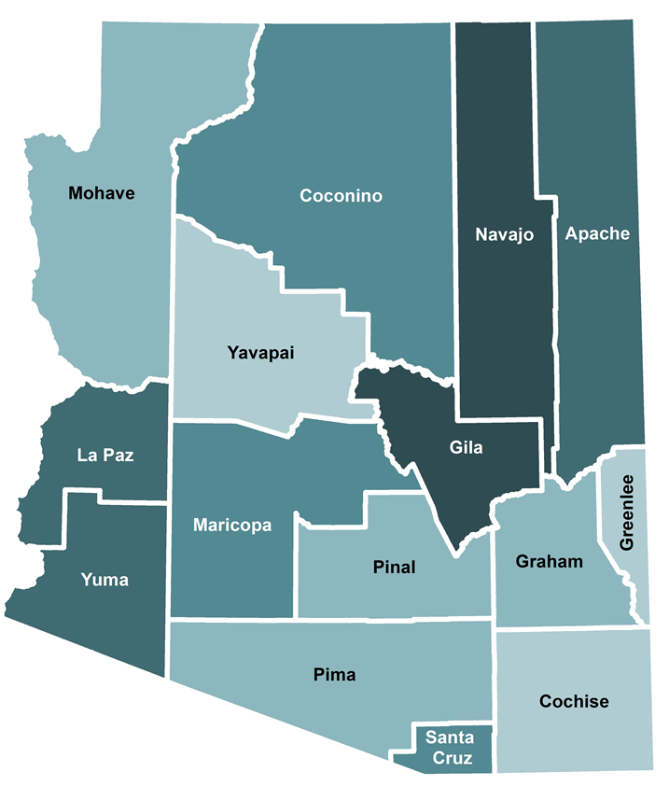
Congenital Syphilis
Arizona has consistently had a higher incidence of congenital syphilis than the United States.
Gila and Navajo counties reported the highest rates of congenital syphilis in 2022.
Notes:
Switching over to congenital syphilis quickly…Arizona has experienced a higher rate of congenital syphilis in comparison to the US for the last 5 years. In 2022 in Arizona, 285 congenital cases were reported per 100,000 births, whereas the US rate was 103 cases per 100,000 births.
Congenital syphilis is present throughout the state, as shown by the map on the right. Gila County had the highest rate in 2022, however, it’s important to keep in mind that rates can be high in areas with a very low population, where even a handful of cases can result in high rates. Ultimately, most congenital syphilis cases reported in Arizona occur in Maricopa county, where the majority of the Arizona population lives.
Notes:
-Rates are calculated per 100,000 births.
-Map: darker color indicates higher rate.

Slide 14
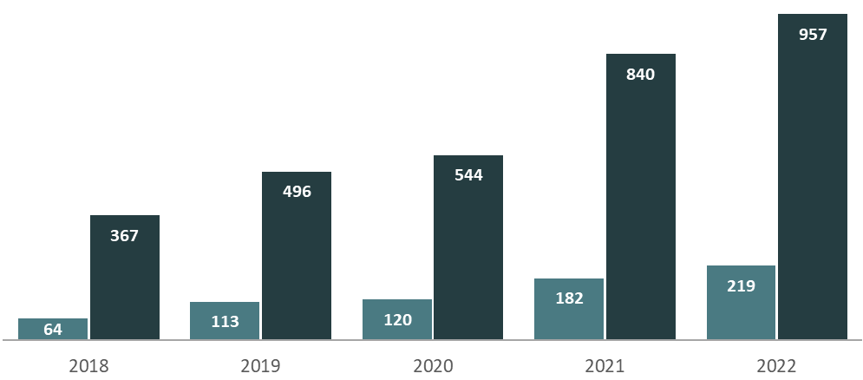
Congenital Syphilis in Infants and Females Aged 15-44
The increase in congenital syphilis cases is reflective of the increase of syphilis among reproductive age females.
Infants | Females Aged 15 - 44
Notes:
In Arizona in 2022, there were a total of 219 congenital cases reported. The graph shown here includes congenital cases in the lighter blue, with new syphilis cases among females aged 15 to 44 in the darker blue. The increase of congenital cases over the past few years is a reflection of the increase of syphilis among reproductive-age females, which highlights the importance of ensuring pregnant persons are brought to treatment in a timely manner, especially for persons who may experience barriers when accessing care.
Additionally, nationally in 2022, 282 syphilis-related stillbirths and infant deaths were reported, 32 of which occurred in Arizona.
Notes:
-New syphilis cases among females aged 15-44

Slide 15
Updated Syphilis Screening Guidelines
New Healthcare Provider Screening Recommendations:
Screen sexually active individuals aged 15 to 44 annually
Implement opt-out screening for pregnant people and people of childbearing capacity with unknown pregnancy status in emergency departments, urgent cares, and other healthcare and/or outreach settings. In settings where follow-up is uncertain, it is recommended to use a rapid/point of care test and offer same-day treatment following a positive result prior to discharge
More information available at: azdhs.gov/STI
Notes:
Although this was a quick overview of STI trends in Arizona, hopefully it is clear that STIs continue to be a public health concern in Arizona. To help combat the rise in STIs, Arizona recently updated the recommended screening guidelines for syphilis. Previously, the guidelines relied on risk based screening for women who are unknown to be pregnant, men who have sex with men, and transgender and gender diverse populations. The updated guidelines recommend screening all sexually active individuals aged 15 to 44 for syphilis every year. Additionally, it’s recommended to implement opt-out testing for persons who may be pregnant or are of childbearing capacity. In settings where follow-up with these individuals is uncertain, it is recommended to use a rapid syphilis test and provide same-day treatment following a positive test result.
For further information and guidance, we ask that you review the updated screening guidelines on our website at azdhs.gov/STI.

Slide 16
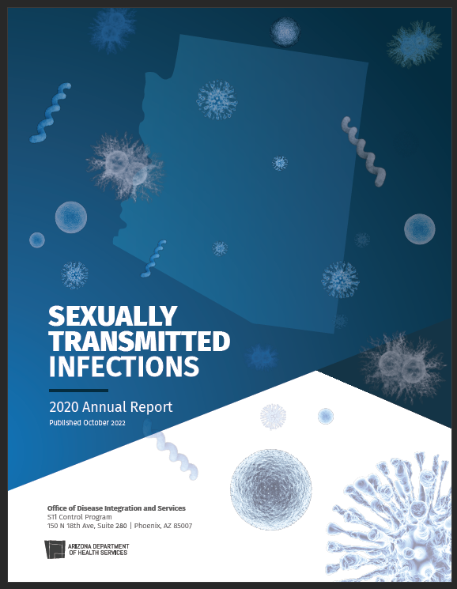
Interested in Learning More?
Interactive STI Data Dashboard & Annual Reports available at azdhs.gov/STI
Have general STI questions? Email us at STI@azdhs.gov
Notes:
Lastly, if anyone is interested in additional STI data, there is an interactive data dashboard available on the ADHS website which has real-time data. We also produce comprehensive annual reports that can be found on the website as well. The most recent year posted is 2021, but the 2022 report will hopefully be released this summer.
Additionally, if anyone has any specific questions relating to STIs, please reach out to our program via email at STI@azdhs.gov.

Slide 17
THANK YOU!
Becca Scranton Deputy Bureau Chief Bureau of Infectious Disease & Services Arizona Department of Health Services
Notes:
Thank you so much and I hope you all enjoy the rest of this clinical update.

