Slide 1
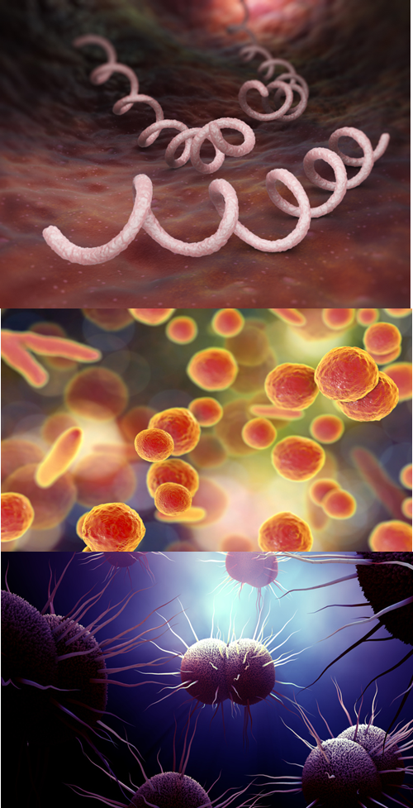
STI Testing and Treatment Update
Image Credit: iLexx / Getty Images
Ina Park, MD, MS
Image Credit: Kateryna Kon / Shutterstock
Professor, UCSF School of Medicine,
PI, CA Prevention Training Center
Medical Consultant, CDC Division of STD Prevention
Image Credit: LaTina Emerson / Institute for Biomedical Sciences Georgia State University

Slide 2
Disclaimer
The views and opinions expressed in this presentation are not necessarily those of the Pacific AIDS Education & Training Center (Pacific AETC) or its eight local partner sites in HRSA Region 9, the Regents of the University of California or its San Francisco campus (UCSF or collectively, University) nor of our funder the Health Resources and Services Administration (HRSA). Neither Pacific AETC, University, HRSA nor any of their officers, board members, agents, employees, students, or volunteers make any warranty, express or implied, including the warranties of merchantability and fitness for a particular purpose; nor assume any legal liability or responsibility for the accuracy, completeness or usefulness of information, product or process assessed or described; nor represent that its use would not infringe privately owned rights.
HRSA Acknowledgement Statement The Pacific AETC is supported by the Health Resources and Services Administration (HRSA) of the U.S. Department of Health and Human Services (HHS) as part of an award totaling $3,887,700.00. The contents are those of the author(s) and do not necessarily represent the official views of, nor an endorsement, by HRSA, HHS, or the U.S. Government. For more information, please visit HRSA.gov.
Trade Name Disclosure Statement Funding for this presentation was made possible by 5 U1OHA29292‐08‐00 from the Human Resources and Services Administration HIV/AIDS Bureau. The views expressed do not necessarily reflect the official policies of the Department of Health and Human Services nor does mention of trade names, commercial practices, or organizations imply endorsement by the U.S. Government. Any trade/brand names for products mentioned during this presentation are for training and identification purposes only.

Slide 3
Disclosure
I have no conflicts of interest to disclose.

Slide 4
Learning Objectives
After this lecture, participants should be able to:
Describe recent changes in HPV testing for cervical cancer screening
Discuss the test performance of zoliflodacin vs ceftriaxone + azithro for GC
Discuss two common side effects of doxycycline as PEP and one common drug-drug interaction
Describe the efficacy of Doxy PEP among MSM living with HIV and those on HIV PrEP
Gonorrhea

Slide 5
STIs and HIV
STIs and HIV can be transmitted through sexual contact.
Having an STI can increase the risk of acquiring or transmitting HIV.
STIs cause inflammation and sores in the genital area, making it easier for HIV to enter the body.
STIs can increase the amount of HIV in genital fluids, making transmission more likely.
Certain STIs, such as syphilis and herpes, can cause open sores or ulcers, providing direct access for HIV to enter the bloodstream.
It is important to be tested regularly for STIs and HIV.
Treat and cure STIs promptly to reduce the risk of HIV transmission.
Reference links: 1. Centers for Disease Control and Prevention (CDC) - STIs and HIV: https://www.cdc.gov/std/hiv/default.htm
2. World Health Organization (WHO) - STIs and HIV: https://www.who.int/news-room/fact-sheets/detail/sexually-transmitted-infections-(stis)

Slide 6
What’s new in testing recommendations?
February 2022

Slide 7
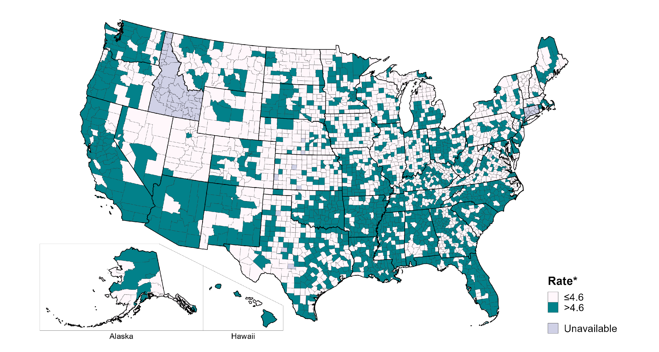
CURRENT STRATEGIES & RECOMMENDATIONS ADDRESSING CONGENITAL SYPHILIS
MORE SCREENING OF SEXUALLY ACTIVE PEOPLE
If a person is sexually active, they should get tested for syphilis.
15 - 44
YRS OLD
Screen all sexually active persons ages 15-44 for syphilis in counties where primary and secondary syphilis rate is above 4.6/100,000 among females aged 15-44 yrs
This includes 76% of the U.S. population
Screen individuals with increased risk of syphilis exposure
Take a comprehensive sexual history (more on that later!)Webinar.
Notes:
This next slide focuses on treating all sexually active individuals.
It is essential that we normalize and destigmatize testing for syphilis.
Since syphilis can be asymptomatic, testing is essential.
CDC treatment guidelines have long included increased geographic risk with need for regular screening.
Last November CDC clarified what rate can be used for this geographic risk assessment, using the goal set by Healthy People 2030 of reducing the syphilis rates in reproductive-aged women to 4.6 per 100,000 or lower.
Recent data from the 2022 surveillance report revealed that 46% of counties, accounting for 76% of the U.S. population, had a primary and secondary syphilis rate among women of reproductive age higher than 4.6 per 100,000. Essentially suggesting almost everyone should consider getting tested since syphilis is widespread.

Slide 8
CURRENT STRATEGIES & RECOMMENDATIONS ADDRESSING CONGENITAL SYPHILIS continued
WHAT’S YOUR COUNTY RATE?
Scan the QR Code above to find out your county rate
Per 100,000
NOTE: The Healthy People 2030 target for the rate of primary and secondary syphilis in women aged 15–44 years is 4.6 per 100,000.
Notes:
If you’re interested in knowing what your county rates are, go ahead and scan the QR code
https://bit.ly/49HzN0i
County-level Syphilis Rates | AtlasPlus | NCHHSTP | CDC

Slide 9
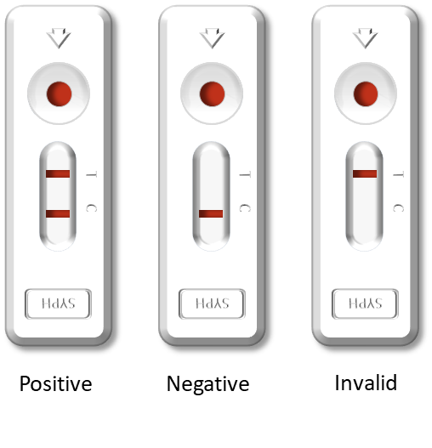
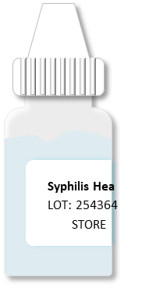
Point-of-Care (POC)Treponemal Tests Are Available, but Anyone With a Positive POC Should Have Lab-based Testing
Syphilis Health Check™ (SHC)
The First FDA Approved and CLIA-waived POC Syphilis Test
Chembio DPP® HIV/Syphilis Test Kit
Second FDA Approved and CLIA-waived POC Syphilis Test
Direct Detection Tests
&

Slide 10
Syphilis Health Check™ (SHC) & Chembio DPP® HIV/Syphilis Treponemal Rapid Tests
Time to Results
Shelf-life
Cost per Test
Sensitivity* & Specificity
Syphilis Health Check™ (SHC)
Approx.
$10
50-71% Sensitivity 92-99% Specificity
10 min.
30 months
Chembio DPP® HIV/Syphilis Test Kit
Approx.
$7-10
47-100% Sensitivity 93-100% Specificity
15 min.
24 months
Field based studies, fingerstick whole blood, treponemal tests alone as the gold standard.

Slide 11
Self collected testing

Slide 12
May 2024: FDA Approves Self Collected HPV Testing
“Self-collection, a form of primary HPV testing, has been studied for over two decades and is feasible, acceptable, and comparable to clinician-collected samples.”

Slide 13
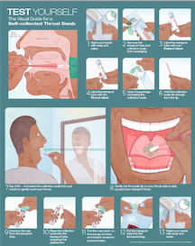
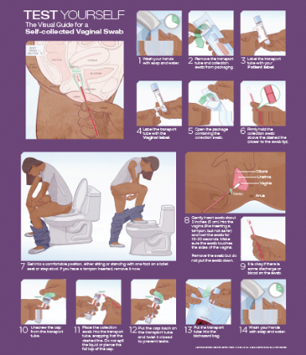
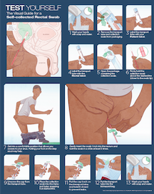
Self-Collected STI Testing
Self-collected swabs accurate and acceptable
Similar performance to provider-collected specimens
Can be performed at lab along with blood draw/urine collection or in the exam room before/after the provider visit
May save the provider time
May save patient an office visit
Van der helm, 2009, STD; Sexton, 2013 J FamPract; Dodge, 2012 Sex Health. Freeman 2011, STD; Alexander 2008, STI; Moncada 2009, STD
Notes:
In addition to provider collected swabs, patient self-collected swabs are both accurate and acceptable among patients, and having patients collect their own specimens could overcome potential barriers to screening such as time constraints and patient/provider discomfort.
Can be performed at the lab; in the bathroom, or in the exam room before and after provider
Can save the provider time
Also may even save patient an office visit – Kaiser, can swab yourself and don’t necessarily need to see a provider if just routine screening
UW has posters and handout for patients that can order – City Clinic in SF also had patient self collection instruction on their website.
BD Probetect NAAT used in your clinics are FDA-approved for patient-collected vaginal swabs in the clinical setting. Many Public Health Labs have validated extragenital specimens for GC/CT and also self-collection. For PPNC, planned to do validation for collection self-collected swabs with BD NAAT.
References: Van der helm, 2009, STD; Sexton, 2013 J Fam Pract; Dodge, 2012 Sex Health
Freeman 2011, STD; Alexander 2008, STI; Moncada 2009, STD

Slide 14
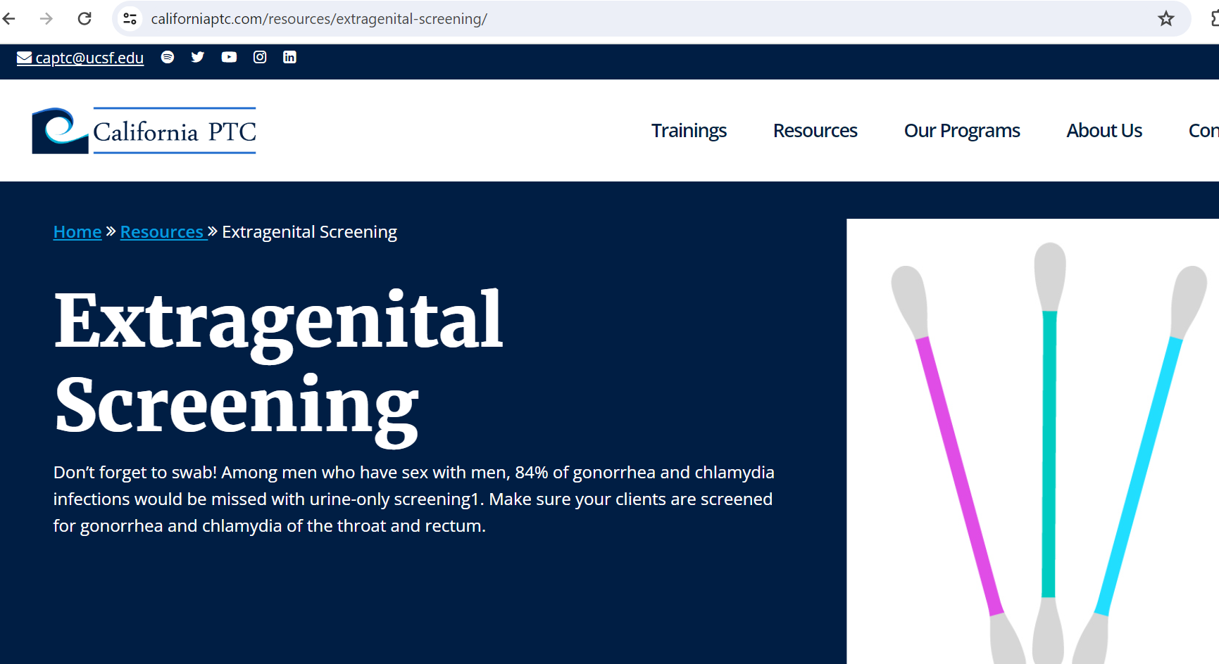
California PTC Extragenital Screening Site

Slide 15
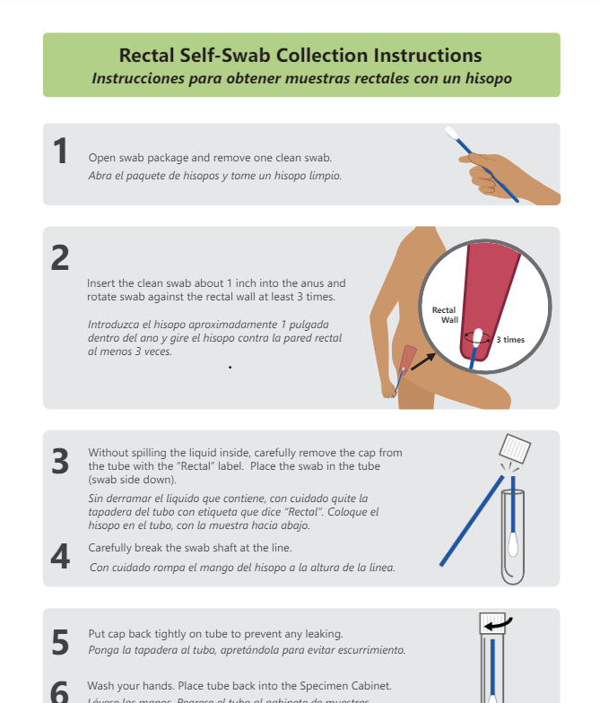
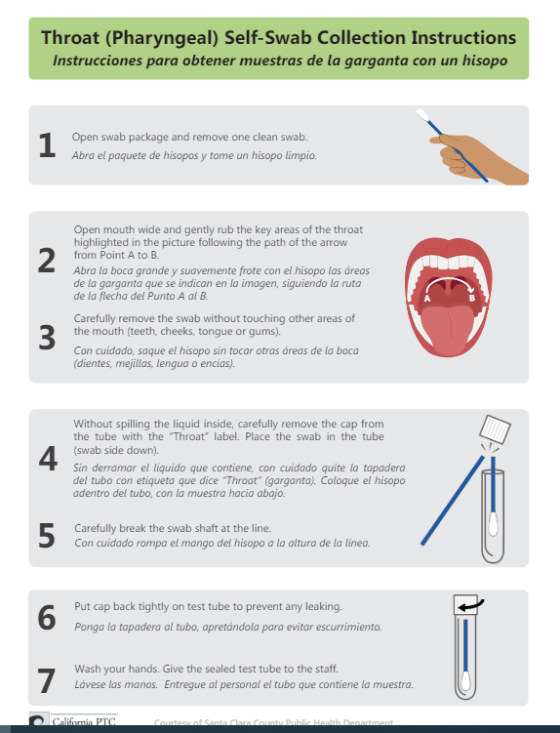
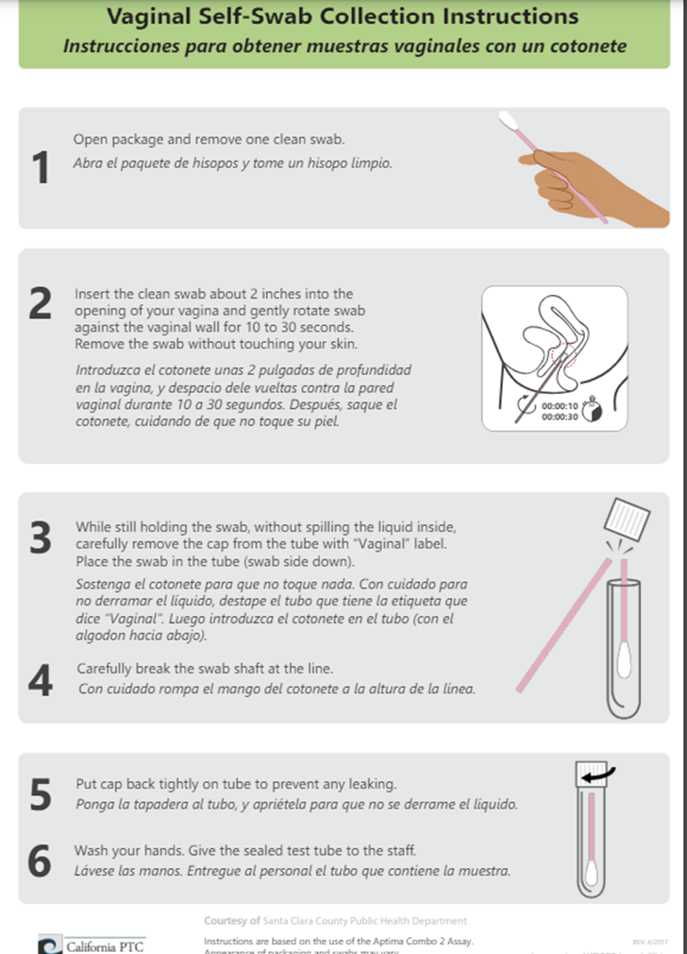
Rectal, Vaginal, Throat Self-Swab Instructions

Slide 16
What about self testing at-home for STIs?

Slide 17
At-Home STI Testing
At-home STI/HIV test kits are either point of care tests, with an immediate result (some HIV tests), or self-sampling with specimens mailed to a commercial lab
Typically are sold directly to consumers or through on-line telehealth companies
Some health departments and NGOs also offer free home-testing programs (more on that later!)
The types of tests often include HIV/syphilis (dried blood spot), and GC/CT/trichomoniasis with urine based testing
Some companies also offer throat/rectal swabs for GC/CT, as well as dried blood spot tests for hepatitis C, HSV1/2
https://www.kff.org/womens-health-policy/issue-brief/telemedicine-in-sexual-and-reproductive-health/

Slide 18
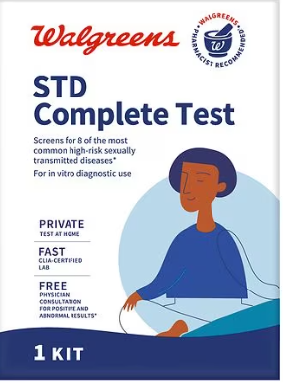
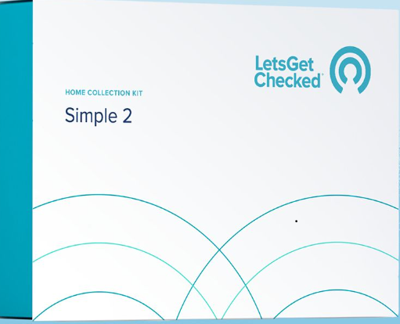
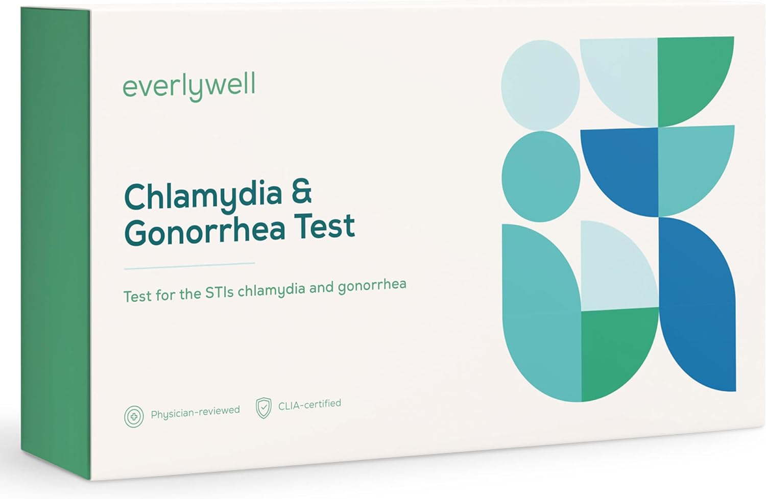
Over the counter STI/HIV testing
One FDA approved OTC test: Simple 2 (genital GC/CT only)
Multiple drugstore tests:
Dried blood spots for HSV-2, syphilis, hepatitis C, HIV
Urine for GC/CT, trichomonas (No rectal/pharyngeal testing)
Many companies mail tests to same laboratory

Slide 19
Regulatory issues
There is an FDA approved home HIV test, but STI tests not approved for home collection.
A laboratory could validate home collection of an FDA approved test or offer their own Laboratory Developed Tests (LDT)
LDTs are often compared against an FDA approved test (or other gold/reference standard), and that data is shown to laboratory inspectors
However, test performance data for many LDTs are proprietary and not published.

Slide 20
Clinical issues
Dried blood spot testing for HIV and hepatitis C has been used for many years and is comparable to laboratory based testing
Dried blood spot testing for syphilis is less clear. Other issues:
All people with syphilis need two types of tests (e.g., RPR plus a treponemal test)
Dried blood spot tests are treponemal tests only, so cannot be used alone to confirm diagnosis or monitor response to treatment. Generally positive for life, so those with a prior history of syphilis should not use this test
Validated against other treponemal EIAs (generally sensitive, but some can have specificity issues)

Slide 21
What home-based testing is available at no charge to clients/patients?

Slide 22
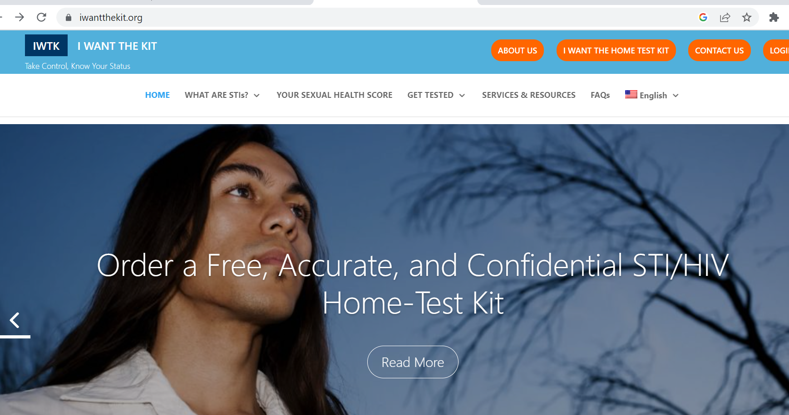
I Want the Kit (iwantthekit.org)
Program of Johns Hopkins University, testing done at JHU
Free 3 site testing for GC/CT, HIV, syphilis (+ Trich for residents of Baltimore)
Available to residents of 15 states including Arizona

Slide 23
HIV tests: together.takemehome.org
Free sexual health home testing program, by Building Healthy Online Communities
FREE HIV tests (anywhere in the US!)

Slide 24
What’s new in treatment and prophylaxis?
February 2022

Slide 25
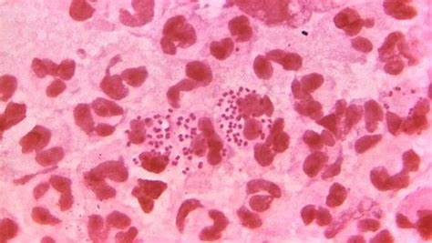
New Treatment for GC: Zoliflodacin

Slide 26
Zoliflodacin for urogenital gonorrhea RCT
Who: 930 persons with uncomplicated gonorrhea, 2019-2023, either symptomatic or asymptomatic, by culture, NAAT or Gram stain/methylene blue
Where: 16 sites in Belgium, Netherlands, South Africa, Thailand, USA
What: Screen, repeat at enrollment, then:
Zoliflodacin 3 grams oral x 1
vs
Ceftriaxone 500 mg intramuscular + azithromycin 1 gram oral
NIH Statement on Preliminary Efficacy Results of First-in-Class Gonorrhea Antibiotic Developed Through Public-Private Partnership | (1 November 2023)
Study Details | Zoliflodacin in Uncomplicated Gonorrhoea | ClinicalTrials.gov

Slide 27
New: Zoliflodacin for urogenital gonorrhea
Primary outcome: urethral or cervical culture at day 6 after treatment
Secondary outcomes: safety; pharyngeal culture; rectal culture; primary outcome by sex, antibiotic susceptibility at baseline; eradication rate of nucleic acid (NAAT) by site
Primary outcome result: Difference was 5.31% (within the definition of non-inferior)
No other results reported yet (including absolute difference in outcomes)
NIH Statement on Preliminary Efficacy Results of First-in-Class Gonorrhea Antibiotic Developed Through Public-Private Partnership (1 November 2023)
Study Details | Zoliflodacin in Uncomplicated Gonorrhoea | ClinicalTrials.gov

Slide 28
Suspected GC Treatment Failure Consultation Form
Purpose: Collect data on cases of GC cephalosporin treatment failure or specimens with decreased cephalosporin susceptibility
Rationale: Identifies clusters/outbreaks
Clinicians should contact their state or local health department (<24 hrs) to coordinate completion of the report form prior to submitting it to CDC
No identifying patient information is collected
Clinicians in CDC DSTDP will follow up with all submitting providers to facilitate consultation
Any questions can be emailed to gcfailure@cdc.gov
PLEASE REPORT!
https://redcap.link/gcfailure

Slide 29
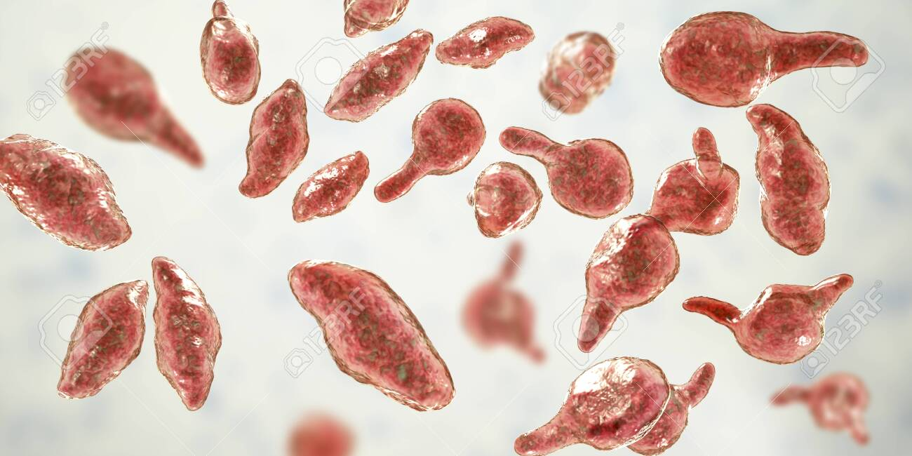
Mycoplasma genitalium
AKA: MG, M. gen, M. gent
Intracellular bacteria, slow growing, very difficult to culture (months)
Can cause:
Cervicitis, PID, infertility
Urethritis (and persistent urethritis)
Prostatitis
Epididymitis
Proctitis? -> Jury still out
Image Credit: Kateryna Kon / Shutterstock
CDC Syphilis Behavioral Supplement, Oct 2022

Slide 30
Case presentation
27 year old cis MSMW on daily PrEP with TDF/FTC with scant clear penile discharge and mild burning with urination x 4 days
Reported insertive anal and vaginal sex, gives and receives oral sex
Last PrEP visit was 3 weeks ago, has missed only 1 dose in last 3 weeks
On 5/14 treated empirically with azithromycin 1g while awaiting GC/CT results, which ended up being negative

Slide 31
Case continued
5/23 patient returned with symptoms and was re-treated with azithromycin. M. gentialium urine NAAT was ordered. 6/4 the patient’s M genitalium NAAT positive
Patient started doxycycline 100mg BID x 7 days, followed by moxifloxacin 400 mg daily x 10 days
7/16 patient about 50% better, M genitalium NAAT positive

Slide 32
CDC guidelines for M. genitalium cervicitis or NGU
NAAT for GC/CT (all); Wet mount Or NAAT for BV/TV (cervicitis)
Doxycycline 100mg PO BID 7-days
Test for MG (NAAT) and if positive treat
Persistent symptoms
Cervicitis or NGU

Slide 33
Prevalence of M. genitalium in US STI clinics
Seattle, WA: 9.9%
(7.1-13.3)
New York City, NY: 12.5%
(9.1-16.7)
Indianapolis, IN: 22.2%
(2.8-60.0)
Denver, CO: 16.3%
(12.8-20.2)
St. Louis, MO: 23.5%
(19.6-28.0)
Greensboro, NC: 22.0%
(16.9-27.9)
Attribution: iStock Photo License. Data from Manhart et al. 2023.
Notes:
MyGeniUS study – tested GC/CT collection specimens from symptomatic/asymptomatic persons for M. genitalium in 6 cities across the US. Testing sites were sexual health clinics. Urine samples.
Graphic from L. Barbee at the CDC.

Slide 34
M. gen macrolide resistance in the U.S.
Seattle, WA: 52.6%
(35.8-69.0)
New York City, NY: 51.3%
(34.8-67.6)
Denver, CO: 52.3%
(39.5-64.9)
St. Louis, MO: 62.6%
(51.9-72.6)
Greensboro, NC: 70.6%
(56.2-82.5)
Attribution: iStock Photo License. Data from Manhart et al. 2023.
Notes:
MyGeniUS study 2023.

Slide 35
M. gen fluoroquinolone resistance in the U.S.
Seattle, WA: 15.6%
(5.3-32.8)
Pittsburgh, PA: 6.3%
(1.3-17.2)
Greensboro, NC: 16.9%
(8.3-29)
Durham, NC: 18.2%
(5.2-40.3)
New Orleans, LA: 13.3%
(3.8-30.7)
Attribution: iStock Photo License. Data from Manhart et al. 2023.
Notes:
MyGeniUS study 2023.

Slide 36
Case continued 2
7/30 Patient started 21 days of moxifloxacin 400 mg daily, plus doxycycline 100 mg BID x 7 days for the last week of the moxifloxacin treatment
9/1 M. genitalium NAAT positive

Slide 37
M. genitalium treatment failure: Outside the box
Minocycline has been effective in some case series 100mg po BID x 14 days (greater activity against M. gen than doxy)
Pristinamycin 1g orally QID x 10d (licensed in Fr, N. Africa for MRSA, also research use in Australia) and sitafloxacin 100 mg BID x 7-14 days (licensed in Japan) in combination with doxycycline
Lefamulin, a pleuromutilin FDA approved for community acquired PNA but has good in vitro activity against M. genitalium
Clinical trial began but then manufacturer went out of business, can acquire from wholesalers, contact STDCCN or CDC
Unemo and Jensen, Nature Reviews Urol 2017
Paukner and Jensen, AAC 2018

Slide 38
Clinical course
Patient prescribed minocycline 100 mg po BID x 14 days
Complete resolution of his symptoms

Slide 39
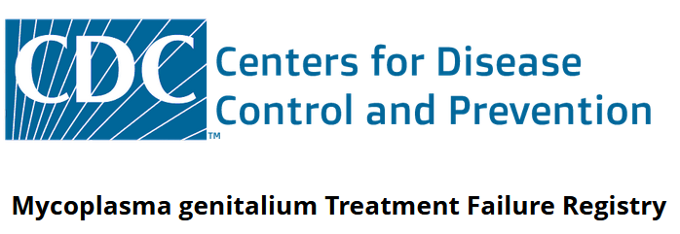
When treatment fails, let CDC know
Mycoplasma genitalium Treatment Failure Registry (https://redcap.link/mgenregistry)
Any provider may enter data (no personal health info collected)
Someone from CDC may contact you with more questions

Slide 40
Doxycycline as Post-Exposure Prophylaxis

Slide 41
Polling Question #1
I have heard of doxycycline as post-exposure prophylaxis for STIs
Yes
No
Maybe

Slide 42
Polling Question #2
I have prescribed doxy PEP to more than 10 patients
(or I have more than 10 clients on doxy PEP)
Yes
No

Slide 43
What is it?
Doxycycline Post-Exposure Prophylaxis
One-time, 200 mg tablet of Doxycycline, an antibiotic, taken within 72 hours after having oral, anal, or insertive vaginal sex when not using a condom, to reduce infections of gonorrhea (GC), chlamydia (CT), & syphilis.
“Plan B” or “Morning After Pill” for bacterial STIs
Slide adapted from: K. Mohr, CA Dept of Public Health
DoxyPEP AIDS 2022
Doxy-PEP: Day 1 of CROI 2023 | HIV.gov
Notes:
So, what is it? What is Doxy as PEP?
It is a Single, one time tablet of 200mg of Doxycycline, an antibiotic, that is taken within 72hrs after having oral sex, anal sex, and/or Insertive* vaginal sex WITHOUT using a condom, to reduce infections from gonorrhea, chlamydia and syphilis.
Some call it the “morning after pill” or “Plan B” for bacterial STIs, as a nickname to indicate a one-time event, and not to be confused with PrEP or pre-exposure prophylaxis, such as HIV PrEP, which is often a daily dosing method. Also, as a reminder, this is an antibiotic and does not protect against viruses like Herpes, HPV, HIV or mpox – and this needs to be shared with patients so that they don’t think it protects them from everything, but only against bacterial STIs like gonorrhea, chlamydia and syphilis.
https://programme.aids2022.org/Abstract/Abstract/?abstractid=13231
Doxy-PEP for STIs and More: Dr. Dieffenbach’s Highlights from Day 1 of CROI 2023 | HIV.gov
https://www.hiv.gov/blog/doxy-pep-for-stis-and-more-dr-dieffenbach-s-highlights-from-day-1-of-croi-2023

Slide 44
Doxy PEP – How to Take
= sex without a condom, including oral sex
Two 100 mg pills of doxycycline ideally within 24 hours but no later than 72 hours after condomless oral, anal or vaginal sex
Example: Sex on Sat; take dose of doxy by Tues
Example: Sex on Thursday; take dose of doxy by Sunday
Doxy
Doxy
Up to 72 hours after sex
Up to 72 hours after sex
Friday
Thursday
Friday
Saturday
Sunday
Monday
Tuesday
Wednesday
Saturday
Sunday
Example 2: Daily (or more) sex Sat-Tues; take daily dose of doxy and last dose within 24 hours but not later than 72 hours after last sex
Doxy
Doxy
Doxy
Doxy
Up to 72 hours after sex
Friday
Thursday
Friday
Saturday
Sunday
Monday
Tuesday
Wednesday
Saturday
Sunday
No more than 200 mg every 24 hours
Slide Credit, Stephanie Cohen, SFDPH

Slide 45
Tell me about Doxycycline
Dev. 1960s
Class: Tetracycline
Half life: 18-22hrs
HIGH oral absorption (93%)
HIGH barrier to resistance
Side Effects: sun-sensitivity,
stomach upset & esophagitis
Avoid w/ milk, metals/minerals (iron, magnesium, calcium)
Uses (some):
Lungs – bronchitis, pneumonia
Skin – acne
Zoonotic – malaria
Atypical infections
Many, many more
21.7 million doxy Rx in 2021
42% Respiratory
34% skin & soft tissue
<1% genitourinary (GU)
Slide adapted from: K. Mohr, CA Dept of Public Health
Notes:
Before we review the specifics, I want to give you a background on the antibiotic Doxycycline, its uses, its overuses and how we’ll be using it in the future for STI prevention.
Starting on the LEFT SIDE, you can see Doxy has been around for a long time, since the 1960s! It is among the class of antibiotics called Tetracyclines
It’s very well absorbed when taken by mouth, with over 90% of it being available. It also lasts a long time in our system before being broken down, and it has a high barrier to resistance considering we still use it today from it’s invention 60 years ago.
Keep in mind, there are some side effects, most notably a sun-sensitivity or photosensitivity when using doxycycline – so counseling patients to avoid direct sun exposure and to wear sun screen is important. Antibiotics can cause gastrointestinal symptoms or an upset stomach, including diarrhea (although the overall numbers for any serious adverse drug events in study participants, were low).
Also a need-to-known, Doxycycline absorption can be impaired with common minerals & metals, such as calcium, iron, magnesium that are found in milk/dairy products or supplements and multivitamins –– the metals bind to doxycycline and prevent its absorption. It’s good to educate patients to avoid mixing these compounds and doxycycline.
On the RIGHT side, you can see the many uses of Doxycycline, not just for STI prevention. Brain, lungs, Gut, skin and a many animal infections (not all listed here) are treated with Doxycycline
Interestingly, in the Box on the lower right, you’ll see that 42% of the nearly 22 million prescriptions for doxycycline were for Respiratory infections – as doxycycline can be used for treating pneumonia - 34% for skin & soft tissue infections, but LESS THAN 1% were for genitourinary infections, including STIs.

Slide 46
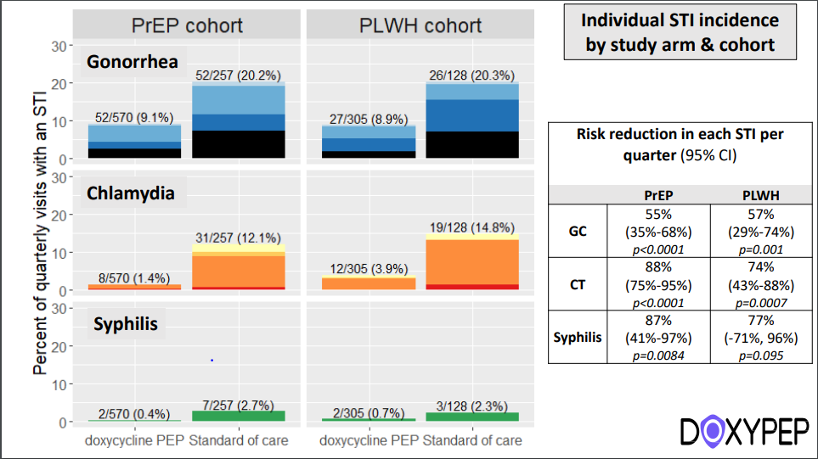
Effective for CT, GC & Syphilis
Risk reduction per quarter: 50-57% for GC; 70-80% for CT & syphilis
Similar efficacy for patients living with HIV and those on PrEP
Luetkemeyer A., N Engl J Med 2023; 388:1296-1306
Slide credit: DOXYPEP study

Slide 47
What about cisgender women?

Slide 48
dPEP: Doxy PEP for Cisgender Women
Design: Open-label randomized trial
200 mg doxy (w/in 72 hours of sex) vs standard of care (quarterly STI screening/treatment)
Population: 18-30 yr women – Kisumu Kenya
All pts taking daily oral HIV PrEP
Contraception not required (doxy stopped if pregnancy occurred)
Adherence:
Weekly SMS surveys to assess doxy use w/sex
Endpoint: Incident CT, GC, or syphilis infection
Measured quarterly x 1 year, at study visits q3 months
Stewart J et al. Doxycycline postexposure prophylaxis for prevention of STIs among cisgender women.
30th Conference on Retroviruses and Opportunistic Infections, Seattle, abstract 121, 2023
Methods: doxy-PEP vs Standard of Care among Women
Slide adapted from: K. Johnson, CAPTC

Slide 49
dPEP Results: No difference in STIs by Study Group
Overall: Incident STIs detected @ 109 follow-up visits (85 CT, 31 GC – including 8 co-infections w/CT, 1 syphilis)
50 STIs in doxyPEP group vs 59 STIs in standard of care group; no significant difference
RR 0.88 (95% CI 0.60-1.29; p=0.51)
Findings unchanged in additional analyses
Analysis of each STI separately
Subgroup analyses (by age, contraception use, transactional sex, STIs at baseline)
No serious AEs; no incident HIV infections
Slide adapted from: K. Johnson, CAPTC

Slide 50
Adherence: hair sampling
Proximal 1.0 cm of hair corresponds to aprox. 4 weeks of growth
Random subset of participants tested
10% of baseline (n=45)
5% quarterly follow up in standard of care group (n=11)
22% quarterly follow up in doxy PEP group (n=50)
Results for doxy PEP group
56% of participants had doxy detected at least once
44% may not have taken any doxycycline
“Differing results between trials among MSM and this trial among cisgender women are likely explained by low use of doxycycline PEP.”
Stewart et al. 2023

Slide 51
Other PREVENTION STRATEGIES
51

Slide 52
Contraception and STI protection?: Lactic Acid, Citric Acid, and Potassium Bitartrate Vaginal gel (Phexxi)
Acidic pH (3.5-4.5) reduces sperm motility
Prescription only
7-cycle typical use pregnancy rate: 13.7% similar to a diaphragm or spermicide

Slide 53
Multipurpose Prevention: Contraception/STI
Chlamydia
Gonorrhea
4.8%
0.7%
9.7%
3.2%
Relative risk reduction of CT: 50 %
Relative risk reduction of GC: 78%
Chappell BT, et al. (2021) EVO100 prevents chlamydia and gonorrhea in women at high risk for infection. Am J Obstet Gynecol
Notes:
Women 18-45 who had been diagnosed and treated for CT or GC 6 weeks before enrollment
376 in treatment group; 388 in placebo group
52% White, 42% Black, 32%: Hispanic or Latino)
Instructed to apply the study drug up to 1 hour before each act of sex

Slide 54
EVOFEM Phase III study
Enrolled 1903 adult women with documented urogenital CT or GC, or self reported CT/GC with risk factors in the 17 weeks prior
Randomized to receive active vaginal gel or placebo gel in prefilled applicators, to apply 1 hour up to immediately before vaginal sex
Infection rates did not differ between the two arms
“I believe COVID impacted the observed infection rates” (Lead statistician on both trials)
Company decided to drop the STI indication for FDA approval

Slide 55
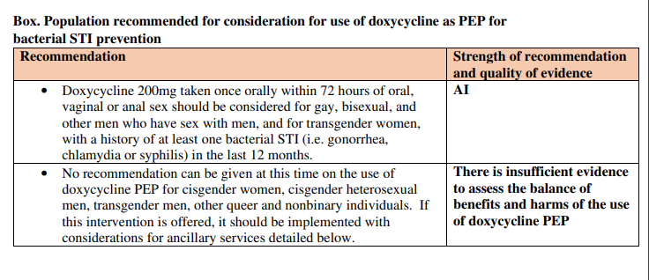
Preliminary CDC Doxy PEP Guidelines (10/2023)

Slide 56
Will doxy PEP promote antimicrobial resistance (AMR)? Will doxy PEP cause harm to the gut microbiome?
Unanswered Questions:

Slide 57
RESOURCES
57

Slide 58
Love STIs and want free CME? https.//www.std.uw.edu/

Slide 59
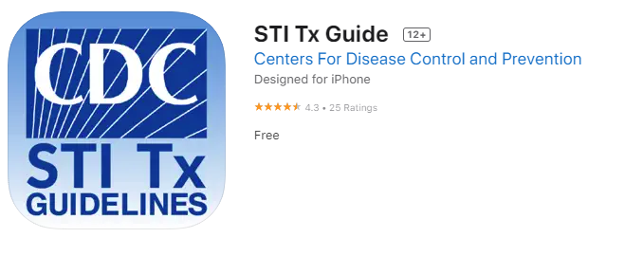
Get the free CDC Treatment Guidelines App
App Store (Apple)
Google Play (Android)
https://www.cdc.gov/std/treatment-guidelines/default.htm
Notes:
The next few cases will highlight key updates to STI treatment guidelines in the 2021 CDC guidelines

Slide 60
National Network of STD Clinical Prevention Training Centers
STDCCN.org
Notes:
The STD Clinical Consultation Network is a FREE online system where CLINICIANS can submit complex STI questions, and a NNPTC expert will answer in 1
to 5 business days.

Slide 61
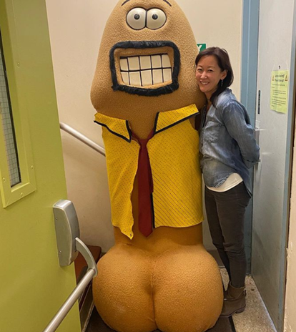
Acknowledgements
The Doxy PEP Study Team
Kurtis Mohr, CA Dept of Public Health
Kelly Johnson, CAPTC/ CA Dept of Public Health
Stephanie Cohen, San Francisco DPH/ SF City Clinic
Lindley Barbee, CDC

Slide 62
Thank you!!
Contact information
Ina.park@ucsf.edu

